Slide 1
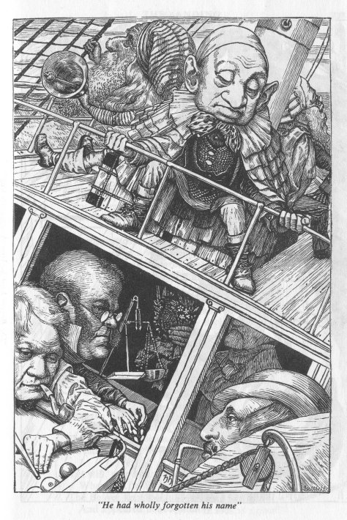
C: There’s a SNARK for That
Alessandro Chiesa
Daniel Genkin
Eli Ben-Sasson
Eran Tromer
Madars Virza
& Co.

Slide 2
Problem: integrity on untrusted platform
Faults
Someone else’s cloud
Platform trojans
Blue pill
OS bugs
Untrusted data origins
Crypto protocols

Slide 3
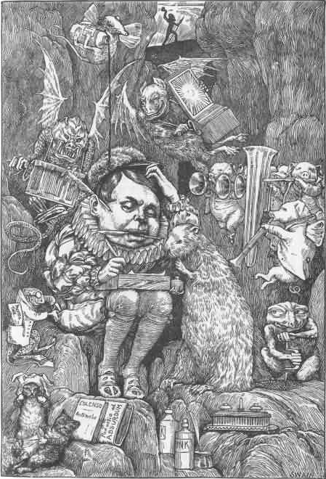
Solution: zk-SNARKs
For C programs
with pointers and loops
Argument
Noninteractive
Argument
Succint Noninteractive
Argument
Succint Noninteractive
Argument of Knowledge
zero knowledge
Succint Noninteractive
Argument of Knowledge
AKA
Non-interactive CS proofs of knowledge
Succint NIZK

Slide 4
#include <tinyram.h>
#define LEN 16
int main() {
int state[256], stream[LEN];
int i, j, t, k;
for (i=0; i < 256; ++i) state[i] = i;
/* KSA: mix in key */
k = 0; j = 0;
for (i=0; i < 256; ++i) {
t = state[i];
keybyte = read_aux_input_tape();
j = (j + t + keybyte) & 0xFF;
state[i] = state[j]; state[j] = t;
}
/* PRGA: produce stream */
i=0; j=0;
for (k=0; k < LEN; k++) {
i = (i + 1) & 0xFF;
t = state[i];
j = (j + t) & 0xFF;
state[i] = state[j];
state[j] = t;
stream[k] = state[(state[i] + state[j]) & 0xFF];
}
/* compare with the claim */
for (i=0; i < LEN; i++)
if (stream[i] != read_primary_input_tape()) {
return 1;
return 0;
}

Slide 6
C program
Compiler
based on GCC
TinyRAM program

Slide 7
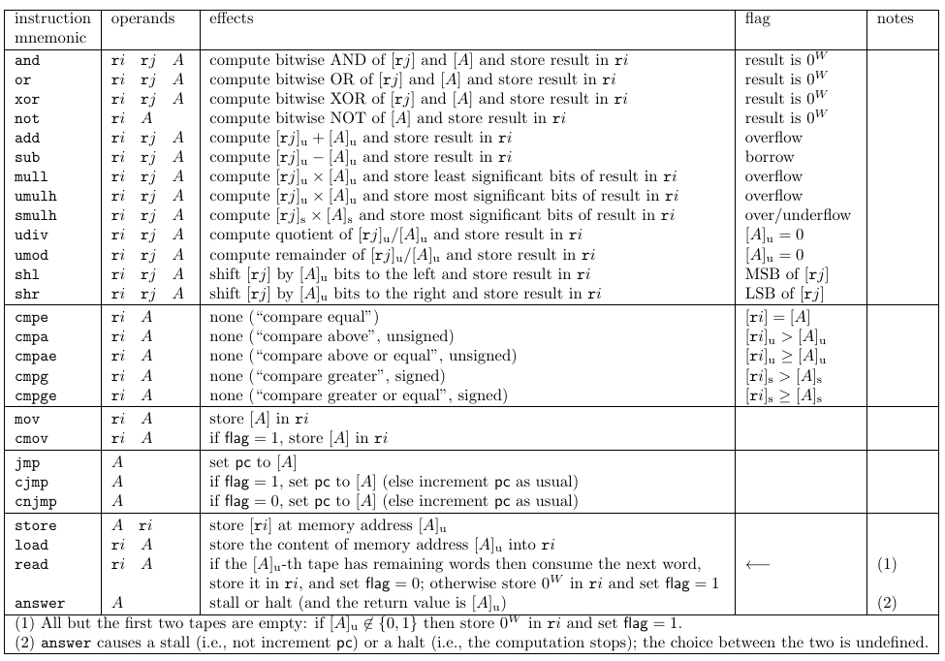
TinyRAM architecture for fast verification
$+,−,×,div,mod,⊕,$shifts
Arithmetic comparison, Branches
Memory load/store Input tapes read
Spec: http://scipr-lab.org/tinyram

Slide 8
C program
Compiler
based on GCC
TinyRAM program
Circuit Generator
based on theory
of [BCGT13]
circuit

Slide 9
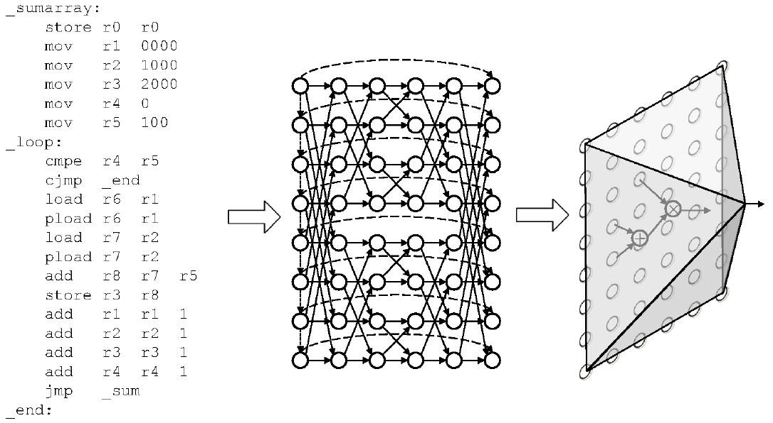
Converting TinyRAM verification to circuit satisfiability

Slide 10
C program
Compiler
based on GCC
TinyRAM program
Circuit Generator
based on theory
of [BCGT13]
circuit
based on theory
of [GGPR13] [BCIOP13]
zkSNARK for CircuitSAT

Slide 11
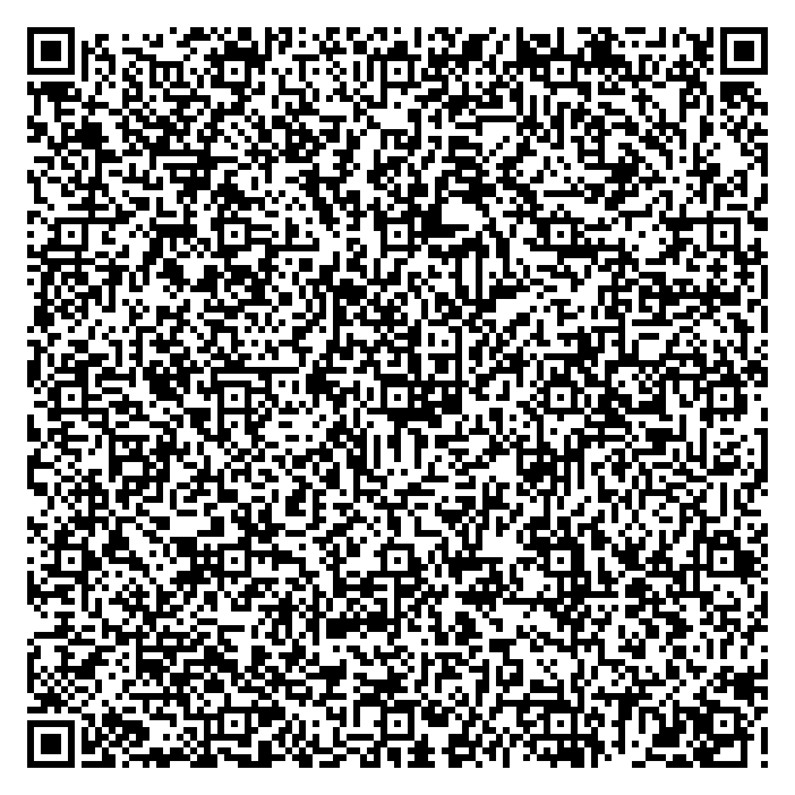
“I know an RC4 key producing 26 41 5B C4 4C EC ED 6C 89 99 68 E1 82 04 DE”
322-byte proof

Slide 12
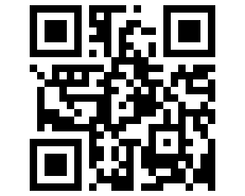
“The execution of arbitrary C programs can be verified in a few milliseconds and 322 bytes”
http://scipr-lab.org What Would you Like to Prove Today?

