Slide 1
Scalable Multi-Access Flash Store for Big Data Analytics
Sang-Woo Jun, Ming Liu
Kermin Fleming*, Arvind
Massachusetts Institute of Technology
*Intel, work while at MIT
This work is funded by Quanta and Samsung.
We also thank Xilinx for their generous hardware donations
Notes:
Affiliation, elliott at intel , work while at mit
sponsers

Slide 2
Big Data Analytics
Analysis of previously unimaginable amount of data provides deep insight
Examples:
Analyzing twitter information to predict flu outbreaks weeks before the CDC
Analyzing personal genome to determine predisposition to disease
Data mining scientific datasets to extract accurate models
Likely to be the biggest economic driver for the IT industry for the next 5 or more years
Notes:
Start with examples, description in next slide (size, randomness < db sequential)

Slide 3
Big Data Analytics
Data so large and complex, that traditional processing methods are no longer effective
Too large to fit reasonably in fast RAM
Random access intensive, making prefetching and caching ineffective
Data is often stored in the secondary storage of multiple machines on a cluster
Storage system and network performance become first-order concerns
Notes:
Start with examples, description in next slide (size, randomness < db sequential)

Slide 4
Designing Systems for Big Data
Due to terrible random read latency of disks, analytic systems were optimized for reducing disk access, or making them sequential
Widespread adoption of flash storage is changing this picture
rescaled
Modern systems need to balance all aspects of the system to gain optimal performance
Notes:
Add “re-scaling” to new chart

Slide 5
Designing Systems for Big Data
Network Optimizations
High-performance network links (e.g. Infiniband)
Storage Optimizations
High-performance storage devices (e.g. FusionIO)
In-Store computing (e.g. Smart SSD)
Network-attached storage device (e.g. QuickSAN)
Software Optimizations
Hardware implementations of network protocols
Flash-aware distributed file systems (e.g. CORFU)
FPGA or GPU based accelerators (e.g. Netezza)
Cross-layer optimization is required for optimal performance

Slide 6
Current Architectural Solution
Previously insignificant inter-component communications become significant
When accessing remote storage:
Read from flash to RAM
Transfer from local RAM to remote RAM
Transfer to accelerator and back
Infiniband
Infiniband
FusionIO
FusionIO
RAM
RAM
FPGA
FPGA
CPU
CPU
Motherboard
Motherboard
Potential bottleneck at multiple transport locations
Hardware and software latencies are additive
Notes:
Add request packet from cpu to cpu
Loop animations?

Slide 7
BlueDBM Architecture Goals
Low-latency high-bandwidth access to scalable distributed storage
Low-latency access to FPGA acceleration
Many interesting problems do not fit in DRAM but can fit in flash
Flash
Flash
Network
Network
RAM
RAM
CPU
CPU
FPGA
FPGA
Motherboard
Motherboard
Notes:
Add request packet that goes from cpu to remote fpga
Loop animations!

Slide 8
BlueDBM System Architecture
FPGA manages flash, network and host link
Controller Network
~8 High-speed (12Gb/s)
serial links (GTX)
1TB Flash
1TB Flash
1TB Flash
Programmable
Controller
(Xilinx VC707)
Programmable
Controller
(Xilinx VC707)
Programmable
Controller
(Xilinx VC707)
…
PCIe
Host PC
Host PC
Host PC
Node 20
Node 19
Node 0
Ethernet
Expected to be constructed by summer, 2014
A proof-of-concept prototype is functional!
Notes:
Bandwidth numbers? Topology?

Slide 9
Inter-Controller Network
BlueDBM provides a dedicated storage network between controllers
Low-latency high-bandwidth serial links (i.e. GTX)
Hardware implementation of a simple packet-switched protocol allows flexible topology
Extremely low protocol overhead (~0.5μs/hop)
Controller Network
~8 High-speed (12Gb/s)
serial links (GTX)
1TB Flash
1TB Flash
1TB Flash
Programmable
Controller
(Xilinx VC707)
Programmable
Controller
(Xilinx VC707)
…
Programmable
Controller
(Xilinx VC707)
Notes:
Virtual channel? Virtual network?

Slide 10
Inter-Controller Network
BlueDBM provides a dedicated storage network between controllers
Low-latency high-bandwidth serial links (i.e. GTX)
Hardware implementation of a simple packet-switched protocol allows flexible topology
Extremely low protocol overhead (~0.5μs/hop)
High-speed (12Gb/s)
serial link (GTX)
1TB Flash
1TB Flash
1TB Flash
Programmable
Controller
(Xilinx VC707)
Programmable
Controller
(Xilinx VC707)
…
Programmable
Controller
(Xilinx VC707)
Protocol supports virtual channels to ease development
Notes:
Virtual channel? Virtual network?

Slide 11
Controller as a Programmable Accelerator
BlueDBM provides a platform for implementing accelerators on the datapath of storage device
Adds almost no latency by removing the need for additional data transport
Compression or filtering accelerators can allow more throughput than hostside link (i.e. PCIe) allows
Example: Word counting in a document
Counting is done inside accelerators, and only the result need to be transported to host

Slide 12
Two-Part Implementation of Accelerators
Accelerators are implemented both before and after network transport
Local accelerators parallelize across nodes
Global accelerators have global view of data
Virtualized interface to storage and network provided in these locations
Host
e.g., aggregate count
Global Accelerator
e.g., count words
Network
e.g., count words
Local Accelerator
Local Accelerator
Flash
Flash

Slide 13
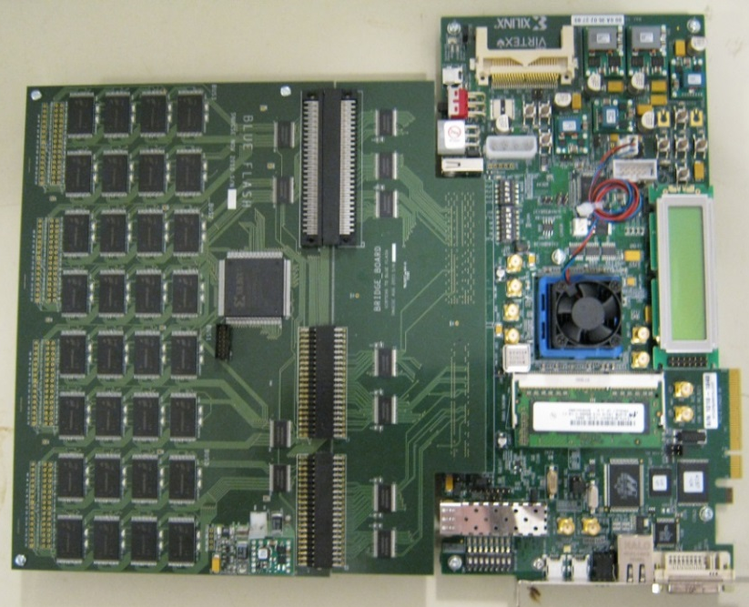
Prototype System (Proof-of-Concept)
Prototype system built using Xilinx ML605 and a custom-built flash daughterboard
16GB capacity, 80MB/s bandwidth per node
Network over GTX high-speed transceivers
Flash board is 5 years old, from an earlier project

Slide 14
Prototype System (Proof-of-Concept)
Hub nodes
Notes:
We needed hub nodes because the ML605 only has one SMA port pinned out
Forced to take a switched fabric topology because ML605 has only one SMA port.

Slide 15
Prototype Network Performance

Slide 16
Prototype Bandwidth Scaling
rescaled
Only reachable
by accelerator
Maximum PCIe bandwidth
Notes:
new graph with expected performance
Animation? Show orig, scale, show compare

Slide 17
Prototype Latency Scaling

Slide 18
Benefits of in-path acceleration
Less software overhead
Not bottlenecked by flash-host link
Experimented using hash counting
In-path: Words are counted on the way out
Off-path: Data copied back to FPGA for counting
Software: Counting done in software
We’re actually building both configurations
Notes:
Describe in-path vs out-path
Describe the experiment (route data back to FPGA, pipeline bubbles, pcie bottlenecks)

Slide 19
Work In Progress
Improved flash controller and File System
Wear leveling, garbage collection
Distributed File System as accelerator
Application-specific optimizations
Optimized data routing/network protocol
Storage/Link Compression
Database acceleration
Offload database operations to FPGA
Accelerated filtering, aggregation and compression could improve performance
Application exploration
Including medical applications and Hadoop

Slide 20
Thank you
Takeaway: Analytics systems can be made more efficient by using reconfigurable fabric to manage data routing between system components
Flash
Flash
CPU
+
RAM
CPU
+
RAM
FPGA
FPGA
Network
Network

Slide 21
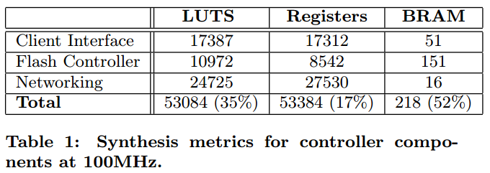
FPGA Resource Usage

Slide 22
New System Improvements
A new, 20-node cluster will exist by summer
New flash board with 1TB of storage at 1.6GB/s
Total 20TBs of flash storage
8 serial links will be pinned out as SATA ports, allowing flexible topology
12Gb/s per link GTX
Rack-mounted for ease of handling
Xilinx VC707 FPGA boards
Rackmount
Node 0
Node 1
Node 2
Node 3
Node 4
Node 5
…

Slide 23
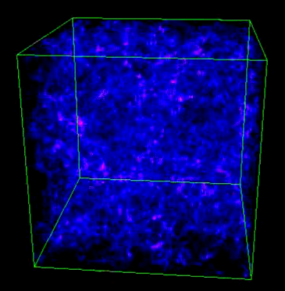
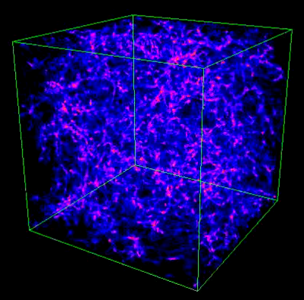
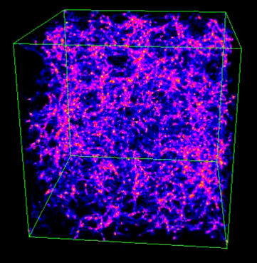
Example: Data driven Science
Massive amounts of scientific data is being collected
Instead of building an hypothesis and collecting relevant data, extract models from massive data
University of Washington N-body workshop
Multiple snapshots of particles in simulated universe
Interactive analysis provides insights to scientists
~100GBs, not very large by today’s standards
“Visualize clusters of particles moving faster than X”
“Visualize particles that were destroyed,
After being hotter than Y”

Slide 24
Workload Characteristics
Large volume of data to examine
Access pattern is unpredictable
Often only a random subset of snapshots are accessed
Snapshot 1
Snapshot 2
Row
Rows of interest
“Hotter than Y”
Row
Row
Row
Row
Row
Row
Row
Row
Row
Sequential
scan
Row
Row
Access at
random intervals
“Destroyed?”
Row
Row

Slide 25
Constraints in System Design
Latency is important in a random-access intensive scenario
Components of a computer system has widely different latency characteristics
“even when DRAM in the cluster is ~40% the size of the entire database, [... we could only process] 900 reads per second, which is much worse than the 30,000”
“Using HBase with ioMemory” -FusionIO

Slide 26
Constraints in System Design
Latency is important in a random-access intensive scenario
Components of a computer system has widely different latency characteristics
“even when DRAM in the cluster is ~40% the size of the entire database, [... we could only process] 900 reads per second, which is much worse than the 30,000”
“Using HBase with ioMemory” -FusionIO

Slide 27
Existing Solutions - 1
Baseline: Single PC with DRAM and Disk
Size of dataset exceeds normal DRAM capacity
Data on disk is accessed randomly
Disk seek time bottlenecks performance
Solution 1: More DRAM
Expensive, Limited capacity
Solution 2: Faster storage
Flash storage provides fast random access
PCIe flash cards like FusionIO
Solution 3: More machines

Slide 28
Existing Solutions - 2
Cluster of machines over a network
Network becomes a bottleneck with enough machines
Network fabric is slow
Software stack adds overhead
Fitting everything on DRAM is expensive
Trade-off between network and storage bottleneck
Solution 1: High-performance network such as Infiniband

Slide 29
Existing Solutions - 3
Cluster of expensive machines
Lots of DRAM
FusionIO storage
Infiniband network
Now computation might become the bottleneck
Solution 1: FPGA-based Application-specific Accelerators

Slide 30
Previous Work
Software Optimizations
Hardware implementations of network protocols
Flash-aware distributed file systems (e.g. CORFU)
Accelerators on FPGAs and GPUs
Storage Optimizations
High-performance storage devices (e.g. FusionIO)
Network Optimizations
High-performance network links (e.g. Infiniband)

Slide 31
BlueDBM Goals
BlueDBM is a distributed storage architecture with the following goals:
Low-latency high-bandwidth storage access
Low-latency hardware acceleration
Scalability via efficient network protocol & topology
Multi-accessibility via efficient routing and controller
Application compatibility via normal storage interface
Flash
Network
RAM
CPU
FPGA
Motherboard

Slide 32
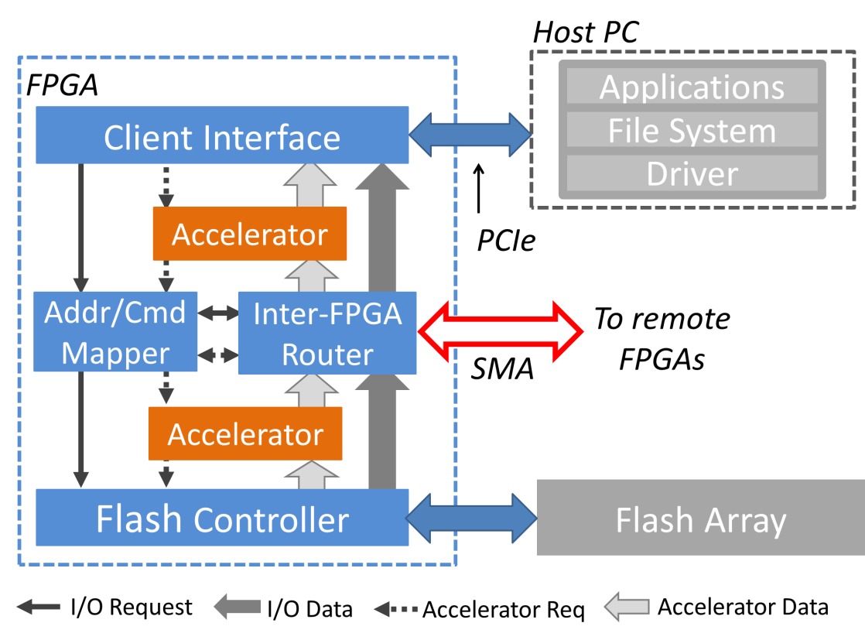
BlueDBM Node Architecture
Address mapper determines the location of the requested page
Nodes must agree on mapping
Currently programmatically defined, to maximize parallelism by striping across nodes

Slide 33
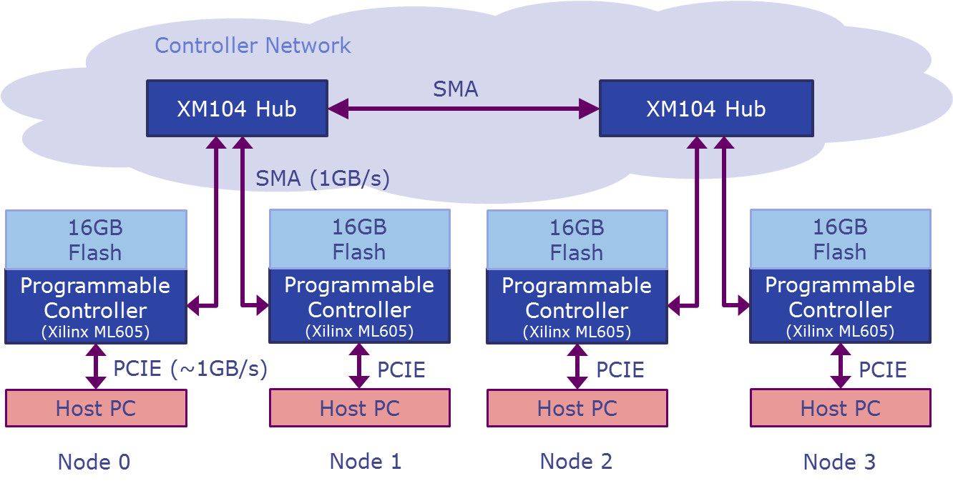
Prototype System
Topology of prototype is restricted because ML605 has only one SMA port
Network requires hub nodes

Slide 34
Controller as a Programmable Accelerator
BlueDBM provides a platform for implementing accelerators on the datapath of storage device
Adds almost no latency by removing the need for additional data transport
Compression or filtering accelerators can allow more throughput than hostside link (i.e. PCIe) allows
Example: Word counting in a document
Controller can be programmed to count words and only return the result
Flash
Flash
Accelerator
Accelerator
Host Server
Host Server
We’re actually building both systems
Notes:
Separate in-path to out-path into separate slide ( in prototype results )
Differentiate word counting example from prev slides

Slide 35
Accelerator Configuration Comparisons

