Slide 1
Certified Control for Self-Driving Cars
Xin Zhang
joint work with Daniel Jackson, Jonathan DeCastro, Soonho Kong, Dimitrios Koutentakis, Angela Leong Feng Ping, Armando Solar-Lezama, Mike Wang

Slide 2
self-driving car: a complex system prone to failure
physical device failures
reliance on external infrastructure
sensors
GPS
perception
malware with updates
map
unpredictable ML
software complexity: bugs
planning
control
actuators

Slide 3
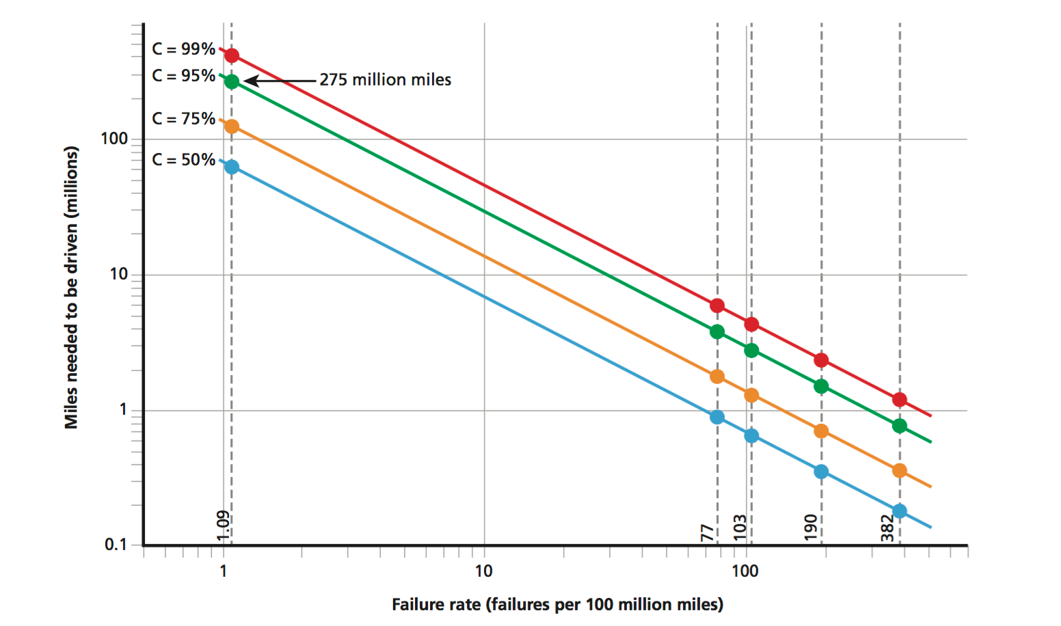
evidence of safety?
Testing?
(Kalra et al.)
for 95% confidence in 10⁻⁸ failures/mile, need to drive 275M miles
Notes:
https://ts.data61.csiro.au/publications/nictaabstracts/Klein_AEMSKH_14.abstract.pml
Citation

Slide 4
evidence of safety?
Verification?
SEL4 verification: $400/line 10m lines of critical code: $4B
Notes:
https://ts.data61.csiro.au/publications/nictaabstracts/Klein_AEMSKH_14.abstract.pml

Slide 5
option #1: inline checks
idea
add inline checks to controller code
override proposed action if deemed dangerous
example
Responsibility-Sensitive Safety (Shashua et al)
ensures safe separation maintained
pros and cons
+ easy to implement
- may fail to perform check (eg, if compromised)
- doesn’t protect against flawed interpretation of sensor data
Sensors
Controller
Actuators
command
Checker

Slide 6
option #2: safety controller
idea
checks are carried out by independent device
can veto controller commands even if controller fails
example
Simplex (Sha et al)
pros and cons
+ checker may be smaller and easier to verify
+ immune to compromise of controller
- checker requires access to sensors
- checker must interpret sensor data
major source of failures!
Sensors
Controller
Checker
Actuators
command
command

Slide 7
option #3: certified control
idea
like safety controller, but checker has no direct access to sensors
controller presents certificate to checker, which can be checked without sensors
pros and cons
+ like safety controller, checker is isolated
+ but checker does not require sensor analysis, so easier to verify
- not clear how to certify all forms of sensor interpretation
Sensors
Controller
Checker
Actuators
certificate
command

Slide 8
example: certificate for continuing in lane
action proposed by certificate
continue ahead without decreasing speed
sensor data provided
a distance D
3 LIDAR readings L[0..2], signed by LIDAR unit
current ego car velocity V, signed by velocity unit
what the checker does
D
Notes:
Runtime
Instance-based
Design interface
Easy to check

Slide 9
example: certificate for continuing in lane
Checker
Certificate
LIDAR
points
D
distance D
LIDAR points with signature
if the lead car suddenly brakes, can our car avoid a collision in the next action cycle?
velocity
velocity with signature
acceleration
of car
deceleration
of other car
verified using an SMT solver
Notes:
Runtime
Instance-based
Design interface
Easy to check

Slide 10
a certificate is…
a runtime assurance case
provides evidence that action is safe
in terms of physical impact, not just code correctness
evaluated at runtime, not during development
Notes:
Emphasize combination of dynamic and static. Not just property we’re checking, some safety guarantee after check

Slide 11
a certificate is…
a runtime assurance case
instance-specific
evidence for this action, not for all actions

Slide 12
a certificate is…
a runtime assurance case
instance-specific
a designed interface
agreed in advance by designers of controller and checker

Slide 13
a certificate is…
a runtime assurance case
instance-specific
a designed interface
easily checked
exploiting complexity gap between finding a solution and checking one

Slide 14
a certificate is…
a runtime assurance case
instance-specific
a designed interface
easily checked
unforgeable
for example, uses signed LIDAR readings
so controller can’t present spurious sensor data

Slide 15
status
simulations
1/10th scale mini racecar with LIDAR JavaScript virtual simulation
assurance case
arguments for safe separation
checked with DREAL and Z3

Slide 16
Simulation using Racecar
Without Certified Control

Slide 17
Simulation using Racecar
With Certified Control

Slide 18
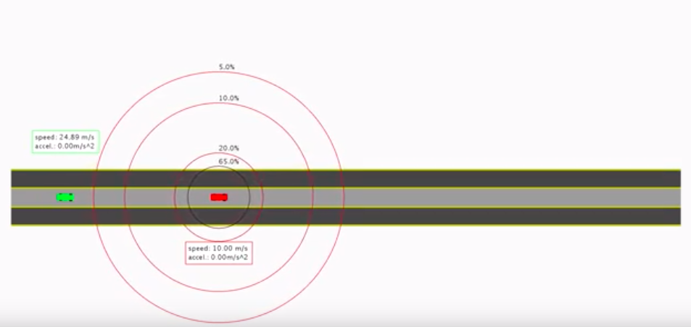
Virtual Simulation

Slide 19
next steps
certificates for other actions
accelerating, lane switching
map evidence
including data about position on road in certificate
also existence of lanes!
general framework for certificate check
constraint-based using DReal
other kinds of sensor interpretation
certification for machine learning more generally
how would you certify a visual analysis?
Notes:
Feedback:
Pathlogical case where the other cars work against you.
SMT solvers are too costly to run at runtime. (Ask Soonhoo, people do us e

