Slide 1
An Analysis of Patch Plausibility and Correctness of Generate-And-Validate Patch Generation System
Zichao Qi, Fan Long, Sara Achour, and
Martin Rinard
MIT CSAIL

Slide 2
Generate-And-Validate Patch Generation Systems
Buggy Program
Candidate patch space
Test suite of test cases

Slide 3
Generate-And-Validate Patch Generation Systems
GenProg – Genetic Programming
C. L. Goues, M. Dewey-Vogt, S. Forrest, and W. Weimer. A systematic study of automated program repair: Fixing 55 out of 105 bugs for $8 each. ICSE 2012
W. Weimer, T. Nguyen, C. Le Goues, and S. Forrest. Automatically finding patches using genetic programming. ICSE 2009
S. Forrest, T. Nguyen, W. Weimer, and C. Le Goues. A genetic programming approach to automated software repair. GECCO 2009
C. Le Goues, T. Nguyen, S. Forrest, and W. Weimer. Genprog: A generic method for automatic software repair. Software Engineering, IEEE Transactions on 38(1), 2012
AE – Adaptive Search
W. Weimer, Z. P. Fry, and S. Forrest. Leveraging program equivalence for adaptive program repair: Models and first results. ASE 2013
RSRepair – Random Search
Y. Qi, X. Mao, Y. Lei, Z. Dai, and C. Wang. The strength of random search on automated program repair. ICSE 2014

Slide 4
All of them report impressive results
GenProg
AE
RSRepair
Benchmark
Defects
105
105
24
Reported Fixed Defects
55
54
24
Patches generated by these systems are different from human written patch
No systematic analysis

Slide 5
We analyze the reported patches for these systems
Plausible?
Produce correct outputs for all test cases in the test suite
All generated patches should be plausible

Slide 6
Plausibility
GenProg
AE
RSRepair
Benchmark
Defects
105
105
24
Reported Fixed Defects
55
54
24
Defects With Plausible Patches
18
27
10
Reason - Weak Proxy
Patch evaluation does not check for correct output
php, libtiff – check exit code, not output
Accepted php patch: main(){ exit(0); }

Slide 7
Analysis of the reported patches for these systems
Plausible?
Produce correct outputs for all test cases in the test suite
Majority of the patches are not plausible
Correct?
Eliminate the defect
Passing test suite != correctness

Slide 8
Correctness
GenProg
AE
RSRepair
Benchmark
Defects
105
105
24
Reported Fixed Defects
55
54
24
Defects With Plausible Patches
18
27
10
Defects With Correct Patches
2
3
2
Developed new test cases that expose defects for all plausible but incorrect patches

Slide 9
GenProg Statistics
Stronger Test Suites?
Will GenProg generate correct patches given new test cases that eliminate incorrect patches?
Fixed Test Scripts?
Will GenProg generate plausible patches given fixed patch evaluation scripts?

Slide 10
Analysis of the reported patches for these systems
Plausible?
Produce correct outputs for all test cases in the test suite
Majority of the patches are not plausible
Correct?
Eliminate the defect
The overwhelming majority of the patches are not correct
Do stronger test suites help?
Rerun GenProg with
fixed patch evaluation scripts and new test cases that eliminate incorrect patches

Slide 11
Reexecution of GenProg on Remaining 103 Defects
First Reexecution
Fixed patch evaluation
New test cases
Second Reexecution
2 additional test cases
Patches for 2 defects
Patches for 0 defects
Why?
Developer patches are not in GenProg search space
GenProg search space may not contain any correct patch for these 103 defects
May need richer search space to generate correct patches

Slide 12
Bottom Line For GenProg
Rerun GenProg with
Fixed test scripts
Stronger test suites
GenProg generates patches for only 2 of 105 defects (both patches are correct)

Slide 13
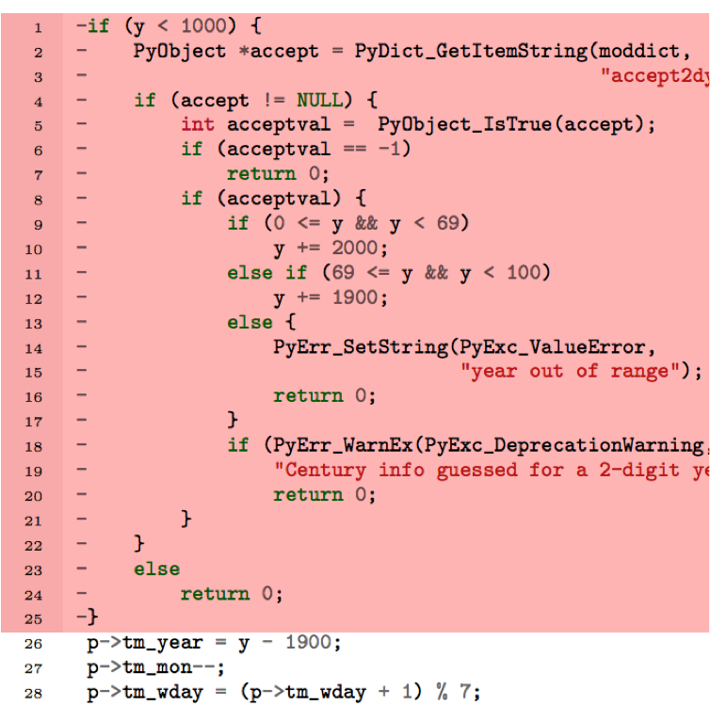
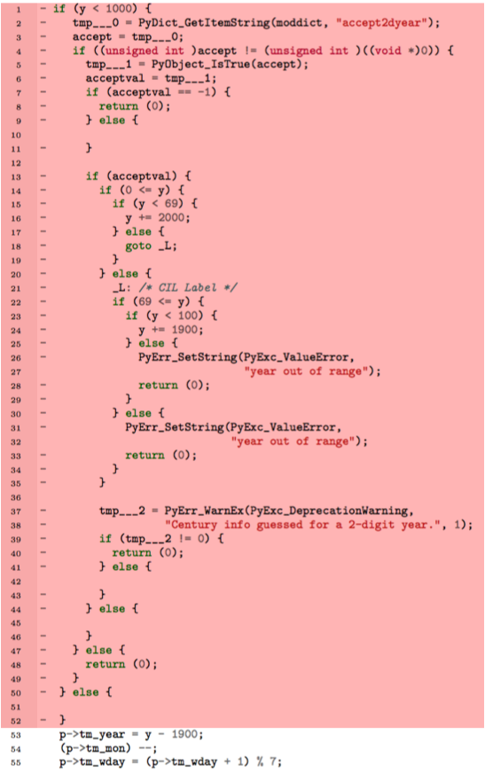
Examples of Correct GenProg Patch(1/2)
Developer GenProg
Notes:
Note – not a bug!

Slide 14
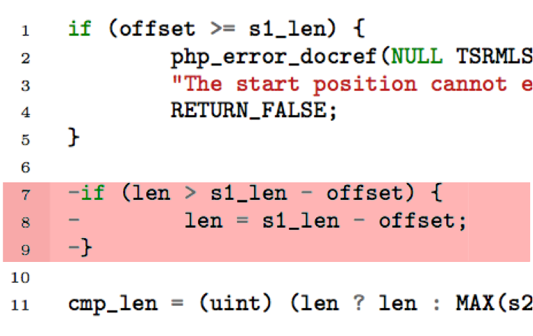
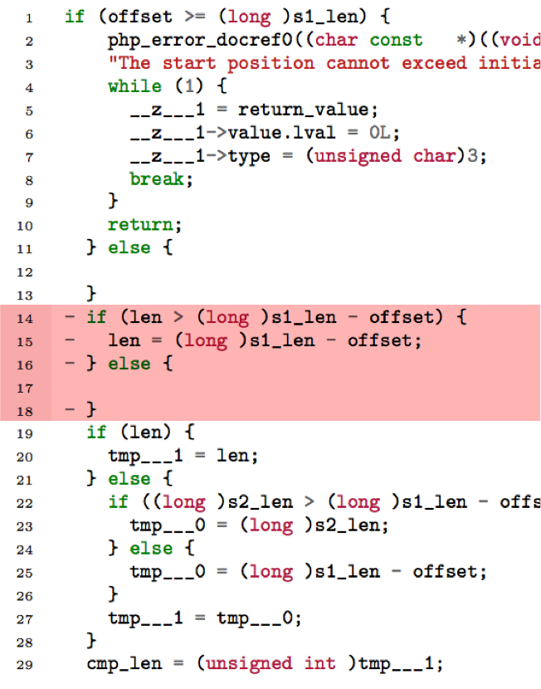
Examples of Correct GenProg Patch(2/2)
Developer GenProg

Slide 15
All Correct Patches Simply Delete Code

Slide 16
Semantic Analysis
Analyze all the plausible patches
Determine if patch is equivalent to single functionality deletion modification
Results
GenProg: 14/18
AE: 22/27
RSRepair: 8/10

Slide 17
We found a common scenario
A negative test case exposes the defect
Feature is otherwise unexercised
The patch simply deletes the functionality
Introduces new security vulnerabilities (buffer overflows)
Disables critical functionality (gzip cannot decompress non-zero files)
Weak test suites
May be appropriate for human developers
May not be appropriate for automatic patch generation systems (at least not by themselves)

Slide 18
If all these patches simply delete functionality
Why not build a patch generation system that ONLY deletes functionality?

Slide 19
We present Kali
Automatic patch generation system
Consider the search space that consists of only patches that remove functionality
Notes:
Please refer our paper for more details

Slide 20
Experimental Results of Kali
GenProg
AE
RSRepair
Kali
Benchmark
Defects
105
105
24
105
Reported Fixed Defects
55
54
24
Defects With Plausible Patches
18
27
10
27
Defects With Correct Patches
2
3
2
3
Kali is as good as previous systems
Much simpler
Not need to know the source code file to repair
Can pinpoint the defective code
Can provide insight into important defect characteristics.

Slide 21
Experimental Results of Kali
GenProg
AE
RSRepair
Kali
Benchmark
Defects
105
105
24
105
Reported Fixed Defects
55
54
24
Defects With Plausible Patches
18
27
10
27
Defects With Correct Patches
2
3
2
3

Slide 22
Is Automatic Patch Generation A Total Failure?
NO!

Slide 23
Path To Success
Richer search spaces
More efficient search algorithms
Incorporate additional sources of information
Correct code from other applications
Learned characteristics of human patches
Learned invariants
Specifications

Slide 24
Promising directions
Learn invariant from correct execution
ClearView: J. H. Perkins, S. Kim, S. Larsen, S. Amarasinghe, J. Bachrach, M. Carbin, C. Pacheco, F. Sherwood, S. Sidiroglou, G. Sullivan, et al. Automatically patching errors in deployed software. SOSP 2009.
Patches security vulnerabilities in 9 of 10 defects
At least 4 patches are correct
Solvers
NOPOL: F. DeMarco, J. Xuan, D. Le Berre, and M. Monperrus. Automatic repair of buggy if conditions and missing preconditions with smt. CSTVA 2014
SemFix: H. D. T. Nguyen, D. Qi, A. Roychoudhury, and S. Chandra. Semfix: Program repair via semantic analysis. ICSE 2013

Slide 25
Promising directions
Specifications
Autofix-E: Yu Pei, Carlo A. Furia, Martin Nordio, Yi Wei, Andreas Zeller, and Bertrand Meyer. Automated Fixing of Programs with Contracts. IEEE Transactions on Software Engineering, 2014.
Etienne Kneuss, Manos Koukoutos and Viktor Kuncak. Deductive Program Repair. CAV 2015
Correctness evaluation
Thomas Durieux, Matias Martinez, Martin Monperrus, Romain Sommerard, Jifeng Xuan. Automatic Repair of Real Bugs: An Experience Report on the Defects4J Dataset. Technical report 1505.07002, Arxiv, 2015
Code from another application
CodePhage: S. Sidiroglou, E. Lahtinen, F. Long, and M. Rinard. Automatic error elimination by multi-application code transfer. PLDI 2015

Slide 26
Promising Directions
SPR
Staged condition synthesis
Prophet
Learn from successful patches
Benchmark
Defects
105
105
Defects With Plausible Patches
41
42
Defects With Correct Patches
11
15
SPR: F. Long and M. Rinard. Staged program repair in SPR. To appear in ESEC-FSE 2015
Prophet: F. Long and M. Rinard. Prophet: Automatic patch generation via learning from successful human patches. Under submission

Slide 27
Take Aways
Facts about GenProg/AE/RSRepair
These systems fix 2/3/2 of 105 bugs (not 55/54/24)
Errors in test scripts and weak test suites
Fixed test scripts and stronger test suites do not help
Paths to success
Richer search spaces
More efficient search algorithms
Incorporate additional sources of information
Correct code from other applications (CodePhage)
Learned characteristics of human patches (Prophet)
Learned invariants (ClearView)
Specifications (AutoFixE, Deductive Repair)

Slide 28
Summary
Evaluation of GenProg, AE and RSRepair
Incorrect results
Equivalent to functionality elimination
Stronger test suites do not help
Kali
Functionality elimination system
Help developer better understand the bug

Slide 29
Path to Success for the automatic patch generation systems
Richer search spaces
More efficient search algorithms
Incorporate additional sources of information
Correct code from other applications
Learned characteristics of human patches
Learned invariants
Better patch evaluation
Correctness
Understand the negative effects
Questions?

