Slide 1
Roll Call! Taking a Census of MOOC Students
Betsy Williams
Stanford University, Graduate School of Education

Slide 2
Where’s the data??!?
In the past, economists and education researchers forced to rely on demographic and school record data to make inferences and provide all covariates.
Fine-grained data in MOOC log files is a dream come true!
BUT demographic and administrative data have been shown to be important, and their absence is a problem.
Notes:
Necessity is the mother of invention. → Develop techniques and first use data sources based on limitations in computing power, data.

Slide 3
Claim: We Should Conduct a Cross-Platform Census of MOOC Students
Motivation
What We Know
How To
Benefits
Business and planning
Instructional Design
Research
Concerns
Costs of data collection
Privacy
Stereotype threat
Maladaptive use of the information
Next Steps

Slide 4
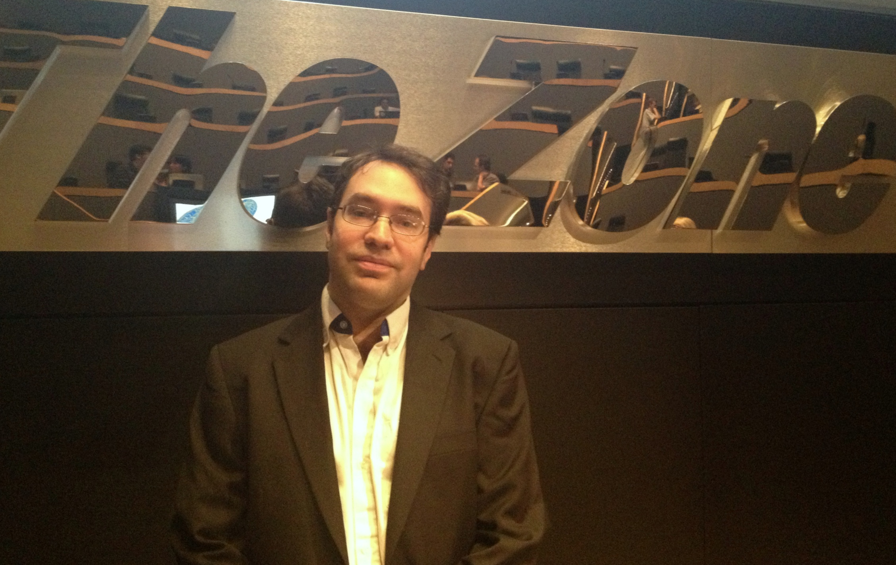
Motivation
“We need context in our datasets… so bug your colleagues to collect as much as possible.”
Ryan Baker, EDM 2013

Slide 5
Background Data Helps Interpret Behavior
Age
Work & Education History
Language Background
Access to Technology and Internet

Slide 6
What we know

Slide 7
Evidence from MOOCs
DeBoer et al. (EDM 2013)
Collected information in edX “Circuits and Electronics”
Not significant in model: gender & “teach EE”
Significant across models: “parent engineer,” “worked with other online,” & “took differential equations”
Kizilcec et al. (LAK 2013)
Collected information in 3 Coursera CS classes, classified learner trajectories
Age group, employment status similarly represented across trajectories
Some differences by geography, gender, intentions

Slide 8
Practice in Psychometrics
Differential Item Functioning (DIF) (e.g. Zwick 1990)
Standard check to run for test items
Given estimate of student ability based on other items, do students vary by race or gender in who gets the item right or wrong?
Cultural bias undermines public trust, as well as biasing results and perpetuating inequity

Slide 9
Major Findings on College Completion
Race and socioeconomic status correlate with different behaviors in preparation for, application to, selection of, experience in, and completion of college. (Espenshade & Radford 2009)
Resources in environment seem to matter
Financial aid awards (Dynarski & Scott-Clayton 2006)
Likelihood BA given starting at 2-year vs. 4-year school (Rouse 1995)
Unselective colleges have non-traditional & less-prepared students
Remediation literature suggests students drop out between remedial courses, not for failing those courses: long remedial sequences discourage students (Bailey et al. 2011)
Designing program structure around student completion (scheduling, counseling) matters (Rosenbaum, Person, Deil-Amen 2006)
Academic preparation affects outcomes (Adelman 1996)
Social & academic engagement matter (Tinto 1994)

Slide 10
Bias Possible If Variables Ignored
Not all researchers here aim at causal models or experiments, but some (now and in the future) do.
Omitted variable bias
If background variable is correlated with both variable of interest and outcome variable, then coefficients are biased.
Attrition bias
Even in an RCT, differential attrition by a background variable can bias the results, especially if this variable is not measured and is correlated with explanatory/treatment variables.

Slide 11
How To
Implementing a Comprehensive Survey

Slide 12
Best Tackled at Platform Level
More flexibility in data collection
Incentives could be offered more easily
Questions could be embedded in the site
Questions could be asked over time, or reminders issued
Simplify process
Captures students only once who enroll in multiple classes
Standardized questions
Allows instructors to expect who might enroll, from overall platform population.
For a random sample of students, allocate resources to follow-up on survey to improve response

Slide 13
Information of Interest on MOOC Students
Background
Age, gender, race, ethnicity, countries of residence and origin
Socioeconomic status and family structure
Native language and familiarity with course language
Detailed educational and work history
Previous knowledge in subject area (tested?)
Attitudes and beliefs about online class
Motivation, goals, reasons for taking class
Beliefs about value of online learning
Experience with MOOCs and other self-directed or distance learning
Behavioral & metacognitive factors
Level of risk aversion and level of time discounting/present orientation
Planned goal for class, amount of time planned for it
Resources available for class
Availability of electronic devices and Internet connection
What is available? Must they be shared with others?
External supports (peers, tutors, library, campus)

Slide 14
Benefits

Slide 15
Planning and Business Strategy
Who is willing and able to pay?
Course recommendation engine would benefit,
Sort students interested in consumption vs. investment value
Predict demand for classes taught at a certain level or on a certain topic
Suggest other institutions that may be good for partnerships (businesses, colleges, governments)

Slide 16
Instructional Design
Knowing students key to teaching (Shulman 1987)
Knowing likely misconceptions is vital for teaching new information (Piaget; Ackermann 2004)
More real-time feedback available to instructor in traditional classroom
Without background knowledge of students, behaviors measured may be poorly interpreted.

Slide 17
Research
This is a novel, weird context. But how weird?
MOOCs offer radical levels of access and so include many non-traditional and out-of-school learners, who are often elusive research subjects.
Number of students and means of instruction very amenable to experimentation.
MOOCs strip down the traditional classroom to only those elements designed into it; this provides for a fantastic place to experiment on the importance of things taken for granted in other classrooms.
Results not externally valid unless we know who learners are.

Slide 18
Concerns

Slide 19
Costs of Data Collection
Attention is limited
Time answering question takes away from time engaging with platform/class
At extreme, too many questions may drive students away
High quality survey responses may take persistent follow-up
Cost could be lessened with matrix sampling or long and short forms, if needed

Slide 20
Privacy
More background data collected, more risk individual can be identified from composite data, and greater cost if data is intercepted.
Privacy concerns about answering some questions may bias sample, if students opt out differentially
Clear data use policy may encourage contribution
Might use special procedure for sensitive questions (Du & Zhan 2003)

Slide 21
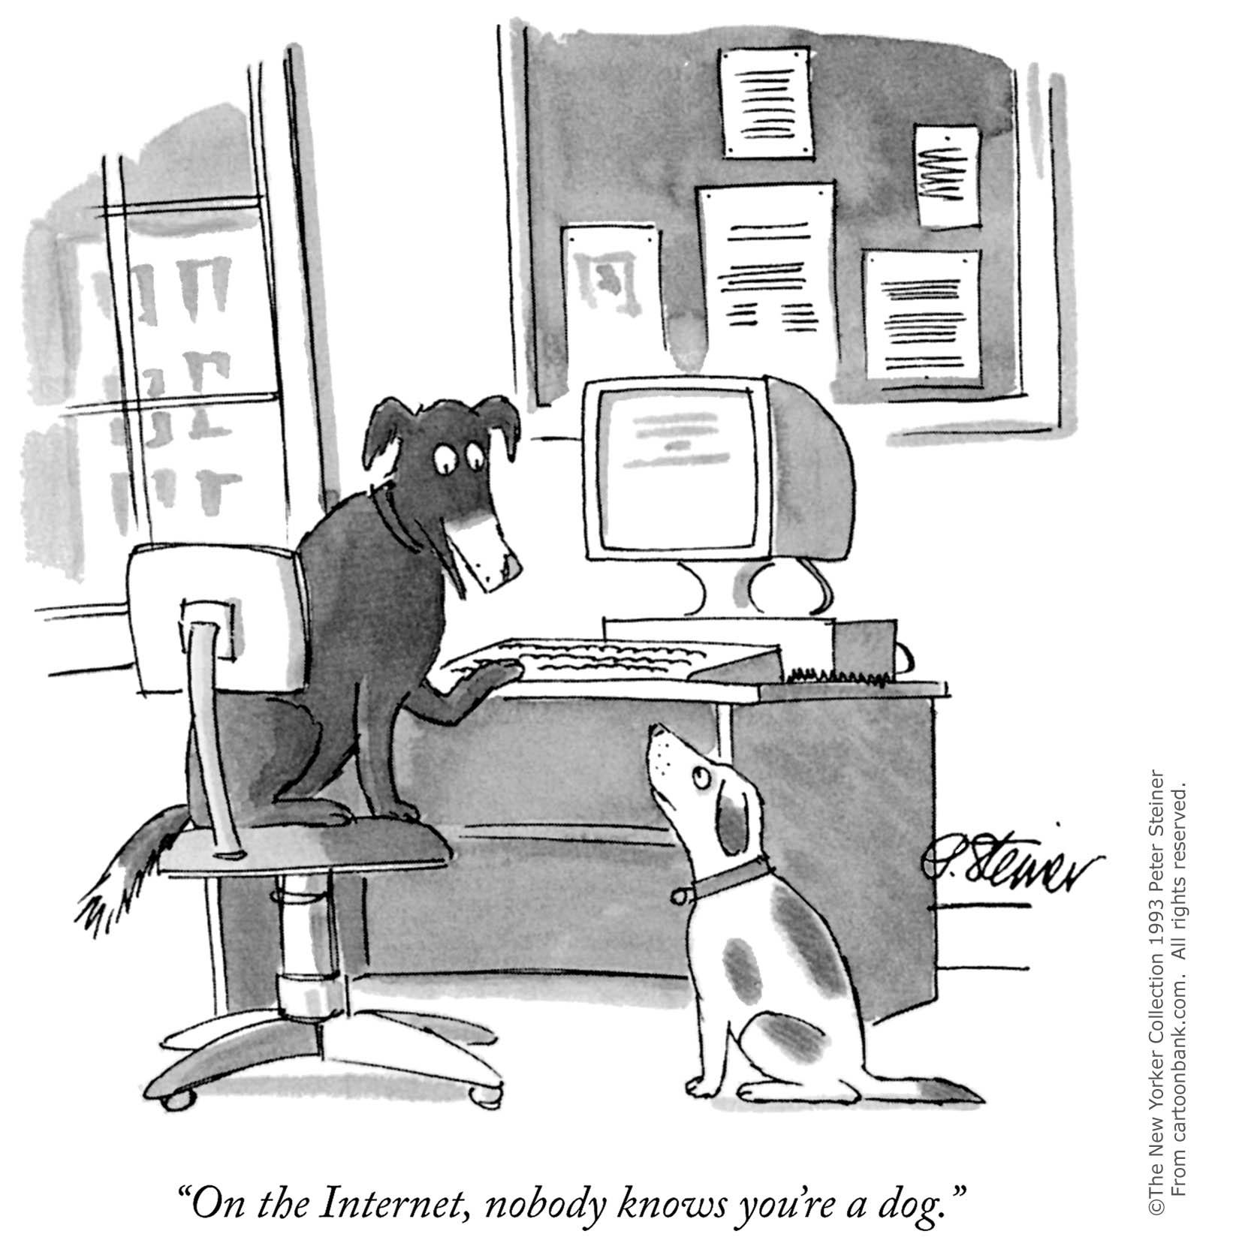

Slide 22
Stereotype Threat & Side Effects
If race, gender, etc. are queried, this may remind students of stereotypes and affect performance (e.g. Walton et al. 2012)
MOOCs seem to offer a refreshing blank slate—but are there ever neutral contexts?
Given the significance of identity in education, it is too big of an assumption to make that it is never a factor here.
Knowing their results are being studied may induce other changes
Hawthorne Effect, etc.
Maladaptive use of information
Instructors may adapt courses wrong or in ways that undermine comparability

Slide 23
Next Steps
Continue discussion about potential need for background data
More studies that test whether models differ when run separately by background variables
Create a prototype survey
Based on intake instruments currently used in traditional higher education and MOOCs
Input from researchers in diverse fields
Invest in survey design, offer survey for others
Suggest standard field formats, for easier interoperability

Slide 24
Thank you!
Questions?
betsyw@stanford.edu

Slide 25
APPENDIX

Slide 26
Indulgent Example of Data Value
Value of background information
Knowing it to be a peach-faced lovebird suggested how to care for it.
Suggests prior results to consult.
Value of observed behavior
Can help identify background, patterns
Hopped into cage, implying it was a pet.
Helps tell many things about the individual
It MIGHT talk, but does this one?
It MIGHT bite, but does this one?
Value of ad hoc tests
Giardia test performed because bird underweight; led to successful treatment
Must evaluate cost of obtaining data
Is costly DNA test for sex worthwhile?

Slide 27
Types of Information
Background information
Suggests new hypotheses
Connects us to findings from prior social science research
Informs theory and choice of model
Different people may behave differently, in a systematic way, by background
Observed behavior
May capture otherwise absent information
Connects us to findings from prior educational data mining research
May be endogenous and related to omitted variables
Tests (changing course beyond typical coursework)
Experiments
Additional assessments
Can allow for causal evaluations
Is it fair? Is it worth the partner’s time? Is it worth the student’s time?
Must evaluate cost of obtaining each versus value of the information

Slide 28
How does factor T affect outcome Y?
Simple correlation: when we see T, what is Y?
Do any factors (X) change with both T and Y?
If any X is left out, omitted variable bias.
If we control for absolutely all of them, this model is causal. (Selection on observables)
Attrition bias works through different people leaving the sample, correlated with T and Y.
Do any factors (W) affect Y but not T?
Including them improves precision of estimates.
Does any exogenous Z not affect the Xs or Y, except through T?
We can use this variation to get a causal estimate. (E.g. via instrumental variables)
Using a random process to generate Z ensures that Z is not possibly related to X’s and Y except through Y. (Experiment)
Z
X
W
T
Y
E(Y| T ) = a + bT + error
E(Y| T, X) = a + bT + cX + error
(plus more complex models, e.g. Heckman selection)
E(Y| T, X, W) = a + bT + cX + dW + error
^
^
E(Y| T(Z), X, W) = a + bT(Z) + cX + dW + error

Slide 29
Big Takeaway from the Last Slide: We Need Background Data X
Simple correlation: when we see T, what is Y?
Do any factors (X) change with both T and Y?
If any X is left out, omitted variable bias.
If we control for absolutely all of them, this model is causal. (Selection on observables)
Attrition bias works through different people leaving the sample, correlated with T and Y.
Do any factors (W) affect Y but not T?
Including them improves precision of estimates.
Does any exogenous Z not affect the Xs or Y, except through T?
We can use this variation to get a causal estimate. (E.g. via instrumental variables)
Using a random process to generate Z ensures that Z is not possibly related to X’s and Y except through Y. (Experiment)
Z
X
W
T
Y
E(Y| T ) = a + bT + error
E(Y| T, X) = a + bT + cX + error
(plus more complex models, e.g. Heckman selection)
E(Y| T, X, W) = a + bT + cX + dW + error
^
^
E(Y| T(Z), X, W) = a + bT(Z) + cX + dW + error

