Slide 1
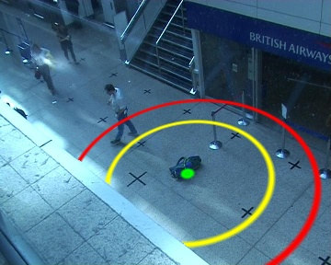
Event Detection Using an Attention-Based Tracker
Workshop on Performance Evaluation of Tracking Systems 2007,
held at the International Conference on Computer Vision 2007
Gerald Dalley, Xiaogang Wang, and W. Eric L. Grimson

Slide 2
Processing Pipeline
Input Data
Background
Modeling
Illumination
Normalization
Background Subtraction
Tracking & Event Detection

Slide 3
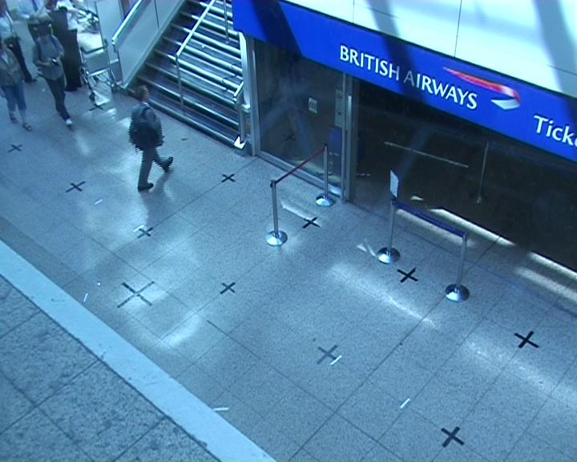
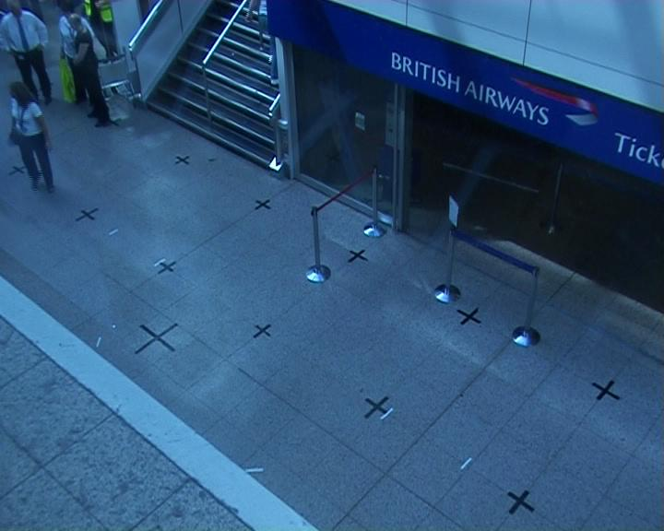
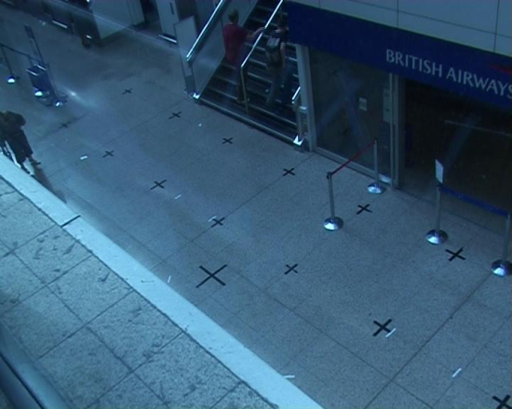
Illumination Changes
BACKGROUND
126
999
S08
2999

Slide 4
Illumination Changes by Clip
Notes:
Drop legend

Slide 5
Background Modeling
Input Data
Background
Modeling
Illumination
Normalization
Background Subtraction
Tracking & Event Detection
Normalized
BACKGROUND
Robust Gaussian Fit
Background Model Search
Background Models
Normalized
S01-S08
Ground-Plane Registration

Slide 6
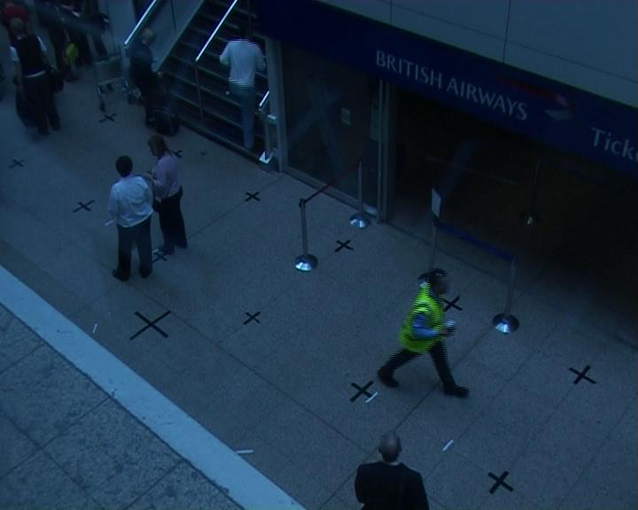
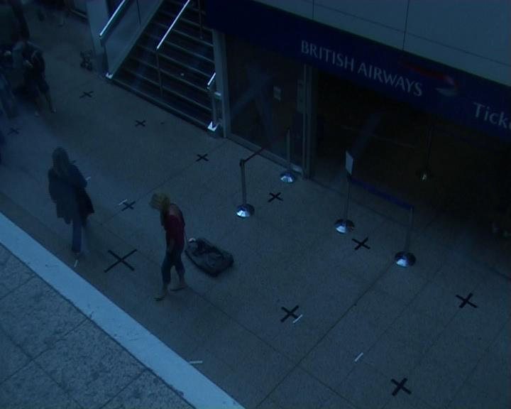
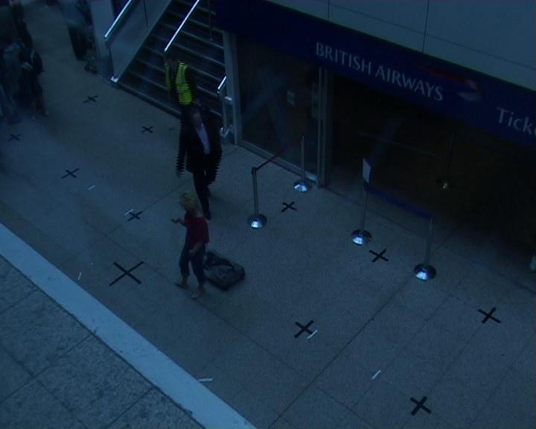
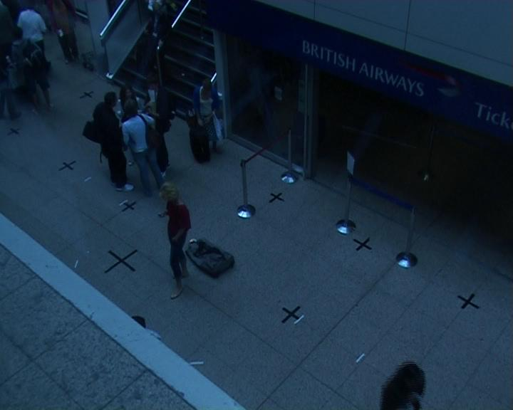
Breaking Adaptive Background Subtraction
Fundamental assumption
  foreground is rare at every pixel
Reality for PETS 2007…
  background is rare for the pixels we care about most
    Some pixels: foreground as much as 90% of the time
0
2000
3000
4000
Notes:
S02

Slide 7
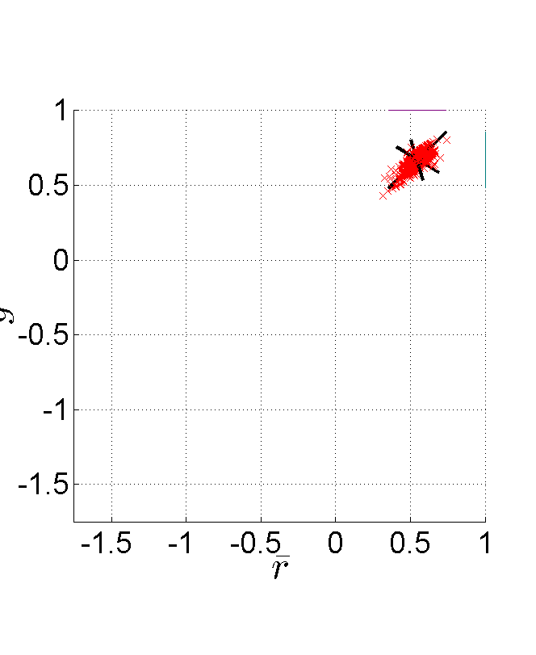
Robust Gaussian Fit (per pixel)
BACKGROUND clip
  Foreground is rare everywhere
  Fit a Gaussian
  Refit to inliers

Slide 8
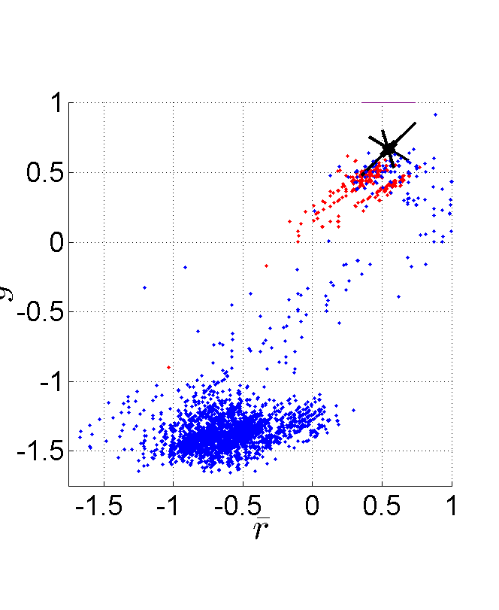
Need for Model Adaptation
Another clip (S02)
  BACKGROUND’s model: Suboptimal fit
BACKGROUND’s Gaussian model
Background samples
Foreground samples

Slide 9
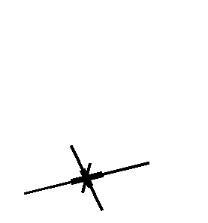
Model Adaptation
  Until convergence
    Find inliers
    Shift Gaussian center

Slide 10
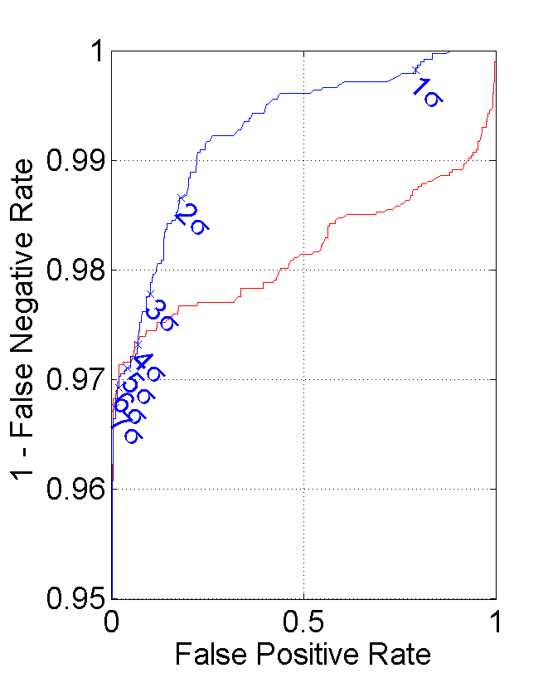
Improvement
Adaptation
  Is robust
  Improves FG/BG classification rates
Before adaptation
After adaptation

Slide 11
Background Subtraction
Input Data
Background
Modeling
Illumination
Normalization
Background Subtraction
Tracking & Event Detection
Background Models
Mahalanobis Distance
MRF
Blob Extraction
blobs
Normalized
S01-S08

Slide 12
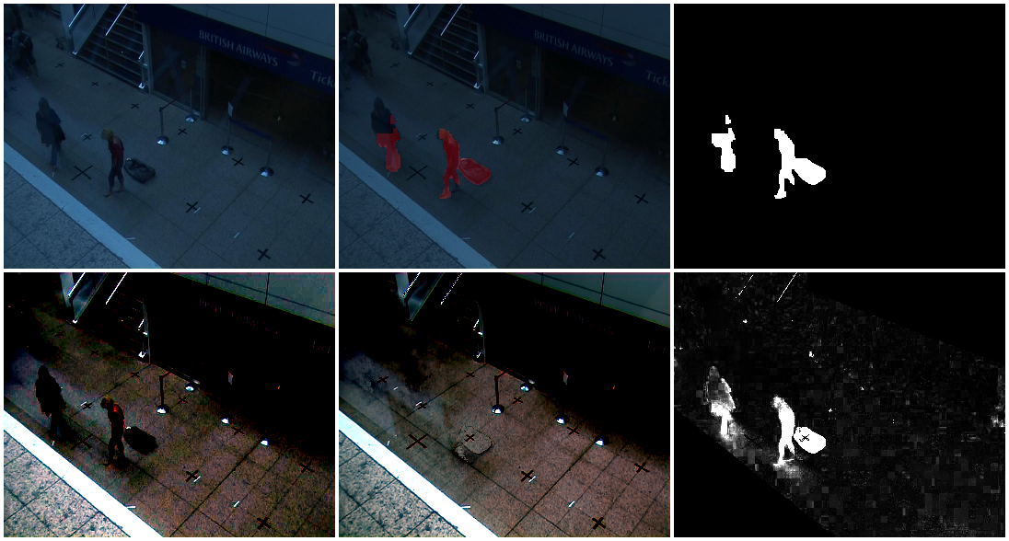
Background Subtraction
MRF
Frame 2000
With Foreground Mask
Foreground Mask
-
=
Normalized
Adapted Model
Mahalanobis Distances

Slide 13
Tracking & Event Detection
Input Data
Background
Modeling
Illumination
Normalization
Background Subtraction
Tracking & Event Detection
Kalman Tracking
Event Detection
Meanshift Tracking
blobs
alerts

Slide 14
Blob Tracking
Idea: Focus on tracking what we care about.
  Loitering humans
  Dropped luggage that becomes dissociated from its owner
Kalman tracking
  Constant velocity
  Low false positive rate

Slide 15
Detecting Humans and Luggage
Loitering humans
  Remain in the scene for a long time
  Likely to create isolated tracks
Dispossessed luggage
  Likely to create at least an isolated blob detection
Object Type | Min. Blob Area (% of frame) | Max. Blob Area (% of frame) | Min. Blob Track Length
humans | 1.5% | 3.0% | 16s
luggage | 0.2% | 1.0% | 1 frame

Slide 16
Mean-Shift Tracking
Blob tracking
  Yields high-quality tracks (good)
  Requires isolated blobs (bad)
Meanshift tracker
  Learn a model (color histogram) from the good blob tracks
  Tracks through occlusions
  Humans
    Find scene entry/exit times
  Luggage
    Find drop/pickup times
    Associate with human owners

Slide 17
Results

Slide 18
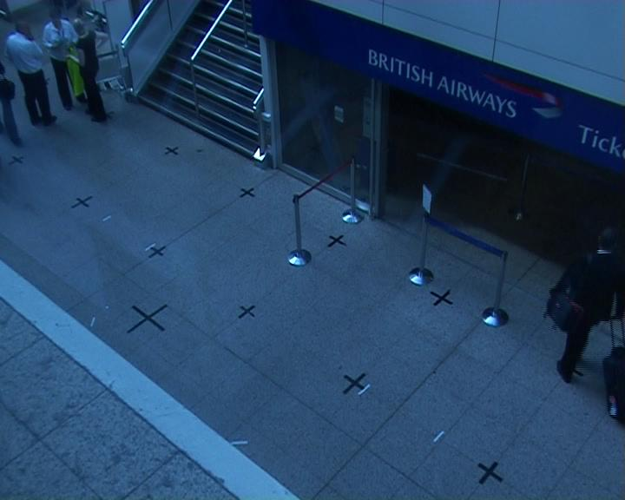
S00 – No Defined Behavior
No events occur
None detected

Slide 19
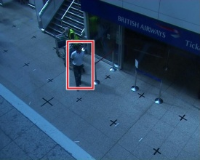
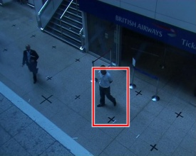
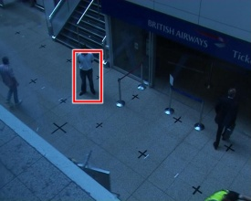
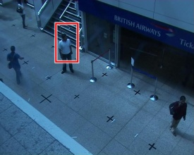
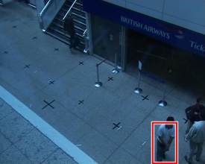
S01 – General Loitering 1 (Easy)
Staged loitering
  5.1s late

Slide 20
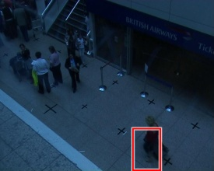
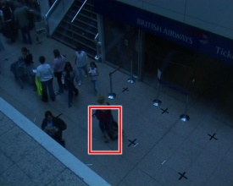
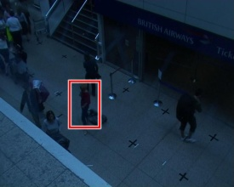
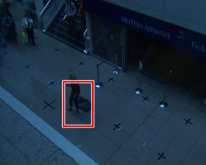
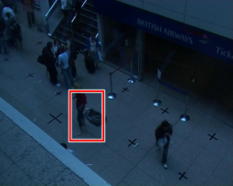
S02 – General Loitering 2 (Hard)
Staged loitering
  1.4s late

Slide 21
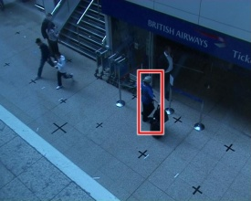
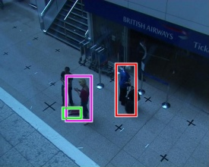
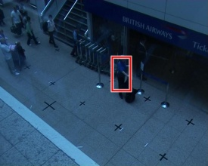
S03 – Bag Swap 1 (Easy)
Staged loitering
  8.2s late
Dropped luggage
  Should not trigger an alarm
  No alarm triggered
Staged loitering man near purple-outlined woman
  Missed
Unscripted loitering
  Detected

Slide 22
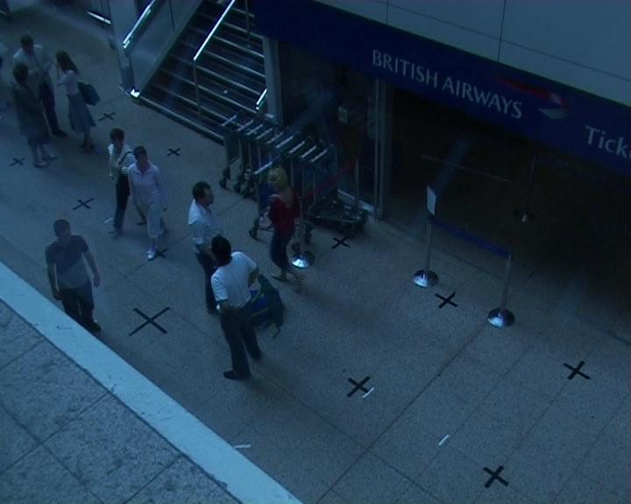
S04 – Bag Swap 2 (Hard)
Stay close to each other the whole time

Slide 23
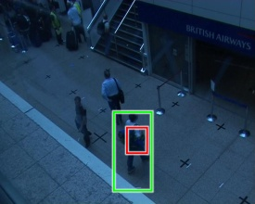
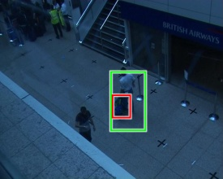
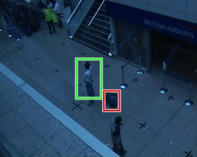
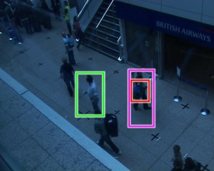
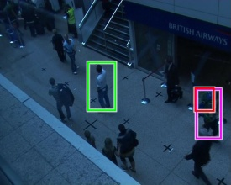
S05 – Theft 1 (Easy)
Victim enters
  19.2s late
Luggage stolen
  0.08s late
Thief exits
  0.08s late

Slide 24
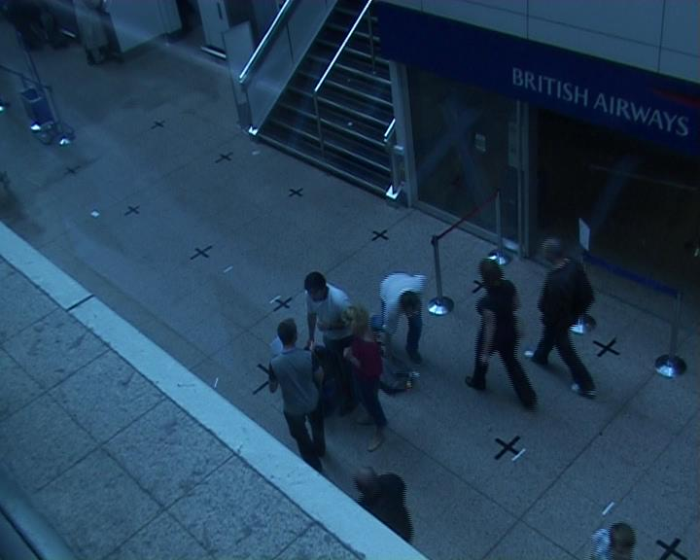
S06 – Theft 2 (Hard)
Victims
Thief
Luggage
(never isolated)
Assistant thief

Slide 25
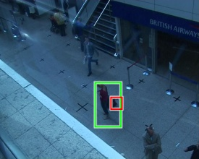
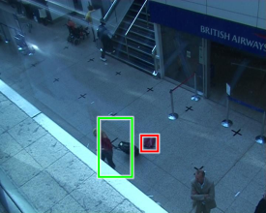
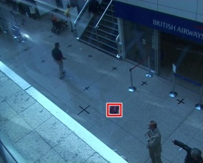
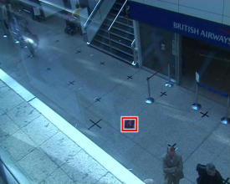
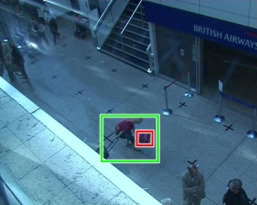
S07 – Left Luggage 1 (Easy)
Luggage dropped
  0.12s late
Owner tracked
Luggage taken
  0.08s late
  By owner

Slide 26
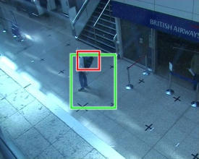
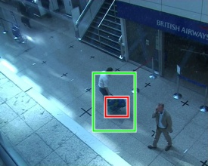
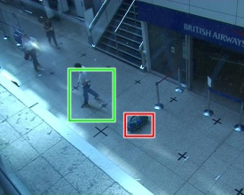
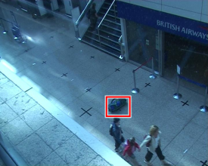
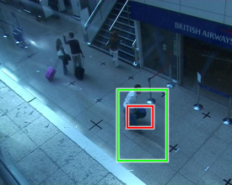
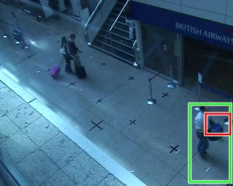
S08 – Left Luggage 2 (Hard)
Owner drops: 0.2s late
Owner picks up: 0.12s late

Slide 27
Questions?

Slide 28
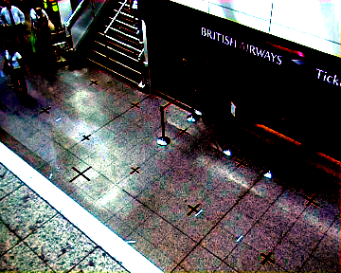
Illumination Normalization
where

Slide 29
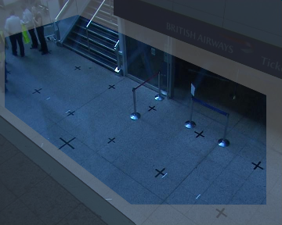
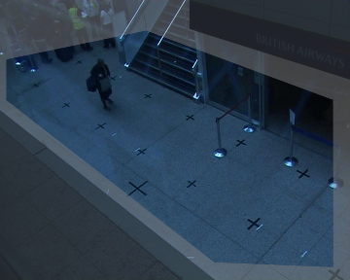
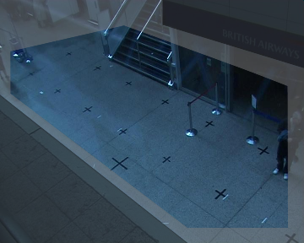
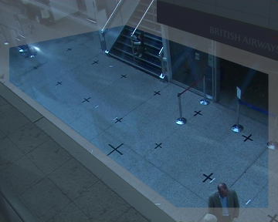
Region-of-Interest Masks
BG-S04
S05
S06
S07-S08

Slide 30
Background Subtraction
Input Data
Background
Modeling
Illumination
Normalization
Background Subtraction
Tracking & Event Detection
Background Models
BG-Biased MRF
Blob Extraction
fragmented blobs
Mahalanobis Distance
Normalized
S01-S08
FG-Biased MRF
Blob Extraction
merged blobs

Slide 31

Dual Background Subtraction
Foreground-Biased Blobs
Mahalanobis Distance Map
Background-Biased Blobs
Low fragmentation
But blobs merged
Good for human tracking
Sharp boundaries
But fragmented blobs
Good for dropped luggage detection
Notes:
TODO: figure out the textual description
Break up into a few slides + extra images

Slide 32
Tracking & Event Detection
Input Data
Background
Modeling
Illumination
Normalization
Background Subtraction
Tracking & Event Detection
fragmented blobs
Kalman Tracking
Event Detection
Meanshift Tracking
merged
blobs
Kalman Tracking
alerts

Slide 33
Why Dual Trackers/Motion Blobs
Luggage:
  it often doesn’t travel far from the owner, so we need BG-biased to avoid merging the dropped luggage blob with the owner
  The floor is more boring (except for specularities), so camouflaging doesn’t occur much there, relative to the vertical surfaces
  Easy to tell people fragments from luggage: small people fragments move
    They move when they’re isolated
    They move before and after isolation
Humans
  With the busyness of the scene, a BG-biased MRF produces a lot of fragments and many-to-many blob matching quickly becomes impractical
  A FG-biased MRF avoids the fragmentation issue but merges lots of blobs
    We only care about loiterers
      Loiterers are in the scene for a long time
      They’re likely to be isolated from other people at least at some point in time
Notes:
TODO: coordinate this content with the surrounding slides

Slide 34

Oriented Ellipsoids

