Slide 1
A Short Note About
Short Notes (to Self)
Note to Self: Examining Personal Information Keeping
in a Lightweight Note-Taking Tool
Max Van Kleek - emax@csail.mit.edu
MIT CSAIL
with Michael Bernstein, Katrina Panovich, Greg Vargas,
David Karger, and mc schraefel
CHI 2009 in Boston
April 8, 2009

Slide 2
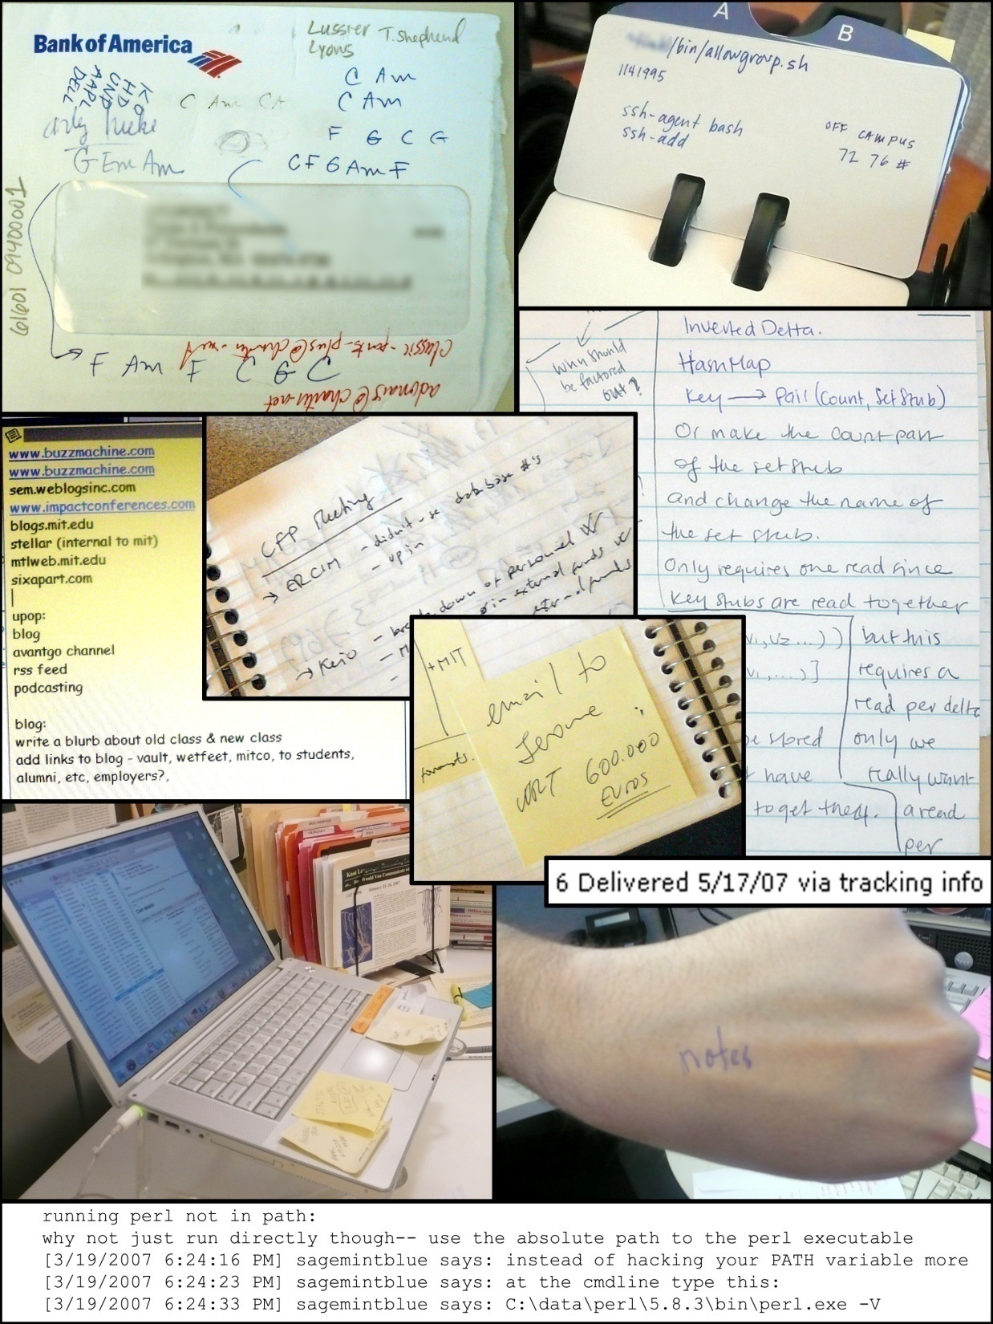
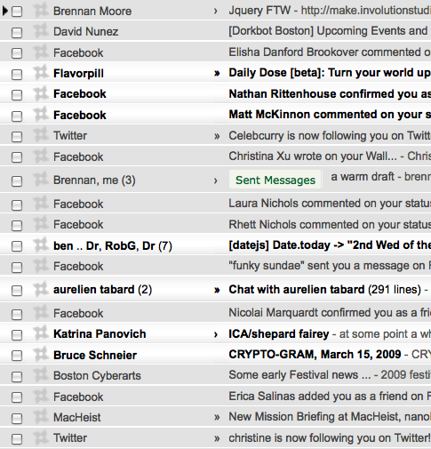

Slide 3
A. Sellen & R. Harper “Myth of the Paperless Office”,
MIT Press 2001
V. Bellotti, “Quantity versus Quality: E-Mail Centric
Task Management and Its Relation with Overload”
Human-Computer Interaction, 2005.
W. Jones, “The World Is At My Doorstop.. And the
House is a Mess: Putting Our Information In Its
Place in the Digital Age”, 2008.
S. Whittaker & V. Kalnikaite, “Software or Wetware:
Discovering When and Why People Use Digital
Prosthetic Memory.” CHI May 2007.
Notes:
Of course, we aren’t the first to look at problems in digital personal information management tools. Victoria Bellotti

Slide 4
Types?
Uses?
Needs/Affordances?

Slide 5
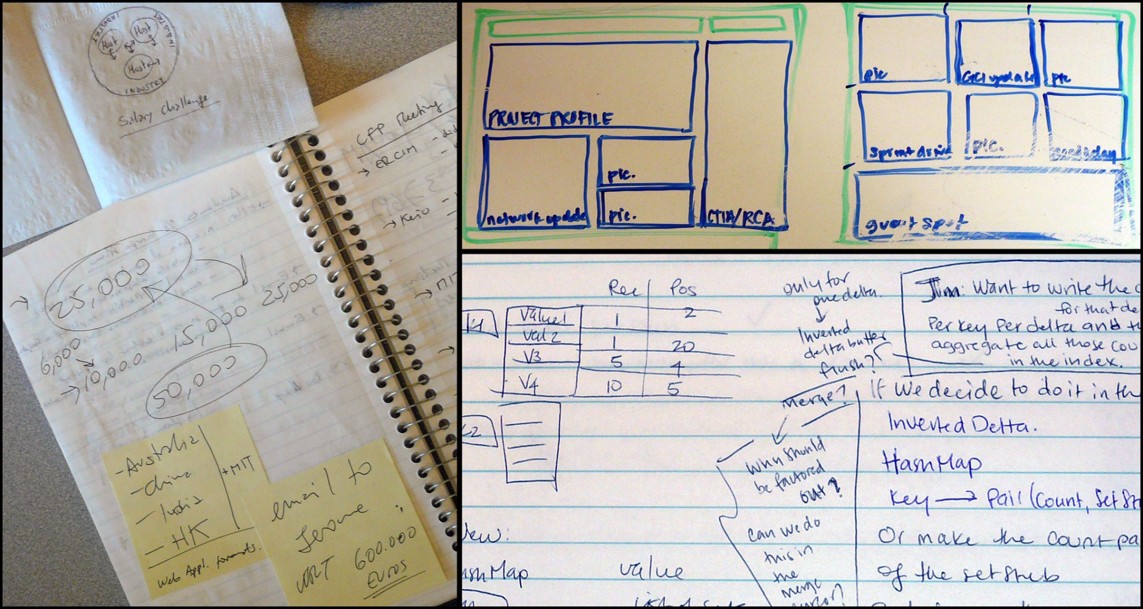
information scraps study
27 participants. 5 organizations. 1-hour sessions, semi-structured interviews and artifact examination
“Information Scraps: How and Why Information Eludes our Personal Information
Tools”. ACM TOIS Special Issue on Personal Information Management, 2008

Slide 6
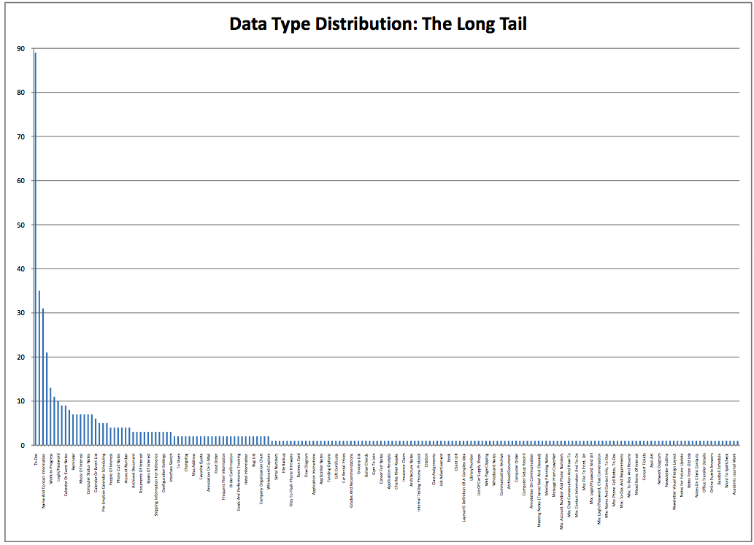
Types?
Bicycle part # (1)
Gift Certificate # (1) Guitar Chords, (1)
Gym To Join, (1)
Insurance Claim (1)
Kayaking Resources (1)
Puzzle Answers (1)
Rebate UPCs (1)
Salary Calculation (1)
Serial Numbers (1)
Sign Out Sheet (1)
Song Lyrics (1)
Name of Travel Agent (1)
To-Do reminders (92)
Meeting Notes (44)
Name/Contact Information (38)
How-Tos (25)
Work-In-Progress/Drafts (16)
File Path/Directory Path/URL (14)
Desired Items (13)
Login/Password (12)
Brainstorm, Calendar/Event Details (9)
Progress Reports, Receipts (8)
Computer Repair Status, Chat transcripts,
Financial Data, Prices of things to buy (7)

Slide 7
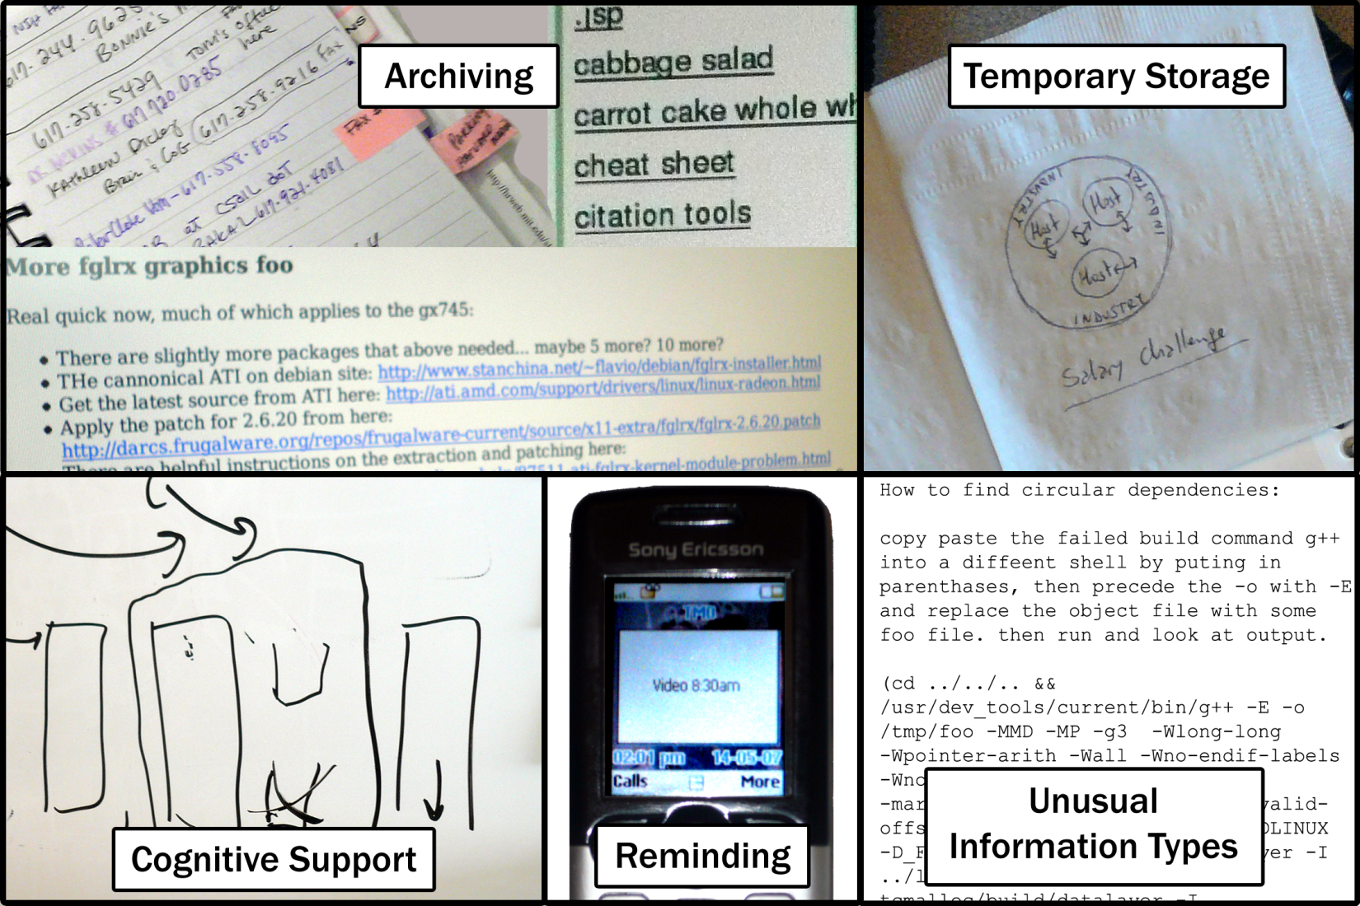
Uses?

Slide 8
Needs?
too much effort to write it down/put it in
2. no tool for it / it doesn’t fit
3. too hard to organize
4. visibility and availability
“If it takes three clicks to get it down, it’s easier to e-mail [to myself].”
“I wanted to assign dates to notes, but [it] would only allow dates on tasks.”
“Where else would I keep my { guitar tabs / poetry }?”
“It’s too much work to decide which section it should go in –sometimes things don’t fit in just one place. It’s hard to decide what to do.”
“If it’s not in my face, I’ll forget about it.”
“I need it with me at all times, so I have no choice.”

Slide 9
Needs?
too much effort to write it down/put it in
2. no tool for it / it doesn’t fit
3. too hard to organize
4. visibility and availability
“If it takes three clicks to get it down, it’s easier to e-mail [to myself].”
“I wanted to assign dates to notes, but [it] would only allow dates on tasks.”
“Where else would I keep my { guitar tabs / poetry }?”
“It’s too much work to decide which section it should go in –sometimes things don’t fit in just one place. It’s hard to decide what to do.”
What about lightweight note-taking tools
and snippet-keepers?
“If it’s not in my face, I’ll forget about it.”
“I need it with me at all times, so I have no choice.”

Slide 10
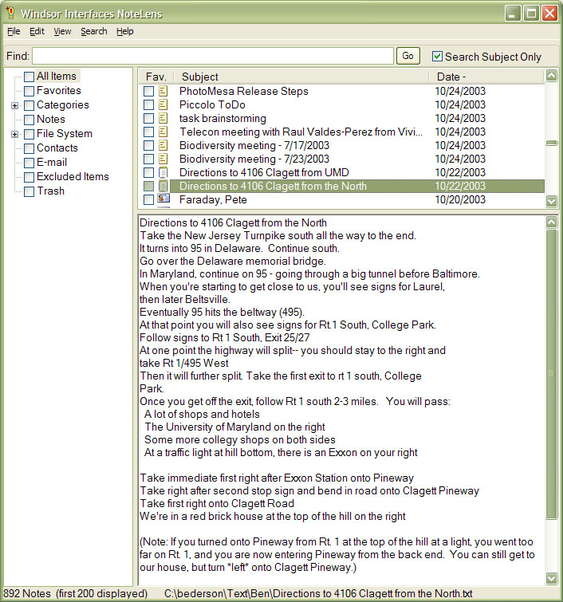
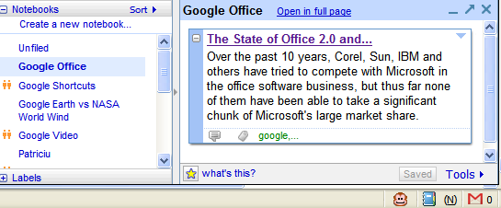

Slide 11
note-taking tools and snippet-keepers
How do people use them?
What do people write in them?
(Types)
What kinds of roles do they serve?

Slide 12
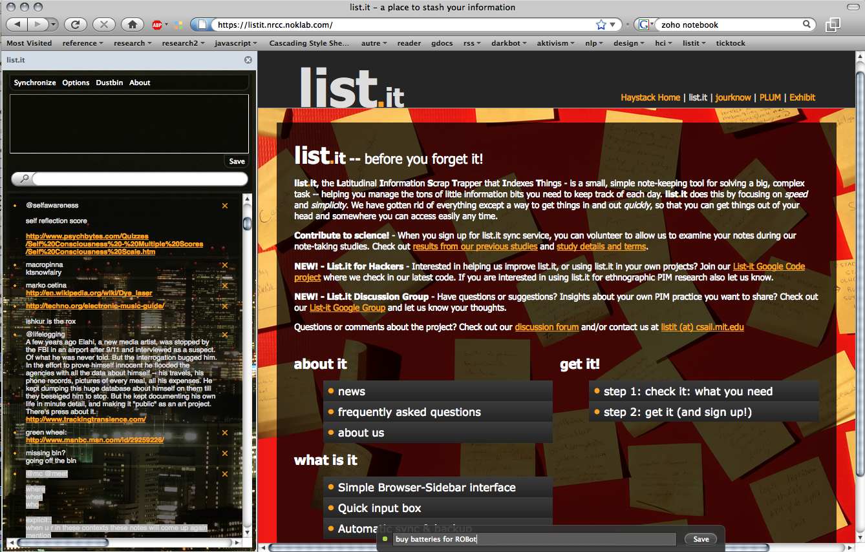

Slide 13
List.it (demo)
For studying note-taking in situ
Open source! (MIT License) Instrumented for logging

Slide 14
List.it field study (Nov 2008)
42 participants
10 days
“as you see fit”
exit survey

Slide 15
results

Slide 16
results:
number of non-exercise notes taken by person (42 participants)
min: 2, median : 11, max: 146 (overall: 853)
across participants: ~ 35 new notes per day

Slide 17
notes were created quickly and tersely
30% of notes were captured in under 5 seconds
50% in under 10 seconds
95% in under 2 minutes

Slide 18
note edits were infrequent, quick and minor
75% of notes were never edited
19% were edited exactly once
39% of edited notes were edited <5 mins after creation
40% of edits were < 2 character edits
clean kitchen
!clean kitchen

Slide 19
notes were extremely short
median : 29 characters, 7 words
43% were 5 words or fewer

Slide 20
why so short?
CAMPING. Get: backpacking tents, ask michael, if not buy @ REI, propane stoves x 2, check gatage [sic]
teapot, laptop
email HW re vacation
talk to Brin re:ictd
make inspiration wall. corkboard tiles.
ask dslr
deposit checks
sb at 8:15, 1267 Bent St
costco optometrist?
BGM wiki http://…
renter's insurance
jshieh
4212B9
Thurs 11.30am - Soojin fMRI
soy latte java
laptop at HMS (next week)
waiting on mechanic for AAA
Harp photos
meltmuck http://web.mit.edu/…
malt, malted vanilla
jimmy: (323) 668-xyzz
pacific auto service
talk at noon, 7 Div Av
bring tonight:laundry, dishes,
pesto
hotel for Reunions
mw 965 $100 shoemall.com
Play some more Lich King beta.

Slide 21
website -> “Get bits for new website; update and transfer old website data to new website.”
scholo -> “I was leveling my warlock in World of Warcraft [...] part of it
involved running the instance Scholomance ( "Scholo"
for short).”
jhsieh -> “I need to contact this person soon”

Slide 22
notes were rarely deleted
28% of notes were deleted
notes deleted sooner after creation were more likely to be shorter
t(165)=2.26, p<0.05
deletion strategies:
(7/42=17%) deleted over half the notes they created;
most participants deleted fewer (μ=21%, σ=4.6%)
Evidence of the “to keep or not to keep” dilemma [Jones, 2004]
And “deletion paradox” [Bergman 2003] ?

Slide 23
information types naturally ambiguous
participants asked to categorize up to 15 non-prompted notes
however, empirically notes often combined traditional PIM types
to-do, calendar item, contact information, …
Sept 4 12-1pm CCI meeting NE25-746
coders (3/3): “calendar item” user: “to-do”

Slide 24
search is infrequent and targeted
Most (36/42) participants searched fewer
than 10 times
Two participants used search heavily,
76% of their searches were repeats:
“today” and “todo”
22% of searches yielded exactly 1 note (search-as-navigation)
34% of notes were re-found at least once
(by self-report)

Slide 25
metadata added to aid re-finding
Write python calculator for 20.110? to do classes
search logs:
to do
today
9.18
@do
!read by wed
!!pay rent

Slide 26
people used the design affordances of list.it
"List.it seemed most useful for small lists and brief notes [...] due
mostly to its simplicity. Overall, I think I'll continue to use it [...] for
jotting down quick notes and reminders."
Why in list.it and not elsewhere?
quick capture (35%), browser integration (18%), visibility (13%)
Without list.it, where would you have put it?
• I wouldn't have saved it, I don't have anything else to quickly take a note like that.
• I probably would not have taken a note at all, and I probably would have forgotten to do it.
• [I would have written it] probably on a piece of paper that would
then get lost

Slide 27
list.it struck a chord
(as of april 7th):
11059 registered users
1904 users consented to be studied
48,214 notes uploaded
52 list.it “groupies”
(PIM researchers, fans, hobbyists)
First open personal note corpus for PIM research

Slide 28
Adaptive list.it
(“Notes that Float”)
Too many notes? Forget they exist?
Predicts note relevance to
activity and location
and makes relevant notes
automatically visually salient

Slide 29
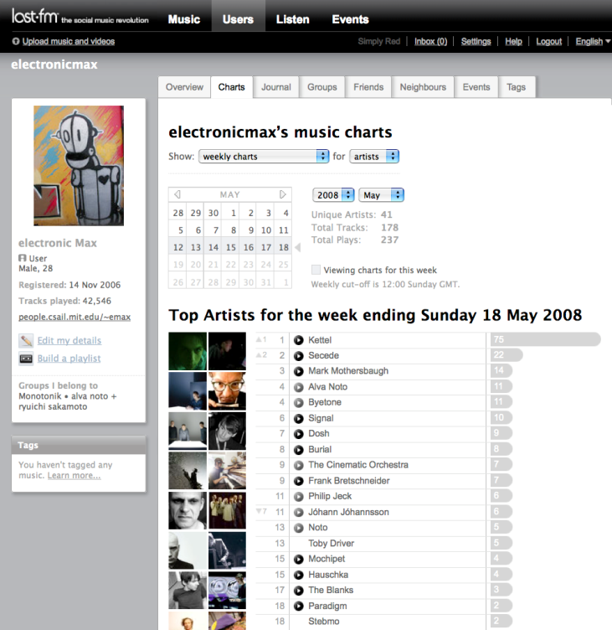
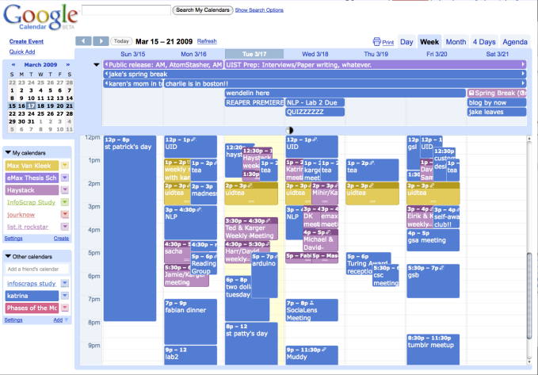
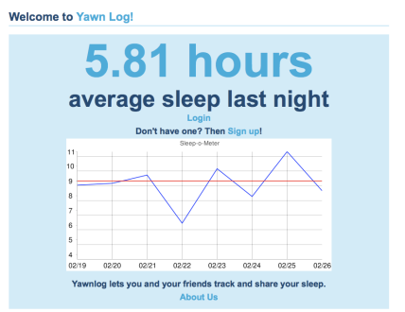
Coming soon!
scrobbler
web accesses
web apis & rss
entities
OIL location
tracks places sites
events
(sqlite dbs)
For other self-trackers:
The Quantified Self: http://www.quantifiedself.com/

Slide 30
Recap: List it study
Notes were short, very quickly taken
Abbreviation strategies
Reminding
Few edits and deletions
Search used as filter, navigation mechanism
Notes mixed types (to-dos, contact, how-tos)

Slide 31
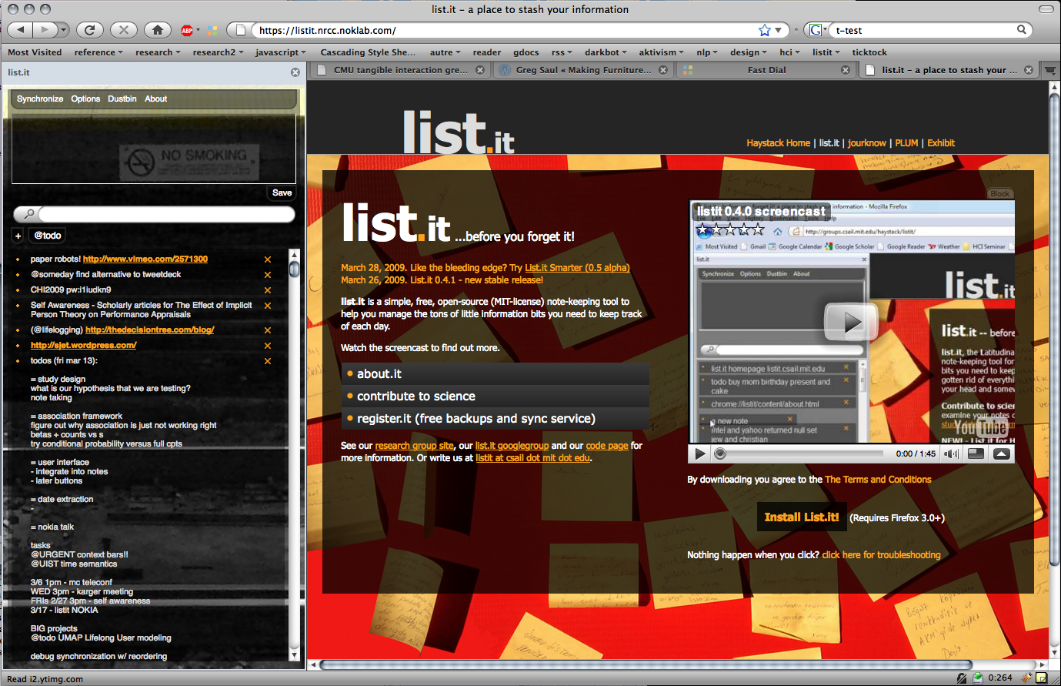
Thank you!
List.it http://listit.csail.mit.edu http://code.google.com/p/list-it
This project was funded by Nokia Research, Web Science Research Institute,
and the National Science Foundation

