Slide 1
Reflections on
Team-based Teaching of
Discrete Mathematics
Albert R Meyer
Professor of Computer Science
Massachusets Institute of Technology

Slide 2
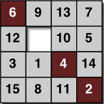
Math for Computer Science
MIT 6.042J/18.062J
Complete materials on
MIT Open Course Ware:
http://ocw2.mit.edu/courses
/electrical-engineering-and-computer-science
/6-042j-mathematics-for-computer-science
-spring-2015/

Slide 3
Math for Computer Science
MIT 6.042J/18.062J
Created early 1990’s by Leighton
& Leiserson
Enrollment is 405, 75% Sophomores
Taught by regularly by ARM since 2001
Evolved from standard lecture/recitation
into:

Slide 4
“Flipped” Classroom
Before class:
lecture videos
online questions
reading

Slide 5
“Flipped” Classroom
Before class:
lecture videos

Slide 6
“Flipped” Classroom
Before class:
online questions

Slide 7
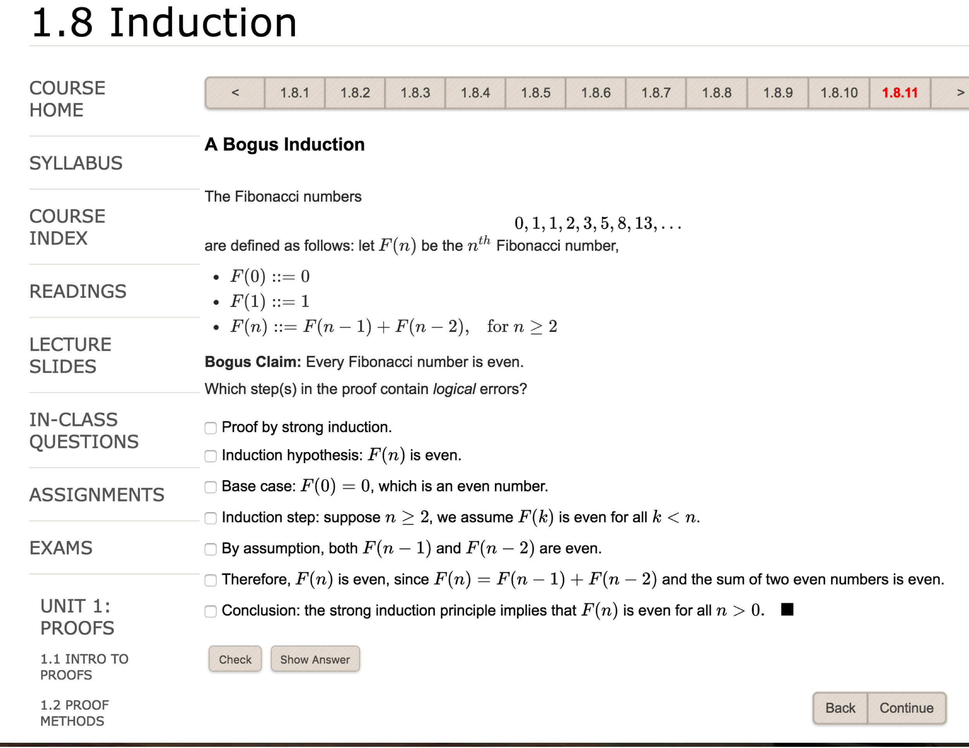

Slide 12
“Flipped” Classroom
Before class:
reading

Slide 13
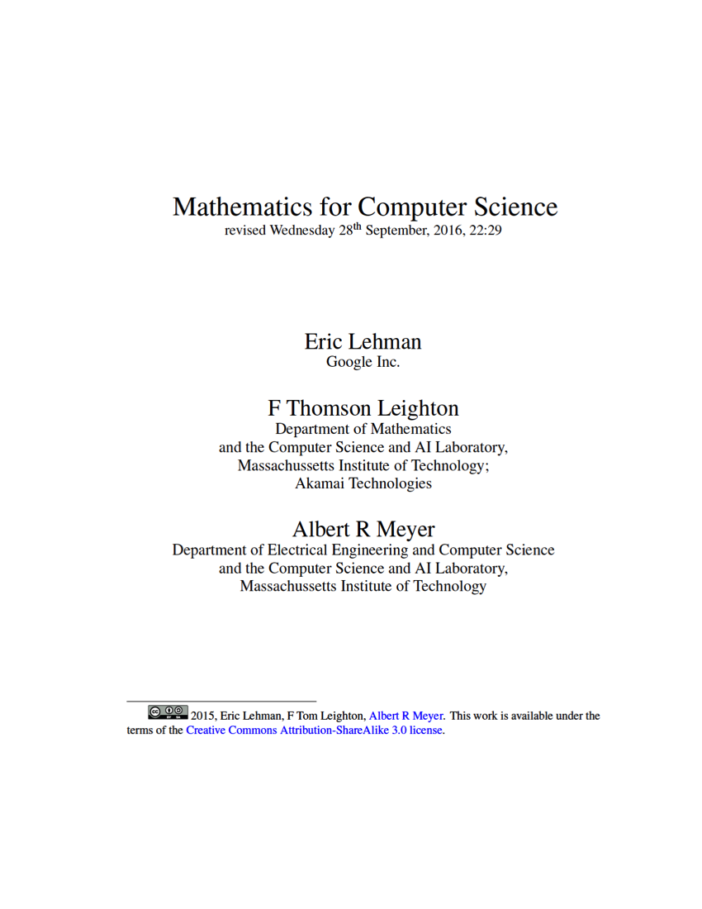

Slide 14
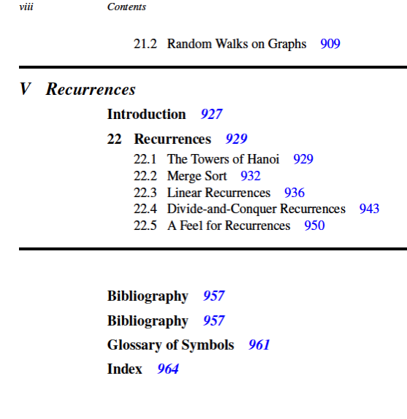

Slide 15
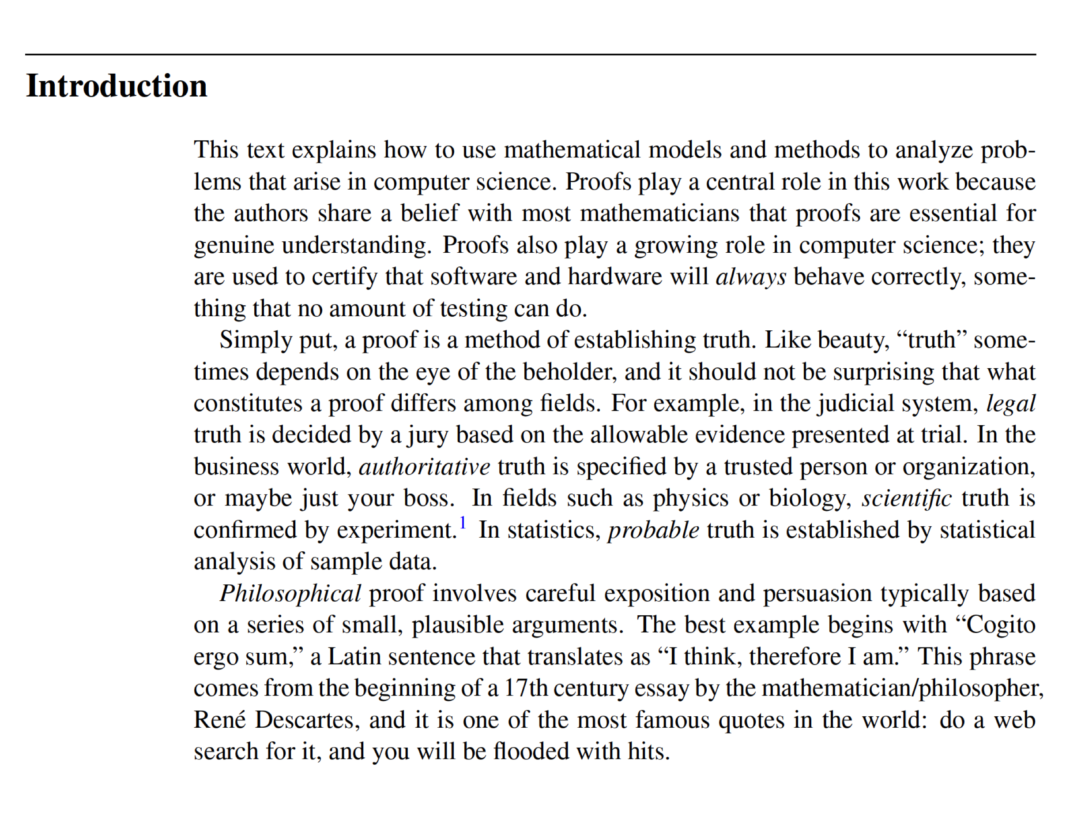

Slide 16
Organization
80 min classes, 3/week
Final exam
4 midterms

Slide 17
Team Problem Solving
In class:
Teams of 6-8 students
with LA/TA “coach”
Graded for participation

Slide 18
Team Problem Solving
In class:
Heterogeneous teams:
men/women, Year 1 & G,
A’s & C’s, Arabs/Jews,…
Team solution on whiteboard

Slide 19
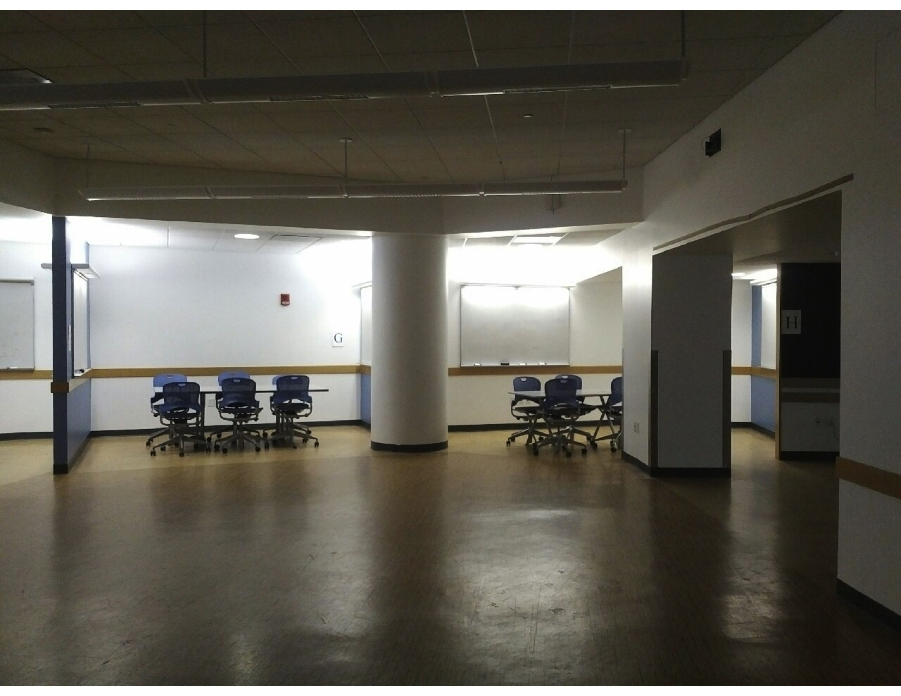

Slide 20
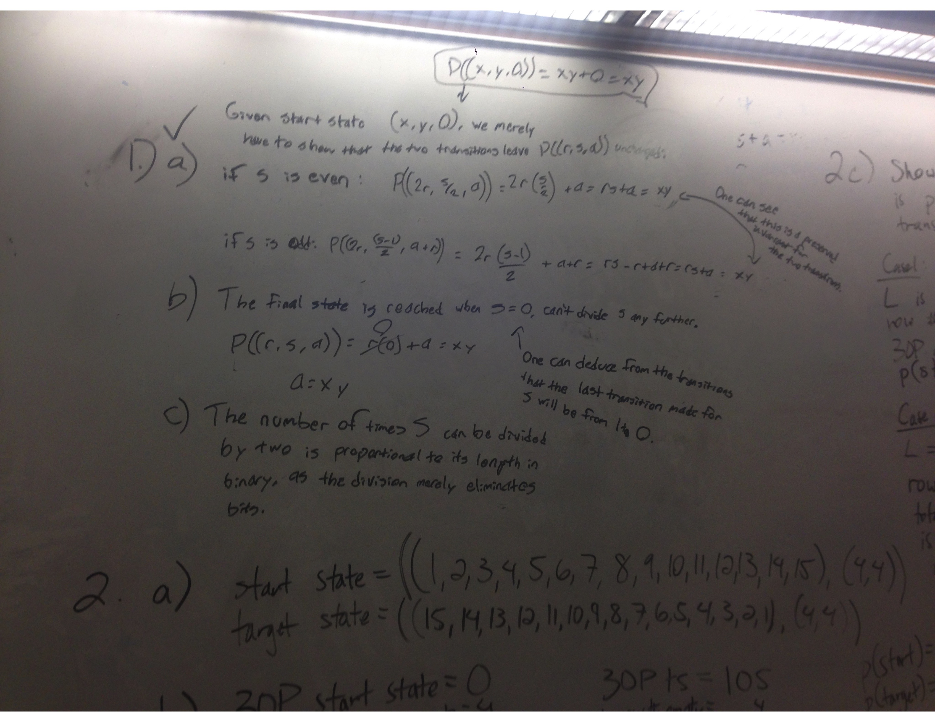

Slide 21
Management Issues
Train student staff of 50
Team Coaches
Problem Sets??
Grading
Cheating

Slide 22
After Class
Office hours
Problem Sets?
Grading?
Cheating??

Slide 23
Management Issues
No lectures, but instructor
is busy:
Train student staff of 50
Team Coaches
Compose 4 midterms &
a final exam
Update videos, online system

Slide 24
Active Learning Background
Eric Mazur, Harvard 2001:
Make lectures active
Lecture clickers
Peer conversation

Slide 25
Active Learning Background
MIT Physics: TEAL 2005 by
John Belcher with Judy Dori
Proven learning gains
Initially very unpopular
Student satisfaction now OK

Slide 26
Math for CS Student Opinions
Take team-based again?
Required attendance
--prepared
Learning is hard!
never
neutral
love to

Slide 27
Active Learning at MIT
Math for CS more radical: no live lectures
Large MIT “Digital Learning” effort
Mostly MOOCs
growing residential focus
Only a handful of large subjects flipped
Most MIT STEM still lecture/recitation

Slide 28
Active Learning at MIT Now
Large “Digital Learning” effort
Mostly MOOCs
Growing residential focus
Most STEM still live lecture

Slide 29
6.042 Outcomes
Understand Math Topics
Math abstraction/modeling literacy
Elementary proofs
Communication (written, oral)
Teamwork

Slide 30
LEARNING?
No less
(maybe more?)
More efficient?

Slide 31
Math for CS Educational Assessment
Ongoing research with Dori
who learns?
who loves?, who hates?
perceived vs measured?
efficient learning?

Slide 32
Math for CS Learning?
Same exam performance
Actually learn more?
More efficient?
Who loves? Who hates?

