Slide 1
Election Security
Ronald L. Rivest
MIT
2019 D.C. Circuit Judicial Conference
June 26, 2019

Slide 2
Outline
Security Requirements
Evidence-based Elections
Software Independence
Auditing of Paper Ballots
Remote (Internet) Voting ???

Slide 3
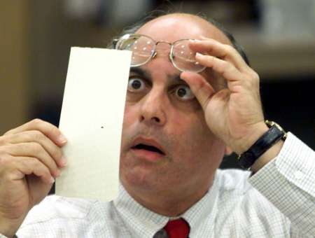
Have we made progress since 2000?
Hanging chads (2000)
Voting Machines at Risk (2015)

Slide 4
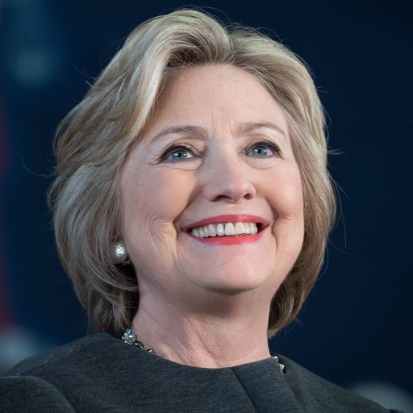
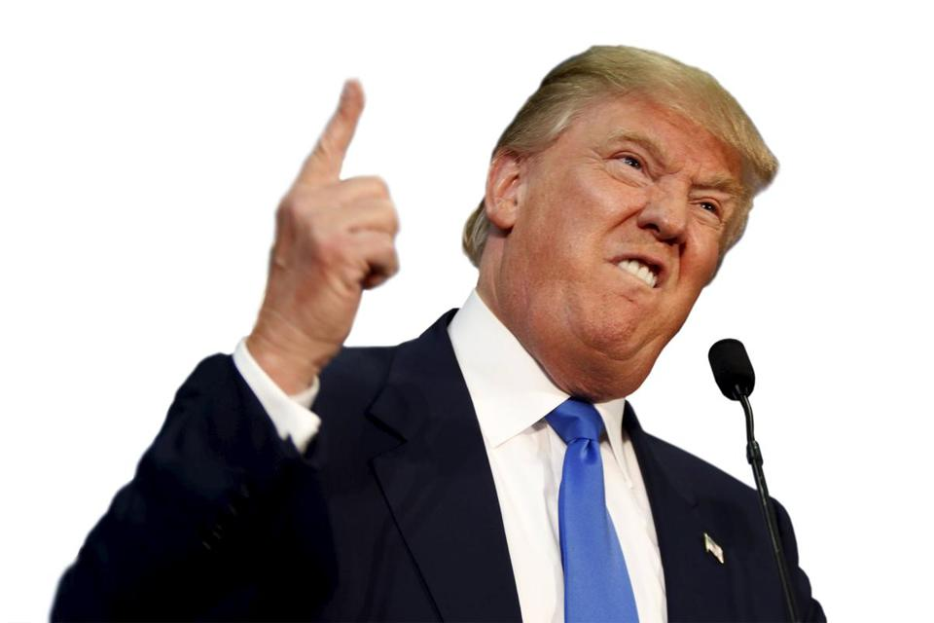
Nov. 2016 – Who Really Won?

Slide 5
How do we vote?

Slide 6
Paper Ballots, mostly

Slide 7
1893 – “Australian” Paper Ballot

Slide 8
About 80% of voters use paper ballots

Slide 9
Optical scanners are used for efficient tabulation

Slide 10
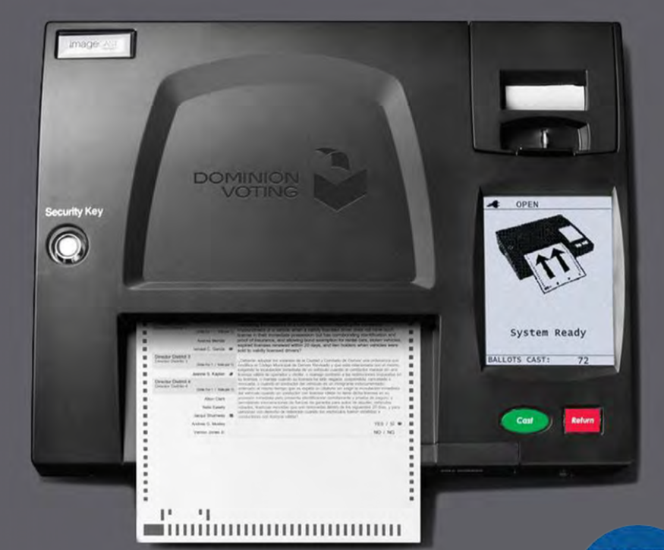

Slide 11
(Concern:) Scanners may introduce systematic errors

Slide 12
Causes of scanner errors
Differences in interpretation between machine interpretation, and hand interpretation based on “voter intent” rules.
Stray marks (e.g. caused by folds)
Configuration errors
Programming errors
Hacking (adversarial attack)

Slide 13
How should we vote?

Slide 14
Security Requirements

Slide 15
Security Requirements
Only eligible voters may vote, and each eligible voter votes at most once.
Each cast vote is secret, even if voter wishes otherwise! -- No vote-selling! -- No receipt showing how you voted!
Final outcome is verifiably correct.
No ``trusted parties’’ – all are suspect! Vendors, voters, election officials, candidates, spouses, other nation-states, …

Slide 16
Evidence-Based Elections
An election system should not only
accurately figure out who won,
but should also
provide convincing evidence
that the winner really won.
(Stark & Wagner 2012)

Slide 17
Software Independence
(Rivest & Wack, 2006)

Slide 18
And Who Do You Hope You Voted For?

Slide 19
Software Independence
Software is not to be trusted!
A voting system is software independent if an undetected error in the software can not cause an undetectable change in the election outcome.
Strongly software-independent if it is possible to correct any such outcome error
Example: Paper ballots (with hand recount)

Slide 20
NASEM Report (9/6/18)
National Academies issued report on ”Securing the Vote”
www.nap.edu/futureofvoting
(159 pages; free pdf)
41 recommendations

Slide 21
Recommendation 4.12 Use voter verifiable paper ballots everywhere by 2020

Slide 22
Recommendations 5.7—5.9 Audit election outcomes!

Slide 23
Recommendations 5.7—5.9 Audit election outcomes!
A risk-limiting audit (RLA) uses manual interpretation of randomly chosen cast paper ballots to verify with high probability the reported election outcome (or correct it, if wrong).

Slide 24
Election Process (paper ballots)
Print ballots; setup
Mark Choices; Verify Vote; Cast Vote!
Optical scanners give initial (“reported”) outcome
Statistical audit of cast paper ballots by hand to confirm/disprove reported outcome
“Brush your teeth; eat your spinach; audit your elections!” -- Poorvi Vora

Slide 25
Auditing of Paper Ballots

Slide 26
Audits
Sample cast paper ballots at random
Figuring out what the sampled ballots tell you about the reported election results
Risk-Limiting audits

Slide 27
Who is audit for?
Losing candidates – to convince them that “they lost fair and square”
The winner – to provide a mandate
The public – to assuage doubts about “rigged elections”
Election officials – to help them provide accurate and efficiently-verified results

Slide 28
What a RLA does not do
A RLA does not address:
correctness of the tally (as opposed to the outcome)
voter eligibility
voter authentication
usability
privacy
chain of custody of paper ballots

Slide 29
Audit Rochester Hills MI (12/3/2018)
Reported results for Proposition: 22,999 Yes 12,343 No 1,324 Other
Sample results for Proposition: 50 Yes 26 No 0 Other
So… ???

Slide 30
Risk-Limiting Audit
RLA Question: What is current ``risk’’? (Probability that if reported winner is incorrect, audit would nonetheless accept it if audit stopped now.)

Slide 31
Results
RLA results:
Risk measured at 2.1 %
(Kellie Ottoboni using SUITE tool)
Reported outcome confirmed (accepted by audit) after only 76 ballots sampled!

Slide 32
Recommendation 5.11 No Internet voting!

Slide 33
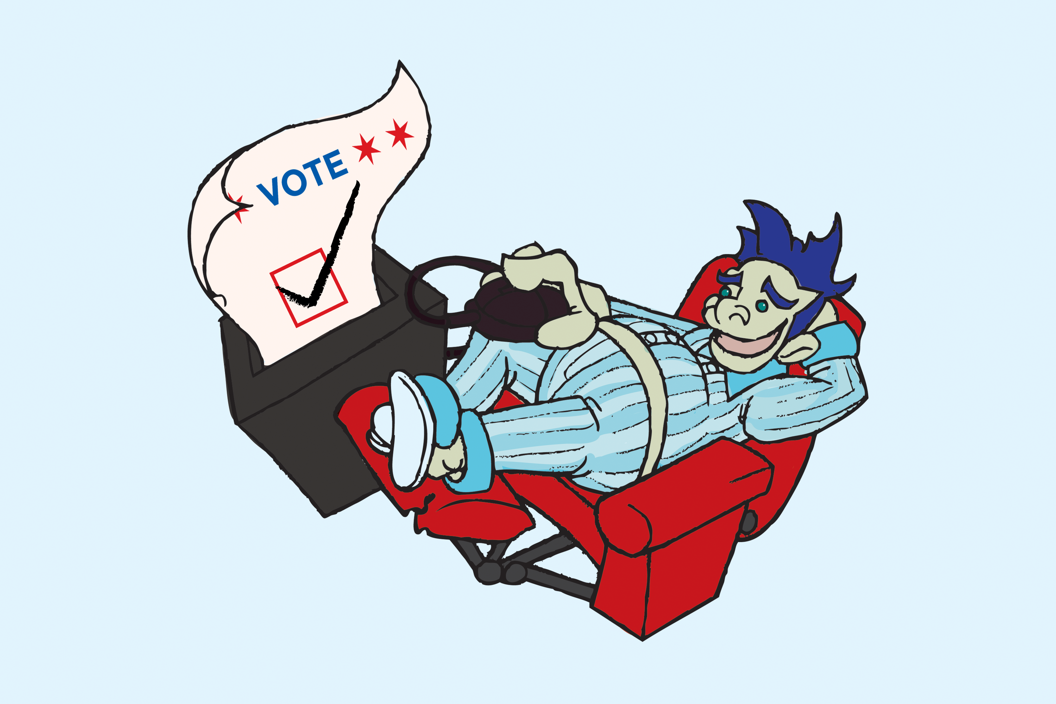
When can I vote on the Internet? (or on my phone?)
http://voteinyourpajamas.org/

Slide 34
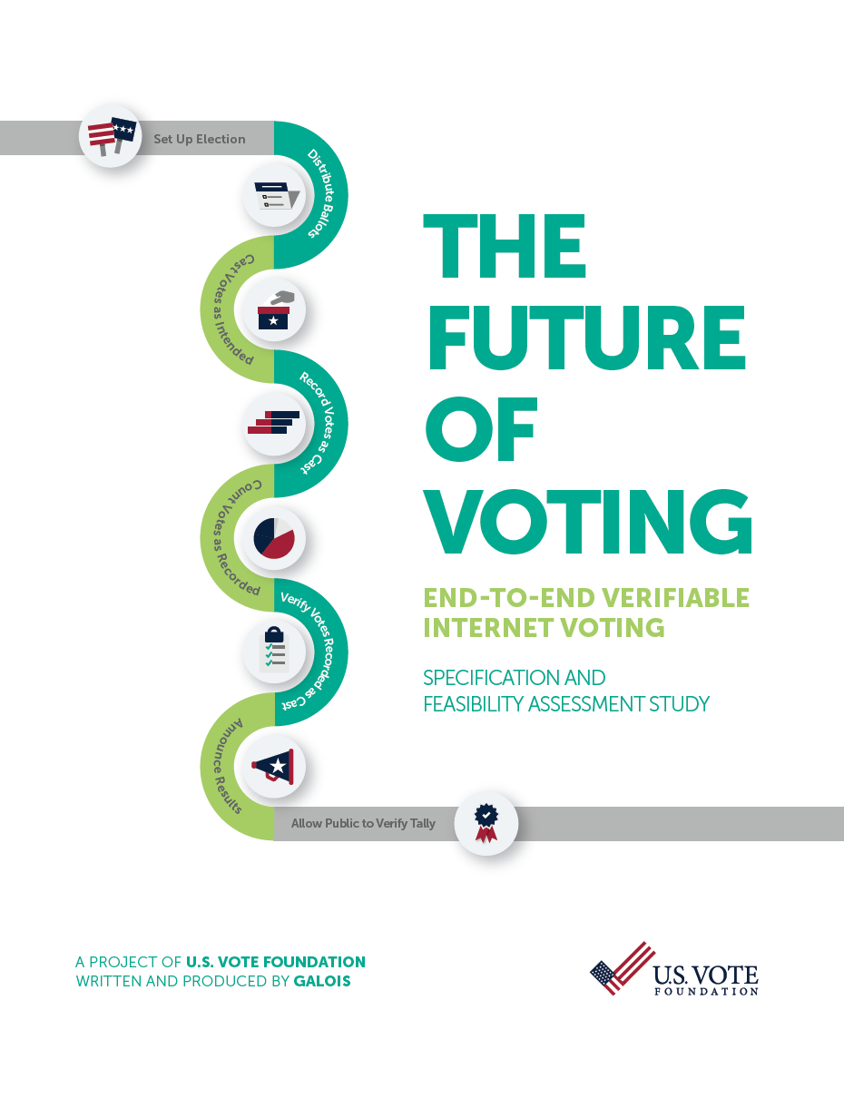
U.S. Vote Foundation 2015 Report on Internet Voting:
Internet voting requires solutions to many as-yet-unsolved problems:
Malware
DDOS attacks
Authentication
MITM attacks
Zero-day attacks on servers
Coercion & vote-selling
…

Slide 35
Conclusions
We can make elections much more secure with post-election risk-limiting audits.
We’re not yet ready for ``internet voting,’’ and may not be for 20 years…

Slide 36
The End
Thanks for your attention!
(and thanks to NSF CSOI and to Verified Voting!)

