Slide 1
Four-Cut: An Approximate Sampling Procedure for Election Audits
Mayuri Sridhar
Ronald L. Rivest

Slide 2
Overview
We present a new way of picking a random sample for election audits
This method avoids having to count ballots and, thus, is more efficient
However, the sample is now only “approximately uniformly” random.
We show how to mitigate for the approximations in RLAs and Bayesian audits

Slide 3
Goals

Slide 4
Ballot-Polling RLA Procedure
Sample some ballots uniformly at random from the cast votes
Produce a sample tally for the contest:
  Ex: 70 votes for Alice, 30 votes for Bob
If the sample tally satisfies the risk limit, the audit is finished
If not, sample more ballots
Notes:
-define sample tally

Slide 5
Goals
Can we make the sampling process faster?
Yes! However, the samples will only be approximately random

Slide 6
Assumptions
We expect to sample 1-2 ballots per batch
We expect the ballot manifest to be accurate, in terms of the number of ballots per batch
All ballots are in a straight pile

Slide 7
Assumptions
What is a “cut”?
  Remove some ballots from the top of the stack and place them on the bottom
The person making a single cut chooses some ballots and places them at the bottom
  The person making the cut cannot see the vote on the ballot that will end up on top

Slide 8
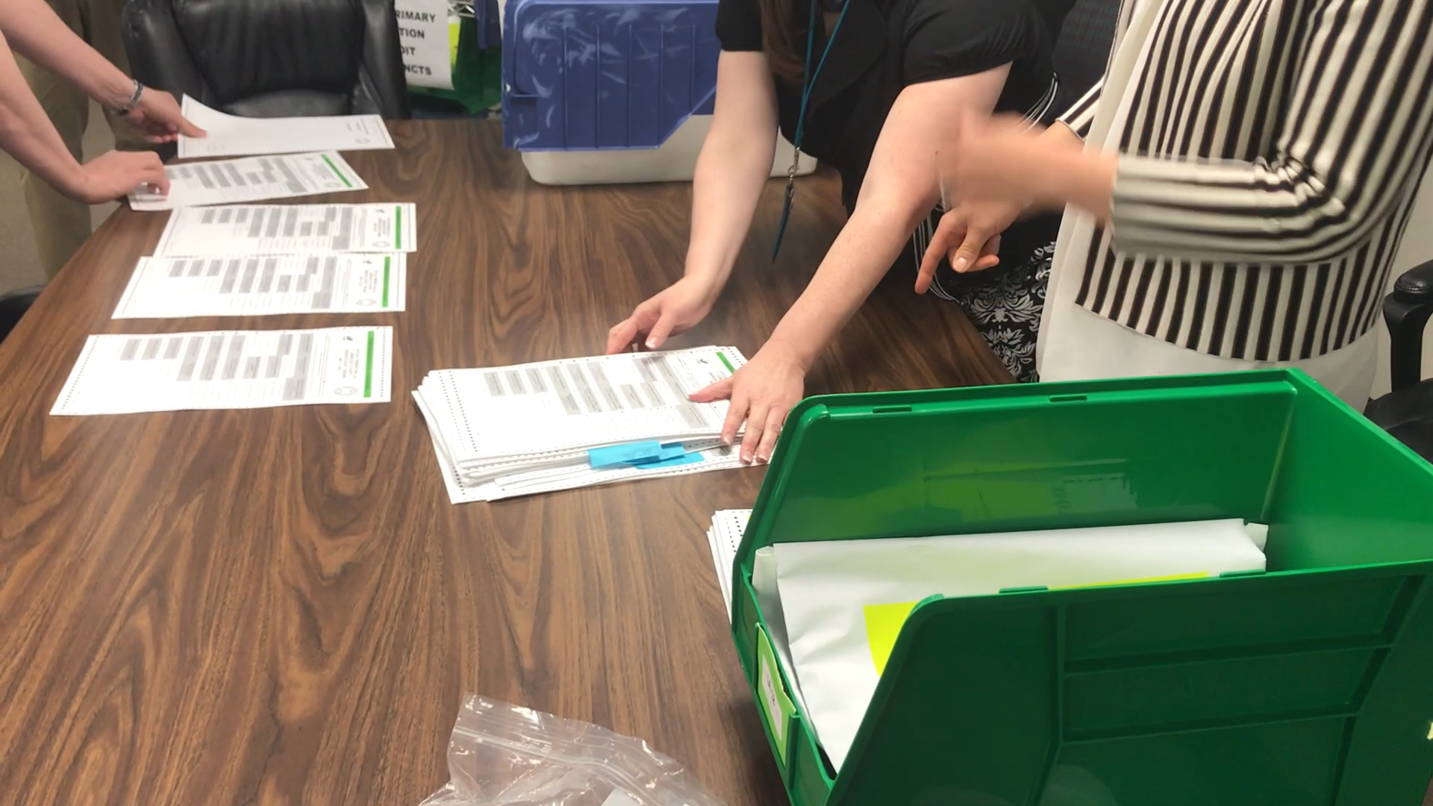

Slide 9
k-Cut Overview
k-Cut
  Given a pile of ballots from which to select sample
  Make k cuts
  Choose the ballot on top and add it to the sample
  Repeat until sample has desired size
Notes:
-make sure you define k

Slide 10
Typical Sampling Plan
Ballot 25 from Batch 1
Ballots 50, 132 from Batch 3
Ballot 92 from Batch 4
…
Notes:
-make sure you define k

Slide 11
Single Ballot Speed Comparison
Uniformly random audit plan
  Choose ballot 50 from batch 3
4-cut audit plan
  Get the set of ballots in batch 3
  Make 4 cuts and choose the ballot on top
Notes:
-make sure you define k

Slide 12

Speed Comparison

Slide 13
Speed Comparison
Counting: 3 ballots per second
Cutting: 15 seconds per 4 cuts
If we have to count more than 45 ballots, then Four-Cut is more efficient!

Slide 14
Properties

Slide 15
Is k-cut good enough?
How close is choosing the ballot on top after k cuts to choosing a ballot at random?
How much does “approximate sampling” affect the auditing procedure? Can we compensate?

Slide 16
Distance to “truly” random
Infinite-Time Convergence
  As the number of cuts increases, any card will be equally likely to be on top
Finite-Time Convergence:
  Distance from the uniform distribution decreases exponentially with k, the number of cuts

Slide 17
How close to uniform?
Number Of Cuts | Variational Distance to Uniform
2 | 0.1111
3 | 0.0089
4 | 0.0009
5 | 0.0008
6 | 0.0001

Slide 18
Approximate Sampling Effect
After 4 cuts, the distance to the uniform distribution is small
Implies that the change in margin in the sample is small
  In particular, we can analyze a 2-candidate race, with 100,000 ballots

Slide 19
Approximate Sampling Effect
Sample Size | Maximum Change in Margin (with 99% probability)
25 | 1
30 | 1
50 | 1
100 | 1
300 | 2
500 | 3

Slide 20
What can go wrong?
  The sample tally satisfies the risk limit, but, in reality, the election result is incorrect
  We stop the audit without realizing the election result is incorrect.

Slide 21
RLA Mitigation Procedure
  We know that the margin between any pair of candidates changes by at most 1 vote with 99% probability
  For any sample, we can move 1 ballot from the reported winner to the runner-up

Slide 22
What does this tell us?
After the ballot adjustment, with 1% probability, the reported winner only wins because of the approximate sampling
A risk limit of 0.05 in the original audit becomes a risk limit of 0.06

Slide 23
What does this tell us?
We might have to sample more ballots due to the sample tally adjustments
However, the sampling can be done much faster

Slide 24
Bayesian Audits

Slide 25
Bayesian Audit Overview
Sample ballots uniformly at random
For any given sample tally
  Run a “restore” simulation to model unsampled ballots
Compute winner of sampled + simulated ballots

Slide 26
What happens to the risk?
The mitigation procedure is also safe for Bayesian audits
However, we can find a more efficient bound for Bayesian audits
  Most of the time, the sample tallies won’t need to be updated.

Slide 27
Acknowledgements and Contributions

Slide 28
Acknowledgements
Thank you to participants in Indiana pilot audit May 30, 2018, which provided the photos and videos.

Slide 29
Use Cases
Our approximate sampling procedure is primarily for use with ballot-polling audits, but can be extended for comparison audits
The analysis shows how approximate sampling affects the statistics in RLAs and Bayesian audits

Slide 30
Open Problems
Understanding the distribution of cuts, in practice
Techniques for handling missing or extra ballots
Generalizing to handle non-plurality elections

Slide 31
Contributions
Designed an approximate sampling procedure to improve the speed of sampling for post-election audits
Analyzed how approximate sampling affects risk for RLAs and Bayesian audits
Showed how to adjust risk limit and sample tallies to correct for approximate sampling in both audits

