Slide 1


Sulfate Deficiency in
Neurological Disease Following Aluminum and Glyphosate Exposure
Stephanie Seneff
June 2, 2015

Slide 2
”If we all worked on the assumption that what is accepted as true is really true, there would be little hope of advance."
-- Orville Wright

Slide 3
Outline
Introduction
Sulfate
Melatonin and the pineal gland
Aluminum-glyphosate synergy
Sulfate, vitamin D and autism
Anemia and hypoxia
Manganese dysbiosis
Glyphosate and mitochondria
Iron and mycoplasmas
Sulfate and histamines (if time!)
Summary

Slide 4
Outline
Introduction
Sulfate
Melatonin and the pineal gland
Aluminum-glyphosate synergy
Sulfate, vitamin D and autism
Anemia and hypoxia
Manganese dysbiosis
Glyphosate and mitochondria
Iron and mycoplasmas
Sulfate and histamines
Summary

Slide 5
What happens to us in the modern world
Toxic chemicals in the food destroy the gut and then the liver and then the kidneys and the heart and the brain
Toxic metals work synergistically with glyphosate (Roundup) to cause harm
Drugs make things worse by disrupting essential biological pathways
We develop many painful and debilitating chronic illnesses

Slide 6

At the Cellular Level…
CELL
Cells deficient in cholesterol sulfate can’t recycle their garbage
They have two options:
  Proliferate to dilute the garbage
  Die and let a macrophage clean up the mess
When even the macrophages are sick:
  Proliferation is the only option → cancer
  Prostate cancer cells produce cholesterol sulfate
  Breast cancer cells produce estrone sulfate → good substitute for cholesterol sulfate

Slide 7
At the Cellular Level…
CELL
Cells deficient in cholesterol sulfate can’t recycle their garbage
They have two options:
  Proliferate to dilute the garbage
  Die and let a macrophage clean up the mess
When even the macrophages are sick:
  Proliferation is the only option → cancer
  Prostate cancer cells produce cholesterol sulfate
  Breast cancer cells produce estrone sulfate → good substitute for cholesterol sulfate
Neurons in the brain clear their cellular debris while we sleep, and they depend upon sulfate to do this.

Slide 8
Wake-Sleep Cycle*
“Circadian signals are more important than food or exercise for wellness. Wellness is about optimized circadian signal specificity and sensitivity.”
Jack Kruze, MD
*jackkruse.com/tensegrity-4-magnetism-electrons-sleep/
(Thanks to Lienke Katz for pointing me to Jack Kruze’s writings)

Slide 9
Wake-Sleep Cycle*
“Circadian signals are more important than food or exercise for wellness. Wellness is about optimized circadian signal specificity and sensitivity.”
Jack Kruze, MD
Healthy circadian rhythms
depend on sulfate
*jackkruse.com/tensegrity-4-magnetism-electrons-sleep/
(Thanks to Lienke Katz for pointing me to Jack Kruze’s writings)

Slide 10
P < 0.0000077

Slide 11
U.S. Market is 25% of World Market of Roundup

Slide 12
Sleep disorder is associated with depression, Alzheimer’s disease, dementia, Parkinson’s disease, ADHD, multiple sclerosis and autism.

Slide 13
Outline
Introduction
Sulfate
Melatonin and the pineal gland
Aluminum-glyphosate synergy
Sulfate, vitamin D and autism
Anemia and hypoxia
Manganese dysbiosis
Glyphosate and mitochondria
Iron and mycoplasmas
Sulfate and histamines
Summary

Slide 14

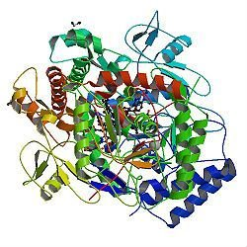
A Provocative Proposal
Cholesterol sulfate supplies oxygen, sulfur, cholesterol, energy energy and negative charge to all the tissues
Sulfate is synthesized from sulfide in skin and blood stream utilizing energy in sunlight
  Protects from UV damage and keeps microbes out
Endothelial Nitric Oxide Synthase (eNOS) performs the magic
The skin is a solar powered battery!

Slide 15
eNOS is Very Vulnerable*
eNOS depends on:
  Cobalamin (vitamin B12, cobalt)
  Heme iron, sulfur, zinc, oxygen
  Glutathione
  Sunlight
  Tryptophan: converts UV to blue light; source of NAD
eNOS is a cytochrome P450 enzyme:
  Highly vulnerable to various environmental toxicants like mercury, aluminum, glyphosate, etc.
*S. Seneff et al., Entropy 2012, 14, 2492-2530.

Slide 16
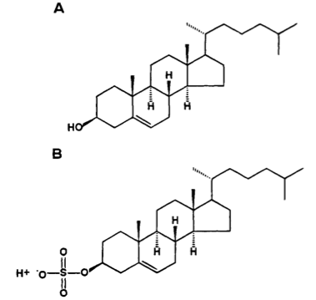
Cholesterol and Cholesterol Sulfate
Sulfation makes cholesterol water-soluble and therefore much easier to transport
SULFATE
Notes:
From cholesterol_sulfate_agile.pdf – this was the original article on that topic.

Slide 17
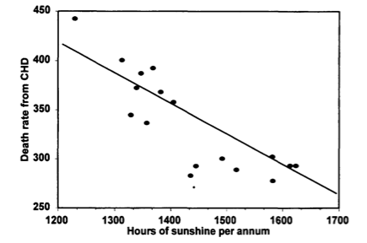
Heart Disease Mortality and Sunlight*
*Grimes et al., Q. J. Med. 1996; 89:579-589
Notes:
vitaminK/sunlight_heart_disease.pdf

Slide 18

Swedish Population Study on
Sun Exposure*
“We found that all-cause mortality was inversely related to sun exposure habits. The mortality rate amongst avoiders of sun exposure was approximately twofold higher compared with the highest sun exposure group”
*PG Lindqvist et al., Journal of Internal Medicine, 2014, 276; 77–86
Notes:
./sun_avoidance_increases_death_risk_Sweden_2014

Slide 19
Sulfate is Vastly Underappreciated!
Sulfate is the 4th most abundant anion in the blood and protects it from coagulating
Detoxifies drugs, food additives, and toxic metals
Essential component of extracellular matrix proteins throughout the tissues and vasculature
Cerebroside sulfate is a major constituent of myelin sheaths surrounding axons in neurons

Slide 20
Sulfated Biomolecules*
Sulfated mucopolysaccharides (glycosaminoglycans)
Steroid sulfates
Phenol sulfates
Tyrosine sulfate
Bilirubin sulfate
Arylamine sulfates
Choline sulfate in lichens, fungi and marine algae
Sulfolipids
*IH Goldberg, The sulfolipids. J. Lipi Res. Apr. 1961, 2(2), 103-109.
Notes:
Treasures/sulfolipids_review_1961.pdf

Slide 21
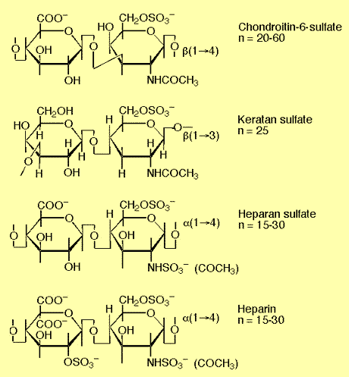
Sulfated Glycosaminoglycans (GAGs)
(also called “Mucopolysaccharides”)
Prominent in extracellular matrix of all cells
Amount of sulfate depends on availability
Crucial for maintaining negative charge and protecting from infection
http://www.science-autism.org/sulphate.htm

Slide 22
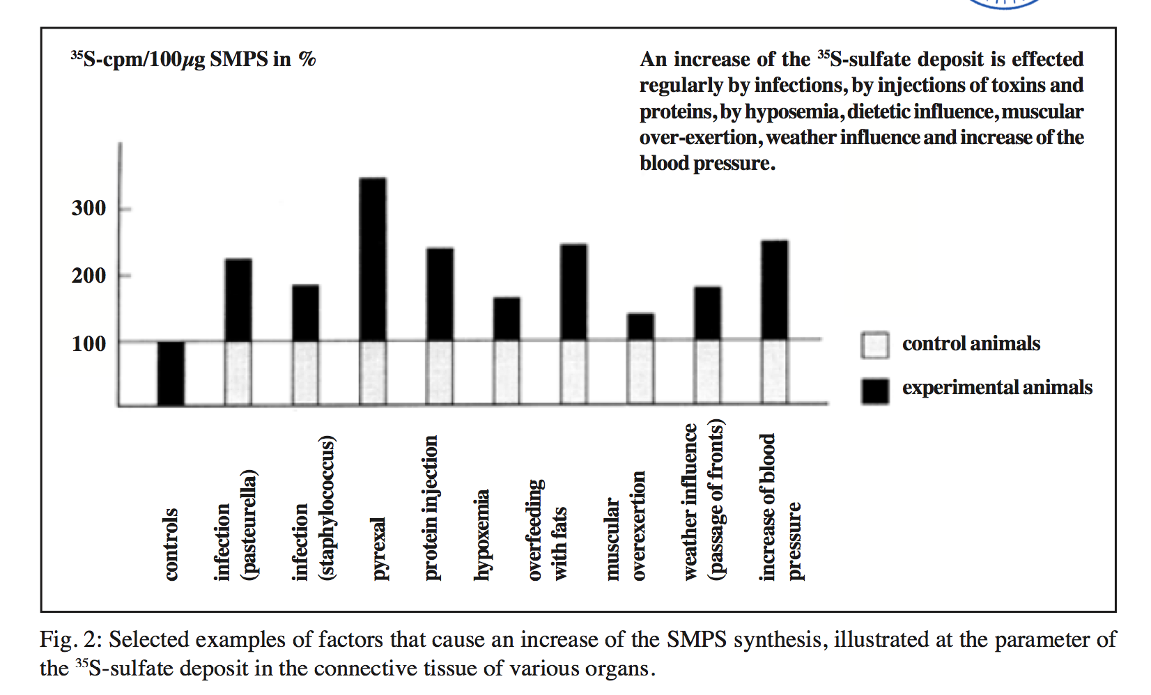
Various Factors that Increase Sulfate*
An increase of the 35S-sulfate deposit is effected regularly by infections, by injections of toxins and proteins, by hypoxemia, dietetic influence, muscular over-exertion, weather influence and increase of the blood pressure.
SMPS= Sulfated mucopolysaccharides
*Report by Bernhard Muschlien
SMPS = Sulfated mucopolysaccharides = glycosaminoglycans
First published in the German language in the SANUM-Post magazine (17/ 1991)
Notes:
Treasures/bacteria_renew_sulfate_German.pdf
Pyrexal is an endotoxin

Slide 23
Outline
Introduction
Sulfate
Melatonin and the pineal gland
Aluminum-glyphosate synergy
Sulfate, vitamin D and autism
Anemia and hypoxia
Manganese dysbiosis
Glyphosate and mitochondria
Iron and mycoplasmas
Sulfate and histamines
Summary

Slide 24
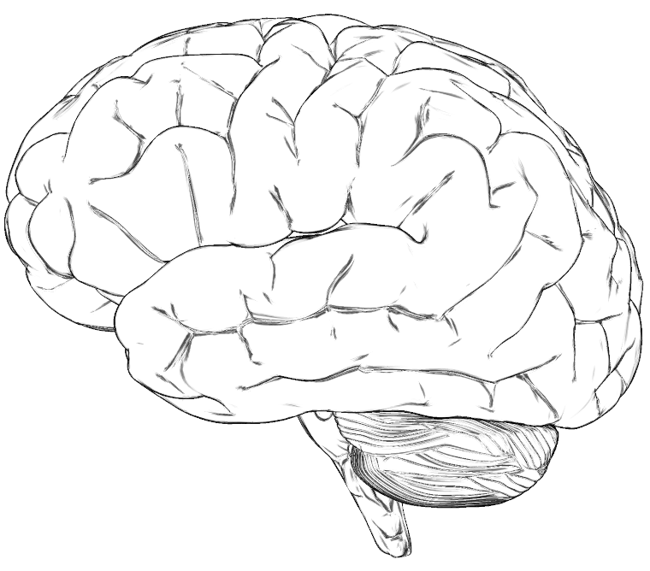
A Hypothesis
Many neurological diseases of the brain have a common origin:
  Insufficient supply of sulfate to the brain
  Enhanced toxic metal exposure (e.g., aluminum, mercury) due to impaired ability to detoxify and eliminate them
  Toxic metals interfere with sulfate synthesis
  This results in accumulation of cellular debris, including damaged mitochondria

Slide 25
In Brief…
Heparan sulfate in the lysosomes is critical for recycling cellular debris
  Heparan sulfate deficiency leads to autism
Pineal gland delivers sulfate to cerebral spinal fluid via melatonin
Aluminum and mercury disrupt pineal gland
Sunlight deficiency is a contributing factor
Glyphosate works synergistically with aluminum

Slide 26
An Important Role for Sleep
It has recently been argued that a crucial role for sleep is to clear cellular debris*
This takes place in the lysosome, which depends upon sulfate in heparan sulfate proteoglycans to protect from free radicals**
*Sleep Drives Metabolite Clearance from the Adult Brain. L Xie et al., Science 342:373-377, 2013
**Inhibition by heparin of Fe(II)-catalysed free-radical peroxidation of linolenic acid. M.A. Ross et al., Biochem. J. 1992, 286: 717-720.
Notes:
treasures/sleep_clears_garbage_in_brain_Science_2013.pdf
http://www.biochemj.org/bj/286/bj2860717.htm

Slide 27
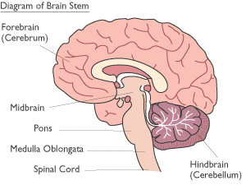
The Brain
Limbic System
Ventricles
Pineal Gland
Notes:
http://corticalchauvinism.files.wordpress.com/2013/03/locus_coeruleus.gif

Slide 28
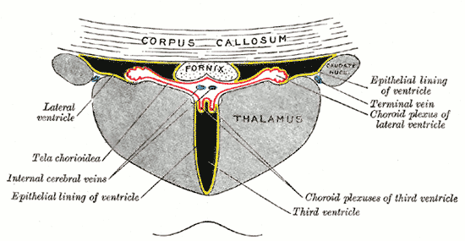
Third Ventricle and Pineal Gland
The third ventricle is depleted in heparan sulfate in association with autism in both humans and mice*,**
Heparan sulfate depleted
Pineal Gland
*B.L. Pearson et al., Behav Brain Res. 2013 Apr 15;243:138-45.
**F Mercie et al., Neurosci Lett 506, 2012, 208-213.
Notes:
Where are they?

Slide 29
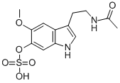
“Melatonin Enters the Cerebrospinal Fluid through the Pineal Recess”*
The tip of the third ventricle is encased in the pineal gland
The pineal gland delivers melatonin sulfate to the third ventricle and it diffuses to all the cerebrospinal fluid
I propose that a key purpose of melatonin is to deliver sulfate to the neurons at night.
Melatonin sulfate
*H. Tricoire et al., Endocrinology 143(1):84–90
Notes:
Wendy/melatonin_cerebrospinal_fluid_pineal_recess_DYNAMITE.pdf

Slide 30
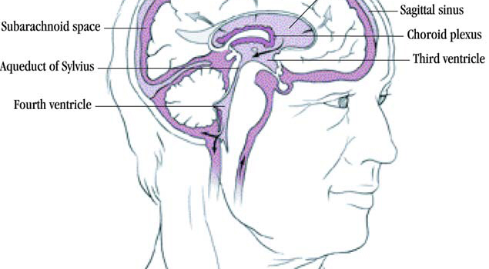

Sulfate!!!
Pineal Gland

Slide 31
“Light-induced 3-O-Sulfotransferase Expression Alters Pineal Heparan Sulfate Fine Structure : A Surprising Link to Circadian Rhythm”*
Pineal gland builds up heparan sulfate supplies by day
Melatonin is sulfated in transport at night
  Highly lipophilic molecule needs sulfate to make it water-soluble
  This allows it to move through the cerebrospinal fluid
When melatonin is delivered, sulfate is released!
Melatonin is a sulfate-delivery system!!
*B. Kuberan et al., J. Biol. Chem. 2004, 279:5053-5054.
Notes:
Samantha/light_sulfotransferase_pineal_gland_heparan_sulfate.pdf

Slide 32

A Really Bad Idea!

Slide 33

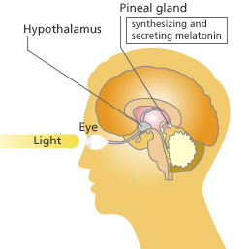
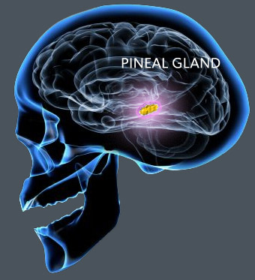
Pineal Gland: “Seat of the Soul”
The pineal gland produces sulfate by day (responding to light) and stores it in heparan sulfate molecules
The pineal gland produces melatonin in the evening and transports it as melatonin sulfate to various parts of the brain

Slide 34
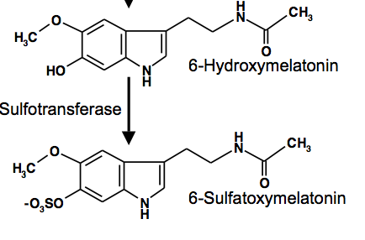
REM Sleep Cycle
Melatonin Induces REM sleep
Alzheimer’s is associated with reduced REM sleep cycle AND calcified pineal gland*
  Pineal gland calcification correlates inversely with REM sleep**
  DHEA SULFATE but not DHEA injections increase melatonin production in rats***
*R. Mahlberg et al., Neurobiol Aging. 2008 Feb;29(2):203-9
**R. Mahlberg et al., Sleep Med. 2009 Apr;10(4):439-45.
***Y. Djeridane et al., Steroids. 2004 May;69(5):343-9.
Notes:
Alzheimers/pineal_calcification_alzheimers.text
Treasures/pineal_calcification_melatonin_sleep.pdf
Treasures/DHEA_sulfate_boosts_melatonin.text
melatonin_review_2012.pdf

Slide 35
Outline
Introduction
Sulfate
Melatonin and the pineal gland
Aluminum-glyphosate synergy
Sulfate, vitamin D and autism
Anemia and hypoxia
Manganese dysbiosis
Glyphosate and mitochondria
Iron and mycoplasmas
Sulfate and histamines
Summary

Slide 36
Sleep Disorder, Aluminum, and the Pineal Gland
Sleep disorder is linked to many neurological diseases:
  Autism, Alzheimer’s, depression, schizophrenia, ALS, Parkinson’s disease, etc.
Insomnia occurs much more frequently as an adverse reaction in VAERS to vaccines containing aluminum than to those not containing aluminum (p = 0.0025)
Pineal gland is heavily perfused and outside of the blood brain barrier
  Susceptible to aluminum toxicity

Slide 37
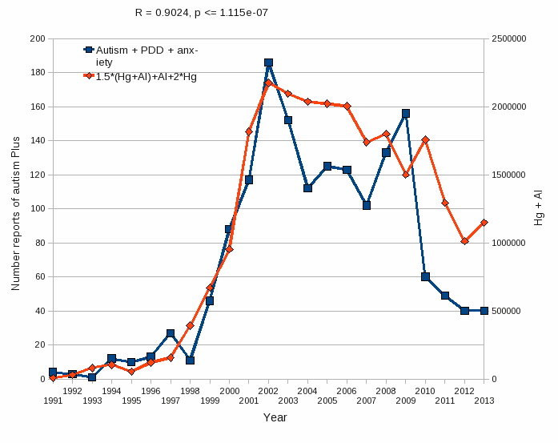
Aluminum & Mercury
Autism & PDD & Anxiety
VAERS
database
Formula: Al + 1.5 x (Al w/ Hg) + 2.0 x Hg

Slide 38
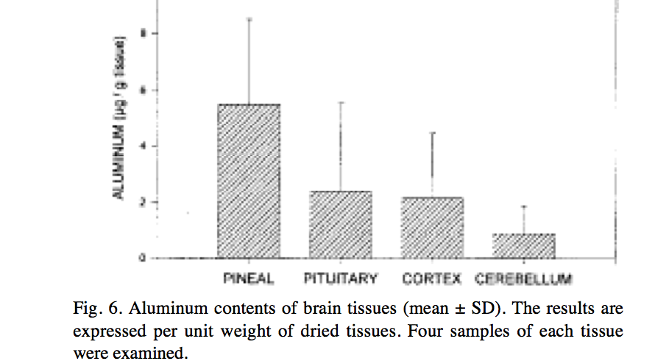
Aluminum in the Pineal Gland*
*S.B. Lang et al./Bioclectrochemistry and Bioenergetics 41(1996)191—195
Notes:
Csail/2013/ChrisShaw/piezoelectricity_aluminum_pineal_gland.pdf

Slide 39
A Critical Role for Sunlight*
Hypothesis:
  Endothelial and neuronal nitric oxide synthase (both present in the pineal gland) produce sulfate from reduced sulfur sources catalyzed by sunlight
  Sulfate deficiency results when this process is impaired
Aluminum and retinoic acid, present in high SPF sunscreens, interfere with sulfate synthesis
Aluminum accumulation in pineal gland would disrupt sulfate supplies to brain
*S. Seneff et al., Entropy 2012, 14, 2492-2530.

Slide 40
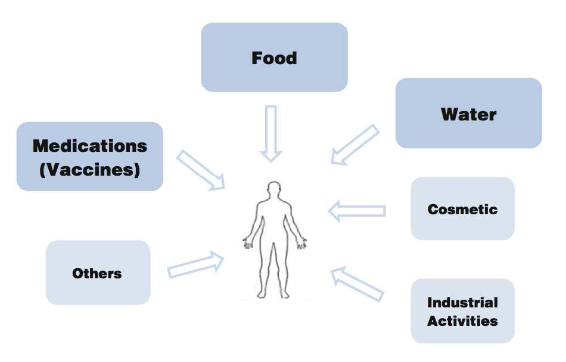
We live in the age of aluminum*
*C.A. Shaw and L. Tomljenovic, Immunol. Res. Epub ahead of print, 2013
Notes:
Tomljenovich/ShawTomljenovichAluminumWorld.pdf

Slide 41
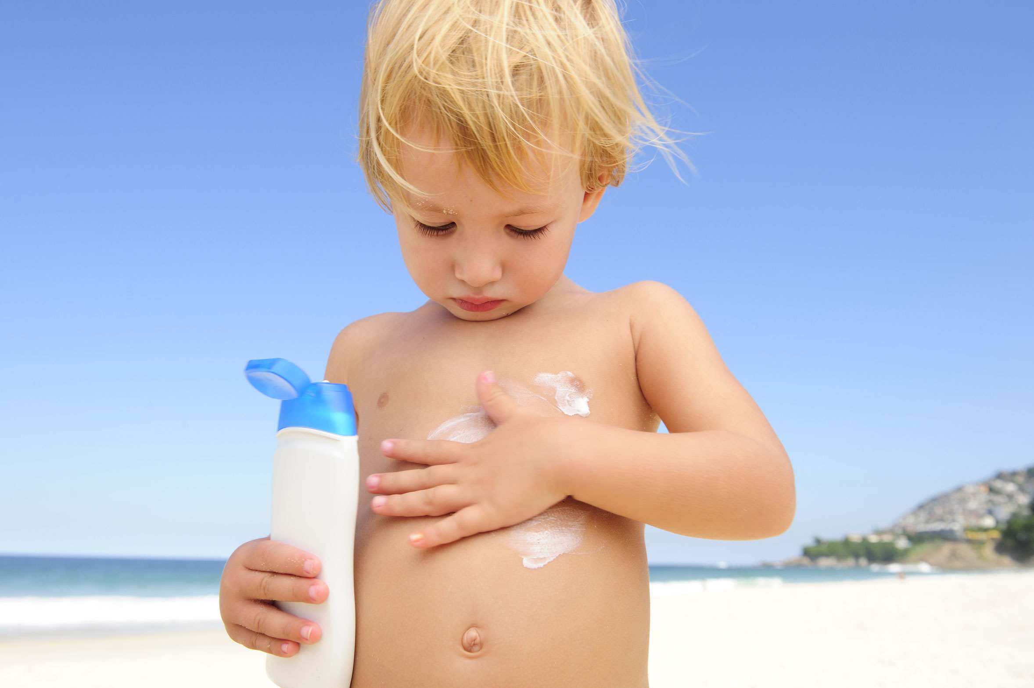
We live in the age of aluminum*
*C.A. Shaw and L. Tomljenovic, Immunol. Res. Epub ahead of print, 2013
Notes:
Tomljenovich/ShawTomljenovichAluminumWorld.pdf

Slide 42
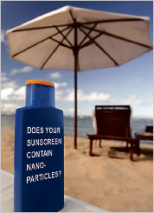
Aluminum Nanoparticles: Highly Destructive in the Brain*
Destroyed mitochondria and severely depleted ATP
Induced autophagy and programmed cell death
Increased permeability of blood brain barrier
Were persistent
Far more damaging than larger sized aluminum particles
*L Chen et al., Nanomedicine Feb 2013; 9(2): 212–221.
Notes:
./autophagy_brain_aluminum_nanoparticles.pdf

Slide 43

Glyphosate and Aluminum: Partners in Crime
Glyphosate induces pathogens like C. difficile in gut, leading to leaky gut syndrome
  C. diff produces p-cresol which promotes aluminum uptake by cells
  p-Cresol is a known biomarker for autism
  p-Cresol is an important factor in kidney failure which leads to aluminum retention in tissues → dementia
Glyphosate cages aluminum to promote entry
Glyphosate promotes calcium uptake by voltage-activated channels
  Aluminum gains entry as calcium mimetic
Aluminum promotes calcium loss from bones → pineal gland calcification

Slide 44
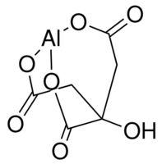
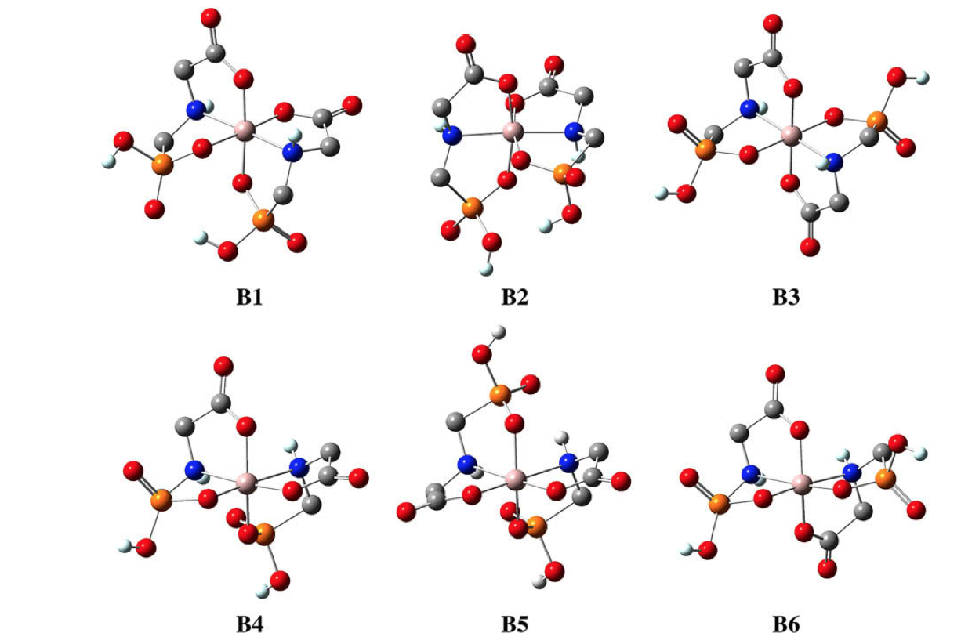
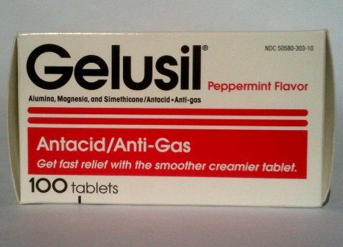
Aluminum Glyphosate*
Six different ways two glyphosate molecules can chelate aluminum
Aluminum citrate**
ALUMINA
aluminum
*M. Purgel et al., Journal of Inorganic Biochemistry 103 (2009) 1426–1438
** P. Sianina et al., Clin. Chem. 32/3, 539-541, 1986.
Notes:
AnthonySamsel/swine/aluminum_glyphosate.pdf
aluminum_citrate_absorbs_well_vinegar_antacids.pdf
Csail/2013/project/Anthony/

Slide 45
Glyphosate Suppresses
Melatonin Synthesis!
Glyphosate interferes with shikimate pathway in plants and microbes → tryptophan depletion*
Tryptophan is sole precursor to melatonin
Melatonin binds to aluminum, cadmium, copper, iron and lead, reducing their toxicity**
*N. de María et al., J Agric Food Chem 2006, 54, 2621-2628.
**J. Limson et al. J. Pineal Res. 1998; 24:15–21.
Notes:
ChrisNice/Melatonin_binds_toxic_metals_1999.pdf

Slide 46
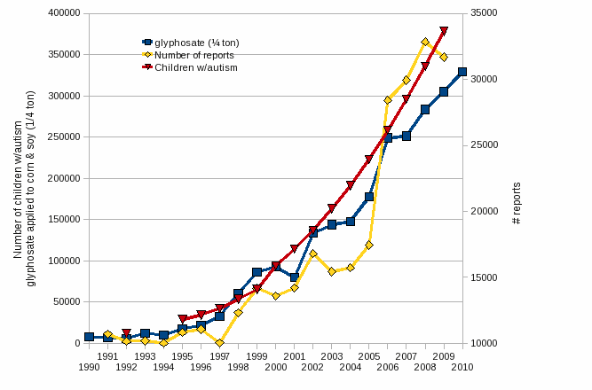
Autism, Glyphosate, Vaccine Reactions*
Glyphosate application to corn and soy, US
Children with Autism, US
# Adverse Reactions in VAERS
*Collaboration with Nancy Swanson
Notes:
Individuals with Disabilities Education Act

Slide 47
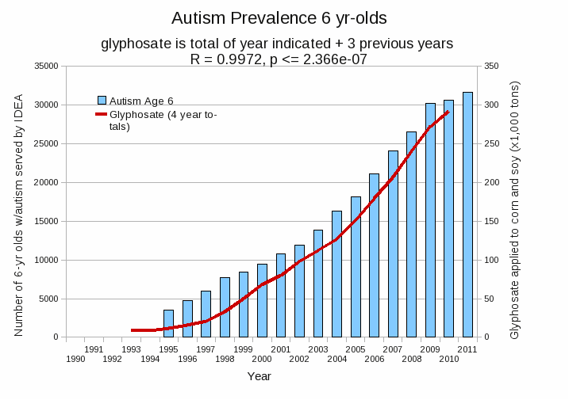
Autism Prevalence: 6 year olds
R = 0.9972
*Plot provided by Nancy Swanson, with permission
Data sources: autism: US Department of Education; Glyphosate: US Department of Agriculture
Notes:
Nancy/latest_plots/6-yr-old autism.gif
autism: USDE
oil consumption: USDA
glyphosate: USDA
GE crops: USDA
Mortality data: CDC

Slide 48
Outline
Introduction
Sulfate
Melatonin and the pineal gland
Aluminum-glyphosate synergy
Sulfate, vitamin D and autism
Anemia and hypoxia
Manganese dysbiosis
Glyphosate and mitochondria
Iron and mycoplasmas
Sulfate and histamines
Summary

Slide 49
Sulfate in Fetal Development*
Fetus depends on mother for sulfate supply
Sulfate is essential for transporting sterols (like estrogen and DHEA) and supplying extracellular matrix proteins everywhere with sufficient negative charge
Sulfate detoxifies xenobiotics like acetaminophen (tylenol) and is essential for excreting toxins like aluminum and mercury
Sulfate is severely deficient in autistic children (1/3 the normal level of free sulfate in blood stream)
* Dawson, “Sulfate in Fetal Development,” Semin Cell Dev Biol 2011
Notes:
Cancer/sulfate_in_fetal_development.pdf
Dawson PA. Sulfate in fetal development. Semin Cell Dev Biol (2011), doi:10.1016/j.semcdb.2011.03.004

Slide 50
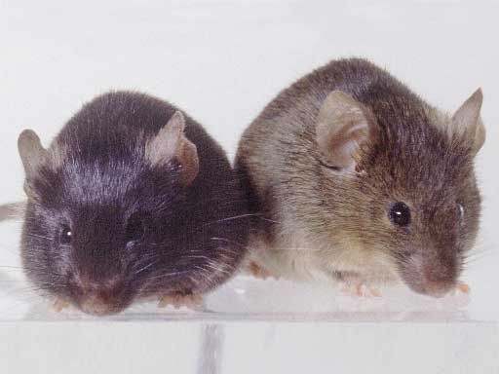
Autism-like socio-communicative deficits and stereotypies in mice lacking heparan sulfate*
Experiment with “designer” mice: impaired heparan sulfate synthesis in brain
Mice exhibited all the classic features of autism – both cognitive and social
* F. Irie et al., PNAS Mar. 27, 2012, 109(13), 5052-5056.
Notes:
vitaminK/mice_no_heparan_sulfate_get_autism_2012.pdf
Samantha/heparan_sulfate_knockout_mice_get_autism.pdf

Slide 51
“Heparan sulfate deficiency in autistic postmortem brain tissue from the subventricular zone of the lateral ventricles”*
“Aberrant extracellular matrix glycosaminoglycan function localized to the subventricular zone of the lateral ventricles may be a biomarker for autism, and potentially involved in the etiology of the disorder.”
*BL Pearson et al., Behav Brain Res. 2013;243:138-45
Notes:
Samantha/heparan_sulfate_deficiency_autism_postmortem_brain.pdf

Slide 52
“Heparan sulfate deficiency in autistic postmortem brain tissue from the subventricular zone of the lateral ventricles”*
“Aberrant extracellular matrix glycosaminoglycan function localized to the subventricular zone of the lateral ventricles may be a biomarker for autism, and potentially involved in the etiology of the disorder.”
New neurons develop from stem cells in this zone through the action of “fractones” composed of heparan sulfate proteoglycans**
*BL Pearson et al., Behav Brain Res. 2013;243:138-45
**F. Mercier et al., Neuroscience Letters 506 (2012) 208–213
Notes:
Samantha/heparan_sulfate_deficiency_autism_postmortem_brain.pdf

Slide 53
Vitamin D Prevents Sulfate Wasting*
Activated vitamin D prevents sulfate wasting from the kidney in urine
Mice engineered to have defective vitamin D receptors or with vitamin D deficiency had significantly reduced serum sulfate levels
This was associated with sulfate depletion in the skeleton
*M.J.G. Bolt et al., Am J Physiol Endocrinol Metab 287: E744 –E749, 2004.
Notes:
SteveKette/vitamin_D_regulates_sulfate_kidney.pdf

Slide 54
Vitamin D Deficiency Epidemic
Year
Plot derived from hospital discharge data from the CDC

Slide 55
Vitamin D Deficiency Epidemic
Vitamin D depends on CYP enzymes for activation in the liver and the kidney
Year
Plot derived from hospital discharge data from the CDC

Slide 56
Vitamin D Deficiency Epidemic
Vitamin D protects from sulfate wasting
from the kidneys*
Year
*MJG Bolt et al., Am J Physiol - Endocrinology and Metabolism 2004;287(4):E744-E749.
Plot derived from hospital discharge data from the CDC

Slide 57
Vitamin D Deficiency Epidemic
Autism is associated with vitamin D deficiency, low serum sulfate and high urinary sulfate*
Year
*RH Waring et al., Journal of Nutritional and Environmental Medicine 2000;10(1):25-32.
Plot derived from hospital discharge data from the CDC

Slide 58
Inflammation and Vitamin D:
The Infection Connection*
The problem appears to be a bottleneck in the production of 25(OH) vitamin D in the liver
D3 → 25(OH) D3 → 1,25(OH)2 D3
Liver Kidney
Both steps depend on CYP enzymes
Liver CYPs are destroyed by glyphosate and aluminum??
→ 1,25(OH2) D3 >> 25(OH) D3
*M. Mangin et al., Inflamm Res 2014; 63:803-819.
Notes:
Treasures/inflammation_and_vitaminD_supplements_bad.pdf
Brilliant paper!!!

Slide 59
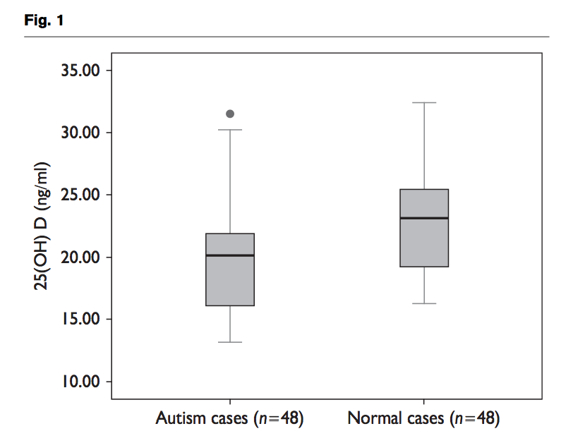
Recent Study from China*
Serum Vitamin D
*Z-L Gong et al., NeuroReport 2014, 25:23–27
Notes:
Samantha/autism_vitamin_D_deficiency_Chinese_study.pdf
Boxplot of serum 25(OH) D levels between ASD patients and normal cases. The mean serum 25(OH) D levels were significantly (P = 0.002) lower in children with ASD as compared with normal cases. 25(OH) D, 25-hydroxyvitamin
d

Slide 60
Outline
Introduction
Sulfate
Melatonin and the pineal gland
Aluminum-glyphosate synergy
Sulfate, vitamin D and autism
Anemia and hypoxia
Manganese dysbiosis
Glyphosate and mitochondria
Iron and mycoplasmas
Sulfate and histamines
Summary

Slide 61
Glyphosate:
The Central Mechanisms
Glyphosate acts as an antibiotic to disrupt gut bacteria, leading to overgrowth of pathogens
Disruption of liver CYP enzymes leads to impaired bile flow and low vitamin D
  This disrupts sulfate synthesis and transport
  Also impairs detoxification of other toxic chemicals
Damage to red blood cells leads to anemia and toxicity due to free iron
  Hypoxia ensues → low grade encephalopathy
Manganese, aluminum and glutamate become toxic to the brain

Slide 62
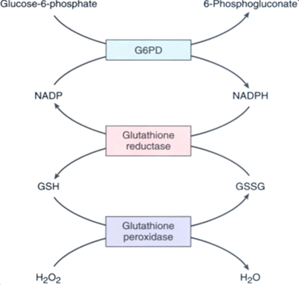
This Detoxification Scheme is Essential in Red Blood Cells
Inhibited by glyphosate
Product of shikimate pathway
Depleted by glyphosate
Induced by excess folic acid
Depends on selenium

Slide 63
This Detoxification Scheme is Essential in Red Blood Cells
Inhibited by glyphosate
Product of shikimate pathway
G6PD Deficiency Leads to Hemolysis and Anemia
Depleted by glyphosate
Depends on selenium

Slide 64
Glyphosate also interferes with heme synthesis
needed to replenish RBCs

Slide 65
Anemia leads to low oxygen which induces chronic low grade encephalopathy linked to autism

Slide 66
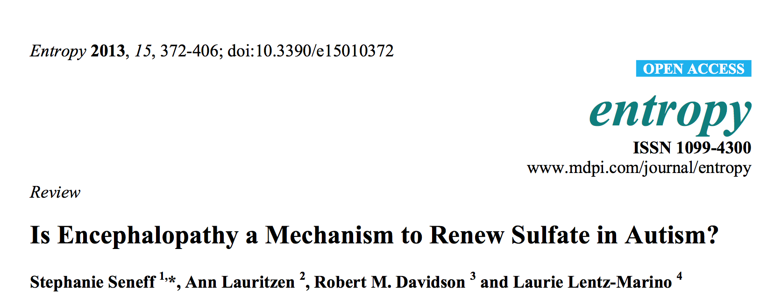

Slide 67
Outline
Introduction
Sulfate
Melatonin and the pineal gland
Aluminum-glyphosate synergy
Sulfate, vitamin D and autism
Anemia and hypoxia
Manganese dysbiosis
Glyphosate and mitochondria
Iron and mycoplasmas
Sulfate and histamines
Summary

Slide 68
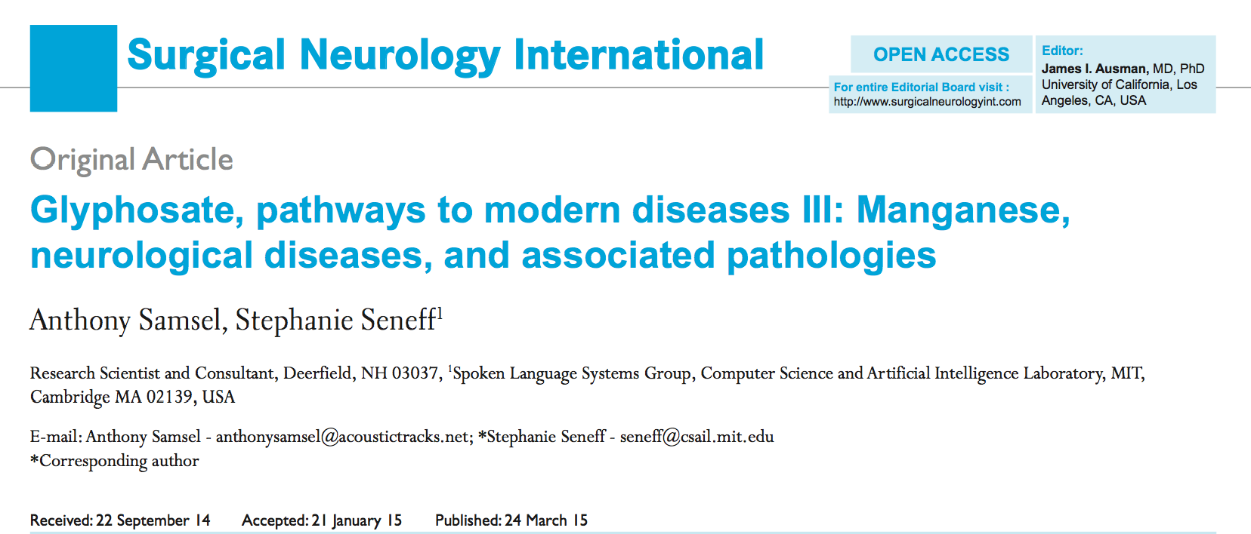
Paper on Glyphosate and Manganese
Published March 24, 2015

Slide 69
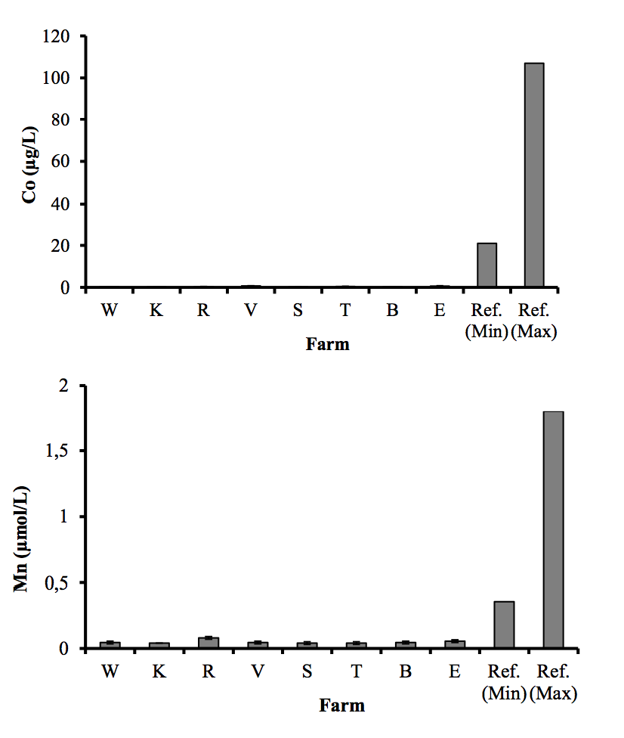
Severe Deficiency in Serum Manganese and Cobalt in Cows*
Eight different farms: all cows tested had glyphosate in the urine
*M. Krüger et al., J Environ Anal Toxicol 2013, 3:5
Notes:
glyphosate//cows_cobalt_deficiency_glyphosate.pdf

Slide 70
Manganese and Autism*
Glyphosate chelates manganese
Manganese disruption leads to:
  Disrupted gut bacteria → anxiety
  Impaired dopamine synthesis → thyroid disease
  Glutamate and ammonium toxicity in the brain
  Mitochondrial damage (impaired Mn-SOD)
  Impaired bone development and osteoporosis
  Impaired development of perineuronal nets
Many of these pathologies are associated with autism
*A Samsel and S Seneff, Surg. Neurol. Int. 2015;6:45.
Notes:
./manganese_damages_dopamine_brainstem.pdf

Slide 71

Low Manganese in Teeth Linked to Autism*
Studied lead, mercury and manganese levels in tooth enamel of shed primary teeth in 84 children
Manganese accumulated after birth was down by 60% in autistic children
No other result was statistically significant
*MM Abdullah et al., J Autism Dev Disord. 2012 Jun;42(6):929-36.
Notes:
Samantha/heavy_metal_in_childrens_tooth_enamel_as_diagnostic_autism.pdf

Slide 72
Low Manganese in Teeth Linked to Autism*
Studied lead, mercury and manganese levels in tooth enamel of shed primary teeth in 84 children
Manganese accumulated after birth was down by 60% in autistic children
No other result was statistically significant
Other studies have shown low serum manganese and low manganese in urine samples in association with autism
*MM Abdullah et al., J Autism Dev Disord. 2012 Jun;42(6):929-36.
Notes:
Samantha/heavy_metal_in_childrens_tooth_enamel_as_diagnostic_autism.pdf

Slide 73
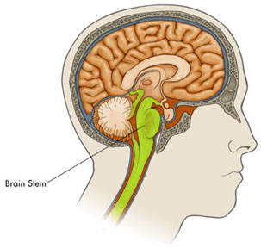
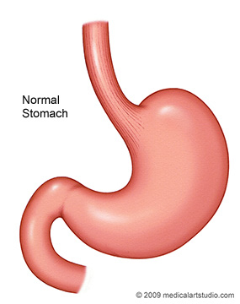
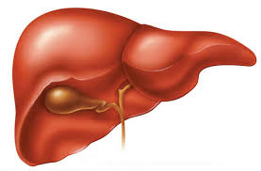

It’s not just deficiency!
Too much manganese in the brain stem
Too little manganese in the cortex
Vagus Nerve
Bile acids

Slide 74

Balancing the Scales
manganese
iron
iron
manganese
Autism
ADHD
Alzheimer’s
Parkinson’s
Glyphosate disrupts the body’s ability to distribute the minerals safely: Everybody walks a tight rope between deficiency and toxicity

Slide 75
Outline
Introduction
Sulfate
Melatonin and the pineal gland
Aluminum-glyphosate synergy
Sulfate, vitamin D and autism
Anemia and hypoxia
Manganese dysbiosis
Glyphosate and mitochondria
Iron and mycoplasmas
Sulfate and histamines
Summary

Slide 76
Glyphosate &
Mitochondria

Slide 77
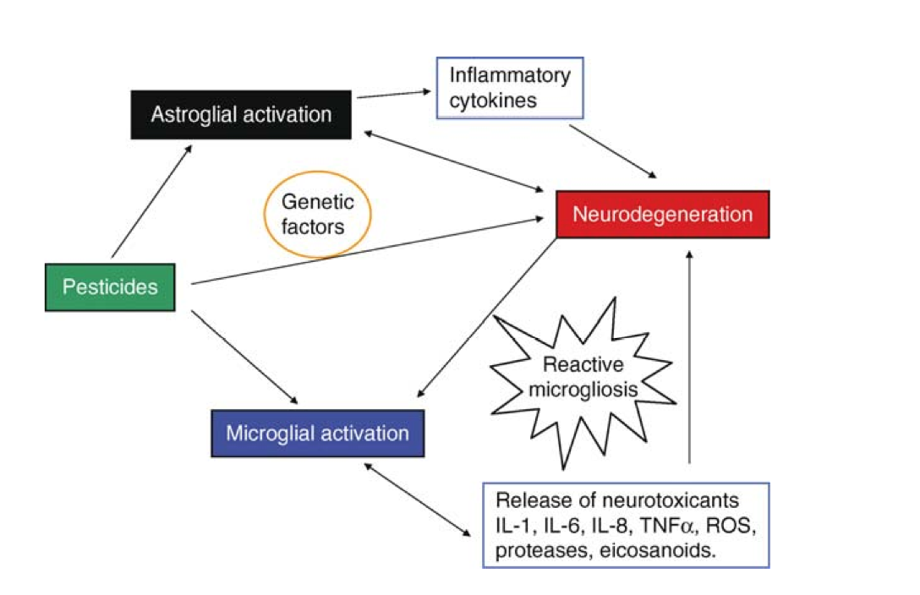
Pesticides and
Neuroinflammatory Response*
*Figure 1 , HR Dhaini, Encyclopedia of Neuroscience, Chapter 14,
Springer Berlin Heidelberg., D, Hirokawa N, Windhorst U, Ed. pp.2734-2739
Notes:
./pesticide_induced_neuroinflammation.pdf
In book: Encyclopedia of Neuroscience, Chapter: Part 14, Publisher: Springer Berlin Heidelberg., Editors: Binder MD, Hirokawa N, Windhorst U, pp.2734-2739

Slide 78
Autism and Mitochondrial Impairment*
Mitochondrial impairment is a key feature of autism, especially in the brain
  Impaired detox of glutamate by astrocytes (requires manganese)
  Excess stimulation of NMDA receptors in neurons
Glyphosate excites NMDA receptors and prevents glutamate metabolism
*Dayan Goodenowe and Elodie Pastural , Chapter 4
.intechopen.com/books/autism-a-neurodevelopmental-journey-from-genes-to-behaviour/
the-biochemical-basis-of-autistic-behavior-and-pathology
Notes:
Samantha/autism_mitochondria_glutamate.pdf

Slide 79
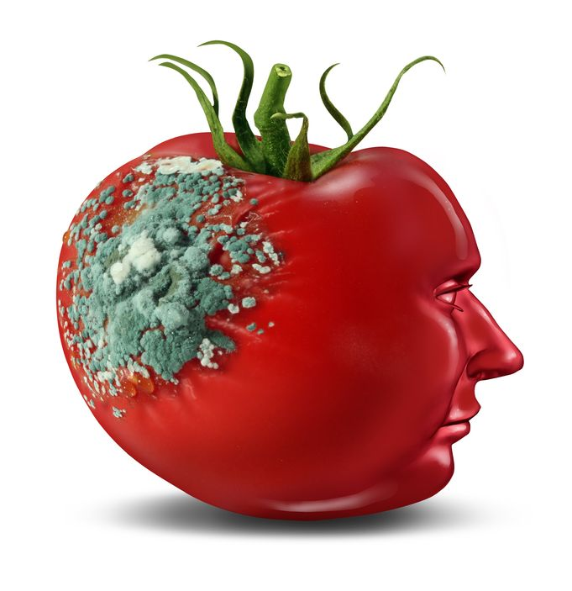
Glyphosate and Glutamate*
Acute exposure activates NMDA receptors and voltage-dependent calcium channels
  Oxidative stress and neural cell death
  Increased glutamate released into the synaptic cleft → excessive extracellular glutamate levels
  Decreased glutathione content
  Increased peroxidation of lipids (fats)
Chronic exposure:
  Decreased glutamate uptake and metabolism
  Induced calcium uptake
  Induced oxidative stress
*http://www.greenmedinfo.com/blog/roundup-weedkiller-brain-damaging-neurotoxin
Notes:
http://www.greenmedinfo.com/blog/roundup-weedkiller-brain-damaging-neurotoxin
Why was this referenced??
T. Bohn et al. Food Chemistry 153, 15 June 2014, 207-215.

Slide 80
Mitochondria are Key!
“Damage to mitochondria is now understood to play a role in the pathogenesis of a wide range of seemingly unrelated disorders such as schizophrenia, bipolar disease, dementia, Alzheimer's disease, epilepsy, migraine headaches, strokes, neuropathic pain, Parkinson's disease, ataxia, transient ischemic attack, cardiomyopathy, coronary artery disease, chronic fatigue syndrome, fibromyalgia, retinitis pigmentosa, diabetes, hepatitis C, and primary biliary cirrhosis.”*
*J Neustadt and SR Pieczenik, Molecular Nutrition and Food Research 2008;52:780-788
Notes:
./Duty\ to\ Warn\ Mitochondrial\ Disorders\ Drug\ and\ Vaccine-induced\ Collateral\ Damage\ from\ Big\ Pharma.doc .
./DrugsCauseMitochondrialDamage.PDF .

Slide 81
Mitochondria are Key!
“Damage to mitochondria is now understood to play a role in the pathogenesis of a wide range of seemingly unrelated disorders such as schizophrenia, bipolar disease, dementia, Alzheimer's disease, epilepsy, migraine headaches, strokes, neuropathic pain, Parkinson's disease, ataxia, transient ischemic attack, cardiomyopathy, coronary artery disease, chronic fatigue syndrome, fibromyalgia, retinitis pigmentosa, diabetes, hepatitis C, and primary biliary cirrhosis.”*
Many of these conditions are going up in prevalence in step with glyphosate usage on corn and soy crops
Glyphosate makes manganese unavailable to mitochondria, and they need manganese to protect them from oxidative damage
*J Neustadt and SR Pieczenik, Molecular Nutrition and Food Research 2008;52:780-788
Notes:
./Duty\ to\ Warn\ Mitochondrial\ Disorders\ Drug\ and\ Vaccine-induced\ Collateral\ Damage\ from\ Big\ Pharma.doc .
./DrugsCauseMitochondrialDamage.PDF .

Slide 82
Microglia are Crucial for
Synaptic Transmission*
Microglia are the immune cells of the brain
Microglia have their “fingers” on the pulse of synaptic transmission by neurons
Microglial activation by toxic stimuli provokes astrocytes to release glutamate which is then metabolized by neurons in the mitochondria in place of sugar
This signals that mitochondrial complex I is sick
*C Béchade et al., Front Cell Neurosci. 2013; 7: 32.
Notes:
./microglia_control_neuronal_activity_2013.pdf

Slide 83
Microglia are Crucial for
Synaptic Transmission*
Microglia are the immune cells of the brain
Microglia have their “fingers” on the pulse of synaptic transmission by neurons
Microglial activation by toxic stimuli provokes astrocytes to release glutamate which is then metabolized by neurons in the mitochondria in place of sugar
Glyphosate interferes with its conversion to glutamine
Glutamate metabolism by mitochondria bypasses Complex I (unlike glucose)
*C Béchade et al., Front Cell Neurosci. 2013; 7: 32.
Notes:
./microglia_control_neuronal_activity_2013.pdf

Slide 84
Mechanisms underlying the neurotoxicity induced by glyphosate*
“Taken together, these results demonstrated that Roundup® might lead to excessive extracellular glutamate levels and consequently to glutamate excitotoxicity and oxidative stress in rat hippocampus. “ - quote from abstract
*D Cattani et al., Toxicology 320 (2014) 34–45
Notes:
Glyphosate/
mechanisms_glyphosate_neurotoxicity_glutamate_rats_2014.pdf
./Vasquez_on_glyphosate_neurotoxicity_rats.text

Slide 85
Outline
Introduction
Sulfate
Melatonin and the pineal gland
Aluminum-glyphosate synergy
Sulfate, vitamin D and autism
Anemia and hypoxia
Manganese dysbiosis
Glyphosate and mitochondria
Iron and mycoplasmas
Sulfate and histamines
Summary

Slide 86
Iron is Essential but Toxic
Glyphosate interferes with heme synthesis – this greatly increases the problem of free iron in the blood
Fenton reaction leads to hypersensitivity to hydrogen peroxide → damage to delicate cellular membrane fatty acids
“ROS” = reactive oxygen species

Slide 87
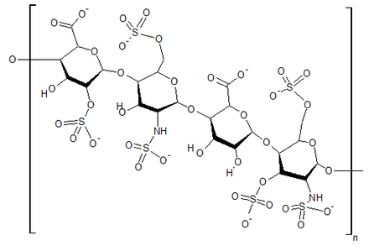
Heparin Protects from ROS due to Iron*
superoxide
Free radical production (Fenton reaction):
Fe(II) + 0₂ + 20H⁻ --> Fe(III)(OH) ₂ + 0₂⁻
But, in the acidic environment of heparin:
4Fe(II) + 0₂ + 4H+ --> 4Fe(III) + 2H₂0
water
*M.A. Ross et al., Biochem. J. 1992, 286, 717-720.

Slide 88
“Chronic and age-related increases in ROS production will cause mitochondrial damage and dysfunction that perpetuate a catastrophic cycle of cellular injury, further ROS generation, mitochondrial decline, and cell death.”*
.* S.W. Ballinger et al., Circ Res. 2000;86. P. 965

Slide 89
Eventually the Mitochondria Become so Impaired that they can’t produce ATP
Is this why mycoplasmas come into play??
Mycoplasmas are tiny bacteria without a cell wall
Micoplasmas can produce ATP without CYP enzymes: a SUPER benefit when CYPs are impacted by toxic chemicals in the environment
Mycoplasma
Host Cell

Slide 90
Mycoplasmas
Smallest bacteria yet discovered
Can live without oxygen
Can not live outside of a host cell
Generate ATP from arginine
arginine → citrulline + ammonia
They have no cytochromes!!! (SAFE)
Associated with gastric cancer, lung cancer, renal cancer, prostate cancer, colon cancer
Hide inside immune cells and inactivate the vitamin D receptors!
Notes:
http://www.atsu.edu/faculty/chamberlain/website/lects/rickett.htm
./Mycoplasma_metabolism_ATP_from_arginine.pdf

Slide 91
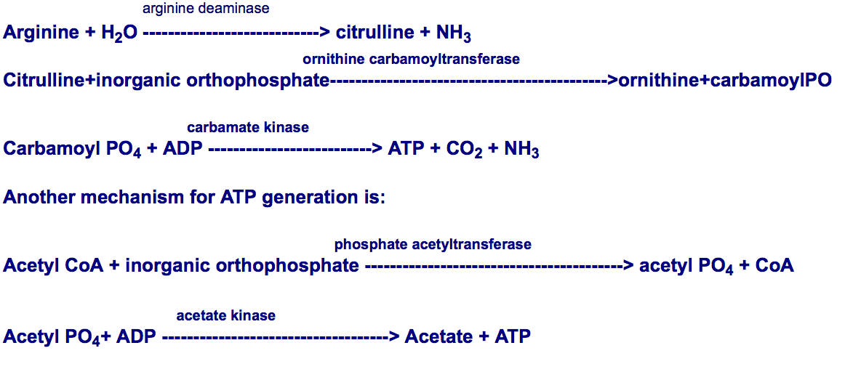
Mycoplasma: Safe Metabolism to generate ATP for the host cell!!
4
Ammonia!
Notes:
http://www.atsu.edu/faculty/chamberlain/website/lects/rickett.htm
./Mycoplasma_metabolism_ATP_from_arginine.pdf

Slide 92
Outline
Introduction
Sulfate
Melatonin and the pineal gland
Aluminum-glyphosate synergy
Sulfate, vitamin D and autism
Anemia and hypoxia
Manganese dysbiosis
Glyphosate and mitochondria
Iron and mycoplasmas
Sulfate and histamines
Summary

Slide 93
Sulfate and Histamines

Slide 94
Heparan Sulfate Promotes
Histamine Breakdown*
Intestinal diamine oxidase (DAO) is synthesized in the mature enterocytes of the villus tip and is then transported to the binding sites on the intestinal vasculature.
Heparin and heparan sulfate induce release of the bound DAO, so that it can break down histamine
Conclusion: deficiencies in heparan sulfate lead to build-up of histamines!
* L. D'Agostino et al., Biochim Biophys Acta 1989;993(2-3):228-32.
Notes:
Treasures/Diamine_oxidase_released_in_rats_by_heparan_sulfate.text
Treasures/DAGs_release_histamine_into_plasma.pdf

Slide 95
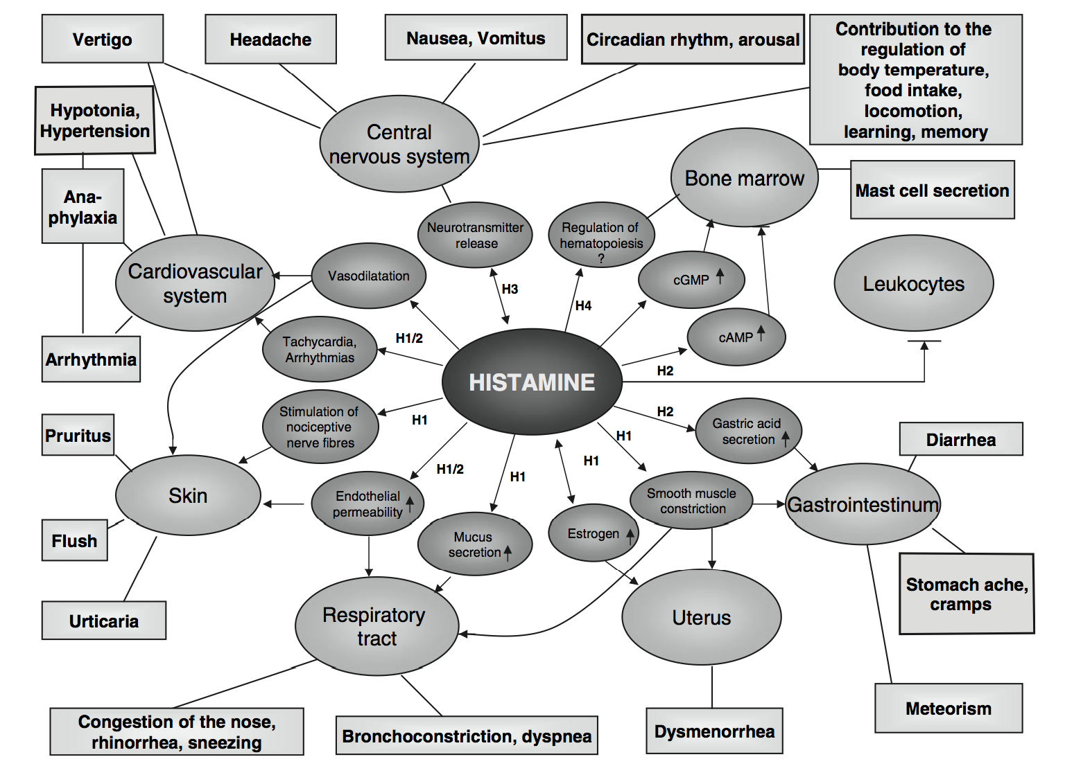
Symptoms Caused by Histamines*
*Figure 1, L. Maintz and N. Novak, Am J Clin Nutr 2007;85:1185–96.
Notes:
FIGURE 1. Summary of histamine-mediated symptoms. Adapted with permission from Maintz L et al. Dtsch Artzebl 2006;103:A3477-83
Treasures/histamine_intolerance_review_2007.pdf

Slide 96
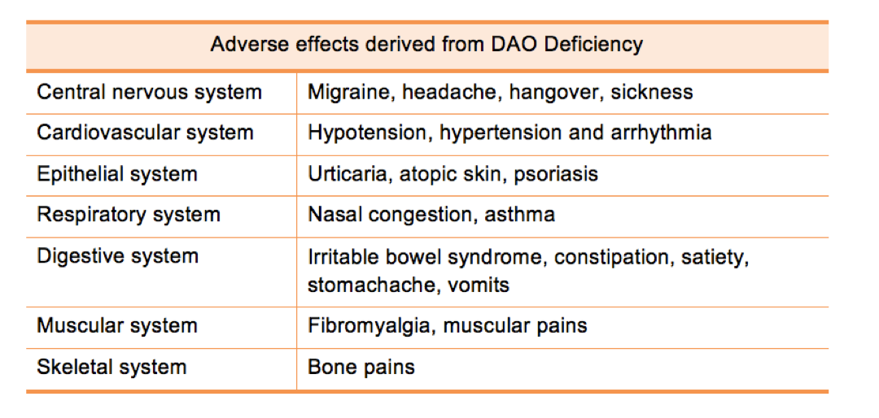
DAO Deficiency →
Histamine Accumulation*
*www.deficitdao.org/dao-deficiency/#.VRWYtWZGqDc
Notes:
http://www.deficitdao.org/dao-deficiency/#.VRWYtWZGqDc
./DAO_deficiency.pdf

Slide 97
Summary
Autism and Alzheimer’s disease have reached epidemic proportions in the Western world
  Hypothesis: Both are caused by a severe deficiency in sulfate supplies to the brain
Pineal gland can synthesize sulfate stimulated by sunlight and deliver it via melatonin sulfate
  Aluminum and glyphosate work synergistically to derail this process
  Sunlight deficiency contributes to the pathology
Mitochondrial disorder: mycoplasmas and histamines arise from impaired sulfate supplies

