Slide 1
Download these slides
people.csail.mit.edu/seneff/2015/WAPF_heart.pptx

Slide 2
New Paper Just Released!
Anthony Samsel and Stephanie Seneff.
Glyphosate, pathways to modern diseases IV: cancer and related pathologies.
Journal of Biological Physics and Chemistry 15 (2015) 121–159.
Check it out here:
http://www.gmfreecymru.org/pivotal_papers/crucial61.html

Slide 3
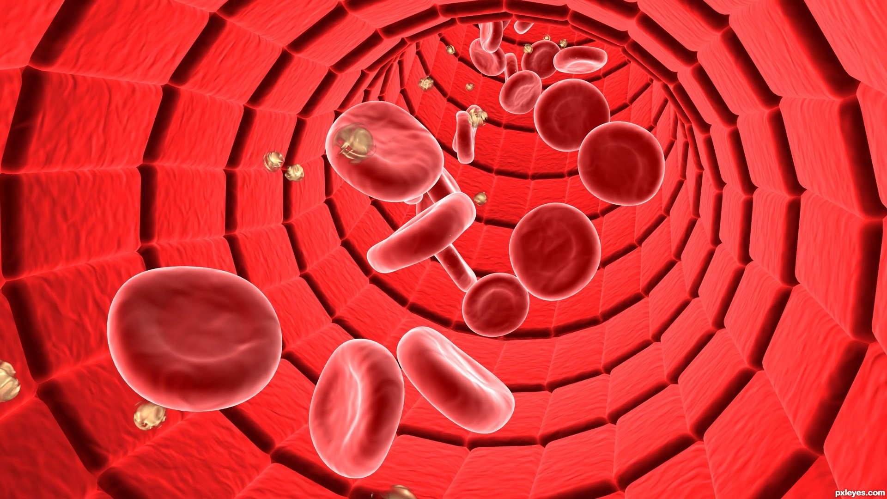
Cholesterol Sulfate, Electricity and the Vasculature
Stephanie Seneff
MIT CSAIL
September 15, 2015

Slide 4
The fatal tendency of mankind to leave off thinking about a thing when it is no longer doubtful, is the cause of half their errors.
– John Stuart Mill, 1859

Slide 5
Belief:
Cholesterol is a toxic substance that needs to be avoided in the diet, and statin drugs are the best way to keep cholesterol levels low
Reality:
Cholesterol is essential for human life and it protects us from multiple modern diseases
Notes:
¼ of the population over 45
32 million Americans

Slide 6
Outline
Sulfate and the Glycocalyx
Cholesterol Sulfate and Heart Disease
Streaming Potential
Roundup, StAR and Sterol Homeostasis
Iron and GGT
How to Stay Healthy!

Slide 7
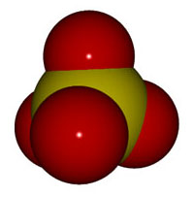
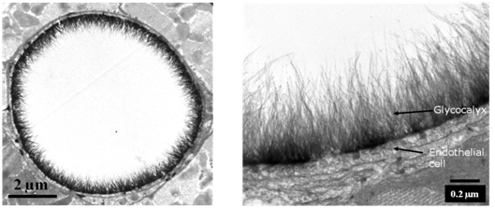
Sulfate and the Glycocalyx
Expanded View
Artery
Cross Section

Slide 8
The Broad Picture
Water plays a vital role in human physiology, but it needs sulfate to work properly
Cholesterol sulfate, produced upon sun exposure, provides sulfate to the vasculature
Toxic chemicals (especially glyphosate) disrupt sulfate synthesis and sulfate transport
This harms red blood cells and induces anemia
It also induces an inflammatory response leading to systemic cellular injury
Sulfate deficiency is behind most modern diseases

Slide 9
It’s All About the Blood
We are 2/3 water by mass and 99% by molecule count
Most of the water in the body is gelled
The BIG EXCEPTION is the flowing blood!
Blood delivers nutrients to and removes waste from all the tissues
Gelled water lines the vessel wall and provides slick, slick frictionless passage of red blood cells through the capillaries
Sulfate keeps the water gelled along the border
Sulfate transport is problematic ….

Slide 10
Sulfate is Crucial to Maintain Structured Water
Most cells in the body maintain an extracellular matrix that is formed from “glycosylated” proteins with complex sugar chains attached to them, and sulfate ions bound to the sugars at strategic locations in an irregular but non-random pattern
The glycocalyx that lines the walls of all blood vessels is formed from these glycoproteins

Slide 11
Sulfated Glycosaminoglycans (GAGs) (also called “Mucopolysaccharides”)
Prominent in extracellular matrix surrounding cells
Amount of sulfate depends on availability
Crucial for maintaining negative charge and communicating
http://www.science-autism.org/sulphate.htm

Slide 12
Endothelial Glycocalyx Schematic*
“GAG chain”
(GlycosAminoGlycan =
Amino-sugar-chain)
*S Reitsma et al., Pflugers Arch - Eur J Physiol (2007) 454:345–359
Notes:
treasures/endothelial_glycocalyx_review.pdf
Fig. 1 Schematic representation of the endothelial glycocalyx, showing its main components. Left: The endothelial glycocalyx can be observed in vivo as a red blood cell exclusion zone, located on the luminal side of the vascular endothelium. It consists of membrane- bound and soluble molecules. Right: Components of the endothelial glycocalyx. Bound to the endothelial membrane are proteoglycans, with long unbranched glycosaminoglycan side-chains (GAG-chain) and glycoproteins, with short branched carbohydrate side-chains. Incorporated in and on top of this grid are plasma and endothelium
derived soluble components, including hyaluronic acid and other soluble proteoglycans (e.g., thrombomodulin) and various proteins, such as extracellular superoxide dismutase (ec-SOD) and antithrombin III (AT III). Together, these components form the endothelial glycocalyx that functions as a barrier between blood plasma and the endothelium and exerts various roles in plasma and vessel wall homeostasis. Note that this figure is not drawn to scale; its purpose is to illustrate glycocalyx composition

Slide 13
Endothelial Glycocalyx Schematic*
Gel layer prevents attack of vessel wall by blood sugars and oxidizing agents.
Cellular signaling mechanisms (e.g., antioxidant ec-SOD and clot-protective AT III) depend on sulfates to work.
*S Reitsma et al., Pflugers Arch - Eur J Physiol (2007) 454:345–359
Notes:
antithrombin
treasures/endothelial_glycocalyx_review.pdf
Fig. 1 Schematic representation of the endothelial glycocalyx, showing its main components. Left: The endothelial glycocalyx can be observed in vivo as a red blood cell exclusion zone, located on the luminal side of the vascular endothelium. It consists of membrane- bound and soluble molecules. Right: Components of the endothelial glycocalyx. Bound to the endothelial membrane are proteoglycans, with long unbranched glycosaminoglycan side-chains (GAG-chain) and glycoproteins, with short branched carbohydrate side-chains. Incorporated in and on top of this grid are plasma and endothelium
derived soluble components, including hyaluronic acid and other soluble proteoglycans (e.g., thrombomodulin) and various proteins, such as extracellular superoxide dismutase (ec-SOD) and antithrombin III (AT III). Together, these components form the endothelial glycocalyx that functions as a barrier between blood plasma and the endothelium and exerts various roles in plasma and vessel wall homeostasis. Note that this figure is not drawn to scale; its purpose is to illustrate glycocalyx composition

Slide 14
Exclusion Zone: Model of Capillary*
Battery!
Blood
Sulfated GAGs
Endothelium
*Figure 9, M. Rohani and G.H. Pollack, Langmuir 2013, 29, 6556−6561
Notes:
Langmuir_Pollack_flow_through_tube_protons_gather_2013.pdf
Images/Pollack1.jpg
Figure 9. (a) Distribution of charge in the exclusion zone and water beyond the exclusion zone as shown by electrical potential measurements and pH- sensitive dye studies. Protons spread in bulk water, although some cling to the negatively charged EZ. (b) Disposition of charge anticipated in a tubular configuration.

Slide 15
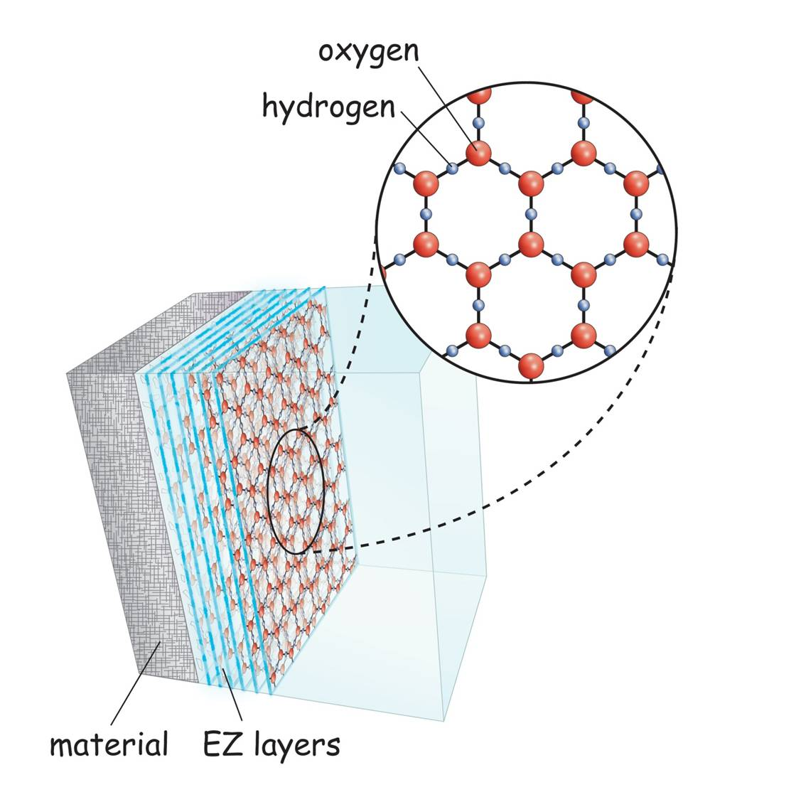
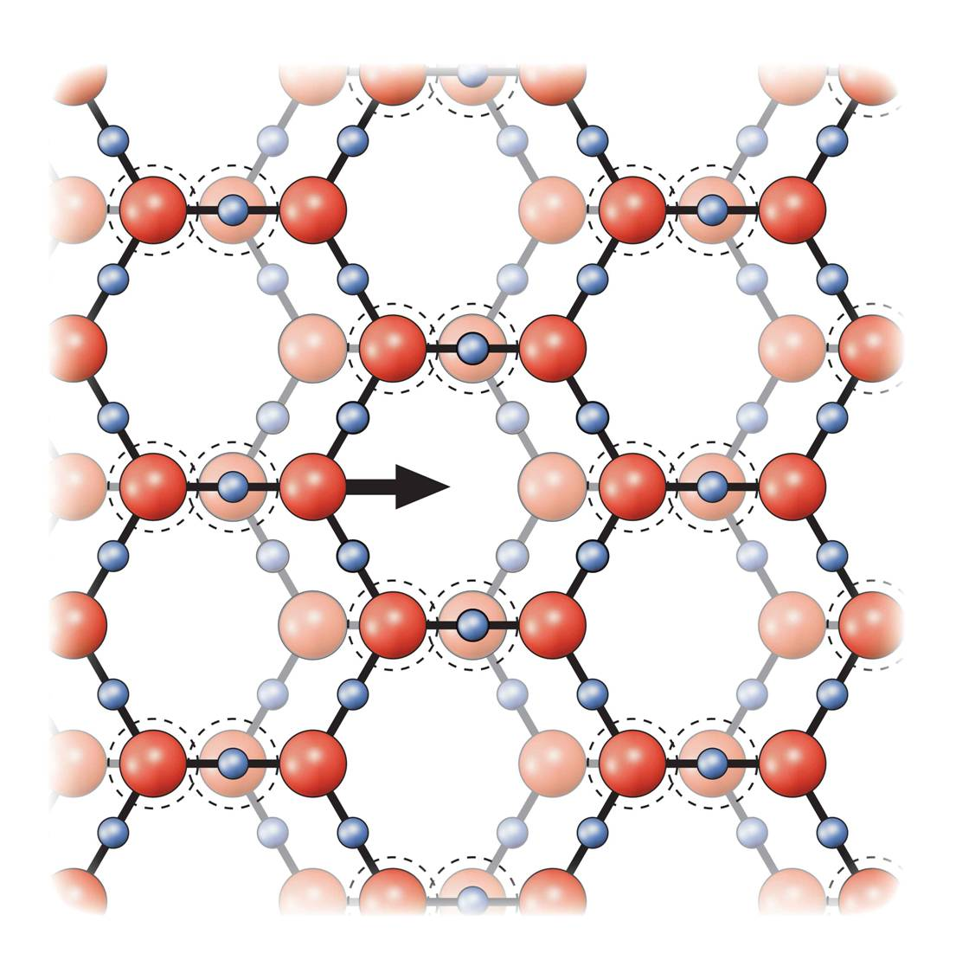
Water Organizes Into “Crystals” in the Exclusion Zone*
endothelial cells
+
+
+
Protons collect at the interface between
The exclusion zone and the bulk water in the blood
Negatively
Charged
Exclusion Zone
+
+
Unstructured water in blood
*http://doublehelixwater.eu/understanding-water-contents/exclusion-zone-form/

Slide 16
Water Organizes Into “Crystals” in the Exclusion Zone*
endothelial cells
The surface energy of water is a non-metabolic "fuel" source for the molecular motors of our bodies
+
+
+
Protons collect at the interface between
The exclusion zone and the bulk water in the blood
Negatively
Charged
Exclusion Zone
+
+
Unstructured water in blood
*http://doublehelixwater.eu/understanding-water-contents/exclusion-zone-form/

Slide 17
Cholesterol Sulfate
and Heart Disease

Slide 18
Cholesterol: Saint, Not Villain
Cholesterol is to animals as chlorophyll is to plants: it gives us a brain and mobility
The brain makes up 5% of the body’s weight and contains 25% of the body’s cholesterol
Why would cholesterol pile up in the arteries leading to the heart, if not for a good reason??

Slide 19
Cholesterol and Cholesterol Sulfate
Sulfation makes cholesterol water-soluble and therefore much easier to transport
Equally important is that cholesterol carries sulfate
SULFATE
Notes:
From cholesterol_sulfate_agile.pdf – this was the original article on that topic.

Slide 20
A Provocative Proposal*
Cholesterol sulfate supplies oxygen, sulfur, cholesterol, energy and negative charge to all the tissues
Sulfate is synthesized from sulfide in skin and blood stream utilizing energy in sunlight
Protects from UV damage and keeps microbes out
*S Seneff et al. Theor Biol Med Model 2015; 12:9

Slide 21
Heart Disease Mortality and Sunlight*
*Grimes et al., Q. J. Med. 1996; 89:579-589
Notes:
vitaminK/sunlight_heart_disease.pdf

Slide 22
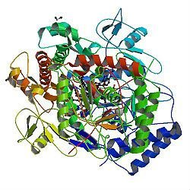
A Provocative Proposal*
Cholesterol sulfate supplies oxygen, sulfur, cholesterol, energy energy and negative charge to all the tissues
Sulfate is synthesized from sulfide in skin and blood stream utilizing energy in sunlight
Protects from UV damage and keeps microbes out
Endothelial Nitric Oxide Synthase (eNOS) performs the magic
The skin is a solar powered battery!
*S Seneff et al. Theor Biol Med Model 2015; 12:9

Slide 23
A Provocative Proposal*
Cholesterol sulfate supplies oxygen, sulfur, cholesterol, energy energy and negative charge to all the tissues
Sulfate is synthesized from sulfide in skin and blood stream utilizing energy in sunlight
Protects from UV damage and keeps microbes out
Endothelial Nitric Oxide Synthase (eNOS) performs the magic
BOLD CLAIM:
Deficiencies in cholesterol and sulfate supplies to the blood and to the tissues are the most important factor behind modern diseases
The skin is a solar powered battery!
*S Seneff et al. Theor Biol Med Model 2015; 12:9

Slide 24
eNOS is Very Vulnerable*
eNOS depends on:
Cobalamin (vitamin B12, cobalt)
Heme iron, sulfur, zinc, oxygen
Glutathione
Sunlight
eNOS is a cytochrome P450 enzyme:
Highly susceptible to damage from various environmental toxicants like mercury, aluminum, glyphosate (Roundup herbicide), etc.
*S. Seneff et al., Entropy 2012, 14, 2492-2530

Slide 25
Cholesterol sulfate provides negative charge*
-
-
-
-
-
-
-
-
-
-
-
-
-
-
-
-
-
-
-
-
-
-
-
-
-
-
-
-
-
-
-
-
-
-
-
-
-
-
-
-
-
-
-
-
-
-
-
-
-
-
-
-
-
-
-
-
-
Red blood cells export cholesterol sulfate to the capillary wall, supplying it with cholesterol, sulfate, and negative charge
* Davidson and Seneff, Entropy 14, 1399-1442, 2012

Slide 26
They Knew a Long Time Ago*
Article published in 1960
Fed cholesterol to monkeys
Induced atherosclerosis
If sulfur-containing nutrients are added, atherosclerosis is prevented
These nutrients provide source of sulfate to enable cholesterol transport
* G.V. Mann et al., Am. J. Clin. Nutr. 8, 491-497, 1960
Notes:
./ monkeys_sulfur_solves_cholesterol_problem_1960

Slide 27
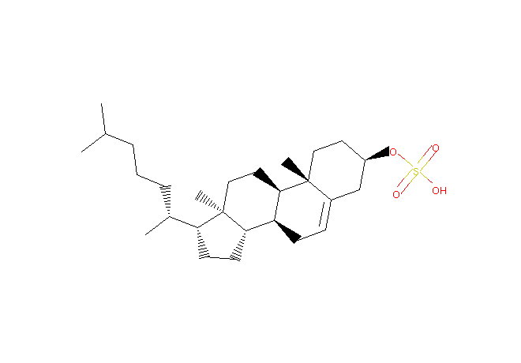
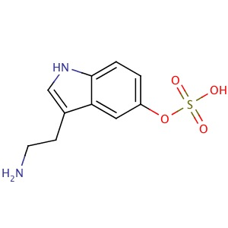
Sulfation as Sulfate Transport
STEROLS
NEUROTRANSMITTERS/
HORMONES
cholesterol sulfate
Serotonin sulfate
DHEA
Cortisol
Estrogen
Progesterone
Testosterone
Vitamin D
Vitamin C
Melatonin
Adrenalin
Dopamine
Thyroid hormone
These are all sulfated for transport in the blood
Is sulfate transport an important role that they play??

Slide 28
Various Factors that Increase Sulfate*
An increase of the 35S-sulfate deposit is effected regularly by infections, by injections of toxins and proteins, by hypoxemia, dietetic influence, muscular over-exertion, weather influence and increase of the blood pressure.
SMPS= Sulfated mucopolysaccharides
*Report by Bernhard Muschlien
SMPS = Sulfated mucopolysaccharides = glycosaminoglycans
First published in the German language in the SANUM-Post magazine (17/ 1991)
Notes:
Treasures/bacteria_renew_sulfate_German.pdf
Pyrexal is an endotoxin

Slide 29
Sulfur Incorporation into GAGs with Age*
Plaque regions
Normal aorta
*WH Hauss et al.. J Atheroscler Res. 1962;2(1–2):50–61
Notes:
CholesterolSulfate2_2015.pdf
Fig. 5 Sulfur Incorporation into GAGs with Age. Incorporation of 35Sulfur into chondroitin sulphuric acids (CSA) of the connective tissue of normal human aortae (x) and atherosclerotic human aortae (o) in in vitro experiment. (Redrawn from [110], with permission from Elsevier)

Slide 30
Streaming Potential

Slide 31
Zeta Potential
Zeta potential (Z) is a measure of the flow rate of charged particles (e.g., red blood cells) in an electric field
Impaired blood flow is a key problem in multiple modern diseases
Results from insufficient negative charge (Z) in the blood vessels, due to insufficient supply of sulfate anions (delivered as cholesterol sulfate by the red blood cells)
The benefits of “grounding” are due to supply of negative charge from the earth

Slide 32
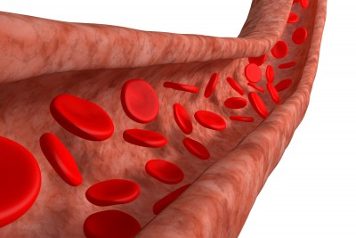
Electrokinetic Vascular Streaming Potential (EVSP)*
+
Field strength is proportional to the zeta potential → promotes blood flow
Contains a DC component and an AC component (very low frequency, depends on pulse rate and heart rate)
Influences endothelial cells:
Enhances release of nitric oxide (vasorelaxant)
Increases calcium-based depolarization
-
-
*D.P. Trivedi et al., Bioelectromagnetics 34:22-30, 2013
Notes:
Treasures/electric_fields_induced_by_blood_flow_modulate_nitric_oxide.pdf

Slide 33
Moving RBC Creates Magnetic Field*
Magnetic field
Red
Blood
Celll
Nitric Oxide
*S Seneff et al., Theor Biol Med Model 2015; 12: 9
Notes:
CholesterolSulfate2_2015.pdf
Fig. 4 Schematic of a red blood cell moving through a capillary, propelled by the force field generated by the voltage drop between the artery and the vein. The moving RBC creates an electromagnetic field that induces the release of nitric oxide from the capillary wall. This relaxes the vessel and further promotes flow

Slide 34
Various Factors that Increase Sulfate*
SMPS= Sulfated mucopolysaccharides
*Report by Bernhard Muschlien
SMPS = Sulfated mucopolysaccharides = glycosaminoglycans
First published in the German language in the SANUM-Post magazine (17/ 1991)
Notes:
Treasures/bacteria_renew_sulfate_German.pdf
Pyrexal is an endotoxin

Slide 35
Streaming Potential
Streaming potential
E_{s} =[ Zee_{o}P/ηk] [f(Y_{a})]
E_{s} = streaming potential (volts)
e = electrolyte dielectric constant
P = systolic pressure (N/m²)
k = conductivity (S/m)
Z = zeta potential (volts)
e_{o} = permitivity of free space
η = viscosity (kg/m*s)
F(Y_{a}) = correction for pulsatile flow
Notes:
Siemens per meter (S/m)
Newtons per square meter
Kg/ meter * second
Treasures/Darshan_electrovascular_streaming_potential_endothelium.pdf
Systolic during beat; diastolic during rest

Slide 36
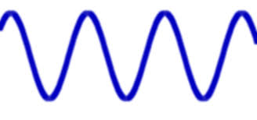
Streaming Potential
Contains both DC and AC component
AC component controlled by heart rate
Higher heart rate induces stronger response
Streaming potential
E_{s} =[ Zee_{o}P/ηk] [f(Y_{a})]
E_{s} = streaming potential (volts)
e = electrolyte dielectric constant
P = systolic pressure (N/m²)
k = conductivity (S/m)
Z = zeta potential (volts)
e_{o} = permitivity of free space
η = viscosity (kg/m*s)
F(Y_{a}) = correction for pulsatile flow
Notes:
Treasures/Darshan_electrovascular_streaming_potential_endothelium.pdf
Siemens per meter (S/m)
Newtons per square meter
Kg/ meter * second

Slide 37
Streaming Potential
Proportional to Zeta potential
E_{s} =[ Zee_{o}P/ηk] [f(Y_{a})]
E_{s} = streaming potential (volts)
e = electrolyte dielectric constant
P = systolic pressure (N/m²)
k = conductivity (S/m)
Z = zeta potential (volts)
e_{o} = permitivity of free space
η = viscosity (kg/m*s)
F(Y_{a}) = correction for pulsatile flow
Notes:
Treasures/Darshan_electrovascular_streaming_potential_endothelium.pdf

Slide 38
Streaming Potential
Proportional to blood pressure
E_{s} =[ Zee_{o}P/ηk] [f(Y_{a})]
E_{s} = streaming potential (volts)
e = electrolyte dielectric constant
P = systolic pressure (N/m²)
k = conductivity (S/m)
Z = zeta potential (volts)
e_{o} = permitivity of free space
η = viscosity (kg/m*s)
F(Y_{a}) = correction for pulsatile flow
Notes:
Treasures/Darshan_electrovascular_streaming_potential_endothelium.pdf

Slide 39
Streaming Potential
Inversely proportional to viscosity
E_{s} =[ Zee_{o}P/ηk] [f(Y_{a})]
E_{s} = streaming potential (volts)
e = electrolyte dielectric constant
P = systolic pressure (N/m²)
k = conductivity (S/m)
Z = zeta potential (volts)
e_{o} = permitivity of free space
η = viscosity (kg/m*s)
F(Y_{a}) = correction for pulsatile flow
Notes:
Treasures/Darshan_electrovascular_streaming_potential_endothelium.pdf

Slide 40
Some Insights
When Z is too low (not enough bound sulfate), blood pressure must go up to compensate (high blood pressure)
When viscosity is too high, blood pressure must go up to compensate (high blood pressure)
Nitric oxide release is induced by the streaming potential

Slide 41
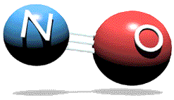
Why is Nitric Oxide Important?
Nitric oxide relaxes the vessel wall and promotes increased flow & therefore oxygen
Nitric oxide quickly converts to nitrite which can break down the glycocalyx, releasing sulfated GAGs
These can be passed on to the capillaries to correct their deficiencies

Slide 42
eNOS Uncoupling*
eNOS makes either sulfate or nitrite depending on control factors
Builds up matrix
SULFATE
NITRITE
Breaks down matrix
*Figure 1, M Yokoyama and K-I Hirata Cardiovascular Research 73 (2007) 8–9
Notes:
Treasures/eNOS_uncoupling_2007.pdf
Fig. 1. Potential mechanisms of physiological regulation of cerebral arterial tone by eNOS. eNOS: endothelial nitric oxide synthase; SOD: superoxide dismutase; GPx: glutathione peroxidase.

Slide 43
Roundup, StAR and
Sterol Homeostasis
StAR:
Steroidogenic
Acute
Regulatory
protein

Slide 44
Non-alcoholic Fatty Liver Disease: An Epidemic in America
NAFLD affects almost one-quarter of the general U.S. population
Notes:
.steatohepatitis
/StAR_overexpression_NASH.text
https://en.wikipedia.org/wiki/Steroidogenic_acute_regulatory_protein
Leydig Cells testes

Slide 45
An Epidemic in the Western World*
Most common liver disorder in countries that adopt the “Western” diet
Rate doubled between 2004 and 2010 in S. Korea
Linked to low HDL, high LDL, and high cholesterol
Vegetarian diet increases risk
Insulin resistance and oxidative injury play a role
*SH Choi et al., Turk J Gastroenterol 2015; 26: 336-43
Notes:
Gerry/A\ vegetarian\ diet\ does\ not\ protect\ against\ nonalcoholic\ fatty\ liver\ disease\ \(NAFLD\).pdf .

Slide 46
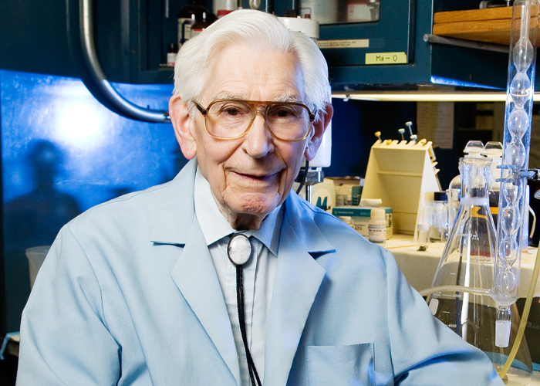
Fred Kummerow on LDL*
"LDL is not a marker of heart disease," Kummerow said. "It's a marker of ApoB." And ApoB is a marker of a lack of tryptophan.
Tryptophan is a product of the shikimate pathway, which glyphosate disrupts.
*https://news.illinois.edu/blog/view/6367/204646

Slide 47
“Sulfation of 25-hydroxycholesterol regulates lipid metabolism, inflammatory responses, and cell proliferation”*
Cholesterol and fats shipped out through bile acids
Fixes fatty liver
Liver cells proliferate, restoring damaged liver
Suppresses inflammation
LIVER CELL
Turns on and off many enzymes
cholesterol
StAR
nucleus
StAR
25HC
CYP
SULT2B1b
SULFATE
mitochondrion
25HC3S
*S Ren and Y Ying, Am J Physiol Endocrinol Metab 306: E123–E130, 2014
Notes:
Treasures/sulfated_oxysterol_regulates_everything_2014.pdf

Slide 48
StAR is a Superstar!
StAR protects from fatty liver disease and elevated serum LDL by promoting bile flow
StAR is essential for synthesis of cortisol, testosterone and estrogen by the adrenal glands and by the gonads
StAR induces export of cholesterol from cardiovascular plaque into HDL

Slide 49
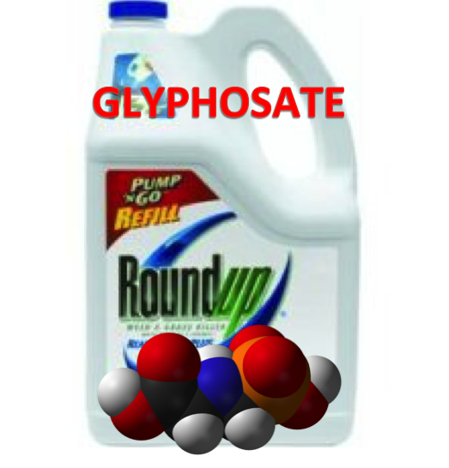
Roundup Inhibits Steroidogenesis by Disrupting StAR Protein Expression*
In vitro study on testicular Leydig cells
Roundup reduced testosterone synthesis by 94%
Effect due to both StAR suppression and CYP suppression
Roundup reduced StAR protein levels by 90%
Reduction in StAR expression in the adrenal gland disrupts synthesis of stress hormones and sex hormones
*LP Walsh et al., Environ Health Perspect 2000; 108:769-776
Notes:
Roundup_inhibits_StAR_protein_expression.pdf
Leydig cells produce testosterone

Slide 50
StAR Protein, Cholesterol Sulfate, and LDL*
StAR
Bile Acids
LDL
25HC3S is an important regulator of lipid biosynthesis
Decreases liver accumulation of fat and cholesterol
Increases bile acid production and decreases LDL export
*Q Bai et al., Metabolism. 2012 June ; 61(6): 836–845
Notes:
Steroidogenic acute regulatory protein
https://en.wikipedia.org/wiki/Steroidogenic_acute_regulatory_protein
Treasures/oxysterol_sulfation_reduces_fatty_liver_disease_StAR_involved.pdf
Glyphosate/roundup_inhibits_StAR_protein_expression.pdf
Csail/2015/project/RobertMelamede.email.text

Slide 51
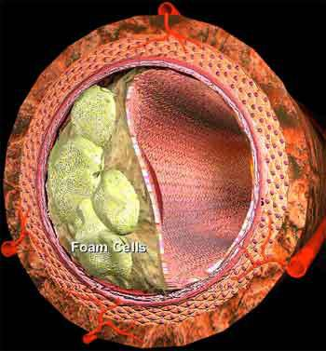
Overexpression of StAR increases macrophage cholesterol efflux to HDL-AI*
Atherosclerosis: Macrophages infiltrate the artery wall and transform to foam cells, storing fat and cholesterol
Macrophages export their cholesterol to HDL-A1, the so-called “good cholesterol”
Overexpression of StAR in macrophages promotes cholesterol export
*JMW Taylor et al., Cardiovascular Research (2010) 86, 526–534

Slide 52
Why Does Cholesterol Accumulate in the Arteries Supplying the Heart?
The heart is arguably the most important organ in the body
It needs abundant cholesterol and sulfate to stay healthy
When there are deficiencies, the artery wall stockpiles cholesterol waiting to become cholesterol sulfate
Inflammation induces superoxide which oxidizes sulfur to sulfate (e.g. in homocysteine)
Sulfate conjugation is needed for cholesterol export/delivery

Slide 53
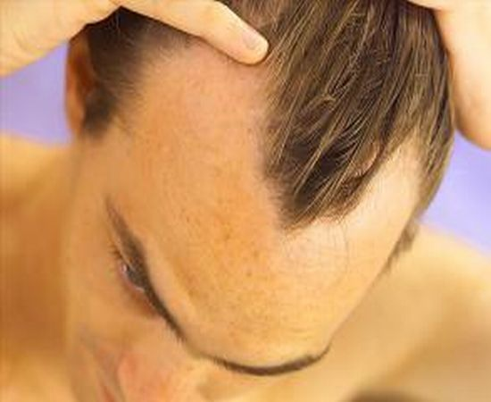
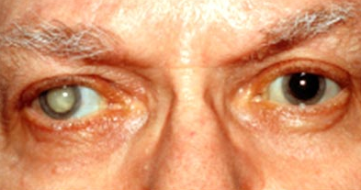
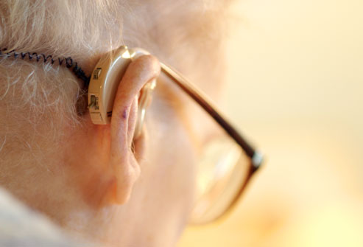
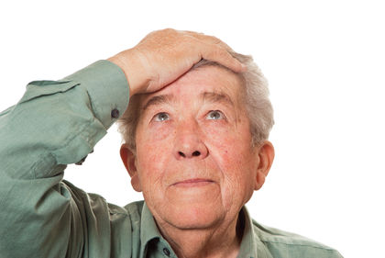
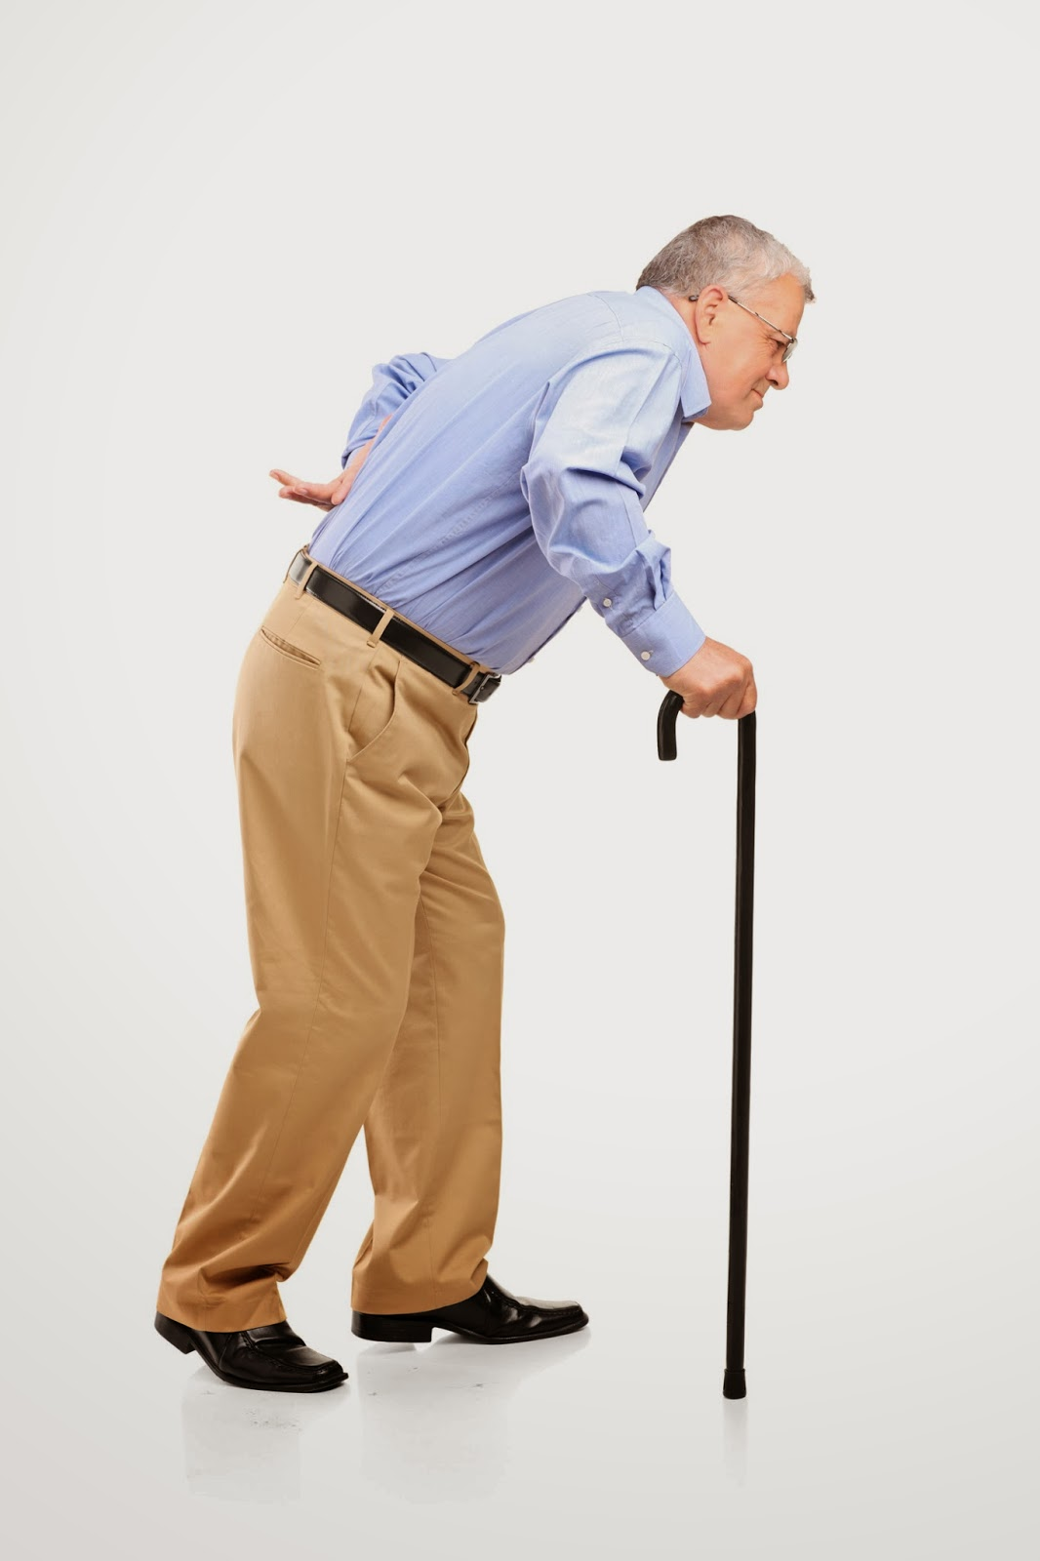
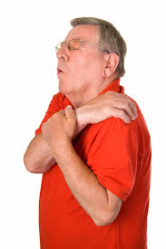
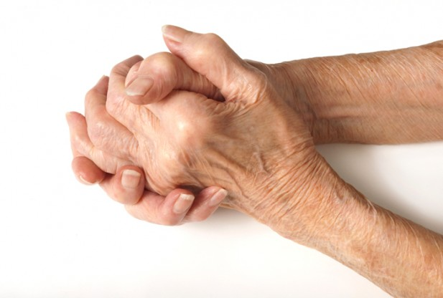
Statins Make You Grow Older Faster*
*J Liu and S Seneff, Proc. IMMM, Barcelona, Spain, Oct. 2011.
Notes:
Reference IMMM_Paper.pdf

Slide 54
Evidence that Statins Make You Grow Older Faster*
Statins
Reduce the overall growth rate of Mesenchymal Stem Cells (MSCs)
Inhibit their potential to differentiate into macrophages, osteoblasts and chondrocytes
Impair DNA repair capabilities
Increase cell senescence and apoptosis
* R Izadpanah et al. Am J Physiol Cell Physiol. 2015 Jul 29:ajpcell.00406.2014 [Epub ahead of print]

Slide 55
Statins CAUSE Atherosclerosis and Heart Failure!*
Inhibit vitamin K2 synthesis
Increase risk of hardening of the arteries (calcification)
Function as mitochondrial toxins
Deplete Coenzyme Q10 and heme A → reduced ATP supply
Inhibit selenoprotein synthesis → oxidative stress
Increase chances for heart failure
Enlarged left ventricle associated with selenium deficiency
* H Okuyama et al. Expert Review of Clinical Pharmacology 2015: 8:2; 189-199

Slide 56
Paul’s Story (anecdotal)
Lipid Measure | March | April | August
Cholesterol | 149 | 213 | 168
Cholesterol/HDL | 4.4 | 5.5 | 3.4
HDL | 34 | 39 | 49
LDL | 68 | 134 | 97
Triglycerides | 235 | 198 | 110
Stopped statin drug in March
Switched to organic diet high in sulfur and cholesterol
Spent considerable time every day outside in the sunlight, starting in April; practiced “grounding”
Vitamin D: 44 (March), 77 (May), 112 (June)
Lost weight and felt much more energetic
Notes:
PaulHarris/Paul_documenting_his_story.text

Slide 57
Iron and GGT

Slide 58
What’s the Problem With Iron?
…just right…
…too little… …too much…
The iron paradox: iron is both vital & lethal
Vital & harmful effects result from same reactions:
redox chemistry, interactions with O₂
Results of iron excess:
Reduction of O₂ (ROS) + iron → OH•
Oxidative stress damages cell membranes, DNA, protein
Anti-oxidant defenses are overcome → iron toxicity

Slide 59
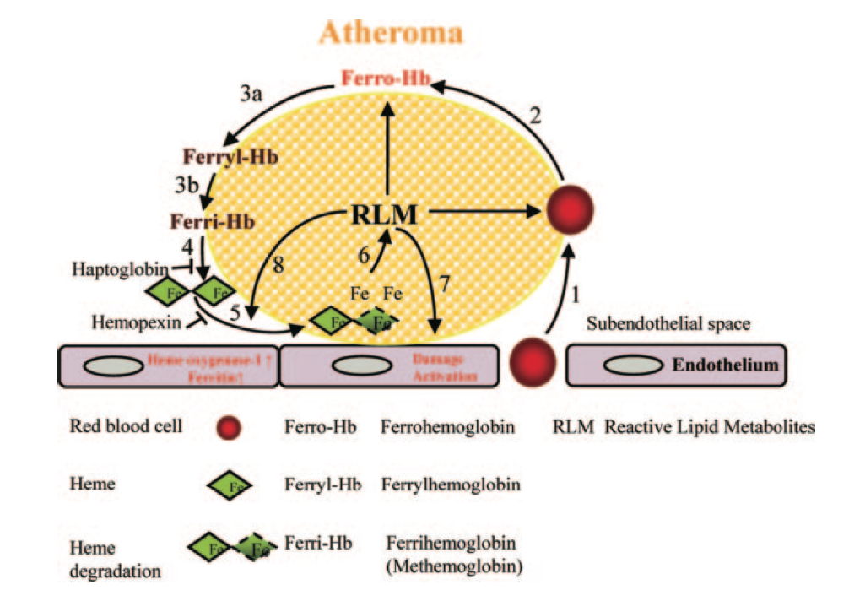
Hemoglobin: Source of Iron Overload Causing LDL Oxidation*
Reactive Lipid Metabolites
Red blood cell crosses endothelial wall and gets broken down, releasing hemoglobin
HMOX-1 UP
Message activation
*Figure 6, E. Nagy et al., Arterioscler Thromb Vasc Biol. 2010;30:1347-1353
Notes:
GerryKoenig/heme/Red_Cells,_Hemoglobin,_Heme,_Iron,_and_Atherogenesis.pdf
Figure 6. A model for red cell-mediated progres- sion of atherogenesis. 1, Infiltration by red blood cells of the atheromatous lesion. 2, Erythrocyte lysis and liberation of ferrohemoglobin (Ferro-Hb) by lipids of atheroma. 3, Oxidation of ferrohemo- globin to ferrylhemoglobin (Ferryl-Hb) (a) and to ferrihemoglobin (Ferri-Hb) (b). 4, Release of heme from ferrihemoglobin. 5, Heme uptake by athero- ma lipid. 6, Amplification of lipid oxidation in ather- oma. 7, Damage and activation of endothelium induced by reactive lipid metabolites of atheroma. 8, Induction of HO-1 and ferritin by atheroma lipid and heme.

Slide 60
Hemolytic Anemia*
Hemolytic
anemia
Hemoglobin destroys NO
Impaired vasodilation
Redox-active
heme and iron
RBC arginase released
L-arginine depleted
ROS
Ischemia/reperfusion injury
Endothelial and smooth muscle proliferation
Hemolytic anemia leads to cardiovascular disease
*RF Machado et al., AMA, July 19, 2006 296(3), 310-318.
Notes:
Heart/N-Terminal\ Pro-Brain\ Natriuretic\ Peptide\ Levels\ and\ Risk\ of\ Death\ in\ Sickle\ Cell\ Disease_marked.pdf

Slide 61
This Detoxification Scheme is Essential in Red Blood Cells
Inhibited by glyphosate
Product of shikimate pathway
Depleted by glyphosate
Depends on selenium

Slide 62
This Detoxification Scheme is Essential in Red Blood Cells
Inhibited by glyphosate
Product of shikimate pathway
G6PD Deficiency Leads to Hemolysis and Anemia
Depleted by glyphosate
Depends on selenium

Slide 63
Gamma Glutamyl Transferase (GGT)*
GGT is an enzyme that breaks down glutathione into its component amino acids
Elevated serum GGT is a sign of liver and biliary diseases
It's also associated with cardiovascular disease, metabolic syndrome and diabetes
GGT accumulates in atherosclerotic plaque
High GGT is associated with iron overload
*G. Koenig and S. Seneff. Disease Markers Volume 2015 (2015), Article ID 818570.

Slide 64
Are we getting enough sulfur in our diet?*
Amino Acid Pool → Protein Synthesis
α-ketoglutarate
Urea
SULFATE
Glycosaminoglycans
*Figure 1, ME Nimni et al., Nutrition & Metabolism 2007, 4:24
Notes:
tFSeiAimignAup,slriyGfenieAt1dhGedsisiasygnratanhmdesntihist,arstotgdoernpagimcetesottfahbceoyslritesemlianteioanshgilpustabtehtiownee,npro- Simplified diagram that depicts the relationships between SAA, GAG synthesis, storage of cysteine as glutathione, pro- tein synthesis and nitrogen metabolism.

Slide 65
Are we getting enough sulfur in our diet?*
GGT = Gamma glutamyl transferase
Amino Acid Pool → Protein Synthesis
GGT
α-ketoglutarate
Urea
SULFATE
glycosaminoglycans
Glycosaminoglycans
*Figure 1, ME Nimni et al., Nutrition & Metabolism 2007, 4:24
Notes:
tFSeiAimignAup,slriyGfenieAt1dhGedsisiasygnratanhmdesntihist,arstotgdoernpagimcetesottfahbceoyslritesemlianteioanshgilpustabtehtiownee,npro- Simplified diagram that depicts the relationships between SAA, GAG synthesis, storage of cysteine as glutathione, pro- tein synthesis and nitrogen metabolism.

Slide 66
GGT Cycle*
SULFATE
glutathione
*Figure 4 in SC Lu et al.,, Mol Aspects Med. 2009 ; 30(1-2): 42–59.
Notes:
GerryKoenig/regulation_of_glutathione_synthesis_2008
Fig. 4.
GSH as cysteine storage via the γ-glutamyl cycle. The γ-glutamyl cycle utilize GSH as a continuous source of cysteine. Cysteine is taken up readily by most cells and once it enters the cell, most of it is incorporated into GSH while the rest is incorporated into newly synthesized proteins and/or broken down into sulfate and taurine. GSH is exported from the cell and the ecto-enzyme GGT then transfers the γ-glutamyl moiety of GSH to an amino acid (the best acceptor being cystine), forming γ-glutamyl amino acid and cysteinylglycine. The γ-glutamyl amino acid can then be transported back into the cell to complete the cycle. Once inside the cell, the γ-glutamyl amino acid can be further metabolized to release the amino acid and 5- oxoproline, which can be converted to glutamate. Cysteinylglycine is broken down by dipeptidase (DP) to generate cysteine and glycine, which are then transported back into the cell to be reincorporated into GSH.

Slide 67
The Real Reason for GGT?
glutathione
GGT
cysteine
glycine
glutamate
CDO
α-ketoglutarate
oxygen
cysteinesulfinate
pyrrole
succinate
AST
succinyl
Coenzyme A
homocysteine
sulfite
heme
O₂⁻
Sulfite oxidase
sulfate
sulfate
Notes:
Figure 1
Caption: Schematic of proposed pathways following GGT’s breakdown of glutathione into its component amino acids.
AST = aspartate transaminase
GGT = Gamma glutamyl transferase
CDO = Cysteine dioxygenase

Slide 68
The Real Reason for GGT?
glutathione
GGT
Use Component Amino Acids to Synthesize Sulfate and Heme!
cysteine
glycine
glutamate
CDO
α-ketoglutarate
oxygen
cysteinesulfinate
pyrrole
succinate
AST
succinyl
Coenzyme A
homocysteine
sulfite
heme
O₂⁻
Sulfite oxidase
sulfate
sulfate
Notes:
Figure 1
Caption: Schematic of proposed pathways following GGT’s breakdown of glutathione into its component amino acids.
AST = aspartate transaminase
GGT = Gamma glutamyl transferase
CDO = Cysteine dioxygenase

Slide 69
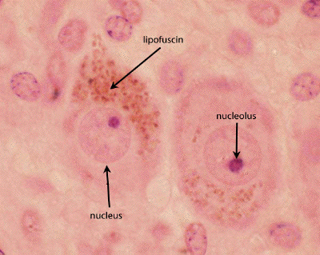
Ferrous Iron in Lysosomes: Key Role in Cardiovascular Disease*
lipofuscin
Lysosomes in macrophages recycle iron in hemoglobin in atherosclerotic plaque
Fe(II) → superoxide via Fenton reaction
Superoxide damages cellular proteins and DNA
Result: lipofuscin accumulation
Lipofuscin accumulation reflects biological rather than chronological age
*T Kurz et al., The International Journal of Biochemistry & Cell Biology 43 (2011) 1686–1697
Notes:
Heart/iron_lysosomes_pathology_heart_disease.pdf

Slide 70
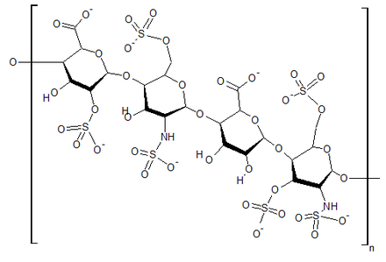
Heparin Protects from ROS due to Iron*
superoxide
Free radical production (Fenton reaction):
Fe(II) + 0₂ + 20H⁻ --> Fe(III)(OH) ₂ + 0₂⁻
But, in the acid environment of heparin:
4Fe(II) + 0₂ + 4H+ --> 4Fe(III) + 2H₂0
water
*M.A. Ross et al., Biochem. J. 1992, 286: 717-720.

Slide 71
Heparin Protects from ROS due to Iron*
superoxide
Free radical production (Fenton reaction):
Fe(II) + 0₂ + 20H⁻ --> Fe(III)(OH) ₂ + 0₂⁻
But, in the acid environment of heparin:
4Fe(II) + 0₂ + 4H+ --> 4Fe(III) + 2H₂0
Heparin taken up by lysosomes allows them to safely handle iron
water
*M.A. Ross et al., Biochem. J. 1992, 286: 717-720.
Notes:
Where?

Slide 72
Heparin Protects from ROS due to Iron*
superoxide
Free radical production (Fenton reaction):
Fe(II) + 0₂ + 20H⁻ --> Fe(III)(OH) ₂ + 0₂⁻
But, in the acid environment of heparin:
4Fe(II) + 0₂ + 4H+ --> 4Fe(III) + 2H₂0
Heparin is loaded with sulfates!!
water
*M.A. Ross et al., Biochem. J. 1992, 286: 717-720.
Notes:
Where?

Slide 73
GGT induces Inflammatory Response
GGT releases iron from chelators (such as glyphosate!)
Free iron induces Fenton reaction (damages cellular proteins and membrane fatty acids)
GGT is needed to break glutathione into its component amino acids to produce heme and sulfate
Glyphosate disrupts both pathways

Slide 74
GGT induces Inflammatory Response
GGT releases iron from chelators (such as glyphosate!)
Free iron induces Fenton reaction (damages cellular proteins and membrane fatty acids)
GGT is needed to break glutathione into its component amino acids to produce heme and sulfate
Glyphosate disrupts both pathways
5.4-fold increased expression of GGT in livers of rats exposed to Roundup over their lifetime (Seralini’s study)
Notes:
n addition, by the end of the experiment, Gamma GT hepatic activity was increased, particularly in the GMO + R groups (up to 5.4 times higher), this prob- ably being reflective of liver dysfunction.
p. 4

Slide 75
GGT & Chronic Obstructive Pulmonary Disease (COPD)*
“We found that in adults aged 40 years and older, representative of the Korean population, elevated GGT levels are associated with decreased pulmonary function (in both genders) and an increased prevalence of COPD in men.”
*HW Kim et al., Lung, 2014 Jul 11. [Epub ahead of print]
Notes:
heart/GGT_and_COPD_Korea.pdf
Mucus gland hyperplasia
Wright DT, Fischer BM, Li C, Rochelle LG, Akley NJ, Adler KB (1996) Oxidant stress stimulates mucin secretion and PLC in airway epithelium via a nitric oxide-dependent mechanism. Am J Physiol 271(5 Pt 1):L854–L861

Slide 76
GGT & Chronic Obstructive Pulmonary Disease (COPD)*
“We found that in adults aged 40 years and older, representative of the Korean population, elevated GGT levels are associated with decreased pulmonary function (in both genders) and an increased prevalence of COPD in men.”
COPD is associated with excessive mucus production in the lungs which I believe provides sulfate for the vasculature**
*HW Kim et al., Lung, 2014 Jul 11. [Epub ahead of print]
**DT Wright et al., Am J Physiol 271(5 Pt 1):L854–L861
Notes:
GerryKoening/oxidant_stress_stimulates_mucin_secretion.text
In Beijing – look this up!!!
Wright DT, Fischer BM, Li C, Rochelle LG, Akley NJ, Adler KB (1996) Oxidant stress stimulates mucin secretion and PLC in airway epithelium via a nitric oxide-dependent mechanism. Am J Physiol 271(5 Pt 1):L854–L861

Slide 77
“Iron deficiency: an emerging therapeutic target in heart failure”*
"In patients with heart failure, iron deficiency is frequent but overlooked, with a prevalence of 30%–50%. ... Recent European guidelines recommend the monitoring of iron parameters (ie, serum ferritin, transferrin saturation) for all patients with heart failure. Ongoing clinical trials will explore the benefits of iron deficiency correction on various heart failure parameters."
*A Cohen-Solal et al., Heart 2014 [Epub ahead of print]
Notes:
Heart/iron_deficiency_heart_failure.text
Heart/iron_deficiency_heart_failure.pdf

Slide 78
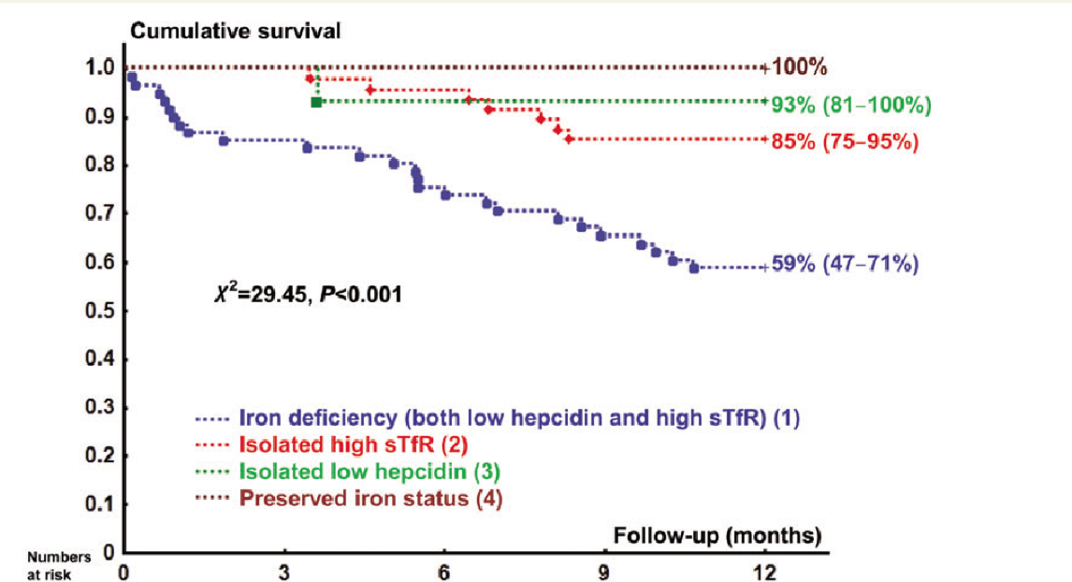
Low Iron Linked to Heart Failure*
*EA Jankowska et al., European Heart Journal Advanced Access, June 13, 2014
Notes:
GerryKoenig/low_iron_heart_failure_2014.pdf
sTfR = soluble transferrin receptor

Slide 79
“The long term effects of all these factors on the heart can be disastrous”*
ANEMIA
Tissue hypoxia
Reduced EPO
Sympathetic response
Fluid retention
Edema
Vasoconstriction
Renal ischemia
Left ventricular dilation and hypertrophy
Angiotensin-II
Aldosterone
Heart failure
*DS Silverberg et al., The European Journal of Heart Failure 4 (2002) 681–686
Notes:
Heart/The_importance_of_anemia_and_its_correction_in_the_management_of_severeCHF.pdf
Paragraph on p. 682

Slide 80
Heart Failure Rate Is Increasing*
Female
Male
*Chart 7-3, Circulation Jan 29, 2008, p. e89
Notes:
./Heart_Failure_Statistics—2008_Update.pdf

Slide 81
How to Stay Healthy!

Slide 82
How to Stay Healthy
Plenty of dietary sulfur
Plenty of dietary cholesterol
Plenty of flavonoids
Plenty of sun exposure

Slide 83
Go Organic!

Slide 84
Hang Out in the Water at the Seashore

Slide 85
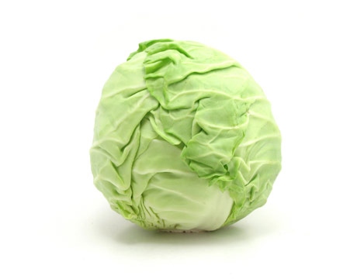
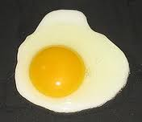
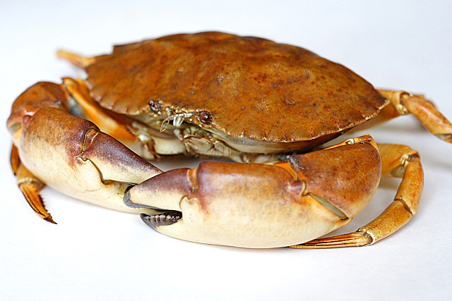
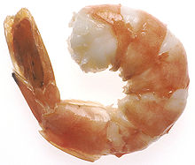
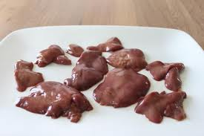
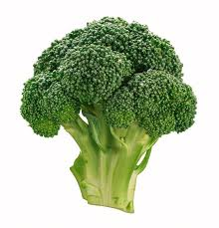
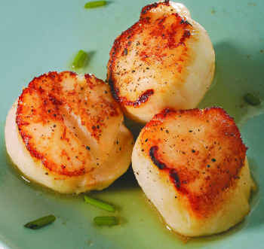
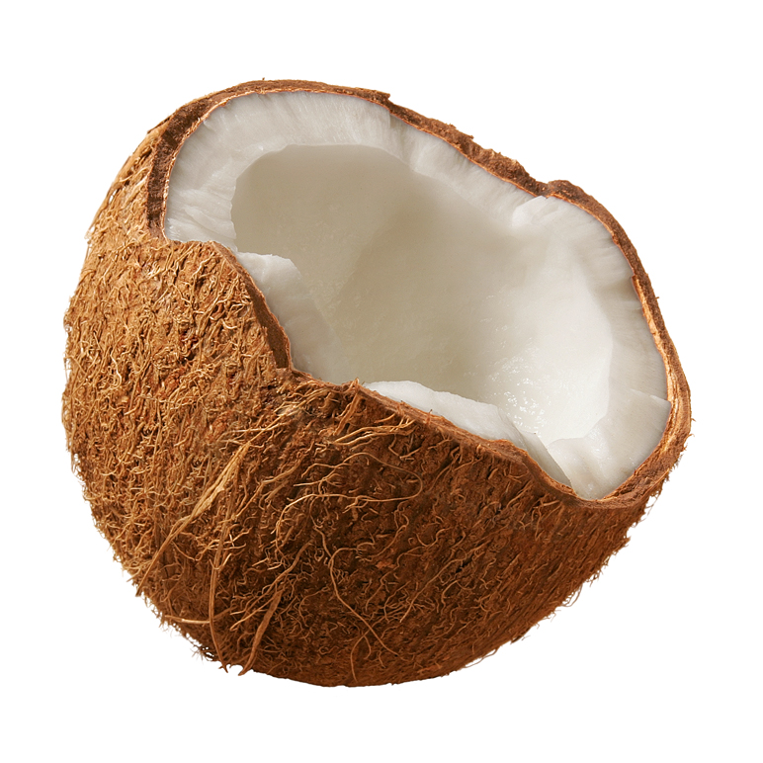
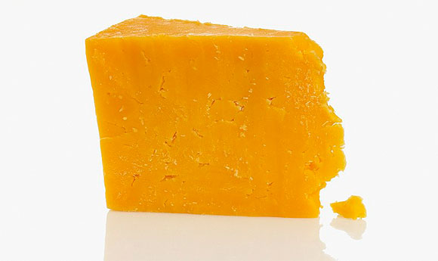
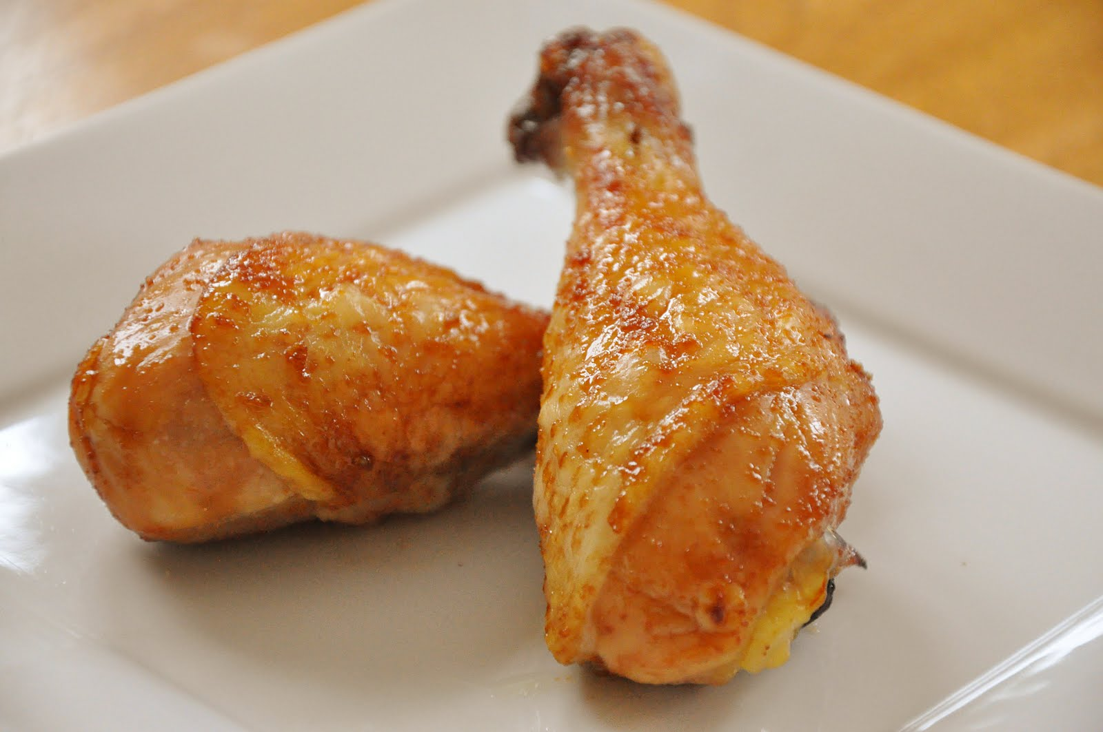
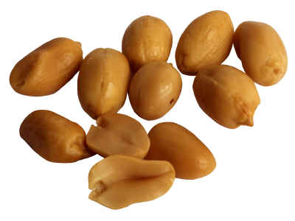
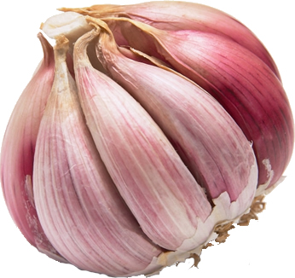
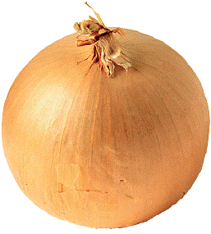
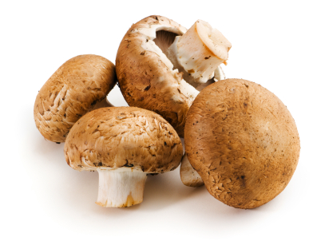
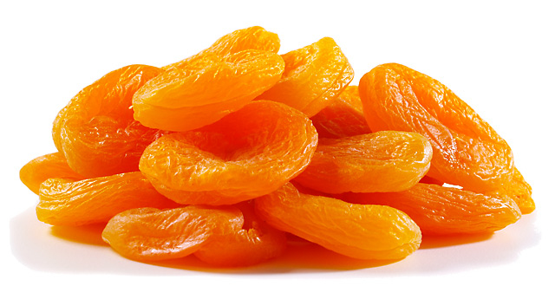
Eat Foods Containing Sulfur!
Notes:
http://healthyeatingclub.com/info/books-phds/books/foodfacts/html/data/data5g.html
http://www.livestrong.com/article/486021-foods-high-in-sulphur/

Slide 86
Supplemental Sources of Sulfur*
glucosamine sulfate
chondroitin sulfate
glutathione
N-acetylcysteine
alpha lipoic acid
taurine
DMSO, MSM
S-adenosylmethionine (SAMe)
Epsom salts (Mg-sulfate)
These can have many beneficial effects and are nearly nontoxic
My personal favorite is Epsom salt baths:
Magnesium sulfate uptake through the skin
*S Parcell, Alternative Medicine Review 7(1), 2002, 22-44
Notes:
./sulfur_in_human_nutrition_review.pdf

Slide 87
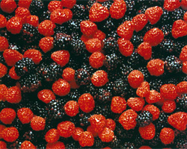
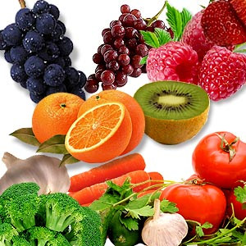
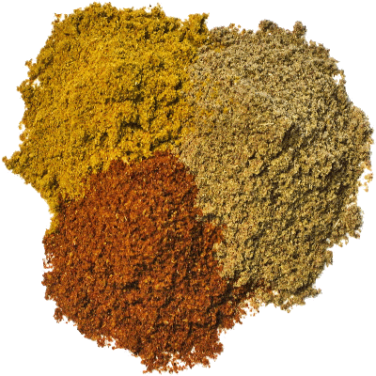
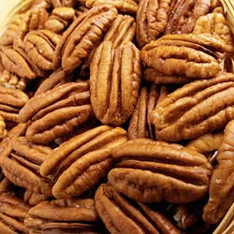
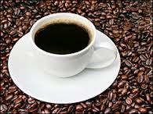
AND Flavonoids and Polyphenols!

Slide 88
Flavonoids Transport Sulfate!
Flavonoids are found in fruits, vegetables, nuts, seeds, herbs, spices, stems, flowers, tea and red wine.
Flavonoids suppress nitric oxide synthesis in macrophages (inflammatory response)
In plants, they generally occur as glycosylated and sulfated derivatives

Slide 89
Summary
Cholesterol sulfate is vitally important to health
It is produced in the skin upon sunlight exposure
Roundup and other toxic exposures disrupt its supply
Sulfate deficiency is behind most modern diseases
The blood depends on sulfate to maintain flow
Zeta potential drives blood flow from artery to vein
Heart disease and fatty liver disease reflect cholesterol buffering waiting for sulfate supplies
StAR is a superstar but it’s vulnerable to Roundup
StAR deficiency leads to fatty liver, heart disease, adrenal insufficiency and low testosterone
Roundup induces GGT which causes inflammation but recovers hemoglobin and sulfate for RBCs

Slide 90
Thanks to Many People
Robert Davidson
Gerry Koenig
Ann Lauritzen
Jerry Pollack
Anthony Samsel
Nancy Swanson
Glyn Wainwright
And many others ….

