Slide 1
Impact of Glyphosate: Possible Modes of Action
Stephanie Seneff
CSAIL, MIT
March 6, 2016

Slide 2
US Health Status
US makes up 5% of the world’s population but consumes more than 50% of the world’s pharmaceutical drugs
Spends more on health care than Japan, France, China, UK, Italy, Canada, Brazil, Spain, and Australia, combined
US ranks last or near last among developed nations on infant mortality and life expectancy
Americans also suffer from more chronic illnesses
US consumes 25% of the world supply of glyphosate

Slide 3
Roundup and GMO Crops
GMO Roundup-Ready corn, soy, canola, sugar beets
cotton, tobacco and alfalfa
What is glyphosate?

Slide 4
1 in 45!

Slide 5
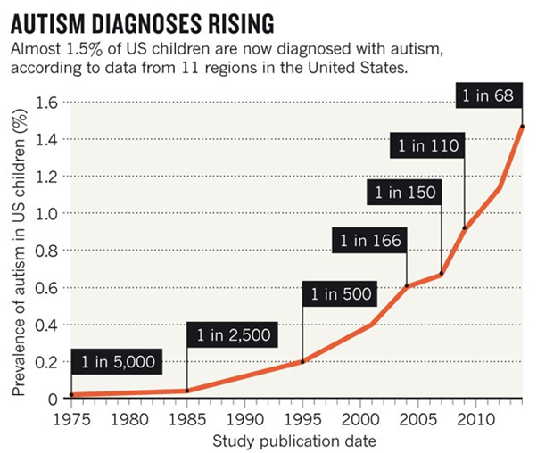
A Frightening Trend*
?
Exponential Growth!
12 years
*K. Weintraub, Nature 479, Nov. 3 2011, 22-24.
Notes:
./NatureAutismRising.pdf
CDC provides these numbers for kids who are 12 years old at the time the numbers are reported.
You have to project twelve years into the future to get the rate for kids being born at that time.

Slide 6
Percentage of children with Autism in the US
50%
2032
Notes:
Plotting the CDC’s data on a log scale reveals that the growth is exponential.
Extending the line predicts 1 in 4 kids born in 2025 will be diagnosed with autism, and 1 in 2 kids seven years later (by 2032).

Slide 7
Percentage of children with Autism in the US
50%
A linear extension of the trend line says that 1 in 2 children born in 2032 will end up on the autism spectrum.
(80% of the boys)
2032
Notes:
Plotting the CDC’s data on a log scale reveals that the growth is exponential.
Extending the line predicts 1 in 4 kids born in 2025 will be diagnosed with autism, and 1 in 2 kids seven years later (by 2032).

Slide 8
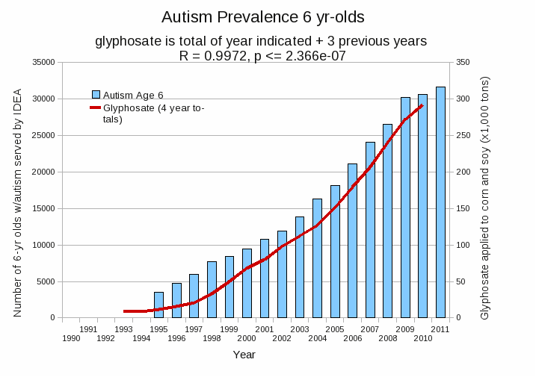
Autism Prevalence: 6 year olds*
R = 0.9972
* Figure 15, Seneff et al., Agricultural Sciences, 2015, 6, 42-70
Notes:
Nancy/latest_plots/6-yr-old autism.gif
autism: USDE
oil consumption: USDA
glyphosate: USDA
GE crops: USDA
Mortality data: CDC

Slide 9
Glyphosate and Autism: Some Biological Mechanisms
Disruption of gut microbes¹
Children with autism suffer from many digestive issues
Disruption of sulfur metabolism, glutathione deficiency, impaired methylation pathways¹
Metal chelation (especially manganese)²
Manganese deficiency leads to impaired mitochondrial function and glutamate toxicity in the brain
Inhibition of pituitary release of thyroid stimulating hormone → hypothyroidism³
Moms with hypothyroidism have 4-fold increased risk to autism in the fetus
1. Samsel and Seneff, Entropy 2013;15(4):1416-1463.
2. Samsel and Seneff, Surg Neurol Int. 2015;6:45.
3. Beecham and Seneff, Journal of Autism 2016;3:1.

Slide 10
“Glyphosate Now the Most-Used Agricultural Chemical Ever”* By Douglas Main, Feb 2, 2016 Newsweek
Glyphosate usage has increased 50-fold since 1996, when GMO glyphosate-resistant crops were introduced in the US.
Today, 50 times more glyphosate is allowed by the EPA on corn grain than in 1996
Half of the American farmers' fields have weeds that are resistant to glyphosate
New GMO crops offer dual resistance to glyphosate & 2-4,D → Enlist Duo
*www.newsweek.com/glyphosate-now-most-used-agricultural-chemical-ever-422419
Notes:
./Newsweek_on_glyphosate_overuse.text

Slide 11
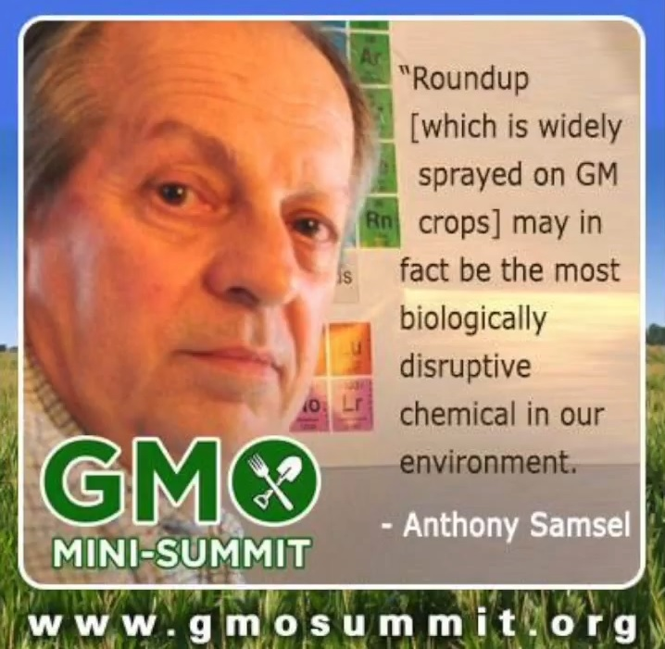
Bait and Switch*
All of the formulations use glyphosate salts¹
All of Monsanto’s early studies on animal toxicity of glyphosate used “Technical glyphosate”
The salts are far more toxic because they increase water solubility and uptake by the cells
*http://farmwars.info/?p=14610&cpage=1#comment-167131
1. Propionate, hydrochloride, sodium, potassium salts, etc.

Slide 12
Growth of GM Corn, Soy and Cotton in US, 1996-2012*
Soy
*N. Swanson et al., Journal of Organic Systems, 9(2), 2014, 6-37.

Slide 13
Another claim of Monsanto's has been that residue levels of up to 5.6 mg/kg in GM-soy represent “...extreme levels, and far higher than those typically found” (Monsanto 1999).
Study of glyphosate and AMPA (breakdown product) residues in soy crops*
5.6
*Figure 1, T. Bohn et al. Food Chemistry 153, 15 June 2014, 207-215.
www.greenmedinfo.com/blog/how-extreme-levels-roundup-food-became-industry-normal
Notes:
http://www.greenmedinfo.com/blog/how-extreme-levels-roundup-food-became-industry-normal

Slide 14
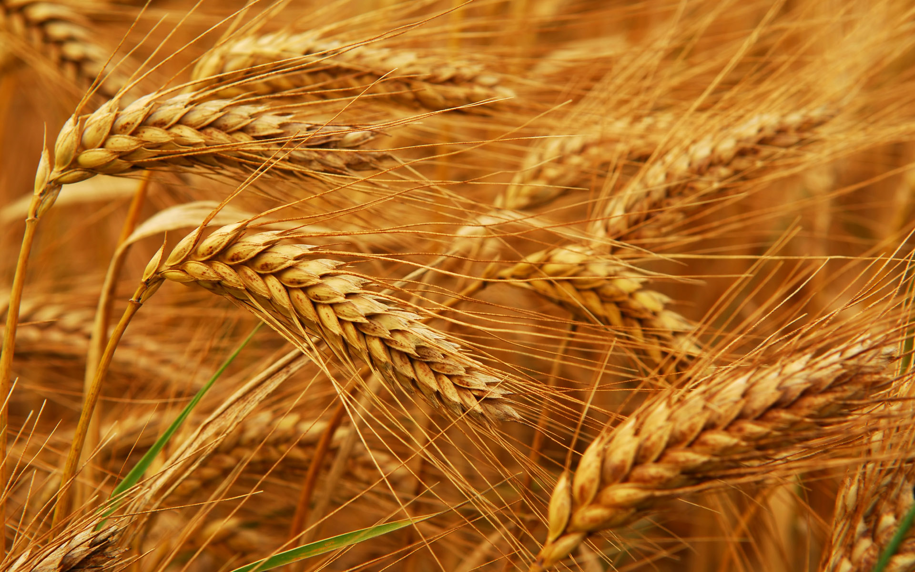
Glyphosate and Celiac Disease*
Glyphosate Use
Celiac disease
*Samsel and Seneff, Interdiscip Toxicol. 2013;6(4): 159–184.

Slide 15
Glyphosate and Celiac Disease*
Wheat, sugar cane, peanuts, barley and legumes are now often sprayed with glyphosate right before harvest as a desiccant/ripener
Glyphosate Use
Celiac disease
*Samsel and Seneff, Interdiscip Toxicol. 2013;6(4): 159–184.

Slide 16
Inhibition of Cytochrome P450 (CYP) Enzymes in the Liver*
Study in rats on 2,4-D, clofibrate, MCPA, and glyphosate
*E Hetanen et al., Acta Pharmacol. Et Toxicol. 1983, 53, 103-1 12.
Notes:
./glyphosate_inhibits_CYPS_and_other_issues.pdf
Fig. 1. The concentration of hepatic cytochrome P-450 in rats exposed to clofibrate, glyphosate, 2,4dichlorophen- oxyacetic acid (2,4-D) or 4-chloro-2-methylphenoxyace- tic acid (MCPA) for 2 weeks. The doses of 2,4-D and MCPA are also shown. The meansfS.E.M. are shown. The statistical significances were analyzed with Student's t-test using controls as a reference group. The following symbol is used: *: P<0.05.

Slide 17
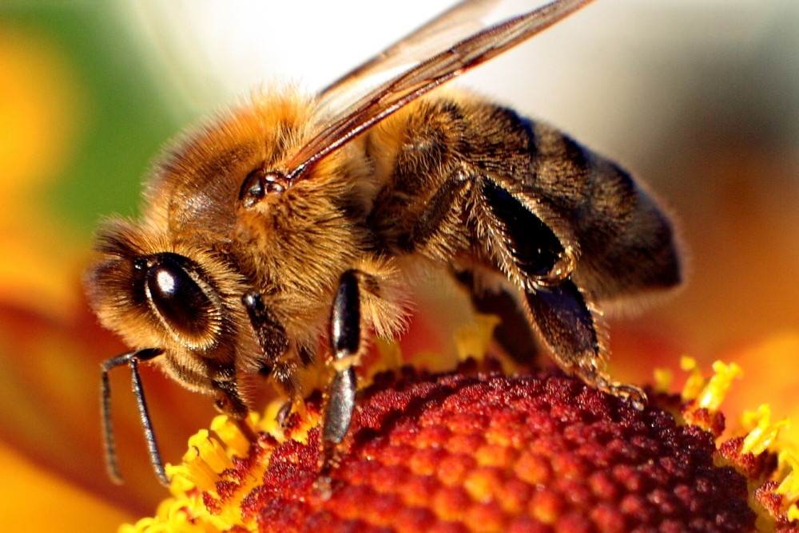
Inhibition of Cytochrome P450 (CYP) Enzymes in the Liver*
CYPs are necessary for bile acid production, vitamin D activation, and detoxing other toxic chemicals
Study in rats on 2,4-D, clofibrate, MCPA, and glyphosate
*E Hetanen et al., Acta Pharmacol. Et Toxicol. 1983, 53, 103-1 12.
Notes:
./glyphosate_inhibits_CYPS_and_other_issues.pdf
Fig. 1. The concentration of hepatic cytochrome P-450 in rats exposed to clofibrate, glyphosate, 2,4dichlorophen- oxyacetic acid (2,4-D) or 4-chloro-2-methylphenoxyace- tic acid (MCPA) for 2 weeks. The doses of 2,4-D and MCPA are also shown. The meansfS.E.M. are shown. The statistical significances were analyzed with Student's t-test using controls as a reference group. The following symbol is used: *: P<0.05.

Slide 18
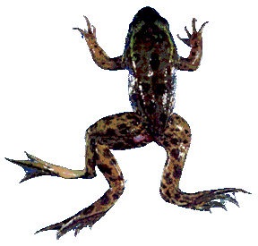
Glyphosate is an endocrine disruptor that promotes breast cancer*
Low and environmentally relevant concentrations of glyphosate possess estrogenic activity
Glyphosate caused human hormone-dependent breast cancer cells to proliferate at concentrations of parts per trillion
* S. Thongprakaisang et al., Food Chem Toxicol. 2013 Jun 8. S0278-6915(13)00363-3.
Notes:
./glyphosate_and_breast_cancer.text
Swine/glyphosate_breast_cancer.pdf
Please make a note that this study shows Glyphosate effects down to parts per trillion (10 to the minus12th).
In this study, we found that glyphosate at a log interval concentration ranging from 10-12 to 10-6 M increased the cell proliferation of a hormorne dependent breast cancer T47D ce

Slide 19
Glyphosate is an endocrine disruptor that promotes breast cancer*
Low and environmentally relevant concentrations of glyphosate possess estrogenic activity
Glyphosate caused human hormone-dependent breast cancer cells to proliferate at concentrations of parts per trillion
In March, 2015, the World Health Organization
declared glyphosate a “probable carcinogen”
* S. Thongprakaisang et al., Food Chem Toxicol. 2013 Jun 8. S0278-6915(13)00363-3.
Notes:
./glyphosate_and_breast_cancer.text
Swine/glyphosate_breast_cancer.pdf
Please make a note that this study shows Glyphosate effects down to parts per trillion (10 to the minus12th).
In this study, we found that glyphosate at a log interval concentration ranging from 10-12 to 10-6 M increased the cell proliferation of a hormorne dependent breast cancer T47D ce

Slide 20
Glyphosate and Heart Disease*
Glyphosate usage
Enlarged Right Ventricle, Adults
Congenital Heart Condition, Newborns
* Figure 22, J. Hoy et al. Poult Fish Wildl Sci 2015, 3:1
Notes:
2015/JudyHoy/submission/figures/

Slide 21
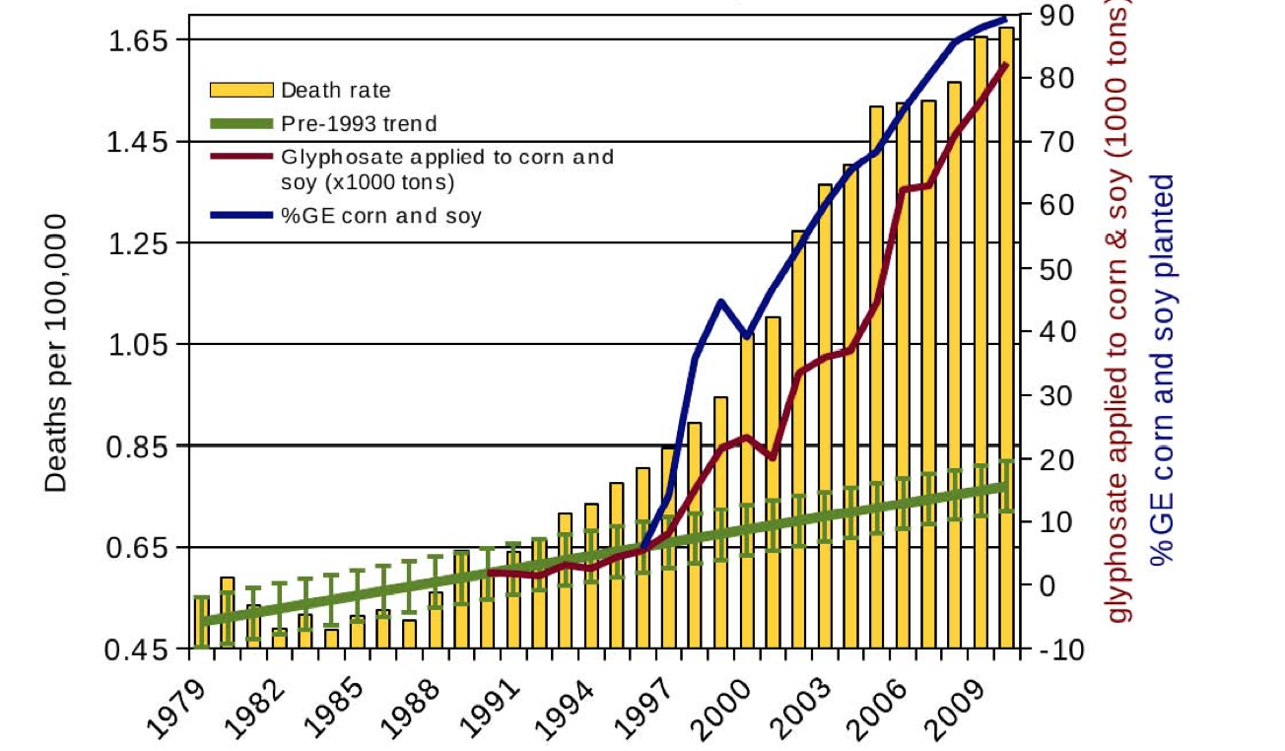
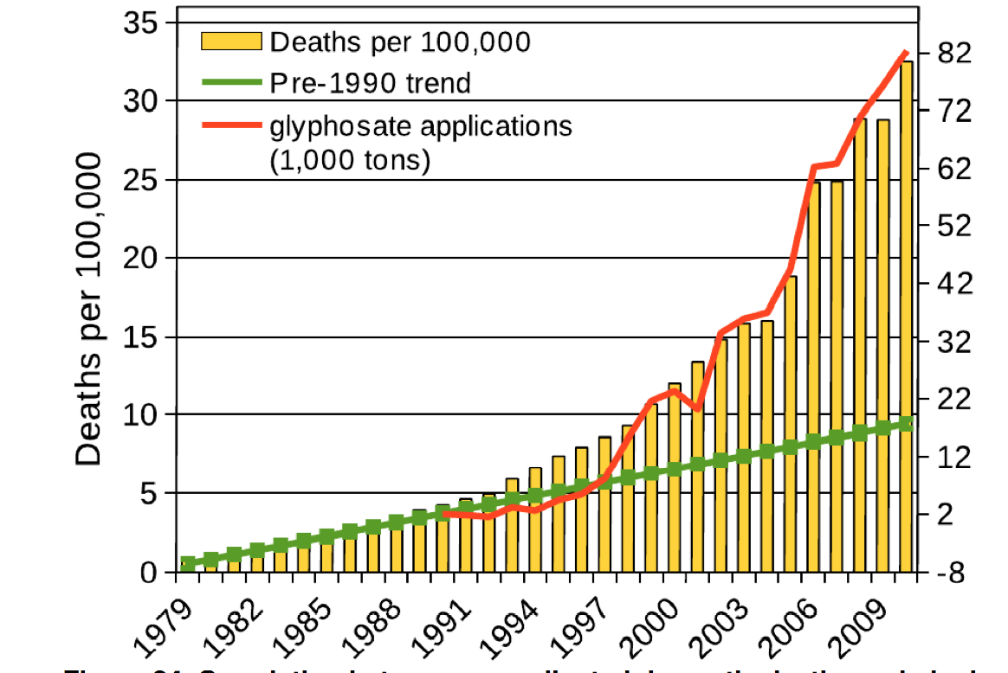
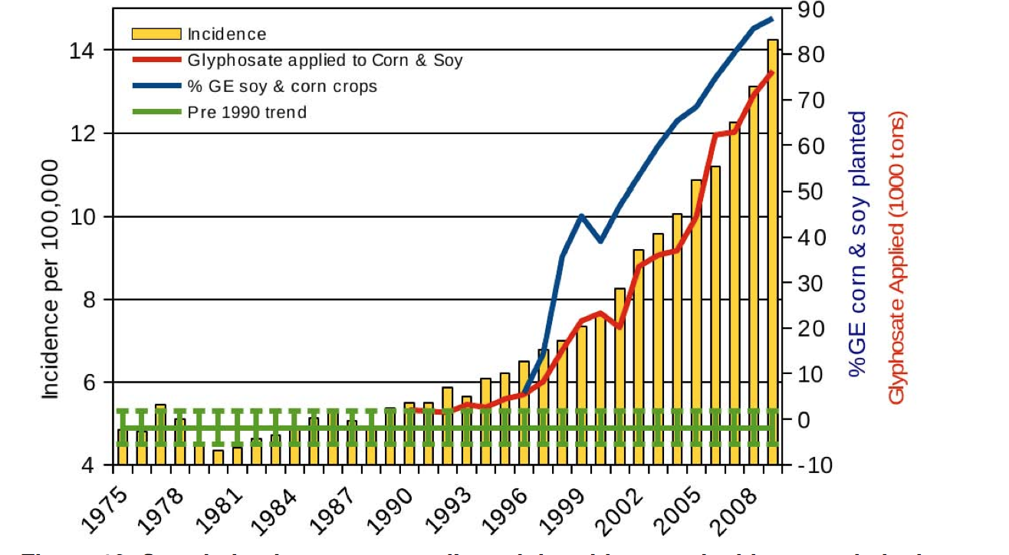
Data from Swanson et al., Journal of Organic Systems, 9(2), 2014
Diabetes
Death from obesity
Death from Dementia
Thyroid cancer

Slide 22
The Only Way Forward….

Slide 24
Summary
The US spends much more on health care than any other country
Is our excessive use of glyphosate the cause?
Our children today suffer from many chronic diseases
The exponential growth of autism is alarming
Glyphosate’s known toxicological effects align well with the complex symptoms of autism
Glyphosate is an endocrine disruptor and carcinogen
Glyphosate is likely the reason for the epidemic in gluten intolerance
Many diseases are rising in frequency exactly in step with the rise in the use of glyphosate on core crops
Sustainable organic agriculture is the only path forward

