Slide 1
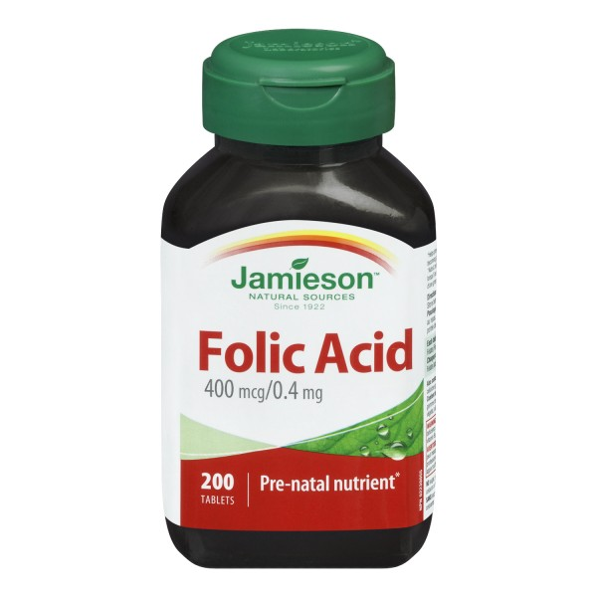
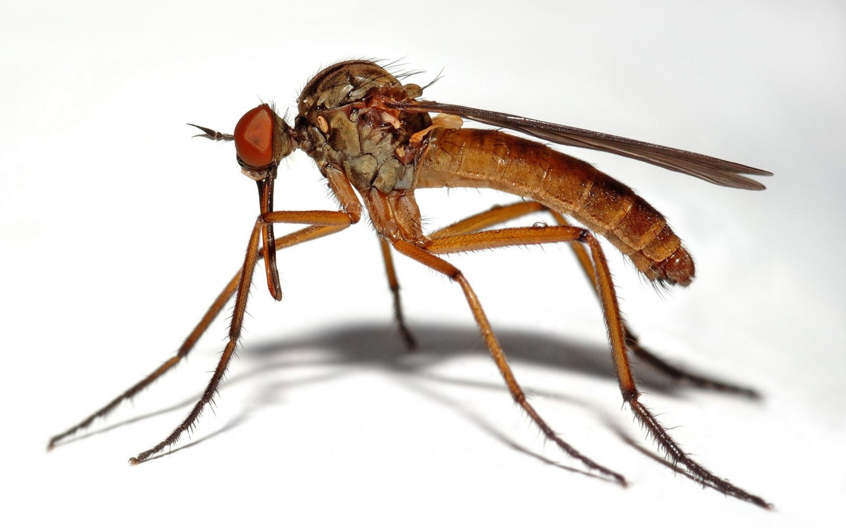
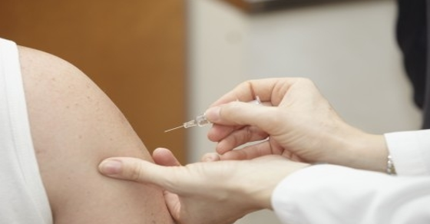
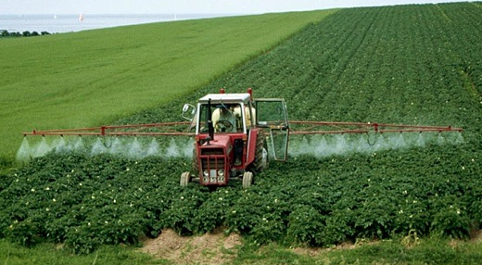
Zika, Glyphosate, Vaccines, Folic Acid, Neural Tube Defects and Autism
Stephanie Seneff, MIT
AutismOne
Friday, May 27, 2016

Slide 2
The fatal tendency of mankind to leave off thinking about a thing when it is no longer doubtful, is the cause of half their errors.
– John Stuart Mill, 1859
British philosopher, political economist, and civil servant

Slide 3
Outline
Introduction
Glyphosate displacing glycine in protein synthesis
Glyphosate and Zika
Glyphosate, folic acid and pyriproxifen
A role for vaccines
A role for glufosinate (Liberty herbicide)
Summary

Slide 4
Introduction

Slide 5
Neural Tube Defects

Slide 6
Neural Tube Defects
Neural tube defects occur in 1 in 1000 pregnancies and often lead to spontaneous or elected abortion

Slide 7
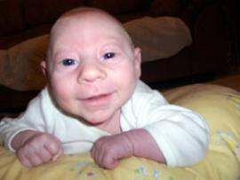
Zika Virus and Microcephaly
Mass hysteria has developed due to the fear that a new virus, Zika, spread by mosquitoes, is causing an epidemic in microcephaly in NE Brazil
Could there be something more to the story?

Slide 8
Zika Virus and Microcephaly
Mass hysteria has developed due to the fear that a new virus, Zika, spread by mosquitoes, is causing an epidemic in microcephaly in NE Brazil
Could there be something more to the story?
Zika has been around since the mid 1900’s and it has never been known to cause microcephaly
Notes:
Colombia no microcephaly

Slide 9
Some Statistics*
3,670 cases of potential microcephaly in Brazil investigated
404 confirmed cases of microcephaly
17 of these tested positive for Zika = 4.2%
98% of the 404 cases were from the NE corner of Brazil (Pernambuco)
What about the 96% who didn’t test positive for Zika??
* http://noticias.uol.com.br/ultimas-noticias/agencia-estado/2016/02/02/
pais-tem-404-casos-confirmados-de-microcefalia.htm

Slide 10
Both Macrocephaly and Microcephaly are linked to Autism*
126 autistic children studied
16.7% diagnosed with macrocephaly
15.1% diagnosed with microcephaly
Both of these numbers are abnormally high, compared to the general population
These abnormal brain developmental features are milder forms of the more severe defects associated with neural tube disorders
*E Fombonne et al., J Autism Dev Disord 1999;29(2):113-9.
Notes:
Samantha/macrocephaly_microcephaly_autism.text

Slide 11
Anecdotal Evidence
Feb 8 PBS Evening News segment on Zika: interviewed young mother of a child with microcephaly
The closing remark was that the mother would have to quit her job as an agricultural worker to tend to the child

Slide 12
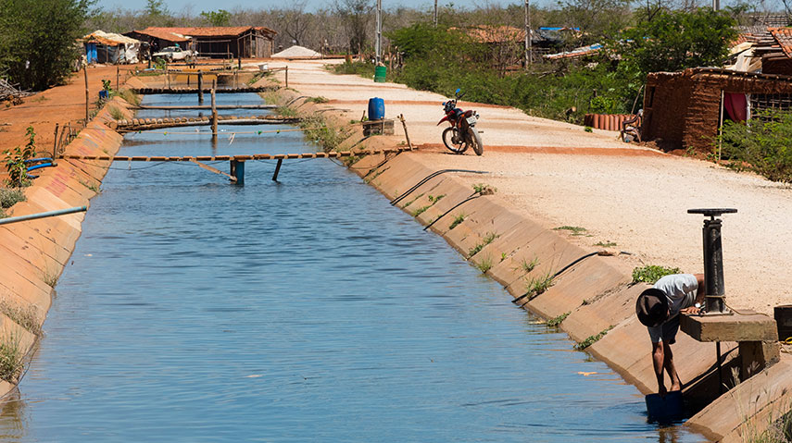
“Why Brazil has a big appetite for risky pesticides”*
“In the rural northeast, rampant use has led to sickness and violence”
A series of irrigation canals in the arid NE sector have allowed farming to flourish
Many of the region’s residents get their water from the same open­air canals that irrigate the farms
In 2012, Brazil passed the United States as the largest buyer of pesticides
*http://www.reuters.com/investigates/special-report/brazil-pesticides/
Notes:
./GLYPHO\ Brazil\ has\ a\ big\ appetite\ for\ risky\ pesticides.pdf

Slide 13
Some Other Potential Factors
Pesticides: GMO Roundup-Ready crops plus a new GMO resistance gene to glufosinate
Vaccines during pregnancy: Tdap, flu
Synergistic toxicity of glyphosate & (aluminum, mercury, glutamate)
Measles outbreak in NE Brazil; aggressive MMR booster campaign?
Insecticide to control the mosquitoes: Pyroproxifen
GMO mosquito introduced into same area where microcephaly is highest
Supposed to reduce mosquito burden: fewer mosquitoes = more infection??
Notes:
./Brazil_article_on_Zika.text
Because of a measles outbreak, there was a major vaccination campaign with MMR (measles/mumps/rubella) in Pernambuco, Brazil, in late 2014.
http://wwwnc.cdc.gov/eid/article/21/9/15-0391_article

Slide 14
Some Other Potential Factors
Pesticides: GMO Roundup-Ready crops plus a new GMO resistance gene to glufosinate
Vaccines during pregnancy: Tdap, flu
Synergistic toxicity of glyphosate & (aluminum, mercury, glutamate)
Measles outbreak in NE Brazil; aggressive MMR booster campaign?
Insecticide to control the mosquitoes: Pyroproxifen
GMO mosquito introduced into same area where microcephaly is highest
Supposed to reduce mosquito burden: fewer mosquitoes = more infection??
US CDC recommends flu vaccine
for pregnant women (since 2004)
Notes:
./Brazil_article_on_Zika.text
Because of a measles outbreak, there was a major vaccination campaign with MMR (measles/mumps/rubella) in Pernambuco, Brazil, in late 2014.
http://wwwnc.cdc.gov/eid/article/21/9/15-0391_article

Slide 15
Glyphosate Displacing
Glycine in Protein Synthesis

Slide 16
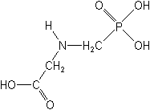
What If Glyphosate Could Insert Itself Into Protein Synthesis???
glyphosate
Code for Glycine
GGC
mRNA
. . .
. . .
Glyphosate
Alanine
Proline
-- Any proteins with conserved glycine residues are likely to be affected in a major way

Slide 17
Some Predicted Consequences
Neural tube defects
Autism
Impaired collagen → osteoarthritis
Steatohepatitis (fatty liver disease)
Obesity and adrenal insufficiency
Hypothyroidism
Impaired iron homeostasis and kidney failure
Insulin resistance and diabetes
Cancer

Slide 18
An Analogy: ALS in Guam
An epidemic in ALS in Guam was traced to a natural toxin found in cycads
BMAA is a non-coding amino acid that gets inserted by mistake in place of serine
Defective versions of a glutamate transporter have been linked to ALS*
The transporter has an essential serine-rich region in its sequence**
*Antioxidants & Redox Signaling 2009;11: 1587-1602.
**DJ Slotboom et al., PNAS 1999; 96(25): 14282-14287.
Notes:
cyanobacteria_BMAA_article.pdf
Slotbloom_1999_conserved_serine_glutamate_transporter.pdf
Dunlop.pdf
ALS_glutamate_transporter_link_2009.pdf
Guam/
*ALS_glutamate_transporter_link_2009.pdf
ChrisShawChapter7GuamFantastic.docx
Dunlop.pdf
**Slotbloom_1999_conserved_serine_glutamate_transporter.pdf

Slide 19
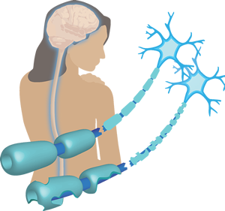
Another Analogy: MS & Sugar Beets*
Sugar beets contain an analogue of proline called Aze
Remarkable correlation between MS frequency and proximity to sugar beet agriculture
Myelin basic protein contains a concentration of proline residues that are absolutely essential for its proper function
*E. Rubenstein, J Neuropathol Exp Neurol 2008;67(11): 1035-1040.
Notes:
./misincorporation_of_proline_analogue_MS.pdf

Slide 20
Into The Wild*
Chris McCandless died in the Alaskan wilderness in 1992
A staple of McCandless' diet was seeds from a wild potato plant which contained L-canavanine, a non-coding amino acid analogue of L-arginine
Author Jon Krakauer determined that McCandless was slowly poisoned by L-canavanine
*J Krakauer et al., Wilderness & Environmental Medicine 2015; 26: 36-42.

Slide 21
Vulnerable Proteins: Resulting Pathologies
Conserved Glycines | Disease Profile
Hormone-sensitive Lipase | Obesity
Insulin Receptor | Diabetes
Amyloid Beta Plaque | Alzheimer’s Disease
OGG1 | DNA Damage → Cancer
Lipocalin | Kidney Failure
ACTH | Adrenal Insufficiency
Cytochrome C Oxidase | Mitochondrial Disease
Alpha Synuclein | Parkinson’s Disease
TDP-43 | ALS

Slide 22
Glycine decarboxylase deficiency causes neural tube defects and features of non-ketotic hyperglycinemia in mice*
Fascinating article about mice with a deficiency in a protein involved in generating methyl groups from glycine → methylfolate deficiency
These mice have very high rate of neural tube defects
Those that are viable have swollen ventricles (a feature of autism) and delayed development
Methylation pathway impairment is a common feature of autism
*YJ Pai et al., Nature Communications 2015; 6:6388

Slide 23
Glycine decarboxylase deficiency causes neural tube defects and features of non-ketotic hyperglycinemia in mice*
Fascinating article about mice with a deficiency in a protein involved in generating methyl groups from glycine -> methylfolate deficiency
These mice have very high rate of neural tube defects
Those that are viable have swollen ventricles (a feature of autism) and delayed development
Methylation pathway impairment is a common feature of autism
Glycine decarboxylase has a glycine-rich region that maintains shape and flexibility of active site**
**A Kume et al., JBC 1991; 266(5): 3323-3329

Slide 24
Glyphosate & Zika

Slide 25
Sugar Cane and Roundup*
Roundup is used to ripen sugar cane in NE Brazil at harvest
The workers harvest by machete and chop off a small chunk of stalk to chew on as they harvest throughout the day
They suffer from end-stage kidney failure
Kidney failure is much lower in other regions where they have switched to a different ripening agent besides glyphosate
The workers also take stalk sections home for the family to eat
* Prof.. Don Huber, Personal Communication

Slide 26
Sugar Cane, Sugar Beets and Ethanol*
Brazil is a leader in introducing flexible fuel vehicles (FFVs) into the market.
Designed to run on gasoline or gasoline-ethanol blends of up to 85% ethanol (E85)
Brazil has a major industry converting sugar from sugar beets and sugar cane to ethanol
Ethanol-based fuels produce toxic carcinogens: formaldehyde and acetaldehyde**
There is likely glyphosate present in the fuel
*https://en.wikipedia.org/wiki/Pernambuco
** MZ Jacobson, Environ. Sci. Technol., 2007, 41 (11), pp 4150–4157
Notes:
James_Lyons_Weiler/ethanol.email.text

Slide 27
Trucks in Brazil Lining Up Following Truckers’ Strike: February, 2015*
*kticradio.com/agricultural/deal-reached-in-brazil-truckers-strike-trucks-still-blocked/

Slide 28
GMO Mosquito*
Grown in contained spaces in Cayman Islands
Fed sucrose as larvae followed by blood as adults (sucrose comes from sugar beets or sugar cane)
Males engineered to become infertile without access to tetracycline
They could be harboring more glyphosate than mosquitoes in the wild
*AF Harris et al., Nature Biotechnology 2011; 29:1034-1037.
Notes:
./GM_mosquito2.pdf

Slide 29
Zika and Protein Mimicry
Studies from the Vaccine Induced Immunological Damage (VIID) Program
Zika E Protein: GWGNGCGLFGKGSLV
IGG heavy chain: GYSSGCGYWGQGTLV
Lots of glycines! – These could get displaced by glyphosate during protein synthesis!!
Likely to disrupt protein folding and cause resistance to breakdown
→ Autoimmune reaction to similar protein (IGG heavy chain)
Notes:
IPAK STUDY 6: Zika E protein (ZEP) vs. Homo sapiens Immunoglobulin
(IMG heavy chain) (NEW IPAK FIND, JANUARY 2016)

Slide 30
Zika and Protein Mimicry
Studies from the Vaccine Induced Immunological Damage (VIID) Program
Zika E Protein: GWGNGCGLFGKGSLV
IGG heavy chain: GYSSGCGYWGQGTLV
Lots of glycines! – These could get displaced by glyphosate during protein synthesis!!
Likely to disrupt protein folding and cause resistance to breakdown
→ Autoimmune reaction to similar protein (IGG heavy chain)
A Zika virus growing in a GMO mosquito is likely to end up with glyphosate in its proteins
Notes:
IPAK STUDY 6: Zika E protein (ZEP) vs. Homo sapiens Immunoglobulin
(IMG heavy chain) (NEW IPAK FIND, JANUARY 2016)

Slide 31
A Chromosomal Breakage Syndrome With Profound Immunodeficiency*
Chromosomal Breakage Syndrome: case study
Spontaneous chromosomal breaks, gaps and rearrangements in T-cells
Failure to thrive, microcephaly, immune deficiency, neurological abnormalities
Very low levels of immunoglobulins
*ME Conley et al., Blood 1986;67(5):1251-1256.
Notes:
WIKI
All of these processing events result in an antigen-binding region that is highly variable, even when the same gene segments are recombined. V(D)J recombination allows for the generation of immunoglobulins and T cell receptors to antigens that neither the organism nor its ancestor(s) need to have previously encountered, allowing for an adaptive immune response to novel pathogens that develop or to those that frequently change (e.g., seasonal influenza). However, a major caveat to this process is that the DNA sequence must remain in-frame in order to maintain the correct amino acid sequence in the final protein product. If the resulting sequence is out-of-frame, the development of the cell will be arrested, and the cell will not survive to maturity. V(D)J recombination is therefore a very costly process that must be (and is) strictly regulated and controlled.

Slide 32
A Chromosomal Breakage Syndrome With Profound Immunodeficiency*
Chromosomal Breakage Syndrome: case study
Spontaneous chromosomal breaks, gaps and rearrangements in T-cells
Failure to thrive, microcephaly, immune deficiency, neurological abnormalities
Very low levels of immunoglobulins
Suggests a link between microcephaly and low immunoglobulins which can arise because of an autoimmune response to IGG heavy chain via Zika protein mimicry
*ME Conley et al., Blood 1986;67(5):1251-1256.
Notes:
WIKI
All of these processing events result in an antigen-binding region that is highly variable, even when the same gene segments are recombined. V(D)J recombination allows for the generation of immunoglobulins and T cell receptors to antigens that neither the organism nor its ancestor(s) need to have previously encountered, allowing for an adaptive immune response to novel pathogens that develop or to those that frequently change (e.g., seasonal influenza). However, a major caveat to this process is that the DNA sequence must remain in-frame in order to maintain the correct amino acid sequence in the final protein product. If the resulting sequence is out-of-frame, the development of the cell will be arrested, and the cell will not survive to maturity. V(D)J recombination is therefore a very costly process that must be (and is) strictly regulated and controlled.

Slide 33
PNKP & Microcephaly*
The body relies on DNA repair mechanisms to repair chromosomal breaks and errors
PNKP is intimately involved in DNA repair
PNKP is both a phosphatase and a kinase: it takes away and adds phosphate groups to DNA
Mutations in PNKP have been shown to cause microcephaly, seizures and defective DNA repair
Glyphosate substitution for conserved glycines in PNKP would disrupt both of its activities
*JJ Reynolds et al., Nucleic Acids Res 2012;40(14):6608-19.
Notes:
PNKP = ?
polynucleotide kinase/phosphatase
James_Lyons_Weiler/DNA_Impact\ of\ PNKP\ mutations\ associated\ with\ microcephaly,\ seizures\ and\ developmental\ delay\ on\ enzyme\ activity\ and\ DNA\ strand\ break\ repair.pdf

Slide 34
Glyphosate, Folic Acid
and Pyriproxifen

Slide 35
“Glyphosate-Based Herbicides Produce Teratogenic Effects on Vertebrates by Impairing Retinoic Acid Signaling”*
*A Paganelli et al., Chem Res Toxicol 2010; 23(10):1586-1595.

Slide 36
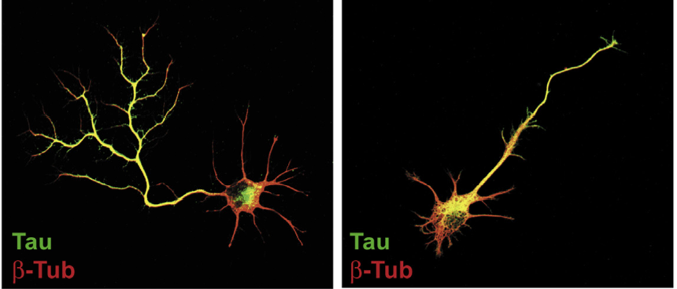
“Neuronal development and axon growth are altered by glyphosate through a WNT non-canonical signaling pathway”*
Neurons grown in culture & exposed to glyphosate
“They elicited shorter and unbranched axons and they also developed less complex dendritic arbors compared to controls”
+ Glyphosate
*RP Coullery et al., NeuroToxicology 2016;52:150-161.
Notes:
./Coullery_glyphosate_neurotoxicity_2016.pdf

Slide 37
Glyphosate Could Cause Microcephaly through Impaired Methylation Pathway
Disrupted folate one-carbon metabolism (methylation pathway)
Folate carries the methyl group that methylates DNA during development to regulate gene expression
Folate is produced for the host by gut microbes from the shikimate pathway
Methyl group is provided by metabolism of glycine; a critical enzyme in this pathway depends on a glycine-rich region that glyphosate could disrupt
Notes:
Glycine decarboxylase

Slide 38
Folic Acid Fortification/Supplementation: A Bad Idea!
U.S. started requiring flour to be fortified with folic acid in 1998
Folic acid is a synthetic, unmethylated, oxidized form of folate
This stresses the liver, causing gluthathione loss and loss of methyl groups
Excess folic acid during pregnancy ends up in the blood stream and binds to the fetal folate receptors in the brain, causing cerebral folate deficiency!

Slide 39
Glyphosate and Anencephaly*
Yakima, Benton and Franklin counties in Washington State have an unusually high number of pregnancies affected by anencephaly
75 pesticides were analyzed in studying contamination due to surrounding agriculture
47 (63%) of these were detected
Glyphosate was applied in large amounts, but was not studied
5% solution of glyphosate was also used heavily around irrigation ditches to control weeds
Main herbicide recommended due to its “low toxicity”
*Barbara H. Peterson. Farm Wars, http://farmwars.info/?p=11137

Slide 40
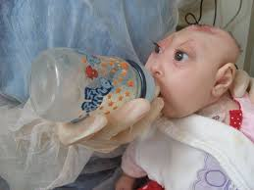
“Glyphosate, Brain Damaged Babies, and
Yakima Valley - A River Runs Through It”*
8
6
4
2
0
Noxious aquatic weed
control program with
Glyphosate ‘Rodeo’
1980 1990 2000 2010 2020
“Glyphosate, Three Rivers, and Anencephaly”
Yakima Harold Republic
Slide thanks to Prof. Don Huber, with permission
*Farm Wars 3/6/14
Notes:
From Don Huber:
Attached/LondonGlyphosate/
2014-0618_Huber_short.ppt

Slide 41
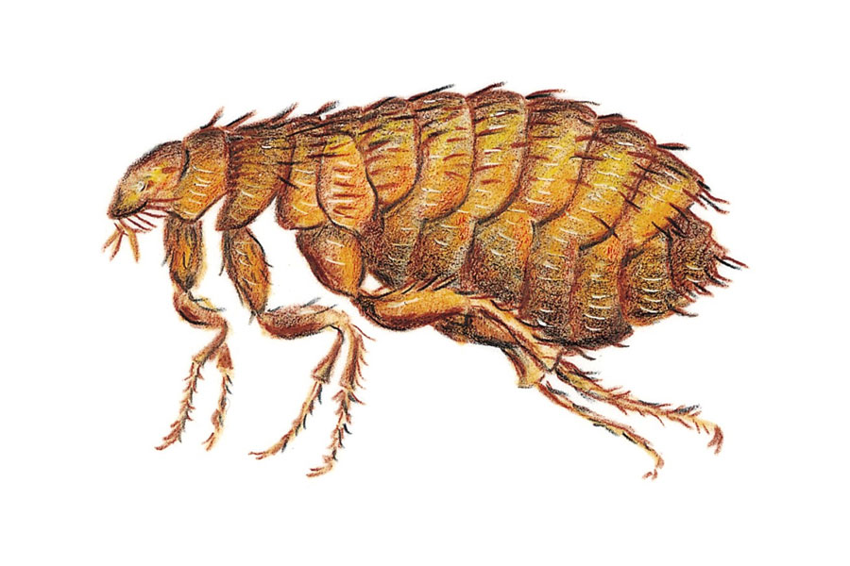
Pyriproxifen: Insecticide*
Pyriproxifen is a commonly used insecticide to control mosquitoes, fleas on pets and the whitefly in agriculture
Brazil is the only country that puts pyriproxifen in the drinking water to control mosquitoes (since 2014)
Pyriproxifen is a powerful juvenile hormone analog
Juvenile hormone controls metamorphosis and reproduction in insects
*D Evans et al., A Possible Link Between Pyriproxyfen and Microcephaly.
http://necsi.edu/research/social/pandemics/pyriproxyfen
Notes:
./pyriproxifen_and_microcephaly.pdf

Slide 42
Pyriproxifen: Insecticide, Cont’d*
Juvenile hormone and retinoic acid (vitamin A) are both lipid-soluble terpenoids
Isotretinoin (a vitamin A analogue) causes microcephaly in human babies via maternal exposure
Juvenile hormone and its analogs bind to the vertebrate retinoic acid receptor
This could prevent the normal retinoic acid from binding to the receptor and cause developmental disorders in mammals
Liver CYP enzymes needed to detox pyriproxifen are suppressed by glyphosate
*D Evans et al., A Possible Link Between Pyriproxyfen and Microcephaly.
http://necsi.edu/research/social/pandemics/pyriproxyfen
Notes:
./pyriproxifen_and_microcephaly.pdf
pyriproxifen_detoxed_by_CYP_enzymes.pdf

Slide 43
A Role for Vaccines
Notes:
Without any knowledge as to whether or not this vaccination is safe to use in pregnancy, at the end of 2014, Brazil mandated the TdaP vaccine for use in pregnancy. Ten months later, disaster struck when a growing number of babies were born with microcephaly.

Slide 44
A Role for Vaccines: Tdap
In the spring of 2015, public health officials in Brazil mandated that pregnant women be vaccinated with the adult form of DTaP, called Tdap.
Tdap viruses are grown on a protein source derived from bovine casein (protein in milk)
Casein has significant amounts of glycine which could be displaced by glyphosate
Tdap also contains aluminum, which is a neurotoxin
Aluminum and glyphosate are synergistically toxic
Notes:
Csail/2016/zika/GaryKohls_zika_flame.email.text

Slide 45
Glyphosate and Aluminum: Partners in Crime*
Glyphosate induces pathogens like C. difficile in gut, leading to leaky gut syndrome
C. diff produces p-cresol which promotes aluminum uptake by cells
p-Cresol is a known biomarker for autism
p-Cresol is an important factor in kidney failure which leads to aluminum retention in tissues → dementia
Glyphosate cages aluminum to promote entry
Glyphosate promotes calcium uptake by voltage-activated channels
Aluminum gains entry as calcium mimetic
*S Seneff et al., Agricultural Sciences 2015;6:42-70

Slide 46
“Measles Reemergence in Ceará, Northeast Brazil, 15 Years after Elimination”*
CDC post: 21(9), September 2015
Measles “eliminated” in Brazil in 2000 w/ massive vaccination campaign
From December 2, 2013, through December 31, 2014, in the state of Ceará, NE Brazil, 681 measles cases were reported
19% were patients aged 20 to 29
Either measles infection or MMR vaccine could be a factor
*http://wwwnc.cdc.gov/eid/article/21/9/15-0391_article
Notes:
Preferentially under one year old or older than 15 years.

Slide 47
Autism, Glyphosate, Vaccine Reactions*
Glyphosate application to corn and soy, US
Children with Autism, US
# Adverse Reactions in VAERS
*Collaboration with Dr. Nancy Swanson
Notes:
Individuals with Disabilities Education Act

Slide 48
Glyphosate in Vaccines?
For MMR, flu vaccine, and rabies vaccine, live virus is grown on gelatin derived from ligaments of pigs
Pigs are fed GMO Roundup-Ready corn and soy feed
Gelatin (derived from collagen) contains significant amounts of both glycine and glutamate
These two neurotransmitters excite the NMDA receptors in the brain
Glyphosate substitution by mistake for glycine is a possibility!
Glyphosate stimulation of NMDA receptors could cause neuronal burnout

Slide 49
Glyphosate and Glutamate*,**
Acute exposure activates NMDA receptors and voltage-dependent calcium channels
Oxidative stress and neural cell death
Increased glutamate release into the synaptic cleft → excessive extracellular glutamate levels
Decreased glutathione content
Increased peroxidation of lipids (fats)
*http://www.greenmedinfo.com/blog/roundup-weedkiller-brain-damaging-neurotoxin
**D Cattani et al., Toxicology 2014; 320: 34-45.
Notes:
http://www.greenmedinfo.com/blog/roundup-weedkiller-brain-damaging-neurotoxin
acute exposure (30 minutes) and chronic (pregnancy and lactation) exposure.
Why was this referenced??
T. Bohn et al. Food Chemistry 153, 15 June 2014, 207-215.

Slide 50
Symptoms of Adverse Reactions to MMR before and after 2002*
*Data analyzed from the VAERS database

Slide 51
Symptoms of Adverse Reactions to MMR before and after 2002*
Joint pain
seizures
shortness of breath
hives
These are all characteristic symptoms of allergies to MSG
eczema
anaphylactic shock
Facial swelling
swelling
swelling
*Data analyzed from the VAERS database

Slide 52
Measles Virus and Hemagglutinin*
The measles virus synthesizes the protein hemagglutinin
Antibodies to hemagglutinin are essential following MMR vaccination to induce immunity
Hemagglutin bears a sequence resemblance to myelin basic protein (MBP) → potential for autoimmune reaction
MBP is essential for the formation of the myelin sheath surrounding nerve fibers
Children with a rare genetic defect involving deletion of MBP can suffer from microcephaly**
Autoantibodies to MBP along with excessive levels of antibodies to measles hemagglutinin are linked to autism***
*Oldstone, MBA, Ed. Molecular mimicry: Infection inducing autoimmune disease.
Springer Berlin Heidelberg; January 9, 2006.
**AD Kline et al., Am J. Hum. Genet. 1993;52:895-906.
***VK Singh et al., J Biomed Sci 2002;9(4):359-64.

Slide 53
Autism and Measles Hemagglutinin*
125 autistic children and 92 control children
60% of the children with autism had high levels of antibodies to measles hemagglutinin specific to the MMR vaccine
90% of these had autoantibodies to myelin basic protein (MBP)
0% of the control children had high antibody titers to either hemagglutinin or MBP
There were no elevations in antibodies detected against any proteins in the mumps or rubellla viruses
*VK Singh et al., J Biomed Sci 2002;9(4):359-64.

Slide 54
Precedent: Glyphosate in Drugs?*
Trasylol (aprotinin) is a protein derived from bovine lung used to reduce bleeding during open heart surgery
Rare acute reaction to Trasylol involves precipitous drop in blood pressure, acute kidney failure, and sudden death
Piglets injected with glyphosate salts had similar acute reaction with high mortality rate
Cows fed GMO Roundup-Ready feed had highest residue levels of glyphosate in lungs
*S Seneff et al., Agricultural Sciences 2015; 6:1472-1501.
Notes:
Trypsin inhibitor

Slide 55
A Role for Glufosinate
(Liberty Herbicide)

Slide 56
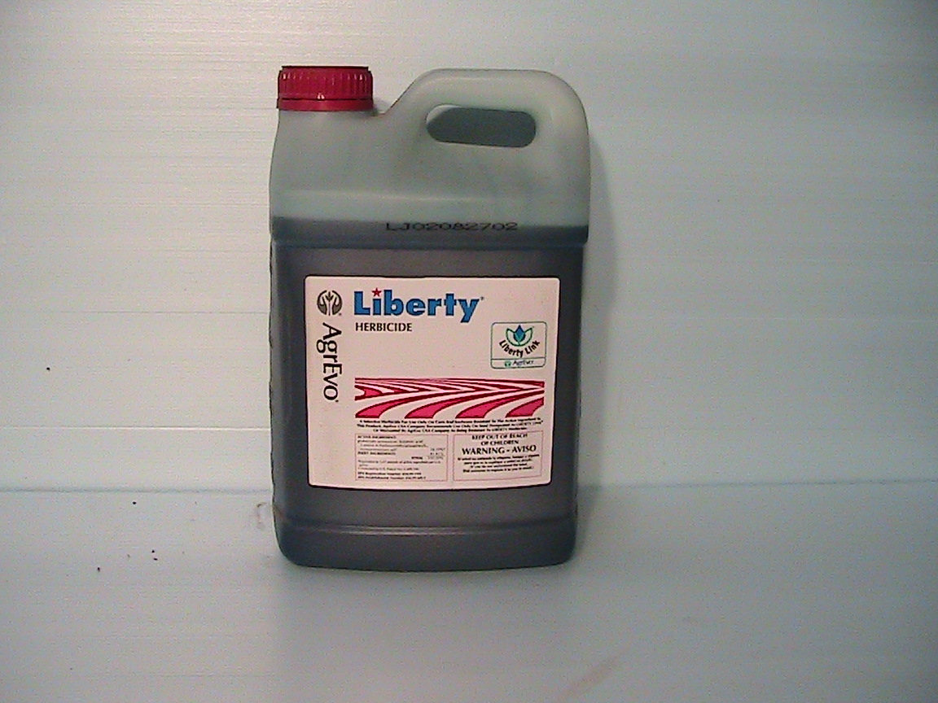
Glyphosate Resistant Weeds
Widespread appearance of glyphosate-resistant weeds has necessitated ever-increasing applications of glyphosate on Roundup-Ready crops
Liberty is an alternative herbicide to kill these resistant weeds – glufosinate!
LibertyLink is a GMO modification to support glufosinate resistance

Slide 57
Increased Use of Glufosinate after 2010
LibertyLink is a Bayer-owned brand of genes for use in agriculture providing tolerance to Liberty herbicide and glufosinate
LibertyLink is the only GMO herbicide tolerant gene other than Roundup-Ready on the market.
LibertyLink versions of cotton, corn and soybeans are approved in Brazil
LibertyLink soybeans approved in 2010

Slide 58
Glufosinate is a Glutamate Analogue!*
Its toxicity to plants is based on its disruption of glutamine synthetase by pretending to be glutamate
This causes a build-up of excess ammonia and glutamate and a depletion of glutamine
As an analogue of glutamate, it could substitute for glutamate during protein synthesis – and this could lead to microcephaly!
*G Haerlein, Rev Environ Contam Toxicol 1994;138:73-145.
Notes:
./glufosinate_ammonium_abstract.text

Slide 59
Protein Disruption Through Coding Errors
Amino Acid | Imposter | Protein | Disease
serine | BMAA | Glutamate transporter | ALS (Lou Gehrig’s)
proline | Aze | Myelin basic protein | Multiple Sclerosis
glutamate | glufosinate | Asparagine synthetase | Microcephaly Immune deficiency
glycine | glyphosate | Many proteins | Autism, microcephaly, etc.
Asparagine synthetase

Slide 60
Microcephaly and Asparagine Synthetase*
Loss-of-function mutation in asparagine synthetase causes a severe condition
Congenital microcephaly, intellectual disability, progressive cerebral atrophy, and intractable seizures
Mutant mice have enlarged ventricles, reduced thickness of cortex, and learning disabilities
*EK Ruzzo et al., Neuron 2013;80(2):429-41.

Slide 61
Microcephaly and Asparagine Synthetase*
Loss-of-function mutation in asparagine synthetase causes a severe condition
Congenital microcephaly, intellectual disability, progressive cerebral atrophy, and intractable seizures
Mutant mice have enlarged ventricles, reduced thickness of cortex, and learning disabilities
Asparagine synthetase has a conserved glutamate that is essential for its function**
*EK Ruzzo et al., Neuron 2013;80(2):429-41.
** ME Meyer et al., Biochemistry 2010;49(43):9391-401.
Notes:
asparagine_synthetase_deficiency_microcephaly.pdf

Slide 62
A Theory Emerges: Glyphosate/Glufosinate Synergy
Glyphosate disrupts glutamine synthesis through chelation of manganese
Glutamine is precursor to asparagine
Glufosinate disrupts enzyme that synthesizes asparagine
Both shortages of glutamine and impaired enzyme activity result in severe deficiency in asparagine → microcephaly

Slide 63
A Bit of Chemistry
NH₄
Glutamate
Glutamine
Aspartate
Glutamine synthetase
glufosinate
Glyphosate
Asparagine synthetase
Asparagine deficiency
Leads to microcephaly and
Impaired immunity
Asparagine

Slide 64
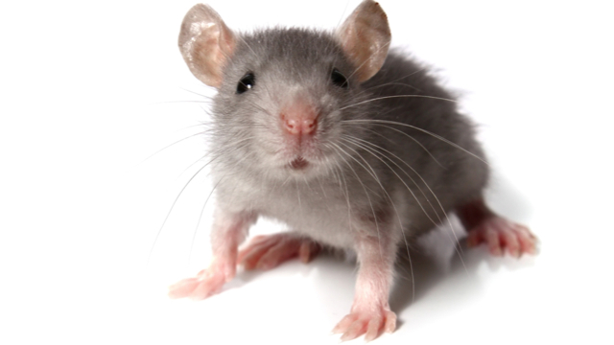
Glufosinate Induces Autistic Symptoms in Mice*
1 mg/kg administered three times a week to dam during gestation and lactation
Offspring demonstrated autistic behaviors – socialization impairment, repetitive activities
Dose was about 5 times lower than the EPA approved dose
* A. Laugeray et al., Frontiers in Behavioral Neuroscience 2014;8:390.
Notes:
./glufosinate_induces_autism_in_mice.pdf

Slide 65
Glufosinate Induces Autistic Symptoms in Mice*
1 mg/kg administered three times a week to dam during gestation and lactation
Offspring demonstrated autistic behaviors – socialization impairment, repetitive activities
Dose was about 5 times lower than the EPA approved dose
We can expect a dramatic rise in the use of glufosinate on core crops as more and more weeds become resistant to Roundup
* A. Laugeray et al., Frontiers in Behavioral Neuroscience 2014;8:390.
Notes:
./glufosinate_induces_autism_in_mice.pdf

Slide 66
Summary
Brazil’s microcephaly epidemic should be a lesson to us all!
The Zika virus likely plays only a minor role
Exposure to toxic chemicals in agriculture is an unacceptable risk to our children and therefore to our future
Multiple vaccines with dangerous toxicants now administered to pregnant women in Brazil
Some vaccines may also be contaminated with glyphosate
I believe synergy between glyphosate and glufosinate is the key factor in the epidemic
These chemicals are both amino acid analogues and this is a very dangerous class of molecules
We need to go back to sustainable organic agricultural methods to protect our children from disability

