Slide 1
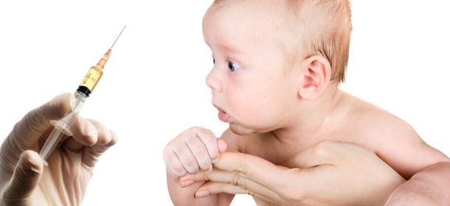
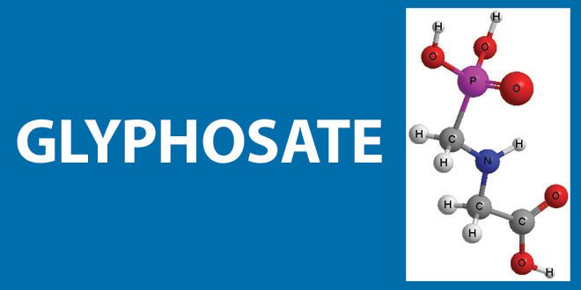
Glyphosate in MMR: Does This Explain the Autism Link?
Stephanie Seneff
CSAIL, MIT
Tuesday, Sept. 19, 2017

Slide 2
“It is dangerous to be right in matters on which the established authorities are wrong.”
– Voltaire

Slide 4
Outline
What is glyphosate?
How glyphosate affects the gut barrier
Glyphosate in vaccines
Glutamate and glyphosate synergy in MMR
Autoimmune disease through molecular mimicry
Summary

Slide 5
What is Glyphosate?

Slide 6
Roundup and GMO Crops
GMO Roundup-Ready corn, soy, canola, sugar beets
cotton, tobacco and alfalfa
What is glyphosate?

Slide 7
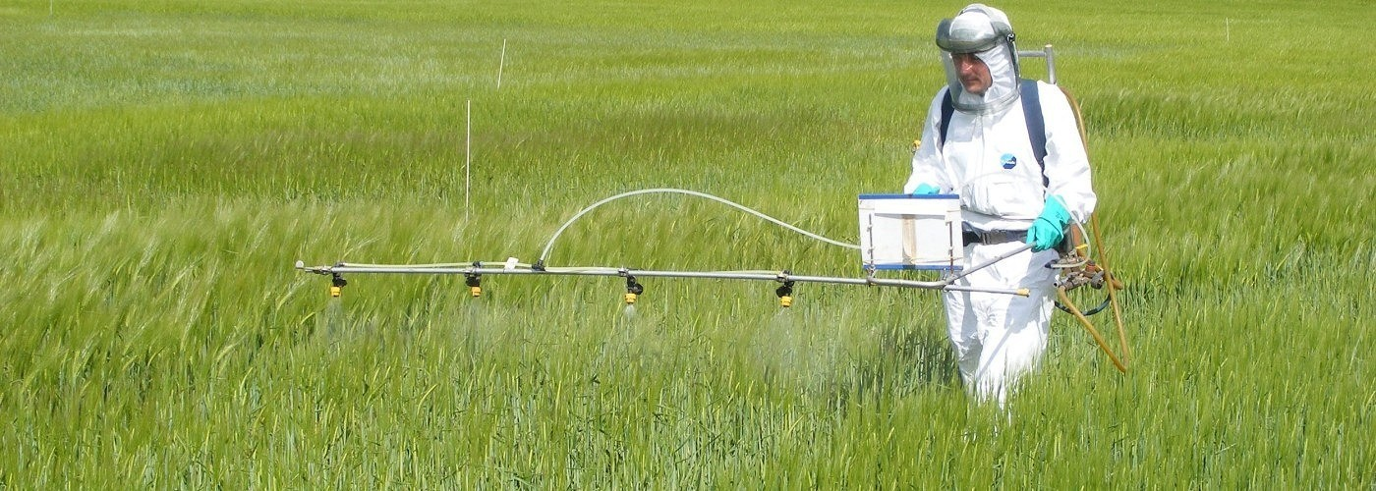
Roundup as a Desiccant/Ripener just before Harvest
Wheat, Oats, Barley, Rye, Sugar cane, Beans, Lentils, Peas, Flax, Sunflowers, Pulses, Chick Peas

Slide 8
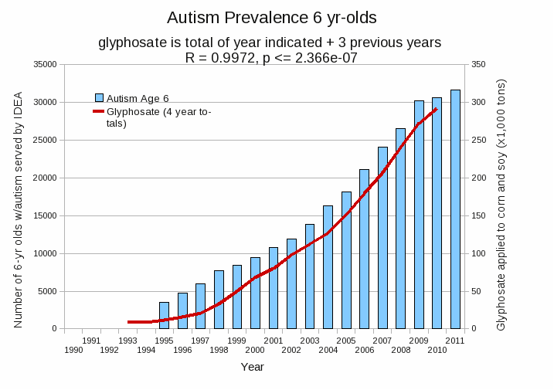
Autism Prevalence: 6 year olds*
R = 0.9972
* Figure 15, Seneff et al., Agricultural Sciences, 2015, 6, 42-70
Notes:
Nancy/latest_plots/6-yr-old autism.gif
autism: USDE
oil consumption: USDA
glyphosate: USDA
GE crops: USDA
Mortality data: CDC

Slide 9
Is Glyphosate Nontoxic?
Monsanto has argued that glyphosate is harmless to humans because we don’t have the shikimate pathway which it disrupts in plants
However, our gut bacteria DO have this pathway
They use it to supply us with essential aromatic amino acids (precursors to neurotransmitters, thyroid hormone and B vitamins)
Other ingredients in Roundup greatly increase glyphosate’s toxic effects
Insidious effects of glyphosate accumulate over time
Most studies are too short to detect damage

Slide 10
How Glyphosate Affects
the Gut Barrier

Slide 11
Glyphosate and the Gut
Glyphosate has been found as a contaminant in digestive enzymes trypsin, pepsin and lipase*
Trypsin impairment prevents proteins like gluten in wheat from being digested
Undigested proteins induce release of zonulin which opens up gut barrier**
Zonulin lingers because trypsin is defective
*A Samsel and S Seneff. J Biol Phys Chem 2017;17:8-32
** JJ Gildea et al. J Clin Nutr Diet. 2017, 3:1.
Notes:
Glyphosate/ZachBushPaper_tight_junctions_glyphosate_2017.pdf

Slide 12
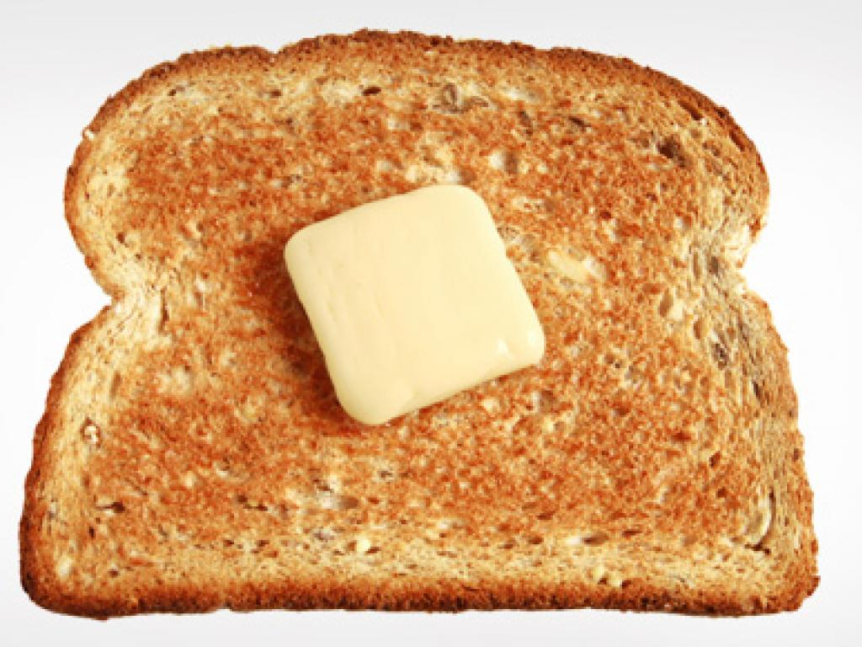
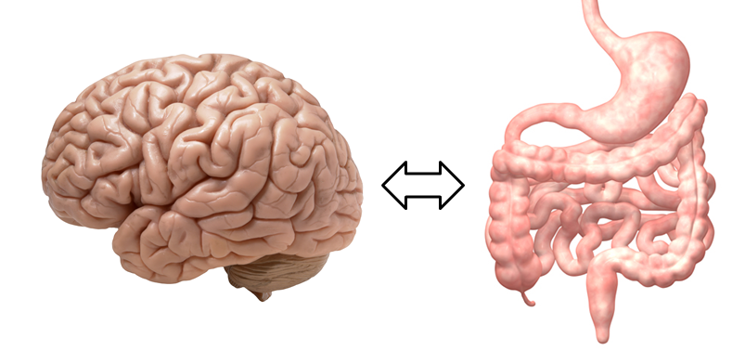
A Scenario
Glyphosate in wheat
Leaky brain barrier
Zonulin
Trypsin defective
Autoimmune disease
Zonulin released
Gliadin
Leaky barrier

Slide 13
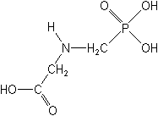
What if glyphosate could insert itself into protein synthesis by mistake???
glyphosate
Code for glycine
GGC
mRNA
. . .
. . .
Glyphosate
Alanine
Proline
Any proteins with conserved glycine residues are likely to be affected in a major way

Slide 14
What if glyphosate could insert itself into protein synthesis by mistake???
Trypsin contains several glycine-rich regions that are essential for its function as a digestive enzyme
glyphosate
Code for glycine
GGC
mRNA
. . .
. . .
Glyphosate
Alanine
Proline
Any proteins with conserved glycine residues are likely to be affected in a major way

Slide 15
Glyphosate is a non-coding amino acid analogue of glycine
H
Glycine
Glyphosate

Slide 16
Extra Piece Sticks Out at Active Site
Substrate no longer fits in active site
Active Site
Extra Stuff
Glyphosate
Alanine
Proline
glycine
Peptide chain

Slide 17
Extra Piece Sticks Out at Active Site
Substrate no longer fits in active site
This explains how glyphosate disrupts EPSPS in the shikimate pathway: Multiple bacteria have developed resistance by replacing active site glycine with alanine and this is the basis for GMO Roundup Ready crops*
Active Site
Extra Stuff
Glyphosate
Alanine
Proline
glycine
Peptide chain
*T Funke et al., Molecular basis for the herbicide resistance of Roundup Ready crops. PNAS 2006;103(35):13010-13015.
Notes:
glyphosate/Padgette_1991_EPSPS_conserved_glycine_modified_resistant_to_glyphosate.pdf

Slide 18
Inhibition of EPSPS by glyphosate: Resistant E coli mutant*
Mutant with alanine substituted for glycine 96
Wild type with glycine 96
*Figure 3, S Eschenburg et al. Planta 2002;216:129-135.

Slide 19
Glyphosate in Vaccines

Slide 20
Glyphosate in Vaccines?
For MMR, flu vaccine, and rabies vaccine, live virus is grown on gelatin derived from ligaments of pigs and fetal bovine serum
Cows and pigs are fed GMO Roundup-Ready corn and soy feed
Gelatin is derived from collagen which is highly enriched in glycine and also contains glutamate
These two neurotransmitters excite the NMDA receptors in the brain
Glyphosate stimulation of NMDA receptors could cause neuronal burnout

Slide 21
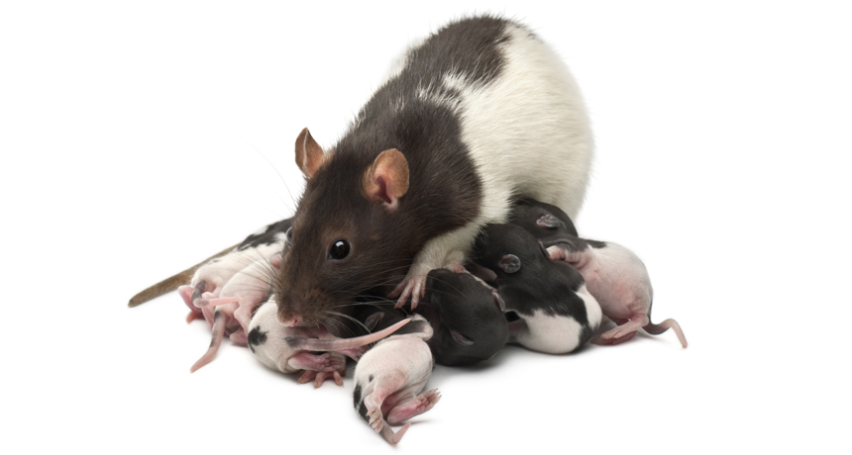
Glyphosate Excites NMDA Receptors in Hippocampus*,**
Excess glutamate in synapse leads to neuronal burnout
*D Cattani et al. Toxicology 2014; 320:34-45.
**D Cattani et al. Toxicology 2017 [Epub ahead of print]
Notes:
./glyphosate_rat_hippocampus_glutamate_depression_2017.pdf
70 mg of glyphosate/Kg/day. 0- way below alleged level of toxicity.
Acetylcholinase inhibition as well.
On the other hand, the activity of GGT was induced by GBH exposure (Figure 7G),

Slide 22
Glyphosate Excites NMDA Receptors in Hippocampus*,**
Excess glutamate in synapse leads to neuronal burnout
Rats exposed to glyphosate perinatally exhibited depressive behaviors
*D Cattani et al. Toxicology 2014; 320:34-45.
**D Cattani et al. Toxicology 2017 [Epub ahead of print]
Notes:
./glyphosate_rat_hippocampus_glutamate_depression_2017.pdf

Slide 23
Glyphosate Excites NMDA Receptors in Hippocampus*,**
Excess glutamate in synapse leads to neuronal burnout
Glutamate is elevated in the blood in association with autism, and blood glutamate levels correlate with brain glutamate levels.*
*Z Zheng et al. PLOS ONE 2016; 11(7): e0158688.
Notes:
./glyphosate_rat_hippocampus_glutamate_depression_2017.pdf

Slide 24
Autism, Glyphosate, Vaccine Reactions*
Glyphosate application to corn and soy, US
Children with Autism, US
# Adverse Reactions in VAERS
*Data readily available from the CDC, FDA (VAERS) and USDA
Notes:
Individuals with Disabilities Education Act

Slide 25
*A Samsel and S Seneff, Journal of Biological Physics and Chemistry 2017;17:8-32.

Slide 26
… Most disturbing is the presence of glyphosate in many popular vaccines including the measles, mumps and rubella (MMR) vaccine, which we have verified here for the first time.
*A Samsel and S Seneff, Journal of Biological Physics and Chemistry 2017;17:8-32.

Slide 27
Glyphosate Contamination in Vaccines (Parts Per Billion)*
Merck ZOSTAVAX 0.62 Shingles
Merck MMR-II 3.74 Measles, Mumps and Rubella
Merck VARIVAX 0.56 Varicella, Chicken Pox
MERCK PNEUMOVAX ND Pneumococcal 18
MERCK PROQUAD 0.66 Measles, Mumps, Rubella, Varicella
GSK ENERGIX-B 0.34 Heptatitis B
*A Samsel and S Seneff, Journal of Biological Physics and Chemistry 2017;17:8-32.

Slide 28
Symptoms of Adverse Reactions to MMR before and after 2002*
Data analyzed from the VAERS database
*A Samsel and S Seneff. J Biol Phys Chem 2017;17:8-32

Slide 29
Symptoms of Adverse Reactions to MMR before and after 2002*
Joint pain
seizures
shortness of breath
hives
These are all characteristic symptoms of allergies to MSG
eczema
anaphylactic shock
Facial swelling
swelling
swelling
*Data analyzed from the VAERS database

Slide 30
Autoimmune Disease through
Molecular Mimicry

Slide 31
“Nobel Laureate Charles Richet demonstrated over a hundred years ago that injecting a protein into animals or humans causes immune system sensitization to that protein. Subsequent exposure to the protein can result in allergic reactions or anaphylaxis. This fact has since been demonstrated over and over again in humans and animal models.”
Notes:
./vaccine_protein_causes_food_allergies.pdf

Slide 32
Large Proteins in Vaccines: Allergenic*
“Vaccines clog our lymphatic system and lymph nodes with large protein molecules which have not been adequately broken down by our digestive processes, since vaccines bypass digestion with injections. This is why vaccines are linked to allergies, because they contain large proteins which as circulating immune complexes (CICs) or 'klinkers’ cause our body to become allergic.”
*Dave Mihalovic, ND, http://whale.to/v/vaccines_cause_allergies.html

Slide 33
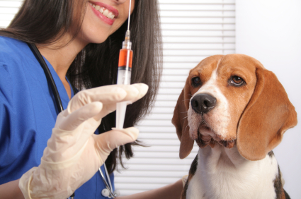
The Purdue Vaccination Studies and Autoantibodies*
“The Purdue studies … found that vaccinated dogs were developing autoantibodies to their own collagen”
*http://www.dogsnaturallymagazine.com/purdue-vaccination-studies/

Slide 34
A Scenario
1. Child is vaccinated with MMR
2. Live measles virus infects gut
6. Zonulin induces leaky brain barrier
3. Measles haemagglutinin undigested
6. Measles virus infects brain
4. Induces leaky gut
7. Brain’s immune system produces antibodies
5. Measles virus
8. Autoantibodies attack myelin sheath
5. Zonulin

Slide 35
Measles Virus and Haemagglutinin*
The measles virus synthesizes the protein haemagglutinin
Antibodies to haemagglutinin are essential following MMR vaccination to induce immunity
Measles virus infects brain due to leaky barrier
Haemagglutin bears a sequence resemblance to myelin basic protein (MBP) → potential for autoimmune reaction
MBP is essential for the formation of the myelin sheath surrounding nerve fibers
Autoantibodies to MBP along with excessive levels of antibodies to measles haemagglutinin are linked to autism**
*Oldstone, MBA, Ed. Molecular mimicry: Infection inducing autoimmune disease.
Springer Berlin Heidelberg; January 9, 2006.
**VK Singh et al., J Biomed Sci 2002;9(4):359-64.

Slide 36
Autism and Measles Haemagglutinin*
125 autistic children and 92 control children
60% of the children with autism had high levels of antibodies to measles haemagglutinin specific to the MMR vaccine
90% of these had autoantibodies to myelin basic protein (MBP)
0% of the control children had high antibody titers to either haemagglutinin or MBP
There were no elevations in antibodies detected against any proteins in the mumps or rubella viruses
*VK Singh et al., J Biomed Sci 2002;9(4):359-64.

Slide 37
Summary
Glyphosate’s insidious cumulative toxicity may be due to its ability to get into proteins by mistake in place of glycine
Glyphosate has been detected in multiple vaccines, with highest concentrations in MMR
Many vaccines include gelatin and fetal bovine serum as ingredients, both of which are contaminated with glyphosate
Glyphosate and glutamate (from the vaccine) can excite NMDA receptors, and cause neuronal burnout
Glyphosate contamination leads to resistance to breakdown and autoimmune disease through molecular mimicry
A causal link between MMR and autism can be explained through autoimmune attack on myelin basic protein via molecular mimicry with measles haemagglutinin
Multiple large proteins found in vaccines are allergenic and they may be a causal factor in food allergies and anaphylaxis

