Slide 1
The Glyphosate, Oxalate, and Sulfate Connection - Key Links between Diet and Chronic Disease
Stephanie Seneff
MIT CSAIL
March 22, 2017

Slide 2
Download these slides
http://people.csail.mit.edu/seneff/2017/
SeneffOxalate2017.pptx

Slide 3
Outline
Introduction
Glyphosate in Proteins
Glyphosate, Oxalate, Autism and Anemia
Glyphosate and Sulfur Homeostasis
Mitochondria, Lysosomes and ALS
Flu Restores Sulfate
Glyphosate and Gout
How to Stay Healthy

Slide 4
Introduction

Slide 5
US Health Status
US makes up 5% of the world’s population but consumes more than 50% of the world’s pharmaceutical drugs
We spend more on health care than Japan, France, China, UK, Italy, Canada, Brazil, Spain, and Australia, combined
US ranks last or near last among developed nations on infant mortality and life expectancy
We also suffer from more chronic illnesses
We consume 25% of the world supply of glyphosate

Slide 6
US Health Status, 2015*
“Eight of the nation's top 10 leading causes of death — heart disease, chronic lower respiratory diseases, unintentional injuries, stroke, Alzheimer’s disease, diabetes, and kidney disease — proved to be deadlier in 2015.”
*www.newsmax.com/Health/Health-News/
heart-mortality-cardiovascular-disease/2016/12/08/id/762920/
Notes:
http://www.newsmax.com/Health/Health-News/heart-mortality-cardiovascular-disease/2016/12/08/id/762920/?ns_mail_uid=579590

Slide 7
Roundup and GMO Crops
GMO Roundup-Ready corn, soy, canola, sugar beets
cotton, tobacco and alfalfa
What is glyphosate?

Slide 8
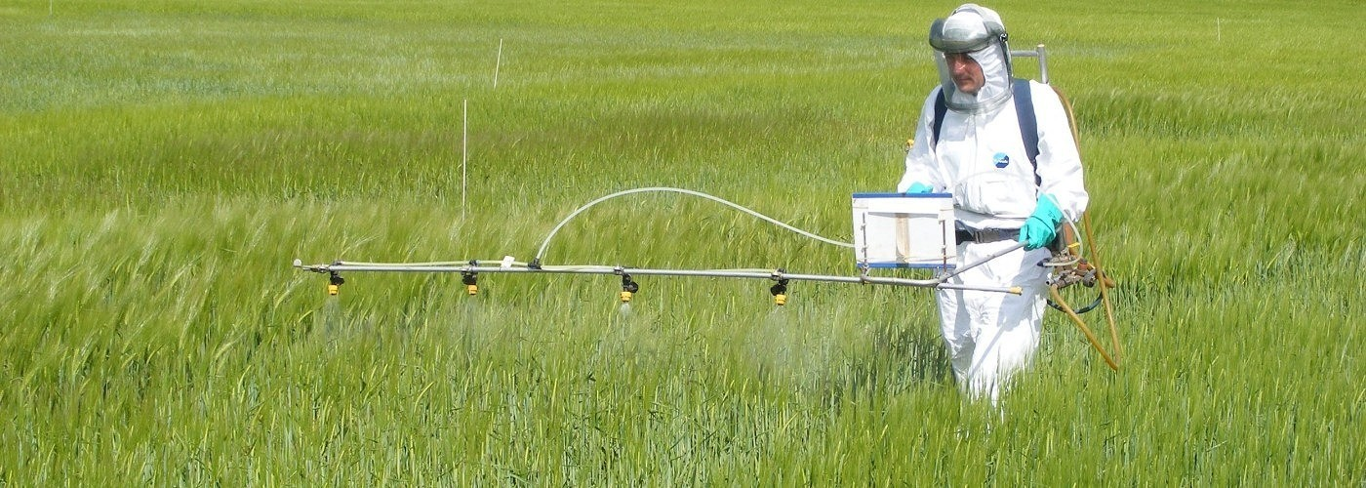
Roundup as a Desiccant/Ripener just before Harvest
Wheat, Oats, Barley, Rye, Sugar cane, Beans, Lentils, Peas, Flax, Sunflowers, Pulses, Chick Peas

Slide 9
Glyphosate vs. Other Pesticides: Usage in the United States*
Glyphosate
*http://sustainablepulse.com/wp-content/uploads/GMO-health.pdf

Slide 10
Glyphosate Acronym*
G Glycine mimicry, Gut bacteria disruption
L Lymphoma - the cancer most often linked to G
Liver, one of the key organs damaged by G
YP CYP-450 enzyme impairment by G
H Hemoglobin activity reduced due to chelation of iron and suppressed synthesis of the pyrrole ring
O Osteoarthritis due to collagen disruption
S Shikamate pathway suppression - 'good' gut bacteria disrupted
Sulfur pathways disrupted
A Accumulation in bone marrow, may contribute to lymphoma Anemia
T Transition metal chelation, Tryptophan deficiency
E Enzyme disruption through metal chelation and glycine substitution during protein synthesis
*Thanks to David Fichtenberg

Slide 11
Glyphosate in Proteins

Slide 12
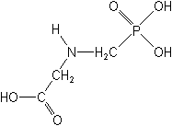
What If Glyphosate Could Insert Itself Into Protein Synthesis by mistake???
glyphosate
Code for glycine
GGC
mRNA
. . .
. . .
Glyphosate
Alanine
Proline
Any proteins with conserved glycine residues are likely to be affected in a major way

Slide 13
Glyphosate is a non-coding amino acid analogue of glycine
H
Glycine
Glyphosate

Slide 14
Extra Piece Sticks Out at Active Site
Substrate no longer fits in active site
Active Site
Extra Stuff
Glyphosate
Alanine
Proline
glycine
Peptide chain

Slide 15
Extra Piece Sticks Out at Active Site
Substrate no longer fits in active site
This explains how glyphosate disrupts EPSPS in the shikimate pathway: Multiple bacteria have developed resistance by replacing active site glycine with alanine and this is the basis for GMO Roundup Ready crops*
Active Site
Extra Stuff
Glyphosate
Alanine
Proline
glycine
Peptide chain
*T Funke et al., Molecular basis for the herbicide resistance of Roundup Ready crops. PNAS 2006;103(35):13010-13015.

Slide 16
Inhibition of EPSPS by glyphosate: Resistant E coli mutant*
Mutant with alanine substituted for glycine 96
Wild type with glycine 96
*Figure 3, S Eschenburg et al. Planta 2002;216:129-135.

Slide 17
Hypothesis
Cumulative glyphosate exposure sets up a weakened immune system, a leaky gut barrier and a leaky brain barrier
Glyphosate contamination in proteins makes them hard to break down
Person develops overactive antibody response to foreign protein contaminated with glyphosate and, through molecular mimicry, this leads to autoimmune disease
This easily explains gluten intolerance and other food allergies as well as the rise in autoimmune diseases like Crohn’s and type I diabetes.

Slide 18
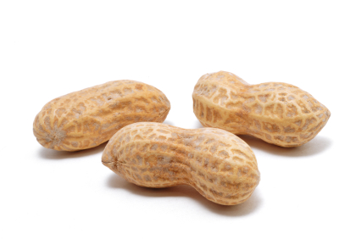
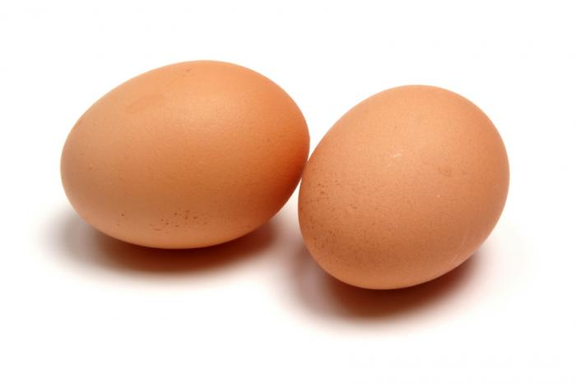
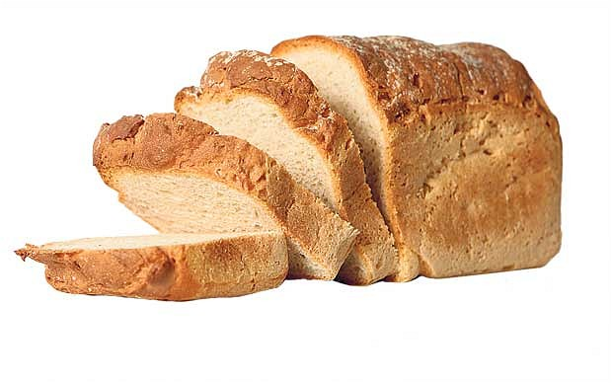
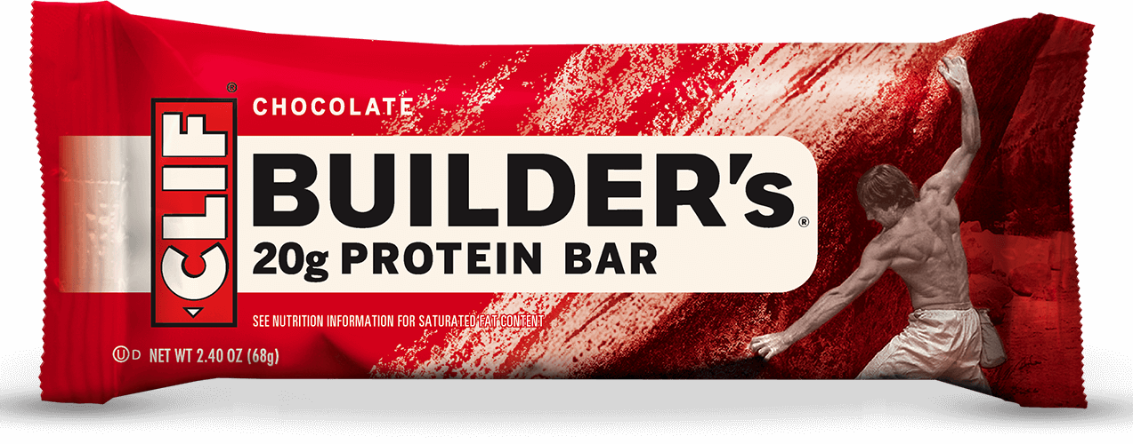
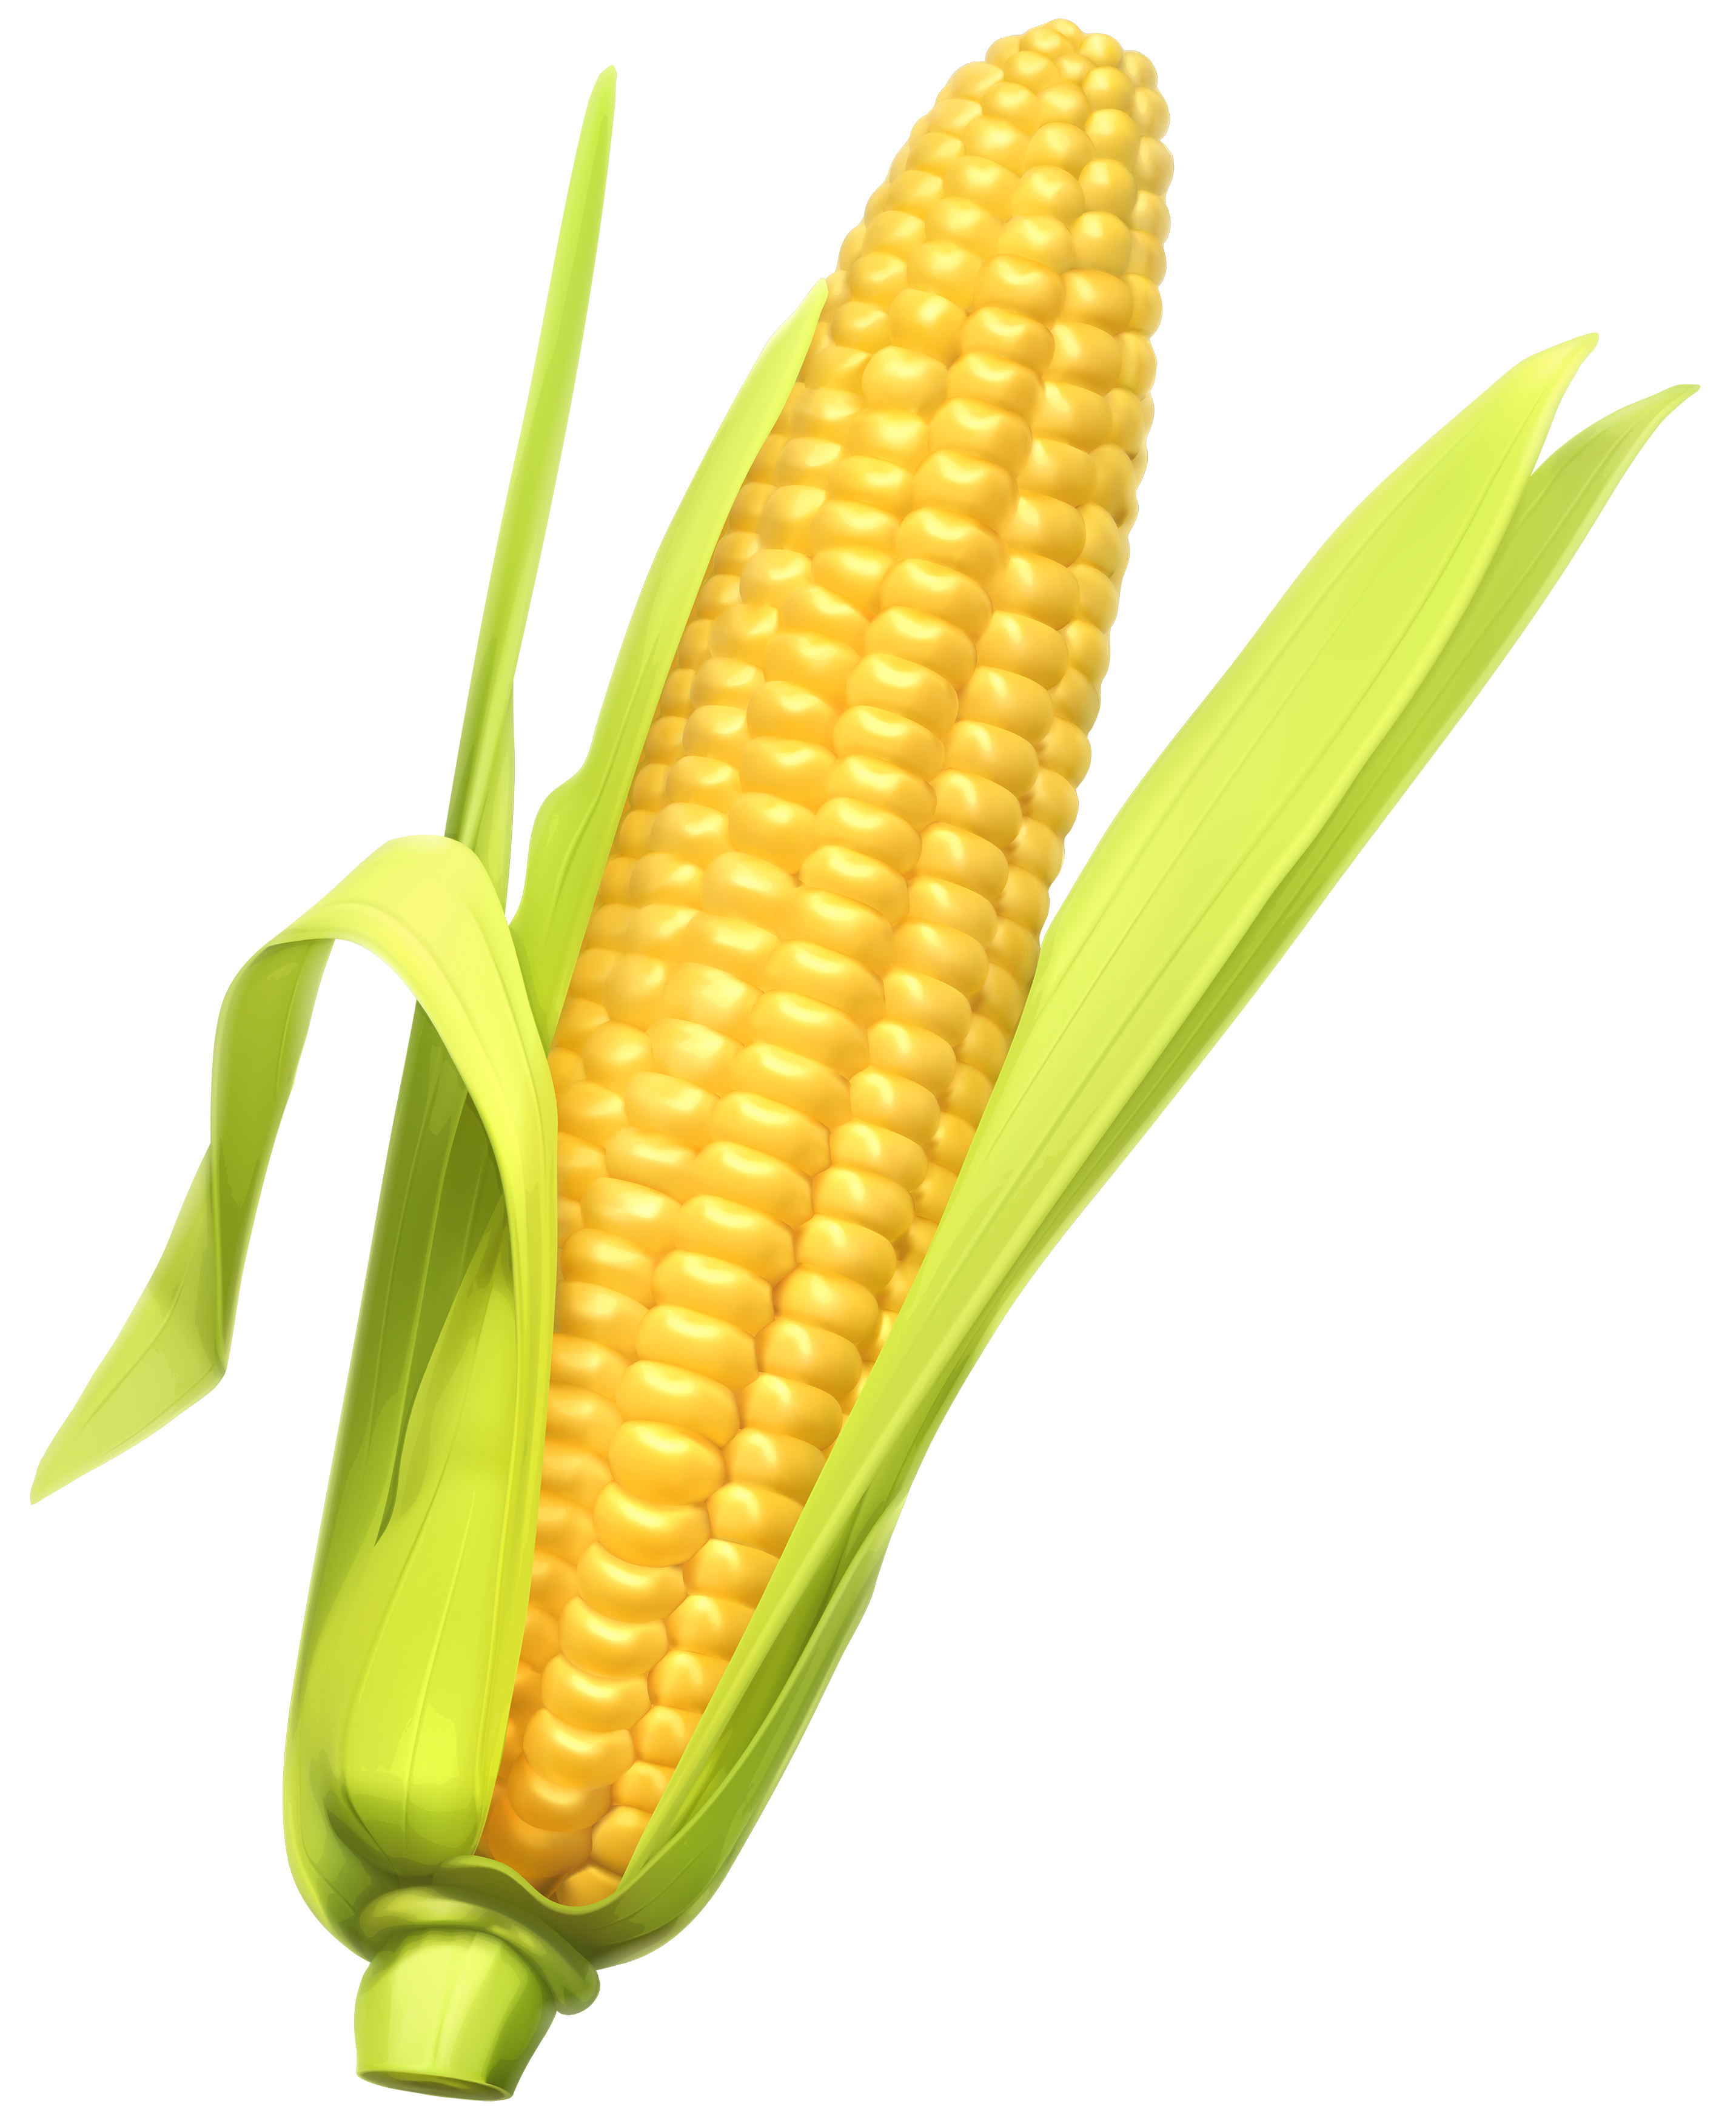
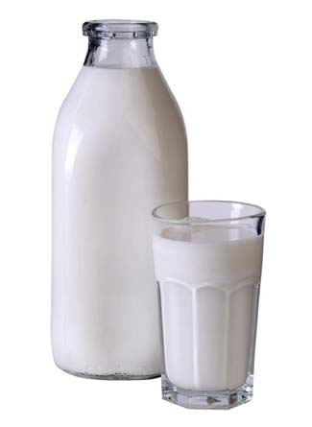
Food Allergies

Slide 19
Food Allergies
All of these foods can be expected to be contaminated with glyphosate, given how they’re produced

Slide 20
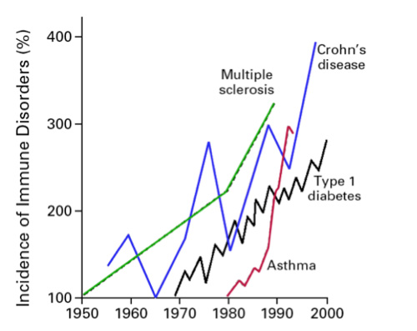
Rise in Autoimmune Diseases in U.S.*
* Bach JF. The effect of infections on susceptibility to autoimmune and
allergic diseases. N Engl J Med. Sep 2002;347(12):911-920.
Notes:
AutismOne/Autoimmune\ Disease\ -\ Science\ re-evaluation.docx

Slide 21
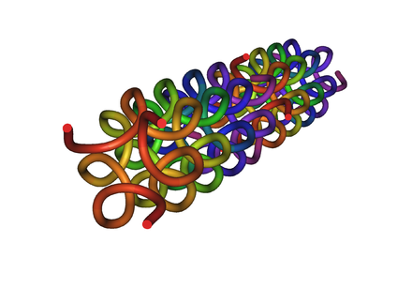
Collagen and Gelatin
25% of the protein in our body is collagen
Collagen forms a triple helix with building block triples of Gly-X-X, where X is often proline.
Glyphosate substitution for glycine will disrupt triple-helix formation and lead to diseases of the vasculature, joints and bones
Gelatin is derived from collagen in bones and ligaments sourced from cows and pigs fed glyphosate-contaminated GMO Roundup-Ready feed

Slide 22
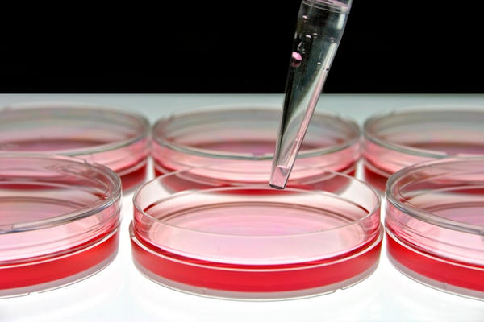
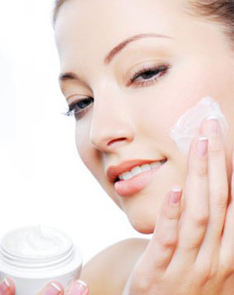
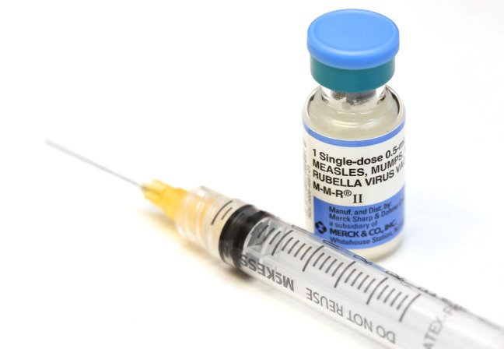
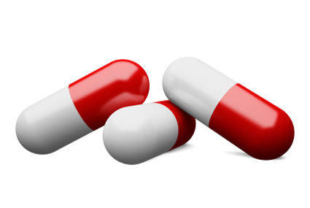
Products Containing Gelatin !!

Slide 23
Rheumatoid Arthritis
Inflammation in the joints causes pain and limits movement
Small joints of the hands, feet and cervical spine most affected
30% of cases suffer from necrotizing granuloma – nodule formation in the skin
Can lead to lung fibrosis
Increases risk to atherosclerosis, heart attack and stroke.
Poor iron absorption leads to "anemia of chronic disease"
Fatigue, low grade fever, malaise, morning stiffness, loss of appetite and loss of weight

Slide 24
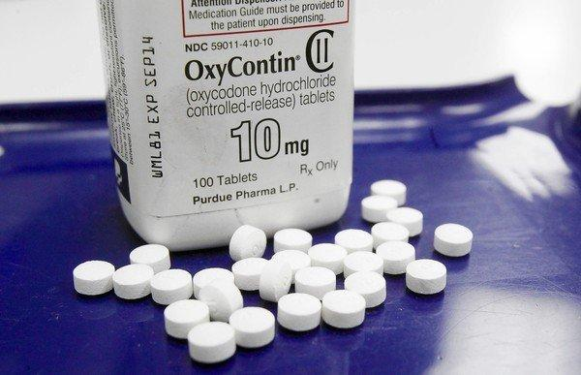
US Department of Health and Human Services Data on Pain-Killer Drug Abuse*
Drug overdose is the leading cause of injury death in the United States
Heroin, morphine, and prescription pain relievers
More people died from drug overdoses in 2014 than in any previous year on record
More than 6 out of 10 involved an opioid drug
More than 650,000 opioid prescriptions are dispensed every day
*http://www.hhs.gov/opioids/about-the-epidemic/
Notes:
./Factsheet-opioids-061516.pdf

Slide 25
Glyphosate, Oxalate,
Autism and Anemia

Slide 26
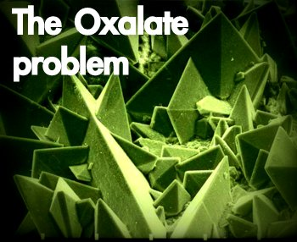
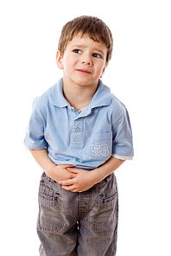
Autism Linked to Oxalate Crystals*
Crystals of oxalate form kidney stones and cause great discomfort
Study has shown at least 3-fold higher serum and urinary levels of oxalate in autistic kids**
*William Shaw, The Role of Oxalates in Autism and Chronic Disorders WAPF, March 26, 2010
**J Konstantynowicz et al., European Journal of Paediatric Neurology 16(5), 2012, 485-491.
Notes:
samantha/oxalates_in_autism.text~
samantha/william_shaw_on_oxalates_autism.text
http://www.westonaprice.org/health-topics/the-role-of-oxalates-in-autism-and-chronic-disorders/

Slide 27
“Oxalate crystals in the bone may crowd out the bone marrow cells, leading to anemia and immunosuppression”*
*http://www.greatplainslaboratory.com/home/span/oxalates.asp

Slide 28
“Cerebral edema, and perhaps injury to other organs, could result from oxalate crystal deposition in small blood vessels in the brain and other organs.”*
*K Froberg et al., Clin Toxicol (Phila). 2006;44(3):315-8.
Notes:
2015’Anthony/oxalate_crystals_brain.text

Slide 29
Oxalate Metabolism*
*http://www.greatplainslaboratory.com/home/eng/oxalates.asp
Notes:
./oxalates.text

Slide 30
Glyphosate Metabolism*
*Figure 3 in L. Polligioni et al., FEBS Journal 278 (2011) 2753–2766
Notes:
Glyphosate/glyphosate_metabolism_to_glyoxylate.pdf

Slide 31
Monsanto Patents: 2002-2010: Pesticide Compositions Containing Oxalic Acid
“[origin: WO02069718A2] Pesticidal concentrate and spray compositions are described which exhibit enhanced efficacy … More particularly, the present invention relates to a method of enhancing the herbicidal effectiveness of glyphosate concentrate and tank mix formulations containing one or more surfactants through the addition of oxalic acid.”
Monsanto Technology,
St. Louis, MO
Notes:
https://data.epo.org/gpi/EP1389912A2-PESTICIDE-COMPOSITIONS-CONTAINING-OXALIC-ACID (quote)
“[origin: WO02069718A2] Pesticidal concentrate and spray compositions are described which exhibit enhanced efficacy due to the addition thereto of a compound which increases cell membrane permeability, suppresses oxidative burst, or increases expression of hydroxyproline-rich glycoproteins. More particularly, the present invention relates to a method of enhancing the herbicidal effectiveness of glyphosate concentrate and tank mix formulations containing one or more surfactants through the addition of oxalic acid.”

Slide 32
Monsanto Patents: 2002-2010: Pesticide Compositions Containing Oxalic Acid
“[origin: WO02069718A2] Pesticidal concentrate and spray compositions are described which exhibit enhanced efficacy … More particularly, the present invention relates to a method of enhancing the herbicidal effectiveness of glyphosate concentrate and tank mix formulations containing one or more surfactants through the addition of oxalic acid.”
Oxalic acid and oxalate are essentially
the same thing!
Monsanto Technology,
St. Louis, MO
Notes:
https://data.epo.org/gpi/EP1389912A2-PESTICIDE-COMPOSITIONS-CONTAINING-OXALIC-ACID (quote)
“[origin: WO02069718A2] Pesticidal concentrate and spray compositions are described which exhibit enhanced efficacy due to the addition thereto of a compound which increases cell membrane permeability, suppresses oxidative burst, or increases expression of hydroxyproline-rich glycoproteins. More particularly, the present invention relates to a method of enhancing the herbicidal effectiveness of glyphosate concentrate and tank mix formulations containing one or more surfactants through the addition of oxalic acid.”

Slide 33
Oxalate Enhances Glyphosate’s Toxicity to Plants at Small Concentrations*
*Figure 1, Monsanto Patent #US 7,771,736 B2, Aug. 10, 2010

Slide 34
Hypothesis: flooding with oxalate prevents metabolism of glyoxylate to oxalate. Glyoxylate is a very potent glycating agent, leading to widespread damage.
This also inhibits glyphosate breakdown to glyoxylate.

Slide 35
sec.gov/Archives/edgar/data/1110783/000103570403000400/c77652exv99w2.htm

Slide 36
WEATHERMAX!!
sec.gov/Archives/edgar/data/1110783/000103570403000400/c77652exv99w2.htm

Slide 37
New Roundup Transorb'R' Herbicide Formulation to Hit Retail Shelves in Eastern Canada*
“In 2004, this powerful new formulation was chosen by more western Canadian growers than any other non-selective herbicide on the market. Grower satisfaction with the performance in the field has reached new heights - 99% of growers who used Roundup WeatherMAX were satisfied with their experience.”
*www.highbeam.com/doc/1P2-13686824.html
JANUARY 3, 2005
Notes:
The product received its registration certificate in October 2003 after six years of research and development work and field testing across various regions in Canada. It was introduced in Western Canada last
season.

Slide 38
Plot produced in collaboration with Dr. Nancy Swanson from US Government data

Slide 39
This Detoxification Scheme is Essential in Red Blood Cells
Inhibited by glyphosate
Product of shikimate pathway
Depleted by glyphosate
Induced by excess folic acid
Depends on selenium

Slide 40
This Detoxification Scheme is Essential in Red Blood Cells
Inhibited by glyphosate
Product of shikimate pathway
G6PD Deficiency Leads to Hemolysis and Anemia
Depleted by glyphosate
Induced by excess folic acid
Depends on selenium

Slide 41
Anemia leads to low oxygen which induces chronic low grade encephalopathy linked to autism

Slide 43
Oxalate, Iron and Autism
Agricultural workers exposed to glyphosate suffer from high rate of kidney failure due to tubular interstitial diseases*
Tubules depend on transferrin to supply iron
Oxalate interferes with transferrin iron delivery**
Autistic children also have intractable iron deficiency
Child with defective gene for transferrin receptor had developmental delay and intractable seizures***
*C Jayasumana et al., Int. J. Environ. Res. Public Health 2014
**AN Luck et al., Biochemistry. 2013 November 19; 52(46)
***Stockler et al. Orphanet Journal of Rare Diseases 2014, 9:141.
Notes:
Glyphosate/glyphosate_sri_lanka_kidney_failure_epidemiology.pdf
./defective_endocytosis_autism_transferrin_impairment.pdf
Where is this?
J Konstantynowicz et al., European Journal of Paediatric Neurology 2012;16(5):485–491.

Slide 44
Autistic Children are Sensitive to Iron Overload*
Children with autism have low levels of transferrin, which protects from oxidative damage due to free iron in the cells
*A Chauhan et al., Life Sciences 2004; 75: 2539–2549
Notes:
WAPF/low_transferrin_autism_oxidative_stress_2004.pdf

Slide 45
Oxalobacter Probiotics?*
Oxalobacter formigenes thrive on oxalate and are probably the main gut microbe responsible for its clearance
Anaerobic bacterium present in the colon
They are harmed by antibiotics (and glyphosate?)
Oxalobacter levels are inversely related to kidney stones
Oxalate metabolism depends on manganese**
Probiotic administration may be therapeutic
* CS Stewart et al., FEMS Microbiology Letters 2004;230:1-7.
**VJ Just et al., Biochemical Journal Nov 01, 2007, 407 (3) 397-406;
Notes:
./oxalobacter_oxalate_metabolism_2004.pdf
**oxalate_decarboxylase_depends_on_manganese.pdf

Slide 46
Recapitulation
Serum oxalate is elevated in association with autism
Oxalate can cause crystals to form in tissues which is very damaging (especially in brain)
Monsanto has patents on oxalate as an additive to enhance toxicity to plants
Oxalate can work synergistically with glyphosate to cause essential iron deficiency
Anemia can lead to low oxygen supply and encephalopathy (linked to autism)
Oxalate interferes with delivery of iron to the tissues, and impaired transferrin receptors are linked to autism

Slide 47
Glyphosate and
Sulfur Homeostasis

Slide 48
A Novel Theory
Nitrate and sulfate are produced in the blood and carefully regulated to maintain proper blood viscosity
The sulfate is also used to make heparan sulfate, which is taken up by lysosomes to help buffer their acidic pH
Sulfate synthesis is disturbed by glyphosate
The body has back-up systems that substitute oxalate, urate, and possibly citrate for sulfate but these can lead to nasty problems due to crystallization

Slide 49
Novel Theory, Part II
The inflammatory response is a mechanism to renew sulfate supplies to the blood
This response is triggered by urate crystals
Hydrogen sulfide gas is produced from cysteine and homocysteine
Superoxide is needed to oxidize hydrogen sulfide gas (but it can cause local damage)
ATP is released to energize the sulfate so it can be conjugated to sulfate carriers to make cholesterol sulfate and heparan sulfate and others

Slide 50
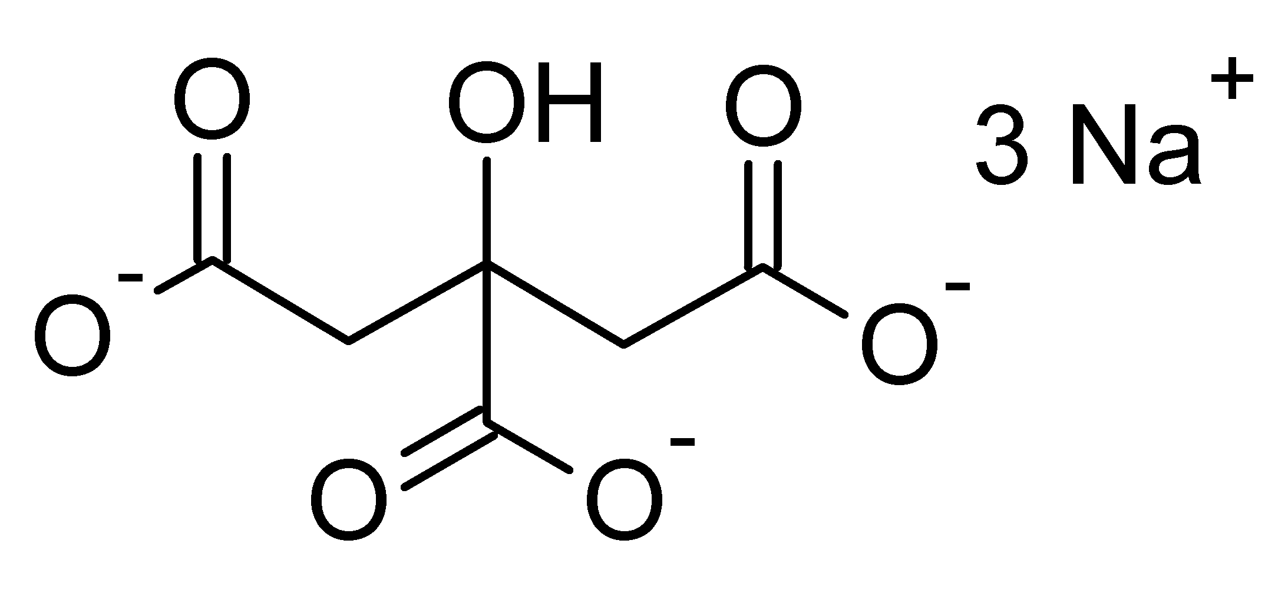
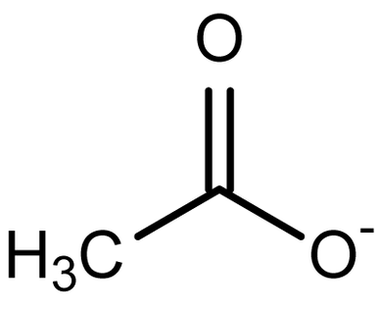
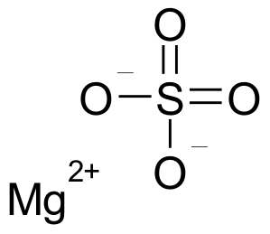
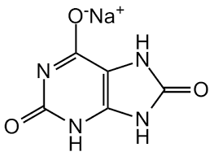
Citrate
Oxalic Acid
Acetate
Sulfate
Urate

Slide 51
Oxaloacetate is a precursor to five amino acids
Oxaloacetate
Aspartate aminotransferase
Glyphosate
Aspartate
Asparagine
Methionine
Lysine
Threonine
Aspartate aminotransferase has several highly conserved glycines that are essential for its function*
*C.J. Jeffrey et al., Protein Science 1998:71380-1387.
Notes:
Glyphosate/crystal_structure_aspartate_aminotransferase_multiple_conserved_glycines.pdf

Slide 52
Deficiencies lead to …
Aspartate: chronic fatigue, reduced stamina, depression, ammonia toxicity.
Asparagine: confusion, headaches, depression, irritability, psychosis
Lysine: anemia, apathy, depression, edema, fatigue, hair loss, loss of concentration, infertility, irritability, lethargy and weakness, muscle loss, stomach ulcers
Methionine: apathy, edema, lethargy, liver damage, muscle loss, fat loss, weakness, slowed growth
Threonine: emotional agitation, confusion, digestive difficulties, fatty liver.

Slide 53
Conserved Glycines in Important Sulfur-processing Enzymes
The sulfotransferases*
GxxGxxG motif required for binding PAPS
Sulfite oxidase**
Changing glycine at residue 473 with aspartate destroys enzyme activity
Aspartate has similar properties as glyphosate, being bulky and negatively charged
Defective SO leads to severe birth defects and neurological problems that usually result in death at an early age
*K. Komatsu et al., Biochemical and Biophysical Research Communications
1994;204(3): 1178-1185.
**H.L. Wilson et al., Biochemistry 2006, 45, 2149-2160 2149.
Notes:
2016/Anthony/conserved_glycines_sulfotransferase_1994_WOW.pdf
./G473D_mutation_sulfite_oxidase_destroys_it_2006.pdf

Slide 54
Various Factors that Increase Sulfate*
An increase of the 35S-sulfate deposit is effected regularly by infections, by injections of toxins and proteins, by hypoxemia, dietetic influence, muscular over-exertion, weather influence and increase of the blood pressure.
SMPS= Sulfated mucopolysaccharides
*Report by Bernhard Muschlien
SMPS = Sulfated mucopolysaccharides = glycosaminoglycans
First published in the German language in the SANUM-Post magazine (17/ 1991)
Notes:
Treasures/bacteria_renew_sulfate_German.pdf
Pyrexal is an endotoxin

Slide 55
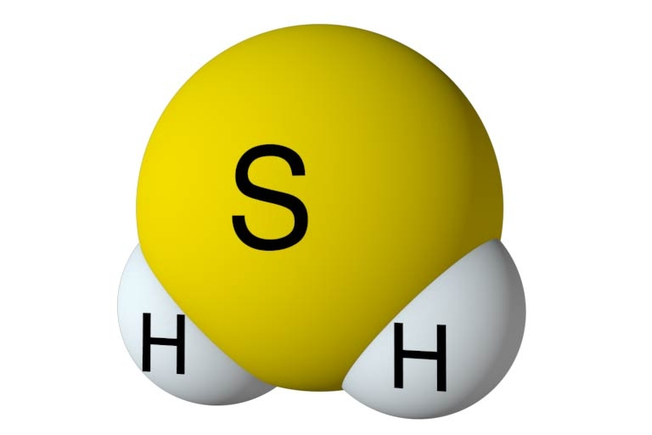
Inflammation and Hydrogen Sulfide*
Enhanced H₂S synthesis in multiple inflammatory diseases and conditions
arthritis
acute pancreatitis
sepsis
hemorrhagic shock
Burns
H₂S is synthesized from cysteine and then oxidized to form sulfate
H₂S induces inflammatory response which supplies superoxide needed for sulfate formation
*M. Nethaji et al., International Journal of Rheumatic Diseases 2014 [ePub ahead of print]
Notes:
2017/gout/Nethaji_2014_gout_hydrogen_sulfide_link.pdf

Slide 56
Inflammation and Hydrogen Sulfide*
Enhanced H₂S synthesis in multiple inflammatory diseases and conditions
arthritis
acute pancreatitis
sepsis
hemorrhagic shock
Burns
H₂S is synthesized from cysteine and then oxidized to form sulfate
H₂S induces inflammatory response which supplies superoxide needed for sulfate formation
Is this a mechanism to renew sulfate supplies to the vasculature?
*M. Nethaji et al., International Journal of Rheumatic Diseases 2014 [ePub ahead of print]
Notes:
2017/gout/Nethaji_2014_gout_hydrogen_sulfide_link.pdf

Slide 57
Sulfate Reducing Microbes
Desulfovibrio is a microbe in the colon that reduces sulfate to hydrogen sulfide gas
Desulfovibrio overgrowth is linked to autism
Hydrogen sulfide travels like a ghost across all tissues
It can travel by diffusion from the colon to the spinal column, the pancreas, the liver, etc.
It can be oxidized to form sulfate at the destination site

Slide 58
Sulfate Reducing Microbes
Desulfovibrio is a microbe in the colon that reduces sulfate to hydrogen sulfide gas
Desulfovibrio overgrowth is linked to autism
Hydrogen sulfide travels like a ghost across all tissues
It can travel by diffusion from the colon to the spinal column, the pancreas, the liver, etc.
It can be oxidized to form sulfate at the destination site
This is a novel way to transport sulfate!

Slide 59
Sulfite Oxidase and Glyphosate*
Sulfite oxidase is needed to oxidize sulfite (from H₂S) to sulfate
Sulfite is extremely toxic and sulfate is essential
Sulfite oxidase depends on molybdenum as catalyst (chelated by glyphosate)
Aspartate substitution for essential glycine residue leads to severe impairment in ability to bind sulfite and in catalysis (five orders of magnitude reduction in reaction rate)
Aspartate is bulkier and negatively charged
Same as glyphosate!
*HL Wilson et al., Biochemistry 45 (7): 2149–60.
Notes:
Gout/molybdenum_sulfite_oxidase.text

Slide 60
Mitochondria, Lysosomes
and ALS

Slide 61
How Glyphosate Damages Mitochondria and Lysosomes
Glyphosate disrupts Cytochrome C Oxidase
Glyphosate depletes glutathione → insufficient antioxidant capacity
Glyphosate impairs sulfate supply → insufficient acidity
Notes:
./
Fig. 5 Lysosomal destabilization by oxidative stress. The cell’s
antioxidant defense protects against moderate oxidative
events. However, if the protective shield is overwhelmed, hydrogen
peroxide, which is mainly produced by mitochondria, diffuses into
lysosomes in abnormal amounts. Since many lysosomes are rich in
redox-active iron due to degradation of iron- containing
macromolecules, Fenton-type reactions then take place resulting in
lysosomal rupture with release of powerful lytic enzymes

Slide 62
How Glyphosate Damages Mitochondria and Lysosomes
Glyphosate disrupts Cytochrome C Oxidase
Result is build-up of lipofuscin (direct link to aging and senescence) and impaired ability to recycle damaged molecules
Glyphosate depletes glutathione → insufficient antioxidant capacity
Glyphosate impairs sulfate supply → insufficient acidity
Notes:
./
Fig. 5 Lysosomal destabilization by oxidative stress. The cell’s
antioxidant defense protects against moderate oxidative
events. However, if the protective shield is overwhelmed, hydrogen
peroxide, which is mainly produced by mitochondria, diffuses into
lysosomes in abnormal amounts. Since many lysosomes are rich in
redox-active iron due to degradation of iron- containing
macromolecules, Fenton-type reactions then take place resulting in
lysosomal rupture with release of powerful lytic enzymes

Slide 63
Glyphosate and ALS*
Agricultural workers in Michigan have five-fold increased risk to ALS compared to general population
Many genetic mutations linked to ALS involve highly conserved glycines or glycine-rich regions
But only 5-10% of cases have a genetic link
We traced origins of ALS to the disruption of the gut microbiome
Risk factors include agrichemical exposure, high fructose diet, lean body type, physically very fit
*S. Seneff et al., J Bioinfo Proteomics Rev 2016:2(3): 1-21.

Slide 64
How Glyphosate Causes ALS*
*S. Seneff et al., J Bioinfo Proteomics Rev 2016:2(3): 1-21.

Slide 65
Glycine Rich Region in TDP-43*
*S. Seneff et al., J Bioinfo Proteomics Rev 2016:2(3): 1-21.

Slide 66
Flu Restores Sulfate

Slide 67
Muscle Aches and Pains with Flu*
“Patients with an influenza-like illness should be observed for signs and symptoms of rhabdomyolysis and myoglobinuria during the course of their illness”
Is the virus leaching sulfate from the muscles?
*RA Minow et al., Ann Intern Med. 1974;80(3):359-361.
Notes:
./rhabdomyolisis_flu.text

Slide 68
Does Influenza Virus Transport Sulfate?
Influenza virus
Infects muscle cells and causes muscle wasting*
Incorporates sulfated mucopolysaccharides synthesized by the host cell into its own plasma membrane**
Inhibits mucopolysaccharide incorporation into the host cell's membrane.**
Is viral infection an opportunity to steal sulfate from muscle cells and deliver it to the blood?
* HA Kessler et al., JAMA 1980 243(5), 461-462.
**Nakamura and Compans, Virology 79(2), 1977, 381-392.
Notes:
Treasures/incorporation_of_sulfate_into_influenza_glycoproteins.pdf

Slide 69
Is This True More Generally?*
More sulfur showed up in multiple tissues following infection
Infected animals
Mucopolysaccharides labelled with radioactive sulfur to measure growth
*Bernhard Muschlien, Inflammations and Their Therapy by Means of Isopathy
Notes:
./text_with_example_of_bacteria_cause_sulfate_renewal_German.text
Treasures/bactera_renew_sulfate_German.pdf
Fig. 3: Increase of the MPS-synthesis in the connective tissue of liver, spleen, heart, kidney, cartilage, skin, aorta and bones (rats), controlled by measuring the 35S-sulfate deposit in the SMPS after the infection with Pasteurella multocida. (Universal nonspecific mesenchyme reaction after infection.)
MPS = mucopolysaccharides.

Slide 70
Stroke and Gut Microbes*
The major cause of death after stroke is infection (often from bacterial pneumonia)
Stroke induces leaky gut barrier
Gut microbes are major source of infection in lungs following stroke
Administration of antibiotics after stroke does not help and may actually worsen the situation
*D Stanley et al., Nat Med 2016;22(11):1277-1284.
Notes:
Treasures/stroke_microbiota_leaky_gut_antibiotics_useless.pdf

Slide 71
Stroke and Gut Microbes*
The major cause of death after stroke is infection (often from bacterial pneumonia)
Stroke induces leaky gut barrier
Gut microbes are major source of infection in lungs following stroke
Administration of antibiotics after stroke does not help and may actually worsen the situation
Maybe gut microbes (ushered into the vasculature following stroke) are able to help distribute sulfate to the vasculature
*D Stanley et al., Nat Med 2016;22(11):1277-1284.
Notes:
Treasures/stroke_microbiota_leaky_gut_antibiotics_useless.pdf

Slide 72
Glyphosate and Gout

Slide 73
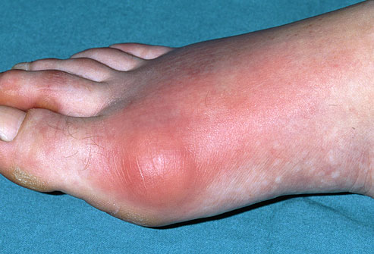
Gout!
Gout is the most common cause of arthritis in men behind osteoarthritis
Currently affects 6% of US males
Gout is triggered by urate crystals
High serum urate is also linked to cardiovascular disease, diabetes and metabolic syndrome

Slide 74
Gout Crystals Accumulate on Collagen Fibers*
Eliseo Pascual et al. Mechanisms of crystal formation in gout—a structural approach, Nature Reviews Rheumatology 2015.
Notes:
Images/gout_crystals.png
chronic_nature_gout_collagen_crystals.pdf

Slide 75
Gout Crystals Accumulate on Collagen Fibers*
Is this due to defective collagen because glyphosate has substituted for glycine in the protein?
Eliseo Pascual et al. Mechanisms of crystal formation in gout—a structural approach, Nature Reviews Rheumatology 2015.
Notes:
Images/gout_crystals.png
chronic_nature_gout_collagen_crystals.pdf

Slide 76
Gout and Glyphosate*
*Data on gout provided by Nick Causton; data on glyphosate provided by Nancy Swanson.
All data readily available on the Web.
Notes:
Nancy and Nick - Friends <Nick.Causton@AssociatedData.co.uk>

Slide 77
How Gout Renews Sulfate Supplies
H₂S is significantly elevated in synovial fluid compared to serum in association with gout and rheumatoid arthritis*
In gout, ApoB in LDL binds to urate and seeds crystals
Heparan sulfate binding protects from urate binding
Crystals induce signaling response that causes release of IL-1β (inflammatory cascade)
Superoxide can oxidize H₂S to sulfate → heparan sulfate
Metalloproteinases erode sulfated GAGs to restore sulfate supplies to vasculature
*N. Muniraj et al., International Journal of Rheumatic Diseases, Sep 8, 2014 [ePub ahead of print]

Slide 78
Chondroitin Sulfate (CS) Alleviates Gout*
Urate crystals induce expression of inflammatory cytokines IL-1β, TNFα and IL-8
IL-1β and TNFα were lowered in a dose-dependent manner by CS administration
CS may elicit an anti-inflammatory effect in many other tissues besides the joint
*EW Orlowsky et al, BMC Musculoskeletal Disorders 2014, 15:318
Notes:
*EW Orlowsky et al, BMC Musculoskeletal Disorders 2014, 15:318.
2017/gout/.chondroitin_sulfate_alleviates_gout_in_vitro_2014.pdf

Slide 79
Hydrogen Sulfide and Disease*
H₂S functions as a pro-inflammatory mediator in arthritis, acute pancreatitis, sepsis, hemorrhagic shock and burns
Mediated through upregulation of CSE
H₂S levels in the synovial fluid in patients with gout or rheumatoid arthritis are significantly higher than plasma levels
Administration of H₂S donors (e.g., NaHS) to animals leads to extensive tissue inflammation and increased expression of pro-inflammatory cytokines
*N. Muniraj et al., International Journal of Rheumatic Disease 2014;1-8.

Slide 80
Hydrogen Sulfide and Disease*
H₂S functions as a pro-inflammatory mediator in arthritis, acute pancreatitis, sepsis, hemorrhagic shock and burns
Mediated through upregulation of CSE
H₂S levels in the synovial fluid in patients with gout or rheumatoid arthritis are significantly higher than plasma levels
Administration of H₂S donors (e.g., NaHS) to animals leads to extensive tissue inflammation and increased expression of pro-inflammatory cytokines
Hydrogen sulfide oxidation to sulfate requires inflammatory response
*N. Muniraj et al., International Journal of Rheumatic Disease 2014;1-8.
Notes:
2017/gout/Muniraj_2014_gout_hydrogen_sulfide_link.pdf

Slide 81
How to Stay Healthy

Slide 82
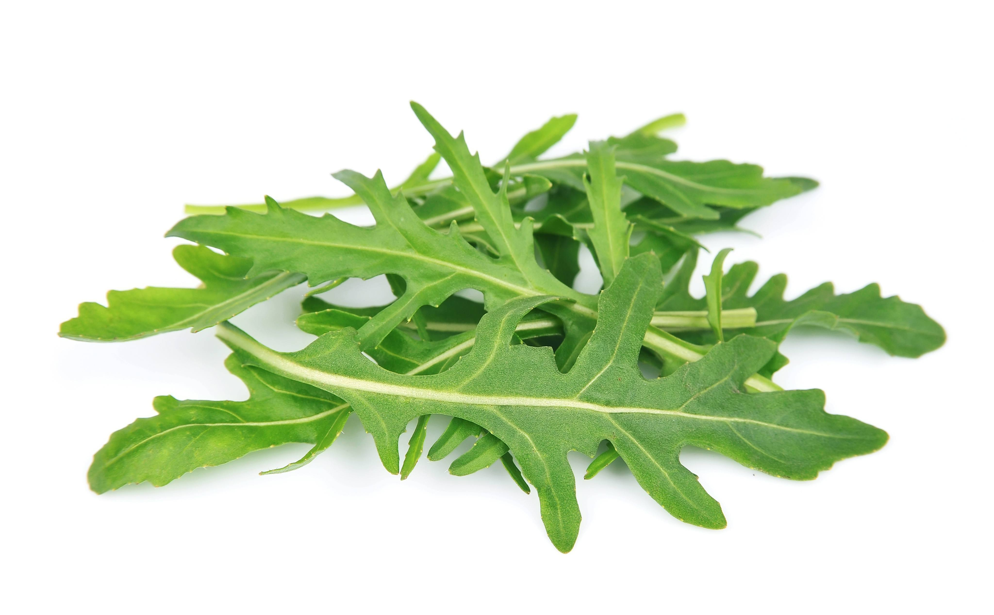
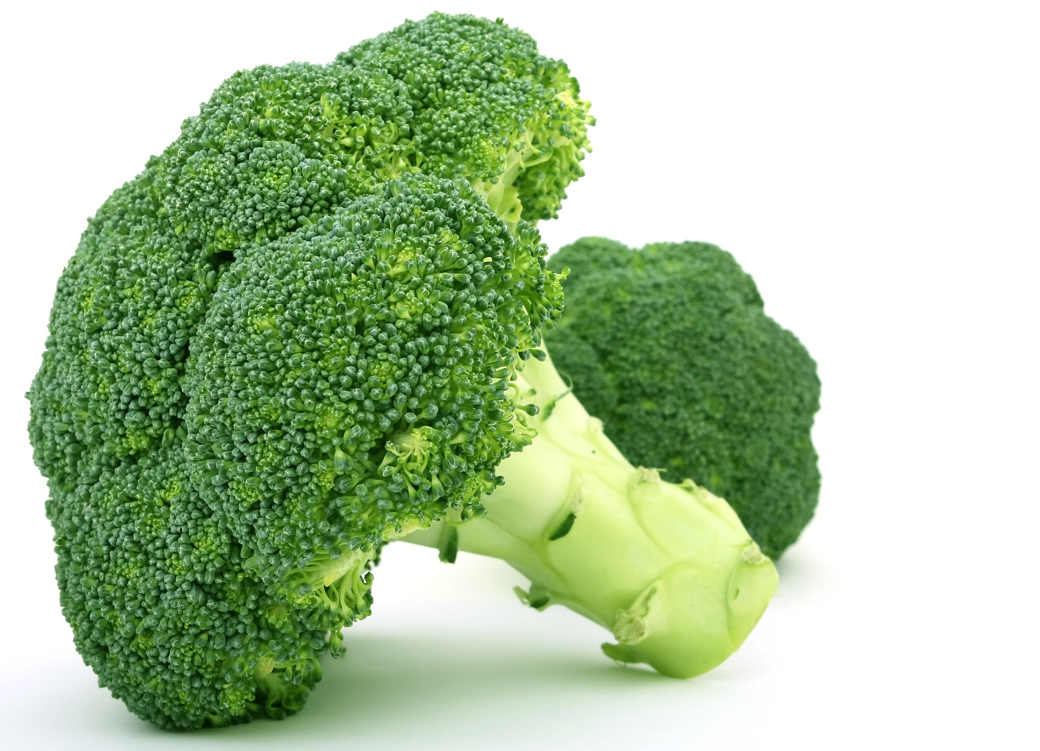
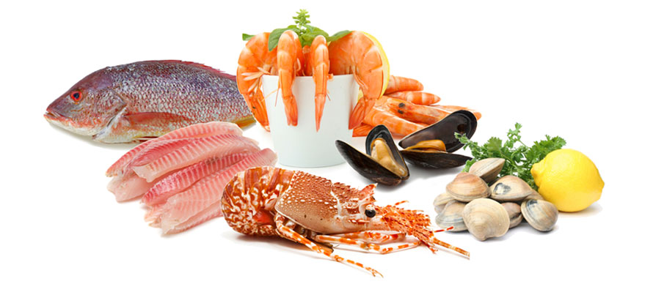
How to Stay Healthy
Eat a strictly certified organic diet
Get lots of dietary sulfur
Get out in the sunlight
Get grounded

Slide 83
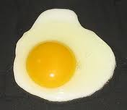
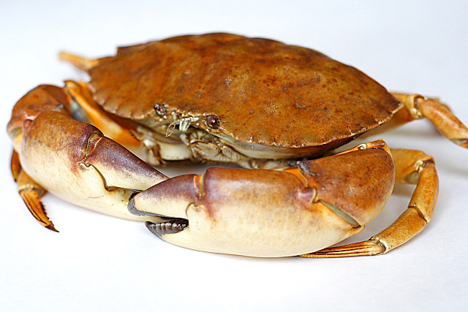
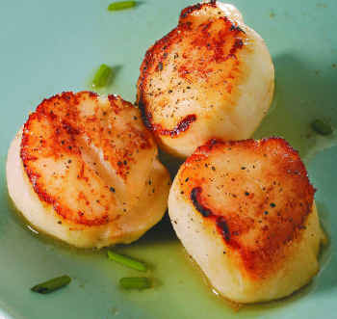
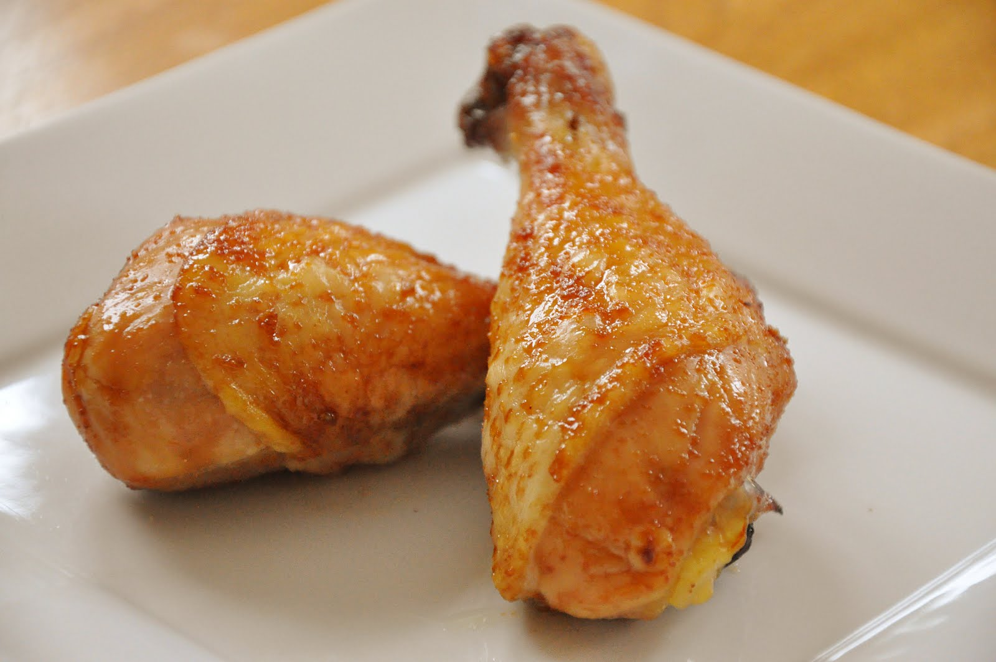
Foods Containing Sulfur
Notes:
http://healthyeatingclub.com/info/books-phds/books/foodfacts/html/data/data5g.html

Slide 84
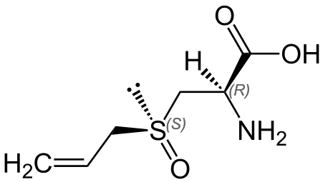
“Hydrogen sulfide mediates the vasoactivity of garlic”*
Garlic consumption leads to reduced risk to cardiovascular disease, high blood pressure, high cholesterol, and blood clots
This benefit is likely mediated by the biological production of H₂S from garlic-derived organic polysulfides
*GA Benavides et al., PNAS 2007; 104(46): 17977–17982.
Notes:
Benavides_2007_H2S_mediates_garlic_vasoactivity.pdf

Slide 85
Supplemental Sources of Sulfur*
glucosamine sulfate
chondroitin sulfate
glutathione
N-acetylcysteine
alpha lipoic acid
taurine
DMSO, MSM
S-adenosylmethionine (SAMe)
Epsom salts (Mg-sulfate)
These can have many beneficial effects and are nearly nontoxic
My personal favorite is Epsom salt baths:
Magnesium sulfate uptake through the skin
*S Parcell, Alternative Medicine Review 7(1), 2002, 22-44
Notes:
./sulfur_in_human_nutrition_review.pdf

Slide 86
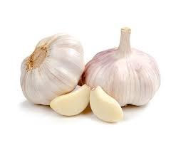
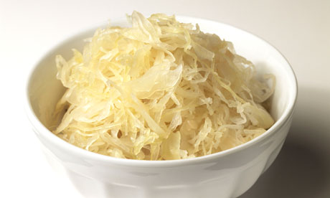
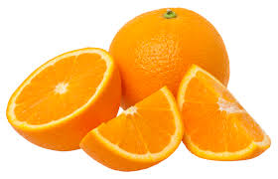
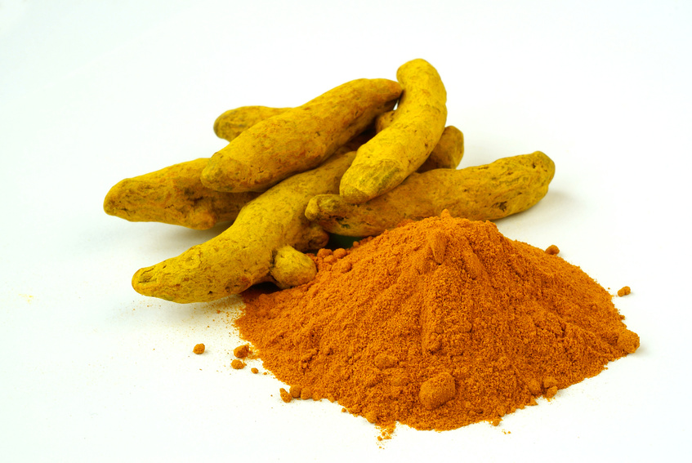
Some Important Nutrients
Curcumin
Garlic
Vitamin C
Probiotics
Methyl tetrahydrofolate
Cobalamin
Glutathione
Taurine
Epsom salt baths

Slide 87
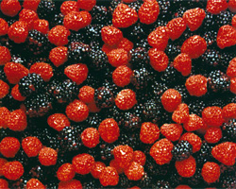
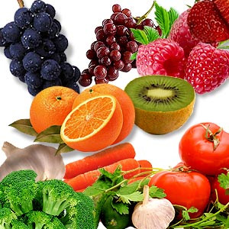
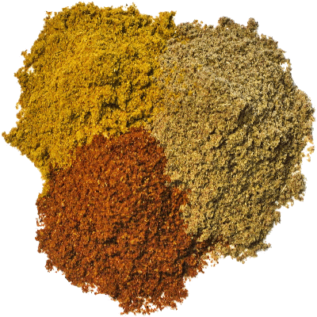
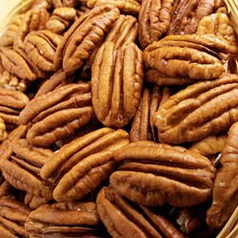
Flavonoids and Polyphenols!

Slide 88
Get Grounded

Slide 89
Go Organic!

Slide 90
Hang Out in the Water at the Seashore

Slide 91
Summary
The US has a dismal health record despite exorbitant health expenditures
Is this due to chronic glyphosate poisoning?
Glyphosate can substitute for glycine by mistake in proteins, causing disastrous consequences
Nutrient deficiencies and toxic metabolites due to dysfunctional enzymes
Glyphosate disrupts sulfate homeostasis and this leads to oxalate and urate crystals damaging tissues
Diseases connected to inflammation exist to renew sulfate supplies to the blood
Organic high-sulfur diet with lots of sunshine exposure is the path to good health

Slide 92
Thank You for Listening!

