Slide 1
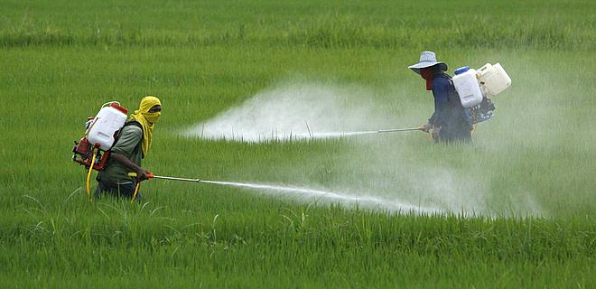
Glyphosate Pretending to be Glycine: Devastating Consequences
Stephanie Seneff
MIT CSAIL
Saturday, April 22, 2017

Slide 2
Outline
Introduction
Glyphosate as a glycine analogue
Autoimmune disease
Collagen and gelatin
How to protect yourself
Summary

Slide 3
Roundup and GMO Crops
GMO Roundup-Ready corn, soy, canola, sugar beets
cotton, tobacco and alfalfa
What is glyphosate?

Slide 4
Glyphosate vs. Other Pesticides: Usage in the United States*
Glyphosate
*http://sustainablepulse.com/wp-content/uploads/GMO-health.pdf

Slide 5
Glyphosate as a
Glycine Analogue

Slide 6
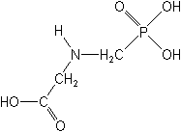
What If Glyphosate Could Insert Itself Into Protein Synthesis by mistake???
glyphosate
Code for glycine
GGC
mRNA
. . .
. . .
Glyphosate
Alanine
Proline
Any proteins with conserved glycine residues are likely to be affected in a major way

Slide 7
Glyphosate is a non-coding amino acid analogue of glycine
H
Glycine
Glyphosate

Slide 8
Extra Piece Sticks Out at Active Site
Substrate no longer fits in active site
Active Site
Extra Stuff
Glyphosate
Alanine
Proline
glycine
Peptide chain

Slide 9
Extra Piece Sticks Out at Active Site
Substrate no longer fits in active site
This explains how glyphosate disrupts EPSPS in the shikimate pathway: Multiple bacteria have developed resistance by replacing active site glycine with alanine and this is the basis for GMO Roundup Ready crops*
Active Site
Extra Stuff
Glyphosate
Alanine
Proline
glycine
Peptide chain
*T Funke et al., Molecular basis for the herbicide resistance of Roundup Ready crops. PNAS 2006;103(35):13010-13015.

Slide 10
Inhibition of EPSPS by glyphosate: Resistant E coli mutant*
Mutant with alanine substituted for glycine 96
Wild type with glycine 96
*Figure 3, S Eschenburg et al. Planta 2002;216:129-135.

Slide 11
Some Predicted Consequences*
Neurological diseases
Autoimmune diseases
Chronic fatigue syndrome
Impaired collagen → osteoarthritis
Fatty liver disease
Obesity and adrenal insufficiency
Impaired iron homeostasis and kidney failure
Insulin resistance and diabetes
Cancer
*Samsel A and Seneff S. Journal of Biological Physics and Chemistry 2016;16:9-46.

Slide 12
Dementia and Glyphosate*
*Nancy Swanson, http://www.examiner.com/article/
data-show-correlations-between-increase-neurological-diseases-and-gmos

Slide 13
Dementia and Glyphosate*
Alzheimer’s disease has been specifically linked to a GXXXG motif in a specific region of amyloid beta plaque*
*L-M Munter et al. The EMBO Journal 2007; 26: 1702-1712.
*Nancy Swanson, http://www.examiner.com/article/
data-show-correlations-between-increase-neurological-diseases-and-gmos
Notes:
2016/Anthony/GxxxG_motif_Abeta_2007.pdf

Slide 14
Autoimmune Disease

Slide 15
Autoimmune Disease: An Invisible Epidemic*
“Taken together, the number of people suffering from autoimmune diseases is 24–50 million Americans, 16% of the US population. To put it in perspective, autoimmune disease prevalence equals heart disease and cancer combined.”
*Feldman B, Martin EM, Simms T. An Invisible Epidemic — When your body attacks itself — Autoimmune Disease; How Reframing the Data Unveils a Public Health Crisis Bigger than Cancer and Heart Disease Combined. www.tincture.io.
Notes:
Feldman B, Martin EM, Simms T. An Invisible Epidemic — When your body attacks itself — Autoimmune Disease; How Reframing the Data Unveils a Public Health Crisis Bigger than Cancer and Heart Disease Combined. www.tincture.io.
IN Beecham Seneff paper. Ref. 13.

Slide 16
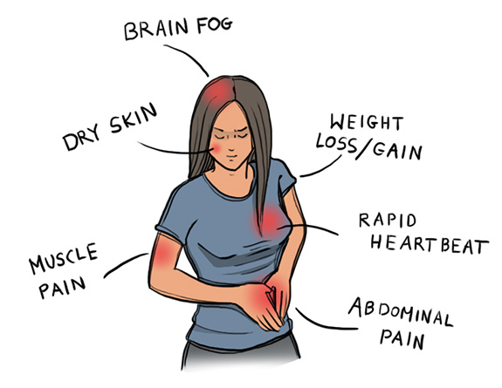
Autoimmune Disease Statistics*
Annual direct health care costs for AD in US estimated to be ~$100 billion
At least 23.5 million Americans suffer from one or more autoimmune diseases
Among the top-10 causes of death in females under 64 years old
Immunosuppressant treatments have devastating side effects
*https://www.aarda.org/autoimmune-information/autoimmune-statistics/

Slide 17
Why do we have an epidemic in
autoimmune disease in America today?

Slide 18
Hypothesis
Glyphosate exposure sets up a weakened immune system, a leaky gut barrier and a leaky brain barrier
Glyphosate contamination in proteins makes them hard to break down
Glyphosate disrupts the pancreatic enzymes that metabolize proteins
Person develops overactive antibody response to foreign protein contaminated with glyphosate and, through molecular mimicry, this leads to autoimmune disease
This easily explains gluten intolerance and other food allergies

Slide 19
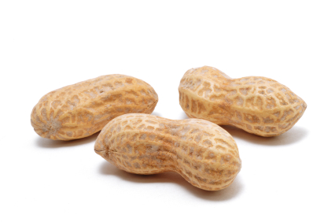
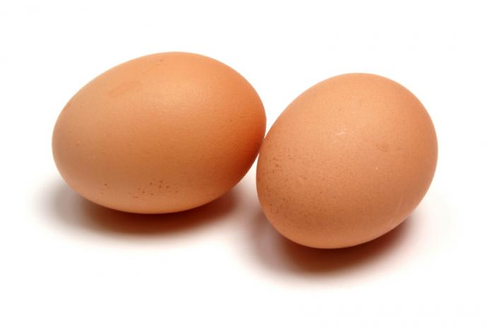
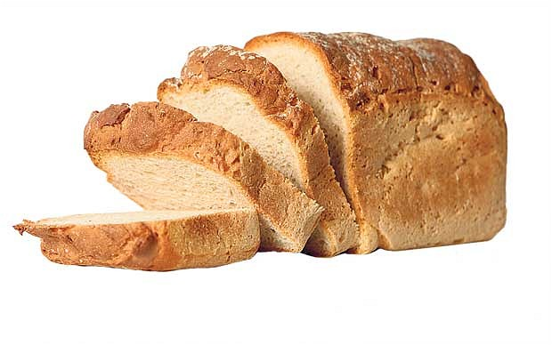
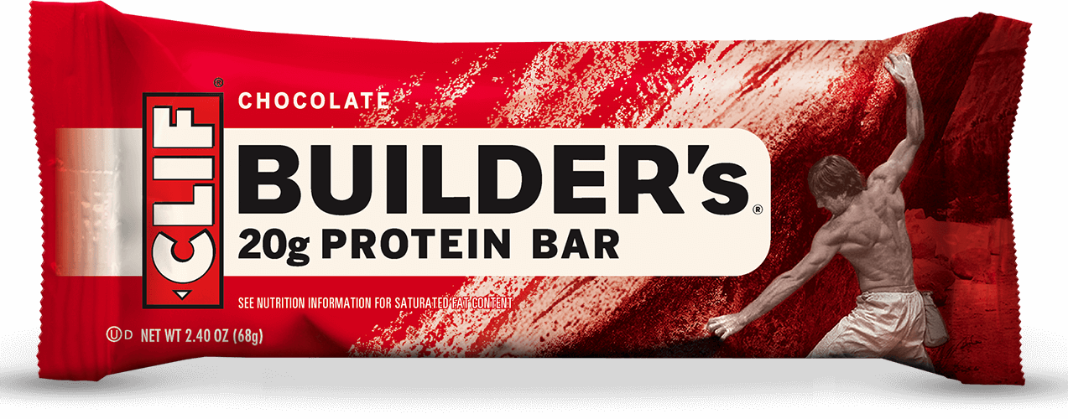
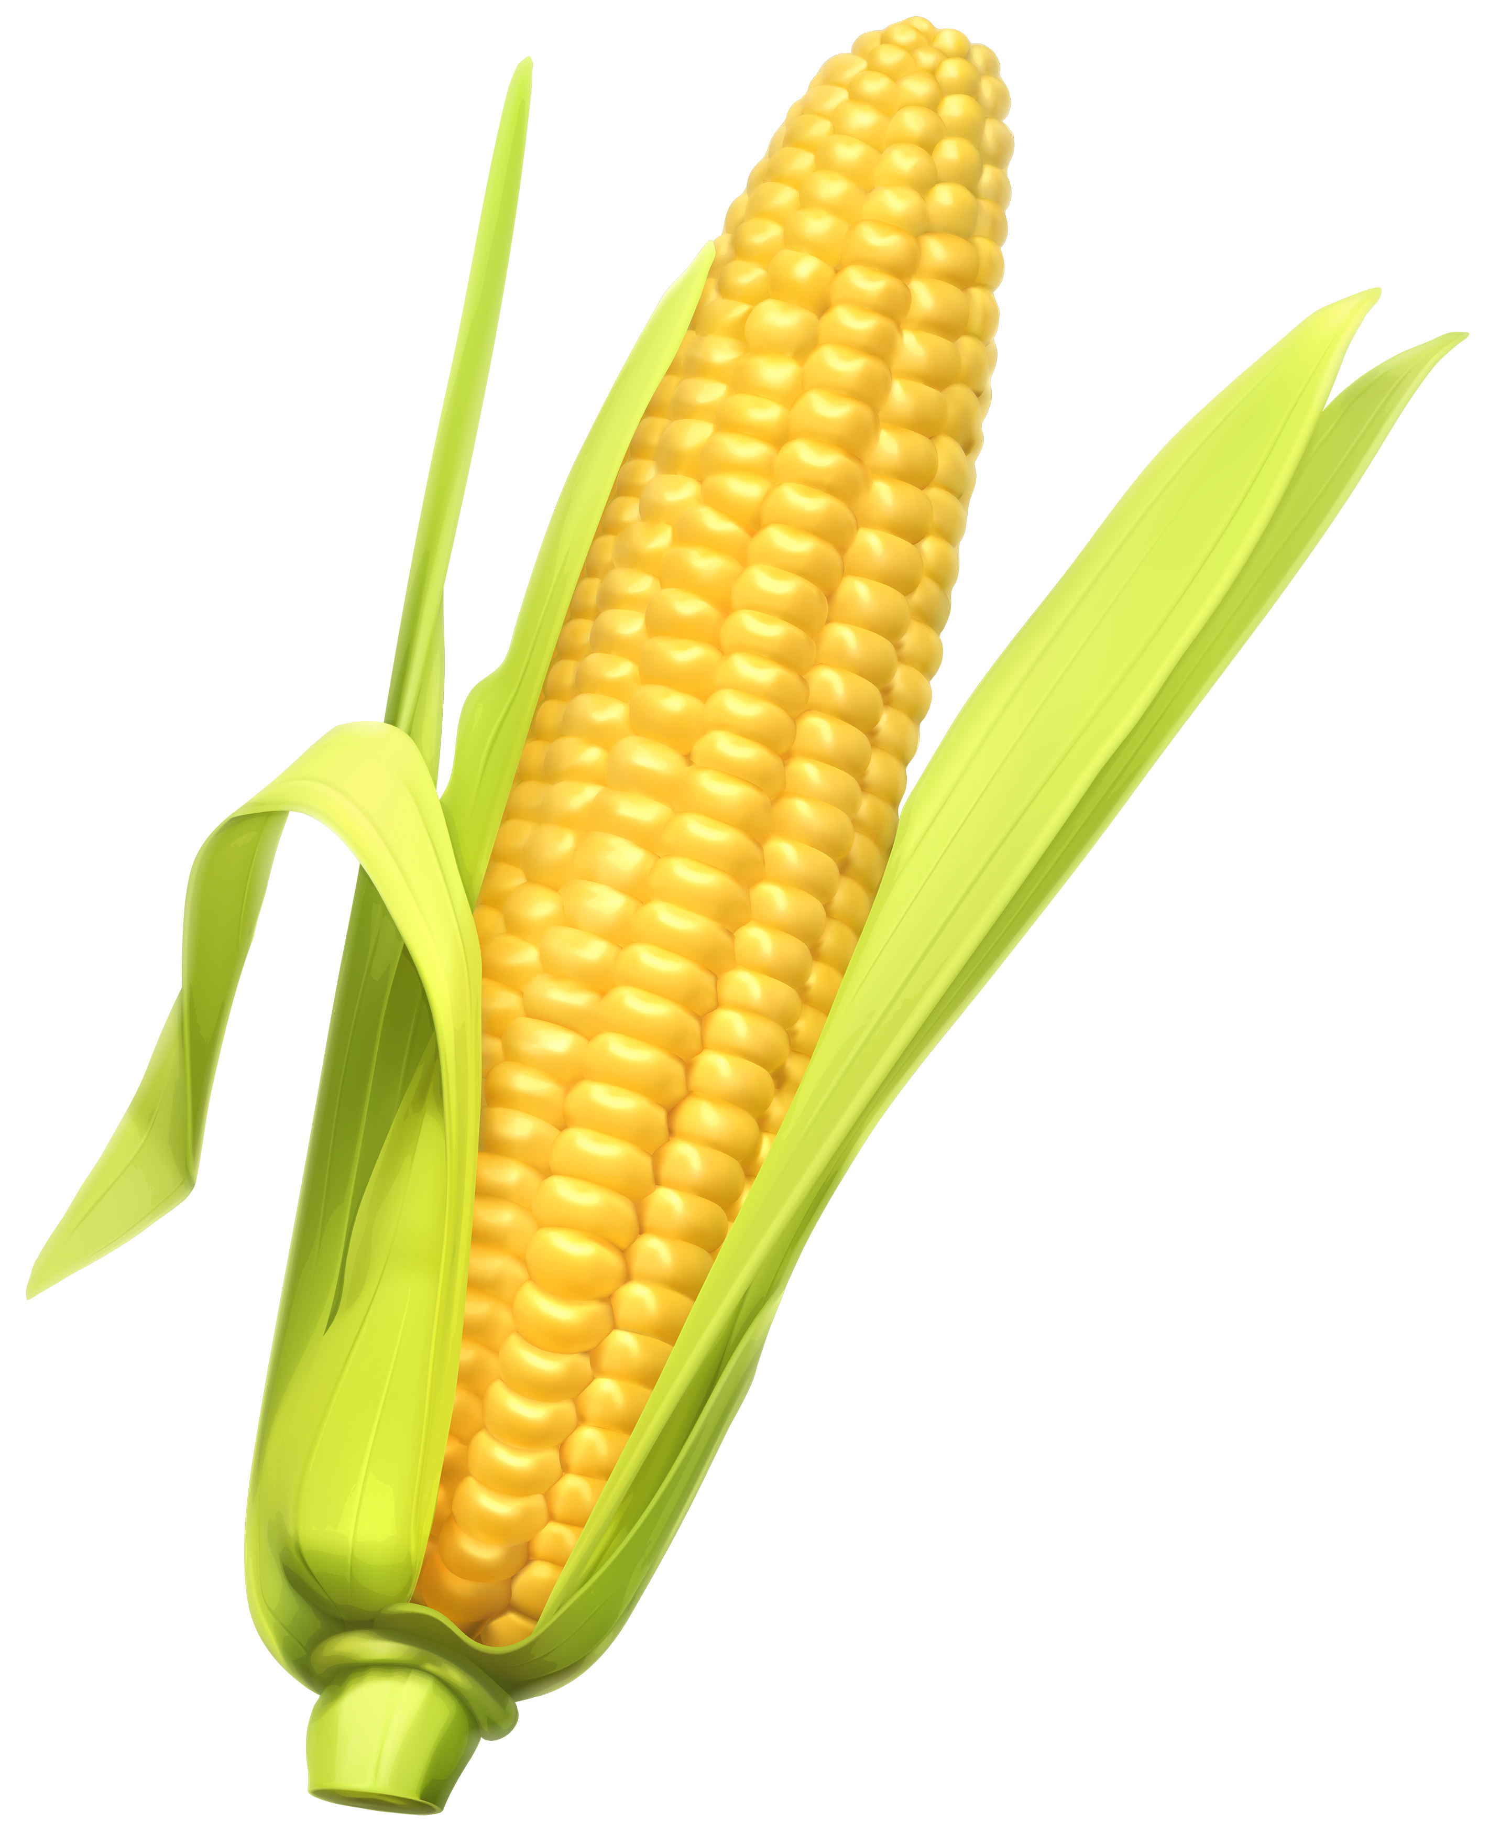
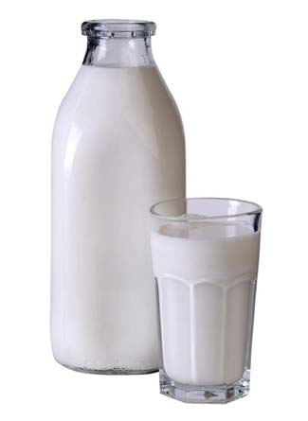
Food Allergies

Slide 20
Food Allergies
All of these foods can be expected to be contaminated with glyphosate, given how they’re produced

Slide 21
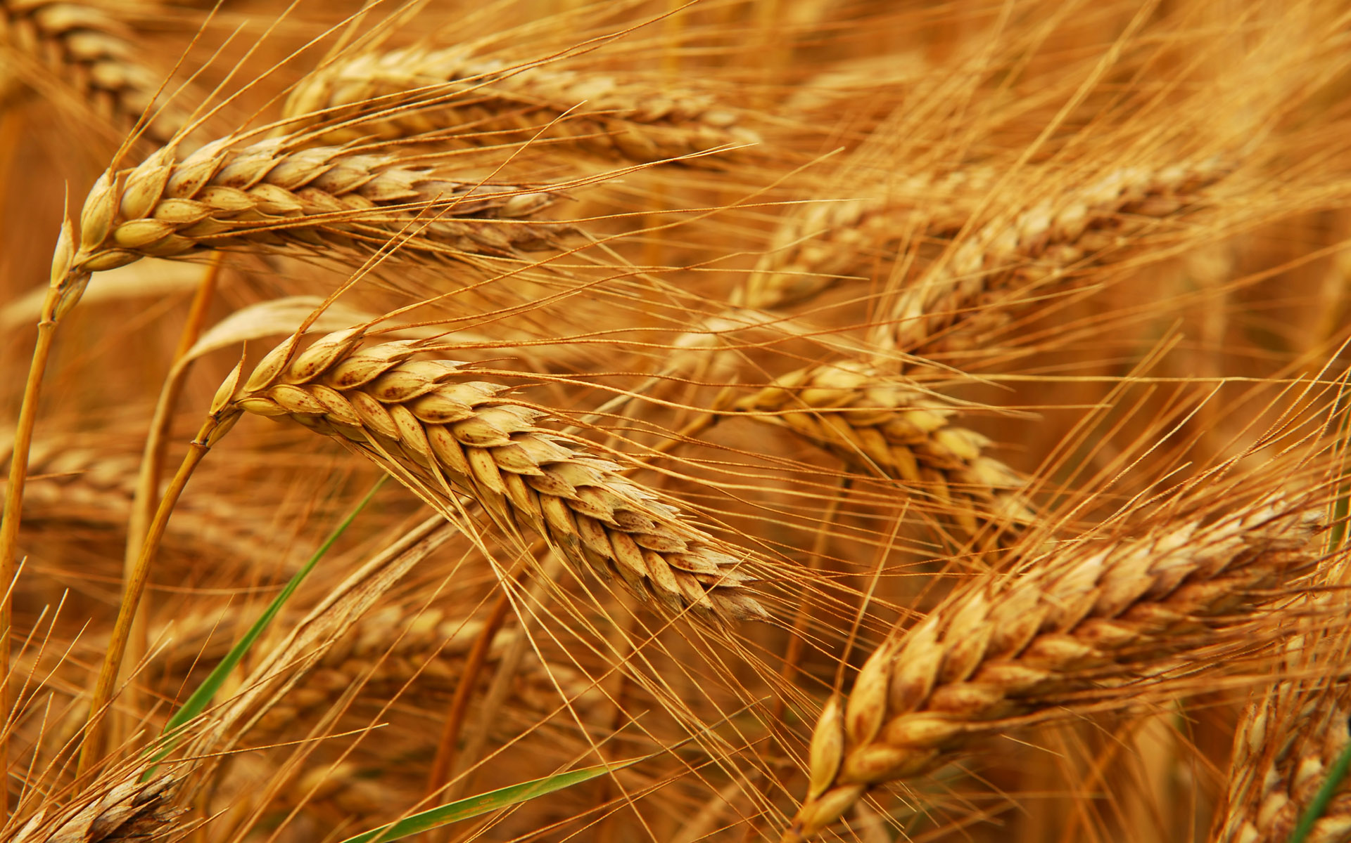
Glyphosate and Celiac Disease*
Glyphosate
Use on wheat
Celiac disease
*Samsel and Seneff, Interdiscip Toxicol. 2013;6(4): 159–184.

Slide 22
Celiac disease: Impaired gluten digestion
Gluten intolerance results from inability to break down gluten, which is enriched in proline*
The enzyme that breaks down proline depends on manganese as a catalyst (depleted by glyphosate)
It also contains three regions with highly conserved glycines**
Malabsorption can lead to nutritional deficiencies and symptoms of autism ***
*G. Janssen et al., PLoS One 2015; 10(6): e0128065
**F Morel et al., Biochimica et Biophysica Acta 1999;1429: 501-505
***SJ Genuis and TP Bouchard, J Child Neurol. 2010;25(1):114-9
Notes:
gluten 麩質
Plos One:
Ineffective Degradation of Immunogenic Gluten Epitopes by Currently Available Digestive Enzyme Supplements
Glyphosate/ineffective_proteolysis_of_proline_in_gluten_digestive_enzymes.pdf

Slide 23
Celiac disease: Impaired gluten digestion
Gluten intolerance results from inability to break down gluten, which is enriched in proline*
The enzyme that breaks down proline depends on manganese as a catalyst (depleted by glyphosate)
It also contains three regions with highly conserved glycines**
Malabsorption can lead to nutritional deficiencies and symptoms of autism ***
Wheat is routinely sprayed right before harvest with glyphosate as a desiccant
Other treated plants include
Sugar cane, barley, peanuts, maize and legumes
*G. Janssen et al., PLoS One 2015; 10(6): e0128065
**F Morel et al., Biochimica et Biophysica Acta 1999;1429: 501-505
***SJ Genuis and TP Bouchard, J Child Neurol. 2010;25(1):114-9
Notes:
gluten 麩質
Plos One:
Ineffective Degradation of Immunogenic Gluten Epitopes by Currently Available Digestive Enzyme Supplements
Glyphosate/ineffective_proteolysis_of_proline_in_gluten_digestive_enzymes.pdf

Slide 24
Drugs and Autoimmune Disease*
Drugs that treat autoimmune disease have a huge problem with side effects
They suppress the immune system, and increase risk to tuberculosis, invasive fungal infections and lymphomas (cancers of the immune system)
Humira is a TNF-alpha inhibitor, which blocks the immune response
It costs about $3,100 per month
U.S. prescriptions for Humira have taken off in recent years: 1.5 million in 2011; 2.4 million in 2015.
It was linked to more than 209,000 adverse event reports since 2013, including more than 4,200 deaths.
* usatoday.com/story/news/nation-now/2017/03/19/
analysis-reports-drug-side-effects-increase-fivefold-12-years/99384190/
Notes:
rug_side_effects_rising_2017.text

Slide 25
Collagen and Gelatin

Slide 26
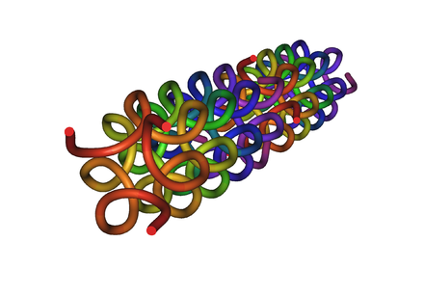
Collagen and Gelatin
25% of the protein in our body is collagen
25% of the amino acids in collagen are glycines
Glyphosate substitution for glycine will disrupt triple-helix formation and lead to diseases of the vasculature, joints and bones
Gelatin is derived from collagen in bones and ligaments sourced from cows and pigs fed glyphosate-contaminated GMO Roundup-Ready feed

Slide 27
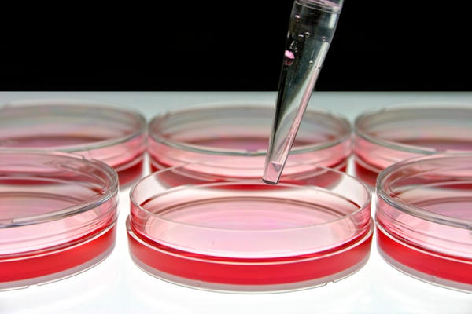
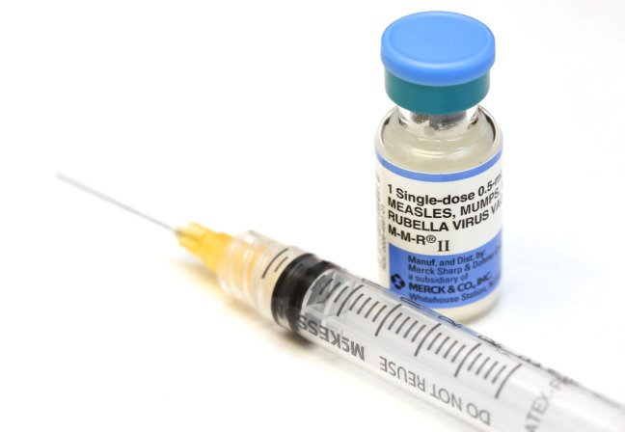
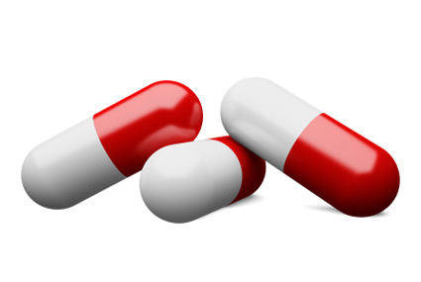
Products Containing Gelatin !!

Slide 28
Rheumatoid Arthritis
Inflammation in the joints causes pain and limits movement
Small joints of the hands, feet and cervical spine most affected
Can lead to lung fibrosis
Increases risk to atherosclerosis, heart attack and stroke.
Poor iron absorption leads to "anemia of chronic disease"
Fatigue, low grade fever, malaise, morning stiffness, loss of appetite and loss of weight

Slide 29
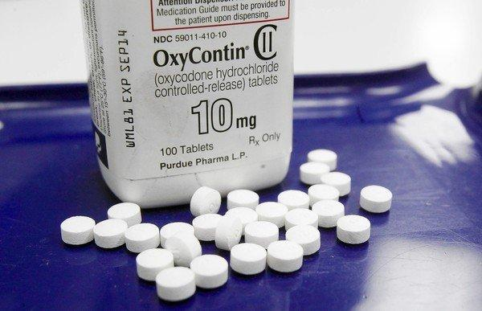
US Department of Health and Human Services Data on Pain-Killer Drug Abuse*
Drug overdose is the leading cause of injury death in the United States
Heroin, morphine, and prescription pain relievers
More people died from drug overdoses in 2014 than in any previous year on record
More than 6 out of 10 involved an opioid drug
More than 650,000 opioid prescriptions are dispensed every day
*http://www.hhs.gov/opioids/about-the-epidemic/
Notes:
./Factsheet-opioids-061516.pdf

Slide 30
How to Protect Yourself

Slide 31
Go Organic!

Slide 32
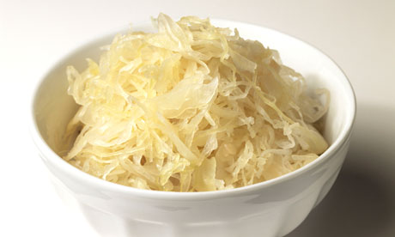
Sauerkraut and apple cider vinegar contain acetobacter, one of the very few microbes that can metabolize glyphosate
Yogurt and kimchi probably do, too

Slide 33
Summary
Glyphosate is pervasive in our food supply today
Recent research shows that glyphosate can have devastating consequences to health through substitution for glycine during protein synthesis by mistake
Bacterial gene mutations introduced in Roundup-Ready crops swap out glycine for alanine
Explains its correlation with multiple diseases, particularly autoimmune diseases
Effects are insidious and cumulative
Probiotics and an organic diet can help protect from glyphosate damage

