Slide 1
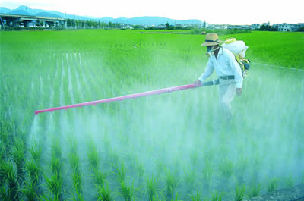
Glyphosate: The “Safe” Herbicide that’s Making us all Sick!
Stephanie Seneff, MIT CSAIL
Institute of Sustainable Nutrition
Saturday, March 24, 2018

Slide 2
New York Times: “Another View” July 13, 2015
“The GMO experiment, carried out in real time and with our entire food and ecological system as its laboratory, is perhaps the greatest case of human hubris ever. It creates yet another systemic, ‘too big too fail’ enterprise — but one for which no bailouts will be possible when it fails.”
Mark Spitznagel and Nassim Nicholas Taleb
nytimes.com/2015/07/14/business/dealbook/another-too-big-to-fail-system-in-gmos.html

Slide 3
Outline
Introduction
Glyphosate as a glycine analogue
Food allergies and autoimmune disease
Collagen and gelatin
Animals in distress
How to protect yourself
Summary

Slide 4
US Health Status
US makes up 5% of the world’s population but consumes more than 50% of the world’s pharmaceutical drugs
We spend more on health care than Japan, France, China, UK, Italy, Canada, Brazil, Spain, and Australia, combined
US ranks last or near last among developed nations on infant mortality and life expectancy
We also suffer from more chronic illnesses
We consume 20% of the world supply of glyphosate

Slide 5
Roundup and GMO Crops
GMO Roundup-Ready corn, soy, canola, sugar beets
cotton, tobacco and alfalfa
What is glyphosate?

Slide 6
Glyphosate vs. Other Pesticides: Usage in the United States*
Glyphosate
*http://sustainablepulse.com/wp-content/uploads/GMO-health.pdf

Slide 7
Glyphosate and AMPA (Breakdown Product) Far Exceed Other Chemicals*
2003-2005
*Table from PRESENCE AND LEVELS OF PRIORITY PESTICIDES IN SELECTED CANADIAN AQUATIC ECOSYSTEMS. published in 2011 by the Canadian Government
Notes:
PRESENCE AND LEVELS OF PRIORITY PESTICIDES IN SELECTED CANADIAN AQUATIC ECOSYSTEMS published in 2011 by the Canadian Government

Slide 8
Main Toxic Effects of Glyphosate*
Interferes with function of cytochrome P450 (CYP) enzymes
Chelates important minerals (iron, cobalt, manganese, etc.)
Interferes with synthesis of aromatic amino acids and methionine
Leads to shortages in critical neurotransmitters and folate
Disrupts sulfate synthesis and sulfate transport
*Samsel and Seneff, Entropy 2013, 15, 1416-1463

Slide 9
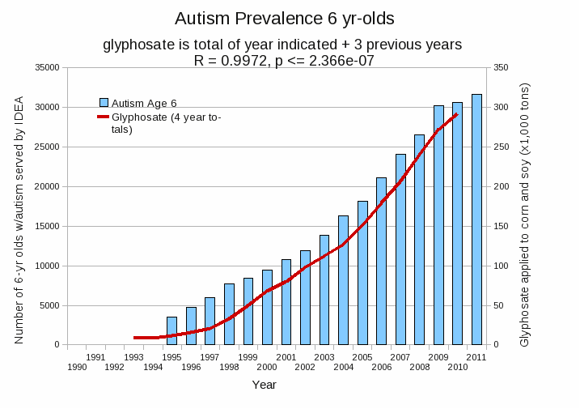
Autism Prevalence: 6 year olds
R = 0.9972
*Plot provided by Nancy Swanson, with permission
Data sources: autism: US Department of Education; Glyphosate: US Department of Agriculture
Notes:
Nancy/latest_plots/6-yr-old autism.gif
autism: USDE
oil consumption: USDA
glyphosate: USDA
GE crops: USDA
Mortality data: CDC

Slide 10
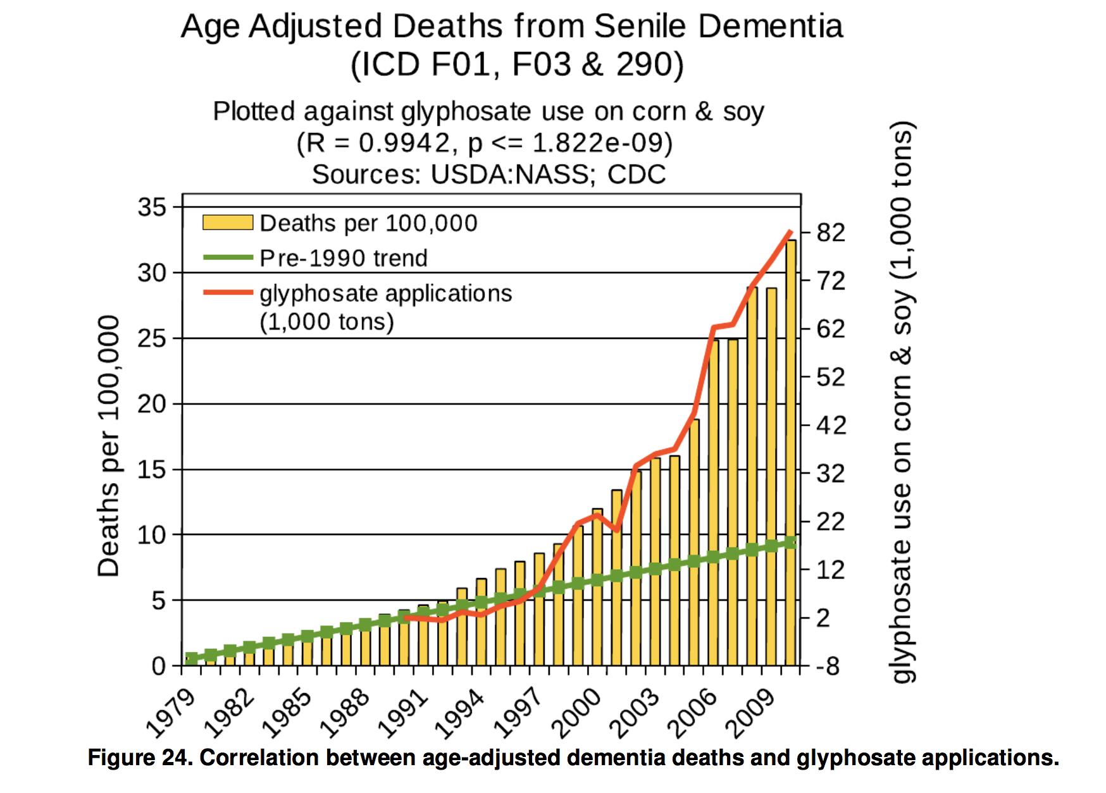
*N Swanson et al. Journal of Organic Systems 2014;9(2): 6-37.

Slide 11
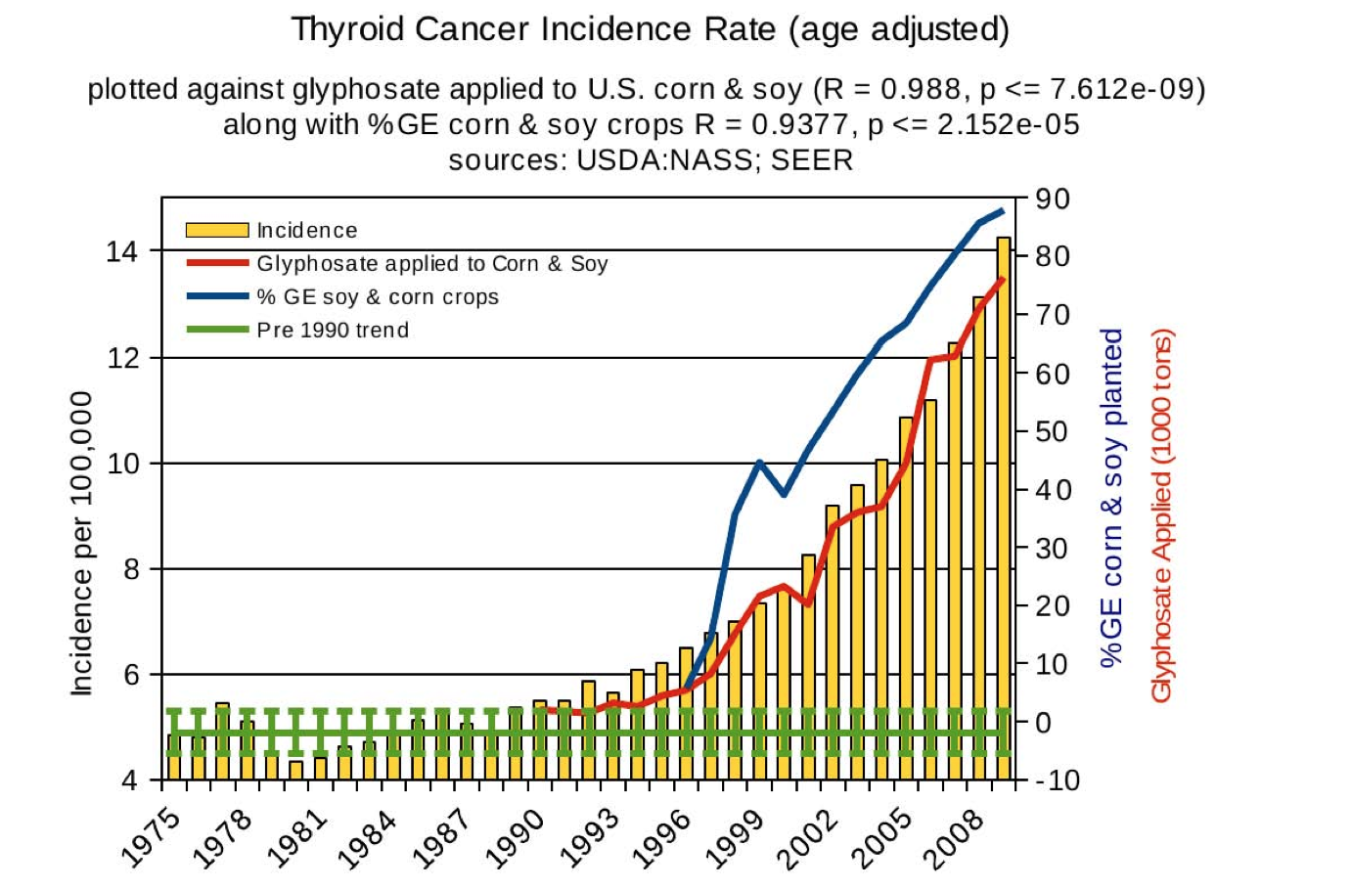
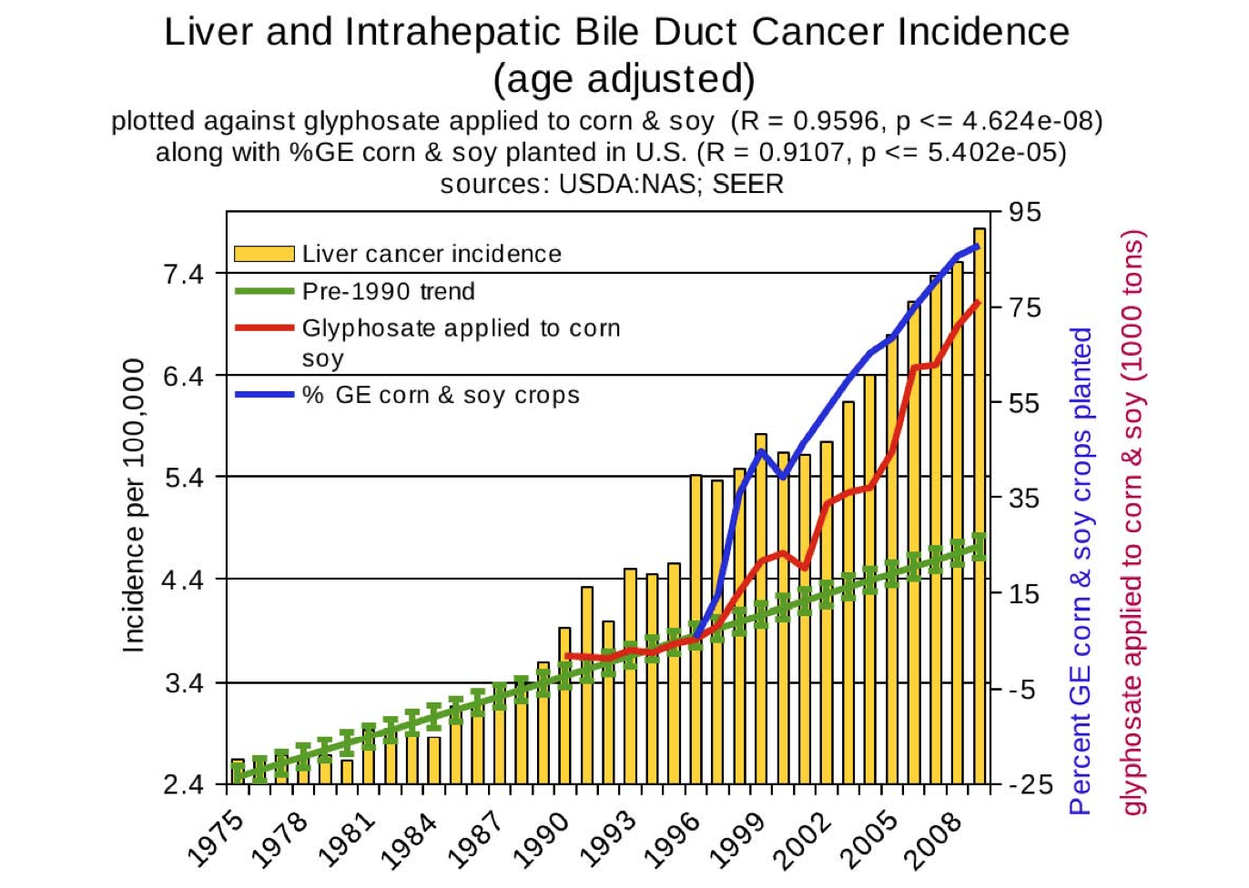
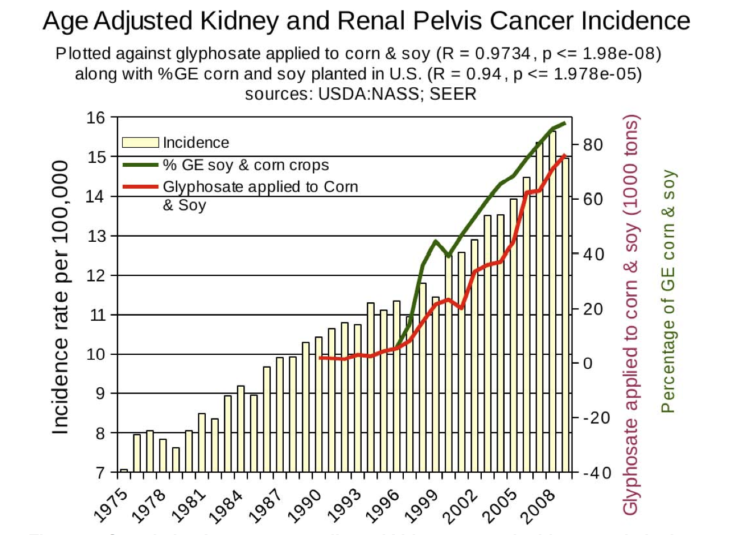
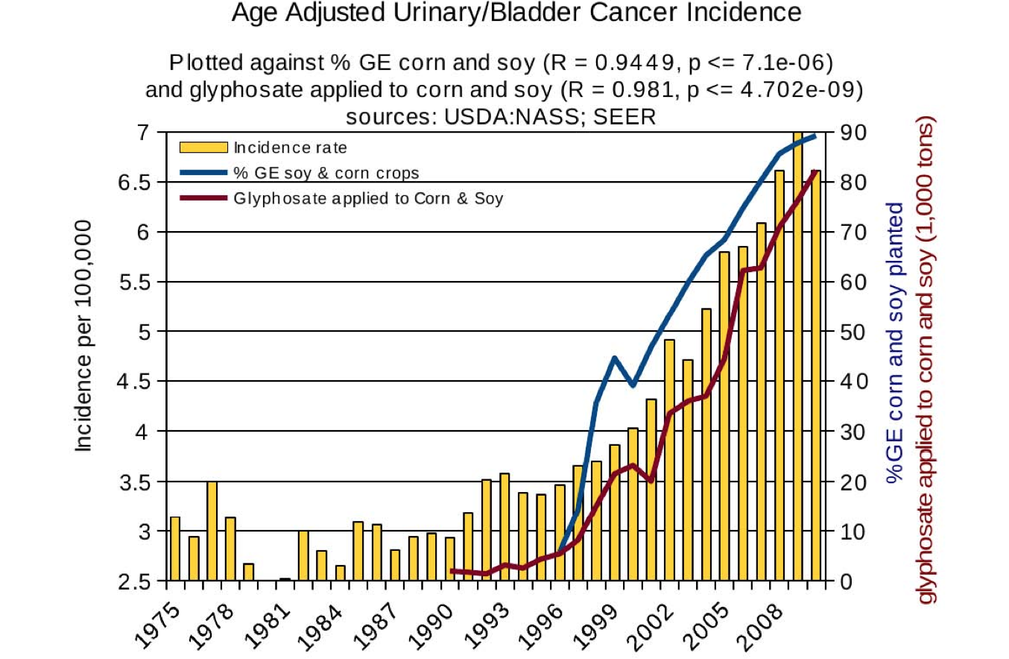
Correlations between Glyphosate and Multiple Cancers*
Thyroid
Liver
Kidney
Bladder
*N Swanson et al. Journal of Organic Systems 2014;9(2): 6-37.

Slide 12
*
IARC declared glyphosate a “probable carcinogen” in 2015
Monsanto sent a threatening letter of intimidation to IARC staff
Ominously, EPA staff has been accused of collusion with Monsanto to downgrade the health hazards of glyphosate
“The interferences by economic interests in cancer evaluations conducted by public health institutions do not bode well for the free flow of scientific information that informs and protects the public and workers from clear risks of cancer.”
*Am J Ind Med. 2018;61:277–281.
Notes:
Infante_2018_IARC_defense.pdf

Slide 13
Glyphosate and Antibiotic Resistance*
Huge and growing problem with antibiotic resistant microbes in hospitals worldwide
Glyphosate is a patented antimicrobial agent
Chronic low-level exposure to one antibiotic empowers pathogens to become resistant to other antibiotics
*B Kurenbach et al., mBio March/April 2015; 6(2):e00009-15.
Notes:
Glyphosate/treasures/mBio_glyphosate_induces_antibiotic_resistance_pathogens_2015.pdf
抗生素耐藥微生物
Kàngshēngsù nài yào wéishēngwù

Slide 14
Glyphosate-Resistant Weeds
From GMO Myths and Truths, EarthOpenSource

Slide 15
Enlist Duo!
The answer to glyphosate resistance in weeds!
Corn and soybean crops are now engineered to resist both glyphosate and 2,4 D
Enlist Duo contains a mixture of both of these herbicides
The synergistic effects can only be imagined at this time

Slide 16
Enlist Duo!
The answer to glyphosate resistance in weeds!
Corn and soybean crops are now engineered to resist both glyphosate and 2,4 D
Enlist Duo contains a mixture of both of these herbicides
The synergistic effects can only be imagined at this time
“Monsanto's new Roundup Ready Xtend cotton and soybeans are engineered to be resistant to a combination of glyphosate and dicamba, while Dow AgroSciences' new breed of Enlist Duo corn and soybeans are resistant to a combination of glyphosate and 2,4-D.”*

Slide 17
Glyphosate as a
Glycine Analogue

Slide 18
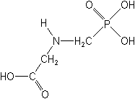
What If Glyphosate Could Insert Itself Into Protein Synthesis by mistake???
glyphosate
Code for glycine
GGC
mRNA
. . .
. . .
Glyphosate
Alanine
Proline
Any proteins with conserved glycine residues are likely to be affected in a major way

Slide 19
Glyphosate is a non-coding amino acid analogue of glycine
H
Glycine
Glyphosate

Slide 20
Extra Piece Sticks Out at Active Site
Substrate no longer fits in active site
Active Site
Extra Stuff
Glyphosate
Alanine
Proline
glycine
Peptide chain

Slide 21
Extra Piece Sticks Out at Active Site
Substrate no longer fits in active site
This explains how glyphosate disrupts EPSPS in the shikimate pathway: Multiple bacteria and weeds have developed resistance by replacing active site glycine with alanine and this is the basis for GMO Roundup Ready crops*
Active Site
Extra Stuff
Glyphosate
Alanine
Proline
glycine
Peptide chain
*T Funke et al., Molecular basis for the herbicide resistance of Roundup Ready crops. PNAS 2006;103(35):13010-13015.

Slide 22
Inhibition of EPSPS by glyphosate: Resistant E coli mutant*
Mutant with alanine substituted for glycine 96
Wild type with glycine 96
*Figure 3, S Eschenburg et al. Planta 2002;216:129-135.

Slide 23
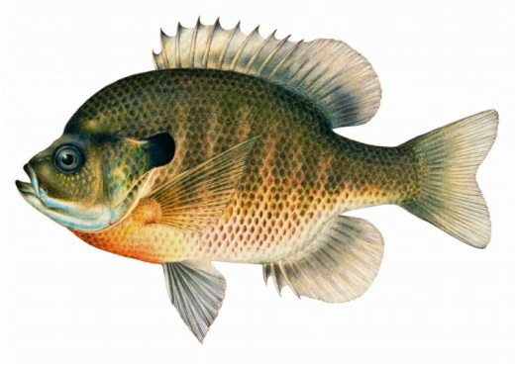
Quote from Monsanto Study (1989)*
Study exposed bluegill sunfish to carbon-14 radiolabelled glyphosate
Measured radiolabel in tissues greatly exceeded measured glyphosate levels
Proteolysis recovered more glyphosate
20%→ 70%
"Proteinase K hydrolyses proteins to amino acids and small oligopeptides, suggesting that a significant portion of the 14C activity residing in the bluegill sunfish tissue was tightly associated with or incorporated into protein.”
*WP Ridley and KA Chott. Monsanto unpublished study. August, 1989.

Slide 24
Some Predicted Consequences*
Impaired CYP enzymes → low bile acids, low vitamin D, impaired detox capabilities
Neurological diseases (autism, Alzheimer’s, …)
Autoimmune diseases (Celiac disease, MS, …)
Chronic fatigue syndrome (myosin impairment)
Impaired collagen → osteoarthritis
Fatty liver disease
Obesity and adrenal insufficiency
Impaired iron homeostasis and kidney failure
Insulin resistance and diabetes
Cancer
*Samsel A and Seneff S. Journal of Biological Physics and Chemistry 2016;16:9-46.

Slide 25
Glyphosate Disrupts Cytochrome P450 (CYP) Enzymes*
Glyphosate has been shown to severely suppress CYP enzymes in rat liver
CYP enzymes have a unique FXXGXRXCXG motif with two and sometimes three critical glycine residues**
*A Samsel and S Seneff. Entropy 2013; 15: 1416-1463.
**K Syed and SS Mashele. PLOS ONE 2014; 9(4):| e95616.

Slide 26
Glyphosate Disrupts Cytochrome P450 (CYP) Enzymes*
Glyphosate has been shown to severely suppress CYP enzymes in rat liver
CYP enzymes have a unique FXXGXRXCXG motif with two and sometimes three critical glycine residues**
CYP enzymes have many roles: producing bile acids, activating vitamin D, synthesizing estrogen, metabolizing vitamin A, detoxifying toxic chemicals
*A Samsel and S Seneff. Entropy 2013; 15: 1416-1463.
**K Syed and SS Mashele. PLOS ONE 2014; 9(4):| e95616.

Slide 27
Inhibition of Cytochrome P450 Enzymes (CYPs) by Various Pesticides*
Study in rats on 2,4-D, clofibrate, MCPA, and glyphosate
*E Hetanen et al., Acta Pharmacol. Et Toxicol. 1983, 53, 103-1 12.
Notes:
./glyphosate_inhibits_CYPS_and_other_issues.pdf
Fig. 1. The concentration of hepatic cytochrome P-450 in rats exposed to clofibrate, glyphosate, 2,4dichlorophen- oxyacetic acid (2,4-D) or 4-chloro-2-methylphenoxyace- tic acid (MCPA) for 2 weeks. The doses of 2,4-D and MCPA are also shown. The meansfS.E.M. are shown. The statistical significances were analyzed with Student's t-test using controls as a reference group. The following symbol is used: *: P<0.05.

Slide 28
Glyphosate Exposure During Pregnancy Leads to Shortened Gestation Length*
Population study in Indiana
Measured glyphosate levels in urine
93% of 71 women had detectable urinary glyphosate
Higher levels associated with rural areas
Higher urinary glyphosate correlated with shorter gestation (p = 0.02)
Hypothesized hormonal disruptions:
Aromatase suppression (CYP enzyme) causes estrogen deficiency
Defective CYPs prevent retinoic acid clearance
*S Parvez et al. Environmental Health 2018; 17:23
Notes:
Glyphosate/glyphosate_exposure_pregnancy_shortened_gestation.pdf

Slide 29
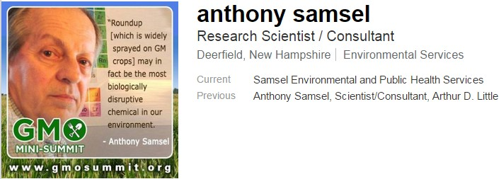
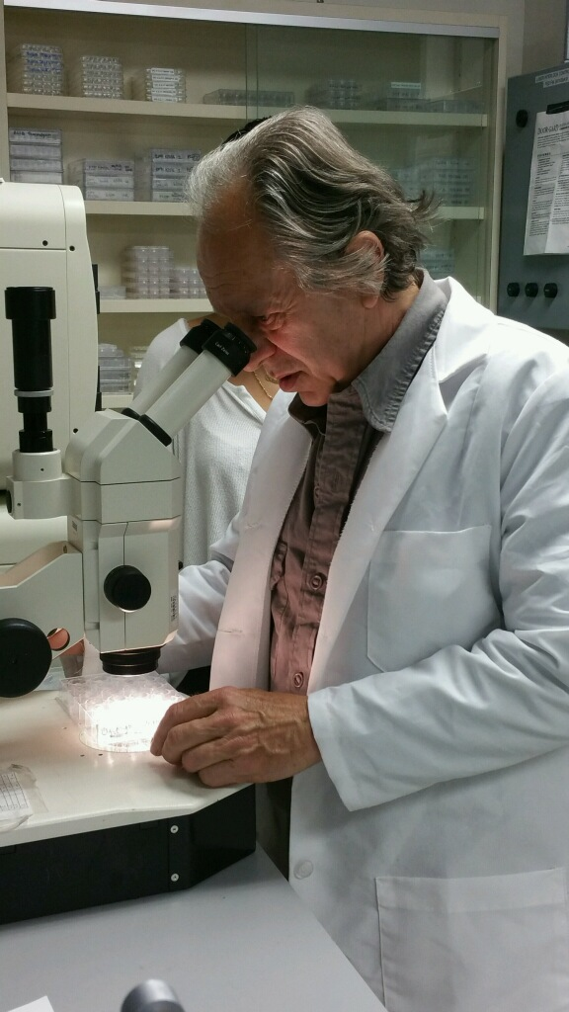

Slide 30
"Glyphosate is not toxic in the conventional sense. It destroys our biology at the cellular level one molecule at a time through disruption of proteins and signaling.
Integration of glyphosate with globular and structural proteins is how it can be the cause of an endless array of unrelated diseases, and unleash a cascade of ill health effects that kill us like a slow cumulative poison.”
-- Anthony Samsel

Slide 31
Dementia and Glyphosate*
*Nancy Swanson, http://www.examiner.com/article/
data-show-correlations-between-increase-neurological-diseases-and-gmos

Slide 32
Dementia and Glyphosate*
Alzheimer’s disease has been specifically linked to a GXXXGXXXGXXXG motif in a specific region of amyloid precursor protein*
*L-M Munter et al. The EMBO Journal 2007; 26: 1702-1712.
*Nancy Swanson, http://www.examiner.com/article/
data-show-correlations-between-increase-neurological-diseases-and-gmos
Notes:
2016/Anthony/GxxxG_motif_Abeta_2007.pdf

Slide 33
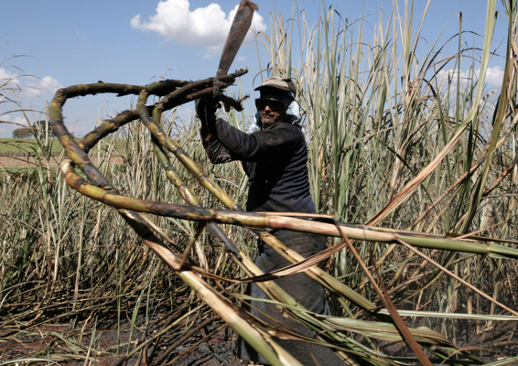
“Glyphosate Substitution for Glycine During Protein Synthesis as a Causal Factor in Mesoamerican Nephropathy”*
Young men who work in the sugar cane fields in Central America are dying in record numbers from an unusual form of kidney failure
Heavy labor in hot climate leads to dehydration
Glyphosate incorporation into multiple proteins can fully explain observed symptoms
*S Seneff and L Orlando. J Environ Anal Toxicol 2018; 8:1.
Notes:
2018/LauraOrlando/submission/final/2161-0525-8-541.pdf

Slide 34
“Glyphosate Substitution for Glycine During Protein Synthesis as a Causal Factor in Mesoamerican Nephropathy”*
“Specifically, glycine substitution in aquaporin, chloride channels, cytochrome C oxidase and collagen, among others, could contribute to dehydration, increased urinary acidification, renal fibrosis, rhabdomyolysis and mitochondrial dysfunction.”
Young men who work in the sugar cane fields in Central America are dying in record numbers from an unusual form of kidney failure
Heavy labor in hot climate leads to dehydration
Glyphosate incorporation into multiple proteins can fully explain observed symptoms
*S Seneff and L Orlando. J Environ Anal Toxicol 2018; 8:1.

Slide 35
Glyphosate and Anencephaly*
Yakima, Benton and Franklin counties in Washington State have an unusually high number of pregnancies affected by the birth defect, anencephaly
75 pesticides were analyzed in studying contamination due to surrounding agriculture
47 (63%) of these were detected
Glyphosate was applied in large amounts, but was not studied
5% solution of glyphosate was also used heavily around irrigation ditches to control weeds
Main herbicide recommended due to its “low toxicity”
Glyphosate has been linked to anencephaly due to its effect on retinoic acid
*Barbara H. Peterson. Farm Wars, http://farmwars.info/?p=11137

Slide 36
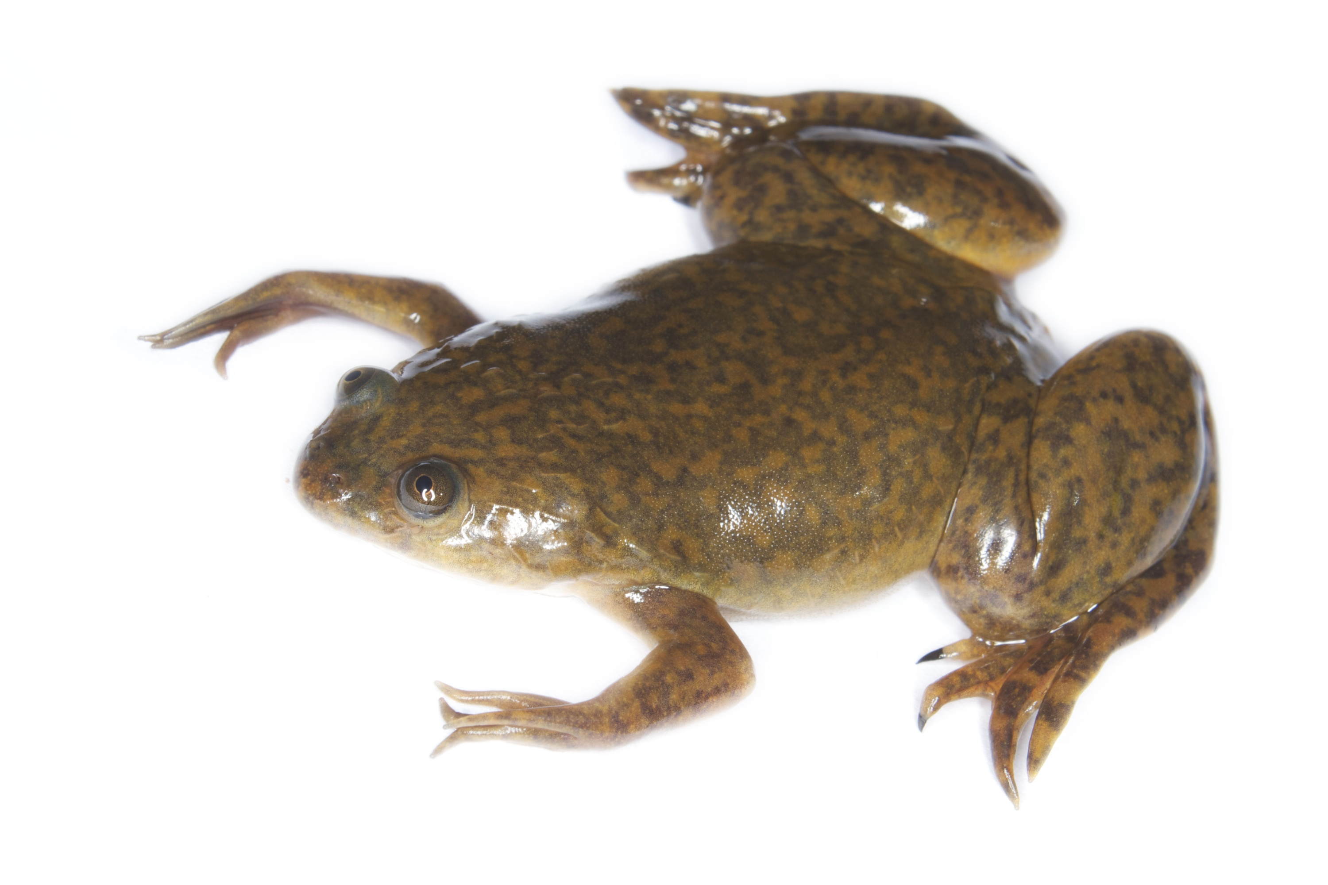
Glyphosate Upregulates Retinoic Acid*
CYP Enzyme Repression
Small Brain
*A. Carrasco, Teratogenesis by glyphosate based herbicides and other pesticides. Relationship with the retinoic acid pathway. In Breckling, B. & Verhoeven, R. (2013) GM-Crop Cultivation – Ecological Effects on a Landscape Scale. Theorie in der Ökologie 17. Frankfurt, Peter Lang.

Slide 37
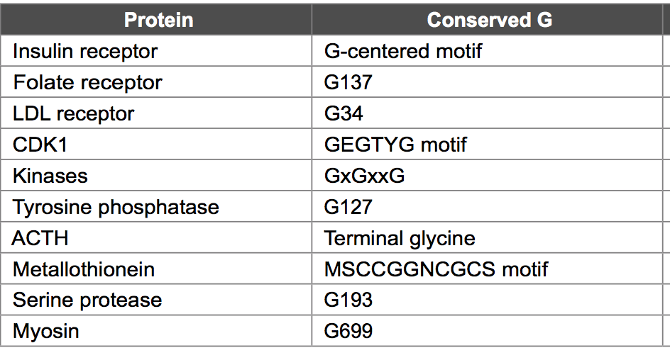

Slide 38
Food Allergies and
Autoimmune Disease

Slide 39
Autoimmune Disease: An Invisible Epidemic*
“Taken together, the number of people suffering from autoimmune diseases is 24–50 million Americans, 16% of the US population. To put it in perspective, autoimmune disease prevalence equals heart disease and cancer combined.”
*Feldman B, Martin EM, Simms T. An Invisible Epidemic — When your body attacks itself — Autoimmune Disease; How Reframing the Data Unveils a Public Health Crisis Bigger than Cancer and Heart Disease Combined. www.tincture.io.
Notes:
Feldman B, Martin EM, Simms T. An Invisible Epidemic — When your body attacks itself — Autoimmune Disease; How Reframing the Data Unveils a Public Health Crisis Bigger than Cancer and Heart Disease Combined. www.tincture.io.
IN Beecham Seneff paper. Ref. 13.

Slide 40
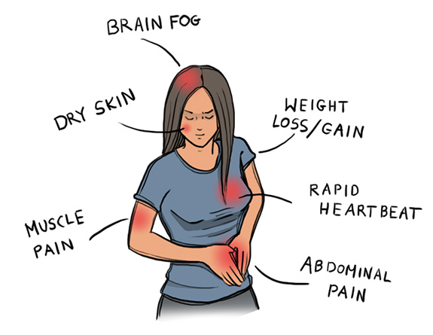
Autoimmune Disease Statistics*
Annual direct health care costs for AD in US estimated to be ~$100 billion
At least 23.5 million Americans suffer from one or more autoimmune diseases
Among the top-10 causes of death in females under 64 years old
Immunosuppressant treatments have devastating side effects
*https://www.aarda.org/autoimmune-information/autoimmune-statistics/

Slide 41
Why do we have an epidemic in
autoimmune disease in America today?

Slide 42
Hypothesis
Glyphosate exposure sets up a weakened immune system, a leaky gut barrier and a leaky brain barrier
Glyphosate contamination in proteins makes them hard to break down
Glyphosate disrupts the pancreatic enzymes that metabolize proteins
Person develops overactive antibody response to foreign protein contaminated with glyphosate and, through molecular mimicry, this leads to autoimmune disease
This easily explains gluten intolerance and other food allergies

Slide 43
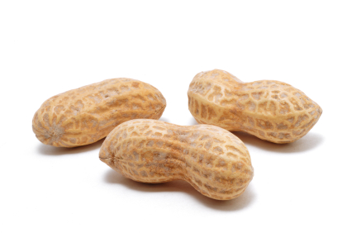
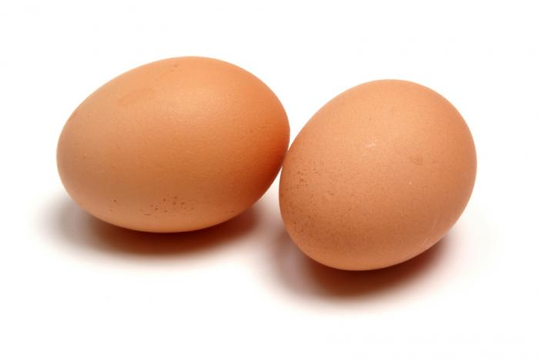
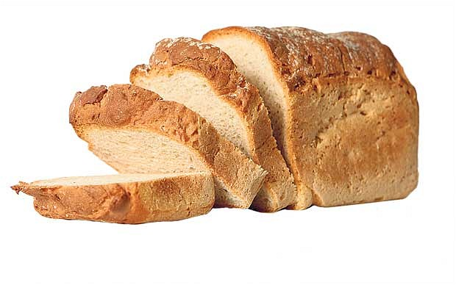
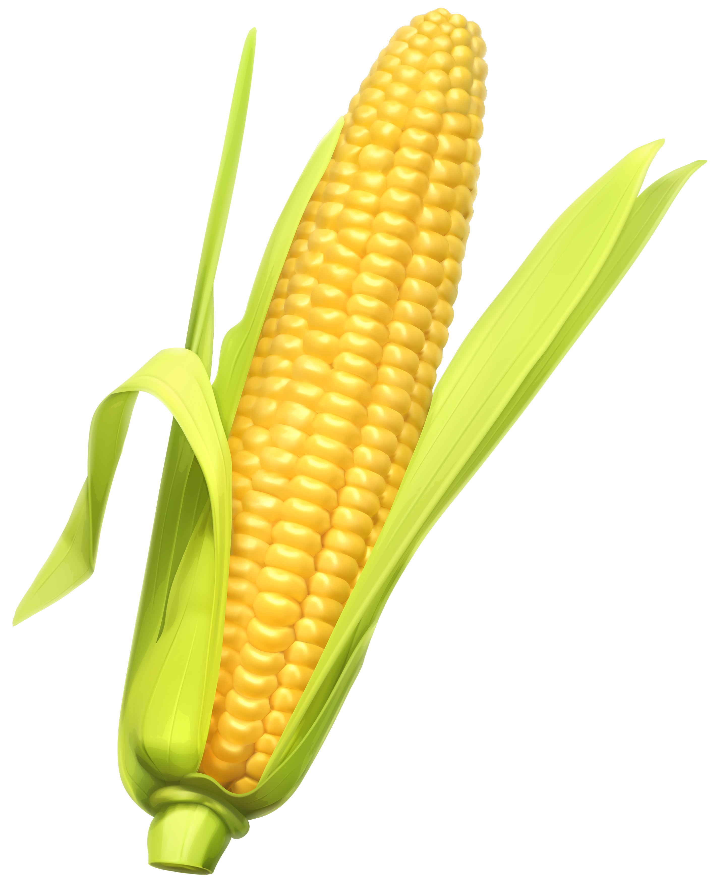
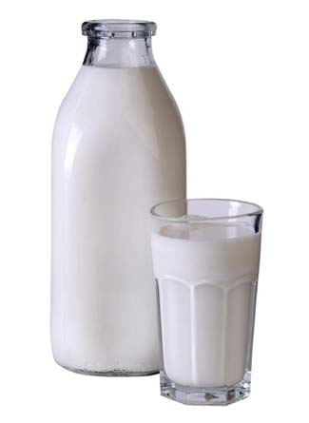
Food Allergies

Slide 44
Food Allergies
All of these foods can be expected to be contaminated with glyphosate, given how they’re produced

Slide 45
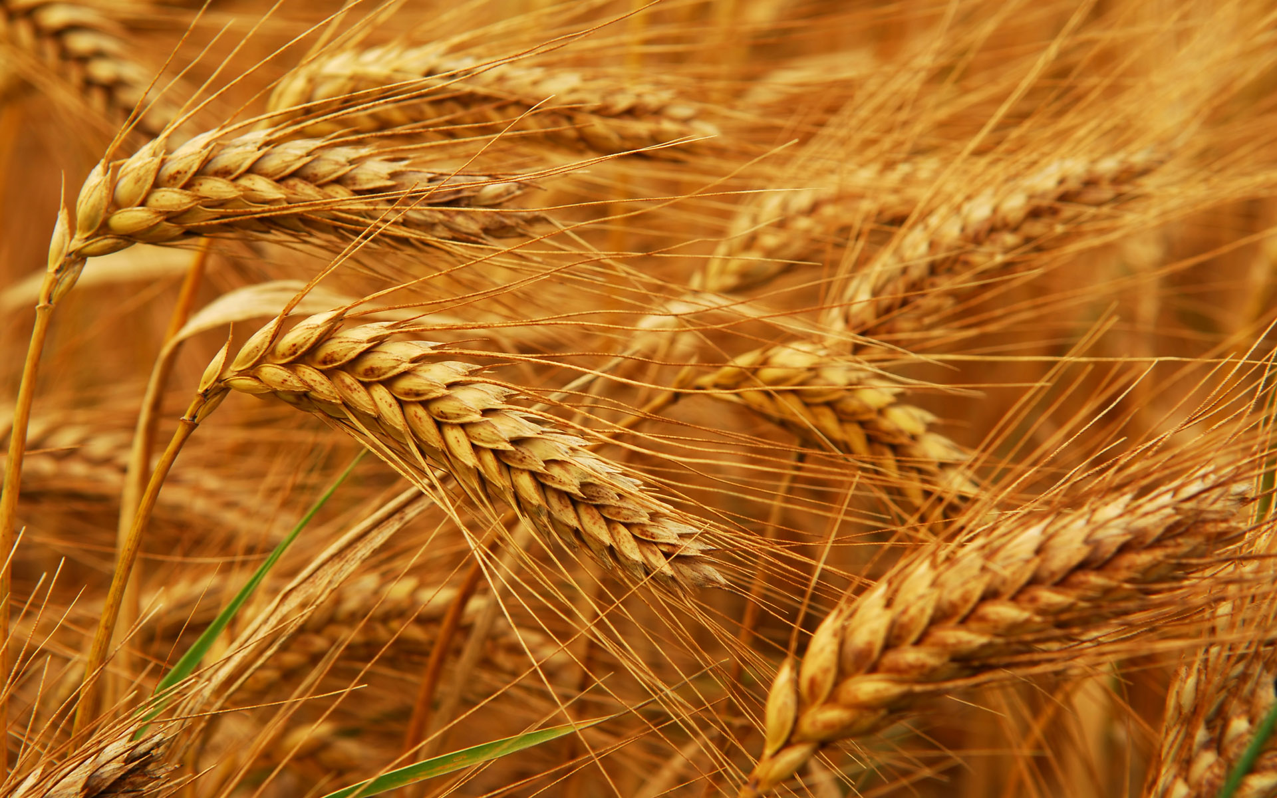
Glyphosate and Celiac Disease*
Glyphosate
Use on wheat
Celiac disease
*Samsel and Seneff, Interdiscip Toxicol. 2013;6(4): 159–184.

Slide 46
Celiac disease: Impaired gluten digestion
Gluten intolerance results from inability to break down gluten, which is enriched in proline*
The enzyme that breaks down proline depends on manganese as a catalyst (depleted by glyphosate)
It also contains three regions with highly conserved glycines**
Malabsorption can lead to nutritional deficiencies and symptoms of autism ***
*G. Janssen et al., PLoS One 2015; 10(6): e0128065
**F Morel et al., Biochimica et Biophysica Acta 1999;1429: 501-505
***SJ Genuis and TP Bouchard, J Child Neurol. 2010;25(1):114-9
Notes:
gluten 麩質
Plos One:
Ineffective Degradation of Immunogenic Gluten Epitopes by Currently Available Digestive Enzyme Supplements
Glyphosate/ineffective_proteolysis_of_proline_in_gluten_digestive_enzymes.pdf

Slide 47
Celiac disease: Impaired gluten digestion
Gluten intolerance results from inability to break down gluten, which is enriched in proline*
The enzyme that breaks down proline depends on manganese as a catalyst (depleted by glyphosate)
It also contains three regions with highly conserved glycines**
Malabsorption can lead to nutritional deficiencies and symptoms of autism ***
Wheat is routinely sprayed right before harvest with glyphosate as a desiccant
Other treated plants include
Sugar cane, barley, peanuts, maize and legumes
*G. Janssen et al., PLoS One 2015; 10(6): e0128065
**F Morel et al., Biochimica et Biophysica Acta 1999;1429: 501-505
***SJ Genuis and TP Bouchard, J Child Neurol. 2010;25(1):114-9
Notes:
gluten 麩質
Plos One:
Ineffective Degradation of Immunogenic Gluten Epitopes by Currently Available Digestive Enzyme Supplements
Glyphosate/ineffective_proteolysis_of_proline_in_gluten_digestive_enzymes.pdf

Slide 48
Collagen and Gelatin

Slide 49
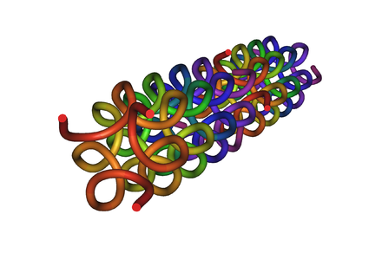
Collagen and Gelatin
25% of the protein in our body is collagen
25% of the amino acids in collagen are glycines
Glyphosate substitution for glycine will disrupt triple-helix formation and lead to diseases of the vasculature, joints and bones
Gelatin is derived from collagen in bones and ligaments sourced from cows and pigs fed glyphosate-contaminated GMO Roundup-Ready feed

Slide 50
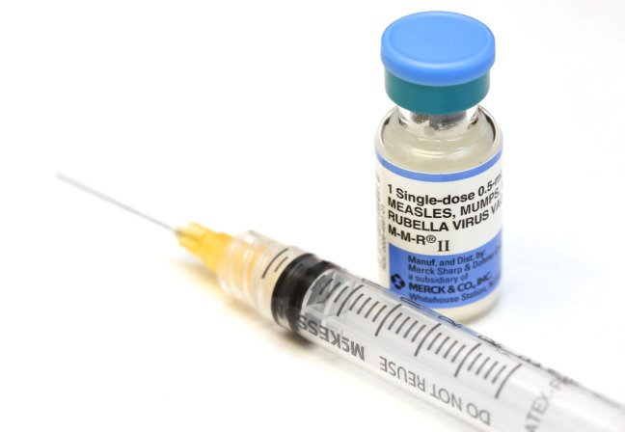
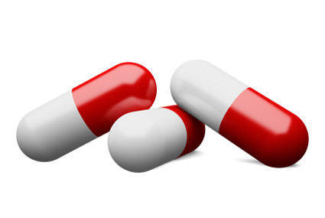
Products Containing Gelatin !!

Slide 51
Glyphosate Contamination in Vaccines (Parts Per Billion)*
Merck ZOSTAVAX 0.62 Shingles
Merck MMR-II 3.74 Measles, Mumps and Rubella
Merck VARIVAX 0.56 Varicella, Chicken Pox
MERCK PNEUMOVAX ND Pneumococcal 18
MERCK PROQUAD 0.66 Measles, Mumps, Rubella, Varicella
GSK ENERGIX-B 0.34 Heptatitis B
*A Samsel and S Seneff, Journal of Biological Physics and Chemistry 2017;17:8-32.

Slide 52
Glyphosate Contamination in Vaccines (Parts Per Billion)*
The suspected link between MMR and autism can be explained through an autoimmune attack on the myelin sheath following exposure to glyphosate-contaminated antigen in the vaccine
Merck ZOSTAVAX 0.62 Shingles
Merck MMR-II 3.74 Measles, Mumps and Rubella
Merck VARIVAX 0.56 Varicella, Chicken Pox
MERCK PNEUMOVAX ND Pneumococcal 18
MERCK PROQUAD 0.66 Measles, Mumps, Rubella, Varicella
GSK ENERGIX-B 0.34 Heptatitis B
*A Samsel and S Seneff, Journal of Biological Physics and Chemistry 2017;17:8-32.

Slide 53
Rheumatoid Arthritis
Inflammation in the joints causes pain and limits movement
Small joints of the hands, feet and cervical spine most affected
Can lead to lung fibrosis
Increases risk to atherosclerosis, heart attack and stroke.
Poor iron absorption leads to "anemia of chronic disease"
Fatigue, low grade fever, malaise, morning stiffness, loss of appetite and loss of weight

Slide 54
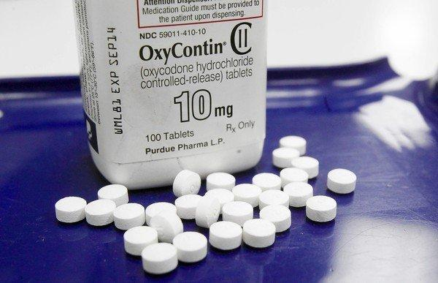
US Department of Health and Human Services Data on Pain-Killer Drug Abuse*
Drug overdose is the leading cause of injury death in the United States
Heroin, morphine, and prescription pain relievers
More people died from drug overdoses in 2014 than in any previous year on record
More than 6 out of 10 involved an opioid drug
More than 650,000 opioid prescriptions are dispensed every day
*http://www.hhs.gov/opioids/about-the-epidemic/
Notes:
./Factsheet-opioids-061516.pdf

Slide 55
Animals in Distress

Slide 56
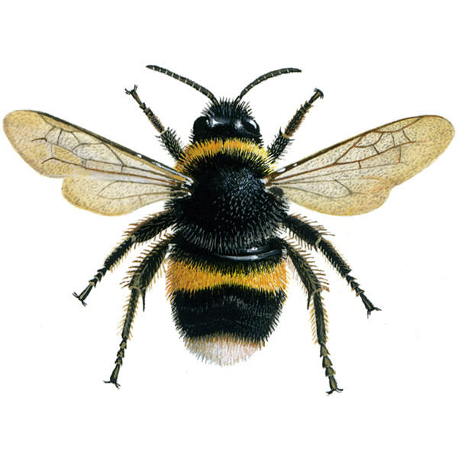
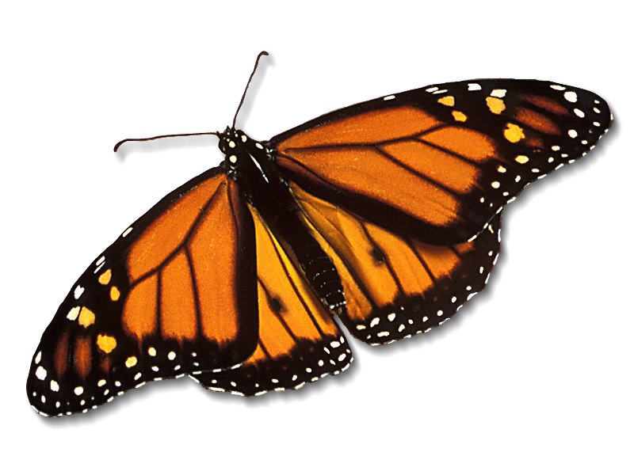
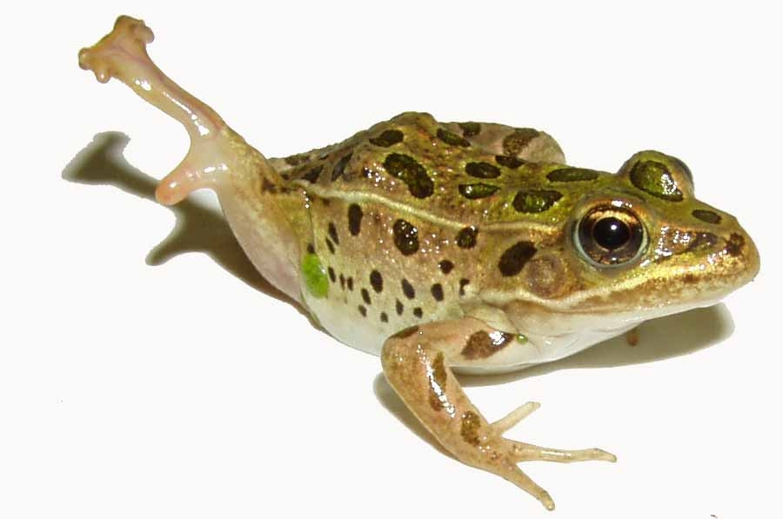
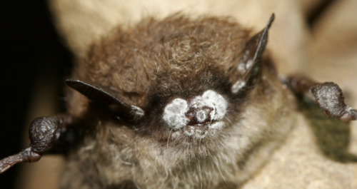
Species in Stress
Fungus Infection
Fungus Infection
Fungus Infection
Fungus Infection
Fungus Infection
*R. Mason et al., Journal of Environmental Immunology and Toxicology 1:1, 3-12; 2013
Notes:
Frogs -- drop 3.7% every year, meaning they could disappear in half of the habitats they now occupy nationwide in 26 years
Monarch butterflies – milkweed being killed by glyphosate
http://salsa3.salsalabs.com/o/1881/p/dia/action3/common/public/?action_KEY=12506

Slide 57
Figure 1, Nature Reviews Paper*
Fungi
Causes of Extinction
*M.C. Fisher et al., Nature Reviews 484(7393), 186-194.
Notes:
2014/nature_fungus.pdf
c, d, Relative proportions of species extinction and/or extirpation events for major classes of infectious disease agents (c) and their temporal trends for fungal pathogens (d). Primary data sources are given in the Supplementary Information.

Slide 58
“Emerging fungal threats to animal, plant and ecosystem health”*
“ In both animals and plants, an unprecedented number of fungal and fungal-like diseases have recently caused some of the most severe die-offs and extinctions ever witnessed in wild species, and are jeopardizing food security.”
*M.C. Fisher et al., Nature Reviews 484(7393), 186-194.
Notes:
./nature_fungus.text
./nature_fungus.pdf
滅絕
Mièjué

Slide 59
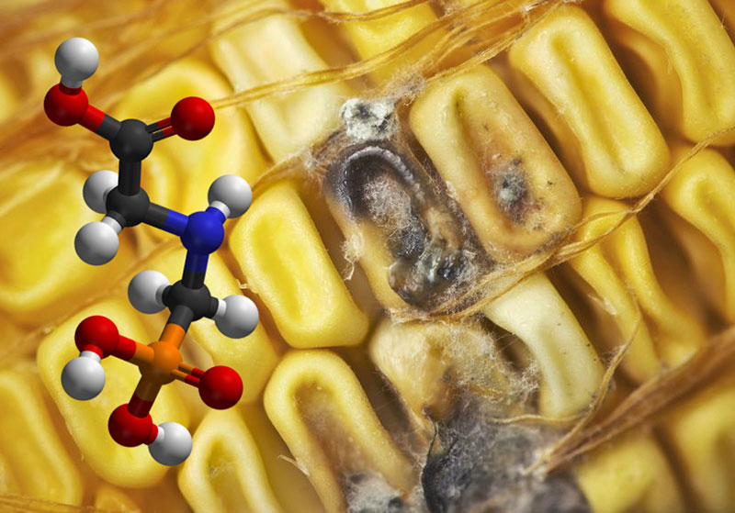
Roundup herbicide enhances the growth of aflatoxin-producing fungi*
*Barberis et al., Journal of Environmental Science and Health, Part B: Pesticides, Food Contaminants, and Agricultural Wastes. 2013, 48(12), 1070-1079.

Slide 60
“Aflatoxins are mutagenic, carcinogenic, teratogenic, hepatotoxic, immunosuppressive, and they also inhibit several metabolic systems”*
*Barberis et al., Journal of Environmental Science and Health, Part B: Pesticides, Food Contaminants, and Agricultural Wastes. 2013, 48(12), 1070-1079.
Notes:
glyphosate/glyphosate_promotes_fungus_growth_2014.pdf
Aflatoxins (AFs) are extensively known to be potent mutagenic,
carcinogenic, teratogenic, hepatotoxic, immunosuppressive, and they
also inhibit several metabolic systems.[13,14]

Slide 61
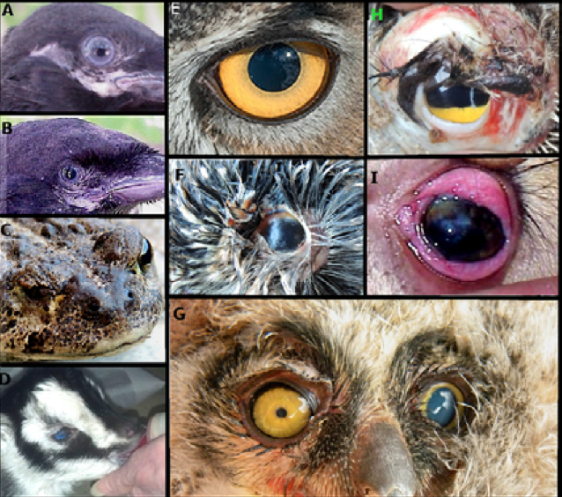
Notes:
32 figures
head and face anomalies (R=0.95), newborn eye disorders, newborn blood disorders (R=0.92), newborn skin disorders (R=0.96), lymph disorders in children 0-15 (R=0.86) and in the general population except newborn (R=0.89), congenital heart conditions in newborns (R= 0.98), enlarged right ventricle in all age groups except newborn (R=0.96), newborn lung problems (R=0.95), pulmonary bleeding and edema for all age groups except newborn (R=0.97), liver cancer for all age groups except newborn (R=0.93), newborn metabolic disorders (R=0.95) and newborn genitourinary disorders (R=0.96).

Slide 62
Congenital Heart Defects*
*Figure 22, Hoy et al., Poultry, Fisheries and Wildlife Sciences, 3:1, 2015

Slide 63
What You Can Do

Slide 64
Go Organic!

Slide 65
Sauerkraut and apple cider vinegar contain acetobacter, one of the very few microbes that can metabolize glyphosate
Yogurt and kimchi probably do, too

Slide 66
New Book by Zen Honeycutt Founder of Moms Across America

Slide 68
Fixing the Soil*
Dirt is inert; soil is alive
Missouri farmer JR Bollinger grew corn and soy on a former coal mine
“We tried … all kinds of goodies: humates, … sea minerals, microbes, fish meal and biochar powder.”
Earthworms till the soil
Soil microbes are crucial for soil health
Greatly reduce fertilizer needs and improve yield
JR Bollinger
*ecofarmingdaily.com/wormhole-customizing-biological-methods-large-scale-farming/
David Yarrow
Down the Wormhole: Customizing Biological Methods for Large Scale Farming
Belize Ag Report 2017;34:5-17.
Notes:
Missouri reclaimed coal mine

Slide 69
Small Organic Farms are the Answer
Bluebird Hill Organic Farm, North Carolina

Slide 70
A Hopeful Quote*
“It’s interesting that in 2016, for the first time in almost 20 years, what we saw is a decrease in the amount of acreage where genetically engineered crops are growing around the world. This represents the fact that this technology is failing, in the sense of superweeds and superpests are popping up all over the world.”
Ronnie Cummins, founder of the Organic Consumers Association
*articles.mercola.com/sites/articles/archive/2017/03/26/market-rejection-of-gmos-grows.aspx
Notes:
http://articles.mercola.com/sites/articles/archive/2017/03/26/market-rejection-of-gmos-grows.aspx

Slide 71
Summary
Glyphosate is pervasive in our food supply today
Contrary to popular belief, it is insidiously cumulatively toxic to all life forms, including humans
Time trends in glyphosate usage on core crops are correlated with alarming rises in a large number of debilitating diseases, including autism, Alzheimer’s and cancer.
Glyphosate’s insidious toxicity is likely mediated through substitution for glycine during protein synthesis by mistake
Explains causal relationship with multiple diseases, particularly autoimmune diseases and neurological diseases
Glyphosate is likely a major factor in antibiotic resistance
Glyphosate in collagen leads to opioid drug epidemic
Glyphosate explains the epidemic in kidney failure among sugarcane workers
Glyphosate urgently needs to be banned, worldwide

