Slide 1
Glyphosate's disruption of methylation/transsulfuration pathways as a key factor in autism and other diseases
Stephanie Seneff, MIT CSAIL
Methylation Summit
July 15, 2018

Slide 2
Download these slides
http://people.csail.mit.edu/seneff/2018/SeneffJuly2018.pptx

Slide 3
Outline
Introduction
Glyphosate and Folic Acid Fortification
Cholesterol Sulfate and Heparan Sulfate
Methylation and Transsulfuration Pathways
Glyphosate Displacing Glycine during Protein Synthesis
How Glyphosate Disrupts Methylation and Sulfation
Summary

Slide 4
Introduction

Slide 5
Roundup and GMO Crops
What is glyphosate?

Slide 6
Roundup and GMO Crops

Slide 7
Roundup and GMO Crops
GMO Roundup-Ready corn, soy, canola, sugar beets
cotton, tobacco and alfalfa

Slide 8
Roundup as a Desiccant/Ripener just before Harvest
Wheat, Oats, Barley, Rye, Sugar cane, Beans, Lentils, Peas, Flax, Sunflowers, Pulses, Chick Peas

Slide 9
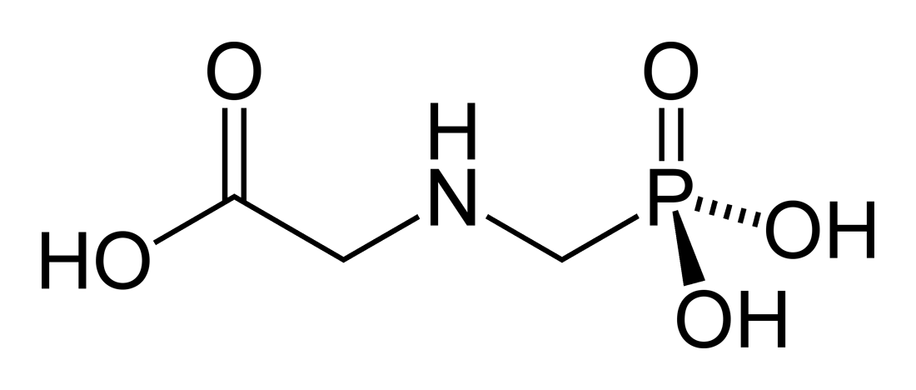
Glyphosate!!
Glyphosate is now the #1 herbicide in use in the U.S. and is increasingly used around the world
Developed and patented by Monsanto in the 1970’s
Introduced into the US food chain in 1974
Came out from under patent in 2000
Inhibits an enzyme in the shikimate pathway involved in the synthesis of tyrosine, tryptophan and phenylalanine (the three aromatic amino acids)
Huge expansion of GMO corn, soy, cotton and canola crops has led to sharp increases in the last two decades
Notes:
WIKI

Slide 10
Glyphosate vs. Other Pesticides: Usage in the United States*
Glyphosate
*http://sustainablepulse.com/wp-content/uploads/GMO-health.pdf

Slide 11
Shikimate Pathway Disruption
Phenylalanine, tryptophan, tyrosine
shikimate
Glyphosate
Neurotransmitters,
thyroid hormone
chorismate
vitamin K
folate

Slide 12
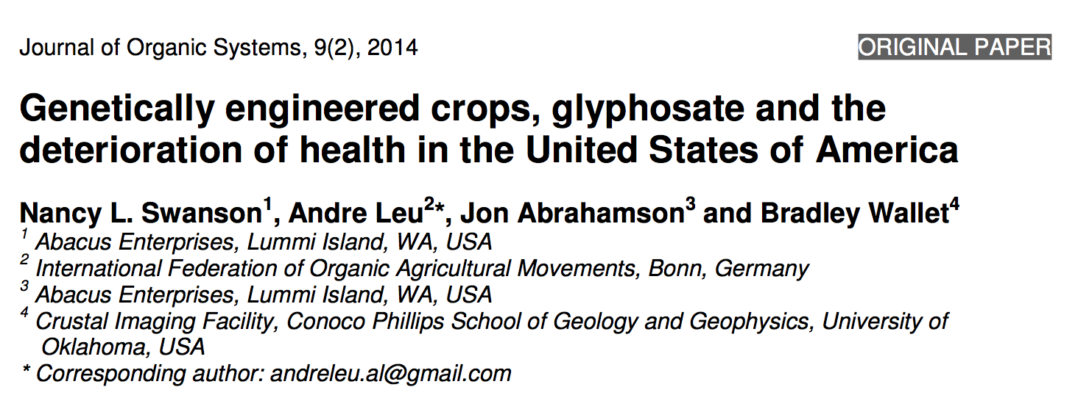
Paper Showing Strong Correlations between Glyphosate Usage and Chronic Disease

Slide 13
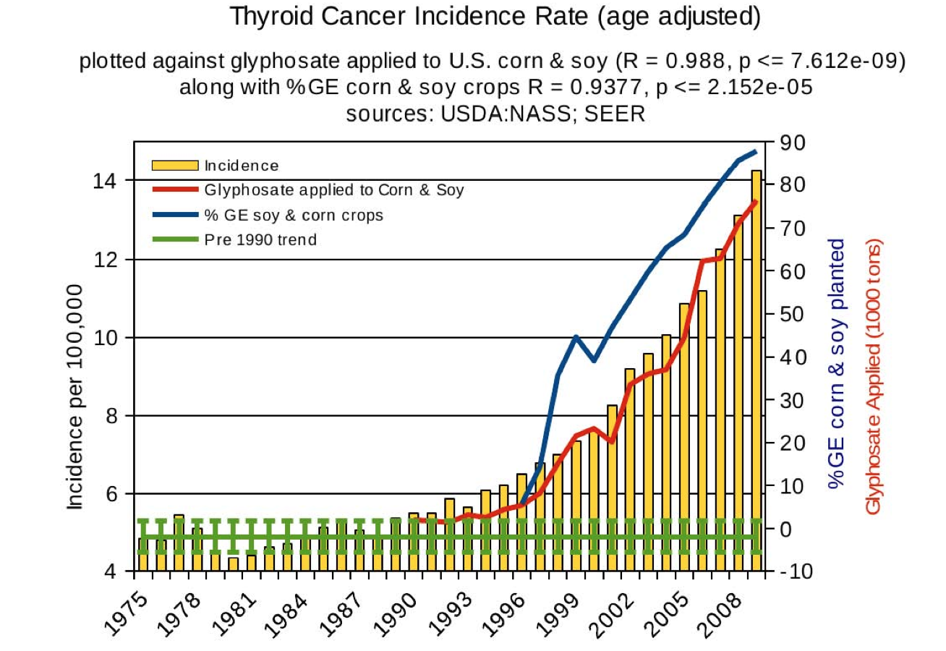
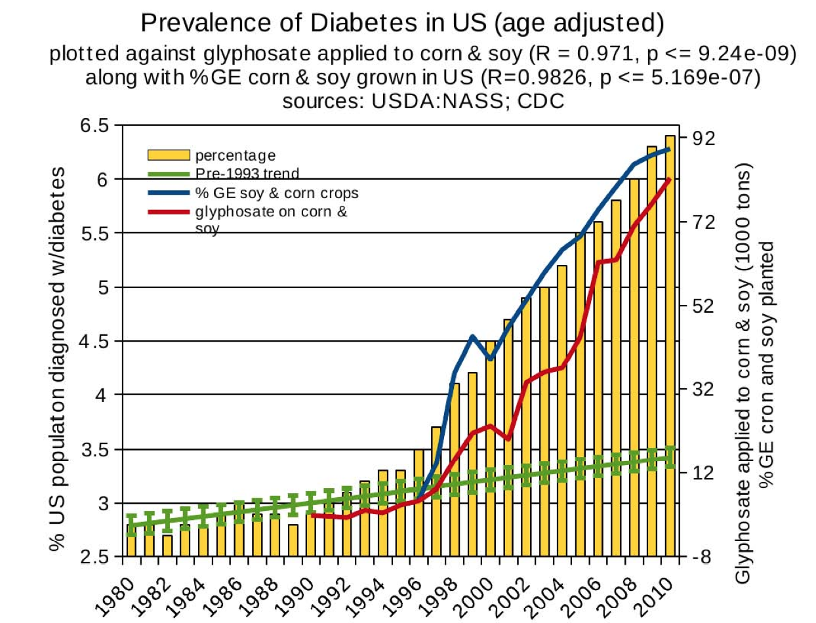
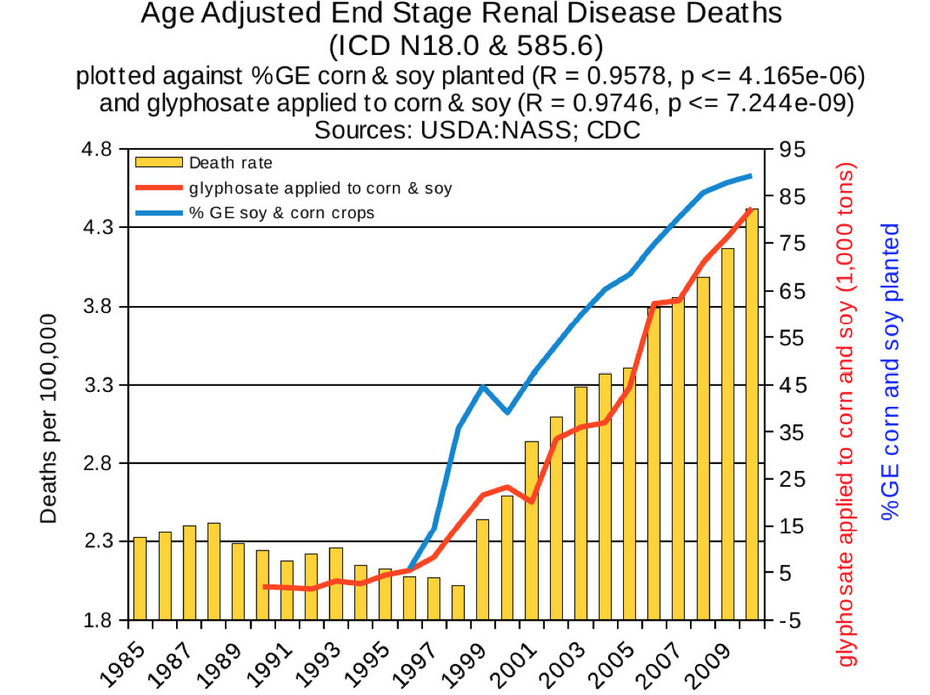
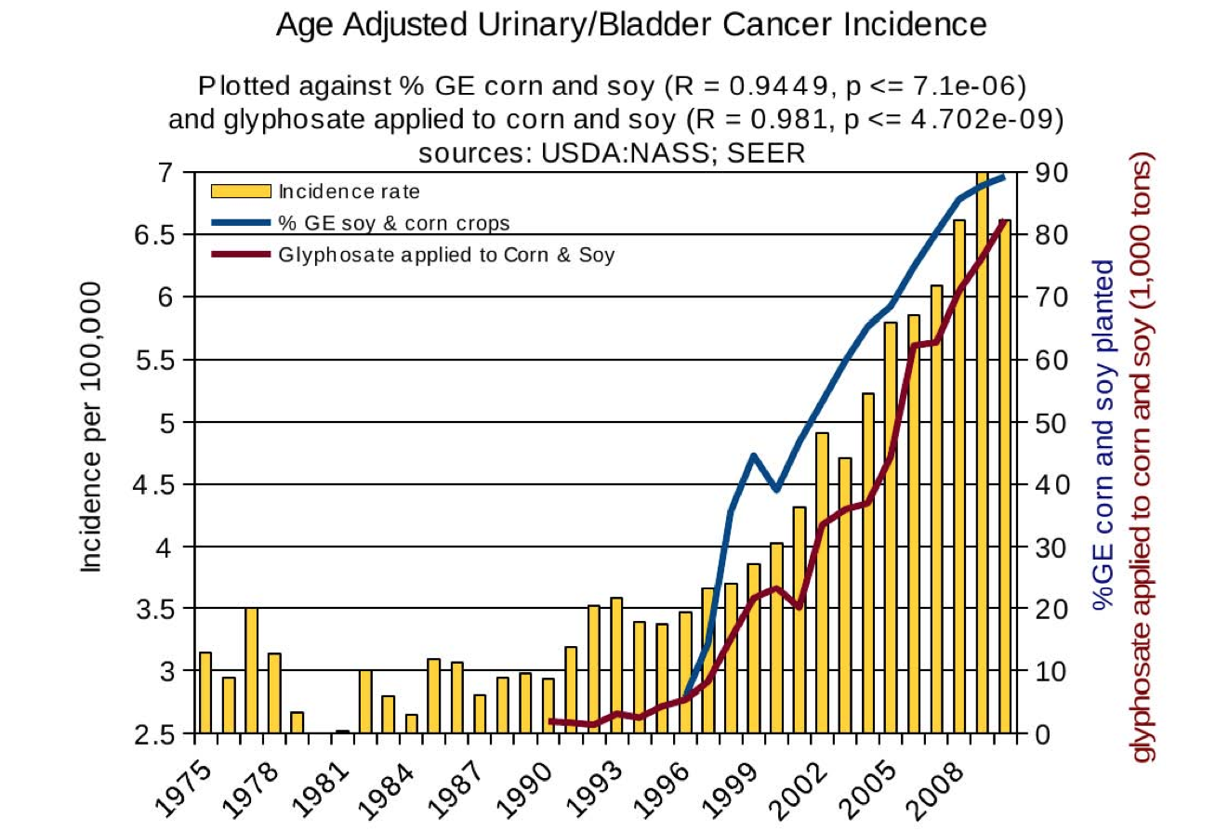
Thyroid cancer
Diabetes
End stage
renal disease
Urinary/bladder
cancer

Slide 14
Thyroid cancer
Diabetes
In 2015, WHO declared glyphosate a “probable carcinogen”
End stage
renal disease
Urinary/bladder
cancer

Slide 15
Quote from the Conclusion*
“Although correlation does not necessarily mean causation, when correlation coefficients of over 0.95 (with p-value significance levels less than 0.00001) are calculated for a list of diseases that can be directly linked to glyphosate, via its known biological effects, it would be imprudent not to consider causation as a plausible explanation.”
*NL Swanson et al. Journal of Organic Systems 9(2), 2014, p. 32,

Slide 16
Glyphosate and
Folic Acid Fortification

Slide 17
The Big Picture
Glyphosate disrupts folate synthesis by gut microbes (from shikimate pathway)
U.S. mandated folic acid fortification in 1998, simultaneous with the widespread introduction of Roundup-Ready crops
Folic acid is an oxidized, unmethylated form of methyl-tetrahydrofolate (5-MTHF)
It costs the liver dearly to “fix” it
Excess serum folic acid leads to cerebral folate deficiency due to folic acid binding to brain receptors
This is a risk factor for autism

Slide 18
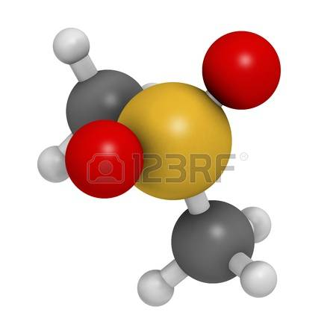
Folate and Methylation Pathways*
Folate donates a methyl group for numerous biochemical pathways
Neurotransmitter synthesis
DNA biosynthesis
Regulation of gene expression
Amino acid synthesis and metabolism
Myelin synthesis and repair
5-MTHF impacts mood and cognition via control of neurotransmitter synthesis
methyl
*AL Miller. Alternative Medicine Review 2008; 13(3): 216-226

Slide 19
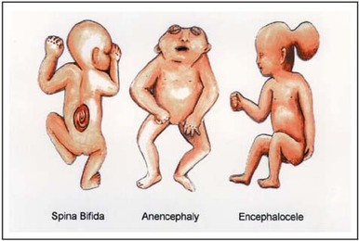
A Bit of History
Neural tube developmental defects like spina bifida and anencephaly (no brain) are due to a very rare but catastrophic developmental disorder linked to low folate during the first trimester of pregnancy
Excess retinoic acid expression during development causes neural tube developmental defects
The US first considered adding folic acid supplements to grains in 1996, and introduced the mandate in 1998
GMO “Roundup Ready” crops were just beginning to be introduced in 1996 and had obtained widespread adoption by 1998

Slide 20
Serum Folate Decreased in Women Aged 15-54 after Folic Acid Fortification was Introduced! *
Serum folate decreased in women of reproductive age among Caucasians, Blacks and Hispanics
GMO Roundup-Ready crops were dramatically ramping up at the same time
Years Serum Folate
(Caucasians)
1999-2000 13.4
2001-2002 12.1
2003-2004 11.3
*Centers for Disease Control and Prevention. MMWR Morb Mortal Wkly Rep 2007;55:1377-80.

Slide 21
Adoption of GM Crops in U.S.
HT = herbicide (glyphosate) tolerant

Slide 22
Glyphosate and Superweeds: U.S.*
*http://sustainablepulse.com/wp-content/uploads/GMO-health.pdf
Notes:
Glyphosate/Nancy/GMO-health.pdf
http://sustainablepulse.com/wp-content/uploads/GMO-health.pdf

Slide 23
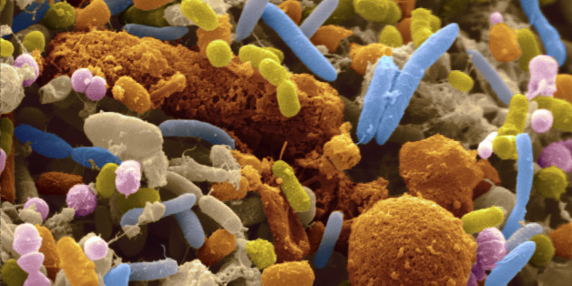
Gut Microbes Provide Folate to Host!*
“In conclusion, the findings from this study suggest that the quantity of microbially synthesized folate in the large intestine of human infants is sufficiently large to potentially affect the folate status of the host.“
*TH Kim et al., J Nutr. 2004 Jun;134(6):1389-94.
Notes:
./large_pool_available_folate_from_gut_microbes_humans_and_pigs_2004.pdf
./folate_from_gut_microbes_1991_J_Nutr.pdf

Slide 24
Gut Microbes Produce Bioavailable Folate*
Strains of lactobacillus and bifidobacteria were shown to synthesize folate
Both of these are especially susceptible to glyphosate toxicity
"Rats fed a probiotic formulation of folate-producing bifidobacteria exhibited increased plasma folate level, confirming that the vitamin is produced in vivo and absorbed"
*M Rossi et al., Nutrients 2011, 3, 118-134
Notes:
./folate_production_by_gut_microbes_2011.pdf

Slide 25
Gut Microbes Produce Bioavailable Folate*
Strains of lactobacillus and bifidobacteria were shown to synthesize folate
Both of these are especially susceptible to glyphosate toxicity
"Rats fed a probiotic formulation of folate-producing bifidobacteria exhibited increased plasma folate level, confirming that the vitamin is produced in vivo and absorbed"
Glyphosate disrupts the shikimate pathway in gut microbes.
Folate, produced by gut microbes, depends on the shikimate pathway
*M Rossi et al., Nutrients 2011, 3, 118-134
Notes:
./folate_production_by_gut_microbes_2011.pdf

Slide 26
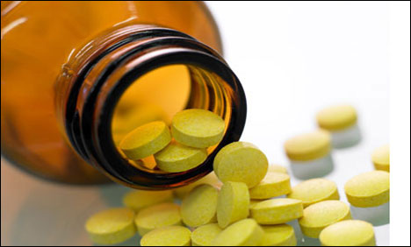
US Aggressive Campaign: A Down Side to Folic Acid?
In addition to fortification, US FDA recommends folic acid (FA) supplements for women of childbearing age
However, excessive FA supplementation has been linked with increased incidences of asthma* and autism** among children.
*MB Bekkers et al. Eur Respir J 2012;39(6):1468–1474.
**CM Beard et al, Med Hypotheses 2011;77(1):15–17.
Notes:
2015/AutismOne/a\ on\ gaba\ receptor\ upregulates\ genes-\ autism.pdf
Bekkers MB, Elstgeest LE, Scholtens S, Haveman-Nies A, de Jongste JC, Kerkhof M, Koppelman GH, Gehring U, Smit HA, Wijga AH (2012) Maternal use of folic acid supplements during pregnancy, and childhood respiratory health and atopy. Eur Respir J 39(6):1468–1474
Beard CM, Panser LA, Katusic SK (2011) Is excess folic acid supplementation a risk factor for autism? Med Hypotheses 77(1):15–17

Slide 27
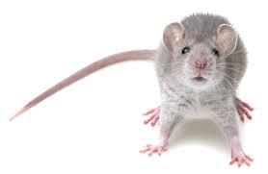
“High folic acid consumption leads to pseudo-MTHFR deficiency, altered lipid metabolism, and liver injury in mice”*
Fed mice excessive amounts of folic acid
Reduced methylation capacity in liver
CYP7A1 level was dramatically reduced. (rate limiting enzyme in bile acid synthesis)
Caused liver damage and fatty liver disease
Works synergistically with glyphosate to disrupt bile flow
*KE Christensen e tal., Am J Clin Nutr 2015;101:646–58.
Notes:
Csail/2015/SallyFallon/high_folic_acid_causes_pseudo_MTHFR_deficiency.pdf

Slide 28
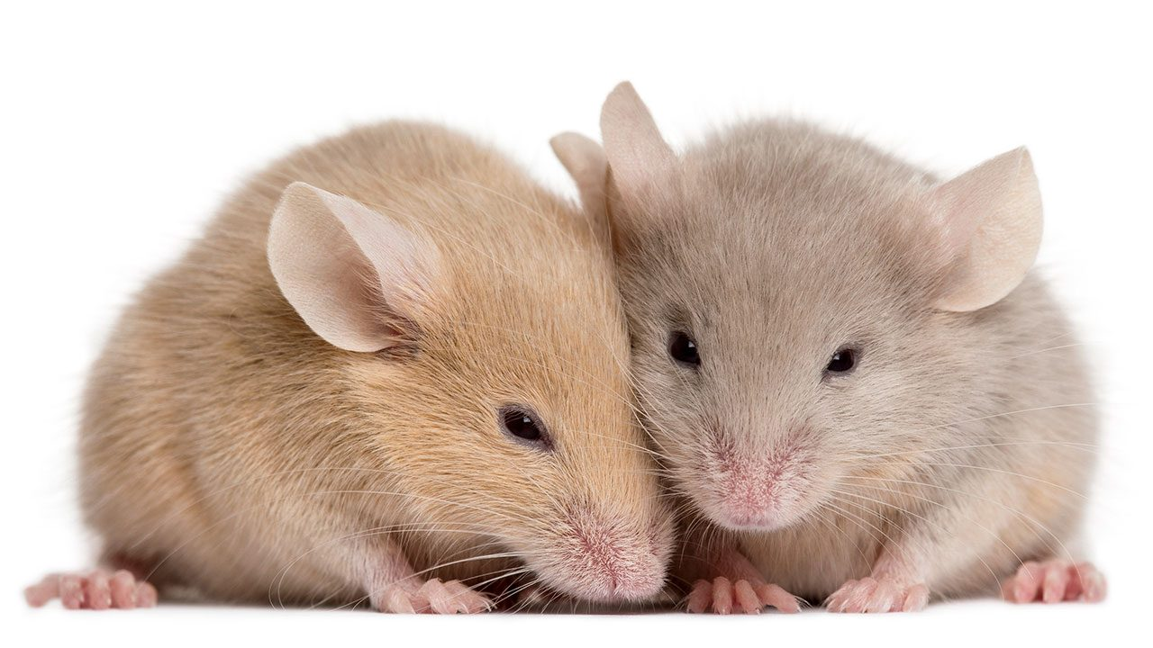
Assessment of Folic Acid Supplementation in Mice*
“Contrary to expectations, we find that three genetic mutants respond adversely to FA [folic acid] supplementation with increased incidence of NTDs [neural tube defects] in homozygous mutants, occurrence of NTDs in heterozygous embryos and embryonic lethality prior to NT closure.”
*A Marean et al., Human Molecular Genetics 2011; 20(18): 3678-3683.
Notes:
folic_acid_harms_murine_neural_tube_embryo_2011.pdf
Long term supply of folic acid to mom

Slide 29
Folic Acid Supplements in Late Pregnancy increase Risk to Asthma in Children *
Prospective cohort of Australian families
Folic acid supplements in late pregnancy increases risk of asthma in children at 3.5 and 5.5 years
Supports possible role of folate-impaired methylation in altering fetal immune phenotype towards Th2
*MJ Whitrow et al., American Journal of Epidemiology 2009;170:1486–1493
Notes:
Csail/2015/SallyFallon/asthma_linked_to_folic_acid_supplements.pdf

Slide 30
Folic Acid and Autism Risk*
Effects of ubiquitous synthetic supplementation of vitamins is unpredictable
Blanket approach may harm those with specific gene variants
Folic acid supplementation during gestation is associated with an increased risk for autism.
Unexpected increases in asthma and breathing problems associated with folic acid use
Excess methylation during gestation leads to epigenetic changes?
Folic acid supplements during gestation linked to premature birth and low birth weight
*MC DeSoto and RT Hitlan, Journal of Pediatric Biochemistry 2 (2012) 251–261
Notes:
synthetic_folic_acid_supplementation_linked_to_autism_2012.pdf

Slide 31
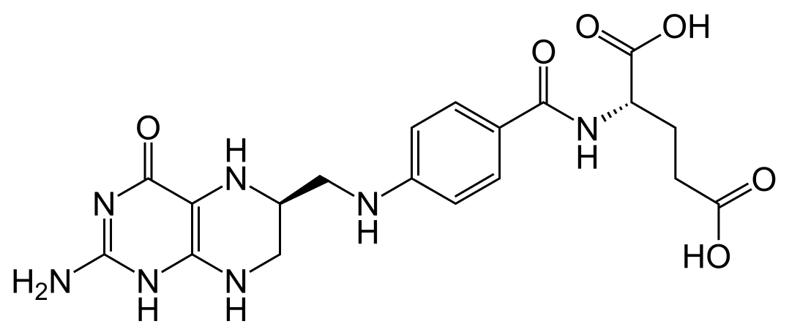
“Cerebral folate deficiency with developmental delay, autism, and response to folinic acid”*
Folinic acid is a form of TETRAHYDRO-folate
* P Moretti et al., Neurology March 22, 2005 vol. 64 no. 6 1088-1090

Slide 32
“Cerebral folate deficiency with developmental delay, autism, and response to folinic acid”*
Folinic acid is a form of TETRAHYDRO-folate
Folate receptor antibodies due to
excess folic acid in the blood???
* P Moretti et al., Neurology March 22, 2005 vol. 64 no. 6 1088-1090

Slide 33
Cholesterol Sulfate
And
Heparan Sulfate

Slide 34
The Big Picture
Connective tissues contain lots of sulfate
Fetus depends on mother to provide sulfate
Sulfate is severely deficient in autism
Cholesterol supply to fetus depends on sulfate
Cholesterol sulfate normally accumulates in high amounts in the placental villi during third trimester
Cholesterol deficiency leads to projectile vomiting due to pyloric stenosis
Sulfate is essential for clearing cellular debris
Low sulfate leads to high oxalate with many symptoms

Slide 35
Connective Tissue Contains Lots of Sulfate
Heparan sulfate
Chondroitin sulfate
Keratan sulfate

Slide 36
Sulfate in Fetal Development*
Fetus depends on mother for sulfate supply
Sulfate is essential for transporting sterols (like estrogen and DHEA) and supplying extracellular matrix proteins everywhere with sufficient negative charge
Sulfate detoxifies xenobiotics like acetaminophen (Tylenol) and is essential for excreting toxins like aluminum and mercury
Sulfate is severely deficient in autistic children (1/3 the normal level of free sulfate in blood stream)
* PA Dawson. Semin Cell Dev Biol 2011 Aug;22(6):653-9.
Notes:
Cancer/sulfate_in_fetal_development.pdf
Dawson PA. Sulfate in fetal development. Semin Cell Dev Biol (2011), doi:10.1016/j.semcdb.2011.03.004

Slide 37
Heparan Sulfate Proteoglycans*
*Figure 2 in HC Christianson et al., Matrix Biology 2014;35: 51-55
Notes:
./HSPGs_endocytosis_review_2013.pdf
Figure 2
Fig. 2. Schematic presentation of HSPG ligand internalization and sorting. Cell-surface HSPGs of both the SDC and GPC type cluster and assemble in membrane lipid rafts upon ligand binding that may be HS epitope specific. Post-synthetic modification of HS structure by sulfatases and heparanase, and core protein shedding represent extracellular processes that modulate HSPG internalizing activity. Membrane invagination, and endosome formation involve the activity of several small GTPases, intracellular kinases, and remodeling of the cytoskeleton. Internalized cargo can be sorted for lysosomal degradation (“off” mechanism), escape into the cytosol e.g. nuclear translocation, or recycle back to the plasma membrane. Notably, both SDCs and GPCs can also follow a clathrin-dependent uptake route, as exemplified by GPC-mediated uptake of Wnt5a and Hedgehog (Capurro et al., 2012; Sakane et al., 2012).

Slide 38
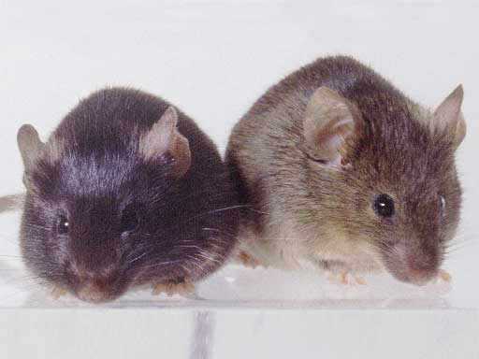
Heparan Sulfate Deficiency and Autism*
Experiment with “designer” mice: impaired heparan sulfate synthesis in brain
Mice exhibited all the classic features of autism – both cognitive and social
* F. Irie et al., Autism-like socio-communicative deficits and stereotypies in mice lacking heparan sulfate. PNAS Mar. 27, 2012, 109(13), 5052-5056.
Notes:
vitaminK/mice_no_heparan_sulfate_get_autism_2012.pdf

Slide 39
Cholesterol Sulfate in Placental Villi*
Placental villi are highly enriched in cholesterol sulfate, especially in third trimester of pregnancy
Mother’s serum cholesterol sulfate steadily rises through pregnancy
In third trimester, villi contain 24 picomol/mg of cholesterol sulfate, compared to only 1.5 in blood serum of a non-pregnant woman
*B Lin et al. J. Chromatogr. B. Biomed. Sci. Appl. 1997, 704, 99–104.
Notes:
From Hartzell paper:
Lin, B.; Kubushiro, K.; Akiba, Y.; Cui, Y.; Tsukazaki, K.; Nozawa, S.; Iwamori, M. Alteration of acidic lipids in human sera during the course of pregnancy: Characteristic increase in the concentration of cholesterol sulfate. J. Chromatogr. B. Biomed. Sci. Appl. 1997, 704, 99–104.

Slide 40
Cholesterol Sulfate in Placental Villi*
Placental villi are highly enriched in cholesterol sulfate, especially in third trimester of pregnancy
Mother’s serum cholesterol sulfate steadily rises through pregnancy
In third trimester, villi contain 24 picomol/mg of cholesterol sulfate, compared to only 1.5 in blood serum of a non-pregnant woman
Hypothesis: cholesterol sulfate is a major supplier of both cholesterol and sulfate to the fetus
*B Lin et al. J. Chromatogr. B. Biomed. Sci. Appl. 1997, 704, 99–104.
Notes:
From Hartzell paper:
Lin, B.; Kubushiro, K.; Akiba, Y.; Cui, Y.; Tsukazaki, K.; Nozawa, S.; Iwamori, M. Alteration of acidic lipids in human sera during the course of pregnancy: Characteristic increase in the concentration of cholesterol sulfate. J. Chromatogr. B. Biomed. Sci. Appl. 1997, 704, 99–104.

Slide 41
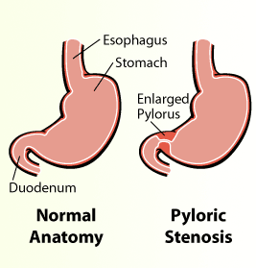
Pyloric Stenosis and Autism
Affects 2 out of 1000 births
Pyloric valve at base of stomach is enlarged, constricting flow
Severe projectile vomiting and dehydration, with electrolyte imbalance.
Corrective surgery is often required
Pyloric stenosis is associated with low serum cholesterol*
Autism is associated with increased risk to pyloric stenosis**
*Feenstra B, et al. JAMA 2013; 310(7): 714-721.
**M.L. Wier et al., Med Child Neurol 2006;48(6):500-507.

Slide 42
Low Sulfate, High Oxalate Phenotype*
Gut Dysbiosis
Decreased sulfomucins, colitis, IBD, leaky gut
Increased susceptibility to pathogens
Fatty liver disease
Reduced detox of heavy metals and toxic chemicals
Elevated serum LDL
Decreased insulin function
Adrenal insufficiency
Increased cancer risk
Stunted growth, slow metabolism
Serotonin deficiency in brain
Autism linked to sulfate wasting in kidneys
*Dr. Rostenberg
www.beyondmthfr.com/side-high-oxalates-problems-sulfate-b6-gut-methylation
Notes:
Add slides from SeneffOxalate2017.pptx in January/
Oxalate_Dr_Rosenberg.text
Down_side_high_oxalate.pdf

Slide 43
Methylation and
Transsulfuration Pathways

Slide 44
The Big Picture
Methionine is an essential sulfur-containing amino acid produced by gut microbes and disrupted by glyphosate
Methionine sits at the crossroads of the methylation and trans-sulfuration pathways
Both methylation and sulfation are essential for development and neuronal function
Glyphosate also suppresses the supply of the B vitamin, folate, essential for methyl transfer

Slide 45
Methionine and Cysteine
MTHFR gene variants linked to autism*
Protein and DNA methylation
Methionine
THF
MTHFR
B12
MTHF
superoxide
Homocysteine
Sulfate
Cysteine
Glutathione
*M Boris et al., Journal of American Physicians and Surgeons 2004;9(4): 106-108.
Notes:
methylenetetrahydrofolate reductase gene (MTHFR),
Depends on NADPH
Inhibited by phosphorylation
Inhibited by dihydrofolate

Slide 46
Generating Methionine from Homocysteine
Methionine
Methionine synthase
Homocysteine
Requirements:
Working MTHFR enzyme
Cobalamin (vitamin B12)
Zinc
Vitamin B6
Methyl tetrahydrofolate

Slide 47
Generating Methionine from Homocysteine
Folate trap: One or more of these requirements are missing; Methyl group stays stuck on folate (inactive)
Methionine
Methionine synthase
Homocysteine
Requirements:
Working MTHFR enzyme
Cobalamin (vitamin B12)
Zinc
Vitamin B6
Methyl tetrahydrofolate

Slide 48
Generating Methionine from Homocysteine
Folate trap: One or more of these requirements are missing; Methyl group stays stuck on folate (inactive)
There is a belief that elevated serum homocysteine is bad, but the homocysteine is desperately needed to produce sulfate
Methionine
Methionine synthase
Homocysteine
Requirements:
Working MTHFR enzyme
Cobalamin (vitamin B12)
Zinc
Vitamin B6
Methyl tetrahydrofolate

Slide 49
Transsulfuration Pathway*
*Figure 1, DA Geier et al., Neurochem Res (2009) 34:386–393.
Notes:
WAPF/transsulfuration_biomarkers_autism_2009.pdf

Slide 50
Pathway from Homocysteine to Sulfate*
homocysteine thiolactone
Vitamin A
thioretinamide
Vitamin C
sulfite
alpha keto butyrate
retinoic acid
Sulfite oxidase
PAPS
*McCully, Annals of Clinical and Laboratory Science 41:4, 300-313, 2011
sulfate
Notes:
AnnClinLabSciChemPatholHomocysteineV.pdf
Spacedoc/McCully/ChemicalPathologyHomocysteineV_McCully.pdf
Figure 1. Hypothetical scheme for synthesis of thioretinamide, oxidation to sulfite and sulfate, and activation of sulfate to phosphoadenosine phosphosulfate, explains sulfation of glycosaminoglycans (GAG) to form sulfate esters [2]. In this scheme superoxide is synthesized from the heme oxygenase group of cystathionine synthase [34], catalyzing retinoic acid synthesis from retinol. Synthesis of thioretinamide from retinoic acid and homocysteine thiolactone is catalyzed by cystathionine synthase and dehydroascorbate.
is hydro- lyzed to Hcy by a calcium-dependent Hcy thiolactonase (HTase) tightly associated with HDL in serum (Jakubowski 1999a). !!
When methionine synthase activity is inhibited by folate or vitamin B-12 deprivation, almost all Hcy is converted to thiolactone.
!

Slide 51
Pathway from Homocysteine to Sulfate*
When folate and B12 are deficient, nearly all homocysteine is converted to homocysteine thiolactone
homocysteine thiolactone
Vitamin A
thioretinamide
Vitamin C
sulfite
alpha keto butyrate
retinoic acid
Sulfite oxidase
PAPS
*McCully, Annals of Clinical and Laboratory Science 41:4, 300-313, 2011
sulfate
Notes:
AnnClinLabSciChemPatholHomocysteineV.pdf
Spacedoc/McCully/ChemicalPathologyHomocysteineV_McCully.pdf
Figure 1. Hypothetical scheme for synthesis of thioretinamide, oxidation to sulfite and sulfate, and activation of sulfate to phosphoadenosine phosphosulfate, explains sulfation of glycosaminoglycans (GAG) to form sulfate esters [2]. In this scheme superoxide is synthesized from the heme oxygenase group of cystathionine synthase [34], catalyzing retinoic acid synthesis from retinol. Synthesis of thioretinamide from retinoic acid and homocysteine thiolactone is catalyzed by cystathionine synthase and dehydroascorbate.
is hydro- lyzed to Hcy by a calcium-dependent Hcy thiolactonase (HTase) tightly associated with HDL in serum (Jakubowski 1999a). !!
When methionine synthase activity is inhibited by folate or vitamin B-12 deprivation, almost all Hcy is converted to thiolactone.
!

Slide 52
Pathway from Homocysteine to Sulfate*
When folate and B12 are deficient, nearly all homocysteine is converted to homocysteine thiolactone
homocysteine thiolactone
Vitamin A
thioretinamide
Superoxide:
Reactive oxygen species
(ROS)
Vitamin C
sulfite
alpha keto butyrate
retinoic acid
Sulfite oxidase
PAPS
*McCully, Annals of Clinical and Laboratory Science 41:4, 300-313, 2011
sulfate
Notes:
AnnClinLabSciChemPatholHomocysteineV.pdf
Spacedoc/McCully/ChemicalPathologyHomocysteineV_McCully.pdf
Figure 1. Hypothetical scheme for synthesis of thioretinamide, oxidation to sulfite and sulfate, and activation of sulfate to phosphoadenosine phosphosulfate, explains sulfation of glycosaminoglycans (GAG) to form sulfate esters [2]. In this scheme superoxide is synthesized from the heme oxygenase group of cystathionine synthase [34], catalyzing retinoic acid synthesis from retinol. Synthesis of thioretinamide from retinoic acid and homocysteine thiolactone is catalyzed by cystathionine synthase and dehydroascorbate.
is hydro- lyzed to Hcy by a calcium-dependent Hcy thiolactonase (HTase) tightly associated with HDL in serum (Jakubowski 1999a). !!
When methionine synthase activity is inhibited by folate or vitamin B-12 deprivation, almost all Hcy is converted to thiolactone.
!

Slide 53
Pathway from Homocysteine to Sulfate*
When folate and B12 are deficient, nearly all homocysteine is converted to homocysteine thiolactone
homocysteine thiolactone
Vitamin A
thioretinamide
Vitamin C
GAGs =
Glycosaminoglycans = sulfomucins
sulfite
alpha keto butyrate
retinoic acid
Sulfite oxidase
PAPS
*McCully, Annals of Clinical and Laboratory Science 41:4, 300-313, 2011
sulfate
Notes:
AnnClinLabSciChemPatholHomocysteineV.pdf
Spacedoc/McCully/ChemicalPathologyHomocysteineV_McCully.pdf
Figure 1. Hypothetical scheme for synthesis of thioretinamide, oxidation to sulfite and sulfate, and activation of sulfate to phosphoadenosine phosphosulfate, explains sulfation of glycosaminoglycans (GAG) to form sulfate esters [2]. In this scheme superoxide is synthesized from the heme oxygenase group of cystathionine synthase [34], catalyzing retinoic acid synthesis from retinol. Synthesis of thioretinamide from retinoic acid and homocysteine thiolactone is catalyzed by cystathionine synthase and dehydroascorbate.
is hydro- lyzed to Hcy by a calcium-dependent Hcy thiolactonase (HTase) tightly associated with HDL in serum (Jakubowski 1999a). !!
When methionine synthase activity is inhibited by folate or vitamin B-12 deprivation, almost all Hcy is converted to thiolactone.
!

Slide 54
Glyphosate Displacing
Glycine in Protein Synthesis

Slide 55
What If Glyphosate Could Insert Itself Into Protein Synthesis???
Code for Glycine
GGC
mRNA
. . .
. . .
Alanine
Proline
-- Any proteins with conserved glycine residues are likely to be affected in a major way

Slide 56
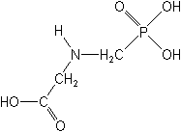
What If Glyphosate Could Insert Itself Into Protein Synthesis???
glyphosate
Code for Glycine
GGC
mRNA
. . .
. . .
Alanine
Proline
-- Any proteins with conserved glycine residues are likely to be affected in a major way

Slide 57
What If Glyphosate Could Insert Itself Into Protein Synthesis???
glyphosate
Code for Glycine
GGC
mRNA
. . .
. . .
Glyphosate
Alanine
Proline
-- Any proteins with conserved glycine residues are likely to be affected in a major way

Slide 58
Extra Piece Sticks Out at Active Site
Substrate no longer fits in active site
Active Site
Glyphosate
Alanine
Proline
Peptide chain

Slide 59
Extra Piece Sticks Out at Active Site
Substrate no longer fits in active site
Active Site
Glyphosate
Alanine
Proline
glycine
Peptide chain

Slide 60
Extra Piece Sticks Out at Active Site
Substrate no longer fits in active site
Active Site
Extra Stuff
Glyphosate
Alanine
Proline
glycine
Peptide chain

Slide 61
Extra Piece Sticks Out at Active Site
Substrate no longer fits in active site
This explains how glyphosate disrupts EPSPS in the shikimate pathway: Multiple bacteria have developed resistance by replacing active site glycine with alanine and this is the basis for GMO Roundup Ready crops*
Active Site
Extra Stuff
Glyphosate
Alanine
Proline
glycine
Peptide chain
*T Funke et al., Molecular basis for the herbicide resistance of Roundup Ready crops. PNAS 2006;103(35):13010-13015.

Slide 62
Inhibition of EPSPS by glyphosate: Resistant E coli mutant*
Mutant with alanine substituted for glycine 96
Wild type with glycine 96
*Figure 3, S Eschenburg et al. Planta 2002;216:129-135.

Slide 63
Some Predicted Consequences*
Neural tube defects
Autism
Impaired collagen → osteoarthritis
Steatohepatitis (fatty liver disease)
Obesity and adrenal insufficiency
Hypothyroidism
Impaired iron homeostasis and kidney failure
Insulin resistance and diabetes
Cancer
*A. Samsel and S. Seneff. Journal of Biological Physics and Chemistry 2016;16:9-46.

Slide 64
An Analogy: ALS in Guam
An epidemic in ALS in Guam was traced to a natural toxin found in cycads
BMAA is a non-coding amino acid that gets inserted by mistake in place of serine
Defective versions of a glutamate transporter have been linked to ALS*
The transporter has an essential serine-rich region in its sequence**
*Antioxidants & Redox Signaling 2009;11: 1587-1602.
**DJ Slotboom et al., PNAS 1999; 96(25): 14282-14287.
Notes:
cyanobacteria_BMAA_article.pdf
Slotbloom_1999_conserved_serine_glutamate_transporter.pdf
Dunlop.pdf
ALS_glutamate_transporter_link_2009.pdf
Guam/
*ALS_glutamate_transporter_link_2009.pdf
ChrisShawChapter7GuamFantastic.docx
Dunlop.pdf
**Slotbloom_1999_conserved_serine_glutamate_transporter.pdf

Slide 65
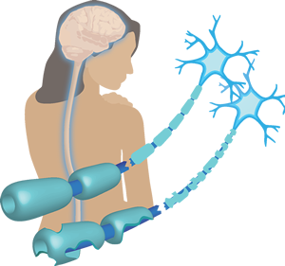
Another Analogy: MS & Sugar Beets*
Sugar beets contain an analogue of proline called Aze
Remarkable correlation between MS frequency and proximity to sugar beet agriculture
Myelin basic protein contains a concentration of proline residues that are absolutely essential for its proper function
*E. Rubenstein, J Neuropathol Exp Neurol 2008;67(11): 1035-1040.
Notes:
./misincorporation_of_proline_analogue_MS.pdf

Slide 66
How Glyphosate Disrupts Methylation and Sulfation

Slide 67
Human Digestive System Disorders
Alarming increase in the US in many diseases related to the gut
Crohn’s disease, inflammatory bowel disease, colitis, acid reflux disease, gluten and casein intolerance, celiac disease, leaky gut
The gut-brain axis links neurological disorders with gut disorders
I believe that glyphosate is a major cause
Notes:
Celiac disease has quadrupled in the US in last 50 years

Slide 68
Inflammatory Bowel Disease and Glyphosate Usage*
*Plot provided by Dr. Nancy Swanson

Slide 69
IBD Under 5 Years Old in Canada: An Epidemic*
Canada has among the highest rates of childhood-onset IBD in the world
Incidence is rapidly rising in children under 5 (7.2% increase per year since 1999)
Suspect early-life environmental triggers
Canadian government's extensive database of glyphosate residues in foods shows by far highest levels in foods from Canada or the US
*EI Benchimol et al., Am J Gastroenterol 2017;112(7):1120-1134.
Notes:
IBD_Canada_children_2017.pdf

Slide 70
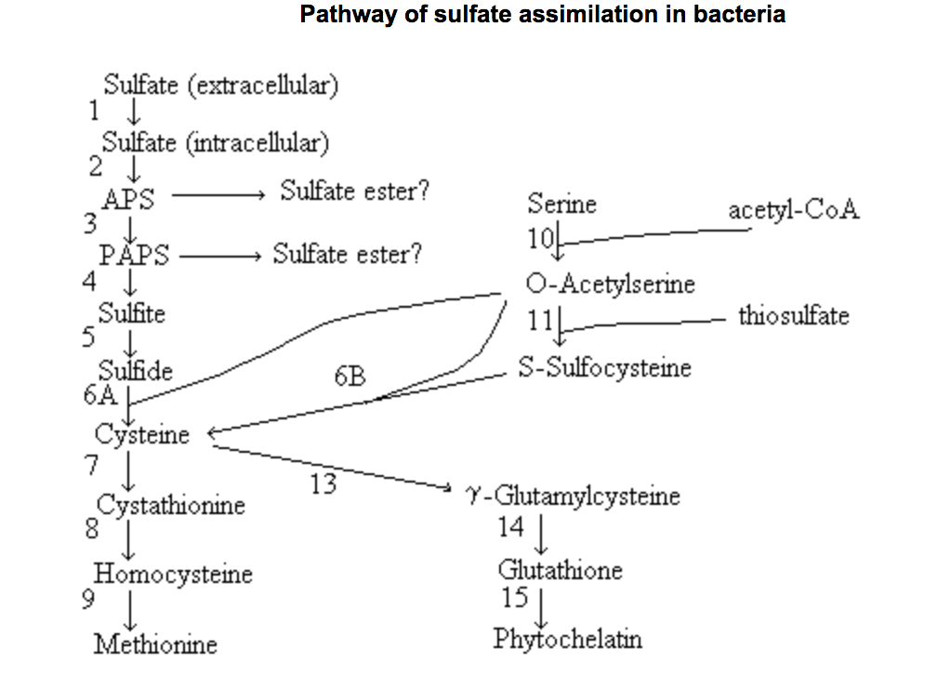
glyphosate
glyphosate

Slide 71
Proteins Suppressed by Glyphosate in E. coli*
PAPS reductase -3.75
sulfite reductase, alpha subunit -3.23
sulfite reductase, beta subunit -4.55
periplasmic sulfate-binding protein -3.39
sulfate transport system permease -2.05
*W. Lu et al., Mol BioSyst 2013; 9: 522-530, Supplementary Table S2.

Slide 72
Proteins Suppressed by Glyphosate in E. coli*
Required for incorporation of inorganic sulfur from sulfate into organic sulfur (methionine)
PAPS reductase -3.75
sulfite reductase, alpha subunit -3.23
sulfite reductase, beta subunit -4.55
periplasmic sulfate-binding protein -3.39
sulfate transport system permease -2.05
*W. Lu et al., Mol BioSyst 2013; 9: 522-530, Supplementary Table S2.

Slide 73
Proteins Suppressed by Glyphosate in E. coli*
PAPS reductase -3.75
sulfite reductase, alpha subunit -3.23
sulfite reductase, beta subunit -4.55
periplasmic sulfate-binding protein -3.39
sulfate transport system permease -2.05
Required for transport of sulfate into the cell
*W. Lu et al., Mol BioSyst 2013; 9: 522-530, Supplementary Table S2.
Notes:
dissimilatory_sulfite_reductase_no_glycine_2010

Slide 74
Sulfite Metabolism: Sulfur Sensitivity
Sulfate
Sulfite oxidase
Sulfite
Assimilatory
Sulfite reductase
Dissimilatory
Sulfite reductase
Methionine
Hydrogen
Sulfide
Notes:
dissimilatory_sulfite_reductase_no_glycine_2010
G473D_mutation_sulfite_oxidase_destroys_it_2006.pdf

Slide 75
Sulfite Metabolism: Sulfur Sensitivity
Sulfate
Sulfite oxidase
Inhibited in E coli
by glyphosate
Sulfite
Assimilatory
Sulfite reductase
Dissimilatory
Sulfite reductase
Methionine
Hydrogen
Sulfide
Notes:
dissimilatory_sulfite_reductase_no_glycine_2010
G473D_mutation_sulfite_oxidase_destroys_it_2006.pdf

Slide 76
Sulfite Metabolism: Sulfur Sensitivity
Sulfate
Sulfite oxidase
Inhibited in E coli
by glyphosate
Desulfovibrio
overgrowth
Sulfite
Assimilatory
Sulfite reductase
Dissimilatory
Sulfite reductase
Methionine
Hydrogen
Sulfide
Notes:
dissimilatory_sulfite_reductase_no_glycine_2010
G473D_mutation_sulfite_oxidase_destroys_it_2006.pdf

Slide 77
Sulfite Metabolism: Sulfur Sensitivity
Depends on essential glycine residue to form active dimer
Sulfate
Sulfite oxidase
Inhibited in E coli
by glyphosate
Desulfovibrio
overgrowth
Sulfite
Assimilatory
Sulfite reductase
Dissimilatory
Sulfite reductase
Methionine
Hydrogen
Sulfide
Notes:
dissimilatory_sulfite_reductase_no_glycine_2010
G473D_mutation_sulfite_oxidase_destroys_it_2006.pdf

Slide 78
“Sulfide as a Mucus Barrier-Breaker in Inflammatory Bowel Disease?”*
"hydrogen sulfide concentrations rise, causing denaturation of the outer and inner mucus layers, thereby allowing penetration and contact of bacteria with the host epithelial lining. This in turn triggers inflammation."
*N. Ijssennagger et al., Trends in Molecular Medicine 2016;22(3): 190-199.
Notes:
sulfide_as_mucus_barrier_buster_2016.pd

Slide 79
Conserved Glycines in Important Sulfur-processing Enzymes
The sulfotransferases*
GxxGxxK motif required for binding PAPS
Sulfite oxidase**
Changing glycine at residue 473 with aspartate destroys enzyme activity
Aspartate has similar properties as glyphosate, being bulky and negatively charged
Defective SO leads to severe birth defects and neurological problems that usually result in death at an early age
*K. Komatsu et al., Biochemical and Biophysical Research Communications
1994;204(3): 1178-1185.
**H.L. Wilson et al., Biochemistry 2006, 45, 2149-2160.
Notes:
2016/Anthony/conserved_glycines_sulfotransferase_1994_WOW.pdf
./G473D_mutation_sulfite_oxidase_destroys_it_2006.pdf

Slide 80
Sulfate Reducing Microbes
Desulfovibrio is a microbe in the colon that reduces sulfate to hydrogen sulfide gas
Desulfovibrio overgrowth is linked to autism
Hydrogen sulfide travels like a ghost across all tissues
It can travel by diffusion from the colon to the spinal column, the pancreas, the liver, etc.
It can be oxidized to form sulfate at the destination site, but this requires superoxide, leading to local tissue damage

Slide 81
Sulfate Reducing Microbes
Desulfovibrio is a microbe in the colon that reduces sulfate to hydrogen sulfide gas
Desulfovibrio overgrowth is linked to autism
Hydrogen sulfide travels like a ghost across all tissues
It can travel by diffusion from the colon to the spinal column, the pancreas, the liver, etc.
It can be oxidized to form sulfate at the destination site, but this requires superoxide, leading to local tissue damage
This is a novel way to transport sulfate!

Slide 82
How Glyphosate Damages Mitochondria and Lysosomes
Notes:
./
Fig. 5 Lysosomal destabilization by oxidative stress. The cell’s
antioxidant defense protects against moderate oxidative
events. However, if the protective shield is overwhelmed, hydrogen
peroxide, which is mainly produced by mitochondria, diffuses into
lysosomes in abnormal amounts. Since many lysosomes are rich in
redox-active iron due to degradation of iron- containing
macromolecules, Fenton-type reactions then take place resulting in
lysosomal rupture with release of powerful lytic enzymes

Slide 83
How Glyphosate Damages Mitochondria and Lysosomes
Glyphosate disrupts Cytochrome C Oxidase
Notes:
./
Fig. 5 Lysosomal destabilization by oxidative stress. The cell’s
antioxidant defense protects against moderate oxidative
events. However, if the protective shield is overwhelmed, hydrogen
peroxide, which is mainly produced by mitochondria, diffuses into
lysosomes in abnormal amounts. Since many lysosomes are rich in
redox-active iron due to degradation of iron- containing
macromolecules, Fenton-type reactions then take place resulting in
lysosomal rupture with release of powerful lytic enzymes

Slide 84
How Glyphosate Damages Mitochondria and Lysosomes
Glyphosate disrupts Cytochrome C Oxidase
Glyphosate depletes glutathione → insufficient antioxidant capacity
Notes:
./
Fig. 5 Lysosomal destabilization by oxidative stress. The cell’s
antioxidant defense protects against moderate oxidative
events. However, if the protective shield is overwhelmed, hydrogen
peroxide, which is mainly produced by mitochondria, diffuses into
lysosomes in abnormal amounts. Since many lysosomes are rich in
redox-active iron due to degradation of iron- containing
macromolecules, Fenton-type reactions then take place resulting in
lysosomal rupture with release of powerful lytic enzymes

Slide 85
How Glyphosate Damages Mitochondria and Lysosomes
Glyphosate disrupts Cytochrome C Oxidase
Glyphosate depletes glutathione → insufficient antioxidant capacity
Glyphosate impairs sulfate supply → insufficient acidity
Notes:
./
Fig. 5 Lysosomal destabilization by oxidative stress. The cell’s
antioxidant defense protects against moderate oxidative
events. However, if the protective shield is overwhelmed, hydrogen
peroxide, which is mainly produced by mitochondria, diffuses into
lysosomes in abnormal amounts. Since many lysosomes are rich in
redox-active iron due to degradation of iron- containing
macromolecules, Fenton-type reactions then take place resulting in
lysosomal rupture with release of powerful lytic enzymes

Slide 86
How Glyphosate Damages Mitochondria and Lysosomes
Glyphosate disrupts Cytochrome C Oxidase
Result is build-up of lipofuscin (direct link to aging and senescence) and impaired ability to recycle damaged molecules
Glyphosate depletes glutathione → insufficient antioxidant capacity
Glyphosate impairs sulfate supply → insufficient acidity
Notes:
./
Fig. 5 Lysosomal destabilization by oxidative stress. The cell’s
antioxidant defense protects against moderate oxidative
events. However, if the protective shield is overwhelmed, hydrogen
peroxide, which is mainly produced by mitochondria, diffuses into
lysosomes in abnormal amounts. Since many lysosomes are rich in
redox-active iron due to degradation of iron- containing
macromolecules, Fenton-type reactions then take place resulting in
lysosomal rupture with release of powerful lytic enzymes

Slide 87
Glycine decarboxylase deficiency causes neural tube defects and features of non-ketotic hyperglycinemia in mice*
Fascinating article about mice with a deficiency in a protein involved in generating methyl groups from glycine -> methylfolate deficiency
These mice have very high rate of neural tube defects
Those that are viable have swollen ventricles (a feature of autism) and delayed development
Methylation pathway impairment is a common feature of autism
*YJ Pai et al., Nature Communications 2015; 6:6388

Slide 88
Glycine decarboxylase deficiency causes neural tube defects and features of non-ketotic hyperglycinemia in mice*
Fascinating article about mice with a deficiency in a protein involved in generating methyl groups from glycine -> methylfolate deficiency
These mice have very high rate of neural tube defects
Those that are viable have swollen ventricles (a feature of autism) and delayed development
Methylation pathway impairment is a common feature of autism
Glycine decarboxylase has a glycine-rich region that maintains shape and flexibility of active site**
**A Kume et al., JBC 1991; 266(5): 3323-3329

Slide 89
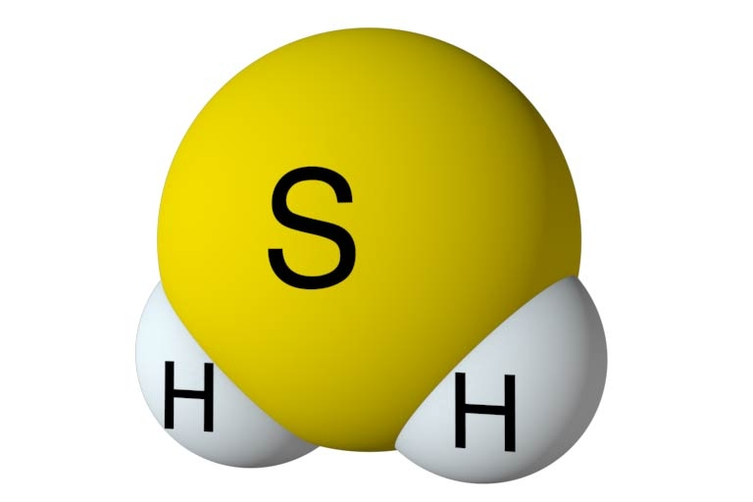
Inflammation and Hydrogen Sulfide*
Enhanced H₂S synthesis in multiple inflammatory diseases and conditions
arthritis
acute pancreatitis
sepsis
hemorrhagic shock
burns
H₂S is synthesized from cysteine and then oxidized to form sulfate
H₂S induces inflammatory response which supplies superoxide needed for sulfate formation
*N Muniraj et al., Int J Rheum Dis. 2017 Feb;20(2):182-189.
Notes:
2017/gout/Muniraj_2014_gout_hydrogen_sulfide_link.pdf

Slide 90
Inflammation and Hydrogen Sulfide*
Enhanced H₂S synthesis in multiple inflammatory diseases and conditions
arthritis
acute pancreatitis
sepsis
hemorrhagic shock
Burns
H₂S is synthesized from cysteine and then oxidized to form sulfate
H₂S induces inflammatory response which supplies superoxide needed for sulfate formation
Is this a mechanism to renew sulfate supplies to the vasculature?
*M. Nethaji et al., International Journal of Rheumatic Diseases 2014 [ePub ahead of print]
Notes:
2017/gout/Nethaji_2014_gout_hydrogen_sulfide_link.pdf

Slide 91
Microcephaly and Prematurity*
Data pooled from hospitals in 11 cities in 5 states
1506 premature infants were studied (GA 23-28 weeks)
Microcephaly occurs much more commonly than expected among babies born prematurely
2.2% expected, nearly 10% observed
Extremely low gestational age and severe intra-uterine growth restriction are risk factors for microcephaly
Intra-uterine growth restriction caused by inflamed and damaged placenta
*TF McElrath et al., Am J Obstet Gynecol. 2010; 203(2): 138.e1–138.e8.

Slide 92
Microcephaly and Prematurity*
Data pooled from hospitals in 11 cities in 5 states
1506 premature infants were studied (GA 23-28 weeks)
Microcephaly occurs much more commonly than expected among babies born prematurely
2.2% expected, nearly 10% observed
Extremely low gestational age and severe intra-uterine growth restriction are risk factors for microcephaly
Intra-uterine growth restriction caused by inflamed and damaged placenta
Hypothesis: Inflamed placenta is trying to recover adequate sulfate by oxidizing reduced sulfur sources
*TF McElrath et al., Am J Obstet Gynecol. 2010; 203(2): 138.e1–138.e8.

Slide 93
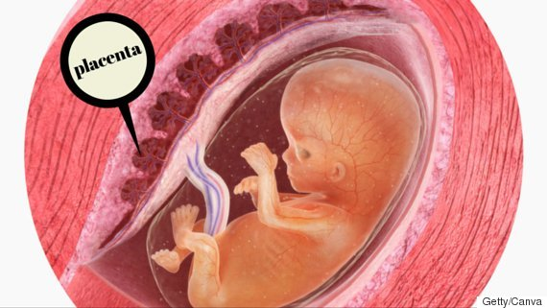
Magnesium Sulfate Protects Placenta from Inflammation*
Rat model: inject LPS to induce inflammation in placenta
Placentas responded with increased expression of inflammatory markers
Simultaneous administration of magnesium sulfate protected placentas
Human placental cultures reacted similarly to both LPS and magnesium sulfate
*O Dowling et al. Placenta 2012;33(5):392-8.
Notes:
GregNigh/HDL_anencephaly/magnesium_sulfate_reduces_LPS_inflammation_placenta.text

Slide 94
This is Good News!*
*https://www.ams.usda.gov/press-release/
2016-count-certified-organic-operations-shows-continued-growth-us-market

Slide 95
Summary
Glyphosate usage has grown exponentially over the past two decades, in step with the introduction of GMO Roundup-Ready crops
Glyphosate causes neural tube defects and autism through multiple metabolic disruptions
Folate and methionine deficiency
Disrupted sulfate synthesis and transport
Methionine sits at the crossroads of the methylation and transsulfuration pathways
Folate deficiency due to glyphosate’s disruption of gut microbes led to regulation to require folic acid fortification of wheat-based foods
Folic acid is a defective form of folate that causes liver disease and increased risk to autism
Cholesterol sulfate, heparan sulfate and chondroitin sulfate are essential for fetal brain development

