Slide 1
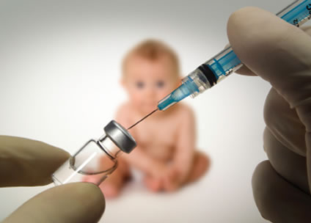
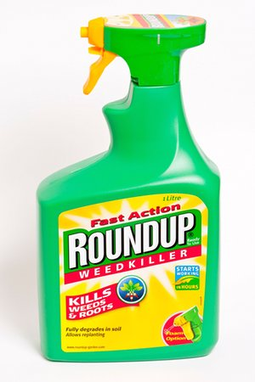
Glyphosate + Aluminum + Mercury + Glutamate = Autism
Stephanie Seneff
MIT CSAIL
AutismOne 2018

Slide 2
Outline
Brief Introduction to Glyphosate
Glyphosate and the Gut
Mouse Models of Autism
Vaccine Toxicants and Autoimmune Disease
Aluminum in Vaccines
Glyphosate IN MMR?
Summary

Slide 3
Brief Introduction to
Glyphosate

Slide 4
Roundup and GMO Crops
GMO Roundup-Ready corn, soy, canola, sugar beets
cotton, tobacco and alfalfa
What is glyphosate?

Slide 5
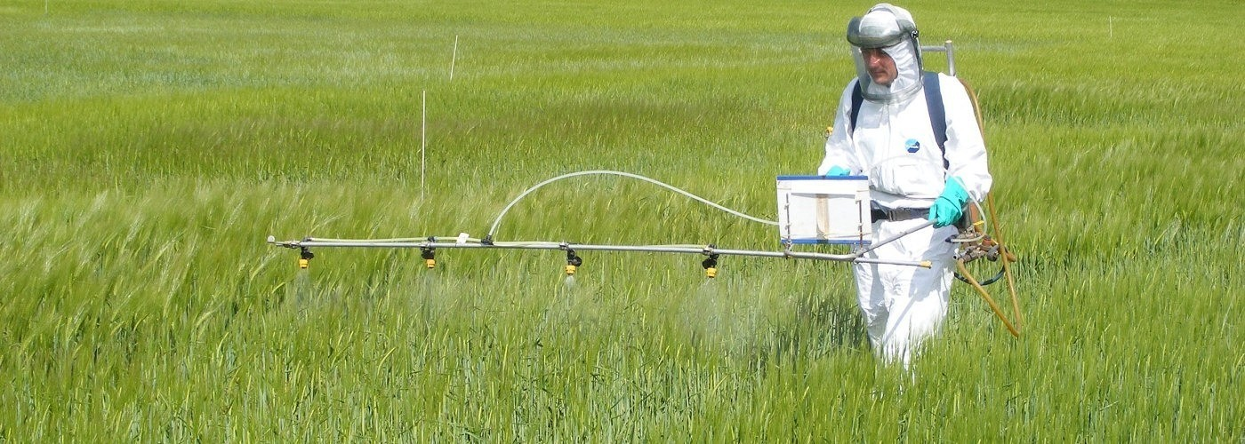
Roundup as a Desiccant/Ripener just before Harvest
Wheat, Oats, Barley, Rye, Sugar cane, Beans, Lentils, Peas, Flax, Sunflowers, Pulses, Chick Peas

Slide 6
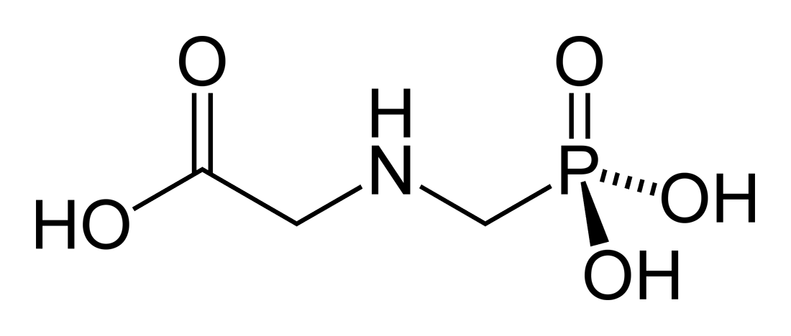
Glyphosate!!
Glyphosate is now the #1 herbicide in use in the U.S. and is increasingly used around the world
Developed and patented by Monsanto in the 1970’s
Introduced into the US food chain in 1974
Came out from under patent in 2000
Inhibits an enzyme in the shikimate pathway involved in the synthesis of tyrosine, tryptophan and phenylalanine (the three aromatic amino acids)
Huge expansion of GMO corn, soy, cotton and canola crops has led to sharp increases in the last two decades
Notes:
WIKI

Slide 7
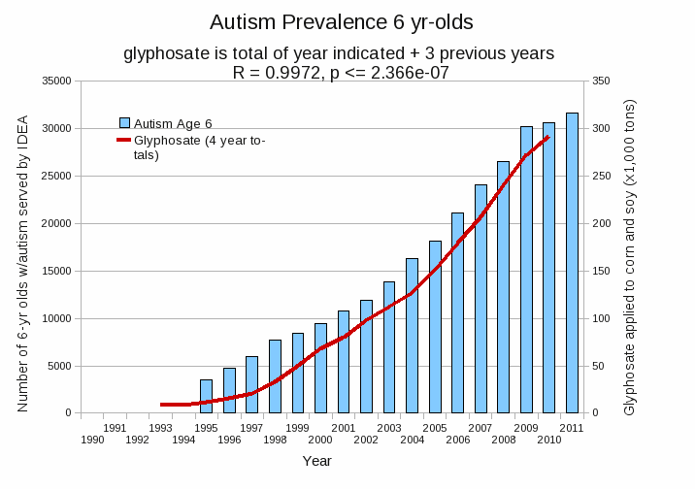
Autism Prevalence: 6 year olds*
R = 0.9972
* Figure 15, Seneff et al., Agricultural Sciences, 2015, 6, 42-70
Notes:
Nancy/latest_plots/6-yr-old autism.gif
autism: USDE
oil consumption: USDA
glyphosate: USDA
GE crops: USDA
Mortality data: CDC

Slide 8
Glyphosate is a non-coding amino acid analogue of glycine
H
Glycine
Glyphosate

Slide 9
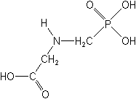
What If Glyphosate Could Insert Itself Into Protein Synthesis by mistake???
glyphosate
Code for glycine
GGC
mRNA
. . .
. . .
Glyphosate
Alanine
Proline
Any proteins with conserved glycine residues are likely to be affected in a major way

Slide 10
Multiple species of bacteria and multiple species of weeds have developed resistance to glyphosate by swapping out a crucial glycine residue in the enzyme EPSP synthase in the shikimate pathway, replacing it with alanine.*
A bacterial gene coding for alanine instead of glycine is the basis of the GMO Roundup-Ready crops**
*S Seneff et al. J Bioinfo Proteomics Rev 2016; 2(3): 1-21.
**T Funke et al. Proc Natl Acad Sci U S A 2006; 103(35): 13010-13015.

Slide 11
Glyphosate Disrupts Cytochrome P450 (CYP) Enzymes*
Glyphosate has been shown to severely suppress CYP enzymes in rat liver
CYP enzymes have a unique FXXGXRXCXG motif with two and sometimes three critical glycine residues**
GLYCINES
*A Samsel and S Seneff. Entropy 2013; 15: 1416-1463.
**K Syed and SS Mashele. PLOS ONE 2014; 9(4):| e95616.
Notes:
CYPs_contain_highly_conserved_glycines_2014.pdf

Slide 12
Glyphosate Disrupts Cytochrome P450 (CYP) Enzymes*
Glyphosate has been shown to severely suppress CYP enzymes in rat liver
CYP enzymes have a unique FXXGXRXCXG motif with two and sometimes three critical glycine residues**
CYP enzymes are needed to produce bile acids for digesting fats, to activate vitamin D and to detoxify many environmental toxicants
GLYCINES
*A Samsel and S Seneff. Entropy 2013; 15: 1416-1463.
**K Syed and SS Mashele. PLOS ONE 2014; 9(4):| e95616.
Notes:
CYPs_contain_highly_conserved_glycines_2014.pdf

Slide 13
Glyphosate and the Gut

Slide 14
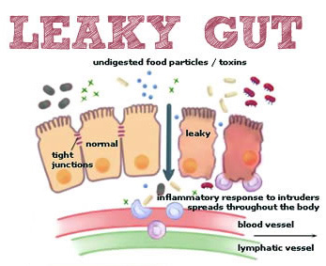
Notes:
Excellent article!!
./glyphosate_vaccines_autism.pdf
http://kinseimindbody.com/synergistic-destruction-how-vaccines-and-gmos-converge-to-fuel-autism-and-neurodegenerative-conditions/

Slide 15
Glyphosate and the Gut: Pathogen Overgrowth
Glyphosate is an antimicrobial agent that preferentially kills beneficial microbes, allowing pathogens to flourish in the gut*
Immune cells invade the gut and release inflammatory cytokines
This causes increased risk to inflammatory bowel diseases such as Crohn’s and ulcerative colitis
* Samsel and Seneff. Entropy 2013; 15: 1416-1463.

Slide 16
Pathogen Overgrowth in Poultry Microbes Exposed to Glyphosate*
Clostridia
Salmonella
Bifidobacteria
*Plot provided by Dr. Martin Michener
Notes:
From Marty Michener!
Sheehata paper.

Slide 17
Glyphosate and the Gut: Digestive Enzymes
Glyphosate has been found as a contaminant in digestive enzymes trypsin, pepsin and lipase*
Trypsin impairment prevents proteins like gluten in wheat from being digested
Undigested proteins induce release of zonulin which opens up gut barrier**
Zonulin lingers because trypsin is defective
*A Samsel and S Seneff. J Biol Phys Chem 2017;17:8-32
** JJ Gildea et al. J Clin Nutr Diet. 2017, 3:1.
Notes:
Glyphosate/ZachBushPaper_tight_junctions_glyphosate_2017.pdf

Slide 18
Trypsin, Pepsin and Lipase are all contaminated with glyphosate*
Enzyme | Glyphosate (PPB)
Pepsin (ELISA) | <40
Pepsin (GC-MS) | 430
Pepsin (HPLC-MSMS) | 290
Trypsin (ELISA) | 62
Lipase (ELISA) | 24
*A Samsel and S Seneff. Journal of Biological Physics and Chemistry 2017;17: 8-32

Slide 19
Trypsin, Pepsin and Lipase are all contaminated with glyphosate*
Trypsin’s activation domain contains four crucial glycine rich subdomains:*
N-terminus to Gly 19
Gly 142 to Pro 152
Gly 184 to Gly 193
Gly 216 to Asn 223
Enzyme | Glyphosate (PPB)
Pepsin (ELISA) | <40
Pepsin (GC-MS) | 430
Pepsin (HPLC-MSMS) | 290
Trypsin (ELISA) | 62
Lipase (ELISA) | 24
*A Samsel and S Seneff. Journal of Biological Physics and Chemistry 2017;17: 8-32

Slide 20
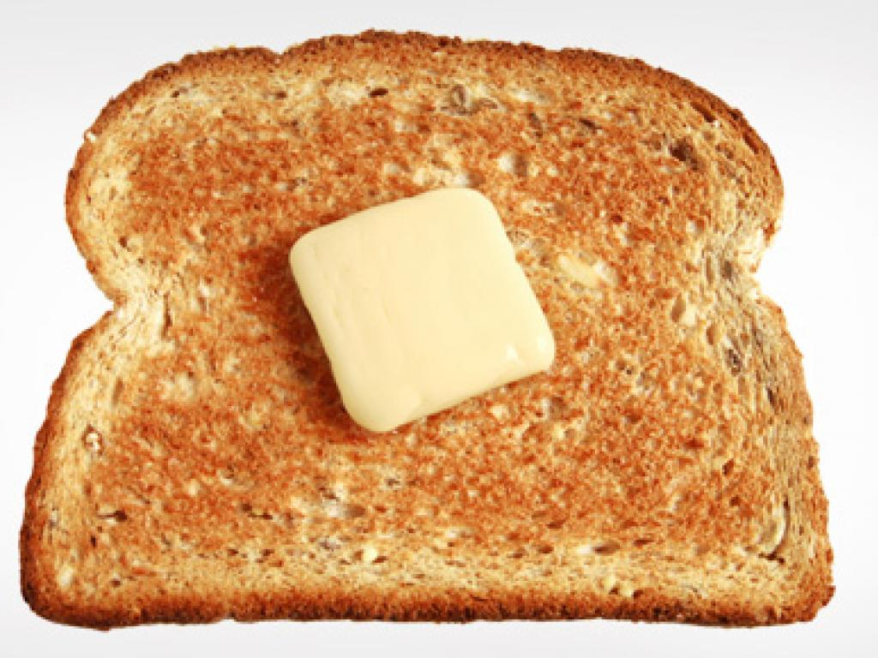
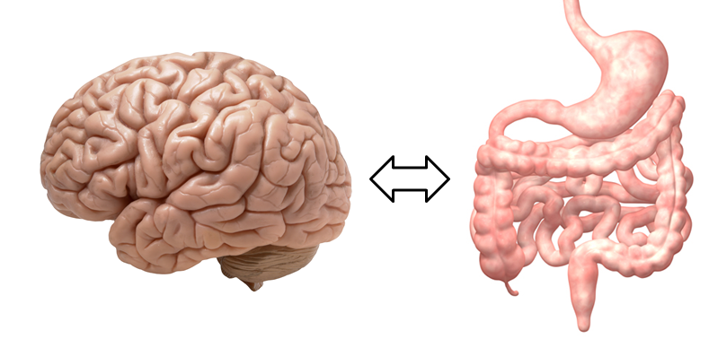
A Scenario for Gluten Intolerance
Glyphosate in wheat
Leaky brain barrier
Zonulin
Trypsin defective
Autoimmune
neurological
disease
Zonulin released
Gliadin
Leaky barrier
Systemic immune response induces multiple complex symptoms

Slide 21
Glyphosate and Celiac Disease*
Glyphosate
Use on wheat
Celiac disease
*Samsel and Seneff, Interdiscip Toxicol. 2013;6(4): 159–184.

Slide 22
Celiac Disease, Glyphosate and Non Hodgkin’s Lymphoma
Glyphosate preferentially kills Bifidobacteria*
Bifidobacteria are depleted in celiac disease**
Celiac disease is associated with increased risk to non Hodgkin’s lymphoma***
Glyphosate itself is also linked directly to non Hodgkin’s lymphoma****
*A.A. Shehata et al., Curr Microbiol. 2013 Apr;66(4):350-8.
** M. Velasquez-Manoff, NY Times Sunday Review, Feb. 23, 2013.
*** C. Catassi et all, JAMA. 2002 Mar 20;287(11):1413-9.
****M. Eriksson et al., Int J Cancer. 2008 Oct 1;123(7):1657-63.
Notes:
**./ bifidobacteria_celiac_disease.text
Cancer/Celiac_disease_increases_hodgkins_lymphoma.text
./Celiac_and_bacteria.text

Slide 23
*Figure 20, NL Swanson et al. Journal of Organic Systems 9(2), 2014, p. 25.

Slide 24
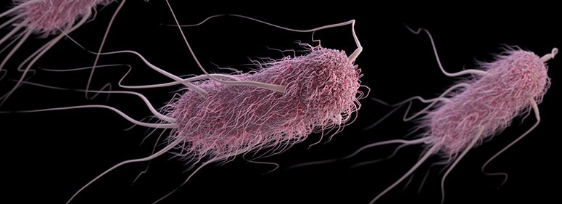
Glyphosate Induces Antibiotic Resistance*
Actinobacteria produce a free radical scavenger in response to glyphosate that provides resistance to a wide range of antibiotics, including penicillin
E. coli exposed to glyphosate develop an "efflux pump" that increases resistance to the fluoroquinolone Ciprofloxacin and the aminoglycoside Kanamycin.
Same effect observed in Salmonella exposed to glyphosate
*AHC Van Bruggen et al. Science of the Total Environment 2018;616-617: 255–268.

Slide 25
Glyphosate Usage and Papers on Antibiotic Resistance*
*AHC Van Bruggen et al. Science of the Total Environment 2018;616-617: 255–268.
Notes:
./VanBruggen_glyphosate_antibiotic_resistance_2017.pdf

Slide 26
Myosin in the Gut
Myosin is a motor protein found in high levels in skeletal muscles
Myosin is also essential for gut motility (peristalsis) and for the release of bile acids into the upper intestine
Myosin contains a highly conserved glycine at position 699*
If this is changed to alanine, the proteins’ contractile ability is reduced to less than 1%.
Glyphosate has been shown in fish studies to suppress myosin expression**
*F Kinose et al. The Journal of Cell Biology 1996;134(4): 895-909.
**Ana Paula Rezende dos Santos et al., Chemosphere 2017;168:933e943.
Notes:
Glyphosate/chemosphere_2017_glyphosate_histomorpholgical_changes_liver_guppies.pdf
Anthony/scleroderma/glycine_699_pivotal_for_motor_activity_skeletal_myosin.pdf

Slide 27
Myosin in the Gut
Myosin is a motor protein found in high levels in skeletal muscles
Myosin is also essential for gut motility (peristalsis) and for the release of bile acids into the upper intestine
Myosin contains a highly conserved glycine at position 699*
If this is changed to alanine, the proteins’ contractile ability is reduced to less than 1%.
Glyphosate has been shown in fish studies to suppress myosin expression**
SIBO (Small Intestinal Bacterial Overgrowth) is associated with impaired peristalsis*
*AC Dukowicz et al. Gastroenterol Hepatol (N Y) 2007; 3(2): 112-122.
Notes:
Glyphosate/chemosphere_2017_glyphosate_histomorpholgical_changes_liver_guppies.pdf
Anthony/scleroderma/glycine_699_pivotal_for_motor_activity_skeletal_myosin.pdf

Slide 28
Mouse Models of Autism

Slide 29
A BTBR Mouse Model of Autism*
These mice had all the mouse features of autism
They were fed “standard rodent chow” – glyphosate contaminated?
Some features in the gut:
Reduced levels of bile acids (due to impaired CYP7A1 activity in the liver)
Further reduced levels of secondary bile acids (impaired metabolism by gut microbes)
Reduced levels of Lactobacillus and Bifidobacteria (microbes that metabolize bile acids)
These microbes are preferentially killed by glyphosate
Serotonin deficiency (due in part to tryptophan conversion to kynurenine to fight infection)
Serotonin is derived from tryptophan, a product of the shikimate pathway which glyphosate disrupts
*AV Glubeva et al. EBioMedicine. 2017 Oct;24:166-178.
Notes:
Anthony/scleroderma/mouse_model_autism_bile_acids_tryptophan_gut_microbes_2017.pdf

Slide 30
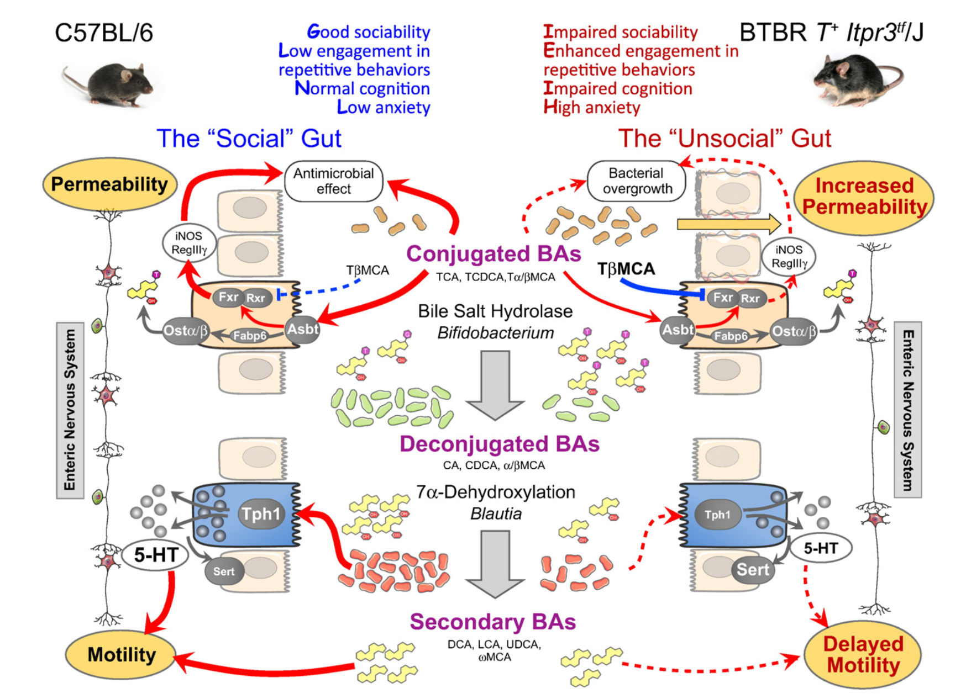
*Figure 8. AV Glubeva et al. EBioMedicine. 2017 Oct;24:166-178.
Notes:
Microbiota-related Changes in Bile Acid & Tryptophan Metabolism are Associated with Gastrointestinal Dysfunction in a Mouse Model of Autism
Fig. 8. Putative mechanisms linking changes in the gut microbiota with GI malfunction in the BTBR mouse model of human ASD. In BTBR mice, autistic-like behavioral phenotype is associated with altered microbiota and marked GI distress: increased epithelial permeability (1) and delayed intestinal motility (2). (1) Reduced abundance of bile-metabolizing Bifidobacterium species increases the fraction of tauro-conjugated BAs (e.g. tauromuricholic acid (TβMCA)) in the GI tract. TβMCA inhibits Fxr signaling and thus supresses anti- microbial defense of the host (iNOS, RegIIIγ). We hypothesise that loss of Fxr signaling in BTBR mice causes small intestinal bacterial overgrowth and, as a result, an increase in epithelial permeability. This effect is further exaggerated by deficient synthesis of BAs, which normally prevent bacterial overgrowth. (2) Healthy intestinal transit relies on many factors, including the ENS, secondary BAs and 5-HT (all deficient in BTBR mice). Secondary BA levels are reduced; 5-HT bioavailability is decreased due to a lower production (down- regulation of Tph1) and a higher breakdown (up-regulation of Sert) rates. Lower abundance of clostridia bacteria, including Blautia species, potentially contributes to these changes. Further, the BTBR myeneric plexus shows reduced numbers of excitatory and inhibitory neurons. All this can cause delayed intestinal motility in BTBR mice.

Slide 31
BTBR mice have low acetate, and glyphosate disrupts acetate synthesis in gut*
BTBR mice
Children with autism had only 3.5 mg/ml acetate in stool samples compared to 5.1 in controls.**
*LN Nielsen et al. Environmental Pollution 2018;233:364e376.
**Adams et al. BMC Gastroenterology 2011; 11:22.
Notes:
./low_acetate_gut_autism_2011.pdf
scleroderma/glyphosate_reduces_acetate_gut_2018.pdf

Slide 32
BTBR mice have low acetate, and glyphosate disrupts acetate synthesis in gut*
BTBR mice
Children with autism had only 3.5 mg/ml acetate in stool samples compared to 5.1 in controls.**
Bifidobacteria produce significant amounts of acetate
Notes:
Where?

Slide 33
BTBR mice have low acetate, and glyphosate disrupts acetate synthesis in gut*
BTBR mice
Children with autism had only 3.5 mg/ml acetate in stool samples compared to 5.1 in controls.**
Elevated pH linked to glyphosate exposure results in small intestinal bacterial overgrowth (SIBO)
Notes:
Where?

Slide 34
Evidence Linking Autism to Clostridia Overgrowth*
14 autistic children with gut disorder compared to 21 controls
Significant increase in Clostridia species in the gut in autistic children
Associated with reduced tryptophan levels and increased expression of inflammatory markers
Tryptophan is a product of the shikimate pathway, which glyphosate blocks
Macrophages in inflamed tissue take up tryptophan, reducing bioavailability to the brain
Proposed role for antibiotics
Glyphosate is a patented antimicrobial agent (2010)
*RA Luna et al., Cellular and Molecular Gastroenterology and Hepatology 2017;3(2): 218-230

Slide 35
*
Triplets: two boys, one girl. Both boys have autism and girl has seizure disorder
Very high levels of glyphosate in urine in all three
Clostridia overgrowth due to glyphosate disruption of gut microbes
Clostridia produce toxins HPHPA and p-cresol, which block the conversion of dopamine to norepinephrine.
Damage to neurons in the brain through oxidative stress
*W. Shaw. Integrative Medicine 2017;16(1);50-57.
Notes:
./Shaw_on_glyphosate_triplets_autism.text

Slide 36
Pathogen Overgrowth in Poultry Microbes Exposed to Glyphosate*
Clostridia
Salmonella
Bifidobacteria
*Plot provided by Dr. Martin Michener
Notes:
From Marty Michener!
Sheehata paper.

Slide 37
Recapitulation
Glyphosate contamination in food proteins makes them hard to break down
This leads to autoimmune disease
Glyphosate contamination in digestive enzymes makes them defective
Undigested proteins induce Celiac disease and leaky gut
Glyphosate is a key factor in the emergence of antibiotic resistant pathogens
Mouse models of autism are consistent with glyphosate damage in the gut
Glyphosate promotes Clostridia overgrowth in the gut
This induces inflammatory bowel disease, an epidemic today
Autism has been linked to Clostridia overgrowth
Clostridia release toxins that induce an inflammatory response

Slide 38
Vaccine Toxicants and
Autoimmune Disease

Slide 39
Vaccine Induced Immune Overload*
Mercury, aluminum, formaldehyde, MSG, neomycin, gentamycin, streptomycin, polymyxin B, polyethylene glycol, squalene, killed and/or live viruses, viral contaminants, etc.
→ Type 1 and type 2 diabetes, NASH, autism, asthma, food allergies, thyroiditis, vasculitis and autoimmune rheumatic diseases like lupus, rheumatoid arthritis, psoriasis and metabolic syndrome.
*Classen JB, J Mol Genet Med 2014, S1:025
Notes:
samantha/vaccine-induced-immune-overload.pdf
./vaccine_overload.pdf
http://www.thepeoplesvoice.org/TPV3/Voices.php/2014/06/16/vaccine-induced-immune-overload-and-the-

Slide 40
Autoimmune Disease and Molecular Mimicry*
A peptide sequence in a foreign protein resembles a sequence in a human protein
The immune system develops antibodies to the foreign protein and then these act as autoantibodies and attack the human protein that looks similar
This is how you get autoimmune disease
The foreign protein could be from a virus in a vaccine or from a live infection or it could be from a food source like wheat gluten
*MF Cusick et al., Clin Rev Allergy Immunol. 2012; 42(1): 102–111.
Notes:
./molecular_mimicry_autoimmunity_2012.pdf

Slide 41
Hypothesis
Cumulative glyphosate exposure sets up a weakened immune system, a leaky gut barrier and a leaky brain barrier
Vaccines introduce foreign proteins that may contain glyphosate as a contaminant
Child develops overactive antibody response to foreign protein contaminated with glyphosate and, through molecular mimicry, this leads to autoimmune disease

Slide 42
A Model from Gut Dysbiosis to Autoimmunity*
*Figure 1, R. Ponte et al. EBioMedicine 1016;4:40-49.
Notes:
./reversing_gut_damage_in_HIV_great_figure_2016.pdf

Slide 43
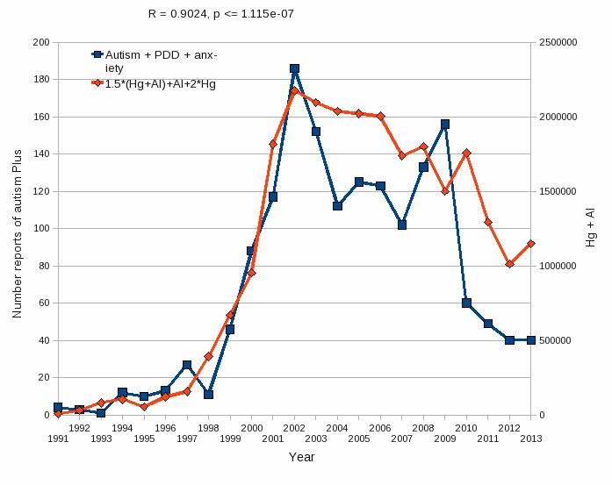
Aluminum & Mercury Autism & PDD & Anxiety
VAERS
database
Formula: Al + 1.5 x (Al w/ Hg) + 2.0 x Hg

Slide 44
"Autoimmune (autoinflammatory) syndrome induced by adjuvants” (ASIA)*
Alum-containing vaccines become insidiously unsafe in certain individuals
Increased risk to develop autoimmune diseases
Chronic fatigue, muscle pain, joint pain, brain fog
Alum nanoparticles adsorb vaccine antigens on their surface -> resistance to proteolysis
Defects in autophagy → biopersistence of alum particles
Trojan horse effect: immune cells carry Al into brain
Leaky brain barrier →Alum accumulates in brain
*RK Gherardi et al., Frontiers in Neurology February 2015; 6:4.

Slide 45
Methodological Issues and Evidence of Malfeasance in Research Purporting to Show Thimerosal in Vaccines Is Safe*
Over 165 studies have found Thimerosal to be harmful:
Death, allergic reactions, malformations, autoimmune reactions, developmental delay
Neurodevelopmental disorders, including tics, speech delay, language delay, attention deficit disorder, and autism
Six studies used by the CDC to support Thimerosal’s safety are flawed
*B Hooker et al., BioMed Research International 2014, Article ID 247218
Notes:
Samantha/Thimerosal_not_safe_Geier_2014

Slide 46
Glyphosate and Mercury Synergy
Glyphosate reduces glutathione levels in the liver
Glutathione binds with mercury and detoxifies it*
This causes a further reduction in glutathione supply
Desulfovibrio (overgrowth with glyphosate exposure) converts mercury to the toxic form, methylmercury
Desulfovibrio flourish when assimiliatory sulfite reductase is defective
This enzyme has been shown to be suppressed by glyphosate in E coli**
Autism is linked to overgrowth of Desulfovibrio***
*H Khan et al. J Pharm Sci. 2012 Apr;25(2):395-400.
**W Lu et al. Mol. BioSyst.2013; 9: 522-530.
***SM Finegold. Med Hypotheses 2011;77(2):270-4.

Slide 47
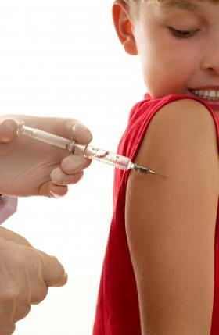
Glutamate is an Additive in Vaccines!
Flu vaccines (FluMist), MMR (measles, mumps and rubella), Rabies vaccine and Varicella vaccine (chicken pox) all contain glutamate
Anecdotal evidence links these vaccines with autism
My own studies on VAERS revealed a correlation between autism and MMR*
Glyphosate’s depletion of manganese prevents glutamate breakdown
*S. Seneff et al., Entropy 2012, 14, 2227-2253.
Notes:
Seizures facial swelling anaphylactic shock
Joint pain

Slide 48
Recapitulation
Vaccines contain many toxic chemicals and viral antigens that can lead to multiple autoimmune diseases
Molecular mimicry causes autoimmune attack on human tissues
Glyphosate exposure sets up leaky barriers that increase autoimmune risk
Total aluminum and mercury burden in vaccine adverse reaction reports correlates strongly with mentions of autism, ADHD and pervasive developmental delay
Thimerosal in vaccines is highly toxic but CDC has downplayed its toxicity
Glyphosate works synergistically with glutamate and mercury in vaccines

Slide 49
Aluminum in Vaccines

Slide 50
Cumulative aluminum exposure from childhood vaccines*
*Source: The vaccine manufacturers' product inserts and the CDC's 2016 vaccination schedule
Notes:
https://medium.com/@jbhandley/did-british-scientists-just-solve-the-autism-puzzle-5a7eacc77415

Slide 51
Aluminum Adjuvant in Vaccines*
DTaP (diphtheria, tetanus, and pertussis): 170–625 mcg, depending on manufacturer
Hepatitis A: 250 mcg
Hepatitis B: 250 mcg
Hib (for meningitis; PedVaxHib brand only): 225 mcg
HPV: 225 mcg
Pediarix (DTaP–hepatitis B–polio combination): 850 mcg
Pentacel (DTaP–Hib–polio combination): 330 mcg
Pneumococcus: 125 mcg
*vactruth.com/2014/01/28/toxic-levels-of-aluminum/

Slide 52
“Subcutaneous injections of aluminum at vaccine adjuvant levels activate innate immune genes in mouse brain that are homologous with biomarkers of autism”*
Study on mice exposed to aluminum hydroxide
Injected them with aluminum several times during early life, mimicking the US vaccination schedule
Predominantly in brain in males:
Activated several immune stimulating cytokines such as CCL2, interferon gamma and TNF alpha
Activated NF kappa B signaling pathway and release of chemokines Il-4 and IL-6.
This induces a neuroinflammatory response that is characteristic of autism in humans
Affected predominantly cerebral cortex in males and cerebellum in females
*D Li et al. Journal of Inorganic Biochemistry 2017;177: 39-5.

Slide 53
“Aluminum hydroxide nanoparticles show a stronger vaccine adjuvant activity than traditional aluminum hydroxide microparticles”*
Aluminum hydroxide is commonly used as an adjuvant in vaccines
Aluminum hydroxide microparticles only weakly potentiate antibody response
Special processing can produce tiny aluminum nanoparticles under 200 nanometers in diameter
These are much more effective in stimulating an immune response and they induce a smaller inflammatory response at the injection site
Plausible explanation is that they are easier for the macrophages to take up, along with the bound antigen
*X Li et al. J Control Release. 2014; 173: 148-157.
Notes:
Aluminum/aluminum_nanoparticles_more_effective_vaccines.pdf

Slide 54
“Aluminum hydroxide nanoparticles show a stronger vaccine adjuvant activity than traditional aluminum hydroxide microparticles”*
Aluminum hydroxide is commonly used as an adjuvant in vaccines
Aluminum hydroxide microparticles only weakly potentiate antibody response
Special processing can produce tiny aluminum nanoparticles under 200 nanometers in diameter
These are much more effective in stimulating an immune response and they induce a smaller inflammatory response at the injection site
Plausible explanation is that they are easier for the macrophages to take up, along with the bound antigen
There is a big problem with this strategy because the macrophages clear the aluminum from the injection site, but they can carry it as stealth cargo into the brain.
*X Li et al. J Control Release. 2014; 173: 148-157.
Notes:
Aluminum/aluminum_nanoparticles_more_effective_vaccines.pdf

Slide 55
“Non-linear dose-response of aluminium hydroxide adjuvant particles: Selective low dose neurotoxicity”*
Alhydrogel is the main adjuvant licensed for human and animal vaccines (aluminum hydroxide gel)
"We conclude that Alhydrogel1 injected at low dose in mouse muscle may selectively induce long-term Al cerebral accumulation and neurotoxic effects."
Lowest dose contained exclusively small agglomerates the size of bacteria, favoring capture by macrophages
Immune cells transport the aluminum to the blood, the spleen and the brain
"The dose makes the poison" view is overly simplistic
*G Crépeaux et al. Toxicology 2017;375:48-57.
Notes:
Aluminum/Crepeaux_aluminum_hydroxide_neurotoxity_2016.pdf

Slide 56
“Remarkably, the study found that the lowest dosage (200 mcg/Kg) was the most toxic! For many outcomes, the 400 and 800 mcg/Kg dosages had no observable adverse effects, but the 200 mcg/Kg dosage did.”
- J.B. Handley*
*November 27, 2017
https://medium.com/@jbhandley/new-study-massive-aluminum-levels-
in-autism-brains-is-this-the-smoking-gun-for-vaccines-54ae85ec2a9c
Notes:
Vaccines/Crepeaux_aluminum_hydroxide_neurotoxity_2016
https://medium.com/@jbhandley/new-study-massive-aluminum-levels-in-autism-brains-is-this-the-smoking-gun-for-vaccines-54ae85ec2a9c

Slide 57
“Thus alum and other poorly biodegradable materials taken up at the periphery by phagocytes circulate in the lymphatic and blood circulation and can enter the brain using a Trojan horse mechanism similar to that used by infectious particles.”

Slide 58
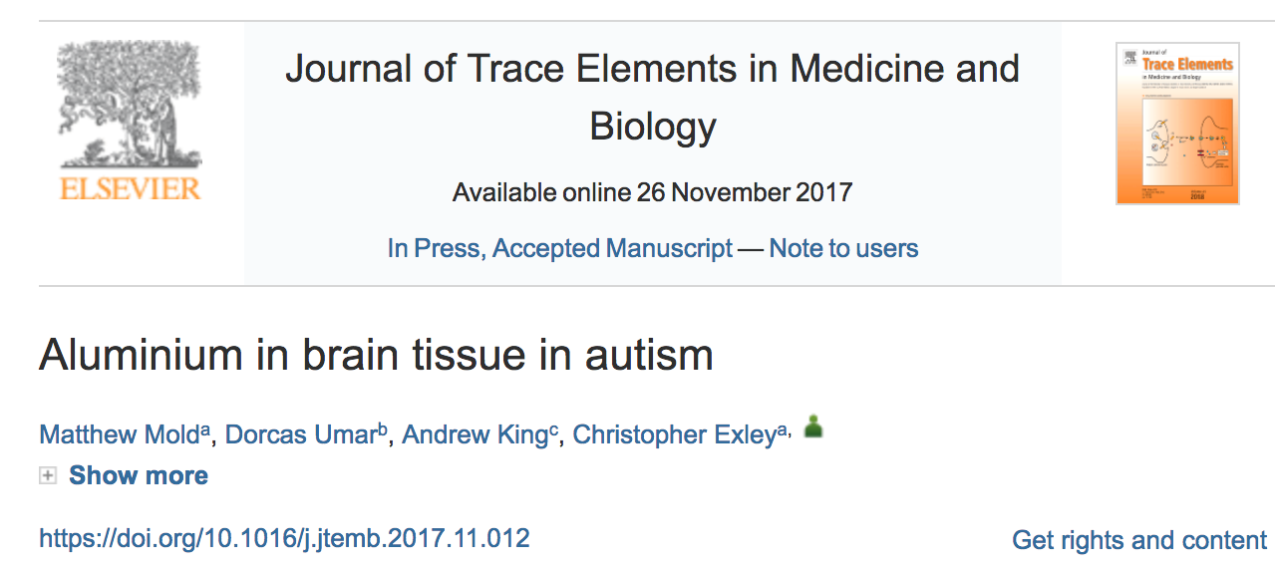
Samples taken from temporal, frontal, parietal and occipital lobes and hippocampus of 5 autistic brains, postmortem
Values of 17.10, 18.57 and 22.11 micrograms/gram dry weight: among highest ever seen
Hypothesis: aluminium entry into the brain via immune cells circulating in the blood and lymph is expedited in Autism Spectrum Disorder due to a leaky brain barrier
Notes:
./aluminum_In_autistic_brains_2017.text
Handley on this:
https://medium.com/@jbhandley/new-study-massive-aluminum-levels-in-autism-brains-is-this-the-smoking-gun-for-vaccines-54ae85ec2a9c
./aluminum_brain_autism.text
./Jon_Rappaport_on_aluminum_in_vaccines.text
Samantha/aluminum_in_brain_tissue_in_autism_2017_Exley.pdf

Slide 59
Potent 5 minute video: Prof. Chris Exley on aluminium in autism*
Some highlights:
The amount of aluminium found in autism brains was extraordinarily high**
They saw more aluminium than they'd seen in almost any other circumstance
Majority was intracellular aluminium within non-neuronal cell populations
Aluminium in vaccines is almost certainly playing a role in autism
The results changed his mind on this topic
Research was only possible because of philanthropy
*www.youtube.com/watch?v=SmkVv8pcVhc&feature=youtu.be
**M Mold et al. Journal of Trace Elements in Medicine and Biology 2018; 46: 76-82.
Notes:
./aluminum_In_autistic_brains_2017.text
Samantha/aluminum_in_brain_tissue_in_autism_2017_Exley.pdf
Handley on this:
https://medium.com/@jbhandley/new-study-massive-aluminum-levels-in-autism-brains-is-this-the-smoking-gun-for-vaccines-54ae85ec2a9c
./aluminum_brain_autism.text
./Jon_Rappaport_on_aluminum_in_vaccines.text
Samantha/aluminum_in_brain_tissue_in_autism_2017_Exley.pdf

Slide 60
Carried into the brain on the backs of immune cells!
*Source: vaccinepapers.org
Notes:
./Alzheimers_aluminum_brain_2017.pdf
https://medium.com/@jbhandley/new-study-massive-aluminum-levels-in-autism-brains-is-this-the-smoking-gun-for-vaccines-54ae85ec2a9c

Slide 61
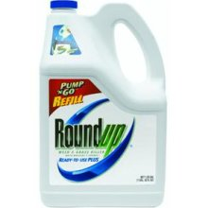
Glyphosate and Aluminum: Partners in Crime
Glyphosate induces pathogens like C. difficile in gut, leading to leaky gut syndrome
C. diff produces p-cresol which promotes aluminum uptake by cells
p-Cresol is a known biomarker for autism
p-Cresol is an important factor in kidney failure which leads to aluminum retention in tissues → dementia
Glyphosate cages aluminum to promote entry
Glyphosate promotes calcium uptake by voltage-activated channels
Aluminum gains entry as calcium mimetic
Aluminum promotes calcium loss from bones → pineal gland calcification

Slide 62
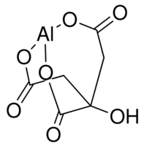
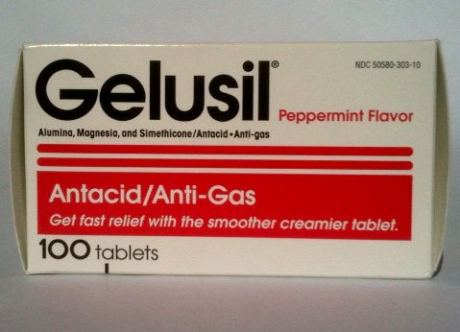
Aluminum Glyphosate*
Six different ways two glyphosate molecules can chelate aluminum
Aluminum citrate**
ALUMINA
aluminum
*M. Purgel et al., Journal of Inorganic Biochemistry 103 (2009) 1426–1438
** P. Sianina et al., Clin. Chem. 32/3, 539-541, 1986.
Notes:
AnthonySamsel/swine/aluminum_glyphosate.pdf
aluminum_citrate_absorbs_well_vinegar_antacids.pdf
Csail/2013/project/Anthony/

Slide 63
Glyphosate IN MMR?

Slide 64
Autism, Glyphosate, Vaccine Reactions*
Glyphosate application to corn and soy, US
Children with Autism, US
# Adverse Reactions in VAERS
*Collaboration with Nancy Swanson
Notes:
Individuals with Disabilities Education Act

Slide 65
Dr. Andrew Wakefield
Lancet, 1998

Slide 66
“We have identified a chronic enterocolitis in children that may be related to neuropsychiatric dysfunction. In most cases, onset of symptoms was after measles, mumps, and rubella immunisation.
Further investigations are needed to examine this syndrome and its possible relation to this vaccine.”
Dr. Andrew Wakefield
Lancet, 1998

Slide 67
Some Adverse Reactions of MMR*
“A shortened version of the vaccine damage associated with the MMR vaccine includes vomiting, diarrhea, anaphylaxis, ear pain, nerve deafness, diabetes, arthritis, myalgia, encephalitis, febrile seizures, pneumonia, and death.”
*https://vactruth.com/2016/06/23/japanese-government-bans-mmr-vaccine/
http://www.merck.com/product/usa/pi_circulars/m/mmr_ii/mmr_ii_pi.pdf
http://www.merck.com/product/usa/pi_circulars…pdf
Notes:
./JapanesegovernmentCautiousVaccines.pdf

Slide 68
*A Samsel and S Seneff, Journal of Biological Physics and Chemistry 2017;17:8-32.

Slide 69
“Most disturbing is the presence of glyphosate in many popular vaccines including the measles, mumps and rubella (MMR) vaccine, which we have verified here for the first time.”
*A Samsel and S Seneff, Journal of Biological Physics and Chemistry 2017;17:8-32.

Slide 70
Glyphosate in Vaccines?
For MMR, flu vaccine, and rabies vaccine, live virus is grown on gelatin derived from ligaments of pigs
Pigs are fed GMO Roundup-Ready corn and soy feed
Gelatin (derived from collagen) contains significant amounts of both glycine and glutamate
These two neurotransmitters excite the NMDA receptors in the brain
Glyphosate substitution by mistake for glycine is a possibility!
Glyphosate stimulation of NMDA receptors could cause neuronal burnout

Slide 71
Glyphosate Contamination in Vaccines (Parts Per Billion)*
Merck ZOSTAVAX 0.62 Shingles
Merck MMR-II 3.74 Measles, Mumps and Rubella
Merck VARIVAX 0.56 Varicella, Chicken Pox
MERCK PNEUMOVAX ND Pneumococcal 18
MERCK PROQUAD 0.66 Measles, Mumps, Rubella, Varicella
GSK ENERGIX-B 0.34 Heptatitis B
*A Samsel and S Seneff, Journal of Biological Physics and Chemistry 2017;17:8-32.

Slide 72
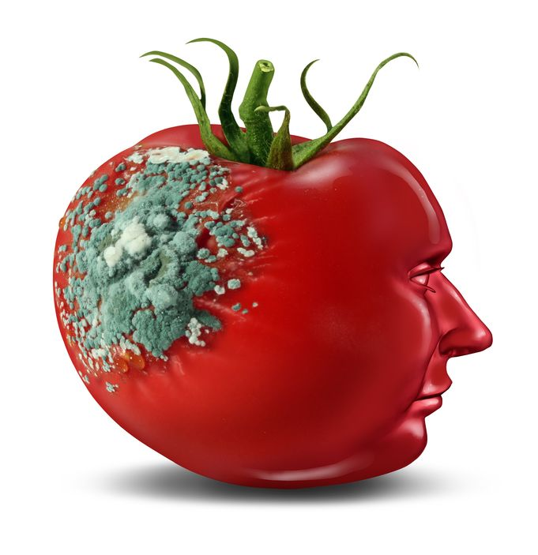
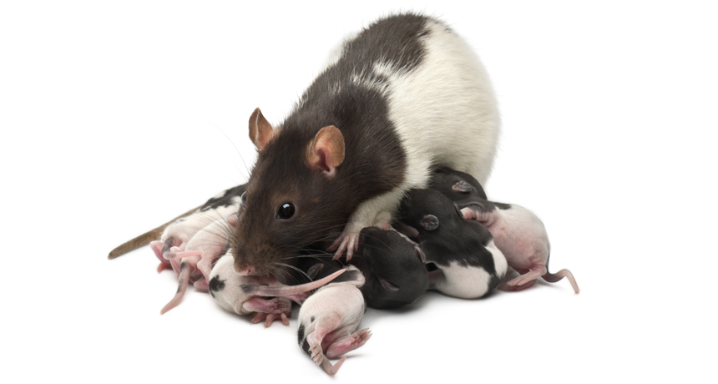
Glyphosate and Glutamate*
Acute exposure activates NMDA receptors and voltage-dependent calcium channels
Oxidative stress and neural cell death
Increased glutamate release into the synaptic cleft → excessive extracellular glutamate levels
Decreased glutathione content
Increased peroxidation of lipids (fats)
*http://www.greenmedinfo.com/blog/roundup-weedkiller-brain-damaging-neurotoxin
Notes:
http://www.greenmedinfo.com/blog/roundup-weedkiller-brain-damaging-neurotoxin
acute exposure (30 minutes) and chronic (pregnancy and lactation) exposure.
Why was this referenced??
T. Bohn et al. Food Chemistry 153, 15 June 2014, 207-215.

Slide 73
Symptoms of Adverse Reactions to MMR before and after 2002*
*Data analyzed from the VAERS database

Slide 74
Symptoms of Adverse Reactions to MMR before and after 2002*
Joint pain
seizures
shortness of breath
hives
These are all characteristic symptoms of allergies to MSG
eczema
anaphylactic shock
Facial swelling
swelling
swelling
*Data analyzed from the VAERS database

Slide 75
Measles Virus and Hemagglutinin*
The measles virus synthesizes the protein hemagglutinin
Antibodies to hemagglutinin are essential following MMR vaccination to induce immunity
Hemagglutin bears a sequence resemblance to myelin basic protein (MBP) → potential for autoimmune reaction
MBP is essential for the formation of the myelin sheath surrounding nerve fibers
Children with a rare genetic defect involving deletion of MBP can suffer from microcephaly**
Autoantibodies to MBP along with excessive levels of antibodies to measles hemagglutinin are linked to autism***
*Oldstone, MBA, Ed. Molecular mimicry: Infection inducing autoimmune disease.
Springer Berlin Heidelberg; January 9, 2006.
**AD Kline et al., Am J. Hum. Genet. 1993;52:895-906.
***VK Singh et al., J Biomed Sci 2002;9(4):359-64.

Slide 76
Autism and Measles Hemagglutinin*
125 autistic children and 92 control children
60% of the children with autism had high levels of antibodies to measles hemagglutinin specific to the MMR vaccine
90% of these had autoantibodies to myelin basic protein (MBP)
0% of the control children had high antibody titers to either hemagglutinin or MBP
There were no elevations in antibodies detected against any proteins in the mumps or rubella viruses
*VK Singh et al., J Biomed Sci 2002;9(4):359-64.

Slide 77
Notes:
./vaccine_protein_causes_food_allergies.pdf

Slide 78
Large Proteins in Vaccines: Allergenic*
“Vaccines clog our lymphatic system and lymph nodes with large protein molecules which have not been adequately broken down by our digestive processes, since vaccines bypass digestion with injections. This is why vaccines are linked to allergies, because they contain large proteins which as circulating immune complexes (CICs) or 'klinkers’ cause our body to become allergic.”
*Dave Mihalovic, ND, http://whale.to/v/vaccines_cause_allergies.ht

Slide 79
Precedent: Glyphosate in Drugs?*
Trasylol (aprotinin) is a protein derived from bovine lung used to reduce bleeding during open heart surgery
Rare acute reaction to Trasylol involves precipitous drop in blood pressure, acute kidney failure, and sudden death
Piglets injected with glyphosate salts had similar acute reaction with high mortality rate
Cows fed GMO Roundup-Ready feed had highest residue levels of glyphosate in lungs
*S Seneff et al., Agricultural Sciences 2015; 6:1472-1501.
Notes:
Trypsin inhibitor

Slide 80
Recapitulation
Glyphosate has been detected in multiple vaccines, with highest concentrations in MMR
Many vaccines include gelatin and fetal bovine serum as ingredients, both of which are contaminated with glyphosate
Glyphosate incorporated into a virus protein can lead to resistance to breakdown and autoimmune disease through molecular mimicry
A causal link between MMR and autism can be explained through autoimmune attack on myelin basic protein through molecular mimicry with measles hemagglutinin
Multiple large proteins found in vaccines are allergenic
Glyphosate is likely also present in certain biological drugs and may explain rare bizarre life-threatening adverse reactions

Slide 81
Summary
Glyphosate is working synergistically with mercury, aluminum and glutamate in vaccines to cause an epidemic in autism
Glyphosate disrupts the gut microbial balance and impairs digestion of proteins, leading to leaky gut and food allergies
Aluminum in multiple vaccines accumulates in the brain and damages neurons
Glyphosate enhances aluminum uptake

