Slide 1
Glyphosate: How a simple molecule can cause so much destruction: Part I
Stephanie Seneff
MIT CSAIL
WAPF Wise Traditions Workshop
November 17, 2018

Slide 2
Download these slides
people.csail.mit.edu/seneff/2018/
Seneff_WAPF_2018_Part1.pptx

Slide 4
“Something very wrong is going on, something that is killing good people and causing untold suffering to families and communities around the world. Never has such a high percentage of the population been afflicted with so many tragic and wasting illnesses. In the past thirty years, a group of diseases has reached epidemic proportions in the United States and many other countries. These afflictions, often collectively referred to as diseases of civilization (DOC), include multiple sclerosis, Alzheimer's disease, breast cancer, lupus erythematosus, rheumatoid arthritis, melanoma, and autism - a once rare birth defect. Because the incidence of these diseases has increased gradually over three decades, we are inclined to accept this as a natural, if unfortunate, part of modern life. But such a lethal trend is not natural; the changes that we have witnessed over the last generation are unprecedented in the history of medical science.”
Woodrow C. Monte, PhD. While Science Sleeps. 2011
Notes:
Aspartame
46 minutes

Slide 5
Outline: Part I
Introduction
California Lawsuit
Celiac Disease, Autism and Glyphosate
Glyphosate as a Glycine Analogue
Fishing for Glycine
Amyloid Beta, Dementia and Macular Degeneration
Autoimmune Disease Epidemic
Collagen, Chronic Pain and Opioid Drugs

Slide 6
Introduction

Slide 7
Roundup and GMO Crops
GMO Roundup-Ready corn, soy, canola, sugar beets
cotton, tobacco and alfalfa
What is glyphosate?

Slide 8
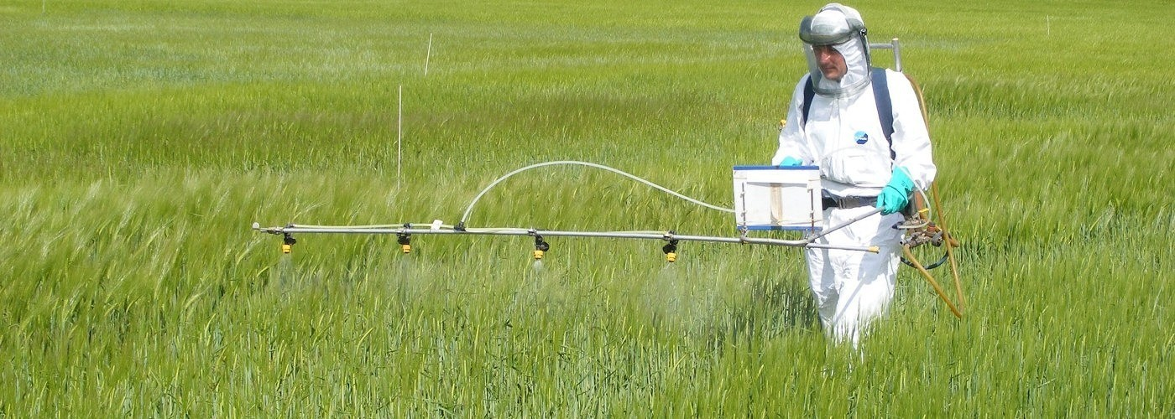
Roundup as a Desiccant/Ripener just before Harvest
Wheat, Oats, Barley, Rye, Sugar cane, Beans, Lentils, Peas, Flax, Sunflowers, Pulses, Chick Peas

Slide 9
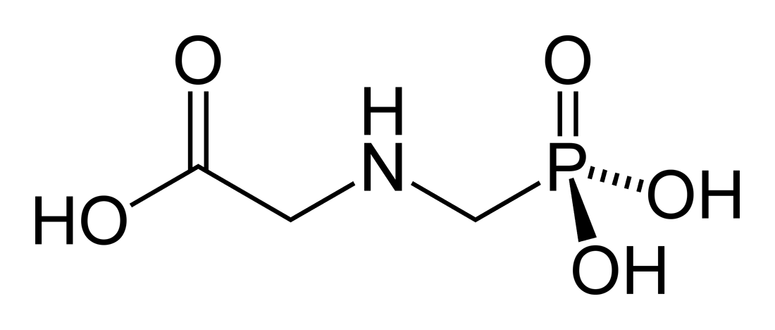
Glyphosate!!
Glyphosate is now the #1 herbicide in use in the U.S. and is increasingly used around the world
Developed and patented by Monsanto in the 1970’s
Introduced into the US food chain in 1974
Came out from under patent in 2000
Inhibits an enzyme in the shikimate pathway involved in the synthesis of tyrosine, tryptophan and phenylalanine (the three aromatic amino acids)
Huge expansion of GMO corn, soy, cotton and canola crops has led to sharp increases in the last two decades
Notes:
WIKI

Slide 10
Glyphosate vs. Other Pesticides: Usage in the United States*
Glyphosate
*http://sustainablepulse.com/wp-content/uploads/GMO-health.pdf

Slide 11
Environmental Working Group Results

Slide 12
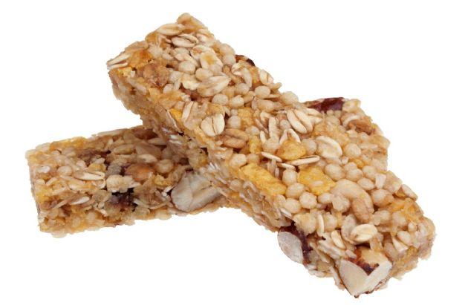
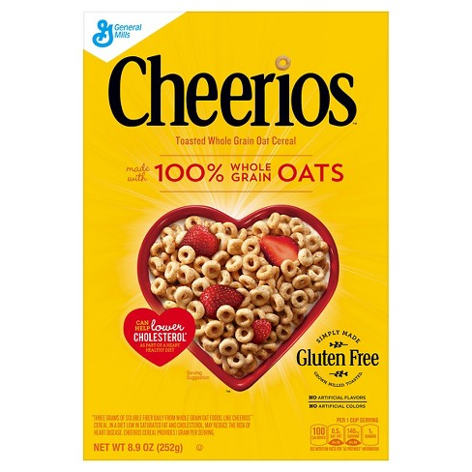
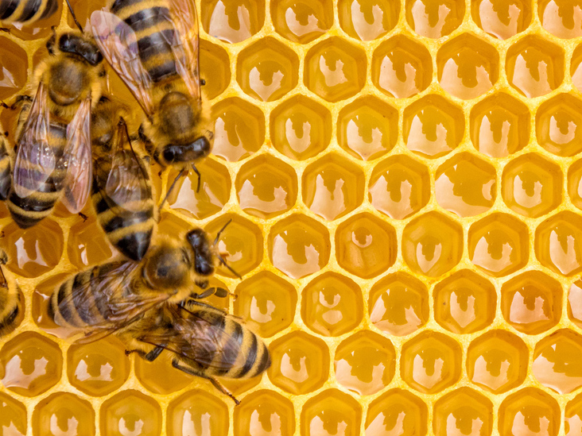
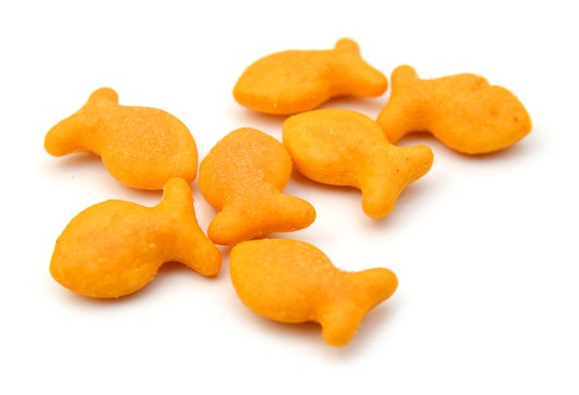
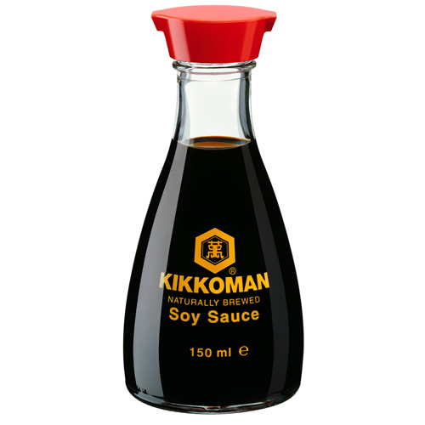
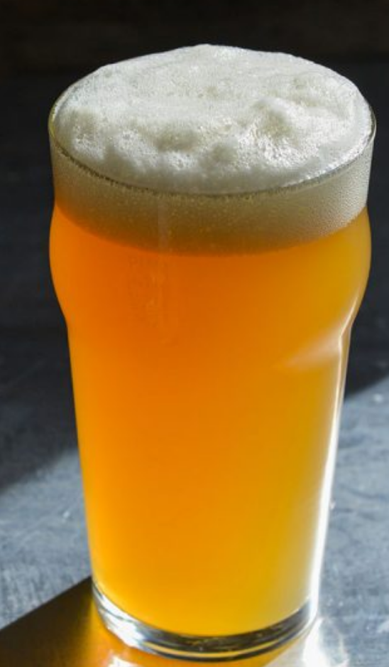
Some Foods Containing Glyphosate
Notes:
glyphosate_residues_in_honey_corn_soy_sauce_2014.pdf
Ten out of twenty eight (36%) soy sauce samples contained glyphosate at a concentration above the method LOQ (75 ng/mL) with a range between 88-564 ng /mL and a mean of 242 ng /mL

Slide 13
Shikimate Pathway Disruption
Phenylalanine, tryptophan, tyrosine
shikimate
Glyphosate
Neurotransmitters,
thyroid hormone
chorismate
vitamin K
folate

Slide 14
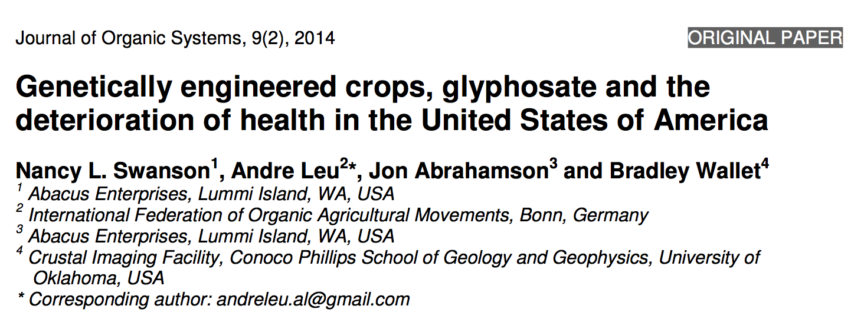
Paper Showing Strong Correlations between Glyphosate Usage and Chronic Disease

Slide 15
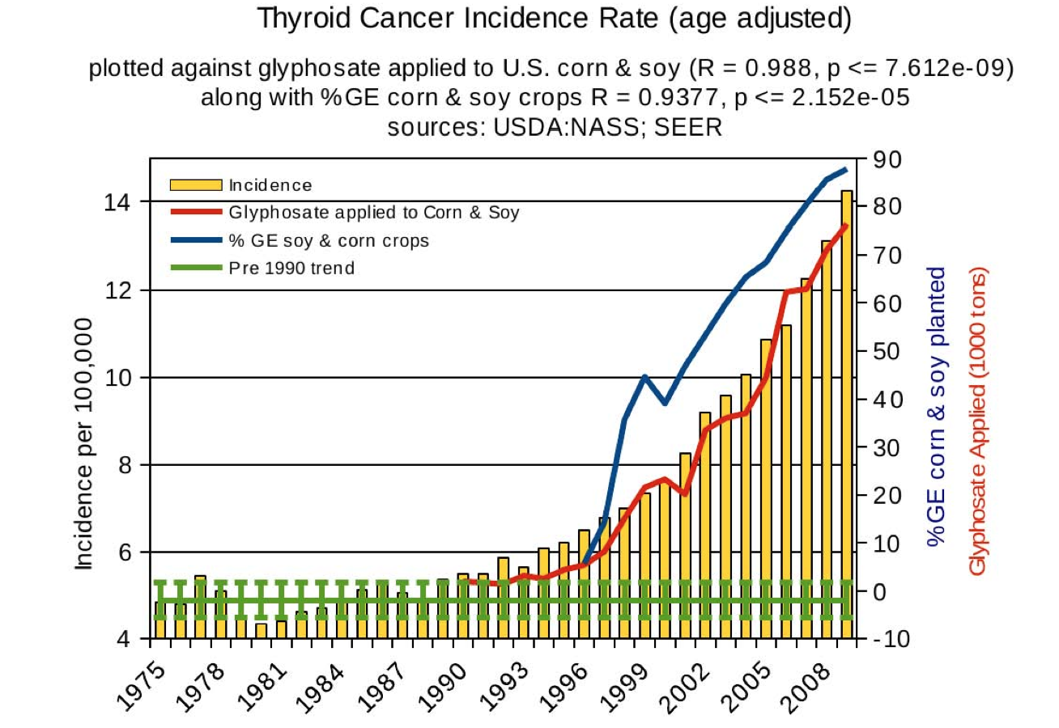
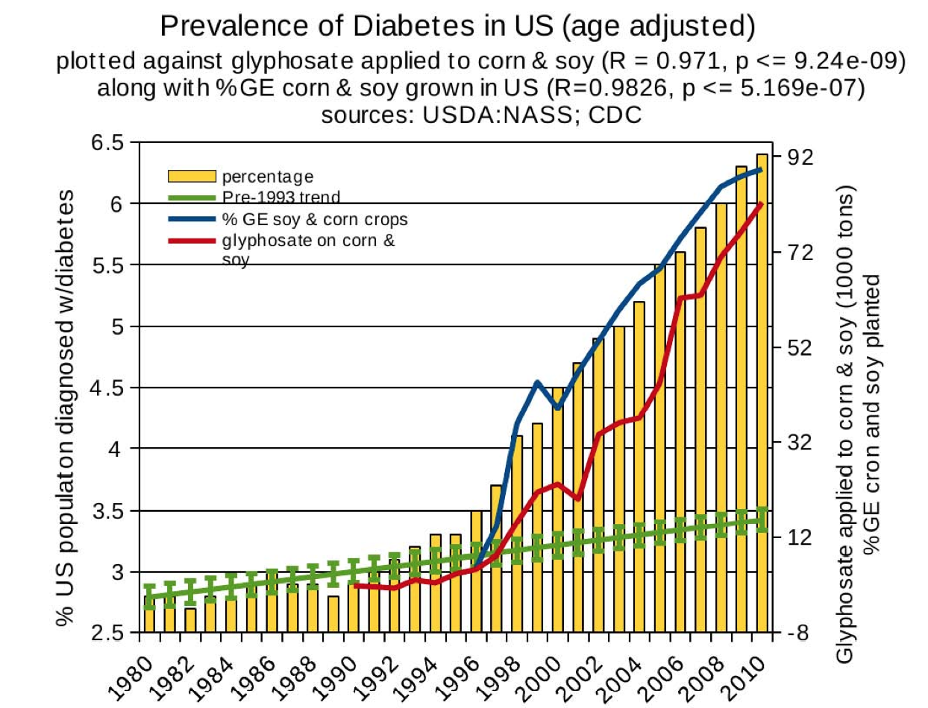
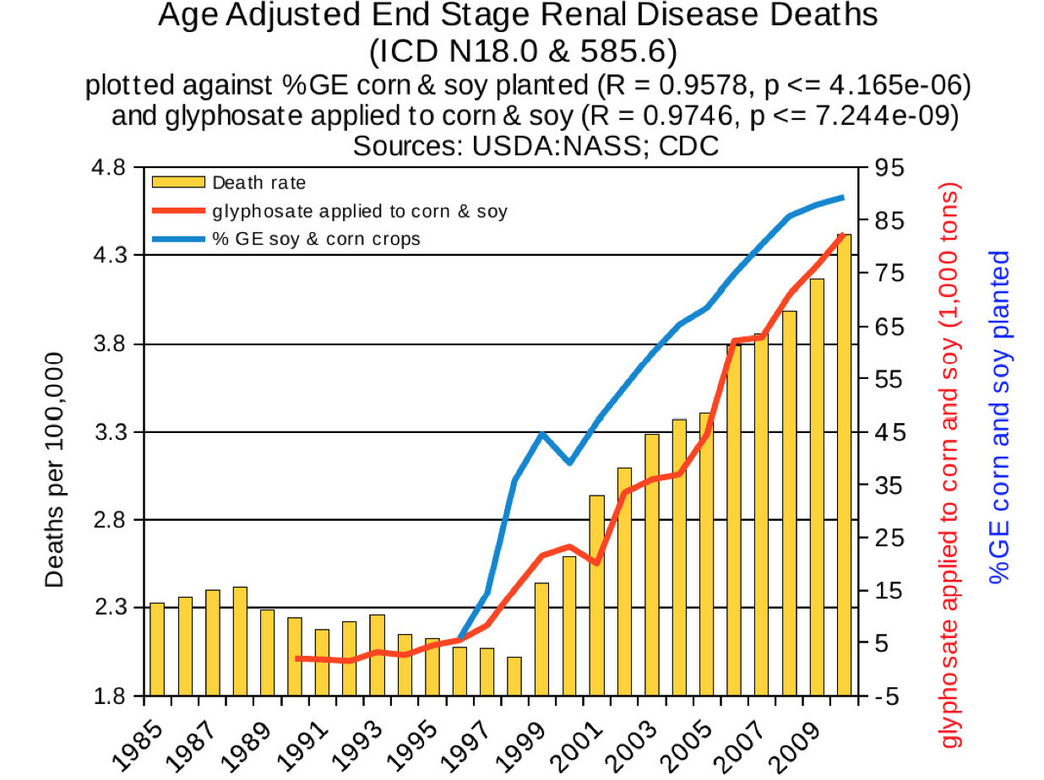
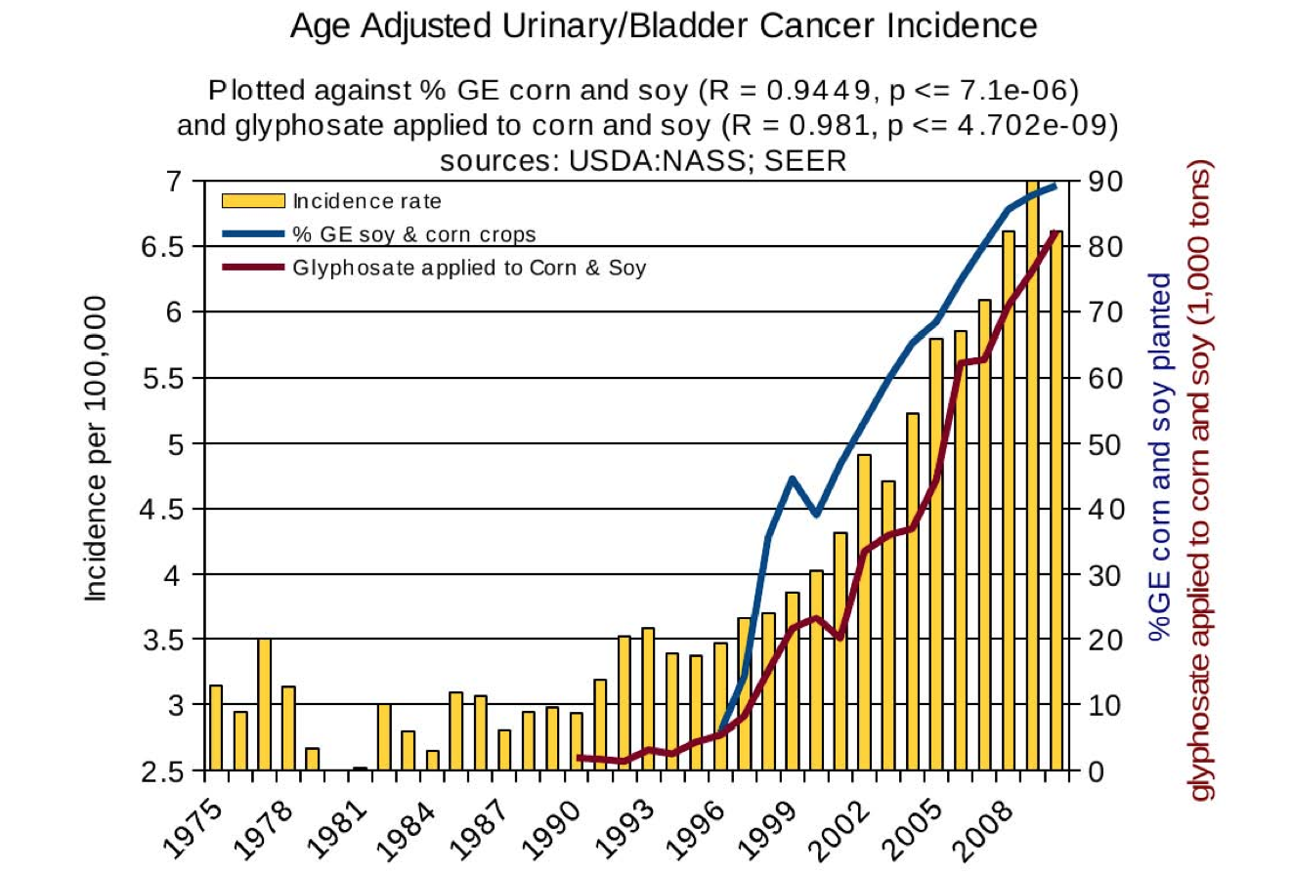
Thyroid cancer
Diabetes
End stage
renal disease
Urinary/bladder
cancer

Slide 16
Thyroid cancer
Diabetes
In 2015, WHO IARC declared glyphosate a “probable carcinogen”
End stage
renal disease
Urinary/bladder
cancer

Slide 17
Quote from the Conclusion*
“Although correlation does not necessarily mean causation, when correlation coefficients of over 0.95 (with p-value significance levels less than 0.00001) are calculated for a list of diseases that can be directly linked to glyphosate, via its known biological effects, it would be imprudent not to consider causation as a plausible explanation.”
*NL Swanson et al. Journal of Organic Systems 9(2), 2014, p. 32,

Slide 18
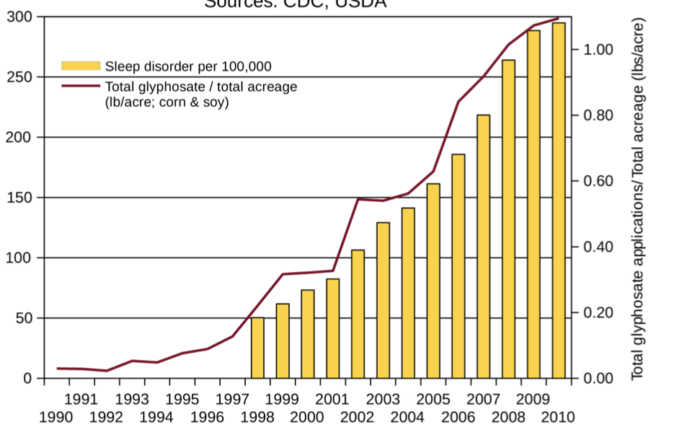
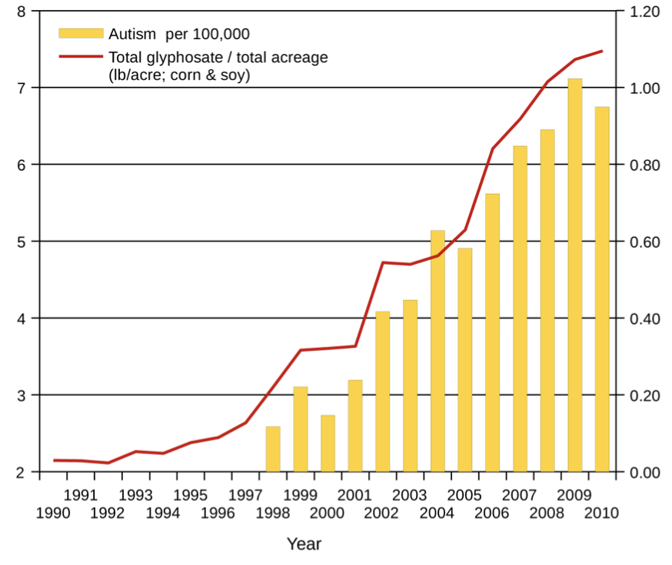
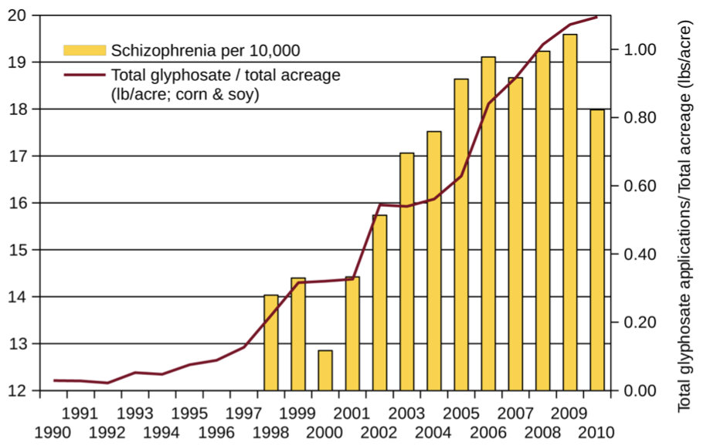
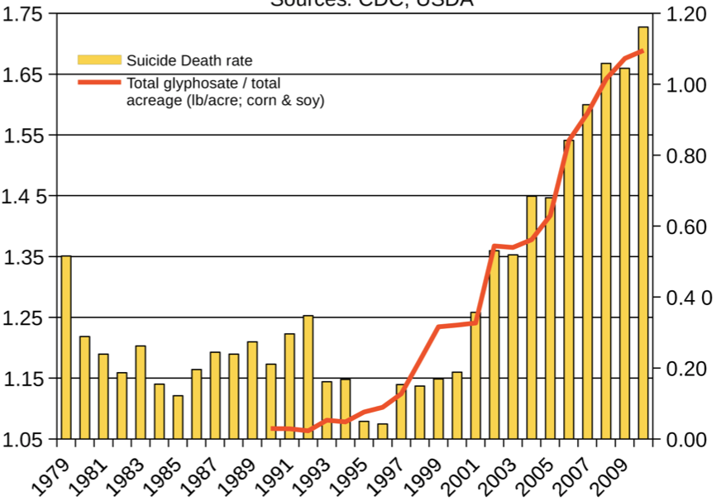
Autism
Sleep Disorder
Schizophrenia
Death by Suicide
*Seneff et al. Agricultural Sciences 2015; 6: 42-70.
Notes:
Hospital discharge diagnoses per 100,000

Slide 19
America’s Children are in Trouble!
It is now "normal" for a kindergarten child to have 12 colds every year and for a baby to have nine
Fourfold increase in childhood obesity
Double the asthma rate since the 1980's
"Chronic illnesses" rose from 1.8% in 1960 to 7% in 2004
Today, 43% of US children are chronically ill
1 in 6 children in the USA has a neurodevelopmental disability
1 in 38 boys are autistic
US has the worst neonatal death rate of all industrialized countries
Today's children in the US will have a shortened life span compared to their parents
Source: http://www.vaccineviolence.com/
Notes:
https://www.facebook.com/groups/1409306052710440/
./TheOutliers.text
Page removed!!
— Joanna Karpasea Jones

Slide 20
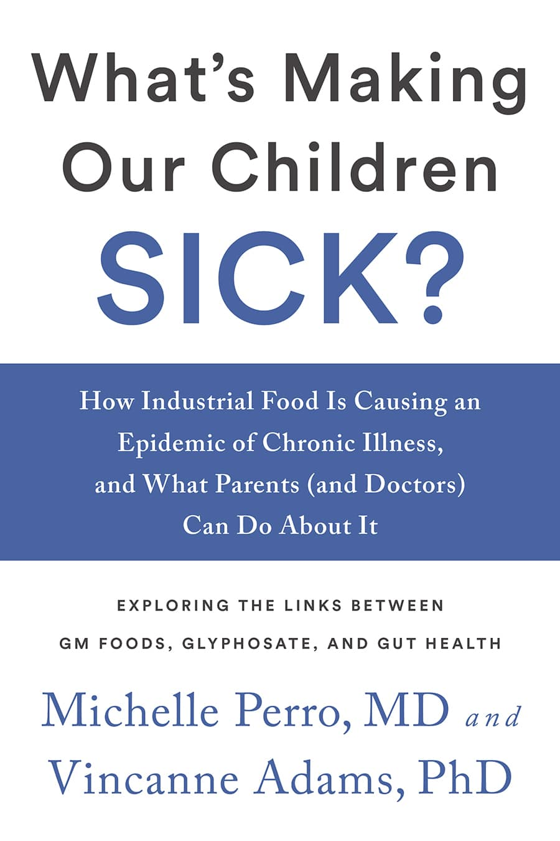
Source: http://www.vaccineviolence.com/
Notes:
https://www.facebook.com/groups/1409306052710440/
./TheOutliers.text
Page removed!!
— Joanna Karpasea Jones

Slide 21
Decreasing IQ scores after 1975*
“scores increased by almost 3 percentage points each decade for those born between 1962 to 1975 -- but then saw a steady decline among those born after 1975.”
“What specific environmental factors cause changes in intelligence remains relatively unexplored.”
*Rory Smith, CNN.
https://www.cnn.com/2018/06/13/health/falling-iq-scores-study-intl/index.html

Slide 22
Decreasing IQ scores after 1975*
“scores increased by almost 3 percentage points each decade for those born between 1962 to 1975 -- but then saw a steady decline among those born after 1975.”
“What specific environmental factors cause changes in intelligence remains relatively unexplored.”
Glyphosate was introduced on the market in 1975
*Rory Smith, CNN.
https://www.cnn.com/2018/06/13/health/falling-iq-scores-study-intl/index.html

Slide 23
1 in 4 American Adults suffer from a serious disability (according to the CDC)*
Mobility (serious difficulty walking or climbing stairs)
Cognition (serious difficulty concentrating, remembering or making decisions)
Hearing (serious difficulty hearing)
Vision (serious difficulty seeing)
Independent living (difficulty doing errands alone)
Self-care (difficulty dressing or bathing)
*https://www.cbsnews.com/news/1-in-4-u-s-adults-has-a-disability-cdc-says/

Slide 24
US
Notes:
http://www.commonwealthfund.org/interactives-and-data/chart-cart/report/2017-mirror-mirror/mortality-amenable-to-health-care

Slide 25
Glyphosate in Human Urine: U.S. Southern California*
*PJ Mills et al. JAMA 2017; 318(16): 1610-1611.
Notes:
./JAMA_glyphosate_urine_US_2018.pdf

Slide 26
Glyphosate reduces sperm motility and sperm count*
*FO Owagboriaye et al. Experimental and Toxicologic Pathology 2017 Sep 5;69(7):461-468.
Notes:
Glyphosate/Glyphosate_Reproductive toxicity of Roundup herbicide exposure in male albino rat.pdf

Slide 27
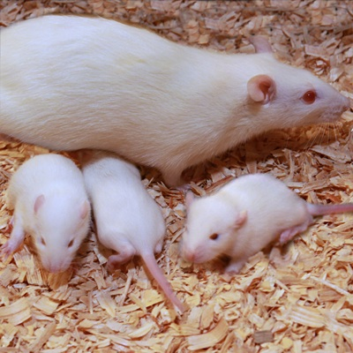
Glyphosate Damages Second Generation*
Pregnant rats exposed to glyphosate starting at day 9 of gestation
Two exposure levels (low, high), both levels considered to be safe according to regulators
Neither the rats nor their offspring showed any obvious effects
The second generation offspring from both exposed group showed delayed growth, lower fetal weight and length and a higher incidence of abnormally small fetusus
Most surprising: there were three cases (each from a different mother) among the second generation offspring with major fetal abnormalities (conjoined fetuses and abnormal limb development)
*MM Milesi et al. Archives of Toxicology June 9, 2018 [Epub ahead of print]
Notes:
glyphosate/Milesi_glyphosate_reproduction_rats_2018.pdf
https://www.gmwatch.org/en/news/latest-news/18363-glyphosate-based-herbicide-impairs-female-fertility-new-study
The second generation offspring from both glyphosate herbicide-exposed groups showed delayed growth, evidenced by lower foetal weight and length, and a higher incidence of abnormally small foetuses.
Also, to the authors' surprise, malformations (conjoined foetuses and abnormally developed limbs) were detected in the second generation of offspring from the higher dose of glyphosate herbicide group. Foetal abnormalities were found in 3 out of 117 foetuses, each one from different mothers within the first generation of offspring (i.e. 3 out of 13 litters were affected). A statistically significant correlation was found between glyphosate herbicide exposure and foetal malformations.

Slide 28
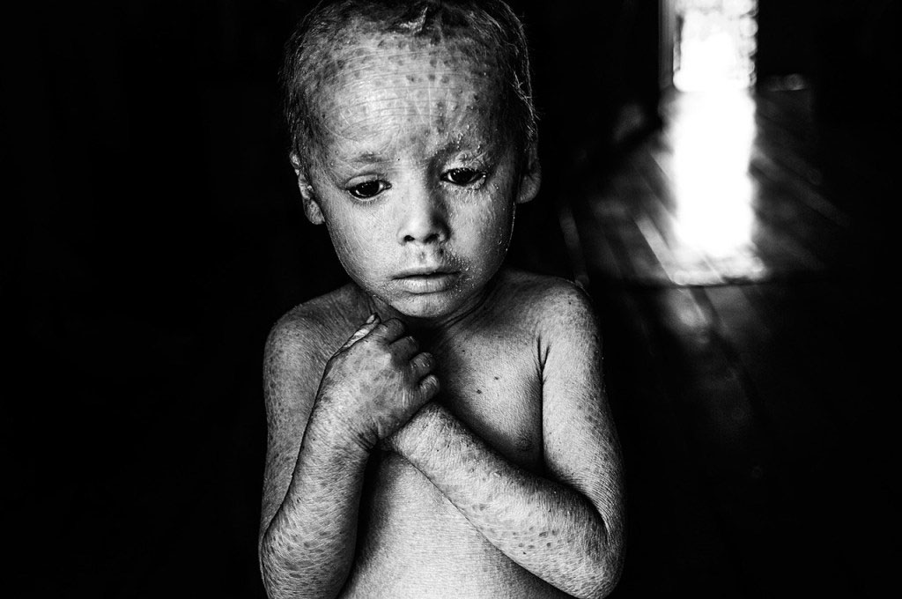
Genetically Modified Children

Slide 29
California Lawsuit

Slide 30
Dewayne “Lee” Johnson vs Monsanto: Glyphosate & Non-Hodgkin’s Lymphoma*
*https://www.cnn.com/2018/06/17/us/
monsanto-roundup-dewayne-johnson-trial/index.html
Notes:
./CNN_Monsanto_lawsuit.text
https://www.cnn.com/2018/06/17/us/monsanto-roundup-dewayne-johnson-trial/index.html

Slide 31
Details of the Lawsuit*
Johnson was a groundskeeper for the school district in Benicia, CA, just north of San Francisco
He was diagnosed with non-Hodgkin’s lymphoma (NHL) in 2014, at age 42.
In 2015, WHO's IARC classified glyphosate as "probably carcinogenic to humans"
Donna Farmer, Monsanto's "product protection lead" said in email to colleagues:
"You cannot say that Roundup does not cause cancer."
Timothy Litzenburg, one of Johnson's lawyers, said:
"so much of what Monsanto has worked to keep secret is coming out."
www.theguardian.com/business/2018/jul/09/
monsanto-trial-roundup-weedkiller-cancer-dewayne-johnson
Notes:
https://www.theguardian.com/business/2018/jul/09/monsanto-trial-roundup-weedkiller-cancer-dewayne-johnson

Slide 32
“We’re going to see for the first time evidence that nobody has seen before, evidence that has been in Monsanto’s files that we’ve obtained from lawyers and the people in Monsanto… I don’t think it’s a surprise after 20 years Monsanto has known about the cancer-causing properties of this chemical and has tried to stop the public from knowing it, and tried to manipulate the regulatory process.”
-- Robert F Kennedy, Jr.
Co-counsel for Johnson

Slide 33
“We’re going to see for the first time evidence that nobody has seen before, evidence that has been in Monsanto’s files that we’ve obtained from lawyers and the people in Monsanto… I don’t think it’s a surprise after 20 years Monsanto has known about the cancer-causing properties of this chemical and has tried to stop the public from knowing it, and tried to manipulate the regulatory process.”
-- Robert F Kennedy, Jr.
Co-counsel for Johnson
” If we get a large award in this case, it could easily threaten the future financial viability of the company.”
-- Robert F Kennedy, Jr.

Slide 34
Del Bigtree of Highwire

Slide 35
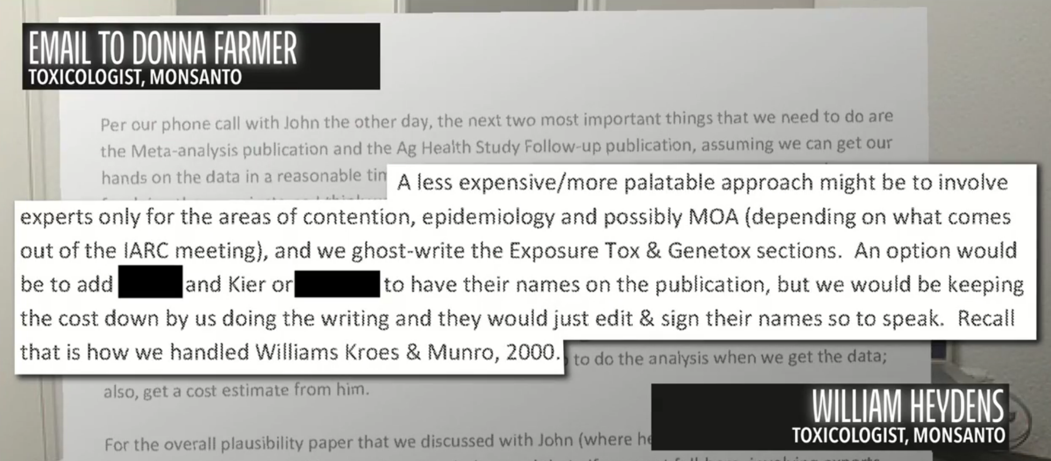
“Rampant Corporate Malfeasance”*
*https://www.facebook.com/HighWireTalk/videos/2157052507846542/
Notes:
https://www.facebook.com/HighWireTalk/videos/2157052507846542/

Slide 36
“Rampant Corporate Malfeasance”*
“A less expensive/more palatable approach might be to involve experts only for the areas of contention, epidemiology and possibly MOA (depending on what comes out of the IARC meeting), and we ghost-write the Exposure Tox & Genetox sections. An option would be to add BLANK and Kier or BLANK to have their names on the publication, but we would be keeping the cost down by us doing the writing and they would just edit & sign their names so to speak. Recall that is how we handled Williams Kroes & Munro, 2000.”
*https://www.facebook.com/HighWireTalk/videos/2157052507846542/
Notes:
https://www.facebook.com/HighWireTalk/videos/2157052507846542/
MOA???

Slide 38
Bayer Stock Prices
Johnson Verdict

Slide 39
“Johnson’s jury heard evidence that for four decades Monsanto maneuvered to conceal Roundup’s carcinogenicity by capturing regulatory agencies, corrupting public officials, bribing scientists and engaging in scientific fraud to delay its day of reckoning. The jury found that these activities constituted “malice, fraud and oppression” warranting $250 million in punitive damages.”
Robert F Kennedy, Jr. (lawyer in the defense)

Slide 40
Verdict Upheld in Higher Court: October 22, 2018
Damages reduced to $78 Million

Slide 41
Celiac Disease, Autism
and Glyphosate
Notes:
25 minutes

Slide 42
Celiac Disease, Non-Hodgkin's Lymphoma and Glyphosate*
People with Celiac disease statistically have a shortened life span, mainly due to increased risk to non-Hodgkin's lymphoma
Statistics from the American Cancer Society show an 80% increase in non- Hodgkin's lymphoma since the early 1970’s (when glyphosate was introduced)
Several studies have shown a statistical correlation between occupational glyphosate exposure and non-Hodgkin's lymphoma
Dewayne Johnson’s lawsuit was based on non-Hodgkin’s lymphoma
*A Samsel and S Seneff. Interdiscip Toxicol. 2013; 6(4): 159-184.

Slide 43
Proline-enriched Gluten Peptides
Gluten is especially rich in proline, and the most allergenic peptides have even more proline
Prolyl amino peptidase specializes in breaking proline bonds in peptides
It depends on manganese as a catalyst (glyphosate chelates manganese)
It has multiple highly conserved glycine residues that are essential for its function
Especially allergenic 33-mer:*
LQLQPFPQPELPYPQPELPYPQPELPYPQPQPF
*S Derum et al. Scientific Reports 2015; 6:25565.
Notes:
33-mer:
./gluten_specific_antibodies_proline_2015.pdf

Slide 44
Association Between Celiac Disease and the Risk of Autistic Spectrum Disorders
In a large population-based study, autistic children had a much higher probability of testing positive for antibodies against gluten and/or against transglutaminase (an enzyme that modifies gluten)*
The mechanism appears to be distinct from that in celiac disease**
Suggests immunologic and/or intestinal permeability abnormalities in affected children
*JF Ludvigsson. JAMA Psychiatry 2013;70(11):1224-1230
**NM Lau et al. PLoS One 2013;8(6):e66155
Notes:
autism_Celiac_link_2013.pdf
celiac_disease_markers_autism_link_2013.pdf

Slide 45
*https://medicalxpress.com/news/2018-07-autism-health-mom-gut-reveals.html
Notes:
./moms_gut_biome_matters_autism.text
mouse model: Il-17a --> autism symptoms in offspring
https://medicalxpress.com/news/2018-07-autism-health-mom-gut-reveals.html
Catherine R. Lammert et al, Cutting Edge: Critical Roles for Microbiota-Mediated Regulation of the Immune System in a Prenatal Immune Activation Model of Autism, The Journal of Immunology (2018). DOI: 10.4049/jimmunol.1701755

Slide 46
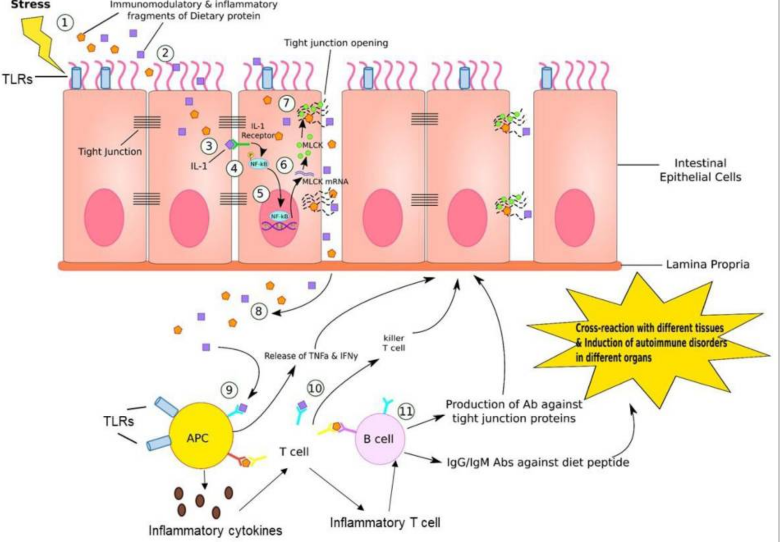
Leaky Gut and Autoimmune Disease*
NF-kB
*RS Eshraghi et al., Frontiers in Cellular
Neuroscience 2018; 12: 256.
Notes:
microbiome_antioxidant_capacity_epigenetics_autism_2018.pdf
MLCK: myosin-light chain kinase
FIGURE 4 | Gut–brain inflammation. (1) Stress, such as medications, neurotransmitters, enzymes, neuropeptides, intestinal flora, or immune dysregulation generates immunomodulatory and inflammatory fragments of dietary proteins. (2) These fragments can diffuse into endothelial cells lining the GI tract. (3) IL-1, which is one of the product of fragment of dietary proteins bind to IL-1 receptor on the lateral border of adjacent epithelial cell. (4) This IL-1/IL-1 receptor complex phosphorylates NF-kB. (5) Activated NF-kB further binds to DNA sequence in nucleus of endothelial cell, inducing transcription of MLCK (myosin-light chain kinase) mRNA. (6) MLCK mRNA travels to cytosol and is translated into MLCK proteins. (7) MLCK proteins bind to and open up the tight junction, where dietary fragment proteins are released into paracellular space. (8) These particles are further released into reticular tissue. (9) APC recognizes this dietary fragment and presents to T cells. (10) T cells generate killer T cell attacking epithelial cells that contain these inflammatory dietary fragments. (11) B cells are activated by T cells presenting the dietary fragment. In response, B cells generate antibodies against tight junction proteins, IgG and IgM antibodies against diet peptides. This leads to cross-reaction in various tissues and induction of autoimmune disorders in different organs. In addition, antigen-presenting cells (APC) such as dendritic cells (DCs) can produce proinflammatory cytokines that educate naive CD4+ T cells into inflammatory T cells that can help B cell maturation to produce antibodies.

Slide 47
*
Triplets: two boys, one girl. Both boys have autism and girl has seizure disorder
Very high levels of glyphosate in urine in all three
Clostridia overgrowth due to glyphosate disruption of gut microbes
Clostridia produce toxins HPHPA and p-cresol, which block the conversion of dopamine to norepinephrine.
Damage to neurons in the brain through oxidative stress
*W. Shaw. Integrative Medicine 2017;16(1);50-57.
Notes:
./Shaw_on_glyphosate_triplets_autism.text

Slide 48
A recent study showed that patients with neurological disease had decreased activity of dopamine beta hydroxylase, the enzyme suppressed by Clostridia toxins.**
*
Triplets: two boys, one girl. Both boys have autism and girl has seizure disorder
Very high levels of glyphosate in urine in all three
Clostridia overgrowth due to glyphosate disruption of gut microbes
Clostridia produce toxins HPHPA and p-cresol, which block the conversion of dopamine to norepinephrine.
Damage to neurons in the brain through oxidative stress
**Md. Khalilur Rahman et al. Int J Biomed Sci. 2009 Dec; 5(4): 395-401.
Notes:
./Shaw_on_glyphosate_triplets_autism.text
AAAMAZING\ Rahman\ 2009\ DBH\ hydroxylation\ Cofactors.pdf

Slide 49
Glyphosate as a
Glycine Analogue

Slide 50
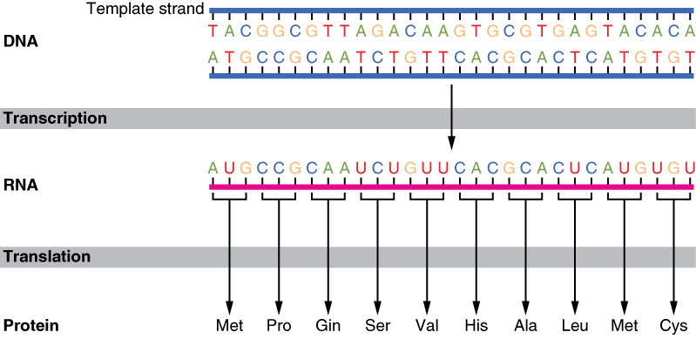
The Basics of Protein Synthesis
Glyphosate
Glycine

Slide 51
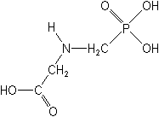
What If Glyphosate Could Insert Itself Into Proteins during Synthesis???
glyphosate
Code for Glycine
GGC
mRNA
. . .
. . .
Glyphosate
Alanine
Proline
-- Any proteins with conserved glycine residues are likely to be affected in a major way

Slide 52
Extra Piece Sticks Out at Active Site
Substrate no longer fits in active site
Active Site
Extra Stuff
Glyphosate
Alanine
Proline
glycine
Peptide chain

Slide 53
Extra Piece Sticks Out at Active Site
Substrate no longer fits in active site
This explains how glyphosate disrupts EPSPS in the shikimate pathway: Multiple bacteria have developed resistance by replacing active site glycine with alanine and this is the basis for GMO Roundup Ready crops*
Active Site
Extra Stuff
Glyphosate
Alanine
Proline
glycine
Peptide chain
*T Funke et al., Molecular basis for the herbicide resistance of Roundup Ready crops. PNAS 2006;103(35):13010-13015.

Slide 54
Inhibition of EPSPS by glyphosate: Resistant E coli mutant*
Mutant with alanine substituted for glycine 96
Wild type with glycine 96
*Figure 3, S Eschenburg et al. Planta 2002;216:129-135.

Slide 55
Only Glyphosate Works!*
“More than 1,000 analogs of glyphosate have been produced and tested for inhibition of EPSP synthase, but minor structural alterations typically resulted in dramatically reduced potency, and no compound superior to glyphosate was identified.”
Hypothesis:
These other molecules failed to work as an amino acid analogue of glycine, because they were not amino acids.
*T Funke et al. PNAS 2006; 103(35): 13010-13015.

Slide 56
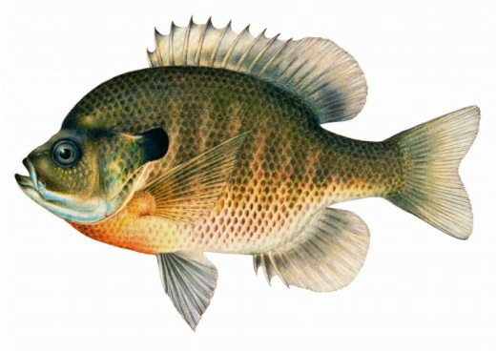
Quote from Monsanto Study (1989)*
Study exposed bluegill sunfish to carbon-14 radiolabelled glyphosate
Measured radiolabel in tissues greatly exceeded measured glyphosate levels
Proteolysis recovered more glyphosate
20% yield → 70% yield
"Proteinase K hydrolyses proteins to amino acids and small oligopeptides, suggesting that a significant portion of the 14C activity residing in the bluegill sunfish tissue was tightly associated with or incorporated into protein.”
*WP Ridley and KA Chott. Monsanto unpublished study. August, 1989.

Slide 57
Some Predicted Consequences*
Neural tube defects
Autism
Impaired collagen → osteoarthritis
Steatohepatitis (fatty liver disease)
Obesity and adrenal insufficiency
Hypothyroidism
Impaired iron homeostasis and kidney failure
Insulin resistance and diabetes
Cancer
*A. Samsel and S. Seneff. Journal of Biological Physics and Chemistry 2016;16:9-46.

Slide 58
An Analogy: ALS in Guam
An epidemic in ALS in Guam was traced to a natural toxin found in cycads
BMAA is a non-coding amino acid that gets inserted by mistake in place of serine
Defective versions of a glutamate transporter have been linked to ALS*
The transporter has an essential serine-rich region in its sequence**
*Antioxidants & Redox Signaling 2009;11: 1587-1602.
**DJ Slotboom et al., PNAS 1999; 96(25): 14282-14287.
Notes:
cyanobacteria_BMAA_article.pdf
Slotbloom_1999_conserved_serine_glutamate_transporter.pdf
Dunlop.pdf
ALS_glutamate_transporter_link_2009.pdf
Guam/
*ALS_glutamate_transporter_link_2009.pdf
ChrisShawChapter7GuamFantastic.docx
Dunlop.pdf
**Slotbloom_1999_conserved_serine_glutamate_transporter.pdf

Slide 59
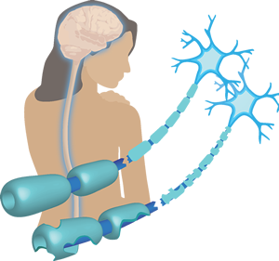
Another Analogy: MS & Sugar Beets*
Sugar beets contain an analogue of proline called Aze
Remarkable correlation between MS frequency and proximity to sugar beet agriculture
Myelin basic protein contains a concentration of proline residues that are absolutely essential for its proper function
*E. Rubenstein, J Neuropathol Exp Neurol 2008;67(11): 1035-1040.
Notes:
./misincorporation_of_proline_analogue_MS.pdf

Slide 60
Fishing for Glycine

Slide 61
I want to teach you how to fish!

Slide 62
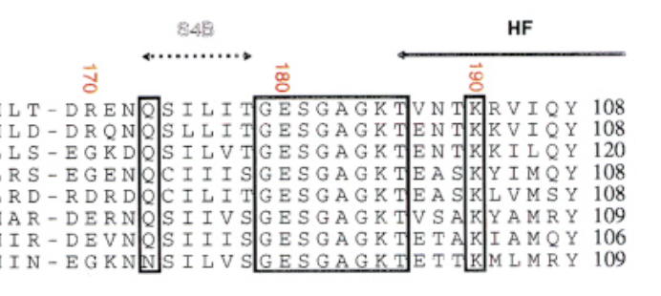
How to Fish
Myosin
alignments
Find a glycine residue in an important protein class that is highly conserved across multiple species
Find papers describing the functional role of that glycine in the protein
Find an example of a genetic mutation mapping that glycine to something else and identify the resulting disease profile
Ideally: find papers that describe dysfunction of that protein linked to glyphosate exposure or a symptom profile of glyphosate exposure that could be explained by that protein’s dysfunction

Slide 63
Glyphosate Disrupts Cytochrome P450 (CYP) Enzymes*
Glyphosate has been shown to severely suppress CYP enzymes in rat liver
CYP enzymes have a unique FGXGXRXCXG motif with two and often three critical glycine residues**
GLYCINES
*A Samsel and S Seneff. Entropy 2013; 15: 1416-1463.
**K Syed and SS Mashele. PLOS ONE 2014; 9(4):| e95616.
Notes:
CYPs_contain_highly_conserved_glycines_2014.pdf

Slide 64
Glyphosate Disrupts Cytochrome P450 (CYP) Enzymes*
Glyphosate has been shown to severely suppress CYP enzymes in rat liver
CYP enzymes have a unique FGXGXRXCXG motif with two and often three critical glycine residues**
CYP enzymes are needed to produce bile acids for digesting fats, to activate vitamin D and to detoxify many environmental toxicants
GLYCINES
*A Samsel and S Seneff. Entropy 2013; 15: 1416-1463.
**K Syed and SS Mashele. PLOS ONE 2014; 9(4):| e95616.
Notes:
CYPs_contain_highly_conserved_glycines_2014.pdf

Slide 65
*
Between 1999 and 2016, deaths from liver cirrhosis rose 60% among young adults in America, and deaths from liver cancer doubled
Impaired CYP activity leads to inability to detoxify toxic chemicals, including both pharmaceutical drugs and pesticides
Impaired bile acid synthesis leads to fatty liver disease
*http://www.kpax.com/story/38687909/liver-disease-deaths-spike-among-young-americans
**Villeneuve JP and Pichette V. Cytochrome P450 and liver diseases.
Curr Drug Metab. 2004 Jun;5(3):273-82.

Slide 66
GxxGxxK Motif in Sulfotransferases*
Sulfotransferases are crucial to attach sulfate ions to multiple bioactive molecules
Steroids (cholesterol, estrogen, testosterone, vitamin D, ...)
Glycosaminoglycans (chondroitin sulfate, heparan sulfate, ...)
Polyphenols, aromatics (curcumin, resveratrol, tryptophan, ...)
Neurotransmitters (dopamine, serotonin, melatonin, ...)
*H Chiba et al. Proc. Natl. Acad. Sci. USA 1995; 92:8176-8179.
Notes:
GxxGxxK_motif_sulfotransferases_1995.pdf

Slide 67
Cationic antimicrobial peptides: naturally occurring antibiotics that are actively being explored as a new class of anti-infective agents*
“The C-terminal helix from Gly16 to Ile23 is indispensable for antibacterial, cytolytic and lipopolysaccharide (LPS)-binding activities.”
*Y Xiao et al., FEBS Journal 273 (2006) 2581–2593
Notes:
./fowlicidin_cathelicidin_antimicrobial_peptide_chicken_glycine_dependency.pdf
Fig. 6. Alignment of representative linear a-helical antimicrobial peptides demonstrating the conservation of a kink induced by glycine near the center. Putatively mature fowlicidin-1 sequence is aligned with representative cathelicidins (mouse CRAMP, rabbit CAP18, bovine BMAP34 and BMAP28, sheep SMAP34 and SMAP29, and porcine PMAP37) as well as three insect peptides (fruit fly cecropin A1, a puta- tive porcine cecropin P1, and honey bee melittin). Dashes are inserted to optimize the alignment, and conserved residues are shaded. Note that each peptide aligned has an a-helix N-terminal to the conserved glycine (boxed) near the center, followed by either a helical or an unstructured tail. The only exception is CRAMP, which has a kink at Gly11 instead of Gly18 [22].

Slide 68
Glycines in Aquaporin 4*
Human
Various
plants
*Aristo Vojdani
Molecular Mimicry as a Mechanism for Food Immune Reactivities and Autoimmunity
Alternative Therapies 21, Suppl. 1, 30-41.
Notes:
Book/autism/Vojdani_infections_dietary_peptides_autism_2003.text
Figure 7. Similarity between human AQP4 and different plant AQP4s.
Neuromyelitis optica (NMO) is a severe neuroautoimmune disorder associated with antibodies to AQP4 that a ects the gray and white matter in the brain and spinal cord, causing demyelination, axonal damage, and necrosis and resulting in sensory loss and paralysis.126 In 75% of cases, NMO is associated with IgG1 antibody development that binds selectively to AQP4, which is a water channel

Slide 69
Glycines in Aquaporin 4*
Human
Autoantibodies to Aquaporin 4 lead to neuromyelitis optica (NMO), which is a severe neuroautoimmune disorder that affects the gray and white matter in the brain and spinal cord, causing demyelination, axonal damage, and necrosis and resulting in sensory loss and paralysis.
Various
plants
*Aristo Vojdani
Molecular Mimicry as a Mechanism for Food Immune Reactivities and Autoimmunity
Alternative Therapies 21, Suppl. 1, 30-41.
Notes:
Figure 7. Similarity between human AQP4 and di erent plant AQP4s.
Neuromyelitis optica (NMO) is a severe neuroautoimmune disorder associated with antibodies to AQP4 that a ects the gray and white matter in the brain and spinal cord, causing demyelination, axonal damage, and necrosis and resulting in sensory loss and paralysis.126 In 75% of cases, NMO is associated with IgG1 antibody development that binds selectively to AQP4, which is a water channel

Slide 70
Lactose Intolerance*
Lactase Sequence
*S Torniainen et al. BMC Gastroenterology 2009; 9:8.
Notes:
https://www.ncbi.nlm.nih.gov/pmc/articles/PMC2635369/
four_novel_mutations_lactase_2009.pdf
Also:
lactase_mutations_glycine_residue.pdf

Slide 71
Amyloid Beta,
Dementia and
Macular Degeneration
Notes:
50 minutes

Slide 72
*
*N Swanson et al. Journal of Organic Systems, 9(2), 2014

Slide 73
The Cost of Alzheimer’s Disease*
Amyloid β Plaque
“The current $259 billion cost of Alzheimer’s care in the U.S. will reach an `unsupportable’ $1 trillion annually by 2050, according to the Alzheimer’s Association.”
*https://www.cnbc.com/2018/07/06/
biogen-alzheimer-drug-success-and-the-long-tail-of-dementia-drug-fails.html
Notes:
Amyloid beta

Slide 74
The Big Picture*
Alzheimer’s disease is associated with accumulation of amyloid-β plaque in the brain
The plaque is formed from insoluble fibers derived from multiple β-sheet strands that precipitate out of solution
The amyloid-β protein normally folds as α-helices and forms transmembrane pores
The helices are stabilized by glycine residues
Substitution of other amino acids for glycine causes misfolding that eventually leads to the precipitated plaque
Glyphosate substitution for glycine disrupts protein folding
Glyphosate’s negative charge attracts aluminum which also accumulates in the plaque
*A Samsel and S Seneff Journal of Biological Physics and Chemistry 2016;16:9-46.

Slide 75
Aluminum [Al] and Alzheimer’s*
“The hypothesis that Al significantly contributes to AD [Alzheimer’s disease] is built upon very solid experimental evidence and should not be dismissed. Immediate steps should be taken to lessen human exposure to Al, which may be the single most aggravating and avoidable factor related to AD.”
*L Tomljenovic. J Alzheimers Dis. 2011;23(4):567-98.
Notes:
Alzheimers\/aluminum_and_AD.text

Slide 76
α-helices and β-sheets

Slide 77
Protein Misfolding*
α-Helix
Ubiquitin chain depends on terminal glycine residues
E.g.,
Amyloid-β Plaque in Alzheimer’s Disease
β-Sheet
Notes:
aggresomes_and_inclusion_bodies_review_2000.pdf

Slide 78
GxxxGxxxG: Glycine Zippers*
“We suggest that the membrane pores formed by the amyloid-β peptide in vitro are constructed by glycine zipper packing and find that mutations in the glycine zipper motif block channel formation.”
*S Kim et al. PNAS 2005; 102(4): 14278–14283
Notes:
./transmembrane_glycine_zippers_GxxxG_motif_2005.pdf

Slide 79
Glycine Zipper Motif*
GxxxGxxxGxxxG motif
Human amyloid beta A4 protein precursor
*S Kim et al. PNAS 2005; 102(40): 14278-14283.
Notes:
Scleroderma/transmembrane_glycine_zippers_GxxxG_motif_2005.pdf
Table 1. List of single-pass TM proteins containing extended glycine zipper motifs
The letters in parentheses indicate a function, where known. a, cell adhesion; o, oligomerization; p, pore formation; c, channel function; v, vesicle formation and vacuolation; f, membrane fusion. Only one representative from a protein family is listed

Slide 80
GxxxG Motif forms a Transmembrane Channel *
*S Kim et al. PNAS 2005; 102(4): 14278-83
Notes:
Amyloid beta

Slide 81
A glycine zipper motif mediates the formation of toxic β-amyloid oligomers in vitro & in vivo*
“Our results demonstrate a critical role for C-terminal glycine residues in the formation of toxic Aβ oligomers”
“An alternative explanation for the enhanced toxicity of the double mutant Aβ is that it is the total number of glycine residues in the C-terminal region of Aβ that is the key determinant of toxicity. Although we cannot exclude this possibility, it is difficult to develop a molecular model that would account for this explanation.”
*Fonte et al. Molecular Neurodegeneration 2011, 6:61

Slide 82
A glycine zipper motif mediates the formation of toxic β-amyloid oligomers in vitro & in vivo*
“Our results demonstrate a critical role for C-terminal glycine residues in the formation of toxic Aβ oligomers”
“An alternative explanation for the enhanced toxicity of the double mutant Aβ is that it is the total number of glycine residues in the C-terminal region of Aβ that is the key determinant of toxicity. Although we cannot exclude this possibility, it is difficult to develop a molecular model that would account for this explanation.”
Glyphosate substitution for glycine?
*Fonte et al. Molecular Neurodegeneration 2011, 6:61

Slide 83
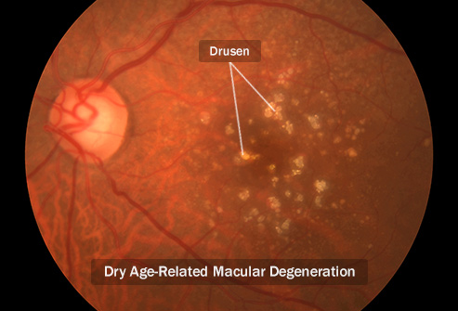
Age-related Macular Degeneration*
Age-related macular degeneration (AMD) causes blindness in nearly 50 million people worldwide
Amyloid-β is elevated in the aging retina and may be a key factor in the pathology
AMD drusen and senile plaques show similarities, arguing for shared molecular mechanisms in AMD and dementia
*JA Ratnayaka et al. Eye 2015; 29: 1013-1026.
Notes:
200 million by 2020
Chris Knobbe
Talk on Sunday
Age related macular degeneration and processed foods

Slide 84
Dementia of the Eye*
Amyloid-β: cross-β structure with slow twist
*Figure 1. JA Ratnayaka et al. Eye 2015; 29: 1013-1026.
Notes:
Scleroderma/Dementia_of_the_eye.pdf
Figure 1 (a–c) Show negative stained transmission electron micrographs depicting the self-assembly of Aβ1–42 at pH 7.4, 50 μM. (a) Shows small spherical oligomers that are visible immediately after preparation of Aβ1-42 peptide (Soura et al50). These assemble further by 24 h to form (b) elongated protofibrils, and finally (c) amyloid fibrils after 48 h incubation. d Shows a structural model of an amyloid fibril composed of cross-β structure and showing a slow twisted architecture. Generation of the model is described in Morris et al.101
1015

Slide 85
Experiment Exposing Rabbit Retina to Glyphosate*
Topical exposure to eyes twice a day of 100 micro- liters of glyphosate in 3 concentrations of 0.12, 0.97, and 7.8 mg/kg for one week.
At the two highest concentrations:
"The β-turns and α-helix content significantly decreased (P< 0.05). On the other hand, the content of β-sheet significantly increased."
*SA Morsy et al. Journal of The Arab Society for Medical Research 2017; 12:92-98.
Notes:
glyphosate_exposure_rabbit_retina_2017.pdf
Potential hazards of glyphosate on rabbit retina
Sahar A. Morsya, Eman M. Alyb, Ahlam M. Ibrahima, Sherif S. Mahmoudb, Gehan M. Kamala

Slide 86
Results on Protein Secondary Structure changes in Rabbit Retina Exposed to Glyphosate*
* Table 4. SA Morsy et al., Journal of the Arab Society for Medical Research 2017; 12: 92-98.

Slide 87
Results on Protein Secondary Structure changes in Rabbit Retina Exposed to Glyphosate*
Glycine residues are critical for reinforcing α-helices and β-turns. Glyphosate substitution can be expected to convert α-helices into β-sheets and disrupt β-turns, consistent with these results
* Table 4. SA Morsy et al., Journal of the Arab Society for Medical Research 2017; 12: 92-98.

Slide 88
Recapitulation
Amyloid-β is a key factor in Alzheimer’s
Amyloid-β depends on glycine residues in a GxxxGxxxGxxxG motif to stabilize trans- membrane helices
Glyphosate substitution for glycine disrupts protein folding, leading to β-sheets precipitating out as toxic fibrils
Negatively charged glyphosate binds to aluminum
Amyloid-β also plays a significant role in macular degeneration in the eye

Slide 89
Autoimmune Disease
Epidemic
Notes:
55 minutes

Slide 90
Autoimmune Disease: An Invisible Epidemic*
“Taken together, the number of people suffering from autoimmune diseases is 24–50 million Americans, 16% of the US population. To put it in perspective, autoimmune disease prevalence equals heart disease and cancer combined.”
*Feldman B, Martin EM, Simms T. An Invisible Epidemic — When your body attacks itself — Autoimmune Disease; How Reframing the Data Unveils a Public Health Crisis Bigger than Cancer and Heart Disease Combined. www.tincture.io.
Notes:
Feldman B, Martin EM, Simms T. An Invisible Epidemic — When your body attacks itself — Autoimmune Disease; How Reframing the Data Unveils a Public Health Crisis Bigger than Cancer and Heart Disease Combined. www.tincture.io.
IN Beecham Seneff paper. Ref. 13.

Slide 91
*
*Graphic provided by Gary Kohls, MD

Slide 92
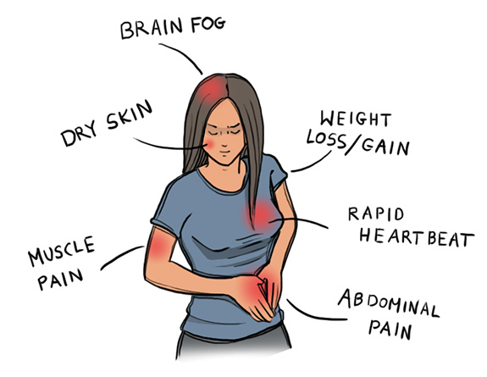
Autoimmune Disease Statistics*
Autoimmune Disease (AD) is a major health problem
Annual direct health care costs for AD in US estimated to be ~$100 billion
At least 23.5 million Americans suffer from one or more autoimmune diseases
Among the top-10 causes of death in females under 64 years old
Immunosuppressant treatments have devastating side effects
*https://www.aarda.org/autoimmune-information/autoimmune-statistics/

Slide 93
Notes:
autoimmune_disease_precedes_ALS_2013.pdf

Slide 94
"Results: There were significantly more cases than expected of ALS associated with a prior diagnosis of asthma, celiac disease, younger-onset diabetes (younger than 30 years), multiple sclerosis, myasthenia gravis, myxedema, polymyositis, Sjögren syndrome, systemic lupus erythematosus, and ulcerative colitis.”
Notes:
autoimmune_disease_precedes_ALS_2013.pdf

Slide 95
Why do we have an epidemic in
autoimmune disease in America today?

Slide 96
Hypothesis
Glyphosate exposure sets up a weakened immune system, a leaky gut barrier and a leaky brain barrier
Glyphosate contamination in proteins makes them hard to break down
Proteolysis enzymes are also defective
Person develops overactive antibody response to foreign protein contaminated with glyphosate and, through molecular mimicry, this leads to autoimmune disease
This easily explains gluten intolerance and other food allergies
And it eventually leads to more serious problems like ALS

Slide 97
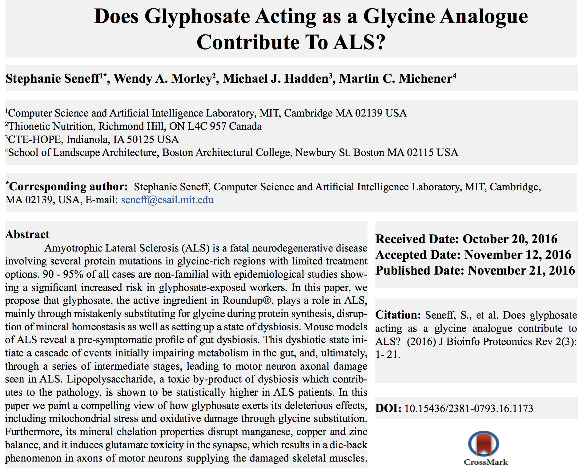

Slide 98
"In this paper, we propose that glyphosate, the active ingredient in Roundup®, plays a role in ALS, mainly through mistakenly substituting for glycine during protein synthesis, disruption of mineral homeostasis as well as setting up a state of dysbiosis. Mouse models of ALS reveal a pre-symptomatic profile of gut dysbiosis."

Slide 99
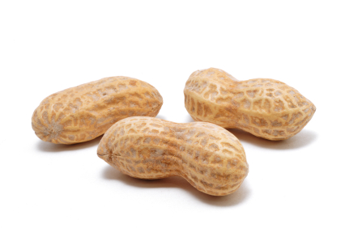
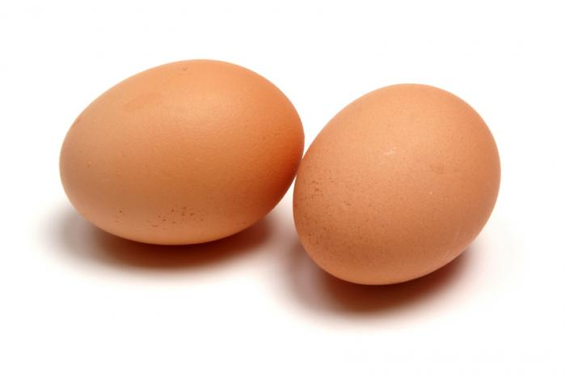
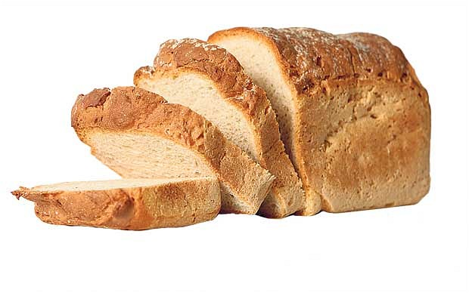
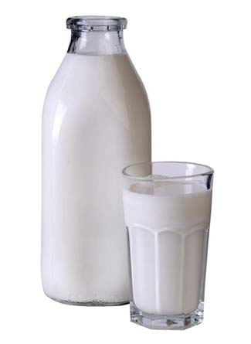
Food Allergies

Slide 100
Food Allergies
All of these foods can be expected to be contaminated with glyphosate, given how they’re produced

Slide 101
Food Allergies
"In our study, with the largest case number reported thus far, the results supported the significant association between ASDs [autism spectrum disorders] and allergic diseases.”*
*J Chen et al. Int J Dev Neurosci. 2014 Jun;35:35-41.

Slide 102
Drugs and Autoimmune Disease*
Drugs that treat autoimmune disease have a huge problem with side effects
They suppress the immune system, and increase risk to tuberculosis, invasive fungal infections and lymphomas (cancers of the immune system)
Humira is a TNF-alpha inhibitor, which blocks the immune response
It costs about $3,100 per month
U.S. prescriptions for Humira have taken off in recent years: 1.5 million in 2011; 2.4 million in 2015.
It was linked to more than 209,000 adverse event reports since 2013, including more than 4,200 deaths.
* usatoday.com/story/news/nation-now/2017/03/19/
analysis-reports-drug-side-effects-increase-fivefold-12-years/99384190/
Notes:
rug_side_effects_rising_2017.text

Slide 103
Collagen, Chronic Pain,
and Opioid Drugs

Slide 104
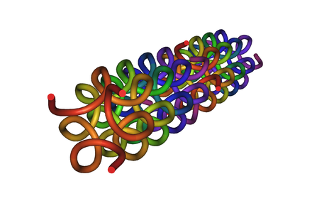
Collagen and Gelatin
25% of the protein in our body is collagen
25% of the amino acids in collagen are glycines
Glyphosate substitution for glycine will disrupt triple-helix formation and lead to diseases of the vasculature, joints and bones
Gelatin is derived from collagen in bones and ligaments sourced from cows and pigs fed glyphosate-contaminated GMO Roundup-Ready feed

Slide 105
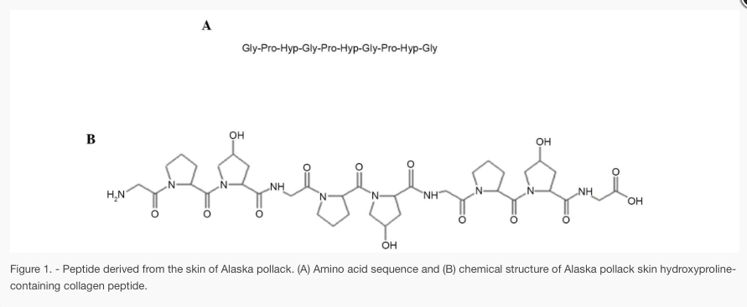
Glyphosate!
OH
OH
P
O
Common sequence in collagen

Slide 106
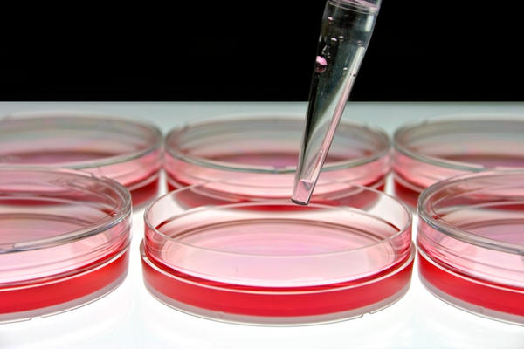
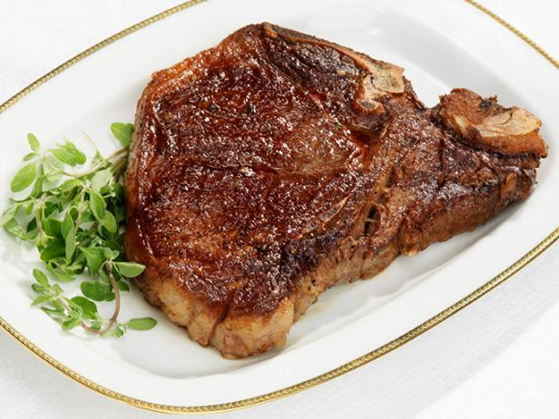
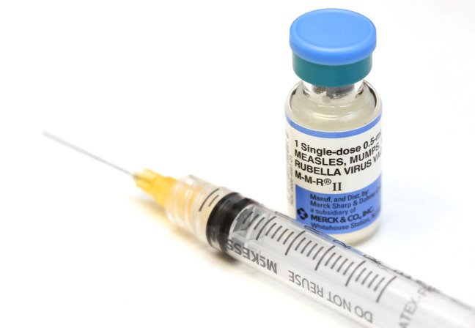
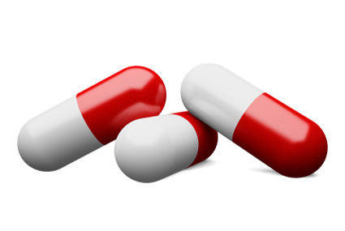
Products Containing Collagen/Gelatin !!

Slide 107
Chronic Pain*
“The list of different types of chronic pain syndrome seems to be growing every day, including complex regional pain syndrome, failed back syndrome, fibromyalgia, interstitial cystitis, myofascial pain syndrome, postvasectomy pain, vulvodynia, pelvic pain syndrome – and on and on.“
*P. 42, Anna Lembke, Drug dealer, MD
.John’s Hopkins U Press, Baltimore, MD
Notes:
Book:

Slide 108
Chronic Pain*
“The list of different types of chronic pain syndrome seems to be growing every day, including complex regional pain syndrome, failed back syndrome, fibromyalgia, interstitial cystitis, myofascial pain syndrome, postvasectomy pain, vulvodynia, pelvic pain syndrome – and on and on.“
Could the epidemic in bone and joint pain be due to glyphosate’s disruption of collagen’s tensile strength, elasticity and ability to hold water?
*P. 42, Anna Lembke, Drug dealer, MD
.John’s Hopkins U Press, Baltimore, MD
Notes:
Book:

Slide 109
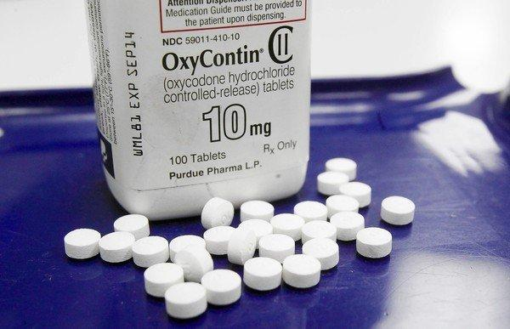
US Department of Health and Human Services Data on Pain-Killer Drug Abuse*
Drug overdose is the leading cause of injury death in the United States
Heroin, morphine, and prescription pain relievers
More people died from drug overdoses in 2014 than in any previous year on record
More than 6 out of 10 involved an opioid drug
More than 650,000 opioid prescriptions are dispensed every day
*http://www.hhs.gov/opioids/about-the-epidemic/
Notes:
./Factsheet-opioids-061516.pdf

Slide 110
US Department of Health and Human Services Data on Pain-Killer Drug Abuse*
According to PBS Evening News (Sept. 29, 2017), 64,000 deaths in the U.S. were attributed to opioid drug overdose in 2016.
This number increased to 72,000 in 2017 (up 10% from previous year)
(Reported August 16, 2018).
Drug overdose is the leading cause of injury death in the United States
Heroin, morphine, and prescription pain relievers
More people died from drug overdoses in 2014 than in any previous year on record
More than 6 out of 10 involved an opioid drug
More than 650,000 opioid prescriptions are dispensed every day
*http://www.hhs.gov/opioids/about-the-epidemic/
Notes:
./Factsheet-opioids-061516.pdf

Slide 111
Enkephalins! Endogenous Opioid Ligands
Opioid receptors are distributed widely in the brain, and are also found in the spinal cord and digestive tract
All of the amino acids in enkephalin are compromised by glyphosate
Morphine stimulates opioid receptors with subsequent upregulation of enkephalin, leading to a 340% increase in enkephalin expression in the nucleus accumbens following morphine exposure to rats*
*MM Nieto et al. The Journal of Neuroscience 2002; 22(3):1034-1041.
Notes:
morphine_increases_enkephalins_2002.pdf
WIKI

Slide 112
Enkephalins! Endogenous Opioid Ligands
Opioid receptors are distributed widely in the brain, and are also found in the spinal cord and digestive tract
All of the amino acids in enkephalin are compromised by glyphosate
Does this have something to do with the opioid drug overdose epidemic in America?
Morphine stimulates opioid receptors with subsequent upregulation of enkephalin, leading to a 340% increase in enkephalin expression in the nucleus accumbens following morphine exposure to rats*
*MM Nieto et al. The Journal of Neuroscience 2002; 22(3):1034-1041.
Notes:
morphine_increases_enkephalins_2002.pdf
WIKI

Slide 113
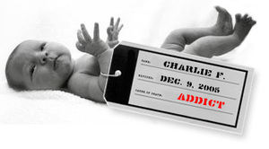
“Expecting mothers' opioid use may stunt kids' learning”*,**
Children exposed to opioid drugs in utero suffer from "newborn abstinence syndrome”
(withdrawal symptoms)
Tremors, hard-to-soothe crying, diarrhea and difficulty feeding and sleeping
Nearly 2,000 out of 7,200 children enrolled in Tennessee's Medicaid program were affected
1 in 7 require special classroom services for developmental delays and speech or language difficulties (compared to 1 in 10 in controls)
*www.nbcnews.com/health/health-news/
expecting-mothers-opioid-use-may-stunt-kids-learning-n905051
**M-M Fill et al. Pediatrics 2018 [Epub ahead of print]
Notes:
opioid_pregnancy.text
Pediatrics_2014_opioid_pregnancy_learning_disabilities.pdf

Slide 114
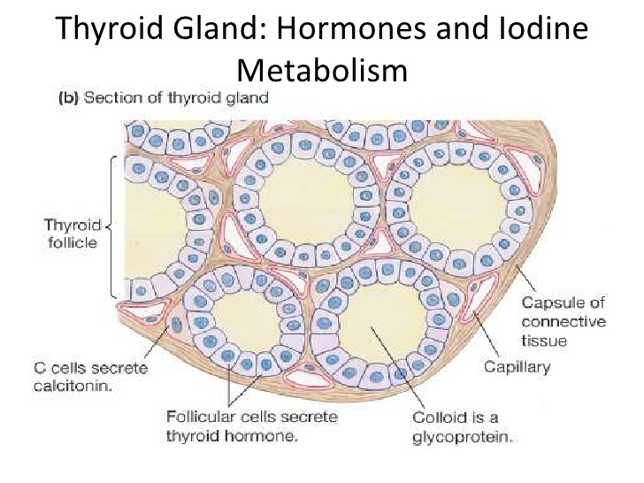
Collagen Damage → Thyroid Disease*
“Anything that destroys connective tissue or collagen, or prevents its proper formation in the first place, would probably increase the risk of thyroid damage and AITD (Autoimmune Thyroid Disease).”
Connective Tissue
*http://fluoroquinolonethyroid.com/book_page/
thiodine-problems-were-not-the-only-issues
/thyroid-damage-due-to-collagenconnective-tissue-damage/

Slide 115
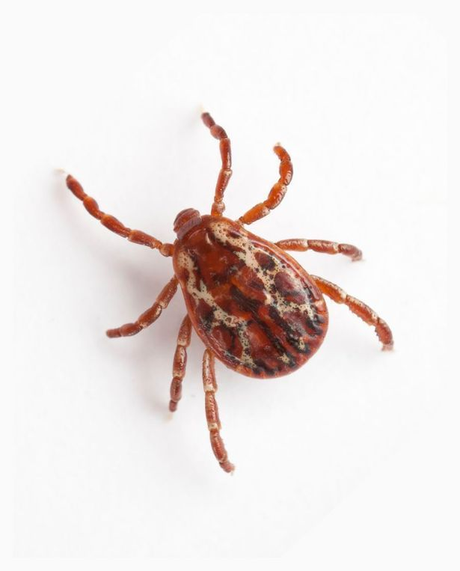
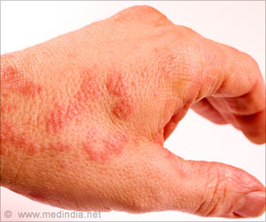
Alpha-Gal Antibodies: Allergy to Meat!*
"Meat allergy was first observed in the 1990s and formally described in 2009, which makes it a relatively recent arrival to the compendium of allergic conditions. Its most curious quality may be that it is seemingly triggered by a tick bite."
The tick releases a protein called dipeptidyl peptidase that works as an adjuvant
*"What the Mystery of the Tick-Borne Meat Allergy Could Reveal".
NY Times July 24,2018.
Notes:
tick_induced_meat_allergy_WOW_2018.pdf
Tick_induced_meat_allergy.text
ipeptidyl_peptidase_tick_anaphylaxis_alignments_glycines_2017.pdf

Slide 116
Dipeptidyl Peptidase Alignments*
Human
Alpha-gal is a kind of sugar that binds to the dipeptidyl peptidase from the saliva of the tick
It also binds to proteins found in meats
*I Sabljic et al. PLoS ONE 12(11): e0187295.
Notes:
ipeptidyl_peptidase_tick_anaphylaxis_alignments_glycines_2017.pdf

Slide 117
Dipeptidyl Peptidase Alignments*
Human
Is glyphosate contamination in dipeptidyl peptidase making it more allergenic than before?
Alpha-gal is a kind of sugar that binds to the dipeptidyl peptidase from the saliva of the tick
It also binds to proteins found in meats
*I Sabljic et al. PLoS ONE 12(11): e0187295.

Slide 118
Ehlers Danlos Syndrome
Hypermobile spectrum disorders are common, but often remain misdiagnosed or under-diagnosed
They can be caused genetically by a mutation in one of the glycine residues in collagen
They can also be caused/aggravated (I suspect) by glyphosate substituting for glycine during collagen synthesis.
Symptoms include loose joints, stretchy skin, and abnormal scar formation.
Complications include aortic dissection, joint dislocations, scoliosis, chronic pain, or early osteoarthritis.

Slide 119
What’s Coming in Part II
Immunity, Inflammation and Cancer
Prescription Drugs
Glyphosate and Vaccines
How Much More Evidence Do We Need?
Fighting Back
How to Stay Healthy in a Toxic World

