Slide 1
Glyphosate: How a simple molecule can cause so much destruction: Part II
Stephanie Seneff
MIT CSAIL
WAPF Wise Traditions Workshop
November 17, 2018

Slide 2
Download these slides
people.csail.mit.edu/seneff/2018/
Seneff_WAPF_2018_Part2.pptx

Slide 5
Outline
Immunity, Inflammation and Cancer
Prescription Drugs
Glyphosate and Vaccines
How Much More Evidence Do We Need?
Fighting Back
How to Stay Healthy in a Toxic World

Slide 6
Immunity, Inflammation
and Cancer

Slide 7
Section Outline
Overview
Excessive Calcium Uptake
Nucleoporin 98 (Nup98)
Activation Induced Deaminase (AID)
Tumor suppressors and DNA Repair

Slide 8
It is a cancer-causing herbicide used liberally by farmers Worldwide but governments are dithering to regulate due to corporate pressure.

Slide 9
The Evidence
Glyphosate exposure is linked to non-Hodgkin’s lymphoma and a California lawsuit resulted in a $289 million settlement (later reduced to $78M)
Rates of pancreatic cancer, thyroid cancer and bladder cancer are going up exponentially, in step with the rise in glyphosate usage on core crops
The WHO IARC issued a statement that glyphosate is a “probably carcinogen” in Spring 2015. California added it to its list of probable carcinogens

Slide 10
An Article I published on GreenMedInfo

Slide 11
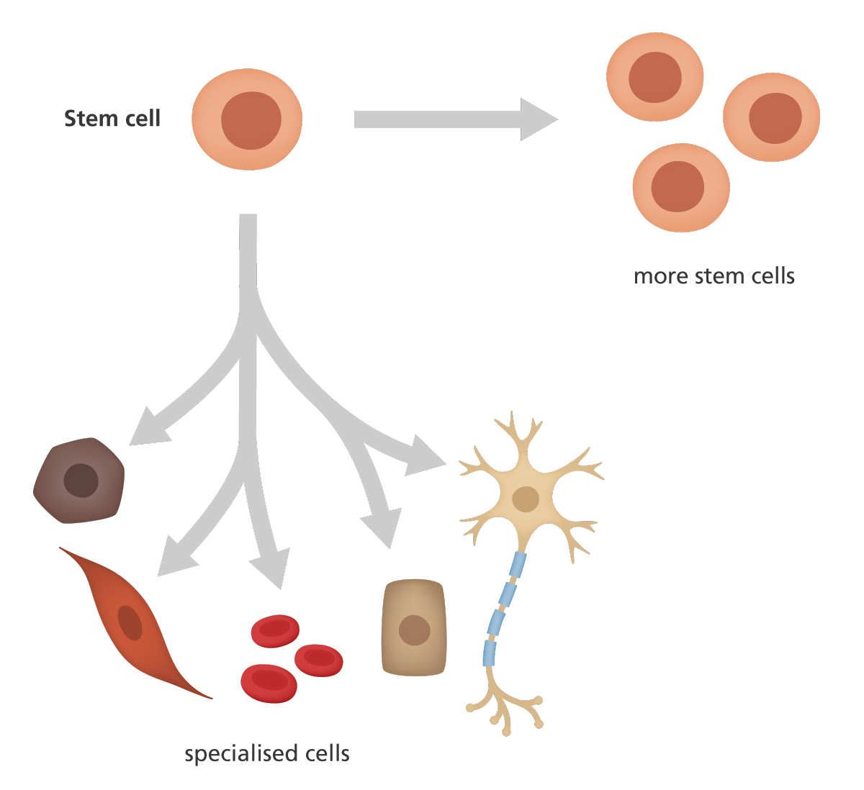
Cancer Cells and Stem Cells*
Stem cell
Uncontrolled self-renewal plays a direct function in the progression of different types of cancers
Cancer stem cells resemble normal stem cells in many ways
Both express OCT4, NANOG and SOX2, which are key proteins to induce pluripotency
Many types of cancer cells (e.g., bladder, colon, prostate cancer, etc.) express these proteins, which induce a proliferative state
DNA demethylation is a critical step towards pluripotency/cancer induction
More stem cells
Specialized cells
*S Amini et al. Anatomy & Cell Biology 2014;47:1-11.
Notes:
./stem_cell_markers_expressed_in_tumors_2014.pdf
50 seconds

Slide 12
The Big Picture
Glyphosate induces excessive calcium uptake which activates NF-κB through phosphorylation in many cell types
NF-κB regulates the transcription of genes that control inflammation, immune cell development, cell cycle, proliferation, and cell death
Disregulated NF-κB is linked to many diseases
Glyphosate induces a runaway phosphorylation cascade that alters protein behaviors, inducing mitosis (cell division) and genetic mutations
Excessive phosphorylation is a factor in many diseases, including cancer, heart disease and neurodegeneration
Glyphosate substitution for glycine in DNA repair enzymes would lead to high mutation rate
Notes:
50 seconds

Slide 13
Excessive Phosphorylation due to Glyphosate Substitution for Glycine*
Kinases are enzymes that add phosphates
Glyphosate substitution for critical glycines would be predicted to increase their activity
Phosphatases are enzymes that remove phosphates
Glyphosate substitution for critical glycines would be predicted to decrease their activity
Overall result is excessive phosphorylation of multiple proteins in the cell, leading to aberrant behavior
*A Samsel and S Seneff. Journal of Biological Physics and Chemistry 2016;16:9-46..

Slide 14
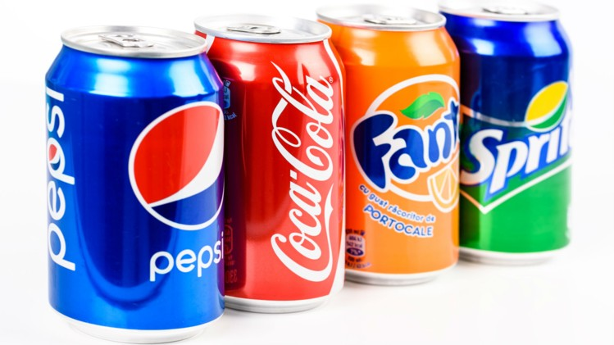
“Phosphate toxicity: new insights into an old problem”*
*MS Razzaque. Clin Sci (Lond). 2011; 120(3): 91–97.
Notes:
phosphate_toxicity_review_2012.pdf
phosphorus_additive_in_soft_drinks_2014.pdf
Nuclear-pores-the-gate-to-neurodegeneration.pdf

Slide 15
Immunity, Inflammation, and Cancer*
Inflammation →
Mutations
Immunosuppression
Angiogenesis
Metastasis
*Figure 1. SI Grivennikov. Cell 2010 March 19; 140(6): 883–89
Notes:
immunity_inflammation_cancer_2010.pdf
Types of inflammation in tumorigenesis and cancer.
Chronic inflammation associated with infections or autoimmune disease precedes tumor development and can contribute to it through induction of oncogenic mutations, genomic instability, early tumor promotion, and enhanced angiogenesis. Prolonged exposure to environmental irritants or obesity can also result in low-grade chronic inflammation that precedes tumor development and contributes to it through the mechanisms mentioned above. Tumor-associated inflammation goes hand in hand with tumor development. This inflammatory response can enhance neo-angiogenesis, promote tumor progression and metastatic spread, cause local immunosuppression, and further augment genomic instability. Cancer therapy can also trigger an inflammatory response by causing trauma, necrosis, and tissue injury that stimulate tumor re-emergence and resistance to therapy. However, in some cases, therapy-induced inflammation can enhance antigen presentation, leading to immune-mediated tumor eradication. Tumor promoting mechanisms are in red and anti-tumorigenic mechanisms are in green.

Slide 16
Section Outline
Overview
Excessive Calcium Uptake
Nucleoporin 98 (Nup98)
Activation Induced Deaminase (AID)
Tumor suppressors and DNA Repair

Slide 17
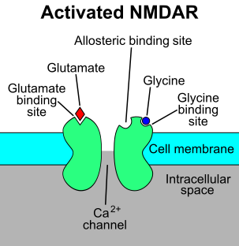
Glyphosate and Glutamate*
Acute exposure to the hippocampus in the brain activates NMDA receptors and voltage-dependent calcium channels
Oxidative stress and neural cell death
Increased glutamate release into the synaptic cleft → neurotoxicity
Glyphosate
Calcium uptake
Through calcium channels
*D. Cattani et al. / Toxicology 320 (2014) 34–45
Notes:
Glyphosate/mechanisms_glyphosate_neurotoxicity_glutamate_rats_2014.pdf
http://www.greenmedinfo.com/blog/roundup-weedkiller-brain-damaging-neurotoxin
acute exposure (30 minutes) and chronic (pregnancy and lactation) exposure.
Why was this referenced??
T. Bohn et al. Food Chemistry 153, 15 June 2014, 207-215.

Slide 18
"The pesticide increased intracellular Ca2+ concentration by opening L-type voltage-dependent Ca2+ channels ..., leading to Ca2+ overload within the cells, which set off oxidative stress and necrotic cell death."
Notes:
glyphosate/Roundup_toxic_to_testes_calcium_implicated_2014.pdf

Slide 19
"In GBH [glyphosate-based herbicide]-poisoned persons, a high incidence of QTc interval prolongation and atrioventricular conduction blocks (from minimal to high grade) were reported along with arrhythmias, longer QTc and older age predicting mortality "
Long-QT Syndrome!
Notes:
Glyphosate/glyphosate_cardiotoxic_effects_rat_ventricular_myocardium_in_vitro_Seralini_2016.pdf

Slide 20
Inflammatory Cytokines Induce Long-QT Syndrome*
Calcium uptake
NF-kB activation
Glyphosate
*PE Lazzerini et al. Frontiers in Cardiovascular Medicine 2015;2:26.
Notes:
./long_QT_syndrome_inflammation_immunity.pdf ~

Slide 21
Inflammatory Cytokines Induce Long-QT Syndrome*
Increased risk to long QT syndrome associated with:
Rheumatoid arthritis
Connective tissue disease
Autoimmune antibodies
End-stage liver disease
Neuropathy
HIV infection
All of these diseases can be linked to glyphosate exposure
*PE Lazzerini et al. Frontiers in Cardiovascular Medicine 2015;2:26.
Notes:
./long_QT_syndrome_inflammation_immunity.pdf ~

Slide 22
Section Outline
Overview
Excessive Calcium Uptake
Nucleoporin 98 (Nup98)
Activation Induced Deaminase (AID)
Tumor suppressors and DNA Repair

Slide 23
FG Repeats: Nup98
nucleus
Cancer
OH
AID
-
-
-
P
OH
-
O
OH
-
AID
OH
-
-
-
P
OH
DNA
Break
-
-
-
P
OH
-
O
OH
O
NF-κB
-
-
-
P
OH
-
O
Cross-link
OH
-
-
-
P
OH
-
O
cytoplasm
NF-κB
OH
Nuclear pore
-
-
-
P
OH
-
O
Inflammatory
Agent

Slide 24
FG Repeats: Nup98
nucleus
Cancer
OH
AID
-
-
-
P
OH
-
O
This is how a B lymphocyte becomes a non-Hodgkin’s lymphoma tumor cell
OH
-
AID
OH
-
-
-
P
OH
DNA
Break
-
-
-
P
OH
-
O
OH
O
NF-κB
-
-
-
P
OH
-
O
Cross-link
OH
-
-
-
P
OH
-
O
cytoplasm
NF-κB
OH
Nuclear pore
-
-
-
P
OH
-
O
Inflammatory
Agent

Slide 25
Nucleoporin*
Nucleoporin:
“FG domain” containing
many repeats of Phe-Gly pairs
Notes:
SallyFallon/Nucleoporin_and_cancer.text
nucleoporin_and_cancer_2010.pdfPr

Slide 26
Gene Regulation by Nucleoporins and Links to Cancer
Nucleoporins are related to a "bewildering" array of diseases
Neurological disorders
Neuroendocrine disorders
Cardiac disorders
Autoimmune diseases
*A. Kohler and E Hurt. Molecular Cell 2010;38: 6-15.
Notes:
nucleoporin_and_cancer_2010.pdf
Nup98_fusions.pdf
Nuclear-pores-the-gate-to-neurodegeneration.pdf

Slide 27
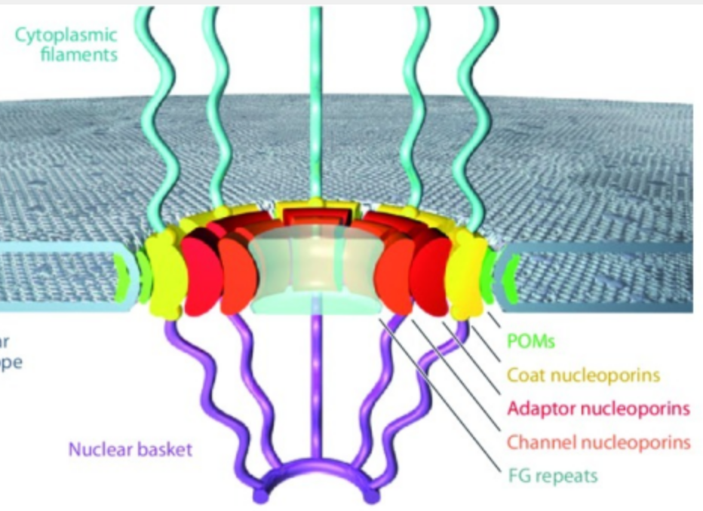
ALS
DEMENTIA
FG…FG…FG…FG…FG –
Multiple FG (Phe-Gly) (Phenylalanine- Glycine) repeats
Notes:
Nuclear-pores-the-gate-to-neurodegeneration.pdf

Slide 28
FG Repeats: phenylalanine-glycine
phenylalanine
phenylalanine
phenylalanine
phenylalanine
phenylalanine
phenylalanine
glyphosate
glycine
glycine
glyphosate
glycine
glycine
Phosphomimetics!
The FG repeat domain
has multiple serines that can get phosphorylated, drastically changing its behavior

Slide 29
FG Repeats: phenylalanine-glycine
phenylalanine
phenylalanine
phenylalanine
phenylalanine
phenylalanine
phenylalanine
Hypothesis:
Glyphosate substitution for glycine in the FG domain imitates serine phosphorylation
glyphosate
glycine
glycine
glyphosate
glycine
glycine
Phosphomimetics!
The FG repeat domain
has multiple serines that can get phosphorylated, drastically changing its behavior

Slide 30
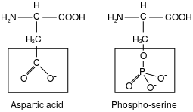
Phosphomimetics!
WIKI:
Phosphomimetics are amino acid substitutions that mimic a phosphorylated protein, thereby activating (or deactivating) it.
H
_
HN
_____
_
C
Glyphosate

Slide 31
Nup98: A Nucleoporin with many critical glycine residues*
Other proteins that bind to Nup98 at glycine-containing sites
Glycine
*SM Gough et al. Blood 2011; 118(24): 6247–6257.
Notes:
Nup98_fusions_leukemia_2011.pdf
No mention of phosphate.
But:
Nup98_Hox_fusion_leukemia.pdf
Nup98_fusions.pdf
[?? Nup98_Hox_fusions_leukemia.pdf]

Slide 32
Nup98 and Cancer
Nup98 is a core component of the plug that blocks nuclear pores
When Nup98 is phosphorylated within its FG domain, it breaks away from the plug and the plug disintegrates
Replacement of some of its glycines for glyphosate will have a similar effect
This gives free access to the nucleus of proteins that are normally retained in the cytoplasm
One of these is Activation Induced Deaminase (AID)
Phosphorylated AID in the nucleus:
Strips DNA of its methyl groups
Initiates DNA double strand breaks
Induces expression of proteins that lead to tumorigenesis

Slide 33
Section Outline
Excessive Calcium Uptake
Nucleoporin 98 (Nup98)
Activation Induced Deaminase (AID)
Tumor suppressors and DNA Repair

Slide 34
Activation-induced cytidine deaminase (AID)
AID is a genome-mutating enzyme that initiates class switch recombination and somatic hypermutation of antibodies during immune system maturation
AID can become a rogue protein if it is hyperphosphorylated and allowed to gain prolonged access to the nucleus
Can induce multiple DNA mutations in proteins related to cancer
Can strip DNA of its methyl groups, leading to a pluripotent state (stem-cell-like cancer cell)

Slide 35
Rogue TGF-β receptor → AID*
TGF-β is a cytokine that induces AID
The TGF-β receptor has a specific peptide sequence where phosphorylation of serines takes place to activate it
These serines are surrounded by glycines
Ser-Gly-Ser-Gly-Ser-Gly
Substitution of glyphosate for any of these glycines would lead to false activation
*S Souchelnytskyi et al. The EMBO Journal 1995;15(22):6231-6240.

Slide 36
Phosphorylation and Negative Charge*
AID protein becomes able to create double strand DNA breaks only after it is phosphorylated on serine 38
Zebrafish have a version of AID that is missing serine (cannot be phosphorylated) yet it is active anyway
Hypothesis is that this is due to a nearby negatively charged amino acid (aspartate)
Analogously, substituting a negatively charged amino acid near the serine residue in human AID caused it to be constitutionally active
A highly conserved glycine at residue 47 would become negatively charged if substituted by glyphosate
*U Basu et al. Mol Cell. 2008 October 24; 32(2): 285–291.
Notes:
2018/SallyFallon/evolution_of_kinase_dependent_regulation_of_AID_2008.pdf
Glyphosate/DNA/DNA_damage_Ecuador_glyphosate.pdf

Slide 37
Phosphorylation and Negative Charge*
AID protein becomes able to create double strand DNA breaks only after it is phosphorylated on serine 38
Zebrafish have a version of AID that is missing serine (cannot be phosphorylated) yet it is active anyway
Hypothesis is that this is due to a nearby negatively charged amino acid (aspartate)
Analogously, substituting a negatively charged amino acid near the serine residue in human AID caused it to be constitutionally active
A highly conserved glycine at residue 47 would become negatively charged if substituted by glyphosate
A study on people living in northern Ecuador near the border to Colombia who were exposed to aerial sprayed glyphosate showed that they had a significant increase in DNA double-strand breaks in blood samples.**
*U Basu et al. Mol Cell. 2008 October 24; 32(2): 285–291.
**C Paz-y-Mino et al. Genetics and Molecular Biology 2007; 30(2): 456-460.
Notes:
2018/SallyFallon/evolution_of_kinase_dependent_regulation_of_AID_2008.pdf
Glyphosate/DNA/DNA_damage_Ecuador_glyphosate.pdf

Slide 38
AID: 7 conserved glycines*
*EM Quinlan et al. Mol Cell Biol. 2017 Sep 26;37(20)
Notes:
Gglyphosate/proof/Quinlan_2017_AID_7_conserved_glycines.pdf

Slide 39
Inflammation, AID and Cancer*
Notes:
Figure 3: Chronic inflammation leads to aberrant AID expression and subsequent mutations that promote tumorigenesis in solid organ systems. Several chronic diseases have been implicated in cancer development. Only those cancers known to express AID in a subset of patients and which have had that expression linked to chronic inflammation are shown here. The common theme for all of these cancers is that chronic inflammation generates a setting of cytokine signaling, generally TNF , which in turn induces AID expression in the epithelial cells. AID then deaminates different genes, including the oncogene p53, leading to mutations that promote tumorigenesis.

Slide 40
AID and Colon Cancer*
*S Perwez Hussain. Gastroenterology 2008 Sep; 135(3): 736–737.
Notes:
inflammation_and_cancer_is_AID_aiding_2008.pdf

Slide 41
Section Outline
Overview
Excessive Calcium Uptake
Nucleoporin 98 (Nup98)
Activation Induced Deaminase (AID)
Tumor suppressors and DNA Repair

Slide 42
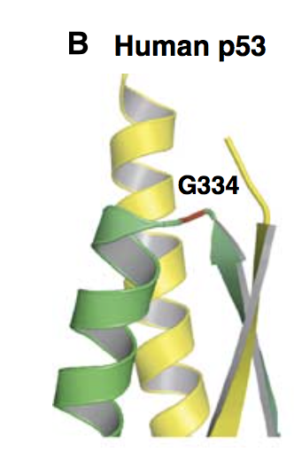
TP53: A nuclear protein that protects from cancer (cancer suppressant)*
GLYCINE
*HD Ou et al. The EMBO Journal 2007; 26: 3463-3473.
Notes:
p53_conserved_glycine_2007.pdf
p53_tetramer_DNA_binding.pdf

Slide 43
Mutant p53 linked to lung cancer: glycine-334 mutated to valine*
Alpha helices become beta sheets
Mutant protein forms tetramers with normal protein that precipitate out as amyloid fibrils
Mutant can’t bind to DNA and can’t protect from proliferation (tumor growth)
Misfolding process analogous to what happens with amyloid beta in Alzheimer’s disease
Over half of all cancers are linked to mutated p53
*Y Higashimoto et al. Biochemistry 2006; 45(6): 1608-1619.
Notes:
glycine_mutation_p53_amyloid_formation_lung_cancer.pdf

Slide 44
MRE11: DNA repair enzyme*
MRE11 is overexpressed in breast cancer cells, probably because they are experiencing excessive numbers of DNA double-strand breaks
This in turn is likely due to constitutionally active AID with both hyperphosphorylation and glyphosate substitution for glycine generating negative charge
MRE11 is expected to be defective with glyphosate substitution for its own glycines in the glycine-arginine domain.
*U Dery et al. Molecular and Cellular Biology May 2008; 28(9): 3058–3069.
Notes:
./glycine_argine_domain_MRE11_DNA_repair_2008.pdf

Slide 45
FG Repeats: Nup98
nucleus
Cancer
OH
AID
-
-
-
P
OH
-
O
OH
-
AID
OH
-
-
-
P
OH
DNA
Break
-
-
-
P
OH
-
O
OH
O
NF-κB
-
-
-
P
OH
-
O
Cross-link
OH
-
-
-
P
OH
-
O
cytoplasm
NF-κB
OH
Nuclear pore
-
-
-
P
OH
-
O
Inflammatory
Agent

Slide 46
FG Repeats: Nup98
nucleus
Cancer
OH
AID
-
-
-
P
OH
-
O
This is how a B lymphocyte becomes a non-Hodgkin’s lymphoma tumor cell
OH
-
AID
OH
-
-
-
P
OH
DNA
Break
-
-
-
P
OH
-
O
OH
O
NF-κB
-
-
-
P
OH
-
O
Cross-link
OH
-
-
-
P
OH
-
O
cytoplasm
NF-κB
OH
Nuclear pore
-
-
-
P
OH
-
O
Inflammatory
Agent

Slide 47
Recapitulation
A B-cell will evolve into a cancer cell through aberrant processes induced by chronic glyphosate exposure
Excessive calcium entry induces inflammatory response that stimulates excessive phosphorylation of multiple proteins
Glyphosate substitution leads to both excessive phosphorylation and excessive “pseudo-phosphorylation”
Excessive phosphorylation of NF-kB, TGF-β, AID and Nup98 in particular will lead to DNA breaks and DNA damage
Glyphosate substitution in DNA repair enzymes will cause higher mutation rates
Mutations eventually turn the cell into a tumor cell, with regression to stem-cell like characteristics and runaway proliferation
→ Non-Hodgkin’s Lymphoma and other cancers

Slide 48
Prescription Drugs

Slide 49
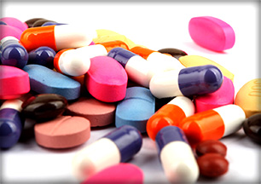
Over the past 20 years...*
20-fold rise in statin drugs
7-fold for antihypertensives
4-fold for diabetes meds
The number of people taking 5 or more different drugs has quadrupled and includes over half of those 65 and over
*J le Fanu. BMJ 2018;361:k2794.
Notes:
mass_medicalizaton.pdf

Slide 50
And “the risk of ill” from this massive upswing in prescribing?*
“A hidden epidemic of immiserating symptoms such as fatigue, muscular aches and pains, insomnia, and general decrepitude, a 75% rise in emergency admissions to hospital for adverse drug reactions …, and almost certainly a contributory factor to the recently noted decline in life expectancy”
*J le Fanu. BMJ 2018;361:k2794.
Notes:
mass_medicalizaton.pdf

Slide 51
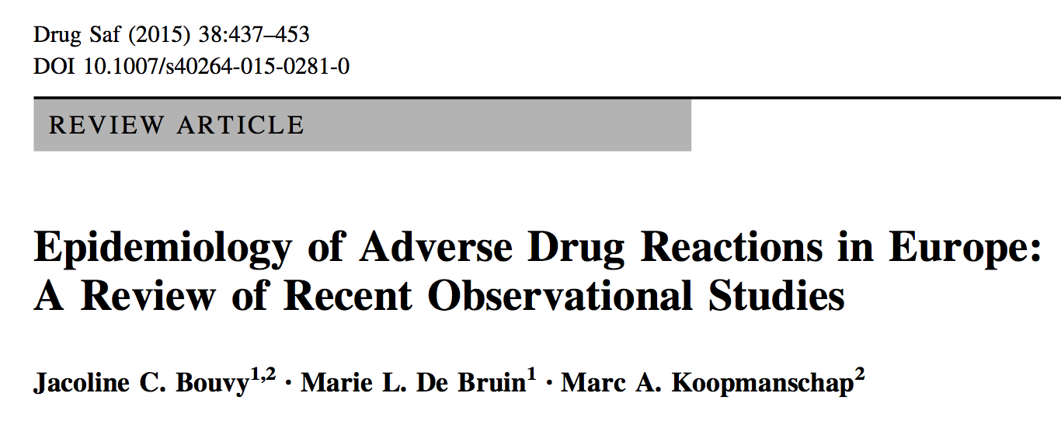
“This review indicates that, in Europe, approximately 3.6 % of all hospital admissions are caused by ADRs [Adverse Drug Reactions], and up to 10% of patients in European hospitals experience an ADR during their stay.”
Notes:
./drug_side_effects_Europe_2015.pdf

Slide 52
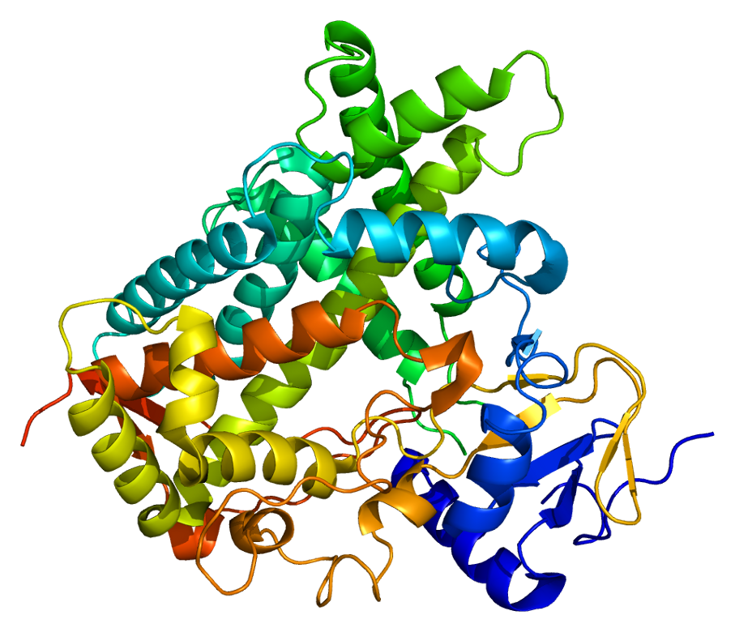
*
“Interactions with warfarin, antidepressants, antiepileptic drugs, and statins often involve the cytochrome P450 enzymes”
CYPs are essential for the:
Production of cholesterol, steroids, prostacyclins, and thromboxane A2
Detoxification of foreign chemicals
Metabolism of drugs
*American Academy of Family Physicians. 2017
https://www.aafp.org/afp/2007/0801/p391.html
Notes:
https://www.aafp.org/afp/2007/0801/p391.html

Slide 53
*
Glyphosate has been shown to severely suppress CYP enzymes in rat liver cells*
“Interactions with warfarin, antidepressants, antiepileptic drugs, and statins often involve the cytochrome P450 enzymes”
CYPs are essential for the:
Production of cholesterol, steroids, prostacyclins, and thromboxane A2
Detoxification of foreign chemicals
Metabolism of drugs
*E Hietanen. Acta pharmacol. et Toxicol. 1983; 53: 103-112.
Notes:
https://www.aafp.org/afp/2007/0801/p391.html

Slide 54
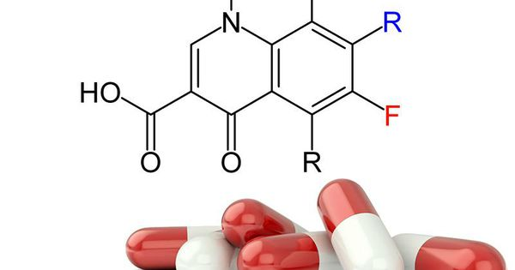
Fluoroquinolone Antibiotics and Oxalate Overload*
Fluoroquinolones kill Oxalobacter formigenes
Oxalobacter metabolizes oxalates
High oxalates lead to low sulfate through flushing out at the kidneys
Low sulfate causes many problems: Circulation, immune function, detox
High oxalates cause kidney stones and can crystallize in the muscles and brain, causing pain, muscle weakness, and brain fog
*https://floxiehope.com/2016/03/23/fluoroquinolone-antibiotics-and-oxalate-overload/
Notes:
./floxie_hope_oxalates
./Shoshanna_on_oxalates.text
tendon rupture, permanent nerve damage or depression.
usually prescribed for respiratory, urinary or ear infections.

Slide 55
Fluoroquinolone Antibiotics and Oxalate Overload*
Fluoroquinolones kill Oxalobacter formigenes
Oxalobacter metabolizes oxalates
High oxalates lead to low sulfate through flushing out at the kidneys
Low sulfate causes many problems: Circulation, immune function, detox
High oxalates cause kidney stones and can crystallize in the muscles and brain, causing pain, muscle weakness, and brain fog
Glyphosate breaks down to oxalate and inhibits oxalate metabolism through chelation of manganese and magnesium and disruption of gut microbes**
*https://floxiehope.com/2016/03/23/fluoroquinolone-antibiotics-and-oxalate-overload/
**A Samsel and S Seneff. Surgical Neurology International 2015; 6:45.
Notes:
./floxie_hope_oxalates
./Shoshanna_on_oxalates.text
tendon rupture, permanent nerve damage or depression.
usually prescribed for respiratory, urinary or ear infections.

Slide 56
Ciprofloxacin has dramatic effects on the mitochondrial genome*
Mitochondrial DNA depends on topoisomerases to regulate supercoiling state
Loss of topoisomerases due to inhibition by Cipro causes accumulation of positively supercoiled mitochondrial DNA
This disrupts DNA transcription and replication, thus depleting mitochondrial DNA
This may account for many of the side effects of Cipro, including tendon rupture, permanent nerve damage and depression
*A Hangas et al. Nucleic Acids Res. 2018 Aug 31. doi: 10.1093/nar/gky793. [Epub ahead of print]
Notes:
cipro_damages_mitochondria.text

Slide 57
Ciprofloxacin has dramatic effects on the mitochondrial genome*
Mitochondrial DNA depends on topoisomerases to regulate supercoiling state
Loss of topoisomerases due to inhibition by Cipro causes accumulation of positively supercoiled mitochondrial DNA
This disrupts DNA transcription and replication, thus depleting mitochondrial DNA
This may account for many of the side effects of Cipro, including tendon rupture, permanent nerve damage and depression
Glyphosate works synergistically with Cipro to cause mitochondrial damage**
*A Hangas et al. Nucleic Acids Res. 2018 Aug 31. doi: 10.1093/nar/gky793. [Epub ahead of print]
**AG Pereira et al. Chemosphere 2018;209:353-362.
Notes:
cipro_damages_mitochondria.text

Slide 58
Statins stimulate atherosclerosis and heart failure*
Epidemic in heart failure and atherosclerosis that plagues modern world may paradoxically be aggravated by pervasive use of statin drugs
Statins increase coronary artery calcification
Statins are mitochondrial toxins: deplete coenzyme Q10
Statins inhibit synthesis of vitamin K2, cofactor for matrix Gla-protein activation (protects from calcification)
Statins inhibit synthesis of selenium-containing proteins
Includes glutathione peroxidase which suppresses oxidative stress
Reminiscent of dilated cardiomyopathies seen in selenium deficiency
*H Okuyama et al. Expert Rev Clin Pharmacol. 2015;8(2):189-99.
Notes:
./statins_heart_failure.text

Slide 59
Glyphosate and Serum Cholesterol*
*https://www.westonaprice.org/health-topics/modern-diseases/
cholesterol-sulfate-deficiency-coronary-heart-disease/

Slide 60
Drugs with Depression as a Side Effect*
Cross-sectional survey study based on National Health and Nutrition Examination Survey (NHANES) (26,192 adults)
Adults in the United States use more than 200 medications that have been associated with depression
Includes antihypertensives (e.g., beta blockers), proton pump inhibitors, analgesics, and hormonal contraceptives
37% of adults take one or more of these drugs
15% of those taking 3 or more of these drugs were depressed, vs. 4.7% for those not using such medications
Findings persisted in analyses restricted to adults with hypertension and after excluding users of any psychotropic medications
Glyphosate likely increases risk to depression due to interference with serotonin synthesis via shikimate pathway
*D M Qato et al. JAMA. 2018;319(22):2289-2298.
Notes:
Qato_2018_JAMA_depression_as_a_side_effect.pdf

Slide 61
Antidepressant Withdrawal Symptoms*
Percentage of adult population taking antidepressants has increased by 160% since 2000 in the US and the UK
More than half of people experience withdrawal symptoms when they try to quit
Symptoms include anxiety, flu-like symptoms, insomnia, nausea, imbalance, dizziness, brain zaps, diarrhea, headaches, muscle spasms and tremors, agitation, hallucinations, confusion, malaise, sweating and irritability.
* J Davies and J Read. Addictive Behaviors 2018 [Epub ahead of print]
Notes:
Book/neurons/antidepressant_withdrawal_symptoms_2018.pdf

Slide 62
Glyphosate in Drugs?*
Trasylol (aprotinin) is a protein derived from bovine lung used to reduce bleeding during open heart surgery
Rare acute reaction to Trasylol involves precipitous drop in blood pressure, acute kidney failure, and sudden death
Piglets injected with glyphosate salts had similar acute reaction with high mortality rate
Cows fed GMO Roundup-Ready feed had highest residue levels of glyphosate in lungs
Several other biological drugs are also suspect
Protamine sulfate derived from sturgeon testes
*S Seneff et al., Agricultural Sciences 2015; 6:1472-1501.
Notes:
Trypsin inhibitor
Also protamine sulfate from sturgeon testes

Slide 63
Glyphosate and Vaccines

Slide 64
Dr. Thomas Cowan’s New Book
Currently,
1 in 11 American children has asthma
1 in 2.5 has an allergy
1 in 13 has severe food allergies
1 in 36 has autism
Vaccines are an ineffective and harmful attempt to shortcut a complex immune response
Risks to autoimmune disease are inherent in antibody induction through vaccination
Authoritarian approach by medical establishment robs parents of informed consent

Slide 65
Dr. Thomas Cowan’s New Book
Currently,
1 in 11 American children has asthma
1 in 2.5 has an allergy
1 in 13 has severe food allergies
1 in 36 has autism
Vaccines are an ineffective and harmful attempt to shortcut a complex immune response
Risks to autoimmune disease are inherent in antibody induction through vaccination
Authoritarian approach by medical establishment robs parents of informed consent
Glyphosate likely disrupts the protein that orchestrates perfection of antibody matching to antigen (AID), causing antibodies induced by vaccines to misrecognize human proteins and attack them instead of or in addition to the target protein
Notes:
AID
Activation induced cytidine deaminase

Slide 66
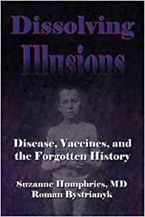
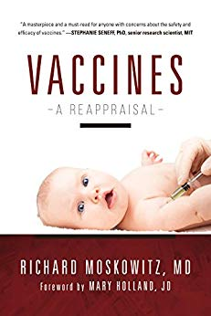
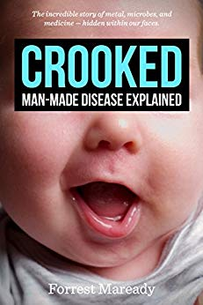

Slide 67
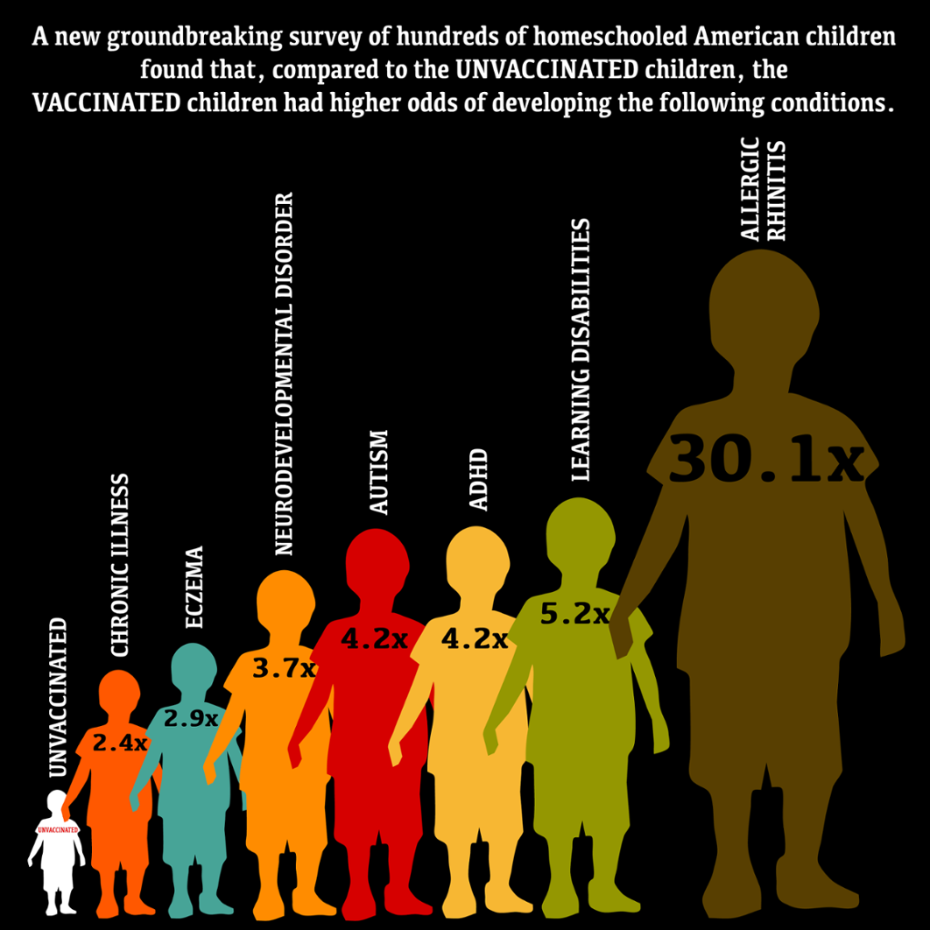
The Unvaccinated Population is Healthier*
*AR Mawson et al. J Transl Sci 2017; 3. DOI: 10.15761/JTS.1000186
Notes:
http://info.cmsri.org/the-driven-researcher-blog/vaccinated-vs.-unvaccinated-guess-who-is-sicker
Vaccinated\ and\ Unvaccinated\ 6-12\ year\ old\ US\ children\ \ JTS-3-186.pdf
./vax_unvax_Mawson_article.text

Slide 68
Prof. Zimmerman’s Testimony*
Hannah Poling was a child who was injured by vaccines, regressing into autism
Her Father, John Poling, collaborated with Prof. Zimmerman at John's Hopkins as fellow neurologists
Prof. Zimmerman became convinced that, in Hannah Poling's case, a preexisting mitochondrial disorder could have led to an adverse reaction to vaccines that caused her to regress into autism
It is estimated that 30% to 50% of autistic kids have preexisting mitochondrial disorders.
The vaccine court committed fraud and obstruction of justice in suppressing the fact that Zimmerman believed vaccines could cause autism under certain circumstances
Over 5000 children were denied justice as a consequence
*JB Handley. How to End the Autism Epidemic.

Slide 69
Big Pharma Mitochondrial Iatrogenocide: Toxic Environmental Chemicals, Drugs and Vaccines are Destroying Mitochondria*
"The avarice of these industries for larger market-share, higher share price, bigger profits, lower wages and more aggressive wealth extraction knows no bounds, and their brain-disabling products makes their goals ever easier to attain."
*Gary Kohls, MD.
waronwethepeople.com/
big-pharma-iatrogenocide-mass-population-poisoning-by-mitochondrial-disruption
Notes:
Mercury ROS drugs
http://www.waronwethepeople.com/big-pharma-iatrogenocide-mass-population-poisoning-by-mitochondrial-disruption/

Slide 70
Glyphosate and Mitochondrial Damage*
"Our results show that GBH [glyphosate-based herbicides] induced in zebrafish brain a decrease in cell viability, inhibited mitochondrial complex enzymatic activity, modulated gene expression related to mitochondrial complexes, …, promoted hyperpolarization of mitochondrial membrane, and induced behavioral impairments… This study pointed to the mitochondria as an important target of GBH.
*AG Pereira et al. Chemosphere 2018;209:353-362.
Notes:
./to_Michelle_glyphosate_mitochondria.text

Slide 72
Glyphosate in Vaccines*
*https://www.facebook.com/HighWireTalk/videos/2157052507846542/
Notes:
This is Del Bigtree’s interview with the lawyer for Dewayne Johnson.
https://www.facebook.com/HighWireTalk/videos/2157052507846542/

Slide 73
Injecting a protein into animals or humans causes immune system sensitization to that protein. Subsequent exposure to the protein can result in allergic reactions or anaphylaxis. This fact has since been demonstrated over and over again …
Notes:
./vaccine_protein_causes_food_allergies.pdf

Slide 74
Large Proteins in Vaccines: Allergenic*
“Vaccines clog our lymphatic system and lymph nodes with large protein molecules which have not been adequately broken down by our digestive processes, since vaccines bypass digestion with injections. This is why vaccines are linked to allergies, because they contain large proteins which as circulating immune complexes (CICs) or 'klinkers’ cause our body to become allergic.”
*Dave Mihalovic, ND, http://whale.to/v/vaccines_cause_allergies.ht

Slide 75
Measles Virus and Hemagglutinin*
The measles virus synthesizes the protein hemagglutinin
Antibodies to hemagglutinin are essential following MMR vaccination to induce immunity
Hemagglutin bears a sequence resemblance to myelin basic protein (MBP) → potential for autoimmune reaction
MBP is essential for the formation of the myelin sheath surrounding nerve fibers
Autoantibodies to MBP along with excessive levels of antibodies to measles hemagglutinin are linked to autism**
*Oldstone, MBA, Ed. Molecular mimicry: Infection inducing autoimmune disease.
Springer Berlin Heidelberg; January 9, 2006.
**VK Singh et al., J Biomed Sci 2002;9(4):359-64.

Slide 76
Autism and Measles Hemagglutinin*
125 autistic children and 92 control children
60% of the children with autism had high levels of antibodies to measles hemagglutinin specific to the MMR vaccine
90% of these had autoantibodies to myelin basic protein (MBP)
0% of the control children had high antibody titers to either hemagglutinin or MBP
There were no elevations in antibodies detected against any proteins in the mumps or rubella viruses
*VK Singh et al., J Biomed Sci 2002;9(4):359-64.

Slide 77
Measles Vaccine: an Epidemiological Nightmare*
Measles vaccine shifted the distribution of disease from children aged 5 to 9 (least vulnerable group) to infants (most vulnerable), teenagers and adults
In 1963, less than 0.5% of measles cases were infants
By 1992, at least 28% of all measles cases were infants
Blood serum from women with natural immunity neutralizes many more strains of measles virus than blood serum from vaccinated women
90% of 200 deaths that occurred during a measles outbreak from 1989 to 1990 in the US occurred among children under 5
Eliminating the natural immunity passed from mother to child has resulted in an epidemiological nightmare
*Neil Miller, Vaccine Safety Manual; CDC; J of Med Virology
Notes:
Where?
https://www.amazon.com/Vaccine-Safety-Concerned-Families-Practitioners/dp/188121737X

Slide 78
Hep-B at Birth: A Dangerous Vaccine*
Hepatitis B vaccine (HBV) is administered to more than 70% of neonates worldwide
HBV induces impairments in behavior and in hippocampal neurogenesis, mediated in part by the cytokines Il-4 and Il-6.
“These findings suggest that clinical events involving neonatal IL-4 over-exposure, including neonatal hepatitis B vaccination and asthma in human infants, may have adverse effects on neurobehavioral development.”
*X Wang et al. Cytokine 110 (2018) 137–149.
Notes:
./JB_Handley_Hep_B_Chinese_study_2018.text
Our current research demonstrates that IL-4 mediates the delayed neurobehavioral impairments induced by neonatal hepatitis B vaccination, which involves the permeability of the neonatal BBB and the down-regulation of the IL-4 receptor
Also his book How to End the Autism Epidemic

Slide 79
How Aluminum Works*
Aluminum hydroxide stimulates immune cells to produce proinflammatory cytokines that activate T cells.
Activated T cells release IL-4 which increases expression of antigen-presenting molecules to enhance immune response
My Conclusion:
IL-4 expressed in response to Hep-B at birth is due to its aluminum hydroxide adjuvant
* M Ulanova et al. Infection and Immunity 2001; 69(2): 1151-1159.
Notes:
Aluminum/aluminum_hydroxide_IL4_adjuvant_2001.pdf

Slide 80
Autistic Brains have High Aluminum Levels*
“I did not see a role for aluminum in autism. And I didn’t see a role for aluminum in vaccines in autism. I have to change my mind now on both of these. I have to change my mind that aluminum has a role in autism. I believe it now does.”
– Dr Chris Exley, 2017.
*http://vaccinepapers.org/high-aluminum-content-autistic-brains

Slide 81
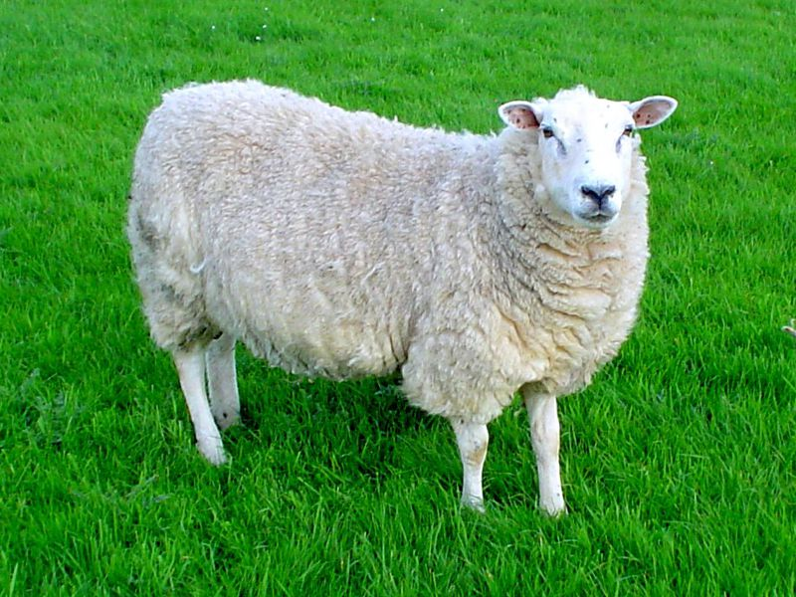
Sheep Exposed to Aluminum Adjuvant
Aluminum-containing vaccines may be responsible for a strange new neurological disease in sheep
A study exposed lambs to multiple injections of either an Al-containing vaccine or aluminum alone*
Compared to controls, both groups showed anxiety and antisocial behavior
A separate study demonstrated that aluminum had accumulated in gramulomas that formed in the lymph nodes of the exposed sheep**
*J Asín et al. Pharmacological Research Nov 3, 2018 [Epub ahead of print]
**J Asin et al. Veterinary Pathology Oct 31, 2018 [Epub ahead of print]

Slide 82
New Book on Dangers of HPV Vaccine
"A Groundbreaking Exposé to the HPV Vaccine and the Science, Safety, and Business Behind It" by Mary Holland, Kim Mack Rosenberg, and Eileen Iorio.
Notes:
https://www.amazon.com/dp/1510710809/ref=tsm_1_fb_lk
WOW!!
Protocol 018.pdf

Slide 83
“A lowered probability of pregnancy in females in the USA aged 25–29 who received a human papillomavirus vaccine injection”*
“For married women, 75% of the group not exposed to the HPV vaccine conceived, while only 50% of the exposed group had been pregnant at least once. Results suggest if 100% of the females in this study had received the HPV shot, the number of women who had ever been pregnant would have fallen by 2 million.”
Data obtained from National Health and Nutrition Examination Survey (NHANES)
An observed adverse reaction to HPV vaccination is primary ovarian failure
*G. DeLong. Journal of Toxicology and Environmental Health, Part A 2018 [Epub ahead of print]
Notes:
./hpv_vaccine_and_infertility.text
./GayleDeLong_HPV_fertility_paper_2018.pdf
http://www.acpeds.org/the-college-speaks/position-statements/health-issues/new-concerns-about-the-human-papillomavirus-vaccine

Slide 84
Vaccines and Anti-phospholipid Syndrome (APS)*,**
APS is an autoimmune disease causing venous thrombosis, fertility issues and pregnancy complications
Molecular mimicry of microbial antigens leads to production of pathogenic autoantibodies in lupus and APS
Experimentally, tetanus toxoid plus aluminum adjuvant induces antibodies associated with APS
Many of the adverse reactions to Gardasil are symptoms of APS
*L Dimitrijevic et al. Lupus (2012) 21, 195–202
**P Cruz-Tapias et al. Curr Opin Rheumatol. 2012 Jul;24(4):389-93.
Notes:
Vaccines/ASIA_2012.pdf
flu_vaccine_anticardiolipins_lupus_2012.pdf
tetanus_vaccine_induces_APS_2012.pdf

Slide 85
“Cancer immunology, bioinformatics and chemokine evidence link vaccines contaminated with animal proteins to autoimmune disease: a detailed look at Crohn’s disease and Vitiligo”*
”Abstract: ... The above findings add to the growing evidence of vaccines inducing autoimmune diseases. Autoantibody and autoreactive T cell levels can vary from person to person.
Not everyone will develop overt disease. For every case of diagnosed autoimmune disease, there are numerous subclinical cases. These subclinical diseases could shave decades off your life. So `rare’ diagnosed vaccine adverse events are the tip of the iceberg."
*V Arumugham and MV Trushin. J. Pharm. Sci. & Res. 2018; 10(8): 2106-2110.
Notes:
Collaboration between a Russian and an American.
vaccines_Crohns_Vitiligo_autoimmune_proteins_2018.pdf

Slide 86
How Much More Evidence
Do We Need?

Slide 87
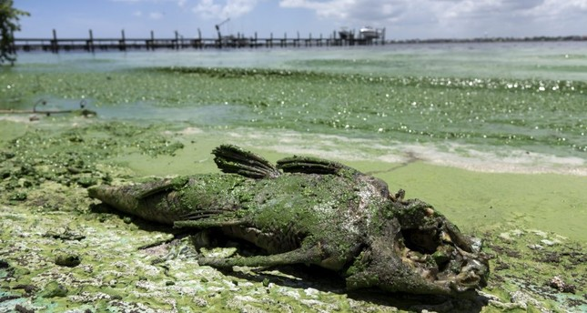
“Is Agriculture’s Use of Glyphosate Feeding Lake O’s Explosive Algae Blooms?”*
Sugar cane agriculture is extensive all around Lake Okeechobee in S. Florida, and glyphosate is used both to control weeds and as a desiccant
Cyanobacteria can break down the C-P bond in glyphosate and use its phosphorus atom as a fuel source**
*Prof. Geoffrey Norris.
https://jacquithurlowlippisch.com/tag/
is-sugarcane-field-glyphosate-feeding-lake-os-blue-green-algae-blloms
**D Drzyzga et al. Environ Microbiol 2017 Mar;19(3):1065-1076
Notes:
,/RedTide_algae_blooms_manmade.pdf
Glyphosate/Zhang_glyphosate_water_cyanobacterium_2016.pdf
Geoffrey Norris:
https://jacquithurlowlippisch.com/tag/is-sugarcane-field-glyphosate-feeding-lake-os-blue-green-algae-blloms/

Slide 88
Corn for Ethanol Production*
2007
Karen Perry Stillerman, July 17, 2018
https://blog.ucsusa.org/karen-perry-stillerman/the-midwests-food-system-is-failing-heres-why
Notes:
https://cdn.blog.ucsusa.org/wp-content/uploads/chart-US-corn-production-and-corn-used-for-ethanol.jpeg

Slide 89
Corn for Ethanol Production*
“Today’s corn crop is mainly used for biofuels (roughly 40 percent of U.S. corn is used for ethanol) and as animal feed (roughly 36 percent of U.S. corn, plus distillers grains left over from ethanol production, is fed to cattle, pigs and chickens). Much of the rest is exported. Only a tiny fraction of the national corn crop is directly used for food for Americans, much of that for high-fructose corn syrup.”
2007
Karen Perry Stillerman, July 17, 2018
https://blog.ucsusa.org/karen-perry-stillerman/the-midwests-food-system-is-failing-heres-why
Notes:
https://cdn.blog.ucsusa.org/wp-content/uploads/chart-US-corn-production-and-corn-used-for-ethanol.jpeg

Slide 90
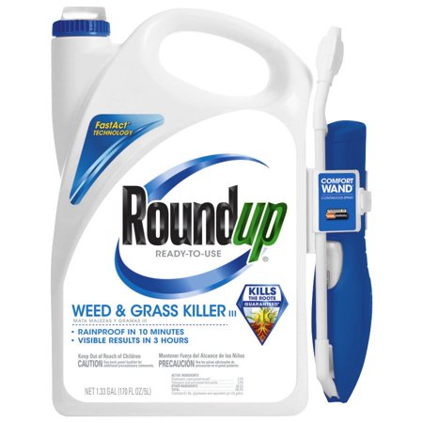
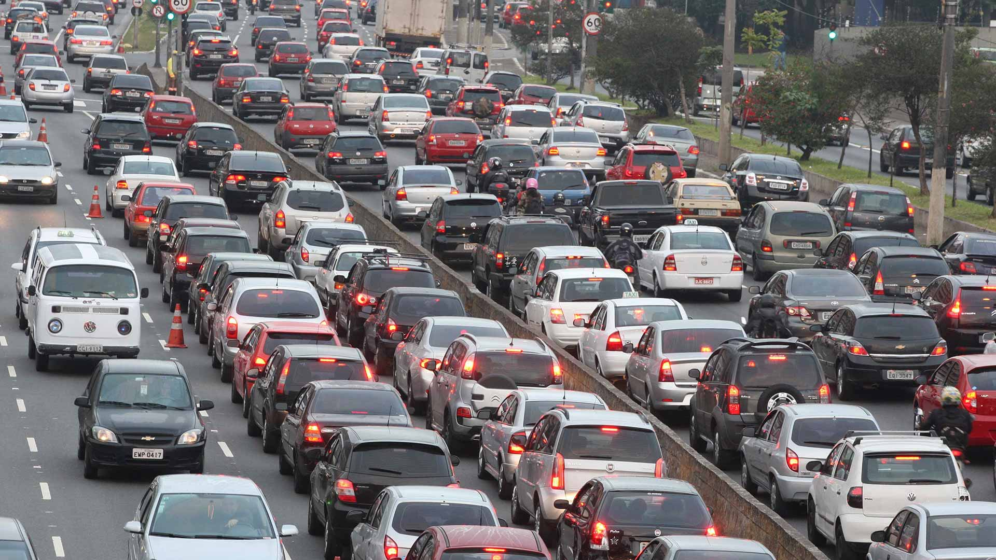
Corn for Ethanol Production*
2007
Karen Perry Stillerman, July 17, 2018
https://blog.ucsusa.org/karen-perry-stillerman/the-midwests-food-system-is-failing-heres-why
Notes:
https://cdn.blog.ucsusa.org/wp-content/uploads/chart-US-corn-production-and-corn-used-for-ethanol.jpeg

Slide 91
*
December 27, 2016
Dead Whale
“A marine mystery is confounding residents of southwest Nova Scotia who are watching thousands of dead fish, starfish, crabs, clams, scallops and lobster wash up on the shore.”
*www.cbc.ca/news/canada/nova-scotia/
fish-kill-off-st-marys-bay-lobster-clams-crabs-beach-1.3913265
Notes:
http://www.cbc.ca/news/canada/nova-scotia/fish-kill-off-st-marys-bay-lobster-clams-crabs-beach-1.3913265

Slide 92
The Answer to the Mystery!
Notes:
./NovaScotiaGlyphosate_trees.text
https://www.localxpress.ca/local-news/nova-scotia-gives-ok-to-spray-hundreds-of-hectares-of-woodland-with-glyphosate-378654
The Nova Scotia govenment just approved Vision Max (Glyphosate) to be sprayed on our forests to manage tree lots this past fall. Prior to the mass die off we had a lot of rain. I think it is runoff from the spraying. https://www.localxpress.ca/local-news/nova-scotia-gives-ok-to-spray-hundreds-of-hectares-of-woodland-with-glyphosate-378654
Tera Abraham Facebook

Slide 93
Counties in Nova Scotia Where Forests Were Sprayed with Glyphosate
Sprayed with Glyphosate
Bay of Fundy

Slide 94
Approvals Issued for Spraying
Environment
August 3, 2018 11:29 AM
The Department of Environment has issued six new approvals for pesticide spraying covering about 1,351 hectares. The approvals are all for forestry. Three are for aerial and three are for ground spraying. Three previously issued multi-year approvals also allow spraying this year.
August 3, 2018
*https://novascotia.ca/news/release/?id=20180803004
Notes:
Get from Belize slides.

Slide 95
https://www.theguardian.com/environment/2017/oct/18/
warning-of-ecological-armageddon-after-dramatic-plunge-in-insect-numbers
Notes:
https://www.theguardian.com/environment/2017/oct/18/warning-of-ecological-armageddon-after-dramatic-plunge-in-insect-numbers

Slide 96
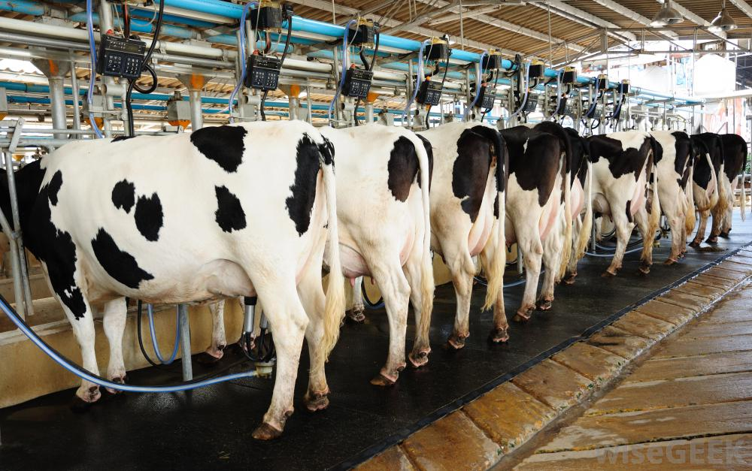
CAFO Cows are Now the Norm*
https://www.nbcnews.com/news/us-news/
best-advice-u-s-dairy-farmers-sell-out-fast-you-n887941

Slide 97
GMO Roundup-Ready Bentgrass*
"Agribusiness companies are very quick to sue farmers when their fields are found to contain their genetically engineered plants, ... but somehow they never seem to suffer from the same problem in reverse when their engineered products threaten the produce of farmers who do not want their products."
"What happens when American agricultural products are so tainted with GMO contaminated crops of plants that countries with stricter regulations quit buying from the USA altogether?"
bentgrass
*gizadeathstar.com/2018/07/the-gmo-bentgrass-problem-growing-out-of-control/
Notes:
https://gizadeathstar.com/2018/07/the-gmo-bentgrass-problem-growing-out-of-control/
Irrigation canals – glyphosate is the only herbicide allowed near water.

Slide 98
Glyphosate Resistant Weeds
Notes:
From Tony Mitra

Slide 99
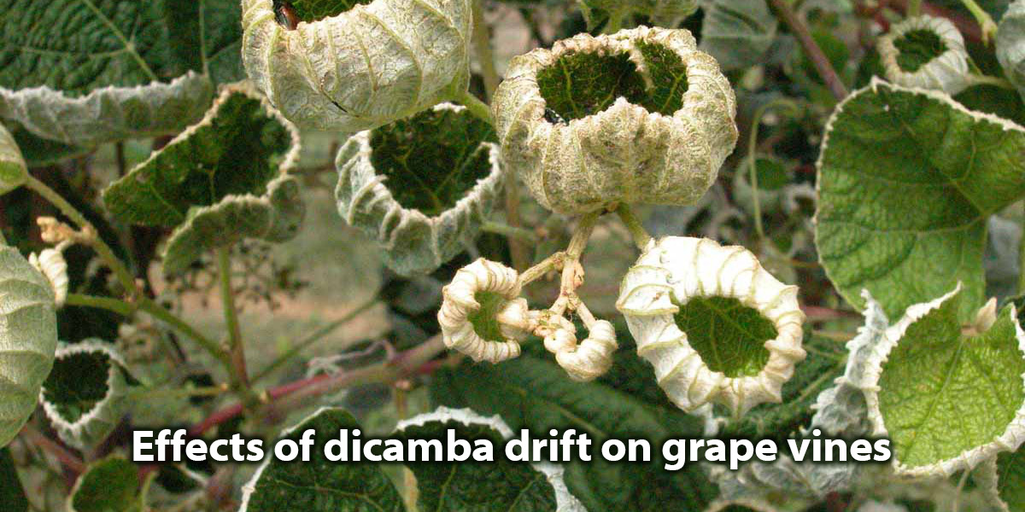
Alternative Herbicides?
New on the market: Dicamba-resistant soy
4% of all soy grown in the US was destroyed by dicamba drift last year.
Dicamba drift is also killing trees, other crops and flowering plants in private gardens
What is it doing to humans?

Slide 100
Fighting Back

Slide 101
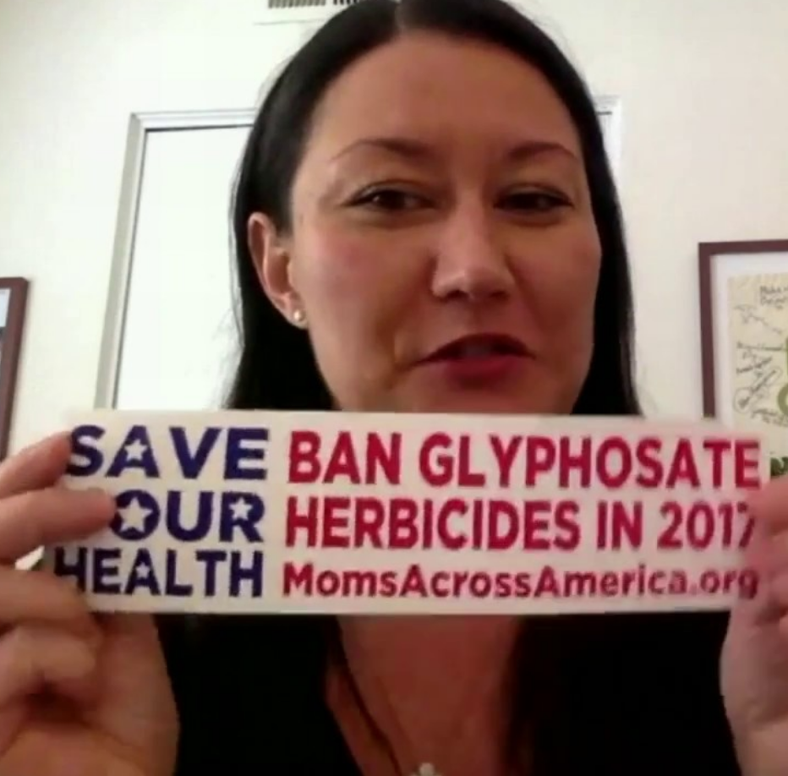
Zen Honeycutt

Slide 102
Tony Mitra
Notes:
Maneka Gandhi is a self-described environmentalist and animal rights leader in India

Slide 103
Tony Mitra
“I am an Indian-born Canadian citizen, holding an overseas citizen of India status. I am a retired engineer and a food security activist currently visiting India. I have reason to suspect India might be getting mass poisoned through man made toxins in food, water and environment. This has the potential to simultaneously collapse India's healthcare system and agriculture, unless the danger signs are taken note of and corrective measures implemented immediately.”
Notes:
Maneka Gandhi is a self-described environmentalist and animal rights leader in India

Slide 104
Article in Newspaper in India
Notes:
It is heartbreaking to see how this toxic, dangerous and unnecessary technology can strong arm its way into every facet of a supposedly democratic system and pollute its science, regulatory mechanism, academia, media, and the widest imaginable swath of political process, leaving virtually no clear avenue for the people to correct this wholesale chemical attack on society and an assault on nature.

Slide 105
Tony Mitra speaking to crowds of Indian Farmers and Villagers
Villagers in Bankura, West Bengal, Inda.
North Dinajpur in Northern Bengal, India.
Notes:
TonyMitraIndia.pdf .

Slide 106
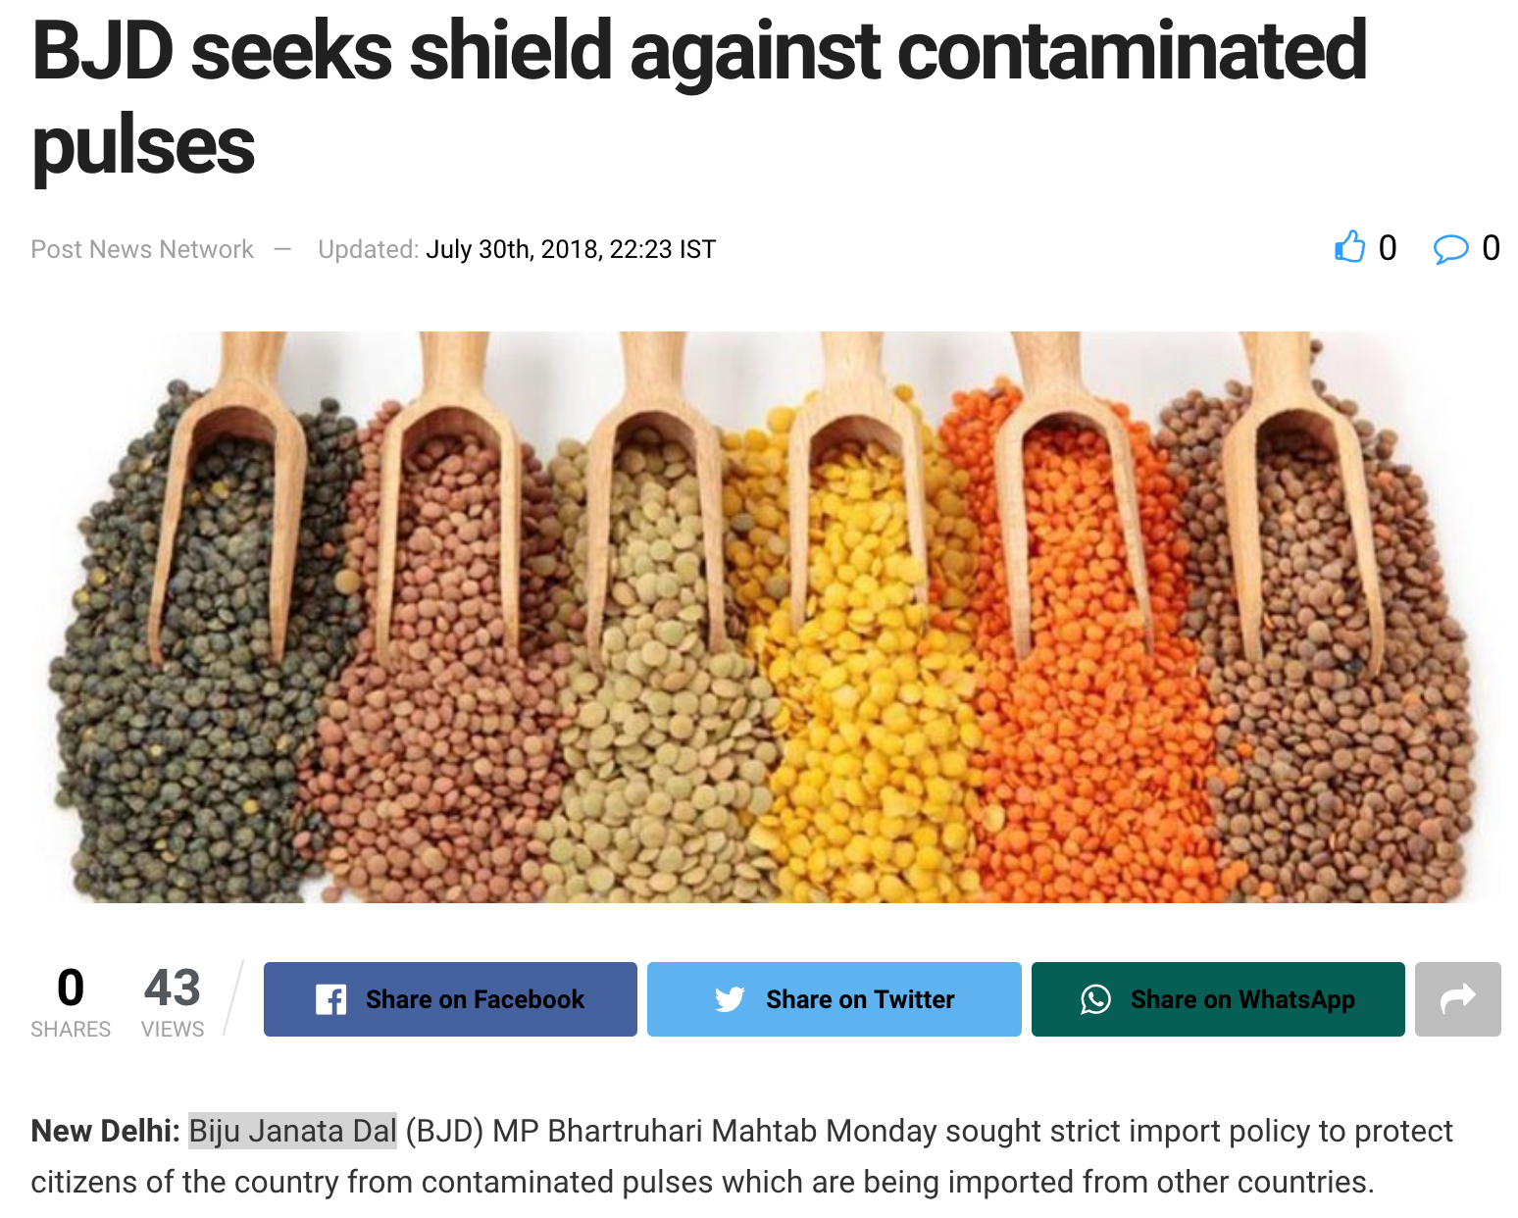
http://www.orissapost.com/bjd-seeks-shield-against-contaminated-pulses/
Notes:
Tony Mitra influence in India.
http://www.orissapost.com/bjd-seeks-shield-against-contaminated-pulses/
The Biju Janata Dal (BJD) is a state political party of the Indian state of Odisha led by Naveen Patnaik,

Slide 107
Local Activism*
*https://theintercept.com/2018/09/15/oregon-pesticides-aerial-spray-ban/
Notes:
Lincoln County aerial spray ban, which passed in May 2017,
Lincoln County Community Rights
Oregon coast
./ragtag_group.pdf
https://theintercept.com/2018/09/15/oregon-pesticides-aerial-spray-ban/

Slide 108
Regenerative Agriculture*
The Goal: Improving soil health
The more plants that grow, the better the soil
Use adaptive high stock density grazing, the way the bison did it
*https://joyce-farms.com/blogs/news/
joyce-farms-regenerative-agriculture-program-an-introduction
Notes:
Regenerativeagriculture.pdf
fretz.karen <fretz.karen@gmail.com>
Mention Dan Kittredge

Slide 109
Regenerative Agriculture*
"Regenerative agriculture is a phenomenal system that has always been here, activated by the sunshine and the rain. It not only restores our land in terms of biodiversity and soil health, but also produces incredibly nutrient dense, vibrantly flavored food."
The Goal: Improving soil health
The more plants that grow, the better the soil
Use adaptive high stock density grazing, the way the bison did it
*https://joyce-farms.com/blogs/news/
joyce-farms-regenerative-agriculture-program-an-introduction
Notes:
Regenerativeagriculture.pdf
fretz.karen <fretz.karen@gmail.com>

Slide 110
Dirt to Soil*
Gabe Brown inherited a 5,000 acre farm from his father-in-law that grew wheat, oats and barley, conventionally
His crop failed due to drought for four straight years
He let it lie fallow and let the weeds grow
The soil improved dramatically: earthworms started to appear
He used less glyphosate to control weeds only because he couldn't afford it
He eventually converted it to a certified organic farm, with animals playing a central role
Profitable organic farm produces beef, lamb, eggs, broilers, pigs, honey, vegetables, fruit , corn, and wheat.
*Gabe Brown. Dirt to Soil. Chelsea green Oct. 11, 2018.
Notes:
Csail/2018/Books/DirtToSoi_eGalley.pdf
./DirtToSoil.text

Slide 111
Dirt to Soil*
Gabe Brown inherited a 5,000 acre farm from his father-in-law that grew wheat, oats and barley, conventionally
His crop failed due to drought for four straight years
He let it lie fallow and let the weeds grow
The soil improved dramatically: earthworms started to appear
He used less glyphosate to control weeds only because he couldn't afford it
He eventually converted it to a certified organic farm, with animals playing a central role
Profitable organic farm produces beef, lamb, eggs, broilers, pigs, honey, vegetables, fruit , corn, and wheat.
*Gabe Brown. Dirt to Soil. Chelsea green Oct. 11, 2018.
Notes:
Csail/2018/Books/DirtToSoi_eGalley.pdf
./DirtToSoil.text

Slide 112
Five Principles of Agriculture*
Limit mechanical, chemical, and physical disturbance of the soil
Tillage diminishes complex mycorrhizal fungi networks
Maintain Armor on the soil surface
Grow a high-carbon cover crop
Build Diversity
A six-species blend yields 2 to 3 times as much biomass as a single-species cover crop
Keep Living Roots in the Soil
It is critically important to have as many roots in the soil as long as possible throughout the year.
Practice Animal Integration
A plant that has been grazed will photosynthesize more and pump much more liquid carbon into the soil
*Gabe Brown. Dirt to Soil. Chelsea green Oct. 11, 2018.
Notes:
Csail/2018/Books/DirtToSoi_eGalley.pdf
./DirtToSoil.text

Slide 113
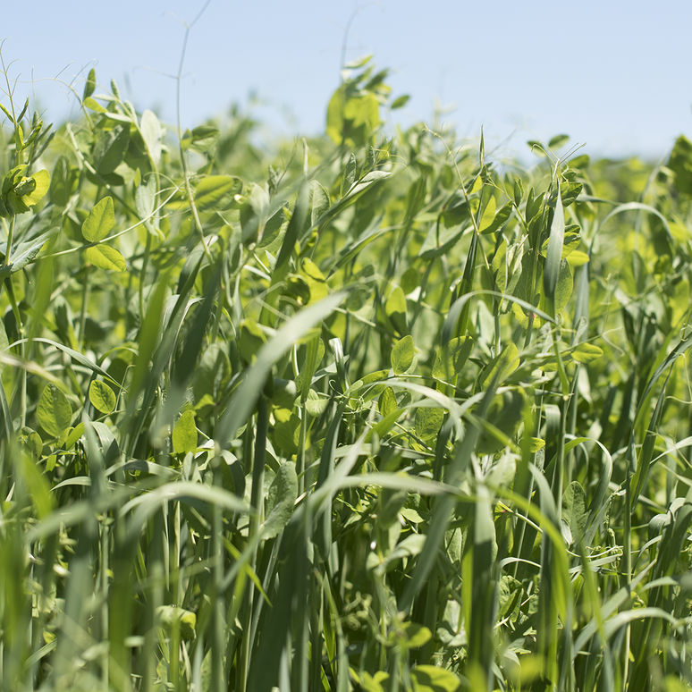
Management of Soil Mulch in Weed Suppression and Sugarcane Productivity*
Growing a cover crop during the off season:
Increases macro and micronutrients
Increases organic matter
Increases nitrogen availability
Suppresses weeds
Mashing the cover crop down ("mechanical topple") results in improved crop yield (sugar cane) 60 days after planting, compared to using glyphosate to kill the cover crop
*DCO de Cerqueira et al. Journal of Agricultural Science2018; 10(8): 125-132.
Notes:
ManagementofSoilMulch.pdf .
Crop_cover.text
legumes

Slide 114
How to Stay Healthy
in a Toxic World

Slide 115
Go Organic!

Slide 116
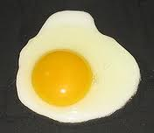
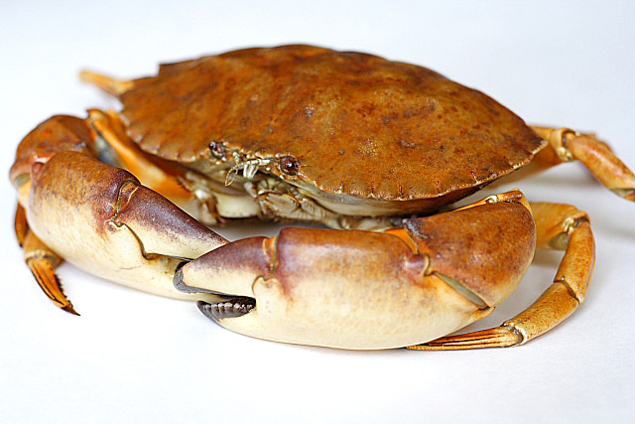
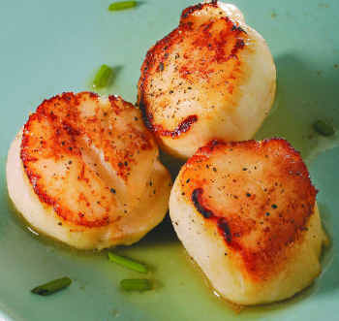
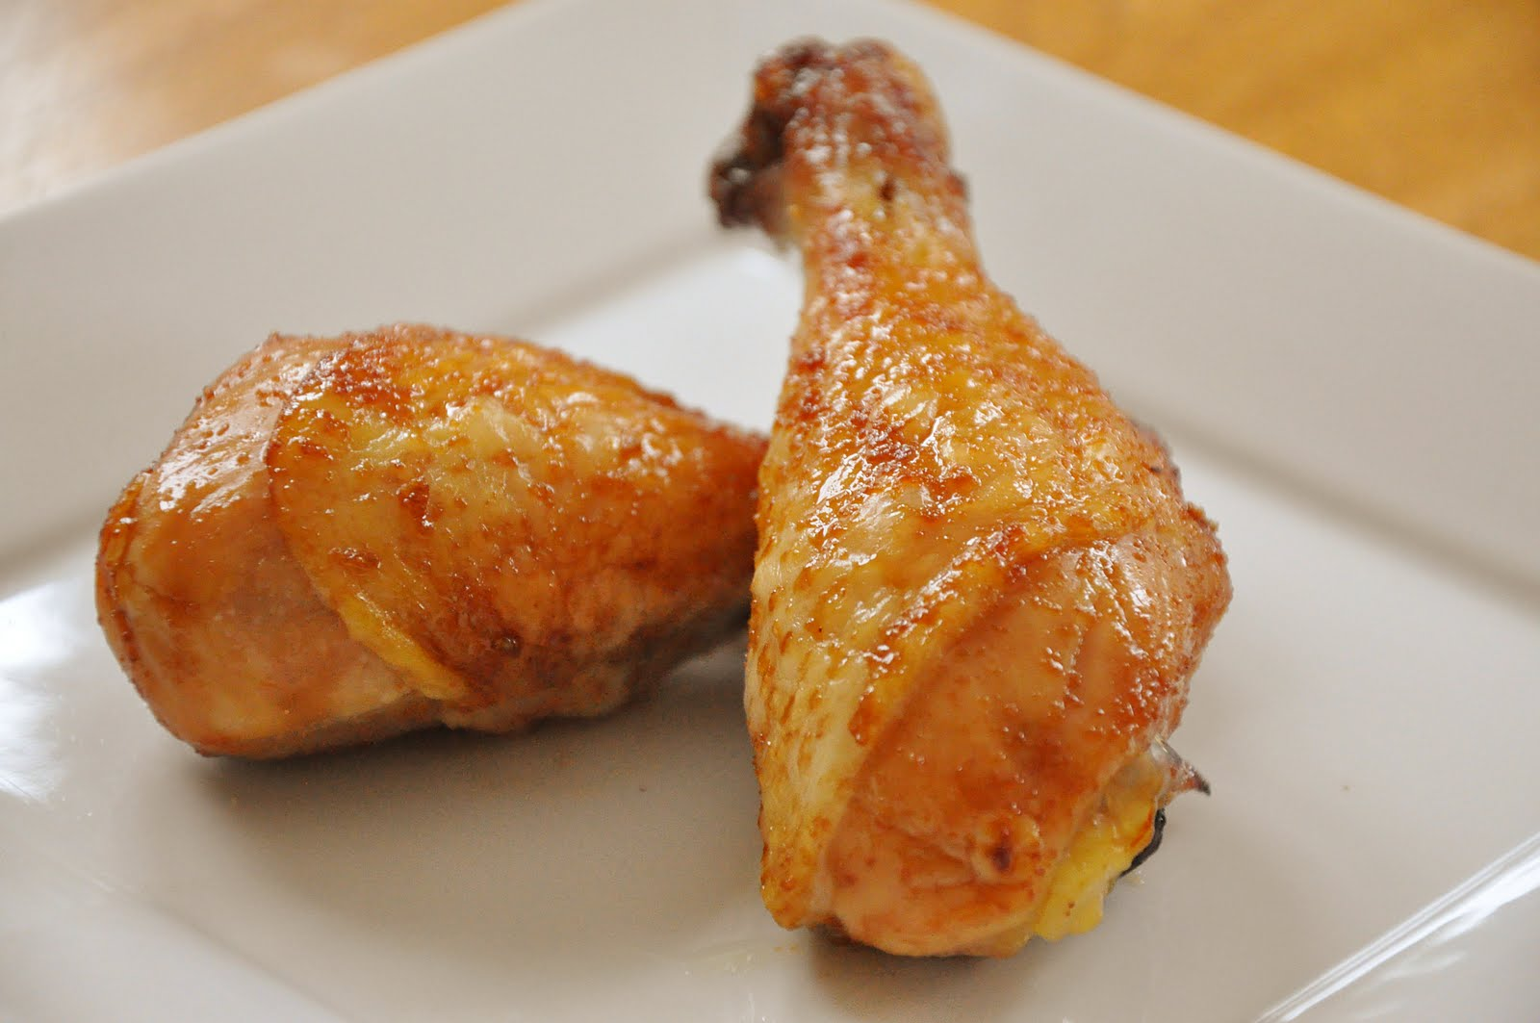
Eat Foods Containing Sulfur
Notes:
http://healthyeatingclub.com/info/books-phds/books/foodfacts/html/data/data5g.html

Slide 117
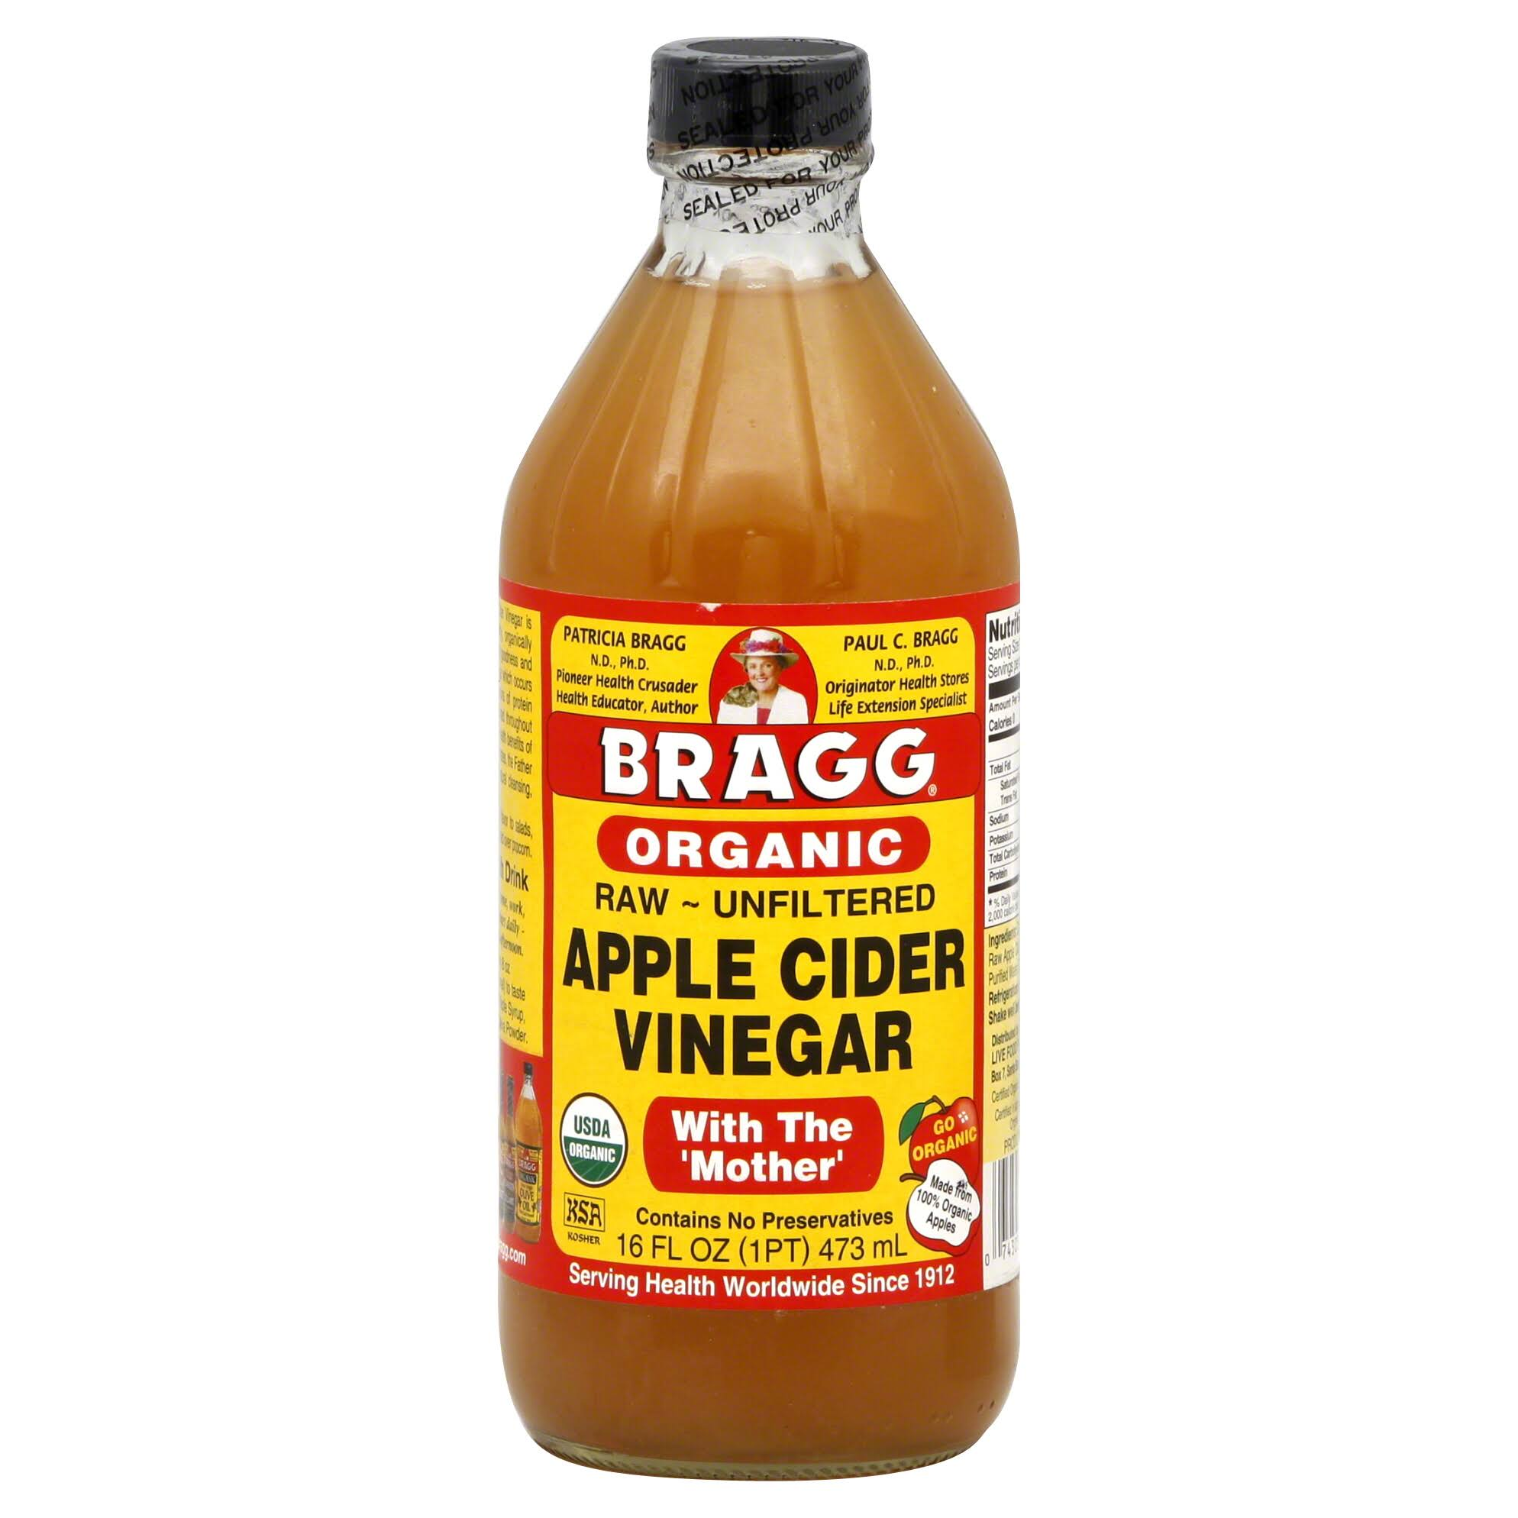
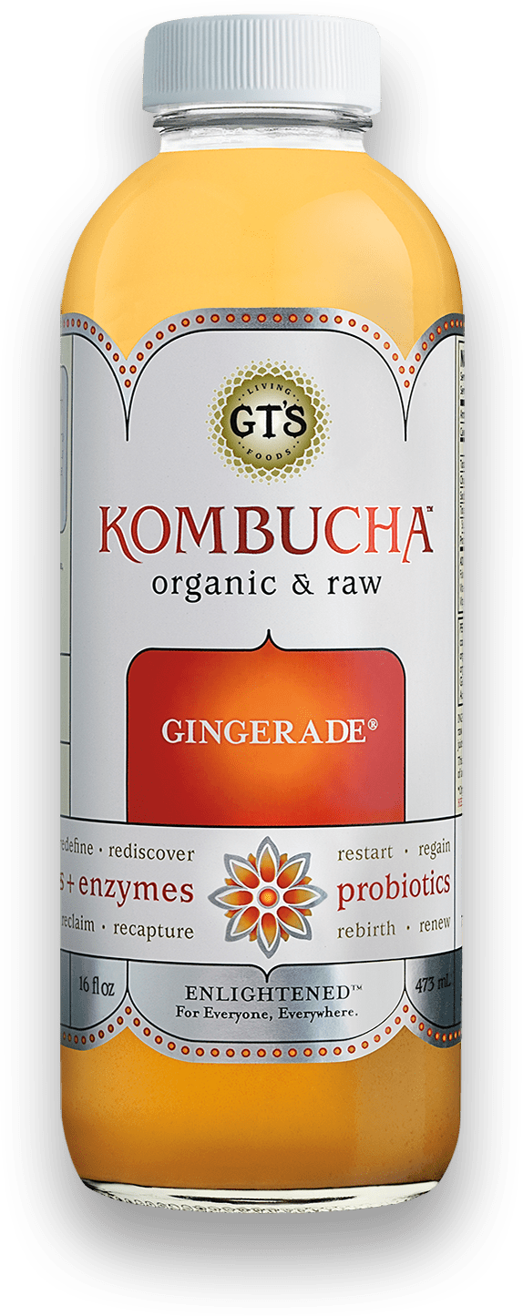
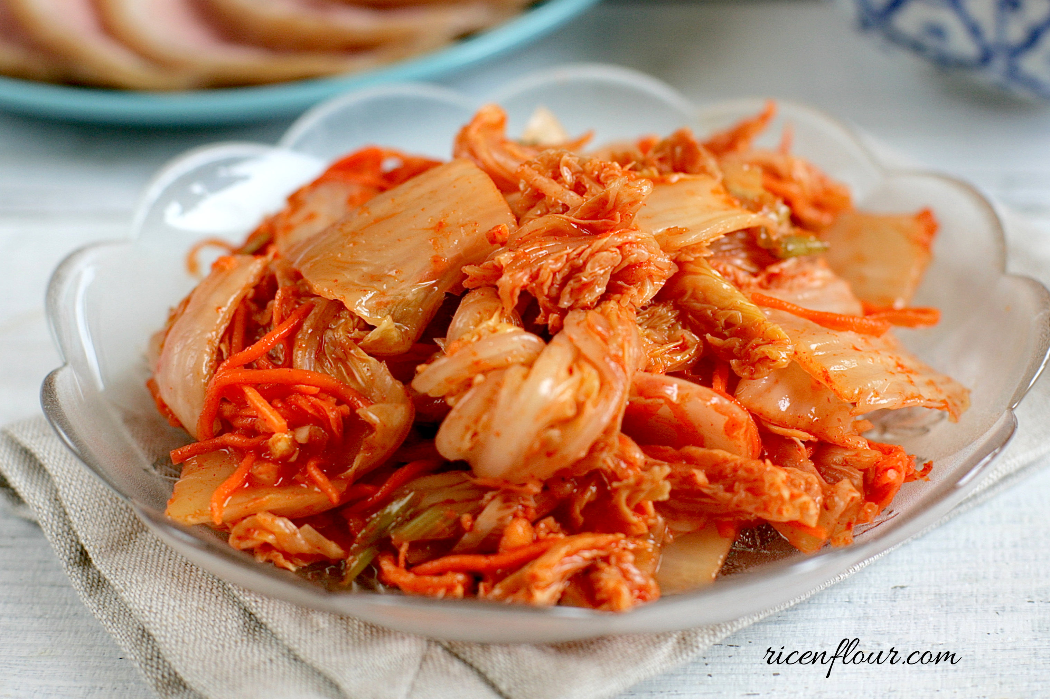
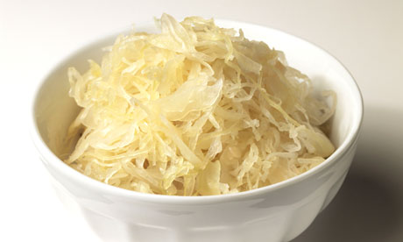
Eat Natural Probiotic Foods
Sauerkraut and apple cider vinegar contain acetobacter, one of the very few microbes that can metabolize glyphosate
Kombucha and kimchi do too!

Slide 118
Kefir: Natural Probiotics*
Kefir is a fermented milk product originating in the Caucasus mountains centuries ago
Can be made from milk from cows, sheep and goats
Slightly sour and carbonated
One of the most potent probiotic foods available
*https://chriskresser.com/kefir-the-not-quite-paleo-superfood/

Slide 119
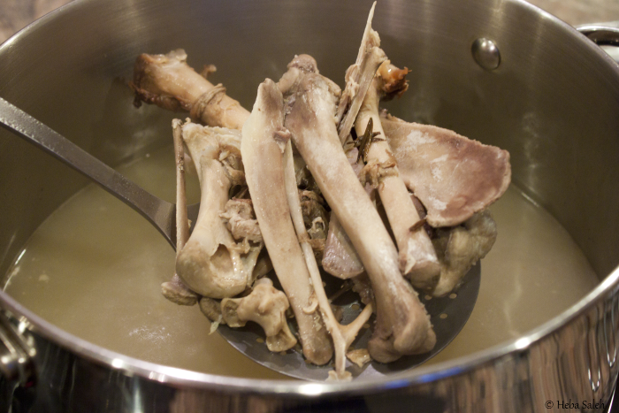
Making Bone Broth a Staple in Your Diet May Be the Key to Improving Your Health*
*articles.mercola.com/sites/articles/archive/2014/09/21/
hilary-boynton-mary-brackett-gaps-cookbook-interview.aspx
Notes:
./MercolaOnBoneBroth.pdf
http://articles.mercola.com/sites/articles/archive/2014/09/21/hilary-boynton-mary-brackett-gaps-cookbook-interview.aspx

Slide 120
Beneficial Effects of the Amino Acid Glycine*
Glycine is a precursor to heme synthesis and supplies methyl groups to methyl folate
Glycine is one of the amino acids in glutathione
Glycine is an inhibitory neurotransmitter at the GABA receptor and an excitatory neurotransmitter at the NMDA receptor
Glycine is one of the 20 or so coding amino acids assembled into proteins
Glyphosate's disruption of glycine-dependent metabolic pathways may necessitate increased demand for glycine
*I Pérez-Torres et atl. Mini-Reviews in Medicinal Chemistry 2017;17(1):15-32.
Notes:
./glycine.text
./BeneficialEffectsoftheAminoAcidGlycinePaperIsrael.pdf

Slide 121
"Combinations of these supplements can reduce significantly the fatigue and other symptoms associated with chronic disease and can naturally restore mitochondrial function, even in long-term patients with intractable fatigue."
L-carnitine
α-lipoic acid
coenzyme Q10
membrane phospholipids
nicotinamide adenine dinucleotide (NADH)
*GL Nicholson. Integrative Medicine 2014;13(4):35-43.
Notes:
mitochondrial_dysfunction_nutritional_supplements.pdf

Slide 122
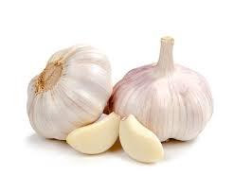
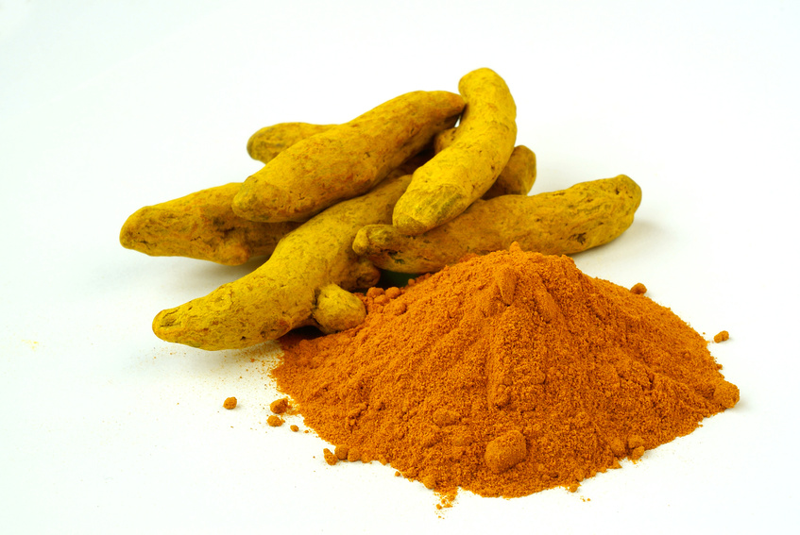
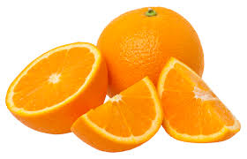
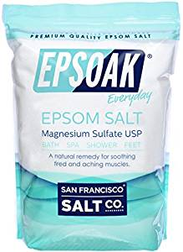
Some Other Important Nutrients
Curcumin
Garlic
Vitamin C
Methyl tetrahydrofolate
Cobalamin
Glutathione
Taurine
Epsom salt baths

Slide 123
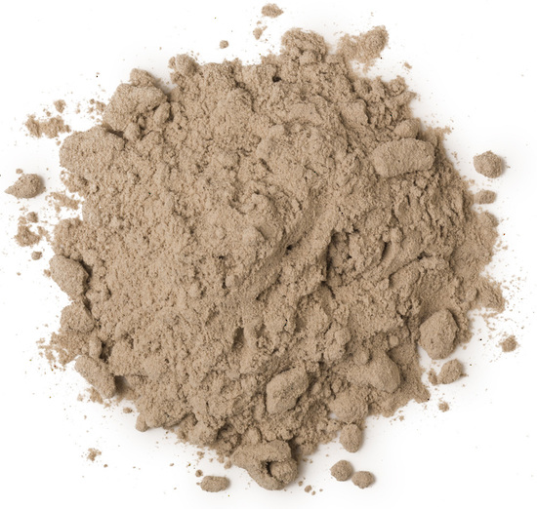
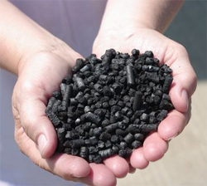
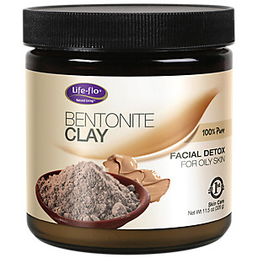
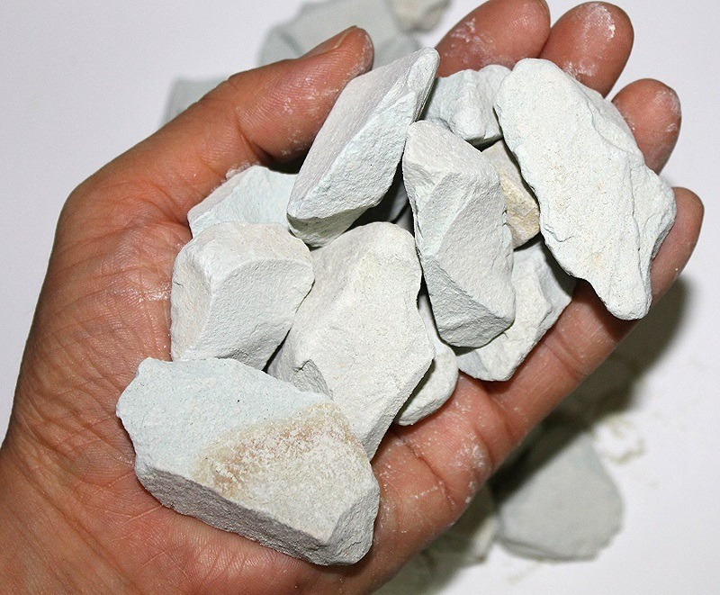
Biochar, Bentonite and Zeolite to maintain healthy microbial distribution in poultry*
*TP Prasai et al. PLoS ONE 11(4): e0154061.
Notes:
Moore\ et\ al\ 2016\ Biochar,\ bentonite\ and\ zeolite\ supplemented\ feeding\ for\ layer\ chickens\ alters\ intestional\ microbiota.pdf .
Reduce need for antibiotics
Redistribute gut microbes

Slide 124
Anecdotal Evidence of Benefits of Fulvic Acid*
"In the last year I have become increasingly sick with ataxia, balance problems, muscle weakness, numbness in the hands and feet and a 'foggy' brain
… To cut a long story short, Jim suggested Fulvic Acid as a detox.
At 10 days the effects started to 'kick in' and by 14 days it was as if a fog had been lifted from my brain. My muscle weakness has gone, I can walk for 2 hours and I can swim in the sea."
"It is a miracle."
*Shared by Nico DaVinci, personal communication concerning a patient
Notes:
Check with Nico DaVinci before showing this
THIS IS ROSEMARY MASON – she is getting a cholinesterase test.
See: RosemaryMason_story.text
Testimony_fulvic_acid.text

Slide 125
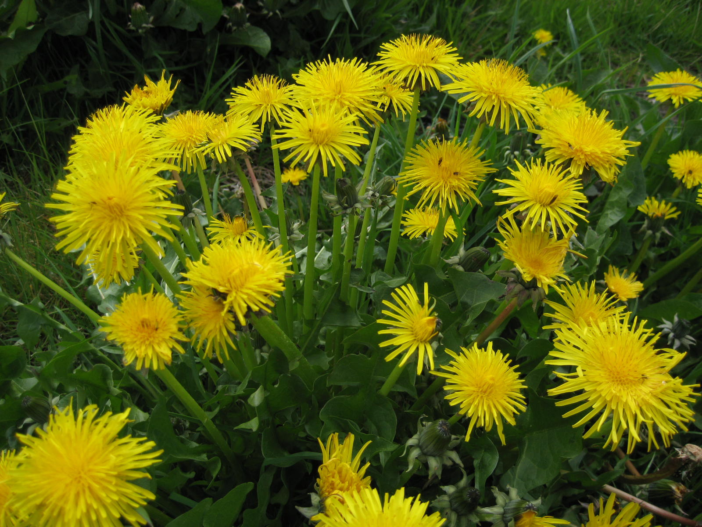
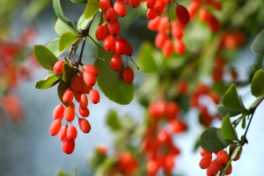
Extracts from Common Plants Can Treat Glyphosate Poisoning*
Roundup is toxic to hepatic and embryonic cells at doses far below those used in agriculture and at residue levels present in some GM food.
Extracts from common plants such as dandelions, barberry, and burdock can protect from damage, especially if administered prior to exposure.
*C Gasnier et al. Journal of Occupational Medicine and Toxicology 2011, 6:3

Slide 126
Waterfalls are Therapeutic!*
Waterfalls produce inhalable, negatively charged nano-water particles known as “Lenard ions” or ballo-electric ions
“Conclusions: Our study provides new data, which strongly support an “added value” of exposure to waterfall microclimate when combined with a therapeutic sojourn at high altitude including regular physical activity.”
*C Grafetstätter et al. Physiol Anthropol. 2017; 36: 10.
Notes:
waterfalls_are_therapeutic.pdf

Slide 127
Conclusions
We are at a crossroads where we can choose to get sicker and sicker while destroying the ecosystem, or we can choose to drastically change our agricultural methods towards renewable organic solutions
Grass roots bottom-up activities will institute a dramatic shift in food choices towards nutrient-dense organic whole foods instead of chemical-contaminated impoverished processed foods
A market-driven economy will force farmers to switch to organic methods if they want to sell their crops to informed and health-conscious consumers
This will lead to a dramatic reduction in health care costs and a vast improvement in the health of the population as a whole, of the nation, and of the earth

