Slide 1
Download These Slides
http://people.csail.mit.edu/seneff/ 2018/Toronto_vaccines.pptx

Slide 2
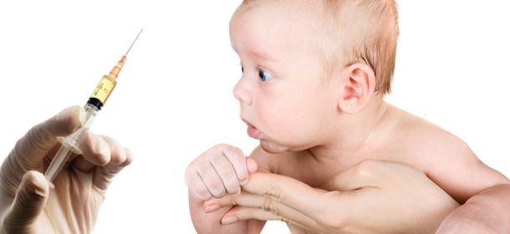
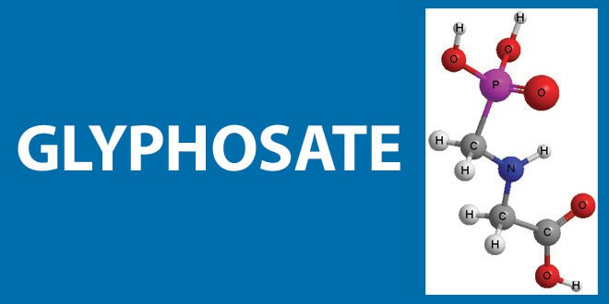
Vaccines and Glyphosate: A Toxic Combination
Stephanie Seneff
Toronto, Canada
March 27, 2018

Slide 3
"The great doctors of the world know the medical theory of immunization and contagious diseases is as false as false can be. But they dare not speak out; and as long as the practice makes money for those who sponsor it, and people can be persuaded to believe in it, there will be no change.”
Prof. Hilton Hotema, 1970.

Slide 5
Outline
Introduction
MMR and glyphosate
Aluminum in vaccines
Gardasil and autoimmune disease
Solutions

Slide 6
Introduction

Slide 7
The Big Picture
Vaccine benefits are over-rated
Vaccine damage is vastly underestimated
Those who should protect us are in collusion with the industry and serve to profit off of vaccines
Vaccines drive the immune system towards antibody-based immunity that leads to autoimmune disease

Slide 8
Source: J.B. Handley, with permission
Notes:
Images/fullyvaccinated.jpg
https://medium.com/@jbhandley/dr-peter-hotez-asked-me-for-an-apology-and-a-retraction-about-his-vaccine-profits-cab1e05106c5#.8u8b0saa0

Slide 9
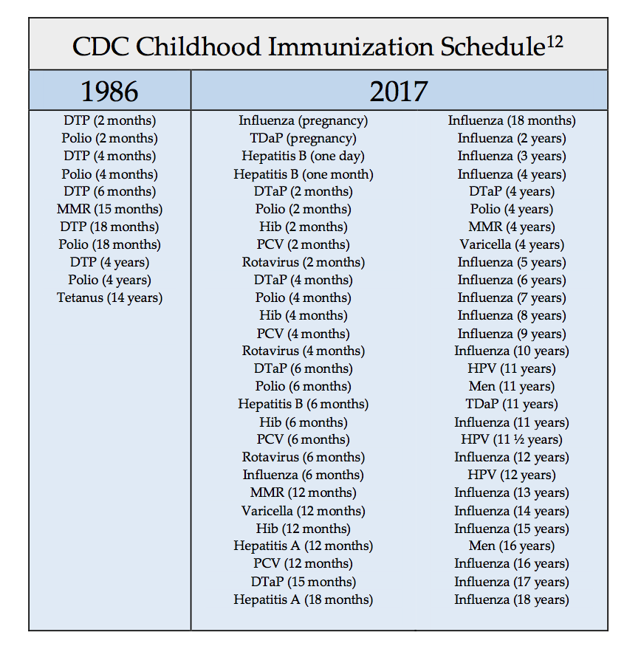
http://www.phrma.org/press-release/medicines-in-development-vaccines

Slide 10
“How is disinterested vaccine safety governance even remotely possible when HHS employees stand as heroes at the head of the parade when a new vaccine is invented within its walls, while agency leaders are leading the cheering section, approving the new product’s launch, making the market for the product with its policy recommendations, and then turning around to cash multimillion-dollar checks?”
Mark Blaxill, A LICENSE TO KILL?
Chapter 19 in VACCINE EPIDEMIC, Louise Kuo Habakus, MA and Mary Holland, JD, Editors
Notes:
Csail/2014/project/Blaxill/gardasillicensetokill.pdf
Department of Health and Human Services

Slide 11
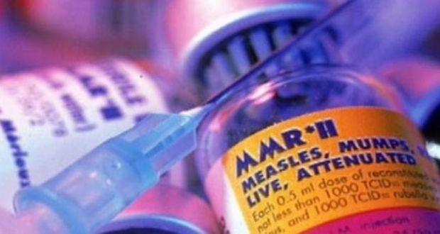
The “Pro-Vax” Message is Not Working*
“Conclusions:
None of the pro- vaccine messages created by public health authorities increased intent to vaccinate with MMR among a nationally representative sample of parents who have children age 17 years or younger at home.”
*B Nyhan et al. Pediatrics 2014;133(4): e835-e842.
Notes:
ProVax_message_not_working_2017.pdf

Slide 12
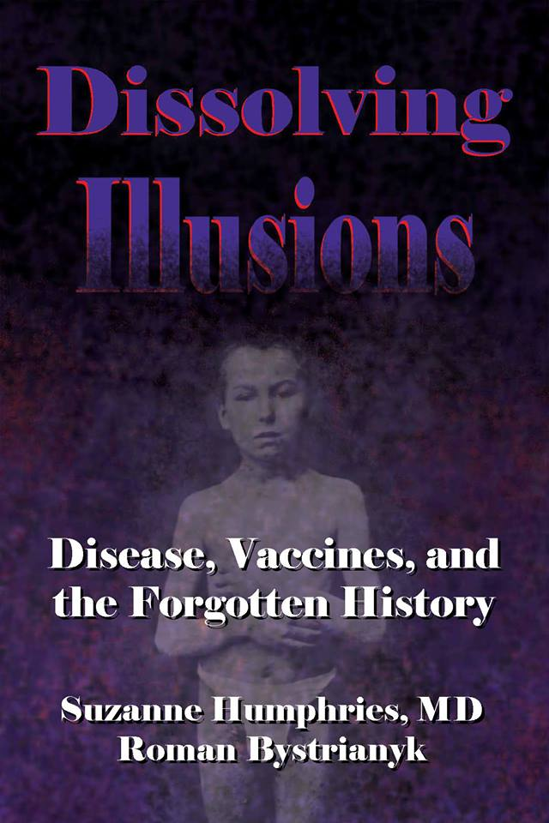
Dr. Suzanne Humphries
Dissolving Illusions

Slide 13
Vaccines are Falsely Credited with Saving Lives Due to Protection from Common Infections
Measles
Whooping Cough

Slide 14
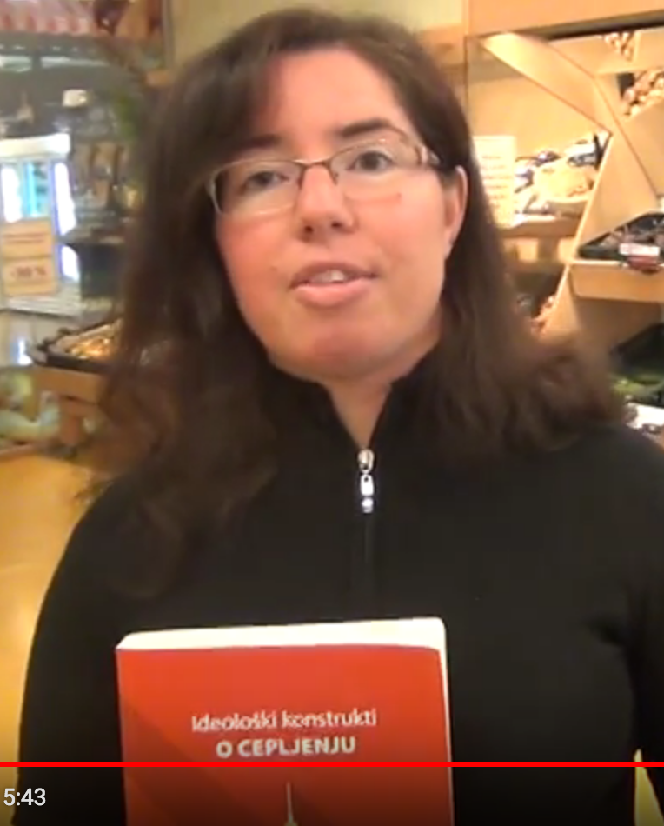
Dr. Mateja Černič

Slide 15
Vaccine Induced Immune Overload*
Mercury, aluminum, formaldehyde, MSG, neomycin, gentamycin, streptomycin, polymyxin B, polyethylene glycol, squalene, killed and/or live viruses, viral contaminants, etc.
→ Type 1 and type 2 diabetes, NASH, autism, asthma, food allergies, thyroiditis, vasculitis and autoimmune rheumatic diseases like lupus, rheumatoid arthritis, psoriasis and metabolic syndrome.
*Classen JB, J Mol Genet Med 2014, S1:025
Notes:
samantha/vaccine-induced-immune-overload.pdf
./vaccine_overload.pdf
http://www.thepeoplesvoice.org/TPV3/Voices.php/2014/06/16/vaccine-induced-immune-overload-and-the-

Slide 16
All Vaccines are Immune Suppressing*
"All vaccines are immune suppressing—that’s just a fact of life. Foreign proteins, toxic chemicals, foreign DNA from animal tissues, and viruses in vaccines permanently alter the body’s immune response, suppressing immunity and creating the opportunity for infection, cancer, brain damage, and autoimmune diseases.”
“Contrast this harm to the few measurable benefits provided by vaccinations and you have to wonder why something so dangerous is allowed on the market, and why parents allow their children to be vaccinated.”
--Raymond Francis
* http://raymondfrancisauthor.com/immune-suppression-and-vaccines/
Notes:
./vaccines_and_weakened_immunity_many_references.text

Slide 17
"Influenza: marketing vaccine by marketing disease"*
“Even the ideal influenza vaccine, matched perfectly to circulating strains of wild influenza and capable of stopping all influenza viruses, can only deal with a small part of the ‘flu’ problem …
Every year, hundreds of thousands of respiratory specimens are tested across the US. Of those tested, on average 16% are found to be influenza positive.“
*Peter Doshi. BMJ 2013; 346:f3037
Notes:
http://www.bmj.com/content/346/bmj.f303
http://www.robertscottbell.com/government/flu-outbreak-across-america-really-by-jon-rappoport/

Slide 18
“Increase in Vaccine-Related Shoulder Injuries”*
Pain develops within 24 hours of vaccination
Flu vaccine is especially significant because it is repeated year after year
Vaccine is administered too high on the shoulder
Pain persists over time and can be debilitating
Issues develop with rotator cuff because of an autoimmune reaction to toxic substances in the vaccine
*articles.mercola.com/sites/articles/archive/2017/12/12/vaccine-shoulder-injuries.aspx

Slide 19
"The most commonly compensated injury in the US National Vaccine Injury Compensation Program is Guillain-Barré Syndrome occurring after the flu shot. GBS is an autoimmune reaction in which the body attacks itself causing paralysis.”
-- Andre Angelantoni. Sep 30, 2017.
https://medium.com/@andreangelantoni/there-are-several-significant-errors-the-doctor-includes-in-her-article-6dfc196afd9b
Notes:
./flu_after_flu_shot_WOW.text

Slide 20
Example Papers Showing Vaccine Ineffectiveness
MMR vaccine decreased immune cell response to Candida (yeast)*
Flu vaccine increased risk to "flu-like" disease by factor of 1.6.**
Children in Hong Kong receiving flu vaccine had 4.4-fold increased risk to non-influenza flu-like infections over the following year***
*TP Maner et al., J Infect Dis. 1975 Jul;132(1):75-8.
**A Dierig et al. Influenza and Other Respiratory Viruses 2014;8(3): 293-301.
***BJ Cowling et al. Clin Infect Dis 2012; 54(12): 1778-1783.
Notes:
./vaccines_and_weakened_immunity_many_references.text

Slide 21
DPT vaccine in Guinea-Bissau, Africa caused 5-fold increase in mortality*
"All currently available evidence suggests that DTP vaccine may kill more children from other causes than it saves from diphtheria, tetanus or pertussis. Though a vaccine protects children against the target disease it may simultaneously increase susceptibility to unrelated infections.”
*S.W. Mogensen et al. EBioMedicine 17 (2017) 192–198
Notes:
DPT_increased_mortality_africa.pdf
3-5 months old
1980’s

Slide 22
Onset of some neuropsychiatric disorders may be temporally related to recent vaccination*
Hepatatis A vaccine linked to OCD and anorexia nervosa
Hepatitis B vaccine linked to anorexia
Meningitis vaccine linked to anorexia and chronic tic disorder
Any vaccine in previous 3 months strongly linked to anorexia
*DL Leslie et al. Front. Psychiatry, 19 January 19, 2017; 8:3.
Notes:
./temporal_association_neuropsychiatric_disorders_vaccines.pdf

Slide 23
Recapitulation
Agencies in charge of health safety hold lucrative vaccine patents
Vaccines weaken the general immunity and increase the risk to autoimmune disease
Flu vaccine works poorly to prevent flu, and most flu-like diseases are not caused by the flu virus
Flu vaccine holds serious risk to paralyzing Guillain-Barré Syndrome
Vaccines can cause severe injury to the rotator cuff if incorrectly administered
DPT vaccine administered in Africa increased infant mortality five-fold due to other causes
Vaccines are associated with anorexia and tic disorders
Multiple recent books provide clear evidence that vaccination risk/benefit ratios are misrepresented by governments

Slide 24
MMR and Glyphosate

Slide 25
Some Adverse Reactions of MMR*
“A shortened version of the vaccine damage associated with the MMR vaccine includes vomiting, diarrhea, anaphylaxis, ear pain, nerve deafness, diabetes, arthritis, myalgia, encephalitis, febrile seizures, pneumonia, and death.”
*https://vactruth.com/2016/06/23/japanese-government-bans-mmr-vaccine/
http://www.merck.com/product/usa/pi_circulars/m/mmr_ii/mmr_ii_pi.pdf
http://www.merck.com/product/usa/pi_circulars…pdf
Notes:
./JapanesegovernmentCautiousVaccines.pdf

Slide 26
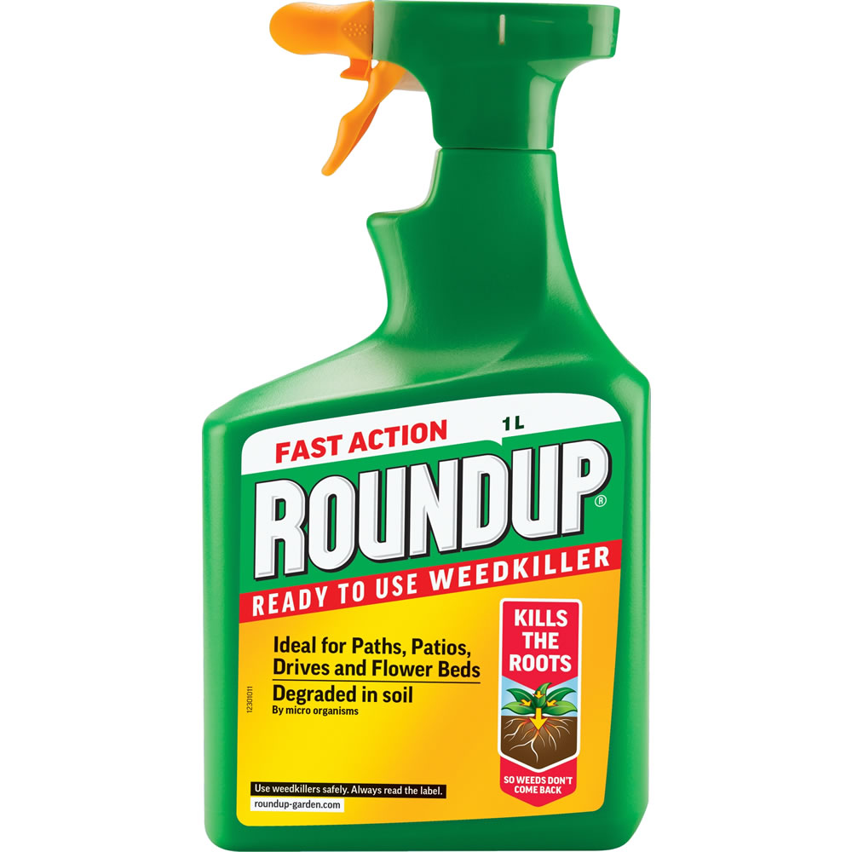
Autism, Glyphosate, Vaccine Reactions*
Glyphosate application to corn and soy, US
Children with Autism, US
# Adverse Reactions in VAERS
*Collaboration with Nancy Swanson
Notes:
Individuals with Disabilities Education Act

Slide 27
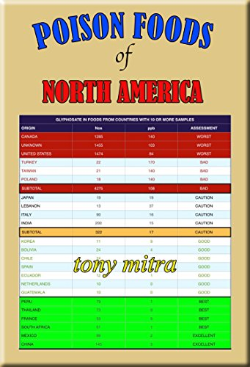
Glyphosate is Pervasive in Our Food Supply!

Slide 28
*A Samsel and S Seneff, Journal of Biological Physics and Chemistry 2017;17:8-32.

Slide 29
“Most disturbing is the presence of glyphosate in many popular vaccines including the measles, mumps and rubella (MMR) vaccine, which we have verified here for the first time.”
*A Samsel and S Seneff, Journal of Biological Physics and Chemistry 2017;17:8-32.

Slide 30
Glyphosate Contamination in Vaccines (Parts Per Billion)*
Merck ZOSTAVAX 0.62 Shingles
Merck MMR-II 3.74 Measles, Mumps and Rubella
Merck VARIVAX 0.56 Varicella, Chicken Pox
MERCK PNEUMOVAX ND Pneumococcal 18
MERCK PROQUAD 0.66 Measles, Mumps, Rubella, Varicella
GSK ENERGIX-B 0.34 Heptatitis B
*A Samsel and S Seneff, Journal of Biological Physics and Chemistry 2017;17:8-32.

Slide 31
Glyphosate Contamination in Vaccines (Parts Per Billion)*
Merck ZOSTAVAX 0.62 Shingles
Merck MMR-II 3.74 Measles, Mumps and Rubella
Merck VARIVAX 0.56 Varicella, Chicken Pox
MERCK PNEUMOVAX ND Pneumococcal 18
MERCK PROQUAD 0.66 Measles, Mumps, Rubella, Varicella
GSK ENERGIX-B 0.34 Heptatitis B
Live measles virus is grown on gelatin which is sourced from the bones and ligaments of pigs and cows fed heavy doses of glyphosate in their feed
*A Samsel and S Seneff, Journal of Biological Physics and Chemistry 2017;17:8-32.

Slide 32
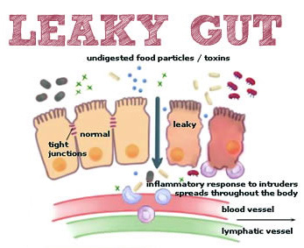
Notes:
Excellent article!!
./glyphosate_vaccines_autism.pdf
http://kinseimindbody.com/synergistic-destruction-how-vaccines-and-gmos-converge-to-fuel-autism-and-neurodegenerative-conditions/

Slide 33
Glyphosate and the Gut: Digestive Enzymes
Glyphosate has been found as a contaminant in digestive enzymes trypsin, pepsin and lipase*
Trypsin impairment prevents proteins like gluten in wheat from being digested
Undigested proteins induce release of zonulin which opens up gut barrier**
Zonulin lingers because trypsin is defective
*A Samsel and S Seneff. J Biol Phys Chem 2017;17:8-32
** JJ Gildea et al. J Clin Nutr Diet. 2017, 3:1.
Notes:
Glyphosate/ZachBushPaper_tight_junctions_glyphosate_2017.pdf

Slide 34
Dr. Andrew Wakefield
Lancet, 1998

Slide 35
“We have identified a chronic enterocolitis in children that may be related to neuropsychiatric dysfunction. In most cases, onset of symptoms was after measles, mumps, and rubella immunisation.
Further investigations are needed to examine this syndrome and its possible relation to this vaccine.”
Dr. Andrew Wakefield
Lancet, 1998

Slide 36
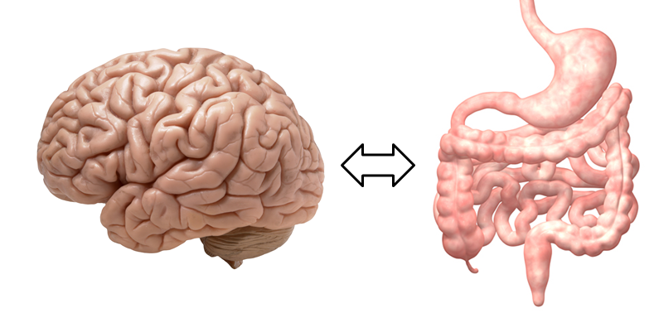
A Scenario
1. Child is vaccinated with MMR
2. Live measles virus infects gut
6. Zonulin induces leaky brain barrier
3. Measles haemagglutinin undigested
6. Measles virus infects brain
4. Induces leaky gut
7. Brain’s immune system produces antibodies
5. Measles virus
8. Autoantibodies attack myelin sheath
5. Zonulin

Slide 37
Measles Virus and Haemagglutinin*
The measles virus synthesizes the protein haemagglutinin
Antibodies to haemagglutinin are essential following MMR vaccination to induce immunity
Measles virus infects brain due to leaky barrier
Haemagglutin bears a sequence resemblance to myelin basic protein (MBP) → potential for autoimmune reaction
MBP is essential for the formation of the myelin sheath surrounding nerve fibers
Autoantibodies to MBP along with excessive levels of antibodies to measles haemagglutinin are linked to autism**
*Oldstone, MBA, Ed. Molecular mimicry: Infection inducing autoimmune disease.
Springer Berlin Heidelberg; January 9, 2006.
**VK Singh et al., J Biomed Sci 2002;9(4):359-64.

Slide 38
Autism and Measles Haemagglutinin*
125 autistic children and 92 control children
60% of the children with autism had high levels of antibodies to measles haemagglutinin specific to the MMR vaccine
90% of these had autoantibodies to myelin basic protein (MBP)
0% of the control children had high antibody titers to either haemagglutinin or MBP
There were no elevations in antibodies detected against any proteins in the mumps or rubella viruses
*VK Singh et al., J Biomed Sci 2002;9(4):359-64.

Slide 39
Recapitulation
Glyphosate usage, rate of adverse vaccine reactions and autism have all increased dramatically in step over past two decades
Dr. Andrew Wakefield identified in 1998 a link between chronic enterocolitis in children and autism following MMR vaccination
Glyphosate has been found as a contaminant in many vaccines with highest amounts by far in MMR
Glyphosate exposure to digestive enzymes causes impaired gluten metabolism and leaky gut syndrome, impairing BBB
A proposed model for MMR-induced autism involves molecular mimicry between measles haemagglutinin and myelin basic protein in the brain
Causes autoimmune attack on the myelin sheath
Experiment on 125 autistic children showed high titers of antibodies to myelin basic protein in the brain linked to MMR measles antigen

Slide 40
Aluminum in Vaccines

Slide 41
Cumulative aluminum exposure from childhood vaccines*
*Source: The vaccine manufacturers' product inserts and the CDC's 2016 vaccination schedule
Notes:
https://medium.com/@jbhandley/did-british-scientists-just-solve-the-autism-puzzle-5a7eacc77415

Slide 42
“Subcutaneous injections of aluminum at vaccine adjuvant levels activate innate immune genes in mouse brain that are homologous with biomarkers of autism”*
Study on mice exposed to aluminum hydroxide
Injected them with aluminum several times during early life, mimicking the US vaccination schedule
Predominantly in brain in males:
Activated several immune stimulating cytokines such as CCL2, interferon gamma and TNF alpha
Activated NF kappa B signaling pathway and release of chemokines Il-4 and IL-6.
This induces a neuroinflammatory response that is characteristic of autism in humans
Affected predominantly cerebral cortex in males and cerebellum in females
*D Li et al. Journal of Inorganic Biochemistry 2017;177: 39-5.

Slide 43
“Aluminum hydroxide nanoparticles show a stronger vaccine adjuvant activity than traditional aluminum hydroxide microparticles”*
Aluminum hydroxide is commonly used as an adjuvant in vaccines
Aluminum hydroxide microparticles only weakly potentiate antibody response
Special processing can produce tiny aluminum nanoparticles under 200 nanometers in diameter
These are much more effective in stimulating an immune response and they induce a smaller inflammatory response at the injection site
Plausible explanation is that they are easier for the macrophages to take up, along with the bound antigen
*X Li et al. J Control Release. 2014; 173: 148-157.
Notes:
Aluminum/aluminum_nanoparticles_more_effective_vaccines.pdf

Slide 44
“Aluminum hydroxide nanoparticles show a stronger vaccine adjuvant activity than traditional aluminum hydroxide microparticles”*
Aluminum hydroxide is commonly used as an adjuvant in vaccines
Aluminum hydroxide microparticles only weakly potentiate antibody response
Special processing can produce tiny aluminum nanoparticles under 200 nanometers in diameter
These are much more effective in stimulating an immune response and they induce a smaller inflammatory response at the injection site
Plausible explanation is that they are easier for the macrophages to take up, along with the bound antigen
There is a big problem with this strategy because the macrophages clear the aluminum from the injection site, but they can carry it as stealth cargo into the brain.
*X Li et al. J Control Release. 2014; 173: 148-157.
Notes:
Aluminum/aluminum_nanoparticles_more_effective_vaccines.pdf

Slide 45
“Non-linear dose-response of aluminium hydroxide adjuvant particles: Selective low dose neurotoxicity”*
Alhydrogel is the main adjuvant licensed for human and animal vaccines (aluminum hydroxide gel)
"We conclude that Alhydrogel1 injected at low dose in mouse muscle may selectively induce long-term Al cerebral accumulation and neurotoxic effects."
Lowest dose contained exclusively small agglomerates the size of bacteria, favoring capture by macrophages
Immune cells transport the aluminum to the blood, the spleen and the brain
"The dose makes the poison" view is overly simplistic
*G Crépeaux et al. Toxicology 2017;375:48-57.
Notes:
Aluminum/Crepeaux_aluminum_hydroxide_neurotoxity_2016.pdf

Slide 46
“Remarkably, the study found that the lowest dosage (200 mcg/Kg) was the most toxic! For many outcomes, the 400 and 800 mcg/Kg dosages had no observable adverse effects, but the 200 mcg/Kg dosage did.”
- J.B. Handley*
*November 27, 2017
https://medium.com/@jbhandley/new-study-massive-aluminum-levels-
in-autism-brains-is-this-the-smoking-gun-for-vaccines-54ae85ec2a9c
Notes:
Vaccines/Crepeaux_aluminum_hydroxide_neurotoxity_2016
https://medium.com/@jbhandley/new-study-massive-aluminum-levels-in-autism-brains-is-this-the-smoking-gun-for-vaccines-54ae85ec2a9c

Slide 47
“Thus alum and other poorly biodegradable materials taken up at the periphery by phagocytes circulate in the lymphatic and blood circulation and can enter the brain using a Trojan horse mechanism similar to that used by infectious particles.”

Slide 48
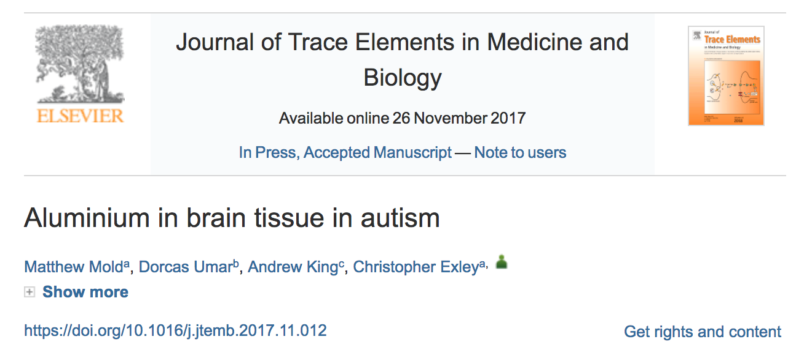
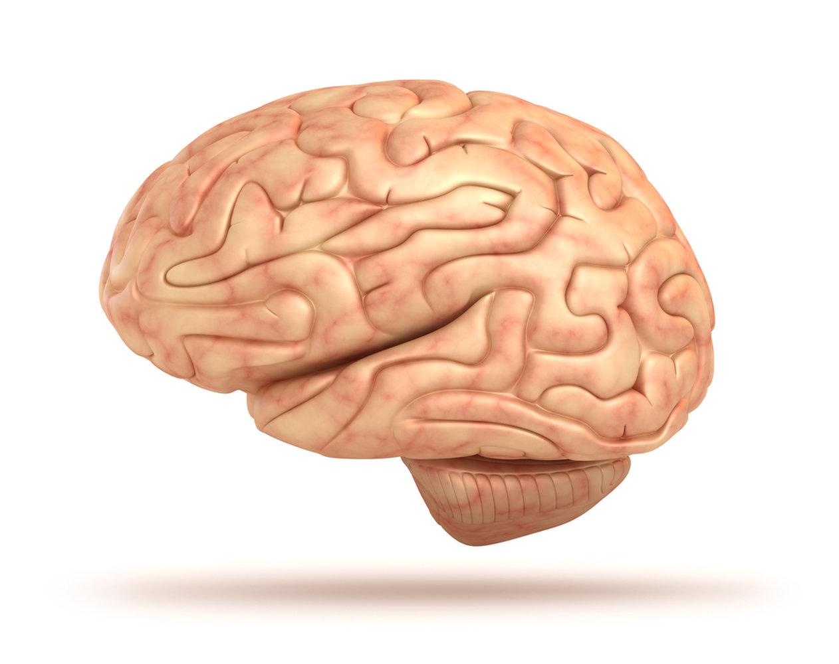
Samples taken from temporal, frontal, parietal and occipital lobes and hippocampus of 5 autistic brains, postmortem
Values of 17.10, 18.57 and 22.11 micrograms/gram dry weight: among highest ever seen
Hypothesis: aluminium entry into the brain via immune cells circulating in the blood and lymph is expedited in Autism Spectrum Disorder due to a leaky brain barrier
Notes:
./aluminum_In_autistic_brains_2017.text
Handley on this:
https://medium.com/@jbhandley/new-study-massive-aluminum-levels-in-autism-brains-is-this-the-smoking-gun-for-vaccines-54ae85ec2a9c
./aluminum_brain_autism.text
./Jon_Rappaport_on_aluminum_in_vaccines.text
Samantha/aluminum_in_brain_tissue_in_autism_2017_Exley.pdf

Slide 49
Potent 5 minute video: Prof. Chris Exley on aluminium in autism*
Some highlights:
The amount of aluminium found in autism brains was extraordinarily high**
They saw more aluminium than they'd seen in almost any other circumstance
Majority was intracellular aluminium within non-neuronal cell populations
Aluminium in vaccines is almost certainly playing a role in autism
The results changed his mind on this topic
Research was only possible because of philanthropy
*www.youtube.com/watch?v=SmkVv8pcVhc&feature=youtu.be
**M Mold et al. Journal of Trace Elements in Medicine and Biology 2018; 46: 76-82.
Notes:
./aluminum_In_autistic_brains_2017.text
Samantha/aluminum_in_brain_tissue_in_autism_2017_Exley.pdf
Handley on this:
https://medium.com/@jbhandley/new-study-massive-aluminum-levels-in-autism-brains-is-this-the-smoking-gun-for-vaccines-54ae85ec2a9c
./aluminum_brain_autism.text
./Jon_Rappaport_on_aluminum_in_vaccines.text
Samantha/aluminum_in_brain_tissue_in_autism_2017_Exley.pdf

Slide 50
Carried into the brain on the backs of immune cells!
*Source: vaccinepapers.org
Notes:
./Alzheimers_aluminum_brain_2017.pdf
https://medium.com/@jbhandley/new-study-massive-aluminum-levels-in-autism-brains-is-this-the-smoking-gun-for-vaccines-54ae85ec2a9c

Slide 51
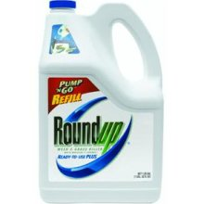
Glyphosate and Aluminum: Partners in Crime
Glyphosate induces pathogens like C. Difficile in gut, leading to leaky gut syndrome
C. diff produces p-cresol which promotes aluminum uptake by cells
p-Cresol is a known biomarker for autism
p-Cresol is an important factor in kidney failure which leads to aluminum retention in tissues → dementia
Glyphosate cages aluminum to promote entry
Glyphosate promotes calcium uptake by voltage-activated channels
Aluminum gains entry as calcium mimetic

Slide 52
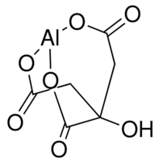
Aluminum Glyphosate*
Six different ways two glyphosate molecules can chelate aluminum
Similar model:
Aluminum citrate**
aluminum
*M. Purgel et al., Journal of Inorganic Biochemistry 103 (2009) 1426–1438
** P. Sianina et al., Clin. Chem. 32/3, 539-541, 1986.
Notes:
AnthonySamsel/swine/aluminum_glyphosate.pdf
aluminum_citrate_absorbs_well_vinegar_antacids.pdf
Csail/2013/project/Anthony/

Slide 53
Recapitulation
A child in the US is exposed to nearly 5000 micrograms of aluminum through vaccines in their first 18 months
Mouse exposure to injected aluminum mimicking US vaccination schedule activated many signaling cascades leading to neuroinflammatory response characteristic of autism
Aluminum nanoparticles designed to enhance vaccine response are picked up by immune cells and delivered to the brain
Low-dose aluminum hydroxide is more dangerous than higher doses because size resembles bacteria and fools immune cells
A recent study by Chris Exley found high levels of aluminum in autistic brains postmortem
He believes that aluminum in vaccines is causal in autism
Glyphosate works synergistically with aluminum in multiple ways

Slide 54
Gardasil (HPV Vaccine)

Slide 55
“In 2006, after only three to five years of clinical trials, the FDA approved for marketing the most expensive vaccine in the history of the world, Gardasil, which has been proclaimed as preventative for cancer of the cervix, a claim that was never proved and which has, to date, not prevented a single case of cervical cancer ... mainly because cancer of the cervix takes 20 to 50 years to develop.”
-- Gary G. Kohls, a retired medical doctor
in Duluth, Minnesota.
Notes:
http://www.duluthnewstribune.com/opinion/4068271-doctors-response-risks-costs-hpv-vaccine-far-outweigh-any-benefit

Slide 56
Only 2 out of 16 HPV vaccine trials used inert saline placebo
(all other “placebos” included aluminum adjuvant)
Aluminum adjuvant is the most likely cause of adverse reactions
2.3 per 100 women exposed to either the placebo or the vaccine developed a systemic autoimmune disorder
HPV vaccine was "fast-tracked" by FDA
Spanish post-marketing study found 10-fold higher incidence of adverse events with HPV compared to other vaccines.
http://healthimpactnews.com/2017/
study-gardasil-risks-hidden-by-vaccine-manufacturer-and-fda-regulators/
Notes:
http://healthimpactnews.com/2017/study-gardasil-risks-hidden-by-vaccine-manufacturer-and-fda-regulators/
BobbyKennedy_on_HPV.text

Slide 57
Are aluminum adjuvants plus Gardasil a uniquely damaging neuroinflammatory cocktail?*
Aluminum is routinely added to the "Placebo" which is completely unethical
New kind of aluminum adjuvants in Gardasil have more "reactogenicity"
Reformulated Gardasil-9 vaccine contains more than twice the amount of aluminum as its quadrivalent predecessor
Vaccine-induced antibodies bind not only the target foreign antigen but also host proteins (due to molecular mimicry)
*http://info.cmsri.org/the-driven-researcher-blog/
are-aluminum-adjuvants-plus-gardasil-a-uniquely-damaging-neuroinflammatory-cocktail
Notes:
Claire Dwoskin published July 28, 2016
./ClaireDwoskin_on_Gardasil.text

Slide 58
Are aluminum adjuvants plus Gardasil a uniquely damaging neuroinflammatory cocktail?*
Aluminum is routinely added to the "Placebo" which is completely unethical
New kind of aluminum adjuvants in Gardasil have more "reactogenicity"
Reformulated Gardasil-9 vaccine contains more than twice the amount of aluminum as its quadrivalent predecessor
Vaccine-induced antibodies bind not only the target foreign antigen but also host proteins (due to molecular mimicry)
“the number of viral matches and their locations make the occurrence of side autoimmune cross-reactions in the human host following HPV16-based vaccination almost unavoidable.”**
** D Kanduc, J Exp Ther Oncol. 2009;8(1):65-76.
Notes:
Kanduc_cross_reactivity.text
Claire Dwoskin published July 28, 2016
./ClaireDwoskin_on_Gardasil.text

Slide 59
*
Identified several short peptide sequences in HPV proteins contained in the vaccines that match sequences in known human proteins linked to systemic lupus erythematosus
Discuss multiple cases of adverse effects following HPV vaccine involving autoimmune diseases
*Y Segal et al., Current Opinion in Rheumatology 2017;29(4):331-342.

Slide 60
Gardasil and Mice*
Experiment on mice injected with Gardasil vaccine
Mice exhibit behaviors indicative of depression
Anti-HPV antibodies were found in the blood
Cross-reactivity induced antibodies targeting mouse brain protein (p < 0.002) and phospholipid extracts (p < 0.001)
Microglial activation in the hippocampus
Conclude:
Gardasil via its Al adjuvant and HPV antigens can trigger neuro-inflammation and autoimmune reactions leading to depression
*R. Inbar et al., Immunol Res. 2016. Published online 16 July, 2016.
Notes:
Vaccines/Lucija_Shaw_new_paper_Gardasil_autoimmune_brain_reaction_2016.pdf
./Gardasil_Lucija_notes.text

Slide 61
Gardasil Side Effects
700 girls in Colombia are currently in the middle of a major class action lawsuit against Merck Sharp & Dohme for damages caused by the Gardasil vaccine*
postural orthostatic tachycardia syndrome (POTS)
The Japanese government suspended recommendation for Gardasil after reports of severe side effects and a social media blitz**
Vaccination rates plummeted from 70% down to less than 1% within a short time period
*www.elheraldo.co/colombia/presuntas-victimas-de-la-vacuna
-contra-el-vph-anuncian-demanda-farmaceutica-389159
**https://www.tokyotimes.com/
side-effects-in-young-girls-take-gardasil-out-from-japanese-market/

Slide 62
Recapitulation
Gardasil is a controversial new "anti-cancer" vaccine that was rushed to market and has never been shown to actually work
Most Gardasil trials used the aluminum adjuvant in the "placebo"
Both treatment and control groups had high rates of autoimmune disease
HPV virus has several short peptide sequences that match lupus-related proteins
Aluminum nanoparticles in Gardasil greatly increase risk to autoimmune attack on host tissues through molecular mimicry
Gardasil induced depression-like behaviors in mice
Gardasil is linked to postural orthostatic tachycardia syndrome
Current lawsuit ongoing in Columbia
HPV vaccination rates plummeted after Japan suspended recommendations for Gardasil

Slide 63
Solutions

Slide 64
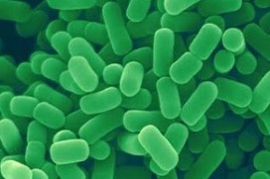
Lactobacillus plantarum probiotics have neuro- protective potential in aluminum exposure*
Aluminum administered to mice for 8 weeks via drinking water
Simultaneous L. plantarum administered over 14 weeks (beginning at the same time):
significantly improved memory deficits
reduced Al accumulation in brains
restored tight junction integrity
alleviated cerebral oxidative stress
decreased pro-inflammatory cytokines in brain
*L Yu et al. Journal of Functional Foods 2017;30:142-150.
Notes:
./probiotic_Lactobacillus_clears_aluminum_in_brain.text
http://www.sciencedirect.com/science/article/pii/S1756464616304406
Lactobacillus plantarum CCFM639 can prevent aluminium-induced neural injuries and abnormal behaviour in mice
samantha/lactobacillus_protect_aluminum_brain.text

Slide 65
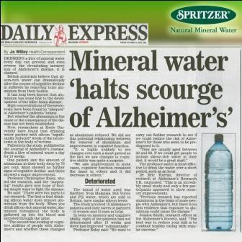
“Urinary Excretion of Aluminium and Silicon in Secondary Progressive Multiple Sclerosis”*
Secondary progressive multiple sclerosis (SPMS) is an autoimmune condition of unknown aetiology
15 people with SPMS were treated for 12 weeks with 1.5 L silicon-rich mineral water every day
Excreted on average 135 nmol/mmol at baseline
Increased to 349 nmol/mmol during treatment (p = 0.000003)
People with SPMS excrete high levels of aluminum in their urine
Silicon-rich mineral waters facilitate the remove of aluminum from the body
*K Jones et al. EBioMedicine. 2017 Nov 1. Epub ahead of print]
Notes:
Aluminum/urinary_excretion_aluminum_MS_Exley.pdf
https://realfarmacy.com/mineral-waters-remove-aluminum-from-brain/
./sliica_water_removes_aluminum.text

Slide 66
Kerri Rivera’s Protocol*
Her own son was diagnosed with autism following a vaccine in 2002
369 patients with autism lost the diagnosis following chlorine dioxide (CD) therapy**
CD is added to water supply as a disinfectant
Reduces inflammation and pathogen overgrowth (e.g., Candida)
Hyperbaric oxygen chamber; chelation therapy
Stop vaccinating
Diet:
Not just gluten-free, casein-free
Organic, ketogenic diet: coconut oil, olive oil
Very low sugar
*Interview with Sarah Westall. November 26, 2017.
https://www.youtube.com/watch?v=zmJiruNjiZ4&feature=youtu.be
**Now 385.
Notes:
https://www.youtube.com/watch?v=zmJiruNjiZ4&feature=youtu.be

Slide 67
Kerri Rivera, cont’d*
Jim Handle cured many autoimmune diseases with CD
Autism, no fever – indicator of broken immune system
CD therapy sometimes induces a fever – it’s a good sign
Trolls complain about toxicity, but Kerri has not seen any serious adverse reactions to CD
Many clinicians won’t use CD because of fear of losing their license
Autism is a good business model if you don’t solve the problem
Cognitive dissonance shakes your core
Facebook groups in many languages – testimonials
Her Book: Healing the Symptoms Known as Autism
Her web page: CDautism.com
*Interview with Sarah Westall. November 26, 2017.
https://www.youtube.com/watch?v=zmJiruNjiZ4&feature=youtu.be

Slide 68
Summary
The risk/benefit ratio for vaccines is not being honestly presented by media and governments
Aluminum commonly used as an adjuvant in vaccines is neurotoxic and is especially dangerous as small nanoparticles binding to antigen
Glyphosate is a contaminant in many vaccines, mostly live-virus vaccines and especially MMR
Glyphosate is working synergistically with the antigen to induce autoimmune attack on the myelin sheath in the brain
This can explain the link to autism
Gardasil represents a new dangerous class of vaccines causing debilitating disease among teenagers
Silicon-rich mineral water and probiotics can clear aluminum
Organic ketogenic diet, hyperbaric oxygen therapy and chlorine dioxide can help heal the gut and even in rare cases reverse autism

