Slide 1
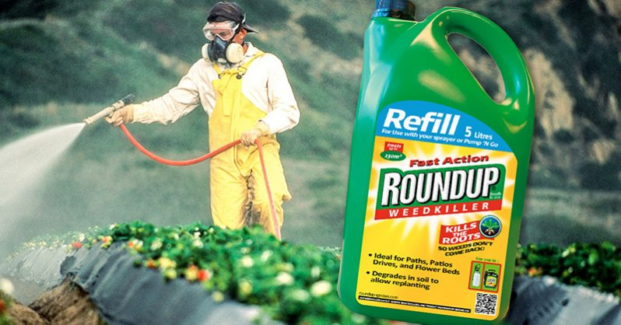
Glyphosate and Autism:
An Indisputable Link
and a Path Towards Healing
Stephanie Seneff
MIT CSAIL
AutismOne, May 2019

Slide 2
Outline
Introduction
Glyphosate as a Glycine Analogue
Glyphosate and the Gut
Glyphosate, Sulfate, Oxalate, Autism
Glyphosate and Vaccines
What You Can Do

Slide 3
Introduction

Slide 4
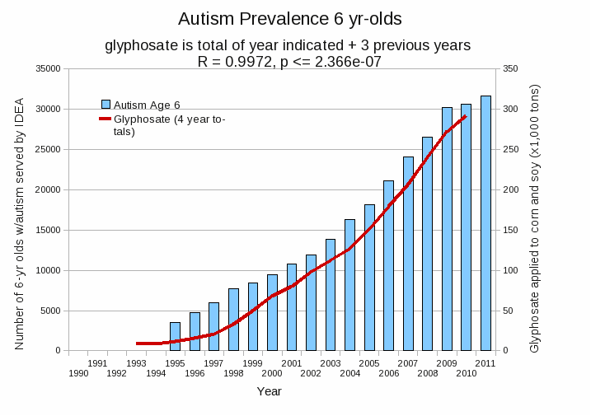
Autism Prevalence: 6 year olds*
R = 0.9972
* Figure 15, Seneff et al., Agricultural Sciences, 2015, 6, 42-70
Notes:
Nancy/latest_plots/6-yr-old autism.gif
autism: USDE
oil consumption: USDA
glyphosate: USDA
GE crops: USDA
Mortality data: CDC

Slide 5
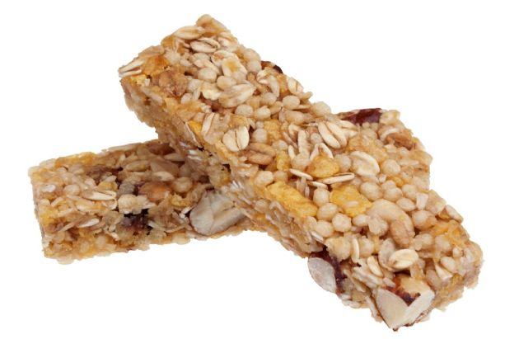
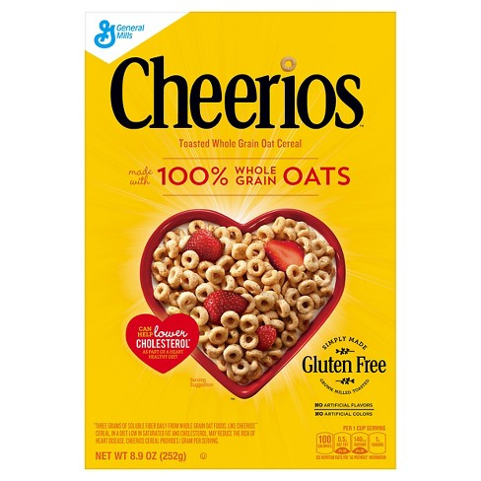
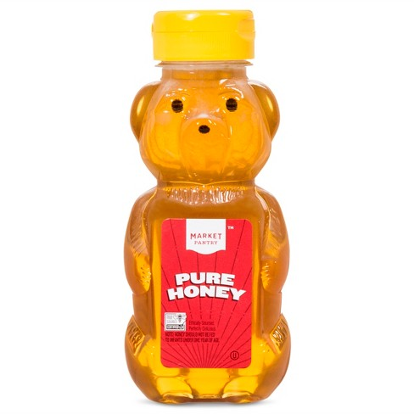
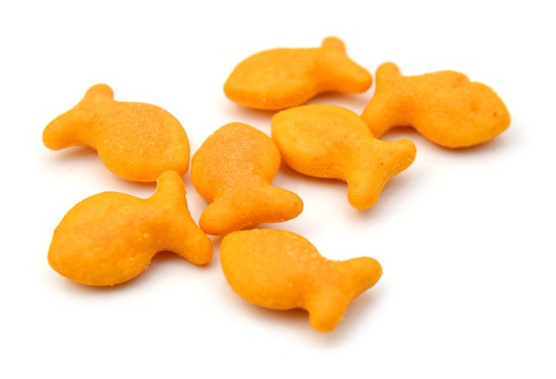
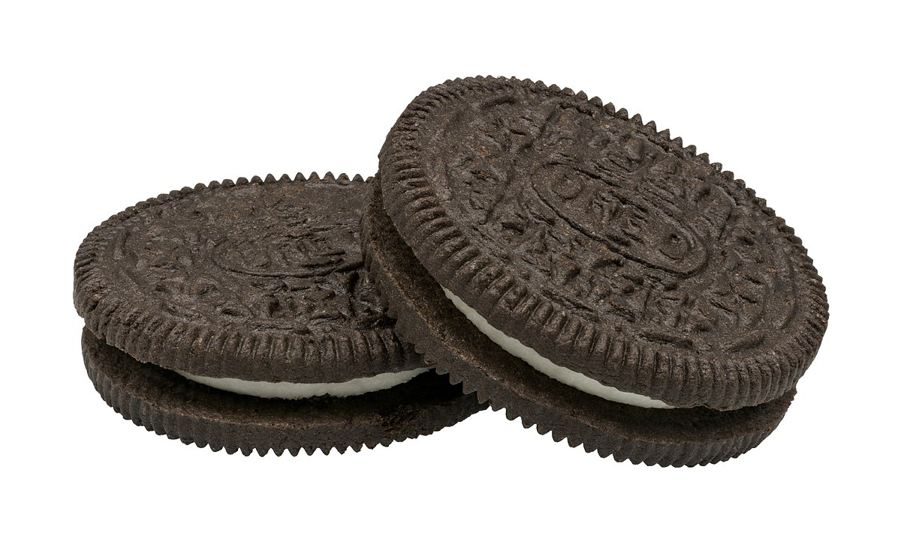
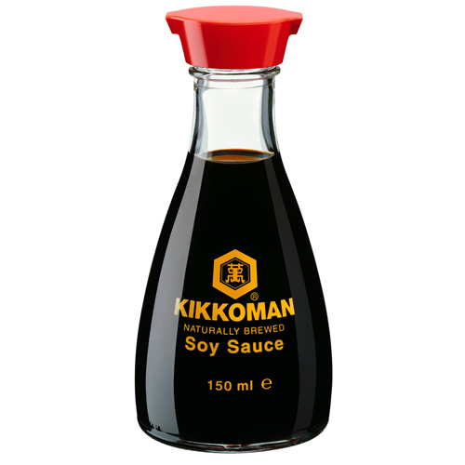
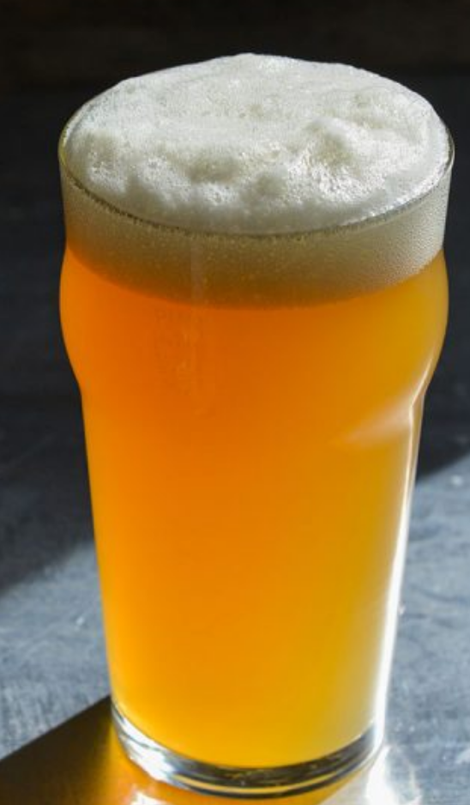
Some Foods Containing Glyphosate
Notes:
glyphosate_residues_in_honey_corn_soy_sauce_2014.pdf
Ten out of twenty eight (36%) soy sauce samples contained glyphosate at a concentration above the method LOQ (75 ng/mL) with a range between 88-564 ng /mL and a mean of 242 ng /mL

Slide 6
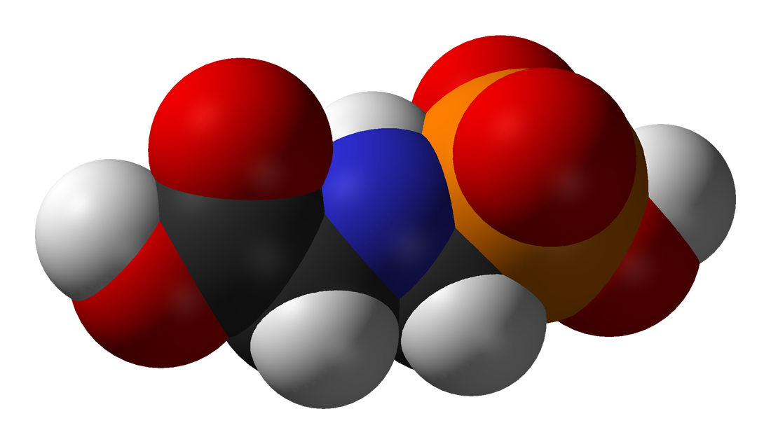
Is Glyphosate Toxic?
Monsanto has argued that glyphosate is harmless to humans because our cells don’t have the shikimate pathway, which it inhibits
However, our gut bacteria DO have this pathway
We depend upon them to supply us with essential amino acids (among many other things)
Other ingredients in Roundup greatly increase glyphosate’s toxic effects and are themselves toxic
Insidious effects of glyphosate accumulate over time
Most studies are too short to detect damage

Slide 7
Main Toxic Effects of Glyphosate*
Disrupts gut microbes leading to overgrowth of pathogens and inflammatory/leaky gut syndrome
Interferes with function of cytochrome P450 (CYP) enzymes
Chelates important minerals (iron, cobalt, manganese, etc.)
Interferes with synthesis of aromatic amino acids and methionine
Leads to shortages in critical neurotransmitters and folate
Disrupts sulfate synthesis and sulfate transport
Leads to disrupted bile flow and impaired fat digestion
*Samsel and Seneff, Entropy 2013, 15, 1416-1463

Slide 8
Glyphosate vs. Other Pesticides: Usage in the United States*
Glyphosate
*http://sustainablepulse.com/wp-content/uploads/GMO-health.pdf

Slide 9
Sobering Statistics on Glyphosate Residues*
Parts per trillion (ppt): increased proliferation of breast cancer cells in vitro
0.1 ppb:
Altered the gene function of over 4000 genes in the livers and kidneys of rats
Severe organ damage in rats
Permitted level for glyphosate and all other herbicides in EU tap water
10 ppb: demonstrated toxic effects on the livers of fish
700 ppb: Permitted level for glyphosate in U.S. tap water
11,900 ppb: found in Genetically Modified (GMO) soybeans
*http://detoxproject.org/glyphosate-in-numbers/

Slide 10
Some Biomarkers for Autism
Disrupted gut bacteria; inflammatory bowel
Low serum sulfate
Methionine deficiency
Serotonin and melatonin deficiency
Defective aromatase
Zinc and iron deficiency
Urinary p-cresol
Mitochondrial disorder
Glutamate toxicity in the brain
These can all be explained as potential effects of glyphosate on biological systems
Notes:
Samantha/zinc_deficiency_autism.text

Slide 11
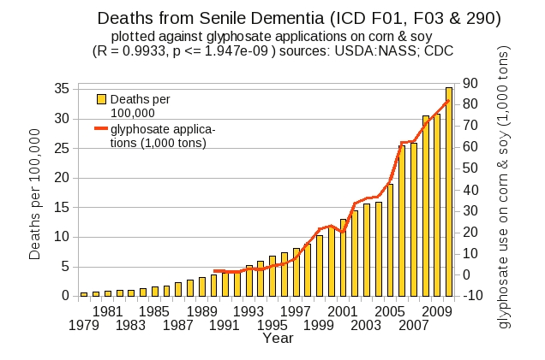
Dementia and Autism Have Much in Common
Plot kindly provided by Nancy Swanson

Slide 12
Glyphosate as a
Glycine Analogue

Slide 13
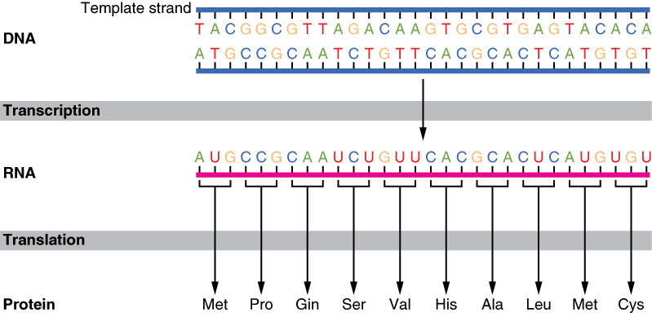
The Basics of Protein Synthesis
Glyphosate
Glycine

Slide 14
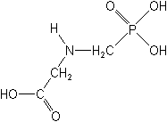
What if Glyphosate could Insert itself into Proteins during Synthesis???
glyphosate
Extra Stuff!
Code for Glycine
Glyphosate
GGC
Glycine
mRNA
. . .
. . .
Glyphosate
Alanine
Proline
-- Any proteins with conserved glycine residues are likely to be affected in a major way

Slide 15
Extra Piece Sticks Out at Active Site
Substrate no longer fits in active site
Active Site
Extra Stuff
Glyphosate
Alanine
Proline
glycine
Peptide chain

Slide 16
Extra Piece Sticks Out at Active Site
Substrate no longer fits in active site
This explains how glyphosate disrupts EPSPS in the shikimate pathway: Multiple bacteria have developed resistance by replacing active site glycine with alanine and this is the basis for GMO Roundup Ready crops*
Active Site
Extra Stuff
Glyphosate
Alanine
Proline
glycine
Peptide chain
*T Funke et al., Molecular basis for the herbicide resistance of Roundup Ready crops. PNAS 2006;103(35):13010-13015.

Slide 17
Inhibition of EPSPS by glyphosate: Resistant E coli mutant*
Mutant with alanine substituted for glycine 96
Wild type with glycine 96
*Figure 3, S Eschenburg et al. Planta 2002;216:129-135.

Slide 18
Only Glyphosate Works!*
“More than 1,000 analogs of glyphosate have been produced and tested for inhibition of EPSP synthase, but minor structural alterations typically resulted in dramatically reduced potency, and no compound superior to glyphosate was identified.”
Hypothesis:
These other molecules failed to work as an amino acid analogue of glycine, because they were not amino acids.
*T Funke et al. PNAS 2006; 103(35): 13010-13015.

Slide 19
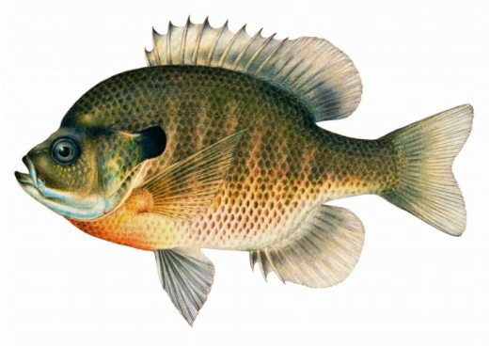
Quote from Monsanto Study (1989)*
Study exposed bluegill sunfish to carbon-14 radiolabelled glyphosate
Measured radiolabel in tissues greatly exceeded measured glyphosate levels
Proteolysis recovered more glyphosate
20% yield → 70% yield
"Proteinase K hydrolyses proteins to amino acids and small oligopeptides, suggesting that a significant portion of the 14C activity residing in the bluegill sunfish tissue was tightly associated with or incorporated into protein.”
*WP Ridley and KA Chott. Monsanto unpublished study. August, 1989.

Slide 20
Some Predicted Consequences*
Neural tube defects
Autism
Impaired collagen → osteoarthritis
Steatohepatitis (fatty liver disease)
Obesity and adrenal insufficiency
Hypothyroidism
Impaired iron homeostasis and kidney failure
Insulin resistance and diabetes
Cancer
*A. Samsel and S. Seneff. Journal of Biological Physics and Chemistry 2016;16:9-46.

Slide 21
Example 1: Myosin in the Gut
Myosin is a motor protein found in high levels in skeletal muscles
Myosin is also essential for gut motility (peristalsis) and for release of bile acids into upper intestine
Myosin contains a highly conserved glycine at position 699*
If this is changed to alanine, the protein’s contractile ability is reduced to less than 1%.
Glyphosate has been shown to suppress myosin**
SIBO (Small Intestinal Bacterial Overgrowth) is associated with impaired peristalsis***
*F Kinose et al. The Journal of Cell Biology 1996;134(4): 895-909.
**Ana Paula Rezende dos Santos et al., Chemosphere 2017;168:933e943.
***AC Dukowicz et al. Gastroenterol Hepatol (N Y) 2007; 3(2): 112-122.
Notes:
Glyphosate/chemosphere_2017_glyphosate_histomorpholgical_changes_liver_guppies.pdf
Anthony/scleroderma/glycine_699_pivotal_for_motor_activity_skeletal_myosin.pdf

Slide 22
Example 2: Glyphosate Disrupts Cytochrome P450 (CYP) Enzymes*
Glyphosate has been shown to severely suppress CYP enzymes in rat liver
CYP enzymes have a unique FXXGXRXCXG motif with two and sometimes three critical glycine residues**
CYP enzymes are needed to produce bile acids for digesting fats, to activate vitamin D and to detoxify many environmental toxicants
GLYCINES
*A Samsel and S Seneff. Entropy 2013; 15: 1416-1463.
**K Syed and SS Mashele. PLOS ONE 2014; 9(4):| e95616.

Slide 23
Example 3: Protein Phosphatase I and Autism
Glyphosate exposure to rat dams led to thyroid deficiency in pups*
Attributed to suppressed release of thyroid stimulating hormone (TSH) from the dam’s pituitary
Thyroid deficiency in mom during pregnancy predicts significant increased risk to autism in child**
Glyphosate link to impaired TSH due to disruption of protein phosphatase I***
*JS deSouza et al., Toxicology To Appear, 2017
**GC Román, Ann Neurol 2013;74(5):733-42.
***JE Beecham and S Seneff. Journal of Autism 2016;3:1.
Notes:
deSouza_glyphosate_suppresses_thyroid_stimulating_hormone_pituitary_2017.pdf
BeechamSeneff2_2016.pdf

Slide 24
Protein Phosphatase 1 Has Many Highly Conserved Glycines!*
Glycines!!
Protein Phosphatase I
*Figure 1, Y. Shi, Cell 2009;139: 468-484.
Notes:
serine_threonine_phosphatase_conserved_glycine_2009.pdf

Slide 25
Protein Phosphatase 1 Has Many Highly Conserved Glycines!*
Glycines!!
Protein Phosphatase I
PP1 also depends on manganese as a catalyst, which glyphosate chelates, making it unavailable
*Figure 1, Y. Shi, Cell 2009;139: 468-484.
Notes:
serine_threonine_phosphatase_conserved_glycine_2009.pdf

Slide 26
Glyphosate and the Gut

Slide 27
Autism and the Gut*
“Prospective, controlled studies suggest that as many as 70% of autistic children exhibit chronic GI-related symptoms [1,5,6] including diarrhea, laxative-dependent constipation, abdominal distension, failure to thrive, weight loss, feeding problems, and abdominal pain related to extreme irritability, aggression, and self-injury.”
*SJ Walker et al. PLOS One March 2013; 8(3):e58058.
Notes:
Walker_et_al_unique_gene_expression_profile_ASD_2013.pdf

Slide 28
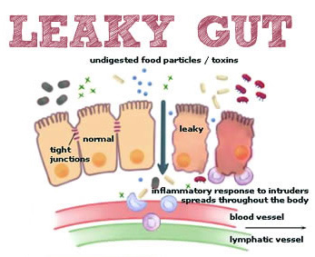
Notes:
Excellent article!!
./glyphosate_vaccines_autism.pdf
http://kinseimindbody.com/synergistic-destruction-how-vaccines-and-gmos-converge-to-fuel-autism-and-neurodegenerative-conditions/

Slide 29
Glyphosate and the Gut: Pathogen Overgrowth*
Glyphosate is an antimicrobial agent that preferentially kills beneficial microbes, allowing pathogens to flourish in the gut
Immune cells invade the gut and release inflammatory cytokines
This causes increased risk to inflammatory bowel diseases such as Crohn’s and ulcerative colitis
* Samsel and Seneff. Entropy 2013; 15: 1416-1463.

Slide 30
Pathogen Overgrowth in Poultry Microbes Exposed to Glyphosate*
Clostridia
Salmonella
Bifidobacteria
*Plot provided by Dr. Martin Michener
Notes:
From Marty Michener!
Sheehata paper.

Slide 31
Glyphosate and the Gut: Digestive Enzymes
Glyphosate has been found as a contaminant in digestive enzymes trypsin, pepsin and lipase*
Trypsin impairment prevents proteins like gluten in wheat from being digested
Undigested proteins induce release of zonulin which opens up gut barrier**
Zonulin lingers because trypsin is defective
*A Samsel and S Seneff. J Biol Phys Chem 2017;17:8-32
** JJ Gildea et al. J Clin Nutr Diet. 2017, 3:1.
Notes:
Glyphosate/ZachBushPaper_tight_junctions_glyphosate_2017.pdf

Slide 32
Trypsin, Pepsin and Lipase are all contaminated with glyphosate*
Enzyme | Glyphosate (PPB)
Pepsin (ELISA) | <40
Pepsin (GC-MS) | 430
Pepsin (HPLC-MSMS) | 290
Trypsin (ELISA) | 62
Lipase (ELISA) | 24
*A Samsel and S Seneff. Journal of Biological Physics and Chemistry 2017;17: 8-32

Slide 33
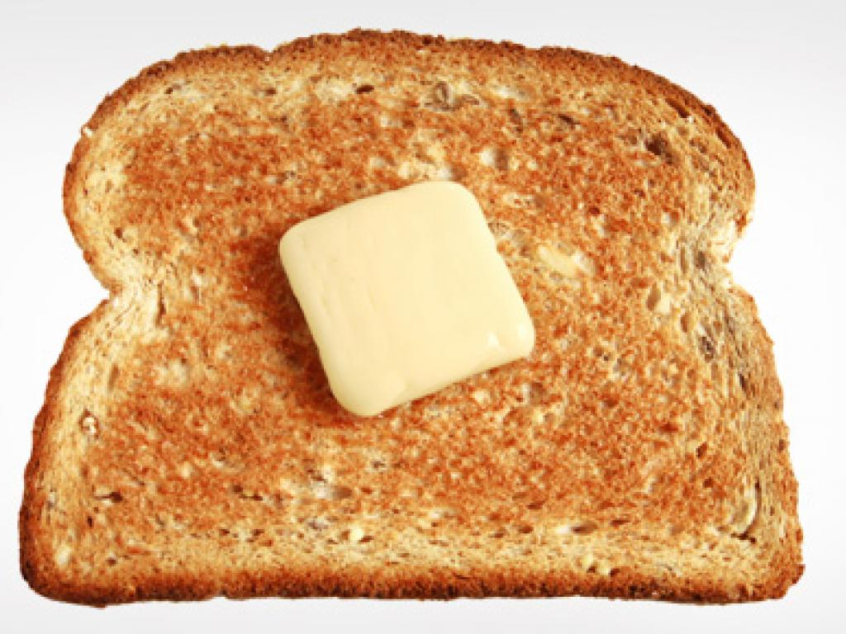
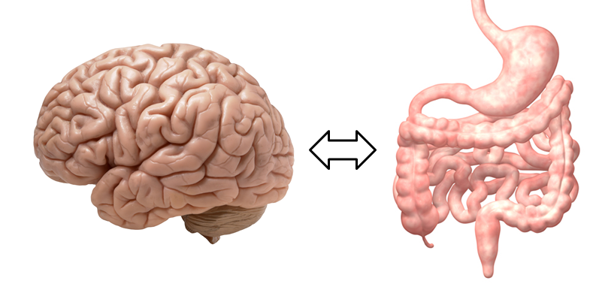
A Scenario for Gluten Intolerance
Glyphosate in wheat
Leaky brain barrier
Zonulin
Trypsin defective
Autoimmune
neurological
disease
Zonulin released
Gliadin
Leaky barrier
Systemic immune response induces multiple complex symptoms

Slide 34
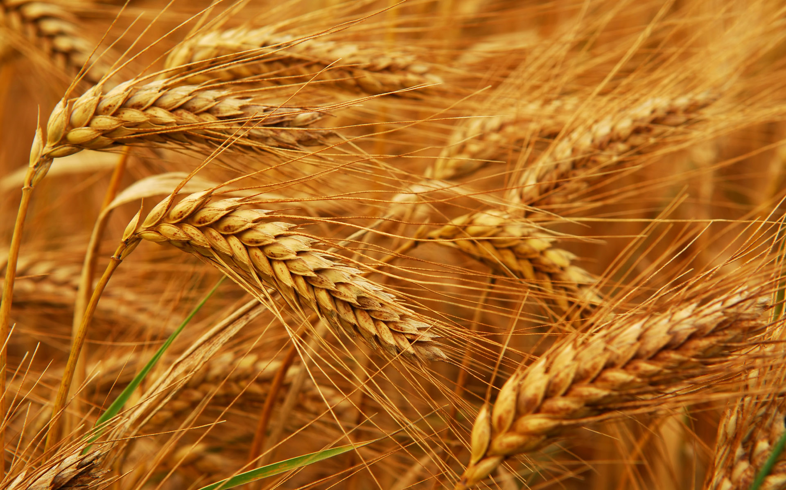
Glyphosate and Celiac Disease*
Glyphosate
Use on wheat
Celiac disease
*Samsel and Seneff, Interdiscip Toxicol. 2013;6(4): 159–184.

Slide 35
Celiac Disease, Glyphosate and Non Hodgkin’s Lymphoma
Glyphosate preferentially kills Bifidobacteria*
Bifidobacteria are depleted in celiac disease**
Celiac disease is associated with increased risk to non Hodgkin’s lymphoma***
Glyphosate itself is also linked directly to non Hodgkin’s lymphoma****
*A.A. Shehata et al., Curr Microbiol. 2013 Apr;66(4):350-8.
** M. Velasquez-Manoff, NY Times Sunday Review, Feb. 23, 2013.
*** C. Catassi et all, JAMA. 2002 Mar 20;287(11):1413-9.
****M. Eriksson et al., Int J Cancer. 2008 Oct 1;123(7):1657-63.
Notes:
**./ bifidobacteria_celiac_disease.text
Cancer/Celiac_disease_increases_hodgkins_lymphoma.text
./Celiac_and_bacteria.text

Slide 36
*Figure 20, NL Swanson et al. Journal of Organic Systems 9(2), 2014, p. 25.

Slide 37
A BTBR Mouse Model of Autism*
These mice had all the mouse features of autism
They were fed “standard rodent chow” – glyphosate contaminated?
Some features in the gut:
Reduced levels of bile acids
Due to impaired CYP7A1 activity in the liver
Further reduced levels of secondary bile acids
Impaired metabolism by gut microbes
Reduced levels of Lactobacillus and Bifidobacteria
Microbes that metabolize bile acids
These microbes are preferentially killed by glyphosate
Serotonin deficiency
Serotonin is derived from tryptophan, a product of the shikimate pathway which glyphosate disrupts
*AV Glubeva et al. EBioMedicine. 2017 Oct;24:166-178.
Notes:
Anthony/scleroderma/mouse_model_autism_bile_acids_tryptophan_gut_microbes_2017.pdf

Slide 38
BTBR mice have low acetate, and glyphosate disrupts acetate synthesis in gut*
BTBR mice
Children with autism had only 3.5 mg/ml acetate in stool samples compared to 5.1 in controls.**
*LN Nielsen et al. Environmental Pollution 2018;233:364e376.
**Adams et al. BMC Gastroenterology 2011; 11:22.
Notes:
./low_acetate_gut_autism_2011.pdf
scleroderma/glyphosate_reduces_acetate_gut_2018.pdf
Sprague Dawley rats

Slide 39
Evidence Linking Autism to Clostridia Overgrowth*
14 autistic children with gut disorder compared to 21 controls
Significant increase in Clostridia species in the gut in autistic children
Associated with reduced tryptophan levels and increased expression of inflammatory markers
Tryptophan is a product of the shikimate pathway, which glyphosate blocks
Macrophages in inflamed tissue take up tryptophan, reducing bioavailability to the brain
Proposed role for antibiotics
Glyphosate is a patented antimicrobial agent (2010)
*RA Luna et al., Cellular and Molecular Gastroenterology and Hepatology 2017;3(2): 218-230
Notes:
samantha/distinct_microbiome_profile_in_autism_serotonin_2017.pdf

Slide 40
*
Triplets: two boys, one girl. Both boys have autism and girl has seizure disorder
Very high levels of glyphosate in urine in all three
Clostridia overgrowth due to glyphosate disruption of gut microbes
Clostridia produce toxins HPHPA and p-cresol, which block the conversion of dopamine to norepinephrine.
Damage to neurons in the brain through oxidative stress
*W. Shaw. Integrative Medicine 2017;16(1);50-57.
Notes:
./Shaw_on_glyphosate_triplets_autism.text

Slide 41
Recapitulation
Glyphosate contamination in food proteins makes them hard to break down
This leads to autoimmune disease
Digestive enzymes are contaminated with glyphosate
Undigested proteins induce Celiac disease and leaky gut
The BTBR mouse model of autism is consistent with glyphosate damage in the gut
Glyphosate promotes Clostridia overgrowth
This induces inflammatory bowel disease, an epidemic today
Autism has been linked to Clostridia overgrowth
Clostridia release toxins that induce an inflammatory response

Slide 42
Glyphosate, Sulfate, Oxalate, Autism

Slide 43
Sulfate in Fetal Development*
Fetus depends on mother for sulfate supply
Sulfate is essential for transporting sterols (like estrogen and DHEA) and supplying extracellular matrix proteins everywhere with sufficient negative charge
Sulfate detoxifies xenobiotics like acetaminophen (Tylenol) and is essential for excreting toxins like aluminum and mercury
Sulfate is severely deficient in autistic children (1/3 the normal level of free sulfate in blood stream)
* PA Dawson, “Sulfate in Fetal Development,”
Semin Cell Dev Biol 2011;22(6): 653-9.
Notes:
Cancer/sulfate_in_fetal_development.pdf
2011 Aug;22(6):653-9.
Dawson PA. Sulfate in fetal development. Semin Cell Dev Biol (2011), doi:10.1016/j.semcdb.2011.03.004

Slide 44
Thyroid and Sulfate
Autism is associated with disrupted sulfate management → systemic sulfate deficiency*
Glyphosate suppresses pituitary release of thyroid stimulating hormone (TSH) → hypothyroidism**
Hypothyroidism in mom is linked to autism in child***
Hypothyroidism causes sulfate loss in urine****
*RH Waring and LV Klovrza. J Nutr & Environ Med 2000; 10: 25-32.
**JS de Souza et al. Toxicology. 2017 Feb 15;377:25-37.
***GC Román, Ann Neurol 2013;74(5):733-42.
****K Sagawa et asl. Am J Physiol. 1999 Jan;276(1 Pt 2):F164-71.

Slide 45
Rosemary Waring on Autism (1990)*
“These results indicate that there may be a fault either in manufacture of sulphate or that sulphate is being used up dramatically on an unknown toxic substance these children may be producing .”
*p. 198, O’Reilly, B.A.; Waring, R.H. Enzyme and sulphur oxidation deficiencies in autistic children with known food/chemical intolerances. Xenobiotica. 1990, 20, 117–122.

Slide 46
Rosemary Waring Found Extremely Abnormal Urinary Sulfur Products in Autism*
* RH Waring and LV Klovrza. Journal of Nutritional &
Environmental Medicine 2000; 10: 25-32.
Notes:
book/sulfate/sulfate_oxalate_kidney_transport_Karen_Lyke.pdf

Slide 47
Rosemary Waring Found Extremely Abnormal Urinary Sulfur Products in Autism*
50-fold increase in urinary sulfite suggests a deficiency in sulfite oxidase
* RH Waring and LV Klovrza. Journal of Nutritional &
Environmental Medicine 2000; 10: 25-32.
Notes:
book/sulfate/sulfate_oxalate_kidney_transport_Karen_Lyke.pdf

Slide 48
Glyphosate Plausibly Disrupts Sulfur Enzymes
Sulfite oxidase*
Depends on molybdenum as catalyst (glyphosate chelation could make it unavailable)
Changing glycine at residue 473 with aspartate destroys enzyme activity
Leads to severe impairment in ability to bind sulfite and 5-fold reduction in catalysis
Aspartate has similar properties as glyphosate, being bulky and negatively charged
Defective SO leads to severe birth defects and neurological problems resulting in early death
The sulfotransferases**
GxxGxxG motif required for binding PAPS
*H.L. Wilson et al., Biochemistry 2006, 45, 2149-2160 2149.
**K. Komatsu et al., Biochemi and Biophys Res Comm 1994;204(3): 1178-1185.
Notes:
2016/Anthony/conserved_glycines_sulfotransferase_1994_WOW.pdf
./G473D_mutation_sulfite_oxidase_destroys_it_2006.pdf

Slide 49
PCOS, Autism, PAPS Synthase
PAPS synthase is essential for DHEA sulfate synthesis
Defective PAPS synthase → polycystic ovary syndrome (PCOS) in women, high androgen*
Glycine 270 → aspartate mutation
PCOS is a risk factor for autism in the woman and in her children**
*Cherskov et al. Translational Psychiatry 2018; 8:136.
**W Oostdijk et al. J Clin Endocrinol Metab. 2015;100(4):E672-80.
Notes:
Book/sulfate/./PCOS_and_autism_2018.pdf
./PAPS_synthase_glycine_mutation_PCOS_WOW_2015.pdf
101 different PAPS synthases all had glycine at 270

Slide 50
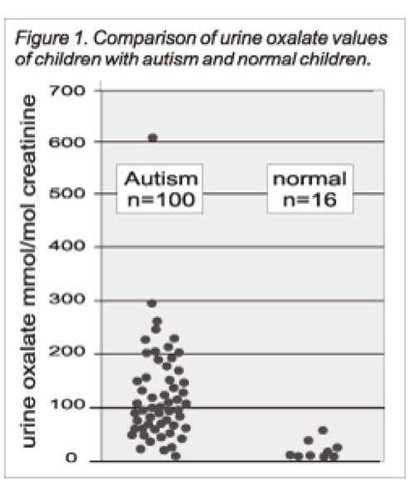
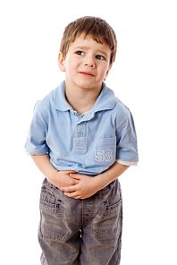
Autism Linked to Oxalate Crystals*
Crystals of oxalate form kidney stones and cause great discomfort
Study has shown at least 3-fold higher serum and urinary levels of oxalate in autistic kids**
*William Shaw, The Role of Oxalates in Autism and Chronic Disorders WAPF, March 26, 2010
**J Konstantynowicz et al., European Journal of Paediatric Neurology 16(5), 2012, 485-491.
Notes:
samantha/oxalates_in_autism.text
samantha/william_shaw_on_oxalates_autism.text
http://www.westonaprice.org/health-topics/the-role-of-oxalates-in-autism-and-chronic-disorders/
*http://www.greatplainslaboratory.com/home/span/oxalates.asp
“Oxalate crystals in the bone may crowd out the bone marrow cells, leading to anemia and immunosuppression”*

Slide 51
Oxalate Causes Sulfate Flushing through Urine*
Sulfate is essential for:
Synthesis of extracellular matrix glycoproteins
Synthesis of cerebroside sulfate, in myelin in nerve fibers
Detoxification of many environmental toxins
Sulfate is flushed in the urine (lost) when kidney oxalate levels are high
Oxalobacter microbes degrade oxalate but they are killed by antibiotics such as Cipro
Oxalate decarboxylase depends on manganese as catalyst**
*W Krick et al., Am J Physiol Renal Physiol 2009;297: F145-F154.
**A Tanner et al. J Biol Chem. 2001;276(47):43627-34
Notes:
book/autism/sulfate_oxalate_kidney_transport_Karen_Lyke.pdf
Book/autism/oxalate/Tanner_2001_oxalate_decarboxylase_requires_manganese_glycine_dependencies.pdf

Slide 52
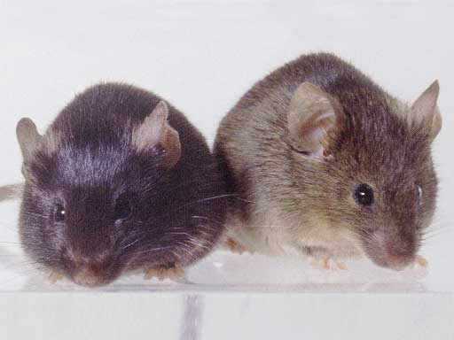
Autism-like socio-communicative deficits and stereotypies in mice lacking heparan sulfate*
Experiment with “designer” mice: blocked heparan sulfate synthesis in brain ventricles
Mice exhibited all the classic features of autism – both cognitive and social
"Fractone-associated N-sulfated heparan sulfate shows reduced quantity in BTBR T+tf/J mice: a strong model of autism." **
* F. Irie et al., PNAS Mar. 27, 2012, 109(13), 5052-5056.
**KZ Meyza et al., Behav Brain Res 2012;228:247–53.
Notes:
vitaminK/mice_no_heparan_sulfate_get_autism_2012.pdf
Samantha/heparan_sulfate_knockout_mice_get_autism.pdf

Slide 53
“Heparan sulfate deficiency in autistic postmortem brain tissue from the subventricular zone of the lateral ventricles”*
“Aberrant extracellular matrix glycosaminoglycan function localized to the subventricular zone of the lateral ventricles may be a biomarker for autism, and potentially involved in the etiology of the disorder.”
New neurons develop from stem cells in this zone through the action of “fractones” composed of heparan sulfate proteoglycans**
*BL Pearson et al., Behav Brain Res. 2013;243:138-45
**F. Mercier et al., Neuroscience Letters 506 (2012) 208–213
Notes:
Samantha/heparan_sulfate_deficiency_autism_postmortem_brain.pdf

Slide 54
Is Encephalopathy a Mechanism to Renew Sulfate in Autism?*
Abstract: “This paper makes two claims:
(1) Autism can be characterized as a chronic low- grade encephalopathy, associated with excess exposure to nitric oxide, ammonia and glutamate in the central nervous system, which leads to hippocampal pathologies and resulting cognitive impairment, and
(2) Encephalitis is provoked by a systemic deficiency in sulfate, but associated seizures and fever support sulfate restoration. …”
*S seneff et al., Entropy 2013; 15: 372-406.

Slide 55
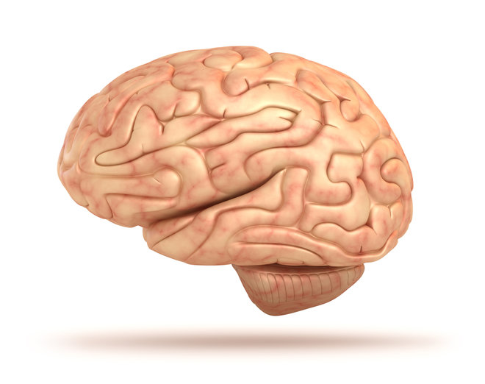
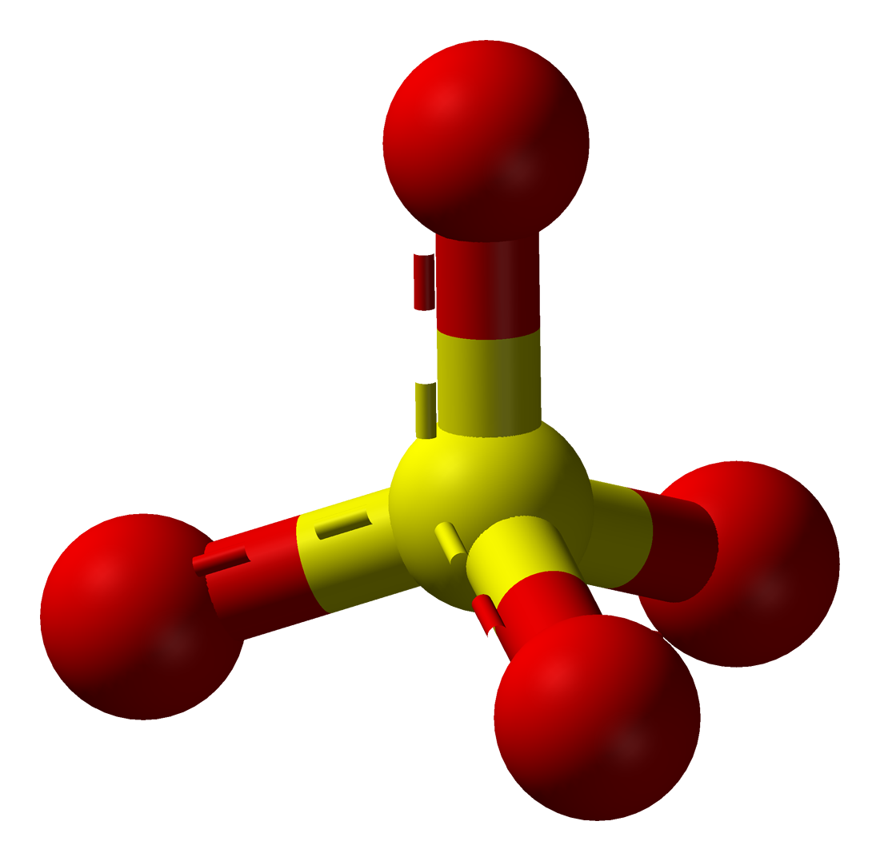
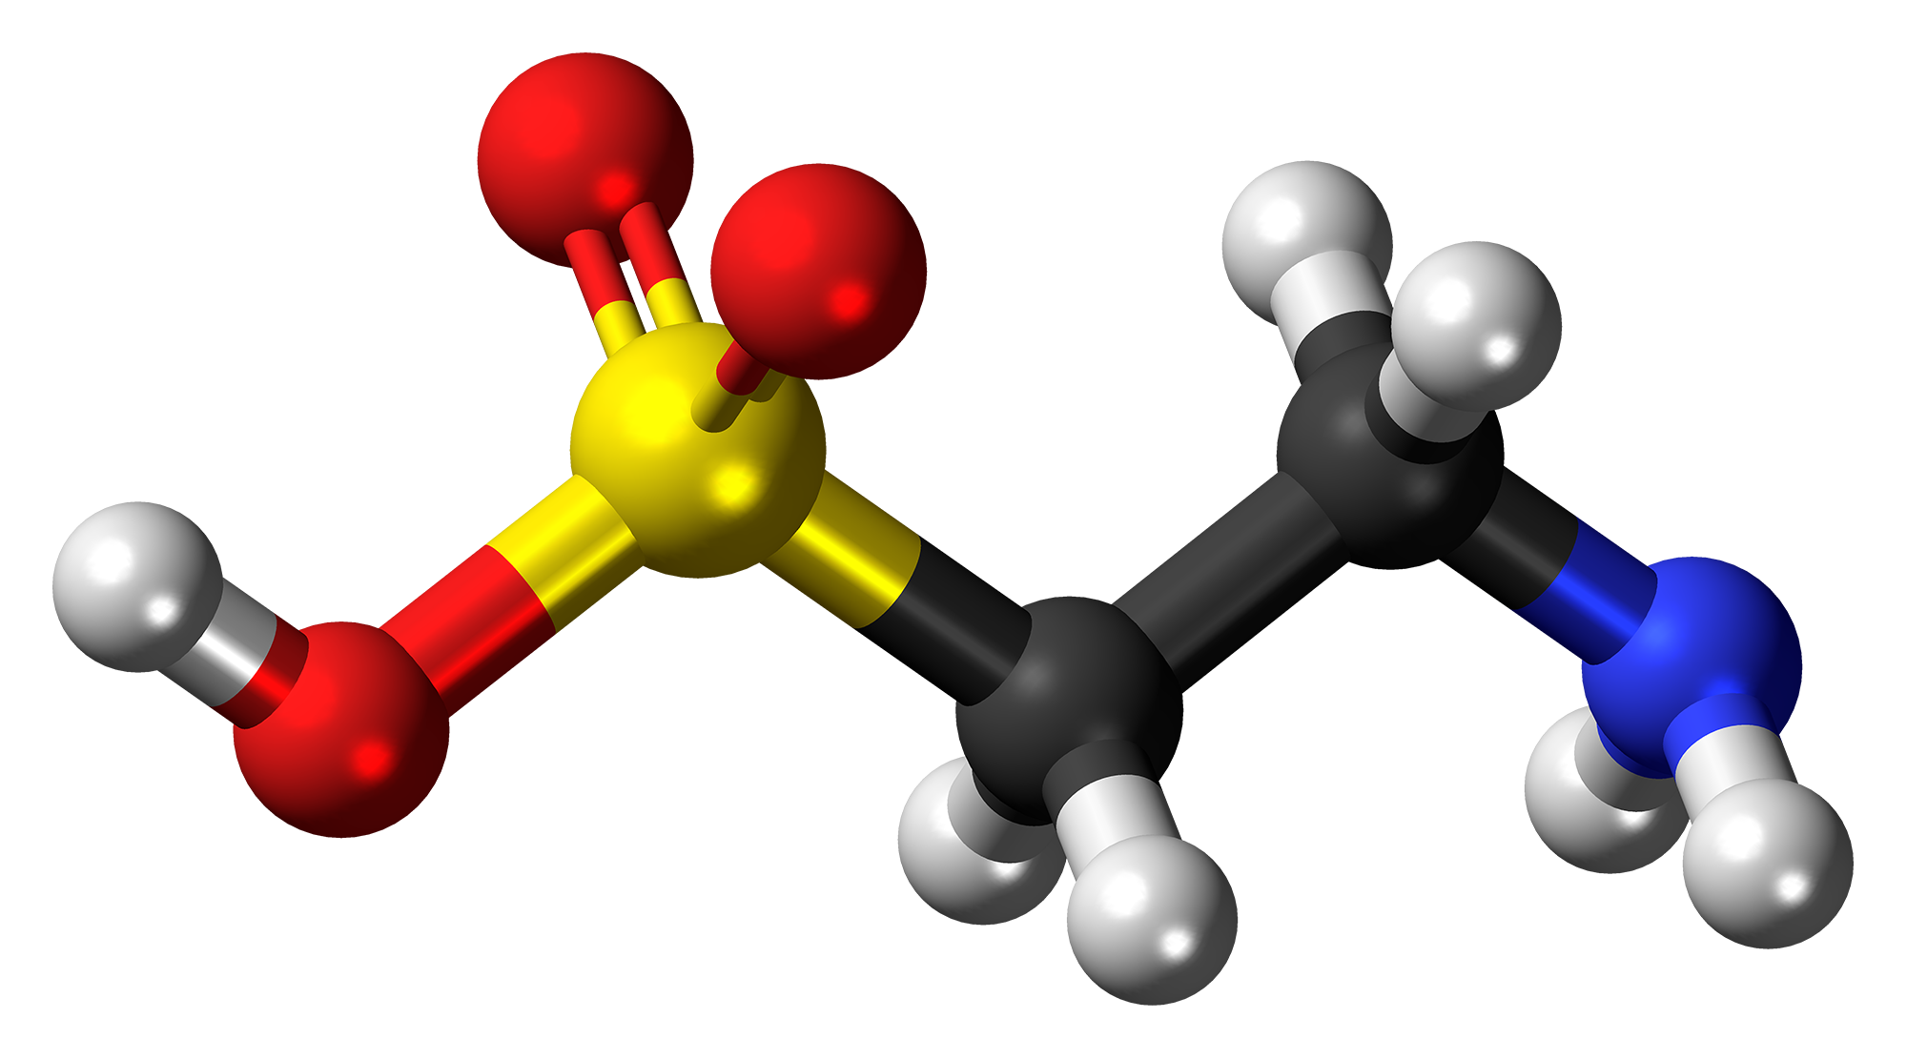
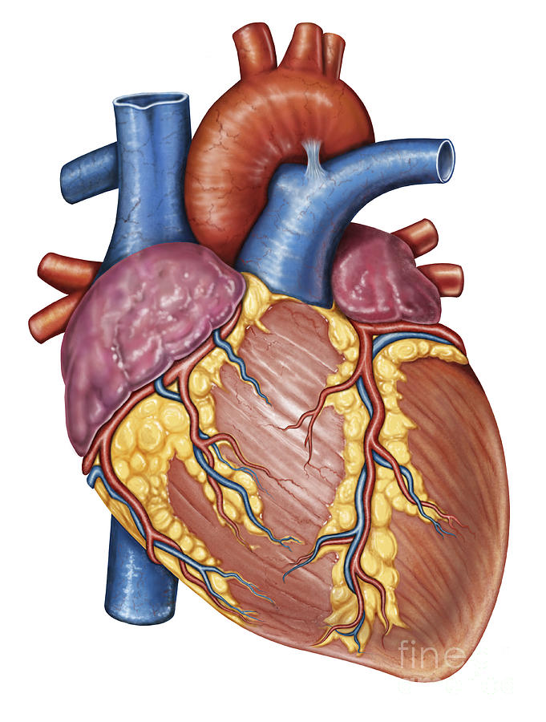
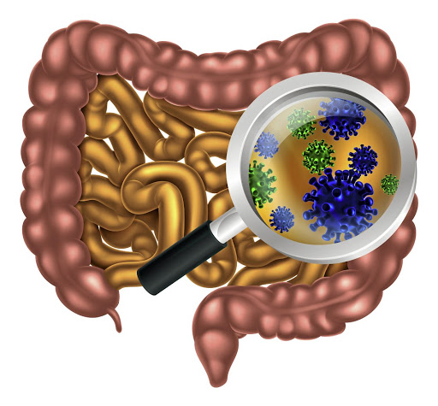
Gut Microbes to the Rescue!
Glyphosate blocks taurine uptake into E coli microbes*
sulfate
taurine
taurine
taurine
taurine
*W Lu et al. Mol BioSyst 2013; 9: 522-530.

Slide 56
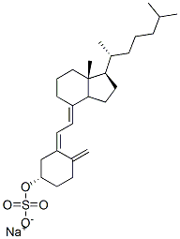
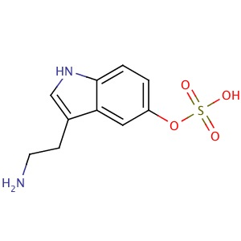
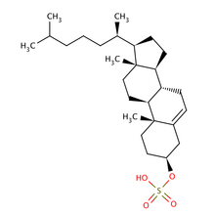
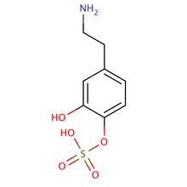
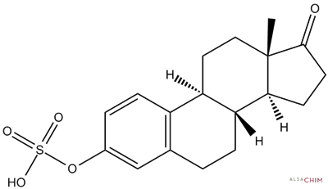
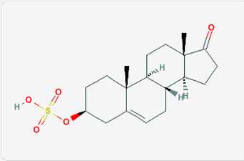
Safe Sulfate Transport: Carbon Rings
vitamin D sulfate
serotonin sulfate
cholesterol sulfate
Glyphosate depletes serotonin and dopamine and disrupts enzymes involved with sterol sulfation: Imperiled sulfate transport
dopamine sulfate
estrone
sulfate
DHEA sulfate

Slide 57
Recapitulation
Sulfate plays many essential roles in the body
Sulfate deficiency is a core feature of autism
Sulfate synthesis and transfer depend critically on both glycine residues and molybdenum
PCOS due to glycine mutation is risk factor for autism
Oxalate metabolism depends on microbial enzymes that are disrupted by glyphosate
High oxalate is linked to autism and causes sulfate flushing through urine
Heparan sulfate deficiency in the brain is associated with autism in both humans and mouse models
A low grade encephalopathy characterizes autism and may reflect the need to synthesize sulfate

Slide 58
Glyphosate and Vaccines

Slide 59
Patreon – Microbiome Vaccine Safety Project*
"Gut microbiota have a significant effect on host response to vaccination where a reduced or absent population of commensal flora coupled with an overgrowth of pathogenic strains may become a microbial predisposition to adverse vaccine reaction."
*thegutclub.org/patreon-microbiome-vaccine-safety-project/
Notes:
Book/gut//Patreon_micrbiome_vaccine_links.text
Deltaproteobacteria:
… contains most of the known sulfate- (Desulfovibrio, Desulfobacter, Desulfococcus, Desulfonema, etc.) and sulfur-reducing bacteria (e.g. Desulfuromonas spp.) alongside several other anaerobic bacteria with different physiology (e.g. ferric iron-reducing Geobacter spp.
Some members of the genus Bacteroides are opportunistic pathogens.

Slide 60
Glyphosate in Vaccines?
For MMR, flu vaccine, and rabies vaccine, live virus is grown on gelatin derived from ligaments of pigs
Pigs are fed GMO Roundup-Ready corn and soy feed
The main component of gelatin is collagen
By far the most common amino acid in collagen is glycine: glyphosate substitution is likely!
There is also a significant amount of glutamate
Excite NMDA receptors in the brain
Glyphosate’s known stimulation of NMDA receptors could cause neuronal burnout

Slide 61
Glyphosate Contamination in Vaccines (Parts Per Billion)*
Merck ZOSTAVAX 0.42 Shingles
Merck MMR-II 2.90 Measles, Mumps and Rubella
Merck VARIVAX 0.41 Varicella, Chicken Pox
MERCK PNEUMOVAX ND Pneumococcal 18
MERCK PROQUAD 0.43 Measles, Mumps, Rubella, Varicella
GSK ENERGIX-B 0.33 Heptatitis B
*A Samsel and S Seneff. Journal of Biological Physics and Chemistry 17 (2017) 8–32

Slide 62
Measles Virus and Hemagglutinin*
The measles virus synthesizes the protein hemagglutinin
Antibodies to hemagglutinin are essential following MMR vaccination to induce immunity
Hemagglutin bears a sequence resemblance to myelin basic protein (MBP) → potential for autoimmune reaction
MBP is essential for the formation of the myelin sheath surrounding nerve fibers
Children with a rare genetic defect involving deletion of MBP can suffer from microcephaly**
Autoantibodies to MBP along with excessive levels of antibodies to measles hemagglutinin are linked to autism***
*Oldstone, MBA, Ed. Molecular mimicry: Infection inducing autoimmune disease.
Springer Berlin Heidelberg; January 9, 2006.
**AD Kline et al., Am J. Hum. Genet. 1993;52:895-906.
***VK Singh et al., J Biomed Sci 2002;9(4):359-64.

Slide 63
Autism and Measles Hemagglutinin*
125 autistic children and 92 control children
60% of the children with autism had high levels of antibodies to measles hemagglutinin specific to the MMR vaccine
90% of these had autoantibodies to myelin basic protein (MBP)
0% of the control children had high antibody titers to either hemagglutinin or MBP
There were no elevations in antibodies detected against any proteins in the mumps or rubella viruses
*VK Singh et al., J Biomed Sci 2002;9(4):359-64.

Slide 64
What you can do!

Slide 65
Go Organic!
Foodland: organic shelf
Wholefoods:
Sign at Entrance

Slide 66
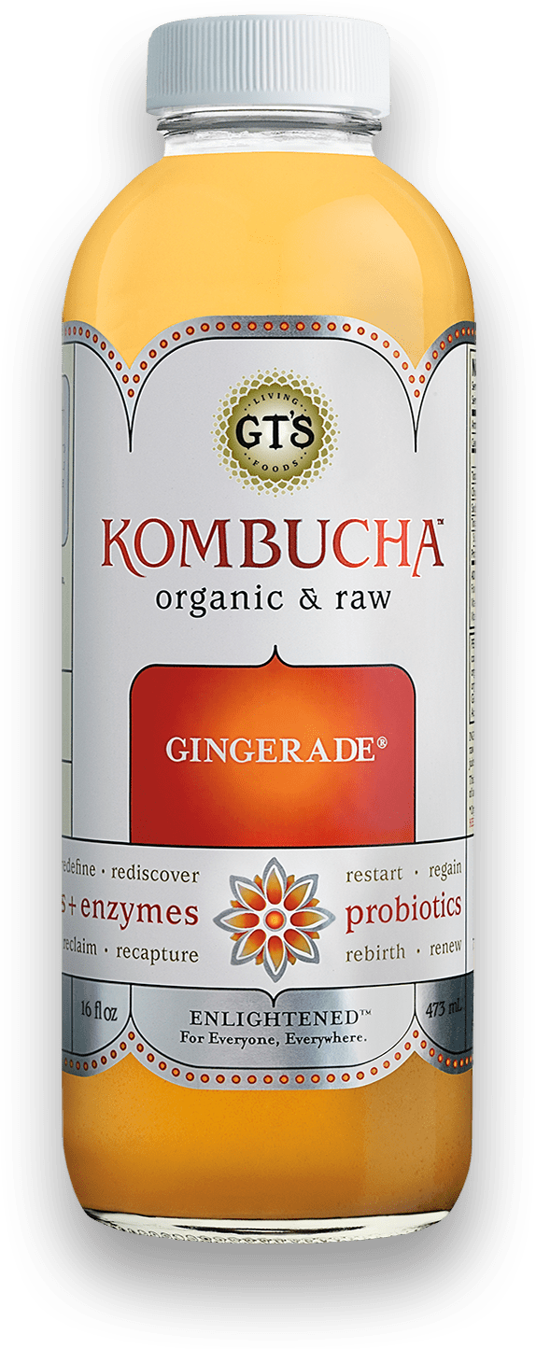
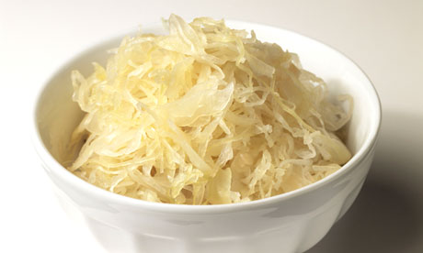
Eat Natural Probiotic Foods
Sauerkraut and apple cider vinegar contain acetobacter, one of the very few microbes that can metabolize glyphosate
Kombucha and kimchi do too!

Slide 67
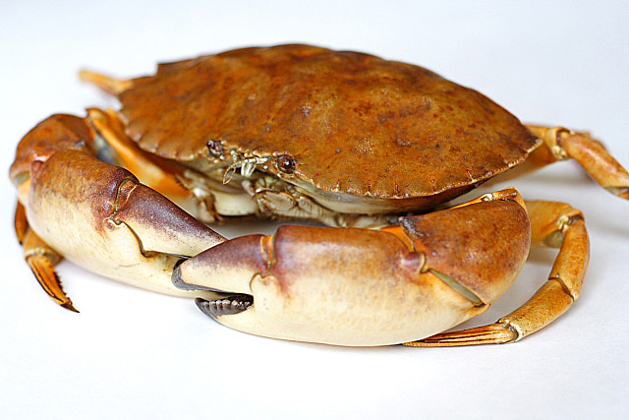
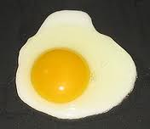
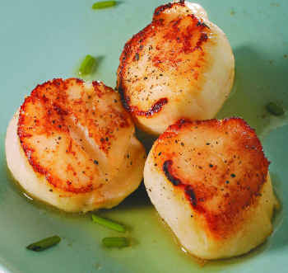
Eat Foods Containing Sulfur
Notes:
http://healthyeatingclub.com/info/books-phds/books/foodfacts/html/data/data5g.html

Slide 68
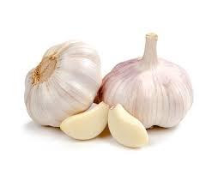
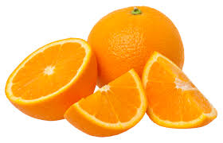
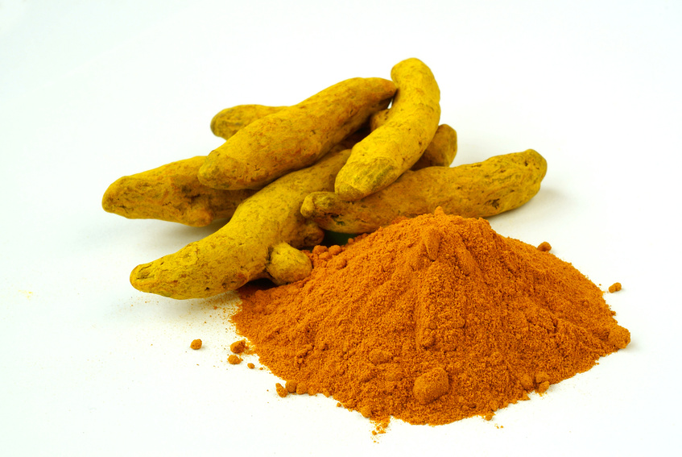
Some Important Nutrients
Curcumin
Garlic
Vitamin C
Probiotics
Methyl tetrahydrofolate
Cobalamin
Glutathione
Taurine
Epsom salt baths

Slide 69
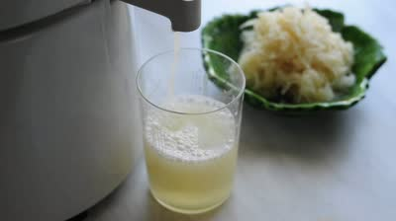
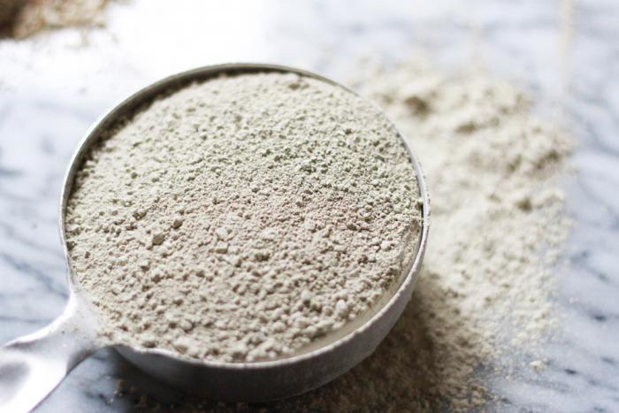
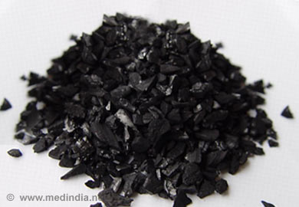
Treating Glyphosate Poisoning in Animals (e.g., cows) *
Activated charcoal, bentonite clay, humic and fulvic acids, and sauerkraut juice have been shown to be effective in reducing urinary levels of glyphosate and improving animal health
Sauerkraut
Juice
Fulvic Acid
Activated Charcoal
Bentonite Clay
*H Gerlach et al., J Environ Anal Toxicol 2014, 5:2
Notes:
Glyphosate/Monika_cows_humic_acid_fulvic_acid_treat_glyphosate.pdf
Activated charcoal
活性炭
clay
粘土
Niántǔ
Huóxìngtàn

Slide 70
Spend Time Outside in the Sunlight – Especially in the Ocean

Slide 71
Summary
Glyphosate is pervasive in our food supply and in our environment
I believe glyphosate is the most important factor in the autism epidemic
Glyphosate may be substituting for glycine by mistake during protein synthesis, with enormous consequences
Insidious, cumulative toxicity
Glyphosate disrupts the gut microbiome
Glyphosate disrupts sulfur homeostasis
Glyphosate causes hypothyroidism
Glyphosate contamination in MMR may explain its observed link to autism
Organic diet, fermented foods, sulfur-rich diet and sunlight exposure are beneficial for health

