Slide 1
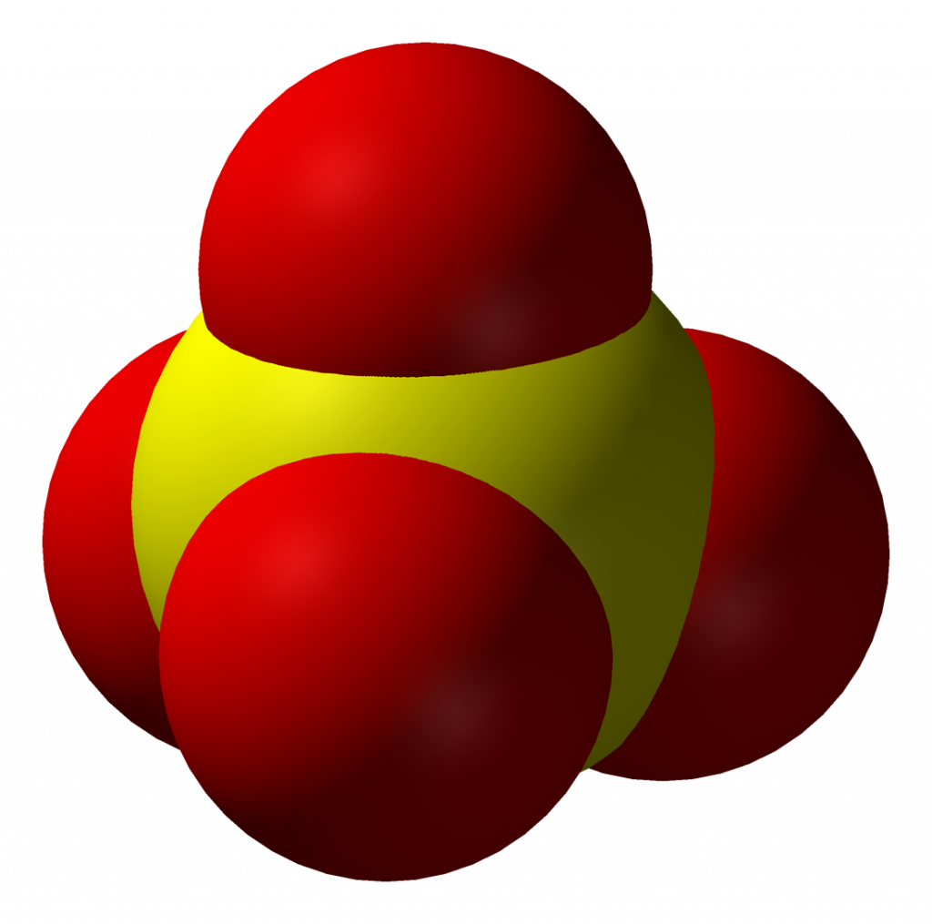
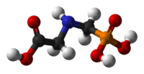
The Many Roles of Sulfate in the Body and its Disruption by Glyphosate
Stephanie Seneff
MIT CSAIL
September 7, 2019

Slide 2
Outline
Sulfate and the Glycocalyx
Cholesterol Sulfate and Heart Disease
Glyphosate as a Glycine Analogue
Endothelial Nitric Oxide Synthase: a Moonlighting Enzyme
Roundup, StAR and Sterol Homeostasis
Glyphosate, Sulfate and Autism
Summary

Slide 3
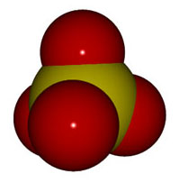
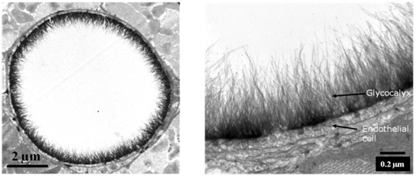
Sulfate and the Glycocalyx
Expanded View
Artery
Cross Section

Slide 4
It’s All About the Blood
We are 2/3 water by mass and 99% by molecule count
Most of the water in the body is gelled
The BIG EXCEPTION is the flowing blood!
Blood delivers nutrients to and removes waste from all the tissues
Gelled water lines the vessel wall and provides slick, frictionless passage of red blood cells through the capillaries
Sulfate keeps the water gelled along the border
Sulfate transport is problematic

Slide 5
Sulfate is Crucial to Maintain Structured Water
Most cells in the body maintain an extracellular matrix formed from proteins with complex sugar chains attached to them
Sulfate ions bind to the sugars at strategic locations in an irregular but non-random pattern
The “glycocalyx” that lines the walls of all blood vessels is formed from these sugar-protein complexes

Slide 6
Endothelial Glycocalyx Schematic*
“GAG chain”
(GlycosAminoGlycan =
Amino-sugar-chain)
*S Reitsma et al., Pflugers Arch - Eur J Physiol (2007) 454:345–359
Notes:
treasures/endothelial_glycocalyx_review.pdf
Fig. 1 Schematic representation of the endothelial glycocalyx, showing its main components. Left: The endothelial glycocalyx can be observed in vivo as a red blood cell exclusion zone, located on the luminal side of the vascular endothelium. It consists of membrane- bound and soluble molecules. Right: Components of the endothelial glycocalyx. Bound to the endothelial membrane are proteoglycans, with long unbranched glycosaminoglycan side-chains (GAG-chain) and glycoproteins, with short branched carbohydrate side-chains. Incorporated in and on top of this grid are plasma and endothelium
derived soluble components, including hyaluronic acid and other soluble proteoglycans (e.g., thrombomodulin) and various proteins, such as extracellular superoxide dismutase (ec-SOD) and antithrombin III (AT III). Together, these components form the endothelial glycocalyx that functions as a barrier between blood plasma and the endothelium and exerts various roles in plasma and vessel wall homeostasis. Note that this figure is not drawn to scale; its purpose is to illustrate glycocalyx composition

Slide 7
Endothelial Glycocalyx Schematic*
Gel layer prevents attack of vessel wall by blood sugars and oxidizing agents.
Cellular signaling mechanisms (e.g., antioxidant ec-SOD and clot-protective AT III) depend on sulfates to work.
*S Reitsma et al., Pflugers Arch - Eur J Physiol (2007) 454:345–359
Notes:
antithrombin
treasures/endothelial_glycocalyx_review.pdf
Fig. 1 Schematic representation of the endothelial glycocalyx, showing its main components. Left: The endothelial glycocalyx can be observed in vivo as a red blood cell exclusion zone, located on the luminal side of the vascular endothelium. It consists of membrane- bound and soluble molecules. Right: Components of the endothelial glycocalyx. Bound to the endothelial membrane are proteoglycans, with long unbranched glycosaminoglycan side-chains (GAG-chain) and glycoproteins, with short branched carbohydrate side-chains. Incorporated in and on top of this grid are plasma and endothelium
derived soluble components, including hyaluronic acid and other soluble proteoglycans (e.g., thrombomodulin) and various proteins, such as extracellular superoxide dismutase (ec-SOD) and antithrombin III (AT III). Together, these components form the endothelial glycocalyx that functions as a barrier between blood plasma and the endothelium and exerts various roles in plasma and vessel wall homeostasis. Note that this figure is not drawn to scale; its purpose is to illustrate glycocalyx composition

Slide 8
Exclusion Zone: Model of Capillary*
Battery!
Blood
Sulfated GAGs
Endothelium
*Figure 9, M. Rohani and G.H. Pollack, Langmuir 2013, 29, 6556−6561
Notes:
Langmuir_Pollack_flow_through_tube_protons_gather_2013.pdf
Images/Pollack1.jpg
Figure 9. (a) Distribution of charge in the exclusion zone and water beyond the exclusion zone as shown by electrical potential measurements and pH- sensitive dye studies. Protons spread in bulk water, although some cling to the negatively charged EZ. (b) Disposition of charge anticipated in a tubular configuration.

Slide 9
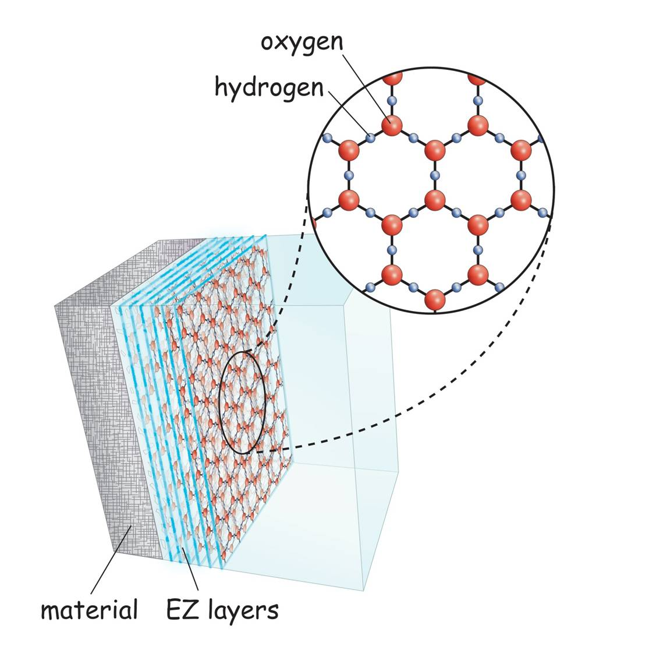
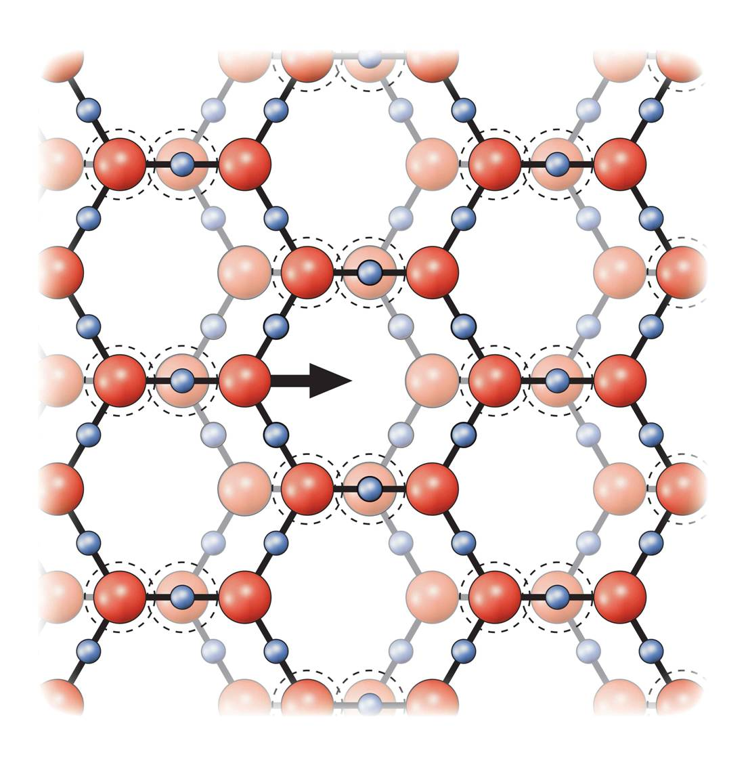
Exclusion Zone*
endothelial cells
+
+
+
Protons collect at the interface between
The exclusion zone and the bulk water in the blood
Negatively
Charged
Exclusion Zone
+
+
Unstructured water in blood
*http://doublehelixwater.eu/understanding-water-contents/exclusion-zone-form/

Slide 10
Exclusion Zone*
endothelial cells
the surface energy of water is a non-metabolic "fuel" source for the molecular motors of our bodies
+
+
+
Protons collect at the interface between
The exclusion zone and the bulk water in the blood
Negatively
Charged
Exclusion Zone
+
+
Unstructured water in blood
*http://doublehelixwater.eu/understanding-water-contents/exclusion-zone-form/

Slide 11
Cholesterol, Sulfate
and Heart Disease

Slide 12
Cholesterol: Saint, Not Villain
Cholesterol is to animals as chlorophyll is to plants: it gives us a brain and mobility
The brain makes up 5% of the body’s weight and contains 25% of the body’s cholesterol
Why would cholesterol pile up in the arteries leading to the heart, if not for a good reason??

Slide 13
Cholesterol and Cholesterol Sulfate
Sulfation makes cholesterol water-soluble and therefore much easier to transport
Equally important is that cholesterol carries sulfate
SULFATE
Notes:
From cholesterol_sulfate_agile.pdf – this was the original article on that topic.

Slide 14
Cholesterol sulfate provides negative charge*
-
-
-
-
-
-
-
-
-
-
-
-
-
-
-
-
-
-
-
-
-
-
-
-
-
-
-
-
-
-
-
-
-
-
-
-
-
-
-
-
-
-
-
-
-
-
-
-
-
-
-
-
-
-
-
-
-
Red blood cells export cholesterol sulfate to the capillary wall, supplying it with cholesterol, sulfate, and negative charge
* Davidson and Seneff, Entropy 14, 1399-1442, 2012

Slide 15
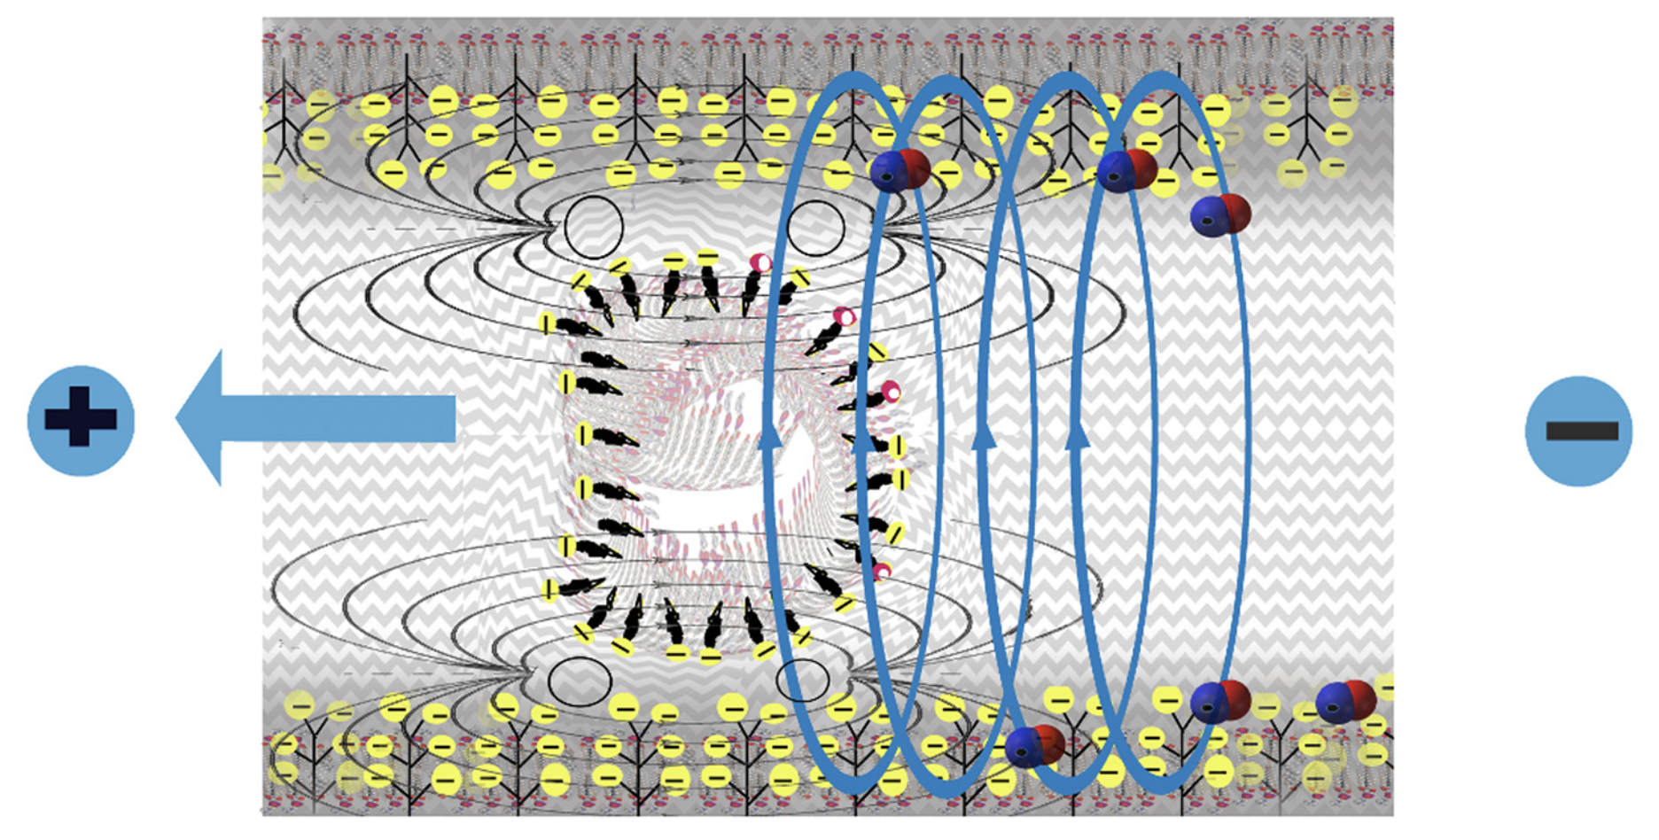
The moving RBC creates an electromagnetic field that induces the release of nitric oxide from the capillary wall. This relaxes the vessel wall and promotes blood flow.
* Seneff et al. Theoretical Biology and Medical Modelling (2015) 12:9

Slide 16
They Knew a Long Time Ago*
Article published in 1960
Fed cholesterol to monkeys
Induced atherosclerosis
If sulfur-containing nutrients are added, atherosclerosis is prevented
These nutrients provide source of sulfate to enable cholesterol transport
* G.V. Mann et al., Am. J. Clin. Nutr. 8, 491-497, 1960
Notes:
./ monkeys_sulfur_solves_cholesterol_problem_1960

Slide 17
Sulfur Incorporation into GAGs with Age*
Plaque regions
Normal aorta
*WH Hauss et al.. J Atheroscler Res. 1962;2(1–2):50–61
Notes:
CholesterolSulfate2_2015.pdf
Fig. 5 Sulfur Incorporation into GAGs with Age. Incorporation of 35Sulfur into chondroitin sulphuric acids (CSA) of the connective tissue of normal human aortae (x) and atherosclerotic human aortae (o) in in vitro experiment. (Redrawn from [110], with permission from Elsevier)

Slide 18
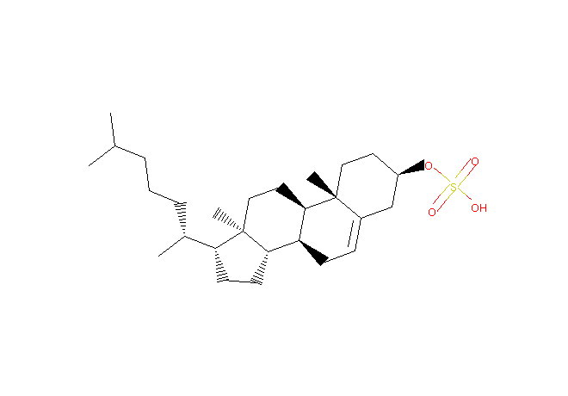
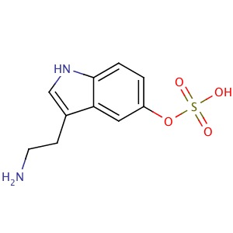
Sulfation as Sulfate Transport
STEROLS
NEUROTRANSMITTERS/HORMONES
cholesterol sulfate
DHEA
Cortisol
Estrogen
Progesterone
Testosterone
Serotonin sulfate
Vitamin D
Vitamin C
Melatonin
Adrenalin
Dopamine
Thyroid hormone
These are all sulfated for transport in the blood
Is sulfate transport an important role that they play??

Slide 19
Glyphosate:
A Glycine Analogue

Slide 20
“Glyphosate Now the Most-Used Agricultural Chemical Ever”*
Glyphosate usage has increased 50-fold since 1996, when GMO glyphosate-resistant crops were introduced in the US.
Today, 50 times more glyphosate is allowed by the EPA on corn grain than in 1996
Half of the American farmers' fields have weeds that are resistant to glyphosate
New GMO crops offer dual resistance to glyphosate & 2,4-D → Enlist Duo
*Douglas Main, Feb 2, 2016 Newsweekwww.newsweek.com/
glyphosate-now-most-used-agricultural-chemical-ever-422419
Notes:
./Newsweek_on_glyphosate_overuse.text

Slide 21
Glyphosate vs. Other Pesticides: Usage in the United States*
Glyphosate
*http://sustainablepulse.com/wp-content/uploads/GMO-health.pdf

Slide 22
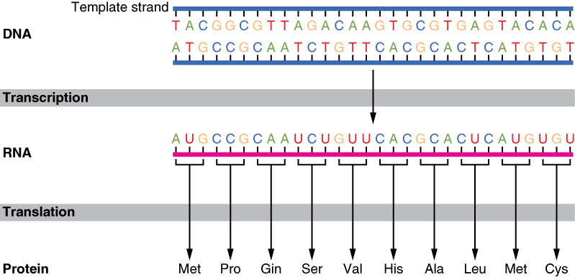
The Basics of Protein Synthesis
Glyphosate
Glycine

Slide 23
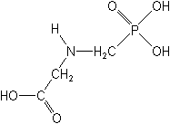
What if Glyphosate could Insert itself into Proteins during Synthesis???
glyphosate
Extra Stuff!
Code for Glycine
Glyphosate
GGC
Glycine
mRNA
. . .
. . .
Glyphosate
Alanine
Proline
-- Any proteins with conserved glycine residues are likely to be affected in a major way

Slide 24
Extra Piece Sticks Out at Active Site
Substrate no longer fits in active site
Active Site
Extra Stuff
Glyphosate
Alanine
Proline
glycine
Peptide chain

Slide 25
Extra Piece Sticks Out at Active Site
Substrate no longer fits in active site
This explains how glyphosate disrupts EPSPS in the shikimate pathway: Multiple bacteria have developed resistance by replacing active site glycine with alanine and this is the basis for GMO Roundup Ready crops*
Active Site
Extra Stuff
Glyphosate
Alanine
Proline
glycine
Peptide chain
*T Funke et al., Molecular basis for the herbicide resistance of Roundup Ready crops. PNAS 2006;103(35):13010-13015.

Slide 26
Inhibition of EPSPS by glyphosate: Resistant E coli mutant*
Mutant with alanine substituted for glycine 96
Wild type with glycine 96
*Figure 3, S Eschenburg et al. Planta 2002;216:129-135.

Slide 27
Only Glyphosate Works!*
“More than 1,000 analogs of glyphosate have been produced and tested for inhibition of EPSP synthase, but minor structural alterations typically resulted in dramatically reduced potency, and no compound superior to glyphosate was identified.”
Hypothesis:
These other molecules failed to work as an amino acid analogue of glycine, because they were not amino acids.
*T Funke et al. PNAS 2006; 103(35): 13010-13015.

Slide 28
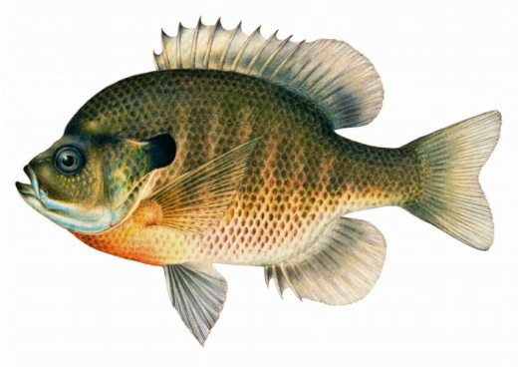
Quote from Monsanto Study (1989)*
Study exposed bluegill sunfish to carbon-14 radiolabelled glyphosate
Measured radiolabel in tissues greatly exceeded measured glyphosate levels
Proteolysis recovered more glyphosate
20% yield → 70% yield
"Proteinase K hydrolyses proteins to amino acids and small oligopeptides, suggesting that a significant portion of the 14C activity residing in the bluegill sunfish tissue was tightly associated with or incorporated into protein.”
*WP Ridley and KA Chott. Monsanto unpublished study. August, 1989.

Slide 29
Some Predicted Consequences*
Impaired cholesterol sulfate synthesis → heart disease
Autism
Impaired collagen → osteoarthritis
Steatohepatitis (fatty liver disease)
Obesity and adrenal insufficiency
Hypothyroidism
Impaired iron homeostasis and kidney failure
Insulin resistance and diabetes
Cancer
*A. Samsel and S. Seneff. Journal of Biological Physics and Chemistry 2016;16:9-46.

Slide 30
Glyphosate Disrupts Cytochrome P450 (CYP) Enzymes*
Glyphosate has been shown to severely suppress CYP enzymes in rat liver
CYP enzymes have a unique FGXGXRXCXG motif with two and often three critical glycine residues**
*A Samsel and S Seneff. Entropy 2013; 15: 1416-1463.
**K Syed and SS Mashele. PLOS ONE 2014; 9(4):| e95616.
GLYCINES
Notes:
CYPs_contain_highly_conserved_glycines_2014.pdf

Slide 31
Glyphosate Disrupts Cytochrome P450 (CYP) Enzymes*
Glyphosate has been shown to severely suppress CYP enzymes in rat liver
CYP enzymes have a unique FGXGXRXCXG motif with two and often three critical glycine residues**
CYP enzymes are needed to produce bile acids for digesting fats, to activate vitamin D and to detoxify many environmental toxicants
*A Samsel and S Seneff. Entropy 2013; 15: 1416-1463.
**K Syed and SS Mashele. PLOS ONE 2014; 9(4):| e95616.
GLYCINES
Notes:
CYPs_contain_highly_conserved_glycines_2014.pdf

Slide 32
Cytochrome P450 Reductase
NADPH
FAD
FMN
Notes:
Where?

Slide 33
NADPH-cytochrome P450 reductases*
NADPH → FAD → FMN → P450 → O₂
*David C Lamb et al. Structure 2006; 14: 51-61.
Notes:
Chemistry/electron_transfer_yeast_NADPH_CYP_reductase_2006.pdf

Slide 34
NADPH-cytochrome P450 reductases*
NADPH → FAD → FMN → P450 → O₂
Four glycine residues absolutely conserved across multiple phyla at the FMN binding site
*David C Lamb et al. Structure 2006; 14: 51-61.
Notes:
Chemistry/electron_transfer_yeast_NADPH_CYP_reductase_2006.pdf

Slide 35
Endothelial Nitric Oxide Synthase:
A Moonlighting Enzyme

Slide 36
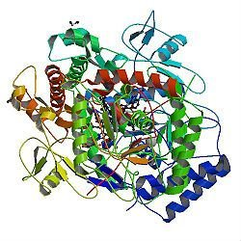
A Provocative Proposal*
Cholesterol sulfate supplies sulfur, oxygen, cholesterol, energy and negative charge to all the tissues
Sulfate is synthesized from sulfide in skin and blood stream utilizing energy in sunlight
Protects from UV damage and keeps microbes out
Endothelial Nitric Oxide Synthase (eNOS) performs the magic
The skin is a solar powered battery!
*S Seneff et al. Theor Biol Med Model 2015; 12:9

Slide 37
A Provocative Proposal*
BOLD CLAIM:
Deficiencies in cholesterol and sulfate supplies to the blood and to the tissues are the most important factors behind modern diseases

Slide 38
Heart Disease Mortality and Sunlight*
*Grimes et al., Q. J. Med. 1996; 89:579-589
Notes:
vitaminK/sunlight_heart_disease.pdf

Slide 39
Hypothesis: eNOS is a Moonlighting Enzyme*
eNOS produces nitric oxide when it is phosphorylated and in the cytoplasm
eNOS produces sulfur dioxide when it is attached to the membrane and unphosphorylated
Electromagnetic signals from the flowing blood regulate the eNOS switch
*S. Seneff et al. Entropy 2012; 14: 2492-2530.

Slide 40
Maintaining Blood Homeostasis
Sulfur dioxide → sulfite → sulfate
Rebuilds the matrix and thickens the blood
Nitric oxide → nitrite → nitrate
Breaks down the matrix and thins the blood

Slide 41
eNOS is Very Vulnerable*
eNOS depends on:
Cobalamin (vitamin B12, cobalt)
Heme iron, sulfur, zinc, oxygen
NADPH
Sunlight
eNOS is an orphan cytochrome P450 enzyme:
Highly susceptible to damage from various environmental toxicants like mercury, aluminum, glyphosate, etc.
*S. Seneff et al., Entropy 2012, 14, 2492-2530

Slide 42
Glycine is Essential to eNOS
Cell membrane
Caveola
Glycine molecules hook eNOS to the membrane* and
hook the two eNOS molecules in the dimer together**
Zinc
G
G
eNOS
eNOS
G
G
*WC Sessa et al. Circulation Res 1993; 72: 921-924.
**HJ Cho et al. Proc Natl Acad Sci USA 1995; 92: 11514-11518.

Slide 43
Glyphosate Disrupts eNOS*
eNOS depends on highly conserved glycines both for dimer formation and for binding to the membrane
eNOS is an NADPH CYP reductase homologue with FMN binding – more glycine dependencies
Replacement of the glycines with glyphosate would disrupt all of these functions
This explains the “pathology” of superoxide release
eNOS cannot make sulfur dioxide AND it introduces damaging oxidizing agents that destroy cell tissues
*A Samsel and S Seneff, J Biol Phys Chem 2016;16:9-46.

Slide 44
eNOS Uncoupling*
glutathione
Angiotensin II induces NOX
NOX produces O₂⁻
NOX uncouples eNOS
eNOS produces more O₂⁻
ONOO⁻ “Oh No!”
eNOS glutathionylation
facilitates SO₂ production
by eNOS but glyphosate
disrupts this function
*Keyvan Karimi Galougahi et al. J Am Heart Assoc 2014;3:e000731.
Notes:
Chemistry/glutathionylation_of_eNOS_by_NADPH_oxidase_ACE_involved_2014.pdf

Slide 45
eNOS and NOX Pathology*
*Ernesto L. Schiffrin. Coronary Circulation. Hypertension 2008; 51(1): 31-32.
Notes:
Chemistry/eNOS_NOS_peroxynitrite_2008.pdf
Figure. Schematic of the balance between NO and ROS that modulates NO bioavail- ability. When ROS production is increased, tetrahydrobiopterin (BH4) generation is reduced, and eNOS produces superoxide (●O2 ). Excess generation of ●O2 by differ- ent sources (NADPH oxidase, uncoupled eNOS, xanthine oxidase, myeloperoxidase, cyclooxygenase, mitochondria) will reduce NO bioavailability and convert NO into per- oxynitrite (ONOO ), which has deleterious effects. Reduced activity of SOD will also result in enhanced ROS accumulation in the vascular wall. COX indicates cyclooxygen- ase; FAD, flavin adenine dinucleotide; MLP, myeloperoxidase; NADPH, reduced nicotin- amide adenine dinucleotide; XO, xanthine oxidase.

Slide 46
eNOS Uncoupling*
eNOS is regulated by electromagnetic signals from flowing blood
Builds up matrix
SULFATE
SULFITE
NITRITE
NITRATE
Breaks down matrix
“Oh No!”
*Figure 1, M Yokoyama and K-I Hirata Cardiovascular Research 73 (2007) 8–9
Notes:
Treasures/eNOS_uncoupling_2007.pdf
Fig. 1. Potential mechanisms of physiological regulation of cerebral arterial tone by eNOS. eNOS: endothelial nitric oxide synthase; SOD: superoxide dismutase; GPx: glutathione peroxidase.

Slide 47
Roundup, StAR and
Sterol Homeostasis
StAR:
Steroidogenic
Acute
Regulatory
protein

Slide 48
Non-alcoholic Fatty Liver Disease: An Epidemic in America
NAFLD affects almost one-quarter of the general U.S. population
Notes:
.steatohepatitis
/StAR_overexpression_NASH.text
https://en.wikipedia.org/wiki/Steroidogenic_acute_regulatory_protein
Leydig Cells testes

Slide 49
Non-alcoholic Fatty Liver Disease: An Epidemic in America
NAFLD affects almost one-quarter of the general U.S. population
A US-based study found that people suffering from NAFLD had elevated levels of glyphosate in their urine*
*Paul J Mills et al. Clin Gastroenterol Hepatol. 2019 Apr 4. [Epub ahead of print]
Notes:
.steatohepatitis
/StAR_overexpression_NASH.text
https://en.wikipedia.org/wiki/Steroidogenic_acute_regulatory_protein
Leydig Cells testes

Slide 50
“Sulfation of 25-hydroxycholesterol regulates lipid metabolism, inflammatory responses, and cell proliferation”*
Cholesterol and fats shipped out through bile acids
Fixes fatty liver
Liver cells proliferate, restoring damaged liver
Suppresses inflammation
LIVER CELL
Turns on and off many enzymes
cholesterol
StAR
nucleus
StAR
25HC
CYP
SULT2B1b
SULFATE
mitochondrion
25HC3S
*S Ren and Y Ying, Am J Physiol Endocrinol Metab 306: E123–E130, 2014
Notes:
Treasures/sulfated_oxysterol_regulates_everything_2014.pdf

Slide 51
StAR is a Superstar!
StAR protects from fatty liver disease and elevated serum LDL by promoting bile flow
StAR is essential for synthesis of cortisol, testosterone and estrogen by the adrenal glands and by the gonads
StAR induces export of cholesterol from cardiovascular plaque into HDL

Slide 52
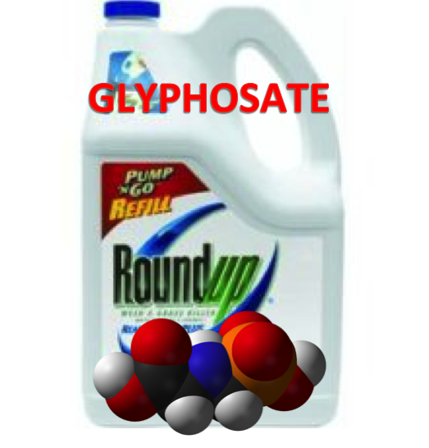
Roundup Inhibits Steroidogenesis by Disrupting StAR Protein Expression*
In vitro study on testicular Leydig cells
Roundup reduced testosterone synthesis by 94%
Effect due to both StAR suppression and CYP suppression
Roundup reduced StAR protein levels by 90%
Reduction in StAR expression in the adrenal gland disrupts synthesis of stress hormones and sex hormones
*LP Walsh et al., Environ Health Perspect 2000; 108:769-776
Notes:
Roundup_inhibits_StAR_protein_expression.pdf
Leydig cells produce testosterone

Slide 53
StAR Protein, Cholesterol Sulfate, and LDL*
StAR
Bile Acids
LDL
25HC3S is an important regulator of lipid biosynthesis
Decreases liver accumulation of fat and cholesterol
Increases bile acid production and decreases LDL export
*Q Bai et al., Metabolism. 2012 June ; 61(6): 836–845
Notes:
Steroidogenic acute regulatory protein
https://en.wikipedia.org/wiki/Steroidogenic_acute_regulatory_protein
Treasures/oxysterol_sulfation_reduces_fatty_liver_disease_StAR_involved.pdf
Glyphosate/roundup_inhibits_StAR_protein_expression.pdf
Csail/2015/project/RobertMelamede.email.text

Slide 54
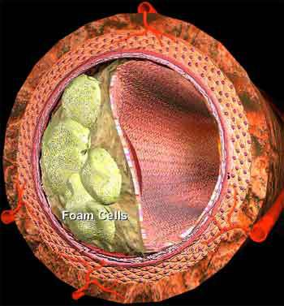
Overexpression of StAR increases macrophage cholesterol efflux to HDL-AI*
Atherosclerosis: Macrophages infiltrate the artery wall and transform to foam cells, storing fat and cholesterol
Macrophages export their cholesterol to HDL-A1, the so-called “good cholesterol”
Overexpression of StAR in macrophages promotes cholesterol export
*JMW Taylor et al., Cardiovascular Research (2010) 86, 526–534

Slide 55
Why Does Cholesterol Accumulate in the Arteries Supplying the Heart?
The heart is arguably the most important organ in the body
It needs abundant cholesterol and sulfate to stay healthy
When there are deficiencies, the artery wall stockpiles cholesterol waiting to become cholesterol sulfate
Inflammation induces superoxide which oxidizes sulfur to sulfate (e.g. in homocysteine)
Sulfate conjugation is needed for cholesterol export/delivery

Slide 56
Recapitulation
Non-alcoholic fatty liver disease is an epidemic in America
Linked to glyphosate exposure
Cholesterol sulfate protects from NAFLD
StAR promotes healthy liver, bile flow, cholesterol efflux from plaque regions and steroid synthesis by adrenals and gonads
Glyphosate suppresses StAR synthesis
Storage of cholesterol in cardiovascular plaque may be a mechanism to make cholesterol readily accessible for sulfation when sulfate becomes available

Slide 57
Glyphosate, Sulfate, Oxalate, Autism

Slide 58
Sulfate in Fetal Development*
Fetus depends on mother for sulfate supply
Sulfate is essential for transporting sterols (like estrogen and DHEA) and supplying extracellular matrix proteins everywhere with sufficient negative charge
Sulfate detoxifies xenobiotics like acetaminophen (Tylenol) and is essential for excreting toxins like aluminum and mercury
Sulfate is severely deficient in autistic children (1/3 the normal level of free sulfate in blood stream)
* PA Dawson, “Sulfate in Fetal Development,”
Semin Cell Dev Biol 2011;22(6): 653-9.
Notes:
Cancer/sulfate_in_fetal_development.pdf
2011 Aug;22(6):653-9.
Dawson PA. Sulfate in fetal development. Semin Cell Dev Biol (2011), doi:10.1016/j.semcdb.2011.03.004

Slide 59
Thyroid and Sulfate
Autism is associated with disrupted sulfate management → systemic sulfate deficiency*
Glyphosate suppresses pituitary release of thyroid stimulating hormone (TSH) → hypothyroidism**
Hypothyroidism in mom is linked to autism in child***
Hypothyroidism causes sulfate loss in urine****
*RH Waring and LV Klovrza. J Nutr & Environ Med 2000; 10: 25-32.
**JS de Souza et al. Toxicology. 2017 Feb 15;377:25-37.
***GC Román, Ann Neurol 2013;74(5):733-42.
****K Sagawa et asl. Am J Physiol. 1999 Jan;276(1 Pt 2):F164-71.

Slide 60
Rosemary Waring on Autism (1990)*
“These results indicate that there may be a fault either in manufacture of sulphate or that sulphate is being used up dramatically on an unknown toxic substance these children may be producing .”
*p. 198, O’Reilly, B.A.; Waring, R.H. Enzyme and sulphur oxidation deficiencies in autistic children with known food/chemical intolerances. Xenobiotica. 1990, 20, 117–122.

Slide 61
Rosemary Waring Found Extremely Abnormal Urinary Sulfur Products in Autism*
* RH Waring and LV Klovrza. Journal of Nutritional &
Environmental Medicine 2000; 10: 25-32.
Notes:
book/sulfate/sulfate_oxalate_kidney_transport_Karen_Lyke.pdf

Slide 62
Rosemary Waring Found Extremely Abnormal Urinary Sulfur Products in Autism*
> 50-fold increase in urinary sulfite suggests a deficiency in sulfite oxidase
* RH Waring and LV Klovrza. Journal of Nutritional &
Environmental Medicine 2000; 10: 25-32.
Notes:
book/sulfate/sulfate_oxalate_kidney_transport_Karen_Lyke.pdf

Slide 63
Glyphosate Plausibly Disrupts Sulfur Enzymes
Sulfite oxidase (SuOx)*
Depends on molybdenum as catalyst (glyphosate chelation could make it unavailable)
Changing glycine at residue 473 with aspartate destroys enzyme activity
Leads to severe impairment in ability to bind sulfite and 5-fold reduction in catalysis
Aspartate has similar properties as glyphosate, being bulky and negatively charged
Defective SuOx leads to severe birth defects and neurological problems resulting in early death
The sulfotransferases**
GxxGxxK motif required for binding PAPS (activated sulfate)
*H.L. Wilson et al., Biochemistry 2006, 45, 2149-2160 2149.
**K. Komatsu et al., Biochemi and Biophys Res Comm 1994;204(3): 1178-1185.
Notes:
2016/Anthony/conserved_glycines_sulfotransferase_1994_WOW.pdf
./G473D_mutation_sulfite_oxidase_destroys_it_2006.pdf

Slide 64
GxxGxxK Motif in Sulfotransferases*
Sulfotransferases are crucial to attach sulfate ions to multiple bioactive molecules
Steroids (cholesterol, estrogen, testosterone, vitamin D, ...)
Glycosaminoglycans (chondroitin sulfate, heparan sulfate, ...)
Polyphenols, aromatics (curcumin, resveratrol, tryptophan, ...)
Neurotransmitters (dopamine, serotonin, melatonin, ...)
*H Chiba et al. Proc. Natl. Acad. Sci. USA 1995; 92:8176-8179.
Notes:
GxxGxxK_motif_sulfotransferases_1995.pdf

Slide 65
PCOS, Autism, PAPS Synthase
PAPS synthase converts sulfate to an activated form
It is essential for DHEA sulfate synthesis
Defective PAPS synthase → polycystic ovary syndrome (PCOS) in women, high androgen*
Glycine 270 → aspartate mutation
PCOS is a risk factor for autism in the woman and in her children**
*Cherskov et al. Translational Psychiatry 2018; 8:136.
**W Oostdijk et al. J Clin Endocrinol Metab. 2015;100(4):E672-80.
Notes:
Book/sulfate/./PCOS_and_autism_2018.pdf
./PAPS_synthase_glycine_mutation_PCOS_WOW_2015.pdf
101 different PAPS synthases all had glycine at 270

Slide 66
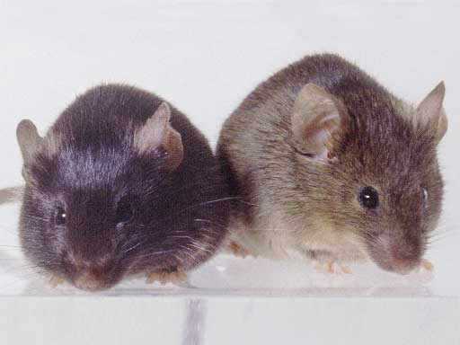
Autism-like socio-communicative deficits and stereotypies in mice lacking heparan sulfate*
Experiment with “designer” mice: blocked heparan sulfate synthesis in brain ventricles
Mice exhibited all the classic features of autism – both cognitive and social
"Fractone-associated N-sulfated heparan sulfate shows reduced quantity in BTBR T+tf/J mice: a strong model of autism." **
* F. Irie et al., PNAS Mar. 27, 2012, 109(13), 5052-5056.
**KZ Meyza et al., Behav Brain Res 2012;228:247–53.
Notes:
vitaminK/mice_no_heparan_sulfate_get_autism_2012.pdf
Samantha/heparan_sulfate_knockout_mice_get_autism.pdf

Slide 67
“Heparan sulfate deficiency in autistic postmortem brain tissue from the subventricular zone of the lateral ventricles”*
“Aberrant extracellular matrix glycosaminoglycan function localized to the subventricular zone of the lateral ventricles may be a biomarker for autism, and potentially involved in the etiology of the disorder.”
New neurons develop from stem cells in this zone through the action of “fractones” composed of heparan sulfate proteoglycans**
*BL Pearson et al., Behav Brain Res. 2013;243:138-45
**F. Mercier et al., Neuroscience Letters 506 (2012) 208–213
Notes:
Samantha/heparan_sulfate_deficiency_autism_postmortem_brain.pdf

Slide 68
Is Encephalopathy a Mechanism to Renew Sulfate in Autism?*
Abstract: “This paper makes two claims:
(1) Autism can be characterized as a chronic low- grade encephalopathy, associated with excess exposure to nitric oxide, ammonia and glutamate in the central nervous system, which leads to hippocampal pathologies and resulting cognitive impairment, and
(2) Encephalitis is provoked by a systemic deficiency in sulfate, but associated seizures and fever support sulfate restoration. …”
*S Seneff et al., Entropy 2013; 15: 372-406.

Slide 69
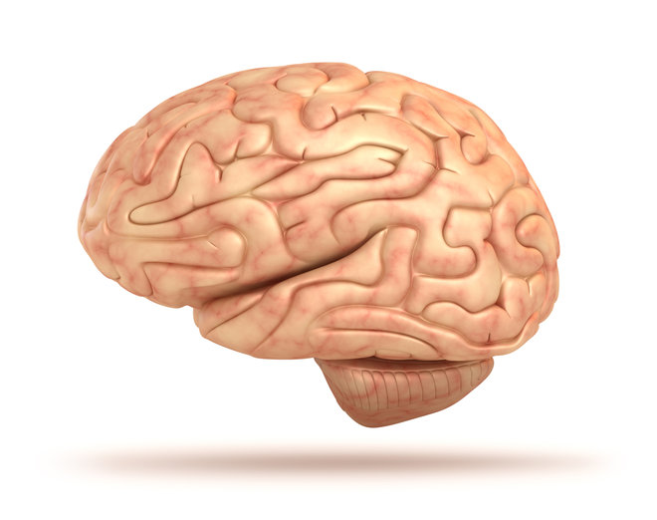
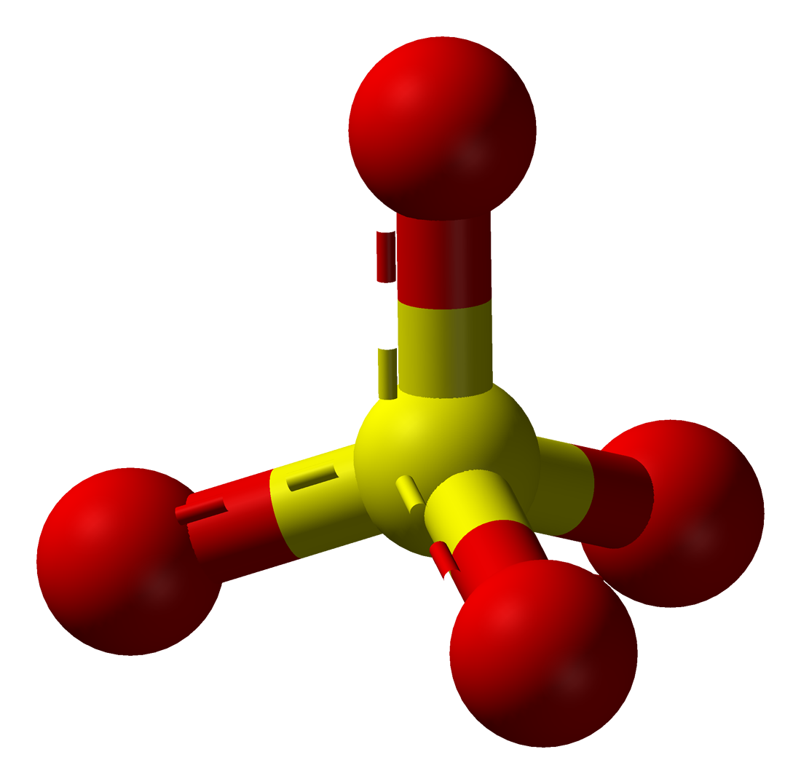
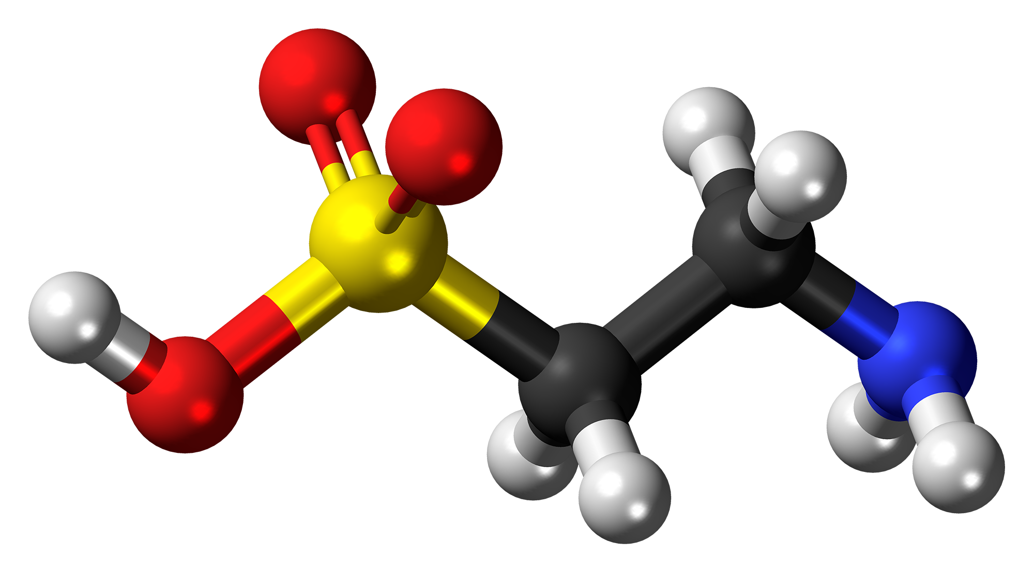
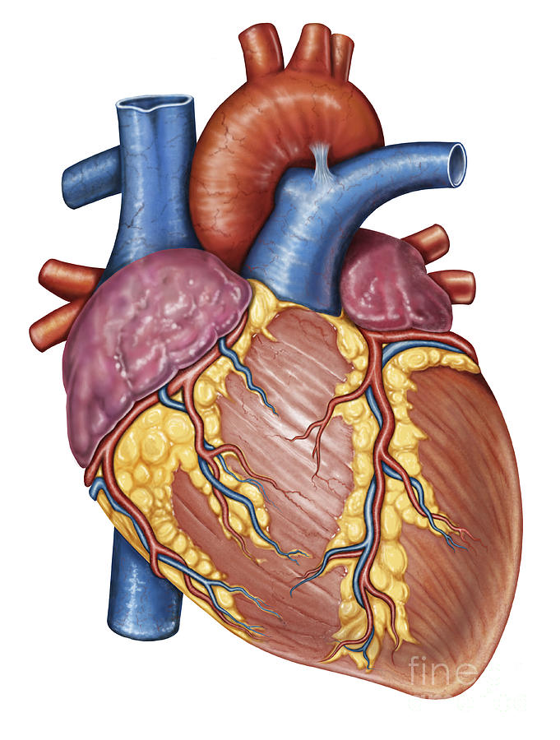
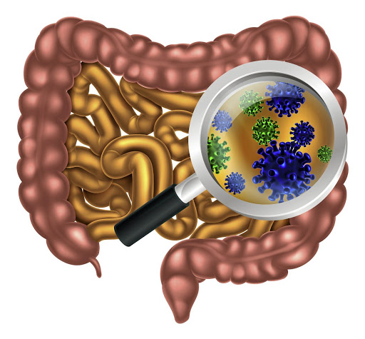
Gut Microbes to the Rescue!
Glyphosate blocks taurine uptake into E coli microbes*
sulfate
taurine
taurine
taurine
taurine
*W Lu et al. Mol BioSyst 2013; 9: 522-530.

Slide 70
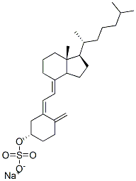
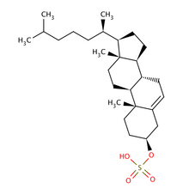
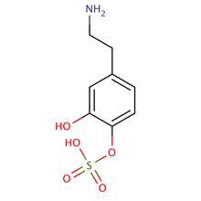
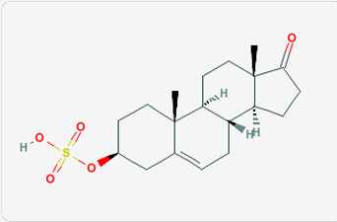
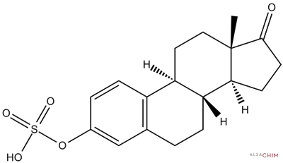
Safe Sulfate Transport: Carbon Rings
vitamin D sulfate
serotonin sulfate
cholesterol sulfate
dopamine sulfate
estrone
sulfate
DHEA sulfate

Slide 71
Safe Sulfate Transport: Carbon Rings
vitamin D sulfate
serotonin sulfate
cholesterol sulfate
Glyphosate depletes serotonin and dopamine and disrupts enzymes involved with sterol sulfation: Imperiled sulfate transport
dopamine sulfate
estrone
sulfate
DHEA sulfate

Slide 72
Recapitulation
Sulfate plays many essential roles in the body
Sulfate deficiency is a core feature of autism
Sulfate synthesis and transfer depend critically on both glycine residues and molybdenum
PCOS due to glycine mutation is a risk factor for autism
Heparan sulfate deficiency in the brain is associated with autism in both humans and mouse models
A low grade encephalopathy characterizes autism and may reflect the need to synthesize sulfate

Slide 73
Summary
Sulfate’s many essential roles in the body are under-appreciated and under-recognized
eNOS is a moonlighting enzyme that switches between sulfur and nitrogen oxidation in response to electromagnetic signals
An important role for many biologically active molecules is sulfate transport
Glyphosate’s insidious mechanism of toxicity is through substitution for glycine during protein synthesis (theory)
Glyphosate can be predicted to disrupt sulfate synthesis, sulfate transport and sulfate attachment to substrates
Glyphosate’s effects on sulfate lead to heart disease, fatty liver disease, adrenal insufficiency, autism, PCOS and many other diseases

