Slide 1
The New Agent Orange: Roundup Poisoning and an Epidemic of Auto-immune and Neurological Disease
Stephanie Seneff
MIT CSAIL
February, 2019

Slide 2
Download These Slides
http://people.csail.mit.edu/seneff/2019/
Seneff_February_2019_Hawaii.pptx

Slide 4
“A truth’s initial commotion is directly proportional to how deeply the lie was believed... When a well-packaged web of lies has been sold gradually to the masses over generations, the truth will seem utterly preposterous and its speaker, a raving lunatic.”
- Dresden James

Slide 5
Outline
Introduction
The California lawsuit: Glyphosate and non-Hodgkin’s Lymphoma
Glyphosate as a Glycine Analogue
Autoimmune Disease Epidemic
How Glyphosate Affects the Gut Barrier
Glyphosate, MMR and Autism
Molecular Mimicry
A Failed System and a Growing Food Movement
How to Safeguard Yourself and Your Family
Summary

Slide 6
Introduction

Slide 7
“Something very wrong is going on, something that is killing good people and causing untold suffering to families and communities around the world. Never has such a high percentage of the population been afflicted with so many tragic and wasting illnesses. In the past thirty years, a group of diseases has reached epidemic proportions in the United States and many other countries. These afflictions, often collectively referred to as diseases of civilization (DOC), include multiple sclerosis, Alzheimer's disease, breast cancer, lupus erythematosus, rheumatoid arthritis, melanoma, and autism - a once rare birth defect. Because the incidence of these diseases has increased gradually over three decades, we are inclined to accept this as a natural, if unfortunate, part of modern life. But such a lethal trend is not natural; the changes that we have witnessed over the last generation are unprecedented in the history of medical science.”
Woodrow C. Monte, PhD. While Science Sleeps. 2011
Notes:
Aspartame

Slide 8
Roundup and GMO Crops
GMO Roundup-Ready corn, soy, canola, sugar beets
cotton, tobacco and alfalfa
What is glyphosate?

Slide 9
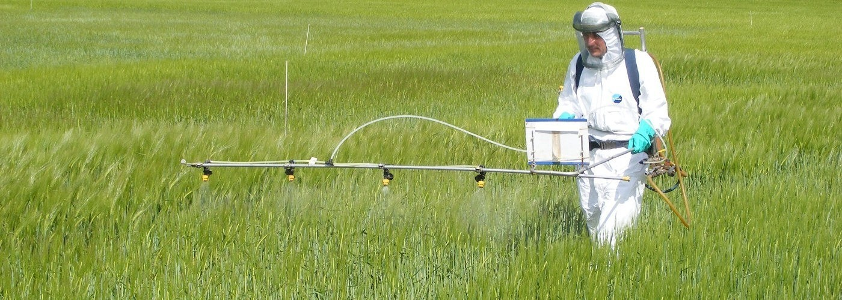
Roundup as a Desiccant/Ripener just before Harvest
Wheat, Oats, Barley, Rye, Sugar cane, Beans, Lentils, Peas, Flax, Sunflowers, Pulses, Chick Peas

Slide 10
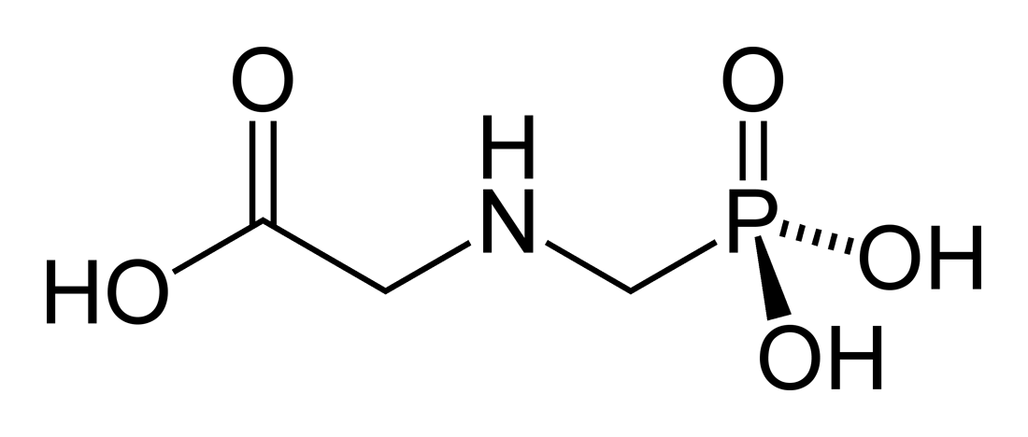
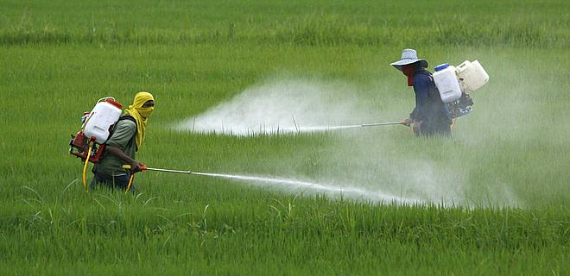
Glyphosate!!
Glyphosate is now the #1 herbicide in use in the U.S. and is increasingly used around the world
Developed and patented by Monsanto in the 1970’s
Introduced into the US food chain in 1974
Came out from under patent in 2000
Inhibits an enzyme in the shikimate pathway involved in the synthesis of tyrosine, tryptophan and phenylalanine (the three aromatic amino acids)
Huge expansion of GMO corn, soy, cotton and canola crops has led to sharp increases in the last two decades
Notes:
WIKI

Slide 11
Glyphosate vs. Other Pesticides: Usage in the United States*
Glyphosate
*http://sustainablepulse.com/wp-content/uploads/GMO-health.pdf

Slide 12
Shikimate Pathway Disruption
Phenylalanine, tryptophan, tyrosine
shikimate
Glyphosate
Neurotransmitters,
thyroid hormone
chorismate
vitamin K
folate

Slide 13
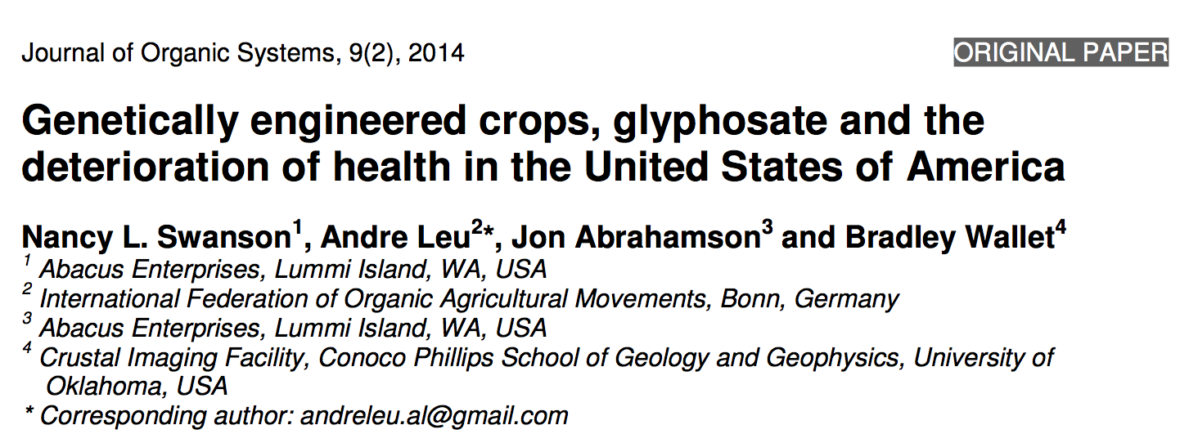
Paper Showing Strong Correlations between Glyphosate Usage and Chronic Disease

Slide 14
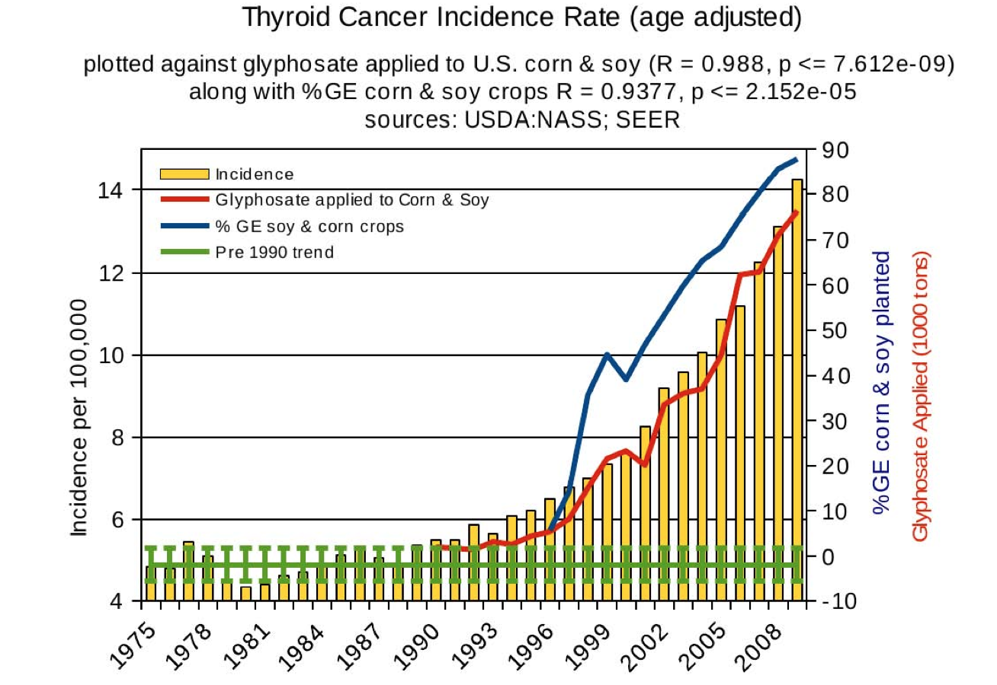
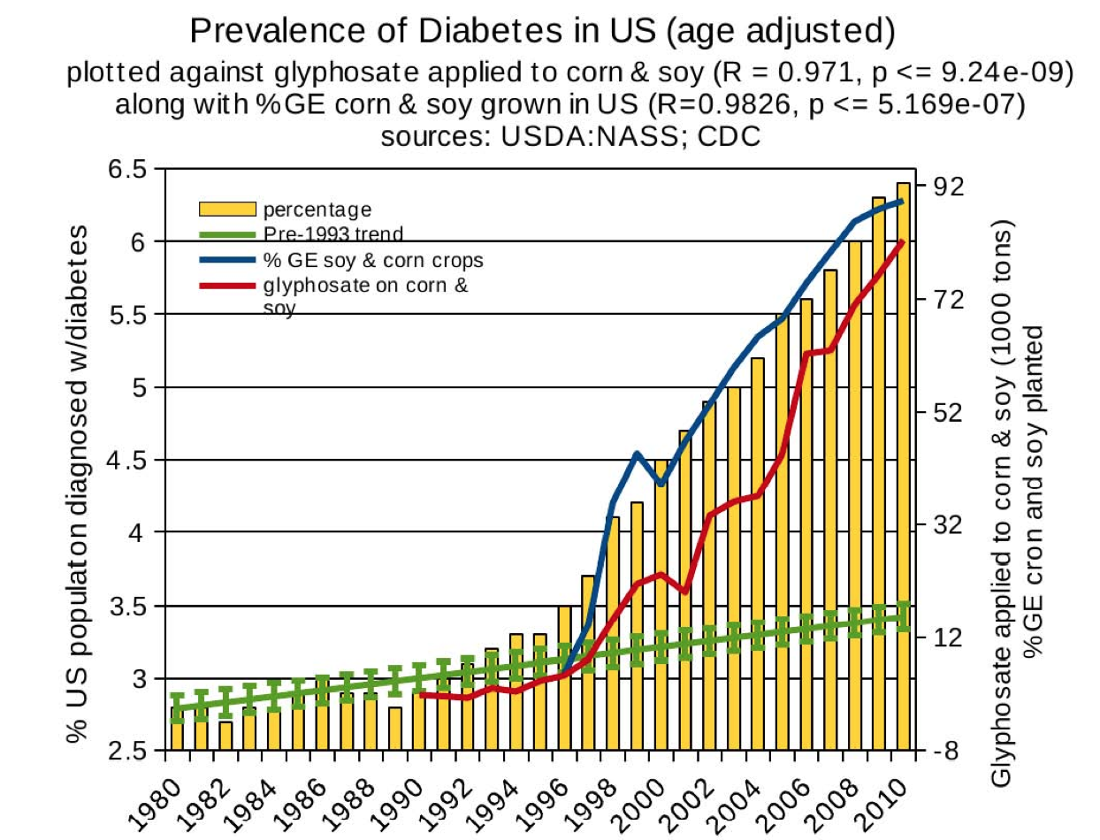
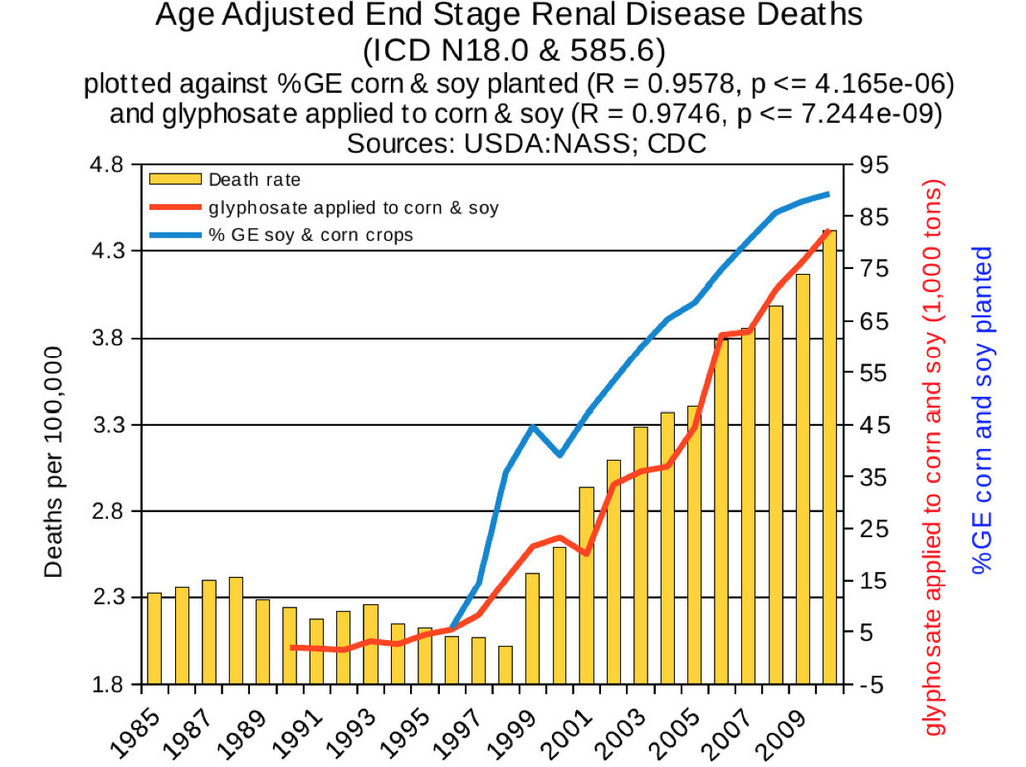
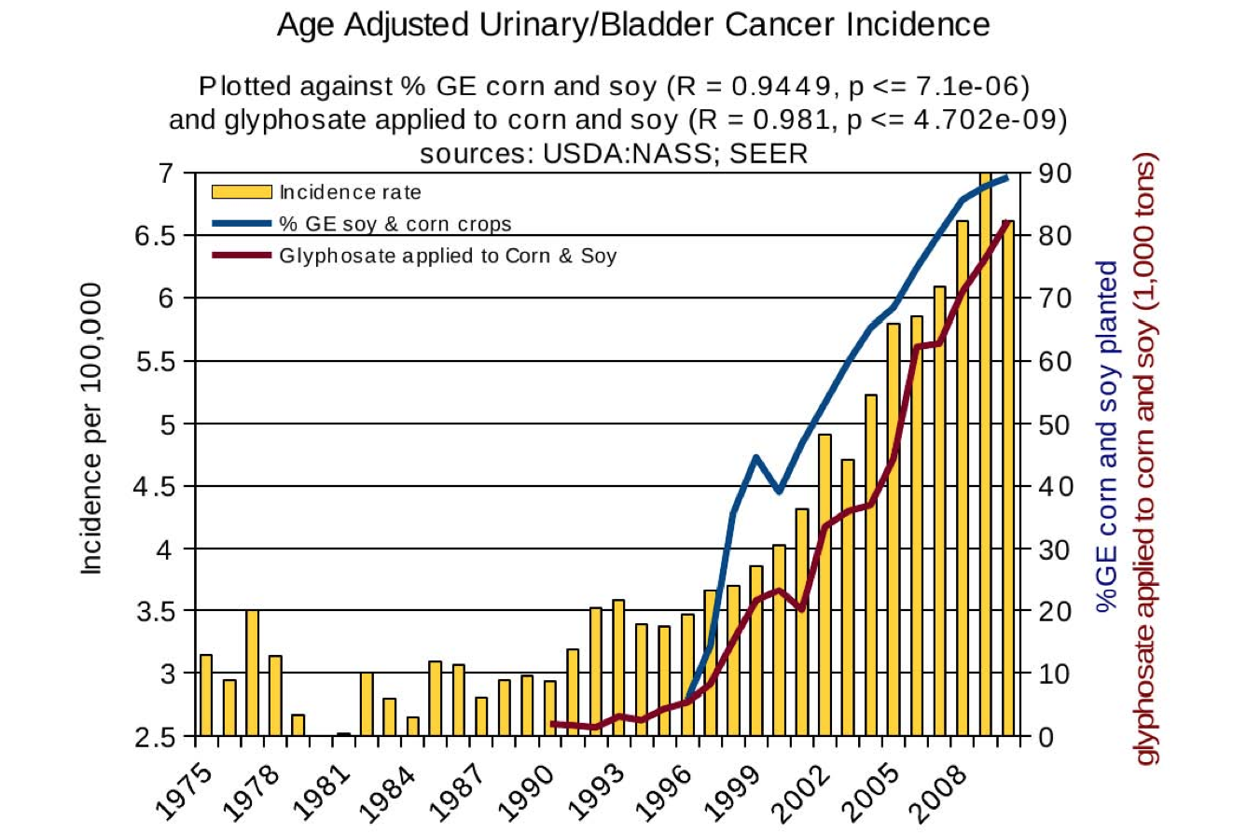
Thyroid cancer
Diabetes
End stage
renal disease
Urinary/bladder
cancer

Slide 15
Thyroid cancer
Diabetes
In 2015, WHO IARC declared glyphosate a “probable carcinogen”
End stage
renal disease
Urinary/bladder
cancer
Notes:
International agency for research on cancer

Slide 16
Quote from the Conclusion*
“Although correlation does not necessarily mean causation, when correlation coefficients of over 0.95 (with p-value significance levels less than 0.00001) are calculated for a list of diseases that can be directly linked to glyphosate, via its known biological effects, it would be imprudent not to consider causation as a plausible explanation.”
*NL Swanson et al. Journal of Organic Systems 9(2), 2014, p. 32,

Slide 17
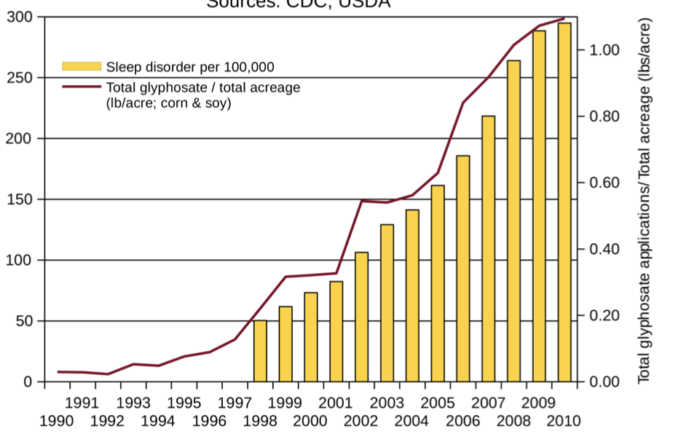
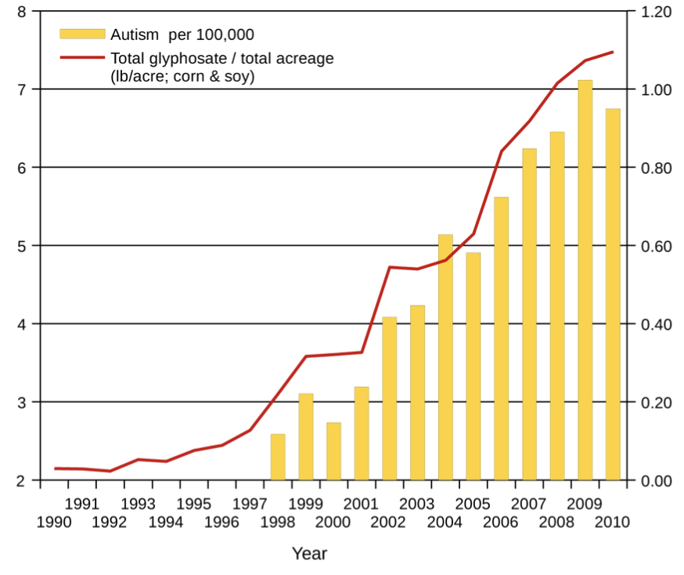
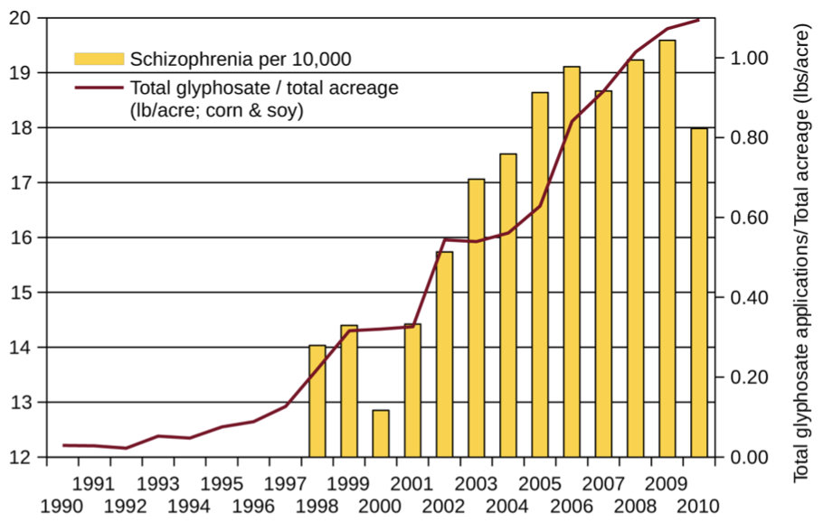
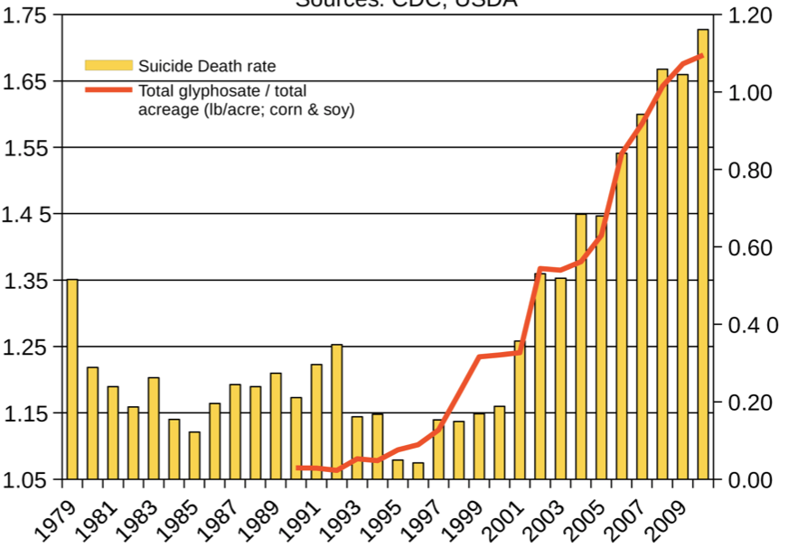
Autism
Sleep Disorder
Schizophrenia
Death by Suicide
*Seneff et al. Agricultural Sciences 2015; 6: 42-70.
Notes:
Hospital discharge diagnoses per 100,000

Slide 18
List Compiled by Prof. Don Huber

Slide 19
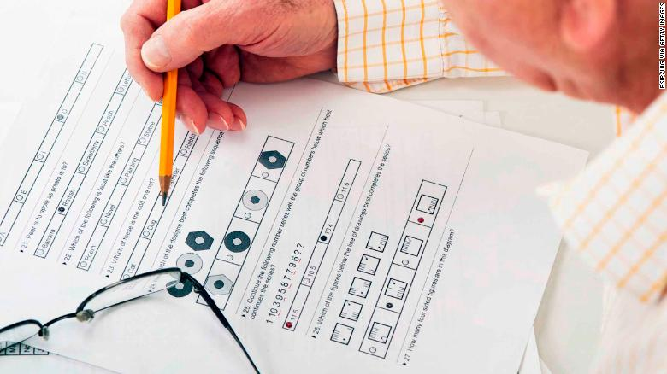
Decreasing IQ scores after 1975*
“scores increased by almost 3 percentage points each decade for those born between 1962 to 1975 -- but then saw a steady decline among those born after 1975.”
“What specific environmental factors cause changes in intelligence remains relatively unexplored.”
*Rory Smith, CNN.
https://www.cnn.com/2018/06/13/health/falling-iq-scores-study-intl/index.html

Slide 20
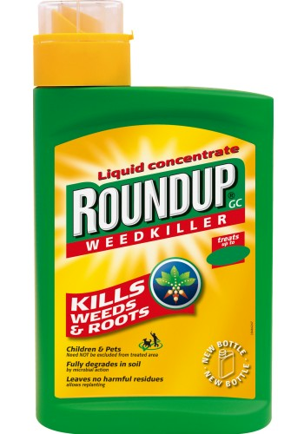
Decreasing IQ scores after 1975*
“scores increased by almost 3 percentage points each decade for those born between 1962 to 1975 -- but then saw a steady decline among those born after 1975.”
“What specific environmental factors cause changes in intelligence remains relatively unexplored.”
Glyphosate was introduced on the market in 1975
*Rory Smith, CNN.
https://www.cnn.com/2018/06/13/health/falling-iq-scores-study-intl/index.html

Slide 21
US
Notes:
http://www.commonwealthfund.org/interactives-and-data/chart-cart/report/2017-mirror-mirror/mortality-amenable-to-health-care

Slide 22
Glyphosate in Human Urine: U.S. Southern California*
*PJ Mills et al. JAMA 2017; 318(16): 1610-1611.
Notes:
./JAMA_glyphosate_urine_US_2018.pdf

Slide 23
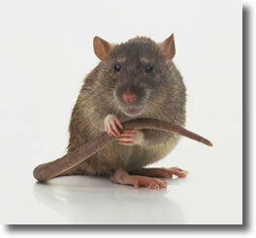
Glyphosate reduces sperm motility and sperm count*
*FO Owagboriaye et al. Experimental and Toxicologic Pathology 2017 Sep 5;69(7):461-468.
Notes:
Glyphosate/Glyphosate_Reproductive toxicity of Roundup herbicide exposure in male albino rat.pdf

Slide 24
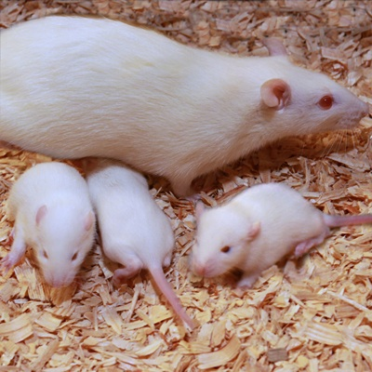
Glyphosate Damages Second Generation*
Pregnant rats exposed to glyphosate starting at day 9 of gestation
Two exposure levels (low, high), both levels considered to be safe according to regulators
Neither the rats nor their offspring showed any obvious effects
The second generation offspring from both exposed groups showed delayed growth, lower fetal weight and length and a higher incidence of abnormally small fetusus
Most surprising: there were three cases (each from a different mother) among the second generation offspring with major fetal abnormalities (conjoined fetuses and abnormal limb development)
*MM Milesi et al. Archives of Toxicology June 9, 2018 [Epub ahead of print]
Notes:
glyphosate/Milesi_glyphosate_reproduction_rats_2018.pdf
https://www.gmwatch.org/en/news/latest-news/18363-glyphosate-based-herbicide-impairs-female-fertility-new-study
The second generation offspring from both glyphosate herbicide-exposed groups showed delayed growth, evidenced by lower foetal weight and length, and a higher incidence of abnormally small foetuses.
Also, to the authors' surprise, malformations (conjoined foetuses and abnormally developed limbs) were detected in the second generation of offspring from the higher dose of glyphosate herbicide group. Foetal abnormalities were found in 3 out of 117 foetuses, each one from different mothers within the first generation of offspring (i.e. 3 out of 13 litters were affected). A statistically significant correlation was found between glyphosate herbicide exposure and foetal malformations.

Slide 25
America’s Children are in Trouble!
It is now "normal" for a kindergarten child to have 12 colds every year and for a baby to have nine
Fourfold increase in childhood obesity
Double the asthma rate since the 1980's
"Chronic illnesses" rose from 1.8% in 1960 to 7% in 2004
Today, 43% of US children are chronically ill
1 in 6 children in the USA has a neurodevelopmental disability
1 in 38 boys are autistic
US has the worst neonatal death rate of all industrialized countries
Today's children in the US will have a shortened life span compared to their parents
Source: http://www.vaccineviolence.com/
Notes:
https://www.facebook.com/groups/1409306052710440/
./TheOutliers.text
Page removed!!
— Joanna Karpasea Jones

Slide 26
The California Lawsuit:
Glyphosate and
non-Hodgkin’s Lymphoma

Slide 27
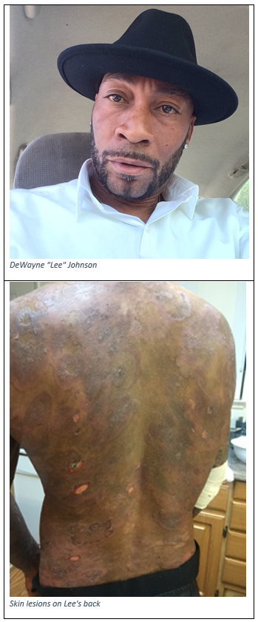
Dewayne “Lee” Johnson vs Monsanto: Glyphosate & Non-Hodgkin’s Lymphoma*
*https://www.cnn.com/2018/06/17/us/
monsanto-roundup-dewayne-johnson-trial/index.html
Notes:
./CNN_Monsanto_lawsuit.text
https://www.cnn.com/2018/06/17/us/monsanto-roundup-dewayne-johnson-trial/index.html

Slide 28
Details of the Lawsuit*
Johnson was a groundskeeper for the school district in Benicia, CA, just north of San Francisco
He was diagnosed with non-Hodgkin’s lymphoma (NHL) in 2014, at age 42.
In 2015, WHO's IARC classified glyphosate as "probably carcinogenic to humans"
Donna Farmer, Monsanto's "product protection lead" said in email to colleagues:
"You cannot say that Roundup does not cause cancer."
Timothy Litzenburg, one of Johnson's lawyers, said:
"so much of what Monsanto has worked to keep secret is coming out."
www.theguardian.com/business/2018/jul/09/
monsanto-trial-roundup-weedkiller-cancer-dewayne-johnson
Notes:
https://www.theguardian.com/business/2018/jul/09/monsanto-trial-roundup-weedkiller-cancer-dewayne-johnson

Slide 29
“We’re going to see for the first time evidence that nobody has seen before, evidence that has been in Monsanto’s files that we’ve obtained from lawyers and the people in Monsanto… I don’t think it’s a surprise after 20 years Monsanto has known about the cancer-causing properties of this chemical and has tried to stop the public from knowing it, and tried to manipulate the regulatory process.”
-- Robert F Kennedy, Jr.
Co-counsel for Johnson

Slide 30
“We’re going to see for the first time evidence that nobody has seen before, evidence that has been in Monsanto’s files that we’ve obtained from lawyers and the people in Monsanto… I don’t think it’s a surprise after 20 years Monsanto has known about the cancer-causing properties of this chemical and has tried to stop the public from knowing it, and tried to manipulate the regulatory process.”
-- Robert F Kennedy, Jr.
Co-counsel for Johnson
” If we get a large award in this case, it could easily threaten the future financial viability of the company.”
-- Robert F Kennedy, Jr.

Slide 32
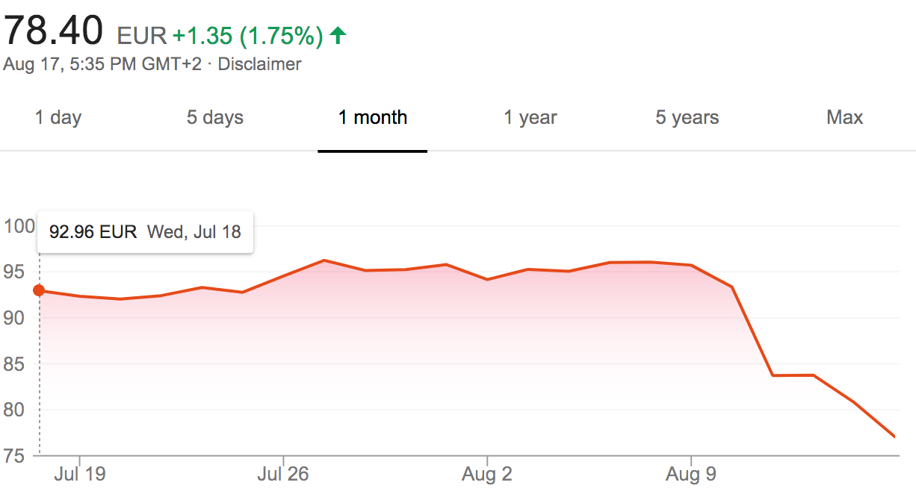
Bayer Stock Prices
Johnson Verdict

Slide 33
Verdict Upheld in Higher Court: October 22, 2018
Damages reduced to $78 Million

Slide 34
Bayer to sell businesses, cut jobs after Monsanto deal*
“Chief Executive Werner Baumann is under pressure to boost Bayer’s share price after a drop of more than 35 percent so far this year, dragged down by concern over more than 9,000 lawsuits it faces over an alleged cancer-causing effect of Monsanto’s Roundup weed killer.”
Ludwig Burger
November 29, 2018
*https://www.reuters.com/article/us-bayer-strategy/
bayer-to-sell-businesses-cut-jobs-after-monsanto-deal-idUSKCN1NY1SI

Slide 35
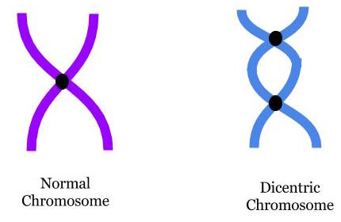
“In vitro evaluation of genomic damage induced by glyphosate on human lymphocytes”*
In vitro exposure of human lymphocytes to glyphosate at levels of 0.5, 0.1, 0.050, 0.025 and 0.0125 μg/ml
0.5 is considered an "acceptable daily exposure level”
Chromosomal aberrations and micronuclei frequencies were significantly high at all except the lowest exposure levels.
*A Santovito et al. Environ Sci Pollut Res Int 2018;25(34):34693-700.
Notes:
https://link.springer.com/article/10.1007%2Fs11356-018-3417-9

Slide 36
“In vitro evaluation of genomic damage induced by glyphosate on human lymphocytes”*
In vitro exposure of human lymphocytes to glyphosate at levels of 0.5, 0.1, 0.050, 0.025 and 0.0125 μg/ml
0.5 is considered an "acceptable daily exposure level”
Chromosomal aberrations and micronuclei frequencies were significantly high at all except the lowest exposure levels.
Lymphocytes are the cell type that transforms into cancer cells in non-Hodgkin’s lymphoma
*A Santovito et al. Environ Sci Pollut Res Int 2018;25(34):34693-700.
Notes:
https://link.springer.com/article/10.1007%2Fs11356-018-3417-9

Slide 37
Glyphosate as a
Glycine Analogue

Slide 38
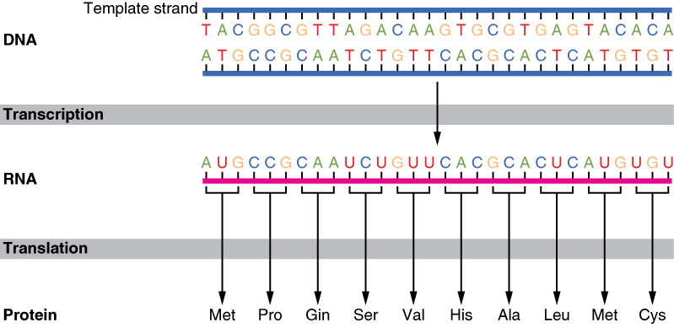
The Basics of Protein Synthesis
Glyphosate
Glycine

Slide 39
Glyphosate is a non-coding amino acid analogue of glycine
H
Glycine
Glyphosate

Slide 40
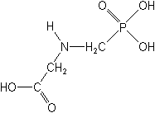
What If Glyphosate Could Insert Itself Into Protein Synthesis by mistake???
glyphosate
Code for glycine
GGC
mRNA
. . .
. . .
Glyphosate
Alanine
Proline
Any proteins with conserved glycine residues are likely to be affected in a major way

Slide 41
What If Glyphosate Could Insert Itself Into Protein Synthesis by mistake???
Multiple species of microbes have independently solved the glyphosate problem in the shikimate pathway by mutating a specific glycine residue in EPSP synthase to alanine.
This mutation forms the basis for the GMO Roundup-Ready crops.
glyphosate
Code for glycine
GGC
mRNA
. . .
. . .
Glyphosate
Alanine
Proline
Any proteins with conserved glycine residues are likely to be affected in a major way

Slide 42
Only Glyphosate Works!*
“More than 1,000 analogs of glyphosate have been produced and tested for inhibition of EPSP synthase, but minor structural alterations typically resulted in dramatically reduced potency, and no compound superior to glyphosate was identified.”
Hypothesis:
These other molecules failed to work as an amino acid analogue of glycine, because they were not amino acids.
*T Funke et al. PNAS 2006; 103(35): 13010-13015.

Slide 43
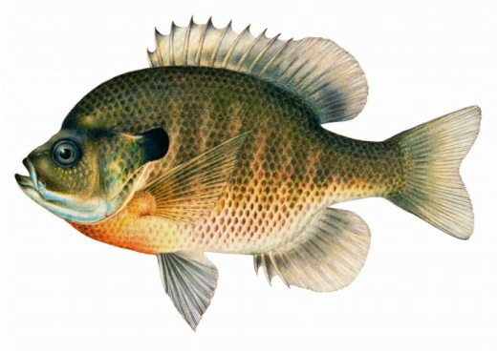
Quote from Monsanto Study (1989)*
Study exposed bluegill sunfish to carbon-14 radiolabelled glyphosate
Measured radiolabel in tissues greatly exceeded measured glyphosate levels
Proteolysis recovered more glyphosate
20% yield → 70% yield
"Proteinase K hydrolyses proteins to amino acids and small oligopeptides, suggesting that a significant portion of the 14C activity residing in the bluegill sunfish tissue was tightly associated with or incorporated into protein.”
*WP Ridley and KA Chott. Monsanto unpublished study. August, 1989.

Slide 44
Some Predicted Consequences*
Neurological diseases
Neural tube defects
Celiac disease
Impaired collagen → osteoarthritis
Steatohepatitis (fatty liver disease)
Obesity and adrenal insufficiency
Impaired iron homeostasis and kidney failure
Insulin resistance and diabetes
Cancer
Autoimmune diseases
*A Samsel and S Seneff. Journal of Biological Physics and Chemistry 2016; 16:9-46.

Slide 45
Some Predicted Consequences*
Neurological diseases
Neural tube defects
Celiac disease
Impaired collagen → osteoarthritis
Steatohepatitis (fatty liver disease)
Obesity and adrenal insufficiency
Impaired iron homeostasis and kidney failure
Insulin resistance and diabetes
Cancer
Autoimmune diseases
*A Samsel and S Seneff. Journal of Biological Physics and Chemistry 2016; 16:9-46.

Slide 46
Autoimmune Disease
Epidemic

Slide 47
Autoimmune Disease: An Invisible Epidemic*
“Taken together, the number of people suffering from autoimmune diseases is 24–50 million Americans, 16% of the US population. To put it in perspective, autoimmune disease prevalence equals heart disease and cancer combined.”
*Feldman B, Martin EM, Simms T. An Invisible Epidemic — When your body attacks itself — Autoimmune Disease; How Reframing the Data Unveils a Public Health Crisis Bigger than Cancer and Heart Disease Combined. www.tincture.io.
Notes:
Feldman B, Martin EM, Simms T. An Invisible Epidemic — When your body attacks itself — Autoimmune Disease; How Reframing the Data Unveils a Public Health Crisis Bigger than Cancer and Heart Disease Combined. www.tincture.io.
IN Beecham Seneff paper. Ref. 13.

Slide 48
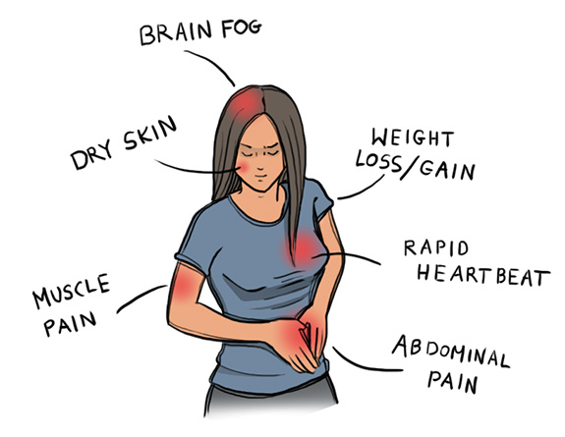
Autoimmune Disease Statistics*
Autoimmune Disease (AD) is a major health problem
Annual direct health care costs for AD in US estimated to be ~$100 billion
At least 23.5 million Americans suffer from one or more autoimmune diseases
Among the top-10 causes of death in females under 64 years old
Immunosuppressant treatments have devastating side effects
*https://www.aarda.org/autoimmune-information/autoimmune-statistics/

Slide 49
Notes:
autoimmune_disease_precedes_ALS_2013.pdf

Slide 50
"Results: There were significantly more cases than expected of ALS associated with a prior diagnosis of asthma, celiac disease, younger-onset diabetes (younger than 30 years), multiple sclerosis, myasthenia gravis, myxedema, polymyositis, Sjögren syndrome, systemic lupus erythematosus, and ulcerative colitis.”
Notes:
autoimmune_disease_precedes_ALS_2013.pdf

Slide 51
Why do we have an epidemic in
autoimmune disease in America today?

Slide 52
Hypothesis
Glyphosate exposure sets up a weakened immune system, a leaky gut barrier and a leaky brain barrier
Glyphosate contamination in proteins makes them hard to break down
Person develops overactive antibody response to foreign protein contaminated with glyphosate and, through molecular mimicry, this leads to autoimmune disease
This easily explains gluten intolerance and other food allergies
And it eventually leads to more serious problems like ALS

Slide 53
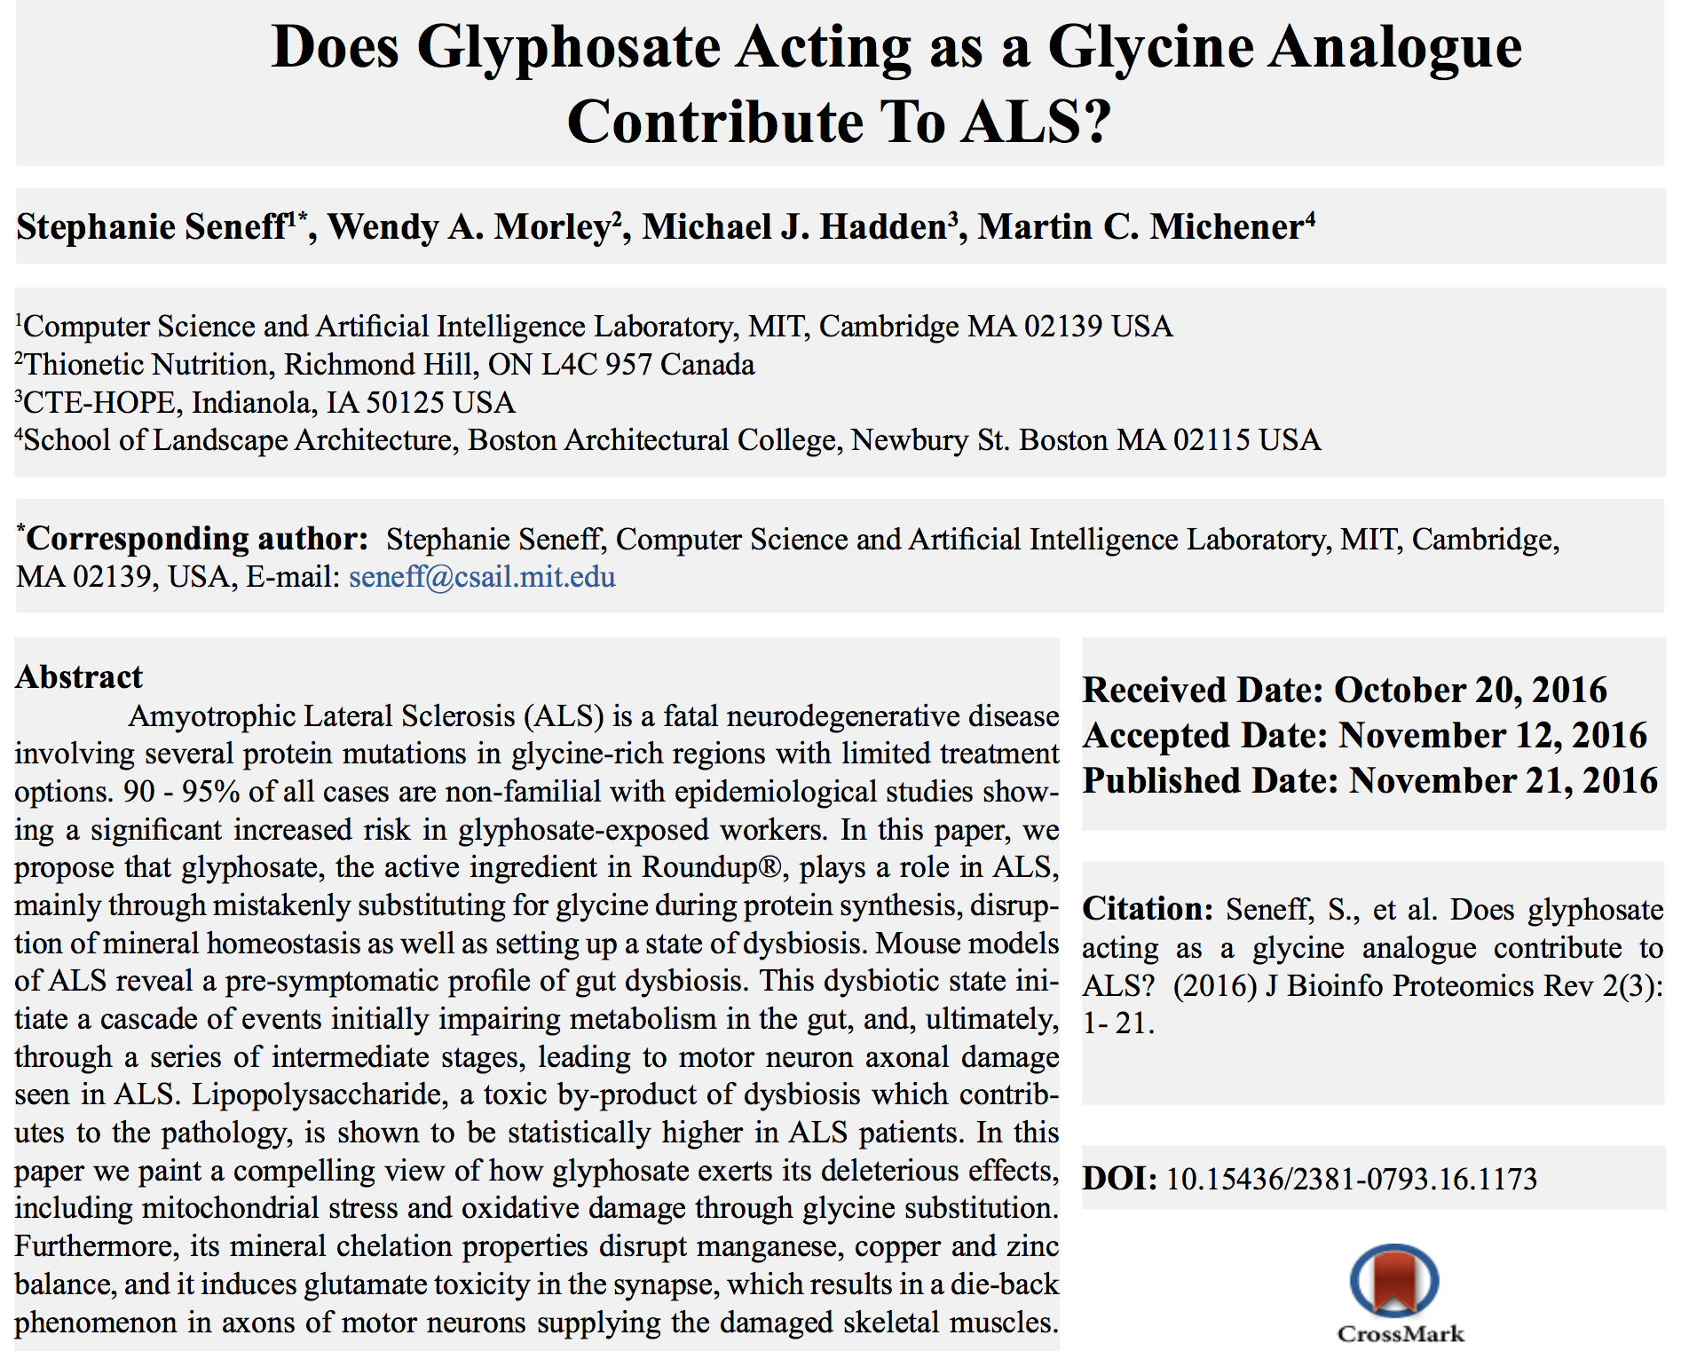

Slide 54
"In this paper, we propose that glyphosate, the active ingredient in Roundup®, plays a role in ALS, mainly through mistakenly substituting for glycine during protein synthesis, disruption of mineral homeostasis as well as setting up a state of dysbiosis. Mouse models of ALS reveal a pre-symptomatic profile of gut dysbiosis."

Slide 55
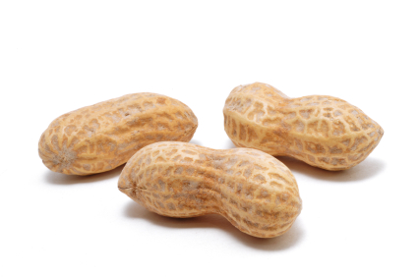
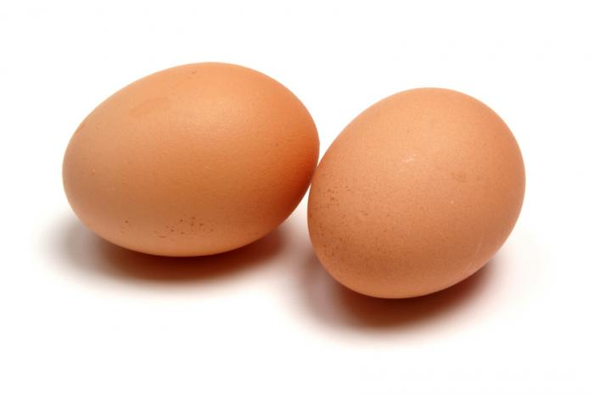
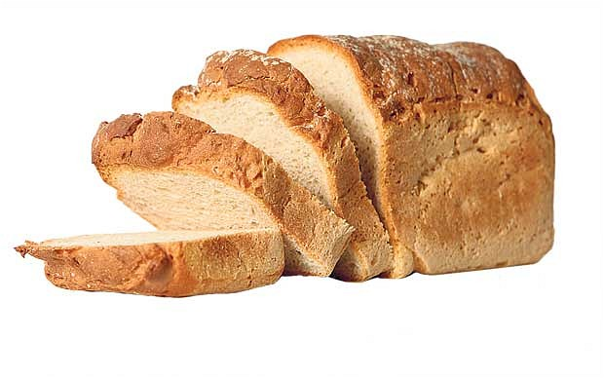
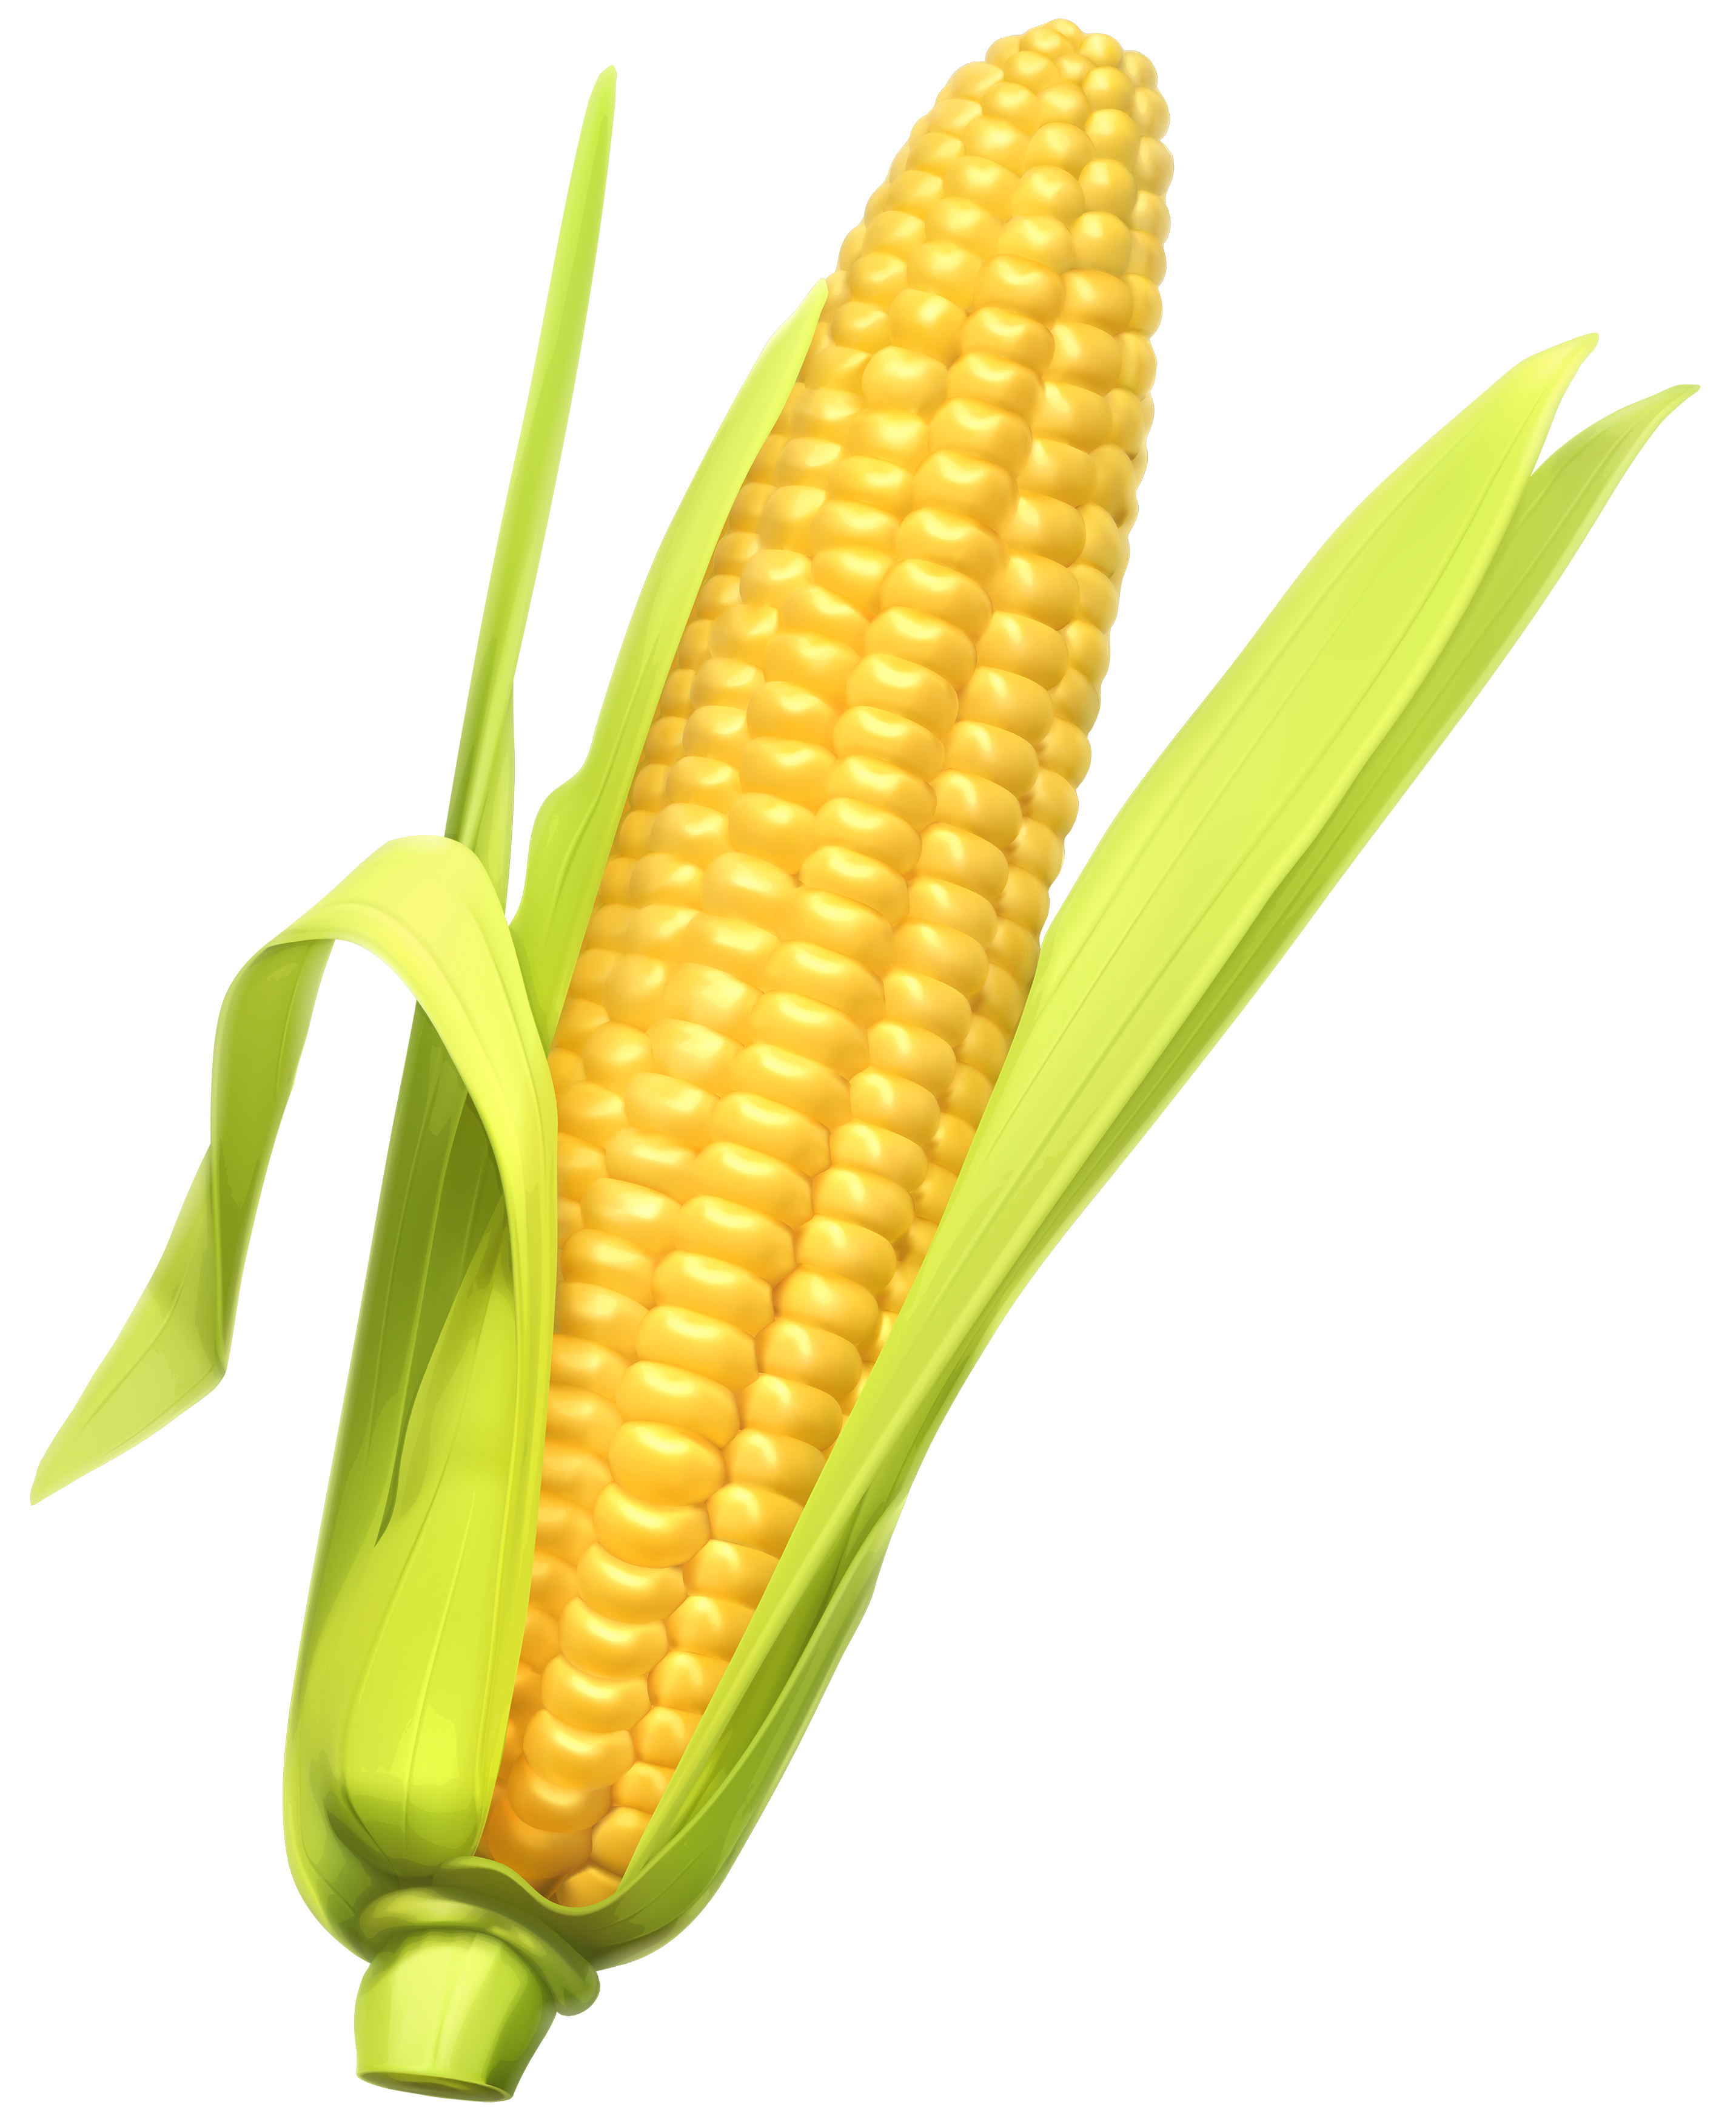
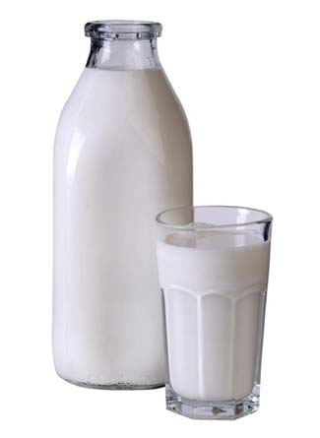
Food Allergies

Slide 56
Food Allergies
All of these foods can be expected to be contaminated with glyphosate, given how they’re produced

Slide 57
Food Allergies
"In our study, with the largest case number reported thus far, the results supported the significant association between ASDs [autism spectrum disorders] and allergic diseases.”*
*J Chen et al. Int J Dev Neurosci. 2014 Jun;35:35-41.

Slide 58
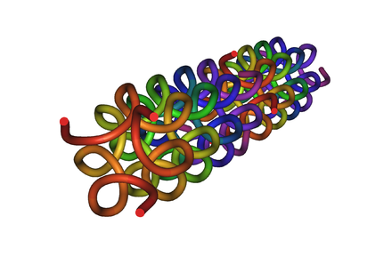
Collagen and Gelatin
25% of the protein in our body is collagen
25% of the amino acids in collagen are glycines
Glyphosate substitution for glycine will disrupt triple-helix formation and lead to diseases of the vasculature, joints and bones
Gelatin is derived from collagen in bones and ligaments sourced from cows and pigs fed glyphosate-contaminated GMO Roundup-Ready feed

Slide 59
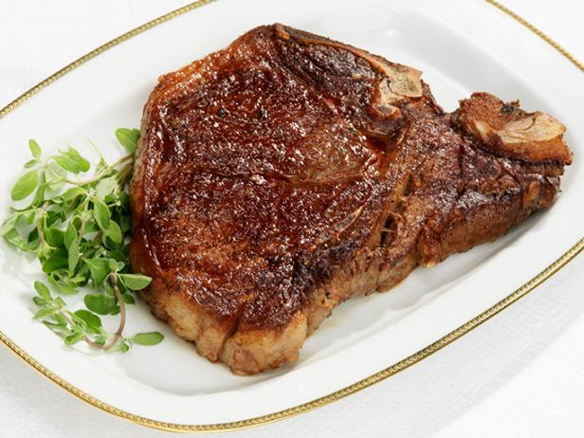
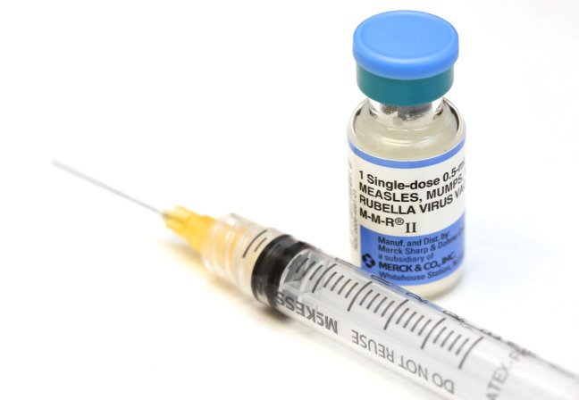
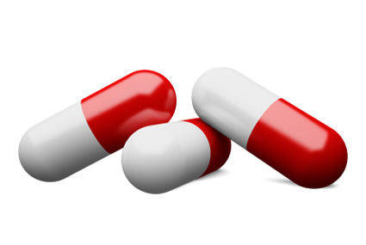
Products Containing Collagen/ Gelatin !!

Slide 60
Drugs and Autoimmune Disease*
Drugs that treat autoimmune disease have a huge problem with side effects
They suppress the immune system, and increase risk to tuberculosis, invasive fungal infections and lymphomas (cancers of the immune system)
Humira is a TNF-alpha inhibitor, which blocks the immune response
It costs about $3,100 per month
U.S. prescriptions for Humira have taken off in recent years: 1.5 million in 2011; 2.4 million in 2015.
It was linked to more than 209,000 adverse event reports since 2013, including more than 4,200 deaths.
* usatoday.com/story/news/nation-now/2017/03/19/
analysis-reports-drug-side-effects-increase-fivefold-12-years/99384190/
Notes:
rug_side_effects_rising_2017.text

Slide 61
Chronic Pain*
“The list of different types of chronic pain syndrome seems to be growing every day, including complex regional pain syndrome, failed back syndrome, fibromyalgia, interstitial cystitis, myofascial pain syndrome, postvasectomy pain, vulvodynia, pelvic pain syndrome – and on and on.“
*P. 42, Anna Lembke, Drug dealer, MD
.John’s Hopkins U Press, Baltimore, MD
Notes:
Book:

Slide 62
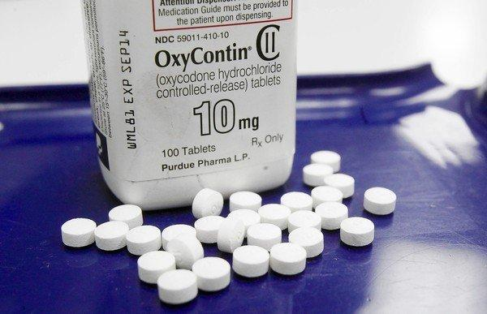
US Department of Health and Human Services Data on Pain-Killer Drug Abuse*
Drug overdose is the leading cause of injury death in the United States
Heroin, morphine, and prescription pain relievers
More people died from drug overdoses in 2014 than in any previous year on record
More than 6 out of 10 involved an opioid drug
More than 650,000 opioid prescriptions are dispensed every day
*http://www.hhs.gov/opioids/about-the-epidemic/
Notes:
./Factsheet-opioids-061516.pdf

Slide 63
US Department of Health and Human Services Data on Pain-Killer Drug Abuse*
According to PBS Evening News (Sept. 29, 2017), 64,000 deaths in the U.S. were attributed to opioid drug overdose in 2016.
This number increased to 72,000 in 2017 (up 10% from previous year)
(Reported August 16, 2018).
Drug overdose is the leading cause of injury death in the United States
Heroin, morphine, and prescription pain relievers
More people died from drug overdoses in 2014 than in any previous year on record
More than 6 out of 10 involved an opioid drug
More than 650,000 opioid prescriptions are dispensed every day
*http://www.hhs.gov/opioids/about-the-epidemic/
Notes:
./Factsheet-opioids-061516.pdf

Slide 64
How Glyphosate Affects
the Gut Barrier

Slide 65
Glyphosate and the Gut: Digestive Enzymes
Glyphosate has been found as a contaminant in digestive enzymes trypsin, pepsin and lipase*
Trypsin impairment prevents proteins like gluten in wheat from being digested
Undigested proteins induce release of zonulin which opens up gut barrier**
Zonulin lingers because trypsin is defective
*A Samsel and S Seneff. J Biol Phys Chem 2017;17:8-32
** JJ Gildea et al. J Clin Nutr Diet. 2017, 3:1.
Notes:
Glyphosate/ZachBushPaper_tight_junctions_glyphosate_2017.pdf

Slide 66
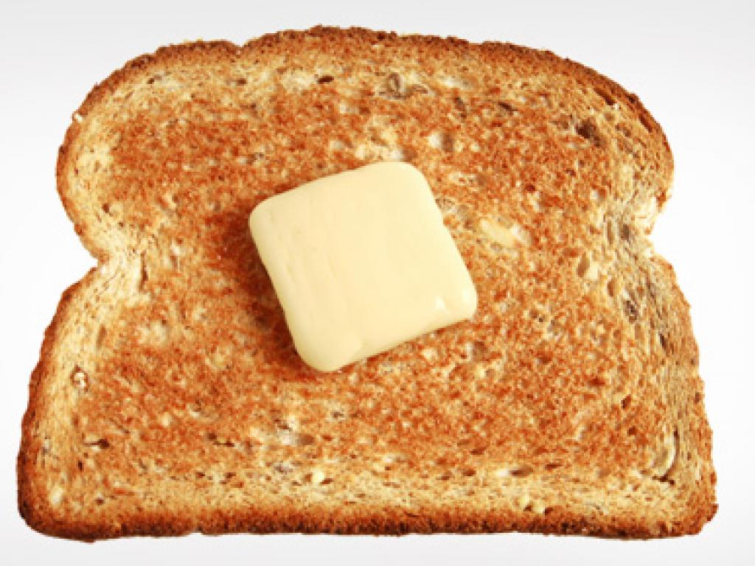
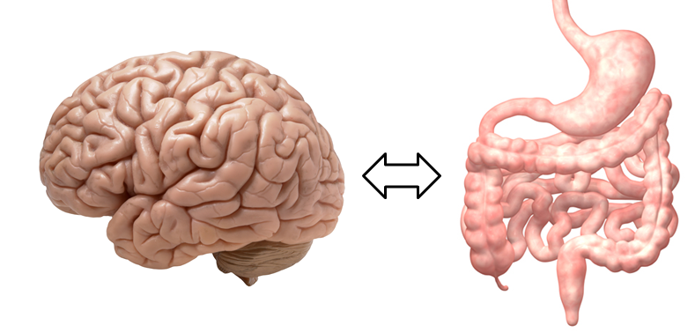
A Scenario
Glyphosate in wheat
Leaky brain barrier
Zonulin
Trypsin defective
Autoimmune disease
Zonulin released
Gliadin
Leaky barrier

Slide 67
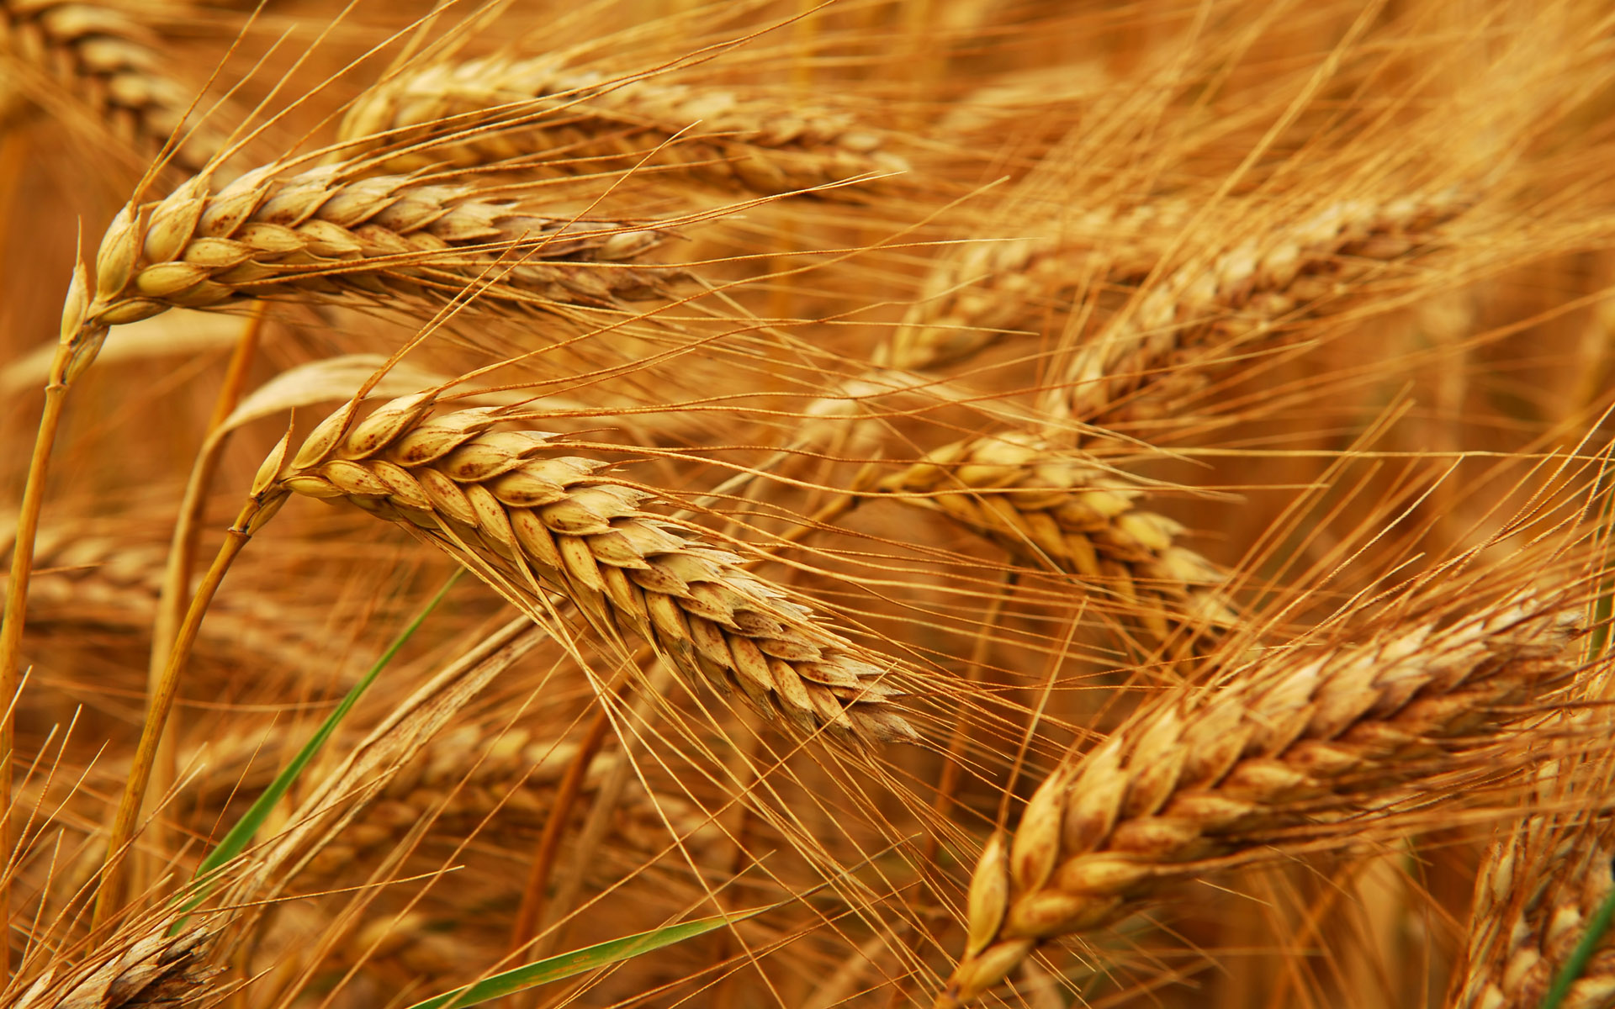
Glyphosate and Celiac Disease*
Glyphosate
Use on wheat
Celiac disease
*Samsel and Seneff, Interdiscip Toxicol. 2013;6(4): 159–184.

Slide 68
Glyphosate and the Gut: Pathogen Overgrowth
Glyphosate is an antimicrobial agent that preferentially kills beneficial microbes, allowing pathogens to flourish in the gut*
Immune cells invade the gut and release inflammatory cytokines
This causes increased risk to inflammatory bowel diseases such as Crohn’s and ulcerative colitis
* Samsel and Seneff. Entropy 2013; 15: 1416-1463.

Slide 69
Pathogen Overgrowth in Poultry Microbes Exposed to Glyphosate*
Clostridia
Salmonella
Bifidobacteria
*Plot provided by Dr. Martin Michener
Notes:
From Marty Michener!
Sheehata paper.

Slide 70
Celiac Disease, Glyphosate and Non Hodgkin’s Lymphoma
Glyphosate preferentially kills Bifidobacteria*
Bifidobacteria are depleted in celiac disease**
Celiac disease is associated with increased risk to non Hodgkin’s lymphoma***
Glyphosate itself is also linked directly to non Hodgkin’s lymphoma****
*A.A. Shehata et al., Curr Microbiol. 2013 Apr;66(4):350-8.
** M. Velasquez-Manoff, NY Times Sunday Review, Feb. 23, 2013.
*** C. Catassi et all, JAMA. 2002 Mar 20;287(11):1413-9.
****M. Eriksson et al., Int J Cancer. 2008 Oct 1;123(7):1657-63.
Notes:
**./ bifidobacteria_celiac_disease.text
Cancer/Celiac_disease_increases_hodgkins_lymphoma.text
./Celiac_and_bacteria.text

Slide 71
*
“We propose that acetate produced by protective bifidobacteria improves intestinal defence mediated by epithelial cells and thereby protects the host against lethal infection.” [e.g., E coli]
*S Fukuda et al. Nature. 27 Jan. 2011; 469: 543-547.

Slide 72
Inflammatory Bowel Disease
*Figure 20, NL Swanson et al. Journal of Organic Systems 9(2), 2014, p. 25.

Slide 73
Evidence linking autism to Clostridia overgrowth*
14 autistic children with gut disorder compared to 21 controls
Significant increase in Clostridia species in the gut in autistic children
Associated with reduced tryptophan levels and increased expression of inflammatory markers
Tryptophan is a product of the shikimate pathway, which glyphosate blocks
Macrophages in inflamed tissue take up tryptophan, reducing bioavailability to the brain
Proposed role for antibiotics
Glyphosate is a patented antimicrobial agent (2010)
*RA Luna et al., Cellular and Molecular Gastroenterology and Hepatology 2017;3(2): 218-230

Slide 74
*
Triplets: two boys, one girl. Both boys have autism and girl has seizure disorder
Very high levels of glyphosate in urine in all three
Clostridia overgrowth due to glyphosate disruption of gut microbes
Clostridia produce toxins HPHPA and p-cresol, which block the conversion of dopamine to norepinephrine.
Damage to neurons in the brain through oxidative stress
*W. Shaw. Integrative Medicine 2017;16(1);50-57.
Notes:
./Shaw_on_glyphosate_triplets_autism.text

Slide 75
Pathogen Overgrowth in Poultry Microbes Exposed to Glyphosate*
Clostridia
Salmonella
*Plot provided by Dr. Martin Michener
Notes:
From Marty Michener!
Sheehata paper.

Slide 76
Recapitulation
Glyphosate contamination in food proteins makes them hard to break down
Glyphosate contamination in digestive enzymes makes them defective
Undigested proteins induce leaky gut barrier
Studies on poultry confirm glyphosate disrupts gut microbes
Celiac disease is associated with increased risk to non-Hodgkin’s lymphoma, which is also linked to glyphosate exposure.
Glyphosate induces overgrowth of Clostridia species in gut
Clostridia release toxins that induce an inflammatory response and prevent dopamine metabolism
Clostridia overgrowth can lead to autism
Inflammation in the brain and excessive neurostimulation by dopamine damages neurons

Slide 77
Glyphosate, MMR and Autism

Slide 78
“There isn’t enough institutional infrastructure to educate the growing numbers of children with autism and house the adults they are becoming. Young adults with autism are increasingly sent to nursing homes because there’s nowhere else to go.”
-- Louise Kuo Habakus
Founder and Chief Executive of Fearless Parent

Slide 79
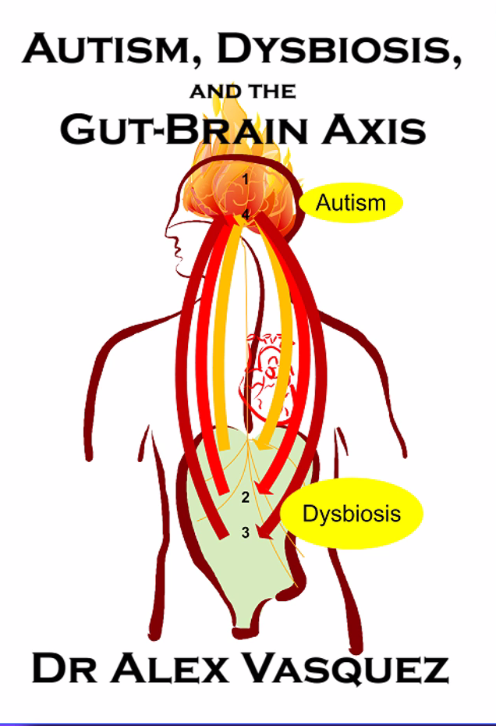
"We now know that autism is a multifaceted disorder associated with gastrointestinal inflammation, nutritional deficiencies, multiple food allergies and intolerances, impairments in liver detoxification and resultant accumulation of xenobiotics, the majority of which have neurotoxic and/or immunotoxic effects.”*
*Dr. Alex Vasquez. Biological Plausibility of the Gut-Brain Axis in Autism
https://vimeo.com/235896380
Notes:
https://vimeo.com/235896380
Vasquez A. Web-like interconnections of physiological factors. Integrative Medicine 2006 Apr.

Slide 80
Autism, Glyphosate, Vaccine Reactions*
Glyphosate application to corn and soy, US
Children with Autism, US
# Adverse Reactions in VAERS
*Data readily available from the CDC, FDA (VAERS) and USDA
Notes:
Individuals with Disabilities Education Act

Slide 81
Vaxxed/Unvaxxed Study*
Children aged 6-12; home-schooled
Vaccinated children were significantly less likely than the unvaccinated to have had chickenpox and pertussis
However, the vaccinated had higher rates of allergies and autism, ADHD, and/or a learning disability than the unvaccinated
*AR Mawson et al. J Transl Sci 2017; 3(3): 1-12.
Notes:
Mawson_et_al_vaxxed_unvaxxed_study_2017.pdf

Slide 82
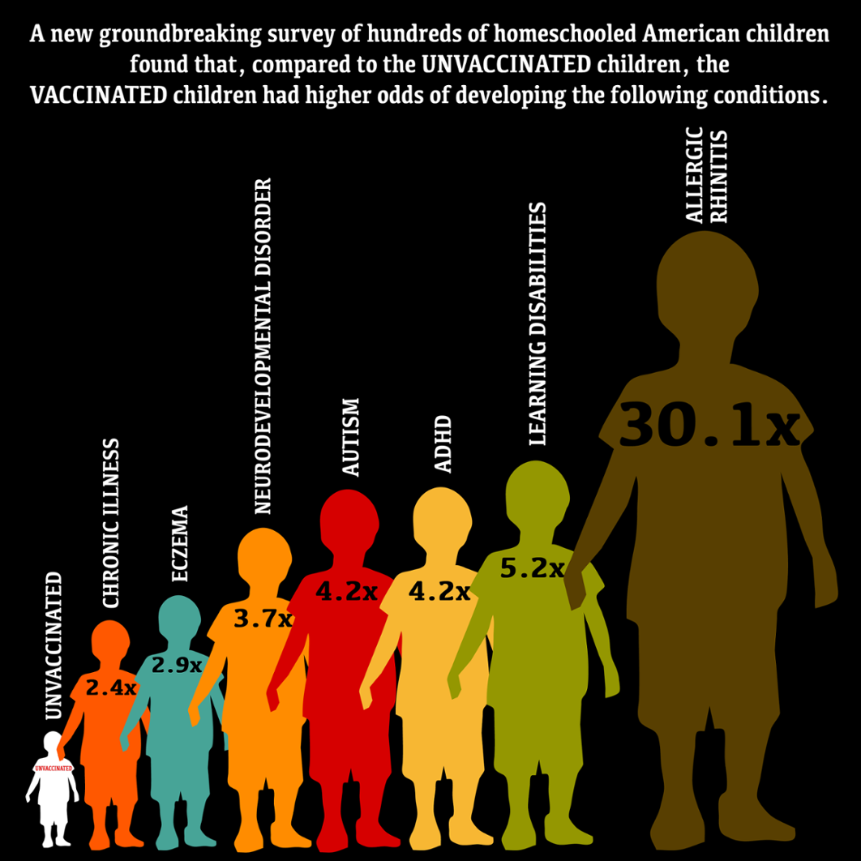
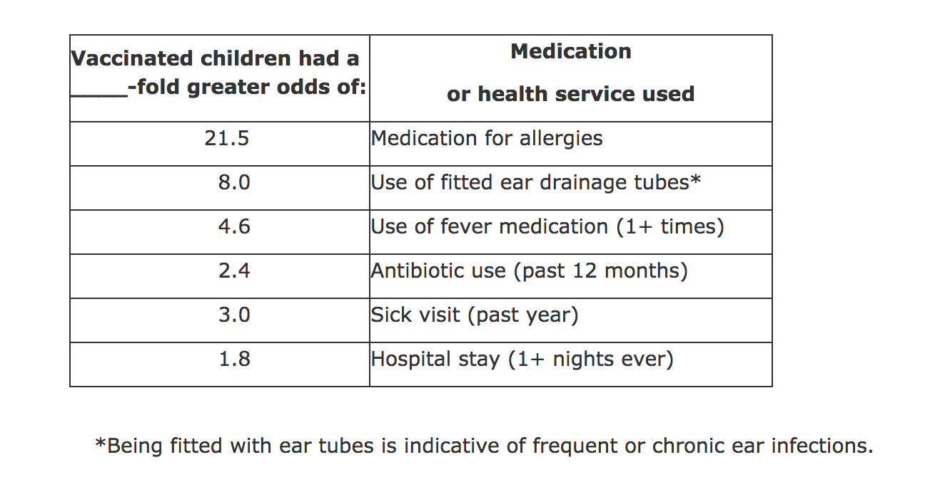
Vaxxed/Unvaxxed Study, Results*
*AR Mawson et al. J Transl Sci 2017; 3(3): 1-12.

Slide 83
MMR and Autism
Andrew Wakefield found a connection in 1998 in a now retracted publication*
CDC claimed proof of no link in 2004 paper**
Whistleblower, Dr. William Thompson, has now come forward:
Data supported significant increased risk for autism in black males with early vaccine
Demand for birth certificate hid this finding
*A Wakefield et al., The Lancet 1998; 351 (9103): 637–41. (RETRACTED)
**F DeStefano et al., Pediatrics 2004;113;259-266 .

Slide 84
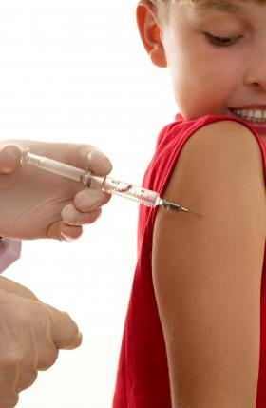
Glutamate is an Additive in Vaccines!
Flu vaccines (FluMist), MMR (measles, mumps and rubella), Rabies vaccine and Varicella vaccine (chicken pox) all contain glutamate
Anecdotal evidence links these vaccines with autism
My own studies on VAERS revealed a correlation between autism and MMR*
Glyphosate’s depletion of manganese prevents glutamate breakdown
*S. Seneff et al., Entropy 2012, 14, 2227-2253.
Notes:
Seizures facial swelling anaphylactic shock
Joint pain

Slide 85
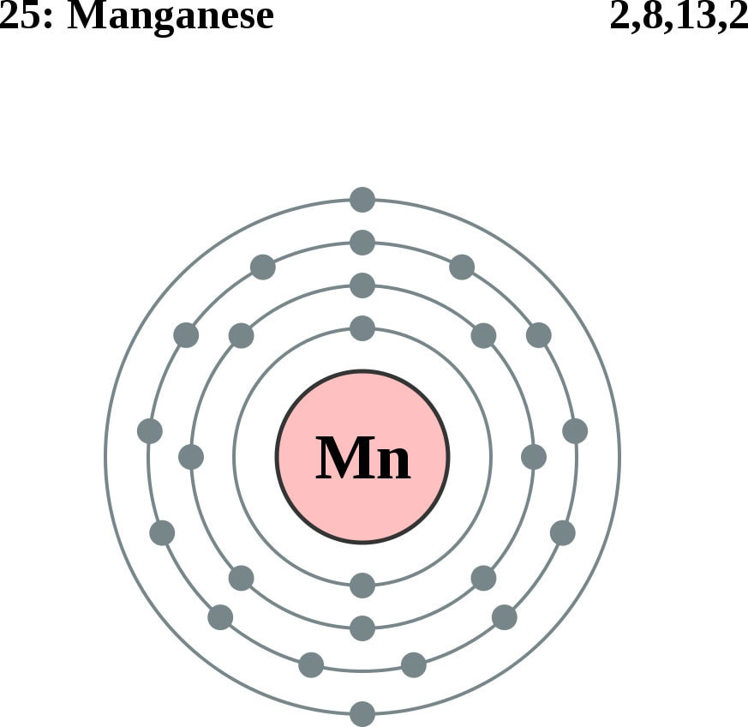
Glutamate Detoxification Depends on Manganese!
Glutamine synthetase
glutamate
glutamine
water
ammonium
Ammonium and glutamate toxicity in the brain
can arise because of insufficient manganese

Slide 86
“Alteration of Plasma Glutamate and Glutamine Levels in Children with High-Functioning Autism”*
*C. Shimmura et al. PLoSone October 2011 6(1):e25340
Notes:
Table 1. Plasma Levels of Amino Acids and related compounds in Control Subjects and Individuals with HFA.
Glyphosate/glutamate_glutamine_autism_2011.pdf

Slide 87
Glyphosate in Vaccines?
For MMR, flu vaccine, and rabies vaccine, live virus is grown on gelatin derived from ligaments of pigs and fetal bovine serum
Cows and pigs are fed GMO Roundup-Ready corn and soy feed
Gelatin is derived from collagen which is highly enriched in glycine and also contains glutamate
These two neurotransmitters excite the NMDA receptors in the brain
Glyphosate stimulation of NMDA receptors could cause neuronal burnout

Slide 88
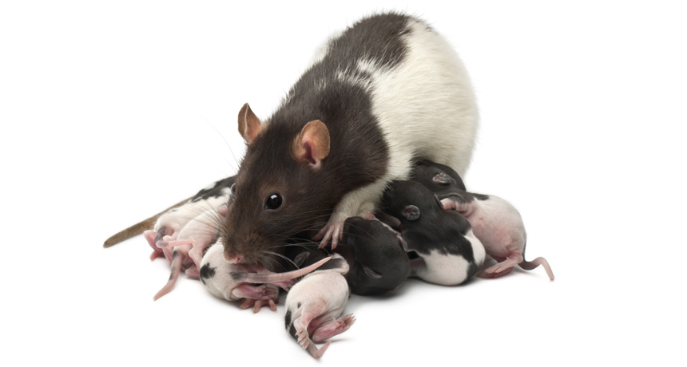
Glyphosate Excites NMDA Receptors in Hippocampus*,**
Excess glutamate in synapse leads to neuronal burnout
*D Cattani et al. Toxicology 2014; 320:34-45.
**D Cattani et al. Toxicology 2017 [Epub ahead of print]
Notes:
./glyphosate_rat_hippocampus_glutamate_depression_2017.pdf
70 mg of glyphosate/Kg/day. 0- way below alleged level of toxicity.
Acetylcholinase inhibition as well.
On the other hand, the activity of GGT was induced by GBH exposure (Figure 7G),

Slide 89
Glyphosate Excites NMDA Receptors in Hippocampus*,**
Excess glutamate in synapse leads to neuronal burnout
Rats exposed to glyphosate perinatally exhibited depressive behaviors
*D Cattani et al. Toxicology 2014; 320:34-45.
**D Cattani et al. Toxicology 2017 [Epub ahead of print]
Notes:
./glyphosate_rat_hippocampus_glutamate_depression_2017.pdf

Slide 90
Glyphosate Excites NMDA Receptors in Hippocampus*,**
Excess glutamate in synapse leads to neuronal burnout
Glutamate is elevated in the blood in association with autism, and blood glutamate levels correlate with brain glutamate levels.*
*Z Zheng et al. PLOS ONE 2016; 11(7): e0158688.
Notes:
./glyphosate_rat_hippocampus_glutamate_depression_2017.pdf

Slide 91
*A Samsel and S Seneff, Journal of Biological Physics and Chemistry 2017;17:8-32.

Slide 92
… Most disturbing is the presence of glyphosate in many popular vaccines including the measles, mumps and rubella (MMR) vaccine, which we have verified here for the first time.
*A Samsel and S Seneff, Journal of Biological Physics and Chemistry 2017;17:8-32.

Slide 93
Glyphosate Contamination in Vaccines (Parts Per Billion)*
Merck ZOSTAVAX 0.62 Shingles
Merck MMR-II 3.74 Measles, Mumps and Rubella
Merck VARIVAX 0.56 Varicella, Chicken Pox
MERCK PNEUMOVAX ND Pneumococcal 18
MERCK PROQUAD 0.66 Measles, Mumps, Rubella, Varicella
GSK ENERGIX-B 0.34 Heptatitis B
Novartis INFLUENZA 0.23 Flu
*A Samsel and S Seneff, Journal of Biological Physics and Chemistry 2017;17:8-32.

Slide 94
Symptoms of Adverse Reactions to MMR before and after 2002*
Data analyzed from the VAERS database
*A Samsel and S Seneff. J Biol Phys Chem 2017;17:8-32

Slide 95
Symptoms of Adverse Reactions to MMR before and after 2002*
Joint pain
seizures
shortness of breath
hives
These are all characteristic symptoms of allergies to MSG
eczema
anaphylactic shock
Facial swelling
swelling
swelling
*Data analyzed from the VAERS database

Slide 96
Recapitulation
Vaxxed/Unvaxxed study reveals neurological and autoimmune disease prevalence among the vaxxed
Glyphosate has been found as a contaminant in multiple vaccines, mostly those that contain live viruses
Likely due to glyphosate present in gelatin used as nutrient
MMR vaccine may be causal factor in autism epidemic
CDC hid evidence of a link between MMR and autism
Glyphosate and glutamate in MMR are synergistically neurotoxic through excitation of NMDA receptors

Slide 97
Molecular Mimicry

Slide 98
“Nobel Laureate Charles Richet demonstrated over a hundred years ago that injecting a protein into animals or humans causes immune system sensitization to that protein. Subsequent exposure to the protein can result in allergic reactions or anaphylaxis. This fact has since been demonstrated over and over again in humans and animal models.”
Notes:
./vaccine_protein_causes_food_allergies.pdf

Slide 99
A Scenario
1. Child is vaccinated with MMR
2. Live measles virus infects gut
6. Zonulin induces leaky brain barrier
3. Measles haemagglutinin undigested
6. Measles virus infects brain
4. Induces leaky gut
7. Brain’s immune system produces antibodies
5. Measles virus
8. Autoantibodies attack myelin sheath
5. Zonulin

Slide 100
Measles Virus and Haemagglutinin*
The measles virus synthesizes the protein haemagglutinin
Antibodies to haemagglutinin are essential following MMR vaccination to induce immunity
Measles virus infects brain due to leaky barrier
Haemagglutin bears a sequence resemblance to myelin basic protein (MBP) → potential for autoimmune reaction
MBP is essential for the formation of the myelin sheath surrounding nerve fibers
Autoantibodies to MBP along with excessive levels of antibodies to measles haemagglutinin are linked to autism**
*Oldstone, MBA, Ed. Molecular mimicry: Infection inducing autoimmune disease.
Springer Berlin Heidelberg; January 9, 2006.
**VK Singh et al., J Biomed Sci 2002;9(4):359-64.

Slide 101
Autism and Measles Haemagglutinin*
125 autistic children and 92 control children
60% of the children with autism had high levels of antibodies to measles haemagglutinin specific to the MMR vaccine
90% of these had autoantibodies to myelin basic protein (MBP)
0% of the control children had high antibody titers to either haemagglutinin or MBP
There were no elevations in antibodies detected against any proteins in the mumps or rubella viruses
*VK Singh et al., J Biomed Sci 2002;9(4):359-64.

Slide 102
A Failed System and
A Growing Food Movement

Slide 103
“It is no measure of health to be well adjusted to a profoundly sick society.”
-Jiddu Krishnaumurti

Slide 104
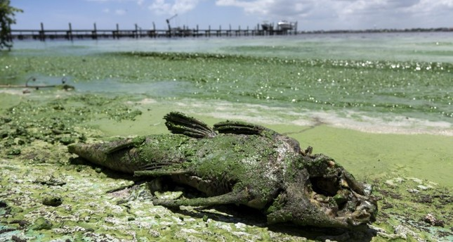
“Is Agriculture’s Use of Glyphosate Feeding Lake O’s Explosive Algae Blooms?”*
Sugar cane agriculture is extensive all around Lake Okeechobee in S. Florida, and glyphosate is used both to control weeds and as a desiccant
Cyanobacteria can break down the C-P bond in glyphosate and use its phosphorus atom as a fuel source**
*Prof. Geoffrey Norris.
https://jacquithurlowlippisch.com/tag/
is-sugarcane-field-glyphosate-feeding-lake-os-blue-green-algae-blloms
**D Drzyzga et al. Environ Microbiol 2017 Mar;19(3):1065-1076
Notes:
,/RedTide_algae_blooms_manmade.pdf
Glyphosate/Zhang_glyphosate_water_cyanobacterium_2016.pdf
Geoffrey Norris:
https://jacquithurlowlippisch.com/tag/is-sugarcane-field-glyphosate-feeding-lake-os-blue-green-algae-blloms/

Slide 105
Cyanobacteria Feed Red Tide Algae
“Both the coastal red tide and the inland blue-green algae have beset South Florida through the summer, killing vast numbers of fish and other wildlife, including dozens of dolphins, manatees, sea turtles, sharks and eels.” *
Cyanobacteria feed off of glyphosate (phosphorus source) and produce nitrates from nitrogen
Red Tide algae flourish, supplied with nitrates produced by cyanobacteria **
*https://www.nbcnews.com/news/us-news/
toxic-red-tide-florida-researchers-investigate-what-s-making-it-n900771
**https://www.sailorsforthesea.org/programs/ocean-watch/nutrients-feed-red-tide
Notes:
https://www.nbcnews.com/news/us-news/toxic-red-tide-florida-researchers-investigate-what-s-making-it-n900771
https://www.sailorsforthesea.org/programs/ocean-watch/nutrients-feed-red-tide

Slide 106
Corn for Ethanol Production*
2007
Karen Perry Stillerman, July 17, 2018
https://blog.ucsusa.org/karen-perry-stillerman/the-midwests-food-system-is-failing-heres-why
Notes:
https://cdn.blog.ucsusa.org/wp-content/uploads/chart-US-corn-production-and-corn-used-for-ethanol.jpeg

Slide 107
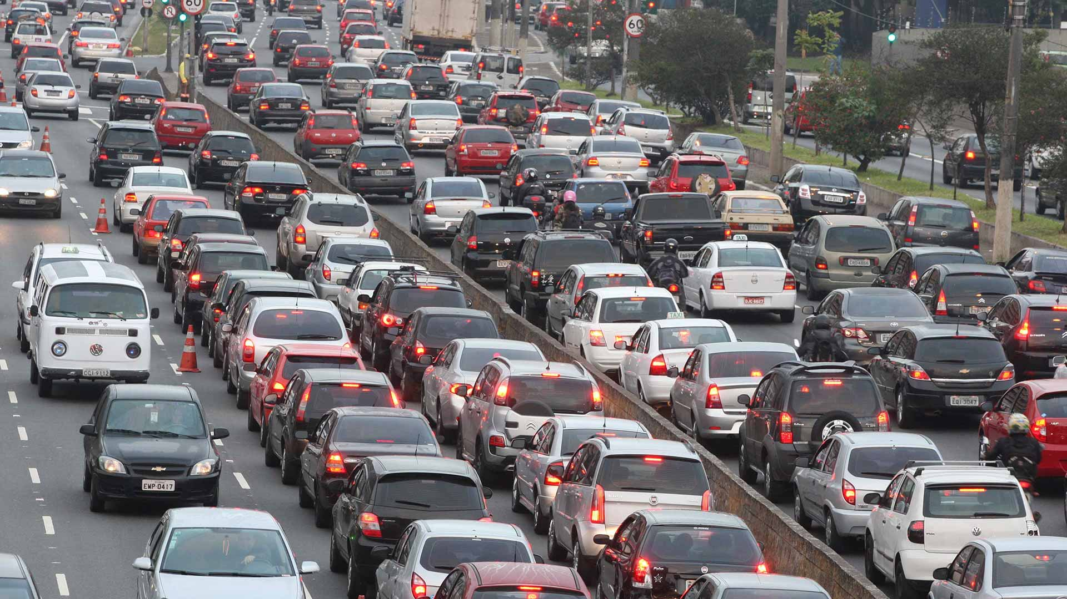
Corn for Ethanol Production*
Notes:
https://cdn.blog.ucsusa.org/wp-content/uploads/chart-US-corn-production-and-corn-used-for-ethanol.jpeg

Slide 108
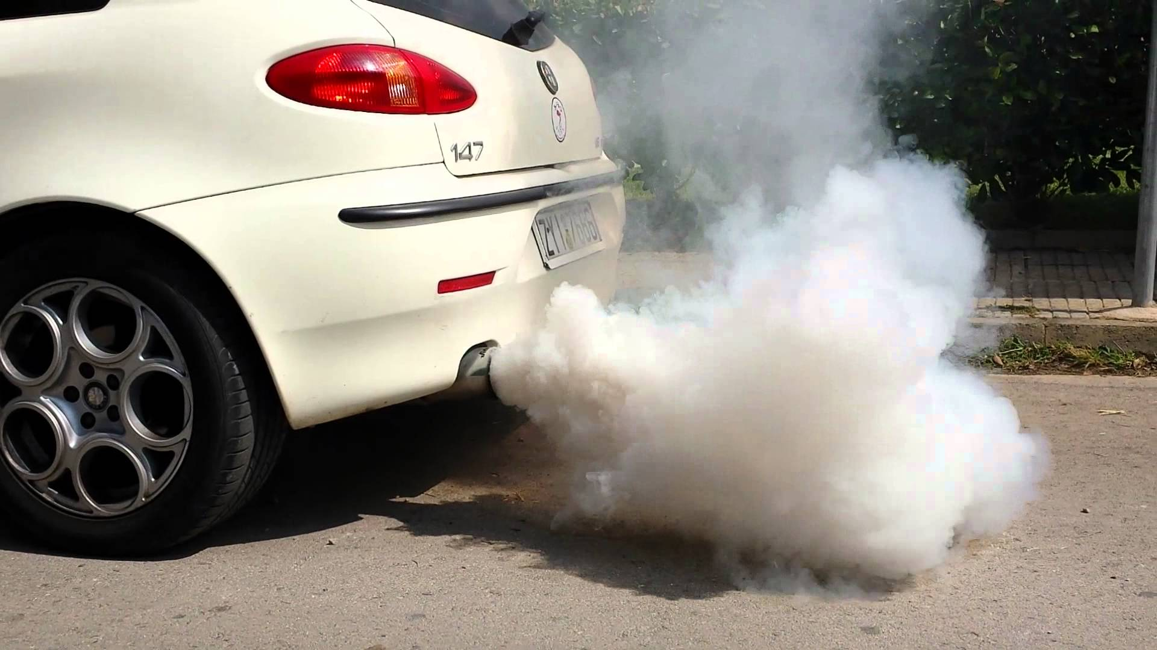
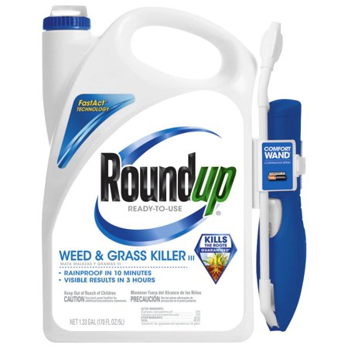
Corn for Ethanol Production*
Notes:
https://cdn.blog.ucsusa.org/wp-content/uploads/chart-US-corn-production-and-corn-used-for-ethanol.jpeg

Slide 109
Excessive confidence in the accuracy of pre-market risk assessments and regulatory thresholds
Insufficient post-approval monitoring of actual impacts of multiple synergistic formulated pesticides
Inadequate tools to deal with failing pest management systems due to the emergence of widespread resistance among the weeds and insects
Lack of tools to stabilize or reverse rising risk trajectories, even when the steps needed are so well known
Notes:
Glyphsoate/Benbrook2018_Article_WhyRegulatorsLostTrackAndContr.pdf

Slide 110
Superweeds Are Now a Huge Problem*
76.8% of samples submitted to a U of Illinois Plant Clinic from 10 states across the Midwest showed glyphosate resistance
“GM crops are on the edge of failure in the U.S. as farmers are asked to fork out more and more money on herbicides to try to control the superweeds. We simply can’t afford it! It is near the end of the road for these crops and many of my friends in the Midwest are on the edge of turning back to conventional farming methods.”
Bill Giles, an Illinois farmer
*sustainablepulse.com/2017/02/04/farmers-losing-midwest-superweeds-
fight-as-glyphosate-resistance-reaches-over-75/#
Notes:
http://sustainablepulse.com/2017/02/04/farmers-losing-midwest-superweeds-fight-as-glyphosate-resistance-reaches-over-75/#

Slide 111
Fixing the Soil*
Dirt is inert; soil is alive
Missouri farmer JR Bollinger grew corn and soy on a former coal mine
“We tried … all kinds of goodies: humates, … sea minerals, microbes, fish meal and biochar powder.”
Earthworms till the soil
Soil microbes are crucial for soil health
Greatly reduce fertilizer needs and improve yield
JR Bollinger
*ecofarmingdaily.com/wormhole-customizing-biological-methods-large-scale-farming/
David Yarrow
Down the Wormhole: Customizing Biological Methods for Large Scale Farming
Belize Ag Report 2017;34:5-17.
Notes:
Missouri reclaimed coal mine

Slide 112
Sustainable Agriculture
“We say that every square meter of land that is worked with agro-ecology is a liberated square meter. We see it as a tool to transform farmers’ social and economic conditions. We see it as a tool of liberation from the unsustainable capitalist agricultural model that oppresses farmers.”
-- Miguel Ramirez
National Coordinator of Organic Agriculture Movement in El Salvador
Notes:
https://www.independentsciencenews.org/health/why-the-food-movement-is-unstoppable/

Slide 113
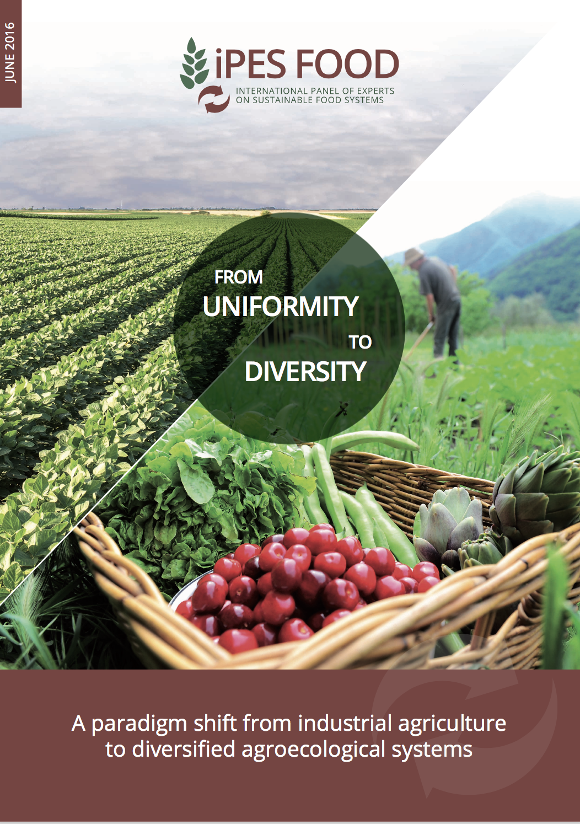
From Uniformity to Biodiversity*
"Industrial Agriculture:" crop monocultures and industrial-scale feedlots
Chemical fertilizers, pesticides, antibiotics → multiple negative outcomes
Diversify farming landscapes: holistic strategies
Retain carbon in the ground, support biodiversity, rebuild soil fertility, sustainable high yields
Political incentives must be shifted to promote ecofriendly agriculture.
*Emile A. Frison, REPORT 02. 2016
IPES Food: International Panel of Experts on Sustainable Food Systems
Notes:
Ecofarming.pdf., .text

Slide 114
Solving Global Climate Change through Agriculture*
“Agriculture, with its unique ability to sequester carbon on … billions and billions of acres, is the only industry poised to reverse global warming. Improved management of cropping and grazing heals land, boosts soil fertility, prevents flooding, enhances drought resilience, increases the nutritional content of food and restores wildlife habitat — while sequestering carbon.
*http://www.rutlandherald.com/articles/using-soil-to-fight-climate-change/

Slide 115
Small Organic Farms are the Answer
Bluebird Hill Organic Farm, North Carolina

Slide 116
Why the Food Movement is Unstoppable*
Philosophy: “The purpose of life is health and the optimal and most just way to attain human health is to maximise the health of all organisms, with the most effective way to do that being through food.”
Practical consequence: “It becomes the task of a food system, or any sub-part of it – such as a farm – to maximise the positive aspects of each component, so that the circle can become ever more virtuous.”
*Jonathan Latham.
www.independentsciencenews.org/health/why-the-food-movement-is-unstoppable

Slide 117
How to Safeguard Yourself
and Your Family

Slide 118
Go Organic!

Slide 119
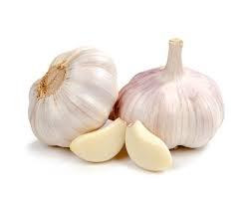
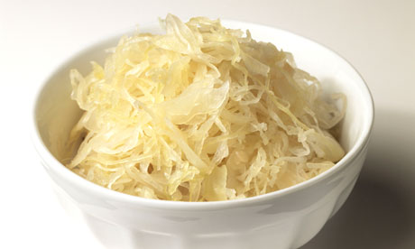
Some Important Nutrients
Curcumin
Garlic
Vitamin C
Probiotics
Methyl tetrahydrofolate
Cobalamin
Glutathione
Taurine
Epsom salt baths

Slide 120
Biochar, Bentonite and Zeolite to maintain healthy microbial distribution in poultry*
*TP Prasai et al. PLoS ONE 11(4): e0154061.
Notes:
Moore\ et\ al\ 2016\ Biochar,\ bentonite\ and\ zeolite\ supplemented\ feeding\ for\ layer\ chickens\ alters\ intestional\ microbiota.pdf .
Reduce need for antibiotics
Redistribute gut microbes

Slide 121
Anecdotal Evidence of Benefits of Fulvic Acid*
"In the last year I have become increasingly sick with ataxia, balance problems, muscle weakness, numbness in the hands and feet and a 'foggy' brain
… To cut a long story short, Jim suggested Fulvic Acid as a detox.
At 10 days the effects started to 'kick in' and by 14 days it was as if a fog had been lifted from my brain. My muscle weakness has gone, I can walk for 2 hours and I can swim in the sea."
"It is a miracle."
*Shared by Nico DaVinci, personal communication concerning a patient
Notes:
Check with Nico DaVinci before showing this
THIS IS ROSEMARY MASON – she is getting a cholinesterase test.
See: RosemaryMason_story.text
Testimony_fulvic_acid.text

Slide 122
Extracts from Common Plants Can Treat Glyphosate Poisoning*
Roundup is toxic to hepatic and embryonic cells at doses far below those used in agriculture and at residue levels present in some GM food.
Extracts from common plants such as dandelions, barberry, and burdock can protect from damage, especially if administered prior to exposure.
*C Gasnier et al. Journal of Occupational Medicine and Toxicology 2011, 6:3

Slide 123
Eat Foods Containing Sulfur
Notes:
http://healthyeatingclub.com/info/books-phds/books/foodfacts/html/data/data5g.html

Slide 124
Sauerkraut and apple cider vinegar contain acetobacter, one of the very few microbes that can metabolize glyphosate
Yogurt and kimchi probably do too

Slide 125
Kefir: Natural Probiotics*
Kefir is a fermented milk product originating in the Caucasus mountains centuries ago
Can be made from milk from cows, sheep and goats
Slightly sour and carbonated
One of the most potent probiotic foods available
*https://chriskresser.com/kefir-the-not-quite-paleo-superfood/

Slide 126
Recommendations from Dr. Zach Bush*
1. Get out into nature. Walk in the woods, barefoot, feel the sunshine – rich environment, breathe in the nutrients in the air
2. Eat probiotics (naturally fermented foods)
3. Eat organic food
Demand is dropping the price.
Thrive Market – order online
4. Eat more fruits and vegetables
5. Bathe in natural waters
*https://www.youtube.com/watch?v=jWgnkgYtqnw&feature=youtu.be

Slide 127
Conclusions
We are at a crossroads where we can choose to get sicker and sicker while destroying the ecosystem, or we can choose to drastically change our agricultural methods towards renewable organic solutions
Grass roots bottom-up activities will institute a dramatic shift in food choices towards nutrient-dense organic whole foods instead of chemical-contaminated impoverished processed foods
A market-driven economy will force farmers to switch to organic methods if they want to sell their crops to informed and health-conscious consumers
This will lead to a dramatic reduction in health care costs and a vast improvement in the health of the population as a whole, of the nation, and of the earth

Slide 128
Thank You for Listening!

