Slide 1
Glyphosate: Is it the Primary Cause of the Autism Epidemic?
Stephanie Seneff
MIT CSAIL
TACA Workshop
March 22, 2019

Slide 2
Outline
Introduction
Glyphosate and the Gut
Glyphosate and Manganese
What you can do!
Summary

Slide 3
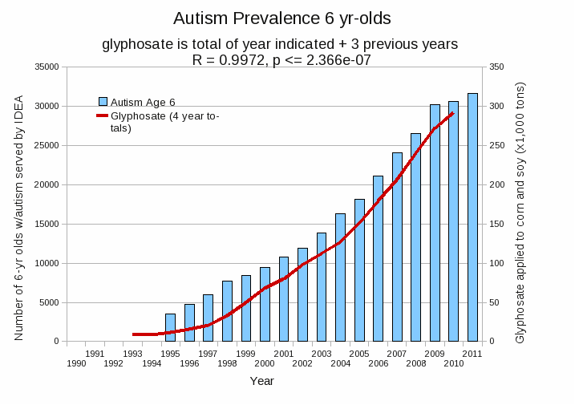
Autism Prevalence: 6 year olds*
R = 0.9972
* Figure 15, Seneff et al., Agricultural Sciences, 2015, 6, 42-70
Notes:
Nancy/latest_plots/6-yr-old autism.gif
autism: USDE
oil consumption: USDA
glyphosate: USDA
GE crops: USDA
Mortality data: CDC

Slide 4
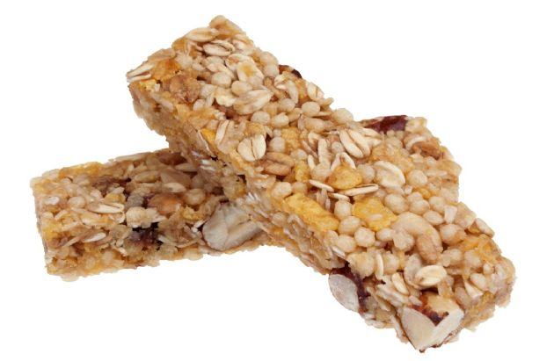
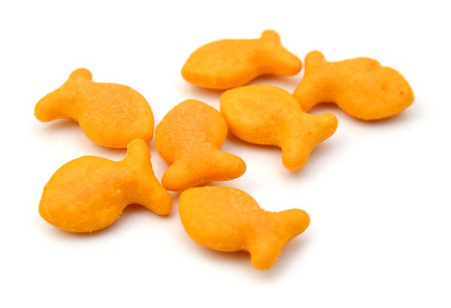
Some Foods Containing Glyphosate
Notes:
glyphosate_residues_in_honey_corn_soy_sauce_2014.pdf
Ten out of twenty eight (36%) soy sauce samples contained glyphosate at a concentration above the method LOQ (75 ng/mL) with a range between 88-564 ng /mL and a mean of 242 ng /mL

Slide 5
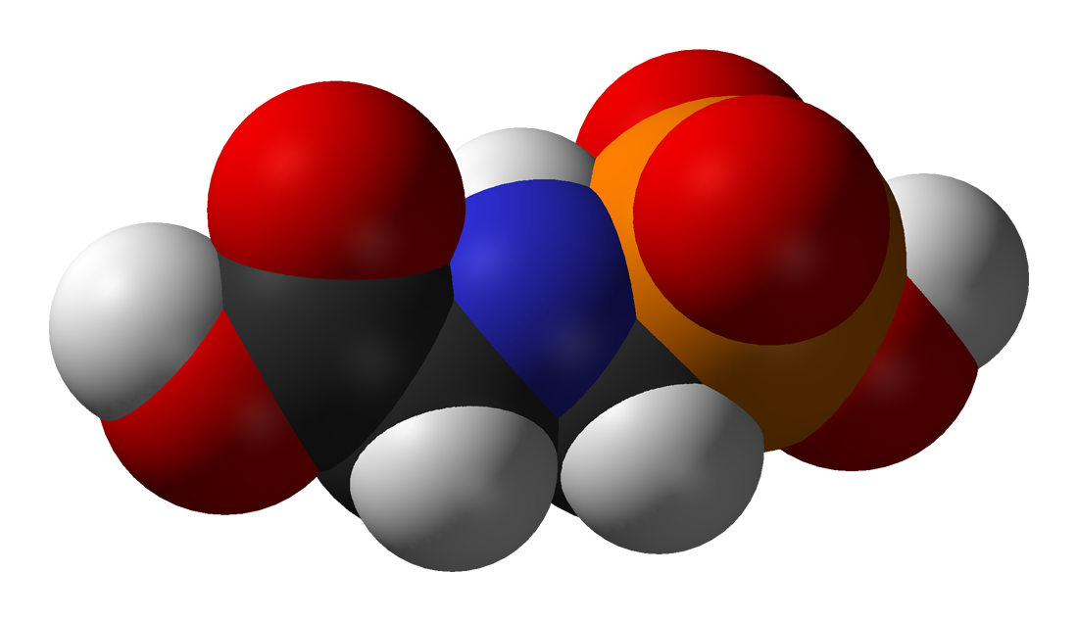
Is Glyphosate Toxic?
Monsanto has argued that glyphosate is harmless to humans because our cells don’t have the shikimate pathway, which it inhibits
However, our gut bacteria DO have this pathway
We depend upon them to supply us with essential amino acids (among many other things)
Other ingredients in Roundup greatly increase glyphosate’s toxic effects and are themselves toxic
Insidious effects of glyphosate accumulate over time
Most studies are too short to detect damage

Slide 6
Main Toxic Effects of Glyphosate*
Disrupts gut microbes leading to overgrowth of pathogens and inflammatory/leaky gut syndrome
Interferes with function of cytochrome P450 (CYP) enzymes
Chelates important minerals (iron, cobalt, manganese, etc.)
Interferes with synthesis of aromatic amino acids and methionine
Leads to shortages in critical neurotransmitters and folate
Disrupts sulfate synthesis and sulfate transport
Leads to disrupted bile flow and impaired fat digestion
*Samsel and Seneff, Entropy 2013, 15, 1416-1463

Slide 7
Glyphosate vs. Other Pesticides: Usage in the United States*
Glyphosate
*http://sustainablepulse.com/wp-content/uploads/GMO-health.pdf

Slide 8
Sobering Statistics on Glyphosate Residues*
Parts per trillion (ppt): increased proliferation of breast cancer cells in vitro
0.1 ppb:
Altered the gene function of over 4000 genes in the livers and kidneys of rats
Severe organ damage in rats
Permitted level for glyphosate and all other herbicides in EU tap water
10 ppb: demonstrated toxic effects on the livers of fish
700 ppb: Permitted level for glyphosate in U.S. tap water
11,900 ppb: found in Genetically Modified (GMO) soybeans
*http://detoxproject.org/glyphosate-in-numbers/

Slide 9
Some Biomarkers for Autism
Disrupted gut bacteria; inflammatory bowel
Low serum sulfate
Methionine deficiency
Serotonin and melatonin deficiency
Defective aromatase
Zinc and iron deficiency
Urinary p-cresol
Mitochondrial disorder
Glutamate toxicity in the brain
These can all be explained as potential effects of glyphosate on biological systems
Notes:
Samantha/zinc_deficiency_autism.text

Slide 10
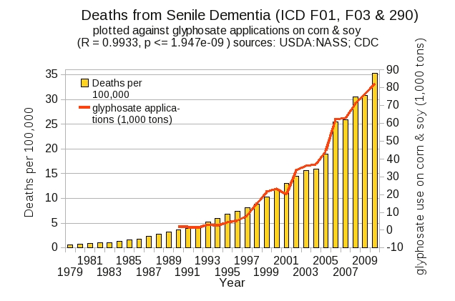
Dementia and Autism Have Much in Common
Plot kindly provided by Nancy Swanson

Slide 11
Glyphosate and the Gut

Slide 12
Autism and the Gut*
“Prospective, controlled studies suggest that as many as 70% of autistic children exhibit chronic GI-related symptoms [1,5,6] including diarrhea, laxative-dependent constipation, abdominal distension, failure to thrive, weight loss, feeding problems, and abdominal pain related to extreme irritability, aggression, and self-injury.”
*SJ Walker et al. PLOS One March 2013; 8(3):e58058.
Notes:
Walker_et_al_unique_gene_expression_profile_ASD_2013.pdf

Slide 13
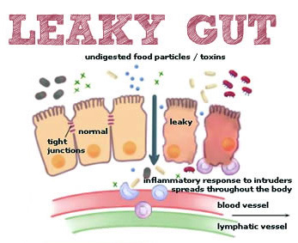
Notes:
Excellent article!!
./glyphosate_vaccines_autism.pdf
http://kinseimindbody.com/synergistic-destruction-how-vaccines-and-gmos-converge-to-fuel-autism-and-neurodegenerative-conditions/

Slide 14
Glyphosate and the Gut: Pathogen Overgrowth*
Glyphosate is an antimicrobial agent that preferentially kills beneficial microbes, allowing pathogens to flourish in the gut
Immune cells invade the gut and release inflammatory cytokines
This causes increased risk to inflammatory bowel diseases such as Crohn’s and ulcerative colitis
* Samsel and Seneff. Entropy 2013; 15: 1416-1463.

Slide 15
Pathogen Overgrowth in Poultry Microbes Exposed to Glyphosate*
Clostridia
Salmonella
Bifidobacteria
*Plot provided by Dr. Martin Michener
Notes:
From Marty Michener!
Sheehata paper.

Slide 16
Glyphosate and the Gut: Digestive Enzymes
Glyphosate has been found as a contaminant in digestive enzymes trypsin, pepsin and lipase*
Trypsin impairment prevents proteins like gluten in wheat from being digested
Undigested proteins induce release of zonulin which opens up gut barrier**
Zonulin lingers because trypsin is defective
*A Samsel and S Seneff. J Biol Phys Chem 2017;17:8-32
** JJ Gildea et al. J Clin Nutr Diet. 2017, 3:1.
Notes:
Glyphosate/ZachBushPaper_tight_junctions_glyphosate_2017.pdf

Slide 17
Trypsin, Pepsin and Lipase are all contaminated with glyphosate*
Enzyme | Glyphosate (PPB)
Pepsin (ELISA) | <40
Pepsin (GC-MS) | 430
Pepsin (HPLC-MSMS) | 290
Trypsin (ELISA) | 62
Lipase (ELISA) | 24
*A Samsel and S Seneff. Journal of Biological Physics and Chemistry 2017;17: 8-32

Slide 18
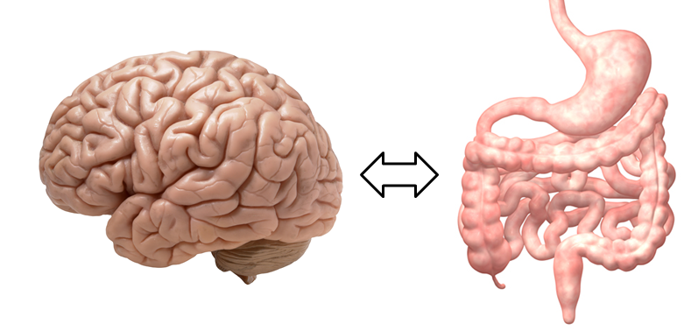
A Scenario for Gluten Intolerance
Glyphosate in wheat
Leaky brain barrier
Zonulin
Trypsin defective
Autoimmune
neurological
disease
Zonulin released
Gliadin
Leaky barrier
Systemic immune response induces multiple complex symptoms

Slide 19
Glyphosate and Celiac Disease*
Glyphosate
Use on wheat
Celiac disease
*Samsel and Seneff, Interdiscip Toxicol. 2013;6(4): 159–184.

Slide 20
Celiac Disease, Glyphosate and Non Hodgkin’s Lymphoma
Glyphosate preferentially kills Bifidobacteria*
Bifidobacteria are depleted in celiac disease**
Celiac disease is associated with increased risk to non Hodgkin’s lymphoma***
Glyphosate itself is also linked directly to non Hodgkin’s lymphoma****
*A.A. Shehata et al., Curr Microbiol. 2013 Apr;66(4):350-8.
** M. Velasquez-Manoff, NY Times Sunday Review, Feb. 23, 2013.
*** C. Catassi et all, JAMA. 2002 Mar 20;287(11):1413-9.
****M. Eriksson et al., Int J Cancer. 2008 Oct 1;123(7):1657-63.
Notes:
**./ bifidobacteria_celiac_disease.text
Cancer/Celiac_disease_increases_hodgkins_lymphoma.text
./Celiac_and_bacteria.text

Slide 21
*Figure 20, NL Swanson et al. Journal of Organic Systems 9(2), 2014, p. 25.

Slide 22
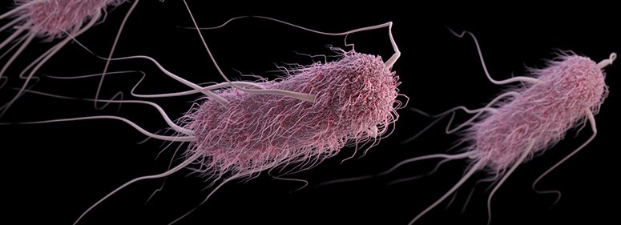
Glyphosate Induces Antibiotic Resistance*
Actinobacteria produce a free radical scavenger in response to glyphosate that provides resistance to a wide range of antibiotics, including penicillin
E. coli exposed to glyphosate develop an "efflux pump" that increases resistance to the fluoroquinolone Ciprofloxacin and the aminoglycoside Kanamycin.
Same effect observed in Salmonella exposed to glyphosate
*AHC Van Bruggen et al. Science of the Total Environment 2018;616-617: 255–268.

Slide 23
Glyphosate Usage and Papers on Antibiotic Resistance*
*AHC Van Bruggen et al. Science of the Total Environment 2018;616-617: 255–268.
Notes:
./VanBruggen_glyphosate_antibiotic_resistance_2017.pdf

Slide 24
A BTBR Mouse Model of Autism*
These mice had all the mouse features of autism
They were fed “standard rodent chow” – glyphosate contaminated?
Some features in the gut:
Reduced levels of bile acids
Due to impaired CYP7A1 activity in the liver
Further reduced levels of secondary bile acids
Impaired metabolism by gut microbes
Reduced levels of Lactobacillus and Bifidobacteria
Microbes that metabolize bile acids
These microbes are preferentially killed by glyphosate
Serotonin deficiency
Serotonin is derived from tryptophan, a product of the shikimate pathway which glyphosate disrupts
*AV Glubeva et al. EBioMedicine. 2017 Oct;24:166-178.
Notes:
Anthony/scleroderma/mouse_model_autism_bile_acids_tryptophan_gut_microbes_2017.pdf

Slide 25
BTBR mice have low acetate, and glyphosate disrupts acetate synthesis in gut*
BTBR mice
Children with autism had only 3.5 mg/ml acetate in stool samples compared to 5.1 in controls.**
*LN Nielsen et al. Environmental Pollution 2018;233:364e376.
**Adams et al. BMC Gastroenterology 2011; 11:22.
Notes:
./low_acetate_gut_autism_2011.pdf
scleroderma/glyphosate_reduces_acetate_gut_2018.pdf
Sprague Dawley rats

Slide 26
BTBR mice have low acetate, and glyphosate disrupts acetate synthesis in gut*
BTBR mice
Children with autism had only 3.5 mg/ml acetate in stool samples compared to 5.1 in controls.**
Elevated pH linked to glyphosate exposure results in small intestinal bacterial overgrowth (SIBO)
*LN Nielsen et al. Environmental Pollution 2018;233:364e376.
**Adams et al. BMC Gastroenterology 2011; 11:22.
Notes:
./low_acetate_gut_autism_2011.pdf
scleroderma/glyphosate_reduces_acetate_gut_2018.pdf

Slide 27
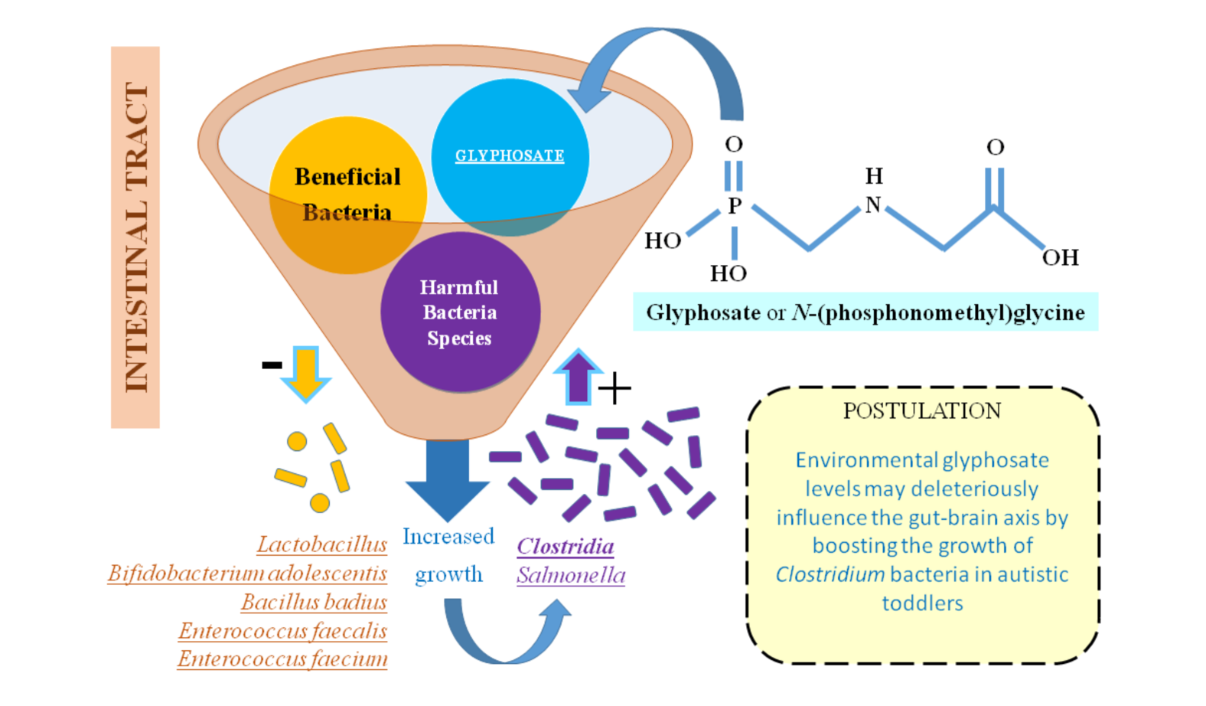
Glyphosate, Pathogens, Autism*
*Figure 2. I Argou-Cardozo and F Zeidán-Chuliá. Med. Sci. 2018; 6: 29.
Notes:
A new paper In Press from the Ramazzini Institute in Italy showed that the gut microbiome was disrupted in rats exposed to "safe" levels of glyphosate.
Glyphosate/glyphosate_Clostridia_autism_WOW_2018.pdf
Figure 2. Glyphosate (GLY) may hypothetically contribute to ASD etiology by deleteriously influencing gut microbiome. Literature evidence suggests the link between Clostridium bacteria and developing and/or aggravating autism among children, highlighted by the present systematic review. Environmental exposure to GLY could contribute to such interplay by affecting the growth of normal gastrointestinal flora and therefore, allowing the growth of harmful bacteria species such as Clostridium, which are not sensitive to this pesticide.

Slide 28
Evidence Linking Autism to Clostridia Overgrowth*
14 autistic children with gut disorder compared to 21 controls
Significant increase in Clostridia species in the gut in autistic children
Associated with reduced tryptophan levels and increased expression of inflammatory markers
Tryptophan is a product of the shikimate pathway, which glyphosate blocks
Macrophages in inflamed tissue take up tryptophan, reducing bioavailability to the brain
Proposed role for antibiotics
Glyphosate is a patented antimicrobial agent (2010)
*RA Luna et al., Cellular and Molecular Gastroenterology and Hepatology 2017;3(2): 218-230
Notes:
samantha/distinct_microbiome_profile_in_autism_serotonin_2017.pdf

Slide 29
*
Triplets: two boys, one girl. Both boys have autism and girl has seizure disorder
Very high levels of glyphosate in urine in all three
Clostridia overgrowth due to glyphosate disruption of gut microbes
Clostridia produce toxins HPHPA and p-cresol, which block the conversion of dopamine to norepinephrine.
Damage to neurons in the brain through oxidative stress
*W. Shaw. Integrative Medicine 2017;16(1);50-57.
Notes:
./Shaw_on_glyphosate_triplets_autism.text

Slide 30
Recapitulation
Glyphosate contamination in food proteins makes them hard to break down
This leads to autoimmune disease
Digestive enzymes are contaminated with glyphosate
Undigested proteins induce Celiac disease and leaky gut
Glyphosate is a key factor in the emergence of antibiotic resistant pathogens
The BTBR mouse model of autism is consistent with glyphosate damage in the gut
Glyphosate promotes Clostridia overgrowth
This induces inflammatory bowel disease, an epidemic today
Autism has been linked to Clostridia overgrowth
Clostridia release toxins that induce an inflammatory response

Slide 31
Glyphosate and Manganese

Slide 32
“Fundamentally the herbicidal effect of glyphosate is ultimately due to soil pathogens gaining access to the “weed” thanks to glyphosate’s weakening of the plant and killing of beneficial microbes by the chelation of manganese and other trace elements.”
Dr. Arden Andersen, D.O.,
Food Plague Primer: Glyphosate and Genetically Engineered Crops
This is analogous to glyphosate’s effect on gut bacteria: killing the beneficial bacteria and allowing the pathogens to overgrow
Notes:
attached/Huber2/FoodPlaguePrimer.pdf

Slide 33
Glyphosate Depletes Iron, Manganese and Zinc in Plants*
*D Huber, What About Glyphosate-Induced Manganese Deficiency? Fluid Journal, 20-22.
Notes:
Glyphosate/glyphosate_induced_manganese_deficiency_plants_Huber.pdf

Slide 34
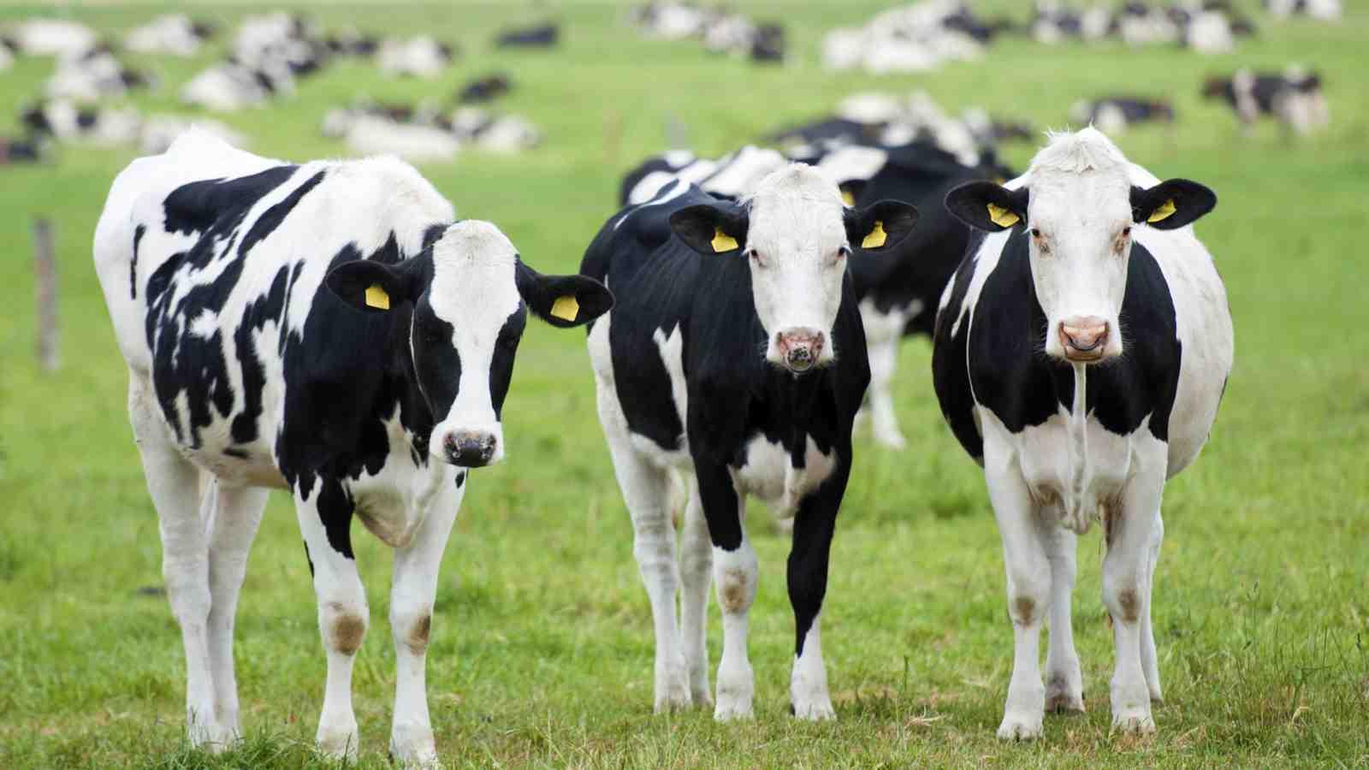
Severe Deficiency in Serum Manganese and Cobalt in Cows*
Cobalt
Manganese
Eight different farms: all cows tested had glyphosate in the urine
*M. Krüger et al., J Environ Anal Toxicol 2013, 3:5
Notes:
glyphosate//cows_cobalt_deficiency_glyphosate.pdf

Slide 35
Low Manganese in Teeth Linked to Autism*
Studied lead, mercury and manganese levels in tooth enamel of shed primary teeth in 84 children
Manganese accumulated after birth was down by 60% in autistic children
No other result was statistically significant
*MM Abdullah et al., J Autism Dev Disord. 2012 Jun;42(6):929-36.
Notes:
Samantha/heavy_metal_in_childrens_tooth_enamel_as_diagnostic_autism.pdf

Slide 36
Some Consequences of Manganese Deficiency
Lactobacillus critically depend on manganese
Manganese superoxide dismutase protects mitochondria from oxidative damage
Manganese is essential for detoxing glutamate (neurotoxin)
Pituitary depends on manganese to release thyroid stimulating hormone
Chondroitin sulfate synthesis in bones

Slide 37
Glyphosate Kills Beneficial Bacteria*
Examined effect of glyphosate and Roundup on three food microorganisms widely used as starters in dairy technologies
Two are species of Lactobacillus
Roundup is always more potent than glyphosate, and in all cases, toxic from levels 10–100 times below the lowest agricultural uses (10,000 ppm).
Unpredictable consequences of Roundup on soil microorganisms have to be considered
*E Clair et al. Curr Microbiol (2012) 64:486–491
Notes:
Glyphosate/Clair_glyphosate_toxic_to_lactobacillus_2012.pdf

Slide 38
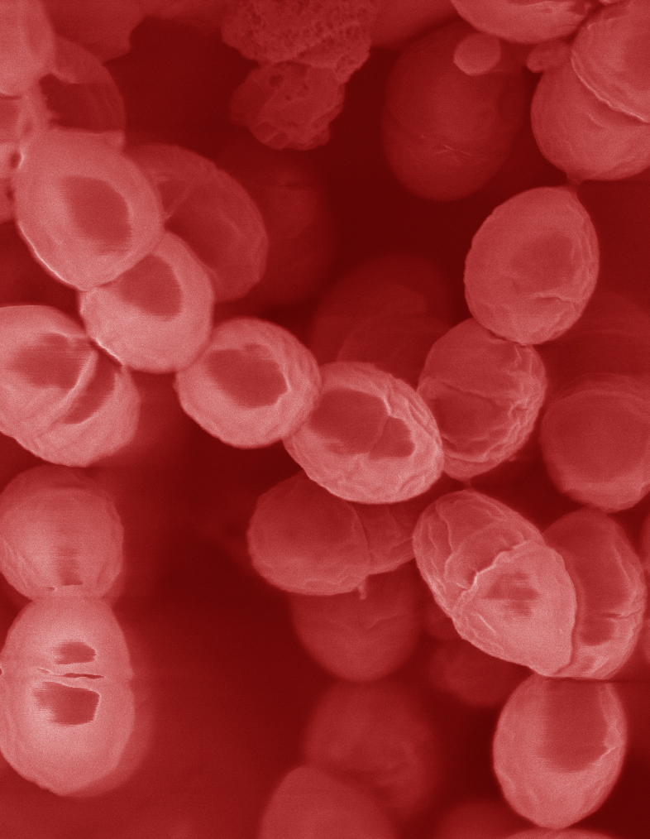
Lactobacillus Depends on Manganese!*
Many lactic acid bacteria contain very high intracellular manganese levels
Scavenges toxic oxygen species, particularly superoxide
Manganese deprivation suppresses growth
Lactobacillus levels are low in the gut in association with autism
* FS Archibald and M-N Duong. Journal of Bacteriology Apr 1084, 1-8.
Notes:
Glyphosate/manganese/manganese_acquisition_by_lactobacillus.pdf

Slide 39
Lactobacillus Alleviate Anxiety*
Patients suffered from chronic fatigue syndrome and associated anxiety
Patients were treated with probiotic strain of Lactobacillus (control group got a placebo)
Significant rise in both Latobacillus and Bifidobacteria in gut
Significant decrease in anxiety symptoms (p = 0.01)
Supports concept of gut-brain axis (communicate with brain via vagal nerve)
*R Av et al. Gut Pathog. 2009 Mar 19;1(1):6. doi: 10.1186/1757-4749-1-6.
Notes:
Glyphosate/manganese/manganese_alleviates_anxiety.text

Slide 40
Anxiety and Autism*
Specific Phobia: 30%
Obsessive-Compulsive Disorder: 17%
Social Anxiety Disorder/Agoraphobia: 17%
Generalized Anxiety Disorder: 15%
Separation Anxiety Disorder: 9 %
Panic Disorder: 2%
*Van Steensel, F.J.A., Bogels, S.M., & Perrin, S. (2011). Anxiety disorders in children and adolescents with autistic spectrum disorders: A meta-analysis. Clinical Child and Family Psychology Review, 14, 302-317.
Notes:
http://www.iidc.indiana.edu/?pageId=3616

Slide 41
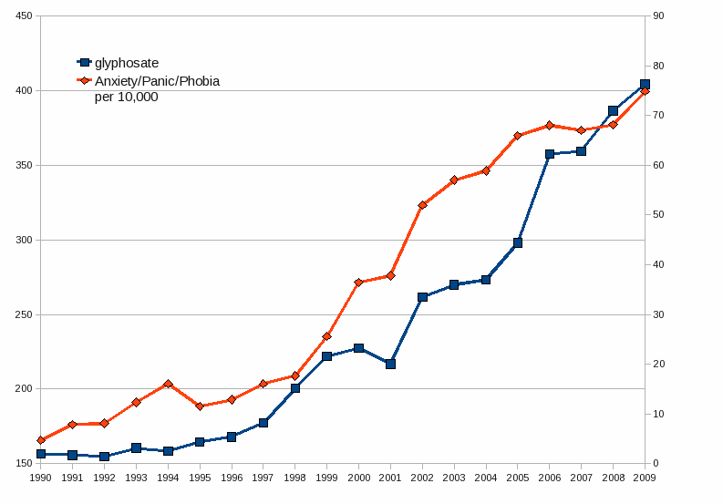
Glyphosate Application on Corn and Soy Plotted against Anxiety, Panic Disorder and Phobias*
*Plots provided by Dr. Nancy Swanson
Notes:
2014/AutismOne/images/anxiety.gif

Slide 42
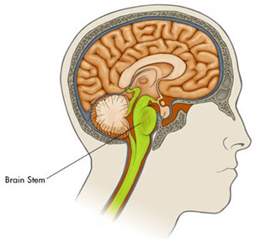
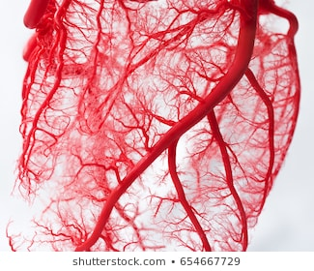
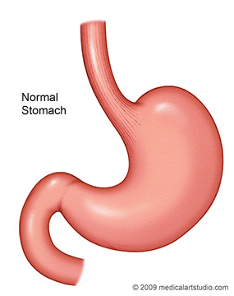
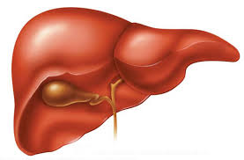
It’s not just deficiency!
Too little manganese in the cortex
Too much manganese in the brain stem
Excessive manganese in the brain stem is linked to ADHD*
Vagus Nerve
Bile acids
*JJ-H Shih et al. Neuropsychiatr Dis Treat. 2018; 14: 1831-1842.

Slide 43
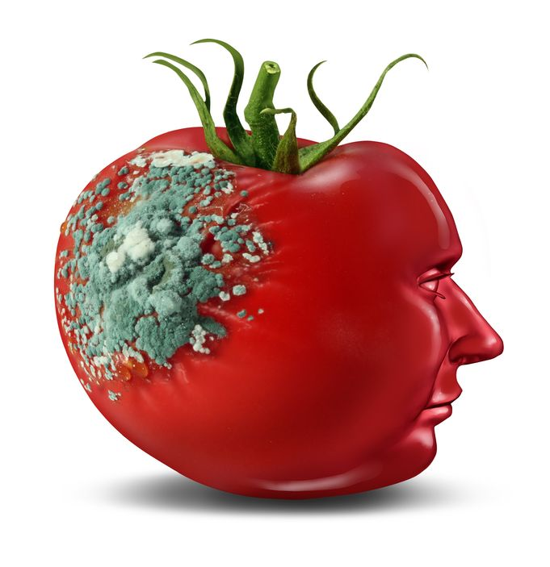
Glyphosate and Glutamate*
Acute exposure activates NMDA receptors and voltage-dependent calcium channels
Oxidative stress and neural cell death
Increased glutamate released into the synaptic cleft → excessive extracellular glutamate levels
Decreased glutathione content
Increased peroxidation of lipids (fats)
Chronic exposure:
Decreased glutamate uptake and metabolism
Induced calcium uptake
Induced oxidative stress
*http://www.greenmedinfo.com/blog/roundup-weedkiller-brain-damaging-neurotoxin
Notes:
http://www.greenmedinfo.com/blog/roundup-weedkiller-brain-damaging-neurotoxin
Why was this referenced??
T. Bohn et al. Food Chemistry 153, 15 June 2014, 207-215.

Slide 44
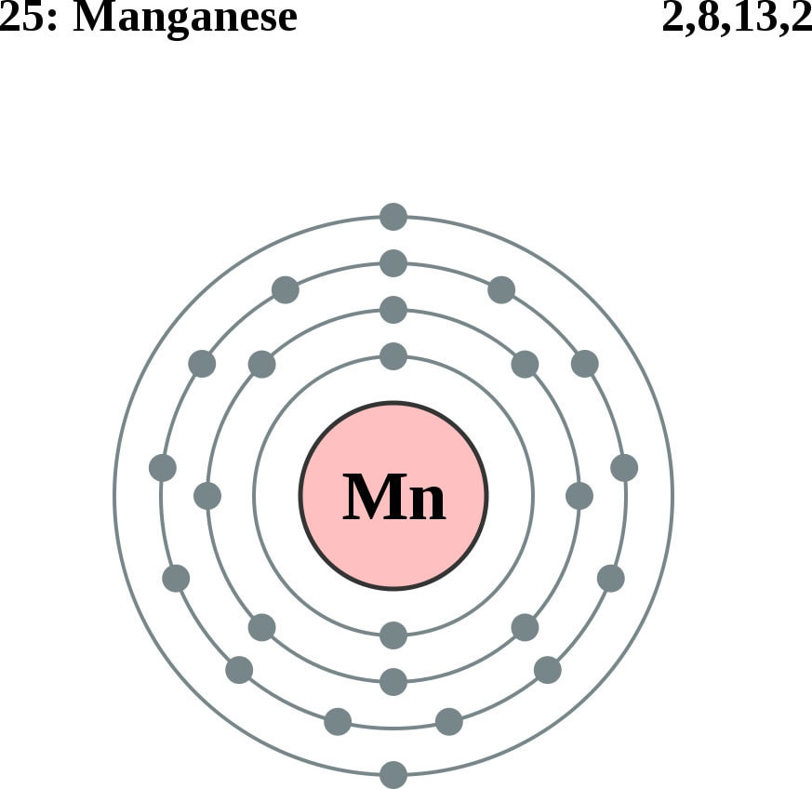
Glutamine Synthesis Depends on Manganese!
Glutamine synthetase
glutamate
glutamine
water
ammonium
Ammonium and glutamate toxicity in the brain
can arise because of insufficient manganese

Slide 45
“Alteration of Plasma Glutamate and Glutamine Levels in Children with High-Functioning Autism”*
*C. Shimmura et al. PLoSone October 2011 6(1):e25340
Notes:
Table 1. Plasma Levels of Amino Acids and related compounds in Control Subjects and Individuals with HFA.
Glyphosate/glutamate_glutamine_autism_2011.pdf

Slide 46
What you can do!

Slide 47
Go Organic!
Foodland: organic shelf
Wholefoods:
Sign at Entrance

Slide 48
Eat Natural Probiotic Foods
Sauerkraut and apple cider vinegar contain acetobacter, one of the very few microbes that can metabolize glyphosate
Kombucha and kimchi do too!

Slide 49
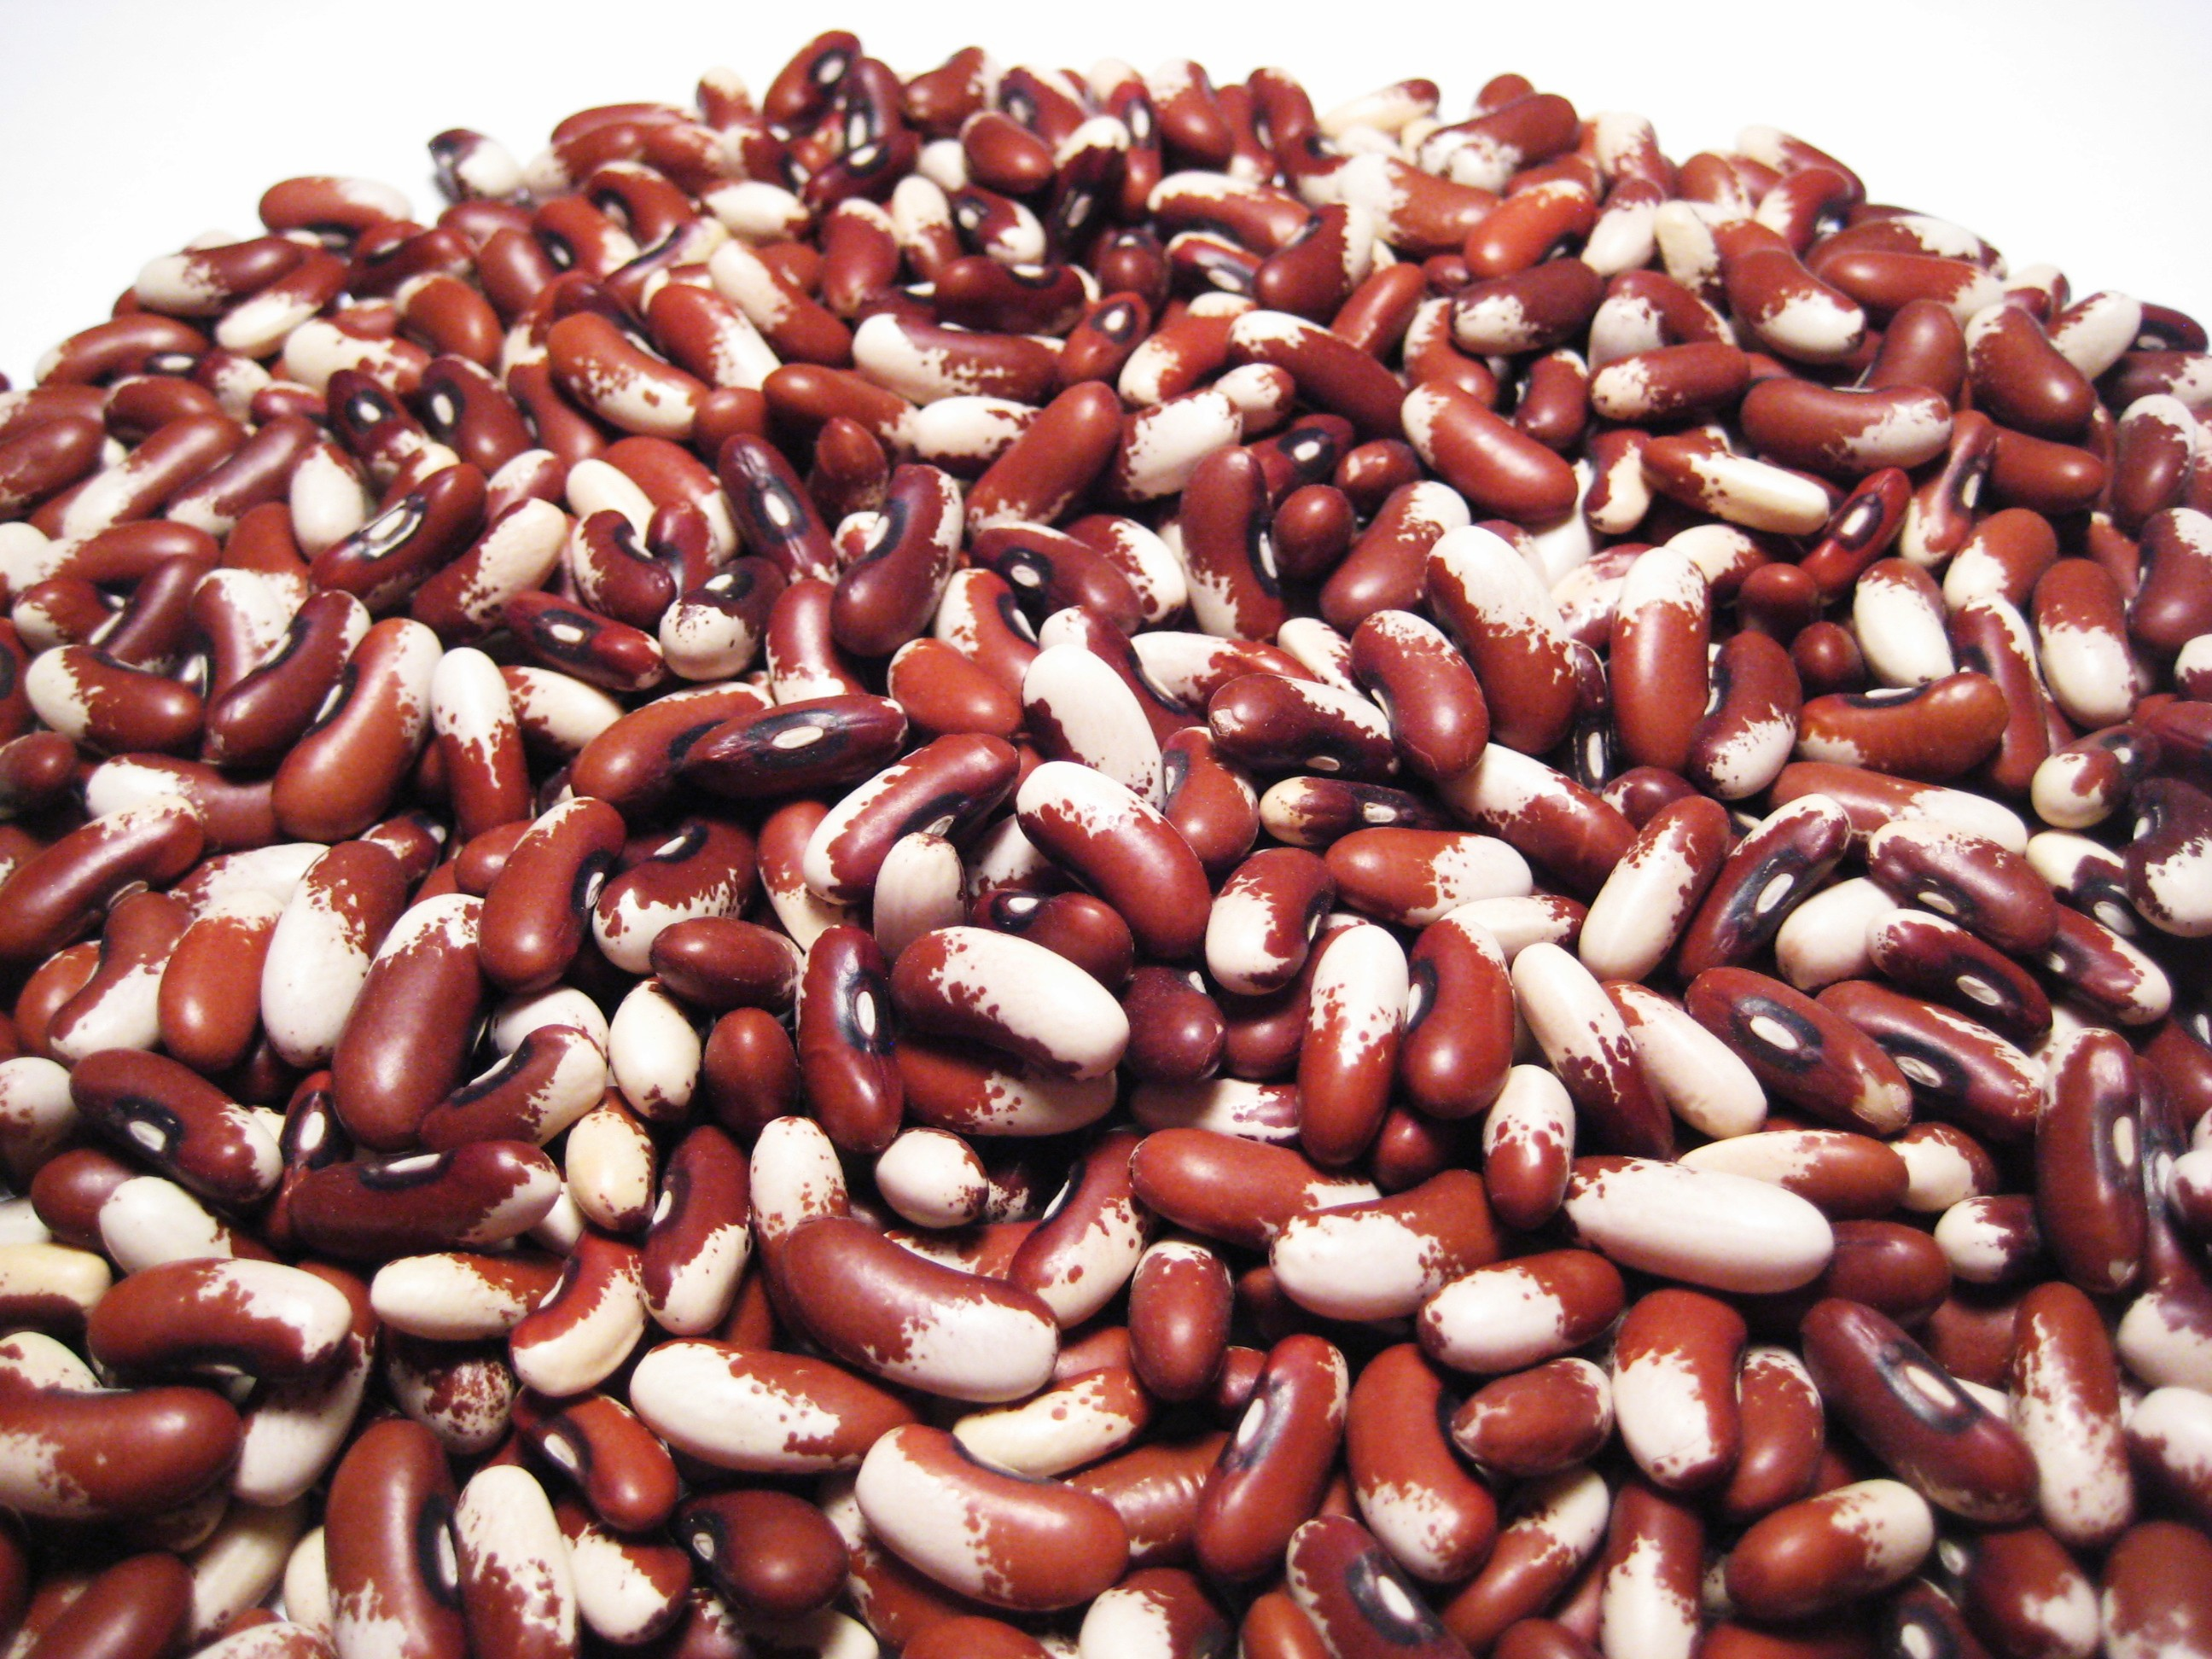
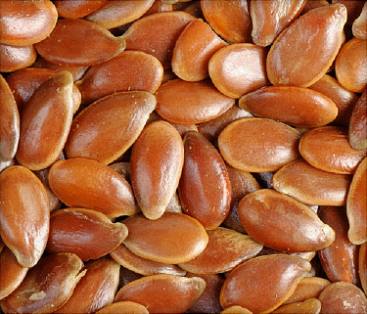
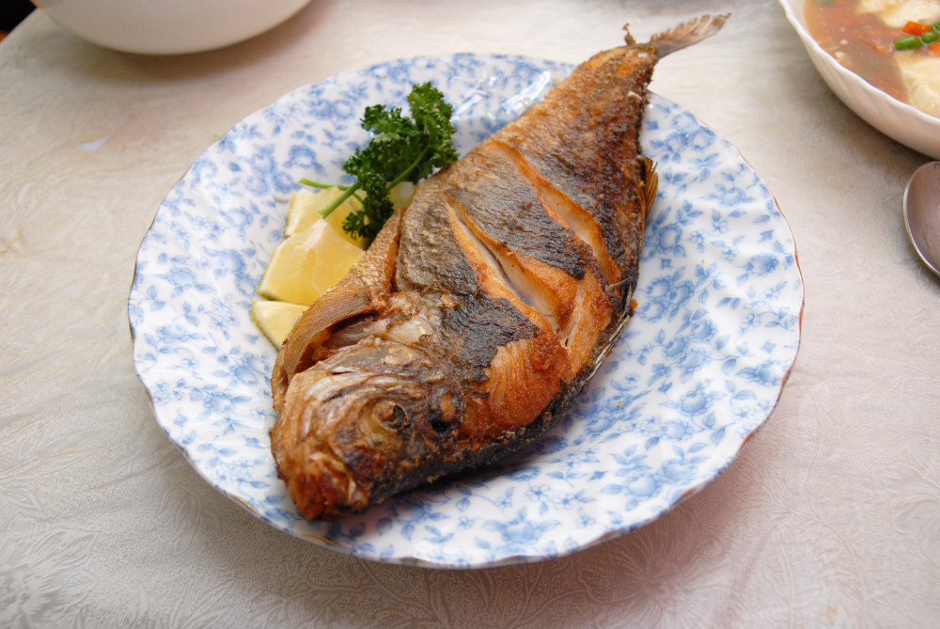
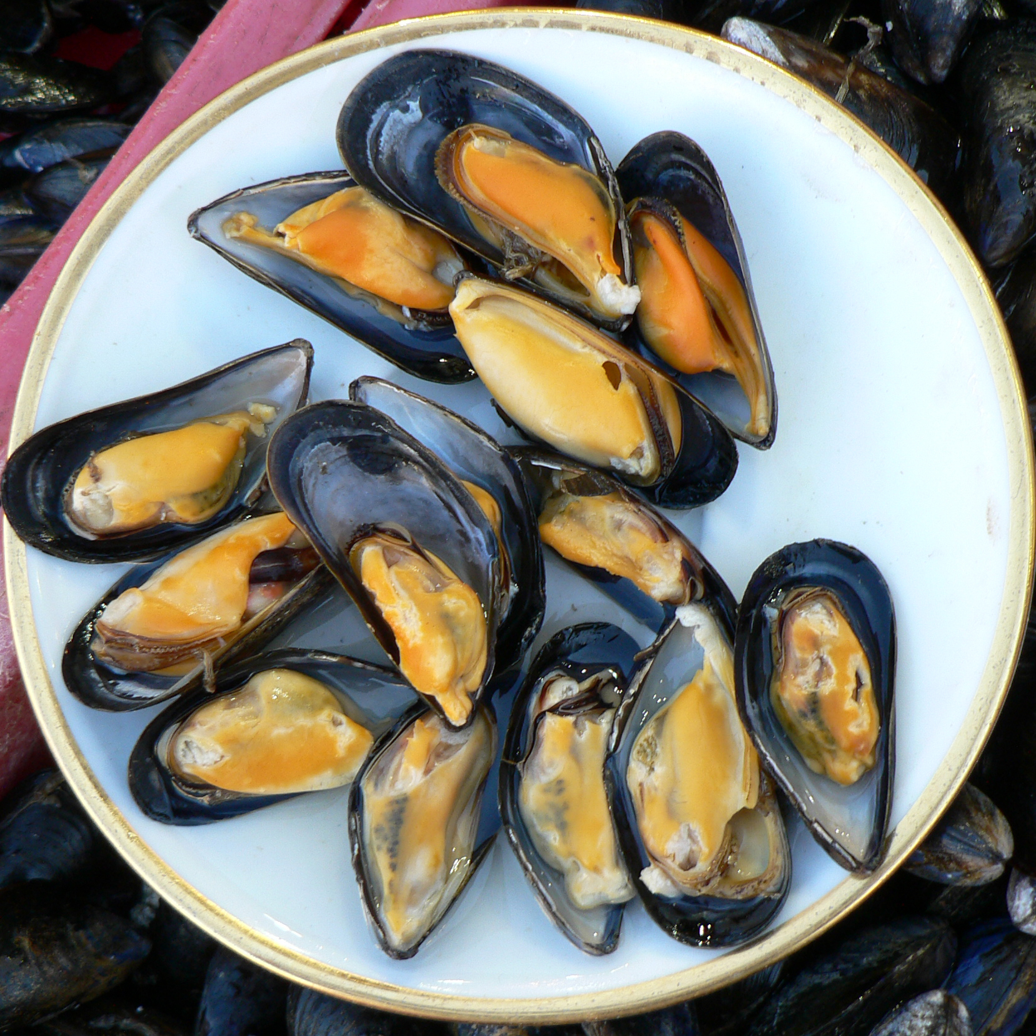
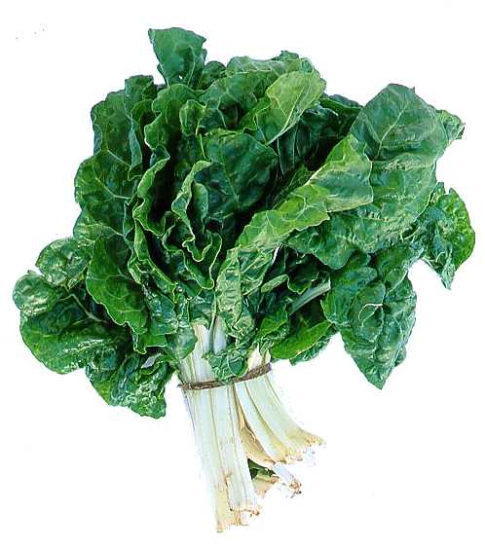
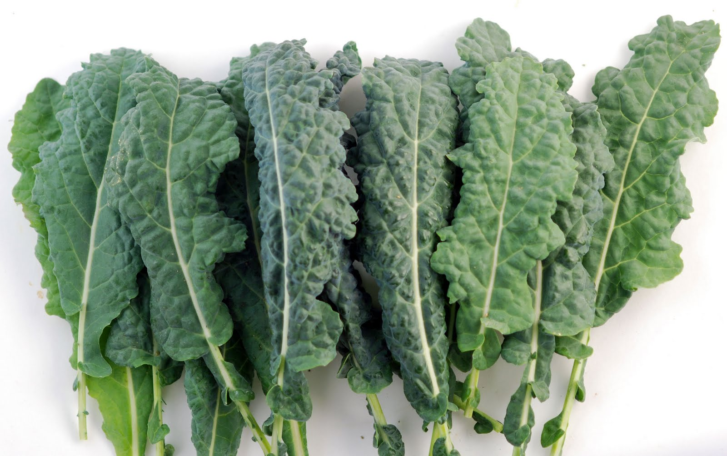
Eat Foods Containing Manganese
But be aware of a possibility of too much manganese being toxic → ADHD

Slide 50
Summary
Glyphosate (from Roundup) is pervasive in our environment
I believe it is the primary cause of the autism epidemic
Glyphosate blocks the shikimate pathway in gut microbes, causing deficiencies in amino acids, neurotransmitters and folate
Glyphosate induces leaky gut and inflammatory gut, and disrupts digestive enzymes, causing Celiac disease
Glyphosate causes Clostridia overgrowth leading to neurotoxins that cause excess dopamine
Glyphosate is a chelator and it binds tightly to manganese, disrupting the liver’s distribution of manganese to the tissues
Results in simultaneous manganese deficiency and manganese toxicity, as well as glutamate toxicity
Lactobacillus depend on manganese to thrive and they alleviate anxiety
Organic diet and probiotic foods are strategies to heal

