Slide 1
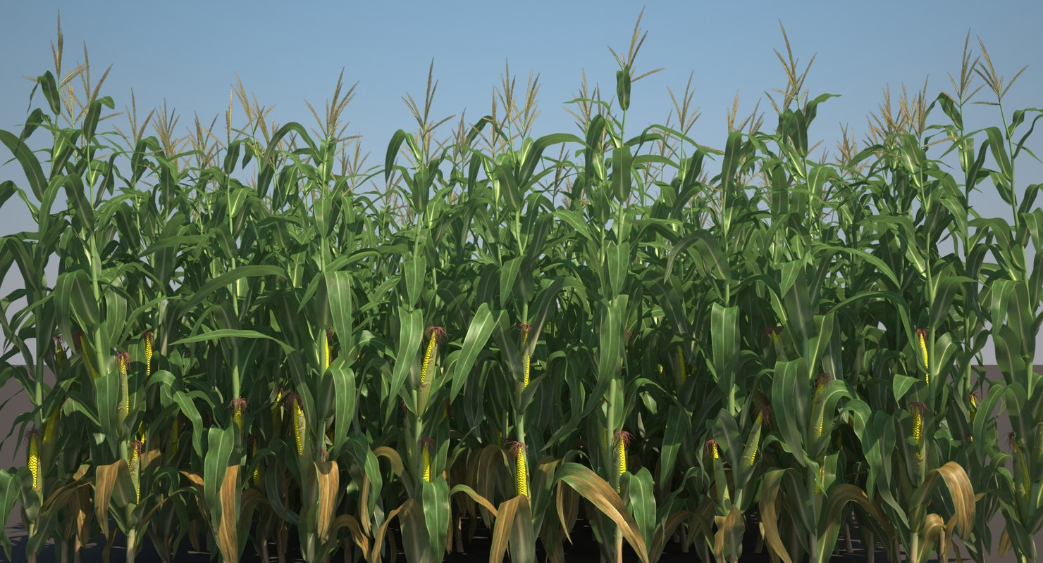
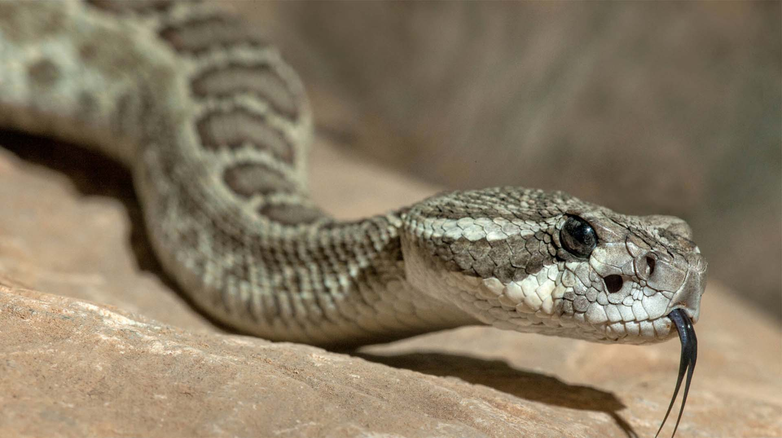
Glyphosate: The Rattlesnake in the Corn Fields
Stephanie Seneff
MIT CSAIL
Wise Traditions Conference
Nov. 16, 2019
Part I

Slide 2
“A truth’s initial commotion is directly proportional to how deeply the lie was believed... When a well-packaged web of lies has been sold gradually to the masses over generations, the truth will seem utterly preposterous and its speaker, a raving lunatic.”
- Dresden James

Slide 3
Outline: Part I
Introduction
Glyphosate Displacing Glycine in Protein Synthesis
Dysfunctional PEP Carboxykinase: Multiple Consequences
The California Lawsuits: Glyphosate and non-Hodgkin’s Lymphoma

Slide 4
Introduction

Slide 5
Roundup and GMO Crops
GMO Roundup-Ready corn, soy, canola, sugar beets
cotton, tobacco and alfalfa
What is glyphosate?

Slide 6
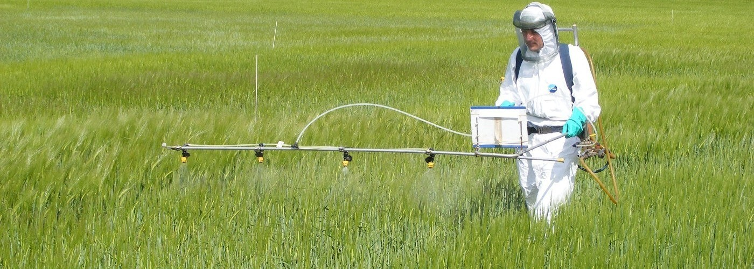
Roundup as a Desiccant/Ripener just before Harvest
Wheat, Oats, Barley, Rye, Sugar cane, Beans, Lentils, Peas, Flax, Sunflowers, Pulses, Chick Peas

Slide 7
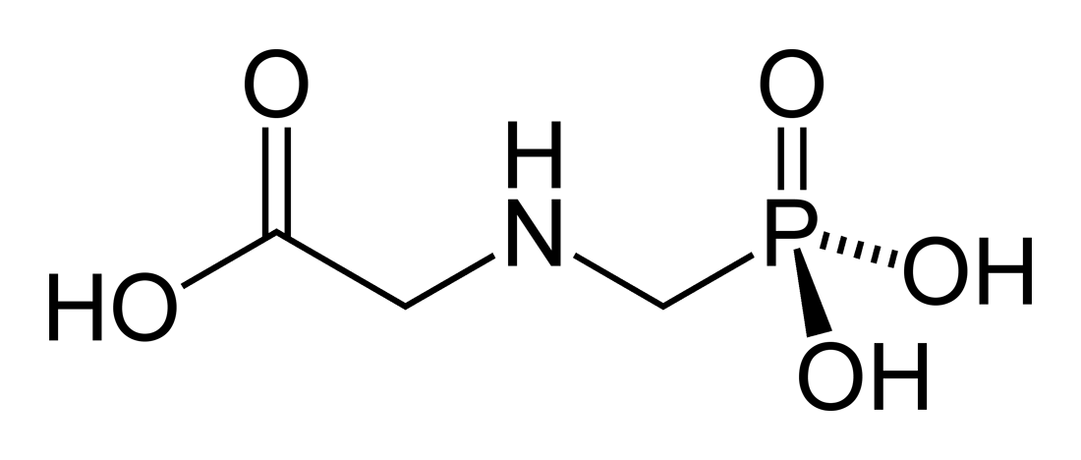
Glyphosate!!
Glyphosate is now the #1 herbicide in use in the U.S. and is increasingly used around the world
Patented by Monsanto in the mid 1970’s
Introduced into the US food chain in 1974
Came out from under patent in 2000
Inhibits an enzyme in the shikimate pathway involved in the synthesis of tyrosine, tryptophan and phenylalanine (the three aromatic amino acids)
Huge expansion of GMO corn, soy, cotton and canola crops has led to sharp increases in the last two decades
Notes:
WIKI

Slide 8
Shikimate Pathway Disruption
Phenylalanine, tryptophan, tyrosine
shikimate
Neurotransmitters,
thyroid hormone
Glyphosate
chorismate
vitamin K
folate

Slide 9
Glyphosate vs. Other Pesticides: Usage in the United States*
Glyphosate
*http://sustainablepulse.com/wp-content/uploads/GMO-health.pdf

Slide 10
Environmental Working Group Results*
*www.ewg.org/childrenshealth/glyphosateincereal/

Slide 11
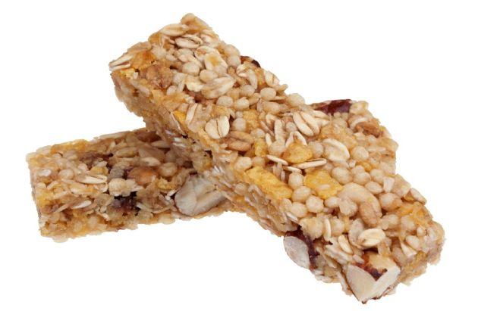
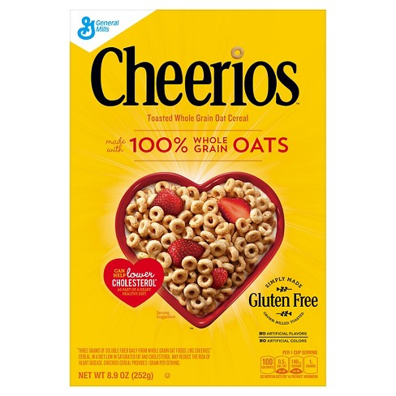
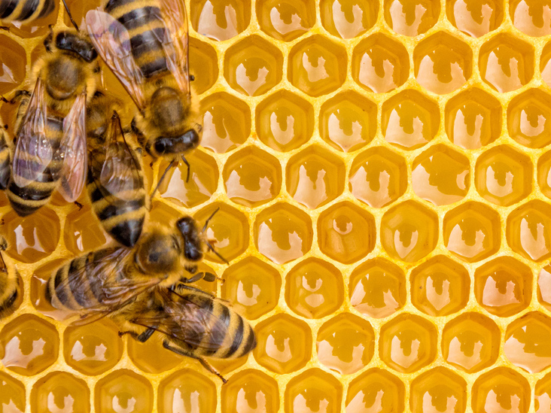
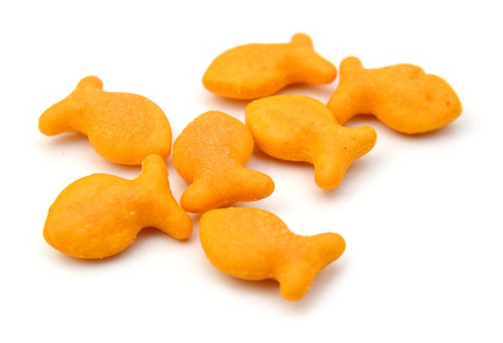
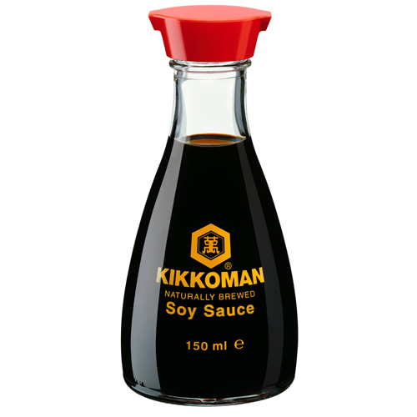
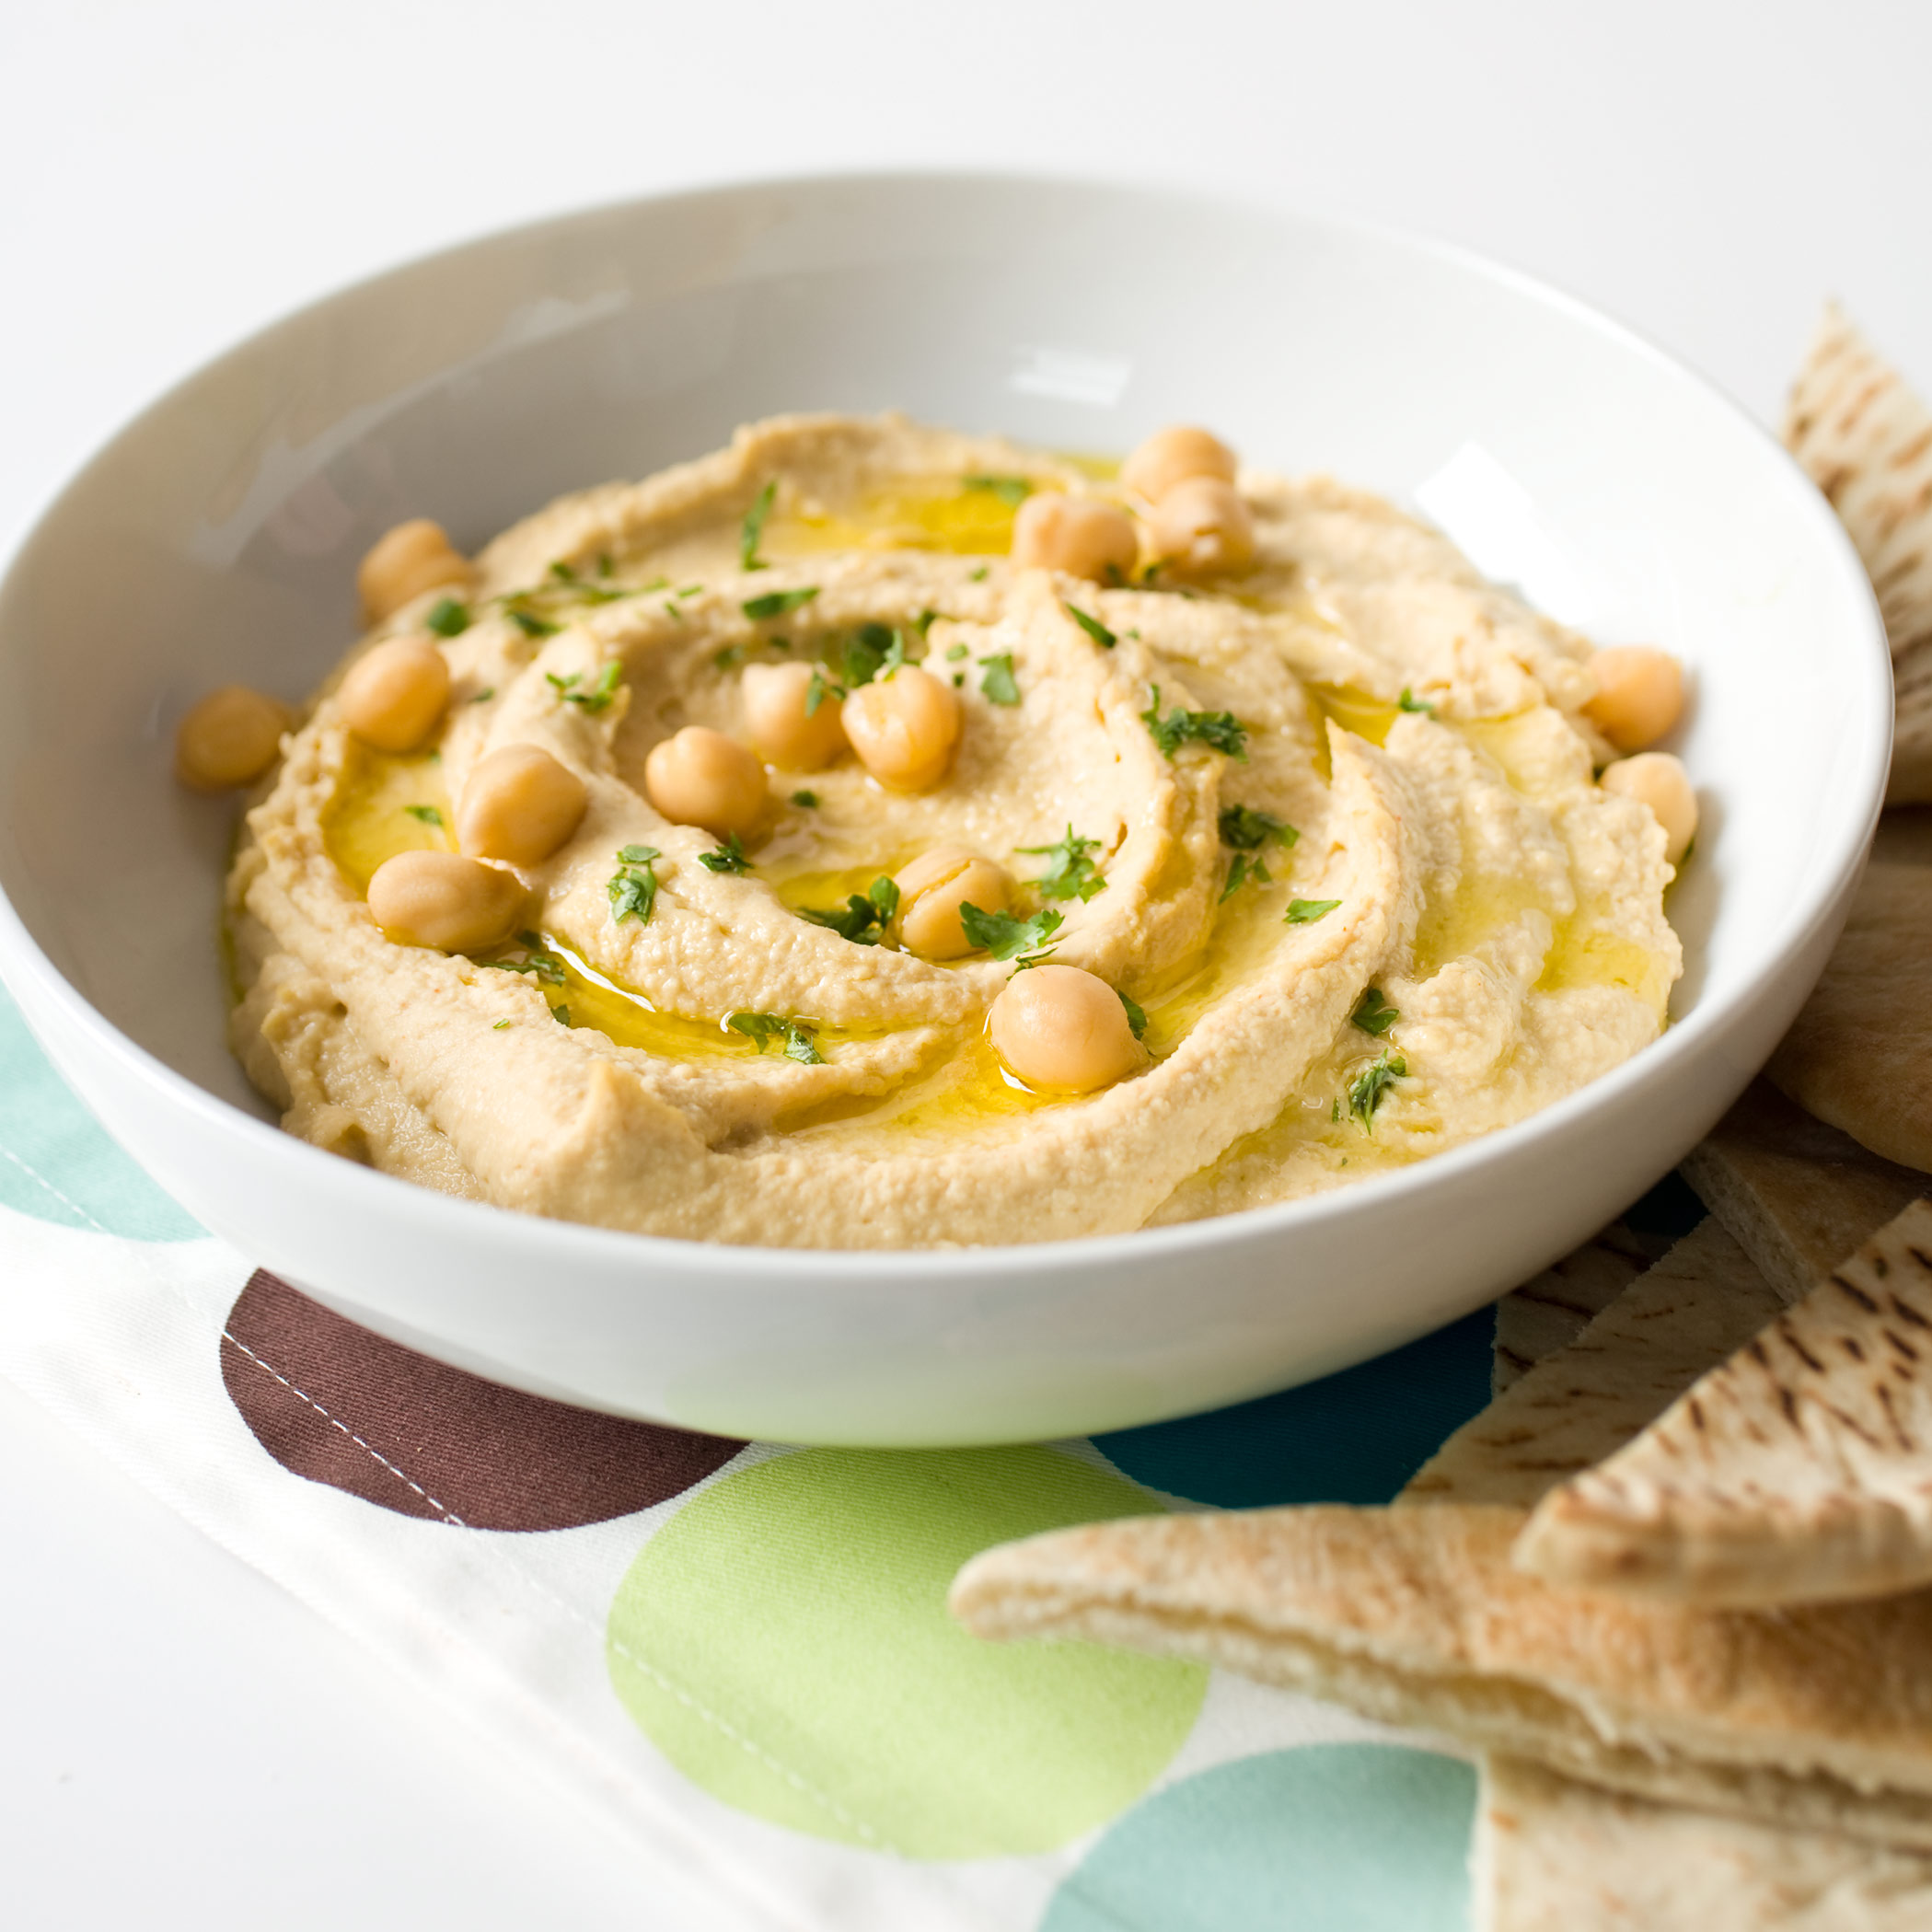
Some Foods Containing Glyphosate
Notes:
glyphosate_residues_in_honey_corn_soy_sauce_2014.pdf
Ten out of twenty eight (36%) soy sauce samples contained glyphosate at a concentration above the method LOQ (75 ng/mL) with a range between 88-564 ng /mL and a mean of 242 ng /mL

Slide 12
Glyphosate in Human Urine Samples*
*Monika Krüger et al., J Environ Anal Toxicol 2014, 4:2
Notes:
Glyphosate/glyphosate_levels_animals_humans_Kruger_2014.pdf

Slide 13
Animals have much higher levels than humans
https://hrilabs.org/animalstudy/
Notes:
./glyphosate_pets.pdf

Slide 14
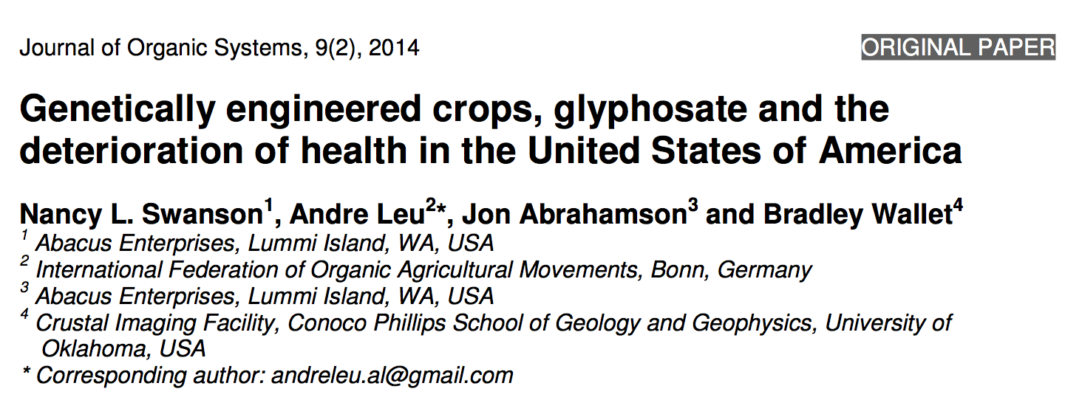
Paper Showing Strong Correlations between Glyphosate Usage and Chronic Disease

Slide 15
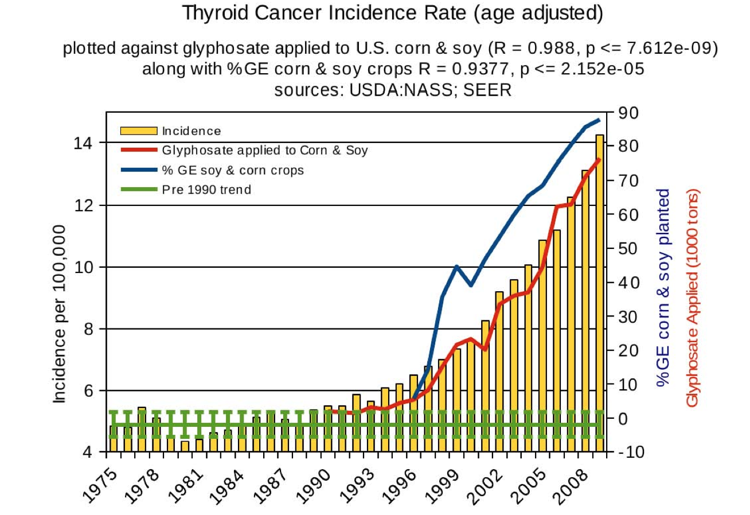
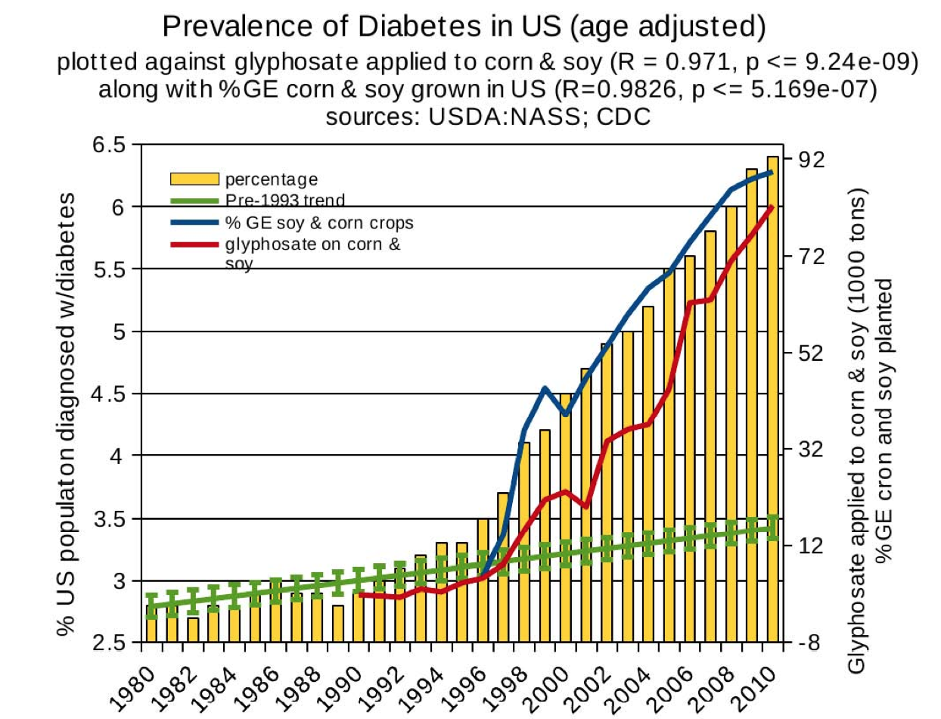
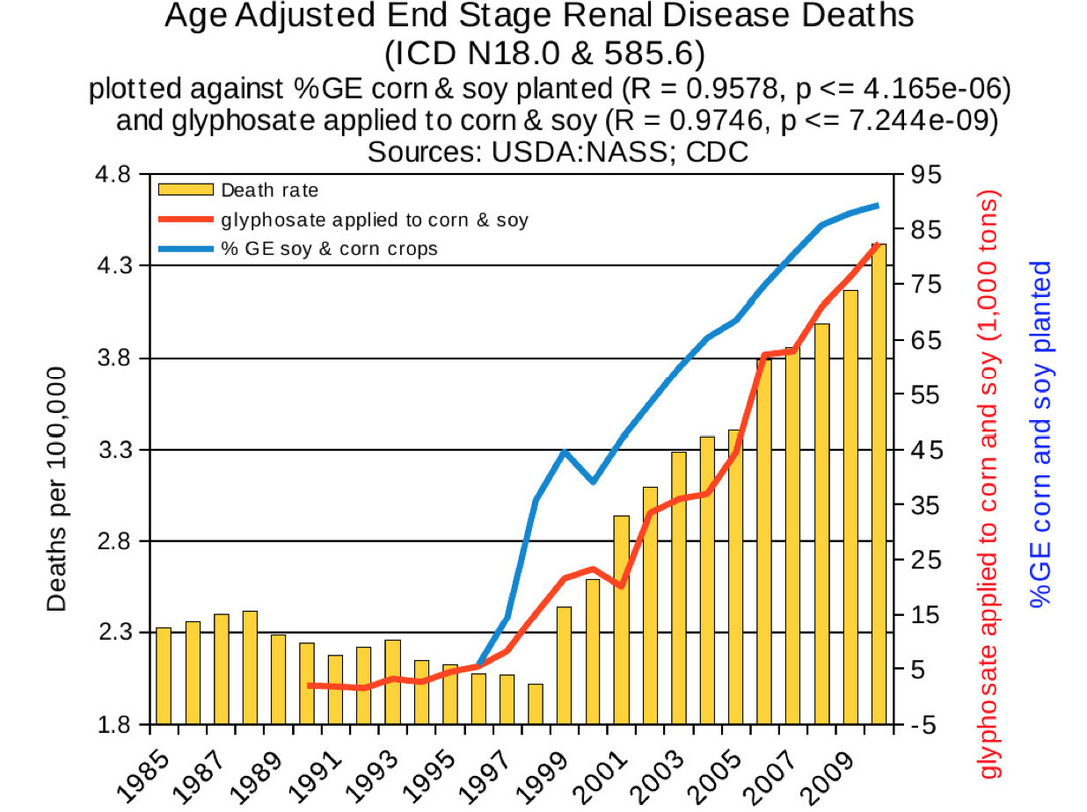
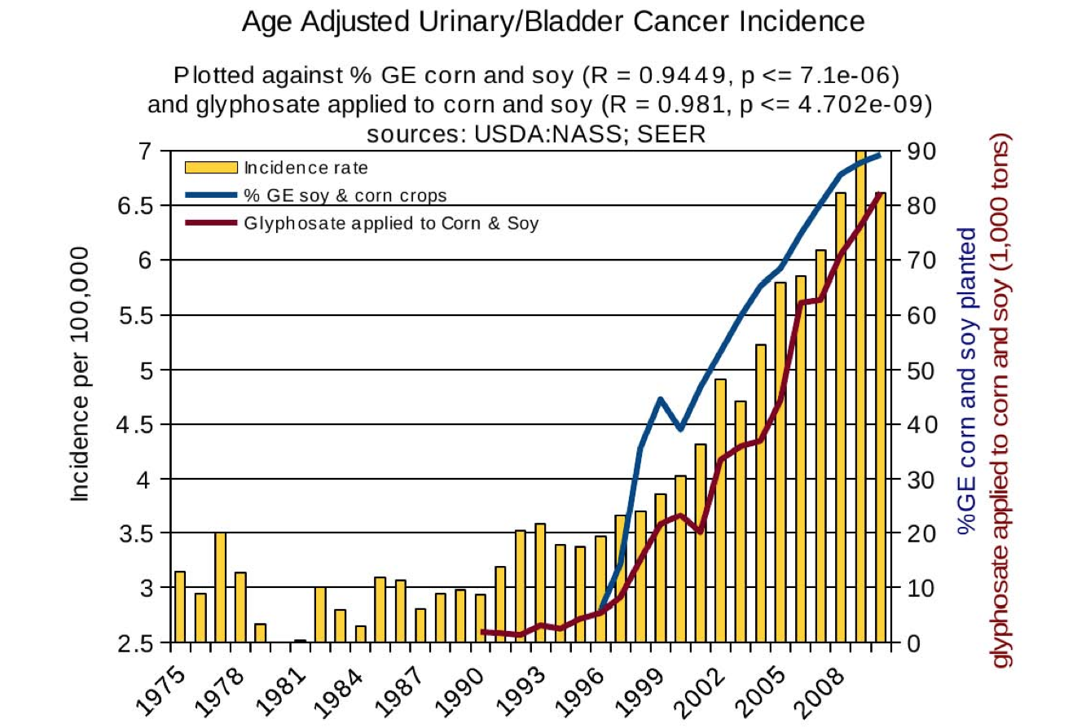
Thyroid cancer
Diabetes
End stage
renal disease
Urinary/bladder
cancer

Slide 16
Thyroid cancer
Diabetes
In 2015, WHO IARC declared glyphosate a “probable carcinogen”
End stage
renal disease
Urinary/bladder
cancer
Notes:
International agency for research on cancer

Slide 17
Quote from the Conclusion*
“Although correlation does not necessarily mean causation, when correlation coefficients of over 0.95 (with p-value significance levels less than 0.00001) are calculated for a list of diseases that can be directly linked to glyphosate, via its known biological effects, it would be imprudent not to consider causation as a plausible explanation.”
*NL Swanson et al. Journal of Organic Systems 9(2), 2014, p. 32,

Slide 18
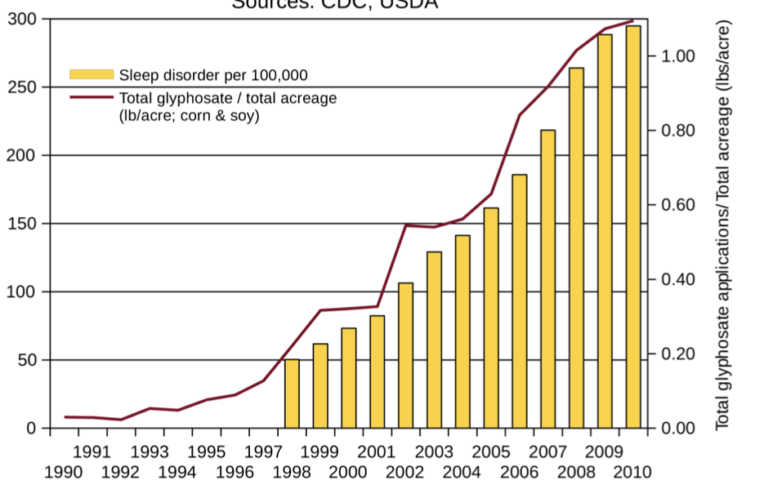
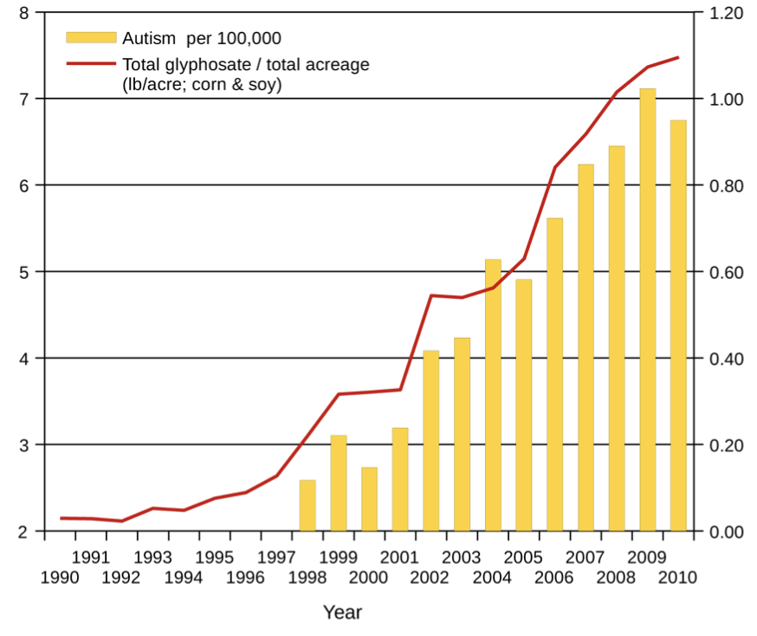
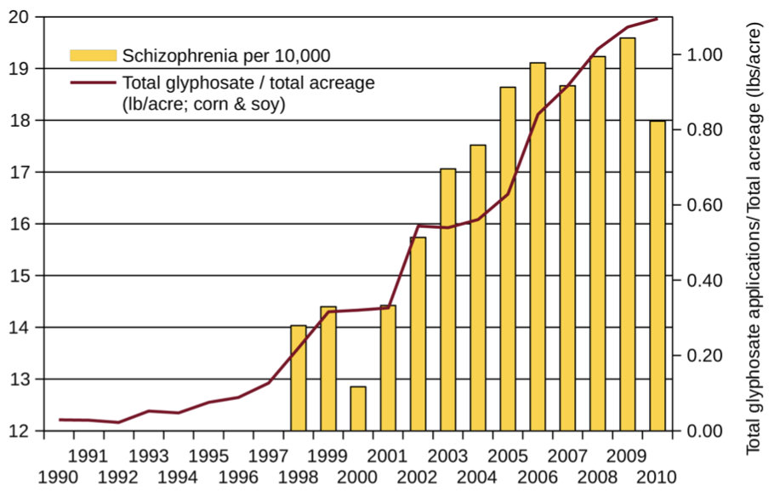
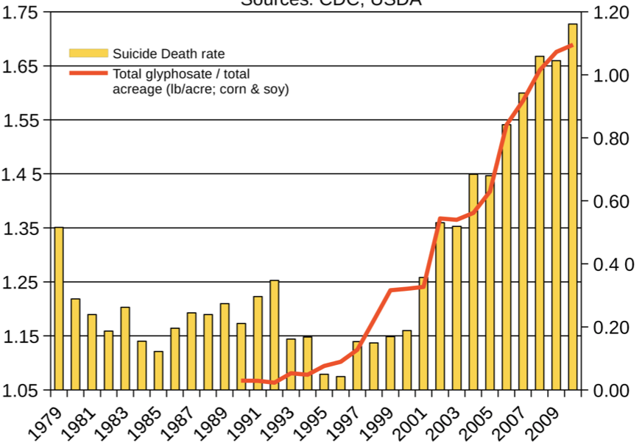
Autism
Sleep Disorder
Schizophrenia
Death by Suicide
*Seneff et al. Agricultural Sciences 2015; 6: 42-70.
Notes:
Hospital discharge diagnoses per 100,000

Slide 19
List Compiled by Prof. Don Huber

Slide 20
Decreasing IQ scores after 1975*
“scores increased by almost 3 percentage points each decade for those born between 1962 and 1975 -- but then saw a steady decline among those born after 1975.”
“What specific environmental factors cause changes in intelligence remains relatively unexplored.”
*Rory Smith, CNN.
https://www.cnn.com/2018/06/13/health/falling-iq-scores-study-intl/index.html

Slide 21
Decreasing IQ scores after 1975*
“scores increased by almost 3 percentage points each decade for those born between 1962 and 1975 -- but then saw a steady decline among those born after 1975.”
“What specific environmental factors cause changes in intelligence remains relatively unexplored.”
Glyphosate was introduced on the market in 1975
*Rory Smith, CNN.
https://www.cnn.com/2018/06/13/health/falling-iq-scores-study-intl/index.html

Slide 22
US
Notes:
http://www.commonwealthfund.org/interactives-and-data/chart-cart/report/2017-mirror-mirror/mortality-amenable-to-health-care

Slide 23
Glyphosate in Human Urine: U.S. Southern California*
*PJ Mills et al. JAMA 2017; 318(16): 1610-1611.
Notes:
./JAMA_glyphosate_urine_US_2018.pdf

Slide 24
Glyphosate reduces sperm motility and sperm count*
Sperm motility (%)
Sperm count x 10⁶
Control (no glyphosate) vs increasing levels of glyphosate exposure
*FO Owagboriaye et al. Experimental and Toxicologic Pathology 2017 Sep 5;69(7):461-468.
Notes:
Glyphosate/Glyphosate_Reproductive toxicity of Roundup herbicide exposure in male albino rat.pdf
Male albino rats
Sperm motility (%) and sperm count (×106 cells/ml) in rats exposed to Roundup at different concentrations of glyphosate.

Slide 25
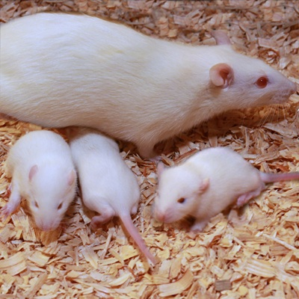
Glyphosate Damages Second Generation*
Pregnant rats exposed to glyphosate starting at day 9 of gestation
Two exposure levels (low, high), both levels considered to be safe according to regulators
Neither the rats nor their offspring showed any obvious effects
The second generation offspring from both exposed groups showed delayed growth, lower fetal weight and length and a higher incidence of abnormally small fetusus
Most surprising: there were three cases (each from a different mother) among the second generation offspring with major fetal abnormalities (conjoined fetuses and abnormal limb development)
*MM Milesi et al. Archives of Toxicology June 9, 2018 [Epub ahead of print]
Notes:
glyphosate/Milesi_glyphosate_reproduction_rats_2018.pdf
https://www.gmwatch.org/en/news/latest-news/18363-glyphosate-based-herbicide-impairs-female-fertility-new-study
The second generation offspring from both glyphosate herbicide-exposed groups showed delayed growth, evidenced by lower foetal weight and length, and a higher incidence of abnormally small foetuses.
Also, to the authors' surprise, malformations (conjoined foetuses and abnormally developed limbs) were detected in the second generation of offspring from the higher dose of glyphosate herbicide group. Foetal abnormalities were found in 3 out of 117 foetuses, each one from different mothers within the first generation of offspring (i.e. 3 out of 13 litters were affected). A statistically significant correlation was found between glyphosate herbicide exposure and foetal malformations.

Slide 26
America’s Children are in Trouble!
It is now "normal" for a kindergarten child to have 12 colds every year and for a baby to have nine
Fourfold increase in childhood obesity
Double the asthma rate since the 1980's
"Chronic illnesses" rose from 1.8% in 1960 to 7% in 2004
Today, 43% of US children are chronically ill
1 in 6 children in the USA has a neurodevelopmental disability
1 in 38 boys are autistic
US has the worst neonatal death rate of all industrialized countries
Today's children in the US will have a shortened life span compared to their parents
Source: http://www.vaccineviolence.com/
Notes:
https://www.facebook.com/groups/1409306052710440/
./TheOutliers.text
Page removed!!
— Joanna Karpasea Jones

Slide 27
Notes:
https://www.facebook.com/groups/1409306052710440/
./TheOutliers.text
Page removed!!
— Joanna Karpasea Jones

Slide 28
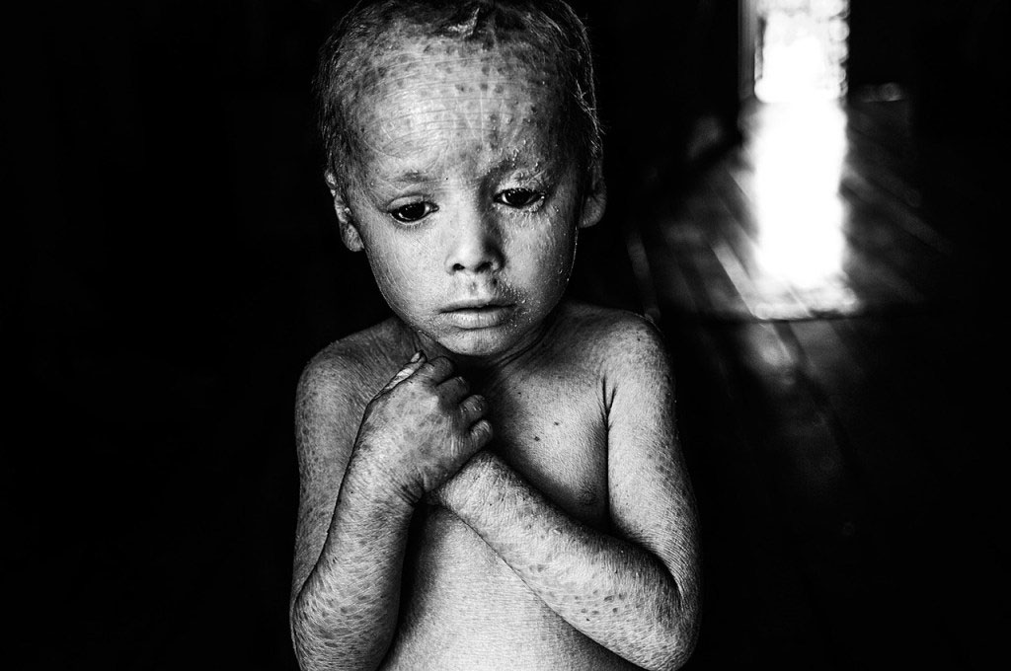
Genetically Modified Children

Slide 29
Glyphosate Displacing
Glycine in Protein Synthesis

Slide 30
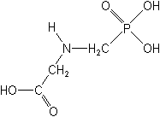
What if Glyphosate could Insert itself into Proteins during Synthesis???
Extra Stuff!
glyphosate
Code for Glycine
GGC
mRNA
. . .
. . .
Glyphosate
Alanine
Proline
-- Any proteins with conserved glycine residues are likely to be affected in a major way

Slide 31
Extra Piece Sticks Out at Active Site
Substrate no longer fits in active site
Active Site
Glyphosate
Alanine
Proline
Peptide chain

Slide 32
Extra Piece Sticks Out at Active Site
Substrate no longer fits in active site
Active Site
Glyphosate
Alanine
Proline
glycine
Peptide chain

Slide 33
Extra Piece Sticks Out at Active Site
Substrate no longer fits in active site
Active Site
Extra Stuff
Glyphosate
Alanine
Proline
glycine
Peptide chain

Slide 34
Extra Piece Sticks Out at Active Site
Substrate no longer fits in active site
This explains how glyphosate disrupts EPSPS in the shikimate pathway: Multiple bacteria have developed resistance by replacing active site glycine with alanine and this is the basis for GMO Roundup Ready crops*
Active Site
Extra Stuff
Glyphosate
Alanine
Proline
glycine
Peptide chain
*T Funke et al., Molecular basis for the herbicide resistance of Roundup Ready crops. PNAS 2006;103(35):13010-13015.

Slide 35
Inhibition of EPSPS by glyphosate: Resistant E coli mutant*
Mutant with alanine substituted for glycine 96
Wild type with glycine 96
*Figure 3, S Eschenburg et al. Planta 2002;216:129-135.

Slide 36
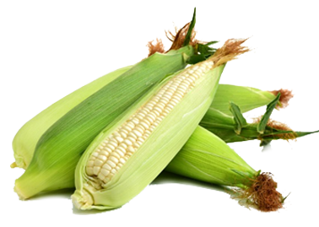
DowDupont Experiments on Maize*
Designer gene introduced into maize using CRISPR technology
Tweaked native EPSP synthase to produce glyphosate- resistant version
First step: mutate glycine to alanine at residue 101 (GNAG → GNAA)
Completely erases any glyphosate sensitivity
[corresponds to 96 in E coli]
Modify additional nearby residues to increase space for EPSP substrate
*Y Dong et al. J Biol Chem 2019; 294(2): 716-725.

Slide 37
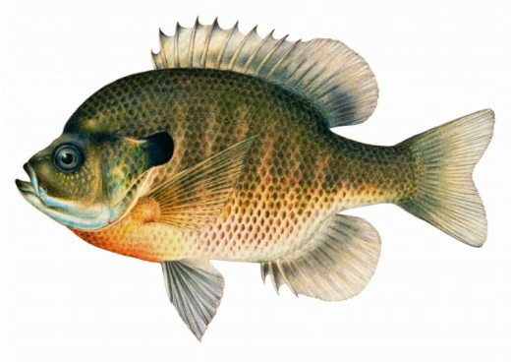
Monsanto Study (1989)*
Study exposed bluegill sunfish to carbon-14 radiolabelled glyphosate
Measured radiolabel in tissues greatly exceeded measured glyphosate levels
Proteolysis recovered more glyphosate
20% yield → 70% yield
*WP Ridley and KA Chott. Monsanto unpublished study. August, 1989.

Slide 38
Monsanto Study (1989)*
Study exposed bluegill sunfish to carbon-14 radiolabelled glyphosate
Measured radiolabel in tissues greatly exceeded measured glyphosate levels
Proteolysis recovered more glyphosate
20% yield → 70% yield
"Proteinase K hydrolyses proteins to amino acids and small oligopeptides, suggesting that a significant portion of the 14C activity residing in the bluegill sunfish tissue was tightly associated with or incorporated into protein.”
*WP Ridley and KA Chott. Monsanto unpublished study. August, 1989.

Slide 39
Some Predicted Consequences*
Neural tube defects
Autism
Impaired collagen → osteoarthritis
Steatohepatitis (fatty liver disease)
Obesity and adrenal insufficiency
Hypothyroidism
Impaired iron homeostasis and kidney failure
Insulin resistance and diabetes
Cancer
*A. Samsel and S. Seneff. Journal of Biological Physics and Chemistry 2016;16:9-46.

Slide 40
An Analogy: ALS in Guam
An epidemic in ALS in Guam was traced to a natural toxin found in cycads
BMAA is a non-coding amino acid that gets inserted by mistake in place of serine
Defective versions of a glutamate transporter have been linked to ALS*
The transporter has an essential serine-rich region in its sequence**
*Antioxidants & Redox Signaling 2009;11: 1587-1602.
**DJ Slotboom et al., PNAS 1999; 96(25): 14282-14287
Notes:
cyanobacteria_BMAA_article.pdf
Slotbloom_1999_conserved_serine_glutamate_transporter.pdf
Dunlop.pdf
ALS_glutamate_transporter_link_2009.pdf
Guam/
*ALS_glutamate_transporter_link_2009.pdf
ChrisShawChapter7GuamFantastic.docx
Dunlop.pdf
**Slotbloom_1999_conserved_serine_glutamate_transporter.pdf

Slide 41
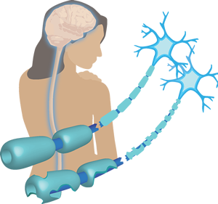
Another Analogy: MS & Sugar Beets*
Sugar beets contain an analogue of proline called Aze
Remarkable correlation between MS frequency and proximity to sugar beet agriculture
Myelin basic protein contains a concentration of proline residues that are absolutely essential for its proper function
*E. Rubenstein, J Neuropathol Exp Neurol 2008;67(11): 1035-1040.
Notes:
./misincorporation_of_proline_analogue_MS.pdf

Slide 42
I want to teach you how to fish!

Slide 43
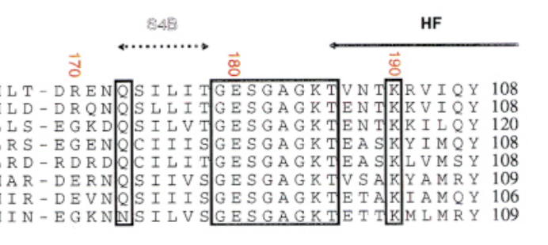
How to Fish
Myosin
alignments
Find a glycine residue in an important protein class that is highly conserved across multiple species
Find papers describing the functional role of that glycine in the protein
Find an example of a genetic mutation mapping that glycine to something else and identify the resulting disease profile
Ideally: find papers that describe dysfunction of that protein linked to glyphosate exposure or a symptom profile of glyphosate exposure that could be explained by that protein’s dysfunction

Slide 44
Vulnerable Proteins: Resulting Pathologies
Conserved Glycines | Disease Profile
Hormone-sensitive Lipase | Obesity
Insulin Receptor | Diabetes
Amyloid Beta Plaque | Alzheimer’s Disease
GABA Receptor | Autism
Lipocalin | Kidney Failure
ACTH | Adrenal Insufficiency
Cytochrome C Oxidase | Mitochondrial Disease
Alpha Synuclein | Parkinson’s Disease
Myosin | Chronic Fatigue Syndrome
*A Samsel and S Seneff, Journal of Biological Physics and Chemistry 2016;16:9-46.

Slide 45
Glyphosate Disrupts Cytochrome P450 (CYP) Enzymes*
Glyphosate severely suppresses CYP enzymes in rat liver
CYP enzymes have a unique FGXGXRXCXG motif with two and often three critical glycine residues**
*A Samsel and S Seneff. Entropy 2013; 15: 1416-1463.
**K Syed and SS Mashele. PLOS ONE 2014; 9(4):| e95616.
GLYCINES
Notes:
CYPs_contain_highly_conserved_glycines_2014.pdf

Slide 46
Glyphosate Disrupts Cytochrome P450 (CYP) Enzymes*
Glyphosate severely suppresses CYP enzymes in rat liver
CYP enzymes have a unique FGXGXRXCXG motif with two and often three critical glycine residues**
CYP enzymes are needed to produce bile acids for digesting fats, to activate vitamin D and to detoxify many environmental toxicants
*A Samsel and S Seneff. Entropy 2013; 15: 1416-1463.
**K Syed and SS Mashele. PLOS ONE 2014; 9(4):| e95616.
GLYCINES
Notes:
CYPs_contain_highly_conserved_glycines_2014.pdf

Slide 47
Dysfunctional PEP
Carboxykinase:
Multiple Consequences

Slide 48
Overview of PEP Carboxykinase (PEPCK)
PEPCK is a crucial enzyme in gluconeogenesis
It is a major regulatory enzyme in metabolism
Defective PEPCK is linked to many diseases and conditions
Fatty liver disease
Neonatal hypoglycemia
Type 1 diabetes
Sudden Infant Death Syndrome
Fungus overgrowth
High oxalate and kidney stones

Slide 49
Basic Chemistry
PEPCK
Oxalacetate + GTP ⇐----⇒ PEP + GDP + CO₂
PEPCK is a cataplerotic enzyme and a feeder reaction for downstream metabolic processes
Cataplerosis: the removal of intermediate metabolites in the citric acid cycle, to prevent their accumulation in the mitochondrial matrix.
PEPCK supports the synthesis of many important metabolites by “stealing” oxaloacetate from the citric acid cycle

Slide 50
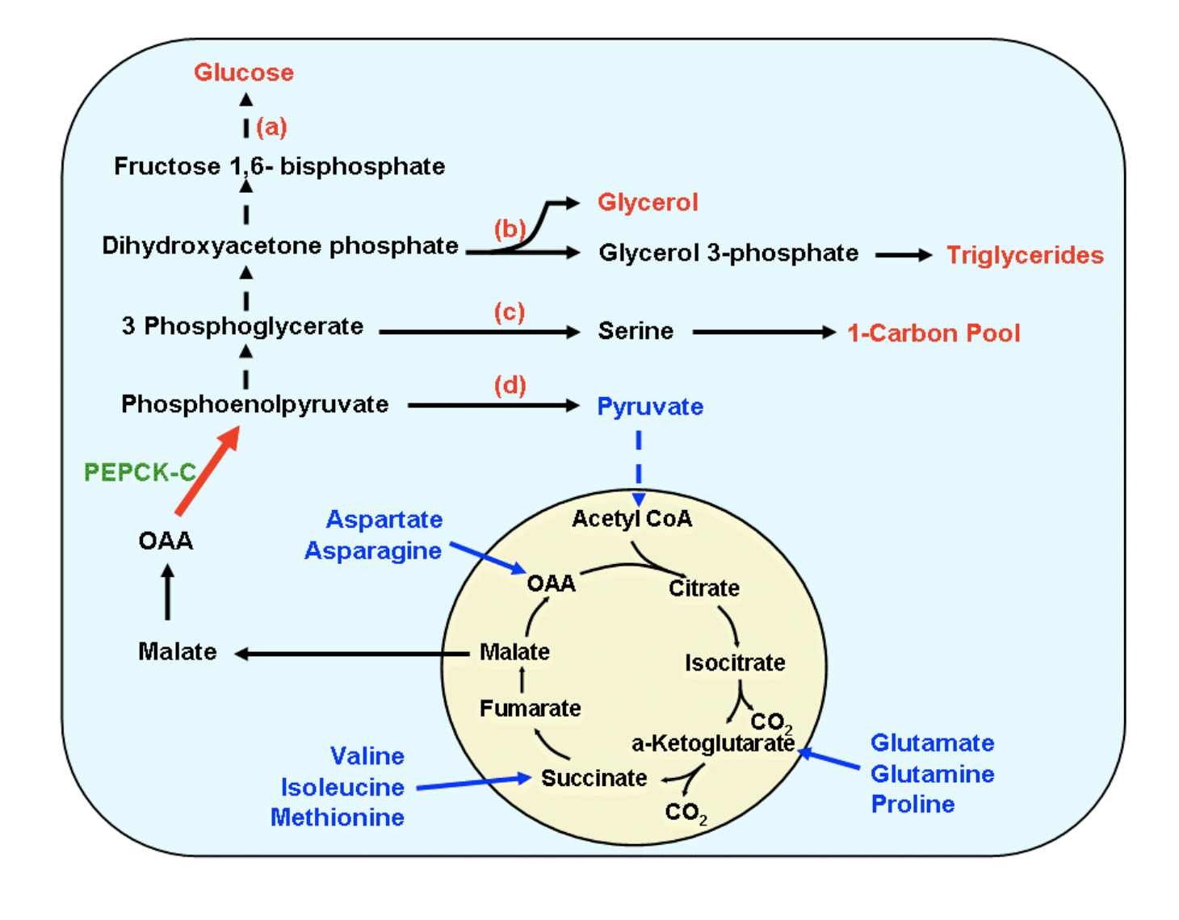
Cytosolic PEPCK and Metabolism*
*Figure 1. Jianqi Yang et al. JBC 2009; 284, 27025-27029
Notes:
Chemistry/ Yang_2009_PEPCK_chemistry.pdf figure
Cancer/PEPCK_upregulation_promotes_cancer_growth_2015.pdf

Slide 51
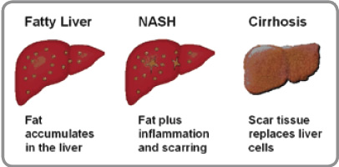
PEP Carboxykinase and Fatty Liver Disease*
Mice with defective PEP carboxykinase (PEPCK) develop dramatic hepatic steatosis
TCA cycle intermediates build up and this blocks fatty acid metabolism
Glucocorticoids stimulate gluconeogenesis in liver and kidney by promoting PEP carboxykinase synthesis**
* Shawn C Burgess et al. JBC 2004; 279(47): 48941-48949
**Taiyi Kuo et al. Adv Exp Med Biol. 2015 ; 872: 99–126.
Notes:
liver/impaired_TCA_cycle_activity_mouse_liver_PEP_carboxykinase_deficiency_2004.pdf

Slide 52
Is Glyphosate Causing an Epidemic in Fatty Liver Disease?
We have a worldwide epidemic in fatty liver disease today*
“Multiomics reveal non-alcoholic fatty liver disease in rats following chronic exposure to an ultra-low dose of Roundup herbicide.”**
Glyphosate causes fatty liver disease in humans***
* Chris Estes et al. Hepatology 2018; 67(1): 123-133.
** Robin Mesnage et al. Sci Rep 2017; 7: 39328.
*** PJ Mills et al. Clinical Gastroenterology and Hepatology 2019
[Epub ahead of print].

Slide 53
“Glyphosate Excretion is Associated With Steatohepatitis and Advanced Liver Fibrosis in Patients With Fatty Liver Disease”*
Patients with liver disease at UC San Diego were carefully screened for NASH
Glyphosate excretion was significantly higher in patients with NASH than in patients without NASH
Patients with advanced fibrosis had significantly higher glyphosate than patients with less fibrosis
* PJ Mills et al. Clin Gastroenterol Hepatol 2019 [Epub ahead of print]

Slide 54
PEP carboxykinase:
PEP-binding site
(CH₂)3
Positively charged
Nitrogen atoms anchor PEP’s phosphate to secure it in place
R405
NH
CH₂
N403
C
NH₂⁺
C
O
NH₂
NH₂
CH₂
PEP
(product)
O
O⁻
O
O
P
O⁻
O⁻
Glycine-237
CH₂
NH₂
NH₂⁺
R87
(CH₂)3
NH
C
NH₂
Stephanie Seneff
Notes:
Chemistry/images/binding_PEP_in_PEP_carboxykinase.png
Chemistry/Carlson_2009_PEP_carboxykinase_active_site_glycine_PEP.pdf

Slide 55
PEP carboxykinase:
PEP-binding site
(CH₂)3
R405
NH
CH₂
N403
C
NH₂⁺
C
O
NH₂
NH₂
CH₂
PEP
(product)
O
O⁻
O
O
P
O⁻
O⁻
Glycine-237
CH₂
NH₂
NH₂⁺
R87
(CH₂)3
NH
C
NH₂
Stephanie Seneff
Notes:
Chemistry/images/binding_PEP_in_PEP_carboxykinase.png
Chemistry/Carlson_2009_PEP_carboxykinase_active_site_glycine_PEP.pdf

Slide 56
PEP carboxykinase:
PEP-binding site
(CH₂)3
R405
NH
CH₂
N403
C
NH₂⁺
C
O
NH₂
NH₂
Methylphosphonyl
Group (Glyphosate)
O
O⁻
CH₂
P
O⁻
Glyphosate-237
CH₂
NH₂
NH₂⁺
R87
(CH₂)3
NH
C
NH₂
Stephanie Seneff
Notes:
Chemistry/images/binding_PEP_in_PEP_carboxykinase.png
Chemistry/Carlson_2009_PEP_carboxykinase_active_site_glycine_PEP.pdf

Slide 57
PEP carboxykinase:
PEP-binding site
(CH₂)3
R405
NH
CH₂
N403
C
NH₂⁺
C
O
Glyphosate’s methylphosphonyl group fills the spot where PEP’s phosphate would otherwise fit.
NH₂
NH₂
Methylphosphonyl
Group (Glyphosate)
O
O⁻
CH₂
P
O⁻
Glyphosate-237
CH₂
NH₂
NH₂⁺
R87
(CH₂)3
NH
C
NH₂
Stephanie Seneff
Notes:
Chemistry/images/binding_PEP_in_PEP_carboxykinase.png
Chemistry/Carlson_2009_PEP_carboxykinase_active_site_glycine_PEP.pdf

Slide 58
PEP carboxykinase:
PEP-binding site
(CH₂)3
R405
NH
CH₂
N403
C
NH₂⁺
C
O
This precisely parallels the situation with EPSP synthase in the shikimate pathway
NH₂
NH₂
Methylphosphonyl
Group (Glyphosate)
O
O⁻
CH₂
P
O⁻
Glyphosate-237
CH₂
NH₂
NH₂⁺
R87
(CH₂)3
NH
C
NH₂
Stephanie Seneff
Notes:
Chemistry/images/binding_PEP_in_PEP_carboxykinase.png
Chemistry/Carlson_2009_PEP_carboxykinase_active_site_glycine_PEP.pdf

Slide 59
Mitochondrial PEPCK Controls Insulin Secretion in Beta Cells*
PEPCK exists in both mitochondrial and cytoplasmic forms
Mitochondrial PEPCK is constitutional, whereas cytoplasmic forms are regulated
Beta cells in pancreas contain only mitochondrial form
“Silencing PEPCK-M prevents insulin secretion in response to glucose”
*Romana Stark et al. Biochim Biophys Acta 2014; 1840(4): 1313–1330

Slide 60
Mitochondrial PEPCK Controls Insulin Secretion in Beta Cells*
PEPCK exists in both mitochondrial and cytoplasmic forms
Mitochondrial PEPCK is constitutional, whereas cytoplasmic forms are regulated
Beta cells in pancreas contain only mitochondrial form
“Silencing PEPCK-M prevents insulin secretion in response to glucose”
Glyphosate suppression of PEPCK in mitochondria of beta cells could lead to suppressed insulin release – type 1 diabetes
*Romana Stark et al. Biochim Biophys Acta 2014; 1840(4): 1313–1330

Slide 61
Designer Mice: Wow!*
Designer mice with ten-fold excess expression of cytoplasmic PEPCK localized to skeletal muscle
Eat 60% more than control pups but weigh half as much
Lived almost 2 years longer; increased fertility
Violate pillar of aging research: limiting food intake increases longevity
Eat a huge amount but are so hyperactive that they burn off most of the calories and stay thin.
Increased insulin sensitivity and recruitment of GLUT-4 to the cell surface in muscle
*Jianqi Yang et al. JBC 2009; 284, 27025-27029
Notes:
./Hanson_born_to_run_mice_PECK_2008.pdf

Slide 62
Born to Run*
*Figure 1. Jianqi Yang et al. JBC 2009; 284, 27025-27029
Notes:
Hanson_born_to_run_mice_PECK_2008.pdf
Fig. 1. Possible mechanism to explain the phenotype of the PEPCK-Cmus mice. The overexpression of PEPCK-C in skeletal muscle leads to a greatly en- hanced rate of glyceroneogenesis in the tissue and the accumulation of triglyc- eride. This results in increased fatty acid oxidation in the tissue and the subsequent stimulation of mitochondrial biogenesis. The increased mitochon- dria, and the availability of ample fatty acids as a fuel in the muscle, are re- sponsible for the hyperactivity noted in the PEPCK-Cmus mice. The hyperactivity results in a marked reduction adipose tissue mass in the animals, which results in a lower level of leptin secretion, increasing food intake in the mice. The hyperactivity increases the insulin sensitivity of the muscle, recruit- ing GLUT-4 to the cell surface in the absence of insulin. The result is a lowered concentration of insulin over the life span of the mice. The reason for the pro- longation of reproductive capacity in female PEPCK-Cmus mice is not clear. Finally, an understanding of the cause of the behavioral changes noted with the PEPCK-Cmus mice will require investigation.

Slide 63
More Details on these Designer Mice
Overexpression of PEPCK in skeletal muscle during development → excessive mitochondria in muscles → hyperactive as early as 10 days after birth
Increase in citric acid flux → more mitochondria
Excess PEPCK in muscle → synthesis of glycerol & triglycerides
Triglycerides fuel muscle overactivity
*Jianqi Yang et al. JBC 2009; 284, 27025-27029

Slide 64
What is the Opposite of This?
Reduced mitochondrial density in muscle
Reduced ability for muscle to utilize fat
Increased adiposity
Low energy; hypoactivity
Insulin resistance and reduced GLUT-4
Shortened lifespan; decreased fertility
Chronic Fatigue Syndrome???

Slide 65
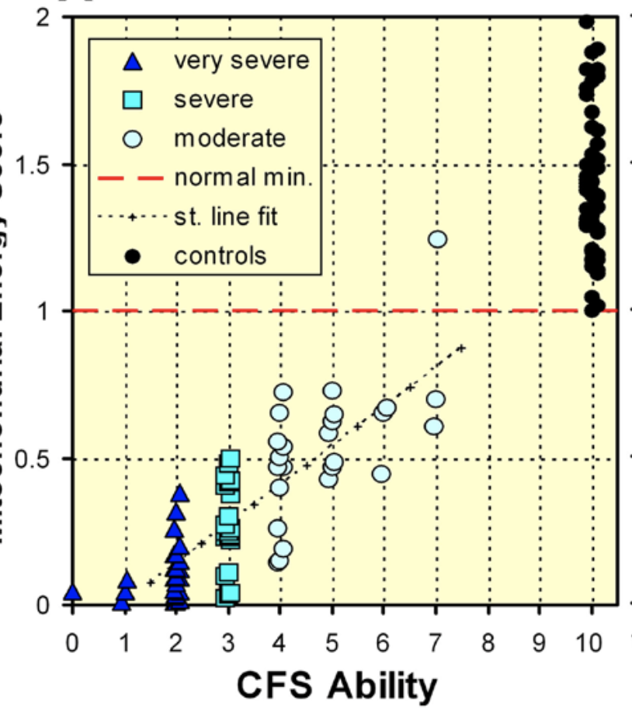
Chronic Fatigue Syndrome/ Myalgic Encephalomyelitis (CFS/ME)*
“Our results strongly suggest that the immediate cause of the symptoms of CFS/ME is mitochondrial dysfunction.”
Mitochondrial energy score
*S. Myhill et al. Int J Clin Exp Med 2009; 2: 1-16.
Notes:
Muscles/chronic_fatigue_syndrome_2009.pdf

Slide 66
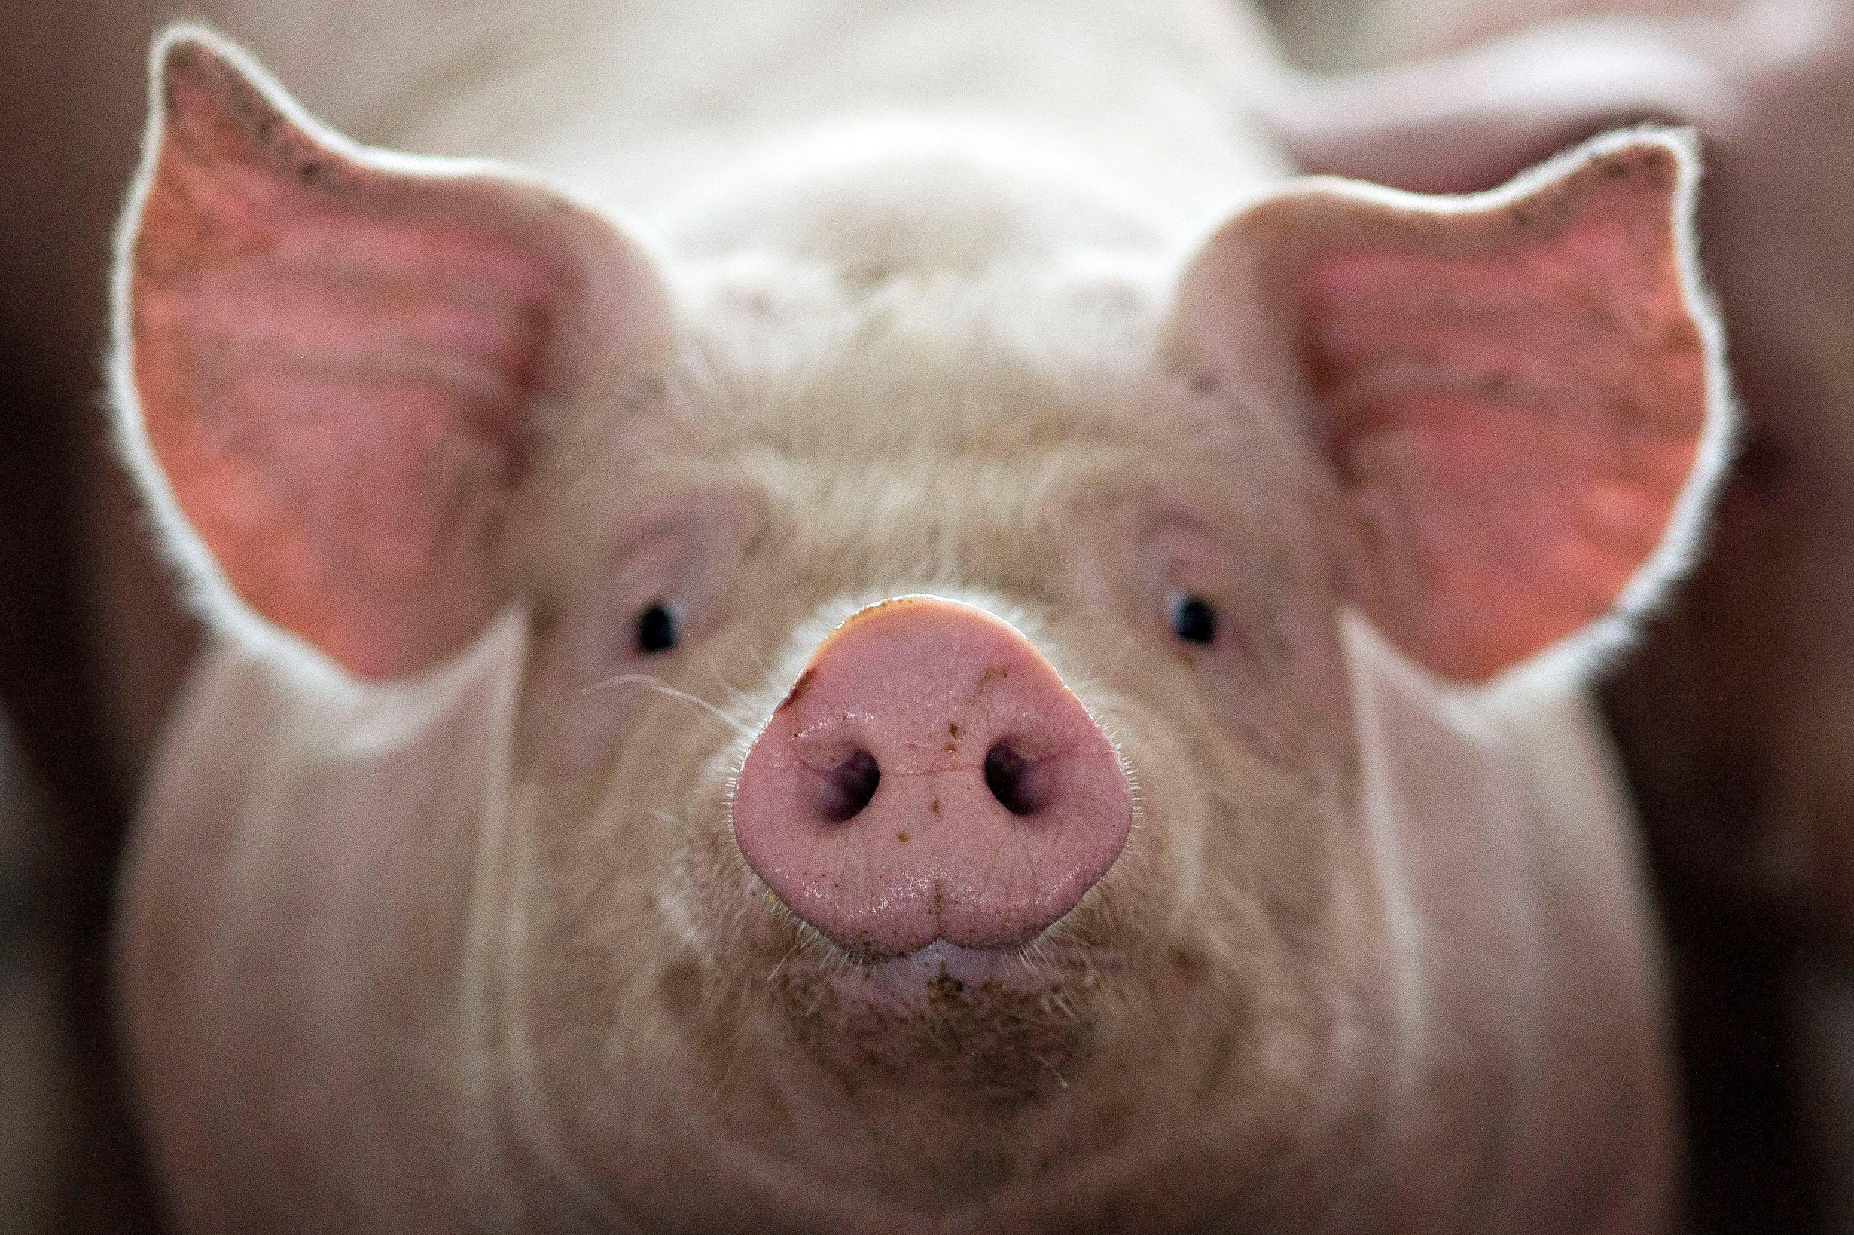
Ractopamine
Ractopamine is a steroid-like drug used as a feed additive to increase lean meat yield in livestock
Banned in most countries, including EU, China, Russia, Taiwan, etc., but not US
US uses Ractopamine on > 60% of its livestock
Ractopamine increases activity of PEPCK*
Exposed pigs are more aggressive and can lose mobility as a side effect
Most countries view it as unsafe for human consumption
*DM Brown et al. Scientific Reports 2016; 6:28693
Notes:
Swhere??

Slide 67
Sugar Addicted Newborns: the Silent Epidemic*
Diabetic moms with high blood sugar supply too much sugar to their fetus during pregnancy
Infant produces too much insulin, which induces hypoglycemia following birth
Symptoms include lethargy, tachycardia, poor feeding, seizures, and even coma
Excessive growth in utero leads to complicated birth
Infant normally upregulates PEP carboxykinase at birth, but glyphosate exposure could be inhibiting protein activity
*www.dunkthejunk.org/blog/2016/1/19/sugar-addicted-newborns-the-silent-epidemic

Slide 68
Glycine mutation in PEP carboxylase leads to hypoglycemia and liver disease
Three cases of homozygous mutation of PEP carboxykinase in Finland
All three had a mutation of glycine at residue 309 to arginine which produced a nonfunctional version of the enzyme
Clinically presented as childhood hypoglycemia, liver dysfunction, and elevations of fumarate and other citric cycle intermediates in the urine
* P Viera et al., Mol Genet Metab 2017; 120(4):337-341.
Notes:
Autism/PEP_carboxykinase_mutation_glycine_2017.text

Slide 69
Critical diaphragm failure in sudden infant death syndrome*
“Critical Diaphragm Failure” hypothesis for SIDS
Weak diaphragm → breathing difficulties
(due to PEPCK impairment?)
PEPCK deficiency in liver → impaired gluconeogenesis
SIDS often occurs at night after child begins to sleep through the night → acute hypoglycemia
*PMA Siren and MJ Siren.
Upsala Journal of Medical Sciences 2011; 116: 115–123.

Slide 70
PEPCK Deficiency: Metabolic Derailments*
Fish exposed to glyphosate had low liver glucose, elevated ALT and AST, and elevated lactate and triglycerides**
*Parvin Hakimi et al. Nutrition and Metabolism 2005: 2:33
**FR de Maura et al. Environ Toxicol Pharmacol 2017; 56: 241-248.
Notes:
ALT = alanine transaminase
Liver/ PEPCK_deficient_mice_high_malate_glutamate_etc_2005.pdf

Slide 71
Could PEP Carboxykinase Deficiency Cause High Serum Oxalate and Fungus Overgrowth?
We have a worldwide epidemic in fungus diseases*
PEP Carboxykinase converts oxaloacetate to PEP
PEP Carboxykinase deficiency leads to excess oxaloacetate
White rot fungus synthesizes oxalate from oxaloacetate**
This leads to accelerated growth and a more pathogenic form
*GD Brown et al. Sci Transl Med 2012; 4: 165rv13.
** Nina Elisabeth Nagy et al. MPMI 2012; 25(11): 1450-1458.

Slide 72
Crops exposed to glyphosate have enhanced oxalate content
Dietary
Oxalate
Inhibited by glyphosate
Glyphosate
Enhanced by glyphosate
Alanine glyoxyl
aminotransferase
X
Oxalate degradation by
gut microbes is reduced
Glyoxylate
Glycine
Oxalate
Sulfate depleted.
Oxalate crystals
Amino Acids
Fungus
X
Oxaloacetate
PEP
Glucose
Lactate
PEP carboxykinase
Notes:
Chapter Autism Figure 1.

Slide 73
Low Sulfate, High Oxalate Phenotype*
Gut Dysbiosis
Decreased sulfomucins, colitis, IBD, leaky gut
Increased susceptibility to pathogens
Fatty liver disease
Reduced detox of heavy metals and toxic chemicals
Elevated serum LDL
Decreased insulin function
Adrenal insufficiency
Increased cancer risk
Stunted growth, slow metabolism
Serotonin deficiency in brain
Autism linked to sulfate wasting in kidneys
*Dr. Rostenberg
www.beyondmthfr.com/side-high-oxalates-problems-sulfate-b6-gut-methylation
Notes:
Add slides from SeneffOxalate2017.pptx in January/
Oxalate_Dr_Rosenberg.text
Down_side_high_oxalate.pdf

Slide 74
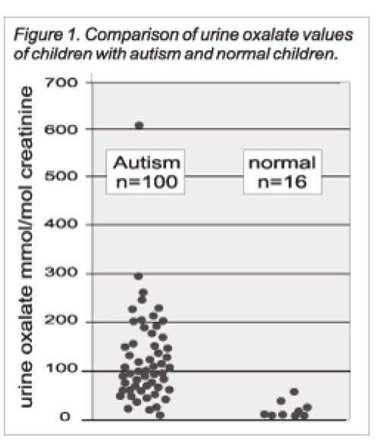
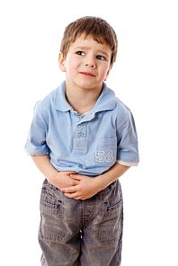
Autism Linked to Oxalate Crystals*
Crystals of oxalate form kidney stones and cause great discomfort
Study has shown at least 3-fold higher serum and urinary levels of oxalate in autistic kids**
*William Shaw, The Role of Oxalates in Autism and Chronic Disorders WAPF, March 26, 2010
**J Konstantynowicz et al., European Journal of Paediatric Neurology 16(5), 2012, 485-491
Notes:
samantha/oxalates_in_autism.text
samantha/william_shaw_on_oxalates_autism.text
http://www.westonaprice.org/health-topics/the-role-of-oxalates-in-autism-and-chronic-disorders/
*http://www.greatplainslaboratory.com/home/span/oxalates.asp
“Oxalate crystals in the bone may crowd out the bone marrow cells, leading to anemia and immunosuppression”*

Slide 75
Oxalate Causes Sulfate Flushing through Urine*
Sulfate is essential for:
Synthesis of extracellular matrix glycoproteins
Synthesis of cerebroside sulfate, in myelin in nerve fibers
Detoxification of many environmental toxins
Sulfate is flushed (lost) when kidney oxalate levels are high
Oxalobacter microbes degrade oxalate but they are killed by antibiotics such as Cipro
Oxalate decarboxylase depends on manganese as catalyst**
*W Krick et al., Am J Physiol Renal Physiol 2009;297: F145-F154.
**A Tanner et al. J Biol Chem. 2001;276(47):43627-34
Notes:
book/autism/sulfate_oxalate_kidney_transport_Karen_Lyke.pdf
Book/autism/oxalate/Tanner_2001_oxalate_decarboxylase_requires_manganese_glycine_dependencies.pdf

Slide 76
Recapitulation
Glyphosate may be disrupting PEPCK in the same way it disrupts EPSP synthase
If so, it explains glyphosate's well established association with fatty liver disease
It also explains the epidemic we see today in:
chronic fatigue syndrome
neonatal hypoglycemia
sudden infant death
autism
oxalate overload
fungus infection
type 1 diabetes

Slide 77
The California Lawsuits:
Glyphosate and
non-Hodgkin’s Lymphoma

Slide 78
DeWayne Lee Johnson Lawsuit
Johnson was a groundskeeper for the school district in Benicia, CA, just north of San Francisco
He was diagnosed with non-Hodgkin’s lymphoma (NHL) in 2014, at age 42.
In 2015, WHO's IARC classified glyphosate as "probably carcinogenic to humans"
Donna Farmer, Monsanto's "product protection lead" said in email to colleagues:
"You cannot say that Roundup does not cause cancer."
Timothy Litzenburg, one of Johnson's lawyers, said:
"so much of what Monsanto has worked to keep secret is coming out."
Notes:
https://www.theguardian.com/business/2018/jul/09/monsanto-trial-roundup-weedkiller-cancer-dewayne-johnson

Slide 79
“We’re going to see for the first time evidence that nobody has seen before, evidence that has been in Monsanto’s files that we’ve obtained from lawyers and the people in Monsanto… I don’t think it’s a surprise after 20 years Monsanto has known about the cancer-causing properties of this chemical and has tried to stop the public from knowing it, and tried to manipulate the regulatory process.”
-- Robert F Kennedy, Jr.
Co-counsel for Johnson

Slide 80
“We’re going to see for the first time evidence that nobody has seen before, evidence that has been in Monsanto’s files that we’ve obtained from lawyers and the people in Monsanto… I don’t think it’s a surprise after 20 years Monsanto has known about the cancer-causing properties of this chemical and has tried to stop the public from knowing it, and tried to manipulate the regulatory process.”
-- Robert F Kennedy, Jr.
Co-counsel for Johnson
” If we get a large award in this case, it could easily threaten the future financial viability of the company.”
-- Robert F Kennedy, Jr.

Slide 82
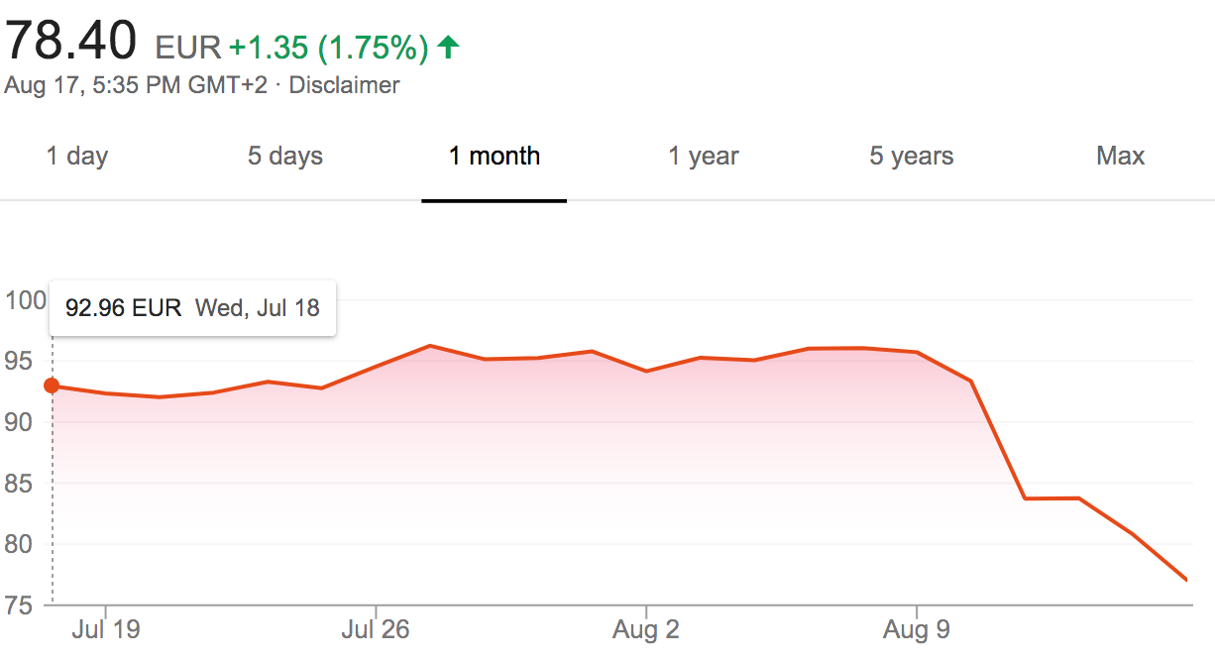
Bayer Stock Prices
Johnson Verdict

Slide 83
Four Ongoing Lawsuits
>42,000 more in the works!

Slide 84
Number of Lawsuits over Time*
*Ruth Bender. How Bayer-Monsanto Became One of the Worst Corporate Deals—in 12 Charts.
The Wallstreet Journal. Aug. 28, 2019.

Slide 85
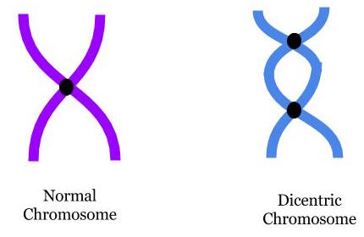
“In vitro evaluation of genomic damage induced by glyphosate on human lymphocytes”*
In vitro exposure of human lymphocytes to glyphosate at levels of 0.5, 0.1, 0.050, 0.025 and 0.0125 μg/ml
0.5 is considered an "acceptable daily exposure level”
Chromosomal aberrations and micronuclei frequencies were significantly high at all except the lowest exposure levels.
*A Santovito et al. Environ Sci Pollut Res Int 2018;25(34):34693-700.
Notes:
https://link.springer.com/article/10.1007%2Fs11356-018-3417-9
antovito\ et\ al.\ 2018\ In\ vitro\ evaluation\ of\ genomic\ damage\ induced\ by\ glyphosate\ in\ human\ lymphocytes.pdf

Slide 86
“In vitro evaluation of genomic damage induced by glyphosate on human lymphocytes”*
In vitro exposure of human lymphocytes to glyphosate at levels of 0.5, 0.1, 0.050, 0.025 and 0.0125 μg/ml
0.5 is considered an "acceptable daily exposure level”
Chromosomal aberrations and micronuclei frequencies were significantly high at all except the lowest exposure levels.
Lymphocytes are the cell type that transforms into cancer cells in non-Hodgkin’s lymphoma
*A Santovito et al. Environ Sci Pollut Res Int 2018;25(34):34693-700.
Notes:
https://link.springer.com/article/10.1007%2Fs11356-018-3417-9
antovito\ et\ al.\ 2018\ In\ vitro\ evaluation\ of\ genomic\ damage\ induced\ by\ glyphosate\ in\ human\ lymphocytes.pdf

Slide 87
Two Papers on Glyphosate and NHL
Retrospective study involving 244 patients with diffuse large B-cell lymphoma (variant of NHL)*
2-year event-free survival was only 56% among those with agricultural occupational exposure compared to 83% for the unexposed group
Meta-analysis involving 65,000 participants in 6 studies**
Those highly exposed to glyphosate-based formulations had an increased risk ratio of 1.41.
*Sylvain Lamure et al. JAMA Netw Open 2019; 2(4): e192093.
**Luoping Zhang et al., Mutation Research 781 (2019): 186-206.

Slide 88
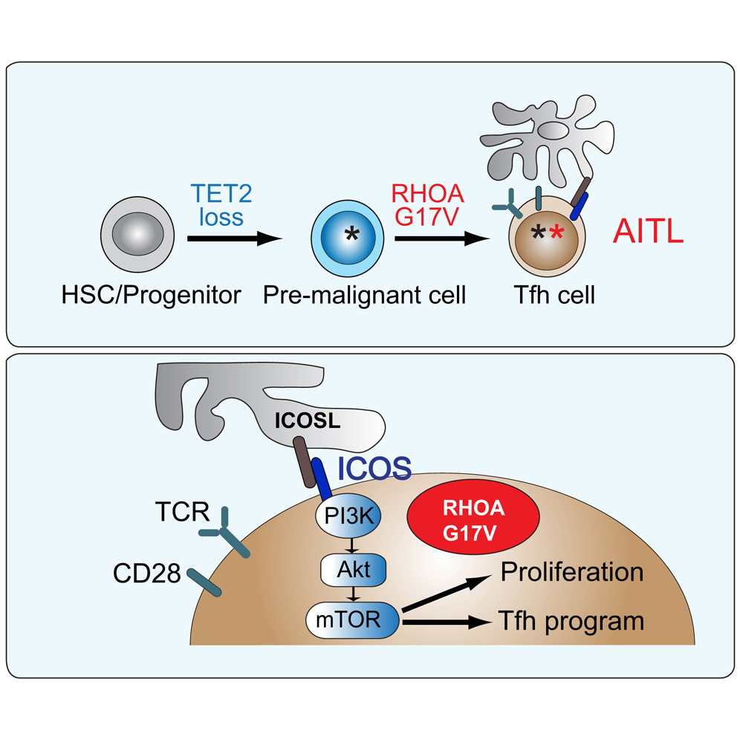
Angioimmunoblastic T Cell Lymphoma (a rare but virulent form of NHL)*
70% of cases have the Glycine-17-Valine mutation
*Jose R. Cortes et al., Cancer Cell 33, 259–273, 2018.
Notes:
Cancer/RhoA_G17V_induces_lymphoma_2018.pdf
Methylcytosine dioxygenase TET2

Slide 89
Outline: Part II
Experiments on Breast Cancer Cells
Glyphosate, Sulfate, Oxalate, Autism
Roundup, StAR and Sterol Homeostasis
A Failed System and A Growing Food Movement
How to Safeguard Yourself and Your Family
Conclusions

