Slide 1
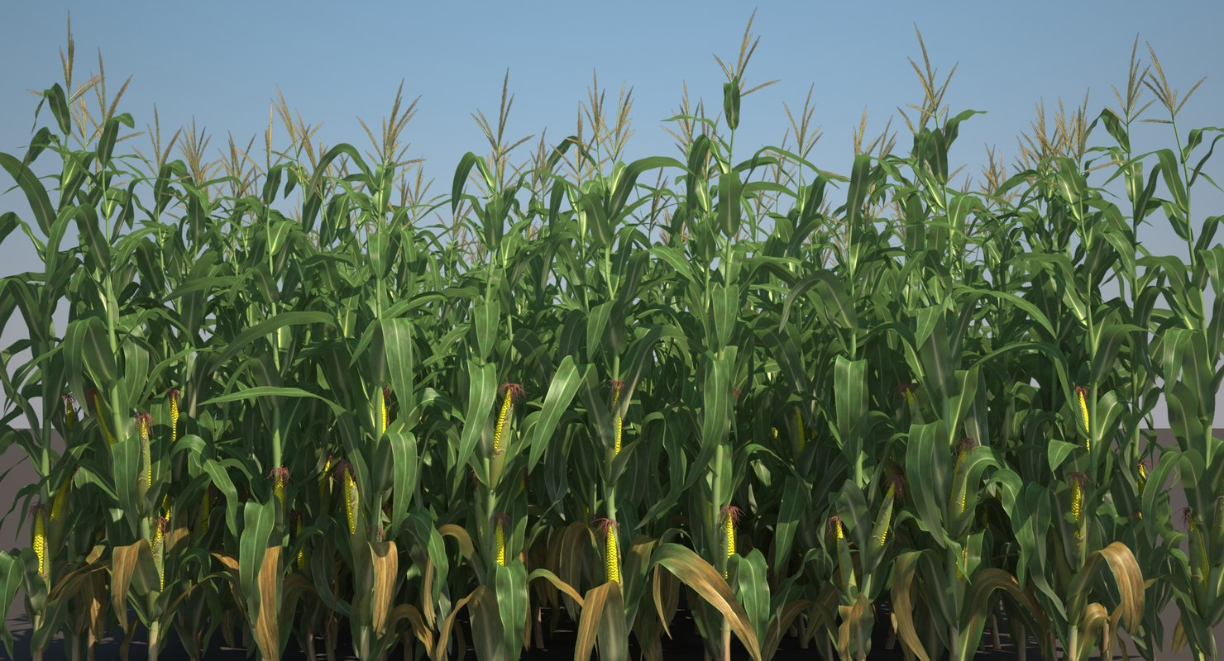
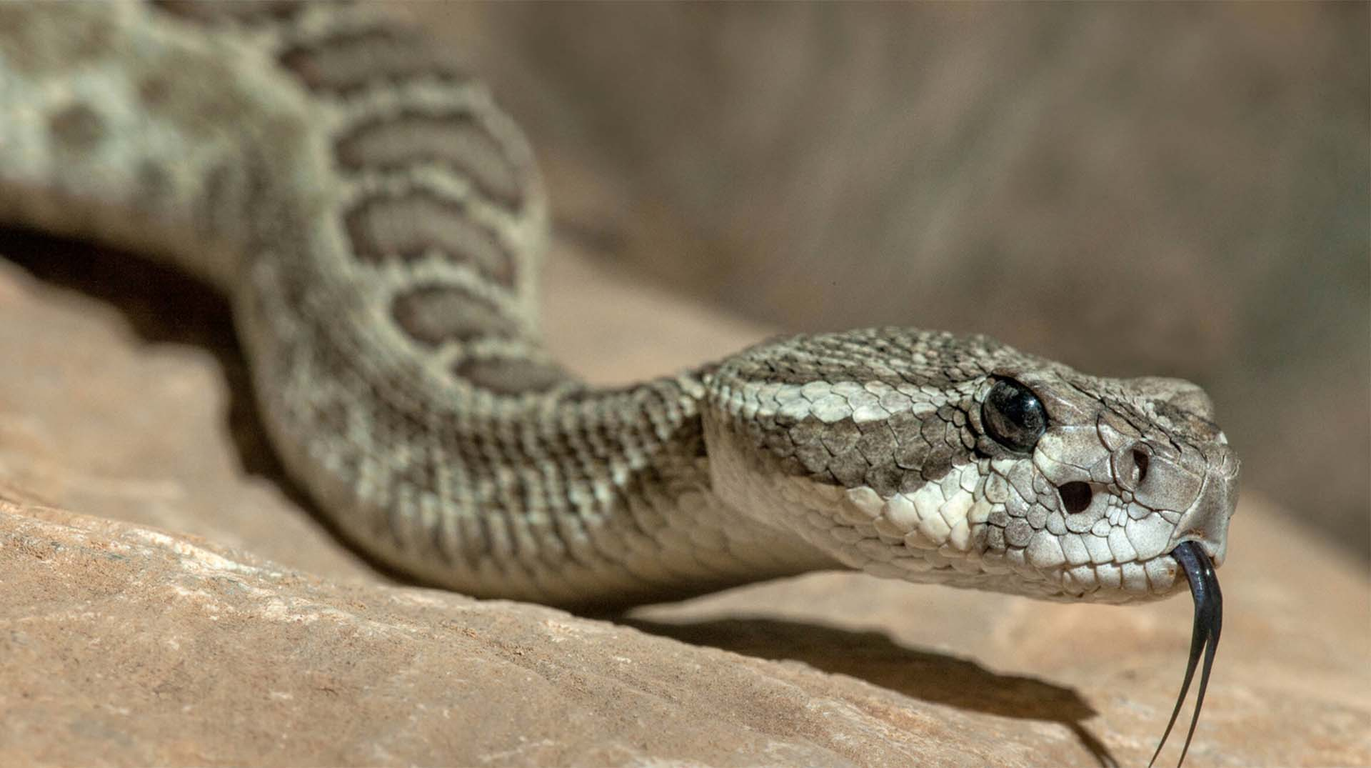
Glyphosate: The Rattlesnake in the Corn Fields
Stephanie Seneff
MIT CSAIL
Wise Traditions Conference
Nov. 16, 2019
Part II

Slide 2
"If our extinction proceeds slowly enough to allow a moment of horrified realization, the doers of the deed will likely be quite taken aback on realizing that they have actually destroyed the world.”
- Eliezer Yudkowsky

Slide 3
Outline: Part II
Experiments on Breast Cancer Cells
Glyphosate, Sulfate, Oxalate, Autism
Roundup, StAR and Sterol Homeostasis
A Failed System and A Growing Food Movement
How to Safeguard Yourself and Your Family
Conclusions

Slide 4
Experiments with
Breast Cancer Cells

Slide 5
Mammary Tumors in Rats*
Rats exposed to Roundup at levels well below established safety limits through their entire lifespan
*GE Seralini et al., Environ Sci Eur 26 (2014): 14.
Notes:
Images/seralini_rats.png
./seralini_paper.pdf

Slide 7
“Glyphosate does not substitute for glycine in proteins of actively dividing mammalian cells”*
Breast cancer cells grown in vitro in six cultures
Half were exposed to glyphosate for six days
Used Tandem Mass Tag technology w/ spectrometry to find anomalously heavy peptides
At least 15 short peptides with specific glyphosate substitutions were identified
Claimed all results were spurious because they showed up in equal amounts in “untreated” cells
*Antoniou et al. BMC Res Notes (2019) 12:494

Slide 8
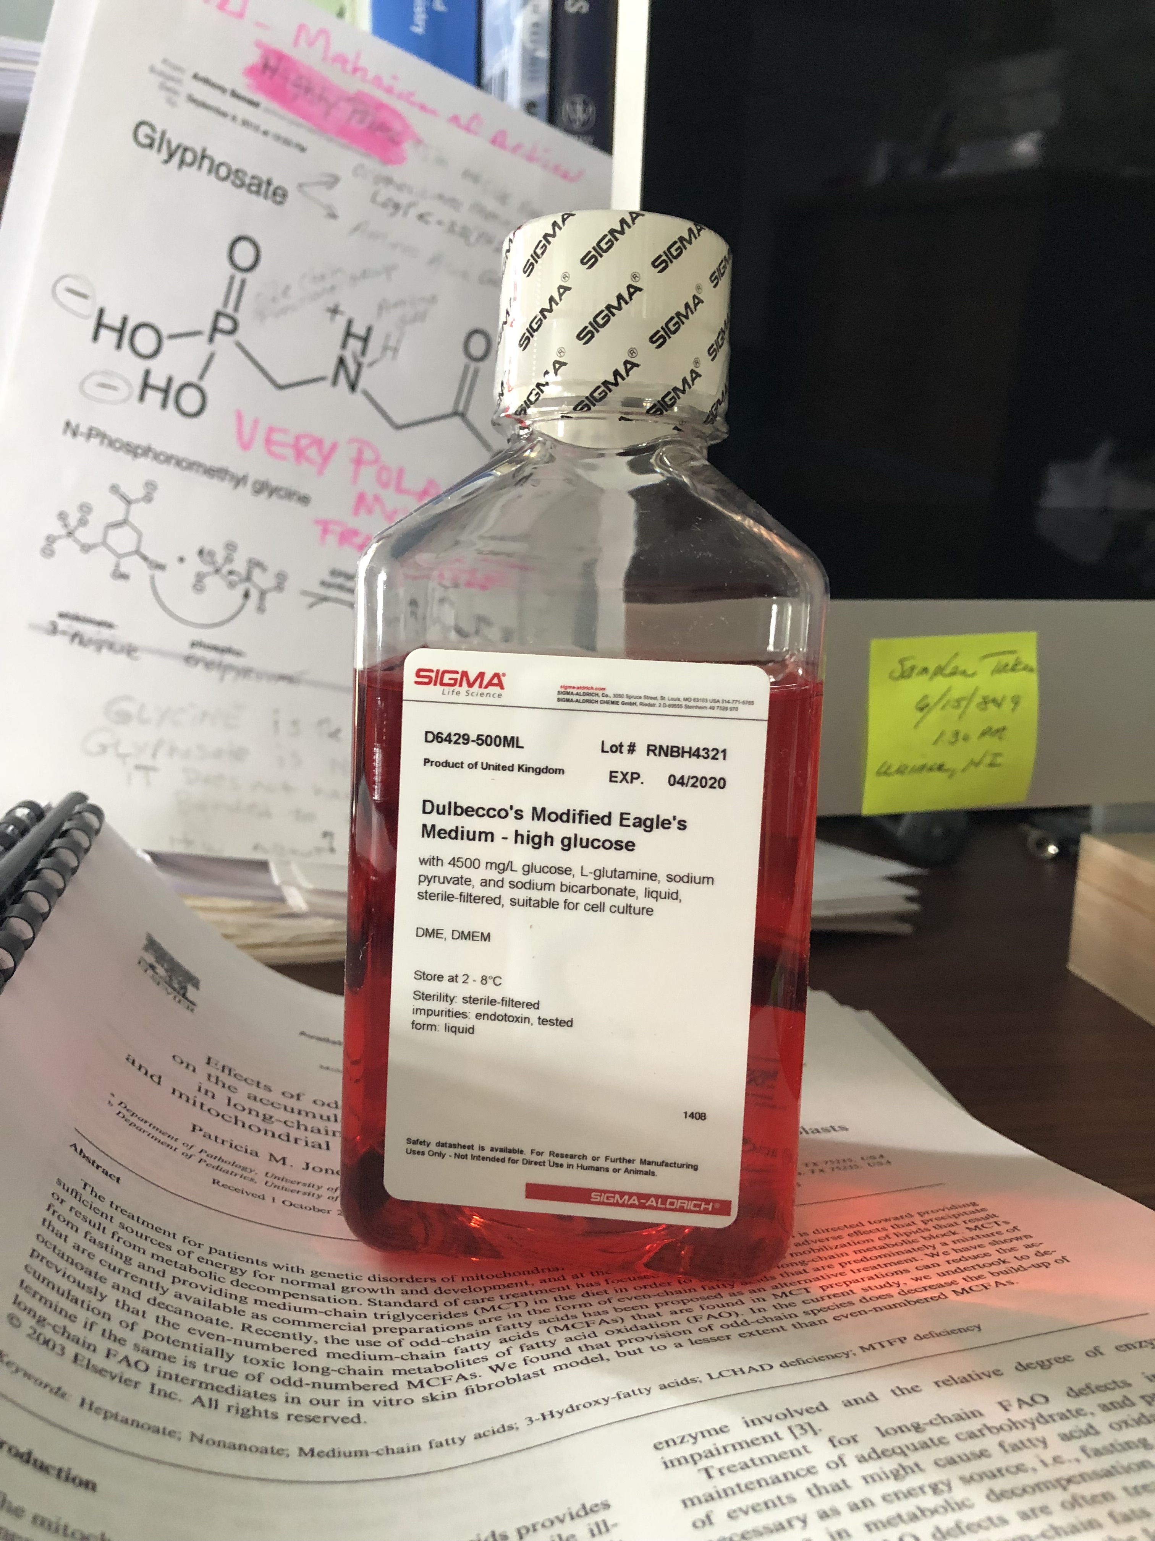
Dulbecco’s Modified Eagle’s Medium: High Glucose
All cells were grown in culture with Dulbecco’s
Glyphosate contaminated?
Anthony Samsel found 10.5 ppb glyphosate in glucose
Both “treated” and “control” cells were probably inadvertently treated with glyphosate for their entire life in vitro and in vivo
Notes:
From Anthony

Slide 9
Fetal Bovine Serum
Tumor cells have been maintained on fetal bovine serum since they were harvested from a human breast and for the duration of the experiment

Slide 10
“Glyphosate does not substitute for glycine in proteins of actively dividing mammalian cells”*
*Figure 3. Antoniou et al. BMC Res Notes (2019) 12:494

Slide 11
LTLFVNG(a2)QPRPLES(ph)SQVK
Uniprot BLAST search: Human protein TFG
BLAST: https://www.uniprot.org/blast/

Slide 12
Exploring One Match
Protein TFG (TRK-fused gene)
Expressed as a fusion partner in many different cancers: thyroid cancer, large cell lymphoma, myxoid chandrosarcoma ...
The analogue gene in roundworms suppresses apoptosis (promotes tumor growth)
Expressed at high levels in brain and spinal cord
Mutations linked to severe neurological and motor disease resembling ALS, with muscle weakness, atrophy, twitches and painful cramps, as well as numbness, tingling, burning, pain
Other matches are markers for poor prognosis in cancer and/or promote proliferation and invasiveness

Slide 13
Glyphosate-Susceptible Motif
EPSP synthase is the enzyme suppressed by glyphosate in the shikimate pathway
Glyphosate interferes with phosphate binding by occupying the spot where phosphate in PEP should fit
If the highly conserved glycine residue at this site is mutated to alanine, the protein is immune to glyphosate
Nearby positively charged amino acids secure PEP (and glyphosate) in place through magnetic charge attractions

Slide 14
Hypothesis Well Supported
Hypothesis: a glycine residue with a small amino acid to the left and a positively charged amino acid to the right is highly susceptible to glyphosate substitution
Nine of the 15 matches in the Antoniou et al. paper had a small amino acid immediately to the left
Six of the 15 matches in the Antoniou et al. paper had a positively charged amino acid immediately to the right
Probability of this occurring by chance is very small

Slide 15
9 Matches were Phosphate Binding Proteins*
All 15 sequences identified by Antoniou et al. had exact matches to human proteins in BLAST
*people.csail.mit.edu/seneff/does_glyphosate_substitute.html

Slide 16
Two Proteins Overexpressed in Cells Exposed to Glyphosate for 6 Days
ANT (ADP/ATP nucleotide translocase):
Programs cell to implement strategies that lead to increased proliferation instead of apoptosis (cell death) in presence of stressors
There has been recent interest in developing drugs that fight cancer by suppressing ANT Activity.
SRSF6 (serine/arginine-rich splicing factor 6 (SRSF6):
Overexpression of SRSF6 in lung epithelial cells enhanced proliferation, protected them from chemotherapy, and increased their ability to form tumors.
Knockdown of SRSF6 in cancer cells reduced their tumorigenic potential.
SRFSF6 in skin cancer alters the splicing of a protein called tenascin C so as to promote invasive and metastatic cancer.

Slide 17
Glyphosate is an endocrine disruptor that promotes breast cancer*
Low and environmentally relevant concentrations of glyphosate possess estrogenic activity
Glyphosate caused human hormone-dependent breast cancer cells to proliferate at concentrations of parts per trillion
* S. Thongprakaisang et al., Food Chem Toxicol. 2013 Jun 8. S0278-6915(13)00363-3.
Notes:
./glyphosate_and_breast_cancer.text
Swine/glyphosate_breast_cancer.pdf
Please make a note that this study shows Glyphosate effects down to parts per trillion (10 to the minus12th).
In this study, we found that glyphosate at a log interval concentration ranging from 10-12 to 10-6 M increased the cell proliferation of a hormorne dependent breast cancer T47D ce

Slide 18
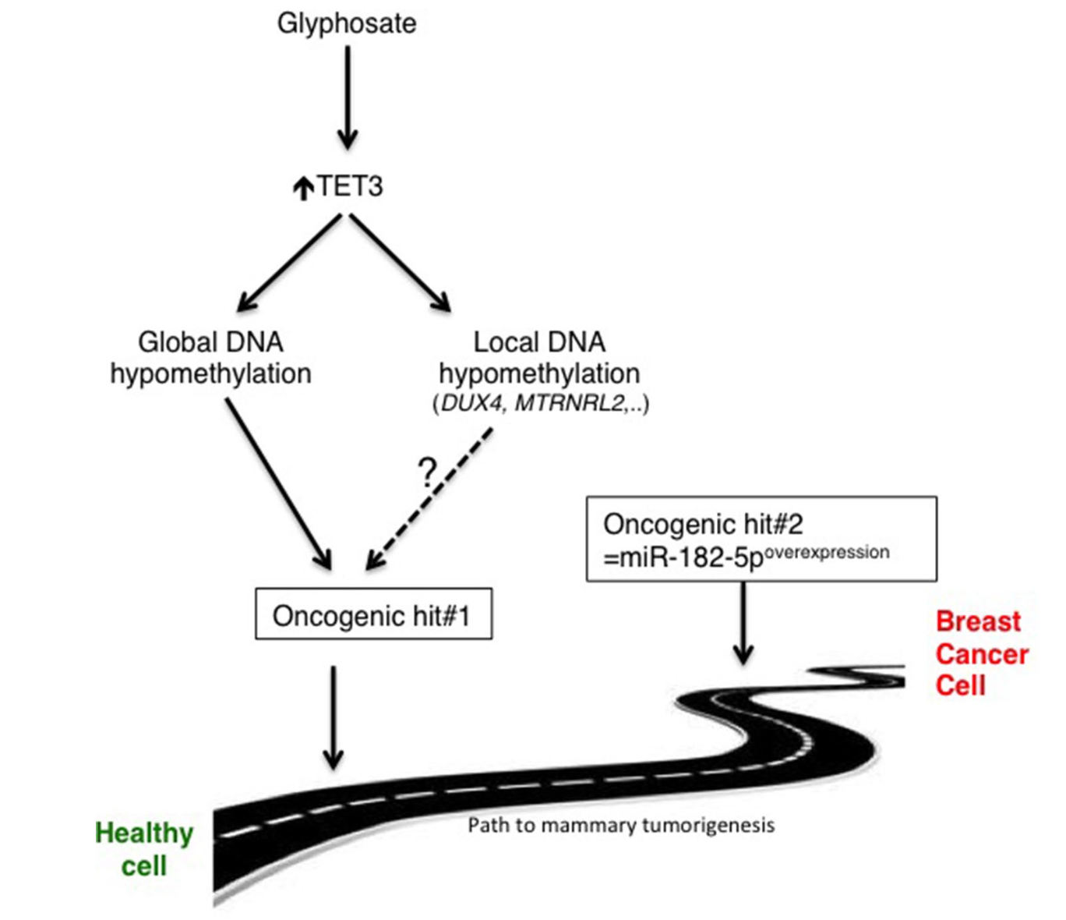
Glyphosate Primes Breast Cells to Become Cancerous*
*Manon Duforestel et al. Frontiers in Genetics 19 (2019): 885.
Notes:
Cancer/TET3_glyphsoate_cancer_2019.pdf

Slide 19
Glyphosate, Sulfate, Oxalate, Autism

Slide 20
Sulfate in Fetal Development*
Fetus depends on mother for sulfate supply
Sulfate is essential for transporting sterols (like estrogen and DHEA) and supplying extracellular matrix proteins everywhere with sufficient negative charge
Sulfate detoxifies xenobiotics like acetaminophen (Tylenol) and is essential for excreting toxins like aluminum and mercury
Sulfate is severely deficient in autistic children (1/3 the normal level of free sulfate in blood stream)
* PA Dawson, “Sulfate in Fetal Development,”
Semin Cell Dev Biol 2011;22(6): 653-9.
Notes:
Cancer/sulfate_in_fetal_development.pdf
2011 Aug;22(6):653-9.
Dawson PA. Sulfate in fetal development. Semin Cell Dev Biol (2011), doi:10.1016/j.semcdb.2011.03.004

Slide 21
Thyroid and Sulfate
Autism is associated with disrupted sulfate management → systemic sulfate deficiency*
Glyphosate suppresses pituitary release of thyroid stimulating hormone (TSH) → hypothyroidism**
Hypothyroidism in mom is linked to autism in child***
Hypothyroidism causes sulfate loss in urine****
*RH Waring and LV Klovrza. J Nutr & Environ Med 2000; 10: 25-32.
**JS de Souza et al. Toxicology. 2017 Feb 15;377:25-37.
***GC Román, Ann Neurol 2013;74(5):733-42.
****K Sagawa et asl. Am J Physiol. 1999 Jan;276(1 Pt 2):F164-71.

Slide 22
Rosemary Waring on Autism (1990)*
“These results indicate that there may be a fault either in manufacture of sulphate or that sulphate is being used up dramatically on an unknown toxic substance these children may be producing .”
*p. 198, O’Reilly, B.A.; Waring, R.H. Enzyme and sulphur oxidation deficiencies in autistic children with known food/chemical intolerances. Xenobiotica. 1990, 20, 117–122.

Slide 23
Rosemary Waring Found Extremely Abnormal Urinary Sulfur Products in Autism*
* RH Waring and LV Klovrza. Journal of Nutritional &
Environmental Medicine 2000; 10: 25-32.
Notes:
book/sulfate/sulfate_oxalate_kidney_transport_Karen_Lyke.pdf

Slide 24
Rosemary Waring Found Extremely Abnormal Urinary Sulfur Products in Autism*
> 50-fold increase in urinary sulfite suggests a deficiency in sulfite oxidase
* RH Waring and LV Klovrza. Journal of Nutritional &
Environmental Medicine 2000; 10: 25-32.
Notes:
book/sulfate/sulfate_oxalate_kidney_transport_Karen_Lyke.pdf

Slide 25
Glyphosate Plausibly Disrupts Sulfur Enzymes
Sulfite oxidase (SuOx)*
Depends on molybdenum as catalyst (glyphosate chelation could make it unavailable)
Changing glycine at residue 473 with aspartate destroys enzyme activity
Leads to severe impairment in ability to bind sulfite and 5-fold reduction in catalysis
Aspartate has similar properties as glyphosate, being bulky and negatively charged
Defective SuOx leads to severe birth defects and neurological problems resulting in early death
The sulfotransferases**
GxxGxxK motif required for binding PAPS (activated sulfate)
*H.L. Wilson et al., Biochemistry 2006, 45, 2149-2160 2149.
**K. Komatsu et al., Biochemi and Biophys Res Comm 1994;204(3): 1178-1185.
Notes:
2016/Anthony/conserved_glycines_sulfotransferase_1994_WOW.pdf
./G473D_mutation_sulfite_oxidase_destroys_it_2006.pdf

Slide 26
GxxGxxK Motif in Sulfotransferases*
Sulfotransferases are crucial to attach sulfate ions to multiple bioactive molecules
Steroids (cholesterol, estrogen, testosterone, vitamin D, ...)
Glycosaminoglycans (chondroitin sulfate, heparan sulfate, ...)
Polyphenols, aromatics (curcumin, resveratrol, tryptophan, ...)
Neurotransmitters (dopamine, serotonin, melatonin, ...)
*H Chiba et al. Proc. Natl. Acad. Sci. USA 1995; 92:8176-8179.
Notes:
GxxGxxK_motif_sulfotransferases_1995.pdf

Slide 27
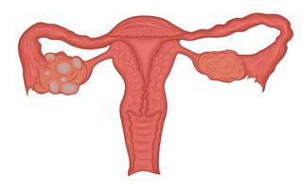
Polycystic Kidney Disease (PCOS)*
PCOS is the most common reproductive disorder in the world
It affects 8-20% of women of reproductive age
40% of women with PCOS develop infertility
90-95% of women being treated in infertility clinics who have impaired ovulation suffer from PCOS
*medium.com/@drjasonfung/the-faces-of-polycystic-ovary-syndrome-pcos-4491740c69ae
Notes:
Glyphosate/G8_glycine_rich_domain_polycystic_kidney_disease_2006.pdf
Also:
PCOS.pdf

Slide 28
PCOS, Autism, PAPS Synthase
PAPS synthase converts sulfate to an activated form
It is essential for DHEA sulfate synthesis
Defective PAPS synthase → polycystic ovary syndrome (PCOS) in women, high androgen*
Glycine 270 → aspartate mutation
PCOS is a risk factor for autism in the woman and in her children**
*Cherskov et al. Translational Psychiatry 2018; 8:136.
**W Oostdijk et al. J Clin Endocrinol Metab. 2015;100(4):E672-80.
Notes:
Book/sulfate/./PCOS_and_autism_2018.pdf
./PAPS_synthase_glycine_mutation_PCOS_WOW_2015.pdf
101 different PAPS synthases all had glycine at 270

Slide 29
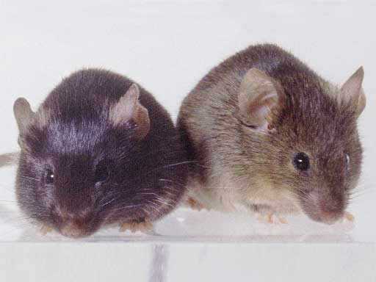
Autism-like socio-communicative deficits and stereotypies in mice lacking heparan sulfate*
Experiment with “designer” mice: blocked heparan sulfate synthesis in brain ventricles
Mice exhibited all the classic features of autism – both cognitive and social
"Fractone-associated N-sulfated heparan sulfate shows reduced quantity in BTBR T+tf/J mice: a strong model of autism." **
* F. Irie et al., PNAS Mar. 27, 2012, 109(13), 5052-5056.
**KZ Meyza et al., Behav Brain Res 2012;228:247–53.
Notes:
vitaminK/mice_no_heparan_sulfate_get_autism_2012.pdf
Samantha/heparan_sulfate_knockout_mice_get_autism.pdf

Slide 30
“Heparan sulfate deficiency in autistic postmortem brain tissue from the subventricular zone of the lateral ventricles”*
“Aberrant extracellular matrix glycosaminoglycan function localized to the subventricular zone of the lateral ventricles may be a biomarker for autism, and potentially involved in the etiology of the disorder.”
New neurons develop from stem cells in this zone through the action of “fractones” composed of heparan sulfate proteoglycans**
*BL Pearson et al., Behav Brain Res. 2013;243:138-45
**F. Mercier et al., Neuroscience Letters 506 (2012) 208–213
Notes:
Samantha/heparan_sulfate_deficiency_autism_postmortem_brain.pdf

Slide 31
Is Encephalopathy a Mechanism to Renew Sulfate in Autism?*
Abstract: “This paper makes two claims:
(1) Autism can be characterized as a chronic low- grade encephalopathy, associated with excess exposure to nitric oxide, ammonia and glutamate in the central nervous system, which leads to hippocampal pathologies and resulting cognitive impairment, and
(2) Encephalitis is provoked by a systemic deficiency in sulfate, but associated seizures and fever support sulfate restoration. …”
*S Seneff et al., Entropy 2013; 15: 372-406.

Slide 32
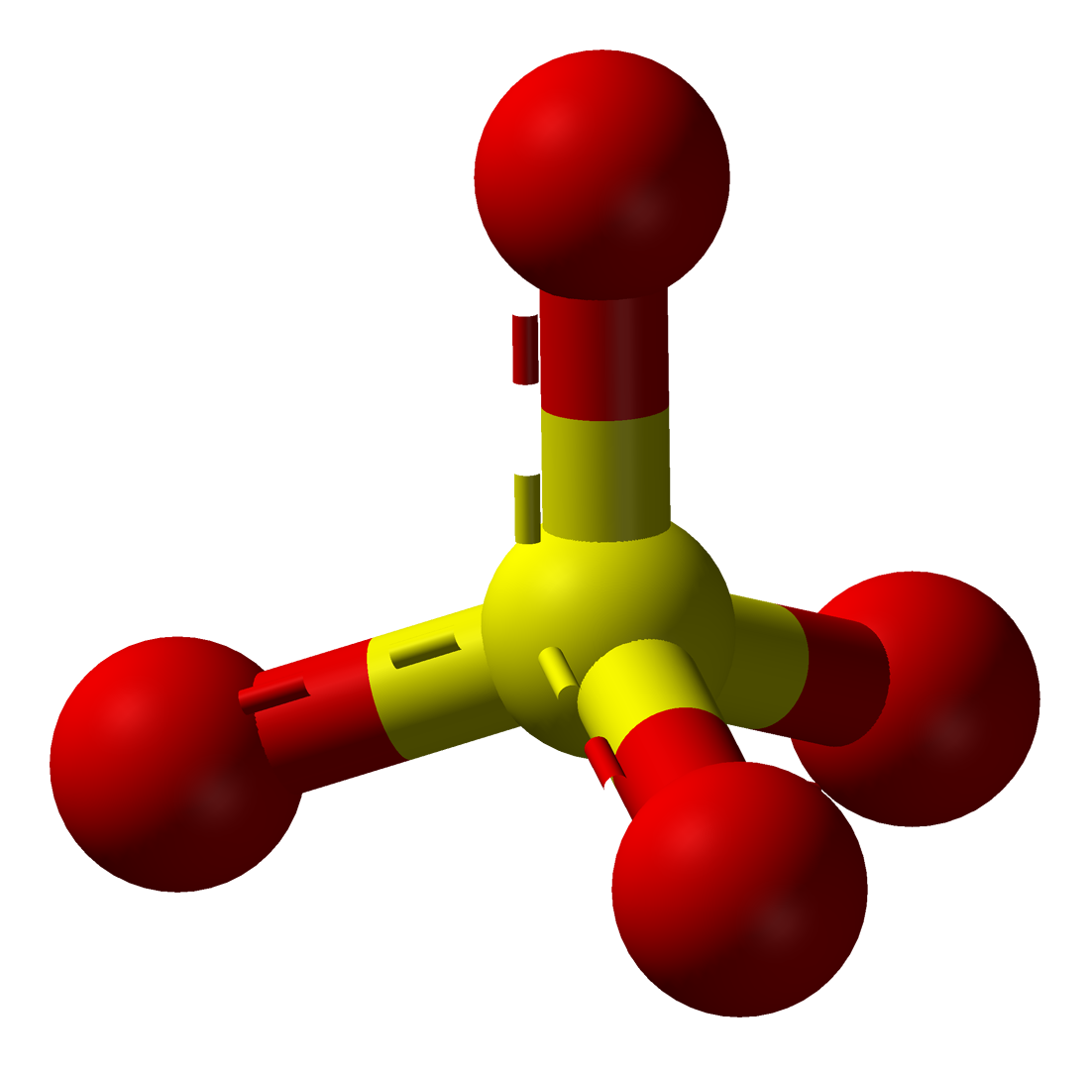
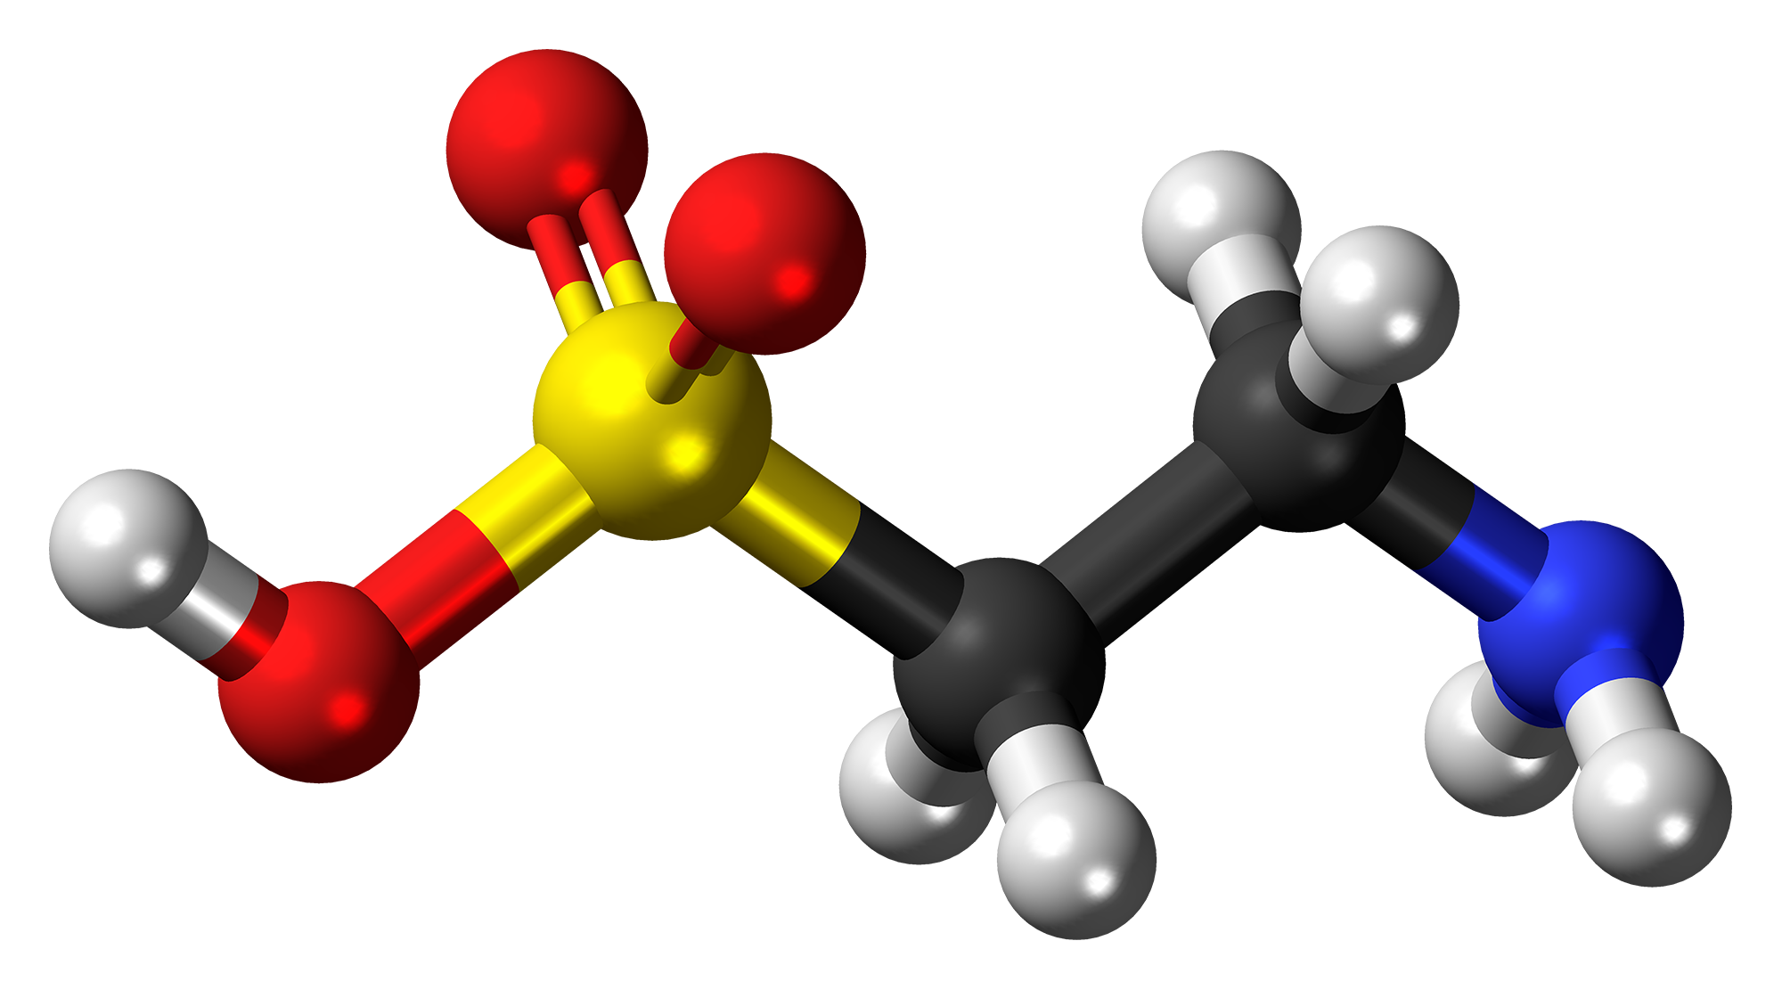
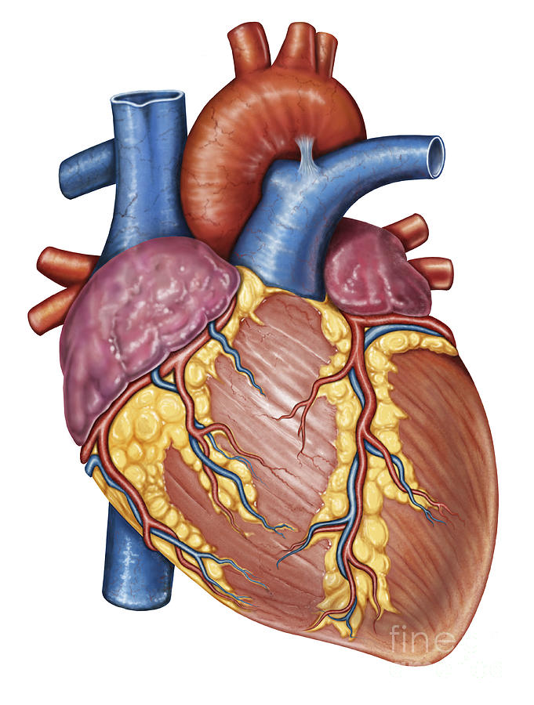
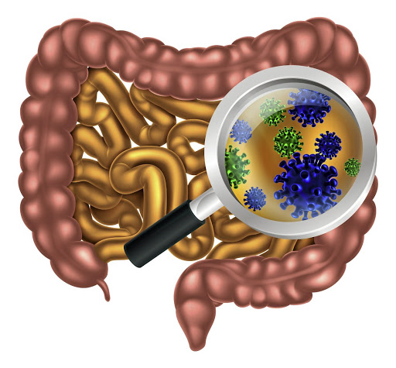
Gut Microbes to the Rescue!
Glyphosate blocks taurine uptake into E coli microbes*
sulfate
taurine
taurine
taurine
taurine
*W Lu et al. Mol BioSyst 2013; 9: 522-530.

Slide 33
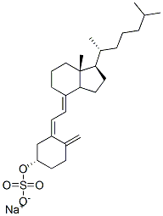
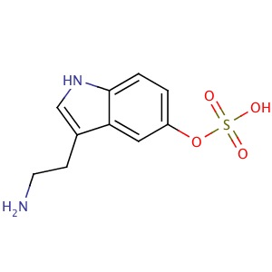
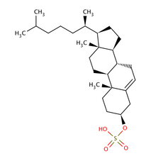
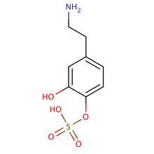
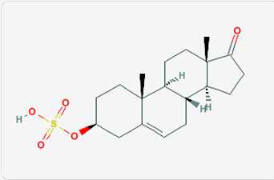
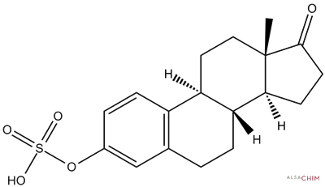
Safe Sulfate Transport: Carbon Rings
vitamin D sulfate
serotonin sulfate
cholesterol sulfate
dopamine sulfate
estrone
sulfate
DHEA sulfate

Slide 34
Safe Sulfate Transport: Carbon Rings
vitamin D sulfate
serotonin sulfate
cholesterol sulfate
Glyphosate depletes serotonin and dopamine and disrupts enzymes involved with sterol sulfation: Imperiled sulfate transport
dopamine sulfate
estrone
sulfate
DHEA sulfate

Slide 35
Recapitulation
Sulfate plays many essential roles in the body
Sulfate deficiency is a core feature of autism
Sulfate synthesis and transfer depend critically on both glycine residues and molybdenum
PCOS due to glycine mutation is a risk factor for autism
Heparan sulfate deficiency in the brain is associated with autism in both humans and mouse models
A low grade encephalopathy characterizes autism and may reflect the need to synthesize sulfate

Slide 36
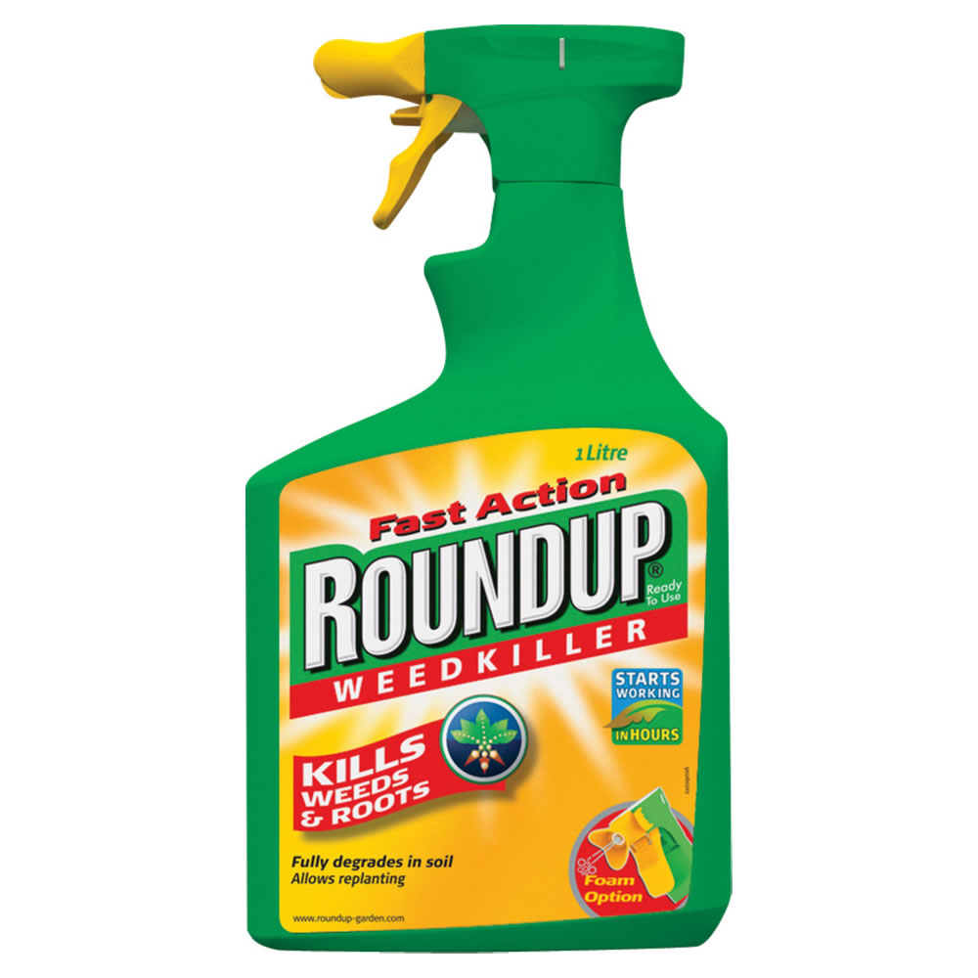
Roundup, StAR and
Sterol Homeostasis
StAR:
Steroidogenic
Acute
Regulatory
protein

Slide 37
Non-alcoholic Fatty Liver Disease: An Epidemic in America
NAFLD affects almost one-quarter of the general U.S. population
Notes:
.steatohepatitis
/StAR_overexpression_NASH.text
https://en.wikipedia.org/wiki/Steroidogenic_acute_regulatory_protein
Leydig Cells testes

Slide 38
“Sulfation of 25-hydroxycholesterol regulates lipid metabolism, inflammatory responses, and cell proliferation”*
Cholesterol and fats shipped out through bile acids
Fixes fatty liver
Liver cells proliferate, restoring damaged liver
Suppresses inflammation
LIVER CELL
Turns on and off many enzymes
cholesterol
StAR
nucleus
StAR
25HC
CYP
SULT2B1b
SULFATE
*S Ren and Y Ying, Am J Physiol Endocrinol
Metab 306: E123–E130, 2014
25HC3S
mitochondrion
Notes:
Treasures/sulfated_oxysterol_regulates_everything_2014.pdf

Slide 39
StAR is a Superstar!
StAR protects from fatty liver disease and elevated serum LDL by promoting bile flow
StAR is essential for synthesis of cortisol, testosterone and estrogen by the adrenal glands and by the gonads
StAR induces export of cholesterol from cardiovascular plaque into HDL

Slide 40
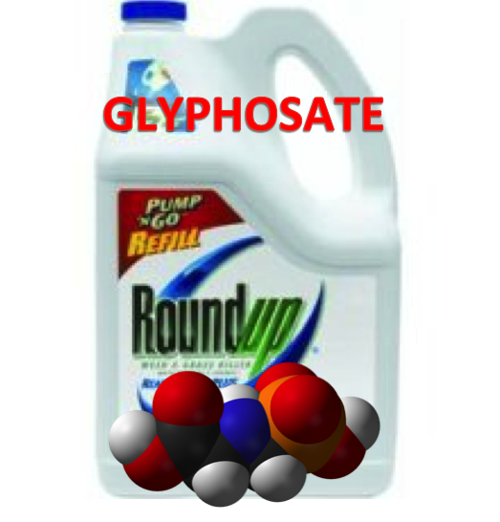
Roundup Inhibits Steroidogenesis by Disrupting StAR Protein Expression*
In vitro study on testicular Leydig cells
Roundup reduced testosterone synthesis by 94%
Effect due to both StAR suppression (90%) and CYP suppression (70%)
Reduction in StAR expression in the adrenal gland disrupts synthesis of stress hormones and sex hormones
This likely explains epidemic in eczema!
*LP Walsh et al., Environ Health Perspect 2000; 108:769-776
Notes:
Roundup_inhibits_StAR_protein_expression.pdf
Leydig cells produce testosterone

Slide 41
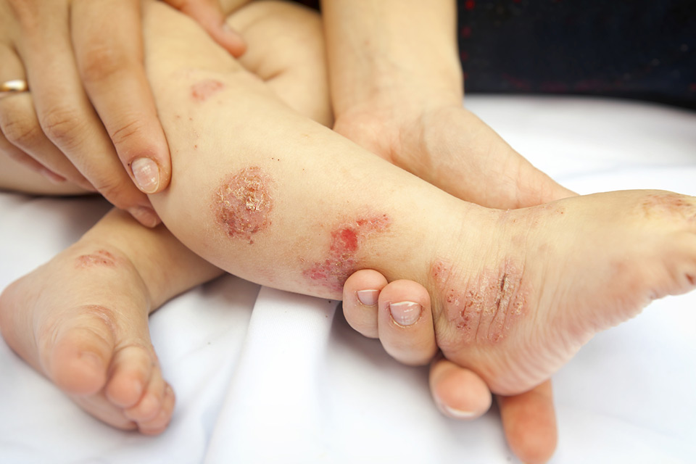
Atopic Eczema: An Epidemic
Atopic eczema (AE) affects between 15 and 20% of people in industrialized countries*
It has very low prevalence in rural Africa
Epidemic developed over past 40 years
Especially prevalent in young children
Topical steroids (corticosteroids) are popular treatment option
Overuse of steroids leads to skin thinning and adrenal insufficiency**
*K Thestrup-Pedersen. J Cosmet Dermatol 2003; 2(3-4): 202-10.
**C Levin and HI Maibach. Am J Clin Dermatol. 2002;3(3):141-7.

Slide 42
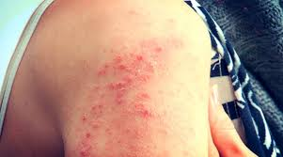
Eczema and StAR
Th2 immune cells are fully capable of synthesizing the steroid pregnenolone from cholesterol, using StAR and CYP enzymes*
This inhibits immune cell proliferation and production of immunoglobulin G, linked to eczema **
Resolves inflammation and eczema flare-ups
StAR expression is decreased or absent in keratinocytes in psoriatic and atopic dermatitis***
*Bidesh Mahata et al., Cell Reports 2014; 7: 1130-1142.
**AC Ferguson and FA Salinas, J Allergy Clin Immunol 1984; 74(5): 678-82.
***Andrzej Slominski et al., J Steroid Biochem Mol Biol 2013; 137: 107-123.

Slide 43
Recapitulation
StAR, CYP enzymes and sulfotransferases collaborate to convert cholesterol into sulfated sterols with many important biological roles
Glyphosate disrupts all of these proteins, leading to many diseases
Fatty liver disease
Impaired bile flow
Adrenal insufficiency
Cardiovascular plaque
Atopic dermatitis
Resolution of inflammation depends critically on synthesis of sulfated sterols

Slide 44
A Failed System and
A Growing Food Movement

Slide 45
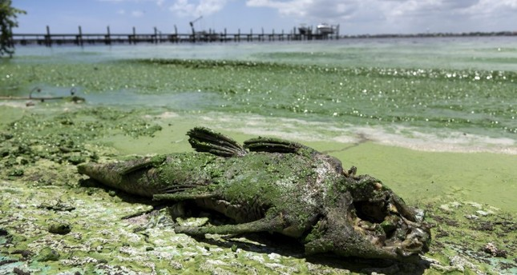
“Is Agriculture’s Use of Glyphosate Feeding Lake O’s Explosive Algae Blooms?”*
Sugar cane agriculture is extensive all around Lake Okeechobee in S. Florida, and glyphosate is used both to control weeds and as a desiccant
Cyanobacteria can break down the C-P bond in glyphosate and use its phosphorus atom as a fuel source**
*Prof. Geoffrey Norris.https://jacquithurlowlippisch.com/tag/
is-sugarcane-field-glyphosate-feeding-lake-os-blue-green-algae-blloms
**D Drzyzga et al. Environ Microbiol 2017 Mar;19(3):1065-1076
Notes:
,/RedTide_algae_blooms_manmade.pdf
Glyphosate/Zhang_glyphosate_water_cyanobacterium_2016.pdf
Geoffrey Norris:
https://jacquithurlowlippisch.com/tag/is-sugarcane-field-glyphosate-feeding-lake-os-blue-green-algae-blloms/

Slide 46
Cyanobacteria Feed Red Tide Algae
“Both the coastal red tide and the inland blue-green algae have beset South Florida through the summer, killing vast numbers of fish and other wildlife, including dozens of dolphins, manatees, sea turtles, sharks and eels.” *
Cyanobacteria feed off of glyphosate (phosphorus source) and produce nitrates from nitrogen
Red Tide algae flourish, supplied with nitrates produced by cyanobacteria **
*https://www.nbcnews.com/news/us-news/
toxic-red-tide-florida-researchers-investigate-what-s-making-it-n900771
**https://www.sailorsforthesea.org/programs/ocean-watch/nutrients-feed-red-tide
Notes:
https://www.nbcnews.com/news/us-news/toxic-red-tide-florida-researchers-investigate-what-s-making-it-n900771
https://www.sailorsforthesea.org/programs/ocean-watch/nutrients-feed-red-tide

Slide 47
Test of Glyphosate Levels in Florida Waterways*
Water sample taken from the coast of Cape Coral, at the mouth of the Caloosahatchee River, where cyanobacteria were present
*https://www.momsacrossamerica.com/orange_juice_postive_for_glyphosate_again
Notes:
https://www.momsacrossamerica.com/orange_juice_postive_for_glyphosate_again

Slide 48
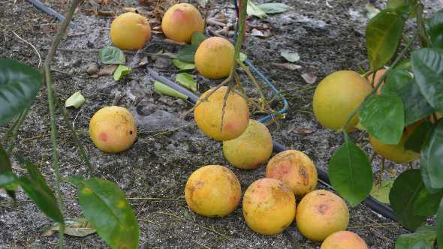
Concerns about Glyphosate and Citrus*
Chief among these concerns are:
Increased crop sensitivity to diseases
Reduced availability of micronutrients to crops through chelation by glyphosate
Inhibition of root growth
Citrus fruit drop
“As citrus weed management programs have continued to rely more heavily on glyphosate, the occurrence of citrus fruit drop resulting from glyphosate application has become an increasing grower concern over the years.”
*http://citrusindustry.net/2018/09/05/how-to-handle-glyphosate-related-fruit-drop/
Notes:
http://citrusindustry.net/2018/09/05/how-to-handle-glyphosate-related-fruit-drop/
./glyphosate_and_citrus.text

Slide 49
Concerns about Glyphosate and Citrus*
Chief among these concerns are:
Increased crop sensitivity to diseases
Reduced availability of micronutrients to crops through chelation by glyphosate
Inhibition of root growth
Citrus fruit drop
“As citrus weed management programs have continued to rely more heavily on glyphosate, the occurrence of citrus fruit drop resulting from glyphosate application has become an increasing grower concern over the years.”
Moms Across America founder Zen Honeycutt has found glyphosate in multiple samples of orange juice produced from Florida orange groves
*http://citrusindustry.net/2018/09/05/how-to-handle-glyphosate-related-fruit-drop/
Notes:
http://citrusindustry.net/2018/09/05/how-to-handle-glyphosate-related-fruit-drop/
./glyphosate_and_citrus.text

Slide 50
https://www.theguardian.com/environment/2017/oct/18/
warning-of-ecological-armageddon-after-dramatic-plunge-in-insect-numbers
Notes:
https://www.theguardian.com/environment/2017/oct/18/warning-of-ecological-armageddon-after-dramatic-plunge-in-insect-numbers

Slide 51
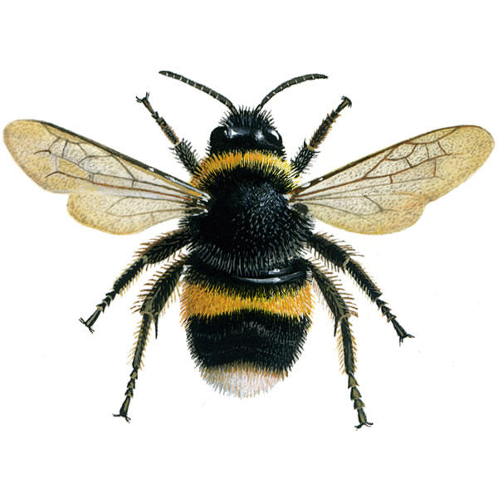
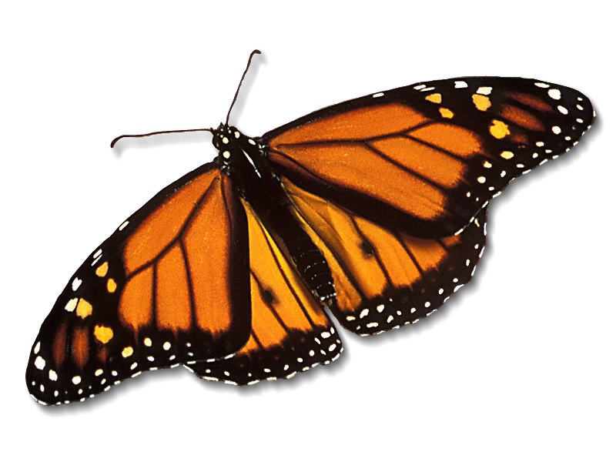
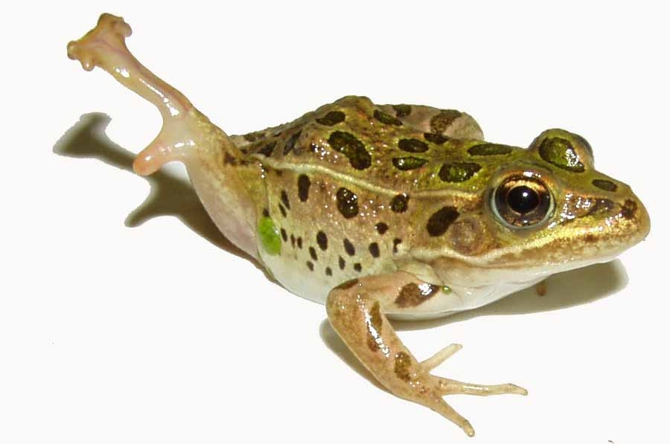
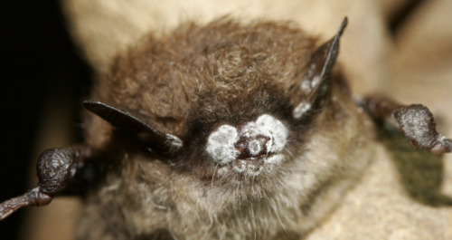
Species in Stress
Fungus Infection
Fungus Infection
Fungus Infection
Fungus Infection
*R. Mason et al., Journal of Environmental Immunology and Toxicology 1:1, 3-12; 2013
Notes:
Frogs -- drop 3.7% every year, meaning they could disappear in half of the habitats they now occupy nationwide in 26 years
Monarch butterflies – milkweed being killed by glyphosate
http://salsa3.salsalabs.com/o/1881/p/dia/action3/common/public/?action_KEY=12506

Slide 52
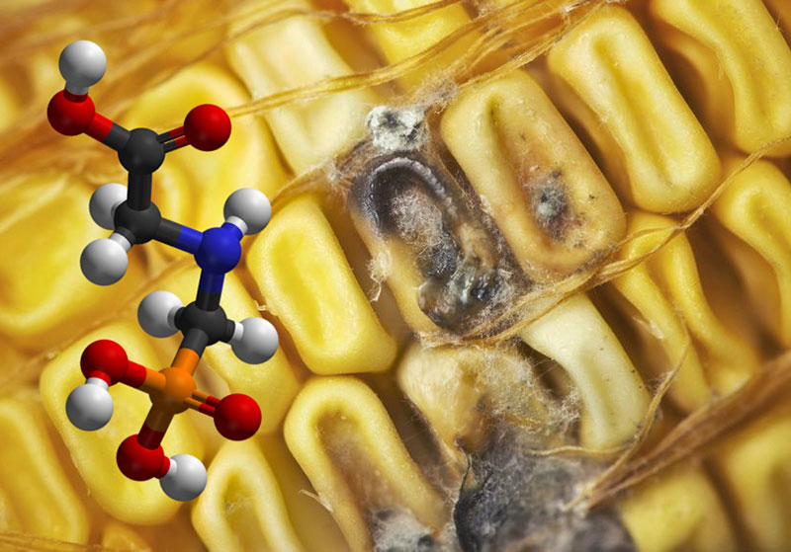
Roundup herbicide enhances the growth of aflatoxin-producing fungi*
*Barberis et al., Journal of Environmental Science and Health, Part B: Pesticides, Food Contaminants, and Agricultural Wastes. 2013, 48(12), 1070-1079.

Slide 53
“Aflatoxins are mutagenic, carcinogenic, teratogenic, hepatotoxic, immunosuppressive, and they also inhibit several metabolic systems”*
*Barberis et al., Journal of Environmental Science and Health, Part B: Pesticides, Food Contaminants, and Agricultural Wastes. 2013, 48(12), 1070-1079.
Notes:
glyphosate/glyphosate_promotes_fungus_growth_2014.pdf
Aflatoxins (AFs) are extensively known to be potent mutagenic,
carcinogenic, teratogenic, hepatotoxic, immunosuppressive, and they
also inhibit several metabolic systems.[13,14]

Slide 54
Prof. Don Huber on Bee Colony Collapse Syndrome*
Glyphosate chelates minerals making them unavailable, especially manganese
Glyphosate kills Lactobacillus and Bifidobacter which interferes with digestion of honey and bee bread by larvae
Makes bees more susceptible to mites and viruses
Acting as an endocrine disruptor, glyphosate causes brain fog in the bees, and they can't find their way back to the hive after foraging
Neonicotinoids have a similar, synergistic effect
Glyphosate is a contaminant even in organic honey because it is pervasive
Probiotics + mineral solutions counter glyphosate's effects remarkably
*personal communication

Slide 55
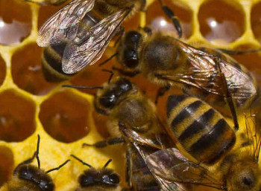
Successful Treatment Protocol for Bees*
Average loss rates in bee hives in the U.S. for the winter of 2015-2016 was 38%
Slide Ridge Honey had only a 5% loss rate
Their success was attributed to mineral supplements and probiotics
*biomineralstechnologies.com/save-the-bees/honeybee-update-2017
Notes:
http://biomineralstechnologies.com/save-the-bees/honeybee-update-2017
Bio Minerals Technologies

Slide 56
Glyphosate was found in 59% of Honey Samples*
USA
*F Rubio et al., J Environ Anal Toxicol 2014, 5:1
Notes:
..glyphosate_in_honey_2014.pdf
*F Rubio et al., J Environ Anal Toxicol 2014, 5:1
Figure 5: Concentration of glyphosate (ng/g) in honey samples listed by honey origin and the allowance of GMO use: (A) Brazil, (B) Canada, (C) China, (D) Germany, (E) Greece, (F) Hungary, (G) India, (H) Korea, (I) blend of Mexico, Brazil, and Uruguay, (J) New Zealand, (K) Spain, (L) Taiwan, (M) blend of Ukraine and Vietnam, (N) USA, (O) blend of USA and Argentina, (P) blend of USA, Argentina and Canada, (Q) blend of USA, South America, (R) unknown origin. Dashed line represents LOQ of method (15 ng/g). ). Error bars represent concentrations obtained during duplicate analysis.

Slide 57
Superweeds Are Now a Huge Problem*
76.8% of samples submitted to a U of Illinois Plant Clinic from 10 states across the Midwest showed glyphosate resistance
“GM crops are on the edge of failure in the U.S. as farmers are asked to fork out more and more money on herbicides to try to control the superweeds. We simply can’t afford it! It is near the end of the road for these crops and many of my friends in the Midwest are on the edge of turning back to conventional farming methods.”
Bill Giles, an Illinois farmer
*sustainablepulse.com/2017/02/04/farmers-losing-midwest-superweeds-
fight-as-glyphosate-resistance-reaches-over-75/#
Notes:
http://sustainablepulse.com/2017/02/04/farmers-losing-midwest-superweeds-fight-as-glyphosate-resistance-reaches-over-75/#

Slide 58
Antibiotic Resistance and Glyphosate*
*AHC Van Bruggen et al. Sci Total Environ 2017; 616–617: 255–268.

Slide 59
Antibiotic Resistance and Glyphosate*
Glyphosate was patented as an antimicrobial agent in 2004.**
Microbes develop efflux pumps in response to chronic glyphosate exposure that can then pump out other antibiotics as well.
**U.S. patent number 20040077608 A1, filed: August 29, 2003; awarded: April 22, 2004

Slide 60
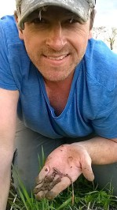
Fixing the Soil*
Dirt is inert; soil is alive
Missouri farmer JR Bollinger grew corn and soy on a former coal mine
“We tried … all kinds of goodies: humates, … sea minerals, microbes, fish meal and biochar powder.”
Earthworms till the soil
Soil microbes are crucial for soil health
Greatly reduce fertilizer needs and improve yield
JR Bollinger
*David Yarrow. Down the Wormhole: Customizing Biological Methods for Large Scale Farming
Belize Ag Report 2017;34:5-17.
Notes:
Missouri reclaimed coal mine
*ecofarmingdaily.com/wormhole-customizing-biological-methods-large-scale-farming/

Slide 61
Solving Global Climate Change through Agriculture*
“Agriculture, with its unique ability to sequester carbon on … billions and billions of acres, is the only industry poised to reverse global warming. Improved management of cropping and grazing heals land, boosts soil fertility, prevents flooding, enhances drought resilience, increases the nutritional content of food and restores wildlife habitat — while sequestering carbon.
*http://www.rutlandherald.com/articles/using-soil-to-fight-climate-change/

Slide 62
Regenerative Agriculture*
The Goal: Improving soil health
The more plants that grow, the better the soil
Use adaptive high stock density (AHSD) grazing, the way the bison did it
*https://joyce-farms.com/blogs/news/
joyce-farms-regenerative-agriculture-program-an-introduction
Notes:
Regenerativeagriculture.pdf
fretz.karen <fretz.karen@gmail.com>

Slide 63
Regenerative Agriculture*
"Regenerative agriculture is a phenomenal system that has always been here, activated by the sunshine and the rain. It not only restores our land in terms of biodiversity and soil health, but also produces incredibly nutrient dense, vibrantly flavored food."
The Goal: Improving soil health
The more plants that grow, the better the soil
Use adaptive high stock density (AHSD) grazing, the way the bison did it
*https://joyce-farms.com/blogs/news/
joyce-farms-regenerative-agriculture-program-an-introduction
Notes:
Regenerativeagriculture.pdf
fretz.karen <fretz.karen@gmail.com>

Slide 64
Dirt to Soil*
Gabe Brown inherited a 5,000 acre farm from his father-in-law that grew wheat, oats and barley, conventionally
His crop failed due to drought for four straight years
He let it lie fallow and let the weeds grow
The soil improved dramatically: earthworms started to appear
He used less glyphosate to control weeds only because he couldn't afford it
He eventually converted it to a certified organic farm, with animals playing a central role
Profitable organic farm produces beef, lamb, eggs, broilers, pigs, honey, vegetables, fruit , corn, and wheat.
*Gabe Brown. Dirt to Soil. Chelsea green Oct. 11, 2018.
Notes:
Csail/2018/Books/DirtToSoi_eGalley.pdf
./DirtToSoil.text

Slide 65
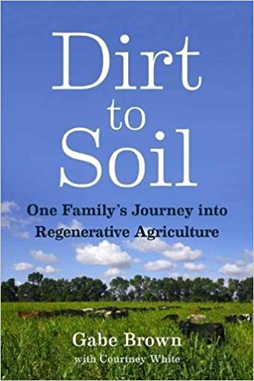
Dirt to Soil*
Gabe Brown inherited a 5,000 acre farm from his father-in-law that grew wheat, oats and barley, conventionally
His crop failed due to drought for four straight years
He let it lie fallow and let the weeds grow
The soil improved dramatically: earthworms started to appear
He used less glyphosate to control weeds only because he couldn't afford it
He eventually converted it to a certified organic farm, with animals playing a central role
Profitable organic farm produces beef, lamb, eggs, broilers, pigs, honey, vegetables, fruit , corn, and wheat.
*Gabe Brown. Dirt to Soil. Chelsea green Oct. 11, 2018.
Notes:
Csail/2018/Books/DirtToSoi_eGalley.pdf
./DirtToSoil.text

Slide 66
Small Organic Farms are the Answer
Bluebird Hill Organic Farm, North Carolina

Slide 67
How to Safeguard Yourself
and Your Family

Slide 68
Go Organic!

Slide 69
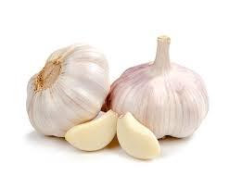
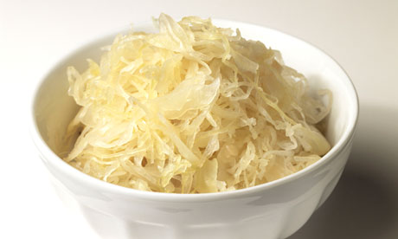
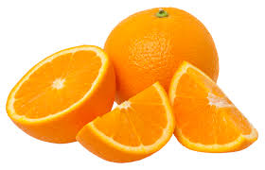
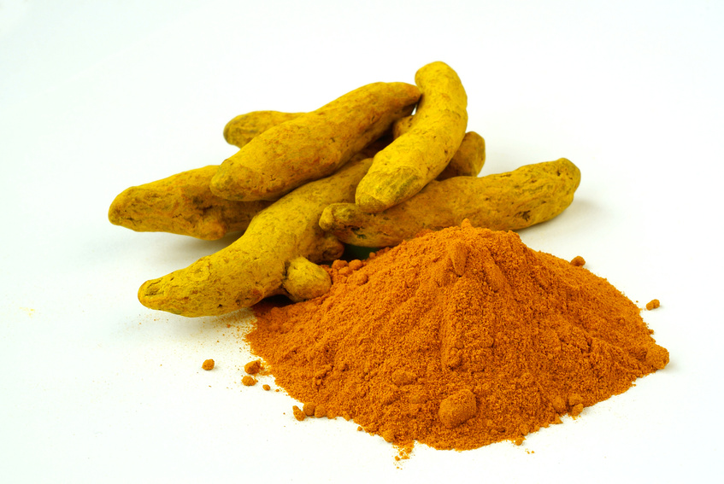
Some Important Nutrients
Curcumin
Garlic
Vitamin C
Probiotics
Methyl tetrahydrofolate
Cobalamin
Glutathione
Taurine
Epsom salt baths

Slide 70
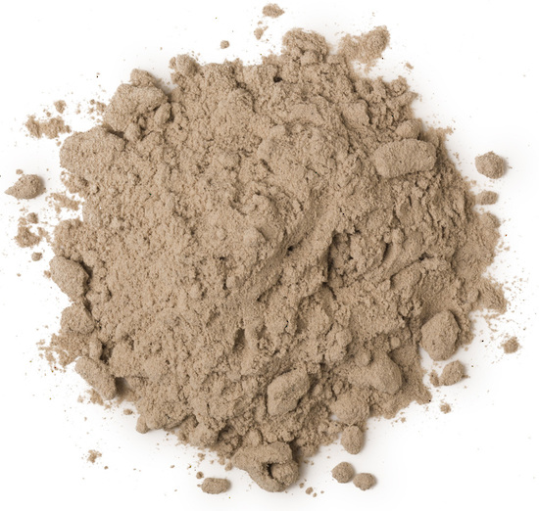
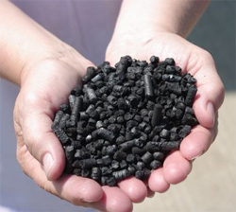
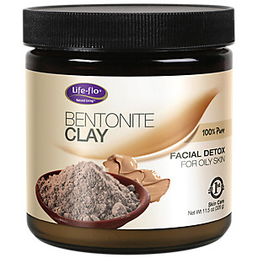
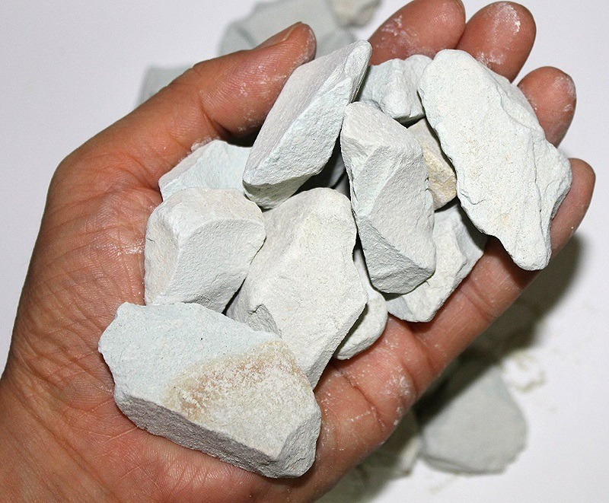
Biochar, Bentonite and Zeolite to maintain healthy microbial distribution in poultry*
*TP Prasai et al. PLoS ONE 11(4): e0154061.
Notes:
Moore\ et\ al\ 2016\ Biochar,\ bentonite\ and\ zeolite\ supplemented\ feeding\ for\ layer\ chickens\ alters\ intestional\ microbiota.pdf .
Reduce need for antibiotics
Redistribute gut microbes

Slide 71
Anecdotal Evidence of Benefits of Fulvic Acid*
"In the last year I have become increasingly sick with ataxia, balance problems, muscle weakness, numbness in the hands and feet and a 'foggy' brain
… To cut a long story short, Jim suggested Fulvic Acid as a detox.
At 10 days the effects started to 'kick in' and by 14 days it was as if a fog had been lifted from my brain. My muscle weakness has gone, I can walk for 2 hours and I can swim in the sea."
"It is a miracle."
*Shared by Nico DaVinci, personal communication concerning a patient
Notes:
Check with Nico DaVinci before showing this
THIS IS ROSEMARY MASON – she is getting a cholinesterase test.
See: RosemaryMason_story.text
Testimony_fulvic_acid.text

Slide 72
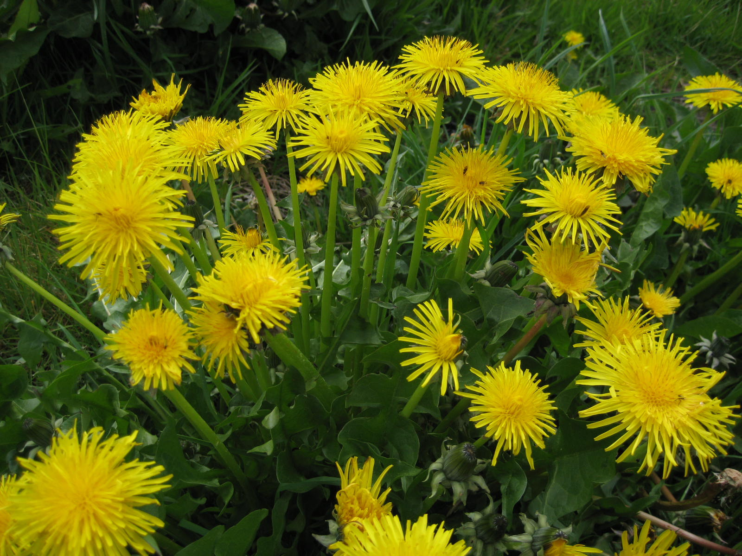
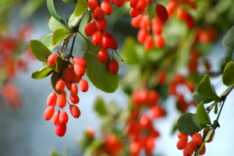
Extracts from Common Plants Can Treat Glyphosate Poisoning*
Roundup is toxic to hepatic and embryonic cells at doses far below those used in agriculture and at residue levels present in some GM food.
Extracts from common plants such as dandelions, barberry, and burdock can protect from damage, especially if administered prior to exposure.
*C Gasnier et al. Journal of Occupational Medicine and Toxicology 2011, 6:3
Notes:
Where?

Slide 73
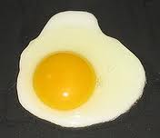
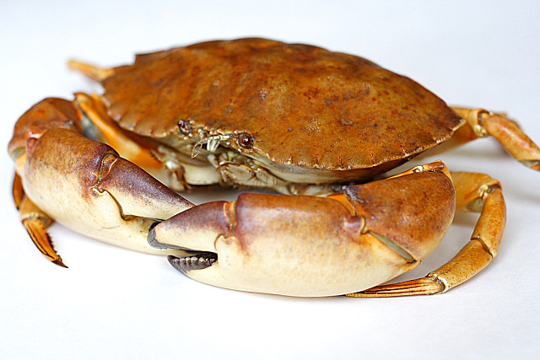
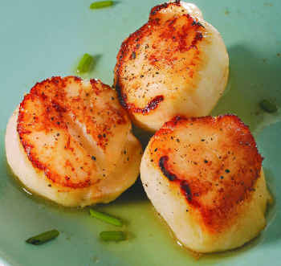
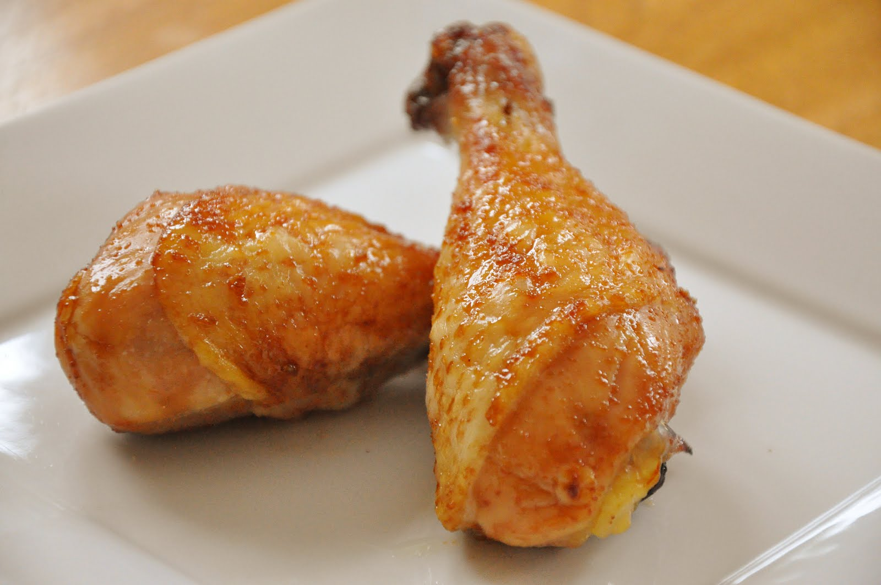
Eat Foods Containing Sulfur
Notes:
http://healthyeatingclub.com/info/books-phds/books/foodfacts/html/data/data5g.html

Slide 74
Supplemental Sources of Sulfur*
glucosamine sulfate
chondroitin sulfate
glutathione
N-acetylcysteine
alpha lipoic acid
taurine
DMSO, MSM
S-adenosylmethionine (SAMe)
Epsom salts (Mg-sulfate)
These can have many beneficial effects and are nearly nontoxic
My personal favorite is Epsom salt baths:
Magnesium sulfate uptake through the skin
*S Parcell, Alternative Medicine Review 7(1), 2002, 22-44
Notes:
./sulfur_in_human_nutrition_review.pdf

Slide 75
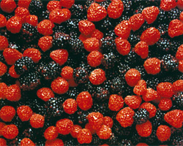
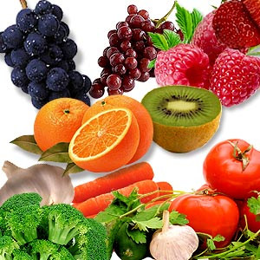
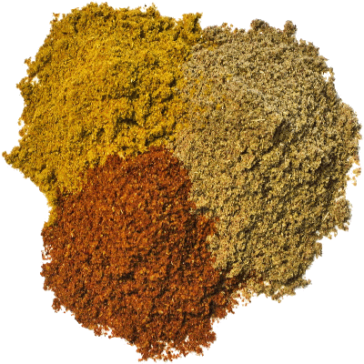
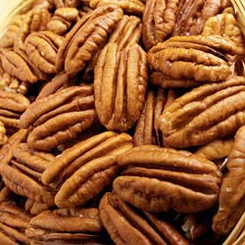
AND Flavonoids and Polyphenols!

Slide 76
Sauerkraut and apple cider vinegar contain acetobacter, one of the very few microbes that can metabolize glyphosate
Yogurt and kimchi probably do too

Slide 77
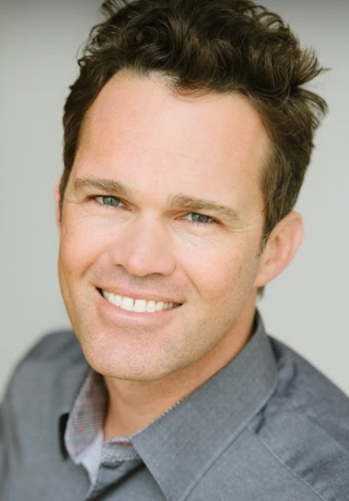
Recommendations from Dr. Zach Bush*
1. Get out into nature. Walk in the woods, barefoot, feel the sunshine – rich environment, breathe in the nutrients in the air
2. Eat probiotics (naturally fermented foods)
3. Eat organic food
Demand is dropping the price.
Thrive Market – order online
4. Eat more fruits and vegetables
5. Bathe in natural waters
*https://www.youtube.com/watch?v=jWgnkgYtqnw&feature=youtu.be

Slide 78
Conclusions
We are at a crossroads where we can choose to get sicker and sicker while destroying the ecosystem, or we can choose to drastically change our agricultural methods towards renewable organic solutions
Grass roots bottom-up activities will institute a dramatic shift in food choices towards nutrient-dense organic whole foods instead of chemical-contaminated impoverished processed foods
A market-driven economy will force farmers to switch to organic methods if they want to sell their crops to informed and health-conscious consumers
This will lead to a dramatic reduction in health care costs and a vast improvement in the health of the population as a whole, of the nation, and of the earth

