Slide 1
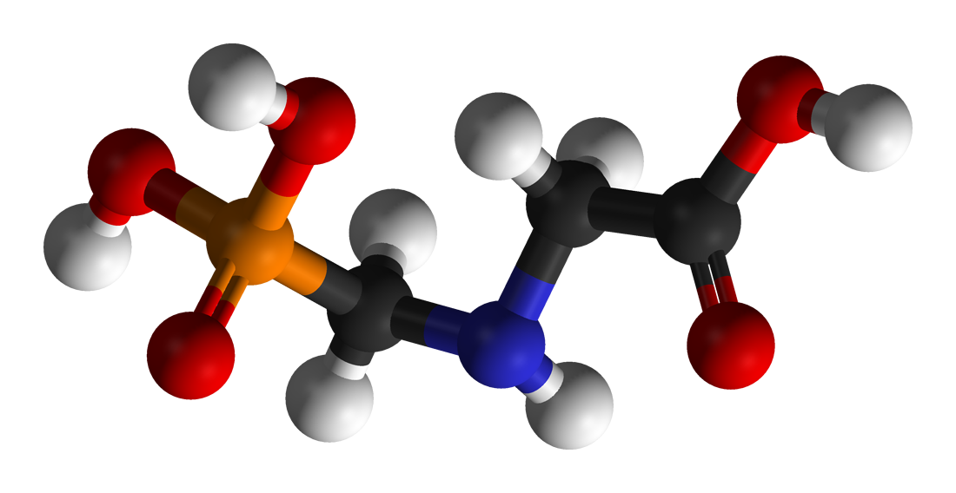
The Myriad Ways Glyphosate Causes Autism and the Myriad Ways You can Heal Your Child
Stephanie Seneff
MIT CSAIL
AutismOne
May, 2020

Slide 2
Outline
Introduction
Glyphosate and the Gut
Glutamate Excitotoxicity
Mineral Disruption
Glyphosate Displacing Glycine in Protein Synthesis
Dysfunctional PEP Carboxykinase (PEPCK): Multiple Consequences
How to Safeguard Yourself and Your Family

Slide 3
Introduction

Slide 4
Roundup and GMO Crops
GMO Roundup-Ready corn, soy, canola, sugar beets
cotton, tobacco and alfalfa
What is glyphosate?

Slide 5
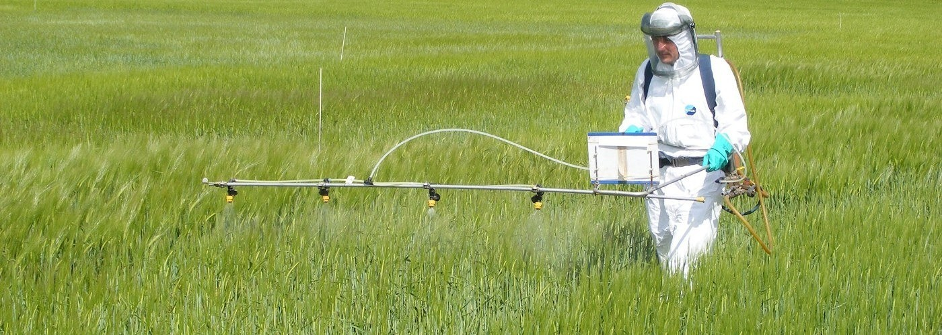
Roundup as a Desiccant/Ripener just before Harvest
Wheat, Oats, Barley, Rye, Sugar cane, Beans, Lentils, Peas, Flax, Sunflowers, Pulses, Chick Peas

Slide 6
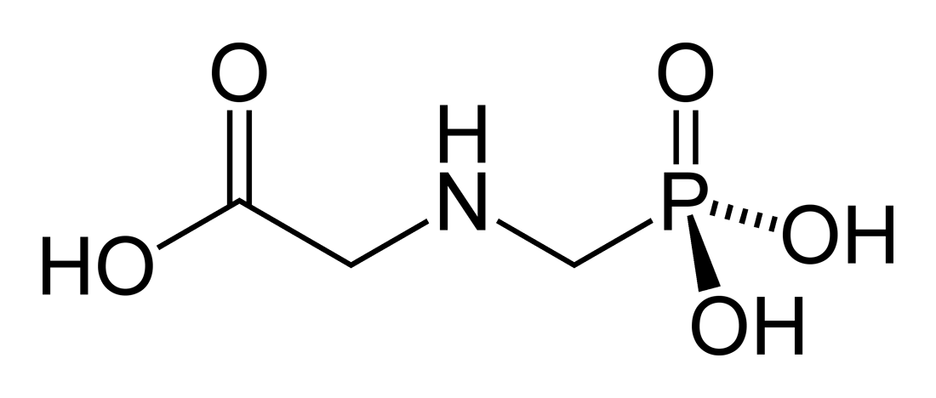
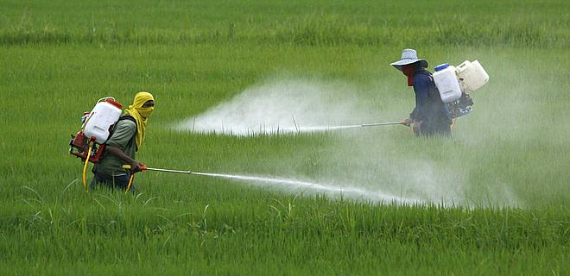
Glyphosate!!
Glyphosate is now the #1 herbicide in use in the U.S. and is increasingly used around the world
Patented by Monsanto in the mid 1970’s
Introduced into the US food chain in 1974
Came out from under patent in 2000
Inhibits an enzyme in the shikimate pathway involved in the synthesis of tyrosine, tryptophan and phenylalanine (the three aromatic amino acids)
Huge expansion of GMO corn, soy, cotton and canola crops has led to sharp increases in the last two decades
Notes:
WIKI

Slide 7
Shikimate Pathway Disruption
Phenylalanine, tryptophan, tyrosine
shikimate
Neurotransmitters,
thyroid hormone
Glyphosate
chorismate
vitamin K
folate

Slide 8
Late
Spraying
*T Bøhn and E Millstone. Foods 2019; 8: 669.
Notes:
2020/glyphosate/glyphosate_in_soy_food_chain_2019.pdf
a single application at eight weeks, i.e., at full bloom of the plant, resulted in a 10–20-fold increase in residual concentrations

Slide 9
Environmental Working Group Results*
*www.ewg.org/childrenshealth/glyphosateincereal/

Slide 10
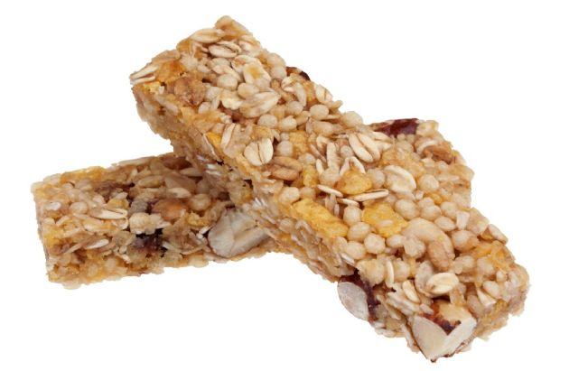
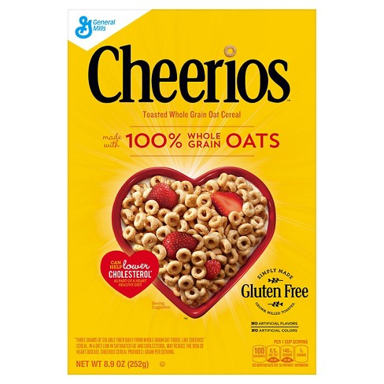
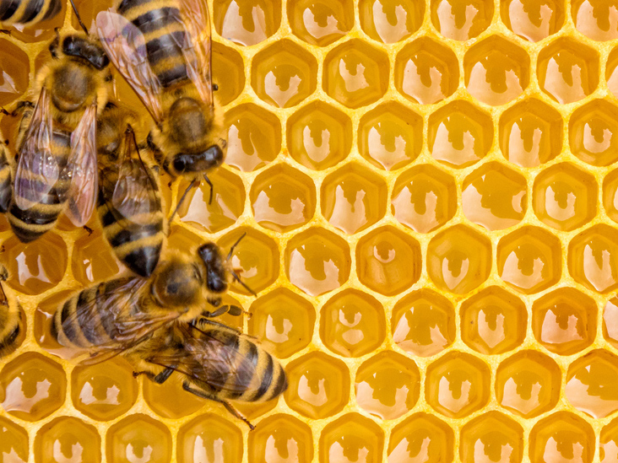
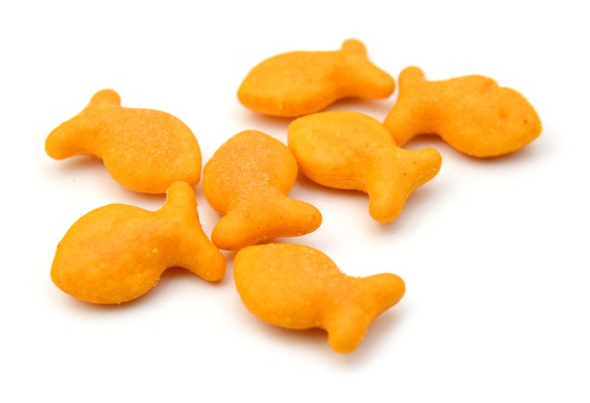
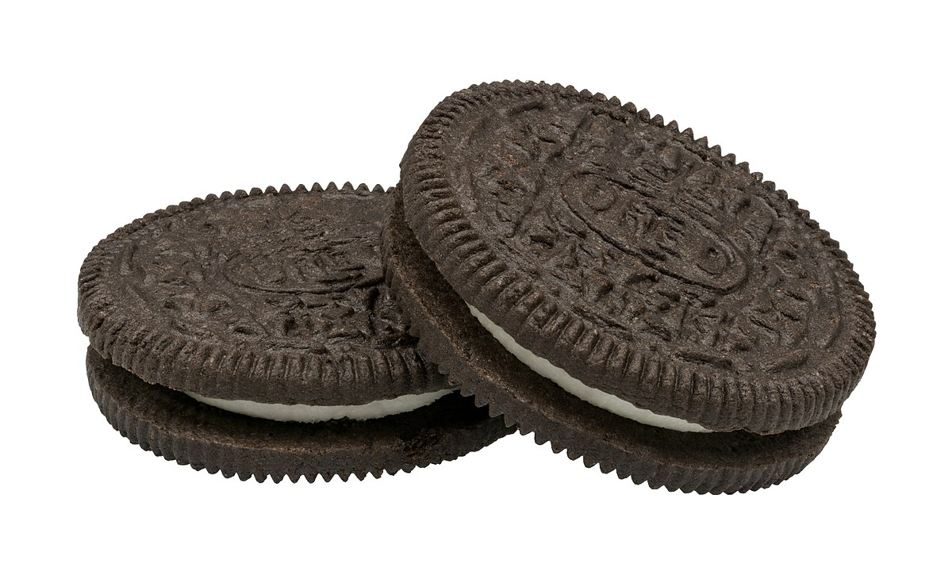
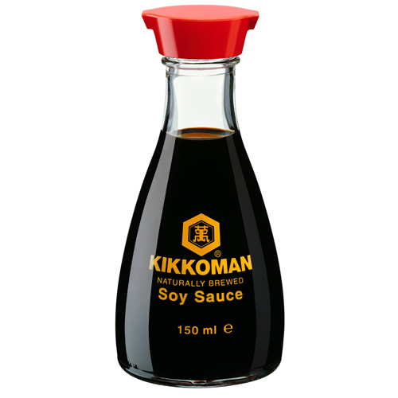
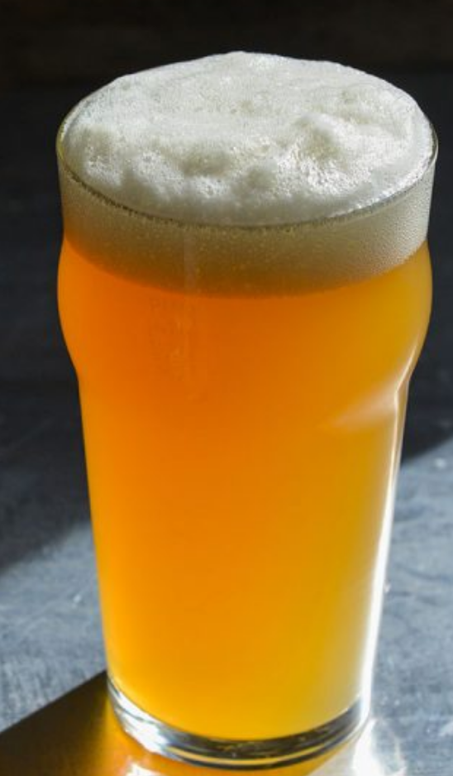
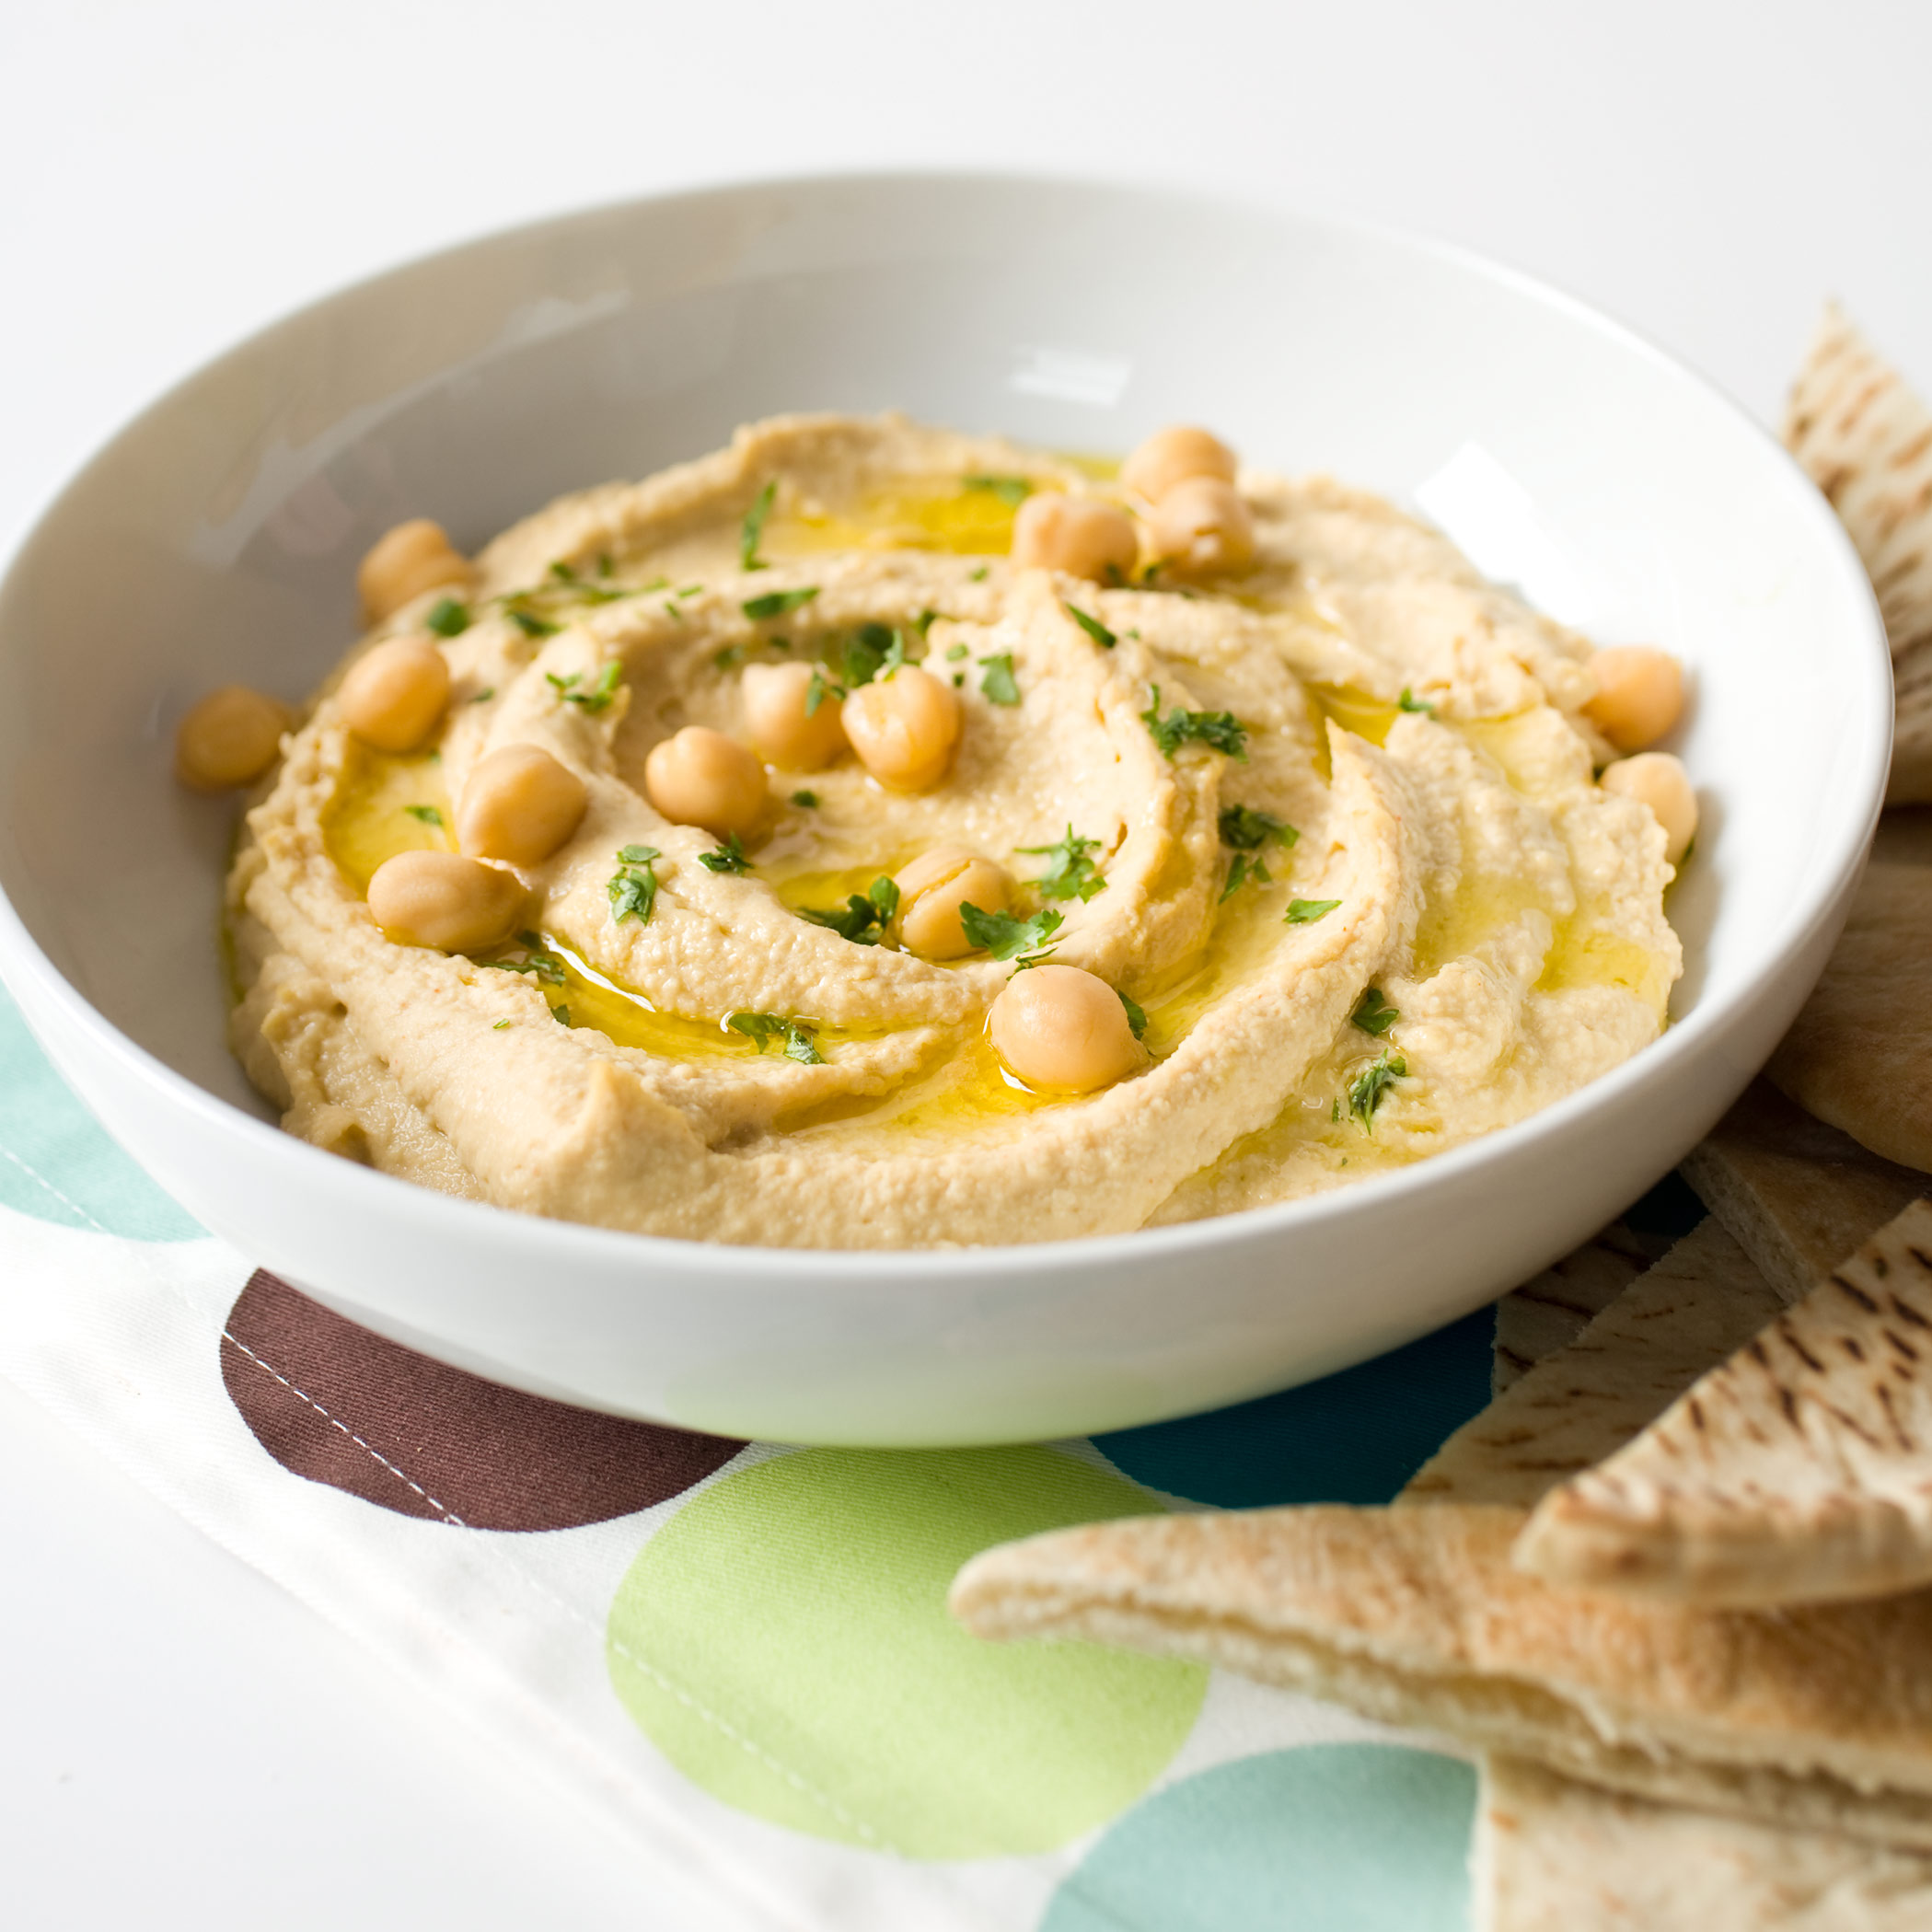
Some Foods Containing Glyphosate
Notes:
glyphosate_residues_in_honey_corn_soy_sauce_2014.pdf
Ten out of twenty eight (36%) soy sauce samples contained glyphosate at a concentration above the method LOQ (75 ng/mL) with a range between 88-564 ng /mL and a mean of 242 ng /mL

Slide 11
Glyphosate in Human Urine Samples*
*Monika Krüger et al., J Environ Anal Toxicol 2014, 4:2
Notes:
Glyphosate/glyphosate_levels_animals_humans_Kruger_2014.pdf

Slide 12
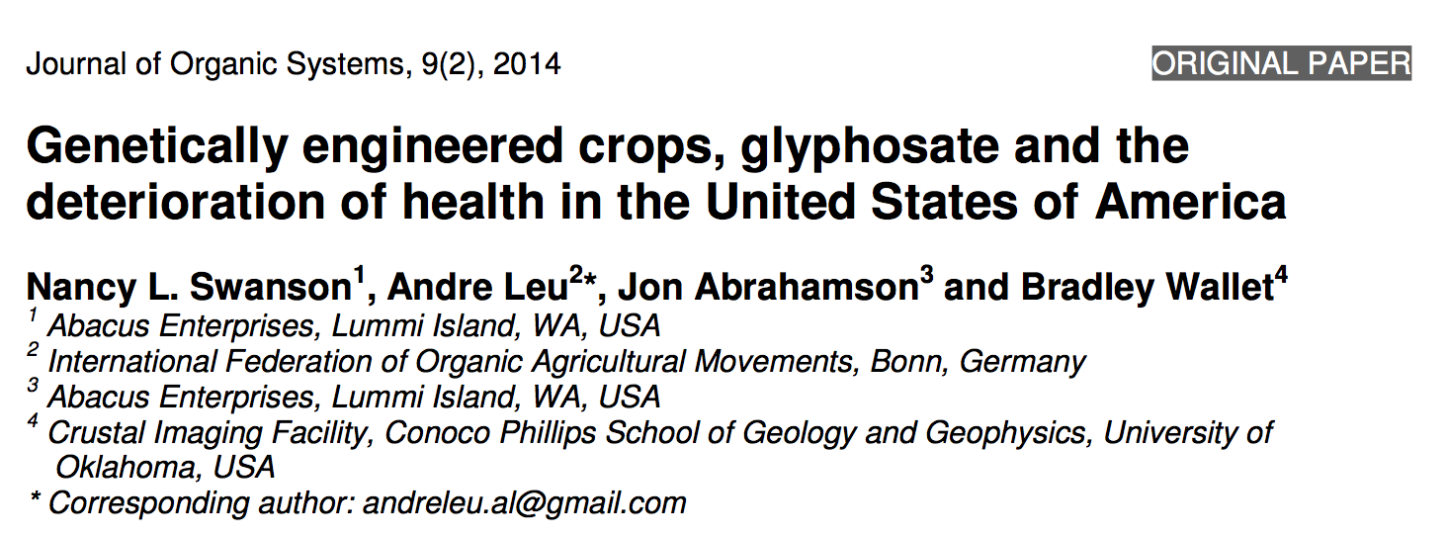
Paper Showing Strong Correlations between Glyphosate Usage and Chronic Disease

Slide 13
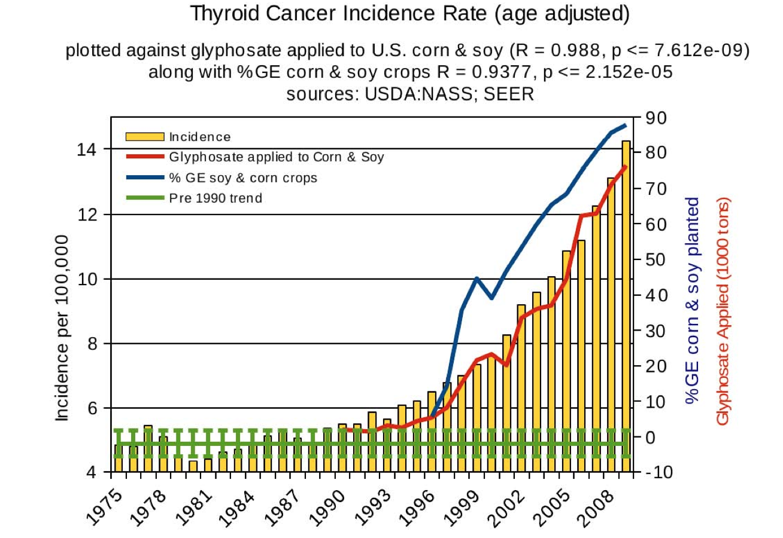
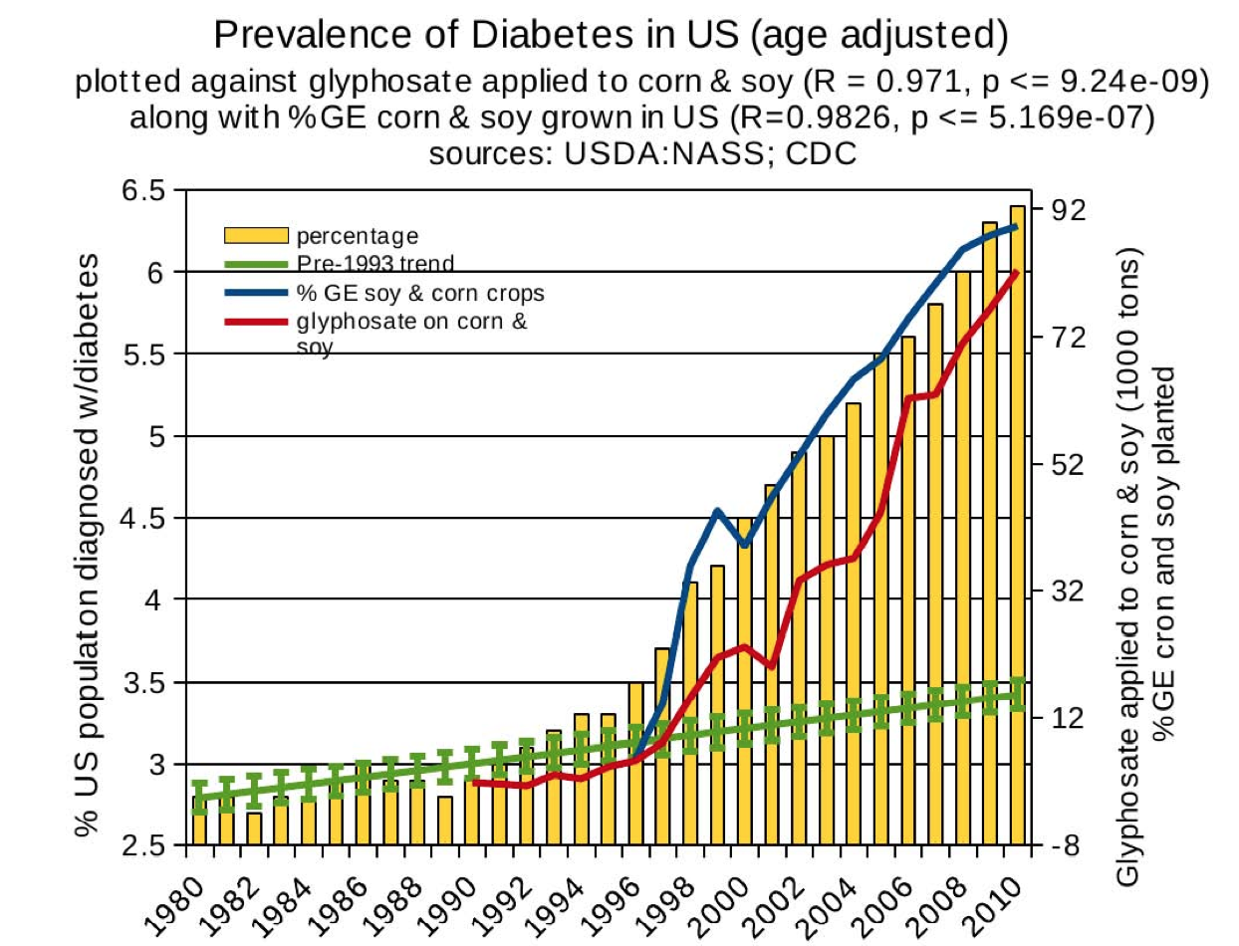
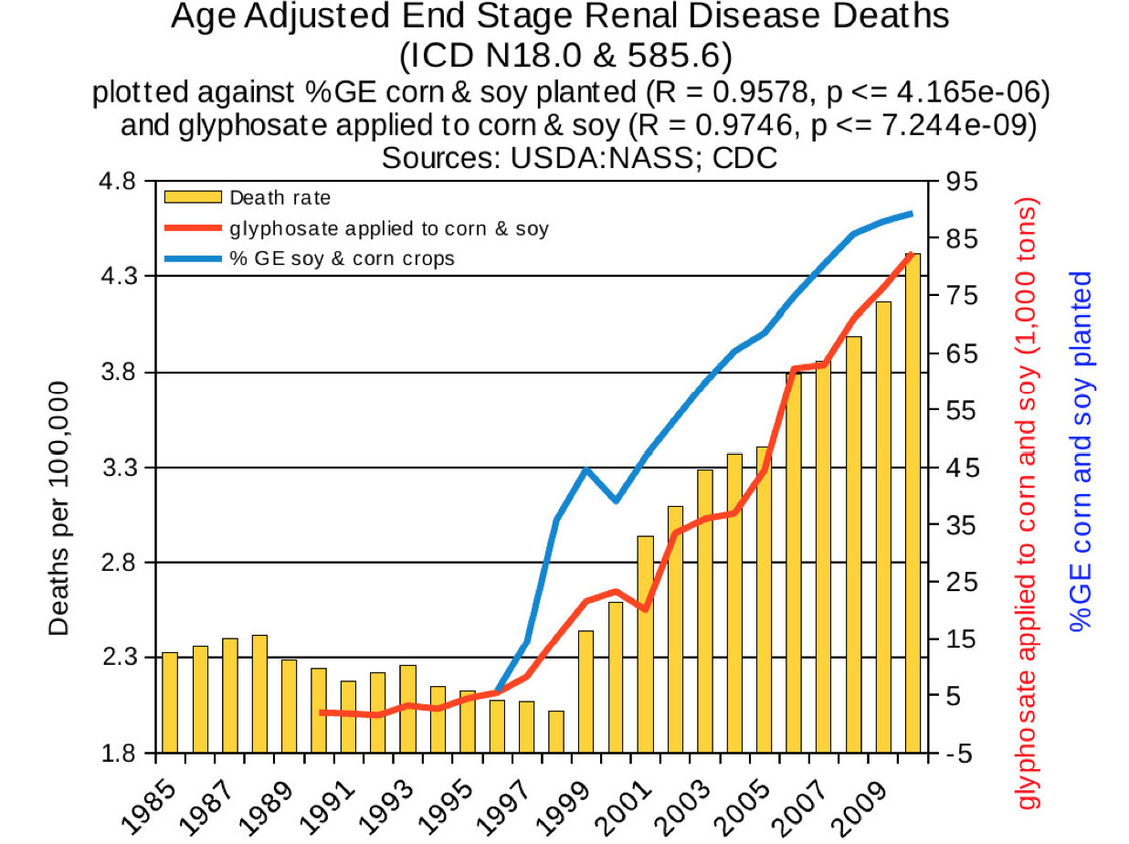
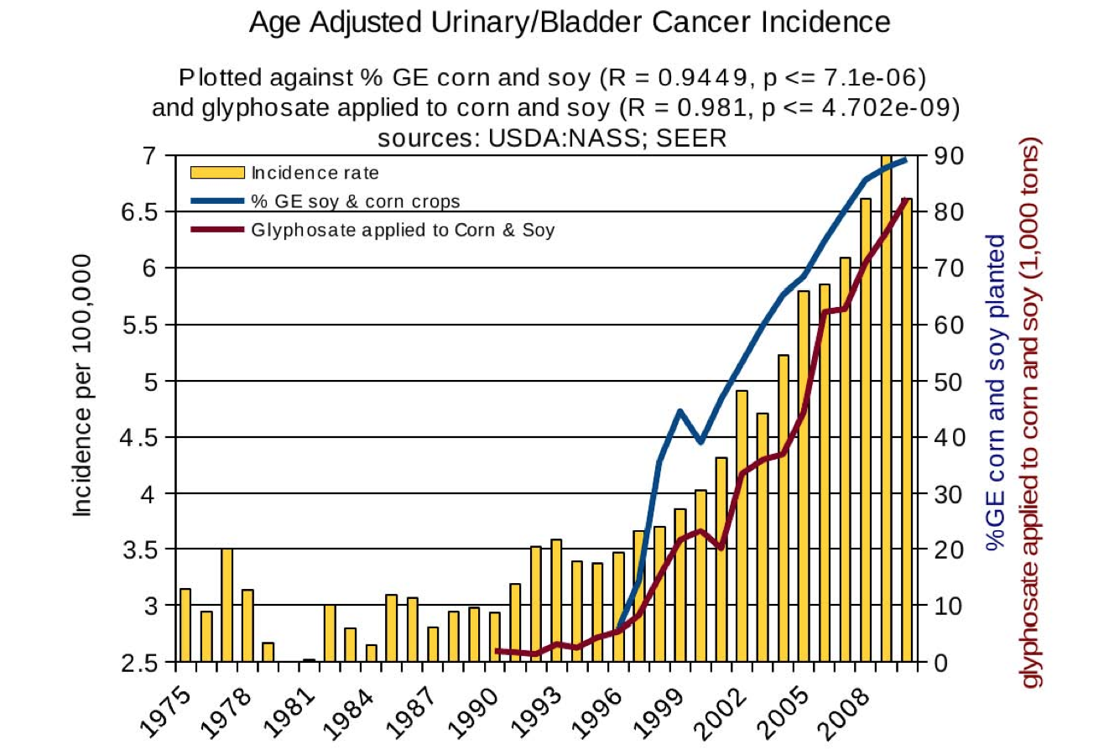
Thyroid cancer
Diabetes
End stage
renal disease
Urinary/bladder
cancer

Slide 14
Thyroid cancer
Diabetes
In 2015, WHO IARC declared glyphosate a “probable carcinogen”
End stage
renal disease
Urinary/bladder
cancer
Notes:
International agency for research on cancer

Slide 15
Quote from the Conclusion*
“Although correlation does not necessarily mean causation, when correlation coefficients of over 0.95 (with p-value significance levels less than 0.00001) are calculated for a list of diseases that can be directly linked to glyphosate, via its known biological effects, it would be imprudent not to consider causation as a plausible explanation.”
*NL Swanson et al. Journal of Organic Systems 9(2), 2014, p. 32,

Slide 16
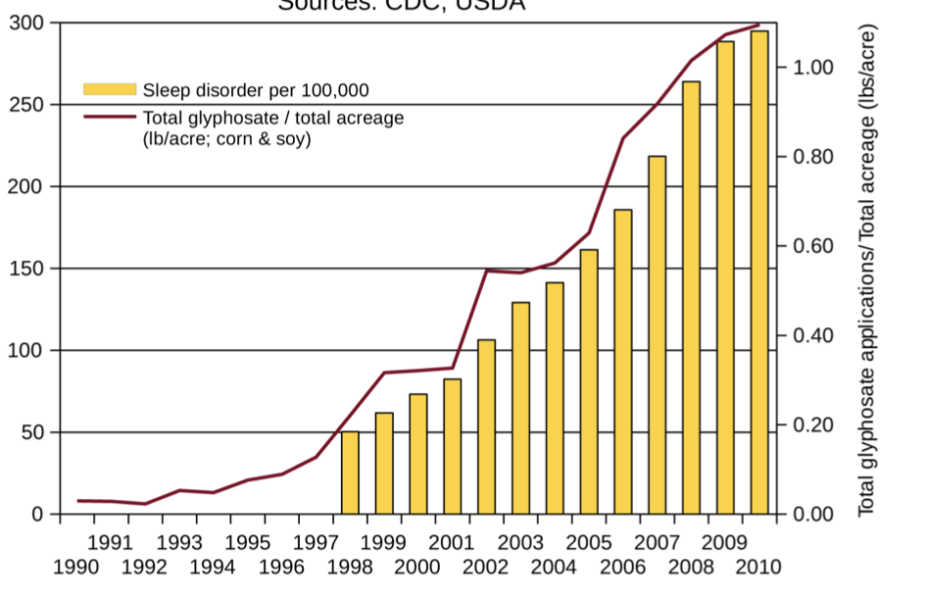
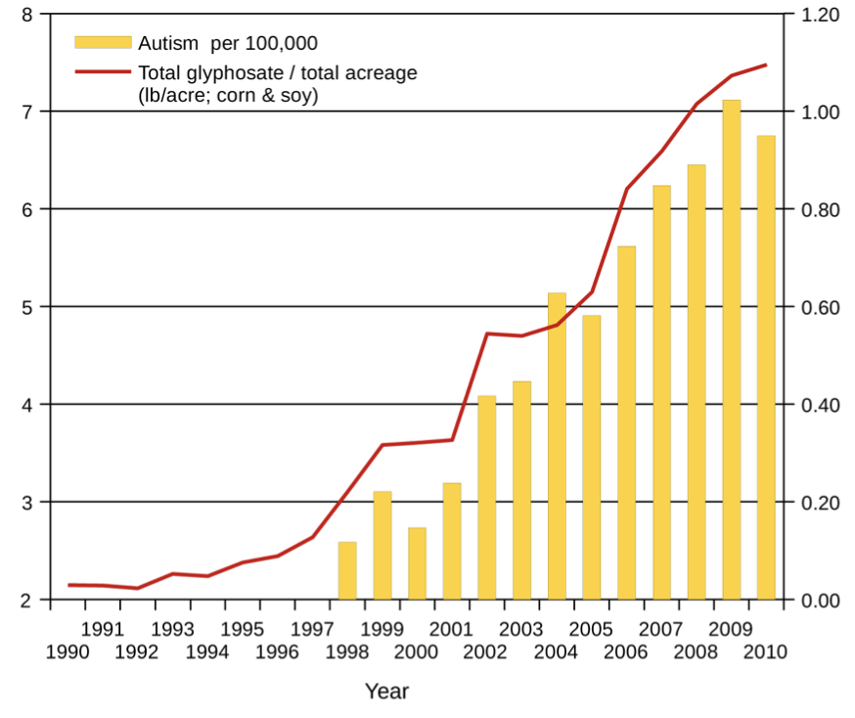
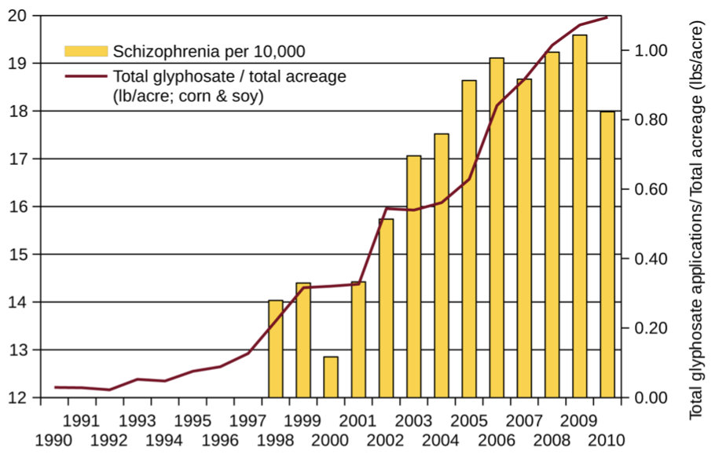
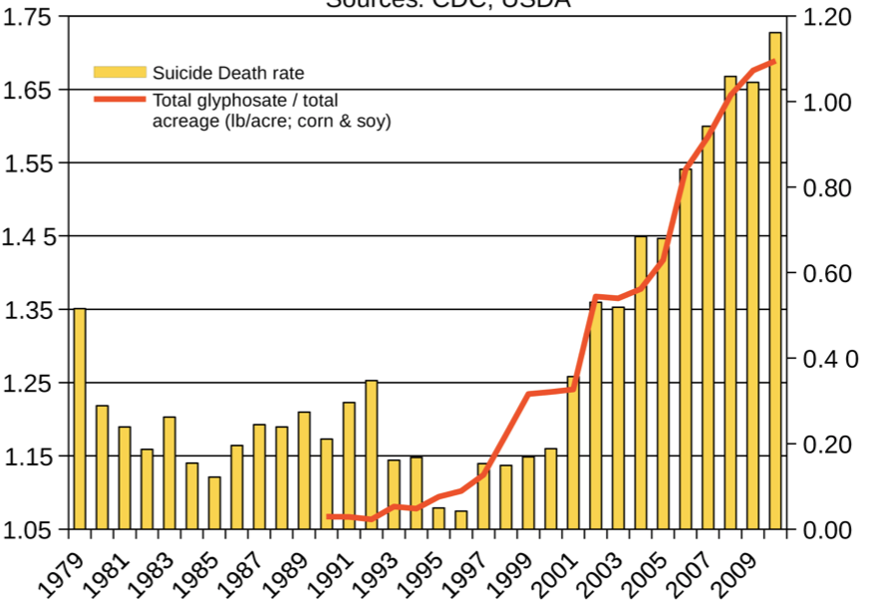
Autism
Sleep Disorder
Schizophrenia
Death by Suicide
*Seneff et al. Agricultural Sciences 2015; 6: 42-70.
Notes:
Hospital discharge diagnoses per 100,000

Slide 17
List Compiled by Prof. Don Huber

Slide 18
America’s Children are in Trouble!
It is now "normal" for a kindergarten child to have 12 colds every year and for a baby to have nine
Fourfold increase in childhood obesity
Double the asthma rate since the 1980's
"Chronic illnesses" rose from 1.8% in 1960 to 7% in 2004
Today, 43% of US children are chronically ill
1 in 6 children in the USA has a neurodevelopmental disability
1 in 38 boys are autistic
US has the worst neonatal death rate of all industrialized countries
Today's children in the US will have a shortened life span compared to their parents
Source: http://www.vaccineviolence.com/
Notes:
https://www.facebook.com/groups/1409306052710440/
./TheOutliers.text
Page removed!!
— Joanna Karpasea Jones

Slide 19
Glyphosate and the Gut

Slide 20
Imbalanced
Gut Microbiome
Inflammatory bowel disease, autoimmune arthritis, obesity and metabolic syndrome, and nonalcoholic fatty liver disease can all be traced to imbalances in gut microbiome*
*Figure 1. RS Goldszmid and G Trinchieri. Nat Immunol 2012;13(10):932-8.
Notes:
Book/autoimmune/price_of_immunity_2012.pdf
Figure

Slide 21
Glyphosate and the Gut: Pathogen Overgrowth
Glyphosate is an antimicrobial agent that preferentially kills beneficial microbes, allowing pathogens to flourish in the gut*
Immune cells invade the gut and release inflammatory cytokines
This causes increased risk to inflammatory bowel diseases such as Crohn’s, ulcerative colitis as well as Celiac disease (gluten intolerance)
* Samsel and Seneff. Entropy 2013; 15: 1416-1463.

Slide 22
Inflammatory Bowel Disease
*Figure 20, NL Swanson et al. Journal of Organic Systems 9(2), 2014, p. 25.

Slide 23
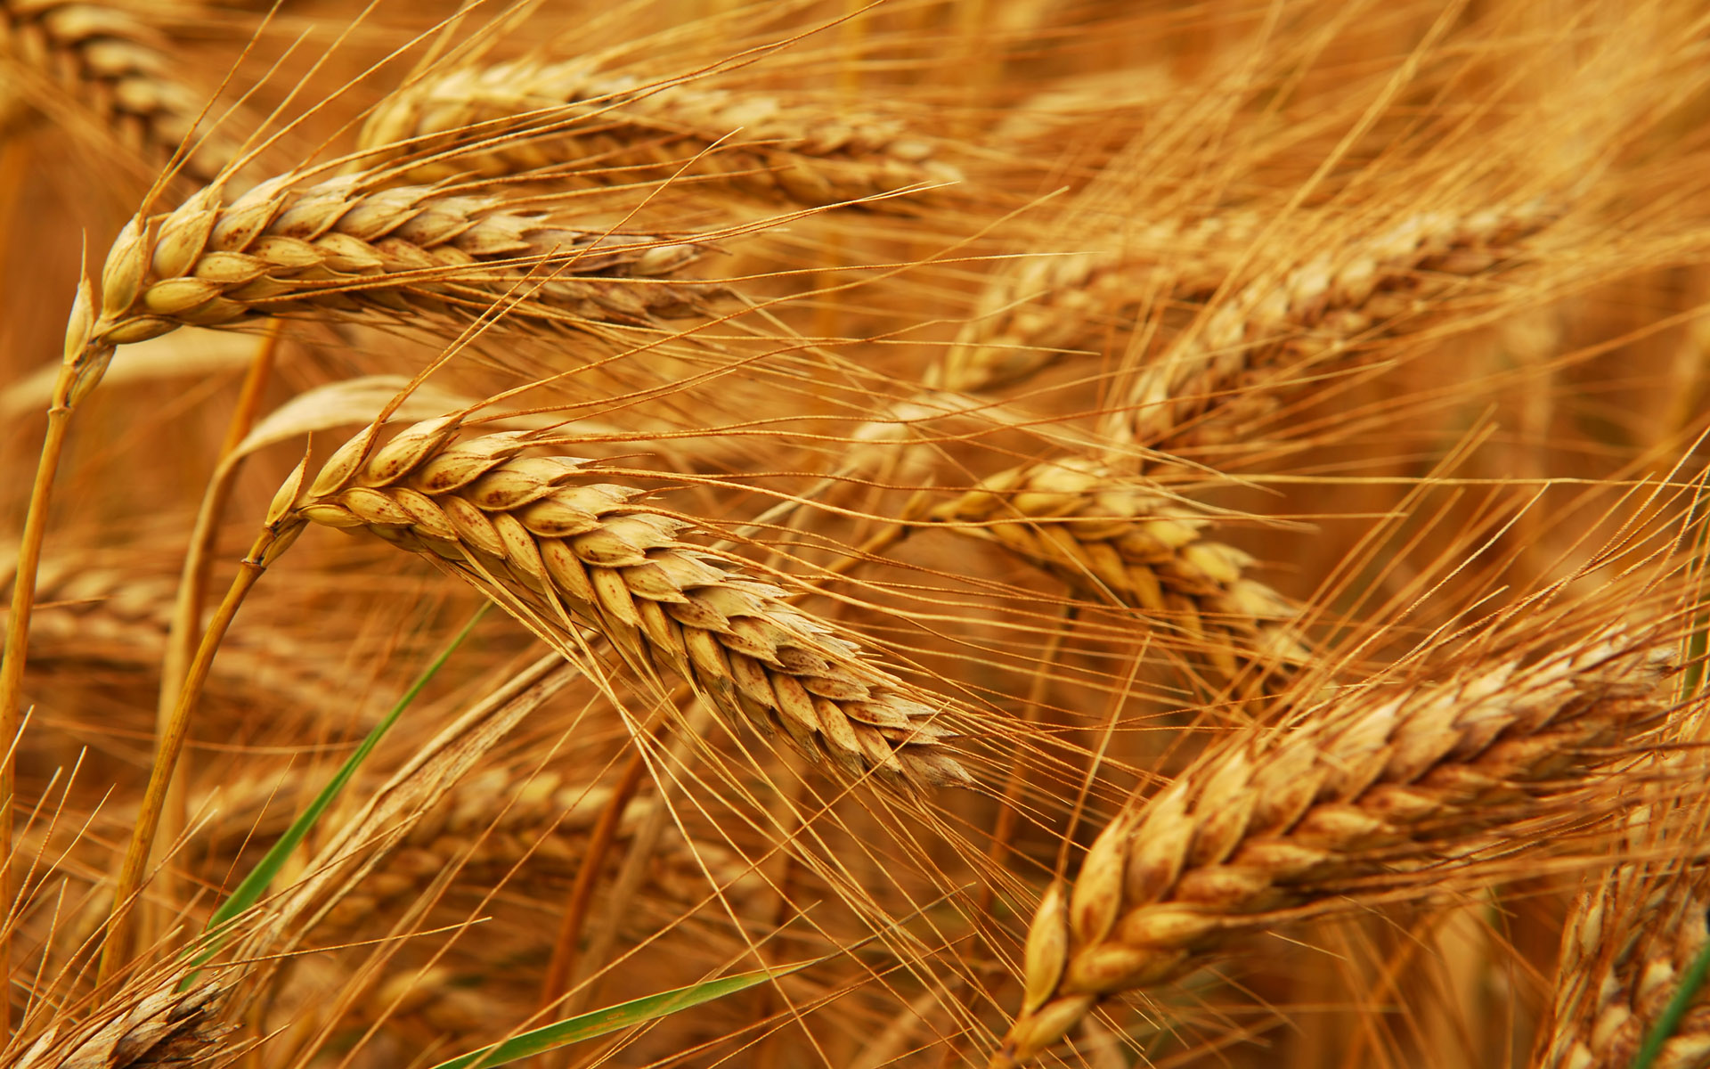
Glyphosate and Celiac Disease*
Glyphosate
Use on wheat
Celiac disease
*Samsel and Seneff. Interdiscip Toxicol 2013;6(4): 159–184.

Slide 24
Impaired Digestive Enzymes
Glyphosate has been found as a contaminant in digestive enzymes trypsin, pepsin and lipase*
Trypsin impairment prevents proteins like gluten in wheat from being digested
Glyphosate induces release of zonulin which opens up gut barrier**
Undigested proteins in the general circulation induce autoimmune disease
*A Samsel and S Seneff. J Biol Phys Chem 2017;17:8-32
** JJ Gildea et al. J Clin Nutr Diet. 2017, 3:1.
Notes:
Glyphosate/ZachBushPaper_tight_junctions_glyphosate_2017.pdf

Slide 25
Celiac Disease, Glyphosate and Non-Hodgkin’s Lymphoma
Glyphosate preferentially kills Bifidobacteria*
Bifidobacteria are depleted in Celiac disease**
Celiac disease is associated with increased risk to non-Hodgkin’s lymphoma***
Glyphosate itself is also linked directly to non-Hodgkin’s lymphoma (multiple ongoing lawsuits)****
*A.A. Shehata et al., Curr Microbiol. 2013 Apr;66(4):350-8.
** M. Velasquez-Manoff, NY Times Sunday Review, Feb. 23, 2013.
*** C. Catassi et all, JAMA. 2002 Mar 20;287(11):1413-9.
****M. Eriksson et al., Int J Cancer. 2008 Oct 1;123(7):1657-63.
Notes:
**./ bifidobacteria_celiac_disease.text
Cancer/Celiac_disease_increases_hodgkins_lymphoma.text

Slide 26
Pathogen Overgrowth in Poultry Microbes Exposed to Glyphosate*
Clostridia
Salmonella
Bifidobacteria
*Plot provided by Dr. Martin Michener
Notes:
From Marty Michener!
Sheehata paper.

Slide 27
Evidence linking autism to Clostridia overgrowth*
14 autistic children with gut disorder compared to 21 controls
Significant increase in Clostridia species in the gut in autistic children
Associated with reduced tryptophan levels and increased expression of inflammatory markers
Tryptophan is a product of the shikimate pathway, which glyphosate blocks
Macrophages in inflamed tissue take up tryptophan, reducing bioavailability to the brain
Proposed role for antibiotics
Glyphosate is a patented antimicrobial agent (2010)
*RA Luna et al., Cellular and Molecular Gastroenterology and Hepatology 2017;3(2): 218-230

Slide 28
*
Triplets: two boys, one girl. Both boys have autism and girl has seizure disorder
Very high levels of glyphosate in urine in all three
Clostridia overgrowth due to glyphosate disruption of gut microbes
Clostridia produce toxins which block the conversion of dopamine to norepinephrine.
Damage to neurons in the brain through oxidative stress
*W. Shaw. Integrative Medicine 2017;16(1);50-57.
Notes:
./Shaw_on_glyphosate_triplets_autism.text

Slide 29
Neurotoxicology 2019; 75:1-8.
“In this work, we state a possible link between Gly-induced dysbiosis and cognitive and motor aggravations in neurodegenerative and neurodevelopmental pathologies, such as autism spectrum disorder (ASD). Hence, we review the negative impact that Gly-induced dysbiosis may have on depression/anxiety, autism, Alzheimer’s and Parkinson’s diseases.”

Slide 30
Recapitulation
Glyphosate contamination in digestive enzymes makes them defective
Undigested proteins induce leaky gut barrier and inflammatory bowel disease
Celiac disease is associated with increased risk to non-Hodgkin’s lymphoma, which is also linked to glyphosate exposure.
Glyphosate induces overgrowth of Clostridia species in gut
Clostridia release toxins that induce an inflammatory response and prevent dopamine metabolism
Clostridia overgrowth can lead to autism
Inflammation in the brain and excessive neurostimulation by dopamine damages neurons
Gut-brain axis leads to neurological disease following gut dysbiosis

Slide 31
Glutamate Excitotoxicity

Slide 32
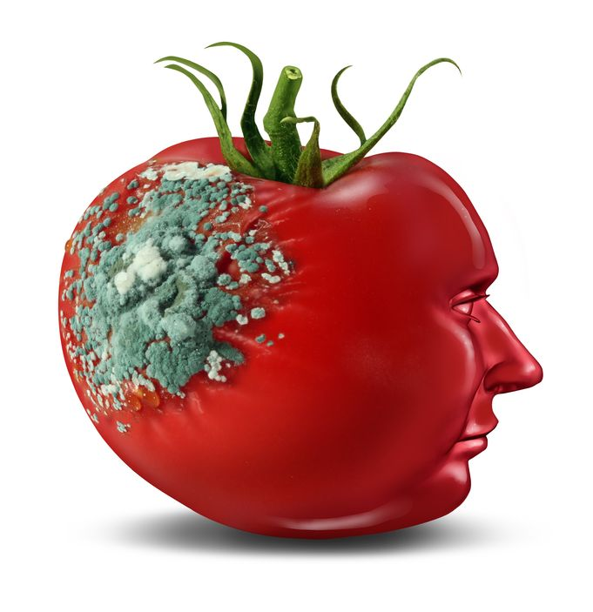
Glyphosate and Glutamate*
Acute exposure of rats to glyphosate activates NMDA receptors and voltage-dependent calcium channels
Oxidative stress and neuronal cell death
Increased glutamate release into the synaptic cleft → excessive extracellular glutamate levels
Decreased glutathione content
Increased peroxidation of lipids (fats)
* Daiane Cattani et al. Toxicology 2014; 320: 34-45.
Notes:
http://www.greenmedinfo.com/blog/roundup-weedkiller-brain-damaging-neurotoxin
acute exposure (30 minutes) and chronic (pregnancy and lactation) exposure.
Toxicology. 2014 Jun 5;320:34-45. doi: 10.1016/j.tox.2014.03.001. Epub 2014 Mar 15.
Mechanisms underlying the neurotoxicity induced by glyphosate-based herbicide in immature rat hippocampus: involvement of glutamate excitotoxicity.
Cattani D et al.
Rat hippocampus
Why was this referenced??
T. Bohn et al. Food Chemistry 153, 15 June 2014, 207-215.

Slide 33
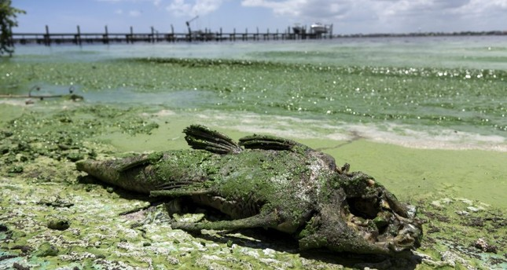
“Is Agriculture’s Use of Glyphosate Feeding Lake O’s Explosive Algae Blooms?”*
Sugar cane agriculture is extensive all around Lake Okeechobee in S. Florida, and glyphosate is used both to control weeds and as a desiccant
Cyanobacteria can break down the C-P bond in glyphosate and use its phosphorus atom as a fuel source**
*Prof. Geoffrey Norris.https://jacquithurlowlippisch.com/tag/
is-sugarcane-field-glyphosate-feeding-lake-os-blue-green-algae-blloms
**D Drzyzga et al. Environ Microbiol 2017 Mar;19(3):1065-1076
Notes:
,/RedTide_algae_blooms_manmade.pdf
Glyphosate/Zhang_glyphosate_water_cyanobacterium_2016.pdf
Geoffrey Norris:
https://jacquithurlowlippisch.com/tag/is-sugarcane-field-glyphosate-feeding-lake-os-blue-green-algae-blloms/

Slide 34
Cyanobacteria Feed Red Tide Algae
“Both the coastal red tide and the inland blue-green algae have beset South Florida through the summer, killing vast numbers of fish and other wildlife, including dozens of dolphins, manatees, sea turtles, sharks and eels.” *
Cyanobacteria feed off of glyphosate (phosphorus source) and produce nitrates from nitrogen
Red Tide algae flourish, supplied with nitrates produced by cyanobacteria **
*https://www.nbcnews.com/news/us-news/
toxic-red-tide-florida-researchers-investigate-what-s-making-it-n900771
**https://www.sailorsforthesea.org/programs/ocean-watch/nutrients-feed-red-tide
Notes:
https://www.nbcnews.com/news/us-news/toxic-red-tide-florida-researchers-investigate-what-s-making-it-n900771
https://www.sailorsforthesea.org/programs/ocean-watch/nutrients-feed-red-tide

Slide 35
“What California Sea Lions Exposed to Domoic Acid might Teach us about Autism”*
Toxin domoic acid produced by the Red Tide species, Pseudo nitzschia, is a glutamate analogue
It causes behavioral symptoms in sea lions that resemble autism
It is neurotoxic, especially in the amygdala and hippocampus
Autism rates are high in the Pacific Northwest and S. Korea, where domoic acid is a contaminant in seafood
Glutamate additives in processed foods may also be problematic
*Garet Paul Lahvis. EPMA J 201; 8(3): 229–235.
Notes:
https://www.ncbi.nlm.nih.gov/pmc/articles/PMC5607054/
./sea_lions_domoic_acid_autism_2017.pdf

Slide 36
Test of Glyphosate Levels in Florida Waterways*
Water sample taken from the coast of Cape Coral, at the mouth of the Caloosahatchee River, where cyanobacteria were present
*https://www.momsacrossamerica.com/orange_juice_postive_for_glyphosate_again
Notes:
https://www.momsacrossamerica.com/orange_juice_postive_for_glyphosate_again

Slide 37
Mineral Disruption

Slide 38
Glyphosate Depletes Iron, Manganese and Zinc in Plants*
*D Huber, What About Glyphosate-Induced Manganese Deficiency? Fluid Journal, 20-22.
Notes:
Glyphosate/glyphosate_induced_manganese_deficiency_plants_Huber.pdf

Slide 39
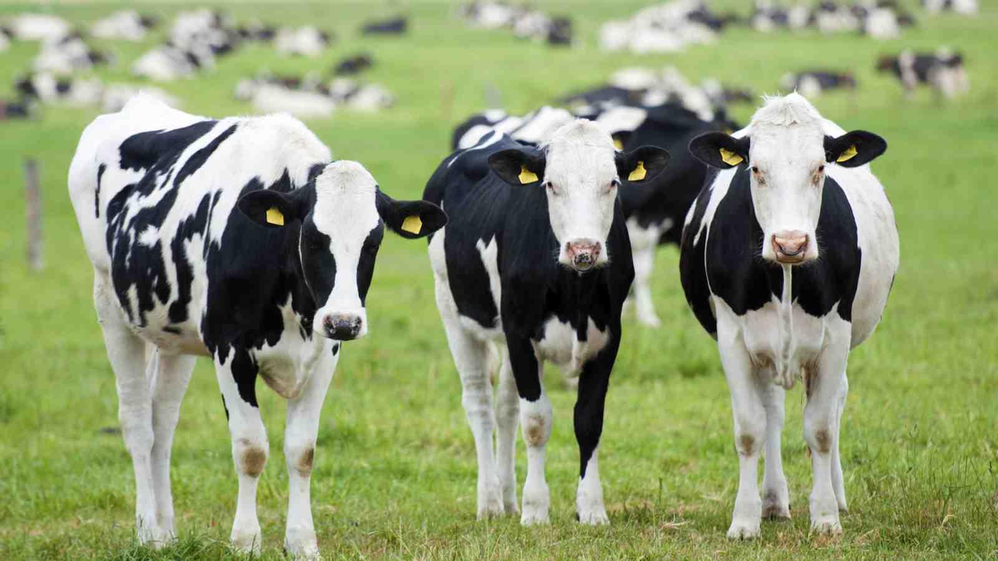
Severe Deficiency in Serum Manganese and Cobalt in Cows*
Cobalt
Manganese
Eight different farms: all cows tested had glyphosate in the urine
*M. Krüger et al., J Environ Anal Toxicol 2013, 3:5
Notes:
glyphosate//cows_cobalt_deficiency_glyphosate.pdf

Slide 40
Low Manganese in Teeth Linked to Autism*
Studied lead, mercury and manganese levels in tooth enamel of shed primary teeth in 84 children
Manganese accumulated after birth was down by 60% in autistic children
No other result was statistically significant
*MM Abdullah et al., J Autism Dev Disord. 2012 Jun;42(6):929-36.
Notes:
Samantha/heavy_metal_in_childrens_tooth_enamel_as_diagnostic_autism.pdf

Slide 41
Some Consequences of Manganese Deficiency
Lactobacillus critically depend on manganese
Manganese superoxide dismutase protects mitochondria from oxidative damage
Manganese is essential for detoxing glutamate (neurotoxin)
Pituitary depends on manganese to release thyroid stimulating hormone
Chondroitin sulfate synthesis in bones

Slide 42
Glyphosate Displacing
Glycine in Protein Synthesis

Slide 43
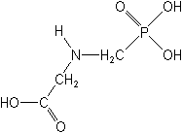
What if Glyphosate could Insert itself into Proteins during Synthesis???
Extra Stuff!
glyphosate
Code for Glycine
GGC
mRNA
. . .
. . .
Glyphosate
Alanine
Proline
-- Any proteins with conserved glycine residues are likely to be affected in a major way

Slide 44
Extra Piece Sticks Out at Active Site
Substrate no longer fits in active site
Active Site
Glyphosate
Alanine
Proline
Peptide chain

Slide 45
Extra Piece Sticks Out at Active Site
Substrate no longer fits in active site
Active Site
Glyphosate
Alanine
Proline
glycine
Peptide chain

Slide 46
Extra Piece Sticks Out at Active Site
Substrate no longer fits in active site
Active Site
Extra Stuff
Glyphosate
Alanine
Proline
glycine
Peptide chain

Slide 47
Extra Piece Sticks Out at Active Site
Substrate no longer fits in active site
This explains how glyphosate disrupts EPSPS in the shikimate pathway: Multiple bacteria have developed resistance by replacing active site glycine with alanine and this is the basis for GMO Roundup Ready crops*
Active Site
Extra Stuff
Glyphosate
Alanine
Proline
glycine
Peptide chain
*T Funke et al., Molecular basis for the herbicide resistance of Roundup Ready crops. PNAS 2006;103(35):13010-13015.

Slide 48
Inhibition of EPSPS by glyphosate: Resistant E coli mutant*
Mutant with alanine substituted for glycine 96
Wild type with glycine 96
*Figure 3, S Eschenburg et al. Planta 2002;216:129-135.

Slide 49
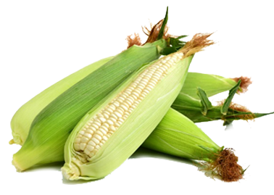
DowDupont Experiments on Maize*
Designer gene introduced into maize using CRISPR technology
Tweaked native EPSP synthase to produce glyphosate- resistant version
First step: mutate glycine to alanine at residue 101 (GNAG → GNAA)
Completely erases any glyphosate sensitivity
[corresponds to 96 in E coli]
Modify additional nearby residues to increase space for EPSP substrate
*Y Dong et al. J Biol Chem 2019; 294(2): 716-725.

Slide 50
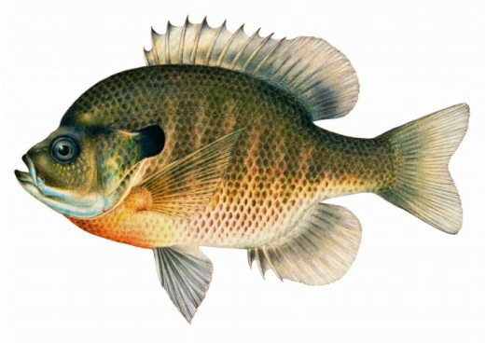
Monsanto Study (1989)*
Study exposed bluegill sunfish to carbon-14 radiolabelled glyphosate
Measured radiolabel in tissues greatly exceeded measured glyphosate levels
Proteolysis recovered more glyphosate
20% yield → 70% yield
*WP Ridley and KA Chott. Monsanto unpublished study. August, 1989.

Slide 51
Monsanto Study (1989)*
Study exposed bluegill sunfish to carbon-14 radiolabelled glyphosate
Measured radiolabel in tissues greatly exceeded measured glyphosate levels
Proteolysis recovered more glyphosate
20% yield → 70% yield
"Proteinase K hydrolyses proteins to amino acids and small oligopeptides, suggesting that a significant portion of the 14C activity residing in the bluegill sunfish tissue was tightly associated with or incorporated into protein.”
*WP Ridley and KA Chott. Monsanto unpublished study. August, 1989.

Slide 52
Some Predicted Consequences*
Neural tube defects
Autism
Impaired collagen → osteoarthritis
Steatohepatitis (fatty liver disease)
Obesity and adrenal insufficiency
Hypothyroidism
Impaired iron homeostasis and kidney failure
Insulin resistance and diabetes
Cancer
*A. Samsel and S. Seneff. Journal of Biological Physics and Chemistry 2016;16:9-46.

Slide 53
Glyphosate Disrupts Cytochrome P450 (CYP) Enzymes*
Glyphosate severely suppresses CYP enzymes in rat liver
CYP enzymes have a unique FGXGXRXCXG motif with two and often three critical glycine residues**
*A Samsel and S Seneff. Entropy 2013; 15: 1416-1463.
**K Syed and SS Mashele. PLOS ONE 2014; 9(4):| e95616.
GLYCINES
Notes:
CYPs_contain_highly_conserved_glycines_2014.pdf

Slide 54
Glyphosate Disrupts Cytochrome P450 (CYP) Enzymes*
Glyphosate severely suppresses CYP enzymes in rat liver
CYP enzymes have a unique FGXGXRXCXG motif with two and often three critical glycine residues**
CYP enzymes are needed to produce bile acids for digesting fats, to activate vitamin D and to detoxify many environmental toxicants
*A Samsel and S Seneff. Entropy 2013; 15: 1416-1463.
**K Syed and SS Mashele. PLOS ONE 2014; 9(4):| e95616.
GLYCINES
Notes:
CYPs_contain_highly_conserved_glycines_2014.pdf

Slide 55
Dysfunctional PEP
Carboxykinase (PEPCK):
Multiple Consequences

Slide 56
Overview of PEP Carboxykinase (PEPCK)
PEPCK is a crucial enzyme in gluconeogenesis
It is a major regulatory enzyme in metabolism
Defective PEPCK is linked to many diseases and conditions
Fatty liver disease
Neonatal hypoglycemia
Type 1 diabetes
Sudden Infant Death Syndrome
Fungus overgrowth
High oxalate and kidney stones

Slide 57
Basic Chemistry
PEPCK
Oxalacetate + GTP ⇐----⇒ PEP + GDP + CO₂
PEPCK is a cataplerotic enzyme and a feeder reaction for downstream metabolic processes
Cataplerosis: the removal of intermediate metabolites in the citric acid cycle, to prevent their accumulation in the mitochondrial matrix.
PEPCK supports the synthesis of many important metabolites by “stealing” oxaloacetate from the citric acid cycle

Slide 58
PEPCK Mimics EPSP Synthase
EPSP synthase is the enzyme that is disrupted by glyphosate to kill weeds
It binds PEP at a site with a highly conserved glycine residue and multiple cationic amino acids
PEPCK also binds PEP at a site with a highly conserved glycine residue and multiple cationic residues
→ Glyphosate disrupts PEPCK as well??

Slide 59
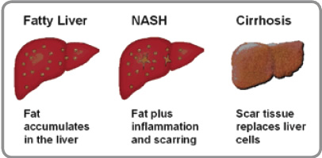
PEPCK and Fatty Liver Disease*
Mice with defective PEPCK develop dramatic hepatic steatosis
TCA cycle intermediates build up and this blocks fatty acid metabolism
Glucocorticoids in response to physical exercise stimulate gluconeogenesis in liver by promoting PEPCK synthesis**
* Shawn C Burgess et al. JBC 2004; 279(47): 48941-48949
**JE Friedman. Am J Physiol 1994; 266(4): E560-6.
Notes:
cortisol, prednisone
https://www.ncbi.nlm.nih.gov/pubmed/8178976
ALSO:
Taiyi Kuo et al. Adv Exp Med Biol. 2015 ; 872: 99–126.
liver/impaired_TCA_cycle_activity_mouse_liver_PEP_carboxykinase_deficiency_2004.pdf

Slide 60
Is Glyphosate Causing an Epidemic in Fatty Liver Disease?
We have a worldwide epidemic in fatty liver disease today*
“Multiomics reveal non-alcoholic fatty liver disease in rats following chronic exposure to an ultra-low dose of Roundup herbicide”**
Glyphosate causes fatty liver disease in humans***
* Chris Estes et al. Hepatology 2018; 67(1): 123-133.
** Robin Mesnage et al. Sci Rep 2017; 7: 39328.
*** PJ Mills et al. Clinical Gastroenterology and Hepatology 2019
[Epub ahead of print].

Slide 61
“Glyphosate Excretion is Associated With Steatohepatitis and Advanced Liver Fibrosis in Patients With Fatty Liver Disease”*
Patients with liver disease at UC San Diego were carefully screened for NASH
Glyphosate excretion was significantly higher in patients with NASH than in patients without NASH
Patients with advanced fibrosis had significantly higher glyphosate than patients with less fibrosis
* PJ Mills et al. Clin Gastroenterol Hepatol 2020; 18(3): 741-743.
Notes:
LaszloBoros/Mills_glyphosate_steatohepatitis_link_humans_2019.pdf

Slide 62
Sugar Addicted Newborns: the Silent Epidemic*
Diabetic moms with high blood sugar supply too much sugar to their fetus during pregnancy
Infant produces too much insulin, which induces hypoglycemia following birth
Symptoms include lethargy, tachycardia, poor feeding, seizures, and even coma
Excessive growth in utero leads to complicated birth
Infant normally upregulates PEPCK at birth, but glyphosate exposure could be inhibiting protein activity
*www.dunkthejunk.org/blog/2016/1/19/sugar-addicted-newborns-the-silent-epidemic

Slide 63
Glycine mutation in PEPCK leads to hypoglycemia and liver disease
Three cases of homozygous mutation of PEPCK in Finland
All three had a mutation of glycine at residue 309 to arginine which produced a nonfunctional version of the enzyme
Clinically presented as childhood hypoglycemia, liver dysfunction, and elevations of fumarate and other citric acid cycle intermediates in the urine
* P Viera et al., Mol Genet Metab 2017; 120(4):337-341.
Notes:
Autism/PEP_carboxykinase_mutation_glycine_2017.text

Slide 64
Critical diaphragm failure in sudden infant death syndrome*
“Critical Diaphragm Failure” hypothesis for SIDS
Weak diaphragm → breathing difficulties
(due to PEPCK impairment?)
PEPCK deficiency in liver → impaired gluconeogenesis
SIDS often occurs at night after child begins to sleep through the night → acute hypoglycemia
*PMA Siren and MJ Siren.
Upsala Journal of Medical Sciences 2011; 116: 115–123.

Slide 65
PEPCK Deficiency: Metabolic Derailments*
Fish exposed to glyphosate had low liver glucose, elevated ALT and AST, and elevated lactate and triglycerides**
*Parvin Hakimi et al. Nutrition and Metabolism 2005: 2:33
**FR de Maura et al. Environ Toxicol Pharmacol 2017; 56: 241-248.
Notes:
ALT = alanine transaminase
Liver/ PEPCK_deficient_mice_high_malate_glutamate_etc_2005.pdf

Slide 66
Could PEPCK Deficiency Cause High Serum Oxalate and Fungus Overgrowth?
We have a worldwide epidemic in fungus diseases*
PEPCK converts oxaloacetate to PEP
PEPCK deficiency leads to excess oxaloacetate
White rot fungus synthesizes oxalate from oxaloacetate**
This leads to accelerated growth and a more pathogenic form
*GD Brown et al. Sci Transl Med 2012; 4: 165rv13.
** Nina Elisabeth Nagy et al. MPMI 2012; 25(11): 1450-1458.

Slide 67
Low Sulfate, High Oxalate Phenotype*
Gut Dysbiosis
Decreased sulfomucins, colitis, IBD, leaky gut
Increased susceptibility to pathogens
Fatty liver disease
Reduced detox of heavy metals and toxic chemicals
Elevated serum LDL
Decreased insulin function
Adrenal insufficiency
Increased cancer risk
Stunted growth, slow metabolism
Serotonin deficiency in brain
Autism linked to sulfate wasting in kidneys
*Dr. Rostenberg
www.beyondmthfr.com/side-high-oxalates-problems-sulfate-b6-gut-methylation
Notes:
Add slides from SeneffOxalate2017.pptx in January/
Oxalate_Dr_Rosenberg.text
Down_side_high_oxalate.pdf

Slide 68
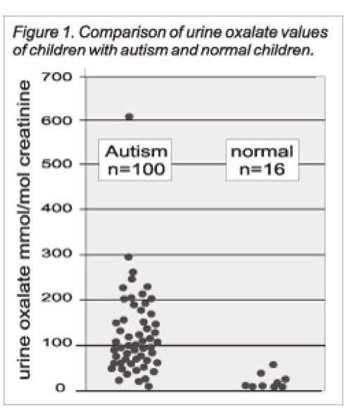
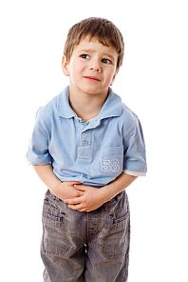
Autism Linked to Oxalate Crystals*
Crystals of oxalate form kidney stones and cause great discomfort
Study has shown at least 3-fold higher serum and urinary levels of oxalate in autistic kids**
*William Shaw, The Role of Oxalates in Autism and Chronic Disorders WAPF, March 26, 2010
**J Konstantynowicz et al., European Journal of Paediatric Neurology 16(5), 2012, 485-491
Notes:
samantha/oxalates_in_autism.text
samantha/william_shaw_on_oxalates_autism.text
http://www.westonaprice.org/health-topics/the-role-of-oxalates-in-autism-and-chronic-disorders/
*http://www.greatplainslaboratory.com/home/span/oxalates.asp
“Oxalate crystals in the bone may crowd out the bone marrow cells, leading to anemia and immunosuppression”*

Slide 69
Oxalate Causes Sulfate Flushing through Urine*
Sulfate is essential for:
Synthesis of extracellular matrix glycoproteins
Synthesis of cerebroside sulfate, in myelin in nerve fibers
Detoxification of many environmental toxins
Sulfate is flushed (lost) when kidney oxalate levels are high
Oxalobacter microbes degrade oxalate but they are killed by antibiotics such as Cipro
Oxalate decarboxylase depends on manganese as catalyst**
*W Krick et al., Am J Physiol Renal Physiol 2009;297: F145-F154.
**A Tanner et al. J Biol Chem. 2001;276(47):43627-34
Notes:
book/autism/sulfate_oxalate_kidney_transport_Karen_Lyke.pdf
Book/autism/oxalate/Tanner_2001_oxalate_decarboxylase_requires_manganese_glycine_dependencies.pdf

Slide 70
Recapitulation
Glyphosate may be disrupting PEPCK in the same way it disrupts EPSP synthase
If so, it explains glyphosate's well established association with fatty liver disease
It also explains the epidemic we see today in:
autism
neonatal hypoglycemia
sudden infant death
oxalate overload
fungus infection
type 1 diabetes

Slide 71
How to Safeguard Yourself
and Your Family

Slide 72
Go Organic!

Slide 73
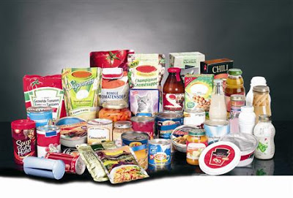
Avoid Processed Foods
Free glutamate (e.g., MSG) is a very common ingredient in processed foods
It is neurotoxic, and glyphosate increases its effects
Other artificial ingredients (artificial flavors and colors) may also cause harm

Slide 74
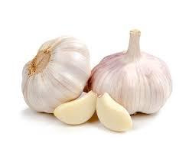
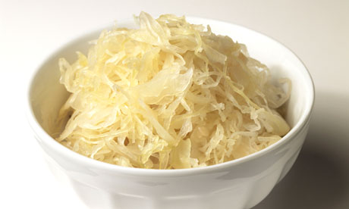
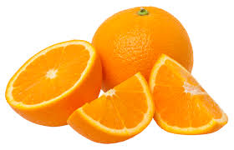
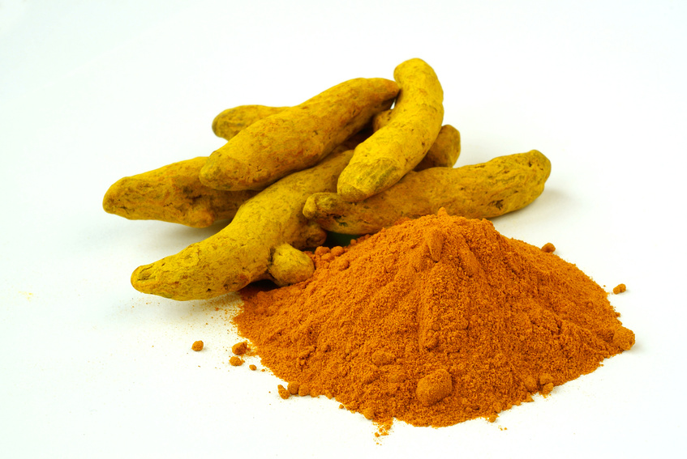
Some Important Nutrients
Curcumin
Garlic
Vitamin C
Probiotics
Methyl tetrahydrofolate
Cobalamin
Glutathione
Taurine
Epsom salt baths

Slide 75
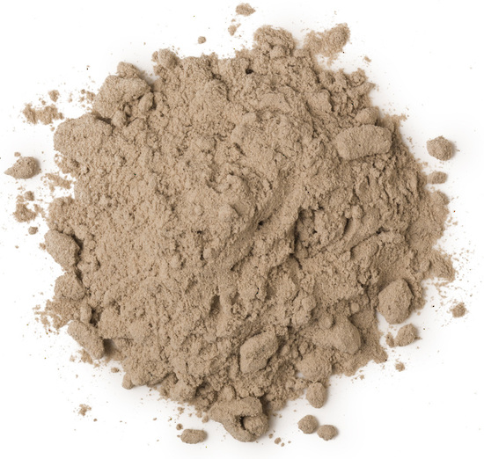
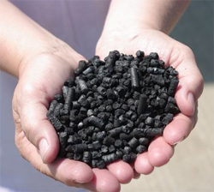
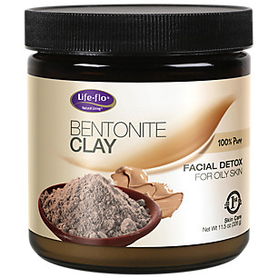
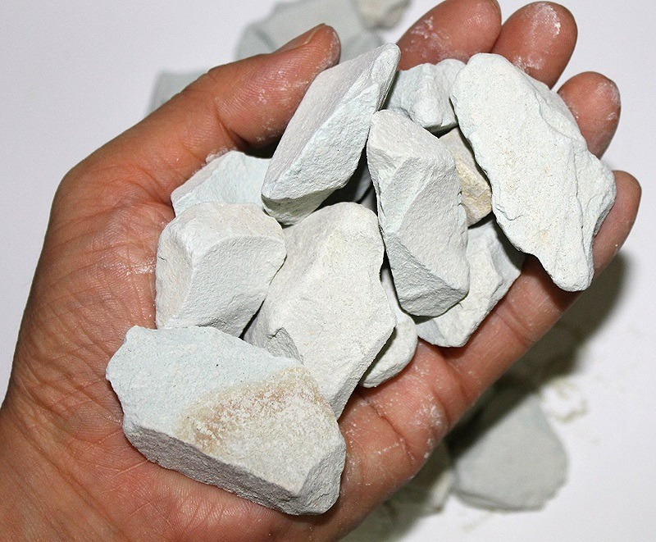
Biochar, Bentonite and Zeolite to maintain healthy microbial distribution in poultry*
*TP Prasai et al. PLoS ONE 11(4): e0154061.
Notes:
Moore\ et\ al\ 2016\ Biochar,\ bentonite\ and\ zeolite\ supplemented\ feeding\ for\ layer\ chickens\ alters\ intestional\ microbiota.pdf .
Reduce need for antibiotics
Redistribute gut microbes

Slide 76
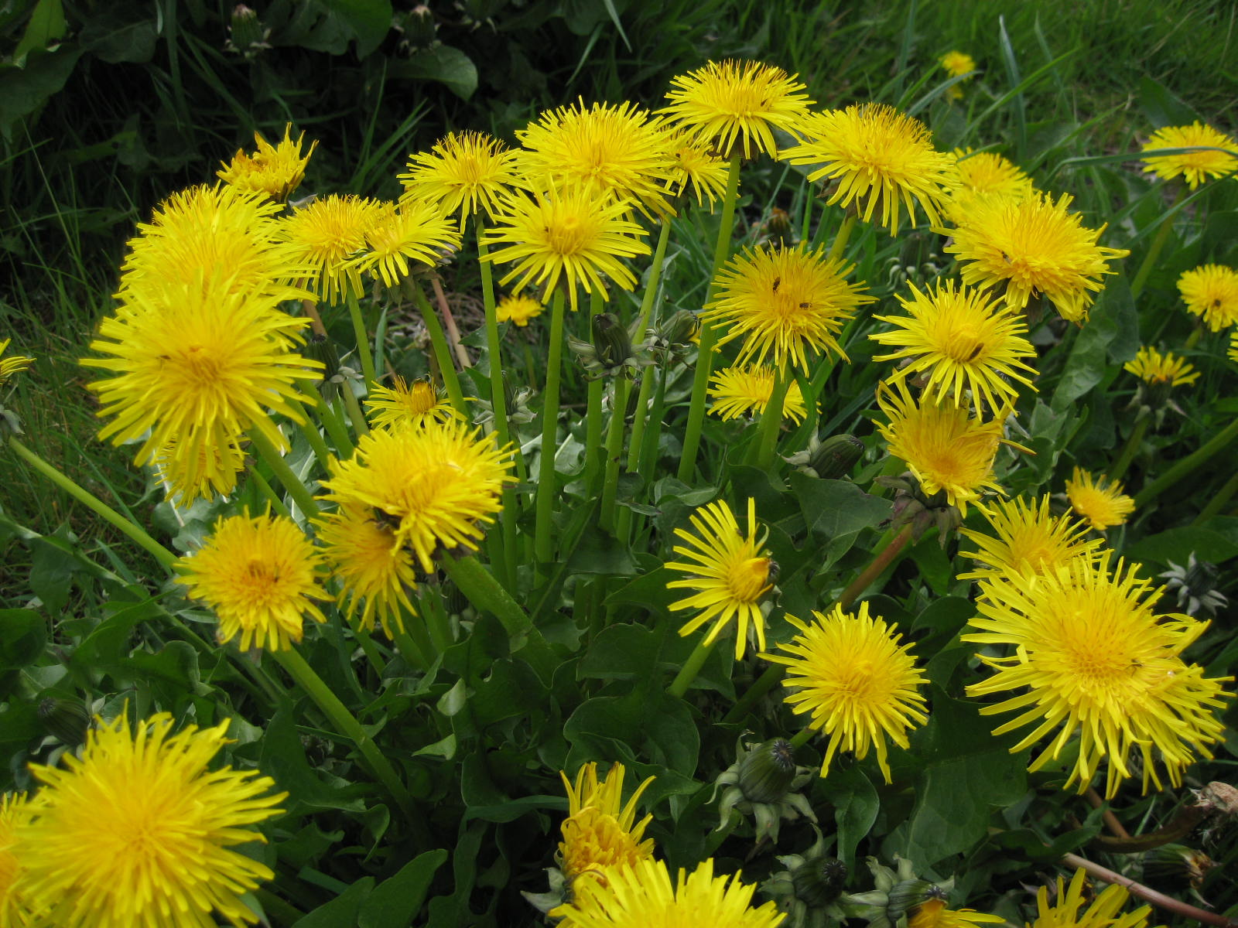
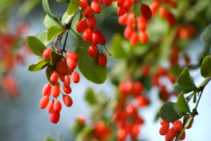
Extracts from Common Plants Can Treat Glyphosate Poisoning*
Roundup is toxic to hepatic and embryonic cells at doses far below those used in agriculture and at residue levels present in some GM food.
Extracts from common plants such as dandelions, barberry, and burdock can protect from damage, especially if administered prior to exposure.
*C Gasnier et al. Journal of Occupational Medicine and Toxicology 2011, 6:3
Notes:
Where?

Slide 77
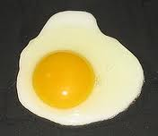
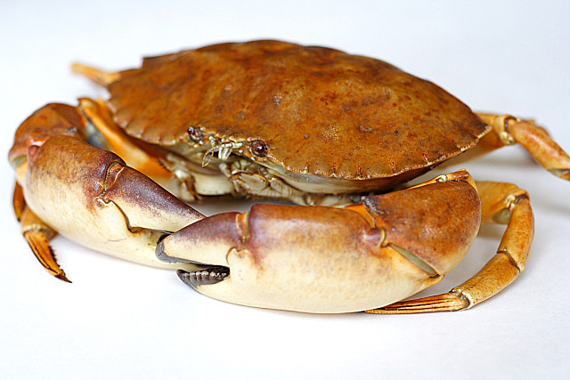
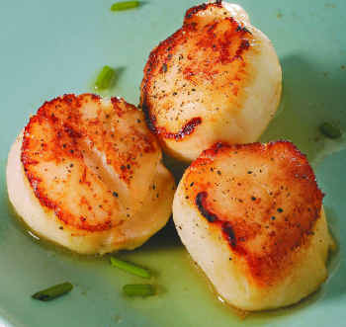
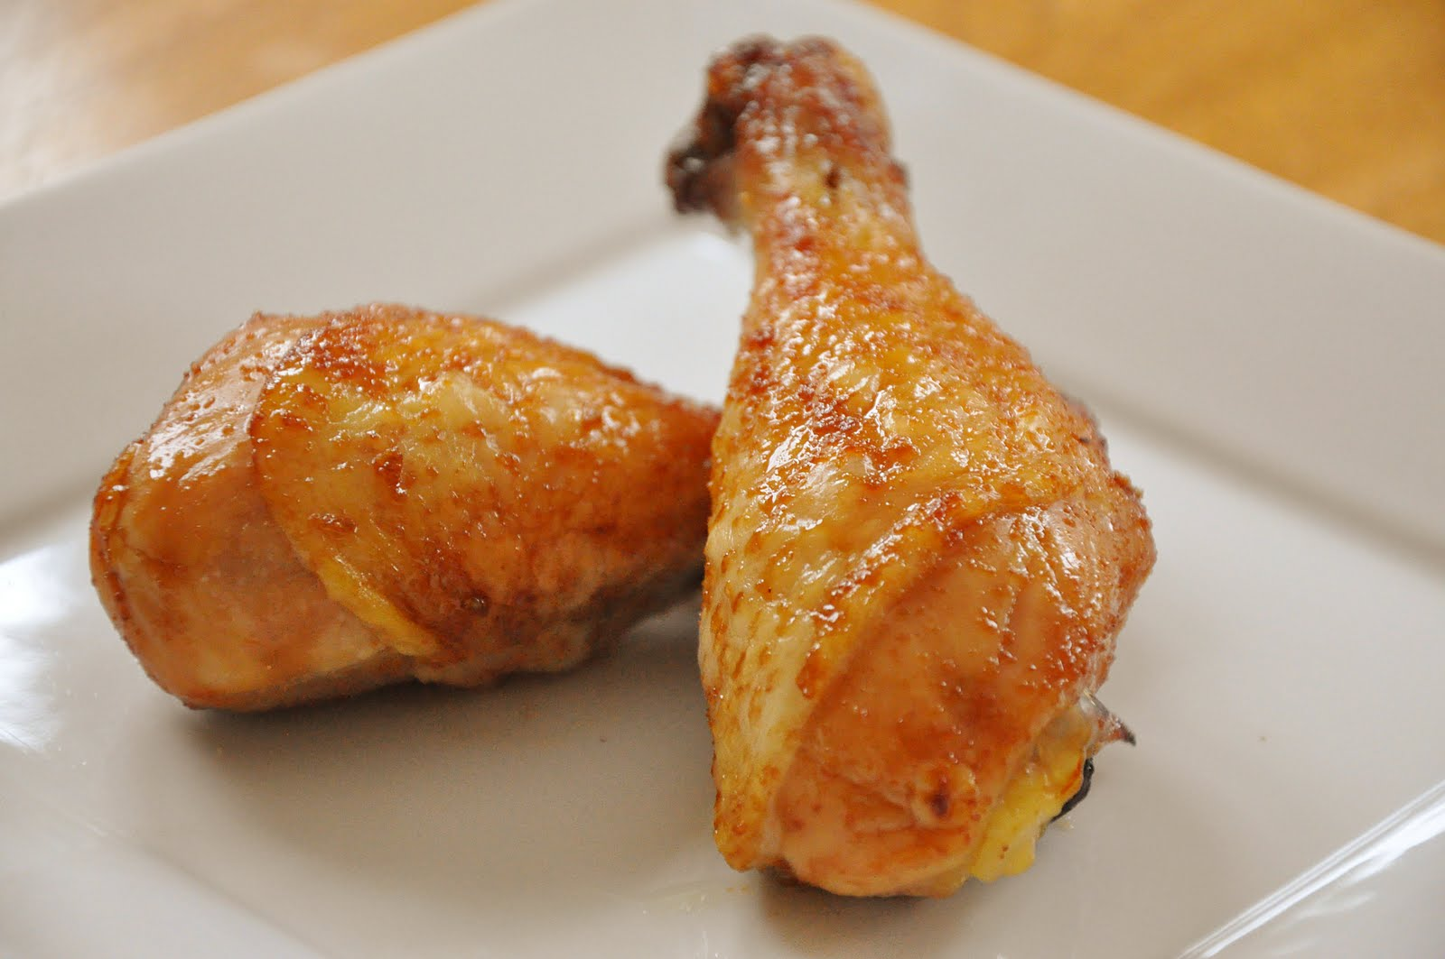
Eat Foods Containing Sulfur
Notes:
http://healthyeatingclub.com/info/books-phds/books/foodfacts/html/data/data5g.html

Slide 78
Supplemental Sources of Sulfur*
glucosamine sulfate
chondroitin sulfate
glutathione
N-acetylcysteine
alpha lipoic acid
taurine
DMSO, MSM
S-adenosylmethionine (SAMe)
Epsom salts (Mg-sulfate)
These can have many beneficial effects and are nearly nontoxic
My personal favorite is Epsom salt baths:
Magnesium sulfate uptake through the skin
*S Parcell, Alternative Medicine Review 7(1), 2002, 22-44
Notes:
./sulfur_in_human_nutrition_review.pdf

Slide 79
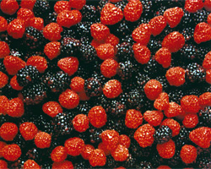
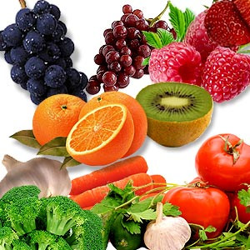
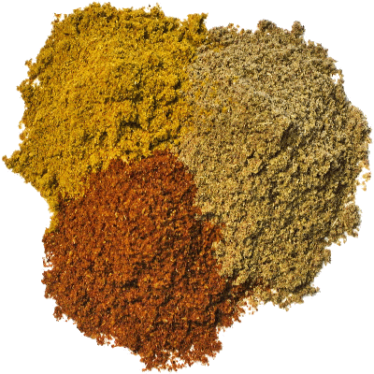
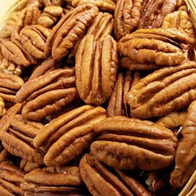
Flavonoids and Polyphenols!

Slide 80
Sauerkraut and apple cider vinegar contain acetobacter, one of the very few microbes that can metabolize glyphosate
Yogurt and kimchi probably do too

Slide 81
Hang Out in the Water at the Seashore

Slide 82
Recommendations from Dr. Zach Bush*
1. Get out into nature. Walk in the woods, barefoot, feel the sunshine – rich environment, breathe in the nutrients in the air
2. Eat probiotics (naturally fermented foods)
3. Eat organic food
Demand is dropping the price.
Thrive Market – order online
4. Eat more fruits and vegetables
5. Bathe in natural waters
*https://www.youtube.com/watch?v=jWgnkgYtqnw&feature=youtu.be

Slide 83
Summary
Glyphosate is pervasive in our food supply, and it is far more toxic than we are led to believe
I believe glyphosate is the primary cause of the autism epidemic, and of many other diseases alarmingly on the rise
Glyphosate disrupts the gut microbiome
Glyphosate works synergistically with glutamate to cause neurotoxicity
Glyphosate chelates minerals, causing widespread deficiencies
Glyphosate may have a unique mechanism of toxicity involving its role as an analogue of the coding amino acid glycine
Glyphosate causes fatty liver disease
PEPCK suppression could explain this, as well as multiple other issues such as SIDS, hypoglycemia, fungus overgrowth and sulfate deficiency
A certified organic diet is the best way to minimize glyphosate exposure

