Slide 1
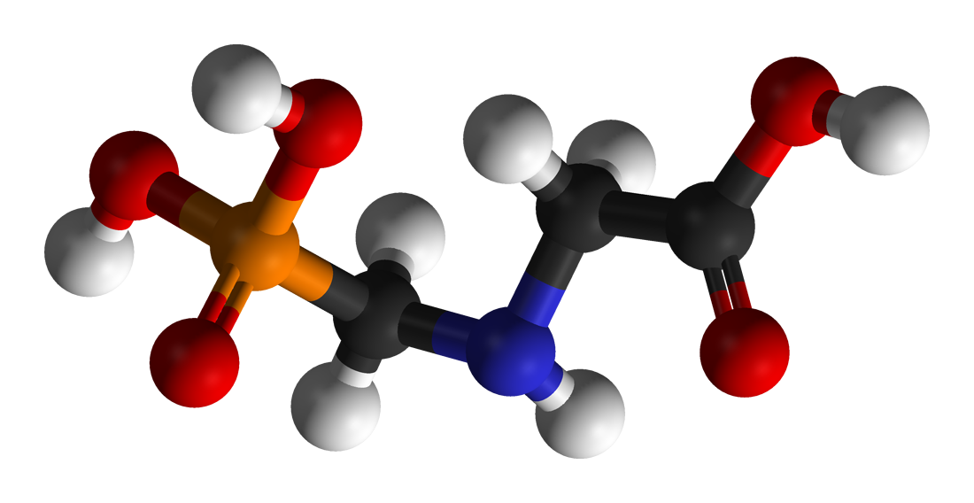
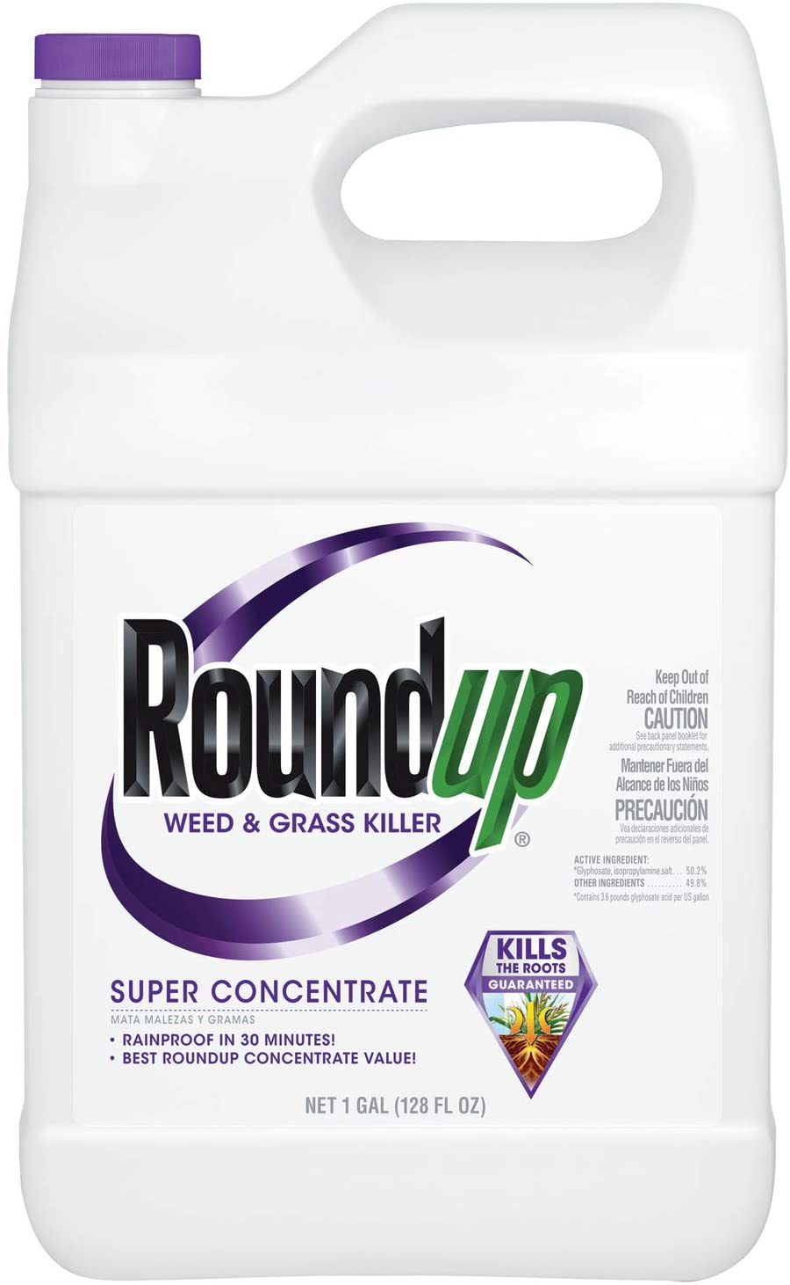
Toxic Legacy: How the Weedkiller Glyphosate is Destroying Our Health
Stephanie Seneff, MIT CSAIL
AutismOne, September 2021

Slide 2
“Future historians may well look back upon our time and write, not about how many pounds of pesticide we did or didn’t apply, but by how willing we are to sacrifice our children and future generations for this massive genetic engineering experiment that is based on flawed science and failed promises just to benefit the bottom line of a commercial enterprise.”
-- Prof. Don Huber

Slide 3
Outline
Introduction
Human and Animal Diseases
Glyphosate and Autism
Glyphosate and Endocrine Disruption
Transgenerational Effects
Conclusion

Slide 4
Introduction

Slide 5
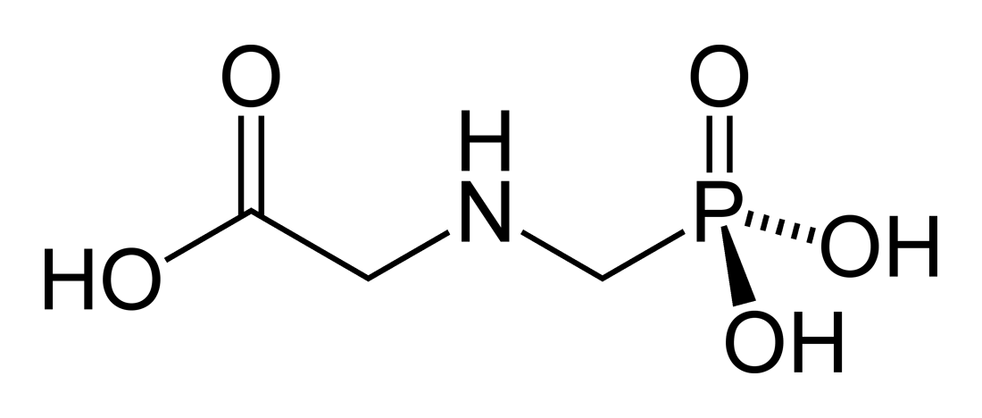
A Brief History of Glyphosate
Glyphosate (active ingredient in Roundup) is now the #1 herbicide in use in the U.S. and is increasingly used around the world
Patented by Monsanto as an herbicide in 1968
Introduced into the US food chain in 1974
Came out from under patent in 2000
Inhibits an enzyme in the shikimate pathway involved in synthesis of tyrosine, tryptophan and phenylalanine (the three aromatic amino acids)
Huge expansion of GMO corn, soy, cotton and canola crops has led to sharp increases in the last two decades
Notes:
WIKI
> 9 billion kilograms worldwide
20% U.S.
1 pound for every man, woman and child.

Slide 6
Glyphosate Blocks EPSP Synthase in the Shikimate Pathway in Plants*
X
*Figure 1 in Robin Mesnage et al. Environmental Health Perspectives 2021; 129(1): 017005.
Notes:
Figure 1. The shikimate pathway and its associated biosynthesis pathways. Information about the biosynthetic pathway associated with the shikimate pathways metabolites were retrieved from the KEGG Orthology database. Note: EPSPS, enolpyruvylshikimate-3-phosphate synthase; KEGG, Kyoto Encyclopedia of Genes and Genomes.
2021/glyphosate/Mesnage_2021_gut_microbiome_study.pdf
coenzyme-q10
an essential electron transfer lipid in the mitochondrial respiratory chain.

Slide 7
“A conservative estimate from our results shows that 54% of species in the core human gut microbiome are sensitive to glyphosate.” *
*Lyydia Leino et al. Journal of Hazardous Materials 2021; 408: 124556.
Notes:
2021/glyphosate/Leino_2021_54_percent_gut_microbes_affected_by_glyphosate.pdf
https://pubmed.ncbi.nlm.nih.gov/33243645/
bio- informatics method

Slide 8
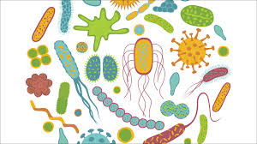
Shikimate Pathway Disruption
Gut Microbes
Phenylalanine, tryptophan, tyrosine
shikimate
Dopamine, adrenaline, serotonin, melatonin, melanin,
thyroid hormone
Glyphosate
chorismate
vitamin K
Several B vitamins

Slide 9
Main Toxic Effects of Glyphosate*
Kills beneficial gut bacteria and allows pathogens to overgrow
Interferes with function of cytochrome P450 (CYP) enzymes in the liver
These enzymes serve many important roles, including making bile acids, activating vitamin D, detoxifying many toxic chemicals and breaking down prescription drugs
Chelates (binds tightly to) important minerals like cobalt, manganese and zinc, making them unavailable to the cells
Interferes with the synthesis of aromatic amino acids and methionine
Disrupts sulfate synthesis and sulfate transport
*Samsel and Seneff, Entropy 2013, 15, 1416-1463

Slide 10
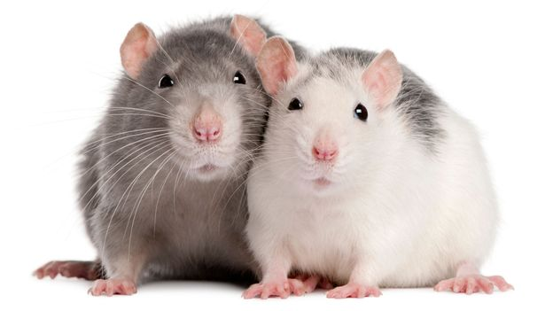
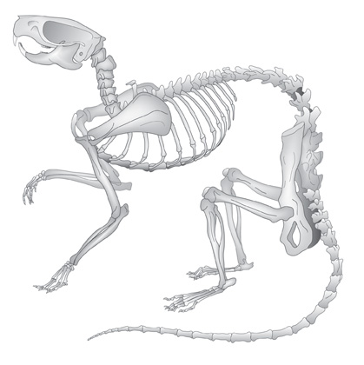
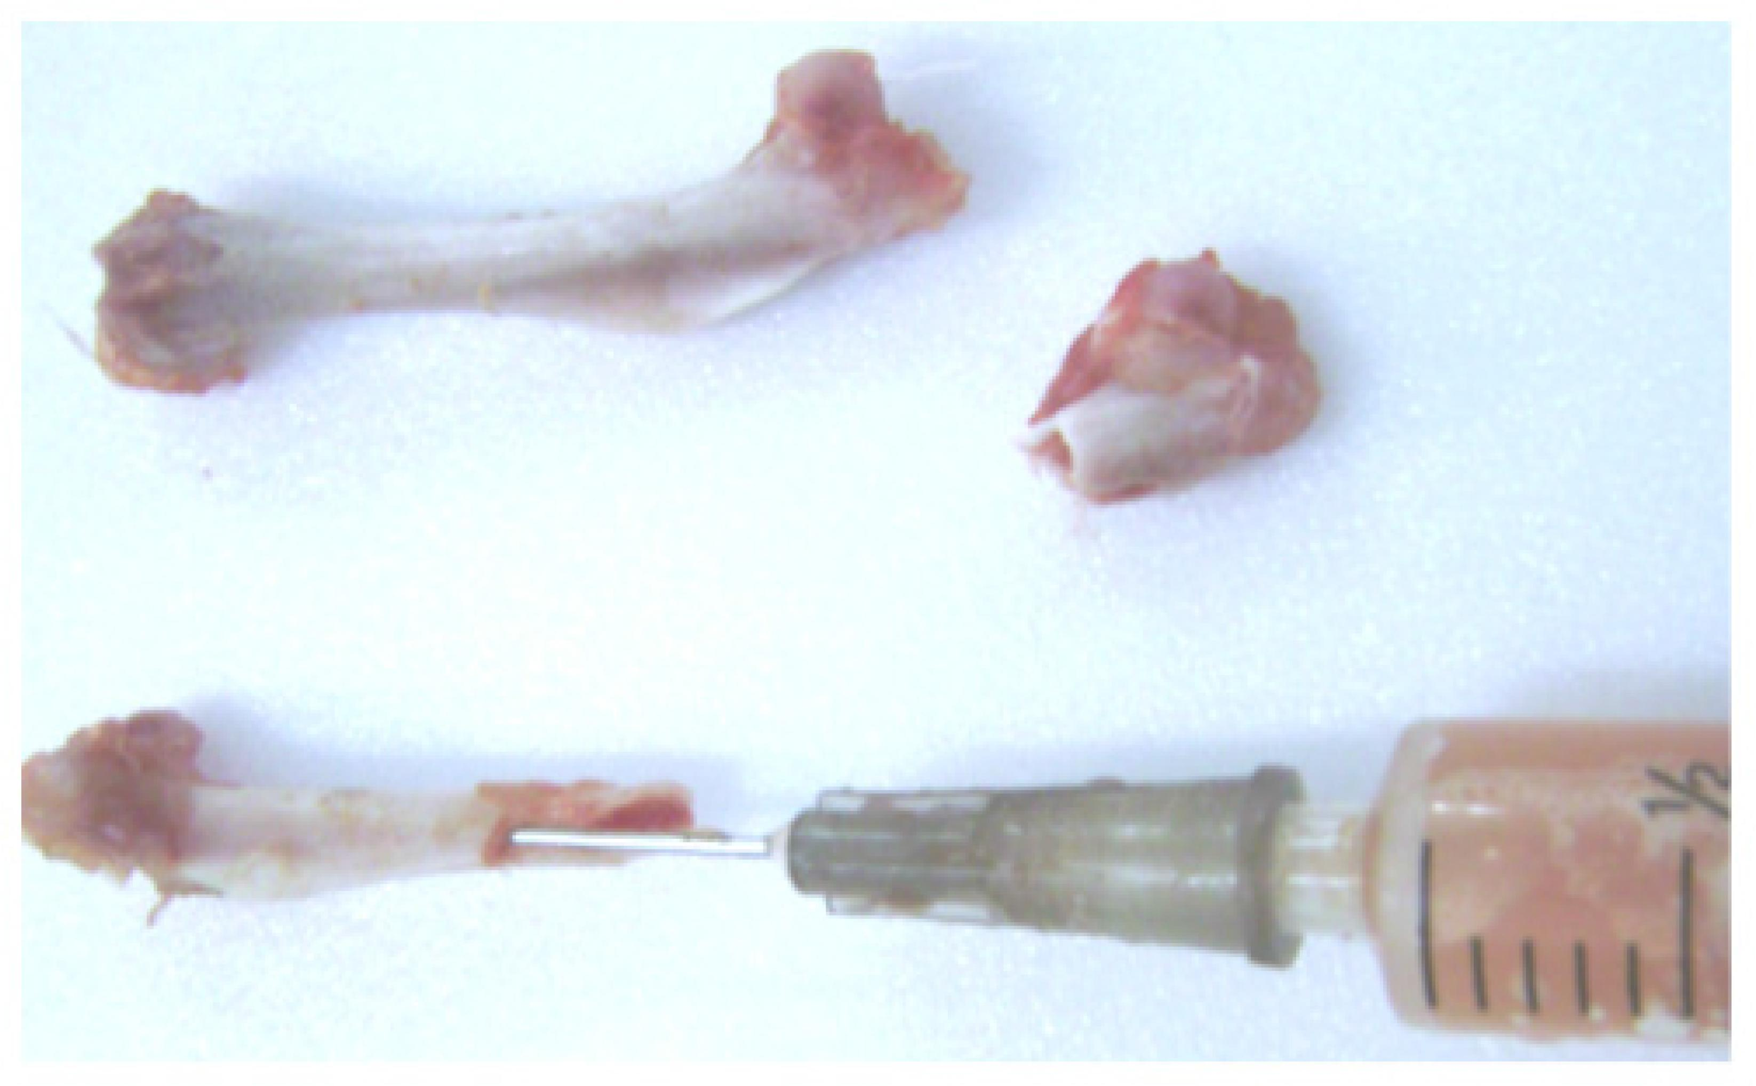
“Glyphosate: Plasma and Bone Marrow Levels Following Intraperitoneal Injection”*
Significant amounts of radiolabeled glyphosate were found in plasma and bone marrow following intraperitoneal injection in rats
Glyphosate in bone marrow reached 340 ppm after 1/2 hour, and it remained at about that level throughout the duration of the study (10 hours)
*WP Ridley et al. Monsanto commissioned study ML-83-218; EHL No. 830109. 1983.
Notes:
project/glyphosate/glyphosate_reaches_bone_marrow_quickly_stays_there_Monsanto_papers_1983.pdf

Slide 11
Glyphosate and Cancer*
In April 2015, the World Health Organization's International Agency for Research on Cancer (IARC) identified glyphosate as a probable human carcinogen
Three trials involving cases where glyphosate was claimed to cause non-Hodgkin's lymphoma resulted in a successful lawsuit
The plaintiffs were awarded $25-80 million in each case
In June, 2020, Bayer offered to pay up to $10.9 billion to roughly 125,000 people in thousands of lawsuits arguing Roundup was responsible for their non-Hodgkin lymphomas
*https://sustainablepulse.com/2020/12/24/
environmental-and-farming-groups-start-us-legal-action-in-attempt-to-ban-glyphosate/

Slide 12
Human and Animal Diseases

Slide 13
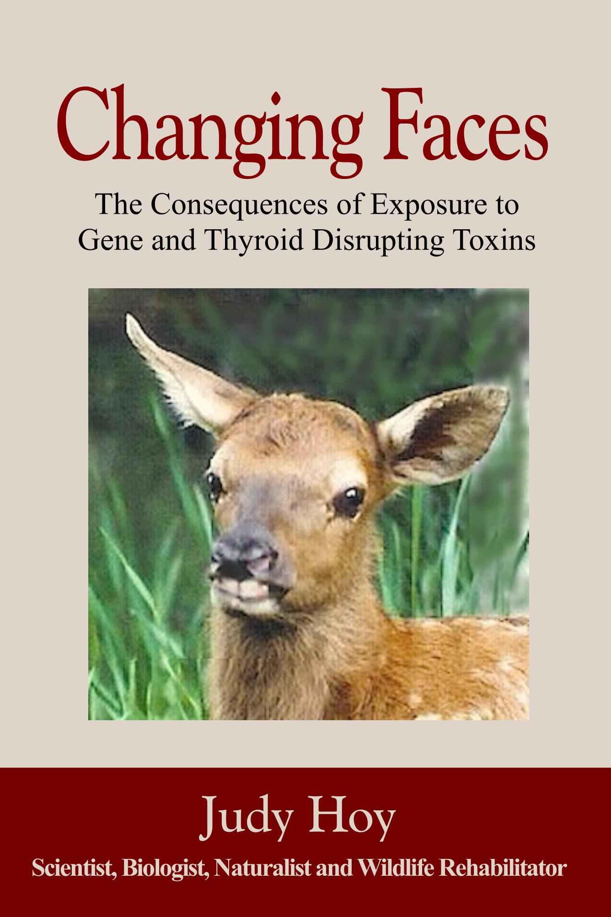
*
The first author, Judy Hoy, runs a wildlife rehabilitation center in the Bitterroot Valley in Western Montana
She has been tracking the dwindling numbers and decreasing health status of wildlife there for decades
Dr. Nancy Swanson and I collaborated with her to compare health issues of the animals with those of humans in the United States
*Hoy et al. Poultry, Fisheries and Wildlife Sciences 2015; 3:1.

Slide 14
Newborn white-tailed deer have severely damaged thymuses*
*Judy Hoy et al., Poultry, Fisheries & Wildlife Sciences 2015; 3(1): 1000132.

Slide 15
Some Correlations between Human Diseases and Glyphosate*
Compared US government data on glyphosate usage and on human disease patterns over time from the 1998-2010 hospital discharge data
Found striking correlations between the rise in glyphosate usage and the rise in multiple health issues in newborn babies:
head and face anomalies R=0.95
blood disorders R=0.92
skin disorders R=0.96
metabolic disorders R=0.95
genitourinary disorders R=0.96
congenital heart conditions R=0.98
lung problems R=0.95
R is the correlation coefficient characterizing how similar the two curves are. 1.0 is the highest value it can take, representing a perfect match.
*Judy Hoy et al., Poultry, Fisheries & Wildlife Sciences 2015; 3(1): 1000132.

Slide 16
Congenital heart conditions (newborns) p<0.000009 and enlarged right ventricle (adults) p<0.00003*
Enlarged right ventricle
Congenital heart conditions
*Judy Hoy et al., Poultry, Fisheries & Wildlife Sciences 2015; 3(1): 1000132.

Slide 17
Long-QT syndrome, atrioventricular block, arrhythmias in both humans and animals
“In fatalities, the common symptoms were cardiorespiratory arrest, cardiovascular shock, hemodynamic disturbances, intravascular disseminated coagulation and multiple-organ failure”
Notes:
Glyphosate/Treasures/glyphosate_effects_on_heart_review_Seralini_2016.pdf
QTc prolongation and arrhythmias along with first-degree atrioventricular block

Slide 18
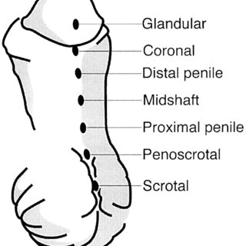
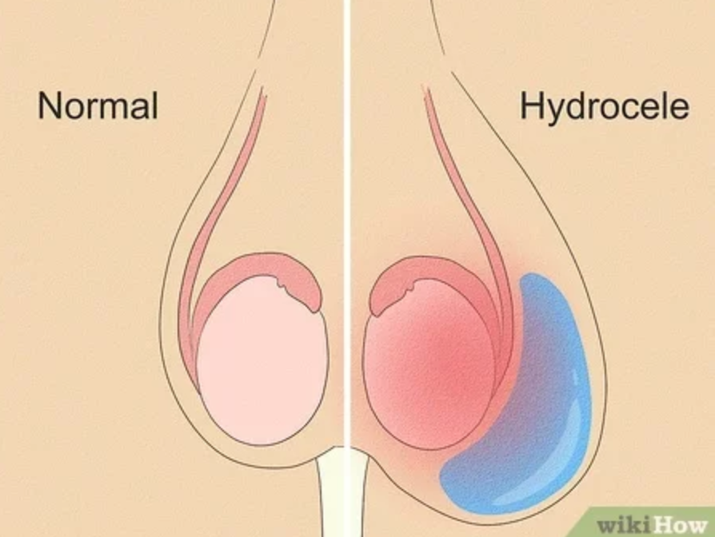
Newborn Genitourinary Disorders (Hypospadias, Hydrocele, etc.) p<0.000024
Urethra opening
below the tip
disorders
Glyphosate use on wheat, corn and soy
Hydrocele:
Swolen testicle
Hypospadias
*Hoy et al., Poultry Fish and Wildlife Science 2015, 3:1
Notes:
Nearly six-fold increase from 1998 to 2010.
URETHRA
A hydrocele (HI-droe-seel) is a type of swelling in the scrotum that occurs when fluid collects in the thin sheath surrounding a testicle.
Figure 31: Hospital discharge rates for newborn genitourinary disorders compared to glyphosate applications to wheat, corn and soy crops. The genitourinary disorders include: Other disorders of the kidney and ureter (ICD 593); hydrocele (watery uid around one or both testicles (ICD 778.6); hypospadias (ICD 752.6); and hydronephrosis- obstruction of urine flow (ICD 591). The Pearson correlation coefficient between the genitourinary disorders and glyphosate use is R=0.9585.

Slide 19
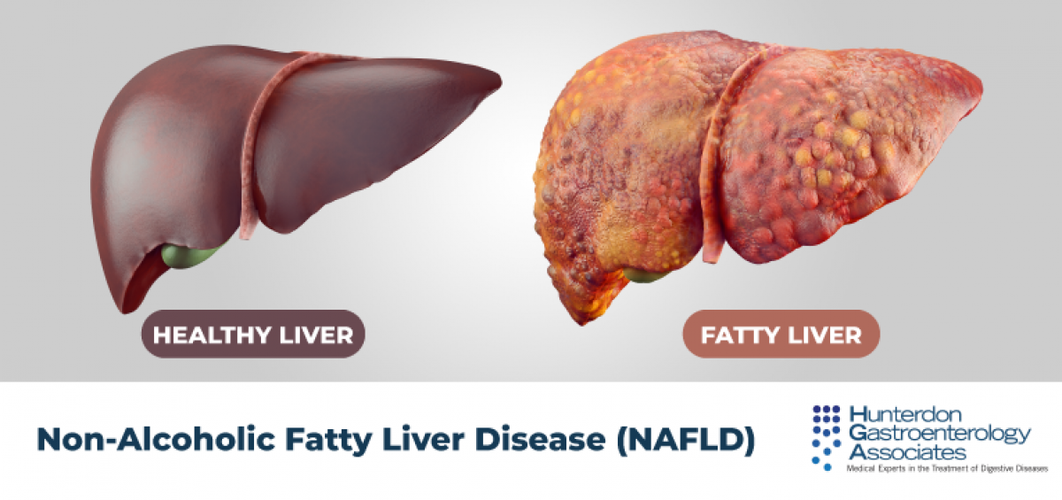
Is Glyphosate Causing an Epidemic in Fatty Liver Disease?
Worldwide epidemic in fatty liver disease today*
“Multiomics reveal non-alcoholic fatty liver disease in rats following chronic exposure to an ultra-low dose of Roundup herbicide”**
Glyphosate correlated with fatty liver disease in humans***
* Chris Estes et al. Hepatology 2018; 67(1): 123-133.
** Robin Mesnage et al. Sci Rep 2017; 7: 39328.
*** PJ Mills et al. Clinical Gastroenterology and Hepatology 2020;18(3):741-743.
Notes:
Where?
Attached/for_Laszlo/Mills_glyphosate_steatohepatitis_link_humans_2019.pdf

Slide 20
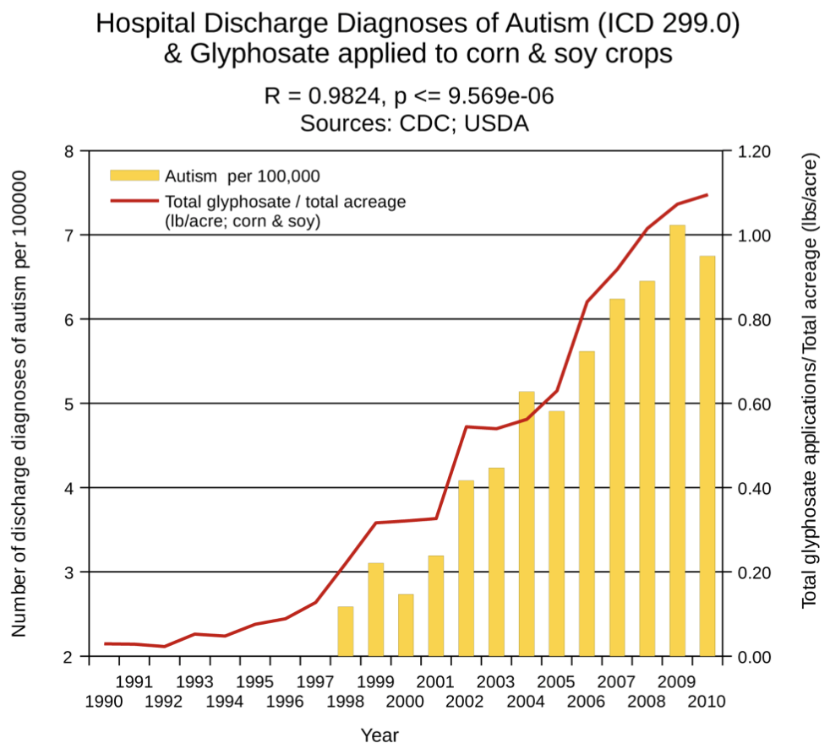
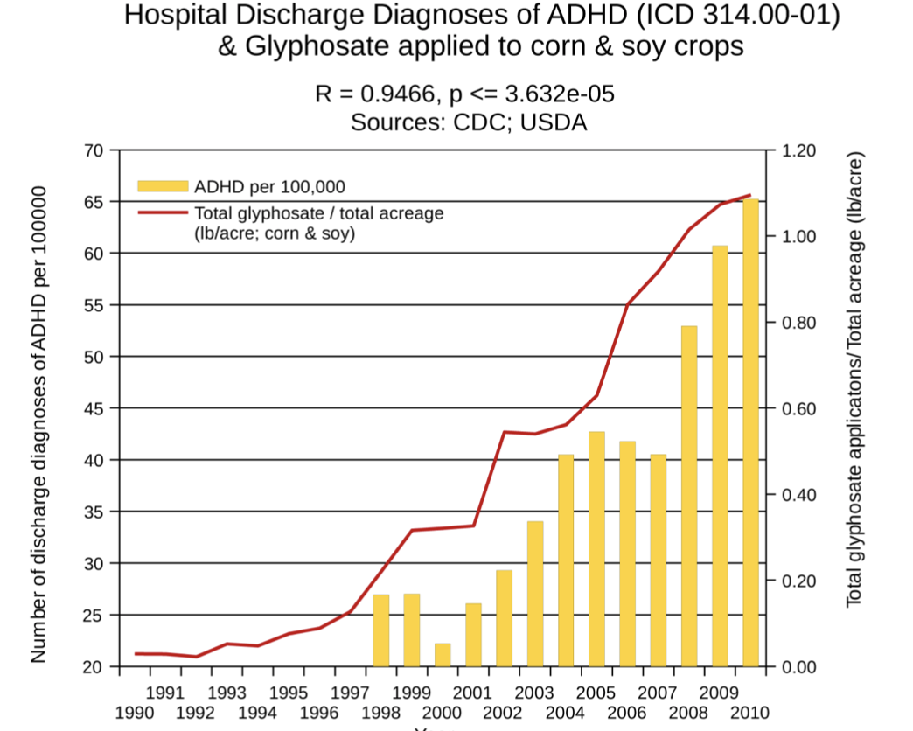
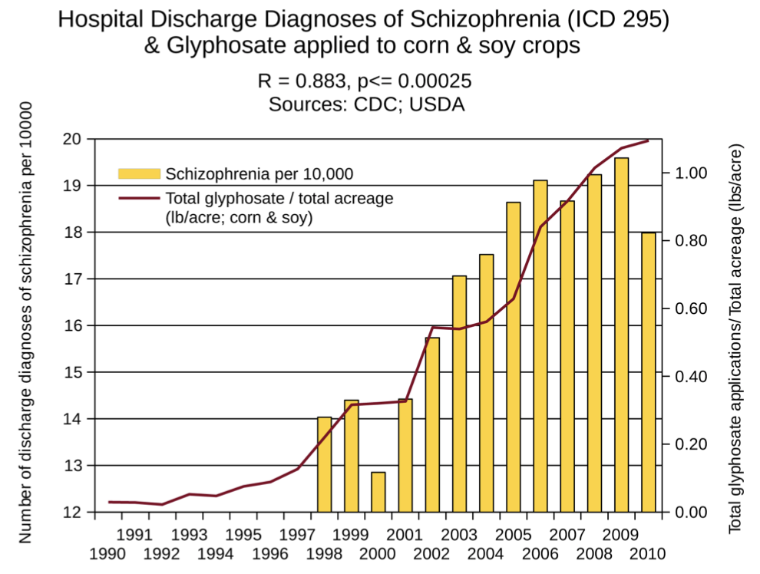
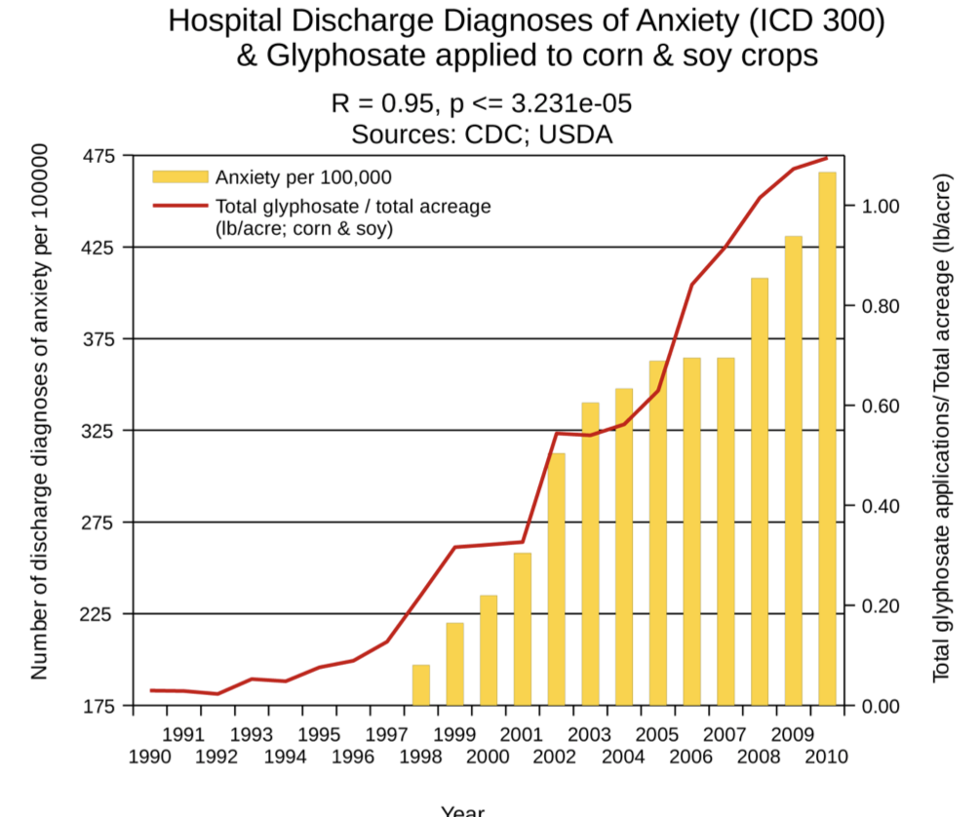
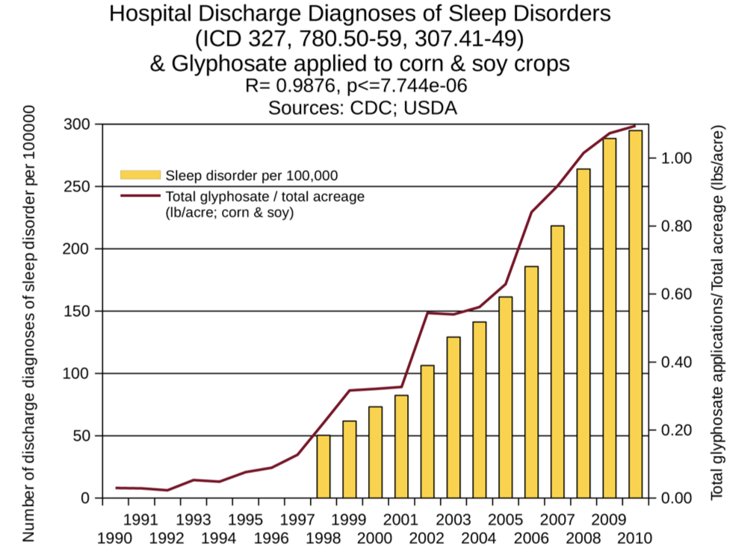
Glyphosate and Neurological Diseases*
Autism
ADHD
Schizophrenia
Anxiety
Sleep Disorder
*S Seneff et al. Agricultural Sciences 2015; 6: 42-70.

Slide 21
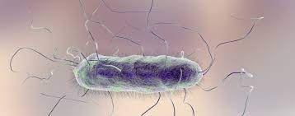
Proteus mirabilis can fully metabolize glyphosate and use its phosphorus atom as a source of phosphorus*
No phosphorus + glyphosate
No phosphorus
*Z. Wybranych et al. Ecol Chem Eng A. 2015; 22(2): 185-193.
Notes:
2021/glyphosate/Proteus_mirabilis_metabolizes_glyphosate.pdf
Proteus_mirabilis_glyphosate.png

Slide 22
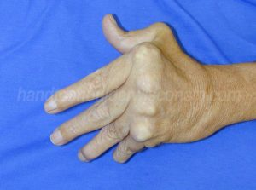
“Rheumatoid arthritis is an autoimmune disease triggered by Proteus urinary tract infection”*
Proteus mirabilis urinary tract infection
rheumatoid arthritis
autoantibody-mediated cytotoxicity in synovial tissues
Antibodies to Proteus antigens
anti-HLA-DRB1 antibodies due to molecular mimicry
*A. Ebringer and T Rashid.Clinical & Developmental Immunology2006; 13(1): 41-48.
Notes:
2021/glyphosate/rheumatoid_arthritis_Proteus_mirabilis_UTI_2006.pdf

Slide 23
Glyphosate and Autism

Slide 24
Glyphosate and Autism*
Glyphosate
*J.E. Beecham and S. Seneff, “Is there a link between autism and glyphosate-formulated herbicides?" J Autism 2016; 3: 1.
Nancy Swanson, http://www.examiner.com/article/
data-show-correlations-between-increase-neurological-diseases-and-gmos

Slide 25
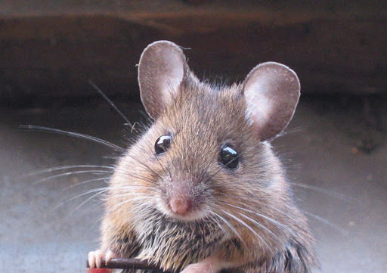
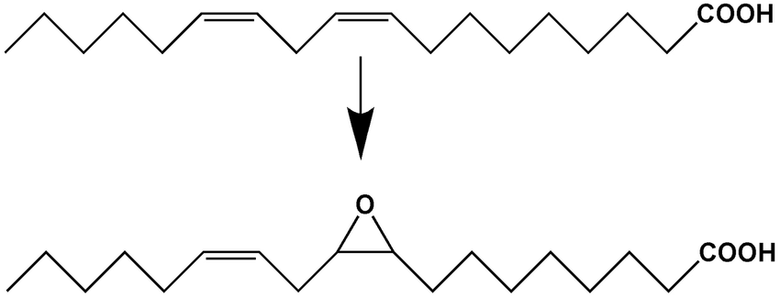
Autism-like Symptoms following Maternal Glyphosate Exposure*
Exposure to herbicides during pregnancy might increase risk for autism in progeny
Exposure of pregnant mice to high-dose glyphosate during pregnancy and lactation induced autism-like symptoms in juvenile offspring
Associated with gut microbiome imbalance and disrupted fatty acid metabolism
Increased expression of soluble epoxyhydrolase (sEH) in prefrontal cortex of the brain
Produces pro-inflammatory fatty acid derivatives
High sEH has been linked to depression, autism, schizophrenia and Parkinson's disease
*Yaoyu Pu et al. PNAS 2020; 117 (21): 11753-11759
Notes:
maternal_glyphosate_exposure_autism_2020.pdf

Slide 26
How to explain this ….
The story links together vitamin D, Cytochrome P450 (CYP) enzymes, aromatase, estrogen, testosterone and sEH
Maternal vitamin D deficiency causes high testosterone in male offspring
Aromatase deficiency causes low estrogen, high testosterone in the brain
Estrogen suppresses synthesis of sEH [low estrogen = high sEH]
Vitamin D activation depends on CYP enzymes
Aromatase is a CYP enzyme
Glyphosate suppresses CYP enzymes → low estrogen and low vitamin D

Slide 27
Glyphosate Suppresses Aromatase in the Placenta*
Some agricultural workers using glyphosate have fertility problems
Glyphosate is toxic to human placental JEG3 cells at concentrations lower than those found with agricultural use
The additional ingredients in Roundup increase glyphosate toxicity
Roundup disrupts aromatase activity
Aromatase is a cytochrome P450 (CYP) enzyme, and glyphosate has been shown to suppress CYP enzymes in the liver**
*Sophie Richard et al. Environmental Health Perspectives 2005; 113(6):716-720.
**Mohamed Ahmed Fathi et al. nvironmental Science and Pollution Research 2020; 27(14): 16865-16875.

Slide 28
“Developmental vitamin D deficiency increases foetal exposure to testosterone”*
Vitamin D regulates gene expression via methylation
Vitamin D deficiency causes hypermethylation of the promoter for aromatase
This results in reduced aromatase expression in male brains
Aromatase converts testosterone to estrogen
Excess testosterone in male foetal brains. → autism
Vitamin D deficient mouse dam
*Asad Amanat Ali et al. Molecular Autism (2020) 11:96.

Slide 29
“Developmental vitamin D deficiency increases foetal exposure to testosterone”*
Vitamin D regulates gene expression via methylation
Vitamin D deficiency causes hypermethylation of the promoter for aromatase
This results in reduced aromatase expression in male brains
Aromatase converts testosterone to estrogen
Excess testosterone in male foetal brains. → autism
Vitamin D is activated by Cytochrome P450 (CYP) enzymes in the liver, and glyphosate has been shown to suppress CYP enzymes
Vitamin D deficient mouse dam
*Asad Amanat Ali et al. Molecular Autism (2020) 11:96.

Slide 30
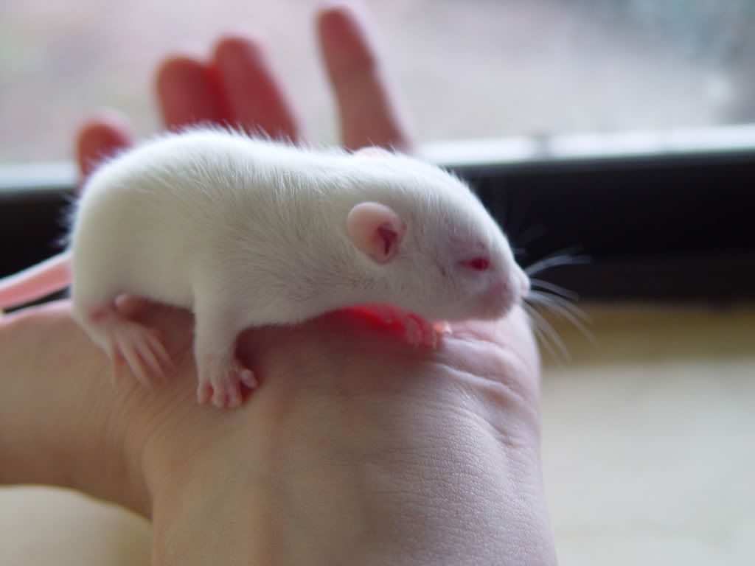
“Glyphosate exposure induces synaptic impairment in hippocampal neurons and cognitive deficits in developing rats”*
Glyphosate-treated hippocampal neurons in culture showed a decrease in dendritic complexity and spine formation
Rat pups were exposed to glyphosate (every two days from 7 days old to 27 days old)
Induced cognitive impairments
Reduced synaptic protein expression in hippocampus
*Sebastian Luna et al. Archives of Toxicology (2021) [Epub ahead of print]
Notes:
https://pubmed.ncbi.nlm.nih.gov/33837468/

Slide 31
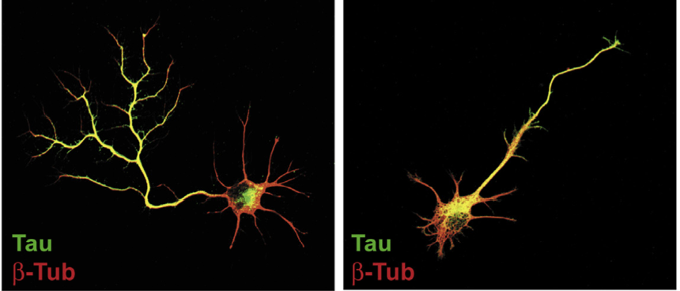
“Neuronal development and axon growth are altered by glyphosate through a WNT non-canonical signaling pathway”*
Neurons grown in culture & exposed to glyphosate
“They elicited shorter and unbranched axons and they also developed. less complex dendritic arbors compared to controls”
+ Glyphosate
*RP Coullery et al., NeuroToxicology 2016;52:150-161.
Notes:
./Coullery_glyphosate_neurotoxicity_2016.pdf

Slide 32
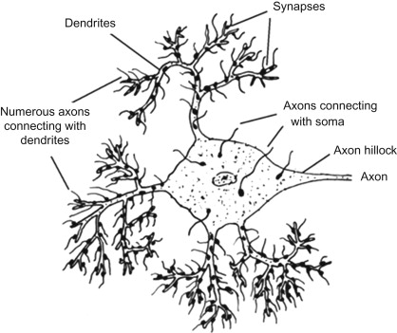
“Dendrite and spine modifications in autism and related neurodevelopmental disorders in patients and animal models” *
"Specifically, autism has been linked to a decrease in the density of spines with mature morphology, indicating a general spine immaturity state in autism."
*Verónica Martínez-Cerdeño, Dev Neurobiol 2017 Apr; 77(4): 393–404.
Notes:
https://www.ncbi.nlm.nih.gov/pmc/articles/PMC5219951/
2021/autism/dendrite_spine_modifications_in_autism_2017.pdf

Slide 33
“Environment permissible concentrations of glyphosate in drinking water can influence the fate of neural stem cells from the subventricular zone of the postnatal mouse”*
"Our findings demonstrated that the permissible concentrations of glyphosate in drinking water recognized by environmental protection authorities are capable of inducing neurotoxicity in the developing nervous system."
"Our findings signify the need to review the safety standards established by environmental protection agencies concerning safe glyphosate concentrations in drinking water."
*Muhammad Irfan Masood et al., Environmental Pollution 270 (2021) 116179.
Notes:
where?

Slide 34
Recapitulation
Glyphosate causes autism-like symptoms in male mice linked to increased expression of soluble epoxyhydrolase (sEH)
Estrogen decreases expression of sEH
Aromatase converts testosterone to estrogen
Aromatase expression in the placenta is suppressed by glyphosate
This explains glyphosate’s effects and the link to autism
→ Low estrogen leads to high sEH
Maternal vitamin D deficiency leads to excess testosterone in males
Vitamin D depends on liver CYP enzymes for activation, which glyphosate suppresses
Aromatase is also a CYP enzyme and this explains how glyphosate suppresses it
Glyphosate suppresses maturation of neuronal dendritic spikes – a characteristic feature of autism

Slide 35
Glyphosate and
Endocrine Disruption

Slide 36
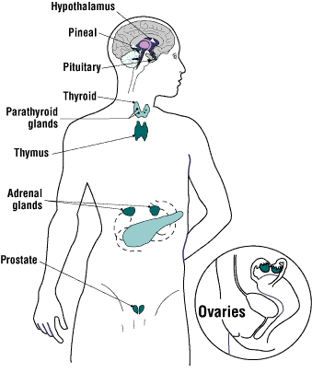
Glyphosate is an Endocrine Disruptor*
Glyphosate at parts per trillion triggers estrogen-sensitive breast cancer cells to proliferate
Glyphosate increases expression levels of estrogen and progesterone receptors
Glyphosate-based herbicides disrupt the hypothalamic-pituitary-thyroid (HPT) axis
Glyphosate alters circulating levels of hormones
Glyphosate induced hypothyroidism in female Wistar rats
Glyphosate-based formulations altered reproductive developmental parameters in animal models
Glyphosate induced malformation in zebrafish embryos
*Juan P. Muñoz et al. Chemosphere October 19, 2020 [Epub ahead of print]
Notes:
Munoz_et_al_Glyphosate_characteristics_endocrine_disruptor_2020.pdf .

Slide 37
"Maternal urinary levels of glyphosate during pregnancy and anogenital distance in newborns in a US multicenter pregnancy cohort”*
Glyphosate in urine measured mid-pregnancy
Anogenital distance in girls was longer (more male typical) in association with higher urinary levels of glyphosate
An earlier study on rats found a similar result**
Glyphosate suppresses aromatase, which converts testosterone to estrogen
Confirms that glyphosate is an endocrine disruptor in humans
*Corina Lesseur et al. Environmental Pollution 2021; 280: 117002.
**Manservisi et al. Environmental Health 2019; 18: 15.
Notes:
2021/glyphosate/maternal_glyphosate_girls_anogenital_distance_testosterone.pdf

Slide 38
Longer anogenital distance in females is linked to infertility
Women in the highest tertile of anogenital distance had an 18-fold increased risk of having polycystic ovary syndrome (PCOS)*
Associated with irregular periods or no menstrual cycle, plus excess growth of hair
PCOS is the most common cause of female infertility, affecting as much as 20% of the world’s female population
Women with PCOS have an increased risk of being diagnosed with autism and of having progeny with autism**
*Yingchen Wu et al. Human Reproduction 2017 Apr 1;32(4):937-943.
**Maria Katsigianni et al. Molecular Psychiatry 2019 Dec;24(12):1787-1797

Slide 39
Glyphosate and Premature Birth*
Study based in Puerto Rico
53 cases (premature birth); 194 controls
Models are adjusted for maternal age, education, pre-pregnancy BMI, and smoking
Measured both glyphosate and AMPA
AMPA is a breakdown product of glyphosate
Women who had high (> 0.65 micrograms/Liter) levels of AMPA in their urine at 26 weeks of gestation had a 4.5-fold increased risk of premature birth (p< 0.006). High urinary glyphosate was associated with a 3.77-fold increased risk.
*Monica K Silver et al. Environmental Health Perspectives 2021; 29(5): 057011.
Notes:
2021/glyphosate/Silver_et_al_prenatal_exposure_glyphosate_preterm_birth_EHP7295_2021.pdf

Slide 40
Glyphosate and Premature Birth*
Study based in Puerto Rico
53 cases (premature birth); 194 controls
Models are adjusted for maternal age, education, pre-pregnancy BMI, and smoking
Measured both glyphosate and AMPA
AMPA is a breakdown product of glyphosate
Women who had high (> 0.65 micrograms/Liter) levels of AMPA in their urine at 26 weeks of gestation had a 4.5-fold increased risk of premature birth (p< 0.006). High urinary glyphosate was associated with a 3.77-fold increased risk.
"Preterm birth is a national epidemic, costing the United States $26.2 billion each year"
-- American Psychological Association
*Monica K Silver et al. Environmental Health Perspectives 2021; 29(5): 057011.
Notes:
2021/glyphosate/Silver_et_al_prenatal_exposure_glyphosate_preterm_birth_EHP7295_2021.pdf

Slide 41
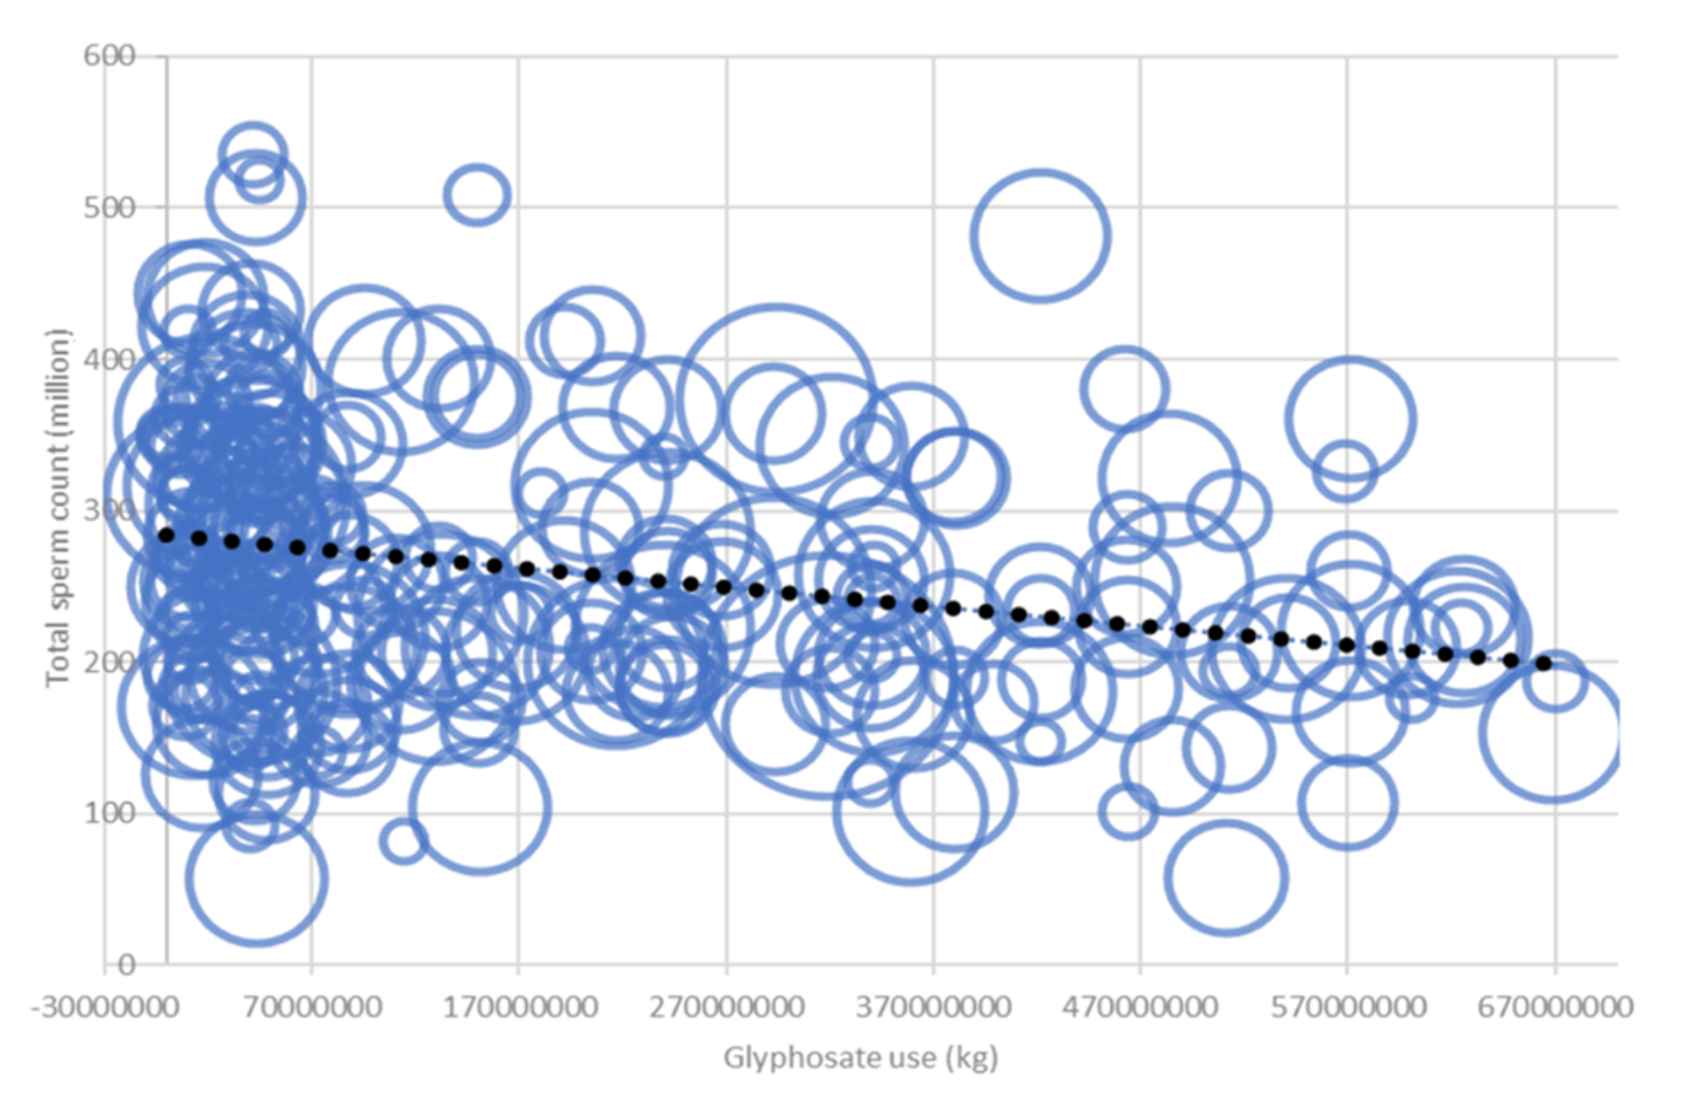
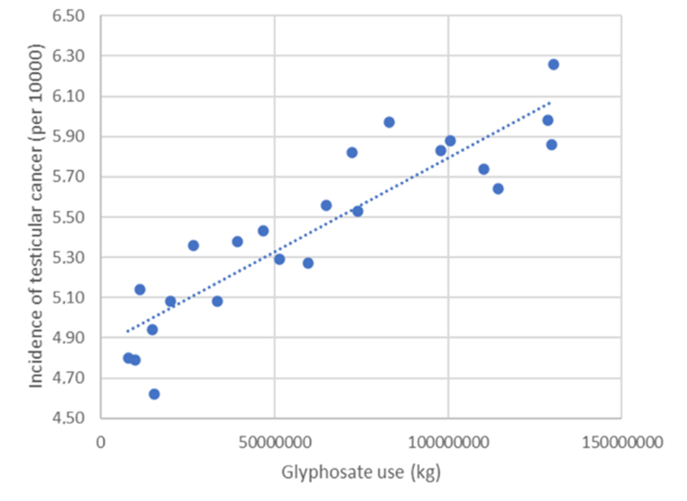
Glyphosate, Sperm Counts and Cancer*
sperm counts
testicular cancer
non-Hodgkin’s lymphoma
p < .000015
p < . 0.00000000039
p < 0.0053
Data were obtained from publicly available databases maintained by the US government
*B. Sopko et al., ACS Omega 2021 June 2, 2021 [Epub ahead of print]
Notes:
2021/glyphosate/Czech_study_US_sperm_testicular_cancer.pdf

Slide 42
Transgenerational Effects

Slide 43
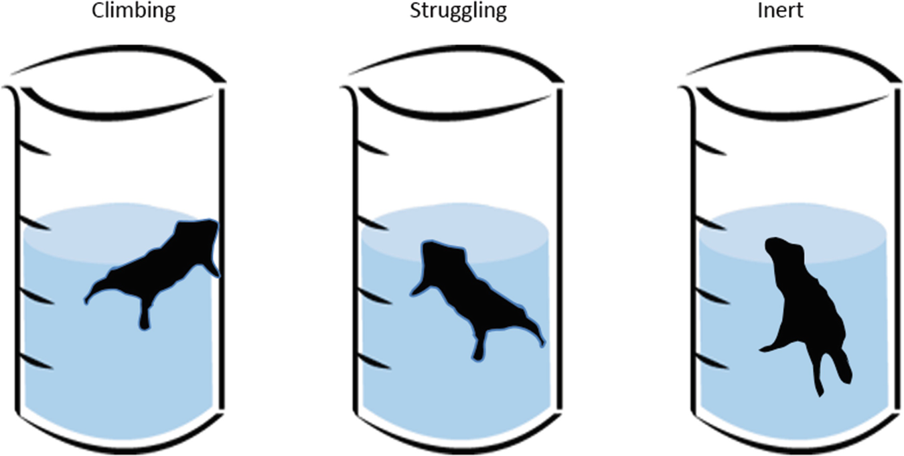
“Developmental exposure to glyphosate-based herbicide and depressive-like behavior in adult offspring: Implication of glutamate excitotoxicity and oxidative stress”*
Mother rats were exposed to glyphosate while pregnant and for fifteen days following birth of the offspring.
The offspring suffered from glutamate excitotoxicity in their brains persistently even after exposure was terminated.
When the offspring were 60 days old, they showed signs of depression in a forced swimming test.
*Daiane Cattani et al., Toxicology 2017; 387: 67-80.

Slide 44
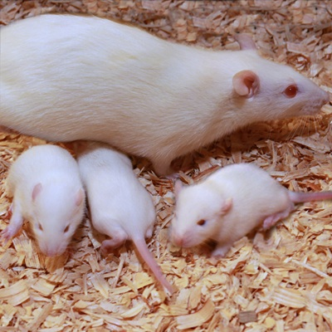
Epigenetic transgenerational toxicology through germline alterations by glyphosate*,**
Pregnant rats were exposed to glyphosate at half the No Observable Adverse Effect Level (NOAEL) from day 8 to day 14 of gestation (timed to match germ cell epigenetic programming)
Offspring were bred to produce pups (F1), grandpups (F2) and great-grandpups (F3)
Exposed rats showed no symptoms
F1 generation were mostly fine
F2 and especially F3 generations suffered from many diseases, including mammary tumors, delayed or early puberty, premature birth abnormalities, prostate disease, kidney disease, and obesity
*Millissia Ben Maamar et al. Epigenetics 2020 Dec 9;1-18.
**Deepika Kubsad et al. Scientific Reports 2019; 9:6372.
Notes:
Maamar_et_al_Epigenome_wide_glyphosate_DNA_methylation_2020.pdf
epigenetic_transgenerational_effects_of_glyphosate_2019.pdf
Also:
glyphosate/transgenerational_sperm_pathologies_glyphosate_exposure_2019.pdf
Kubsad D, Nilsson EE, King SE, et al. Assessment of glyphosate induced epigenetic transgenerational inheritance of pathologies and sperm epimutations: generational toxicology. Sci Rep. 2019;9(1):6372.

Slide 45
My New Book!
Released on July 1, 2021
Presents extensive data on glyphosate toxicity to animals and humans
Explains in detail how glyphosate exposure leads to autism
Provides compelling arguments that glyphosate is insidiously, cumulatively toxic through its diabolical insertion into proteins by mistake in place of the coding amino acid glycine
This unique feature explains why it is causal in so many diseases

Slide 46
Conclusions
Glyphosate is far more toxic to humans than we have been led to believe
The rise in glyphosate usage on core crops in the United States correlates with the rise in prevalence of many diseases and conditions
Glyphosate’s disruption of gut microbes, CYP enzymes, and hormones can play a significant role in autism and other neurological diseases
Glyphosate causes infertility in both males and females, as well as developmental disorders
Many papers published in the last few years are revealing remarkably severe effects of low doses of glyphosate in animal studies, including transgenerational effects
Glyphosate should be banned worldwide

Slide 47
Conclusions
Glyphosate is far more toxic to humans than we have been led to believe
The rise in glyphosate usage on core crops in the United States correlates with the rise in prevalence of many diseases and conditions
Glyphosate’s disruption of gut microbes, CYP enzymes, and hormones can play a significant role in autism and other neurological diseases
Glyphosate causes infertility in both males and females, as well as developmental disorders
Many papers published in the last few years are revealing remarkably severe effects of low doses of glyphosate in animal studies, including transgenerational effects
Glyphosate should be banned worldwide
Adopting a 100% certified organic diet is the best thing you can do to assure long term health of your family members

