Slide 1
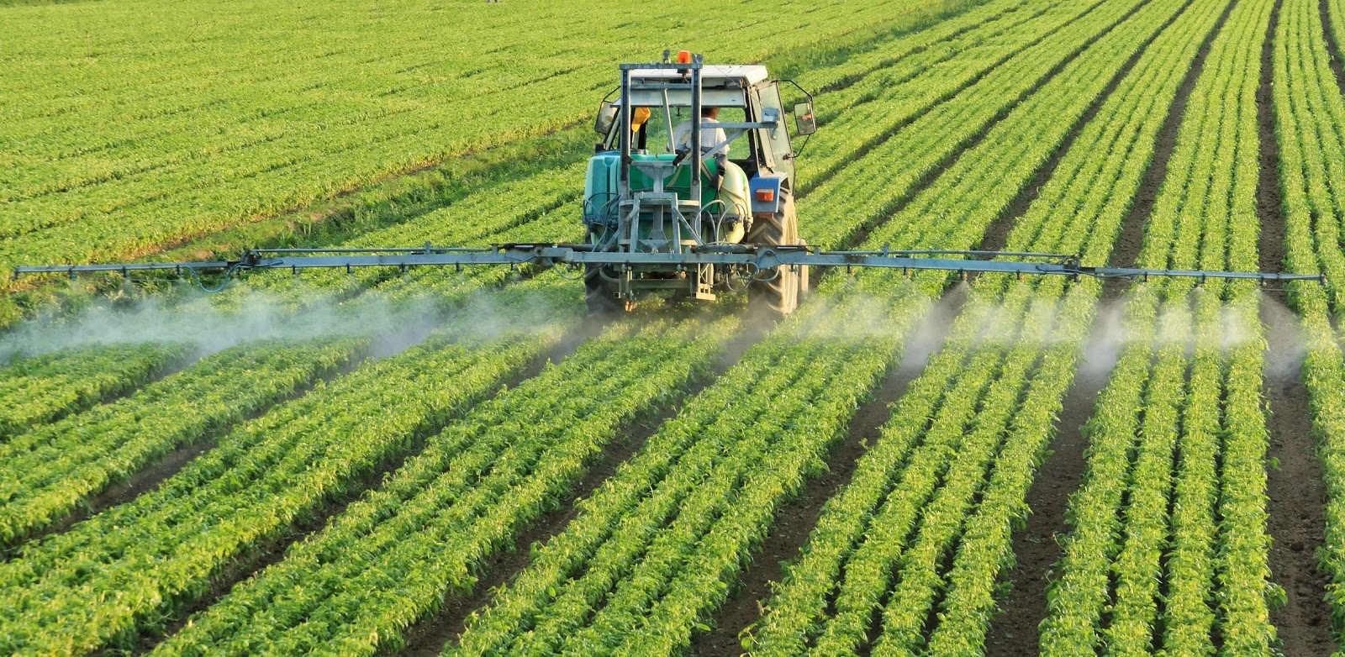
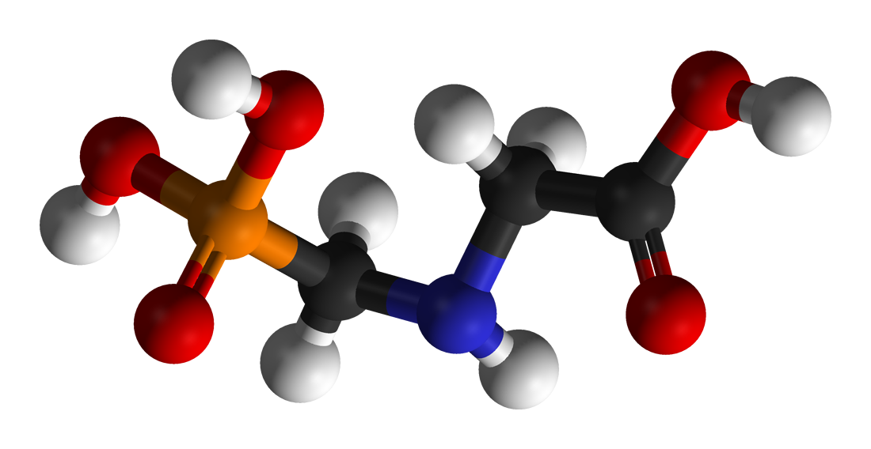
Toxic Legacy: How the Weedkiller Glyphosate is Destroying Our Health and the Environment
Stephanie Seneff
MIT CSAIL
Understanding Ag Webinar
June 10, 2021

Slide 3
“The earth is not dying, it is being killed,
and those who are killing it have names and addresses.”
-- the late activist musician Utah Phillips.

Slide 4
Silent Spring (1962)
Rachel Carson argued that uncontrolled and unexamined pesticide use was harming and even killing not only animals and birds, but also humans.

Slide 5
Outline
Introduction
Evidence of Persistence and Toxicity
Animal and Human Diseases
Glyphosate and the Gut
Glyphosate and Autism
Glyphosate and Endocrine Disruption
Transgenerational Effects
How to Stay Healthy in a Toxic World
Conclusion

Slide 6
Introduction

Slide 7
Roundup and GMO Crops
GMO Roundup-Ready corn, soy, canola, sugar beets
cotton, tobacco and alfalfa
What is glyphosate?

Slide 8
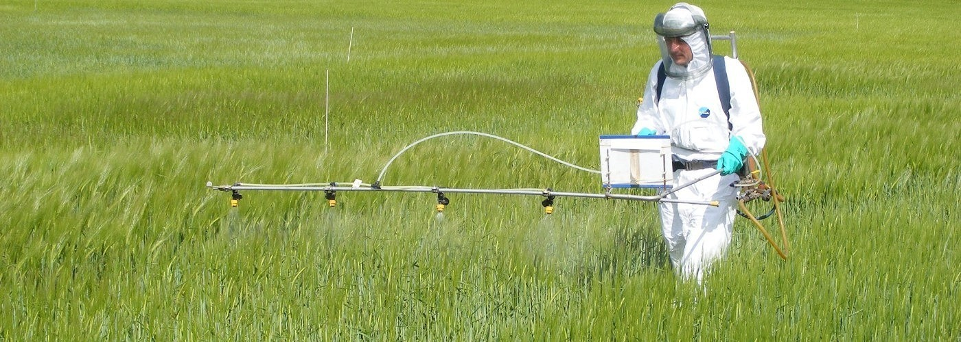
Roundup as a Desiccant/Ripener just before Harvest
Wheat, Oats, Barley, Rye, Sugar cane, Beans, Lentils, Peas, Flax, Sunflowers, Pulses, Chick Peas

Slide 9
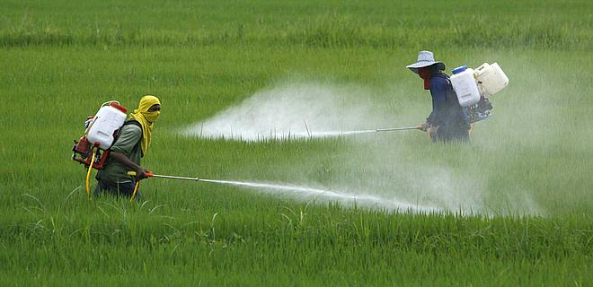
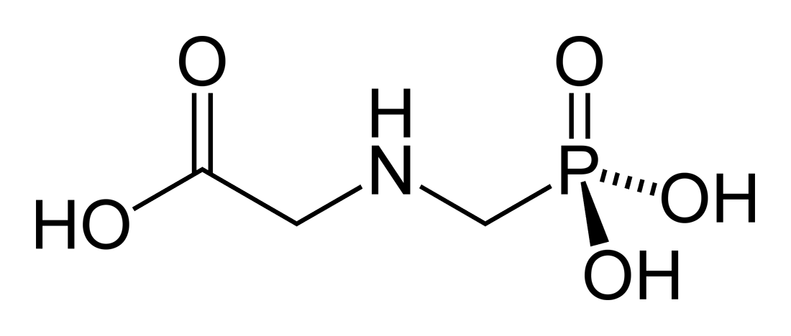
A Brief History of Glyphosate
Glyphosate is now the #1 herbicide in use in the U.S. and is increasingly used around the world
Patented by Monsanto as an herbicide in 1969
Introduced into the US food chain in 1974
Came out from under patent in 2000
Inhibits an enzyme in the shikimate pathway involved in synthesis of tyrosine, tryptophan and phenylalanine (the three aromatic amino acids)
Huge expansion of GMO corn, soy, cotton and canola crops has led to sharp increases in the last two decades
Notes:
WIKI
> 9 billion kilograms worldwide
20% U.S.
1 pound for every man, woman and child.

Slide 10
Is Glyphosate Nontoxic?
Monsanto has argued that glyphosate is harmless to humans because our cells don’t have the shikimate biological pathway which is the pathway glyphosate disrupts to kill plants
However, our gut bacteria DO have this pathway
We depend upon them to supply us with essential amino acids produced through that pathway, and with many other nutrients such as vitamins and short chain fatty acids
Other ingredients in Roundup greatly increase glyphosate’s toxic effects
Insidious effects of glyphosate accumulate over time
Most studies are too short to detect damage
Recently, three successful lawsuits claiming that glyphosate caused non-Hodgkin’s lymphoma are bringing public awareness to glyphosate’s toxicity

Slide 11
Why did we not find this out long ago?
The industry defined the rules for evaluating toxicity
The chemical could be evaluated only in isolation despite enhancing effects of formulations
If high levels appear safe, then no need to study lower levels (“the dose makes the poison”)
No need to study beyond three months in assessing damage to organisms
Glyphosate is an endocrine disruptor
Low exposure levels are more toxic than higher levels
Glyphosate is a “slow kill”
Accumulates in the body and takes time for symptoms to appear
Many studies are coming out in the past few years showing diverse adverse consequences of low-dose exposures, even transgenerational

Slide 12
Evidence of Persistence and Toxicity

Slide 13
Glyphosate Blocks EPSP Synthase in the Shikimate Pathway in Plants*
*Figure 1 in Robin Mesnage et al. Environmental Health Perspectives 2021; 129(1): 017005.
Notes:
Figure 1. The shikimate pathway and its associated biosynthesis pathways. Information about the biosynthetic pathway associated with the shikimate pathways metabolites were retrieved from the KEGG Orthology database. Note: EPSPS, enolpyruvylshikimate-3-phosphate synthase; KEGG, Kyoto Encyclopedia of Genes and Genomes.
2021/glyphosate/Mesnage_2021_gut_microbiome_study.pdf
coenzyme-q10
an essential electron transfer lipid in the mitochondrial respiratory chain.

Slide 14
“A conservative estimate from our results shows that 54% of species in the core human gut microbiome are sensitive to glyphosate.” *
*Lyydia Leino et al. Journal of Hazardous Materials 2021; 408: 124556.
Notes:
2021/glyphosate/Leino_2021_54_percent_gut_microbes_affected_by_glyphosate.pdf
https://pubmed.ncbi.nlm.nih.gov/33243645/
bio- informatics method

Slide 15
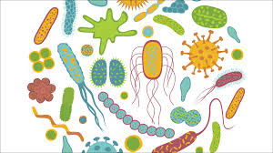
Shikimate Pathway Disruption
Phenylalanine, tryptophan, tyrosine
Gut Microbes
shikimate
Dopamine, adrenaline, serotonin, melatonin, melanin,
thyroid hormone
Glyphosate
chorismate
vitamin K
Several B vitamins

Slide 16
Roundup Safety Claims Disputed*
“It is commonly believed that Roundup is among the safest pesticides. … Despite its reputation, Roundup was by far the most toxic among the herbicides and insecticides tested. This inconsistency between scientific fact and industrial claim may be attributed to huge economic interests, which have been found to falsify health risk assessments and delay health policy decisions.”
*R. Mesnage et al., Biomed Research International, 2014; 2014: 179691
Notes:
Glypohsate/ Mesnage_Seralini_2014_glyphosate_toxicity_proven.pdf

Slide 17
Main Toxic Effects of Glyphosate*
Kills beneficial gut bacteria and allows pathogens to overgrow
Interferes with function of cytochrome P450 (CYP) enzymes in the liver
These enzymes serve many important roles, including making bile acids, activating vitamin D, detoxifying many toxic chemicals and breaking down prescription drugs
Chelates (binds tightly to) important minerals like cobalt, manganese and zinc, making them unavailable to the cells
Interferes with the synthesis of aromatic amino acids and methionine
Disrupts sulfate synthesis and sulfate transport
*Samsel and Seneff, Entropy 2013, 15, 1416-1463

Slide 18
Glyphosate usage increased dramatically over time, likely because of the emergence of glyphosate-resistant weeds
*Judy Hoy et al., Poultry, Fisheries & Wildlife Sciences 2015; 3(1): 1000132.

Slide 19
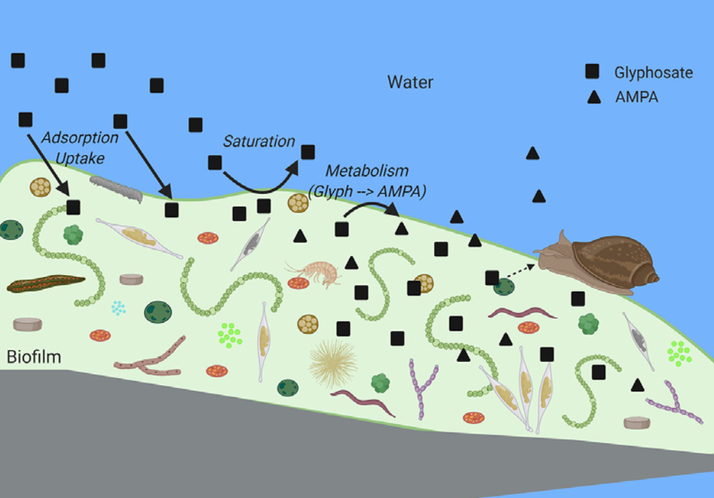
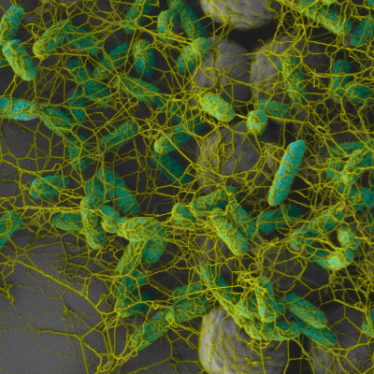
Glyphosate Accumulates in Biofilms*
Glyphosate polluting waterways is rapidly adsorbed into biofilms
Concentrations of glyphosate in biofilms were two to four orders of magnitude higher than those in the surrounding water
Glyphosate appears to rapidly disappear from waterways but this is an illusion
Juvenile fish and amphibians dwell in the biofilms
“We may be underrecognizing the potential ecological risk of contaminants, like glyphosate, that are bioconcentrating in biofilms and subsequently being consumed.”
*Laura Beecraft et al.Science of the Total Environment 756 (2021) 143993.
Notes:
personal/Project/glyphosate/glyphosate_in_biofilms_2020.pdf

Slide 20
“Glyphosate remains in forest plant tissues for a decade or more” *
“We found that residues persisted for up to 12 years in some tissue types, and that root tissues generally retained glyphosate residues longer than shoot tissue types. We also found that samples from the colder, more northern biogeoclimatic zone investigated retained significantly higher levels of glyphosate for longer than samples collected from the warmer biogeoclimatic zone.”
*N Botten et al. Forest Ecology and Management 493 (2021) 119259.

Slide 21
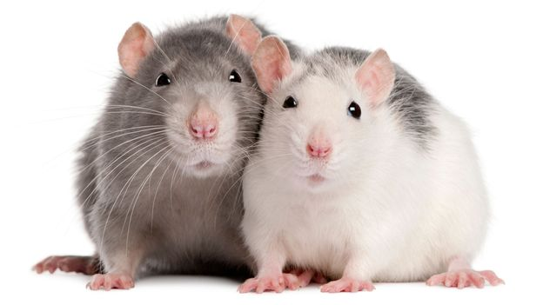
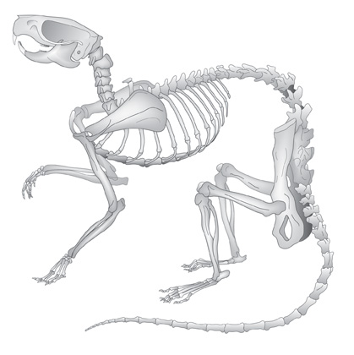
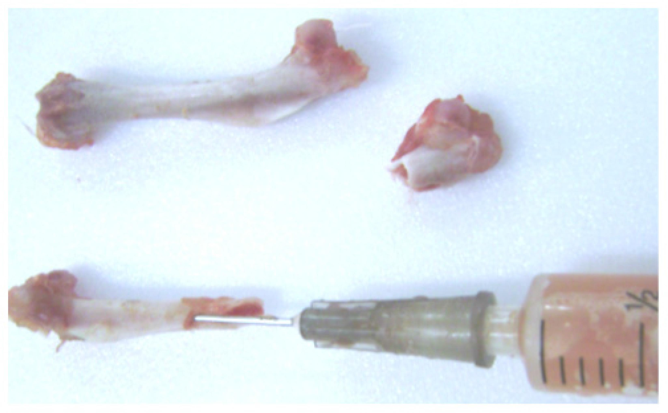
“Glyphosate: Plasma and Bone Marrow Levels Following Intraperitoneal Injection”*
Significant amounts of radiolabeled glyphosate were found in plasma and bone marrow following intraperitoneal injection in rats
Glyphosate in bone marrow reached 340 ppm after 1/2 hour, and it remained at about that level throughout the duration of the study (10 hours)
*WP Ridley et al. Monsanto commissioned study ML-83-218; EHL No. 830109. 1983.
Notes:
project/glyphosate/glyphosate_reaches_bone_marrow_quickly_stays_there_Monsanto_papers_1983.pdf

Slide 22
Glyphosate and Cancer*
In April 2015, the World Health Organization's International Agency for Research on Cancer (IARC) identified glyphosate as a probable human carcinogen
Three trials involving cases where glyphosate was claimed to cause non-Hodgkin's lymphoma resulted in a successful lawsuit
The plaintiffs were awarded $25-80 million in each case
In June, Bayer agreed to pay up to $10.9 billion to roughly 125,000 people in thousands of lawsuits arguing Roundup was responsible for their non-Hodgkin lymphomas
*https://sustainablepulse.com/2020/12/24/
environmental-and-farming-groups-start-us-legal-action-in-attempt-to-ban-glyphosate/

Slide 23
Animal and Human Diseases

Slide 24
Seminal Séralini Study: Mammary Tumors in Rats*
Rats exposed to Roundup over their entire lifespan at levels well below established safety limits
*GE Séralini et al. Environmental Sciences Europe 2014; 26: 14.
Notes:
Images/seralini_rats.png
./seralini_paper.pdf

Slide 25
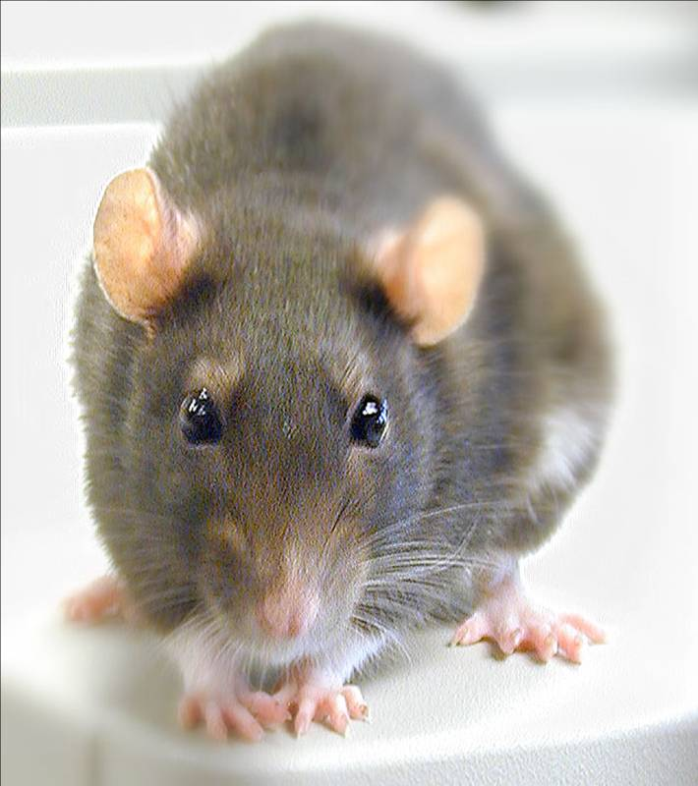
Conclusions from Séralini’s Rat Study *
Female rats had greatly increased risk of mammary tumors
Males had significantly increased risk of liver and kidney disease
Sex hormone disruption for both males and females
Enhanced oxidative stress
Effects didn’t become apparent until after 4 months
*GE Séralini et al. Environmental Sciences Europe 2014; 26: 14.
Notes:
Spacedoc/mercola/GMOS_mouse_study_2012.pdf

Slide 26
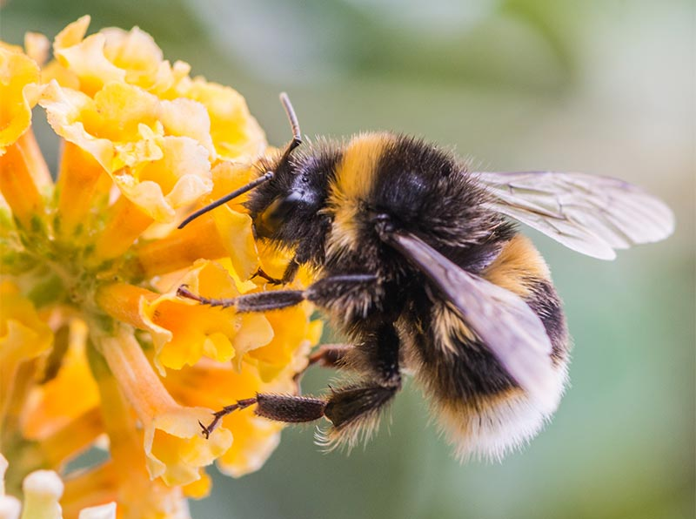
Glyphosate-based formulations: Effect on honeybee behaviors*
Conclusions
“In this study, we provided new information on the influence of commercially formulated glyphosate at the recommended concentration on the behaviours of honeybees. Our findings showed that the water responsiveness, sucrose responsiveness, learning and memory ability and climbing ability of honeybees were affected by commercially formulated glyphosate at or below the recommended concentration.”
*Qi‐Hua Luo et al., Scientific Reports 2021; 11(1): 2115.
Notes:
glyphosate isopropylamine salt

Slide 27
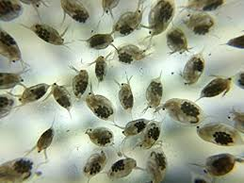
Effect of Glyphosate on Water Flea Embryos*
Water fleas are near the bottom of the aquatic food chain
Tadpoles, salamanders, newts, aquatic insects and many types of small fish feed on water fleas
When water fleas were exposed to concentrations of Roundup and glyphosate well below the approved regulatory threshold, they suffered from:
Embryonic developmental failure
Systemic inflammation
Collagen degradation
Impaired wound healing
Disrupted gut microbes
The animals that eat the water fleas pick up glyphosate from their food
Effects on water fleas propagate up the food chain
*Suppa et al. Microbiome (2020) 8:170.
Notes:
2021/glyphosate/Roundup_causes_embryonic_development_failure_daphnia_2020

Slide 28
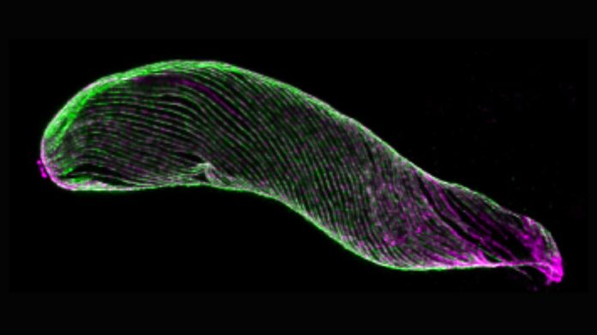
Glyphosate Increases Malaria Spread through Mosquitoes*
Melanin traps and kills invading pathogens
Melanin production rises in response to infection
Highly reactive molecules produced as intermediates in melanin synthesis destroy the invader.
Glyphosate suppressed several enzymes involved in the synthesis of melanin
Mosquitoes exposed to glyphosate were less able to control Plasmodium infections →better vectors for infection (malaria)
*Daniel FQ Smith et al. Plos Biology 2021 19(5): e3001182.
Notes:
2021/glyphosate/glyphosate_inhibits_melanin_insects_fungus_sensitivity_2021.pd
2021/glyphosate/Defender_on_glyphosate_mosquitoes_malaria.textf

Slide 29
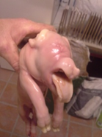
Ib Pedersen: Pig Farmer in Europe*
Glyphosate was found in the lungs, liver, kidney, brain, gut wall and heart of 38 malformed euthanized one-day-old Danish piglets
Highest concentrations were in the lungs and heart
“The summary of my findings is, without a doubt, that Roundup sprayed on crops is the direct reason for the increase in fertility problems, abortions and deformities in animals and as a farmer, knowing how nature works, I quite expect that people are already affected.”
“Glyphosate is everywhere.”
-- Ib Pedersen
* M Kruger et al. Detection of Glyphosate in Malformed Piglets J Environ Anal Toxicol 2014, 4:5
Notes:
./farm_study_pigs_Ib_Pedersen_2016.docx
./detection-of-glyphosate-in-malformed-piglets-2161-0525.1000230.pdf .
https://childrenshealthdefense.org/defender/mosquitoes-glyphosate-spread-malaria/
2021/glyphosate/pathogenesis_of_malaria_Anthony_Mawson.pdf

Slide 30
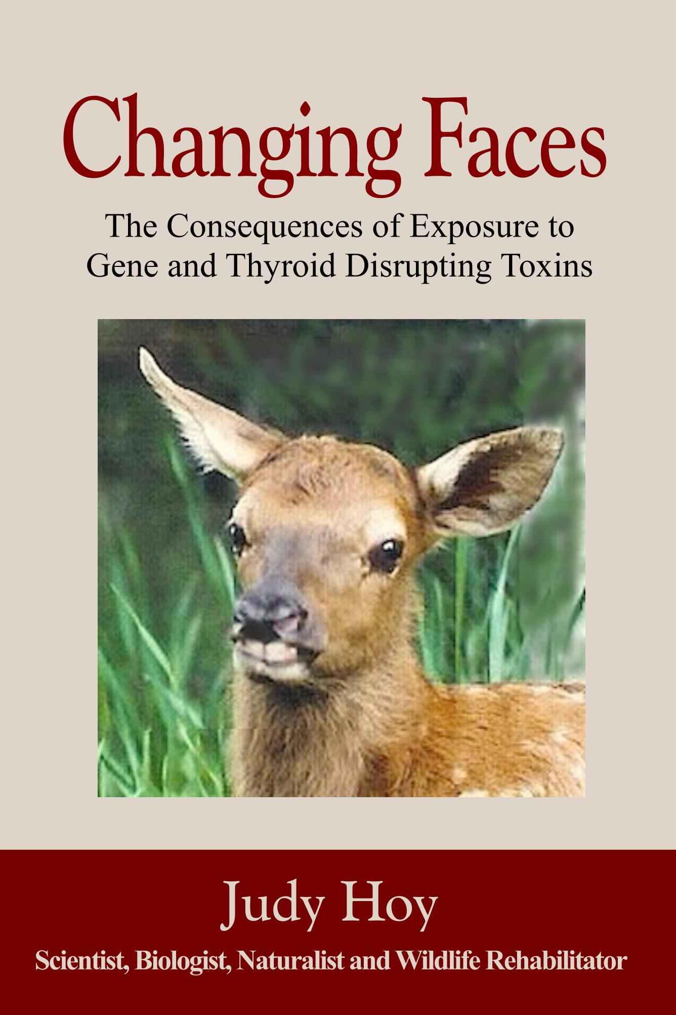
The first author, Judy Hoy, runs a wildlife rehabilitation center in the Bitterroot Valley in Western Montana
She has been tracking the dwindling numbers and decreasing health status of wildlife there for decades
Dr. Nancy Swanson and I collaborated with her to compare health issues of the animals with those of humans in the United States

Slide 31
Newborn white-tailed deer have severely damaged thymuses*
*Judy Hoy et al., Poultry, Fisheries & Wildlife Sciences 2015; 3(1): 1000132.

Slide 32
Some Correlations between Human Diseases and Glyphosate*
Compared US government data on glyphosate usage and on human disease patterns over time from the 1998-2010 hospital discharge data
Found striking correlations between the rise in glyphosate usage and the rise in multiple health issues in newborn babies:
head and face anomalies R=0.95
blood disorders R=0.92
skin disorders R=0.96
metabolic disorders R=0.95
genitourinary disorders R=0.96
congenital heart conditions R=0.98
lung problems R=0.95
R is the correlation coefficient characterizing how similar the two curves are. 1.0 is the highest value it can take, representing a perfect match.
*Judy Hoy et al., Poultry, Fisheries & Wildlife Sciences 2015; 3(1): 1000132.

Slide 33
Congenital heart conditions (newborns) p<0.000009 and enlarged right ventricle (adults) p<0.00003*
Enlarged right ventricle
Congenital heart conditions
*Judy Hoy et al., Poultry, Fisheries & Wildlife Sciences 2015; 3(1): 1000132.

Slide 34
Long-QT syndrome, atrioventricular block, arrhythmias in both humans and animals
“In fatalities, the common symptoms were cardiorespiratory arrest, cardiovascular shock, hemodynamic disturbances, intravascular disseminated coagulation and multiple-organ failure”
Notes:
Glyphosate/Treasures/glyphosate_effects_on_heart_review_Seralini_2016.pdf
QTc prolongation and arrhythmias along with first-degree atrioventricular block

Slide 35
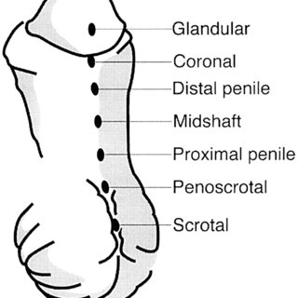
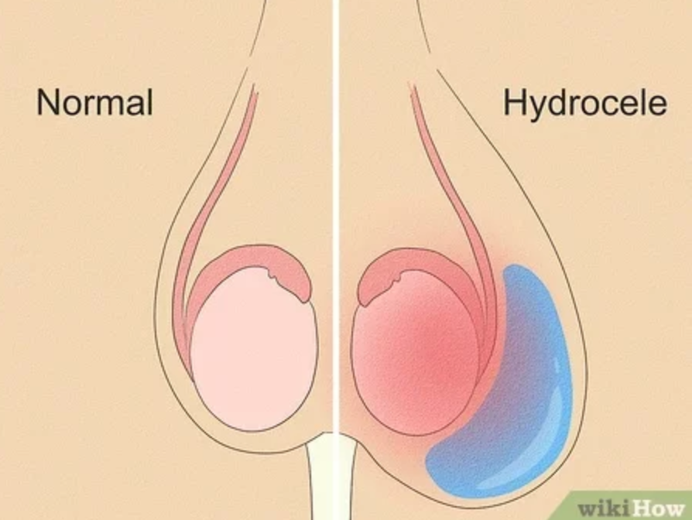
Newborn Genitourinary Disorders (Hypospadias, Hydrocele, etc.) p<0.000024
Urethra opening
below the tip
disorders
Glyphosate use on wheat, corn and soy
Swolen testicle
Hypospadias
*Hoy et al., Poultry Fish and Wildlife Science 2015, 3:1
Notes:
Nearly six-fold increase from 1998 to 2010.
URETHRA
A hydrocele (HI-droe-seel) is a type of swelling in the scrotum that occurs when fluid collects in the thin sheath surrounding a testicle.
Figure 31: Hospital discharge rates for newborn genitourinary disorders compared to glyphosate applications to wheat, corn and soy crops. The genitourinary disorders include: Other disorders of the kidney and ureter (ICD 593); hydrocele (watery uid around one or both testicles (ICD 778.6); hypospadias (ICD 752.6); and hydronephrosis- obstruction of urine flow (ICD 591). The Pearson correlation coefficient between the genitourinary disorders and glyphosate use is R=0.9585.

Slide 36
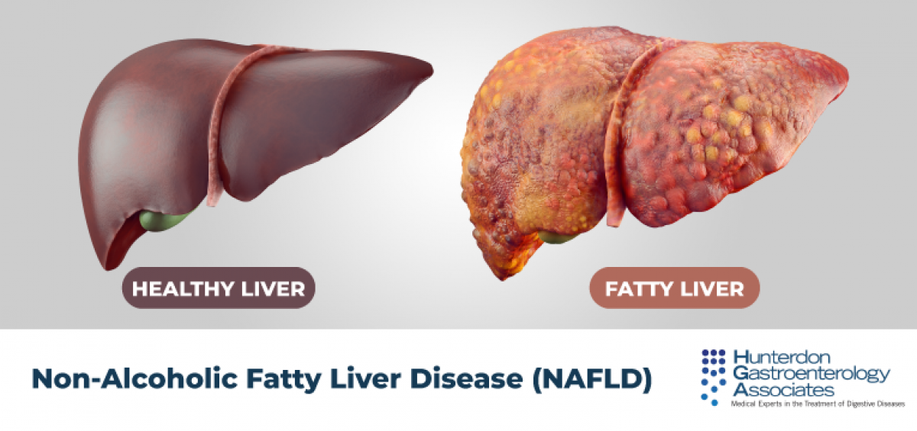
Is Glyphosate Causing an Epidemic in Fatty Liver Disease?
Worldwide epidemic in fatty liver disease today*
“Multiomics reveal non-alcoholic fatty liver disease in rats following chronic exposure to an ultra-low dose of Roundup herbicide”**
Glyphosate correlated with fatty liver disease in humans***
* Chris Estes et al. Hepatology 2018; 67(1): 123-133.
** Robin Mesnage et al. Sci Rep 2017; 7: 39328.
*** PJ Mills et al. Clinical Gastroenterology and Hepatology 2020;18(3):741-743.
Notes:
Where?
Attached/for_Laszlo/Mills_glyphosate_steatohepatitis_link_humans_2019.pdf

Slide 37
Kidney Failure in Agricultural Workers*
Agricultural workers in sugar cane fields in Central America and Sri Lanka are dying at a young age in record numbers from kidney failure
Second-most common cause of death in young men in El Salvador
Attributed to toxic metals (arsenic, cadmium) + nitrates in well water + glyphosate**
Glyphosate chelates arsenic and then unloads it in the acidic environment of the renal tubules
Glyphosate is synergistically toxic with paraquat to destroy the kidneys of agricultural workers in Sri Lanka***
* CM Orantes-Navarro et al., Adv Chronic Kidney Dis 2017;24(2):101-106.
**C Jayasumana et al. Int. J. Environ. Res. Public Health 2014, 11, 2125-2147.
*** Sarath Gunatilake et al., Int J Environ Res Public Health 2019; 16(15): 2734.
Notes:
Glyphosate/interstitial_nephritis_agriculture_2017.;pdf
http://www.ticotimes.net/More-news/News-Briefs/What-is-killing-the-young-men-of-Canas-_Wednesday-August-07-2013
./diabetes_farmers_costa_rica.pdf

Slide 38
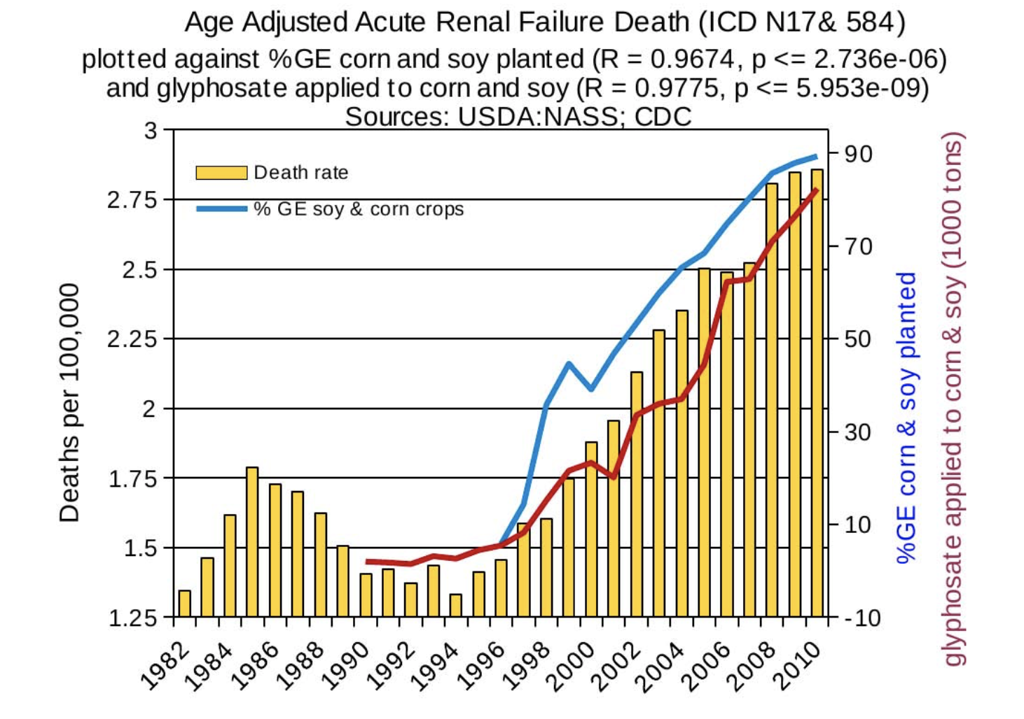
U.S. Acute Kidney Disease Death Rate Plotted against Glyphosate and GMOs*
*Figure 19, NL Swanson et al. Journal of Organic Systems 9(2), 2014, p. 25.
*Plot prepared by Nancy Swanson from available data online
Notes:
Swanson_et_al_2014.pdf

Slide 39
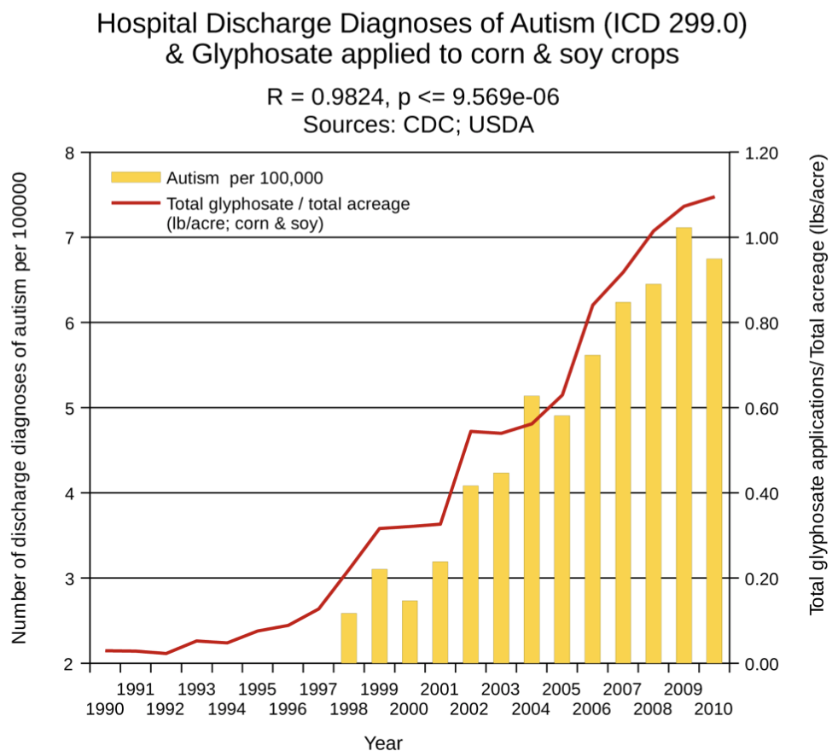
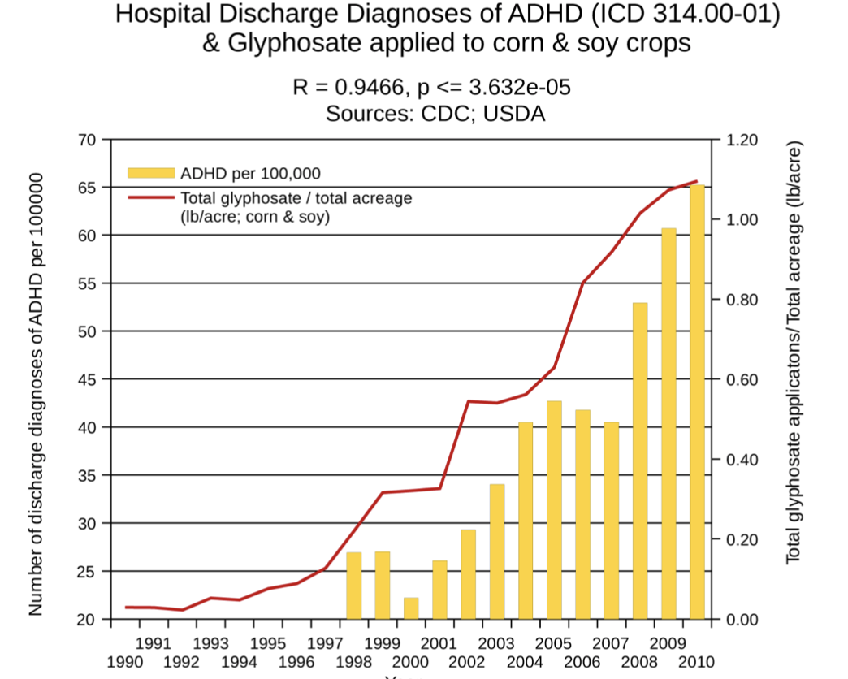
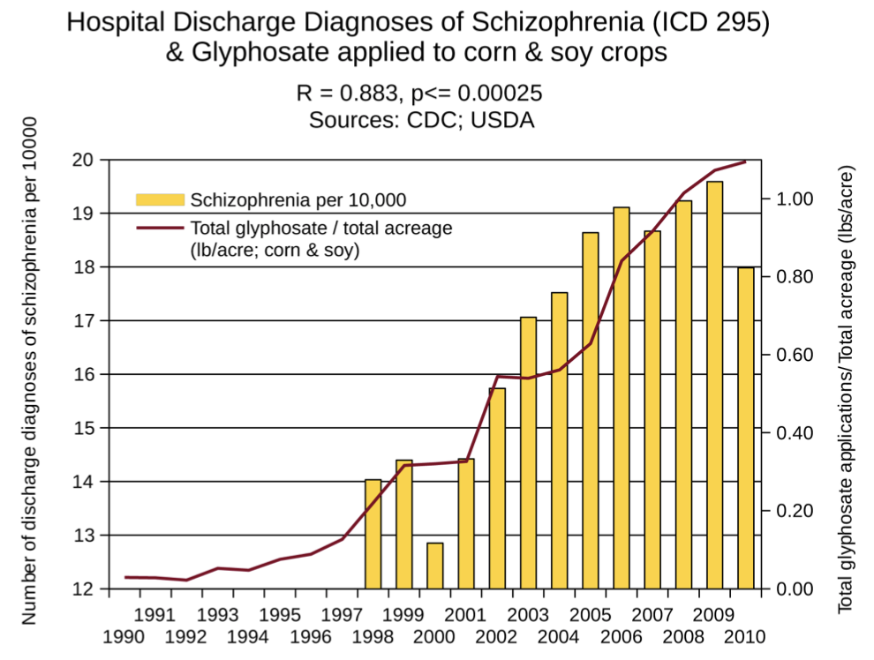
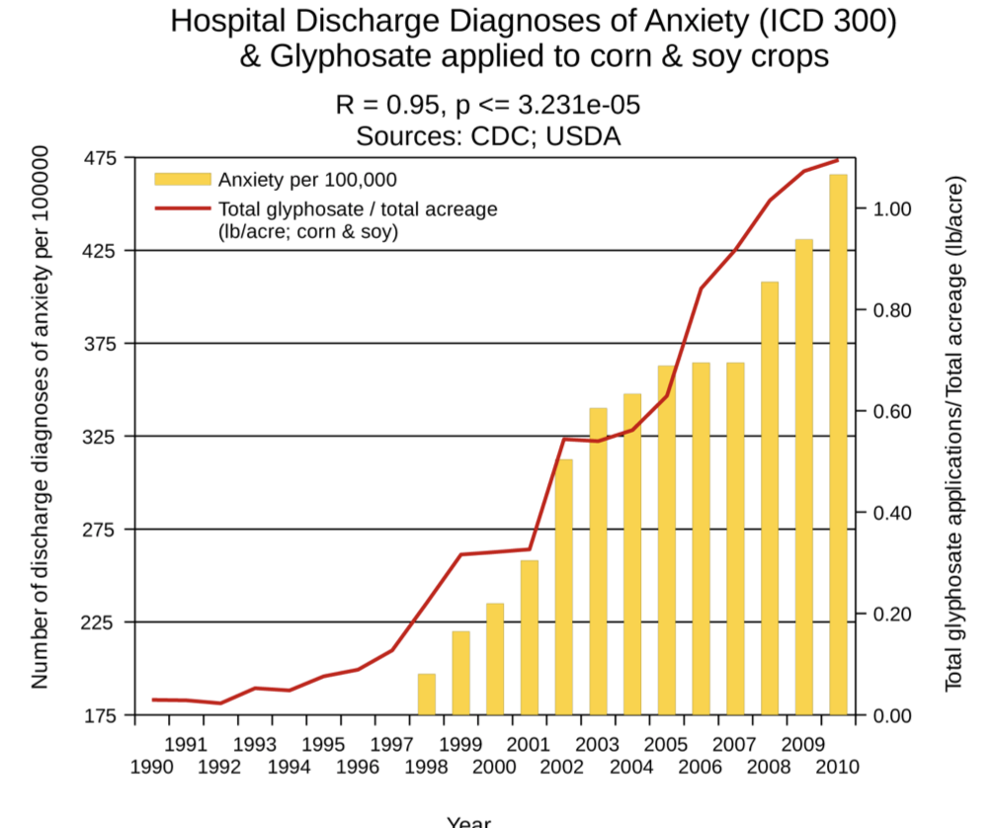
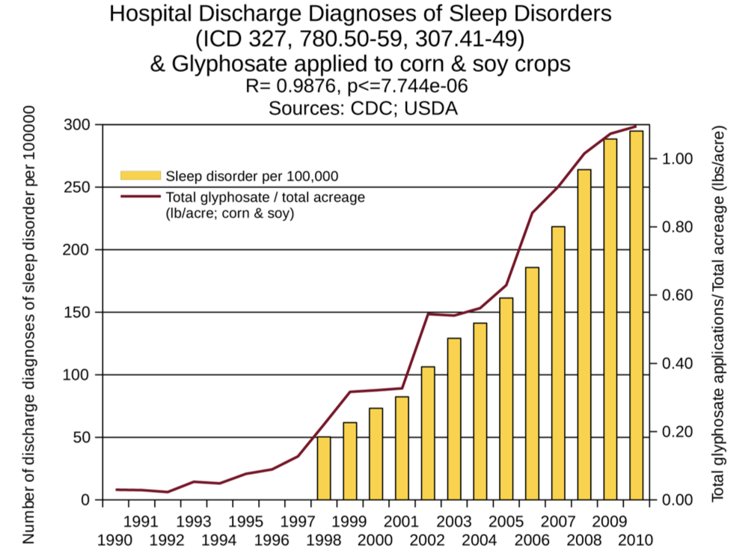
Correlations between Glyphosate and Neurological Diseases*
Autism
ADHD
Schizophrenia
*S Seneff et al. Agricultural Sciences 2015; 6: 42-70.
Anxiety
Sleep Disorder

Slide 40
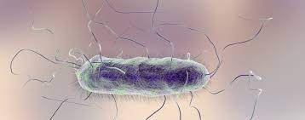
Proteus mirabilis can fully metabolize glyphosate and use its phosphorus atom as a source of phosphorus*
No phosphorus + glyphosate
No phosphorus
*Z. Wybranych et al. Ecol Chem Eng A. 2015; 22(2): 185-193.
Notes:
2021/glyphosate/Proteus_mirabilis_metabolizes_glyphosate.pdf
Proteus_mirabilis_glyphosate.png

Slide 41
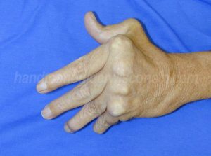
”Rheumatoid arthritis is an autoimmune disease triggered by Proteus urinary tract infection”*
Proteus mirabilis urinary tract infection
rheumatoid arthritis
autoantibody-mediated cytotoxicity in synovial tissues
Antibodies to Proteus antigens
anti-HLA-DRB1 antibodies due to molecular mimicry
*A. Ebringer and T Rashid.Clinical & Developmental Immunology2006; 13(1): 41-48.
Notes:
2021/glyphosate/rheumatoid_arthritis_Proteus_mirabilis_UTI_2006.pdf

Slide 42
Glyphosate and the Gut

Slide 43
Imbalanced
Gut Microbiome
Inflammatory bowel disease, autoimmune arthritis, obesity and metabolic syndrome, and nonalcoholic fatty liver disease can all be traced to imbalances in gut microbiome*
*Figure 1. RS Goldszmid and G Trinchieri. Nat Immunol 2012;13(10):932-8.
Notes:
Book/autoimmune/price_of_immunity_2012.pdf
Figure

Slide 44
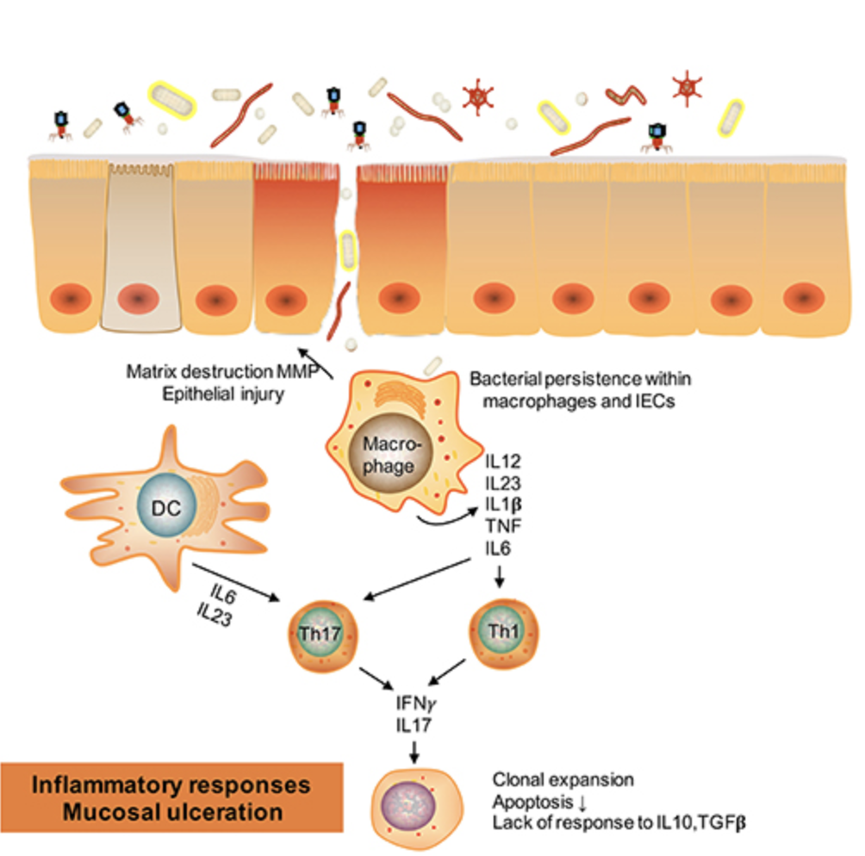
Glyphosate and the Gut: Pathogen Overgrowth*
Glyphosate is an antimicrobial agent that preferentially kills beneficial microbes, allowing pathogens to flourish in the gut
Pathogens cross a leaky gut barrier
Immune cells infiltrate the gut tissue and release inflammatory cytokines
This causes increased risk to inflammatory bowel diseases such as Crohn’s, ulcerative colitis as well as Celiac disease (gluten intolerance)
* Samsel and Seneff. Entropy 2013; 15: 1416-1463.

Slide 45
Inflammatory Bowel Disease
*Figure 20, NL Swanson et al. Journal of Organic Systems 9(2), 2014, p. 25.

Slide 46
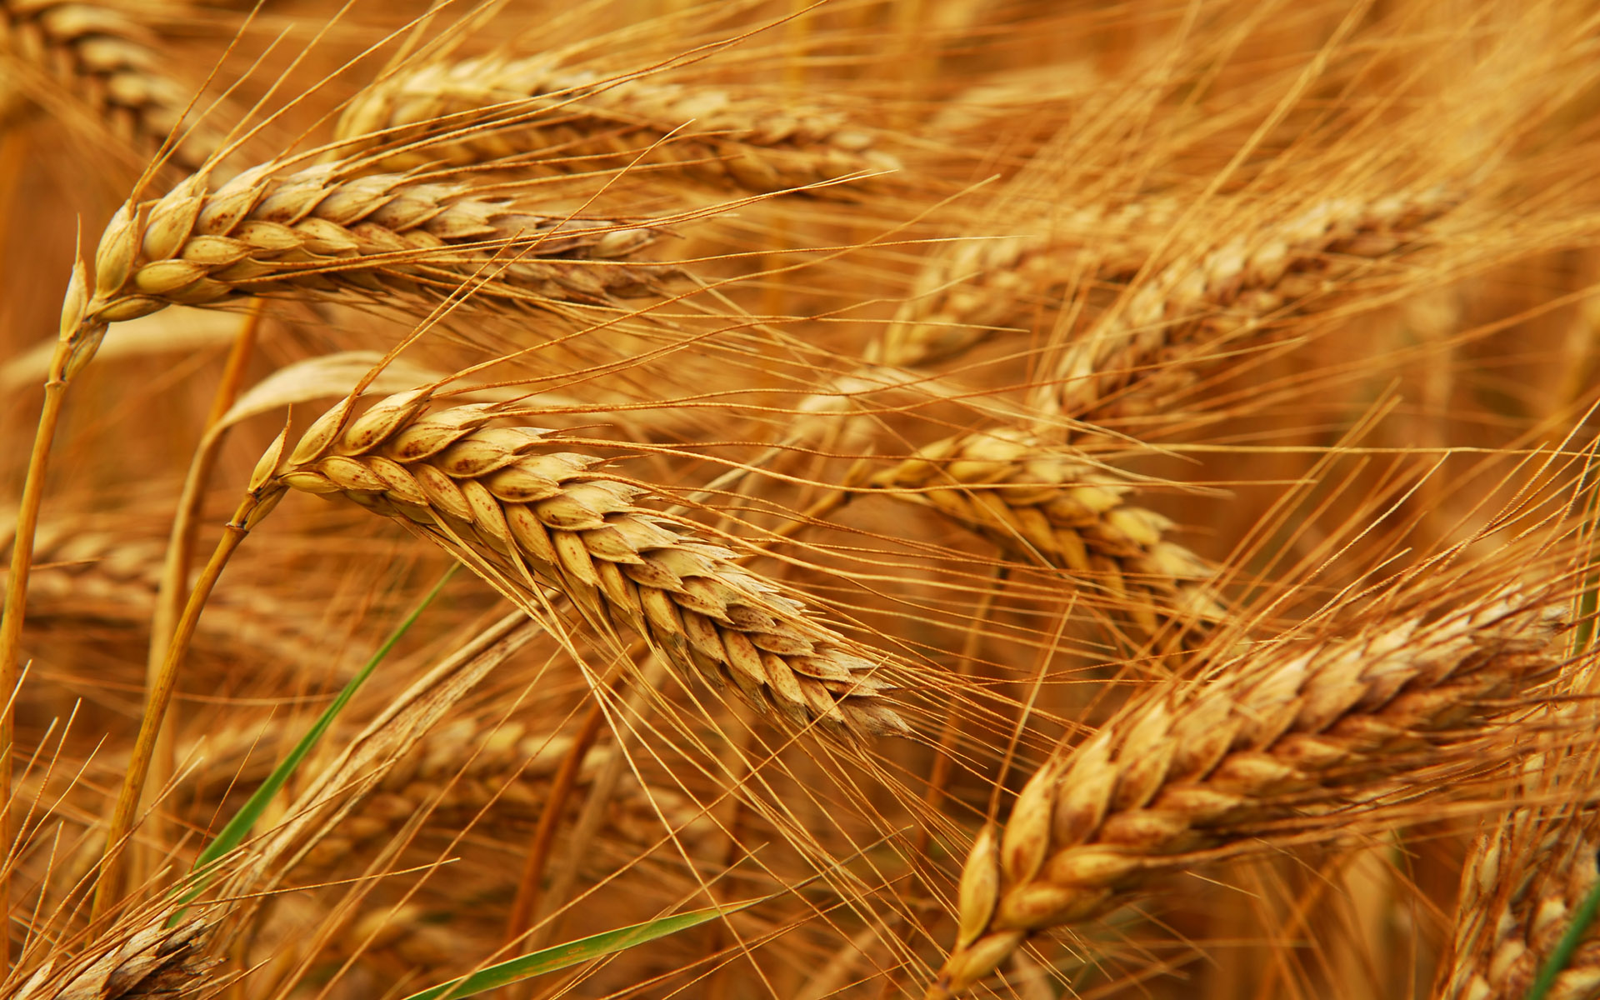
Glyphosate and Celiac Disease*
Glyphosate
Use on wheat
Celiac disease
*Samsel and Seneff, Interdisciplinary Toxicology 2013;6(4): 159–184.

Slide 47
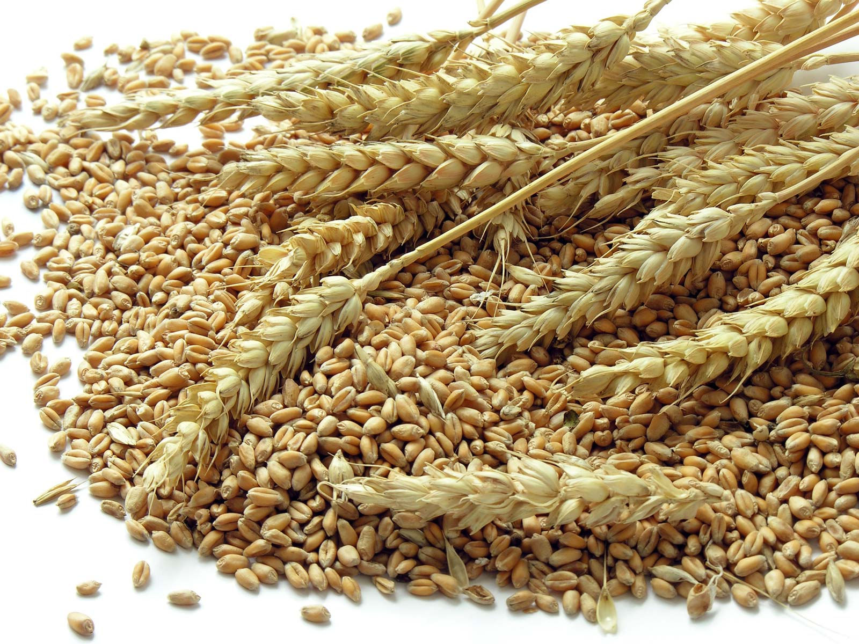
Impaired Digestive Enzymes
Glyphosate has been found as a contaminant in digestive enzymes trypsin, pepsin and lipase*
Trypsin impairment prevents proteins like gluten in wheat from being digested
Undigested proteins induce release of zonulin which opens up gut barrier**
Undigested proteins in the general circulation induce autoimmune disease
*A Samsel and S Seneff. J Biol Phys Chem 2017;17:8-32
** JJ Gildea et al. J Clin Nutr Diet. 2017, 3:1.
Notes:
Glyphosate/ZachBushPaper_tight_junctions_glyphosate_2017.pdf

Slide 48
Celiac Disease, Glyphosate and Non-Hodgkin’s Lymphoma
Glyphosate preferentially kills Bifidobacteria*
Bifidobacteria are depleted in Celiac disease**
Celiac disease is associated with increased risk to non-Hodgkin’s lymphoma***
Glyphosate itself is also linked directly to non- Hodgkin’s lymphoma****
*A.A. Shehata et al., Curr Microbiol. 2013 Apr;66(4):350-8.
** M. Velasquez-Manoff, NY Times Sunday Review, Feb. 23, 2013.
*** C. Catassi et all, JAMA. 2002 Mar 20;287(11):1413-9.
****M. Eriksson et al., Int J Cancer. 2008 Oct 1;123(7):1657-63.
Notes:
**./ bifidobacteria_celiac_disease.text
Cancer/Celiac_disease_increases_hodgkins_lymphoma.text

Slide 49
Glyphosate and Autism

Slide 50
Glyphosate and Autism*
Glyphosate
*J.E. Beecham and S. Seneff, “Is there a link between autism and glyphosate-formulated herbicides?" J Autism 2016; 3: 1.
Nancy Swanson, http://www.examiner.com/article/
data-show-correlations-between-increase-neurological-diseases-and-gmos

Slide 51
Pathogen Overgrowth in Poultry Microbes Exposed to Glyphosate*
Clostridia
Salmonella
Bifidobacteria
*Plot provided by Dr. Martin Michener
Notes:
From Marty Michener!
Shehata paper.
Amount of glyphosate needed to inhibit their growth

Slide 52
Evidence linking autism to Clostridia overgrowth*
14 autistic children with gut disorder compared to 21 controls
Significant increase in Clostridia species in the gut in autistic children
Associated with reduced tryptophan levels and increased expression of inflammatory markers
Tryptophan is a product of the shikimate pathway, which glyphosate blocks
Macrophages in inflamed tissue take up tryptophan, reducing bioavailability to the brain
Proposed role for antibiotics
Glyphosate is a patented antimicrobial agent (2010)
*RA Luna et al., Cellular and Molecular Gastroenterology and Hepatology 2017;3(2): 218-230

Slide 53
*
Triplets: two boys, one girl. Both boys have autism and girl has seizure disorder
Very high levels of glyphosate in urine in all three
Clostridia overgrowth due to glyphosate disruption of gut microbes
Clostridia produce toxins which block the conversion of dopamine to norepinephrine.
Damage to neurons in the brain through oxidative stress
*W. Shaw. Integrative Medicine 2017;16(1);50-57.
Notes:
./Shaw_on_glyphosate_triplets_autism.text

Slide 54
Neurotoxicology 2019; 75:1-8.
“In this work, we state a possible link between Gly[phosate]-induced dysbiosis and cognitive and motor aggravations in neurodegenerative and neurodevelopmental pathologies, such as autism spectrum disorder (ASD). Hence, we review the negative impact that Gly[phosate]-induced dysbiosis may have on depression/anxiety, autism, Alzheimer’s and Parkinson’s diseases.”
Notes:
where?

Slide 55
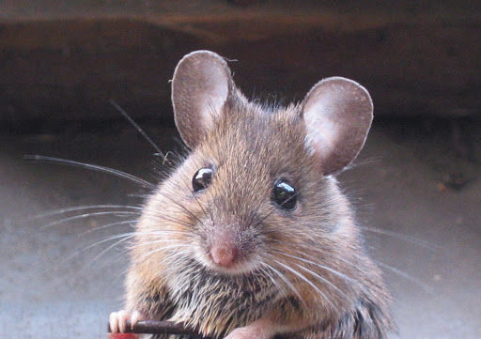
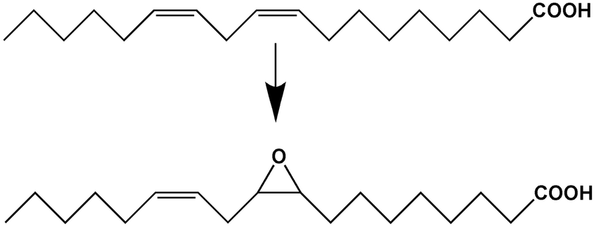
Autism-like Symptoms following Maternal Glyphosate Exposure*
Exposure to herbicides during pregnancy might increase risk for autism in progeny
Exposure of pregnant mice to high-dose glyphosate during pregnancy and lactation induced autism-like symptoms in juvenile offspring
Associated with gut microbiome imbalance and disrupted fatty acid metabolism
Increased expression of soluble epoxyhydrolase (sEH) in prefrontal cortex of the brain
Produces pro-inflammatory fatty acid derivatives
High sEH has been linked to depression, autism, schizophrenia and Parkinson's disease
*Yaoyu Pu et al. PNAS 2020; 117 (21): 11753-11759
Notes:
maternal_glyphosate_exposure_autism_2020.pdf

Slide 56
How to explain this ….
The story links together vitamin D, Cytochrome P450 (CYP) enzymes, aromatase, estrogen, testosterone and sEH
Maternal vitamin D deficiency causes high testosterone in male offspring
Aromatase deficiency causes low estrogen, high testosterone in the brain
Estrogen suppresses synthesis of sEH [low estrogen = high sEH]
Vitamin D activation depends on CYP enzymes
Aromatase is a CYP enzyme
Glyphosate suppresses CYP enzymes → low estrogen and low vitamin D

Slide 57
Glyphosate Suppresses Aromatase in the Placenta*
Some agricultural workers using glyphosate have fertility problems
Glyphosate is toxic to human placental JEG3 cells at concentrations lower than those found with agricultural use
The additional ingredients in Roundup increase glyphosate toxicity
Roundup disrupts aromatase activity
Aromatase is a cytochrome P450 (CYP) enzyme, and glyphosate has been shown to suppress CYP enzymes in the liver**
*Sophie Richard et al. Environmental Health Perspectives 2005; 113(6):716-720.
**Mohamed Ahmed Fathi et al. nvironmental Science and Pollution Research 2020; 27(14): 16865-16875.

Slide 58
“Developmental vitamin D deficiency increases foetal exposure to testosterone”*
Vitamin D regulates gene expression via methylation
Vitamin D deficiency causes hypermethylation of the promoter for aromatase
This results in reduced aromatase expression in male brains
Aromatase converts testosterone to estrogen
Excess testosterone in male foetal brains. → autism
Vitamin D deficient mouse dam
*Asad Amanat Ali et al. Molecular Autism (2020) 11:96.

Slide 59
CYP Enzymes Activate Vitamin D3*
This takes place in the liver, and the same enzymes detoxify a number of pharmaceutical drugs
* Figure 1 in Glenville Jones et al., Anticancer Research 26: 2589-2596 (2006)
Notes:
Celiac/hepatic_activation_D3_CYP_enzymes.pdf
Figure 1. Enzymatic activation of 1·-hydroxylated vitamin D prodrugs by liver enzymes. The putative cytochrome P450 species are indicated by the letter codes. All CYPs, except for the mitochondrial CYP27A1, are microsomal.

Slide 60
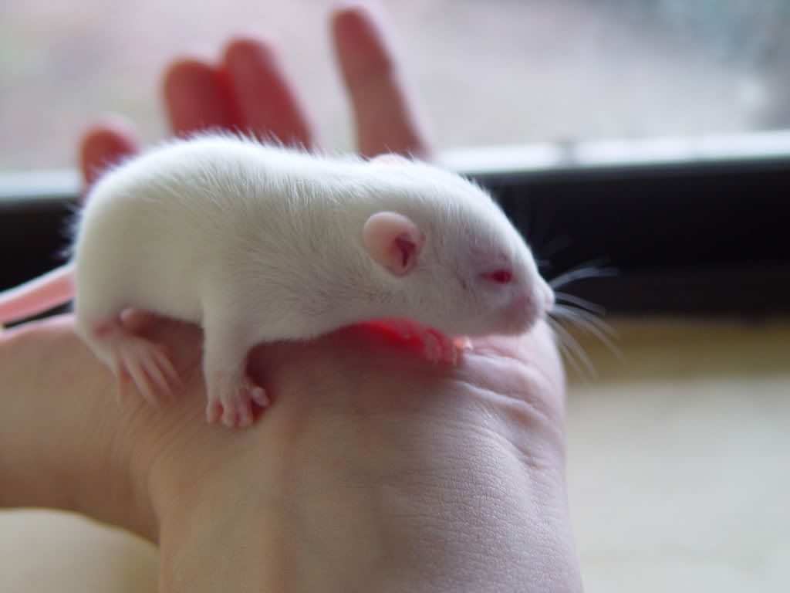
“Glyphosate exposure induces synaptic impairment in hippocampal neurons and cognitive deficits in developing rats”*
Glyphosate-treated hippocampal neurons in culture showed a decrease in dendritic complexity and spine formation
Rat pups were exposed to glyphosate (every two days from 7 days old to 27 days old)
Induced cognitive impairments
Reduced synaptic protein expression in hippocampus
*Sebastian Luna et al. Archives of Toxicology (2021) [Epub ahead of print]

Slide 61
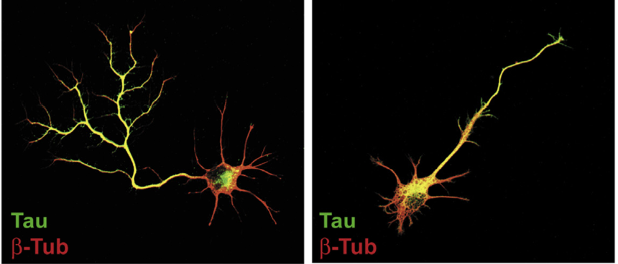
“Neuronal development and axon growth are altered by glyphosate through a WNT non-canonical signaling pathway”*
Neurons grown in culture & exposed to glyphosate
“They elicited shorter and unbranched axons and they also developed less complex dendritic arbors compared to controls”
+ Glyphosate
*RP Coullery et al., NeuroToxicology 2016;52:150-161.
Notes:
./Coullery_glyphosate_neurotoxicity_2016.pdf

Slide 62
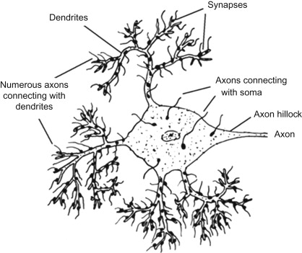
“Dendrite and spine modifications in autism and related neurodevelopmental disorders in patients and animal models” *
"Specifically, autism has been linked to a decrease in the density of spines with mature morphology, indicating a general spine immaturity state in autism."
*Verónica Martínez-Cerdeño, Dev Neurobiol 2017 Apr; 77(4): 393–404.
Notes:
https://www.ncbi.nlm.nih.gov/pmc/articles/PMC5219951/
2021/autism/dendrite_spine_modifications_in_autism_2017.pdf

Slide 63
“Environment permissible concentrations of glyphosate in drinking water can influence the fate of neural stem cells from the subventricular zone of the postnatal mouse”*
"Our findings demonstrated that the permissible concentrations of glyphosate in drinking water recognized by environmental protection authorities are capable of inducing neurotoxicity in the developing nervous system."
"Our findings signify the need to review the safety standards established by environmental protection agencies concerning safe glyphosate concentrations in drinking water."
*Muhammad Irfan Masood et al., Environmental Pollution 270 (2021) 116179.
Notes:
where?

Slide 64
Recapitulation
Glyphosate causes over-representation of Clostridia in the gut, depleting tryptophan → this maps to brain damage through inflammation
Glyphosate causes autism-like symptoms in male mice linked to increased expression of soluble epoxyhydrolase (sEH)
Estrogen decreases expression of sEH
Aromatase converts testosterone to estrogen
Aromatase expression in the placenta is suppressed by glyphosate
This explains glyphosate’s effects and the link to autism
→ Low estrogen leads to high sEH
Maternal vitamin D deficiency leads to excess testosterone in males
Vitamin D depends on liver CYP enzymes for activation, which glyphosate suppresses
Aromatase is also a CYP enzyme and this explains how glyphosate suppresses it
Glyphosate suppresses maturation of neuronal dendritic spikes – a characteristic feature of autism

Slide 65
Glyphosate and
Endocrine Disruption

Slide 66
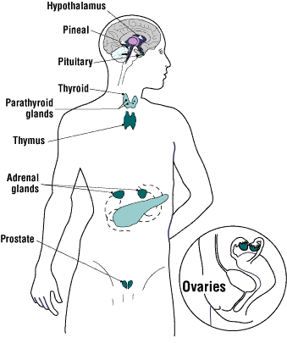
Glyphosate is an Endocrine Disruptor*
Glyphosate at parts per trillion triggers estrogen-sensitive breast cancer cells to proliferate
Glyphosate increases expression levels of estrogen and progesterone receptors
Glyphosate-based herbicides disrupt the hypothalamic-pituitary-thyroid (HPT) axis
Glyphosate alters circulating levels of hormones
Glyphosate induced hypothyroidism in female Wistar rats
Glyphosate-based formulations altered reproductive developmental parameters in animal models
Glyphosate induced malformation in zebrafish embryos
*Juan P. Muñoz et al. Chemosphere October 19, 2020 [Epub ahead of print]
Notes:
Munoz_et_al_Glyphosate_characteristics_endocrine_disruptor_2020.pdf .

Slide 67
Zen Honeycutt on Glyphosate as an Endocrine Disruptor
Zen Honeycutt is the Founder of the advocacy group Moms Across America
On Dec. 10, 2020, a meeting of the Developmental and Reproductive Toxicant Identification Committee (DARTIC) was assembled to determine which chemicals might be endocrine disruptors
Under the California EPA's Office of Health Hazard Assessment (OEHHA)
Zen presented slides showing compelling evidence that glyphosate is an endocrine disruptor
The committee subsequently voted that glyphosate should be labelled as a HIGH probability endocrine disruptor on the Prop 65 list
*https://www.momsacrossamerica.com/win_glyphosate_one
Notes:
Munoz_et_al_Glyphosate_characteristics_endocrine_disruptor_2020.pdf .

Slide 68
"Maternal urinary levels of glyphosate during pregnancy and anogenital distance in newborns in a US multicenter pregnancy cohort”*
Glyphosate in urine measured mid-pregnancy
Anogenital distance in girls was longer (more male typical) in association with higher urinary levels of glyphosate
An earlier study on rats found a similar result**
Glyphosate suppresses aromatase, which converts testosterone to estrogen
Confirms that glyphosate is an endocrine disruptor in humans
*Corina Lesseur et al. Environmental Pollution 2021; 280: 117002.
**Manservisi et al. Environmental Health 2019; 18: 15.
Notes:
2021/glyphosate/maternal_glyphosate_girls_anogenital_distance_testosterone.pdf

Slide 69
Longer anogenital distance in females is linked to infertility
Women in the highest tertile of anogenital distance had an 18-fold increased risk of having polycystic ovary syndrome (PCOS)*
Associated with irregular periods or no menstrual cycle, plus excess growth of hair
PCOS is the most common cause of female infertility, affecting as much as 20% of the world’s female population
Women with PCOS have an increased risk of being diagnosed with autism and of having progeny with autism**
*Yingchen Wu et al. Human Reproduction 2017 Apr 1;32(4):937-943.
**Maria Katsigianni et al. Molecular Psychiatry 2019 Dec;24(12):1787-1797

Slide 70
Glyphosate and Premature Birth*
Study based in Puerto Rico
53 cases (premature birth); 194 controls
Models are adjusted for maternal age, education, pre-pregnancy BMI, and smoking
Measured both glyphosate and AMPA
AMPA is a breakdown product of glyphosate
Women who had high (> 0.65 micrograms/Liter) levels of AMPA in their urine at 26 weeks of gestation had a 4.5-fold increased risk of premature birth (p< 0.006). High urinary glyphosate was associated with a 3.77-fold increased risk.
*Monica K Silver et al. Environmental Health Perspectives 2021; 29(5): 057011.
Notes:
2021/glyphosate/Silver_et_al_prenatal_exposure_glyphosate_preterm_birth_EHP7295_2021.pdf

Slide 71
Glyphosate and Premature Birth*
Study based in Puerto Rico
53 cases (premature birth); 194 controls
Models are adjusted for maternal age, education, pre-pregnancy BMI, and smoking.
Measured both glyphosate and AMPA
AMPA is a breakdown product of glyphosate
Women who had high (> 0.65 micrograms/Liter) levels of AMPA in their urine at 26 weeks of gestation had a 4.5-fold increased risk of premature birth. (p< 0.006). High urinary glyphosate was associated with a 3.77-fold increased risk.
"Preterm birth is a national epidemic, costing the United States $26.2 billion each year"
-- American Psychological Association
*Monica K Silver et al. Environmental Health Perspetives 2021; 29(5): 057011.
Notes:
2021/glyphosate/Silver_et_al_prenatal_exposure_glyphosate_preterm_birth_EHP7295_2021.pdf
Especially high in Puerto Rico.

Slide 72
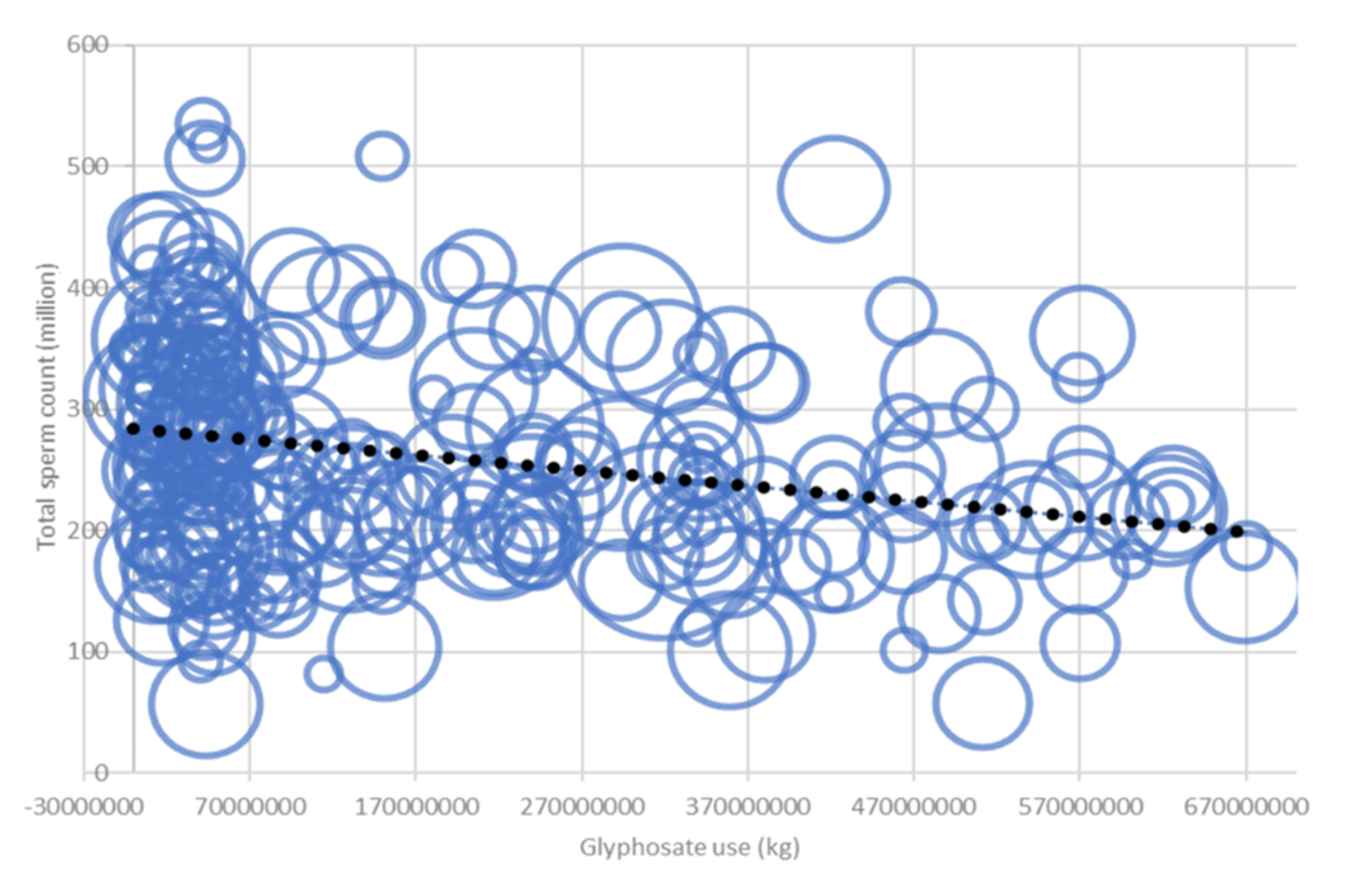
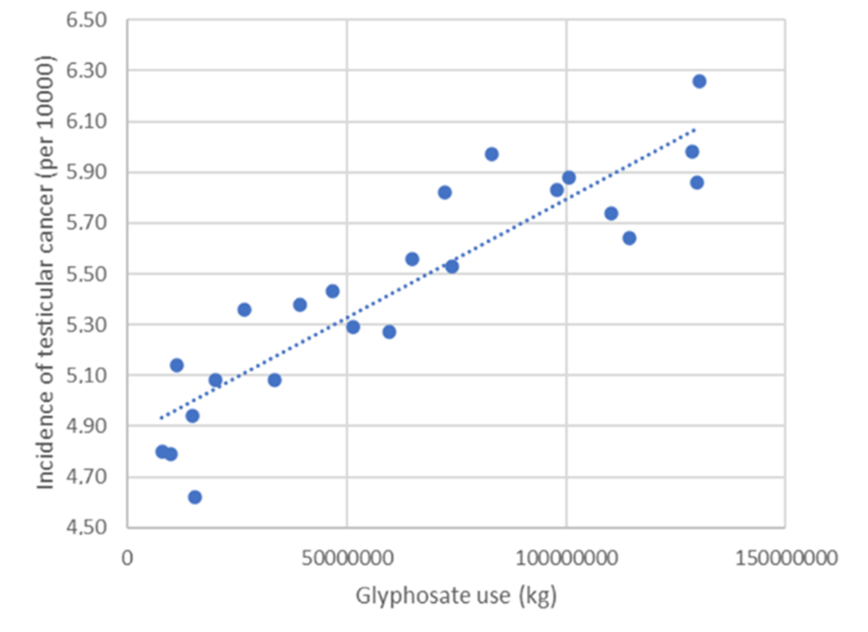
Glyphosate, Sperm Counts and Cancer*
sperm counts
testicular cancer
non-Hodgkin’s lymphoma
p < .000015
p < . 0.00000000039
p < 0.0053
Data were obtained from publicly available databases maintained by the US government
*B. Sopko et al., ACS Omega 2021 June 2, 2021 [Epub ahead of print]
Notes:
2021/glyphosate/Czech_study_US_sperm_testicular_cancer.pdf

Slide 73
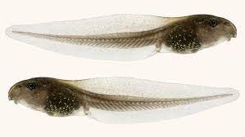
“Glyphosate-Based Herbicides Produce Teratogenic Effects on Vertebrates by Impairing Retinoic Acid Signaling”*
*A Paganelli et al., Chem Res Toxicol 2010; 23(10):1586-1595.
Notes:
Carrasco_glyphosate_teratogenic_frogs.pdf
tadpoles frogs

Slide 74
Transgenerational Effects

Slide 75
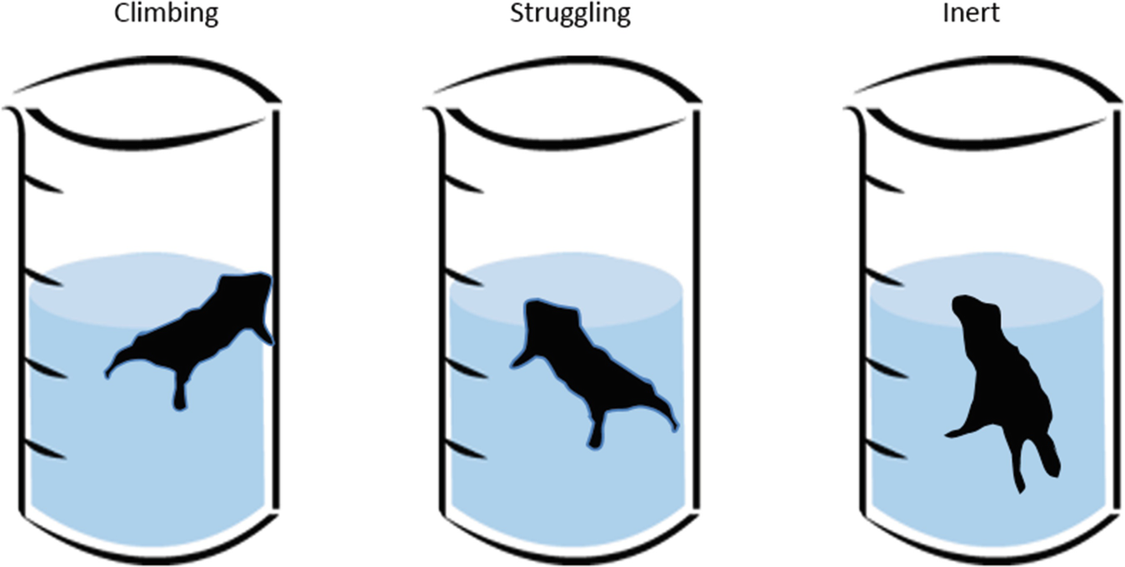
“Developmental exposure to glyphosate-based herbicide and depressive-like behavior in adult offspring: Implication of glutamate excitotoxicity and oxidative stress”*
Mother rats were exposed to glyphosate while pregnant and for fifteen days following birth of the offspring.
The offspring suffered from glutamate excitotoxicity in their brains persistently even after exposure was terminated.
When the offspring were 60 days old, they showed signs of depression in a forced swimming test.
*Daiane Cattani et al., Toxicology 2017; 387: 67-80.

Slide 76
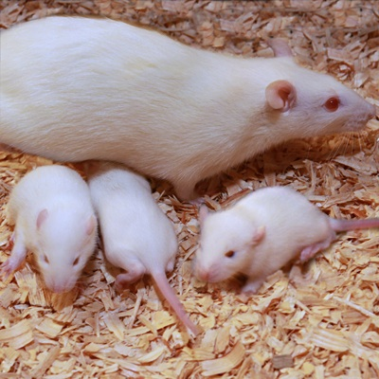
Epigenetic transgenerational toxicology through germline alterations by glyphosate*,**
Pregnant rats were exposed to glyphosate at half the No Observable Adverse Effect Level (NOAEL) from day 8 to day 14 of gestation (timed to match germ cell epigenetic programming)
Offspring were bred to produce pups (F1), grandpups (F2) and great-grandpups (F3)
Exposed rats showed no symptoms
F1 generation were mostly fine
F2 and especially F3 generations suffered from many diseases, including mammary tumors, delayed or early puberty, premature birth abnormalities, prostate disease, kidney disease, and obesity
*Millissia Ben Maamar et al. Epigenetics 2020 Dec 9;1-18.
**Deepika Kubsad et al. Scientific Reports 2019; 9:6372.
Notes:
Maamar_et_al_Epigenome_wide_glyphosate_DNA_methylation_2020.pdf
epigenetic_transgenerational_effects_of_glyphosate_2019.pdf
Also:
glyphosate/transgenerational_sperm_pathologies_glyphosate_exposure_2019.pdf
Kubsad D, Nilsson EE, King SE, et al. Assessment of glyphosate induced epigenetic transgenerational inheritance of pathologies and sperm epimutations: generational toxicology. Sci Rep. 2019;9(1):6372.

Slide 77
My New Book!
Expected to be released on July 1, 2021
Presents extensive data on glyphosate toxicity to animals and humans
Provides compelling arguments that glyphosate is insidiously, cumulatively toxic through its diabolical insertion into proteins by mistake in place of the coding amino acid glycine
This unique feature explains why it is causal in so many diseases

Slide 78
How to Stay Healthy in a Toxic World

Slide 79
Go Organic!

Slide 80
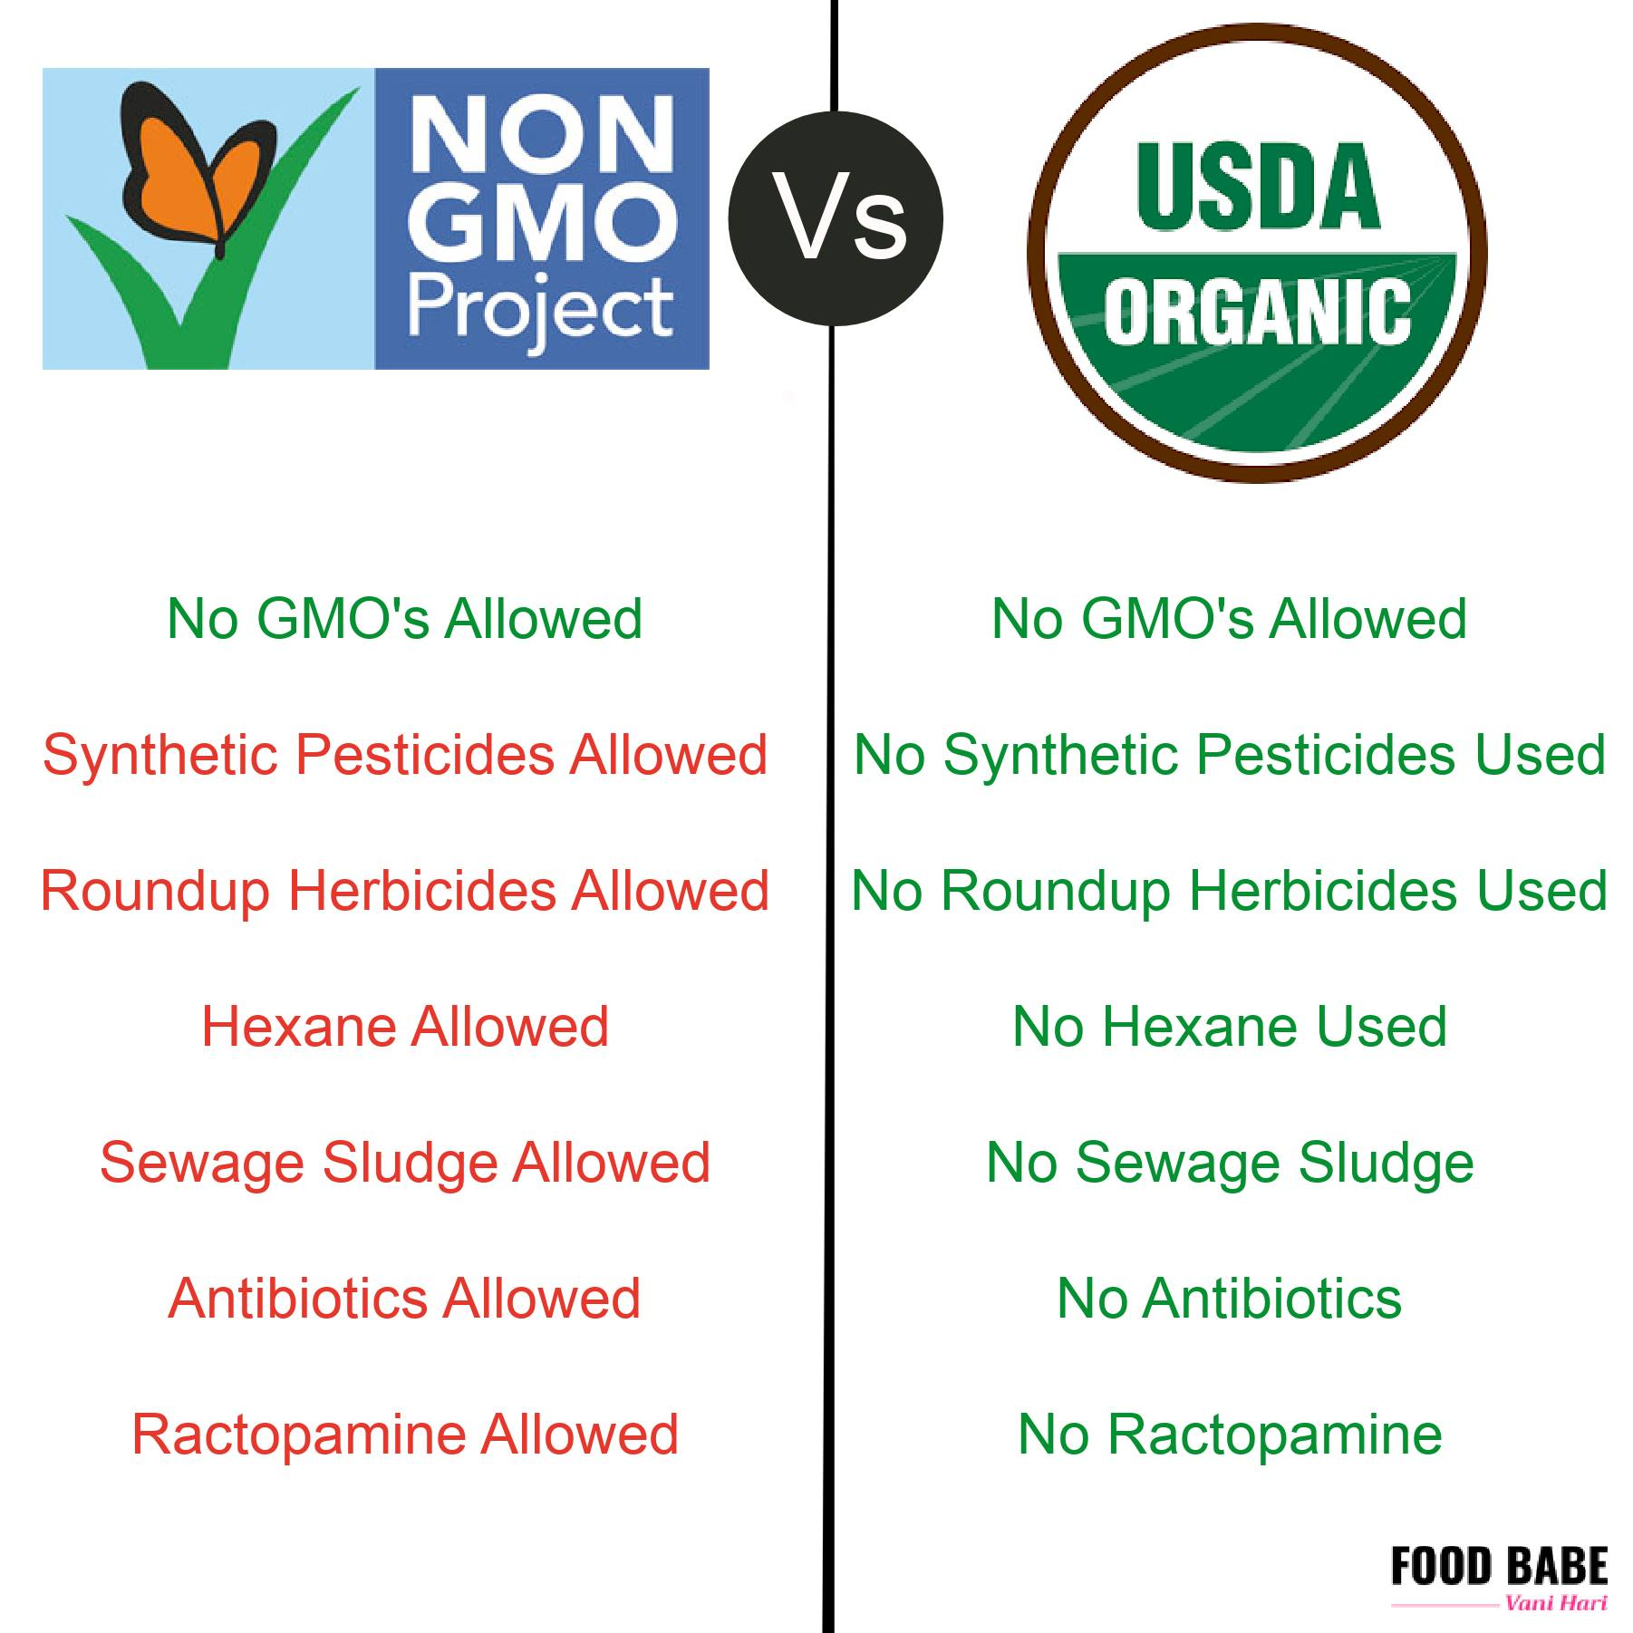

Slide 81
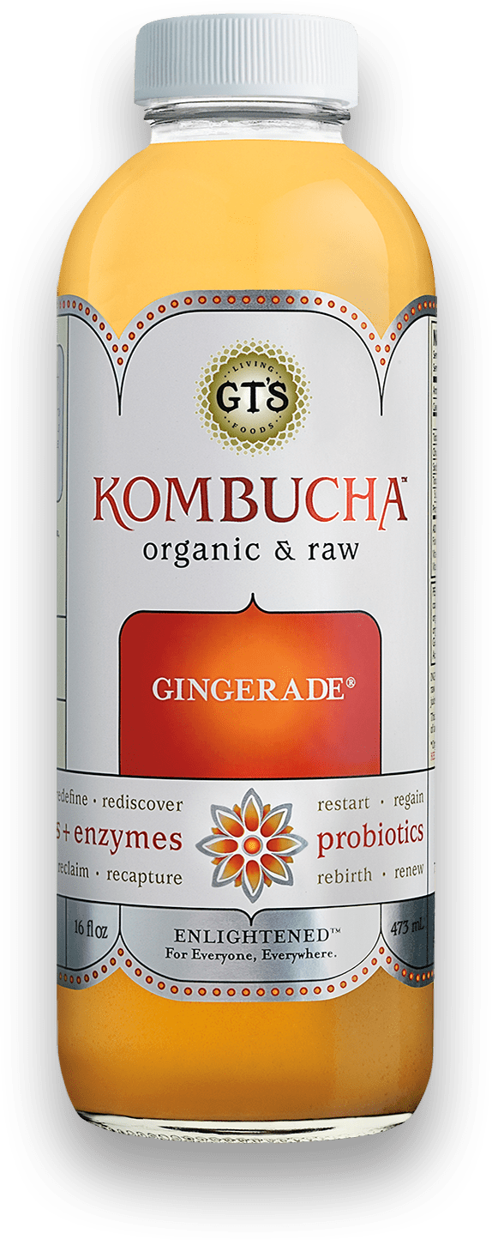
Eat Natural Probiotic Foods
Sauerkraut and apple cider vinegar contain Acetobacter, one of the very few classes of microbes that can metabolize glyphosate
Kombucha and kimchi do too!

Slide 82
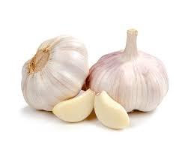
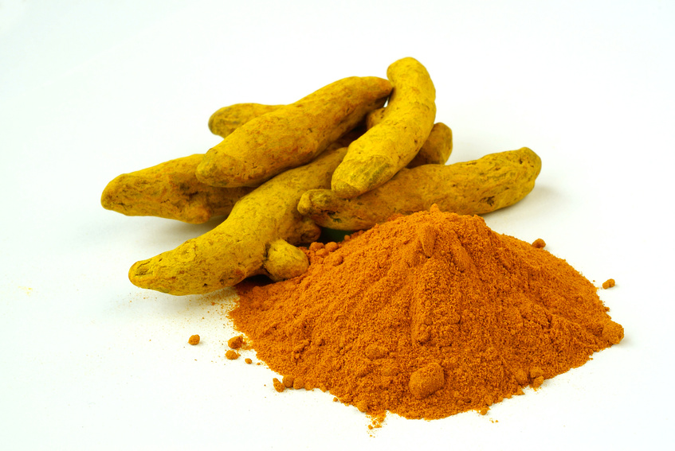
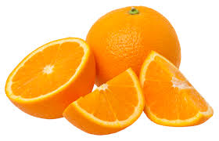
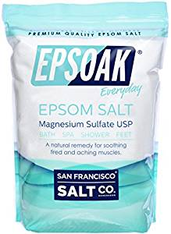
Some Important Nutrients
Curcumin
Garlic
Vitamin C
Methyl tetrahydrofolate
Cobalamin (B12)
N-acetyl cysteine
Glutathione
Taurine
Epsom salt baths

Slide 83
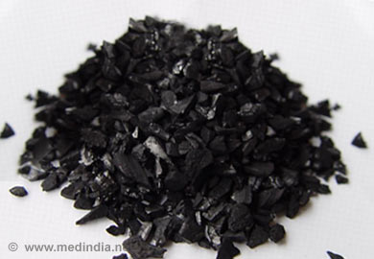
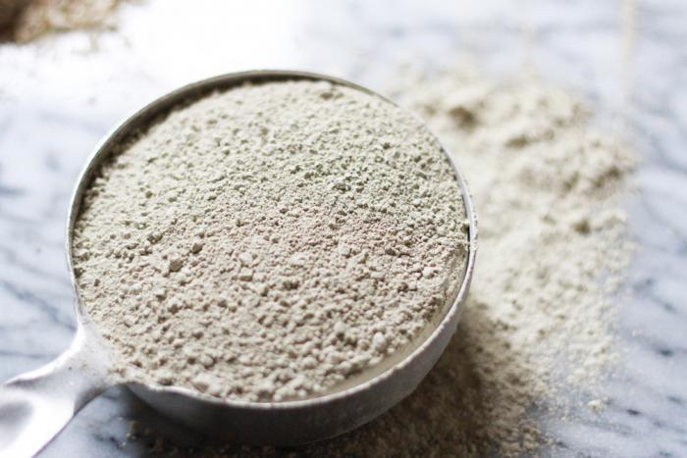
Treating Glyphosate Poisoning in Cows*
Activated charcoal, bentonite clay, humic and fulvic acids, and sauerkraut juice have been shown to be effective in reducing urinary levels of glyphosate and improving animal health
Sauerkraut
Juice
Fulvic Acid
Activated Charcoal
Bentonite Clay
*H Gerlach et al., J Environ Anal Toxicol 2014, 5:2
Notes:
Glyphosate/Monika_cows_humic_acid_fulvic_acid_treat_glyphosate.pdf
Activated charcoal
活性炭
clay
粘土
Niántǔ
Huóxìngtàn

Slide 84
Biochar, Bentonite and Zeolite to maintain healthy microbial distribution in poultry*
*TP Prasai et al. PLoS ONE 2016; 11(4): e0154061.
Notes:
2017/WAPF/Moore\ et\ al\ 2016\ Biochar,\ bentonite\ and\ zeolite\ supplemented\ feeding\ for\ layer\ chickens\ alters\ intestional\ microbiota.pdf .
Reduce need for antibiotics
Redistribute gut microbes

Slide 85
Extracts from Common Plants Can Treat Glyphosate Poisoning*
Roundup is toxic to hepatic and embryonic cells at doses far below those used in agriculture and at residue levels present in some GM food.
Extracts from common plants such as dandelions, barberry, and burdock can protect from damage, especially if administered prior to exposure.
*C Gasnier et al. Journal of Occupational Medicine and Toxicology 2011, 6:3

Slide 86
Healthy Living is the Best Way to Protect Yourself from COVID-19
Vitamin D deficiency is associated with 4-fold increased risk of dying from COVID-19
Vitamin C and Vitamin K2 deficiency are also linked to poor outcomes
Countries where fermented foods are a dietary staple have lower infection rates
I believe the most important ways to protect yourself are to eat a certified organic whole-foods diet and to get out in the sunlight without sunscreen and without sunglasses

Slide 87
Conclusions
Glyphosate is far more toxic to humans than we have been led to believe
The rise in glyphosate usage on core crops in the United States correlates with the rise in prevalence of many diseases and conditions
Glyphosate causes gut dysbiosis, which is increasingly recognized as a major driver behind multiple chronic diseases
Glyphosate’s disruption of gut microbes, CYP enzymes, and hormones can play a significant role in autism and other neurological diseases
Glyphosate causes infertility in both males and females, as well as developmental disorders
Many papers published in the last few years are revealing remarkably severe effects of low doses of glyphosate in animal studies, including transgenerational effects
Glyphosate should be banned worldwide

Slide 88
“Future historians may well look back upon our time and write, not about how many pounds of pesticide we did or didn’t apply, but by how willing we are to sacrifice our children and future generations for this massive genetic engineering experiment that is based on flawed science and failed promises just to benefit the bottom line of a commercial enterprise.”
Prof. Don Huber

Slide 89
Upcoming Webinars
Regen Ag 101, a virtual Soil Health Academy school that farmers, educators, gardeners and other friends of the earth can access 24/7 from virtually anywhere.
Thursday, July 1 at 7:00 pm central
“Regenerating Human Health: Nourishing the Immune System” with Sara Keough
Our immune systems are greatly challenged in our modern world of toxic overload, chronic stress, nutritional deficiencies, inadequate sleep and a myriad of other lifestyle and environmental factors. In the next webinar in our series of 'Regenerating Human Health,' Sara Keough, MS, CNS, LDN will discuss healing foods and lifestyle changes that can deeply nourish and strengthen our immune systems from within.
Through hands-on training from the world’s leading experts, the 3-day Soil Health Academy school will show you how to increase profitability, build resiliency into you land, decrease input costs, and improve the nutrient density and marketability of the agricultural products you produce.
www.soilhealthacademy.org
Thursday, July 8 at 7:00 pm central
“Increasing Profitability in a Corn/Bean Rotation”
Understanding Ag panel webinar (with extended Q&A), Dan DeSutter, David Brandt and David Kleinschmidt will discuss how farmers can lower input costs while increasing farm profitability and resiliency. The secret to success is using soil-health improving regenerative ag principles and practices—and these preeminent experts will answer your questions regarding how you can do the same.
Understanding Ag can help you achieve your regenerative agricultural goals and objective -- whether you’re a farmer, rancher, branded program, processor, restaurant, retailer, or involved consumer.
www.understandingag.com 256-996-3142

