Slide 1
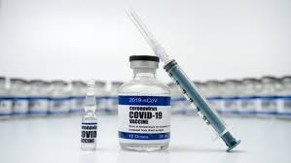
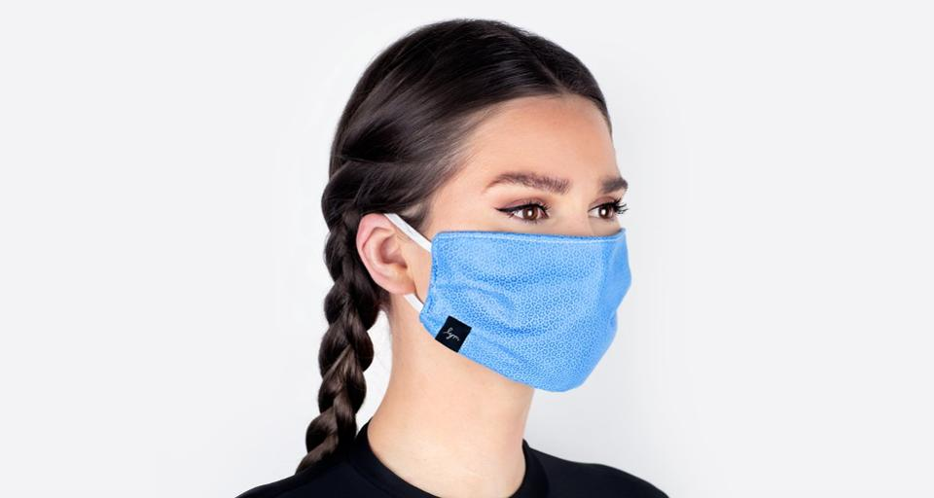
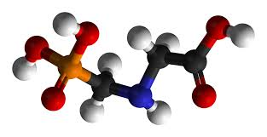
Glyphosate, Vaccines and COVID-19
Stephanie Seneff
MIT CSAIL
Health Freedom Summit
February 15-17, 2021

Slide 2
Download these slides
Powerpoint:
http://people.csail.mit.edu/seneff/2021/HealthFreedom2021.pptx
PDF:
http://people.csail.mit.edu/seneff/2021/HealthFreedom2021.pdf

Slide 3
"The further a society drifts from the truth, the more it will hate those that speak it."
-- George Orwell (1939)

Slide 4
Outline
Introduction
Glyphosate and the MMR Vaccine
COVID-19
The SARS-CoV-2 mRNA Vaccines
Summary

Slide 5
Introduction

Slide 6
Benefits of Infectious Diseases
A large Japanese study found that a history of measles and mumps in childhood is significantly protective against deadly heart attacks and strokes during adulthood*
Adults who had contracted chicken pox were 33% less likely to develop coronary heart disease
Each additional contagious disease contracted during childhood, such as measles, mumps or rubella, increased the protective effect against acute coronary events by 14%**
Tumor remissions after measles infection are well documented in the medical literature
*Y. Kubota et al., Atherosclerosis 2015;241(2):682-686.
** E. Pesonen et al., Atherosclerosis 2007;192(2): 370-375.
Notes:
./first_do_no_harm_vaccine_disease_comparison_NeilMiller_2016.pdf
19. Kubota Y, Iso H, Tamakoshi A; JACC Study Group. Association of measles and mumps with cardiovascular disease: The Japan Collabo- rative Cohort (JACC) study. Atherosclerosis 2015;241(2):682–686
20 Pesonen E, Andsberg E, Ohlin H, et al. Dual role of infections as risk factors for coronary heart disease. Atherosclerosis 2007;192(2): 370–375
*Y. Kubota et al., The Japan Collaborative Cohort (JACC) study. Atherosclerosis 2015;241(2):682-686.
** E. Pesonen et al., Atherosclerosis 2007;192(2): 370-375.

Slide 7
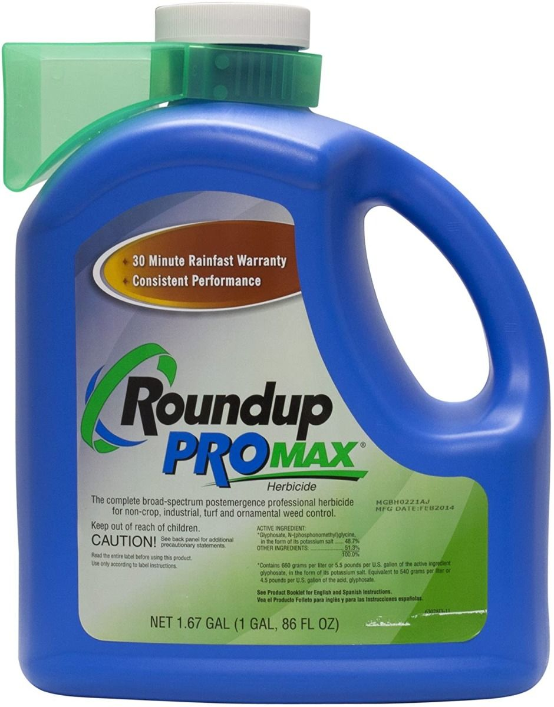
Glyphosate!
Glyphosate is the active ingredient in the pervasive herbicide Roundup
It is widespread in our food supply, especially highly processed foods
Many research papers have been published recently showing that glyphosate at levels below regulatory limits causes harm in animal studies
Embryonic developmental failure and DNA damage in water fleas*
Fatty liver disease in rats**
Epigenetic effects showing up in the third and fourth generation of offspring from rats exposed during pregnancy: prostate disease, obesity, kidney disease, ovarian disease, and birth abnormalities. ***
I have argued that glyphosate is the primary factor in the autism epidemic
Disruption of the gut microbiome is the starting point****
*Anotonio Suppa et al., Microbiome 2020; 8: 170.
**Robin Mesnage et al., Scientific Reports 2017; 7: Article number 39328.
***Deepika Kubsad et al., Scientific Reports 2019; 9 (1): Article number 6372.
****Anthony Samsel and Stephanie Seneff Entropy 2013; 15: 1416-1463.

Slide 8
Autism rates in first grade according to the US Department of Education
Glyphosate use over previous four years according to the US Department of Agriculture

Slide 9
Autism, Glyphosate, Vaccine Reactions*
Glyphosate application to corn and soy, US
VAERS = vaccine adverse event reporting system
Children with Autism, US
# Adverse Reactions in VAERS
*data gathered from US online sources in collaboration with Dr. Nancy Swanson
Notes:
Individuals with Disabilities Education Act

Slide 10
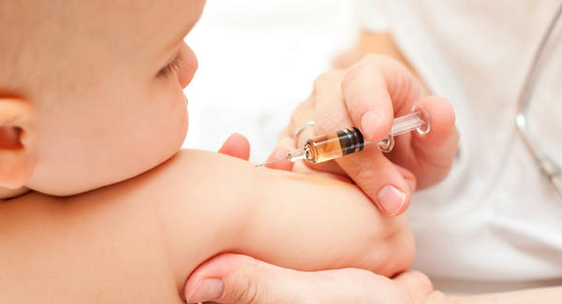
Retrospective Study of Vaxxed/Unvaxxed Children*
Retrospective analysis over ten-year period of a large pediatric practice with a conservative policy towards vaccines
3324 patients in total; 561 never vaccinated; 2763 fully vaccinated; rest variably vaccinated
Overall rate of autism spectrum disorder (0.84%) in the cohort is half that of the US national rate (1.69%)
Fully vaccinated children had a highly significant increased rate of office visits for several common childhood conditions:
Fever, Ear Pain, Ear Infection, Conjunctivitis, Asthma, Allergic Rhinitis, Sinusitis, Breathing Issues, Anemia, Eczema, Hives, Dermatitis, Behavioral Issues, Gastroenteritis, Weight/Eating Disorders
*James Lyons-Weiler and Paul Thomas, International Journal of Environmental Research and Public Health, 2020; 17: 8674.
Notes:
James_Lyons_Weiler_paper_on_vaccines_and_doctor_visits_2020.pdf

Slide 11
Glyphosate and the
MMR Vaccine

Slide 12
The Big Picture
Glyphosate has been detected in multiple vaccines, with highest concentrations in MMR
Many vaccines include gelatin and fetal bovine serum as ingredients, both of which are often contaminated with glyphosate
Glyphosate has been shown to induce neuroexcitotoxicity in the brains of mice due to excess exposure to glutamate
Glutamate has been found to be elevated in the blood and brain of autistic children
A causal link between MMR and autism can be explained by autoimmune attack on myelin basic protein through molecular mimicry with measles hemagglutinin
Hypothesis: glyphosate incorporated into a virus protein can lead to resistance to breakdown and autoimmune disease through molecular mimicry

Slide 13
Glyphosate in Vaccines? From Animal Products?
FDA:
“Animal-derived products used in vaccine manufacture can include amino acids, glycerol [from cow tallow or lard], detergents, gelatin [from cow bones], enzymes and blood. Cow milk is a source of amino acids, and sugars such as galactose ... Cow skeletal muscle is used to prepare broths used in certain complex media.” *
sugars (galactose)
cow tallow --> glycerol
gelatin & amino acids (cow bones)
cow skeletal muscle --> broths
fetal bovine serum
*https://www.fda.gov/vaccines-blood-biologics/questions-about-vaccines/
bovine-derived-materials-used-vaccine-manufacturing-questions-and-answers

Slide 14
Glyphosate in Vaccines? From Animal Products?
FDA:
“Animal-derived products used in vaccine manufacture can include amino acids, glycerol [from cow tallow or lard], detergents, gelatin [from cow bones], enzymes and blood. Cow milk is a source of amino acids, and sugars such as galactose ... Cow skeletal muscle is used to prepare broths used in certain complex media.” *
sugars (galactose)
cow tallow --> glycerol
gelatin & amino acids (cow bones)
cow skeletal muscle --> broths
fetal bovine serum
Cows are exposed to a heavy dose of glyphosate in their feed, and glyphosate has been found in multiple tissue samples from cows as well as in gelatin, fetal bovine serum and cow bones**
*https://www.fda.gov/vaccines-blood-biologics/questions-about-vaccines/
bovine-derived-materials-used-vaccine-manufacturing-questions-and-answers
**A Samsel and S Seneff, Journal of Biological Physics and Chemistry 2017;17:8-32.

Slide 15
Glyphosate Contamination in Vaccines (Parts Per Billion)*
Merck ZOSTAVAX 0.62 Shingles
Merck MMR-II 3.74 Measles, Mumps and Rubella
Merck VARIVAX 0.56 Varicella, Chicken Pox
MERCK PNEUMOVAX ND Pneumococcal 18
MERCK PROQUAD 0.66 Measles, Mumps Rubella, Varicella
GSK ENERGIX-B 0.34 Heptatitis B
Both Anthony Samsel (a toxicologist) and Zen Honeycutt (of Moms Across America) tested multiple vaccines for glyphosate and they found consistent results. Contamination was found mostly in vaccines based on live viruses grown in culture.
*A Samsel and S Seneff, Journal of Biological Physics and Chemistry 2017;17:8-32.

Slide 16
Large Proteins in Vaccines: Allergenic*
“Vaccines clog our lymphatic system and lymph nodes with large protein molecules which have not been adequately broken down by our digestive processes, since vaccines bypass digestion with injections. This is why vaccines are linked to allergies, because they contain large proteins which as circulating immune complexes (CICs) or 'klinkers’ cause our body to become allergic.”
It is possible that glyphosate gets incorporated into proteins by mistake in place of the coding amino acid glycine, and this would make the virus proteins much more allergenic.
*Dave Mihalovic, ND, http://whale.to/v/vaccines_cause_allergies.html

Slide 17
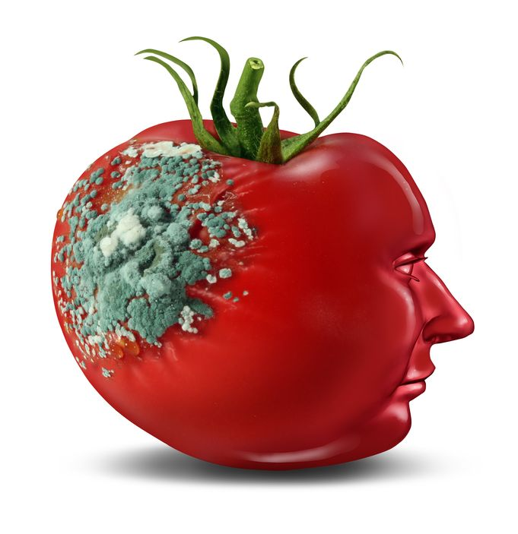
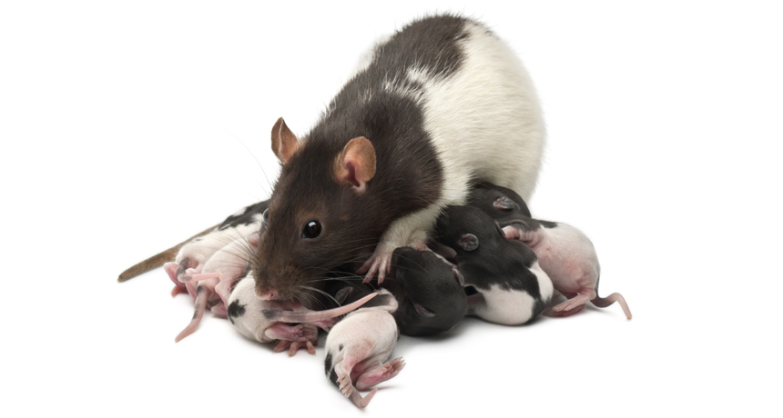
Glyphosate and Glutamate*
Glyphosate is an amino acid and it enters cells via amino acid transporters
Glyphosate causes excess glutamate in the brain by increasing its release and preventing its clearance from the synapses
Acute exposure to rat pups activates NMDA receptors and causes neuron excitotoxicity in the brain
Oxidative stress and neuronal cell death
Increased glutamate levels in the synaptic cleft → excessive extracellular glutamate levels
Decreased glutathione content
Increased peroxidation of lipids (fats)
*http://www.greenmedinfo.com/blog/roundup-weedkiller-brain-damaging-neurotoxin;
Daiane Cattani et al., Toxicology 2014 Jun 5; 320: 34-45.
Notes:
http://www.greenmedinfo.com/blog/roundup-weedkiller-brain-damaging-neurotoxin
acute exposure (30 minutes) and chronic (pregnancy and lactation) exposure.
Why was this referenced??
T. Bohn et al. Food Chemistry 153, 15 June 2014, 207-215.

Slide 18
Symptoms of Adverse Reactions to MMR before and after 2002*
*Data analyzed from the VAERS database

Slide 19
Symptoms of Adverse Reactions to MMR before and after 2002*
Autistic children have a very high rate of seizures.*
Glutamate induces seizures by exciting NMDA receptors.**
*Patrick F Bolton et al., Br J Psychiatry. 2011 Apr; 198(4): 289–294.
**Silvia Josefina López-Pérez et al. Brain Res 2010; 1317: 246-56.
hospitalization
0.00037
seizures
0.0014
autism
0.024
*Data analyzed from the VAERS database

Slide 20
Measles Virus and Hemagglutinin*
The measles virus synthesizes the protein hemagglutinin
Antibodies to hemagglutinin are essential following MMR vaccination to induce immunity
Hemagglutinin bears a sequence resemblance to myelin basic protein (MBP) → potential for autoimmune reaction through molecular mimicry
MBP is essential for the formation of the myelin sheath surrounding nerve fibers
Autoantibodies to MBP along with excessive levels of antibodies to measles hemagglutinin are linked to autism**
*Oldstone, MBA, Ed. Molecular mimicry: Infection inducing autoimmune disease.
Springer Berlin Heidelberg; January 9, 2006.
**VK Singh et al., J Biomed Sci 2002;9(4):359-64.

Slide 21
Autism and Measles Hemagglutinin*
125 autistic children and 92 control children
60% of the children with autism had high levels of antibodies to measles hemagglutinin specific to the MMR vaccine
90% of these had autoantibodies to myelin basic protein (MBP)
0% of the control children had high antibody titers to either hemagglutinin or MBP
There were no elevations in antibodies detected against any proteins in the mumps or rubella viruses
*VK Singh et al., J Biomed Sci 2002;9(4):359-64.

Slide 22
COVID-19

Slide 23
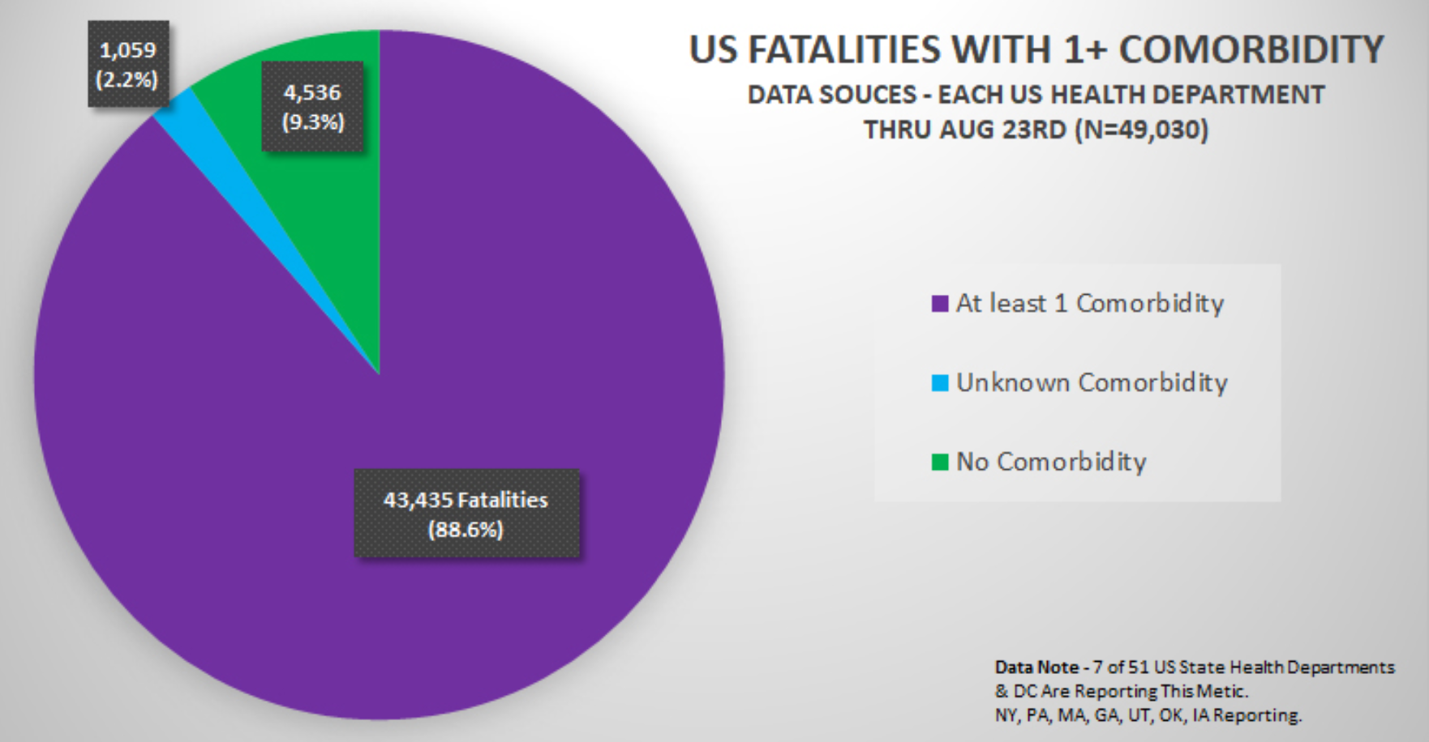
Most People Who Catch COVID 19 Recover*
Over 88%
Most who die have comorbidities
like diabetes, heart disease, obesity, hypertension, etc.
*Henry Ealy et al., Science, Public Health Policy, & Law 2020; 2: 4-22.
Notes:
This means your risk of harm from the vaccine is far greater than your risk of dying from COVID-19, which has an overall noninstitutionalized infection fatality rate of just 0.26%. Among those under the age of 40, the infection fatality rate is a mere 0.01%.

Slide 24
Comorbidities for COVID-19 in New York State*
*https://www.the-hospitalist.org/hospitalist/article/220457/coronavirus-updates/
comorbidities-rule-new-yorks-covid-19-deaths
Notes:
https://www.the-hospitalist.org/hospitalist/article/220457/coronavirus-updates/comorbidities-rule-new-yorks-covid-19-deaths

Slide 25
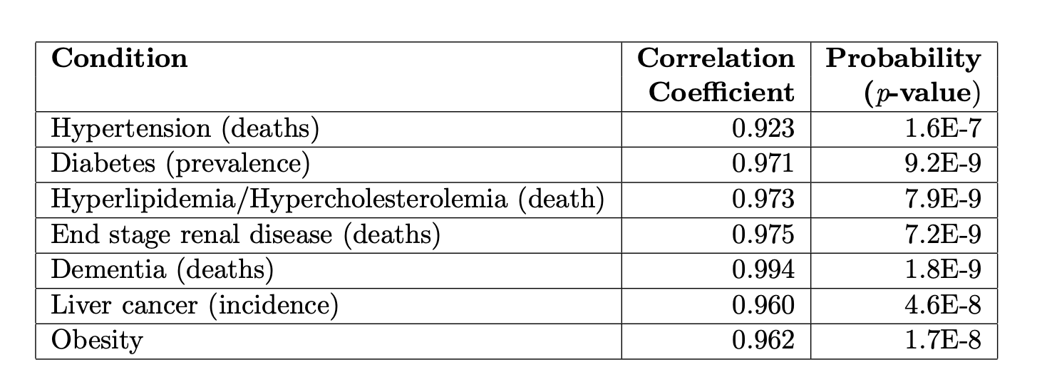
Correlations over time between Glyphosate Usage and Disease in the US*
*Nancy L Swanson et al. J Org Syst 9 (2014) 6-37.

Slide 26
“Neutralising antibodies drive Spike mediated SARS-CoV-2 evasion”*
Cancer patient being treated for recurrent lymphoma with a drug that depletes antibody-producing B cells caught COVID-19
Persistent viral RNA shedding and risk of transmission in the hospital
Patient was moved to a negative-pressure infectious disease isolation room
Patient died 101 days after diagnosis, after being given Remdesivir and two rounds of plasma from recovered patients, which contained antibodies against the virus.
Following antibody exposure, SARS-CoV-2 had acquired several mutations that might have allowed it to elude the antibodies.
New virulent variant from the UK that spreads more easily
Gupta (an author) believes it may have originated from a similar scenario
*SA Kemp et al., medRxiv preprint doi: https://doi.org/10.1101/2020.12.05.20241927
Notes:
https://www.sciencemag.org/news/2020/12/uk-variant-puts-spotlight-immunocompromised-patients-role-covid-19-pandemic

Slide 27
My New Book!
Expected to be released in June 2021
Presents extensive data on glyphosate toxicity to animals and humans
One chapter is devoted to my theories as to how glyphosate suppresses the innate immune system
I believe that this is a primary factor in the inability of countries where glyphosate is heavily used to control the COVID-19 pandemic

Slide 28
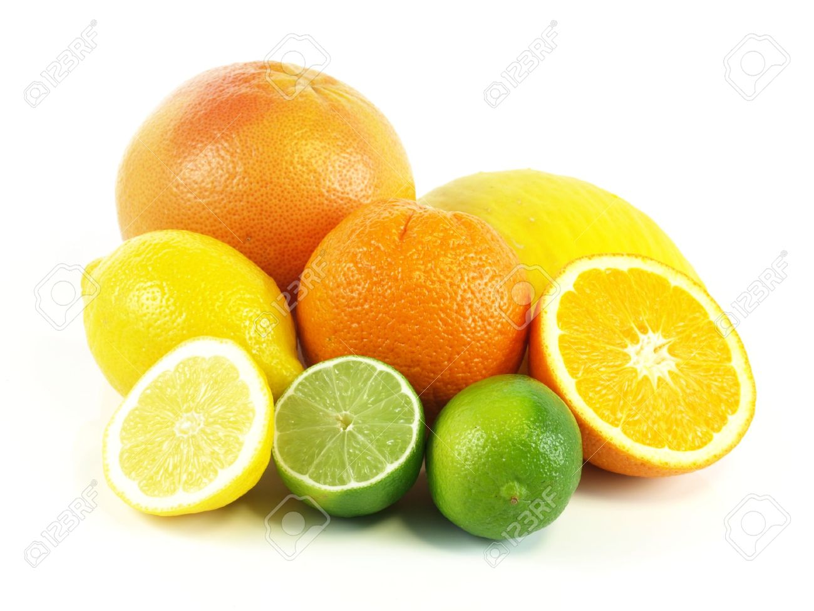
Healthy Living is the Best Way to Protect Yourself
Vitamin D deficiency is associated with 4-fold increased risk of dying from COVID-19
Vitamin C and Vitamin K2 deficiency are also linked to poor outcomes
Countries where fermented foods are a dietary staple have lower infection rates
I believe the most important ways to protect yourself are to eat a certified organic whole-foods diet and to get out in the sunlight without sunscreen and without sunglasses

Slide 29
The Sars-CoV-2 mRNA Vaccines

Slide 30
One Lab Rat to another:
"Are you getting vaccinated?"
Second Rat replies:
"Are you crazy, They haven't finished the Human trials yet"!
Notes:
https://www.youtube.com/watch?v=z72zIfdnjC4&feature=youtu.be

Slide 31
The New COVID-19 mRNA Vaccines
The Pfizer and the Moderna vaccines are based on new technology that involves creating a nanoparticle containing a modified form of the messenger RNA from the SARS-CoV-2 virus that codes for the spike protein
Polyethylene glycol (PEG) is included in the vaccine to keep the RNA from breaking down too quickly
“Instead of delivering a virus or a viral protein, RNA vaccines deliver genetic information that allows the body’s own cells to produce a viral protein. Synthetic mRNA that encodes a viral protein can borrow this machinery to produce many copies of the protein. These proteins stimulate the immune system to mount a response, without posing any risk of infection.”*
*https://news.mit.edu/2020/rna-vaccines-explained-covid-19-1211

Slide 32
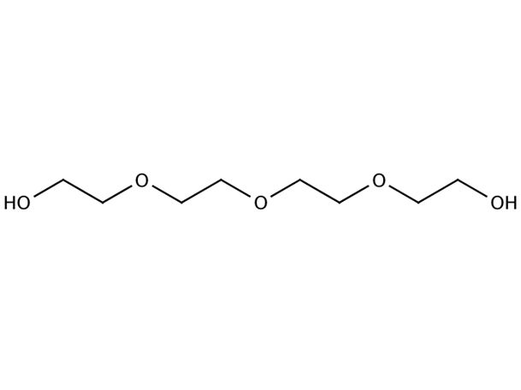
“A Dangerous Inactive Ingredient”*
Polyethylene glycol (PEG) is a major ingredient in the SARS-CoV-2 mRNA-based vaccines
Antibodies to PEG in the vaccine can lead to life-threatening anaphylactic shock
As of January 6, at least 29 US vaccine recipients have developed anaphylaxis
“Scientific studies to quantify the seriousness of the problem estimate that approximately 72% of the US population has acquired anti PEG antibodies. The referenced study used blood samples taken from 1990-1999 and earlier, showing a steady increase over time in the percentage of those with antibodies to PEG, making it conservative to estimate, after two decades, that the incidence is closer to 80% today.”
*https://childrenshealthdefense.org/news/a-dangerous-inactive-ingredient/
Qi Yang et al., Analytical Chemistry 2016, 88, 11804−11812.
Notes:
Life-threatening responses seen in at least eight people
Commandeers

Slide 33
“A Dangerous Inactive Ingredient”*
Polyethylene glycol (PEG) is a major ingredient in the SARS-CoV-2 mRNA-based vaccines
Antibodies to PEG in the vaccine can lead to life-threatening anaphylactic shock
As of January 6, at least 29 US vaccine recipients have developed anaphylaxis
“Scientific studies to quantify the seriousness of the problem estimate that approximately 72% of the US population has acquired anti PEG antibodies. The referenced study used blood samples taken from 1990-1999 and earlier, showing a steady increase over time in the percentage of those with antibodies to PEG, making it conservative to estimate, after two decades, that the incidence is closer to 80% today.”
"CDC: Anaphylaxis Rate With COVID Vax 10 Times Greater Than for Flu Shots"
Molly Walker, Associate Editor, MedPage Today January 6, 2021
https://www.medpagetoday.com/infectiousdisease/covid19/90556
*https://childrenshealthdefense.org/news/a-dangerous-inactive-ingredient/
Qi Yang et al., Analytical Chemistry 2016, 88, 11804−11812.
Notes:
Life-threatening responses seen in at least eight people

Slide 34
“SARS-CoV-2 RNA reverse-transcribed and integrated into the human genome”*
Researchers from MIT and Harvard made an important discovery
Many people continue to test positive for COVID after full recovery
Researchers detected fragments of SARS-CoV-2 proteins fused with human peptide sequences, supporting integration into human DNA
Host can continue to synthesize new viral protein indefinitely
Immune response to virus induces synthesis of LINE-1, a protein that can reverse transcribe RNA into DNA for permanent storage
The AIDS retrovirus virus, HIV, also makes a reverse transcriptase
IS THE VIRUS A MECHANISM FOR RAPID EVOLUTION?
CAN THE SAME THING HAPPEN WITH THE VACCINE?
*Liguo Zhang et al., bioRxiv December 13, 2020, https://doi.org/10.1101/2020.12.12.422516.

Slide 35
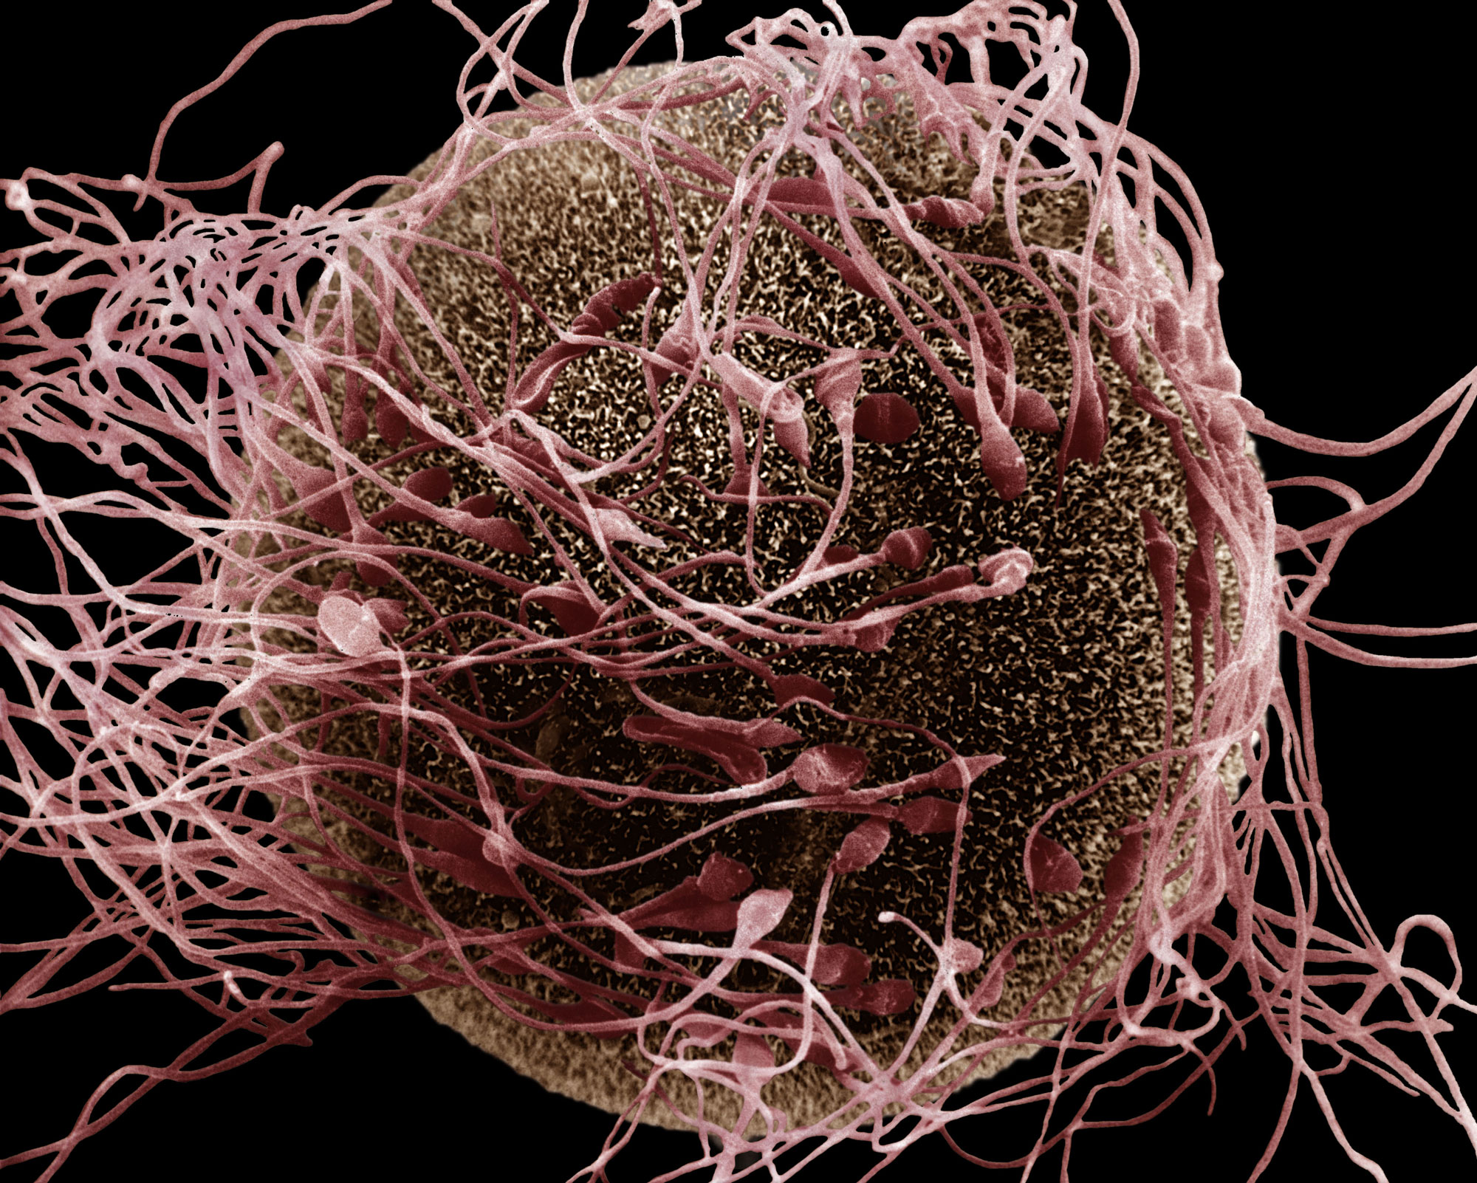
Sperm can insert DNA (from RNA) into the fertilized embryo and transfer it to offspring*
“We recently discovered a reverse transcriptase (RT) activity [e.g., LINE-1] in mouse spermatozoa that can reverse-transcribe exogenous RNA molecules into cDNA copies”
“Spliced EGFP cDNA is transferred from spermatozoa to early embryos at fertilization and propagated to fetuses and born animals” and passed on to their offspring!
Sperm-mediated “reverse” gene transfer happens “when these cells are incubated with exogenous RNA molecules”
*Carmine Pittoggi et al., Molecular Reproduction and Development 2006; 73: 1239-1246.
Notes:
Enhanced green fluorescent protein

Slide 36
Antibody-Dependent Enhancement (ADE)*
The vaccine has the potential to backfire:
Antibody enhances uptake into macrophages leading to increased viral infection and replication
Antibody increases release of cytokines causing enhanced risk of excessive inflammation and cytokine storm
“ADE has been observed in SARS, MERS and other human respiratory virus infections including RSV and measles, which suggests a real risk of ADE for SARS-CoV-2 vaccines and antibody-based interventions.”
“Thus, the absence of ADE evidence in COVID-19 vaccine data so far does not absolve investigators from disclosing the risk of enhanced disease to vaccine trial participants, and it remains a realistic, non-theoretical risk to the subjects.”**
*Wen Shi Lee et al., Nature Microbiology 2020; 5: 1185-1191.
**T Cardozo and R Veazey, Int J Clin Pract 2020 Oct 28; e13795k [Epub ahead of print]
Notes:
https://www.nature.com/articles/s41564-020-00789-5
COVID_vaccine/ADE_and_SARS_2020.pdf
Vaccine_paper/Cardozo_ADE_real_possibility_warn_patients.pdf

Slide 37
Antibody-Dependent Enhancement (ADE)*
The vaccine has the potential to backfire:
Antibody enhances uptake into macrophages leading to increased viral infection and replication
Antibody increases release of cytokines causing enhanced risk of excessive inflammation and cytokine storm
“ADE has been observed in SARS, MERS and other human respiratory virus infections including RSV and measles, which suggests a real risk of ADE for SARS-CoV-2 vaccines and antibody-based interventions.”
“Thus, the absence of ADE evidence in COVID-19 vaccine data so far does not absolve investigators from disclosing the risk of enhanced disease to vaccine trial participants, and it remains a realistic, non-theoretical risk to the subjects.”**
In the COVID-19 vaccine trials, adverse reactions to the second shot in the two-shot series were much more severe than reactions to the first shot.*
*Lindsey R Baden et al. Efficacy and Safety of the mRNA-1273 SARS-CoV-2 Vaccine. The New England Journal of Medicine Dec. 10, 2020. DOI: 10.1056/NEJMoa2035389.
*Wen Shi Lee et al., Nature Microbiology 2020; 5: 1185-1191.
**T Cardozo and R Veazey, Int J Clin Pract 2020 Oct 28; e13795k [Epub ahead of print]
Notes:
https://www.nature.com/articles/s41564-020-00789-5
COVID_vaccine/ADE_and_SARS_2020.pdf
Vaccine_paper/Cardozo_ADE_real_possibility_warn_patients.pdf

Slide 38
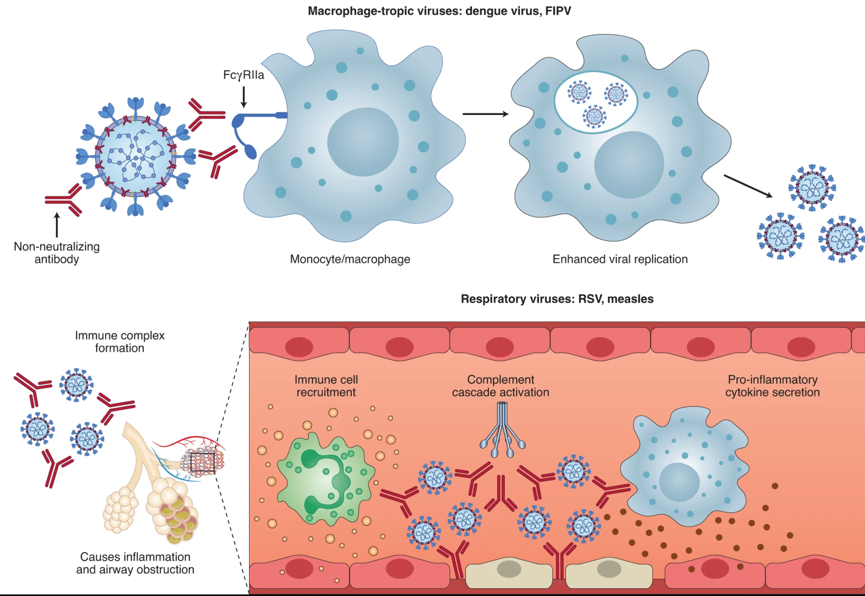
*Figure 1. Wen Shi Lee et al., Nature Microbiology 2020; 5: 1185-1191.
Enhanced viral replication
Cytokine storm

Slide 39
“Potential antigenic cross-reactivity between SARS-CoV-2 and human tissue with a possible link to an increase in autoimmune diseases”*
Cross reaction between spike protein antibody and tissue proteins
Protein Diseases
transglutaminase Celiac disease
extractable nuclear antigens: Scleroderma, lupus
myelin basic protein: Multiple sclerosis, autism
mitochondria: Lupus, primary billiary cirrhosis, hepatitis, myocarditis
nuclear antigen: Sjogren's syndrome, mixed connective disease, lupus
myosin: Myocarditis, dilated cardiomyopathy, Chagas' heart disease, Kawasaki disease, rheumatic fever
thyroid peroxidase: Hashimoto's thyroid disease
S100B: Brain metastases from lung disease, epilepsy, multiple sclerosis, and Parkinson's disease
*Aristo Vojdani and Datis Kharrazian, Clinical Immunology 217 (2020) 108480.
Notes:
https://www.ncbi.nlm.nih.gov/pmc/articles/PMC7246018/
COVID/cross_reactivity_spike_protein_human_proteins.pdf
Commercially available mouse monoclonal antibody made against recombinant SARS coronavirus spike protein a

Slide 40
*
I predict that a massive vaccination campaign against COVID-19 may result in a dramatic increase in all sorts of autoimmune diseases
*Nature News Feature. https://www.nature.com/articles/d41586-021-00149-1

Slide 41
Problems with the vaccine spike protein*
"Is it possible the spike protein itself causes the tissue damage associated with Covid-19?"
The S1 subunit localizes to the endothelia of microvessels in the mouse brain and is a potent neurotoxin."
"So the spike S1 subunit of SARS-CoV-2 alone is capable of being endocytosed by ACE2 positive endothelia in both human and mouse brain, with a concomitant paucicellular microencephalitis that may be the basis for the neurologic complications of COVID-19."
*https://beta.regulations.gov/document/FDA-2020-N-1898-0246
Comment from J. Patrick Whelan MD PhD
Food and Drug Administration on Dec 8, 2020

Slide 42
Problems with the vaccine spike protein*
"Is it possible the spike protein itself causes the tissue damage associated with Covid-19?"
The S1 subunit localizes to the endothelia of microvessels in the mouse brain and is a potent neurotoxin."
"So the spike S1 subunit of SARS-CoV-2 alone is capable of being endocytosed by ACE2 positive endothelia in both human and mouse brain, with a concomitant pauci-cellular microencephalitis that may be the basis for the neurologic complications of COVID-19."
"As important as it is to quickly arrest the spread of the virus by immunizing the population, it would be vastly worse if hundreds of millions of people were to suffer long-lasting or even permanent damage to their brain or heart microvasculature as a result of failing to appreciate in the short-term an unintended effect of full-length spike protein-based vaccines on these other organs.”
*https://beta.regulations.gov/document/FDA-2020-N-1898-0246
Comment from J. Patrick Whelan MD PhD
Food and Drug Administration on Dec 8, 2020
Notes:
Possi

Slide 43
How Long Will the Vaccine Be Effective?
The spike protein mutates very quickly, especially in immune compromised individuals
New strains of SARS-CoV-2 are appearing at an alarming rate
New strains from the UK, South Africa and Brazil spread infection much more rapidly
Will the vaccine be able to keep up with the multitude of variants appearing in greater and greater numbers?
Will the vaccine increase the opportunity for variants to appear?
Daily new confirmed COVID-19 cases per million people
1000
800
600
United Kingdom
400
200
Ireland
Mar 1, 2020
Jan 7, 2021
Notes:
UK – 16 mutations, 8 in spike protein. Brazil -12 mutations in spike protein.

Slide 44
“Large Numbers of Health Care and Frontline Workers Are Refusing Covid-19 Vaccine”*
“Despite the Covid-19 death count in the United States rapidly accelerating, a startlingly high percentage of health care professionals and frontline workers throughout the country—who have been prioritized as early receipts of the coronavirus vaccine—are reportedly hesitant or outright refusing to take it, despite clear scientific evidence that the vaccines are safe and effective.”
*Tommy Beer, Forbes
https://www.forbes.com/sites/tommybeer/2021/01/02
large-numbers-of-health-care-and-frontline-workers-are-refusing-covid-19-vaccine/

Slide 45
Deep Thoughts and Speculation
Viruses are a foundational component of all life on earth
Viruses are almost surely the primary agent in rapid evolution. following extreme stress (such as from toxic environmental chemicals)
Viral infectious diseases in childhood provide long term protection from chronic disease in mysterious ways
A person with a healthy innate immune system can easily clear a virus like SARS-CoV-2 without even developing antibodies
A vaccine intentionally bypasses the innate immune system to induce abundant antibody production
Antibodies in the absence of infection (e.g., induced by a vaccine) can more easily become autoantibodies, and can lead to debilitating autoimmune disease

Slide 46
Summary
Vaccines are assumed to be an essential part of routine healthcare, but they may be doing more harm than good to children’s health
Glyphosate is another overlooked factor in our failing health
Glyphosate has been found as a contaminant in live-virus vaccines (especially MMR) and it may be a significant factor in the adverse reactions
Glyphosate may play a significant role in bad outcomes from COVID 19
The government should be emphasizing healthy living to boost immune function
The SARS-CoV-2 mRNA vaccines are a new unproven technology
There are many unknown but plausible ways that they could cause harm
We are in the middle of a giant experiment on a huge population
Health workers refusing the vaccine show that the warnings are being heeded

