Slide 1
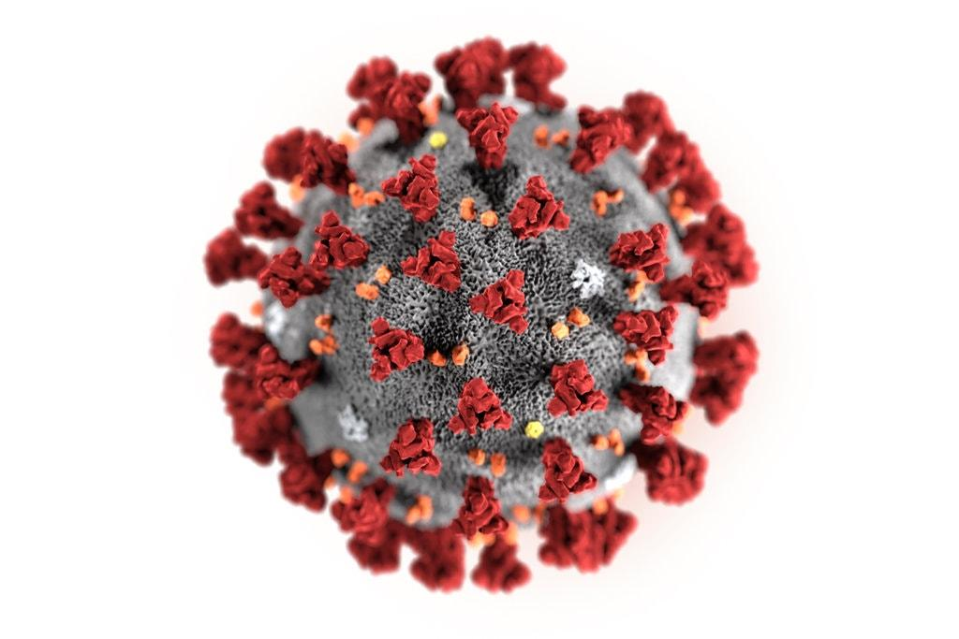
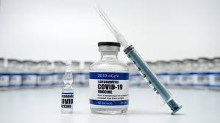
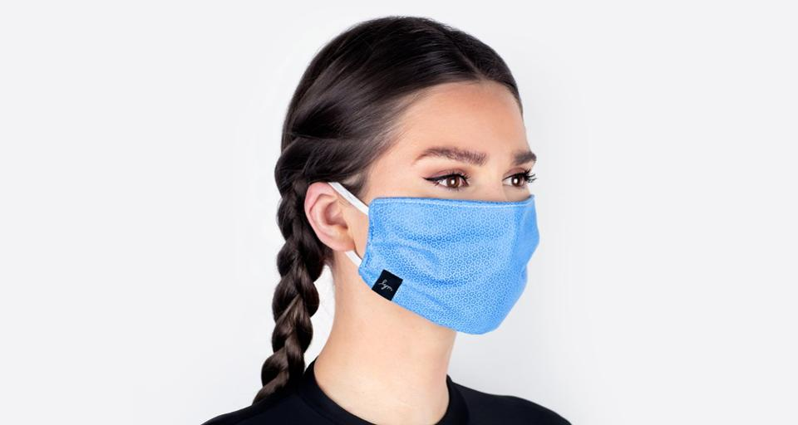
SARS-CoV-2 mRNA Vaccines: Is the Risk Worth the Benefit?
Stephanie Seneff
MIT CSAIL
Rational Responses to Pandemic Challenges Symposium
Boston, Massachusetts
October 12, 2021
Notes:
This set of slides originated from Laszlo_August/Laszlo_August_2021.pptx

Slide 2
Overview

Slide 3
“Worse than the Disease? Reviewing Some Possible Unintended Consequences of the mRNA Vaccines Against COVID-19”*
The mRNA vaccines are a poorly evaluated unprecedented
technology with many unknowns
Some potential adverse consequences:
Pathogenic priming, multisystem inflammatory disease and autoimmunity
Allergic reactions and anaphylaxis
Emergence of novel variants of SARS-CoV-2
Antibody dependent enhancement
Activation of latent viral infections
Neurodegeneration and prion diseases
*S Seneff and G Nigh. IJVTPR 2021; 2(1): 38-79.
Notes:
https://dailyexpose.co.uk/2021/06/10/dr-tess-lawrie-demands-dr-june-raine-the-chief-exec-of-mhra-halts-the-covid-vaccine-programme-immediately-due-to-severe-adverse-reactions-and-deaths/
James Lyons Weiler has a paper about pathogenic priming.

Slide 4
mRNA vaccines contain the genetic code to make spike protein
The mRNA is incorporated into a lipid particle that simulates a human LDL particle
A synthetic cationic (positively charged) lipid is added to act as an adjuvant – very toxic to the cells
Large quantities of polyethylene glycol (PEG) are added to further protect the mRNA from breakdown
The RNA is carefully engineered to resist breakdown and to produce spike protein at high rate

Slide 5
As of August 27,2021
https://vaersanalysis.info/2021/09/03/vaers-summary-for-covid-19-vaccines-through-8-27-2021/

Slide 6
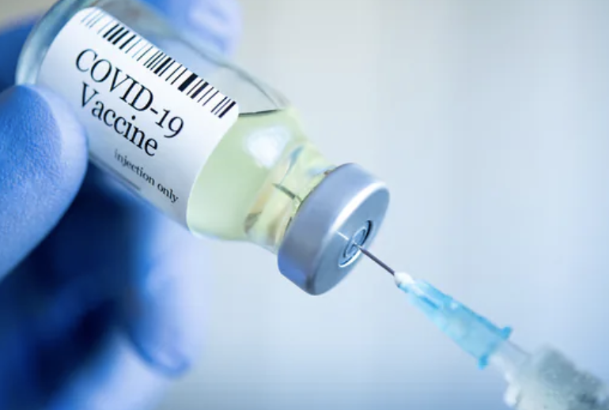
“Substantial Differences in SARS-CoV-2 Antibody Responses Elicited by Natural Infection and mRNA Vaccination”*
After the second dose of the vaccine, antibody titers were up to 10 times higher than those of patients who had recovered from natural COVID-19 infection
In patients with COVID-19, the most severe disease is associated with the highest number of antibodies**
High antibody titers lead to autoimmune disease
*Rafael Assis et al. bioRxiv preprint. May 19, 2021. doi: https://doi.org/10.1101/2021.04.15.440089
**Vincent Legros et al., Cellular & Molecular Immunology 2021; 18: 318-327.
Notes:
https://www.contagionlive.com/view/immune-response-from-mrna-covid-19-vaccines-is-more-robust-than-natural-infection

Slide 7
*
I predict that a massive vaccination campaign against COVID-19 may result in a dramatic increase in all sorts of autoimmune diseases
*Nature News Feature. https://www.nature.com/articles/d41586-021-00149-1

Slide 8
Antibody-Dependent Enhancement (ADE)
and Breakthrough Variants

Slide 9
Antibody-Dependent Enhancement (ADE)*
The vaccine has the potential to backfire:
Non-neutralizing antibody enhances uptake into macrophages via Fcγ receptors leading to increased viral infection and replication
Antibody increases release of cytokines causing enhanced risk of excessive inflammation and cytokine storm
“ADE has been observed in SARS, MERS and other human respiratory virus infections including RSV and measles, which suggests a real risk of ADE for SARS-CoV-2 vaccines and antibody-based interventions.”*
“Thus, the absence of ADE evidence in COVID-19 vaccine data so far does not absolve investigators from disclosing the risk of enhanced disease to vaccine trial participants, and it remains a realistic, non-theoretical risk to the subjects.”**
*Wen Shi Lee et al., Nature Microbiology 2020; 5: 1185-1191.
**T Cardozo and R Veazey, Int J Clin Pract 2021; 75(3): e13795.
Notes:
https://www.nature.com/articles/s41564-020-00789-5
COVID_vaccine/ADE_and_SARS_2020.pdf
Vaccine_paper/Cardozo_ADE_real_possibility_warn_patients.pdf

Slide 10
“SARS-CoV-2 evolution during treatment of chronic infection”*
Cancer patient being treated for recurrent lymphoma with a drug that depletes antibody-producing B cells caught COVID-19
Persistent viral RNA shedding and risk of transmission in the hospital
Patient died 101 days after diagnosis, after being given two rounds of plasma from recovered patients, which contained antibodies against the virus
Following antibody exposure, SARS-CoV-2 had acquired several mutations that might have allowed it to elude the antibodies.
This is a good model for what happens when you vaccinate an immune-compromised person
*SA Kemp et al., Nature 2021; 592: 277-282.
Notes:
https://www.sciencemag.org/news/2020/12/uk-variant-puts-spotlight-immunocompromised-patients-role-covid-19-pandemic

Slide 11
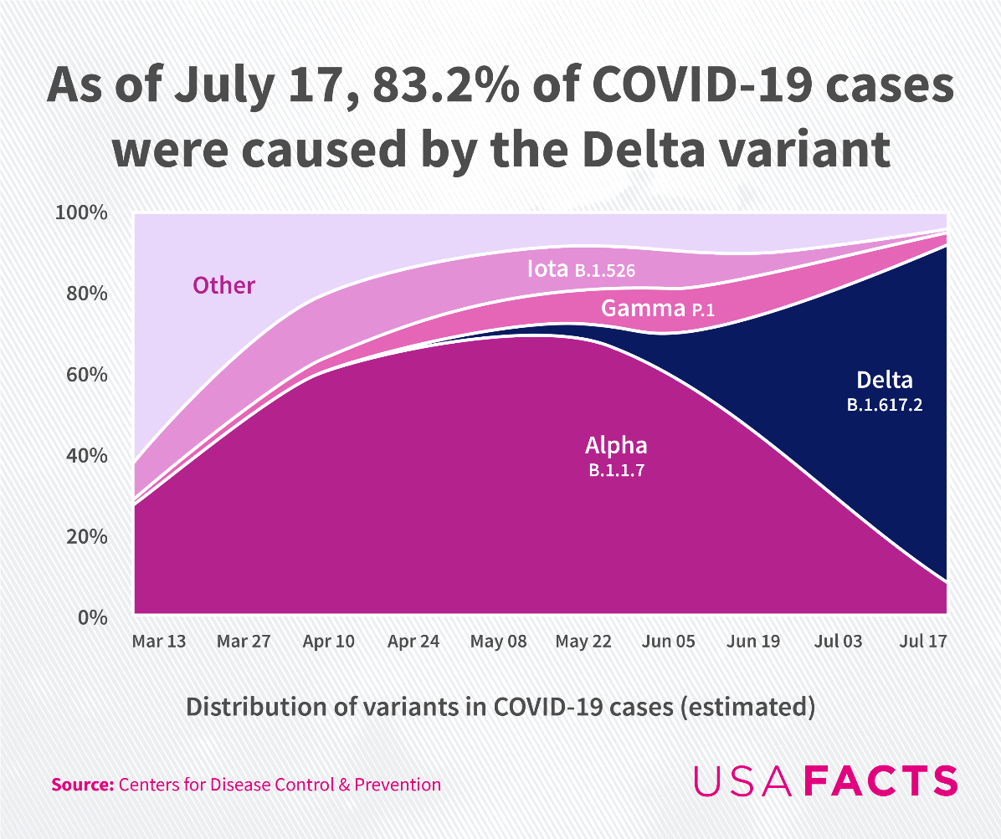
As of September 20, the number had risen to over 99%
Delta variant binds less well to neutralizing antibodies and it binds better to facilitating antibodies*
*Nouara Yahi et al. Journal of Infection August 9, 2021 [Epub ahead of print] doi: 10.1016/j.jinf.2021.08.010
Notes:
out of India
COVID_vaccine/Delta_variant_increases_risk_of_ADE.pdf

Slide 12
“An Effective COVID-19 Vaccine Needs to Engage T Cells”*
All the vaccines currently on the market are specific to the spike protein
Natural infection induces antibodies to many other viral proteins
T cells exposed to internal viral proteins can become memory T cells that respond very quickly to a new infection
They are much more long lasting than memory B cells (up to 17 years!)
These memory T cells can induce a rapid antibody response in B cells to a mutated form of the spike protein
Memory B cells can lose their effectiveness because their antibodies are specific to an obsolete version of the spike protein
Conclusion: natural infection induces far better protection than the vaccines
*Karsten Sauer and Tim Harris. Frontiers in Immunology 2020; 11: 581807.
Notes:
COVID_vaccine/vaccines_must_engage_T_cells.pdf

Slide 13
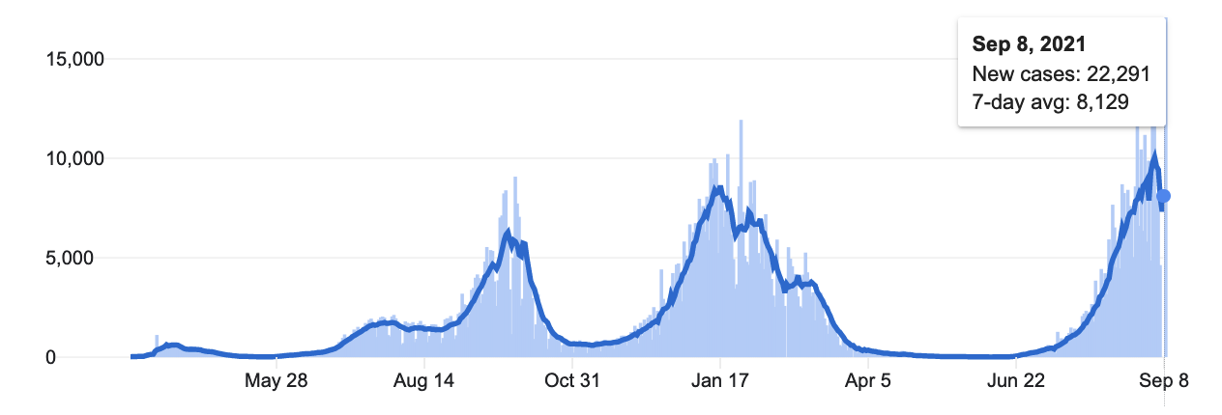
August 18,2020
"Unlike previous epicenters of infection in Israel’s crowded, less-vaccinated ultra-Orthodox communities, this scourge primarily took hold in well-vaccinated, middle-class suburbs."

Slide 14
Neutralizing antibodies fall dramatically in six months*
Red: males; Blue: females
*Mehul S. Suthar et al. bioRxiv preprint Sept. 20, 2021. Doi: 10.1101/2021.09.30.462488.
Notes:
COVID_vaccines/neutralizing_antibodies_fall_fast_vaccines_bioRxiv.pdf
42 days after first vaccine.

Slide 15
“Large-scale study of antibody titer decay following BNT162b2 mRNA vaccine or SARS-CoV-2 infection”*
antibody titer
Vaccine
Initial levels of antibody are much higher in vaccinated patients (Pfizer mRNA vaccine), but they decrease faster.
antibody titer
Infection
*Ariel Israel et al. medRxiv preprint Aug. 22, 2021. doi: 10.1101/2021.08.19.21262111.
Notes:
https://www.medrxiv.org/content/10.1101/2021.08.19.21262111v1
COVID_vaccine/vaccine_antibodies_fade_faster.pdf

Slide 16
Positive trend between vaccination rate and infection rate*
Israel
Number of cases during one week before September 3. 2021
*S. V. Subramanian et al. European Journal of Epidemiology Sept 30, 2021 [Epub ahead of print]
Notes:
Increases in COVID‐19 are unrelated to levels of vaccination across 68 countries and 2947 counties in the United States
where?

Slide 17
Outbreak in Israeli Hospital, July 2021*
24% of the patients (23 people) were infected
An additional 19 people (staff and family members) were also infected
39 out of 42 cases were fully vaccinated.
Median time of 25 weeks after vaccination
Index patient was fully vaccinated
Several transmissions occurred among people wearing face masks
14/23 patients became severely sick or died (five deaths)
The two unvaccinated patients had mild disease
Warning about waning immunity
*Pnina Shitrit et al. Euro Surveill 2021; 26(39): 2100822.
Notes:
COVID_vaccine/Israel_outbreak_Delta_variant_hospital.pdf

Slide 18
Myocarditis and Cardiovascular Disease

Slide 19
The Big Picture
The mRNA vaccines are causing inflammation in the heart in young people who have near zero risk of dying from COVID-19
This can lead to permanent damage to the heart
The spike protein S1 subunit detaches and becomes free to bind to ACE2 receptors which are present at high levels in the heart
The suppression of ACE2 by spike S1 causes upregulation of angiotensin II, which induces inflammation (myocarditis) and cardiovascular disease
S1 has been found in COVID-19 patients long after the virus is cleared, and is believed to play a critical role in “long-haul COVID”
S1 has also been found in the vasculature following vaccination

Slide 20
S1 detected in the blood following vaccination*
Eleven out of 13 health care workers had detectable levels of spike protein and/or S1 in their blood plasma as early as 1 day and up to 28 days following the first mRNA vaccine, with a peak level on average after five days
*Ogata et al. Clinical Infectious Diseases 2021; ciab465. [Epub ahead of print] doi: 10.1093/cid/ciab465.

Slide 21
S1 is toxic to mice*
S1 alone caused COVID-19-like lung symptoms in mice humanized with ACE2 receptor: Immune cell infiltration, cytokine storm, impaired barrier function
*Ruben M. L. Colunga Biancatelli et al. Am J Physiol Lung Cell Mol Physiol 2021; 321: L477–L484

Slide 22
SARS-CoV-2 mRNA Vaccination-Associated Myocarditis in Children Ages 12-17: A Stratified National Database Analysis”*
Rate of myocarditis after two shots of Pfizer vaccine was 162 cases per million in boys 12-15 years old
About 86% required hospitalization
May lead to permanent damage and heart failure
Risk of a healthy adolescent being taken to hospital with COVID-19 in the next three months is 44 per million
*Tracy Beth Høeg et al. medRxiv preprint. August 30, 2021.
doi: https://doi.org/10.1101/2021.08.30.21262866
Notes:
https://www.medrxiv.org/content/10.1101/2021.08.30.21262866v1
COVID_vaccine/myocarditis_mRNA_vaccines_children.pdf

Slide 23
Myocarditis Reports in VAERS*
Sweden and Denmark have decided to pause the use of the Moderna vaccine for all children and young adults
Through September 24, 2021
16-and-over vaccination began December 14, 2020
12-15-year-old vaccination began May 10, 2021
*https://openvaers.com/covid-data/myo-pericarditis

Slide 24
Conclusion
The mRNA vaccines against COVID-19 are neither safe nor effective
Reports of adverse reactions in the VAERS database are much higher than for any other vaccine
The vaccine induces exposed cells to produce large amounts of spike protein, which is toxic
This causes myocarditis in young people who are very safe from COVID-19
The vaccine induces a very high antibody response, which however can lead to autoimmune disease
Vaccine-based immunity fades quickly over time; frequent booster shots may become routine
The vaccines may be responsible for the rapid emergence of vaccine-resistant mutants
Antibody Dependent Enhancement (ADE) is a real risk that may make the vaccinated susceptible to worse symptoms than the unvaccinated

