Slide 1
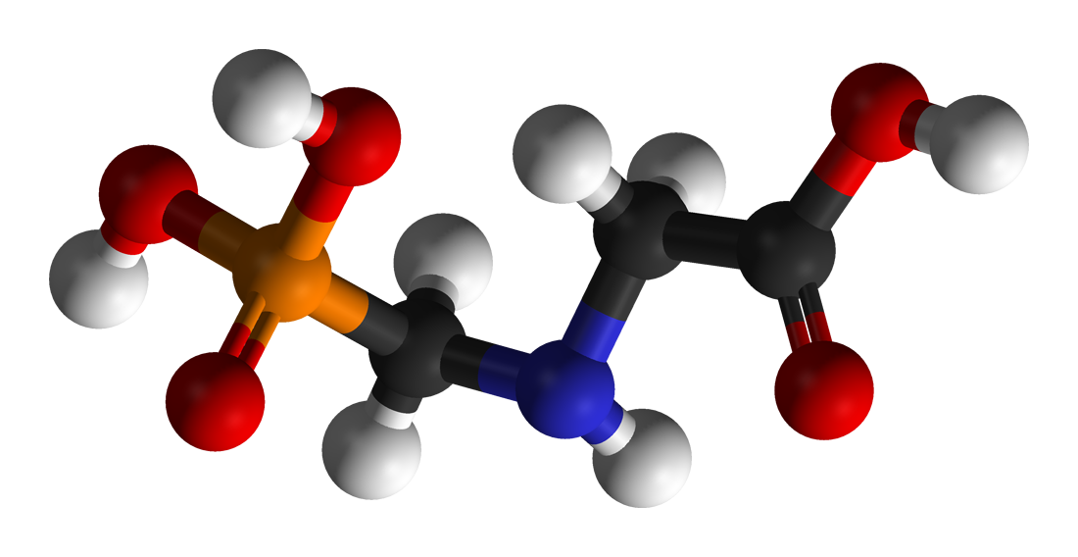
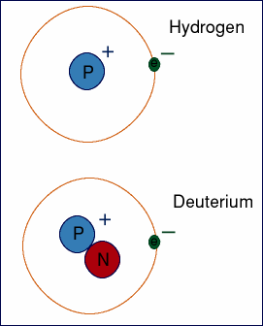
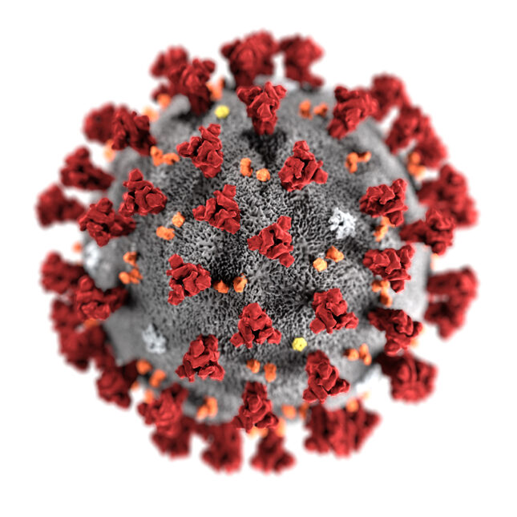
Glyphosate, Deuterium and COVID-19
Stephanie Seneff
MIT CSAIL
WAPF Wise Traditions Conference
November 6, 2021
Notes:
Csail/2020/book/COVID/WAPF_slides.text

Slide 2
Download these slides
Powerpoint:
https://people.csail.mit.edu/seneff/2021/WAPF_2021_Part1.pptx
PDF:
https://people.csail.mit.edu/seneff/2021/WAPF_2021_Part1.pdf

Slide 3
“Men occasionally stumble over the truth, but most of them pick themselves up and hurry off as if nothing happened.”
-- Winston Churchill

Slide 5
Outline
Introduction
Gut Microbes and Hydrogen-Containing Gases
COVID-19, Glyphosate, Biofuels & Vaping
Importance of NAD(P)(H) Redox System to Mitochondrial Health
SARS-CoV-2 Infection in the Lungs: An Extraordinary Response
Rebooting the Mitochondria
Tuberculosis and COVID-19
Vitamin K2!
Advice for Staying Healthy in a Pandemic
Summary

Slide 6
Introduction

Slide 7
Deuterium = “Heavy” Hydrogen
Hydrogen has one proton and one electron
Deuterium has one proton, one electron and one neutron
~ Twice as heavy as hydrogen
Present in ocean water at 155.8 ppm
Has distinct physical and chemical properties compared to hydrogen
The body has evolved complex mechanisms to deal with deuterium

Slide 8
The Big Picture
Deuterium is a natural rare isotope of hydrogen with distinct physical properties
Exposure to high concentrations of D₂O is life threatening
Living organisms have developed sophisticated strategies involving specialized enzymes to deal with it
Gut microbes recycle hydrogen gas to deplete deuterium
Mitochondria require low-deuterium water to function properly
Glyphosate disrupts deuterium homeostasis, causing symptoms of deuterium intoxication

Slide 9
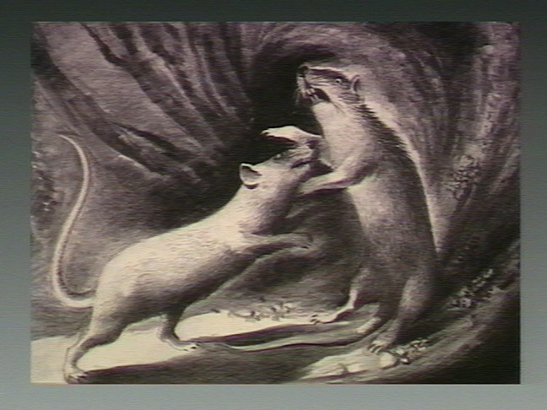
"The Pathologic Anatomy of Deuterium Intoxication"*
Mice received 5% dextrose solution in D₂O water
"Their appetites were voracious, and constant savage attacks upon each other were continually in progress.”
“Eventually, at varying intervals, the animals became hypoactive, lethargic, and dramatically weak.”
“Death occurred in all cases within 6-10 days.”
*Paul Bachner et al. PNAS 1964; 51: 464-471.
Notes:
GregNigh/deuterium_intoxication_mice_1964.pdf

Slide 10
Deuterium in Water and Depression*
Prevalence of Depression
Deuterium levels in tap water
*Tatyana Strekalova et al. Behavioural Brain Research 277 (2015) 237–244.
Notes:
2020/GregNigh/deuterium_depression_US_water_2015.pdf
Fig. 1. Depression rates and deuterium content of tap water. (A) Correlation between reported rates of major depressive disorder in US states and content of deuterium in tap water in the USA. (B) The reported prevalence of individuals with depression in among adults aged ≥18 years in each US state [Centers for Disease Control and Prevention. Mental illness surveillance among adults in the United States. MMWR 2011;60 (Suppl):1–30]. (C) Geographical distribution of average deuterium content in the tap water in the continental USA from samples collected from each state for 2004–2013.

Slide 11
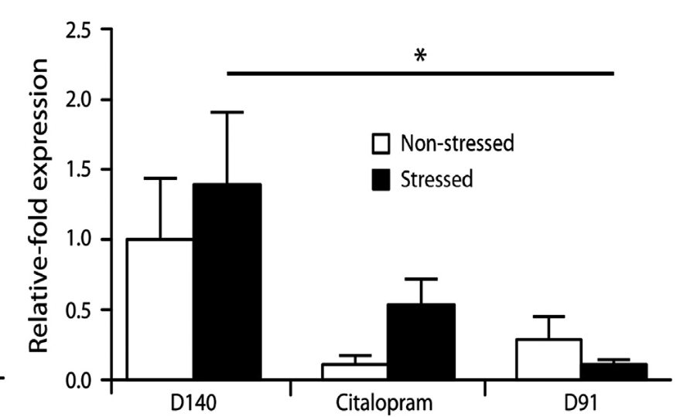
Deuterium-Depleted Water (DDW) Administered to Mice*
Expression level of SERT (serotonin transporter)
Reduced expression of behaviors characteristic of depression
Changes in EEG parameters of sleep similar to those associated with noradrenaline and serotonin reuptake inhibitors
Effects comparable to SSRI citalopram
*Tatyana Strekalova et al. Behavioural Brain Research 277 (2015) 237–244.
Notes:
2020/GregNigh/deuterium_depression_US_water_2015.pdf

Slide 12
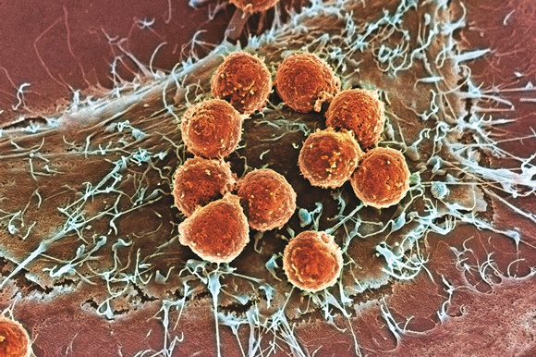
Deuterium Depleted Water to Treat Cancer*
Deuterium depletion inhibits growth of cancer cells in vitro
129 small cell and non-small cell lung cancer patients consumed deuterium- depleted drinking water along with standard cancer therapy
Median survival time was 2-4 times longer than generally observed in lung cancer patients
DDW suppressed expression of oncogenes Bcl2, Kras and Myc in mouse lungs
*Z Gyöngyi et al. Nutr Cancer 2013;65(2):240-6.
Notes:
https://www.ncbi.nlm.nih.gov/pubmed/23441611
./DDW_lung_cancer_survival_2013.pdf

Slide 13
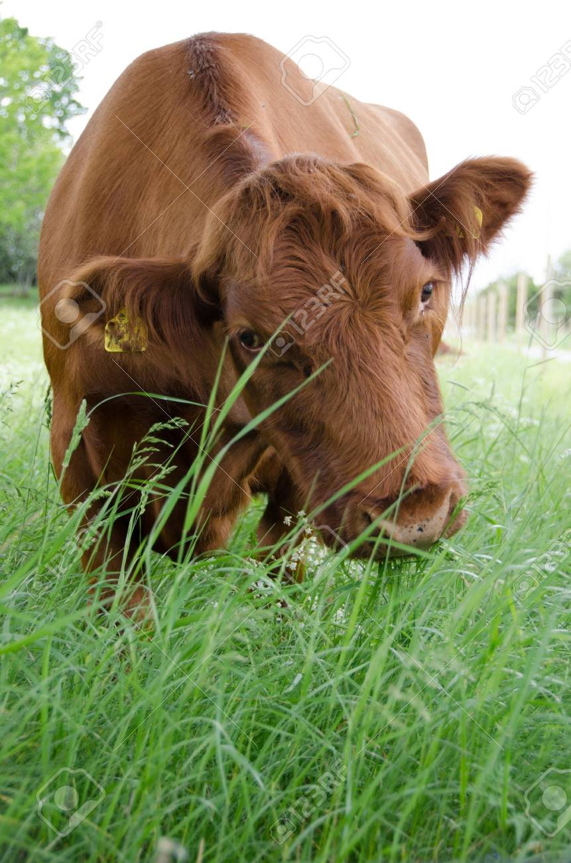
Deuterium in Foods and Mast-Cell Activation Syndrome*
Deuterium increases histamine release from mast cells
Plants get rid of deuterium by storing it in sugar and starch
Fruits, root vegetables (potato) and grains are high in deuterium
Meats from grain-fed animals are high in deuterium
Leafy green vegetables, animal fats (lard, tallow, butter) and plant fats (avocado, coconut, olive oil) are low in deuterium
Grass-fed beef and dairy products derived from pastured cows are excellent sources of low-deuterium fat
*https://healinghistamine.com/deuterium-histamine-intolerance/

Slide 14
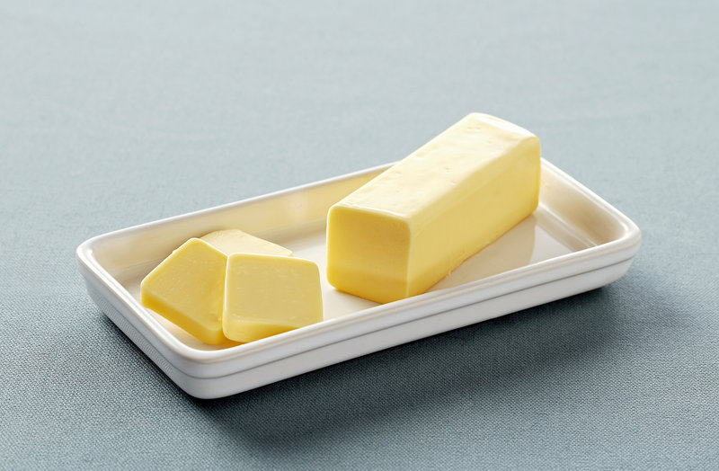
Concentrations of Deuterium in Various Food Items*
ocean water 156 ppb
cottage cheese 151
wheat 150
sugar 146
cheese curds 136
sunflower oil 130
butter 124
pork fat 118

Slide 15
Deuterium Levels are Variable in Fluids*
Deuterium in Antarctic glacier water is only 89 ppm. (compared to 156 in sea water)
Deuterium is higher in rainwater at the equator than at the poles
Due to higher evaporation off of descending water droplets
Deuterium levels are different in different body fluids:
Saliva > Blood > Breast milk
Salivary glands selectively secrete deuterium
*Alexander Basov et al. Nutrients 2019; 11: 1903.
Notes:
GregNigh/DDW_influence_on_cellular_energetics_2019.pdf

Slide 16
Glyphosate: The Big Picture
Glyphosate is the active ingredient in the herbicide Roundup
Pervasive in the food supply
Considered to be safe for humans but there is increasing doubt that this is true
Glyphosate is an amino acid analogue of the coding amino acid glycine
My research suggests that it is getting inserted into certain proteins by mistake in place of glycine, and that this is very disruptive
There are strong correlations between the rise in glyphosate usage in the US and the rise in multiple neurological, oncological, autoimmune and metabolic diseases*
*NL Swanson et al. J Org Systems 2014; 9: 6-37.

Slide 17
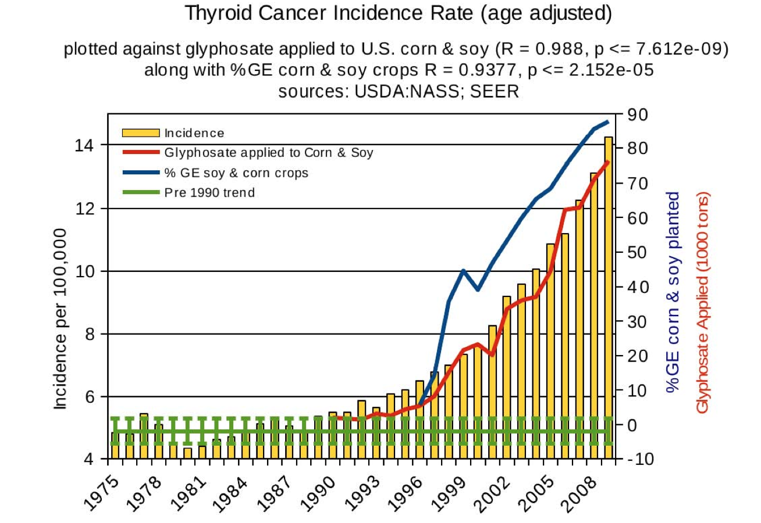
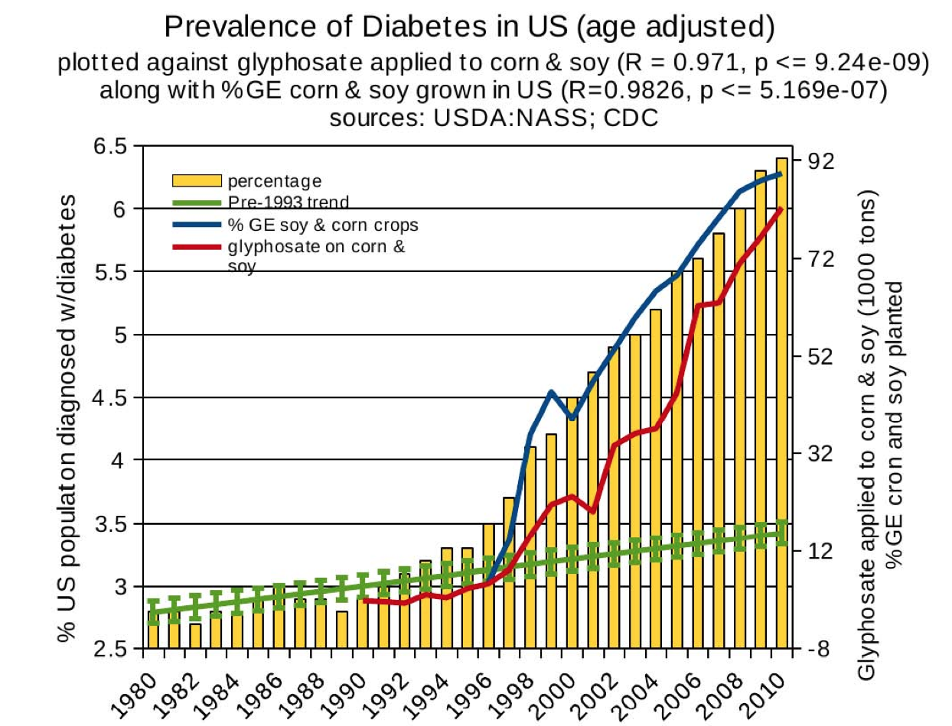
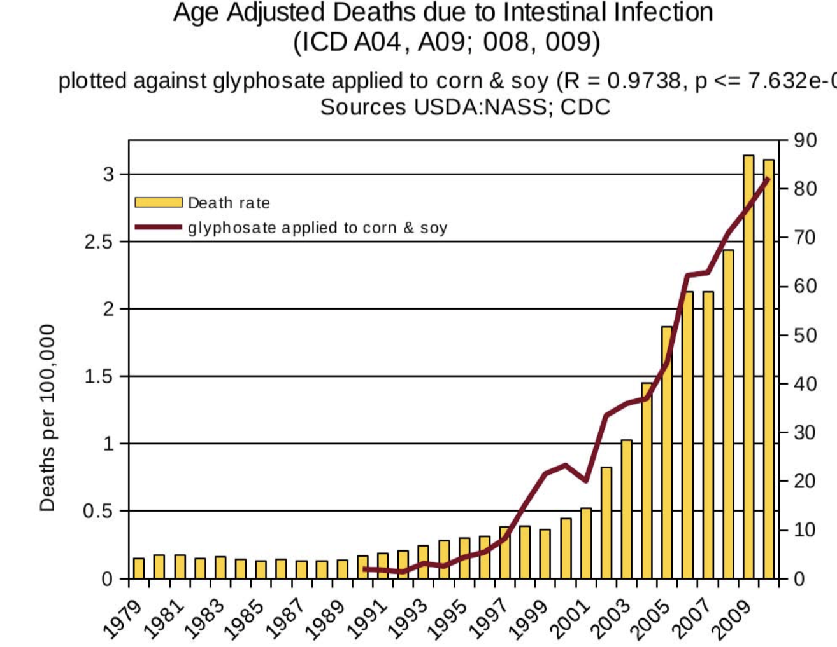
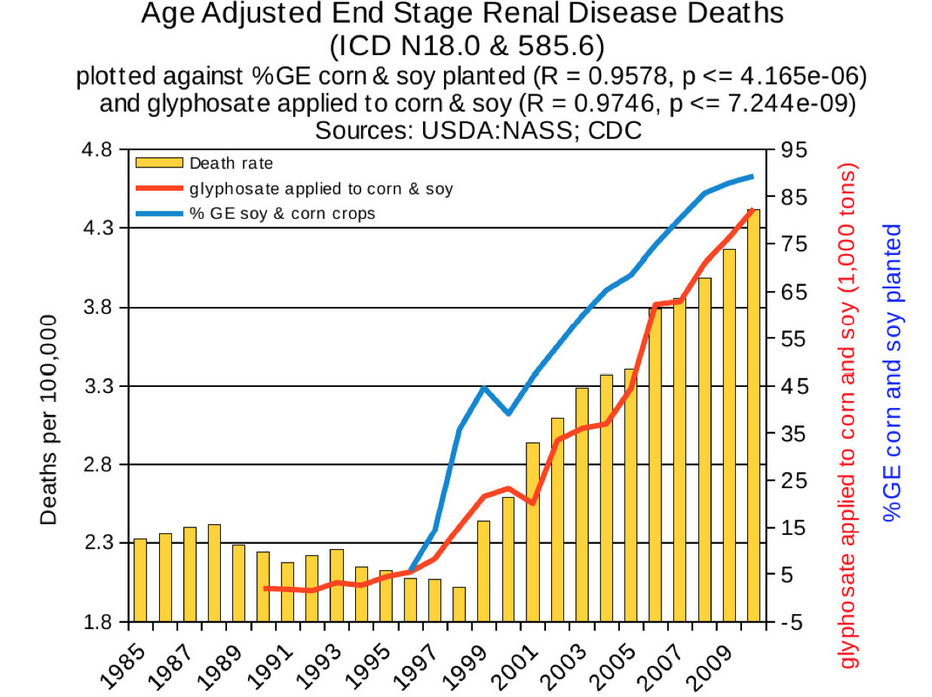
Thyroid cancer
Diabetes
End stage
renal disease
Intestinal
Infection

Slide 18
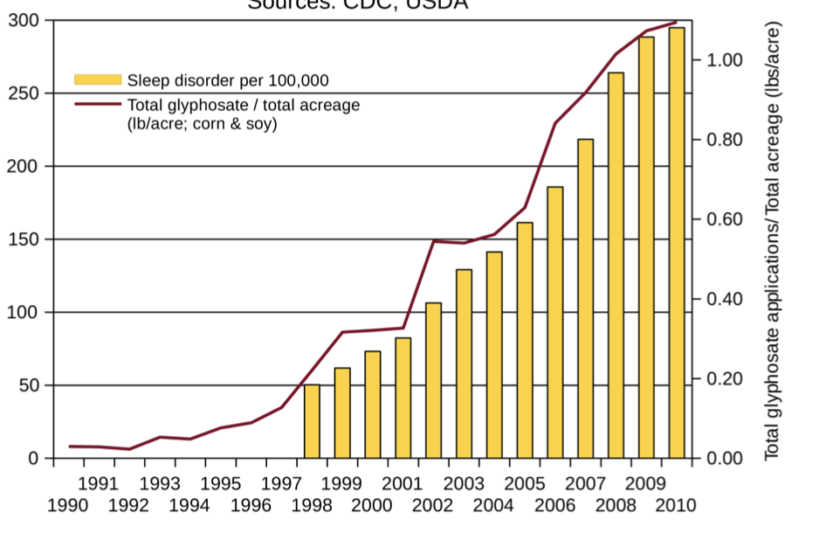
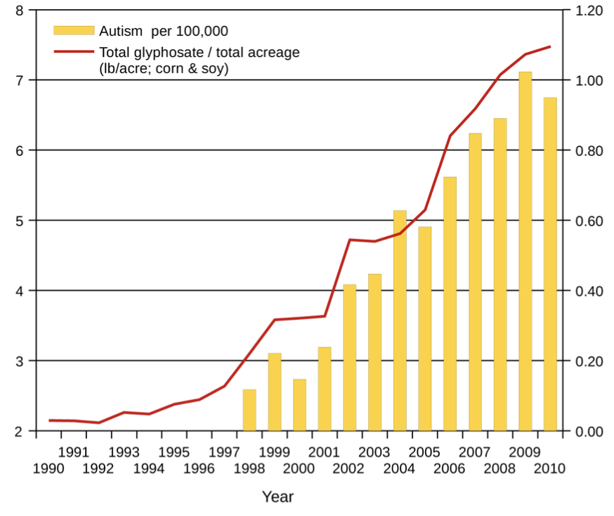
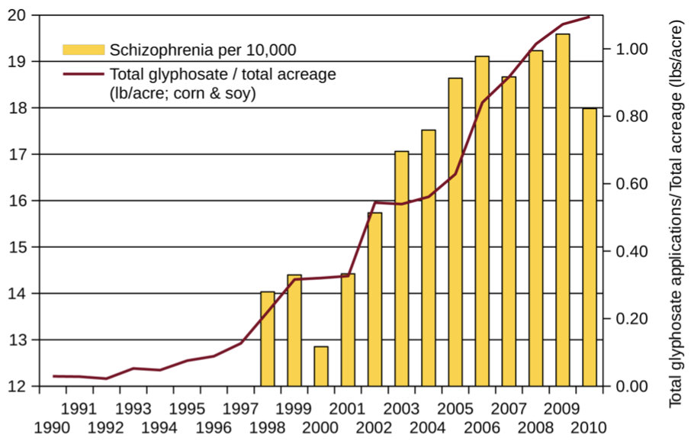
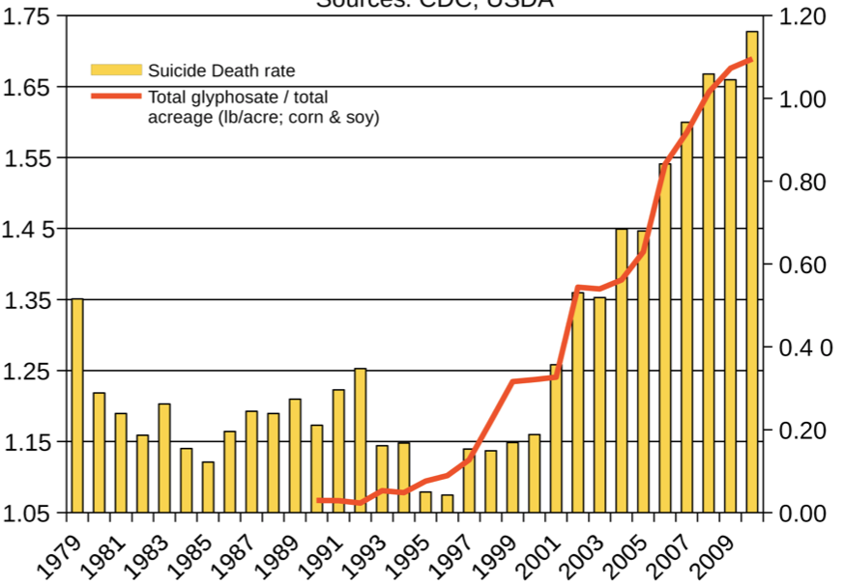
Autism
Sleep Disorder
Schizophrenia
Death by Suicide
*Seneff et al. Agricultural Sciences 2015; 6: 42-70.
Notes:
Hospital discharge diagnoses per 100,000

Slide 19
My New Book!
Released on July 1, 2021, by Chelsea Green publishers
Presents extensive data on glyphosate toxicity to animals and humans
Provides compelling arguments that glyphosate is insidiously, cumulatively toxic through its diabolical insertion into proteins by mistake in place of the coding amino acid glycine
This unique feature explains why it is causal in so many diseases
Notes:
book signing

Slide 20
Gut Microbes and
Hydrogen-containing Gases

Slide 21
The Big Picture
Gut microbes produce hydrogen gas that is remarkably depleted in deuterium
This gas is recycled back into organic nutrients by other microbes → the nutrients are also deuterium depleted
The enzymes involved have strong dependencies on glycine residues that could be substituted by glyphosate
Intestinal bloating and gas pain may be caused by impaired hydrogen recycling due to glyphosate exposure
Hydrogen enriched water and other hydrogen therapies show therapeutic promise
Is the benefit due to the low deuterium in the hydrogen gas?

Slide 22
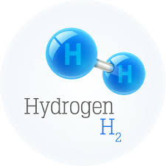
Hydrogen gas produced by microbes anaerobically from glucose or formate is depleted down to 30 ppm deuterium*
“Mass spectrometric analyses of the hydrogen produced by growing cells showed a deuterium content of about 30 ppm. (i.e. depleted by a factor of 4.4 to 5.1…). The same was true whether glucose or formate was the substrate. The intracellular water and cellular hydrogen were not significantly depleted in deuterium.”
30 ppm D
*MI Krichevsky et al. JBC 1961 236(9): 2520-2525.
Notes:
Laszlo_Boros/Krichevsky_1961_formate_formation_produces_deuterium_depleted_hydrogen.pdf
A marine Pseudomonad

Slide 23
What happens to the hydrogen gas?
Hydrogen-producing bacteria
H₂
Sulfate-reducing bacteria
Methanogens
Acetogenic bacteria
Hydrogen Cycling
Hydrogen sulfide
H₂S
Methane
CH₄
Acetate
CH₃COOH
Sulfate
Methyl Groups
Acetyl-CoA
Notes:
https://www.fixyourgut.com/sibo-methane-or-hydrogen-dominant-what-is-the-difference/

Slide 24
NAD and FAD: Essential Molecules
NAD (nicotinamide adenine dinucleotide) and FAD (flavin adenine dinucleotide) are biologically essential molecules for maintaining low deuterium in the mitochondria
NAD is derived from the B vitamin niacin (vitamin B3)
FAD is derived from the B vitamin riboflavin (vitamin B2)
Both are synthesized from products of the shikimate pathway (disrupted by glyphosate)
NADP is a phosphorylated NAD molecule essential for synthesis of fatty acids and cholesterol, and for antioxidant defenses
Many enzymes are involved in transferring H to and from NAD(P)

Slide 25
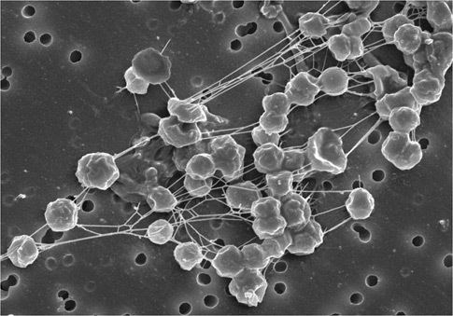
Methanogens and Methanotrophs
Methanogens (archaea) convert carbon dioxide and hydrogen gas to methane (CH₄)
Methanotrophs convert methane to useful organic molecules
methane → methanol → formaldehyde →formate
Methanol dehydrogenase:
methanol + NAD+ ⇌ formaldehyde + NADH + H+
Formaldehyde dehydrogenase:
formaldehyde + NAD+ + H₂O ⇌ formate + NADH + H+
The H’s are very unlikely to be deuterium

Slide 26
Gut Dysbiosis Linked to Many Diseases*
*Chen et al. J Transl Med 2019; 17:5
Notes:
2020/microbes//gut_and_kidney_disease_2020.pdf

Slide 27
Hydrogen Gas as a Therapy*
*L Ge et al. Oncotarget 2017; 8(60): 102653-102673.

Slide 28
COVID-19, Glyphosate, Biofuels & Vaping
Notes:
2014/Indianapolis/influenza_slides.pptx

Slide 29
The Big Picture
Air pollution appears to be a risk factor for COVID-19 only in countries where glyphosate is heavily used
Glyphosate could be causal in a vaping lung disease
Glyphosate would disrupt surfactant proteins through substitution for glycine in their collagen-like stalks
Glyphosate has been shown to cause fatty liver disease – fatty deposits in macrophages in the liver
Many preconditions associated with higher risk to bad outcome with COVID-19 are increasing in prevalence exactly in step with the rise in glyphosate usage

Slide 30
COVID-19 Pathology: Hypothesis
Innate immune system in the lungs is impaired due to chronic exposure to glyphosate (and other toxic chemicals)
Macrophages can’t trap viruses due to defective surfactant proteins
Viruses proliferate and cause a strong reaction from the adaptive immune system
Inflammatory response leads to complex cascade causing a cytokine storm, eventually damaging the systemic circulatory system
Heme oxygenase is upregulated and would normally tame inflammation, but glyphosate turns it into a rogue version of itself
This planned response has a goal of temporarily shutting down the mitochondria so that they can be supplied with deuterium depleted water obtained through direct assistance of the viruses
It backfires when the proteins are disrupted by glyphosate

Slide 31
Air Pollution and COVID-19
Harvard study found strong correlation between nanoparticle levels and deaths from COVID-19 across the United States*
Three studies from Europe also link air pollution to COVID-19 death rate
Biodiesel has been shown in multiple studies to have higher levels of nitrogen oxides and nanoparticles than diesel and to induce a stronger inflammatory response in humans**
*X Wu et al. Exposure to air pollution and COVID-19 mortality in the United States: A nationwide cross-sectional study. medRxiv preprint, April 7, 2020
**NK Fukagawa et al. Environ Sci Technol 2013; 47(21): 12496-504.
Notes:
WAPF./biodiesel_fuel_induces_inflammation_2013.pdf

Slide 32
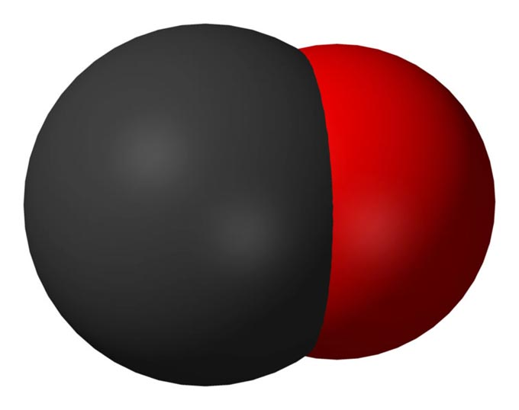
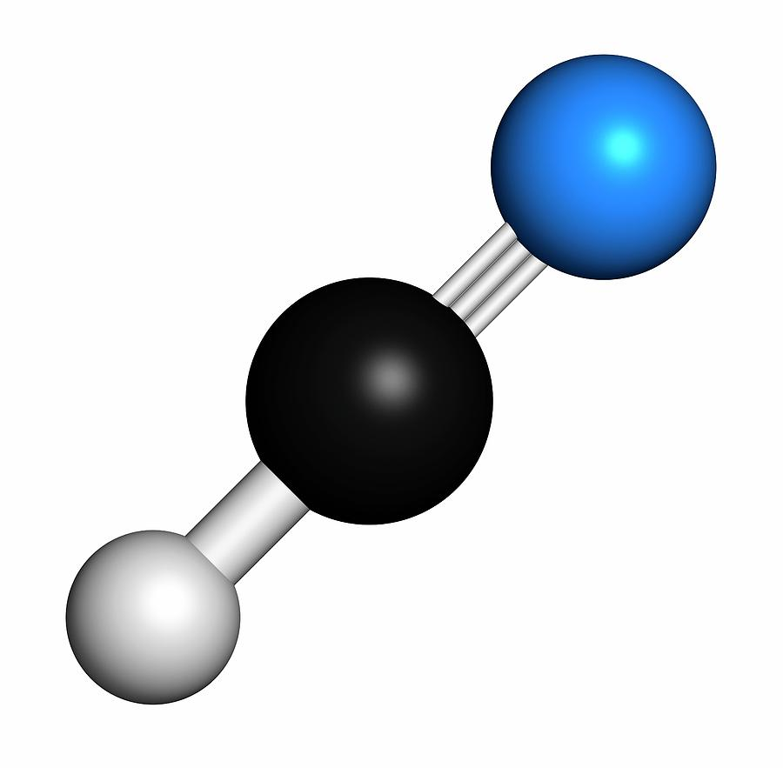
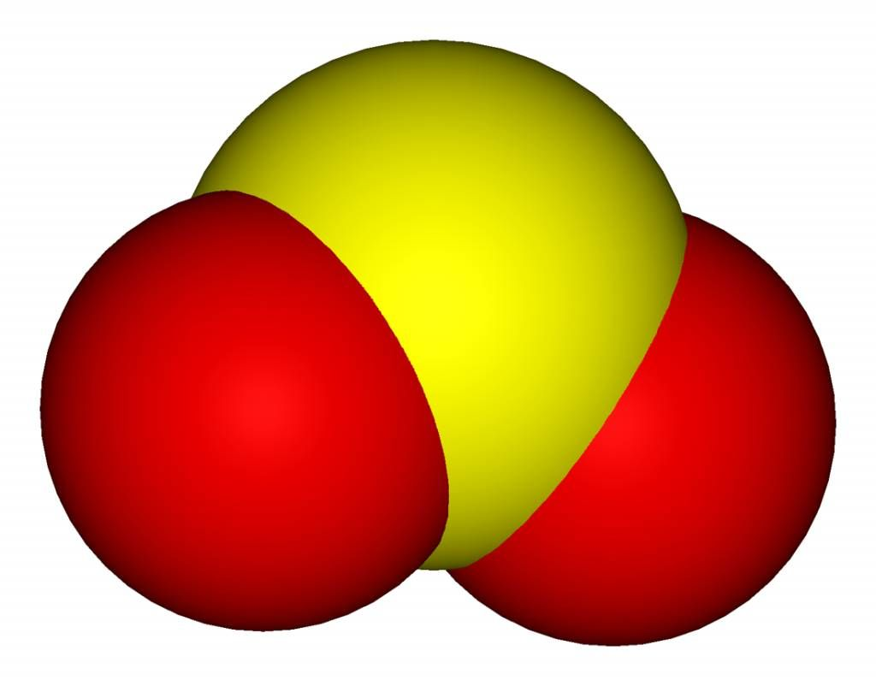
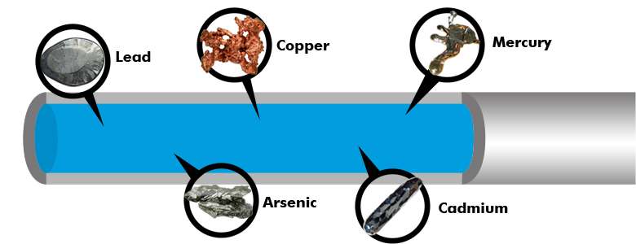
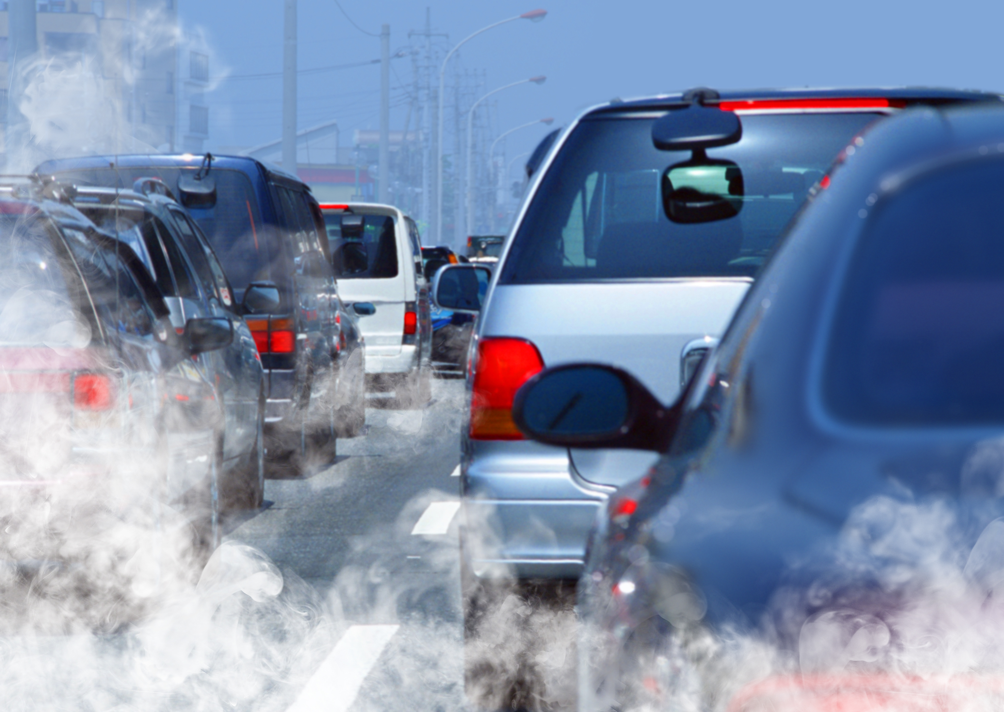
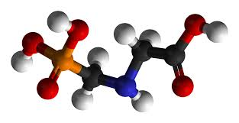
What Might be the Toxic Substances?
Nitrogen oxides? Sulfur dioxide?
Carbon monoxide?
Cyanide?
Nanoparticles?
Lead and other toxic metals?
Glyphosate??

Slide 33
Glyphosate found in nanoparticles in the air in Brazil*
Mean of 41 micrograms/cubic meter in the rural zone and 38 micrograms/cubic meter in the urban zone
Remarkable that levels were almost as high in the city as in the countryside where glyphosate was used on crops
Conclusion of abstract:
"These values can be considered high and dangerous to human health and the environment."
*Maria Gizeuda de F Sousa et al. Environ Monit Assess 2019; 191(10): 604
Notes:
glyphosate_in_air_in_Brazil.pdf

Slide 34
Global Biofuels Market, 2012-2021
Crops are sprayed with glyphosate right before harvest
After the harvest, the stubble is shipped to a processing plant and converted into biofuels
Biogas, bioethanol, biodiesel, bio home heating oil, aviation biofuel
Notes:
https://ville.montreal.qc.ca/idmtl/en/next-generation-biofuels-emerging-in-montreal/

Slide 35
Biofuels Consumption by Country (thousand barrels per day)*
*https://knoema.com/atlas/topics/Energy/Renewables/Biofuels-consumption
Notes:
https://knoema.com/atlas/topics/Energy/Renewables/Biofuels-consumption
Total deaths from COVID as of Oct 6, 2021.
US: 2,179
Brazil: 2,795
620.7 total worldwidea

Slide 36
Total deaths from COVID-19 up to October 6, 2021, normalized by population*
US:
2,179 per million
Brazil:
2,795 per million
Bhutan – mostly small family farms, natural whole foods
4 per million
Worldwide average
620.7 per million
*https://www.worldometers.info/coronavirus/?utm_campaign=homeAdvegas1?
Notes:
https://www.worldometers.info/coronavirus/?utm_campaign=homeAdvegas1?
US: 2,179
Brazil: 2,795
620.7 total worldwidea
Bhutan 4

Slide 37
Nigeria: High Air Pollution; Low COVID Mortality
“Dirtied by success? Nigeria is home to the city with worst PM10 levels”*
Four of the worst cities singled out worldwide for air pollution are in Nigeria, including the top-ranking city in the world: Onitsha
World Bank reported in 2015 that 94% of the Nigerian population experiences air pollution levels above the safe limits set by WHO
Nigeria has a very low death rate from COVID19**
As of August 6, 2020, only 5 people per million in Nigeria had died from COVID19
At the same time 485 people in the US per million had succumbed and 469 per million in Brazil
*https://www.cnn.com/2016/05/31/africa/nigeria-cities-pollution/index.html
**European Centre for Disease Prevention and Control . COVID-19 situation up- date worldwide, as of 6 August 2020.
https://www.ecdc.europa.eu/en/geographical- distribution-2019-ncov-cases

Slide 38
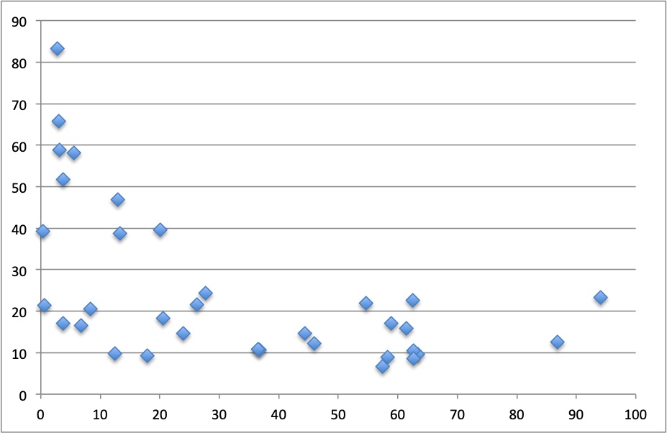
Effect of Air Pollution on Covid-19 Death Rate*
Each dot is a country
Average PM2.5 (micro-grams/cubic meter)
Covid-19 Death Rate (deaths/100k)
*Sources: https://coronavirus.jhu.edu/data/mortality
https://www.iqair.com/us/world-most-polluted-countries
Notes:
Nigeria at 20, axis. Bangladesh at top, Far right: Peru, Belgium.

Slide 39
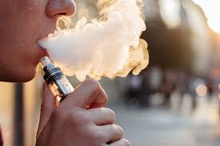
Vaping Lung Disease*
E-cigarette or vaping product use-associated lung injury (EVALI)
The most common respiratory symptoms:
shortness of breath (85%),
cough (85%), and
chest pain (52%)
Gastrointestinal symptoms:
nausea (66%),
vomiting (61%),
diarrhea (44%),
abdominal pain (34%).
All patients had one or more constitutional symptoms, with the most common being subjective fever (84%).
Upper respiratory symptoms such as rhinorrhea, sneezing, or congestion were not commonly reported
* JE Layden et al. N Engl J Med 2020; 382: 903-916
Notes:
Where?

Slide 40
Vaping Lung Disease*
E-cigarette or vaping product use-associated lung injury (EVALI)
The most common respiratory symptoms:
shortness of breath (85%),
cough (85%), and
chest pain (52%)
Gastrointestinal symptoms:
nausea (66%),
vomiting (61%),
diarrhea (44%),
abdominal pain (34%).
All patients had one or more constitutional symptoms, with the most common being subjective fever (84%).
Upper respiratory symptoms such as rhinorrhea, sneezing, or congestion were not commonly reported
These symptoms are remarkably similar to the symptoms of COVID-19
* JE Layden et al. N Engl J Med 2020; 382: 903-916
Notes:
Where?

Slide 41
Glycerol in E-Cigarettes*
E-cigarettes work on the principle of burning glycerol and propylene glycol (derived from glycerol)
Glycerol is a by-product of biodiesel fuel production and is very cheap because the market is glutted
An experiment where humans were asked to smoke E-cigarettes containing only the glycerol and propylene glycol (no nicotine) revealed increased inflammation in the lungs
People who smoke E-cigarettes have a
five-fold increased risk to COVID-19
*Min-Ae Song et al. Cancer Prev Res. Feb. 2020 [Epub ahead of print]

Slide 42
Mice Exposed to Vaping Fumes*
Mice exposed for four months to vaping fumes
Following infection with influenza virus, exposed mice had dramatically higher levels of inflammatory cytokines in their lungs (over-responsive immune system)
Examination of lungs revealed suppressed surfactant proteins A and D and accumulation of fatty lipid deposits in lung macrophages
ENDS =
Electronic nicotine deliver system
*MC Madison et al. J Clin Invest 2019; 129(10): 4290-4304.

Slide 43
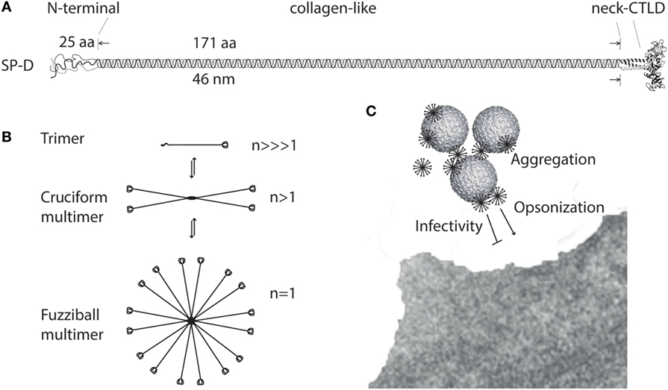
Lung surfactant protein SP-D has collagen-like stalks: GxyGxyGxy…*
“Binding of multimeric SP-D to microbe-associated glycans may block interaction of the microbe with its receptors, aggregate the microbes, or SP-D may act as an opsonin, enhancing endocytic uptake of the microbe in host cells.”
*Grith L. Sorensen. Frontiers in Medicine 2018; 5: 18.
Notes:
https://www.frontiersin.org/articles/10.3389/fmed.2018.00018/full
surfactant_protein_D_review_2018.pdf

Slide 44
GxyGxyGxy… sequence in SP-D
… GLP GRD GRD GRE GPR GEK GDP GLP GAA GQA GMP GQA GPV GPK GDN GSV GEP GPK GDT GPS GPP GPP GVP GPA GRE GPL GKQ GNI GPQ GKP GPK GEA GPK GEV GAP GMQ GSA GAR GLA GPK GER GVP GER GVP GNT GAA GSA GAM GPQ GSP GAR GPP GLK GDK GIP GDK GAK GES GVE …

Slide 45
Collagen & Glyphosate?
SP-A and SP-D are members of a class of proteins produced by immune cells called collectins
They play a powerful role in trapping viruses and other pathogens
They contain a classic collagen-like region that forms their stalk
Collagen is the most abundant protein in the body (25% of the total proteins are collagen)
It makes up a significant component of skin, bones, joints, etc.
Multiple glycine mutations in collagen lead to genetic disease
Ehler’s Danlos Syndrome
Osteogenesis imperfecta
Is glyphosate causal in the epidemic we are seeing today in joint pain and bone fractures?

Slide 46
Is Glyphosate Causing an Epidemic in Fatty Liver Disease?
Worldwide epidemic in fatty liver disease today*
“Multiomics reveal non-alcoholic fatty liver disease in rats following chronic exposure to an ultra-low dose of Roundup herbicide”**
Glyphosate causes fatty liver disease in humans***
* Chris Estes et al. Hepatology 2018; 67(1): 123-133.
** Robin Mesnage et al. Sci Rep 2017; 7: 39328.
*** PJ Mills et al. Clinical Gastroenterology and Hepatology 2020;18(3):741-743.
Notes:
Where?
Attached/for_Laszlo/Mills_glyphosate_steatohepatitis_link_humans_2019.pdf

Slide 47
“Glyphosate Excretion is Associated With Steatohepatitis and Advanced Liver Fibrosis in Patients With Fatty Liver Disease”*
Patients with liver disease at UC San Diego were carefully screened for non-alcoholic steatohepatitis (NASH)
Glyphosate excretion was significantly higher in patients with NASH than in patients without NASH
Patients with advanced fibrosis had significantly higher glyphosate than patients with less fibrosis
This is reminiscent of the “fatty lung disease” observed in people with the lung vaping disease
* PJ Mills et al. Clin Gastroenterol Hepatol 2020; 18(3): 741-743.
Notes:
LaszloBoros/Mills_glyphosate_steatohepatitis_link_humans_2019.pdf

Slide 48
Chronic Disease in the United States*
Chronic disease affects more than 40% of the US population
Half of all adults and 8% of children aged 5-17
1/3 of the population has more than one chronic disease
In 2009, 7 out of 10 deaths were attributable to chronic disease
Chronic disease accounts for more than 75% of all health care costs
Seven chronic diseases – cancer, diabetes, hypertension, stroke, heart disease, pulmonary conditions, and mental illness – cost the economy $1.3 trillion each year
*https://nationalhealthcouncil.org/wp-content/uploads/2019/12/AboutChronicDisease.pdf
Notes:
COVID/AboutChronicDisease.pdf

Slide 49
Pre-existing conditions lead to death from COVID
According to the CDC, 94% of death certificates for COVID-19 victims in the U.S. were in people with pre-existing health conditions including diabetes, obesity, heart disease, lung disease, kidney disease, dementia and hypertension.
-- Most of these conditions are rising dramatically in prevalence in the United States in step with the rise in glyphosate usage on core crops

Slide 50
Comorbidities for COVID-19 in New York State*
*https://www.the-hospitalist.org/hospitalist/article/220457/coronavirus-updates/
comorbidities-rule-new-yorks-covid-19-deaths
Notes:
https://www.the-hospitalist.org/hospitalist/article/220457/coronavirus-updates/comorbidities-rule-new-yorks-covid-19-deaths

Slide 51
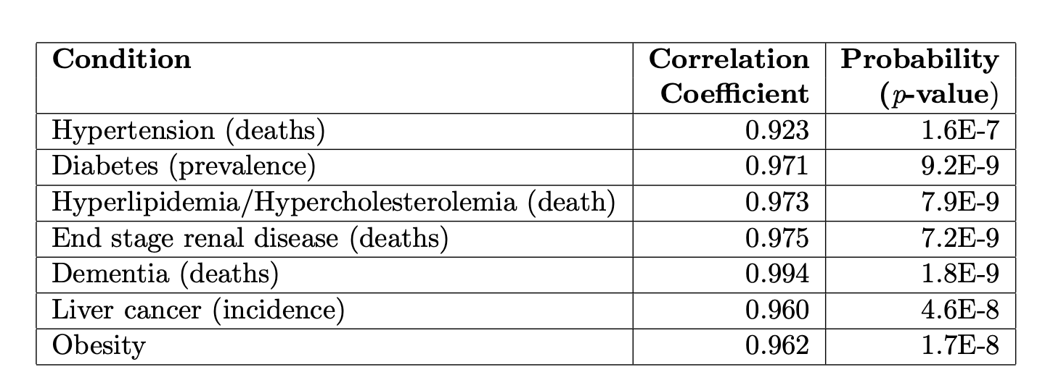
Correlations over time between Glyphosate Usage and Disease in the US*
*Nancy L Swanson et al. J Org Syst 9 (2014) 6-37.

Slide 52
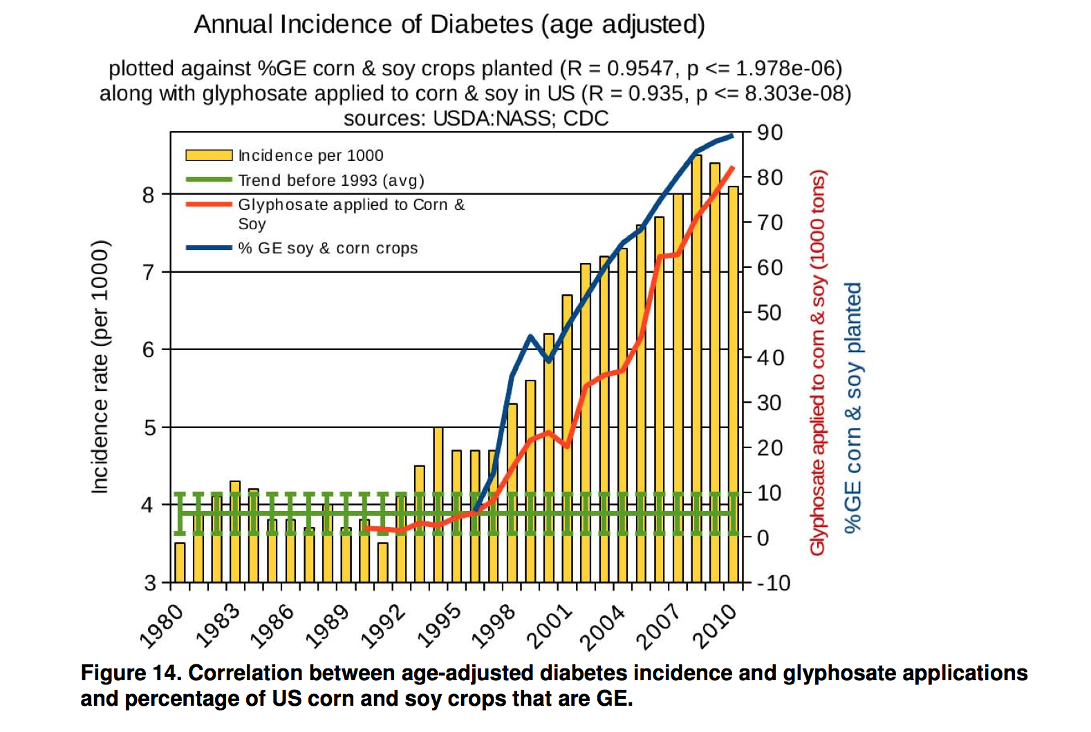
Comorbidities: Obesity and Diabetes*
Diabetes
Obesity
*N Swanson et al. Journal of Organic Systems, 9(2), 2014

Slide 53
Importance of NAD(P)(H) Redox System to Mitochondrial Health

Slide 54
The Big Picture
NAD (Nicotinamide Adenine Dinucleotide) is an essential cofactor in oxidation/reduction reactions
It exists in four forms: with and without hydrogens and with and without phosphate
NAD+ (no H, no P)
NADH (with H, no P)
NADP+ (no H, with P)
NADPH (with H, with P)
Mitochondria are organelles inside cells that supply energy in the form of ATP
Mitochondria depend critically on a proton-ATPase pump to make ATP
Protons derived from NADH and NADPH are pumped into the intermembrane space
Deuterium “gums up” the pump (like sugar in the gas tank)
Glyphosate interferes with the supply of NADH and NADPH to the organism
The enzymes that supply NAD+ and NADP+ with H are specially designed to avoid deuterium

Slide 55
Flavoproteins
Flavoproteins are a large class of enzymes with many roles
They exhibit strong kinetic isotope effects (favor H over D)
Greatly prefer H over D during hydride (H⁻) transfers
Use water wires to fractionate out deuterium
Many steal H from substrate to restore NAD(P)H from NAD(P)+
Others provide D-depleted protons to the mitochondria and for fatty acid and nucleotide synthesis
They have strong glycine dependencies for binding to phosphate at flavin binding sites
Susceptible to suppression through glyphosate substitution

Slide 56
Glyphosate Impairs NAD(P)(H) Pathways*
Glyphosate is the active ingredient in the pervasive herbicide Roundup
It kills weeds by suppressing EPSP synthase in the shikimate biological pathway
Tryptophan is a major product of this blocked pathway
Tryptophan is produced by gut microbes depending on EPSP synthase
NAD(P)(H) is derived from tryptophan
Glyphosate induces ROS in mitochondria and depletes glutathione (antioxidant)
Also increases ratio of GSSG/GSH
Glyphosate inhibits glucose 6 phosphate dehydrogenase (G6PD), which restores NADPH from NADP+
Glyphosate inhibits succinate dehydrogenase, an essential enzyme in both the citric acid cycle and oxidative phosphorylation in the mitochondria
*S Seneff, Toxic Legacy, Chelsea Green Publishers, July 2021.

Slide 57
“COVID-19: NAD+ deficiency may predispose the aged, obese and type2 diabetics to mortality through its effect on SIRT1 activity”*
NAD+ is a cofactor heavily involved in proton-coupled electron transfer (PCET)
Sirtuins are an ancient family of 7 NAD+-dependent signaling proteins that regulate metabolism
Intracellular NAD+ levels are depleted in association with diabetes and obesity, risk factors for bad outcome in COVID-19
Diabetes and obesity rates have been rising dramatically in the United States in step with the rise in glyphosate usage on core crops**
Depletion of SIRT1 causes uncontrolled increases in inflammatory markers TNF-α, IL-6 and IL-1β
Increased risk to cytokine storm due to inability to activate SIRT1
*R Miller et al. Medical Hypotheses 2020; 144: 110044
**N Swanson et al. Journal of Organic Systems, 9(2), 2014
Notes:
NAD_deficiency_elderly_diabetic_COVID19_SIRT1.pdf

Slide 58
Deuterons Disrupt the ATPase Pump*
There are around 15,000 ATPase pumps in a single mitochondrion
Proton force rotates the ATPase pumps at a rate of 1,000 cycles per second
Deuterons resist letting go and stall the pump, producing a stutter
Deuterons also disrupt proton-coupled electron transport (PCET) which is based on proton tunneling
This causes decreased production of ATP and increased production of reactive oxygen species, damaging the pumps.
*Abdullah Olgun. Theoretical Biology and Medical Modelling 2007, 4: 9.
Notes:
Olgun_deuterons_in_ATPase_pumps_WOW_2007.pdf

Slide 59
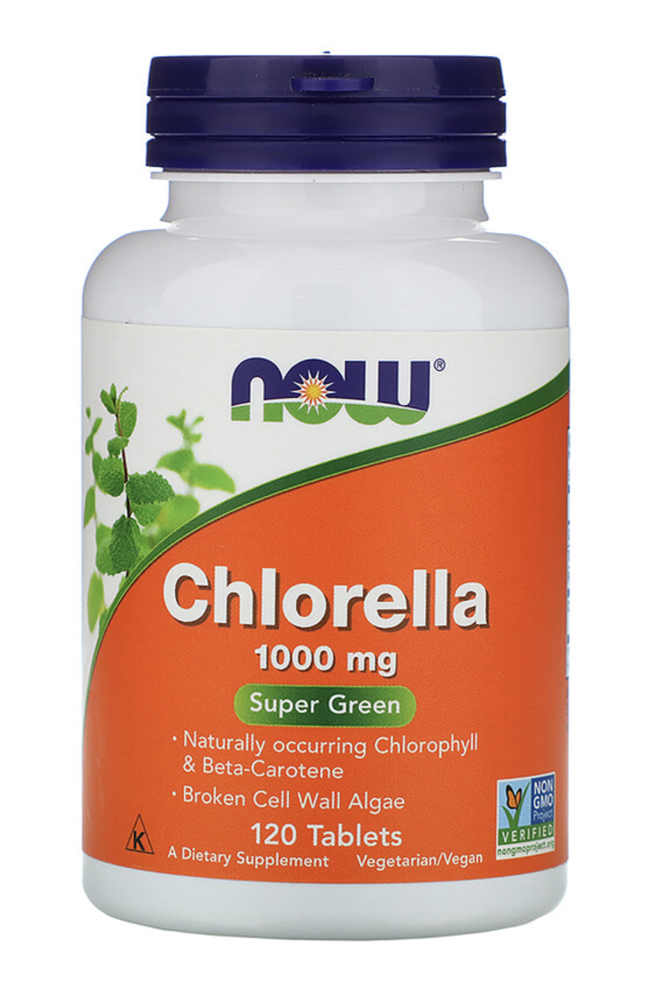
G6PD & Fatty Acids*
Glucose 6 phosphate dehydrogenase (G6PD) converts NADP⁺ to NADPH (has strong preference for H over D)**
NADPH is the largest source of hydrogen in fatty acid biosynthesis
E coli and Bacillus subtilis produce deupleted fatty acids (FAs)
Due to high dependency on G6PD to restore H in NADPH
Photosynthetic organisms (e.g., algae (chlorella)) produce highly deuterium-depleted FAs
*RS Wijker et al. PNAS 2019; 116(25): 12173-12182.
**Xinning Zhang et al. PNAS 2009; 106: 12580-12586.
Notes:
Where?

Slide 60
SARS-CoV-2 Infection in the Lungs: An Extraordinary Response

Slide 61
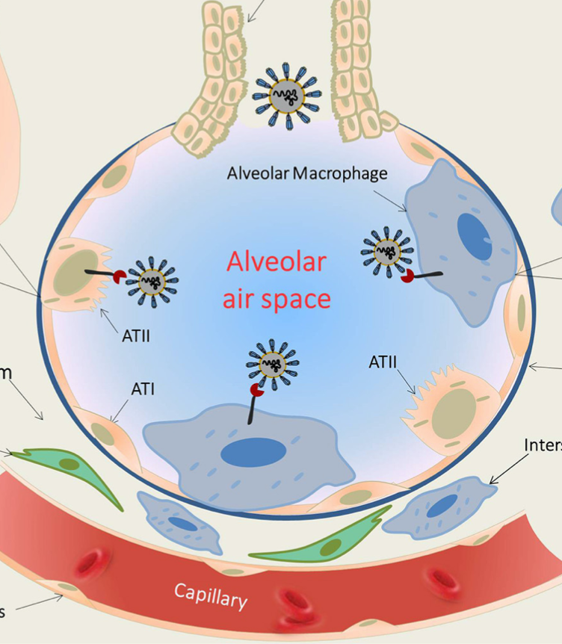
Initial COVID-19 Events
SARS CoV-2 viruses enter through the bronchioles and infect epithelial cells lining the lung’s alveoli
Residential macrophages fail to clear the virus because they are defective
Viruses proliferate wildly
Macrophages send out alarm signals which draw in more macrophages
Capillary wall becomes leaky to support invasion
Blood pressure drops; fluid begins to fill the alveolar space
Person feels as if they are drowning
Infected
Epithelial
cell
macrophages
*Frank L van de Veerdonk et al. eLife 2020; 9: e5755.
Notes:
lung_macrophage_COVID19_friend_or_foe.pdf
Kallikrein_kinin_blockade_COVID-19_SARS_2020.pdf

Slide 62
Is a Bradykinin Storm Brewing in COVID-19?*
Hypertension is a risk factor for COVID-19, but hypotension develops instead during the disease process
ACE2 receptor is upregulated by 199-fold in the lungs in severe COVID-19 patients, and ACE is downregulated (8-fold)
ACE degrades (clears) bradykinin
Bradykinin receptors are upregulated by nearly 3000-fold!
Bradykinin induces vasodilation and hypotension
Inflammatory cytokines induce capillary leakage and inhibit alveolar fluid reabsorption leading to alveolar flooding**
*https://www.the-scientist.com/news-opinion/is-a-bradykinin-storm-brewing-in-covid-19—67876
Michael R Garvin et al. eLife 2020; 9: e59177.
**Andrew M Luks and Erik R Swenson. Ann Am Thorac Soc 2020 Apr 24 [Epub ahead of print]
Notes:
https://www.the-scientist.com/news-opinion/is-a-bradykinin-storm-brewing-in-covid-19--67876
Also:
COVID-19 Lung Injury and High Altitude Pulmonary Edema: A False Equation with Dangerous Implications

Slide 63
Bradykinin-induced hyperpermeability of the lung capillaries causes formation of hyaluronic-acid hydrogel that inhibits gas exchange*
*Michael R Garvin et al. eLife 2020; 9: e59177.
Notes:
COVID/SARS_CoV_2_bradykinin_model_supercomputer_deuterium_link_WOW.pdf

Slide 64
SARS CoV-2 causes massive over-production of hyaluronic acid in the lungs*
"Hyaluronic acid can trap roughly 1000 times its weight in water and when bound to water the resulting hydrogel obtains a stiff viscous quality similar to ‘Jello’ ”
Multiple enzymes that synthesize hyaluronic acid are massively upregulated in COVID-19 lungs: HAS1 (9,113 fold), HAS2 (493 fold), and HAS3 (32 fold)
Excess hyaluronic acid is associated with pulmonary thrombosis, ground glass opacities, and acute respiratory distress syndrome
“Hyaluronic acid in the bronchoalveolar space of the lungs could form a viscous hydrogel that would negatively impact gas exchange”
*Michael R Garvin et al. eLife 2020; 9: e59177.
Notes:
COVID/SARS_CoV_2_bradykinin_model_supercomputer_deuterium_link_WOW.pdf

Slide 65
Heme Oxygenase-1 (HO-1) and COVID-19*
Some cases of COVID-19 cascade into a hyper-inflammatory state leading to thrombosis and multiple organ failure
Inflammation upregulates HO-1 which normally tames the inflammation
“Replacement of the Distal Glycine 139 Transforms Heme Oxygenase-1 into a Peroxidase”**
Glyphosate substitution in HO-1 would convert it to a pro-inflammatory enzyme
Fails to metabolize heme to bilirubin and biliverdin
Releases ferryl iron that reacts with ROS to damage the vascular wall
*S Seneff. Glyphosate, Deuterium and COVID-19. Masters of Health https://joom.ag/xC0C
**Y Liu et al. JBC 2000; 275(44): 34501-34507

Slide 66
Rebooting the Mitochondria

Slide 67
How the Virus Facilitates Repair of the Deuterium Problem - Hypothesis
Hydrogel traps deuterium leaving DDW in the fluid water in the lungs
SARS-CoV-2 virus contains lipids such as linoleic acid in its membrane (stolen from host cell)
Inflammatory response due to weak innate immunity causes release of lipoxygenase
Lipoxygenase extracts protons from lipids in viral membrane and converts oxygen into deuterium depleted water (DDW)
Produces leukotrienes which induce further reaction
Arterioles constrict access to capillary
Venules open up leaks
Macrophages “drink the sweet nectar” – and supply their mitochondria with much-needed deuterium depleted water ??
This empowers them to clear the virus
Lipoxygenase has a fantastic ability to select hydrogen over deuterium in its product (water)*
*Pengfei Li et al. J Phys Chem Lett 2018; 9(22): 6444-6449.
Notes:
Where?

Slide 68
Virus traps linoleic acid in its membrane which then gets oxidized by lipoxygenase to make DDW
Linoleic acid fits perfectly in three binding pockets of SARS CoV-2 membrane S glycoprotein*
Patients with severe COVID-19 show reduced levels of fatty acids**
*Christine Toelzer et al. Science Sept 21 2020 [Epub ahead of print]
**Bo Shen et al. Cell 2020; 182: 59-72.
Notes:
COVID/SARS_CoV_2_binds_linoleic_acid_holy_sh1t.pdf
COVID/proteomics_and_lipidomic_characteristics_of_COVID_patients_reduced_fatty_acids.pdf

Slide 69
Viruses are stabilized by excess deuterium!
The nucleocapsid protein in SARS-CoV-2 starts to unfold at 35 degrees Centigrade (95 degrees Fahrenheit) and is completely denatured at 55 degrees Centigrade (131 degrees Fahrenheit)*
A fever is a natural defense against the virus
Viruses take up deuterium and trap it in their protein coat and in their internal single strand of RNA**
Deuterium stabilizes the viral protein and RNA and protects from temperature denaturation
The virus removes deuterium from the body fluids
When the deuterium level in the body fluids is high, the virus becomes more stable
*Milan Surjit and Sunil K Lal. Infection, Genetics and Evolution 8 (2008) 397-405.
**Jiangsen MAO et al., Chinese Science Bulletin 2004 Vol. 49 No. 3 253-257.
Notes:
COVID/hydrogen_deuterium_exchange_in_viral_particles.pdf
COVD/SARS_CoV_capsid_protein_properties_2008.pdf

Slide 70
“Mitochondrial Transfer via Tunneling Nanotubes is an Important Mechanism by which Mesenchymal Stem Cells Enhance Macrophage Phagocytosis in the In Vitro and In Vivo Models of ARDS”*
“In conclusion, MSC [mesenchymal stem cells] transfer their mitochondria to macrophages both in vitro and in vivo. Mitochondrial donation results in enhancement of macrophage phagocytosis potentially through improvement in bioenergetics and presents a novel mechanism of the antimicrobial effect of MSC.”
ARDS = Acute Respiratory Distress Syndrome
*Megan V Jackson et al. Stem Cells 2016;34:2210–2223
Notes:
Book/mitochondria/mitochondria/TNTs_mitochondrial_transfer_from_mesenchymal_stem_cells_ARDS_2016.pdf

Slide 71
Do the mitochondria and lysosomes get repaired in transit?
“Tunneling nanotubes (TNTs) transport cellular organelles such as mitochondria, endosomes, and lysosomes, as well as other cargoes such as viruses, prions, and Ca²⁺ signals.”*
Tunneling Nanotube
Mitochondrion
*Holly R Chinnery and Kate E Keller. BioMed Research International 2020; 2020: Article ID 7246785.
Notes:
https://www.hindawi.com/journals/bmri/2020/7246785/fig2/
https://www.hindawi.com/journals/bmri/2020/7246785/

Slide 72
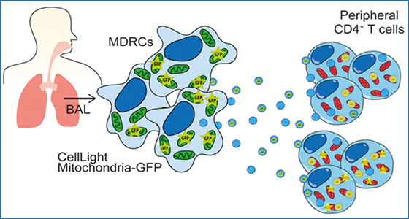
“Exosomal transfer of mitochondria from airway myeloid-derived regulatory cells to T cells”*
(BAL – bronchioalveolar lavage)
Myeloid-derived regulatory cells (MDRCs) are cells that emerge from the bone marrow and infiltrate inflammatory sites, e.g., in asthma
MDRCs in the airways transfer mitochondria to T cells via exosomes
These mitochondria have been shown to be functional in the recipient cell
Hypothesis: Immune cells (e.g., T cells, macrophages, dendritic cells, …) can sweep up DDW and mitochondria via macropinocytosis
Intercellular communication is essential for resolving inflammation
*Kenneth P. Hough et al. Redox Biol 2018; 18: 54-64.
Notes:
miRNA/exosomal_transfer_of_mitochondria_in_lung_disease_2018.pdf
DEFINE EXOSOMES HERE!!

Slide 73
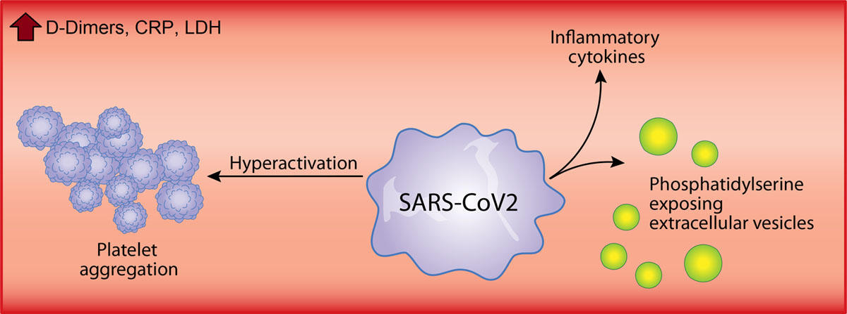
A Role for Platelets!*
Each platelet contains 7 or 8 mitochondria
Platelet mitochondria are very susceptible to oxidative stress
Activated platelets form blood clots that can lead to disseminated intravascular coagulation (DIC) or multiple organ failure
Mitochondria get released into the extracellular space from the platelets either free or embedded in exosomes
*Jumana Saleh et al. Mitochondrion 2020; 54: 1-7.
Notes:
COVID/mitochondrial_dysfunction_COVID19.pdf

Slide 74
Megakaryocytes and Platelets in the Lungs*
Megakaryocytes localized to the lungs are a source of new platelets
Both megakaryocytes and platelets release extracellular vesicles in response to inflammation
CD41 is a marker for megakaryocytes and platelets
CD41 expression as well as extracellular vesicle release were highest in non-severe COVID-19
CTL – Control; NSV – non-severe; SVR = severe COVID
CTL
NSV
SVR
*Younes Zaid et al. Circulation Research 2020;127:1404–1418.
Notes:
where?

Slide 75
Platelet Counts Over Time: Survivors and Nonsurvivors of COVID-19*
*Yanli Liu et al., Platelets 2020; 31(4): 490-496.
Notes:
2020/book/COVID/platelets_low_in_nonsurvivors_COVID.pdf

Slide 76
Recapitulation
COVID-19 affects different countries to different degrees and the primary discriminator could be glyphosate exposure
Glyphosate disrupts the body’s ability to properly manage deuterium
Deuterium toxicity results in impaired innate immune function
The process that unfolds during acute COVID-19 aims to restore mitochondrial and lysosomal health to the immune cells
Inflammation, swelling and alveolar hydrogel reflect mechanisms that produce deuterium depleted water
Platelets and mesenchymal stem cells supply fresh mitochondria to macrophages via tunneling nanotubes and exosomes
Macrophages use macropinocytosis to acquire DDW and mitochondria
Eventually reboots the mitochondria to support viral clearance

Slide 77
Tuberculosis and COVID-19

Slide 78
“Mandated Bacillus Calmette-Guérin (BCG) vaccination predicts flattened curves for the spread of COVID-19”*
Sub-Saharan Africa
BCG vaccine immunizes against tuberculosis
Countries that currently mandate the vaccine have on average lower rates of death from COVID-19
However, there is a huge variance in this group that can be explained by the rate of infection with tuberculosis pathogen
*Martha K Berg et al., Sci Adv 2020; 6: eabc1463.
Notes:
Book/COVID/tuberculosis_vaccine_COVID_paper.pdf

Slide 79
Study in Israel*
Israel required the BCG vaccine prior to 1982, and then eliminated the requirement
Study compared two age groups: those born between 1979 and 1981 and those born between 1983 and 1985
Similar ages but very different exposure to BCG vaccine
Nearly 6000 people in the study
One severe case in each group; no deaths
“In conclusion, this study does not support the idea that BCG vaccination in childhood has a protective effect against COVID-19 in adulthood.”
*Chiara Sartini et al. JAMA 2020; 323: 22.
Notes:
Book/COVID/Sartini_JAMA_2020_tuberculosis_vaccine_Israel_not_protective.pdf

Slide 80
”The US surprised the world when it rose to the top spot in multiple COVID-19 statistics, both for the total number of confirmed cases and the number of deaths. Since then, no other country has surpassed America.”
“Africa is doing better than any other continent, both when it comes to cases and casualties.”
*https://nypost.com/2020/09/04/scientists-cant-explain-puzzling-lack-of-coronavirus-outbreaks-in-africa/

Slide 81
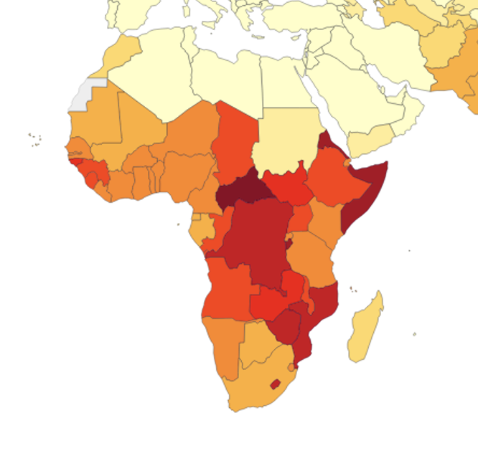
Inverse relationship between COVID-19 and Tuberculosis in Africa
COVID-19 rates in Africa (Sep. 21, 2020)
Tuberculosis death rates in Africa (1990-2017)*
*https://ourworldindata.org/grapher/tuberculosis-death-rates

Slide 82
Some Interesting Facts about Tuberculosis*
As of 2018, 25% of the world’s population was infected with latent tuberculosis
Most are without symptoms for their entire life
In 2018, there were more than 10 million cases of active TB which resulted in 1.5 million deaths
In Asia and Africa, about 80% of the population test positive, while only 5-10% of the US population tests positive
More than half of diagnosed cases are in eight countries:
India (27%), China (9%), Indonesia (8%), the Philippines (6%), Pakistan (6%), Nigeria (4%) and Bangladesh (4%)
*https://en.wikipedia.org/wiki/Tuberculosis

Slide 83
Countries with mandates with and without high infection rate
Country death* obesity** Country death obesity
India 6.15 3.9 United Kingdom 62.86 27.8
Philippines 4.49 6.4 France 46.43 21.6
Indonesia 3.45 6.9 Portugal 18.36 20.8
Pakistan 3.02 8.6 Ireland 36.86 25.3
Bangladesh 3.01 3.6
Nigeria 0.56 8.9
China 0.34 6.2
Mandates; high infection rate Mandates; low infection rate
*number of COVID-19 deaths per 100,000 population
**Obesity rate (percent of population)
*Martha K Berg et al., Sci Adv 2020; 6: eabc1463.

Slide 84
Does Tuberculosis Protect from Obesity and from COVID-19?? *
without
COVID-19 deaths per 100,000
with
Obesity Rate
*All data shown are countries requiring a tuberculosis vaccine
Notes:
COVID/images/obesity_by_country_plus_merged_data.text

Slide 85
Monsanto Patent: “Glyphosate formulations and their use for the inhibition of 5-enolpyruvylshikimate-3-phosphate synthase”*
“Among the various aspects of the present invention is a method for treating a Subject infected or Susceptible to an infection by a pathogen containing the enzyme 5-enolpyruvoylshikimate-3-phosphate synthase [EPSP synthase]”
“The present invention discloses the use of the herbicidal agent glyphosate in combination with the polyvalent anion oxalic acid for the prevention and therapy of these pathogenic infections.”
“Susceptible organisms include, but are not limited to, all species of the Family Mycobacteriaceae, including but not limited to M. tuberculosis, M. bovis, M. africanum, ...”
*US Patent #US7771736B2. August 10, 2010. Assignee: Monstanto Technology LLC
Notes:
glyphosate_patent_malaria_tuberculosis_2010.pdf

Slide 86
Centers for Disease Control. Trends in Tuberculosis, 2018
Notes:
https://www.cdc.gov/tb/publications/factsheets/statistics/tbtrends.htm

Slide 87
Vitamin K₂!

Slide 88
Unusual molecules produced by Mycobacterium tuberculosis: Vitamin K₂ sulfate*
= vitamin K₂ sulfate!!
“To our knowledge, this is the first example of a sulfated
menaquinone produced in any prokaryote.”
Blocked by glyphosate
Coenzyme Q10
Vitamin K ₂
*CM Holsclaw et al. ACS Chem Biol 2008; 3(10): 619-624.
Notes:
COVID?M_tuberculosis_sulfated_menaquinone_2008.pdf
COVID/biosynthesis_of_menaqunine_and_ubiquinone_chorismate_2009.pdf
From search
Lipids of Clinically Significant Mycobacteria
.
https://link.springer.com/referenceworkentry/10.1007%2F978-3-030-15147-8_7

Slide 89
“Menaquinone Synthesis is Critical for Maintaining Mycobacterial Viability During Exponential Growth and Recovery from Non-Replicating Persistence”*
It is estimated that more than one-third of the world’s population is infected with tubercle bacilli (bacteria that cause tuberculosis)
Mycobacterium tuberculosis can persist inside the host without causing clinical symptoms (latent infection)
Many people harbor the microbe throughout their lifespan with no symptoms
Active disease appears only when the immune system is compromised
M tuberculosis synthesizes menaquinone and it is essential for its electron transport chain to work to generate ATP
It uses vitamin K₂ instead of coenzyme Q10 for electron transport
The synthesis of both of these is disrupted by glyphosate
*Rakesh K. Dhiman et al. Mol Microbiol. 2009; 72(1): 85-97.
Notes:
COVID/menaquinone_synthesis_Mycobacteria_tuberculosis_2009.pdf

Slide 90
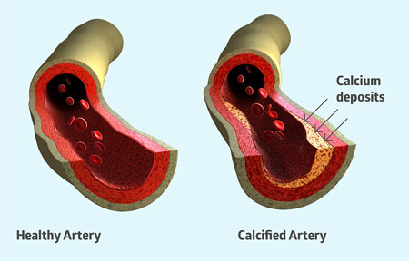
Vitamin K₂ Protects from Heart Disease
Cardiovascular disease rates are much lower in sub-Saharan Africa than in the industrialized world*
Vitamin K₂ protects from arterial calcification**
Coronary arterial calcification is an excellent predictor of future heart attack***
*Churchill Lukwiya Onen et al., Cardiovascular Journal of Africa 2013; 24(2): 34-42.
**M. Geleijnse, et al., J Nutr 2004; 134: 3100-3105.
***Marie Henrike Geisel et al., European Heart Journal 2017; 38(23): 1815-1822.
Notes:
2020/heart/heart_disease_rates_low_in_Africa_2013.pdf
https://www.nutraceuticalbusinessreview.com/news/article_page/Vitamin_K2_new_research_confirms_essential_role_in_heart_health/114933
2020/heart/vitamin_K2_cardioprotective.text
./vitamin_K2_cardioprotective_statins_reduce_it.pdf

Slide 91
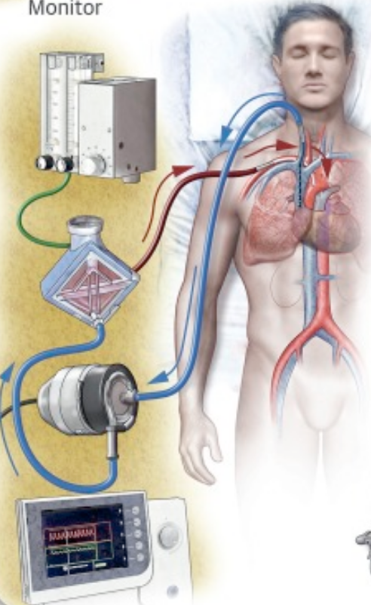
COVID-19 and Heart Disease*
209 consecutive patients, median age 62, hospitalized in France with COVID-19
“The presence and extent of CAC [coronary artery calcification] on chest CT [computed tomography] is associated with a worse prognosis in hospitalized COVID-19 patients”
“CAC is associated with increase in requirement of ventilators, ECMO [extracorporeal membrane oxygenation], and death independent of age and major atherosclerotic CVD risk factors”
*Jean Guillaume Dillinger et al. JACC: Cardiovascular Imaging July 2020 [Epub ahead of print]
DOI: 10.1016/j.jcmg.2020.07.004
Notes:
https://jamanetwork.com/journals/jamacardiology/fullarticle/2768916
ECMOt pumps and oxygenates a patient's blood outside the body, all
https://www.acc.org/latest-in-cardiology/journal-scans/2020/07/17/09/09/coronary-artery-calcification-and-complications

Slide 92
On the Trail of the Elusive X-Factor: A Sixty-Two-Year-Old Mystery Finally Solved*
Weston Price identified a mysterious “activator X” which seemed to be present in animal-derived fats like butter and beef tallow and in organ meats
Dr. Chris Masterjohn, through excellent sleuthing, figured out that this mysterious factor is vitamin K₂
“Whereas K₁ is preferentially used by the liver to activate blood clotting proteins, K₂ is preferentially used by the other tissues to place calcium where it belongs, in the bones and teeth, and keep it out of where it does not belong, in the soft tissues.”
*https://www.westonaprice.org/health-topics/abcs-of-nutrition/
on-the-trail-of-the-elusive-x-factor-a-sixty-two-year-old-mystery-finally-solved/

Slide 93
“Study links better vitamin K status with improved COVID-19 outcomes”*
Patients with severe COVID-19 are more likely to have comorbidities such as type 2 diabetes, hypertension and cardiovascular disease
These are all associated with reduced Vitamin K₂ levels
Matrix Gla protein depends on vitamin K₂ and is reduced in association with K₂ deficiencies
It protects from arterial calcification
A study on 123 patients with COVID-19 compared to controls showed that patients had reduced levels of Matrix Gla protein and that those with a worse outcome had even lower levels than those with milder disease symptoms
*www.nutritioninsight.com/news/study-links-better-vitamin-k-status-with-improved-covid-19-outcomes.html
Notes:
https://www.nutritioninsight.com/news/study-links-better-vitamin-k-status-with-improved-covid-19-outcomes.html
COVID/vitamin_k_protective_COVID.text

Slide 94
Advice for Staying Healthy in a Pandemic

Slide 95
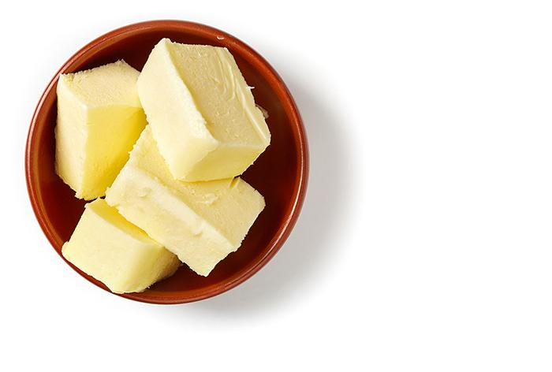
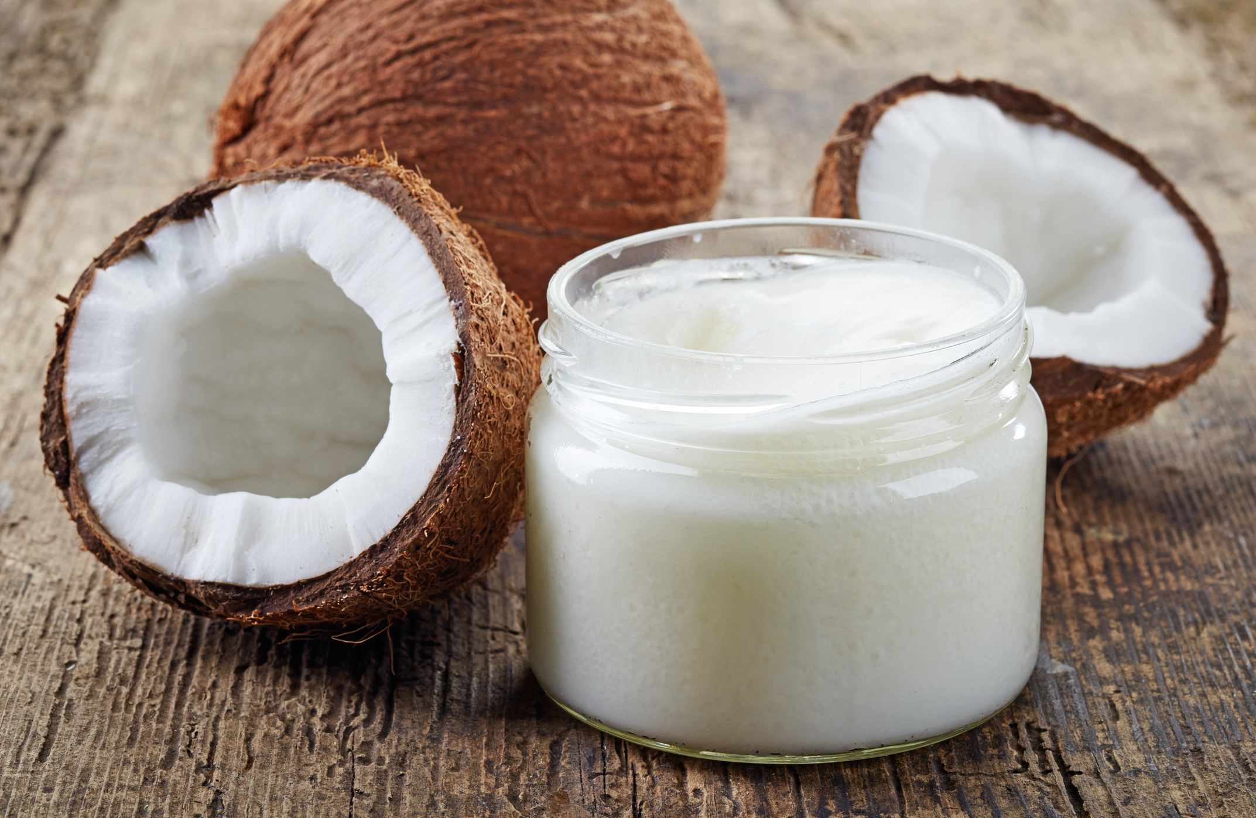
A High-Fat Diet is a Low-Deuterium Diet
Butter, lard and coconut oil were among the foods with the lowest detected levels of deuterium among foods tested
The synthesis of fats involves transfer of hydrogen from NADPH into the growing fatty acid chain

Slide 96
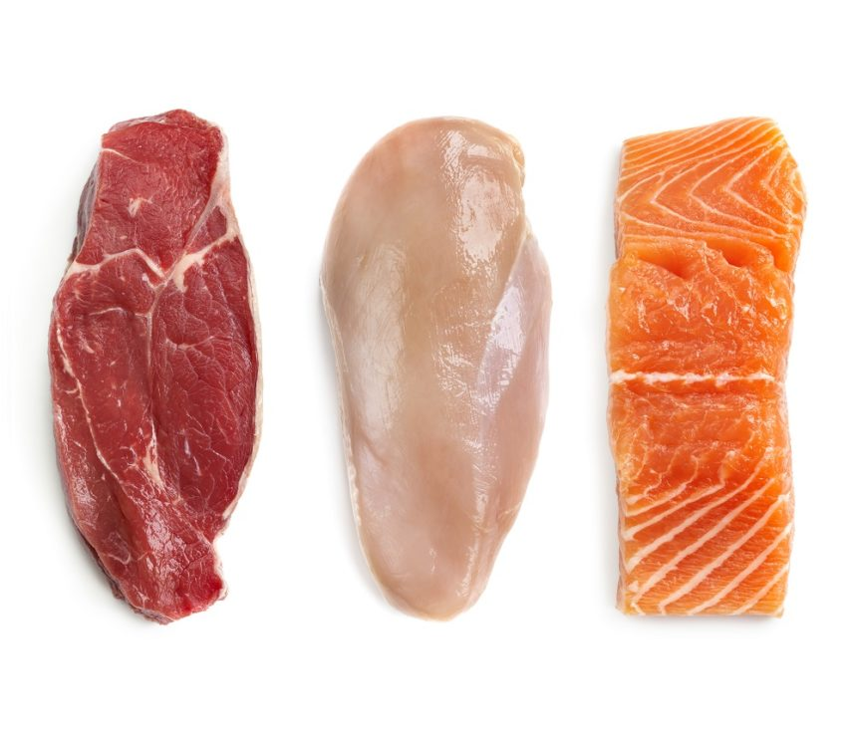
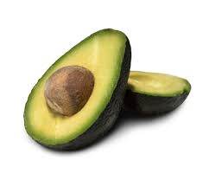
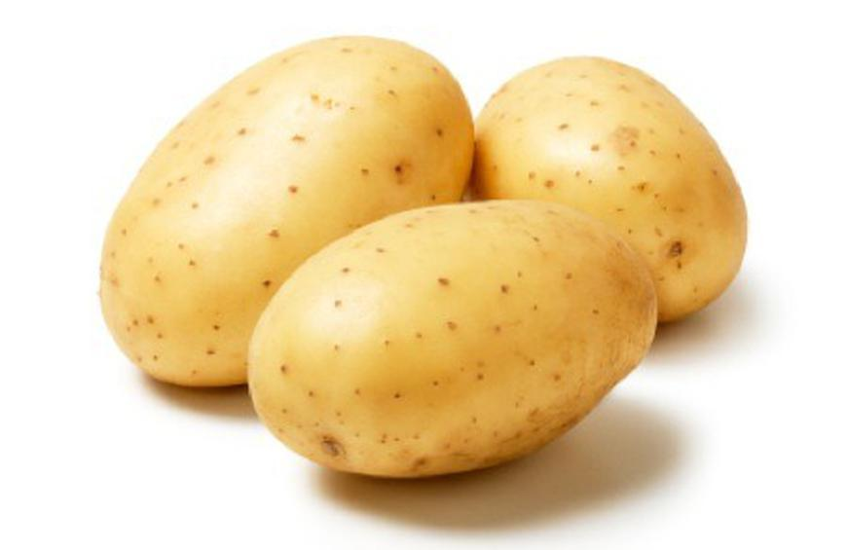
Foods High in Niacin → NAD(P)
Many foods are rich in niacin, especially animal products like meat, fish and poultry.
Vegetarian sources include avocado, peanuts, whole grains, mushrooms, green peas and potatoes.

Slide 97
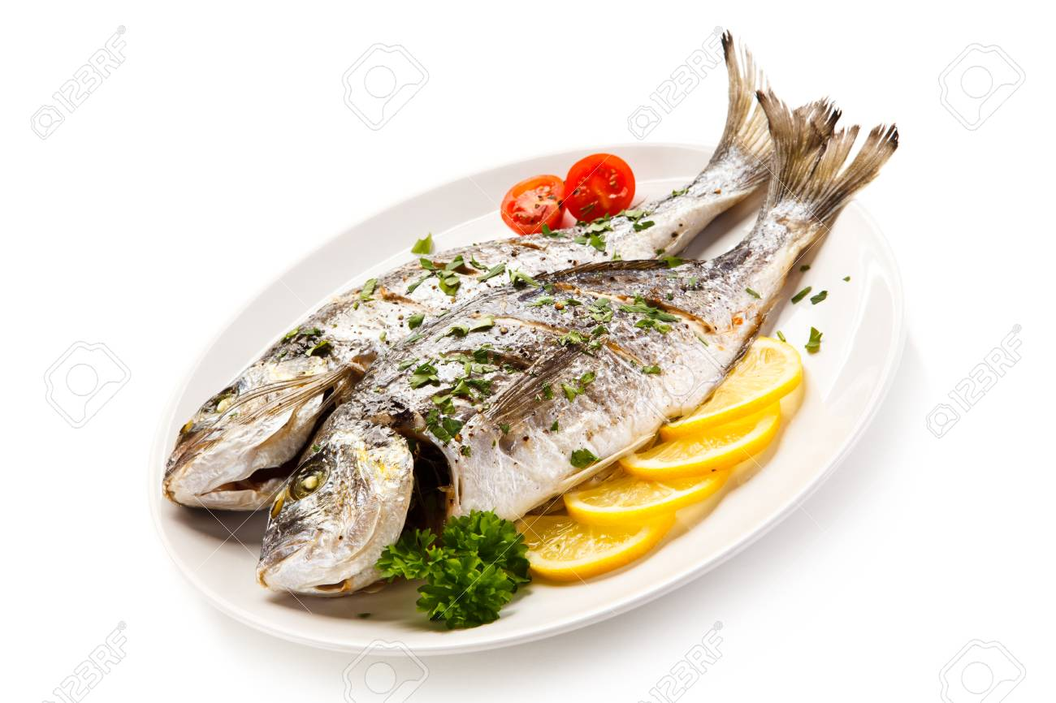
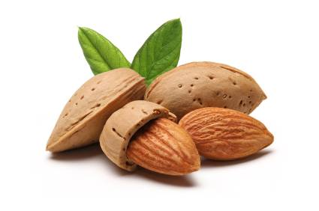
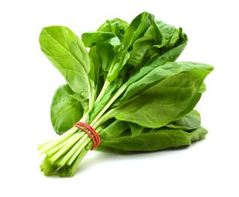
Riboflavin: Source for FAD in Flavoproteins
Foods high in riboflavin include beef, tofu, milk, fish, mushrooms, pork, spinach, almonds, avocados, and eggs

Slide 98
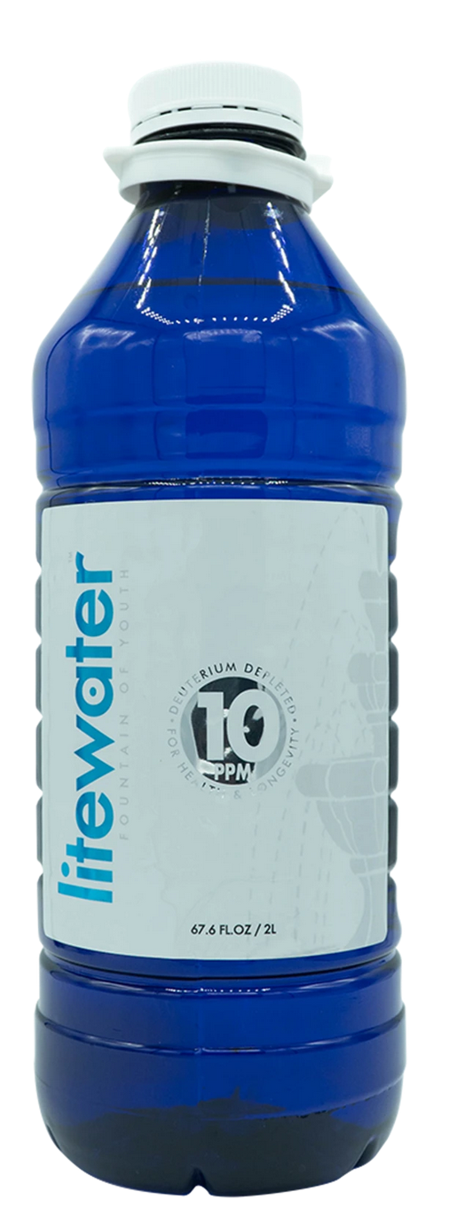
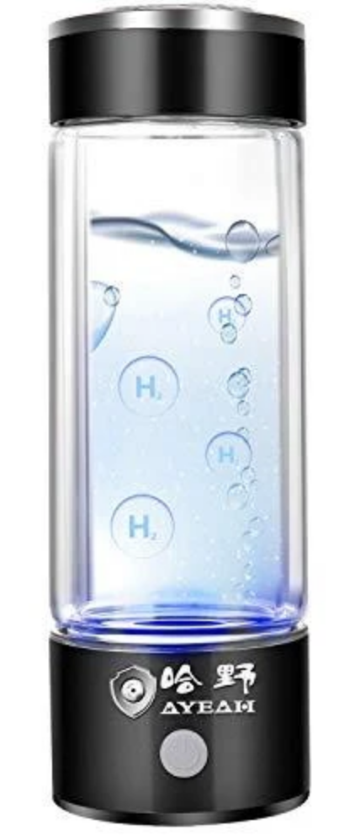
DDW, Glacier Water and Hydrogen Water

Slide 99
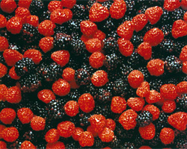
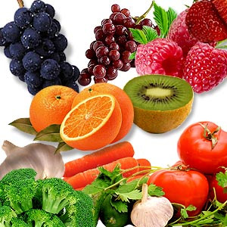
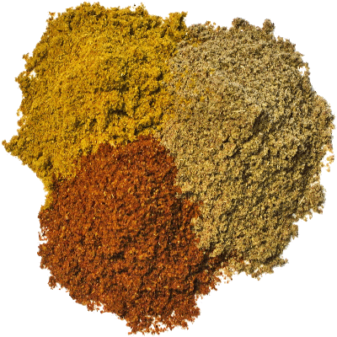
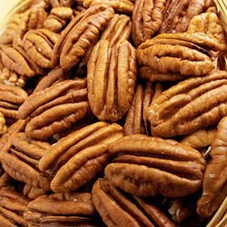
Flavonoids and Polyphenols!

Slide 100
Do Fermented Foods Protect from COVID-19?
South Korea;
kimchi, kombucha;
51 deaths/million
Germany;
sauerkraut
1,126 deaths/
million
United States;
fast food;
2,167 deaths/million
Japan;
natto;
143 deaths/
million
Taiwan;
stinky tofu;
35 deaths/ million
Notes:
As of October 15, 2021.
S Korea 51
Japan 143
Germany 1,126
Taiwan 35
US 2,167

Slide 101
Dietary Sources of Vitamin K₂*
*https://www.healthline.com/nutrition/foods-high-in-vitamin-k
Notes:
Mustard greens, kale, brussel sprouts, etc.
natto

Slide 102
16 participants and a total of 158 urine samples
5 days non-organic diet and 5 days organic diet
Rapid reduction in glyphosate and AMPA levels in urine following adoption of organic diet even after just a few days
Notes:
2020/glyphosate/organic_diet_reduces_glyphosate_in_urine_2020.pdf

Slide 103
"This study demonstrates that diet is a primary source of glyphosate exposure and that shifting to an organic diet is an effective way to reduce body burden of glyphosate and its main metabolite, AMPA.”
16 participants and a total of 158 urine samples
5 days non-organic diet and 5 days organic diet
Rapid reduction in glyphosate and AMPA levels in urine following adoption of organic diet even after just a few days
Notes:
2020/glyphosate/organic_diet_reduces_glyphosate_in_urine_2020.pdf

Slide 104
Conclusions
Flavoproteins are essential for maintaining healthy mitochondria by supplying them with deuterium depleted water
Glyphosate is causing an epidemic in chronic diseases due in part to inhibition of flavoproteins, leading to systemic disruption of DDW supply to mitochondria
COVID-19 disease is caused by SARS-CoV-2, which infects the lungs and induces a concerted effort to restore mitochondrial health to the lungs, the immune system and to the organism as a whole
The viral response critically involves oxidation of membrane lipids by lipoxygenase
In acute cases, the viral response gets derailed by further poisoning by glyphosate
The path towards good health includes eating a certified organic whole foods diet that is rich in fermented foods (vitamin K2), sulfur and the B vitamins niacin and riboflavin

