Slide 1
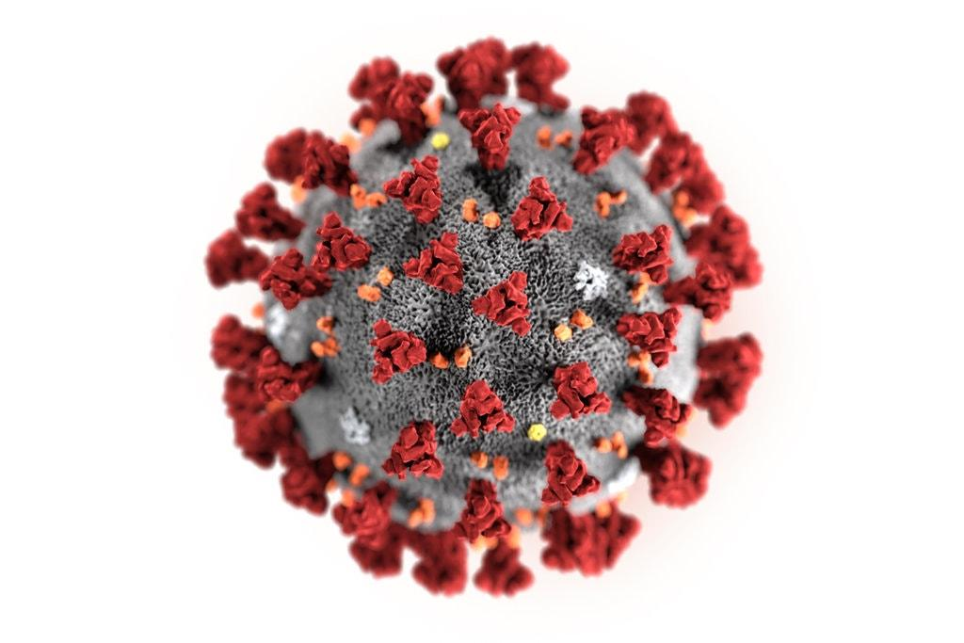
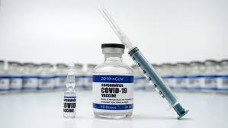
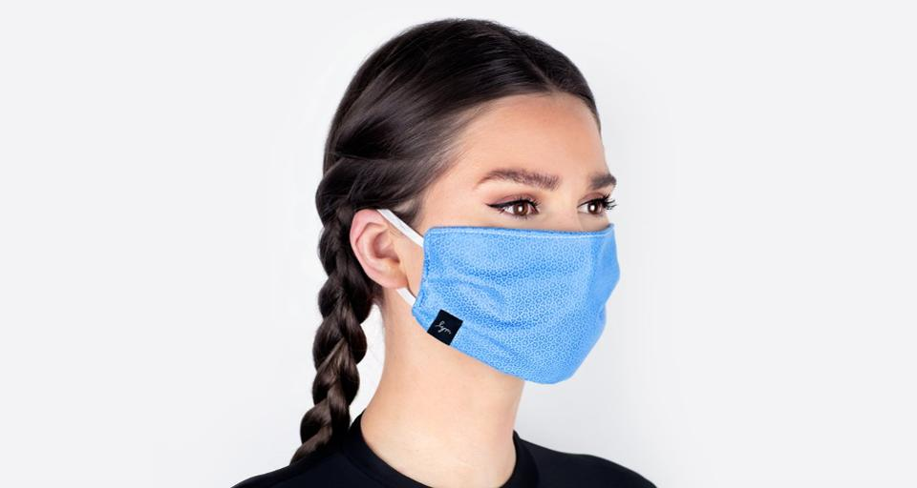
SARS-CoV-2 Vaccines: Is the Risk Worth the Benefit?
Stephanie Seneff
MIT CSAIL
WAPF Wise Traditions Conference
November 6, 2021
Notes:
This set of slides originated from Laszlo_August/Laszlo_August_2021.pptx

Slide 2
Download these slides
Powerpoint:
https://people.csail.mit.edu/seneff/2021/WAPF_2021_Part2.pptx
PDF:
https://people.csail.mit.edu/seneff/2021/WAPF_2021_Part2.pdf
My personal web page:
stephanieseneff.net

Slide 3
“We have never seen this before, however, the vision is so horrible and so awful and terrifying that I myself I don't even want to know what happens next.”
-- Professor Sucharit Bhakdi, retired microbiologist
Notes:
sue sha rit
baak dee

Slide 4
Outline
Overview of mRNA Vaccines
Breakthrough Variants
Antibody Dependent Enhancement
Immune System, Exosomes, and MicroRNAs
Exosomes, MicroRNAs and Heart Disease
Exosomes, MicroRNAs and Prion Diseases
Other Consequences of Vaccine-induced MicroRNAs
Spike Antibodies and Autoimmune Disease
Summary

Slide 5
Overview of mRNA Vaccines

Slide 6
Worldwide Statistics on Pandemic Death
Virus | World Population | Deaths | Normalized Percentage
Spanish Flu (H1N1) | ~2B | 50M | 2.5%
COVID-19 (SARS-CoV-2) | ~7.9B | 4.6M* | 0.05%
While any death is unfortunate, normalized deaths due to Covid-19 are ~50 times fewer than those due to the Spanish Flu in 1918-1920
Flare-ups of H1N1 have continued throughout the last century
Could SARS-CoV-2 have the same fate of lingering indefinitely, i.e. becoming endemic?
* As of September 2021

Slide 7
as of August 24, 2021
United States only
https://physiciansforinformedconsent.org/
physicians-for-informed-consent-publishes-comprehensive-analysis-of-u-s-covid-19-infection-fatality-rate-by-age-group/

Slide 8
The New COVID-19 mRNA Vaccines
The Pfizer and the Moderna vaccines are based on revolutionary technology that involves creating a nanoparticle containing a greatly modified form of the messenger RNA from the SARS-CoV-2 virus that codes for the spike protein
Polyethylene glycol (PEG) is included in the vaccine to keep the RNA from breaking down too quickly
“Instead of delivering a virus or a viral protein, RNA vaccines deliver genetic information that allows the body’s own cells to produce a viral protein. Synthetic mRNA that encodes a viral protein can borrow this machinery to produce many copies of the protein. These proteins stimulate the immune system to mount a response, without posing any risk of infection.”*
*https://news.mit.edu/2020/rna-vaccines-explained-covid-19-1211

Slide 9
Why are the COVID-19 mRNA vaccines so troubling to so many?
They were developed at warp speed (< 1 year), whereas unprecedented vaccine development typically takes 10-15 years, and only 2% make it through the process to final production and distribution
As a result, multiple corners were cut in their development: technology, testing, safety evaluation, deployment, follow-through, …
Data were kept out of reach of the scientific community, and dissenting opinions are being suppressed
There are multiple unknowns in possible adverse outcomes that we may not recognize until years have passed and much damage has been done

Slide 10
The RNA Life Cycle*
5’ cap
The mRNA vaccines are cleverly designed to contain mRNA that is perfectly set up to churn out spike proteins with no way to turn off the spigot
5’ cap and long poly(A) tail added to make it look like a human protein
Select hearty 3’UTR to resist silencing
Modified nucleotides to resist breakdown (methylpseudouridine)
Enhancement of G and C over A and U to promote rapid protein synthesis
poly(A) tail
3’UTR
*Figure 1. Florian J. Bock et al. Mol Cell. 2015 June 18; 58(6): 959–969.
Notes:
https://www.ncbi.nlm.nih.gov/pmc/articles/PMC4475274/
COVD_vaccine/RNA_regulation_by_PARPs_2015.pdf
adenine

Slide 11
mRNA vaccines contain the genetic code to make spike protein
The mRNA is incorporated into a lipid particle that simulates a human LDL particle
A synthetic cationic (positively charged) lipid is added to act as an adjuvant – very toxic to the cells
Large quantities of polyethylene glycol (PEG) are added to further protect the mRNA from breakdown
The RNA is carefully engineered to resist breakdown and to produce spike protein at high rate

Slide 12
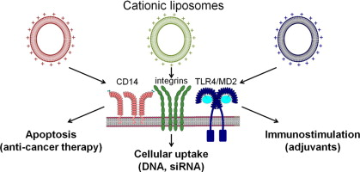
“The mRNA-LNP platform’s lipid nanoparticle component used in preclinical vaccine studies is highly inflammatory”*
“Intradermal injection of these LNPs led to rapid and robust inflammatory responses, characterized by massive neutrophil infiltration, activation of diverse inflammatory pathways, and production of various inflammatory cytokines and chemokines.”
Diagram from: Caroline Lonez et al. Advanced Drug Delivery Reviews 2012; 64(15): 1749-1758.
*Sonia Ndeupen et al. bioRxiv preprint. March 4, 2021. doi: 10.1101/2021.03.04.430128.
Notes:
COVID_vaccine/cationic_lipids_mRNA_vaccines_highly_inflammatory.pdf
DIAGRAM:
https://www.sciencedirect.com/science/article/abs/pii/S0169409X12001901

Slide 13
“Worse than the Disease? Reviewing Some Possible Unintended Consequences of the mRNA Vaccines Against COVID-19” *
The mRNA vaccines are a poorly evaluated novel technology with many unknowns
Some potential adverse consequences:
Pathogenic priming, multisystem inflammatory disease and autoimmunity
Allergic reactions and anaphylaxis
Antibody dependent enhancement
Activation of latent viral infections
Neurodegeneration and prion diseases
Emergence of novel variants of SARS-CoV-2
Potential for integration of the spike protein gene into human DNA
*S Seneff and G Nigh. IJVTPR 2021; 2(1): 38-79.
Notes:
https://dailyexpose.co.uk/2021/06/10/dr-tess-lawrie-demands-dr-june-raine-the-chief-exec-of-mhra-halts-the-covid-vaccine-programme-immediately-due-to-severe-adverse-reactions-and-deaths/
James Lyons Weiler has a paper about pathogenic priming.

Slide 14
Anaphylactic Shock
According to the CDC, “anaphylaxis after COVID-19 vaccination is rare and has occurred in approximately 2 to 5 people per million vaccinated in the United States”*
A careful study based on hospital employees in Boston who received the mRNA vaccines revealed that 2.47 people per 10,000 vaccinations experienced classic symptoms of anaphylaxis following vaccination**
This is 50 times the number reported in the VAERS database
The mRNA vaccines contain polyethylene glycol (PEG) – a likely trigger of shock
Anaphylaxis occurs immediately after vaccination so it should be easy to identify
Other symptoms are probably even more under-reported in VAERS
*CDC. Selected Adverse Events Reported after COVID-19 Vaccination.
** Kimberly G. Blumenthal et al. JAMA 2021;325(15): 1562-1565
https://www.cdc.gov/coronavirus/2019-ncov/vaccines/safety/adverse-events.html
Notes:
COVID_vaccines/JAMA_Blumenthal_acute_anaphylaxis_COVID_vaccines_50X.pdf

Slide 15
As of August 27,2021
https://vaersanalysis.info/2021/09/03/vaers-summary-for-covid-19-vaccines-through-8-27-2021/

Slide 16
DarkHorsePodcast - Dr. Brett Weinstein, Dr. Robert Malone and Mr. Steve Kirsch*
There was no evaluation of reproductive toxicity or genotoxicity in animals before the mRNA vaccines were authorized for humans
A FOIA request from doctors in Canada yielded a Pfizer study written in Japanese
The lipid nanoparticles went everywhere in the body but were found in especially high concentrations in the animals’ lymph nodes, spleen, ovaries, adrenal glands, liver and bone marrow.
Dr. Malone is an early developer of mRNA vaccine technology
https://www.youtube.com/watch?v=-_NNTVJzqtY (CENSORED)
Part 1: https://www.brighteon.com/fc163ab1-82f9-4f2b-b921-7b877923f315
Part 2: https://www.brighteon.com/00b257ec-2077-40b6-88a9-93d8d8451959
Notes:
From Meryl Nass post:
https://anthraxvaccine.blogspot.com/2021/07/in-this-incredibly-important-video-mrna.html

Slide 17
The Action is in the Germinal Centers*
The germinal center (GC) is a specialized microstructure that forms in secondary lymphoid tissues (e.g., lymph nodes and spleen)
produce long-lived antibody-secreting plasma cells and memory B cells
provide protection against reinfection
Within the GC, B cells undergo somatic mutation to achieve successful selection
B cell clones that bind antigen with high affinity emerge from this process
However, this mutation process can also be dangerous, as it can create autoreactive clones that can cause autoimmunity
*Marisa Stebegg et al. Frontiers in Immunology 2018; 9: Article 2469.
Notes:
https://www.frontiersin.org/articles/10.3389/fimmu.2018.02469/full

Slide 18
“SARS-CoV-2 mRNA vaccines induce persistent human germinal centre responses”*
Persistent germinal center (GC) reactions are critical for generating high-affinity and durable antibody responses
"Overall, our data demonstrate a remarkable capacity of SARS-CoV-2 mRNA-based vaccines to induce robust and prolonged GC reactions."
This leads to a very strong induction of memory B cells that produce antibodies specific to the spike protein
*Jackson S Turner et al. Nature 2021 Jun 28 [Epub ahead of print]
doi: 10.1038/s41586-021-03738-2.
Notes:
https://pubmed.ncbi.nlm.nih.gov/34182569/
COVID_vaccines/mRNA_vaccines_persistent_activity_germinal_centers.pdf

Slide 19
“A longitudinal study of SARS-CoV-2-infected patients reveals a high correlation between neutralizing antibodies and COVID-19 severity”*
A study of 140 SARS-CoV-2 infected patients revealed that those with the most severe disease were the ones who developed the strongest antibody response to the spike protein
The antibodies fade rapidly following viral clearance
My conclusion: a strong innate immune system can fight off the virus without ever having the need to produce antibodies
Antibodies are invoked only after innate immune system failure
*Vincent Legros et al., Cellular & Molecular Immunology 2021; 18: 318-327.
Notes:
https://www.nature.com/articles/s41423-020-00588-2
COVID_vaccine/high_antibody_response_only_in_sickest_patients_COVID.pdf

Slide 20
Breakthrough Variants

Slide 21
The Big Picture
Antibodies to the virus in an immune-compromised person can lead to rapid evolution of new antibody-resistant strains
There are parallels between getting antibody therapy from recovered COVID patients and getting antibodies that were induced by a vaccine
The rapid emergence of the Delta strain may have been facilitated by the massive vaccination campaign
Preliminary evidence suggests that vaccinated people and unvaccinated people are equally susceptible to infection with Delta
Israel (vaccinated very early) is facing a fourth wave (Delta variant) as vaccine effectiveness wanes

Slide 22
“SARS-CoV-2 evolution during treatment of chronic infection”*
Cancer patient being treated for recurrent lymphoma with a drug that depletes antibody-producing B cells caught COVID-19
Persistent viral RNA shedding and risk of transmission in the hospital
Patient died 101 days after diagnosis, after being given two rounds of plasma from recovered patients, which contained antibodies against the virus
Following antibody exposure, SARS-CoV-2 had acquired several mutations that might have allowed it to elude the antibodies.
This is a good model for what happens when you vaccinate an immune-compromised person
*SA Kemp et al., Nature 2021; 592: 277-282.
Notes:
https://www.sciencemag.org/news/2020/12/uk-variant-puts-spotlight-immunocompromised-patients-role-covid-19-pandemic

Slide 23
“SARS-CoV-2 501Y.V2 escapes neutralization by South African COVID-19 donor plasma”*
“Sera from the Moderna and Pfizer-BioNTech vaccinees show significantly reduced neutralization of 501Y.V2”
“A substantial proportion of non-neutralizing antibodies remain active against 501Y.V2.”
“These data highlight the prospect of reinfection with antigenically distinct variants and foreshadows reduced efficacy of spike-based vaccines.”
“These data highlight the urgent requirement for rapidly adaptable vaccine design platforms and the need to identify less-mutable viral targets for incorporation into future immunogens.”
*Constantinos Kurt Wibmer et al. Nature Medicine 2021; 27: 622-625.
Notes:
COVID_vaccine/SARS-CoV-2_escapes_neutralization_by_South_African_donor_plasma.pdf

Slide 24
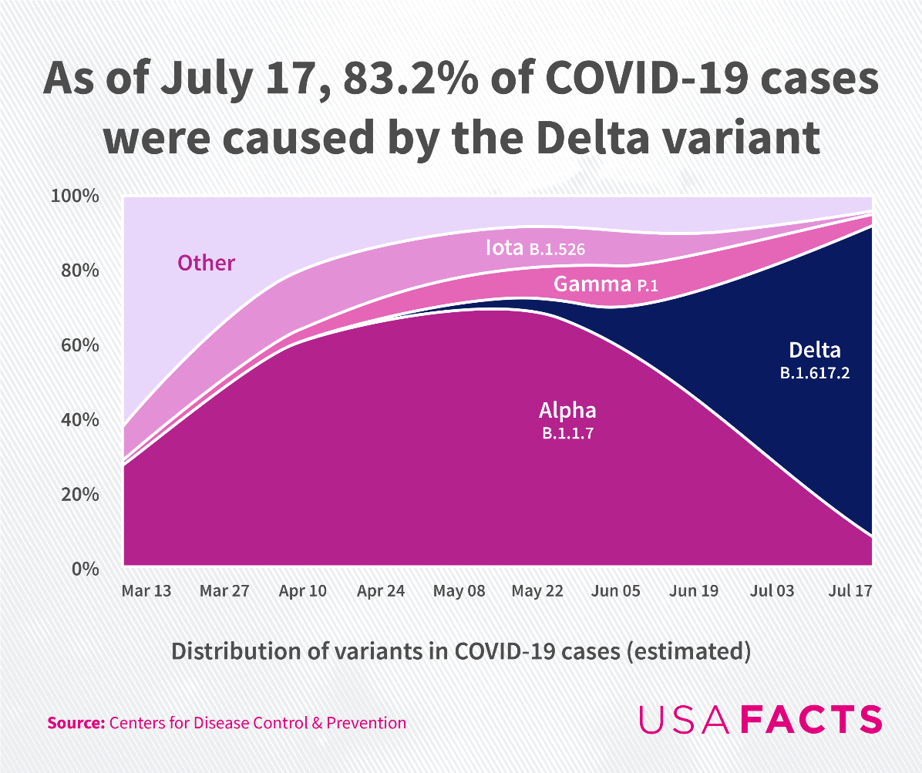
As of September 20, the number had risen to over 99%
Notes:
out of India

Slide 25
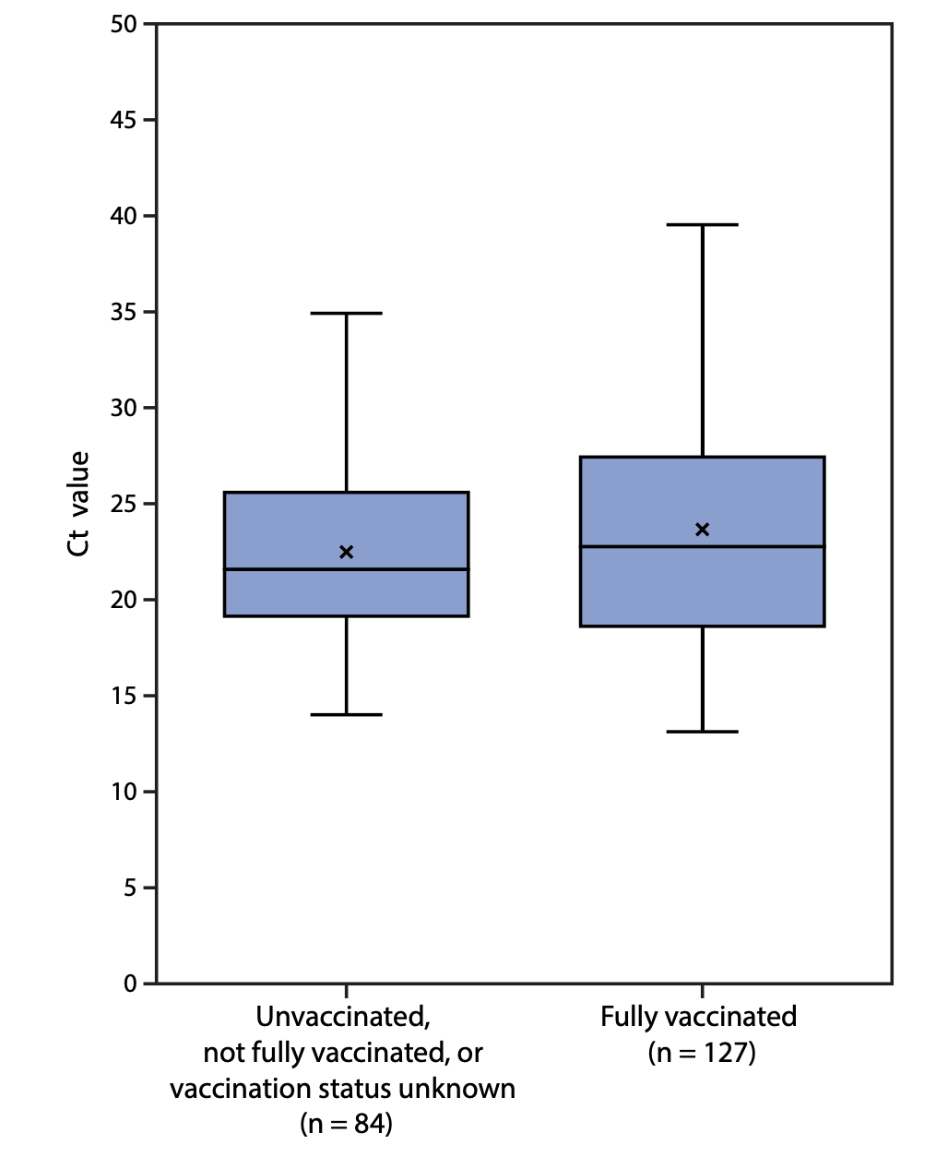
Vaccines Provide Poor Protection from Delta Strain in Cape Cod*
74% of cases were fully vaccinated
80% of fully vaccinated had symptoms
Plot shows PCR threshold values for specimens from vaccinated vs unvaccinated patients in Barnstable County, Massachusetts.
July, 2021
*Morbidity and Mortality Weekly Report , July 30, 2021
Centers for Disease Control
Notes:
COVID_vaccine/MMWR\ July\ 30\ 2021\ Provincetown\ cluster\ 75%\ fully\ vaccinated\ \(2\).pdf
FIGURE 2. SARS-CoV-2 real-time reverse transcription–polymerase chain reaction cycle threshold values* for specimens from patients with infections associated with large public gatherings, by vaccination status† — Barnstable County, Massachusetts, July 2021

Slide 26
“An Effective COVID-19 Vaccine Needs to Engage T Cells”*
All the COVID vaccines currently on the market are specific to the spike protein
Natural infection induces antibodies to many other viral proteins
T cells exposed to internal viral proteins can become memory T cells that respond very quickly to a new infection
They are much more long lasting than memory B cells (up to 17 years!)
These memory T cells can induce a rapid antibody response in B cells to a mutated form of the spike protein
Memory B cells can lose their effectiveness because their antibodies are specific to an obsolete version of the spike protein
Conclusion: natural infection induces far better protection than the vaccines
*Karsten Sauer and Tim Harris. Frontiers in Immunology 2020; 11: 581807.
Notes:
COVID_vaccine/vaccines_must_engage_T_cells.pdf

Slide 27
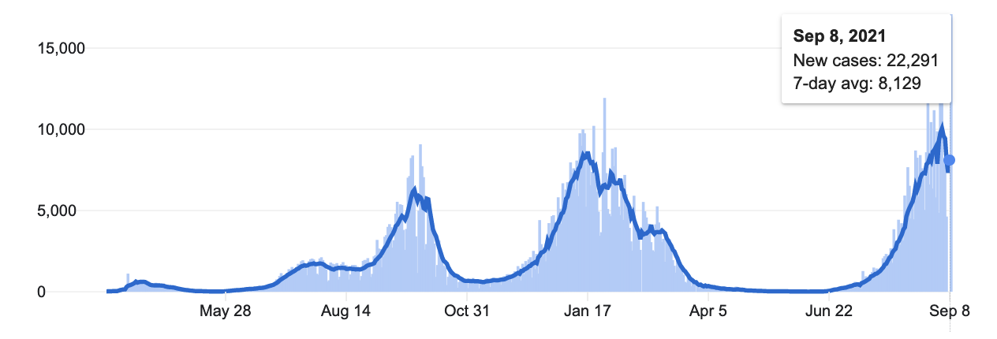
August 18,2020
"Unlike previous epicenters of infection in Israel’s crowded, less-vaccinated ultra-Orthodox communities, this scourge primarily took hold in well-vaccinated, middle-class suburbs."

Slide 28
Outbreak in Israeli Hospital, July 2021*
24% of the patients (23 people) were infected
An additional 19 people (staff and family members) were also infected
39 out of 42 cases were fully vaccinated.
Median time of 25 weeks after vaccination
Index patient was fully vaccinated
Several transmissions occurred among people wearing face masks
14/23 patients became severely sick or died (five deaths)
The two unvaccinated patients had mild disease
Warning about waning immunity
*Pnina Shitrit et al. Euro Surveill 2021; 26(39): 2100822.
Notes:
COVID_vaccine/Israel_outbreak_Delta_variant_hospital.pdf

Slide 29
Neutralizing antibodies fall dramatically in six months*
Red: males; Blue: females
*Mehul S. Suthar et al. bioRxiv preprint Sept. 20, 2021. Doi: 10.1101/2021.09.30.462488.
Notes:
COVID_vaccines/neutralizing_antibodies_fall_fast_vaccines_bioRxiv.pdf
42 days after first vaccine.

Slide 30
“Large-scale study of antibody titer decay following BNT162b2 mRNA vaccine or SARS-CoV-2 infection”*
antibody titer
Vaccine
Initial levels of antibody are much higher in vaccinated patients (Pfizer mRNA vaccine), but they decrease faster.
antibody titer
Infection
*Ariel Israel et al. medRxiv preprint Aug. 22, 2021. doi: 10.1101/2021.08.19.21262111.
Notes:
https://www.medrxiv.org/content/10.1101/2021.08.19.21262111v1
COVID_vaccine/vaccine_antibodies_fade_faster.pdf

Slide 31
Positive trend between vaccination rate and infection rate*
Israel
Number of cases during one week before September 3. 2021
*S. V. Subramanian et al. European Journal of Epidemiology Sept 30, 2021 [Epub ahead of print]
Notes:
Increases in COVID‐19 are unrelated to levels of vaccination across 68 countries and 2947 counties in the United States
where?

Slide 32
Antibody-Dependent Enhancement (ADE)

Slide 33
Antibody-Dependent Enhancement (ADE)*
The vaccine has the potential to backfire:
Antibody enhances uptake into macrophages via Fcγ receptors leading to increased viral infection and replication
Antibody increases release of cytokines causing enhanced risk of excessive inflammation and cytokine storm
“ADE has been observed in SARS, MERS and other human respiratory virus infections including RSV and measles, which suggests a real risk of ADE for SARS-CoV-2 vaccines and antibody-based interventions.”*
“Thus, the absence of ADE evidence in COVID-19 vaccine data so far does not absolve investigators from disclosing the risk of enhanced disease to vaccine trial participants, and it remains a realistic, non-theoretical risk to the subjects.”**
*Wen Shi Lee et al., Nature Microbiology 2020; 5: 1185-1191.
**T Cardozo and R Veazey, Int J Clin Pract 2021; 75(3): e13795.
Notes:
https://www.nature.com/articles/s41564-020-00789-5
COVID_vaccine/ADE_and_SARS_2020.pdf
Vaccine_paper/Cardozo_ADE_real_possibility_warn_patients.pdf

Slide 34
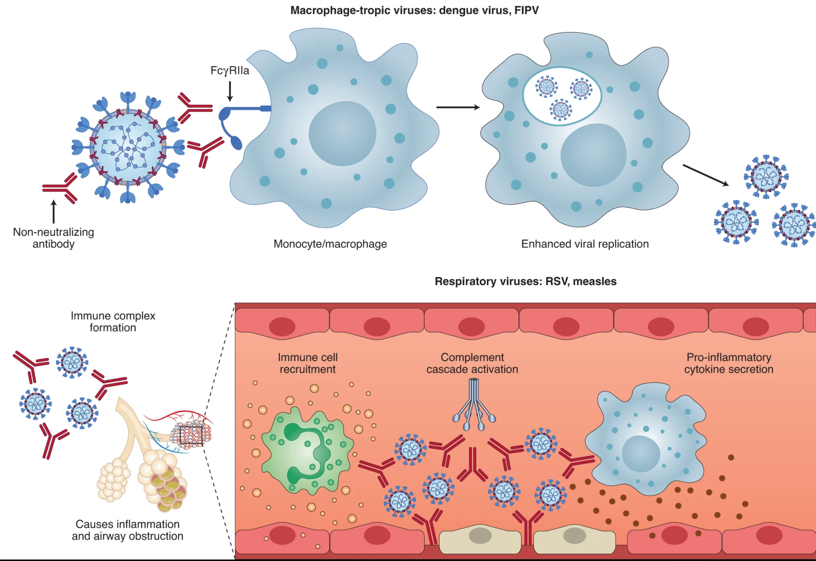
*Figure 1. Wen Shi Lee et al., Nature Microbiology 2020; 5: 1185-1191.
Enhanced viral replication
Cytokine storm
Notes:
COVID_vaccine/ADE_and_SARS_2020.pdf
as antibodies fade.

Slide 35
“Informed consent disclosure to vaccine trial subjects of risk of COVID-19 vaccines worsening clinical disease”*
Conclusion:
“The specific and significant COVID-19 risk of ADE should have been and should be prominently and independently disclosed to research subjects currently in vaccine trials, as well as those being recruited for the trials and future patients after vaccine approval, in order to meet the medical ethics standard of patient comprehension for informed consent.”
*Timothy Cardozo and Ronald Veazey. Int J Clin Pract. 2021; 75: e13795.
Notes:
https://ghionjournal.com/fauci-nih-knew-covid-19-vaccines-could-lead-antibody-dependent-enhancement/
COVD_vaccines/informed_consent_ADE.pdf

Slide 36
Delta Variant Increases Risk of ADE*
“However, in the case of the Delta variant, neutralizing antibodies have a decreased affinity for the spike protein, whereas facilitating antibodies display a strikingly increased affinity.”
"The emergence of SARS-CoV-2 variants may tip the scales in favor of infection enhancement."
Δ
*Nouara Yahi et al. Journal of Infection August 9, 2021 [Epub ahead of print] https://doi.org/10.1016/j.jinf.2021.08.010
Notes:
COVID_vaccine/Delta_variant_increases_risk_of_ADE.pdf

Slide 37
“The SARS-CoV-2 Delta variant is poised to acquire complete resistance to wild-type spike vaccines”*
The Delta variant completely escaped from anti-N-terminal domain (NTD) neutralizing antibodies
Delta variant responsiveness to anti-NTD infectivity-enhancing antibodies is increasing
The Delta variant will continue to acquire further mutations
"When four common mutations were introduced into the receptor binding domain (RBD) of the Delta variant (Delta 4+), some Pfizer BioNTech-immune sera lost neutralizing activity and enhanced the infectivity"
Δ
*Yafei Liu et al. biRxiv preprint. Aug 23, 2021. DOI: 10.1101/2021.08.22.457114
Notes:
COVID_vaccine/Delta_variant_resistant_to_vaccines_Japan.pdf

Slide 38
Immune System, Exosomes and MicroRNAs

Slide 39
Immune System 101
The innate immune system is actually very powerful if it is healthy
If the innate system can’t clear the virus, the adaptive system gets involved
The adaptive system releases antibodies to help tag and trap the viruses, and inflammatory cytokines which induce release of reactive oxygen species
Figure from https://articles.mercola.com/sites/articles/archive/2020/10/14/herd-immunity-coronavirus.aspx
Notes:
https://articles.mercola.com/sites/articles/archive/2020/10/14/herd-immunity-coronavirus.aspx

Slide 40
COVID Lungs: Alveoli: Review from Part 1
Hyaline membrane grows large
Gelled water fills the alveoli
“Ground Glass” opacities
Reminiscent of hyaline membrane disease in premature newborns
Oxygen supply is sharply reduced
Mitochondria (systemically) are disabled
Lungs become site where macrophage health is restored through replenishment of deuterium-depleted water in the mitochondria
Notes:
Where??
Images/covid_lungs_alveoli.png

Slide 41
“Exosomes provide unappreciated carrier effects that assist transfers of their miRNA to targeted cells; I. They are ‘The Elephant in the Room’”*
Exosomes are a type of extracellular vesicle with diverse content that are released from stressed cells
Micro-RNAs are short sequences of RNA that suppress selected proteins by binding to the promoter in their messenger RNA
There are thousands of different miRNAs each with specific functions
They survive well inside the protective coat of exosomes
Cell-cell communication is often carried out through the exchange of exosomes
Exosomes released by immune cells are taken up by tissue cells to influence metabolic policy in the recipient cell through the specific miRNAs contained in the exosome
*Philip W. Askenase. RNA Biology 2021 May 4; 1-16.
Notes:
miRNA./exosomes_transfer_miRNAs_to_target_cells_WOW.pdf

Slide 42
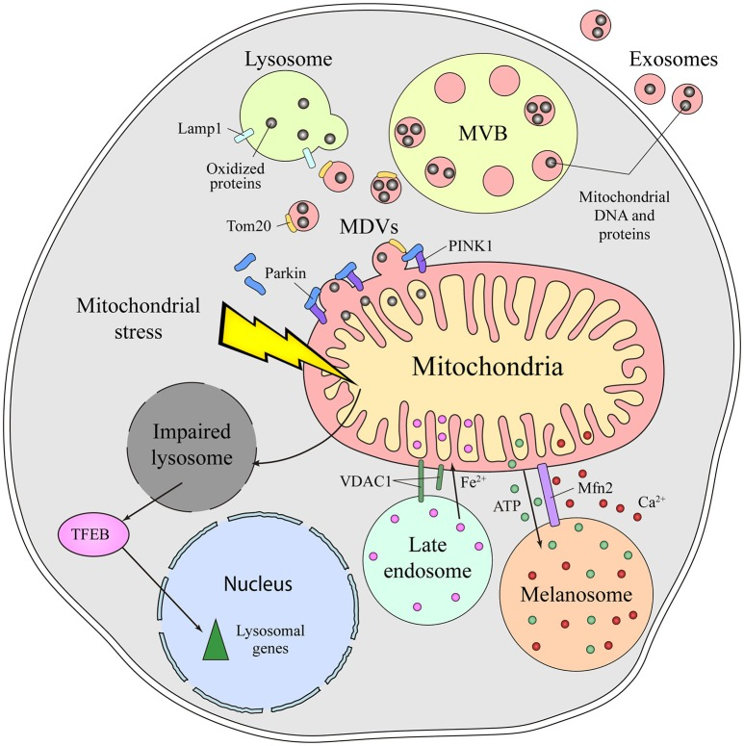
Mitochondria, Lysosomes and Aging*
“Disruption of the mitochondrial–lysosomal axis coupled with abnormal EV [extracellular vesicle] secretion may play a role in the pathogenesis of aging and several disease conditions.”
Damaged mitochondria are normally cleared through an endosome-to-lysosome pathway
When lysosomes are impaired, damaged mitochondria are excreted from the cell inside exosomes (extracellular vesicles)
Excessive extracellular vesicles in the blood are a marker of aging
Figure 2 in GonzaloSoto-Heredero et al. Frontiers in Cell and Developmental Biology 2017; 5: 95.
*Anna Picca et al. Int J Mol Sci 2019; 20: 805.
Notes:
https://www.ncbi.nlm.nih.gov/pmc/articles/PMC6412692/
Mitochondria/mitochondrial_dysfunction_and_aging.pdf
MDV – mitochondrial derived vesicles
MVB = multivesicular bodies
diagram from:
https://europepmc.org/article/pmc/pmc5681906
in
2020/book/mitochondria/mitochondria_lysosomes_communication_exosomes.pdf

Slide 43
A cell that can’t clear its garbage dumps its garbage
SICK CELL
*Brunella Tancini et al. Genes 2019; 10: 510.
Notes:
https://www.mdpi.com/2073-4425/10/7/510/htm
Mitochondria/extracellular_vesicles_lysosomal_storage_diseases_2019.pdf

Slide 44
A cell that can’t clear its garbage dumps its garbage
SICK CELL
Are the mitochondria repaired while they are outside the cells?
*Brunella Tancini et al. Genes 2019; 10: 510.
Notes:
https://www.mdpi.com/2073-4425/10/7/510/htm
Mitochondria/extracellular_vesicles_lysosomal_storage_diseases_2019.pdf

Slide 45
Hypothesis
The reaction that takes place in the lungs following an infection with SARS-CoV-2 facilitates recovery of mitochondrial function in innate system immune cells that eventually enables them to clear the virus
The vaccine introduces the genetic code to force muscle cells in the arm to make massive amounts of spike protein, without the rest of the virus particle
Bypasses both mucosal barrier (lungs) and vascular barrier (blood vessels)
Vaccine essentially introduces a dangerous toxin into the body without supporting the launch of an appropriate immune response that would heal the mitochondria

Slide 46
Exosomes, MicroRNAs and Heart Disease

Slide 47
The Big Picture
Stressed immune cells release exosomes containing microRNAs that signal to tissue cells and can induce an inflammatory response
In particular, miR-155 plays a special role in SARS-CoV-2, facilitated by spike
The spike protein S1 subunit detaches and becomes free to bind to ACE2 receptors which are present at high levels in the heart
The suppression of ACE2 by spike S1 causes upregulation of angiotensin II, which induces inflammation (myocarditis) and cardiovascular disease
S1 has been found in COVID-19 patients long after the virus is cleared, and is believed to play a critical role in “long-haul COVID”
S1 has also been found in the vasculature following vaccination
miR-155 overexpression is linked to worse outcomes in heart attack

Slide 48
“Exosomes take (germinal) center stage”*
Wild Type
Rab27-/-
miR-155-3p
Horizontal transfer of microRNAs via exosomes from T to B cells is necessary for germinal center formation and efficient antibody production
miR-155-3p silences PTEN and BiM, supporting B cell maturation and proliferation
However, miR-155 is also associated with many autoimmune diseases**
*Figure 1. Jennifer Pérez-Boza and Dirk M Pegtel.
EMBO Rep 2020; 21: e50190
**Salar Pashangzadeh et al. Frontiers in Immunology 2021; 12: 669382
Rab27 is essential for exosome secretion
Notes:
https://www.embopress.org/doi/full/10.15252/embr.202050190\
miRNA/exosomes_take_germinal_center_stage.pdf

Slide 49
A role for miRNA-155 in SARS-CoV-2*
“Small RNA profiling showed strong expression of the immunity and inflammation-associated microRNA miRNA-155 upon infection with both viruses” (SARS-CoV and SARS-CoV-2)
“SARS-CoV-2 elicited approximately two-fold higher stimulation of the interferon response compared to SARS-CoV …, and induction of cytokines such as CXCL10 or IL6.”
Interferon-γ upregulates miR-155**
*Wyler Emanuel et al. bioRxiv preprint. May 5, 2020.
doi: https://doi.org/10.1101/2020.05.05.079194.
**Yu-An Hsu et al. Chin J Physiol 2016; 59(6): 315-322.
Notes:
COVID_vaccine/SARS-CoV-2_and_miR-155.pdf
**:
https://pubmed.ncbi.nlm.nih.gov/27817193/

Slide 50
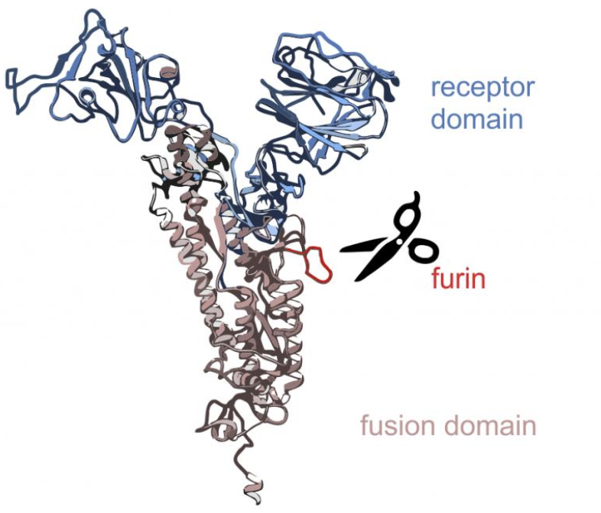
SARS-CoV-2 S1 of spike persists up to 15 months post-infection in immune cells expressing an Fcγ receptor*
S1
Enzymatic cleavage of the spike protein by furin proteases causes the S1 segment to be released and circulate freely in the vasculature
S1 is the part that binds to ACE2 receptors
S1 survives in the immune cells long after infection has cleared
Could be the cause of “long-haul COVID.”
S2
*Bruce K. Patterson et al. bioRxiv July 9, 2021. doi: 10.1101/2021.06.25.449905.
Notes:
https://www.biorxiv.org/content/10.1101/2021.06.25.449905v2
COVID_vaccines/persistance_spike_S1_15_months_post_infection.pdf
CD16 is Fc gamma receptor IIIa.

Slide 51
“Free SARS-CoV-2 Spike Protein S1 Particles May Play a Role in the Pathogenesis of COVID-19 Infection”*
S1 molecules carry intact RBD domains, and their binding to ACE2 may induce ACE2 downregulation and deleterious downstream effects
*Andrey V. Letarov et al. Biochemistry (Moscow) 2020 Dec 30: 1–5.
Notes:
miRNAs/free_S1_spike_role_in_COVID19.pdf
Caption:
Putative involvement of free S1 subunits of the SARS-CoV-2 S protein in the COVID-19 infection. Spontaneous “firing” of the S protein trimers on the surface of virions and infected cells liberates free RBD-containing S1 particles. The binding of these S1 particles to ACE2 may cause a decrease in the ACE2 cell surface expression and lead to the RAS imbalance. (Color version of the figure is available in the online verssion of this article and can be accessed at: https://www.springer.com/journal/10541)

Slide 52
“Free SARS-CoV-2 Spike Protein S1 Particles May Play a Role in the Pathogenesis of COVID-19 Infection”*
S1 molecules carry intact RBD domains, and their binding to ACE2 may induce ACE2 downregulation and deleterious downstream effects
Eleven out of 13 health care workers had detectable levels of spike protein and/or S1 in their blood plasma as early as 1 day and up to 28 days following the first mRNA vaccine, with a peak level on average after five days.**
**Ogata et al. Clinical Infectious Diseases 2021; ciab465. [Epub ahead of print] doi: 10.1093/cid/ciab465.
*Andrey V. Letarov et al. Biochemistry (Moscow) 2020 Dec 30: 1–5.
Notes:
miRNAs/free_S1_spike_role_in_COVID19.pdf
https://academic.oup.com/cid/advance-article/doi/10.1093/cid/ciab465/6279075

Slide 53
“Free SARS-CoV-2 Spike Protein S1 Particles May Play a Role in the Pathogenesis of COVID-19 Infection”*
S1 molecules carry intact RBD domains, and their binding to ACE2 may induce ACE2 downregulation and deleterious downstream effects
S1 alone caused COVID-19-like lung symptoms in mice humanized with ACE2 receptor: Immune cell infiltration, cytokine storm, impaired barrier function.***
***Ruben M. L. Colunga Biancatelli et al.
Am J Physiol Lung Cell Mol Physiol 2021; 321: L477–L484.
*Andrey V. Letarov et al. Biochemistry (Moscow) 2020 Dec 30: 1–5.
Notes:
miRNAs/SARS_S1_causes_lung_damage_transgenic_mice.pdf

Slide 54
“SARS-CoV-2 Spike Protein Impairs Endothelial Function via Downregulation of ACE2”*
Spike-protein "pseudoviruses" cause endothelial damage by downregulating ACE2
This increases oxidative stress and impairs mitochondrial function in the endothelial wall lining blood vessels
Induces vasculitis
*Yuyang Lei et al. Circulation Research 2021; 128: 1323-1326.
Notes:
COVID_vaccines/ spike_protein_alone_downregulates_ACE2.pdf

Slide 55
SARS-CoV-2 mRNA Vaccination-Associated Myocarditis in Children Ages 12-17: A Stratified National Database Analysis”*
Rate of myocarditis after two shots of Pfizer vaccine was 162 cases per million in boys 12-15 years old
About 86% required hospitalization
May lead to permanent damage and heart failure
Risk of a healthy adolescent being taken to hospital with COVID-19 in the next three months is 44 per million
*Tracy Beth Høeg et al. medRxiv preprint. August 30, 2021.
doi: https://doi.org/10.1101/2021.08.30.21262866
Notes:
https://www.medrxiv.org/content/10.1101/2021.08.30.21262866v1
COVID_vaccine/myocarditis_mRNA_vaccines_children.pdf

Slide 56
Myocarditis Reports in VAERS*
Sweden and Denmark have decided to pause the use of the Moderna vaccine for all children and young adults
Through September 24, 2021
16-and-over vaccination began December 14, 2020
12-15-year-old vaccination began May 10, 2021
*https://openvaers.com/covid-data/myo-pericarditis

Slide 57
How Spike Protein can Cause Cardiac Issues*
Stress
Macrophage
Spike protein S1 unit causes stress and binds to ACE2 receptors, disabling them
This causes accumulation of Angiotensin II which activates macrophages
Macrophages secrete abundant exosomes containing miR-155
These exosomes are taken up by fibroblasts, suppressing their proliferation
This interferes with the healing process, leading to cardiac rupture
Exosome
Secretion
Cardiac Fibroblast
Cardiac Rupture
*Chunxiao Wang et al. Molecular Therapy 2017; 25(1): 192-204.
Notes:
blogposts/miRNAs/exosomes_with_miR-155_cardiac_inflammation.pdf

Slide 58
miR-155 overexpression linked to worse outcomes in heart attack*
MI1: heart attack within first 24 hours of clinical symptoms
MI2: heart attack 2-7 days after onset of clinical symptoms
Measured three miRNA levels in autopsy samples of 50 patients with MI
“innate immunity resulting in an intense inflammatory reaction plays an important role in the pathogenesis of the VR [ventricular rupture] after MI [myocardial infarction] in humans.”
*Figure 1. Nina Zidar et al. Disease Markers 2011; 31: 259-265.
Notes:
blogposts/miRNAs./miRNA_155_in_heart_attack_ventricular_rupture_2011.pdf

Slide 59
Exosomes, microRNAs and Prion Diseases
Notes:
28 minutes

Slide 60
Exosomes and Parkinson’s Disease*
Parkinson’s disease often begins in the gut as an immune reaction to prion-like proteins produced by pathogens
The spike protein is a prion-like protein
It contains five glycine zippers (GxxxG) – a characteristic signature of prions
Stressed immune cells in the digestive tract and spleen upregulate α-synuclein and release it packaged up in exosomes, along with foreign misfolded proteins
The exosomes travel along the vagus nerve to the brain stem nuclei
Damage to the substantia nigra causes Parkinson’s disease
The whole process can take years or decades before symptoms appear
*S Seneff and G Nigh. IJVTPR 2021; 2(1): 38-79.

Slide 61
Loss of smell is a common early symptom of Parkinson's and of COVID-19
Virus can gain access to brain along nerve fibers
Olfactory nerve
Vagus nerve
Neuroinvasion of SARS-COV-2 could upregulate α-synuclein
High levels of α-synuclein leads to misfolding and toxicity
Dopaminogenic neurons in substantia nigra express high levels of the ACE2 receptor

Slide 62
Three independent case reports have described the development of Parkinson’s disease following COVID-19.*
Loss of smell is a common early symptom of Parkinson's and of COVID-19
Virus can gain access to brain along nerve fibers
Olfactory nerve
Vagus nerve
Neuroinvasion of SARS-COV-2 could upregulate α-synuclein
High levels of α-synuclein leads to misfolding and toxicity
Dopaminogenic neurons in substantia nigra express high levels of the ACE2 receptor
* Ernesto Estrada Viruses 2021; 13: 897.

Slide 63
SARS-CoV-2 Spike Activates Human Microglia in the Brain via Exosomes Loaded with miRNAs*
"SARS-CoV-2 spike transfected cells release a significant amount of exosomes loaded with microRNAs such as miR-148a and miR-590”
"MicroRNAs get internalized by human microglia in the brain"
"These results uncover a bystander pathway of SARS-CoV-2 mediated CNS [central nervous system] damage through hyperactivation of human microglia"
*Ritu Mishra and Akhil C. Banerjea. Frontiers in Immunology 2021; 12:656700
Notes:
prions/exosomes_spike_WOW.pdf

Slide 64
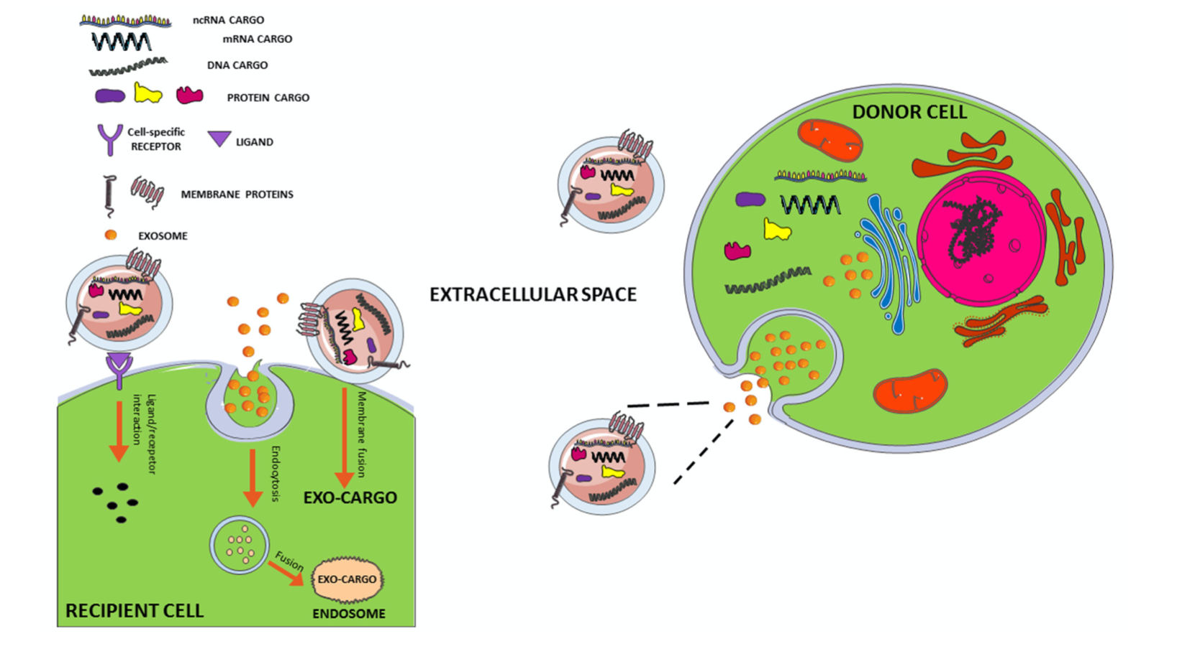
Exosome Transfer from Cell to Cell*
exosome
Endocytosis
Ligand
Receptor
Membrane
Fusion
*Figure 1. Marianna D’Anca et al. Front. Aging Neurosci. 28 August 2019; 11: 232.

Slide 65
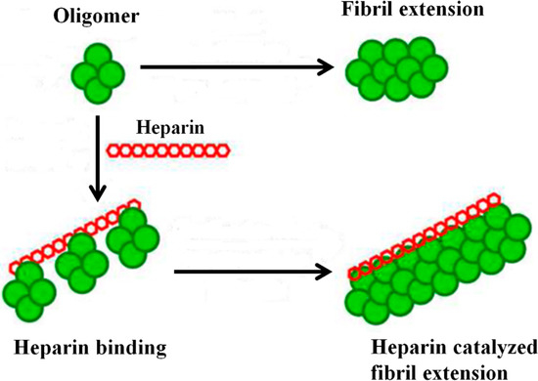
“SARS-CoV-2 spike protein interactions with amyloidogenic proteins: Potential clues to neurodegeneration”*
The receptor binding domain (RBD) of the spike protein binds to heparin and to heparin-binding proteins
Heparin binding accelerates aggregation of amyloid proteins
Amyloid-β, α-synuclein, tau, prion and TDP-43
This could lead to neurodegeneration in the brain
*D Idrees and V Kumar. Biochemical and Biophysical Research Communications 2021; 554: 94e98.
Notes:
diagram is from https://www.mdpi.com/1420-3049/20/2/2510/htm
Article:
blogposts/prions/spike_interacts_with_aBeta_heparan_sulfate.pdf

Slide 66
Prion Corruption of Natively Folded Proteins*
Foreign prion proteins (e.g., spike) act like crystals to induce misfolding of susceptible human proteins (e.g., α-synuclein, amyloid- β, etc.)
Proteins change from α-helix to β-sheet configuration
This leads to formation of oligomers and fibrils → neurodegenerative disease (Parkinson’s, Alzheimer’s, ALS, CKD, ..)
Spike?
*Dana Butnaru and Joab Chapman. Autoimmun Rev 2019; 18(3): 231-240.
Notes:
prions/prions_impact_neurodegeneration_2021.pdf

Slide 67
"COVID-19 Vaccine Associated Parkinson’s Disease, A Prion Disease Signal in the UK Yellow Card Adverse Event Database.”*
“All the COVID-19 vaccines on the market contain spike protein or its nucleic acid sequence creating a possible catastrophic epidemic of prion disease in the future.”
“This analysis should serve as an urgent warning to those mindlessly following advice of politicians and public health officials regarding COVID immunization.”
*J Bart Classen. J Med - Clin Res & Rev. 2021; 5(7): 1-6.

Slide 68
Other Consequences of Vaccine-induced MicroRNAs
Notes:
35 minutes

Slide 69
“The microRNA miR-148a functions as a critical regulator of B cell tolerance and autoimmunity”*
Immunotolerance ensures that the immune cells can react to foreign antigens but do not attack self tissues
Overexpression of miR-148a disrupts B cell tolerance
Autoreactive B cells are linked to lupus, rheumatoid arthritis, diabetes and multiple sclerosis
Patients with lupus show increased expression of miR-148a
miR-148a suppresses expression of the autoimmune suppressor Gadd45α, the tumor suppressor PTEN and the pro-apoptotic protein Bim
→increased risk systemically to autoimmune disease and cancer
*Alicia Gonzalez-Martin et al. Nature Immunology 2016; 17(4): 433-440.
Notes:
prions/148a_regulates_B_cell_tolerance_lupus_2016.pdf

Slide 70
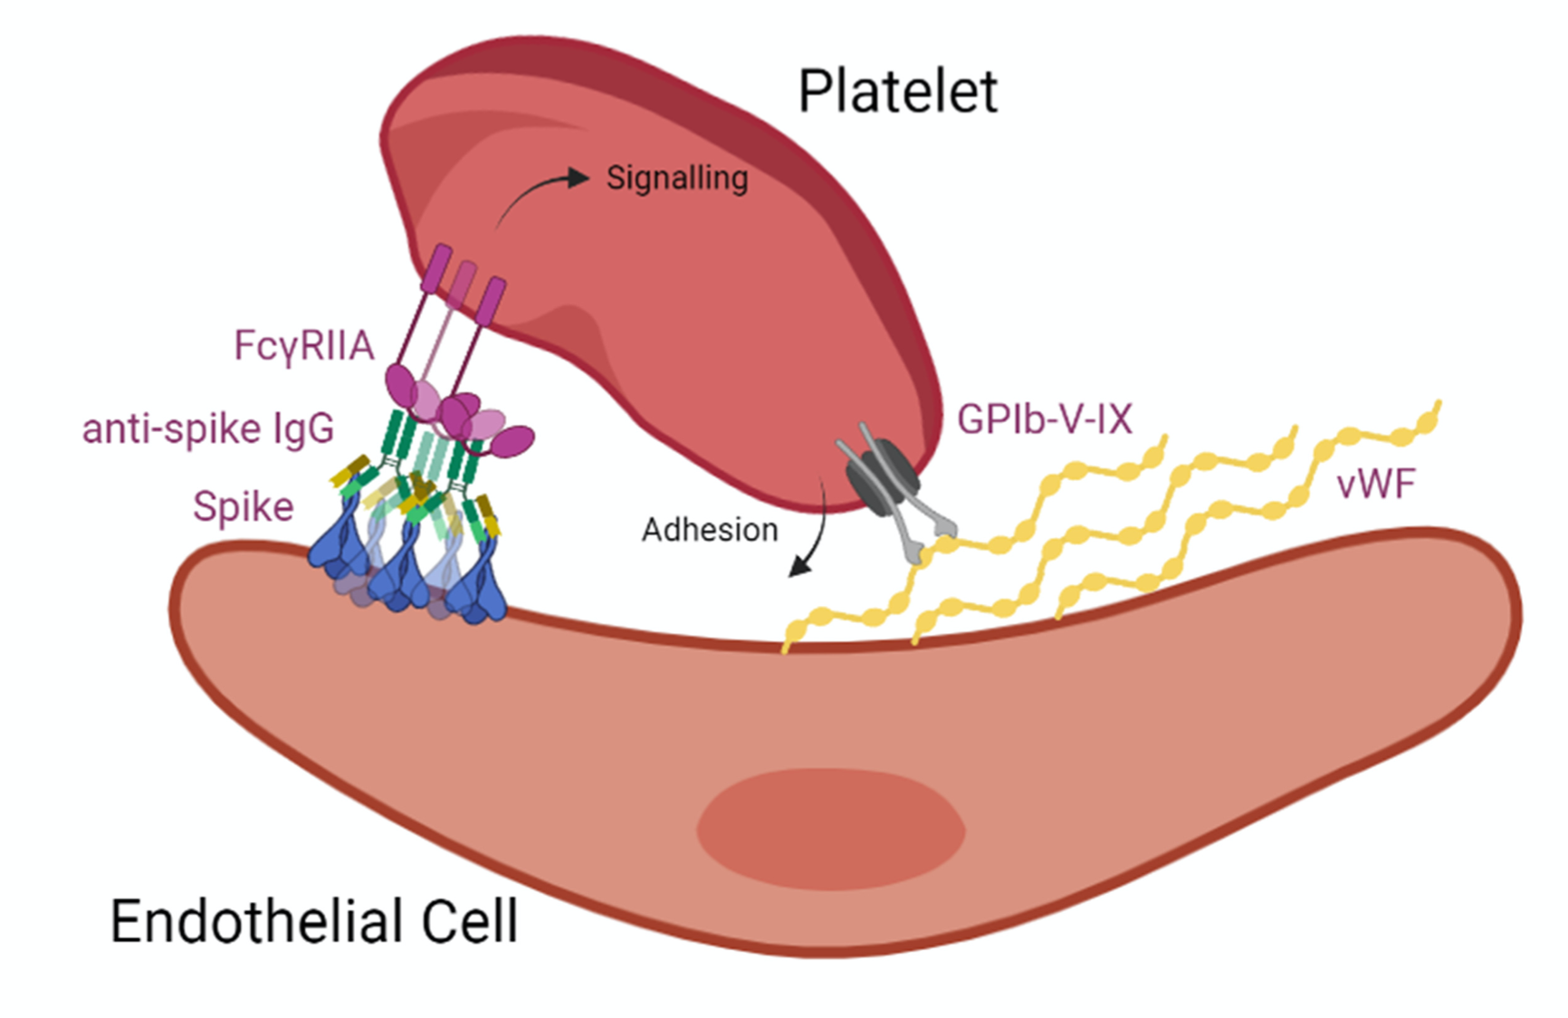
Thrombocytopenia & miR-148a*
Platelets have an Fcγ receptor for the constant fragment of immunoglobulin G in antigen-antibody complexes
Receptor activation leads to platelet activation, aggregation and thrombosis
TULA-2 (T-cell ubiquitin ligand-2) suppresses platelet activation
It inhibits the platelet Fcγ receptor and protects from thrombocytopenia
miR-148a targets TULA-2 mRNA and downregulates TULA-2 protein expression
CONCLUSION: miR-148a overexpression can lead to heparin-induced thrombocytopenia (in the absence of heparin)
*Yuhang Zhou et al. Blood 2015; 126(26): 2871–2881.
Notes:
miRNAs/thrombocytopenia.text
Figure 5 in
COVID_vaccines/aberrant_glycosylation_IgG_platelets_Fc_thrombosis.pdf (diagram)

Slide 71
Thrombocytopenia & miR-148a*
Platelets have an Fcγ receptor for the constant fragment of immunoglobulin G in antigen-antibody complexes
Receptor activation leads to platelet activation, aggregation and thrombosis
TULA-2 (T-cell ubiquitin ligand-2) suppresses platelet activation
It inhibits the platelet Fcγ receptor and protects from thrombocytopenia
miR-148a targets TULA-2 mRNA and downregulates TULA-2 protein expression
CONCLUSION: miR-148a overexpression can lead to heparin-induced thrombocytopenia (in the absence of heparin)
Higher expression of miR-155 in peripheral blood monocytes of immune thrombocytopenia patients also correlated positively with the reduction in platelet count.*
*BH Qian et al. Acta Haematol 2015; 133(3): 257-63.
*Yuhang Zhou et al. Blood 2015; 126(26): 2871–2881.
Notes:
miRNAs/thrombocytopenia.text
Figure 5 in
COVID_vaccines/aberrant_glycosylation_IgG_platelets_Fc_thrombosis.pdf (diagram)

Slide 72
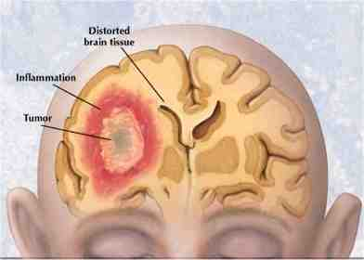
Glioblastoma and Other Cancers
Glioblastoma is the most aggressive form of brain cancer
microRNA-148a is linked to bad outcomes*
High levels were a risk indicator for shortened life span in glioblastoma patients
Increased cell growth, survival, migration, and invasion
MicroRNA‐590‐3p enhances the radioresistance in glioblastoma cells**
miR-590-3p expression was higher in high grade than in low grade gliomas
miRNA-590 overexpression is also linked to breast cancer, cervical cancer, clear cell renal carcinoma and hepatocellular carcinoma
*Jungeun Kim et al. Cancer Res. 2014 March 1; 74(5): 1541–1553.
**Long Chen et al. Experimental and Therapeutic Medicine 2017; 14: 1818-1824.
Notes:
miRNA/exosomes_of_glioma_cells_deliver_miR-148a_promote_glioblastoma_target_CADm1.pdf
cancer/miRNA-148a_in_glioblastoma_2014.pdf

Slide 73
“New-Onset Neurologic Symptoms and Related Neuro-Oncologic Lesions Discovered After COVID-19 Vaccination: Two Neurosurgical Cases and Review of Post-Vaccine Inflammatory Responses”*
Two cases: Metastatic malignant melanoma and glioblastoma
“We hypothesize that the inflammatory response to the COVID vaccine may have played a role in increasing clinical symptoms in these patients, potentially in relation to the COVID-19 spike protein.”
“it is known that spike proteins can initiate inflammatory cascades and cross the blood-brain barrier (BBB) in COVID-19 infections.”
Could it be that miR-148a and miR-590 were delivered to the brain in spike-protein-containing exosomes?
*EH Einstein et al. Cureus 2021; 13(6): e15664.
Notes:
one patient Bell’s palsy that did not resolve, arm paralysis.
blogposts/miRNAs/COVID_vaccines_brain_cancer.pdf
https://www.cureus.com/articles/61880-new-onset-neurologic-symptoms-and-related-neuro-oncologic-lesions-discovered-after-covid-19-vaccination-two-neurosurgical-cases-and-review-of-post-vaccine-inflammatory-responses
Referemced in Mercola article:

Slide 74
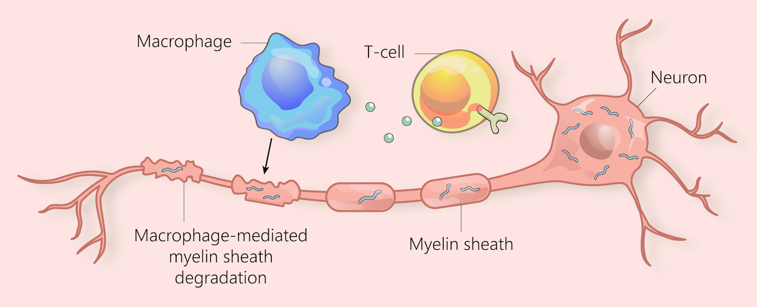
“miR-155 as an Important Regulator of Multiple Sclerosis Pathogenesis. A Review”*
"miR-155 is among those miRNAs that are most strongly implicated in autoimmune diseases"
polarizes myeloid cells (granulocytes, monocytes, macrophages, and dendritic cells) towards a pro-inflammatory form
is strongly overexpressed in B-cell-activated lymphomas
causes pro-inflammatory polarization of microglia in the brain to M1-like phenotype, and neurotoxicity
miR-155 was up-regulated 12-fold in active white matter lesions in association with multiple sclerosis compared with healthy controls
*Karina Maciak et al. International Journal of Molecular Sciences 2021; 22: 4332.
Notes:
miR-155_in_multiple_sclerosis.pdf

Slide 75
“miR-155 as an Important Regulator of Multiple Sclerosis Pathogenesis. A Review”*
"miR-155 is among those miRNAs that are most strongly implicated in autoimmune diseases"
polarizes myeloid cells (granulocytes, monocytes, macrophages, and dendritic cells) towards a pro-inflammatory form
is strongly overexpressed in B-cell-activated lymphomas
causes pro-inflammatory polarization of microglia in the brain to M1-like phenotype, and neurotoxicity
miR-155 was up-regulated 12-fold in active white matter lesions in association with multiple sclerosis compared with healthy controls
Other diseases linked to miR-155 over-expression include systemic lupus erythematosus, rheumatoid arthritis, systemic sclerosis, primary immune thrombocytopenia, inflammatory bowel disease, Graves' ophthalmopathy, myasthenia gravis and idiopathic inflammatory myopathies.*
*Salar Pashangzadeh et al. Frontiers in Immunology 2021; 12: 669382
*Karina Maciak et al. International Journal of Molecular Sciences 2021; 22: 4332.
Notes:
miR-155_in_multiple_sclerosis.pdf

Slide 76
mRNA Transfer to Other Cells via Exosomes*
Lipid nanoparticles containing mRNA coding for a specific protein are taken up by cells at the injection site and repackaged into endosomal vesicles that are then released into the circulation as exosomes
The cationic lipid is included in the exosomes
These exosomes can be taken up by other cells which then translate the RNA into protein
EVs= extracellular vesicles = exosomes
*Marco Maugeri et al. Nature Communications 2019; 10: 4333.
Notes:
COVID_vaccine/mRNA_transfers_into_exosomes_and_passes_to_new_cells.pdf
human erythropoietin

Slide 77
Spike Antibodies and Autoimmune Disease

Slide 78
*
I predict that a massive vaccination campaign against COVID-19 may result in a dramatic increase in all sorts of autoimmune diseases
*Nature News Feature. https://www.nature.com/articles/d41586-021-00149-1

Slide 79
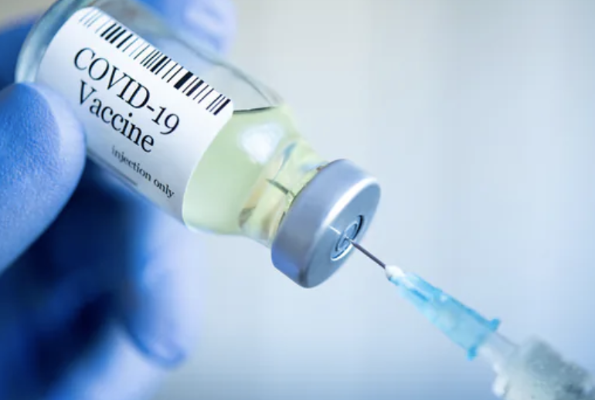
“Substantial Differences in SARS-CoV-2 Antibody Responses Elicited by Natural Infection and mRNA Vaccination”*
After the second dose of the vaccine, antibody titers were up to 10 times higher than those of patients who had recovered from natural COVID-19 infection.
This does not mean that the vaccinated people are better protected than those who recovered from the disease
High antibody titers opens you up for autoimmune disease, especially when miR-148a is overexpressed
*Rafael Assis et al. bioRxiv preprint. May 19, 2021. doi: https://doi.org/10.1101/2021.04.15.440089
Notes:
https://www.contagionlive.com/view/immune-response-from-mrna-covid-19-vaccines-is-more-robust-than-natural-infection

Slide 80
“Potential antigenic cross-reactivity between SARS-CoV-2 and human tissue with a possible link to an increase in autoimmune diseases”*
Cross reaction between spike protein antibody and tissue proteins
Protein/organelle Diseases
transglutaminase Celiac disease
extractable nuclear antigens Scleroderma, lupus
myelin basic protein Multiple sclerosis, autism
mitochondria Lupus, primary billiary cirrhosis, hepatitis, myocarditis
nuclear antigen Sjogren's syndrome, mixed connective tissue disease, lupus
myosin Myocarditis, dilated cardiomyopathy, Chagas' heart disease, Kawasaki disease, rheumatic fever
thyroid peroxidase Hashimoto's thyroid disease
S100B Brain metastases from lung disease, epilepsy, multiple sclerosis, and Parkinson's disease
*Aristo Vojdani and Datis Kharrazian, Clinical Immunology 217 (2020) 108480.
Notes:
https://www.ncbi.nlm.nih.gov/pmc/articles/PMC7246018/
COVID/cross_reactivity_spike_protein_human_proteins.pdf
Commercially available mouse monoclonal antibody made against recombinant SARS coronavirus spike protein a

Slide 81
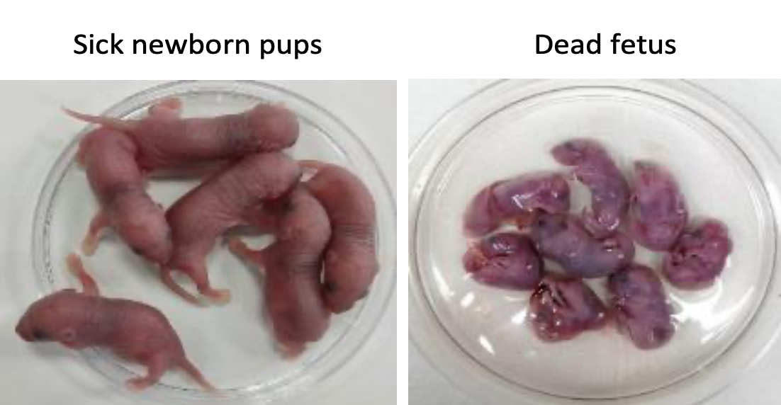
“Pathogenic antibodies induced by spike proteins of COVID-19 and SARS-CoV viruses”*
REGN10987 is a neutralizing IgG antibody produced in response to the spike protein
Researchers injected the antibody into the peritoneum of pregnant rats
The offspring of the pregnancy were highly damaged:
Acute renal tubular injury
Myocardial hemorrhage (heart damage)
Inflammation in the brain
Many were born dead
Antibody also bound broadly to human inflammatory tissues or cancer tissues, likely increasing the severity of preexisting disease
*Huiru Wang et al. Research Square Jun 17, 2021. DOI: 10.21203/rs.3.rs-612103/v2.
Notes:
COVID_vaccine/Hangzhou_China_study_S1_antibodies_toxic_to_fetus_mice_WOW.pdf
SARS-CoV-2_neutralizing_antibodies_REGN10987.pdf

Slide 82
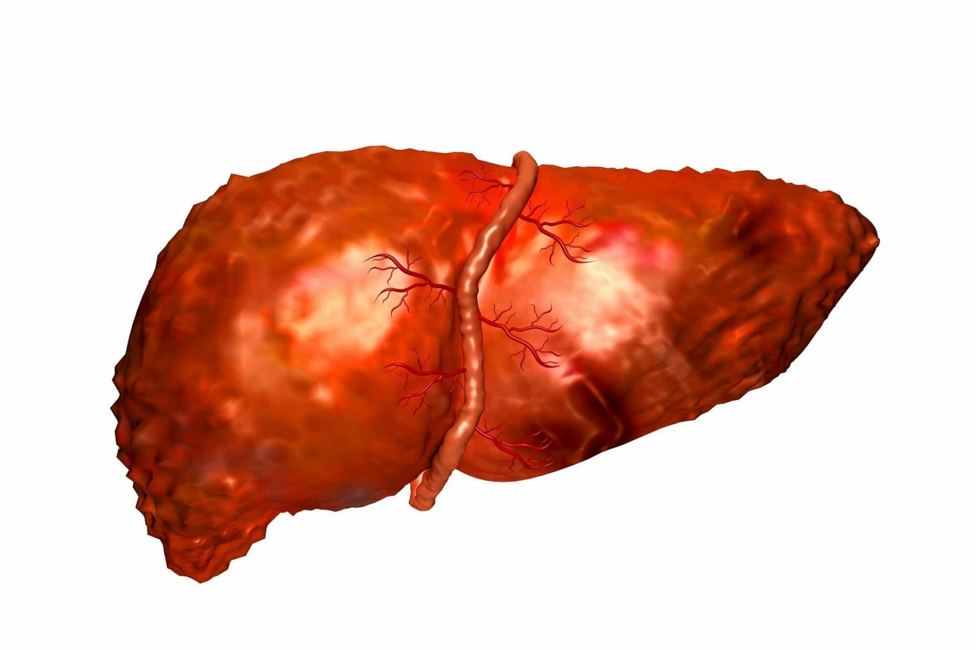
Autoimmune Hepatitis Following COVID-19 Vaccine: Two Case Studies
35-year-old woman developed autoimmune hepatitis one week post-COVID-19 vaccination (Pfizer) associated with antinuclear antibodies*
71-year-old woman noticed jaundice four days post-vaccination with Moderna vaccine**
Total IgG was markedly raised at 21.77g/L
Massive eosinophil infiltration typical of drug-induced liver injury
Liver enzymes elevated
Liver injury has been linked to COVID-19 as well***
*Fernando Bril et al. Journal of Hepatology 2021; 75: 221-255
**Cathy McShane et al. Journal of Hepatology July 7, 2021 (Epub ahead of print] DOI: 10.1016/j.jhep.2021.06.044
***Jose D Debes et al. Dig Liver Dis. 2020; 52(9): 953-955.
Notes:
miRNA/autoimmune_hepatitis_after_COVID_vaccine.pdf

Slide 83
Recapitulation
The mRNA COVID-19 “vaccines” have been carefully bio-engineered to optimize for inducing high levels of antibodies to the spike protein
These antibodies can attack the tissues through molecular mimicry
The injection bypasses the mucosal barriers and the vascular barriers and raises multiple alarm bells in the immune cells
The toxic prion-like spike proteins produced in large amounts in germinal centers in the spleen get distributed throughout the body via exosomes
Exosomes deliver spike and microRNAs to the heart to induce myocarditis and to the brain to induce protein misfolding and neurodegenerative diseases as well as brain cancer
The price of the vaccine is a retuning of the immune system policy towards autoimmune disease and neurodegenerative disease
Notes:
First mention of microRNAs

Slide 84
Summary
The novel vaccine technology for COVID-19 prevention is untested and may cause devastating neurodegenerative, autoimmune, oncological and cardiovascular diseases in the vaccinated population
A primary mechanism may be through the release of massive numbers of exosomes containing spike protein and specific microRNAs
The vaccines may be the primary driver behind the emergence of resistant variants like Delta
Natural immunity is far more protective for a much longer time than vaccine-based immunity
There is real potential for the vaccines to backfire through ADE
Antibodies to the spike protein also bind to many human proteins associated with diverse autoimmune diseases through molecular mimicry

