Slide 1
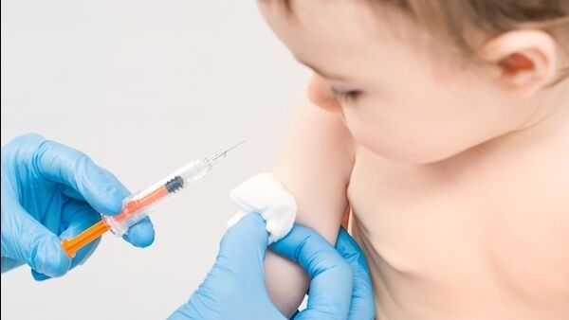
COVID mRNA Vaccines should Not be Given to Children
Dr. Stephanie Seneff
CSAIL, MIT
For Our Rights
Make Americans Free Again (MAFA) Webinar
Nov 12, 2022

Slide 2
Outline
Overview
Myocarditis and Sudden Adult Death
Neurological Damage and Autism
Conclusion

Slide 3
Overview

Slide 4
“CDC Advisory Committee Votes To Add COVID-19 Jabs to Children’s Vaccine Schedule”*
On June 18, 2022, the Centers for Disease Control and Prevention approved COVID-19 vaccination for young children who are at least 6 months old
The CDC’s Advisory Committee on Immunization Practices (ACIP) has approved adding the COVID-19 vaccines from Pfizer and Moderna to the list of recommended childhood vaccines for children six months and older
*https://newspunch.com/cdc-advisory-committee-votes-to-add-covid-19-jabs-to-childrens-vaccine-schedule/
October 20, 2022
Notes:
la DAAP o

Slide 5
Vaccinating After Recovering from COVID-19*
“When the virus infects the nose, with nasal washes and gargles and other treatments in the McCullough Protocol©, the degree of viral invasion in the body should be negligible.”
“When a COVID-19 vaccine is given, however, the genetic code for the Spike protein is installed throughout the body and then it is produced for at least a month or longer, giving a heavy and prolonged exposure to this deadly protein.”
“The highest risk patients for complications after vaccination are those who already had untreated COVID-19 illness and then went on to take unnecessary COVID-19 vaccines.”
*https://petermcculloughmd.substack.com/p/vaccinating-after-recovering-from

Slide 6
Vaccinating After Recovering from COVID-19*
“When the virus infects the nose, with nasal washes and gargles and other treatments in the McCullough Protocol©, the degree of viral invasion in the body should be negligible.”
“When a COVID-19 vaccine is given, however, the genetic code for the Spike protein is installed throughout the body and then it is produced for at least a month or longer, giving a heavy and prolonged exposure to this deadly protein.”
“The highest risk patients for complications after vaccination are those who already had untreated COVID-19 illness and then went on to take unnecessary COVID-19 vaccines.”
"Children have experienced a high burden of SARS-CoV-2 infection, with an overall national seroprevalence of over 74% among US children aged 0-17 years in February 2022, higher than any other age group.”**
*https://petermcculloughmd.substack.com/p/vaccinating-after-recovering-from
**Kristie E N Clarke et al. CDC. SSRN Preprint. May 4, 2022.
http://dx.doi.org/10.2139/ssrn.4092074 s://

Slide 7
Vaccinating After Recovering from COVID-19*
“When the virus infects the nose, with nasal washes and gargles and other treatments in the McCullough Protocol©, the degree of viral invasion in the body should be negligible.”
“When a COVID-19 vaccine is given, however, the genetic code for the Spike protein is installed throughout the body and then it is produced for at least a month or longer, giving a heavy and prolonged exposure to this deadly protein.”
“The highest risk patients for complications after vaccination are those who already had untreated COVID-19 illness and then went on to take unnecessary COVID-19 vaccines.”
A Nature study on the death rate from COVID among children in England between March 2020 and February 2021 found that 2 children died for every million children who contracted COVID.**
*https://petermcculloughmd.substack.com/p/vaccinating-after-recovering-from
**Heidi Ledford. Nature 595, 639 (2021)

Slide 8
“Antibody responses to Omicron BA.4/BA.5 bivalent mRNA vaccine booster shot”*
“A bivalent mRNA vaccine targeting Omicron BA.4/BA.5 and an ancestral SARS‑CoV‑2 strain did not induce superior neutralizing antibody responses in humans.”
This is likely due to “original antigenic sin”: the immune cells of the vaccinated population have memorized the original Wuhan strain, and they are unable to update the antibodies to reflect the new strains
This also suggests that the vaccinated population will be impaired in their ability to develop antibodies to the Omicron strain even when they catch the disease
*Qian Wang et al. BioRxiv Preprint. Oct. 24, 2022. DOI: 10.1101/2022.10.22.513349.

Slide 9
Begging for Trouble with Blood Clots*
"Undertakers are reporting tubular rubbery blood clots in the form of casts of the major blood vessels obstructing the flow of injected embalming fluid."
"Reports indicate the Spike protein is within the clots and is amyloidogenic, meaning the Spike protein folds and encourages complexes of clotting material to organize into a solid form that is resistant to the natural thrombolytic system of the body."
*https://petermcculloughmd.substack.com/p/vaccinating-after-recovering-from
Notes:
COVID_vax/McCullough_blood_clots_Courageous_Discourse.pdf
https://petermcculloughmd.substack.com/p/vaccinating-after-recovering-from?utm_source=substack&utm_medium=email

Slide 10
Abnormal Menstruation Following COVID-19 Vaccines: A Toxicologic Consideration*
mRNA vaccine nanoparticle biodistribution studies showed that nanoparticles were concentrated in the ovaries, liver and spleen of rats at ten times the concentration in other organs after 48 hours
"Approximately 50–60% of reproductive-age women who received the first dose of the COVID-19 vaccine reported menstrual cycle irregularities, regardless of the type of administered vaccine”**
slightly higher (60–70%) after the second dose
Half the cases remained unresolved after two months
*Deirdre Little. Journal of Clinical Toxicology 2022; 12(4): 1000517.
**Antonio Simone Laganà et al. Open Med (Wars) 2022; 17(1): 475-484.
Notes:
2022/COVID_vax/menstruation.text

Slide 11
Abnormal Menstruation Following COVID-19 Vaccines: A Toxicologic Consideration*
mRNA vaccine nanoparticle biodistribution studies showed that nanoparticles were concentrated in the ovaries, liver and spleen of rats at ten times the concentration in other organs after 48 hours
"Approximately 50–60% of reproductive-age women who received the first dose of the COVID-19 vaccine reported menstrual cycle irregularities, regardless of the type of administered vaccine”**
slightly higher (60–70%) after the second dose
Half the cases remained unresolved after two months
There were 1067 reports in VAERS for spontaneous abortion following COVID vaccines in 2021, which represented 98% of ALL reports for abortion following ANY vaccine that year
*Deirdre Little. Journal of Clinical Toxicology 2022; 12(4): 1000517.
**Antonio Simone Laganà et al. Open Med (Wars) 2022; 17(1): 475-484.
Notes:
2022/COVID_vax/menstruation.text

Slide 12
Myocarditis and Sudden Adult Death

Slide 13
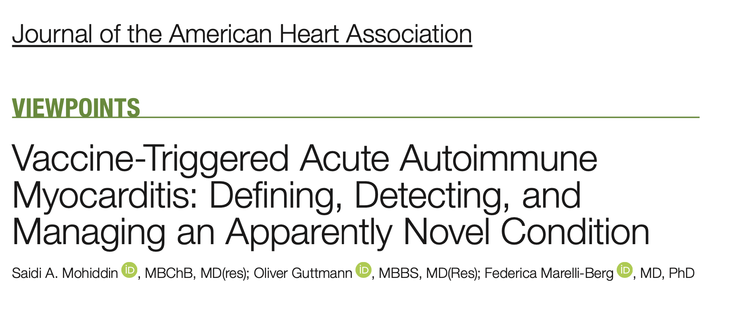
Two Articles appeared in November 2022 in a mainstream journal, admitting that the COVID-19 vaccines cause myocarditis in children

Slide 14
“Cardiovascular Manifestation of the BNT162b2 mRNA COVID-19 Vaccine in Adolescents”*
Prospective study involving 301 students aged 13-18 years
Monitored after second COVID-19 vaccine
Several cardiovascular symptoms were observed
Tachycardia (7.64%)
Shortness of breath (6.64%)
Chest pain (4.32%)
Palpitations (4.32%)
Hypertension (3.99%)
Myocarditis, pericarditis (2.33%)
*Suyanee Mansanguan et al. Tropical medicine and Infectious Disease 2022; 7: 196.
Notes:
2022/Antonis/SuddenDeath/cardiovascular_issues_adolescents_COVID_jabs.pdf
https://www.ncbi.nlm.nih.gov/pmc/articles/PMC9414075/

Slide 15
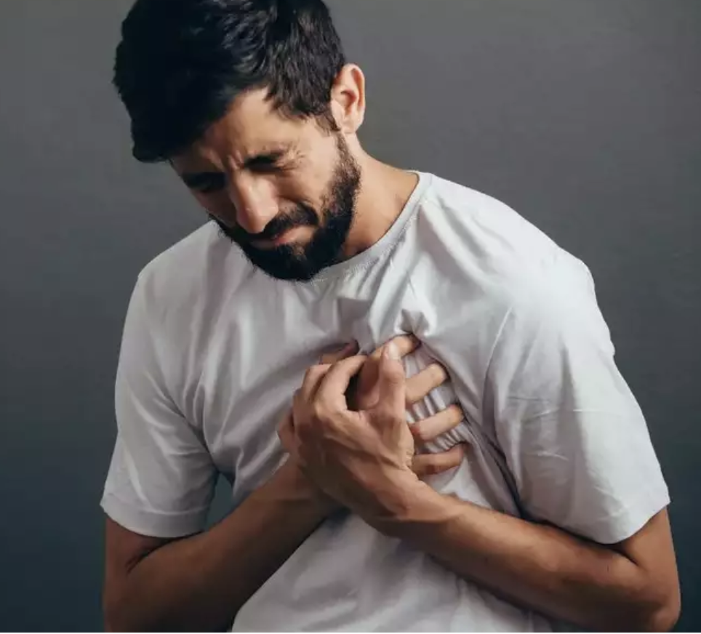
"Excess risk for acute myocardial infarction mortality during the COVID‐19 pandemic”*
"younger adults experienced the greatest relative increase in excess AMI‐associated mortality. Notably, the death rate increased more in males than females when considered in either absolute or relative terms, particularly during the fourth and most recent epoch.”
AMI = acute myocardial infarction; i.e., heart attack
Fourth epoch:
October 2021 to March 2022 (encompassing effects of the Omicron surge)
but is it really the vaccine mandates at universities??
*Yee Hui Yeo et al. J Med Virol. 2022; 1-11
Notes:
https://pubmed.ncbi.nlm.nih.gov/36176195/
SuddenDeath/excess_heart_attack_mortality_young_men_Omicron_2022.pdf

Slide 16
Catecholamines Are the Key Trigger of COVID-19 mRNA Vaccine-Induced Myocarditis*
The adrenal glands were one of the highest SARS-CoV-2 spike protein-producing tissues following vaccination
Preceding myocarditis can induce arrhythmias and catastrophic heart failure during a hyperadrenergic state
Patients who had COVID-19 infection and were later given the mRNA vaccines may develop irreversible cardiomyopathy, necessitating mechanical circulatory support
*FA Cadegiani. Cureus 2022; 14(8): e27883.
Notes:
Antonis/SuddenDeath/catecholamines_mRNA_sudden_death_Cureus.pdf
mechanical_circulatory_support_following_COVID_jab_young_black_male.pdf

Slide 17
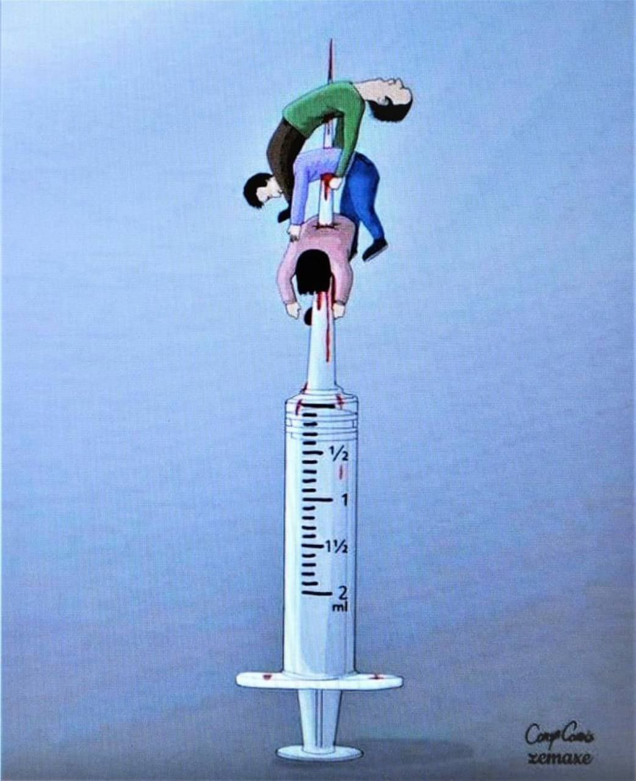
Sudden Adult Death Syndrome Explained*
A seminal experiment from 2005
Mice were inoculated with the encephalomyocarditis virus, which causes myocarditis
120 days later, they were given a shot of adrenaline
70% of the mice died within ten minutes
They developed left ventricular dilation and myocardial fibrosis, as well as slowed heart rate, heart attack, conduction block, premature contractions, and complex arrhythmias
None of the control mice died after the adrenaline shot or exhibited these symptoms
*Ju-Feng Wang et a. Am J Physiol Heart Circ Physiol 2005; 289: H1577–H1583.
Notes:
2022/Antonis/SuddenDeath/adrenaline_exacerbates_myocarditis_rats_2005.pdf

Slide 18
Neurological Damage and Autism

Slide 19
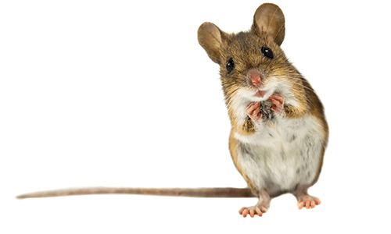
The S1 protein of SARS-CoV-2 crosses the blood–brain barrier in mice*
A furin cleavage site in the spike protein causes it to be cut into two parts: S1 and S2, and S1 is released into the circulation
When S1 alone was injected into mice, it readily crossed the blood-brain barrier
Spike was found in all eleven brain regions examined
The authors suggested this could explain symptoms such as encephalitis, loss of smell, and shortness of breath
*Elizabeth M Rhea et al. Nature Neuroscience 2021; 24: 368-378.

Slide 20
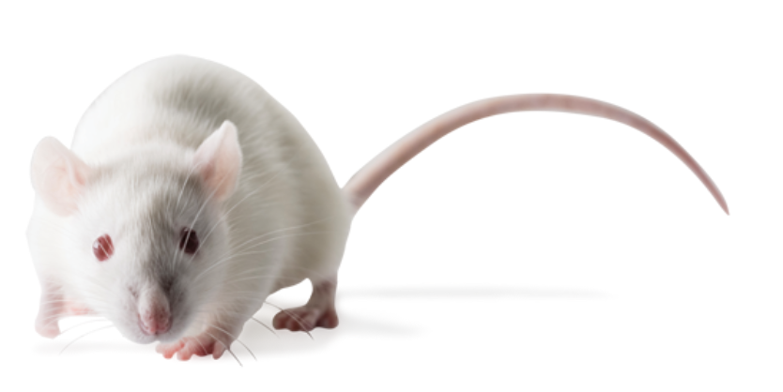
“SARS-CoV-2 spike S1 subunit induces neuroinflammatory, microglial and behavioral sickness responses”*
S1 subunit injected into cerebrospinal fluid of adult male Sprague-Dawley rats
Microglial activation resulted in inflammation in the brain
Modified behaviors: increased social avoidance, reduced motor activities
*MG Frank et al. Brain Behav Immun. 2022; 100: 267-277.
Notes:
https://www.ncbi.nlm.nih.gov/pmc/articles/PMC8667429/

Slide 21
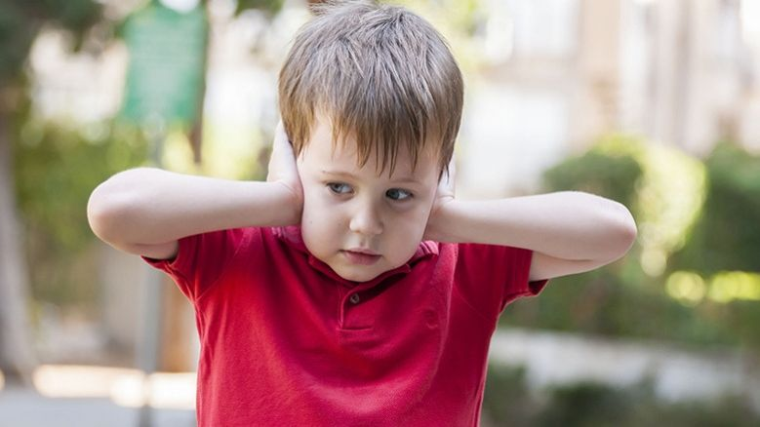
COVID Vaccines and Autism*
VAERS ID 1107574: Autistic man, 26 years old.
Massive stimming meltdowns four days after the first Moderna shot
VAERS ID 1186502: Autistic woman, 60 years old
Hyperactivity, hypervigilance, insomnia, irritability, confusion
VAERS ID 1445733: Autistic woman, 22 years old
Uncontrollable shaking, loss of ability to walk, loss of personal independence in daily activities
VAERS ID 1773508-1: Man, 28 years old
The vaccine caused autism spectrum disorder
*http://wonder.cdc.gov/vaers.html
Notes:
COVID_vax/autism.text

Slide 22
Conclusion
It makes no sense to vaccinate children against COVID-19
Mortality rate from infection is vanishingly low among children
Even the bivalent vaccine offers poor protection against Omicron variants
The vaccines interfere with naturally acquired antibodies during infection
The vaccine disrupts the menstrual cycle, induces a miscarriage, and may have long term adverse effects on fertility
Young male athletes are especially susceptible to myocarditis following COVID vaccination, and this can lead to sudden death
The spike protein can get past the brain barrier where it causes inflammation and neurological damage
VAERS data suggest that autism symptoms can be triggered by the vaccines

