Slide 1
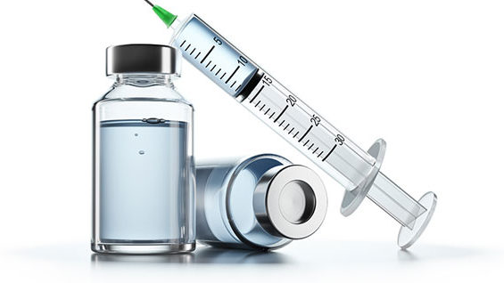
SARS-CoV-2 mRNA vaccines: Is the Risk Worth the Benefit?
Dr. Stephanie Seneff, MIT CSAIL
Corona Investigative
Committee Meeting
July 22,2022

Slide 2
Download these slides
Powerpoint slides
https://people.csail.mit.edu/seneff/2022/Seneff_Corona_2022.pptx
Pdf file, two slides per page
https://people.csail.mit.edu/seneff/2022/Seneff_Corona_2022.pdf

Slide 3
Outline
Introduction
Exosomes and Neurodegeneration
mRNA Vaccines and Heart Disease
G-quadruplexes
Other Aspects
Summary

Slide 4
Introduction

Slide 5
“In this paper, we present evidence that vaccination induces a profound impairment in type I interferon signaling, which has diverse adverse consequences to human health.”
“These disturbances potentially have a causal link to neurodegenerative disease, myocarditis, immune thrombocytopenia, Bell’s palsy, liver disease, impaired adaptive immunity, impaired DNA damage response and tumorigenesis.”

Slide 6
“In this paper, we present evidence that vaccination induces a profound impairment in type I interferon signaling, which has diverse adverse consequences to human health.”
“These disturbances potentially have a causal link to neurodegenerative disease, myocarditis, immune thrombocytopenia, Bell’s palsy, liver disease, impaired adaptive immunity, impaired DNA damage response and tumorigenesis.”

Slide 7
mRNA vaccines contain the genetic code to make spike protein
The RNA is carefully engineered to resist breakdown
All of the uridines are replaced with 1-methyl-pseudouridine (m1Ψ)
The mRNA is incorporated into a lipid particle along with polyethylene glycol (PEG)
A synthetic ionizable cationic (positively charged) lipid is added as an adjuvant – very toxic to the cells
The “humanized” mRNA is a stealth entry system for massive production of spike protein
*S Seneff et al. Food and Chemical Toxicology 2022; 164: 113008.

Slide 8
The Cationic Lipid is Toxic
The vaccines include synthetic cationic (positively charged) lipids that have not been evaluated for toxicity
Experiment involving LNPs [lipid nanoparticles] complexed with noncoding polycytosine mRNA:*
“We show that in mice intradermal, intramuscular, or intranasal delivery of LNPs [lipid nanoparticles] used in preclinical studies triggers inflammation characterized by leukocytic infiltration, activation of different inflammatory pathways, and secretion of a diverse pool of inflammatory cytokines and chemokines”
The cationic lipid, released into the vasculature by vaccine transfected cells, would cause a drop in zeta potential, inducing a thrombosis risk
*Sonia Ndeupen et al. iScience 2021; 24; 103479.
Notes:
COVID_vax/vaccine_cationic_lipid_particles_highly_inflammatory.pdf

Slide 9
Exosomes and Neurodegeneration

Slide 10
mRNA Vaccines, Exosomes and Parkinson’s Disease*
Parkinson’s disease often begins in the gut as an immune reaction to prion-like proteins produced by pathogens
The spike protein is a prion-like protein
Immune cells invade the arm muscle in response to the mRNA vaccine
They actively take up the vaccine and start making lots of spike protein
Immune cells carry the mRNA via the lymph system into the spleen
Stressed immune cells in germinal centers release the spike protein packaged up within exosomes (small lipid particles)
The exosomes travel along the vagus nerve to the brainstem nuclei
Damage to the substantia nigra causes Parkinson’s disease
*S Seneff and G Nigh. IJVTPR 2021; 2(1): 38-79.
Notes:
PD is the second most common neurodegenerative disease;

Slide 11
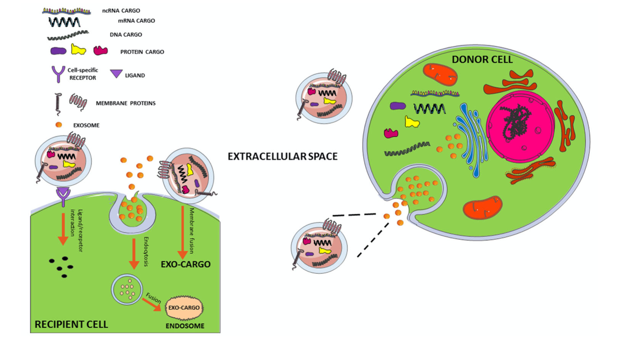
Exosome Transfer from Cell to Cell*
exosome
Endocytosis
Ligand
Receptor
Membrane
Fusion
*Figure 1. Marianna D’Anca et al. Front. Aging Neurosci. 28 August 2019; 11: 232.

Slide 12
“Cutting Edge: Circulating Exosomes with COVID Spike Protein Are Induced by BNT162b2 (Pfizer-BioNTech) Vaccination prior to Development of Antibodies”*
“Our results demonstrated the induction of circulating exosomes carrying the SARS-CoV-2 spike protein by day 14”
“We propose that the mechanism by which immune responses developed following immunization of mice requires binding of exosomes with mice APCs (antigen presenting cells)”
“It is also of interest that such an immunization strategy resulted in increased frequency of splenic lymphocytes secreting IFN-gamma and TNF-alpha following antigenic stimulation”
*Sandhya Bansal et al. J Immunol 2021; 207(10): 2405-2410.
Notes:
new_paper/cutting_edge_circulating_exosomes_Pfizer_vax.pdf
In addition to their role as secretors of antibodies, B cells function as professional antigen-presenting cells (APCs) for CD4+ T cells by expressing cell-surface major histocompatibility complex class II (MHCII) molecules with bound peptide, the ligand of the α/β T cell receptor.

Slide 13
Symptoms in VAERS in 2021 for conditions related to vagus nerve damage*
Symptom | COVID-19 Vaccines | All Vaccines | Percent COVID-19
Anosmia | 3,657 | 3,677 | 99.5
Tinnitus | 13,275 | 13,522 | 98.2
Deafness | 2,895 | 3,033 | 95.5
Bell’s Palsy/facial palsy | 5,881 | 6,129 | 96.0
Vertigo | 7,638 | 7,819 | 97.7
Migraine headache | 8,872 | 9,059 | 97.9
Dysphonia | 1,692 | 1,751 | 96.6
Dysphagia | 4,711 | 4,835 | 97.4
Nausea | 69,121 | 7,1275 | 97.0
Vomiting | 27,885 | 28,955 | 96.3
Dyspnea | 39,551 | 40,387 | 97.9
Syncope | 14,701 | 15,268 | 96.3
Bradycardia | 673 | 699 | 96.3
TOTAL | 200,552 | 206,409 | 97.2
loss of smell
*S Seneff et al. Food and Chemical Toxicology 2022; 164: 113008.
Notes:
~/Symptom.docx

Slide 14
mRNA Transfer to Other Cells via Exosomes*
Lipid nanoparticles containing mRNA coding for a specific protein (erythropoietin) are taken up by cells at the injection site and repackaged into endosomal vesicles that are then released into the circulation as exosomes
The ionizable cationic lipid is included in the exosomes at 1:1 ratios with the nucleotides
These exosomes can be taken up by other cells which then translate the RNA into protein
“Because of their small size, EVs can escape from rapid phagocytosis, and steadily carry and deliver RNA in circulation, passing through the vascular endothelium to the target cells”
EVs= extracellular vesicles = exosomes
*Marco Maugeri et al. Nature Communications 2019; 10: 4333.
Notes:
COVID_vaccine/mRNA_transfers_into_exosomes_and_passes_to_new_cells.pdf
human erythropoietin

Slide 15
mRNA Transfer to Other Cells via Exosomes*
“When mRNA is delivered via LNPs [lipid nanoparticles], the LNPs alone may not deliver mRNA to all cells that express the protein; part of the RNA delivery may be achieved via endo-EVs [extracellular vesicles] secreted by cells that internalize the LNPs.”
“Most importantly, these endo-EVs protect exogenous mRNA during in vivo transport to organs and deliver the intact hEPO-mRNA to the cytoplasm of recipient cells.”
*Marco Maugeri et al. Nature Communications 2019; 10: 4333.
Notes:
erythropoietin

Slide 16
SARS-CoV-2 Spike Activates Human Microglia in the Brain via Exosomes Loaded with miRNAs*
"SARS-CoV-2 spike transfected cells release a significant amount of exosomes loaded with microRNAs such as miR-148a and miR-590”
"MicroRNAs get internalized by human microglia in the brain”
These two microRNAs collaborate to suppress the response to type I interferon
"These results uncover a bystander pathway of SARS-CoV-2 mediated CNS [central nervous system] damage through hyperactivation of human microglia"
*Ritu Mishra and Akhil C. Banerjea. Frontiers in Immunology 2021; 12:656700
Notes:
prions/exosomes_spike_WOW.pdf

Slide 17
Type I Interferon is Critical*
Type I interferon plays an important role in the initial battle against pathogens and in keeping cancer in check
The microRNAs released by transfected immune cells within exosomes along with spike protein suppress type I interferon response
This results in reduced levels of CD8+ killer T cells
Increases risk to other infections and cancer
A preprint study showed that a strong type I interferon response along with robust production of CD8+ cytotoxic T cells characterized the response to infection, but were largely absent following vaccination**
A reduced type I interferon response is associated with severe COVID-19 disease
*S Seneff et al. Food and Chemical Toxicology 2022; 164: 113008.
**Ellie N Ivanova et al. medRxiv preprint doi: 10.1101/2021.04.20.21255677.

Slide 18
Loss of smell (anosmia) is a common early symptom of Parkinson's and of COVID-19
Virus can gain access to the brain along nerve fibers
Olfactory nerve
Vagus nerve
Neuroinvasion of SARS-COV-2 could upregulate α-synuclein
High levels of α-synuclein leads to misfolding and toxicity
Dopaminogenic neurons in substantia nigra express high levels of the ACE2 receptor

Slide 19
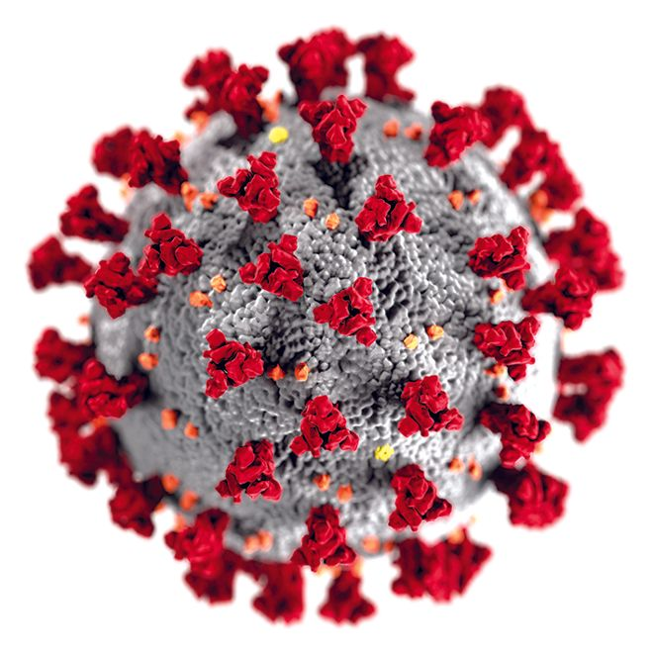
"SARS-CoV-2 Proteins Interact with Alpha Synuclein and Induce Lewy Body-like Pathology In Vitro”*
Lewy bodies are clumps of protein that accumulate in the brain in association with Parkinson’s disease
The spike protein causes cells in the brain to make more alpha synuclein, a protein that appears in Lewy bodies during the disease process
Aggregation of alpha synuclein into Lewy bodies was increased after spike protein exposure (a classic prion-like behavior)
"By confirming that SARS-CoV-2 proteins directly interact with α-Syn, our study offered new insights into the mechanism underlying the development of PD [Parkinson’s disease] on the background of COVID-19."
*Zhengcun Wu et al. Int. J. Mol. Sci. 2022, 23, 3394.
Notes:
prions/SARS-CoV-2_proteins_alpha_synuclein_Lewy_bodies.pdf
Beijing, China
HEK293 cells

Slide 20
Prof. Luc Montagnier’s preprint paper:
26 people developed symptoms of CJD (Creutzfeldt Jakob Disease) within one month of their second mRNA vaccine
Many died within 3 months
All are now dead
https://www.theepochtimes.com/studies-link-incurable-prion-disease-with-covid-19-vaccine_4511204.html

Slide 21
mRNA Vaccines and Heart Disease

Slide 22
How the mRNA Vaccines Cause Heart Disease
Stressed immune cells release exosomes containing microRNAs that signal to tissue cells and can induce an inflammatory response
In particular, miR-155 plays a special role in SARS-CoV-2, facilitated by spike
The spike protein S1 subunit detaches and becomes free to bind to ACE2 receptors which are present at high levels in the heart
The suppression of ACE2 by spike S1 causes upregulation of angiotensin II, which induces inflammation (myocarditis) and cardiovascular disease
S1 has been found in COVID-19 patients long after the virus is cleared, and is believed to play a critical role in “long-haul COVID”
S1 has also been found in the vasculature following vaccination
miR-155 overexpression is linked to worse outcomes in heart attack

Slide 23
How Spike Protein can Cause Cardiac Issues*
Stress
Macrophage
Spike protein S1 unit causes stress and binds to ACE2 receptors, disabling them
This causes accumulation of Angiotensin II which activates macrophages
Macrophages secrete abundant exosomes containing miR-155
These exosomes are taken up by fibroblasts, suppressing their proliferation
This interferes with the healing process, leading to cardiac rupture
Exosome
Secretion
Cardiac Fibroblast
Cardiac Rupture
*Chunxiao Wang et al. Molecular Therapy 2017; 25(1): 192-204.
Notes:
blogposts/miRNAs/exosomes_with_miR-155_cardiac_inflammation.pdf

Slide 24
“Free SARS-CoV-2 Spike Protein S1 Particles May Play a Role in the Pathogenesis of COVID-19 Infection”*
Disabling ACE2 receptors causes Inflammation, thrombosis (blood clots) and damage to the lungs
S1 attached to ACE2 receptor
*Andrey V. Letarov et al. Biochemistry (Moscow) 2020 Dec 30: 1–5.
Notes:
miRNAs/free_S1_spike_role_in_COVID19.pdf
Caption:
Putative involvement of free S1 subunits of the SARS-CoV-2 S protein in the COVID-19 infection. Spontaneous “firing” of the S protein trimers on the surface of virions and infected cells liberates free RBD-containing S1 particles. The binding of these S1 particles to ACE2 may cause a decrease in the ACE2 cell surface expression and lead to the RAS imbalance. (Color version of the figure is available in the online verssion of this article and can be accessed at: https://www.springer.com/journal/10541)

Slide 25
“Free SARS-CoV-2 Spike Protein S1 Particles May Play a Role in the Pathogenesis of COVID-19 Infection”*
Eleven out of 13 health care workers had detectable levels of spike protein and/or S1 in their blood plasma as early as 1 day and up to 28 days following the first mRNA vaccine, with a peak level on average after five days.**
**Ogata et al. Clin Infect Dis 2022; 74(4): 715-718.
Disabling ACE2 receptors causes Inflammation, thrombosis (blood clots) and damage to the lungs
S1 attached to ACE2
*Andrey V. Letarov et al. Biochemistry (Moscow) 2020 Dec 30: 1–5.
Notes:
miRNAs/free_S1_spike_role_in_COVID19.pdf
Caption:
Putative involvement of free S1 subunits of the SARS-CoV-2 S protein in the COVID-19 infection. Spontaneous “firing” of the S protein trimers on the surface of virions and infected cells liberates free RBD-containing S1 particles. The binding of these S1 particles to ACE2 may cause a decrease in the ACE2 cell surface expression and lead to the RAS imbalance. (Color version of the figure is available in the online verssion of this article and can be accessed at: https://www.springer.com/journal/10541)

Slide 26
“Free SARS-CoV-2 Spike Protein S1 Particles May Play a Role in the Pathogenesis of COVID-19 Infection”*
S1 alone caused COVID-19-like lung symptoms in mice equipped with human ACE2 receptors:
Immune cell infiltration, cytokine storm, impaired barrier function.***
***Ruben M. L. Colunga Biancatelli et al.
Am J Physiol Lung Cell Mol Physiol 2021; 321: L477–L484.
Disabling ACE2 receptors causes Inflammation, thrombosis (blood clots) and damage to the lungs
S1 attached to ACE2
*Andrey V. Letarov et al. Biochemistry (Moscow) 2020 Dec 30: 1–5.
Notes:
miRNAs/free_S1_spike_role_in_COVID19.pdf
Caption:
Putative involvement of free S1 subunits of the SARS-CoV-2 S protein in the COVID-19 infection. Spontaneous “firing” of the S protein trimers on the surface of virions and infected cells liberates free RBD-containing S1 particles. The binding of these S1 particles to ACE2 may cause a decrease in the ACE2 cell surface expression and lead to the RAS imbalance. (Color version of the figure is available in the online verssion of this article and can be accessed at: https://www.springer.com/journal/10541)

Slide 27
miR-155 overexpression linked to worse outcomes in heart attack*
MI1: heart attack within first 24 hours of clinical symptoms
MI2: heart attack 2-7 days after onset of clinical symptoms
Measured three miRNA levels in autopsy samples of 50 patients with MI
“innate immunity resulting in an intense inflammatory reaction plays an important role in the pathogenesis of the VR [ventricular rupture] after MI [myocardial infarction] in humans.”
*Figure 1. Nina Zidar et al. Disease Markers 2011; 31: 259-265.
Notes:
blogposts/miRNAs./miRNA_155_in_heart_attack_ventricular_rupture_2011.pdf

Slide 28
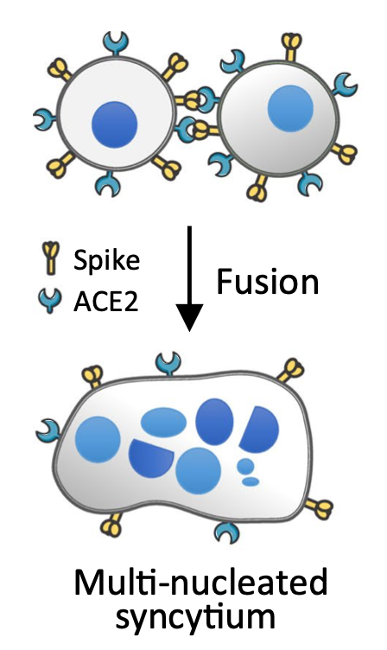
Spike protein causes infected cells to fuse into a giant multi-nucleated cell*
Giant cells become senescent and release cytokines and chemokines that induce inflammation and damage
Presence of micronuclei in those cells indicates DNA double strand breaks
genetic mutations → cancer
*He Ren et al. Biol Direct 2021 Oct 21; 16(1): 202021.
https://pubmed.ncbi.nlm.nih.gov/34674770/
Notes:
old_paper/new/micronucleus_production_activation_DNA_damage_response_cGAS-STING_syncytia_SARS-CoV-2_BeijingChina.pdf

Slide 29
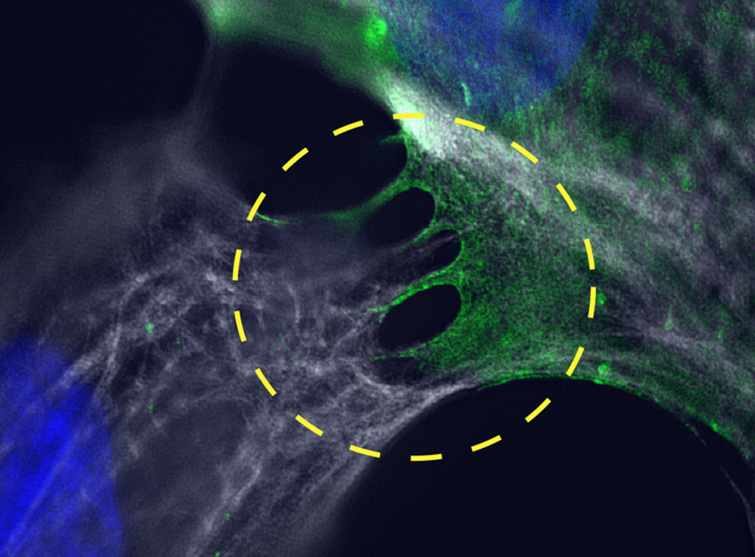
Spike protein induces cell-cell fusion in cardiomyocytes (heart muscle cells)*
Viral spike protein induces filopodia formation and fuses cardiomyocytes, generating syncytia
Furin cleavage site (generates S1/S2) essential for syncytia formation
Filopodia linking two cardiomyocytes
*Chanakha Navaratnarajah et al. Journal of Virology 2021; 95(24): e01368-21
Notes:
Joachim/cardiomyocyte_cell_fusion_spike.pdf

Slide 30
Number of events in VAERS for 2021 where cardiac symptoms were indicated*
Symptom | Covid-19 Vaccines | All Vaccines | Percent COVID-19
Myocarditis | 2,322 | 2,361 | 98.3
Arrest | 1,319 | 1,371 | 96.2
Arrhythmia | 1,069 | 1,087 | 98.3
Heart attack | 2,224 | 2,272 | 97.9
Heart failure | 1,156 | 1,190 | 97.1
TOTAL | 8,090 | 8,281 | 97.7
*S Seneff et al. Food and Chemical Toxicology 2022; 164: 113008.

Slide 31
G-Quadruplexes

Slide 32
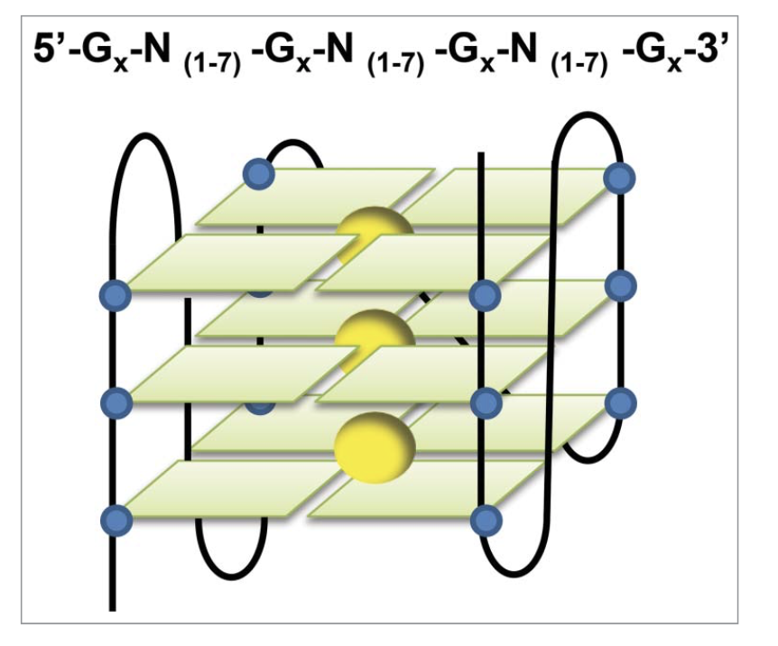
G-Quadruplexes: Many Unknowns
G-quadruplexes (G4s) are a unique structure assumed by several guanines (G) folding together within an mRNA strand
They form gelled water around the structure that impedes activities
Many proteins that regulate protein production bind to G4s to carry out their regulatory influence
Prion proteins have many G4s in their mRNA, and the prion protein itself binds to its own mRNA at the G4s*
Such binding can cause the protein to misfold into its toxic form
Guanine
*René CL Olsthoorn. Nucleic Acids Research, 2014; 42(14): 9327-9333.

Slide 33
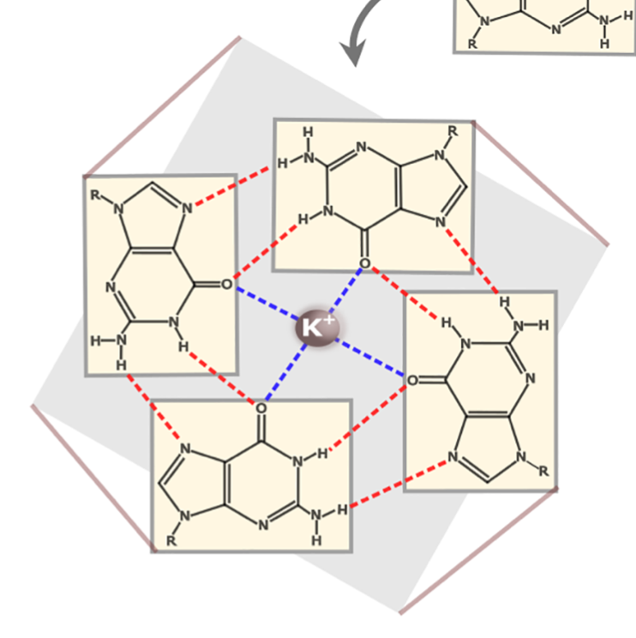
Spike is a prion-like protein*
Prion proteins have a characteristic GxxxG motif (two glycine residues spaced by three wildcard amino acids)
Most proteins have 0 GxxxGs
The human prion protein has 14 GxxxGs
Amyloid beta, the protein that forms plaques in Alzheimer’s, has 4
The SARS-CoV-2 spike protein has 7
The mRNA in the mRNA vaccines has been manipulated to be enriched in guanine through a process called codon optimization
This causes it to produce excess G4s compared to the viral version
GGx GGx GGx UGG GGx
G G G W G
G x x x G
G = Guanine in mRNA
G = Glycine in protein
The GxxxG motif
*S Seneff et al. Food and Chemical Toxicology 2022; 164: 113008.

Slide 34
The vaccines are enriched in G4 potential
A process termed “codon optimization” alters the RNA in the vaccine to optimize for efficient synthesis of spike protein
This results in enrichment in GC content, potentiating G4 formation
Original viral protein: 36% GC; 4 G4s
Pfizer vaccine: 53% GC; 9 G4s
Moderna 61% GC; 19 G4s
Notes:
new_paper/notes.text

Slide 35
The Intricate Coding of G4s
GxxxG motif is a signature motif of prion proteins and prion-like proteins
Glycine (G) DNA code is GGx – two guanine nucleotides followed by any nucleotide
Tryptophan (W) DNA code is UGG
GGGWG is a motif in the human prion protein that repeats many times in the protein
Glycine-glycine-glycine-tryptophan-glycine = GGGWG
Guanine
GGx GGx GGx UGG GGx
G G G W G
G x x x G
Figure 1. Jingwen Song et al. Translation 2016; 4:2, e1244031.
Notes:
Antonis/new_paper//RNA\ G4s\ in\ translation.pdf .

Slide 36
“G-quadruplexes within prion mRNA: the missing link in prion disease?”*
*René CL Olsthoorn. Nucleic Acids Research, 2014; 42(14): 9327-9333.
GxxxG
motif!
G
G
G
G
G
G
G
G
G
G
Protein
RNA
GGGWG motif: four glycines
G-quadruplexes (G4s)

Slide 37
“G-quadruplexes within prion mRNA: the missing link in prion disease?”*
*René CL Olsthoorn. Nucleic Acids Research, 2014; 42(14): 9327-9333.
GxxxG
motif!
Prion proteins bind to G4s in their own mRNA, and this induces the misfolding that leads to disease
G
G
G
G
G
G
G
G
G
G
Protein
RNA
GGGWG motif: four glycines
G-quadruplexes (G4s)

Slide 38
Other Aspects

Slide 39
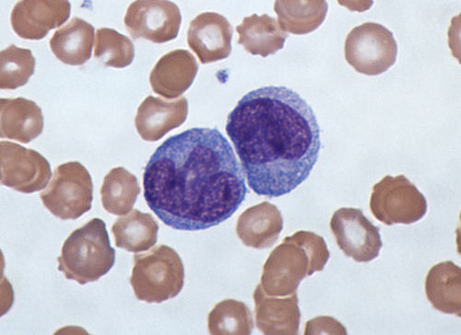
“SARS-CoV-2 S1 Protein Persistence in SARS-CoV-2 Negative Post-Vaccination Individuals with Long COVID/ PASC-Like Symptoms”*
50 people who experienced symptoms of long COVID after vaccination
Statistically significant elevations of sCD40L, CCL5, IL-6, and IL-8
Markers of platelet activation and inflammation
S1 peptides as well as mutant S1 peptides and S2 peptides were present in CD16+ non-classical monocytes months after vaccination
*Bruce Patterson et al. Research Square Preprint. July 12, 2022.
Notes:
Antonis/new_paper/S1_persistence_SARS-negative_post_vacciation_with_PASC.pdf

Slide 40
Spike S1 contains a sequence (red) similar to a potent endotoxin synthesized by Staph aureus*
*Steven J. Hatfill. Journal of American Physicians and Surgeons 2022; 27(2).
Notes:
COVID_vax/Hatfill_superantigen_sequence_spike_adrenalin.pdf

Slide 41
Birth rate changes in Hungary*
Counties with the highest vaccination rate had a much greater drop in birth rate compared to counties with the lowest vaccination rates
*https://igorchudov.substack.com/p/hungary-most-vaccinated-counties
Notes:
also Taiwan, Germany, Sweden, North Dakota Switzerland and UK.

Slide 42
Future plans for the vaccines
The FDA has decided that it is not necessary to do any clinical trials for new versions of the mRNA vaccines with mixes of multiple strains of the spike protein incorporated (to test for safety and effectiveness)
There is a plan to release a version that has both the original omicron (BA.1) and the original Wuhan variant mixed in
A recent study showed that omicron has already mutated to variants now called BA.4 and BA.5 that are resistant even to antibodies against the original omicron BA.1*
*https://www.eurekalert.org/news-releases/957703

Slide 43
People are waking up!
https://expose-news.com/2022/07/03/157million-americans-refuse-covid-vaccine/

Slide 44
Summary
The mRNA vaccines have not been adequately evaluated for safety and effectiveness
The mRNA in the vaccine has been highly altered compared to the original viral version
The vaccines induce rapid production of spike protein by human immune cells in the spleen over a sustained long duration
Spike is a neurotoxic prion-like protein that induces a strong inflammatory response and subsequent tissue destruction
Exosomes play a central role in the distribution of toxic spike protein to diverse organs, notably the heart and the brain
There is growing evidence that these vaccines may cause infertility
People are wising up

