Slide 1
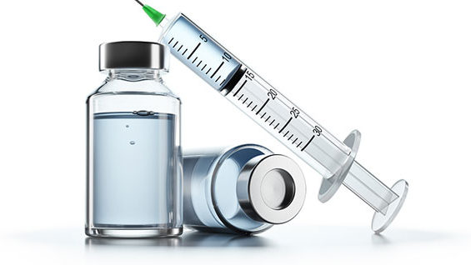
Why are COVID Jabs Injuring So Many Globally?
Stephanie Seneff, MIT CSAIL
World Council for Health
General Assembly Meeting
Monday, December 12, 2022

Slide 2
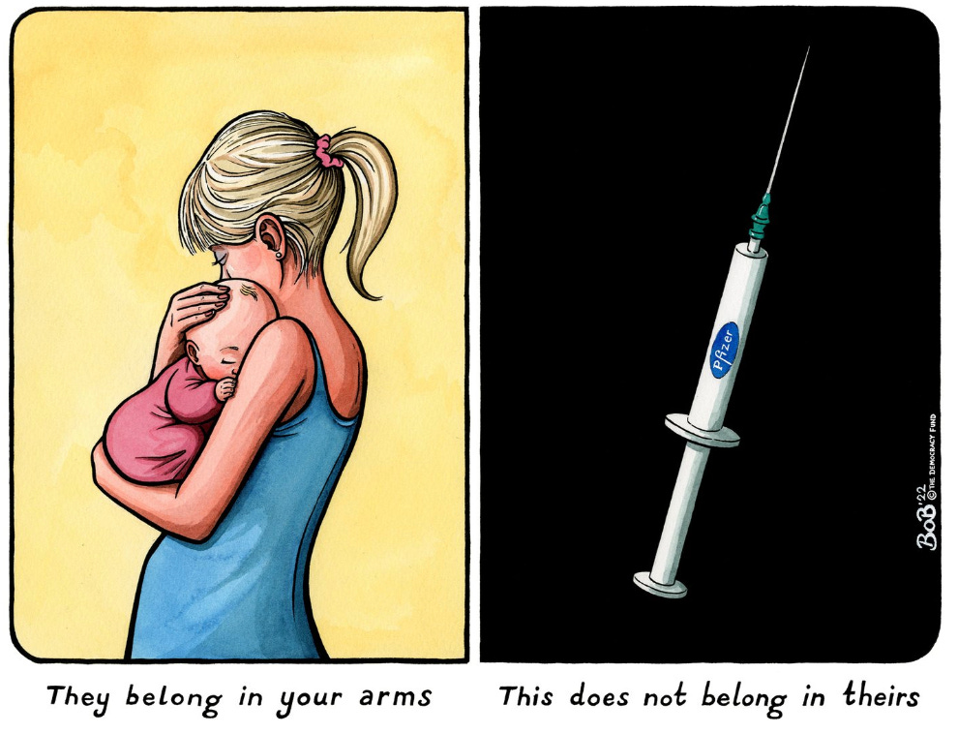

Slide 3
"All the vaccine mandates should be dropped immediately. We need immediate funding for vaccine injury centers of excellence across the US for screening, detection, diagnosis, prognosis and management. ...What is at stake here is death."
-Peter McCullough, MD/MPH

Slide 4
Outline
Germinal Centers, Vagus Nerve, Neurodegenerative Disease
Sudden Death and Cardiovascular Disease
Immune Suppression and Cancer Risk
Molecular Mimicry and Autoimmune Disease
Other Concerns: Reverse Transcription and Reproductive Issues
Summary

Slide 5
Germinal Centers, Vagus Nerve, Neurodegenerative Disease

Slide 6
Why the mRNA vaccines are more likely to cause damage to the organs than an infection
SARS-CoV-2 infection begins in the lungs where most of the action is
The virus only escapes the lungs into the vasculature when the host is immune compromised
The vaccine is injected into the deltoid muscle, past both the mucosal and the vascular barrier
The vaccine mRNA is specially constructed to be very sturdy, resisting enzymatic breakdown and producing spike protein for a long time
Immune cells carry the mRNA particles via the lymph system into the spleen
They release spike protein packaged up in exosomes that travel to the brain, heart, liver and other organs along the vagus nerve
The spike protein causes an inflammatory response wherever it goes, potentially leading to neurodegenerative disease and heart damage

Slide 7
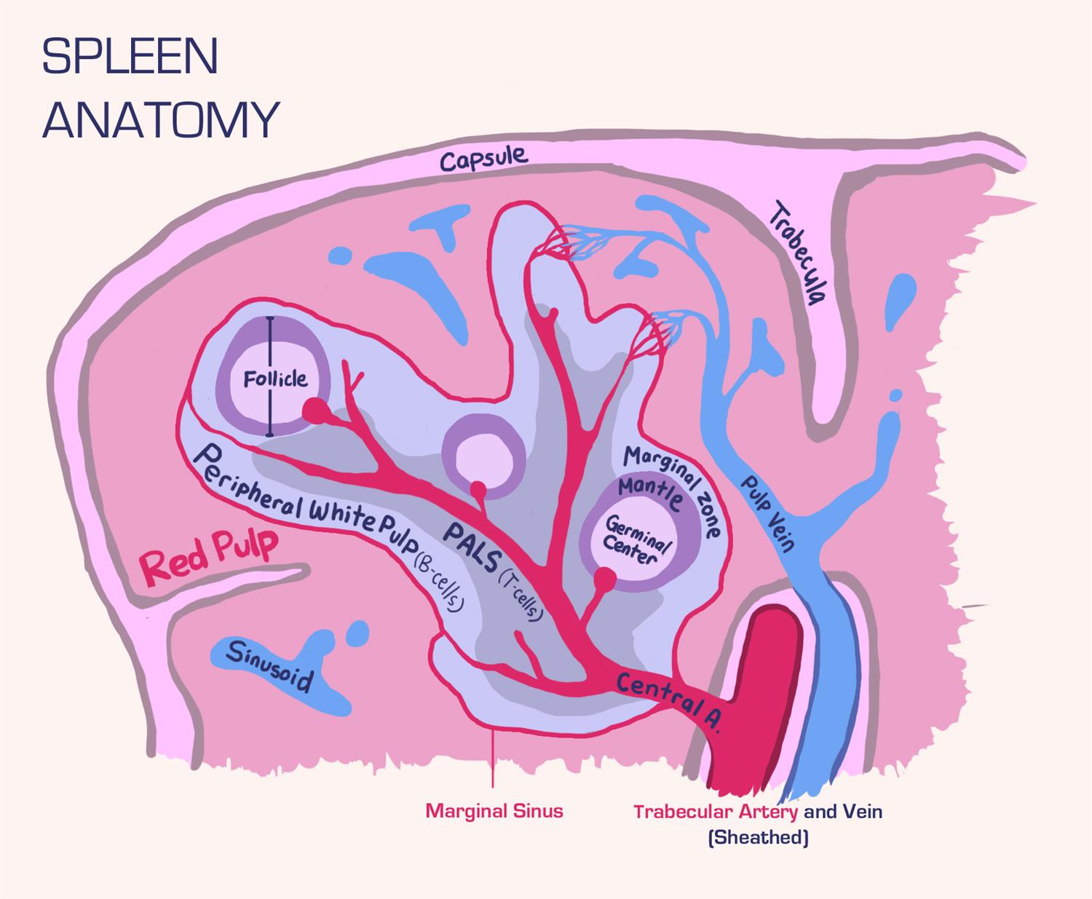
“SARS-CoV-2 mRNA vaccines induce persistent human germinal centre responses”*
Persistent germinal center (GC) reactions are critical for generating high-affinity and durable antibody responses
"Overall, our data demonstrate a remarkable capacity of SARS-CoV-2 mRNA-based vaccines to induce robust and prolonged GC reactions."
"The induced GC reaction recruited cross-reactive memory B cells as well as newly engaged clones that target unique epitopes within SARS-CoV-2 S protein."
Germinal Center
*Jackson S Turner et al. Nature 596, 109–113 (2021)
Notes:
https://pubmed.ncbi.nlm.nih.gov/34182569/
COVID_vaccines/mRNA_vaccines_persistent_activity_germinal_centers.pdf

Slide 8
“Pilot study suggests long COVID could be linked to the effects of SARS-CoV-2 on the vagus nerve”*
“Vagus Nerve Symptoms: dysphonia (persistent voice problems), dysphagia (difficulty swallowing), dizziness, tachycardia (abnormally high heart rate), orthostatic hypotension (low blood pressure) and diarrhoea.”
Adverse reactions in VAERS database**
Reaction | COVID vaccines(2021) | All vaccines (2021) | Percent COVID
Diarrhoea | 23,128 | 23,861 | 96.9
Tachycardia | 5,524 | 5,653 | 97.7
Dizziness | 69,843 | 71,648 | 97.5
Dysphagia | 4,714 | 4,837 | 97.5
Dysphonia | 1,693 | 1,752 | 96.6
Orthostatic Hypotension | 172 | 180 | 95.5
*G Lladós and L Mateu. European Congress of Clinical Microbiology and Infectious Diseases (ECCMID 2022, Lisbon, 23-26 April).
**S Seneff et al. Food and Chemical Toxicology 2022;164:113008.
Notes:
https://www.eurekalert.org/news-releases/943102
COVID_vax/pilot_study_vagus_nerve_long_COVID.pdf
dysphonia (persistent voice problems), dysphagia (difficulty in swallowing), dizziness, tachycardia (abnormally high heart rate), orthostatic hypotension (low blood pressure) and diarrhoea.

Slide 9
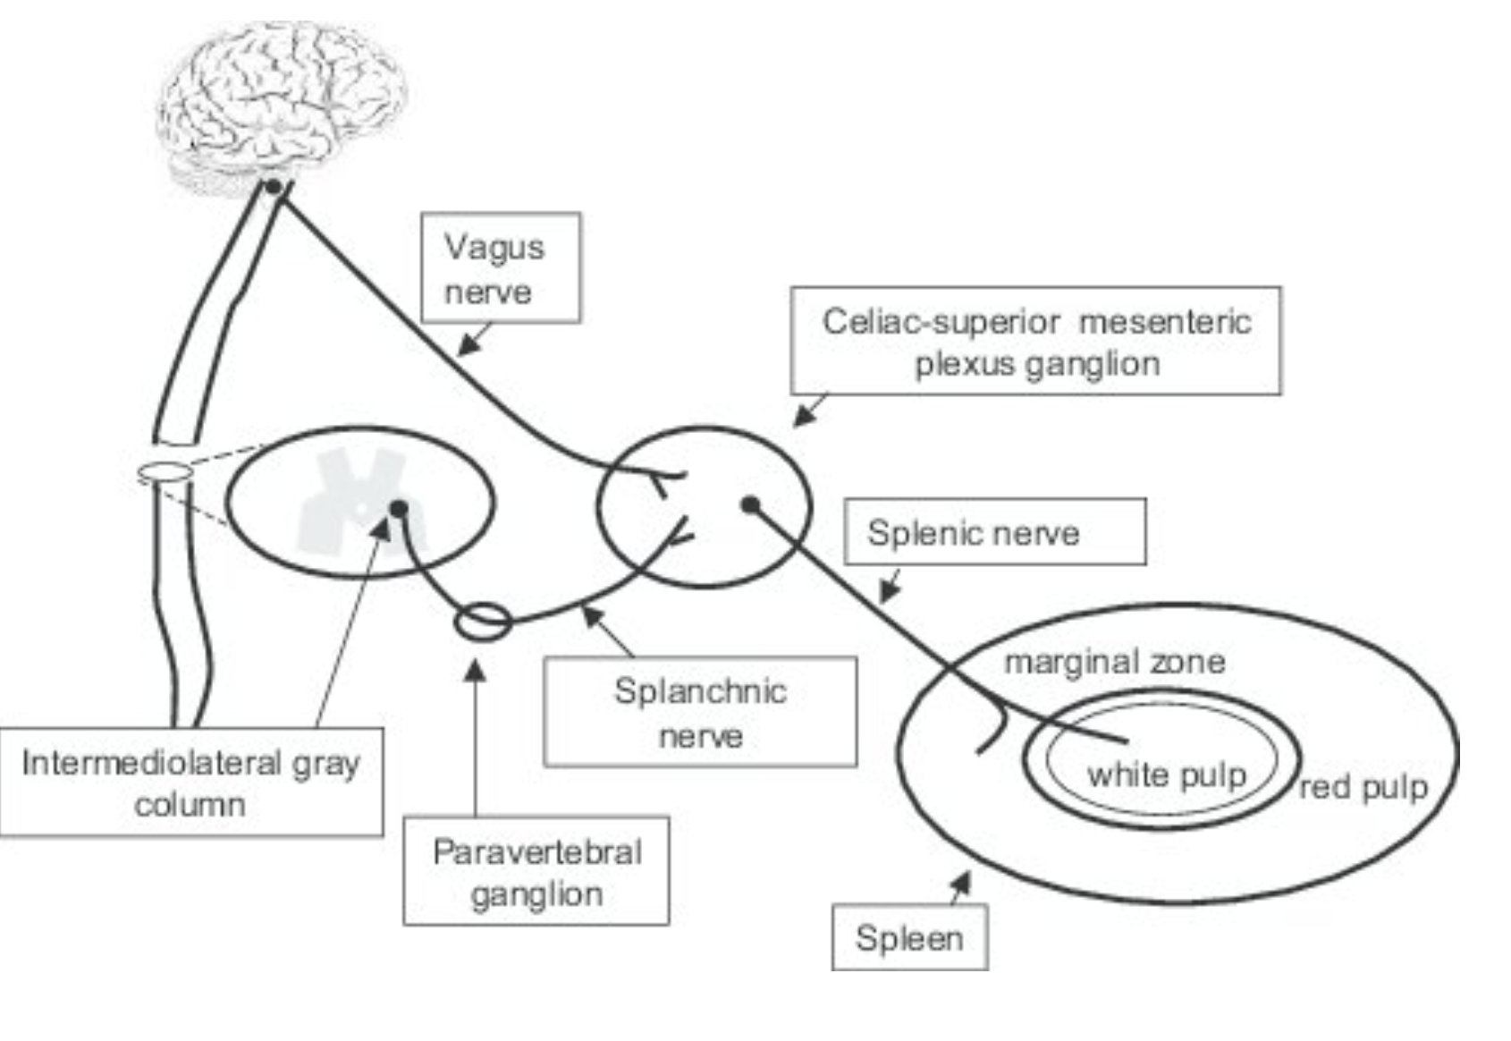
From the Spleen to the Vagus Nerve to the Brain
Vagus Nerve
Figure 7. Mauricio Rosas-Ballina et al. PNAS 2008; 105(31):11008-110.
Notes:
Spleen figure is from here:
https://www.pnas.org/doi/10.1073/pnas.0803237105
Splenic nerve is required for cholinergic antiinflammatory pathway control of TNF in endotoxemia

Slide 10
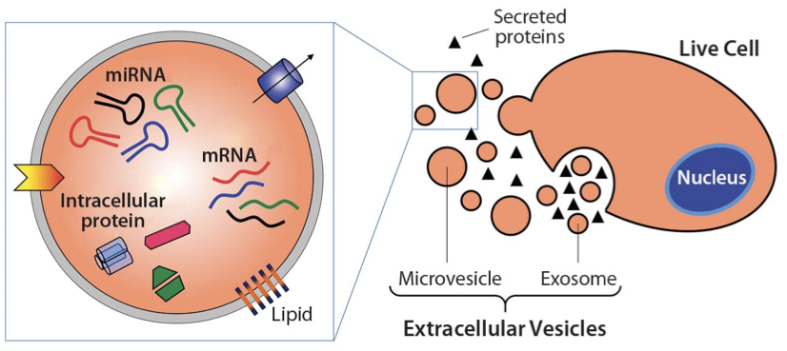
SARS-CoV-2 Spike Activates Human Microglia in the Brain via Exosomes Loaded with miRNAs*
"SARS-CoV-2 spike transfected cells release a significant amount of exosomes loaded with microRNAs such as miR-148a and miR-590”
"MicroRNAs get internalized by human microglia in the brain"
"These results uncover a bystander pathway of SARS-CoV-2 mediated CNS [central nervous system] damage through hyperactivation of human microglia"
*R Mishra and AC Banerjea. Frontiers in Immunology 2021 Apr 14;12:656700.
Notes:
prions/exosomes_spike_WOW.pdf

Slide 11
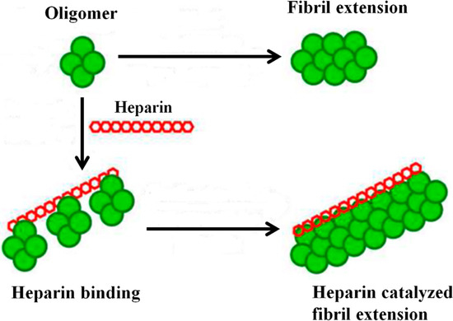
“SARS-CoV-2 spike protein interactions with amyloidogenic proteins: Potential clues to neurodegeneration”*
The receptor binding domain (RBD) of the spike protein binds to heparin and to heparin-binding proteins
Heparin binding accelerates aggregation of amyloid proteins
Amyloid-β, α-synuclein, tau, prion and TDP-43
This could lead to neurodegeneration in the brain
*D Idrees and V Kumar. Biochemical and Biophysical Research Communications 2021; 554: 94e98.
Notes:
diagram is from https://www.mdpi.com/1420-3049/20/2/2510/htm
Article:
blogposts/prions/spike_interacts_with_aBeta_heparan_sulfate.pdf

Slide 12
Sudden Death and Cardiovascular Disease

Slide 13
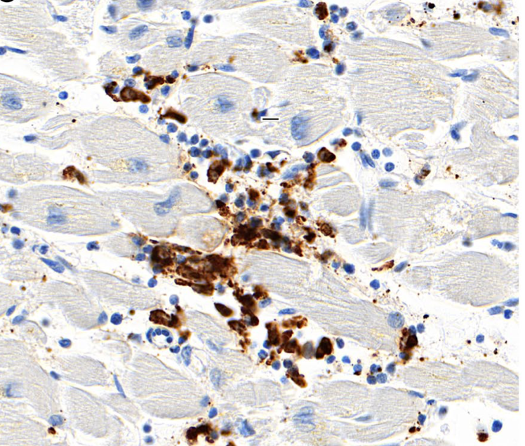
Sudden Death after Vaccination: Cardiovascular Issues*
Autopsy analysis of 5 patients who died unexpectedly within 7 days of a COVID-19 vaccine
Hypothesis: molecular mimicry between the spike protein and self proteins may trigger an autoimmune attack on the heart muscle.
*Constantin Schwab et al. Clinical Research in Cardiology. Published online 27 November 2022.
Macrophages invade the heart muscle
Notes:
Antonis/SuddenDeath/
sudden_death_after_COVID_cardiovascular_issues.pdf
memory_CD4+_T-cells_in_immunity_and_autoimmune_disease_2020.pdf

Slide 14
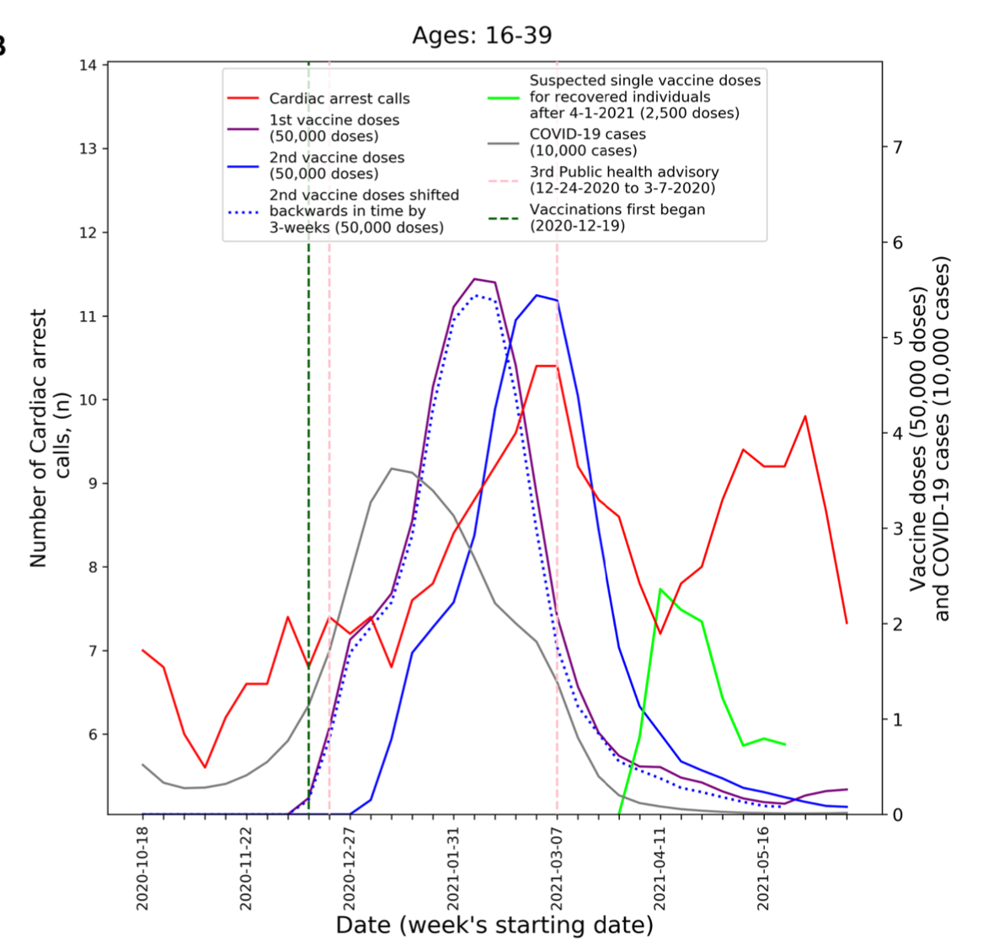
“Increased emergency cardiovascular events among under-40 population in Israel during vaccine rollout and third COVID-19 wave”* 26% increase in cardiac events among men aged 16-39 compared to previous year
Second vaccine
First vaccine
Cardiac arrest
Vaccine for those with previous infection
*Christopher LF Sun et al. Scientific Reports 2022; 12: 6978.
Notes:
https://www.nature.com/articles/s41598-022-10928-z
cardiovascular_events_under_40_vaccines_Retsef_Levi_MIT.pdf
Retsef Levi

Slide 15
“A Case Report: Multifocal Necrotizing Encephalitis and Myocarditis after BNT162b2 mRNA Vaccination against COVID-19”
76-year-old man with Parkinson’s disease died three weeks after receiving his third COVID-19 vaccination
Lymphocytes, activated microglia, and inflammation in the brain
“Surprisingly, only spike protein but no nucleocapsid protein could be detected within the foci of inflammation in both the brain and the heart”
The red arrow points to brown material which is the spike protein inside a capillary in the heart
*Michael Mörz. Vaccines 2022; 10(10): 1651.
Notes:
SuddenDeath/necrotizing_encephalitis_and_myocarditis_after_COVID_jab.pdf
According to his family, there was no history of a clinical or laboratory diagnosis of COVID-19 in the past.
https://popularrationalism.substack.com/p/on-the-sudden-death-pathophysiology?utm_source=post-email-title&publication_id=475124&post_id=87666166&isFreemail=true&utm_medium=email
The above image (from the Mörz article: https://www.mdpi.com/2076-393X/10/10/1651) shows a cross section of a capillary in the heart. It demonstrates the presence of an abundant amount of spike protein (the brown material to which the red arrow points) within endothelial cells, which are the cells that line the inner wall of the capillary. There is endothelial cell swelling, and there are a few mononuclear inflammatory cells within the wall of the capillary. The spike protein was demonstrated to be of vaccinal origin, not from SARS-CoV-2 infection.

Slide 16
“A Case Report: Multifocal Necrotizing Encephalitis and Myocarditis after BNT162b2 mRNA Vaccination against COVID-19”
“Since the nucleocapsid protein of SARS-CoV-2 was consistently absent, it must be assumed that the presence of spike protein in affected tissues was not due to an infection with SARS-CoV-2 but rather to the transfection of the tissues by the gene-based COVID-19-vaccines.”
76-year-old man with Parkinson’s disease died three weeks after receiving his third COVID-19 vaccination
Lymphocytes, activated microglia, and inflammation in the brain
“Surprisingly, only spike protein but no nucleocapsid protein could be detected within the foci of inflammation in both the brain and the heart”
The red arrow points to brown material which is the spike protein inside a capillary in the heart
*Michael Mörz. Vaccines 2022; 10(10): 1651.
Notes:
SuddenDeath/necrotizing_encephalitis_and_myocarditis_after_COVID_jab.pdf
https://popularrationalism.substack.com/p/on-the-sudden-death-pathophysiology?utm_source=post-email-title&publication_id=475124&post_id=87666166&isFreemail=true&utm_medium=email
The above image (from the Mörz article: https://www.mdpi.com/2076-393X/10/10/1651) shows a cross section of a capillary in the heart. It demonstrates the presence of an abundant amount of spike protein (the brown material to which the red arrow points) within endothelial cells, which are the cells that line the inner wall of the capillary. There is endothelial cell swelling, and there are a few mononuclear inflammatory cells within the wall of the capillary. The spike protein was demonstrated to be of vaccinal origin, not from SARS-CoV-2 infection.

Slide 17
Immune Suppression and Cancer Risk

Slide 18
PD-L1 Overexpression Following COVID Vaccination*
PD-L1 = Programmed death-ligand 1
62 vaccinated patients
Measured on day 2 after the second vaccine
"An activated immune system needs to be regulated to avoid autoimmune collateral damage"
"Vaccinations may have a non-specific immunosuppressive effect lasting for a certain period of time"
Granulocytes
Monocytes
*Lorin Loacker et al. Clin Chem Lab Med 2023; 61(1): e17–e19.
Notes:
2023/Antonis/interferon/post_vaccination_PD-L1_granulocytes.pdf
monocytes – precursors to macrophage or a dendritic cell.
Neutrophils, eosinophils, and basophils are granulocytes

Slide 19
PD-L1 Overexpression Following COVID Vaccination*
PD-L1 = Programmed death-ligand 1
"The PD-L1/PD-1 signaling pathway can inhibit the activation of T lymphocytes and enhance the immune tolerance of tumor cells, thereby achieving tumor immune escape.” **
**Xianjie Jiang et al. Molecular Cancer (2019) 18:10.
Measured on day 2 after the second vaccine
"An activated immune system needs to be regulated to avoid autoimmune collateral damage"
"Vaccinations may have a non-specific immunosuppressive effect lasting for a certain period of time"
Granulocytes
Monocytes
*Lorin Loacker et al. Clin Chem Lab Med 2023; 61(1): e17–e19.
Notes:
2023/Antonis/interferon/post_vaccination_PD-L1_granulocytes.pdf

Slide 20
Antibodies to PD-L1 and PD-1 Treat Cancer*
Elevated PD-L1 is a marker for bad outcomes in cancer
Cancer researchers are developing antibodies to both PD-1 and PD-L1, as a way to increase the activity of killer T cells and enhance their ability to destroy cancer cells
*Emilie Alard et al. Cancer 2020; 12: 1826.
Notes:
2023/Antonis/interferon/anti_cancer_immunotherapy_PDL1_antibodies.pdf
Schematic representation of PD-1 and anti-PD-1/PD-L1 mechanisms of action on T cell activity. Activated T cells at secondary lymphoid organs/tumour tissue (a) will upregulate the expression of co-inhibitory cell surface receptor PD-1. Binding of PD-1 to its ligands, PD-L1 or PD-L2, found on the surface of several immune cells as well as tumour cells, will inhibit signalling downstream of the TCR, thus downregulating T cell activity. (b) Targeting PD-1 or PD-L1 with antibody therapeutics can reinvigorate exhausted T cells at the tumour site, increase the activity, consequently allowing T cell-mediated tumour cell killing.

Slide 21
Molecular Mimicry and Autoimmune Disease

Slide 22
“Potential antigenic cross-reactivity between SARS-CoV-2 and human tissue with a possible link to an increase in autoimmune diseases”*
Cross reaction between spike protein antibody and tissue proteins
Protein/organelle Diseases
transglutaminase Celiac disease
extractable nuclear antigens Scleroderma, lupus
myelin basic protein Multiple sclerosis, autism
mitochondria Lupus, primary billiary cirrhosis, hepatitis, myocarditis
nuclear antigen Sjogren's syndrome, mixed connective tissue disease, lupus
myosin Myocarditis, dilated cardiomyopathy, Chagas' heart disease, Kawasaki disease, rheumatic fever
thyroid peroxidase Hashimoto's thyroid disease
S100B Brain metastases from lung disease, epilepsy, multiple sclerosis, and Parkinson's disease
*Aristo Vojdani and Datis Kharrazian, Clinical Immunology 217 (2020) 108480.
Notes:
https://www.ncbi.nlm.nih.gov/pmc/articles/PMC7246018/
COVID/cross_reactivity_spike_protein_human_proteins.pdf
Commercially available mouse monoclonal antibody made against recombinant SARS coronavirus spike protein a

Slide 23
Antibodies to Spike Attack the Brain*
Autopsy studies on 9 patients who died from COVID-19
“One possibility is
that anti-idiotypic antibodies against the spike protein might bind to the ACE-2 receptor on endothelial cells triggering the cascade”
*Myoung-Hwa Lee et al. Brain 2022: 145; 2555–2568.
Notes:
Leukocytes employ VWF to assist their rolling on, adhesion to and passage through the endothelium.
All techniques failed to detect any virus in the brain, including regions where there were obvious signs of inflammation
parenchyma = functional tissue of the brain
SuddenDeath/neurovascular_injury_with_COVID-19.pdf
Figure 6 Neurovascular injury with complement activation and inflammation in COVID-19. (A) Correlation matrix of the various cell type markers. Pearson’s correlation coefficient (r) between two pairs of variables is shown in the heat map. The correlation coefficients are represented in terms of the changes of the intensity of red/blue colour, as shown in the colour bar. (B) The proposed cascade of events to explain the neuropathological find- ings is as follows: C1 binds to the IgG and IgM antibodies and activates the classic complement pathway. The end product of this cascade, C5b-9 binds to endothelial cells and causes endothelial cell damage. This leads to activation of endothelial cells and increased PECAM-1 and vWF release, resulting in platelet aggregation and thrombus formation. Simultaneously, there is leakage of serum proteins into the perivascular space, which leads to an influx of monocytes and T lymphocytes into the parenchyma. Monocytes differentiate to macrophages and there is activation of microglia and astrocytes in the brain parenchyma. This leads to neuronal injury and neuronophagia.

Slide 24
“A Possible Role for Anti-idiotype Antibodies in SARS-CoV-2 Infection and Vaccination”*
The Ab2 antibodies to the Ab1 antibodies can potentially represent an exact mirror image of the initial targeted antigen (spike)
As a result, Ab2 antibodies may be able to bind the same receptor as the original antigen (ACE-2 receptors)
*WJ Murphy and DL Longo. N Engl J Med 2022;386: 394-396.
Notes:
2022/Antonis/SuddenDeath/anti-idiotype_antibodies_SARS_vaccines.pdf

Slide 25
Other Concerns: Reverse Transcription and Reproductive Issues

Slide 26
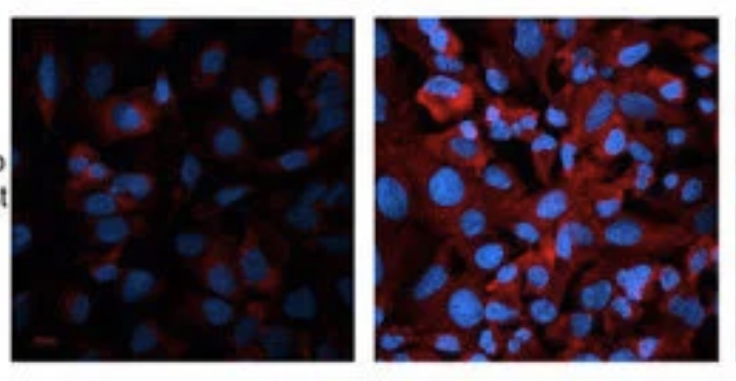
"Intracellular Reverse Transcription of Pfizer BioNTech COVID-19 mRNA Vaccine BNT162b2 In Vitro in Human Liver Cell Line"*
Cells upregulate LINE-1 in response to exposure to the spike protein mRNA
LINE-1 is able to reverse transcribe RNA into DNA and integrate it into the genome
“BNT162b2 mRNA is reverse transcribed intracellularly into DNA in as fast as 6 hours upon BNT162b2 exposure”
Control
Exposed
*Markus Aldén et al. Curr. Issues Mol. Biol. 2022, 44, 1115–1126.
Notes:
2023/COVID-19_mRNA_vaccine_reverse_transcribed_liver_cancer_cells.pd

Slide 27
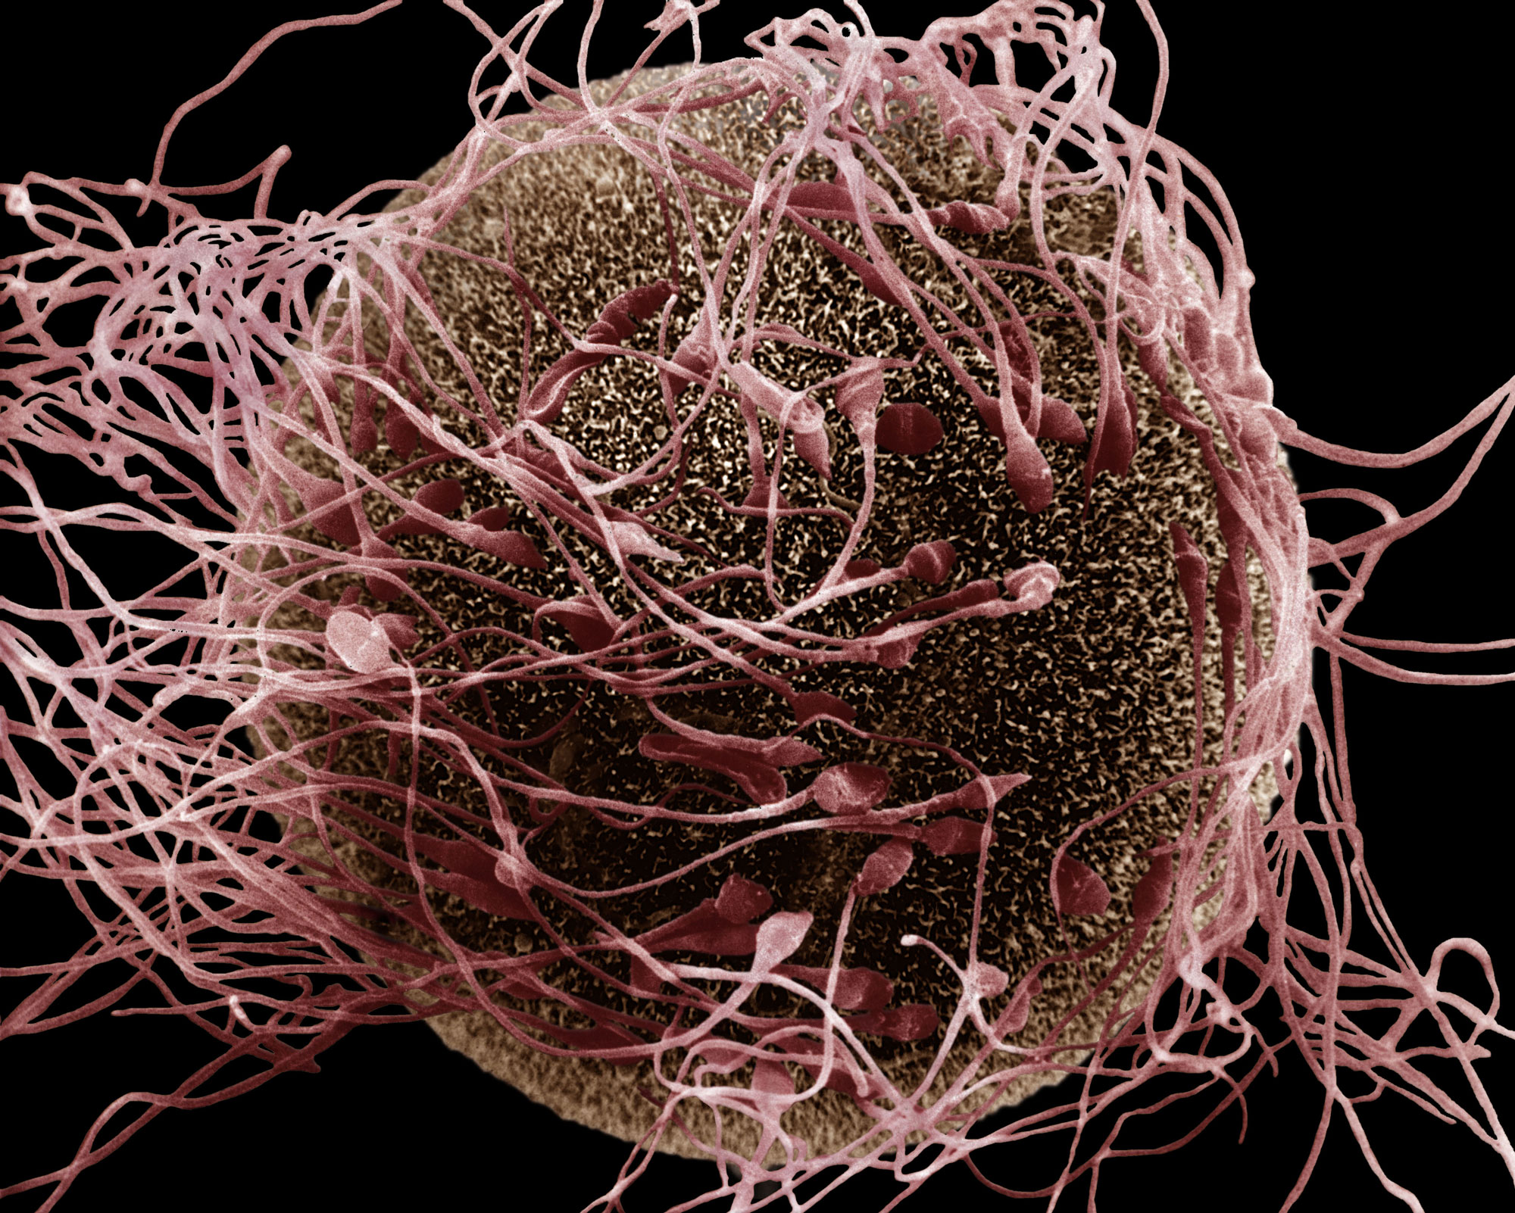
Sperm can insert DNA (from RNA) into the fertilized embryo and transfer it to offspring*
“We recently discovered a reverse transcriptase (RT) activity [e.g., LINE-1] in mouse spermatozoa that can reverse-transcribe exogenous RNA molecules into cDNA copies”
“Spliced EGFP cDNA is transferred from spermatozoa to early embryos at fertilization and propagated to fetuses and born animals” and passed on to their offspring!
Sperm release DNA-containing plasmids that are taken up by the fertilized egg
Sperm-mediated “reverse” gene transfer happens “when these cells are incubated with exogenous RNA molecules”
*Carmine Pittoggi et al., Molecular Reproduction and Development 2006; 73: 1239-1246.
Notes:
Enhanced green fluorescent protein

Slide 28
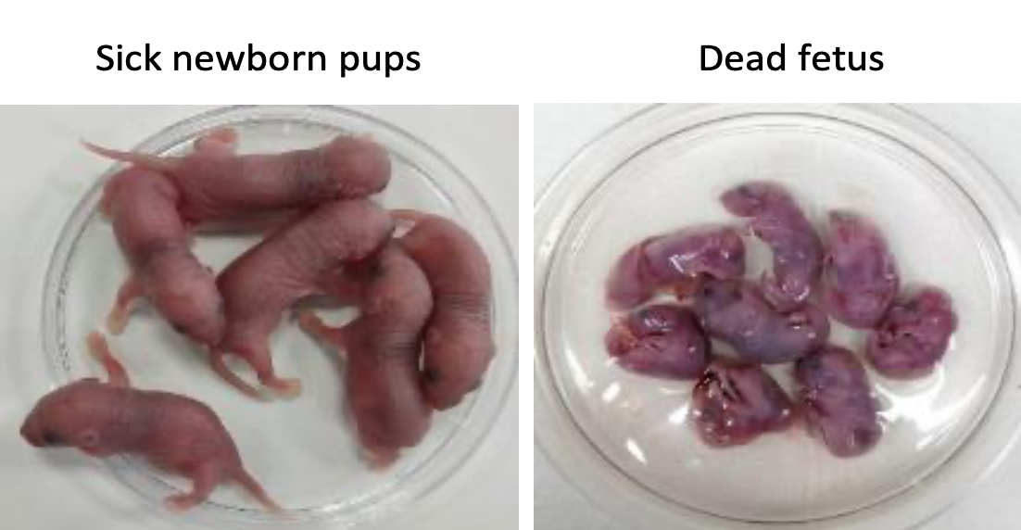
“Pathogenic antibodies induced by spike proteins of COVID-19 and SARS-CoV viruses”*
REGN10987 is a neutralizing IgG antibody produced in response to the spike protein
Researchers injected the antibody into the peritoneum of pregnant rats
The offspring of the pregnancy were highly damaged:
Acute renal tubular injury
Myocardial hemorrhage (heart damage)
Inflammation in the brain
Many were born dead
Antibody also bound broadly to human inflammatory tissues or cancer tissues, likely increasing the severity of preexisting disease
*Huiru Wang et al. Research Square Jun 17, 2021. DOI: 10.21203/rs.3.rs-612103/v2.
Notes:
COVID_vaccine/Hangzhou_China_study_S1_antibodies_toxic_to_fetus_mice_WOW.pdf
SARS-CoV-2_neutralizing_antibodies_REGN10987.pdf

Slide 29
9 months
Data are from Switzerland
January 2021 – September 2022
Source: Mary Beth Pfeiffer. The Missing Babies of Europe.
https://rescue.substack.com/p/the-missing-babies-of-europe
Notes:
Source: Mary Beth Pfeiffer. The Missing Babies of Europe.
https://rescue.substack.com/p/the-missing-babies-of-europe
in Switzerland, births declined sharply after covid vaccination campaigns. Monthly vaccination rates are shown at top, births at bottom. The red line at center is labeled in German, “9 Monate," or 9 months, showing the interval between the trends. A nearly identical pattern in other countries is depicted below. (Source: Lawsuit against Swissmedic, November 14, 2022.)
Also:
https://palexander.substack.com/p/the-f-word-no-not-that-one-fertility

Slide 30
Summary
The mRNA SARS-CoV-2 vaccines are based on a poorly evaluated technology with potential to cause many debilitating diseases
Immune cells carry the mRNA into the spleen and produce massive amounts of the toxic spike protein, releasing it into exosomes
Exosomes travel to the brain to cause neurodegenerative disease
Exosomes travel to the heart to cause cardiovascular issues
The vaccines upregulate PD-L1 in immune cells, leading to immune suppression and impaired clearance of tumor cells
The vaccines induce high titers of antibodies to spike that can cause autoimmune disease via molecular mimicry
Evidence is growing to suggest infertility issues and the potential for the RNA in the vaccines to become integrated into the human genome, with unknown consequences

