Slide 1
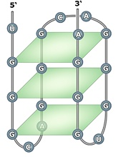
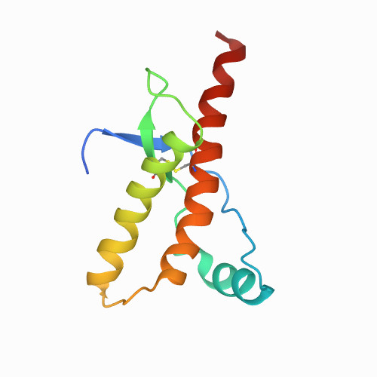
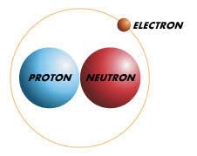
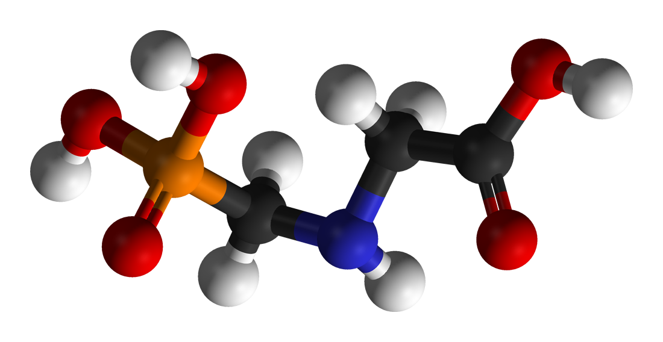
Glyphosate, Deuterium, Prions and Neurodegeneration
Stephanie Seneff, MIT CSAIL
The Real Truth About Health
April 12, 2022

Slide 2
Download these slides
Powerpoint:
https://people.csail.mit.edu/seneff/2022/Seneff_slides_2022.pptx
PDF, 2 per page: https://people.csail.mit.edu/seneff/2022/Seneff_slides_2022.pptx

Slide 3
Men occasionally stumble over the truth, but most of them pick themselves up and hurry off as if nothing happened.
--- Winston Churchill

Slide 4
Outline
Introduction
NAD(P)(H) is Essential to Support Mitochondria
Glyphosate, Glycine and Flavoproteins
Lipid Pathways and Deuterium
Prions and Neurodegenerative Disease
SARS-CoV-2, Deuterium and Glyphosate
Healthy Lifestyle
Summary

Slide 5
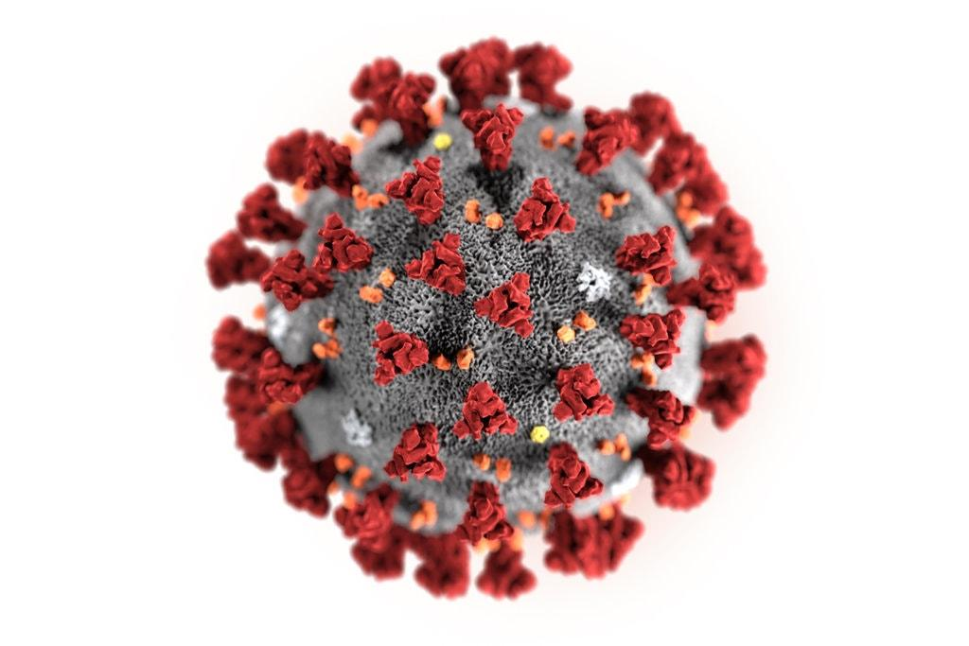
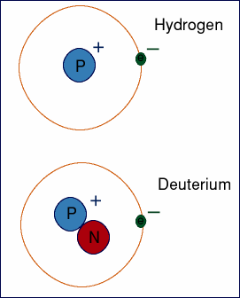
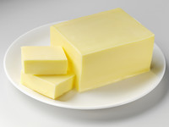
Introduction

Slide 6
The Big Picture
Deuterium is a natural rare isotope of hydrogen with distinct physical properties
Exposure to high concentrations of D₂O is life threatening
Living organisms have developed sophisticated strategies involving specialized enzymes to deal with it
Mitochondria require low-deuterium water to function properly
Choices in water and food consumption can influence deuterium exposure
Glyphosate disrupts deuterium homeostasis, causing deuterium intoxication
Hypothesis: prion proteins promote recovery from deuterium overload
In severe reactions to COVID-19, a complex response ensues aimed at restoring mitochondrial health in immune cells

Slide 7
Deuterium = “Heavy” Hydrogen
Hydrogen has one proton and one electron
Deuterium has one proton, one electron and one neutron
~ Twice as heavy as hydrogen
Present in ocean water at 155.8 ppm
Present in the blood at 6x the concentration of calcium
Has distinct physical and chemical properties compared to hydrogen
Deuterium disrupts the ATPase pumps in the mitochondria
Deuterium management in the body involves trapping deuterium in hydrogel and invoking specialized enzymes that choose hydrogen over deuterium for their reaction in order to fuel the mitochondria with hydrogen rather than deuterium

Slide 8
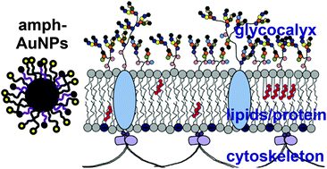
Sulfate’s Critical Role for Maintaining Exclusion Zone Water*
The glycocalyx which lines blood vessels generates electricity to supply the cells
(Hypothesis) The glycocalyx traps deuterium and extrudes D-depleted protons
Protons enter the cells along cytoskeletal “wires”
They fuel the mitochondrial intermembrane space
Sulfate is crucial for maintaining gelled water in the glycocalyx
Sulfated glycosaminoglycans (GAGs) become depleted in sulfate when chronically exposed to glyphosate
*S Seneff and G Nigh. Water 2019; 11: 22-42.
https://waterjournal.org/current-volume/seneff-summary/
Notes:
attached/SeneffNighSulfateWater2019.pdf

Slide 9
Ketogenic Diet and DDW: Health Benefits*
Deuterium depleted water (DDW) is essential for mitochondria to function properly
People whose water supply is naturally depleted in deuterium are healthier
Deuterium depletion maintains strong hydrogen bond networks in DNA (keeps it stable)
DDW inhibits tumor progression
A ketogenic diet is a deuterium-depleted diet
*Laszlo G Boros et al. Medical Hypotheses 2016; 87: 69-74.
Notes:
Chemistry/Laszlo_Boros_Med_Hyp_deuterium_depleting_water_2016.pdf

Slide 10
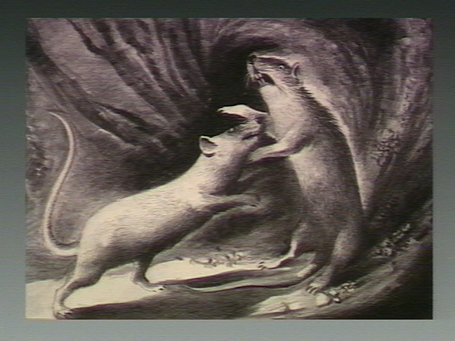
"The Pathologic Anatomy of Deuterium Intoxication"*
Mice received 5% dextrose solution in D₂O water
"Their appetites were voracious, and constant savage attacks upon each other were continually in progress.”
“Eventually, at varying intervals, the animals became hypoactive, lethargic, and dramatically weak.”
“Death occurred in all cases within 6-10 days.”
*Paul Bachner et al. PNAS 1964; 51: 464-471.
Notes:
GregNigh/deuterium_intoxication_mice_1964.pdf

Slide 11
Deuterium in Water and Depression*
Prevalence of Depression
Deuterium levels in tap water
*Tatyana Strekalova et al. Behavioural Brain Research 277 (2015) 237–244.
Notes:
2020/GregNigh/deuterium_depression_US_water_2015.pdf
Fig. 1. Depression rates and deuterium content of tap water. (A) Correlation between reported rates of major depressive disorder in US states and content of deuterium in tap water in the USA. (B) The reported prevalence of individuals with depression in among adults aged ≥18 years in each US state [Centers for Disease Control and Prevention. Mental illness surveillance among adults in the United States. MMWR 2011;60 (Suppl):1–30]. (C) Geographical distribution of average deuterium content in the tap water in the continental USA from samples collected from each state for 2004–2013.

Slide 12
Deuterium Levels are Variable in Fluids*
Deuterium in Antarctic glacier water is only 89 ppm (compared to 155 in sea water).
People who get their water from glaciers live longer
Deuterium is higher in rainwater at the equator than at the poles
Due to higher evaporation off of descending water droplets
Deuterium levels are different in different body fluids:
Saliva > Blood > Breast milk
Salivary glands selectively secrete deuterium
Breast milk is a low-deuterium nutrient
*Alexander Basov et al. Nutrients 2019; 11: 1903.
Notes:
GregNigh/DDW_influence_on_cellular_energetics_2019.pdf

Slide 13
Glyphosate: The Big Picture
Glyphosate is the active ingredient in the herbicide Roundup
Pervasive in the food supply
Considered to be safe for humans but there is increasing doubt that this is true
Glyphosate kills weeds by suppressing an enzyme in the shikimate pathway called EPSP synthase
Our gut bacteria use this enzyme to make essential aromatic amino acids for the host
There are strong correlations between the rise in glyphosate usage in the US and the rise in multiple neurological, oncological, autoimmune and metabolic diseases*
*NL Swanson et al. J Org Systems 2014; 9: 6-37.

Slide 14
My New Book!
Released by Chelsea Green in July 2021
Presents extensive data on glyphosate toxicity to animals and humans
Shows how glyphosate interferes with sulfate homeostasis
Argues that glyphosate is insidiously, cumulatively toxic through its diabolical insertion into proteins by mistake in place of the coding amino acid glycine
This unique feature explains why it is causal in so many diseases

Slide 15
NAD(P)(H) is Essential to Support Mitochondria

Slide 16
The Big Picture
NAD (Nicotinamide Adenine Dinucleotide) is an essential cofactor in oxidation/reduction reactions
It exists in four forms: with and without hydrogens and with and without phosphate
NAD+ (no H, no P)
NADH (with H, no P)
NADP+ (no H, with P)
NADPH (with H, with P)
Mitochondria are organelles inside cells that supply energy in the form of ATP
Mitochondria depend critically on a proton-ATPase pump to make ATP
Protons derived from NADH and NADPH are pumped into the intermembrane space
Deuterium “gums up” the pump (like sugar in the gas tank)
Glyphosate interferes with the supply of NADH and NADPH to the organism
The enzymes that supply NAD+ and NADP+ with H are specially designed to avoid deuterium

Slide 17
A Mitochondrion
Notes:
From Laszlo’s slides.

Slide 18
Electron Transport Chain
DDW
Protons from NADH and FADH₂ are pumped across the membrane and then flow back through the ATPase pump, reacting with oxygen to form deuterium-depleted “metabolic water”

Slide 19
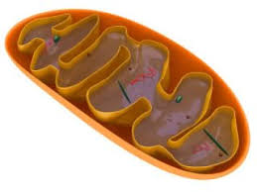
ATPase Proton Pump*
ATPase pumps get stalled by deuterium
(analogous to sugar in the gas tank)
ATPase pumps
Cytoplasm
Mitochondrial
Matrix
*Figure credit: Figure 1. Qiang Cui. J Gen Physiol 2018; 150(6): 777-780.
Notes:
Figure 1.
GregNigh/Membrane-mediated\ interaction\ drives\ mitochondrial\ ATPase\ assembly.pdf .
Membrane-mediated protein–protein interactions. Schematic illustration of protein organization in the mitochondrial cristae membranes (adapted from Fig. 5 of Davies et al., 2011); the ATP synthase dimers (yellow) assemble into rows along the cristae ridge, whereas proton pumps (green) resi- due predominantly in the at membrane regions. Such organization has been proposed to support a high local proton gradient (however, see the discussion by Rieger et al., 2014) and e cient ATP synthesis (Davies et al., 2011).

Slide 20
Deuterons Disrupt the ATPase Pump*
There are around 15,000 ATPase pumps in a single mitochondrion
Proton force rotates the ATPase pumps at a rate of 1,000 cycles per second
Deuterons resist letting go and stall the pump, producing a stutter
Deuterons also disrupt proton-coupled electron transport (PCET) which is based on proton tunneling
This causes decreased production of ATP and increased production of reactive oxygen species, damaging the pumps.
*Abdullah Olgun. Theoretical Biology and Medical Modelling 2007, 4: 9.
Notes:
2021/Laszlo_Boros/Olgun_deuterons_in_ATPase_pumps_WOW_2007.pdf

Slide 21
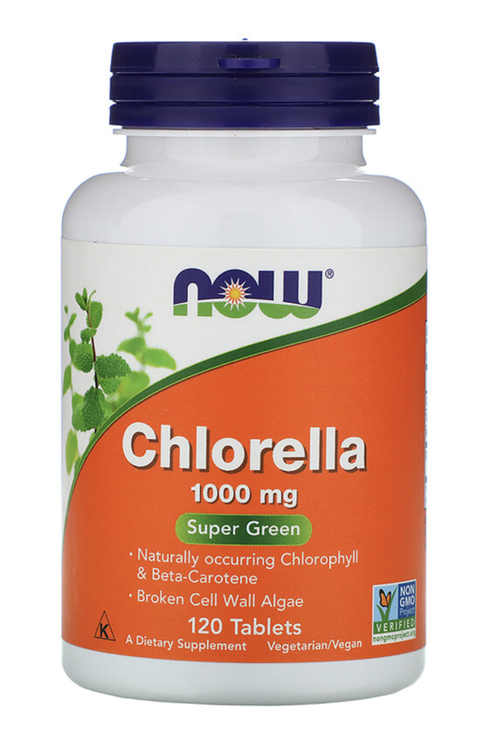
G6PD & Fatty Acids*
Glucose 6 phosphate dehydrogenase (G6PD) converts NADP⁺ to NADPH (has strong preference for H over D)**
NADPH is the largest source of hydrogen in fatty acid biosynthesis
E coli and Bacillus subtilis produce deupleted fatty acids (FAs)
Due to high dependency on G6PD to restore H in NADPH
Photosynthetic organisms (e.g., algae (chlorella)) produce highly deuterium-depleted FAs
*RS Wijker et al. PNAS 2019; 116(25): 12173-12182.
**Xinning Zhang et al. PNAS 2009; 106: 12580-12586.
Notes:
Where?

Slide 22
G6PD & Fatty Acids*
Glucose 6 phosphate dehydrogenase (G6PD) converts NADP⁺ to NADPH (has strong preference for H over D)**
NADPH is the largest source of hydrogen in fatty acid biosynthesis
E coli and Bacillus subtilis produce D-depleted fatty acids (FAs)
Due to high dependency on G6PD to restore H in NADPH
Photosynthetic organisms (e.g., algae (chlorella)) produce highly deuterium-depleted FAs
Fatty acids are a preferred fuel for the mitochondria because they are deuterium depleted
*RS Wijker et al. PNAS 2019; 116(25): 12173-12182.
**Xinning Zhang et al. PNAS 2009; 106: 12580-12586.
Notes:
Where?

Slide 23
Glyphosate, Glycine
and Flavoproteins

Slide 24
The Big Picture
Flavoproteins are an important class of proteins that transfer hydrogens to and from NAD(P)H using flavins (FAD, FMN) as intermediaries
Glyphosate’s disruption of the shikimate pathway in gut microbes leads to deficiencies in tryptophan – a precursor to NAD
Tryptophan is also a precursor to serotonin, the “feel good” hormone
Serotonin deficiency is linked to depression, obesity and violent behavior
Both glyphosate and excess deuterium deplete serotonin and cause depression
My research strongly suggests that glyphosate suppresses enzymes that bind phosphate
NAD(P)(H), FAD and FMN all contain multiple phosphate anions
Flavoproteins contain essential glycine residues at all the sites where they bind phosphate
Tremendous susceptibility to glyphosate’s mischief through glycine substitution

Slide 25
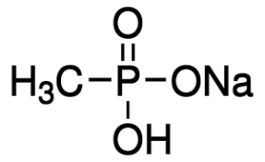
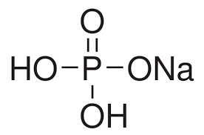
Hypothesis: Glyphosate Disrupts Proteins that Bind Phosphate*
Glyphosate kills plants by suppressing EPSP synthase
Glyphosate blocks EPSP synthase binding to the phosphate in PEP
Glyphosate is a glycine molecule with a methylphosphonate unit attached to the nitrogen atom
The binding site for PEP has a highly conserved glycine residue
If this glycine is swapped out for alanine, the enzyme becomes completely insensitive to glyphosate → glyphosate is displacing glycine in the protein??
Sodium Methyl-
phosphonate
Sodium Phosphate
*S Gunatilake et al., Int J Environ Res Public Health 2019; 16(15): 2734.

Slide 26
Hypothesis: Glyphosate Disrupts Proteins that Bind Phosphate*
Glyphosate kills plants by suppressing EPSP synthase
Glyphosate blocks EPSP synthase binding to the phosphate in PEP
Glyphosate is a glycine molecule with a methylphosphonate unit attached to the nitrogen atom
The binding site for PEP has a highly conserved glycine residue
If this glycine is swapped out for alanine, the enzyme becomes completely insensitive to glyphosate → glyphosate is displacing glycine in the protein??
Glyphosate’s methylphosphonate unit fits nicely in the pocket that is reserved for phosphate, blocking phosphate binding.
Sodium Methyl-
phosphonate
Sodium Phosphate
*S Gunatilake et al., Int J Environ Res Public Health 2019; 16(15): 2734.

Slide 27
Grotthuss Effect: Water Wires
A few water molecules settle into the reaction center and facilitate proton transfer
Deuterium is a reluctant participant
This assures that a proton rather than a deuteron ends up in the reaction product
Flavoproteins and many other enzymes take advantage of this effect to select hydrogen over deuterium
Flavin-binding is essential for this to work

Slide 28
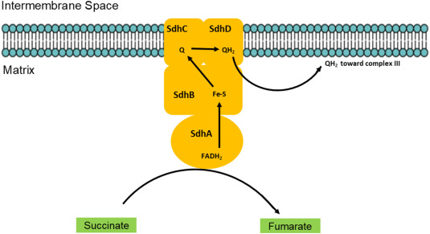
Succinate Dehydrogenase
Succinate dehydrogenase (Complex II) is the only enzyme in the mitochondria that is intimately involved in both the citric acid cycle and oxidative phosphorylation
It is a flavoprotein (binds FAD)
It extracts two protons from succinate and embeds them in the membrane (by converting ubiquinone to ubiquinol (coenzyme Q10))
Genetic mutations in succinate dehydrogenase are associated with multiple cancers:*
E.g., neuroblastoma, breast cancer, colon cancer, renal cancer, melanoma and uterine cancer, prostate cancer, endometrial cancer, bladder cancer, and gastrointestinal stromal tumor
*Marianne Dubard Gault et al., Cold Spring Harb Mol Case Stud. 2018 Aug; 4(4): a002584.
Notes:
The enzyme catalyzes the FAD-dependent oxidation of succinate to fumarate coupled with the reduction of ubiquinone to ubiquinol.

Slide 29
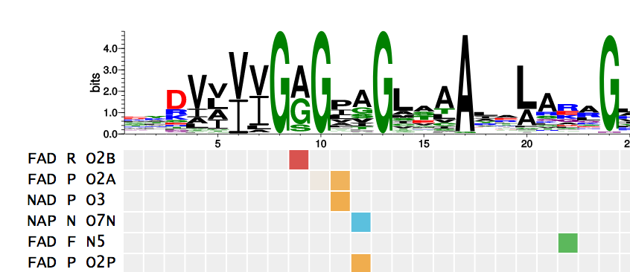
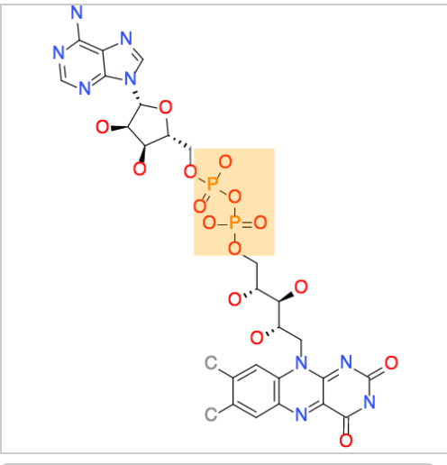
Succinate Dehydrogenase: GxGGxG Motif*
GAGGAG
FAD(H)
Binds FAD as a cofactor to catalyze electron transport in the mitochondria
*http://nbdb.bii.a-star.edu.sg/search
Notes:
P31040
Succinate dehydrogenase (SDH) or succinate-coenzyme Q reductase (SQR) or respiratory ... After the electrons are derived from succinate oxidation via FAD, they tunnel along the [Fe-S] relay until they reach the [3Fe-4S] cluster. ... To fully reduce the quinone in SQR, two electrons as well as two protons are needed.

Slide 30
Glyphosate Suppresses Succinate Dehydrogenase
Study on glyphosate’s effects on E. coli proteins found that glyphosate significantly suppressed (by 3-4-fold) three different components of succinate dehydrogenase complex*
In vitro study on rat liver mitochondria in isolation exposed to Roundup and glyphosate alone**
Roundup significantly suppressed succinate dehydrogenase although glyphosate did not – authors proposed that surfactants in Roundup enabled glyphosate transport across mitochondrial membranes
Analysis of mechanism of glyphosate suppression suggested it disrupted binding of succinate dehydrogenase to FAD***
*W Lu et al., Mol. Biosys. 9 (2013) 522–530.
**Francisco Peixoto Chemosphere 61 (2005) 1115-1122.
***R Ugarte. Computational Theor. Chem. 1043 (2014) 54–63.

Slide 31
Glyphosate Formulations Induce Apoptosis and Necrosis in Human Umbilical, Embryonic, and Placental Cells*
Intrinsic Pathway
Extrinsic Pathway
SD = succinate dehydrogenase
Key mechanism is through suppression of succinate dehydrogenase
*N Benachour and G-E Seralini. Chem Res Toxicol 2009; 22: 97-105
Notes:
Glyphosate/Seralini_Benachour_2009_human_placenta.pdf

Slide 32
Glyphosate Suppresses NADPH Reductase*
This enzyme supplies NADPH to the enzyme aromatase that converts testosterone to estrogen and to many other enzymes involved in steroid metabolism
*Sophie Richard et al. Environmental Health Perspectives 2005; 113(6): 716-720.
Notes:
2020/glyphosate/glyphosate_suppresses_NADPH_reductase_aromatase_2005.pdf
Effect of Roundup on reductase activity. Activity of purified equine reductase was measured in the presence of increasing concentrations of Roundup in nonadjusted or adjusted pH (7.4) medium for 15 min at 37°C (n = 9). Error bars indicate SE.

Slide 33
Besides succinate dehydrogenase and NADPH reductase, other phosphate-binding enzymes that glyphosate has been shown to suppress include cytochrome P450 enzymes, NAD transhydrogenase (transfers hydrogen from NAD to NADP), G6PD and RuBisCo (in plants, the most common enzyme in the world)

Slide 34
Lipid Pathways and Deuterium

Slide 35
The Big Picture
The synthesis of long chain polyunsaturated fatty acids involves a series of reactions catalyzed by elongases and desaturases
Longer chains in the membrane protect from hydrogen leakage
Membrane lipids are released under stress conditions
Released membrane lipids can be processed through three primary pathways
CYP-enzyme-based production of endogenous cannabinoids
Lipoxygenase-based production of leukotrienes
Cycloxygenase-based production of prostaglandins
The diverse products of lipid modifications are powerful signaling molecules
Most, if not all, of these pathways produce deuterium-depleted water, which might be the primary product
Glyphosate likely disrupts many of these pathways

Slide 36
A Quick Tutorial on Fatty Acids
saturated
monounsaturated
poly-unsaturated (PUFA)
20
COOH
highly-unsaturated (HUFA)
c26:0 hexacosanoic acid
Notes:
HUFA have at least 20 carbons.

Slide 37
A Quick Tutorial on Fatty Acids
saturated
monounsaturated
poly-unsaturated (PUFA)
20
COOH
highly-unsaturated (HUFA)
Eicosapentaenoic acid (EPA)
20 carbons;
5 double bonds
Notes:
HUFA have at least 20 carbons.

Slide 38
Some pathways of fatty acid synthesis and metabolism
D6D
D6D
D5D
D5D
Prostaglandins and leukotrienes are signaling molecules with powerful pro-inflammatory effects
*Figure 1 in Zhila Arshad et al. Asian Pac J Cancer Prev, 20 (4), 1005-1018.
Notes:
2021/cancer/delta-6-desaturase_linked_to_cancer_2019.pdf
Association of Delta-6-Desaturase Expression with Aggressiveness of Cancer, Diabetes Mellitus, and Multiple Sclerosis: A Narrative Review

Slide 39
Desaturases produce DDW
PUFA
Oxygen
HUFA
2 DDW
D5D (Delta-5 desaturase) produces HUFA from PUFA.
For each molecule of HUFA produced, it produces two molecules of DDW from one molecule of oxygen.
Flavin adenine dinucleotide (FAD) is a required co-factor.
Notes:
Flavoproteins/images/desaturase.png

Slide 40
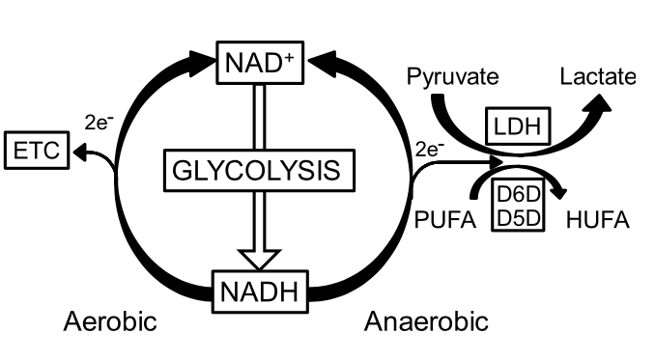
HUFA synthesis by D5D and D6D is a mechanism for glycolytic NAD+ recycling*
PUFA
Blocking the electron transport chain or lactate production reduces cytosolic NAD+/ NADH and increases HUFAs
HUFA synthesis by D5D and D6D is a mechanism for glycolytic NAD+ recycling
D5D- and D6D-mediated NAD+ regeneration can be acutely adaptive in vivo
2
DDW!
HUFA
HUFA = highly unsaturated fatty acid
PUFA = polyunsaturated fatty acid
*Wondong Kim et al. Cell Metabolism 2019; 29: 856-870.
Notes:
chemistry/PUFA_synthesis_regenerates_NAD+_2019.pdf
Uniprot:
https://www.uniprot.org/uniprot/P00167
Cytochrome b5 is a membrane-bound hemoprotein functioning as an
electron carrier for several membrane-bound oxygenases.

Slide 41
HUFA synthesis by D5D and D6D is a mechanism for glycolytic NAD+ recycling*
D5D and D6D are desaturases
When the electron transport chain is sick (too much deuterium), the cell naturally reverts to creating fats that are more highly unsaturated by extracting the hydrogen in the fats to make DDW and repair the mitochondria
Glyphosate may interfere with this process as well
(flavin-binding)
PUFA
Blocking the electron transport chain or lactate production reduces cytosolic NAD+/ NADH and increases HUFAs
HUFA synthesis by D5D and D6D is a mechanism for glycolytic NAD+ recycling
D5D- and D6D-mediated NAD+ regeneration can be acutely adaptive in vivo
DDW!
HUFA
HUFA = highly unsaturated fatty acid
PUFA = polyunsaturated fatty acid
*Wondong Kim et al. Cell Metabolism 2019; 29: 856-870.
Notes:
chemistry/PUFA_synthesis_regenerates_NAD+_2019.pdf
Uniprot:
https://www.uniprot.org/uniprot/P00167
Cytochrome b5 is a membrane-bound hemoprotein functioning as an
electron carrier for several membrane-bound oxygenases.

Slide 42
CYP2C9 Metabolizes AA
an organic molecule
(e.g., arachidonic acid)
FMNH2
an alcohol
FMN
DDW
The product of arachidonic acid metabolism by CYP2C9 is an endogenous cannabinoid. It stimulates the cannabinoid receptors just like tetrahydrocannabinol (THC)
CYP enzymes are suppressed by glyphosate -- likely due to its demonstrated ability to suppress CYP reductase, the enzyme that maintains CYP-enzyme-bound NADPH in its reduced state**
When CYP activity is suppressed, AA gets redirected to lipoxygenase pathway
*Jian-Kang Chen et al. JBC 2008;283 (36) 24514-24524
**Sophie Richard et al. Environmental Health Perspectives 2005; 113(6): 716-720
Notes:
2020/book/flavoproteins/Chen_2008_CYP_enzymes_make_cannabinoids_from_arachidonic_acid.pdf

Slide 43
“Inflammation, Cancer and Oxidative Lipoxygenase Activity are Intimately Linked”*
Lipoxygenases oxidize arachidonic acid (AA) and its derivatives producing leukotrienes (pro-inflammatory) and ultimately lipoxins (anti-inflammatory)
Leukotrienes activate NF-κB pathway and TNF-alpha expression (inflammatory signals)
15-LOX is highly expressed in white blood cells
Over-expression of lipoxygenases has been implicated in many human acute and chronic inflammatory diseases such as asthma, atherosclerosis, rheumatoid arthritis, inflammatory bowel diseases, dermatitis, and cancer
Leukotriene LTB4 is a potential stimulator for cancer cell growth, and it also plays a role in the formation of reactive oxygen species in response to hypoxia
*Rosalina Wisastra and Frankj J Dekker. Cancers 2014, 6, 1500-1521.

Slide 44
“Inflammation, Cancer and Oxidative Lipoxygenase Activity are Intimately Linked”*
Lipoxygenases oxidize arachidonic acid (AA) and its derivatives producing leukotrienes (pro-inflammatory) and ultimately lipoxins (anti-inflammatory)
Leukotrienes activate NF-κB pathway and TNF-alpha expression. (inflammatory signals)
15-LOX is highly expressed in white blood cells
Over-expression of lipoxygenases has been implicated in many human acute and chronic inflammatory diseases such as asthma, atherosclerosis, rheumatoid arthritis, inflammatory bowel diseases, dermatitis, and cancer
Leukotriene LTB4 is a potential stimulator for cancer cell growth, and it also plays a role in the formation of reactive oxygen species in response to hypoxia
Lipoxygenase has a fantastic ability to select hydrogen over deuterium despite not being a flavoprotein*
*Pengfei Li et al. J Phys Chem Lett 2018; 9(22): 6444-6449.
*Rosalina Wisastra and Frankj J Dekker. Cancers 2014, 6, 1500-1521.

Slide 45
”The Endocannabinoid System: A Target for Cancer Treatment”*
Cannabinoid receptor (CB-R) agonists inhibit cancer cell proliferation through various receptor-mediated mechanisms
Slowed growth of Lewis lung adenocarcinoma in culture and in a mouse model after oral administration
Many types of cancer cells upregulate cannabinoid receptor expression
Cannabinoids suppress metastasis and angiogenesis
In HER2-overexpressing breast cancer cells, CBD arrested cancer cell proliferation in vitro and in vivo by inhibiting Akt and ERK signaling
Receptor activation locks cell cycle at the G1/S phase and at the G2/M phase
Anti-tumor properties have also been seen in pancreatic cancers
*Chiara Laezza et al. Int. J. Mol. Sci. 2020, 21, 747.
Notes:
2021/cancer/endocannabinoid_systme_target_for_cancer_2020.pdf

Slide 46
Prions and Neurodegenerative Disease

Slide 47
Some Mysteries
Several “prion-like” proteins expressed in neurons are linked to neurodegenerative disease (amyloid beta, alpha-synuclein, TDP-43, FUS, the prion protein (PrP), tau, …)
Researchers have been unable to figure out what is the toxic form of these prion-like proteins (soluble oligomers? Insoluble fibrils in plaque and Lewy bodies?) and, more importantly, how they induce toxicity
Impairments may even arise from a loss-of-function effect
Researchers have also been unable to figure out what these proteins actually do, even though it is established that mutations in most of them are embryologically lethal

Slide 48
The Big Picture (Hypothesis)
Do prion-like proteins play a role in maintaining low deuterium in the cytoplasm??
Hypothesis: These proteins can trap deuterium inside water-inaccessible precipitates
Bold claims:
Misfolded proteins in Alzheimer’s plaque or Lewy bodies are a sign of impaired deuterium homeostasis
Prion diseases begin with stressed immune cells in the gut and spleen
Cells with impaired ability to clear misfolded proteins release them inside exosomes and deliver them to other cells, propagating the disease process
Impaired sulfate homeostasis plays a significant role in the pathology

Slide 49
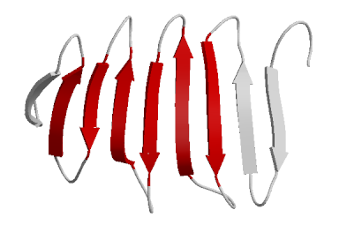
“Structural Organization of Brain-derived Mammalian Prions as Probed by Hydrogen Exchange”*
Unstructured:
Exchange H with D
“The H/D exchange method exploits the rapid exchange of backbone amide hydrogens within the unstructured regions of proteins compared to relatively slow exchange of those involved in systematically H-bonded structures such as ß-sheets or α-helices.”
ß-sheets:
Trap deuterium?
Prion protein gathers deuterium from the medium and traps it within ß-sheets when there is too much?
*V Smirnovas et al. Nat Struct Mol Biol 2011; 18(4): 504-506.
Notes:
pions/mammalian_prions_hydrogen_deuterium_exchange.pdf

Slide 50
Protein Misfolding*
Ribosome
Proteins synthesized in the endoplasmic reticulum (ER) can fold incorrectly
Molecular chaperones carry misfolded proteins to the lysosome or proteasome for clearance
Insoluble aggregates accumulate when these processes are impaired
Chaperone
*Figure 1. Dezerae Cox et al. Biochim Biophys Acta 2014;1842(9):1830-43.
Notes:
2022/prions/aggregation_alpha_synuclein_2014.pdf
Fig. 1. Cellular proteostasis mechanisms. In the endoplasmic reticulum (ER), molecular chaperones assist newly synthesised protein intermediates to fold into their native conformation for transport into the cytosol. Persistent or misfolded protein intermediates can be proteolytically degraded within the ER or transported to the cytosol [30]. Once in the cytosol, protein intermediates are recognised by molecular chaperones and targeted for refolding or degradation via lysosomal or proteasomal pathways [31]. When these mechanisms fail to clear protein intermediates, insoluble aggregates can accumulate within the ER or cytosol as aggresomes. Adapted from [22].

Slide 51
How “damaged” proteins are cleared*
Lysosome:
Macroautophagy
Microautophagy
Endocytosis
Proteasome:
Ubiquitin-mediated protein degradation
*Figure 1. Marta Martinez-Vicente and Ana Maria Cuervo. Lancet Neurol 2007; 6: 352-61.
Notes:
2022/neurons/autophagy_and_neurodegeneration.pdf
Figure 1: Proteolytic systems in mammalian cells Substrate proteins are delivered to lysosomes from the extracellular media (heterophagy) or from inside the cell (autophagy). The best described heterophagic pathway is endocytosis. Three different types of autophagy have been described in mammalian cells: macroautophagy, microautophagy, and chaperone-mediated autophagy (CMA). In macroautophagy intracellular components are sequestered by a limiting membrane to form an autophagic vacuole that then fuses with lysosomes. In microautophagy, substrates are directly internalised through invaginations of the lysosomal membrane. In contrast to this “in-bulk” degradation, in CMA, selective substrate proteins are translocated into the lysosomes one by one after binding to a lysosomal receptor (LAMP-2A). The ubiquitin-proteasome system (UPS) is the other major pathway for degradation of intracellular proteins inside cells. Substrates are tagged with a small protein (ubiquitin) that is recognised by the proteasome, the protease of this pathway.

Slide 52
“Amyloid proteotoxicity initiates an inflammatory response blocked by cannabinoids”*
Amyloid-β (Aβ) is the protein that misfolds and accumulates as plaques in the brain in association with Alzheimer’s disease
Intraneuronal Aβ increases production of leukotrienes by 5-lipoxygenase (5-LOX) (→ deuterium-depleted water!)
Leukotrienes increase Aβ accumulation (positive feedback loop) and nerve cell death through production of proinflammatory cytokines
Cannabinoids reduce intraneuronal Aβ accumulation and improve memory (possibly by catalyzing flavoproteins)
*Antonio Currai et al. snpj Aging Mech Dis 2016; 2: 16012.
Notes:
neurons/amyloid_inflammation_cannabinoids_2016.pdf

Slide 53
“Amyloid proteotoxicity initiates an inflammatory response blocked by cannabinoids”*
Amyloid-β (Aβ) is the protein that misfolds and accumulates as plaques in the brain in association with Alzheimer’s disease
Intraneuronal Aβ increases production of leukotrienes by 5-lipoxygenase (5-LOX) (→ deuterium-depleted water!)
Leukotrienes increase Aβ accumulation (positive feedback loop) and nerve cell death through production of proinflammatory cytokines
Cannabinoids reduce intraneuronal Aβ accumulation and improve memory (possibly by catalyzing flavoproteins)
The endogenous cannabinoids derived from arachidonic acid would do the same thing, but the CYP enzymes that are needed to synthesize them are blocked by glyphosate and other toxic environmental chemicals
*Antonio Currai et al. snpj Aging Mech Dis 2016; 2: 16012.
Notes:
neurons/amyloid_inflammation_cannabinoids_2016.pdf

Slide 54
Glyphosate Usage on Corn and Soy is Highly Correlated over Time with Deaths from Dementia

Slide 55
"Prion Diseases and their Biochemical Mechanisms”*
Creutzfeldt Jakob Disease is the human form of Madcow
Neurodegenerative disorder caused by prion protein misfolding
Ingested prions can seed the disease process
Taken up by dendritic cells and carried into the gut-associated lymphoid tissue (GALT) and the spleen
Act like a crystal to induce further misfolding of human prion proteins
Exosomes are released by the dendritic cells in the GALT and spleen, and they travel along retrograde nerve fibers (splanchnic nerve and vagus nerve) to the brain stem
Neurons in the brain take up the misfolded proteins which bind to prion proteins in the brain and induce further misfolding
*Nathan J Cobb and Witold K Surewicz. Biochemistry 2009; 48(12): 2574-2585.

Slide 56
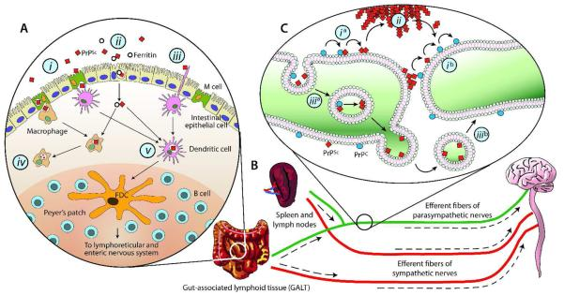
*Figure 1. Nathan J Cobb and Witold K Surewicz. Biochemistry 2009; 48(12): 2574-2585.
Notes:
prions/prion_biochemical_mechanisms.pdf
Schematic representation of the potential mechanism of neuroinvasion in transmissible spongiform encephalopathies. (A) Inital uptake of the TSE agent from the intestinal lumen has been proposed to occur through a number of alternative mechanisms, including M cell transcytosis (i), ferritin-dependent trancytosis through intestinal epithelial cells (ii), or via direct capture by dendritic cells (iii). While phagocytic cells such as macrophages appear to degrade PrPSc (iv), dendritic cells may deliver the TSE agent to follicular dendritic cells (FDCs) where early accumulation of PrPSc occurs (v). (B) After amplification of the TSE agent in lymphoid tissue such as the GALT and spleen, invasion of the nervous system is believed to proceed through peripheral nerves. Retrograde transport of the TSE agent is believed to occur along two distinct pathways, following efferent fibers of the sympathetic and parasympathetic nerves to the CNS. (C) Retrograde transport and propagation of PrPSc along neuronal processes may occur by step-wise interactions along the cell surface (i , i ), via extracellular deposits (ii), or by vesicle-mediated mechanisms (iii , iii ). See text for details

Slide 57
“Deuterium Isotope Effects on Lymphoid Tissues and Humoral Antibody Responses in Mice”*
Mice were exposed to water enriched with 30% D₂O
Deuteration resulted in depression of antibody response to a toxin
“A particularly striking weight loss of the thymus and spleen, and a marked systemic lymphocyte depletion were apparent, particularly in the thymus, white pulp of the spleen, lymph nodes, and gut-associated lymphoid tissue (GALT)”
The spleen was especially sensitive to the deuterium compared to all other organs
*JA Laissue and RD Stone. Virchows Arch. A Path Anat and Histol 1979; 383: 149-166.
Notes:
csail/2022/GAPS/deuterium_lymphoid_tissue_germinal_centers_1979.pdf

Slide 58
“Deuterium Isotope Effects on Lymphoid Tissues and Humoral Antibody Responses in Mice”*
Mice were exposed to water enriched with 30% D₂O
Deuteration resulted in depression of antibody response to a toxin
“A particularly striking weight loss of the thymus and spleen, and a marked systemic lymphocyte depletion were apparent, particularly in the thymus, white pulp of the spleen, lymph nodes, and gut-associated lymphoid tissue (GALT)”
Perhaps the spleen plays an essential role in maintaining low deuterium levels in the blood?
The spleen was especially sensitive to the deuterium compared to all other organs
*JA Laissue and RD Stone. Virchows Arch. A Path Anat and Histol 1979; 383: 149-166.
Notes:
csail/2022/GAPS/deuterium_lymphoid_tissue_germinal_centers_1979.pdf

Slide 59
Alpha-Synuclein & Parkinson’s Disease
"When autophagic mechanisms fail to digest the toxic a-SYN oligomers, exosome-mediated release could be a way to clear the cells of the toxic species, unfortunately allowing uptake of these exosomes by neighboring cells”
Alpha-synuclein binds to membranes in its N-terminal domain
Alpha-synuclein has a C-terminal domain that is intrinsically disordered
Excessive phosphorylation and/or crowding induce the formation of soluble oligomers that block access of the hydrophobic domain to water
*Angélique Deleersnijder et al. Trends in Molecular Medicine 2013 19(6): 368-377.
Notes:
prions/alpha_synuclein_blessing_or_curse.pdf

Slide 60
alpha-Synuclein Facilitates Dopamine Uptake into Vesicles*
High propensity for dopamine to oxidize when not stored in synaptic vesicles
*Figure 2. Julie Lotharius and Patrik Brundin. Nature Reviews 2002; 3: 932-942.
Notes:
neurons/Parkinsons_dopamine_alpha_synuclein.pdf

Slide 61
ROS kill dopaminergic neurons in PD*
DDW
“Defective sequestration of dopamine into vesicles, leading to the generation of reactive oxygen species in the cytoplasm, is a key event in the demise of dopaminergic neurons in Parkinson’s disease”
*Figure 1. Julie Lotharius and Patrik Brundin. Nature Reviews 2002; 3: 932-942.
Notes:
neurons/Parkinsons_dopamine_alpha_synuclein.pdf

Slide 62
Prion-like Proteins: A Hypothesis
Prion-like proteins are normally “intrinsically disordered”:
They have broad access to the water-based medium and freely exchange hydrogen with deuterium
Prion-like proteins bind to membranes in order to gain access to structured water where deuterium is enriched and pH is elevated
Prion-like proteins spontaneously organize into oligomers under conditions of high pH, deuterium rich exposure (in structured water)
Excess bound deuterium/hydrogen ratio facilitates this refolding
Prion-like proteins ultimately trap deuterium in fibrils that precipitate out into Alzheimer’s plaque and Lewy bodies
This serves to lower the deuterium levels in the cell
When there is impaired ability to clear “misfolded” proteins, they are shipped out as exosomes
Exosomes can then get taken up by other cells better equipped to degrade the prions

Slide 63
A Bold Claim
Researchers have been unable to figure out exactly how misfolded prion-like proteins cause disease
I propose that they are looking under the wrong light!
Lewy bodies and plaque are an indicator of impaired ability to maintain low deuterium levels in the mitochondria and lysosomes
The proteins misfold when deuterium levels rise too high
Their misfolding works to deplete the deuterium – helping to solve the problem
Impaired ability to clear misfolded proteins can be caused by insufficient heparan sulfate in the membrane glycoproteins
The plaque regions are the solution to, not the cause of, the toxicity

Slide 64
G-Quadruplexes (G4s) and Prion Proteins
Guanosine and its corresponding nucleotides are well known gelators
This unique gelating ability is due to propensity of guanine to self-associate into stable higher-order assemblies, such as … G-quadruplexes*
PrP(C) binding to G4 RNAs destabilizes its structure and is thought to trigger its conversion to PrP(Sc)**
PrP messenger RNA (mRNA) itself contains several G4 motifs, located in the octarepeat region
PrP binds to G4s in its own mRNA !! Both the protein and the mRNA are affected
“Our results allowed to surmise a quadruplex unwinding-activity of PrP, that may have a feedback in vivo”***
*Gretchen Peters and Jeffery Davis. Chemical Society Reviews 2016; 45: 3188-3206.
**René CL Olsthoorn. Nucleic Acids Research, 2014; 42(14): 9327-9333
***Paola Cavaliere et al. Nucleic Acids Research 2013; 41(1): 327–339
Notes:
PrP(Sc) scrapie- associated prion protein;
https://pubs.rsc.org/en/content/articlelanding/2016/cs/c6cs00183a/unauth
prions/G4s_role_in_prion_diseases.pdf
prions/crosstalk_between_prions_and_G4s_2013.pdf
G-ribbons, G4-quartets, and G-quadruplexes

Slide 65
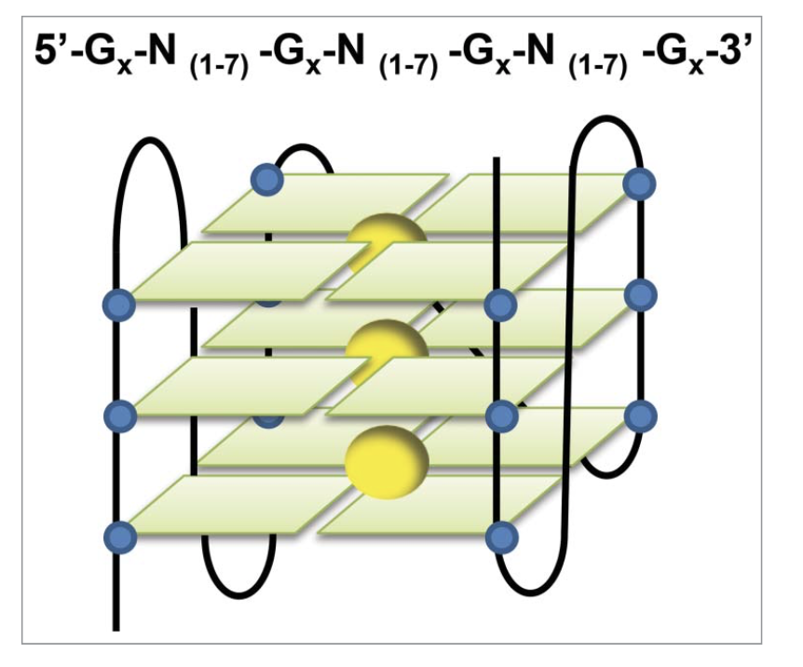
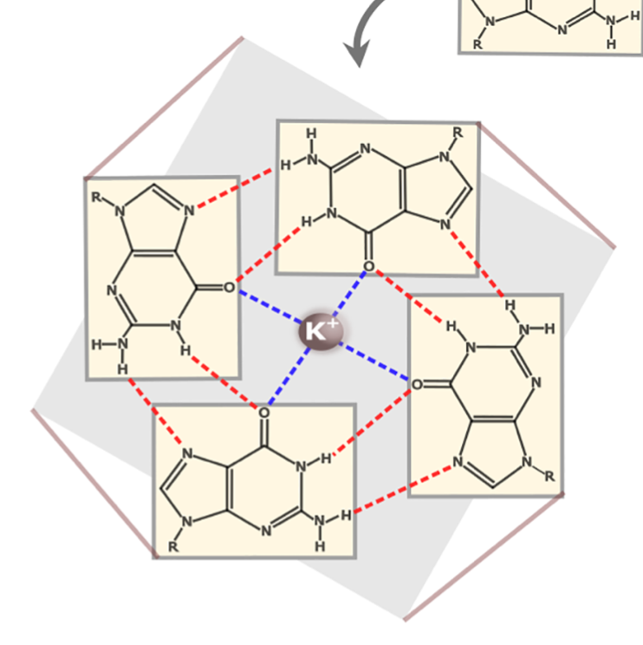
The Intricate Coding of G4s
GxxxG motif is a signature motif of prion proteins and prion-like proteins – two glycines spaced by three wild cards
Glycine (G) DNA code is GGx – two guanine nucleotides followed by any nucleotide
Tryptophan (W) DNA code is UGG
GGGWG is a motif in the human prion protein that repeats many times in the protein
Glycine-glycine-glycine-tryptophan-glycine = GGGWG
Guanine
GGx GGx GGx UGG GGx
G G G W G
G x x x G
Figure 1. Jingwen Song et al. Translation 2016; 4:2, e1244031.
Notes:
Antonis/new_paper//RNA\ G4s\ in\ translation.pdf .

Slide 66
“G-quadruplexes within prion mRNA: the missing link in prion disease?”*
*René CL Olsthoorn. Nucleic Acids Research, 2014; 42(14): 9327-9333.
Protein
RNA
GGGWG motif: four glycines
G-quadruplexes (G4s)

Slide 67
“G-quadruplexes within prion mRNA: the missing link in prion disease?”*
*René CL Olsthoorn. Nucleic Acids Research, 2014; 42(14): 9327-9333.
GxxxG
motif!
G
G
G
G
G
G
G
G
G
G
Protein
RNA
GGGWG motif: four glycines
G-quadruplexes (G4s)

Slide 68
“Does Glyphosate Acting as a Glycine Analogue Contribute To ALS?”*
TAR (transactive response) DNA-binding protein 43 (TDP-43) is a protein that misfolds in association with Amyotrophic Lateral Sclerosis (ALS)
TDP-43 has a long glycine-rich region where there are many mutations in glycines that are linked to familiar ALS
TDP-43 binds to G4s in multiple mRNAs
Fused in Sarcoma (FUS) is another protein linked to ALS
FUS has an RGG/RG domain that binds RNA
*S Seneff et al. Journal of Bioinformatics and Proteomics Review 2016; 2(3): 1-21.

Slide 69
“Does Glyphosate Acting as a Glycine Analogue Contribute To ALS?”*
TAR (transactive response) DNA-binding protein 43 (TDP-43) is a protein that misfolds in association with Amyotrophic Lateral Sclerosis (ALS)
TDP-43 has a long glycine-rich region where there are many mutations in glycines that are linked to familiar ALS
TDP-43 binds to G4s in multiple mRNAs
Fused in Sarcoma (FUS) is another protein linked to ALS
FUS has an RGG/RG domain that binds RNA
Whenever a protein binds RNA, it is binding to phosphate.
Phosphate-binding sites are typically enriched in glycine.
This is a glyphosate-susceptibility motif.
*S Seneff et al. Journal of Bioinformatics and Proteomics Review 2016; 2(3): 1-21.

Slide 70
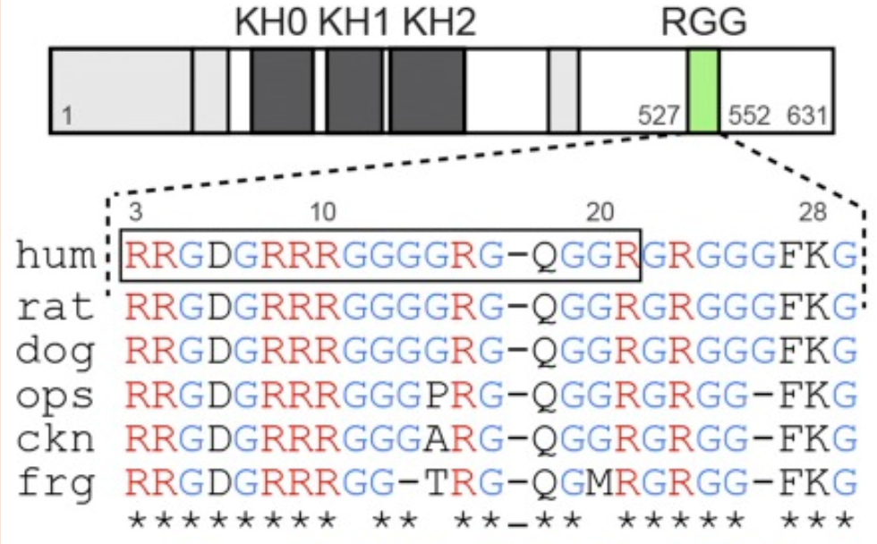
RGG motif of FMRP*
Fragile Mental Retardation Protein
> 10-fold reduction in binding affinity if Gly-11 is not glycine
Gly-11
*Nikita Vasilyeva et al. PNAS 112(39): 2015; E5391-E5400.
Notes:
arginine: AGG and AGA
2022/neurons/RGG_domain_fragile_X_protein_glycine_conserved.pdf
> 10 fold reduction in binding affinity if not glycine.

Slide 71
Glycine-to-glutamate mutation in FMRP causes fragile-X syndrome*
G266E (glycine at residue 266 substituted by glutamate)
Mutated protein was unable to bind to RNA
“Structurally, position 266 likely requires a small, flexible, and nonpolar amino acid, all the characteristics of glycine. Glutamic acid, on the other hand, is large and negatively charged and is predicted to clash sterically and ionically with surrounding amino acids”
Glyphosate, like glutamate, is a bulky negatively charged amino acid
*Joshua A Suhl and Stephen T Warren. J Exper Neurosci 2015: 9(s2): 35-41.

Slide 72
Glycine-to-glutamate mutation in FMRP causes fragile-X syndrome*
G266E (glycine at residue 266 substituted by glutamate)
Mutated protein was unable to bind to RNA
“Structurally, position 266 likely requires a small, flexible, and nonpolar amino acid, all the characteristics of glycine. Glutamic acid, on the other hand, is large and negatively charged and is predicted to clash sterically and ionically with surrounding amino acids”
Glyphosate, like glutamate, is a bulky negatively charged amino acid
About a third of individuals with Fragile X Syndrome have features of autism such as problems with social interactions and delayed speech
*Joshua A Suhl and Stephen T Warren. J Exper Neurosci 2015: 9(s2): 35-41.

Slide 73
The Big Picture (Hypothesis)
Do prion-like proteins play a role in maintaining low deuterium in the cytoplasm??
Hypothesis: These proteins can trap deuterium inside water-inaccessible precipitates
Bold claims:
Misfolded proteins in Alzheimer’s plaque or Lewy bodies are a sign of impaired deuterium homeostasis
Prion diseases begin with stressed immune cells in the gut and spleen
Cells with impaired ability to clear misfolded proteins release them inside exosomes and deliver them to other cells, propagating the disease process
Impaired sulfate homeostasis plays a significant role in the pathology

Slide 74
SARS CoV-2, Deuterium and Glyphosate

Slide 75
The Big Picture
People who suffer from acute symptoms with COVID-19 are immune compromised due to system-wide defective mitochondria
The virus invades the lungs and proliferates there, inducing an inflammatory response
This allows lipids in the viral membranes to be metabolized by lipoxygenase, producing deuterium-depleted water
Sharp upregulation of bradykinin results in a dramatic drop in blood pressure, and infiltration of water and macrophages into the lung alveoli
Massive overproduction of hyaluronan
A hydrogel encasing the hyaluronan fills the alveoli and traps deuterium
The signaling cascade causes myeloid cells from the bone marrow and platelets to infiltrate the lungs and release their mitochondria into the medium, which is rich in deuterium-depleted water
These mitochondria resupply the immune cells, thus revitalizing them

Slide 76
“Pathogenesis of COVID-19 described through the lens of an undersulfated and degraded epithelial and endothelial glycocalyx”*
Sulfation defects potentially play a major role in the pathogenesis of COVID-19
The intact highly sulfated glycocalyx inhibits viral infection
Undersulfated glycocalyx leads to dysregulated immune response and subsequent cytokine storm
Many toxic environmental chemicals disrupt sulfate supply
*Heidi N. du Preez et al. FASEB J. 2022; 36: e22052.
Notes:
2020/book/COVID/glycocalyx_undersulfated_in_severe_COVID19_2021_WOW.pdf
F I G U R E 1 Sulfation pathway in mammalians illustrating the conversion of inorganic sulfate (SO42−) to the activated form sulfonucleotide 3-phosphoadenosine 5-phosphosulfate (PAPS). The enzyme ATP sulfurylase catalyzes the production of adenosine-5- phosphosulfate (APS) from sulfate and ATP, to provide APS as a substrate to APS kinase, which transfers a phosphate group from ATP to APS to yield PAPS. Sodium chlorate is a selective inhibitor of both ATP sulfurylase and PAPS synthetase, which inhibits PAPS synthesis, resulting in profound undersulfated glycosaminoglycans (GAGs) and impaired detoxification. Sulfotransferase enzymes transfer a sulfate group from PAPS to the substrate molecule to form a sulfated product

Slide 77
“Pathogenesis of COVID-19 described through the lens of an undersulfated and degraded epithelial and endothelial glycocalyx”*
Both PAPS synthetase and sulfotransferase bind phosphate at sites that have highly conserved glycine residues:
GxxGxGK motif
Sulfation defects potentially play a major role in the pathogenesis of COVID-19
The intact highly sulfated glycocalyx inhibits viral infection
Undersulfated glycocalyx leads to dysregulated immune response and subsequent cytokine storm
Many toxic environmental chemicals disrupt sulfate supply
*Heidi N. du Preez et al. FASEB J. 2022; 36: e22052.
Notes:
2020/book/COVID/glycocalyx_undersulfated_in_severe_COVID19_2021_WOW.pdf
F I G U R E 1 Sulfation pathway in mammalians illustrating the conversion of inorganic sulfate (SO42−) to the activated form sulfonucleotide 3-phosphoadenosine 5-phosphosulfate (PAPS). The enzyme ATP sulfurylase catalyzes the production of adenosine-5- phosphosulfate (APS) from sulfate and ATP, to provide APS as a substrate to APS kinase, which transfers a phosphate group from ATP to APS to yield PAPS. Sodium chlorate is a selective inhibitor of both ATP sulfurylase and PAPS synthetase, which inhibits PAPS synthesis, resulting in profound undersulfated glycosaminoglycans (GAGs) and impaired detoxification. Sulfotransferase enzymes transfer a sulfate group from PAPS to the substrate molecule to form a sulfated product

Slide 78
“Pathogenesis of COVID-19 described through the lens of an undersulfated and degraded epithelial and endothelial glycocalyx”*
Sulfate maintains gelled water lining the walls of the blood vessels and the gel traps deuterium, leaving the fluid blood plasma depleted in deuterium
Sulfation defects potentially play a major role in the pathogenesis of COVID-19
The intact highly sulfated glycocalyx inhibits viral infection
Undersulfated glycocalyx leads to dysregulated immune response and subsequent cytokine storm
Many toxic environmental chemicals disrupt sulfate supply
*Heidi N. du Preez et al. FASEB J. 2022; 36: e22052.
Notes:
2020/book/COVID/glycocalyx_undersulfated_in_severe_COVID19_2021_WOW.pdf
F I G U R E 1 Sulfation pathway in mammalians illustrating the conversion of inorganic sulfate (SO42−) to the activated form sulfonucleotide 3-phosphoadenosine 5-phosphosulfate (PAPS). The enzyme ATP sulfurylase catalyzes the production of adenosine-5- phosphosulfate (APS) from sulfate and ATP, to provide APS as a substrate to APS kinase, which transfers a phosphate group from ATP to APS to yield PAPS. Sodium chlorate is a selective inhibitor of both ATP sulfurylase and PAPS synthetase, which inhibits PAPS synthesis, resulting in profound undersulfated glycosaminoglycans (GAGs) and impaired detoxification. Sulfotransferase enzymes transfer a sulfate group from PAPS to the substrate molecule to form a sulfated product

Slide 79
Immune System 101
The innate system is actually very powerful if it is healthy
If the innate system can’t clear the virus, the adaptive system gets involved
The adaptive system releases antibodies to help tag and trap the viruses, and inflammatory cytokines which induce release of reactive oxygen species
Figure from https://articles.mercola.com/sites/articles/archive/2020/10/14/herd-immunity-coronavirus.aspx
Notes:
https://articles.mercola.com/sites/articles/archive/2020/10/14/herd-immunity-coronavirus.aspx

Slide 80
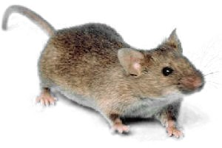
Mouse Study Shows Link Between Mitochondrial Dysfunction and Virus Susceptibility*
Aged mice had dysfunctional T-cells with reduced mitochondrial oxidative phosphorylation
Skew towards Th1 type response, with higher secretion of TNF-α and IFN-γ (inflammatory response)
Aged mice had weakened immune system
Infection with a mouse pox virus caused all the elderly mice to die, but none of the young mice
In humans, "inflammaging" predicts susceptibility to cardiovascular diseases, neurodegeneration, frailty, and multi-morbidity
*Desdín-Micó et al., Science 2020; 368: 1371-1376.
Notes:
JudyMikovits/T-cells_dysfunctional_mitochondria_premature_senescence_2020.pdf

Slide 81
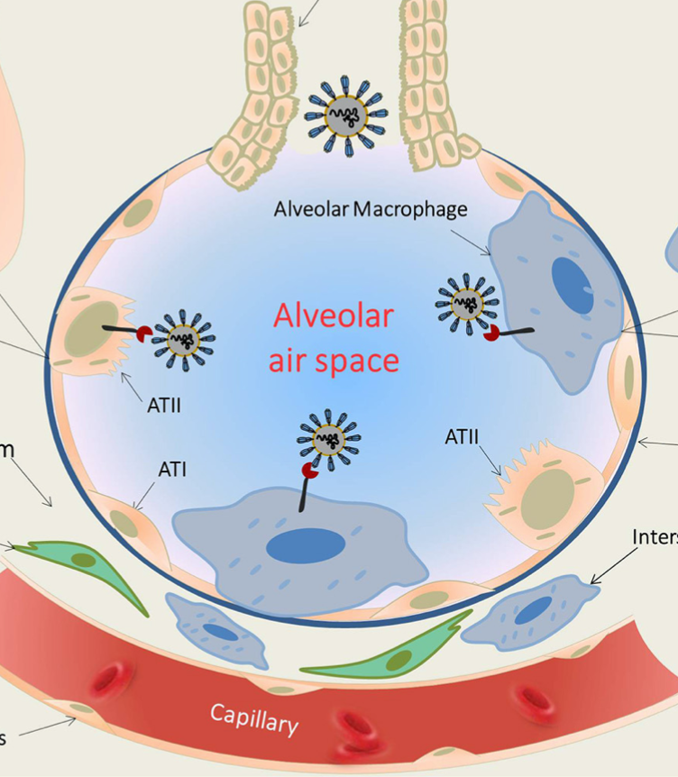
Initial COVID-19 Events
SARS-CoV-2 viruses enter through the bronchioles and infect epithelial cells lining the alveoli
Residential macrophages fail to clear the virus because they are defective
Viruses proliferate wildly
Macrophages send out alarm signals which draw in CD4+ and CD8+ T-cells
Capillary wall becomes leaky to support invasion
Blood pressure drops; fluid begins to fill the alveolar space
Person feels as if they are drowning
macrophages
Infected
Epithelial
cell
*Frank L van de Veerdonk et al. eLife 2020; 9: e5755.
Notes:
lung_macrophage_COVID19_friend_or_foe.pdf
Kallikrein_kinin_blockade_COVID-19_SARS_2020.pdf

Slide 82
Is a Bradykinin Storm Brewing in COVID-19?*
Hypertension is a risk factor for COVID-19, but hypotension develops instead during the disease process
ACE2 receptor is upregulated by 199-fold in the lungs in severe COVID-19 patients, and ACE is downregulated (8-fold)
ACE normally degrades (clears) bradykinin
Bradykinin receptors are upregulated by nearly 3000-fold!
Bradykinin induces vasodilation and hypotension
Inflammatory cytokines induce capillary leakage and inhibit alveolar fluid reabsorption leading to alveolar flooding**
*https://www.the-scientist.com/news-opinion/is-a-bradykinin-storm-brewing-in-covid-19—67876
Michael R Garvin et al. eLife 2020; 9: e59177.
**Andrew M Luks and Erik R Swenson. Ann Am Thorac Soc 2020 Apr 24 [Epub ahead of print]
Notes:
https://www.the-scientist.com/news-opinion/is-a-bradykinin-storm-brewing-in-covid-19--67876
Also:
COVID-19 Lung Injury and High Altitude Pulmonary Edema: A False Equation with Dangerous Implications

Slide 83
Bradykinin-induced hyperpermeability of the lung capillaries causes formation of hyaluronic-acid hydrogel that inhibits gas exchange*
*Michael R Garvin et al. eLife 2020; 9: e59177.
Notes:
COVID/SARS_CoV_2_bradykinin_model_supercomputer_deuterium_link_WOW.pdf

Slide 84
SARS CoV-2 causes massive overproduction of hyaluronic acid in the lungs*
"Hyaluronic acid can trap roughly 1000 times its weight in water and when bound to water the resulting hydrogel obtains a stiff viscous quality similar to ‘Jello’ ”
Multiple enzymes that synthesize hyaluronic acid are massively upregulated in COVID-19 lungs: HAS1 (9,113-fold), HAS2 (493-fold), and HAS3 (32-fold)
Excess hyaluronic acid is associated with pulmonary thrombosis, ground glass opacities, and acute respiratory distress syndrome
“Hyaluronic acid in the bronchoalveolar space of the lungs could form a viscous hydrogel that would negatively impact gas exchange”
*Michael R Garvin et al. eLife 2020; 9: e59177.
Notes:
COVID/SARS_CoV_2_bradykinin_model_supercomputer_deuterium_link_WOW.pdf

Slide 85
How the Viral Response Attempts to Repair the Deuterium Problem - Hypothesis
Virus contains lipids such as linoleic acid in its membrane (stolen from host cell)
Inflammatory response due to weak innate immunity causes release of lipoxygenase
Lipoxygenase extracts protons from lipids in viral membrane and converts oxygen into deuterium depleted water (DDW)
Produced leukotrienes are powerful signaling molecules which induce further reaction
Arterioles constrict access to capillary
Venules open up leaks
Macrophages and T-cells “drink the sweet nectar” – and supply their mitochondria with much-needed deuterium depleted water ??
This empowers them to clear the virus
Lipoxygenase has a fantastic ability to select hydrogen over deuterium despite not being a flavoprotein*
*
*
DDW
*
*
*
*
*
macrophage
virus
*Pengfei Li et al. J Phys Chem Lett 2018; 9(22): 6444-6449.
Notes:
Where?

Slide 86
Virus traps linoleic acid in its membrane which then gets oxidized by lipoxygenase to make DDW
Linoleic acid fits perfectly in three binding pockets of SARS CoV-2 membrane S glycoprotein*
Patients with severe COVID-19 show reduced levels of fatty acids**
*Christine Toelzer et al. Science Sept 21 2020 [Epub ahead of print]
**Bo Shen et al. Cell 2020; 182: 59-72.
Notes:
COVID/SARS_CoV_2_binds_linoleic_acid_holy_sh1t.pdf
COVID/proteomics_and_lipidomic_characteristics_of_COVID_patients_reduced_fatty_acids.pdf

Slide 87
Viruses are stabilized by excess deuterium!
The nucleocapsid protein in SARS-CoV-2 starts to unfold at 35 degrees Centigrade (95 degrees Fahrenheit) and is completely denatured at 55 degrees Centigrade (131 degrees Fahrenheit)*
A fever is a natural defense against the virus
Viruses take up deuterium and trap it in their protein coat and in their internal single strand of RNA**
Deuterium stabilizes the viral protein and protects from temperature denaturation
The virus removes deuterium from the body fluids
When the deuterium level in the body fluids is high, the virus becomes more stable
*Milan Surjit and Sunil K Lal. Infection, Genetics and Evolution 8 (2008) 397-405.
**Jiangsen MAO et al., Chinese Science Bulletin 2004 Vol. 49 No. 3 253-257.
Notes:
COVID/hydrogen_deuterium_exchange_in_viral_particles.pdf
COVD/SARS_CoV_capsid_protein_properties_2008.pdf

Slide 88
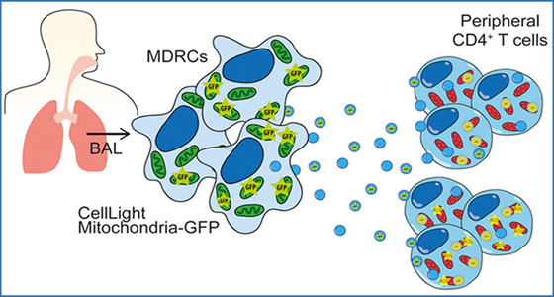
“Exosomal transfer of mitochondria from airway myeloid-derived regulatory cells to T cells”*
(BAL – bronchioalveolar lavage)
Myeloid-derived regulatory cells (MDRCs) are cells that emerge from the bone marrow and infiltrate inflammatory sites, e.g., in asthma
MDRCs in the airways transfer mitochondria to T cells via exosomes
These mitochondria have been shown to be functional in the recipient cell
Hypothesis: Immune cells (e.g., T cells, macrophages, dendritic cells, …) can sweep up DDW and mitochondria via macropinocytosis
Intercellular communication is essential for resolving inflammation
*Kenneth P. Hough et al. Redox Biol 2018; 18: 54-64.
Notes:
miRNA/exosomal_transfer_of_mitochondria_in_lung_disease_2018.pdf
DEFINE EXOSOMES HERE!!

Slide 89
“Coronavirus (Covid‐19) sepsis: revisiting mitochondrial dysfunction in pathogenesis, aging, inflammation, and mortality”*
Dysregulated host response to an infection leads to sepsis
Destructive downstream effects manifested as profound persistent hypoxia, profuse blood clots and lactic acidosis
Multiple organ failure – high mortality risk
Elderly disproportionately suffer from impaired mitochondrial function
Depleted glutathione weakens antioxidant defenses
Damaged mitochondria release their DNA which upregulates HIF-1α
Depleted NAD+ supplies impede recovery phase
*Santosh Shenoy. Inflamm Res 2020 Aug 7: 1-9.
Notes:
COVID/COVID19_mitochondrial_dysfunction_sepsis_2020.pdf

Slide 90
Heme Oxygenase 1 (HO-1) and COVID-19*
Some cases of COVID-19 cascade into a hyper-inflammatory state leading to thrombosis and multiple organ failure
HIF-1α upregulates HO-1 which normally tames the inflammation
For every molecule of heme that HO-1 converts to biliverdin, it produces three molecules of deuterium depleted water (DDW) from oxygen and NADPH
Glyphosate substitution for a critical glycine residue in HO-1 would convert it to a pro-inflammatory enzyme**
Fails to metabolize heme to bilirubin and biliverdin (doesn’t produce DDW)
Releases ferryl iron (Fe⁺⁴) that reacts with ROS to damage the vascular wall
Positive feedback loop is highly destructive
*J Greil et al. Haematologica 2016; 101:e437; Y Liu et al. JBC 2000; 275(44): 34501-34507
**S Seneff. Glyphosate, Deuterium and COVID-19. Masters of Health. https://joom.ag/xC0C

Slide 91
Recapitulation
Innate immune system in the lungs is impaired due to chronic exposure to glyphosate (and other toxic chemicals)
Macrophages can’t trap and clear viruses due to defective mitochondria
Viruses proliferate and cause a strong reaction from the adaptive immune system
Inflammatory response leads to complex cascade causing a cytokine storm, eventually damaging the systemic circulatory system
Heme oxygenase is upregulated and would normally tame inflammation, but glyphosate turns it into a rogue version of itself
This planned response has a goal of temporarily shutting down the mitochondria so that they can be supplied with deuterium depleted water obtained through direct assistance of the viruses
It backfires when many of the proteins are disrupted by glyphosate

Slide 92
Healthy Lifestyle

Slide 93
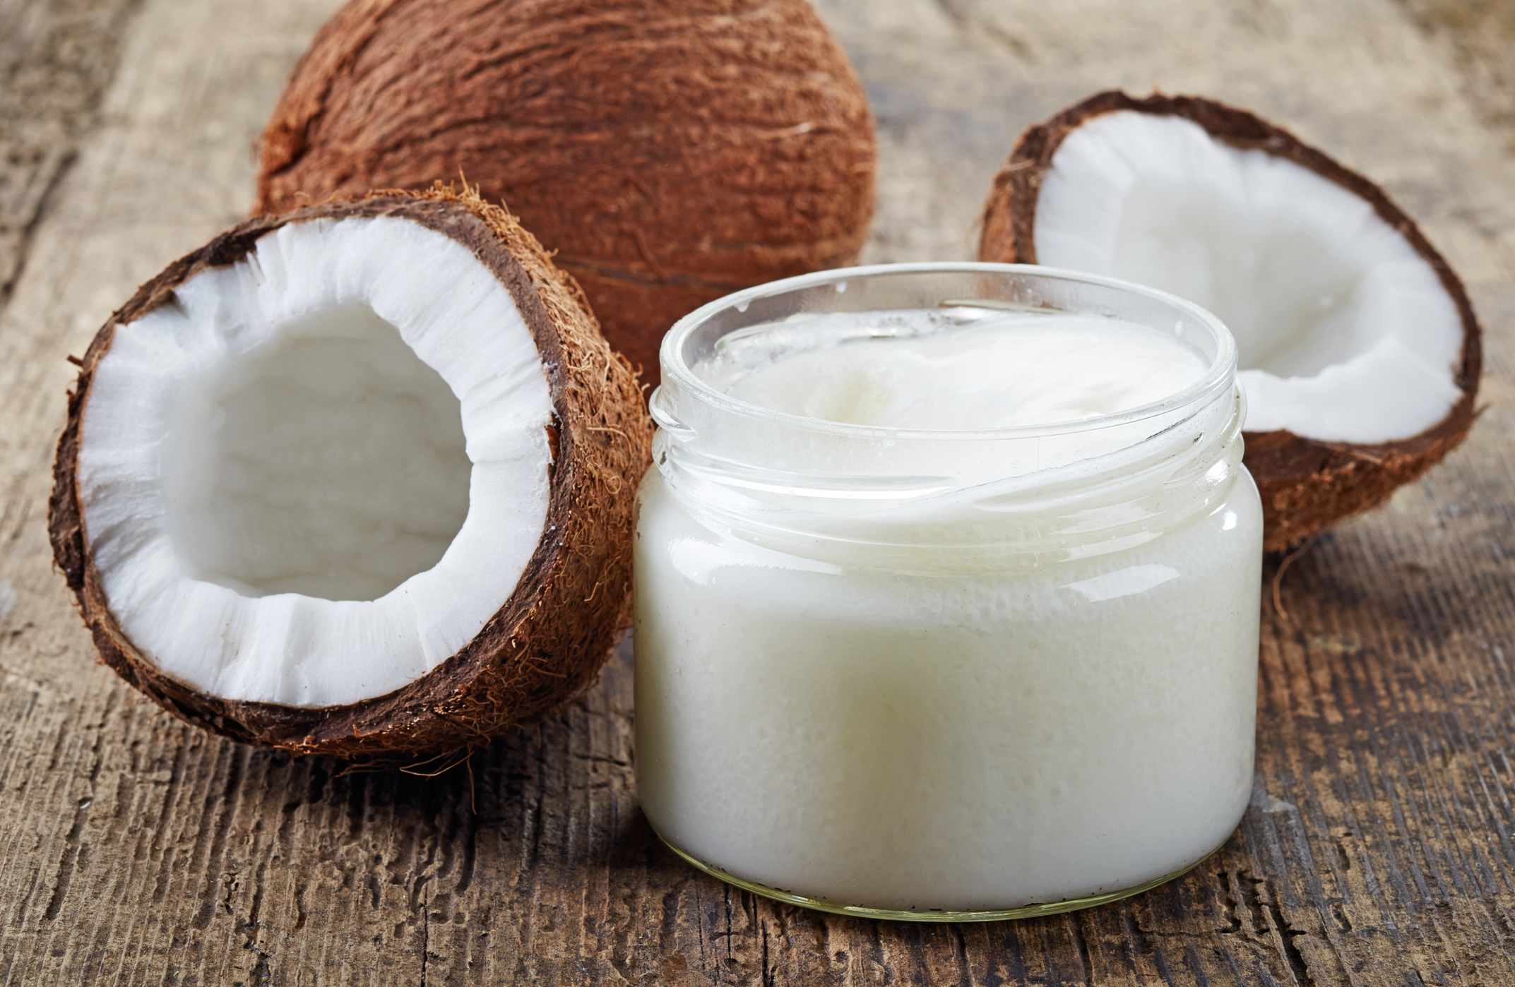
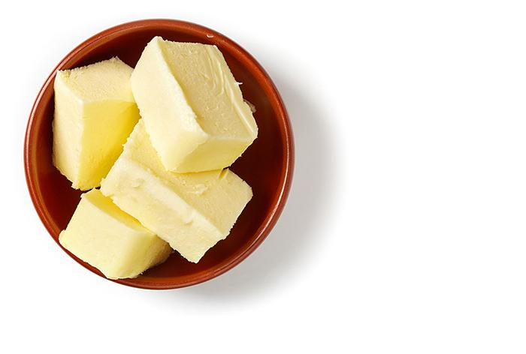
A High-Fat Diet is a Low-Deuterium Diet
Butter, lard and coconut oil were among the foods with the lowest detected levels of deuterium among foods tested
The synthesis of fats involves transfer of hydrogen from NADPH into the growing fatty acid chain

Slide 94
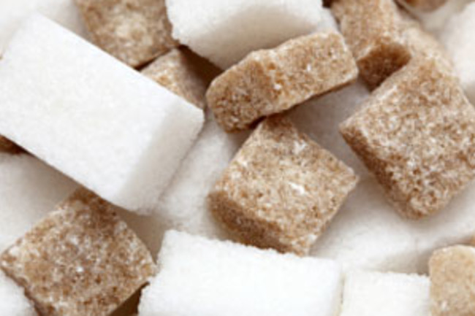
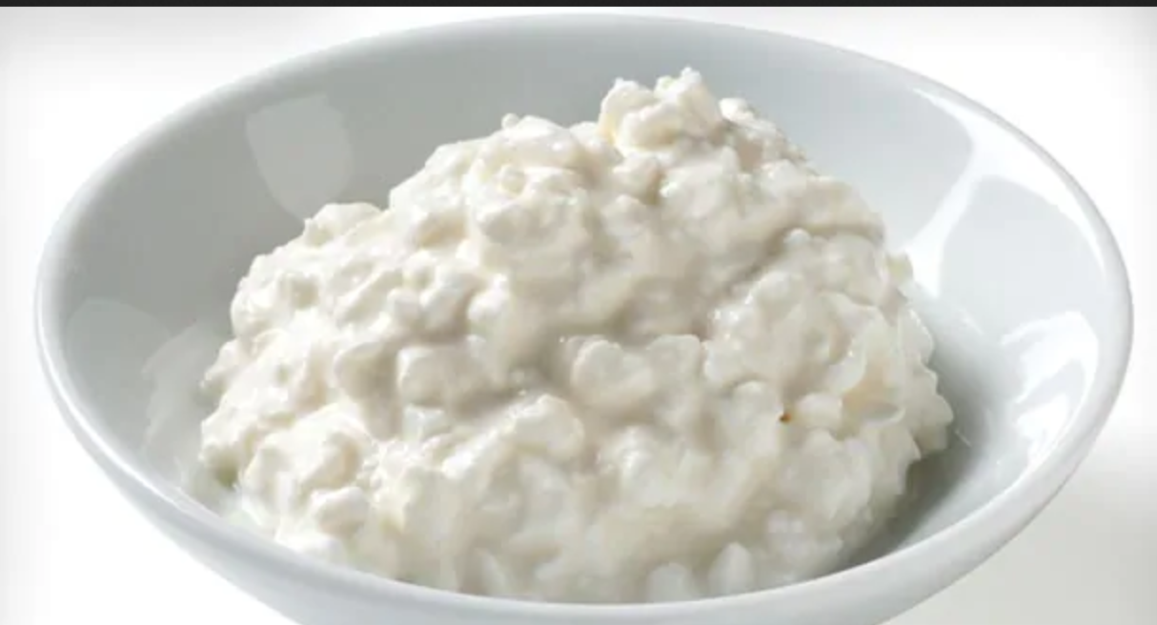
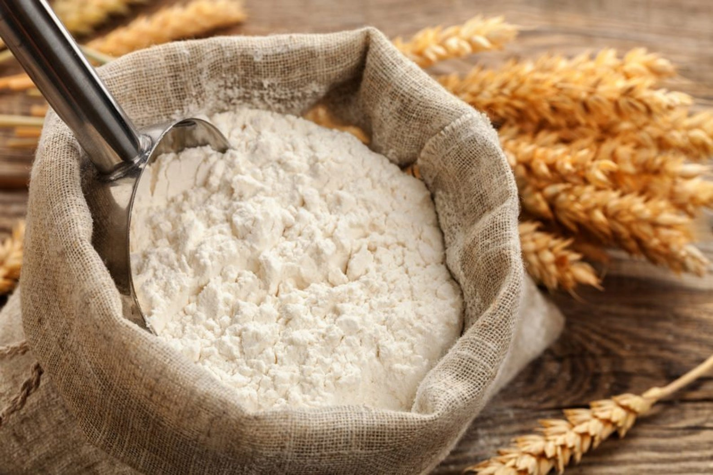
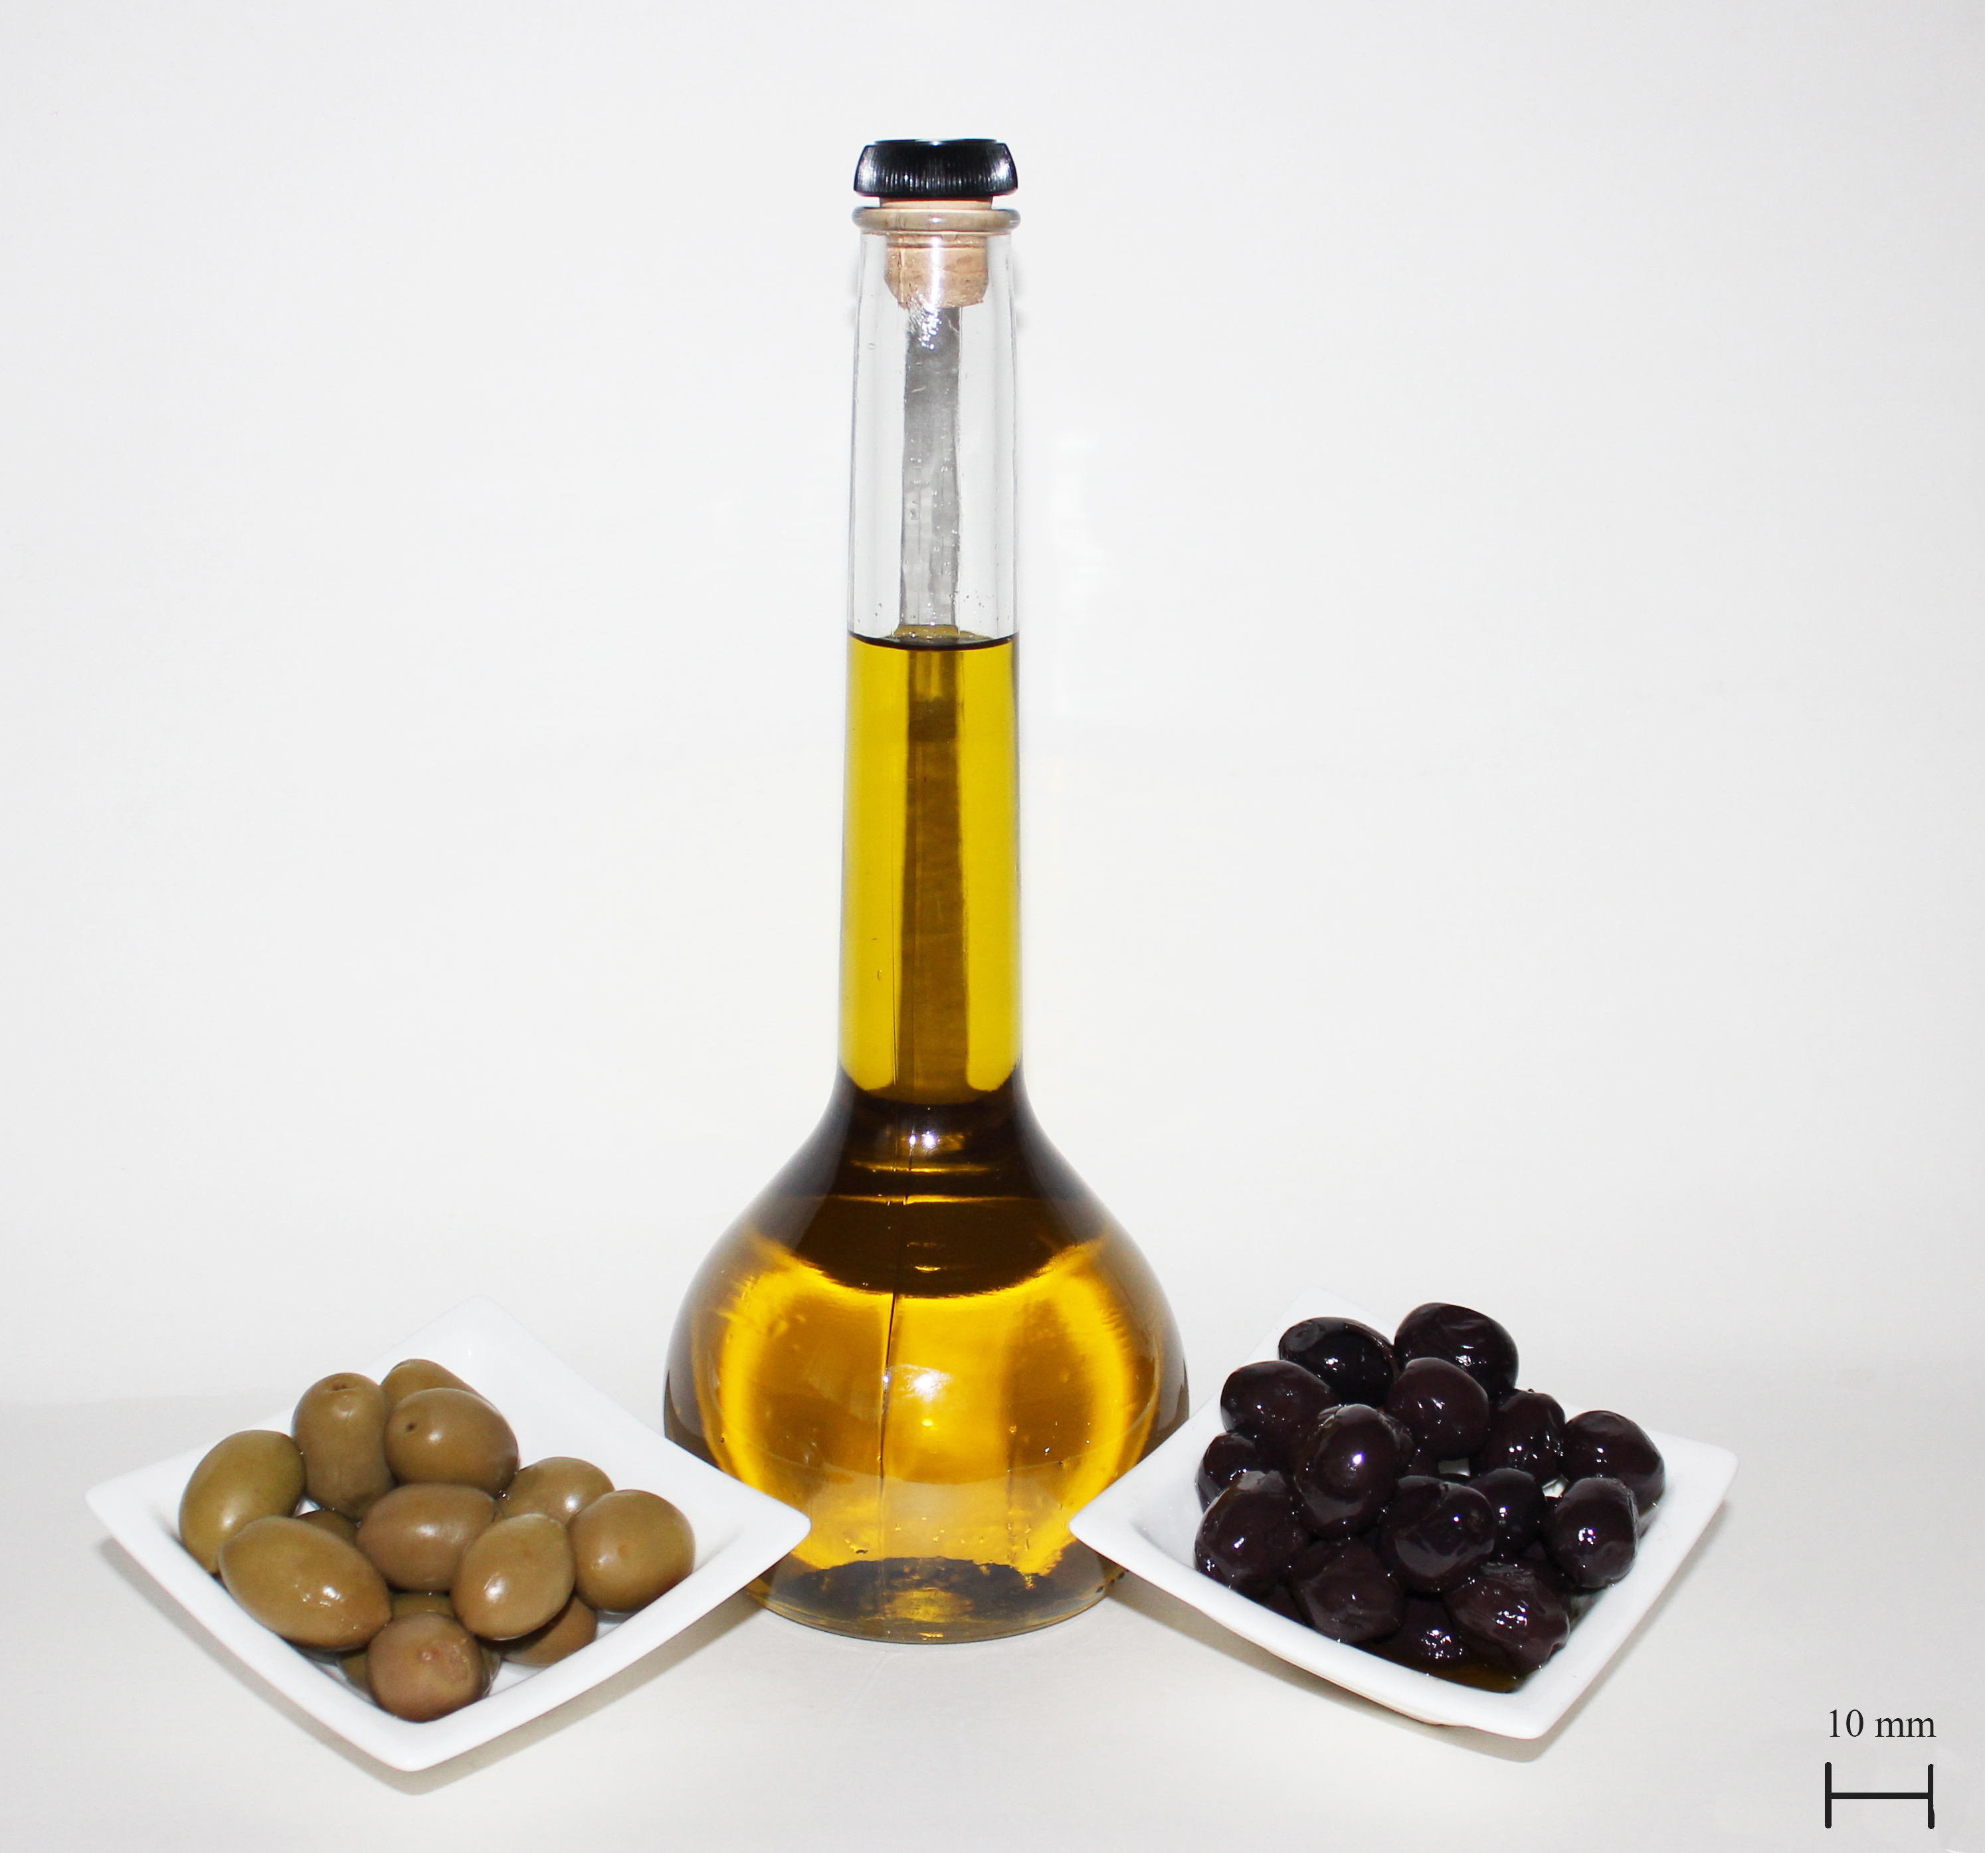
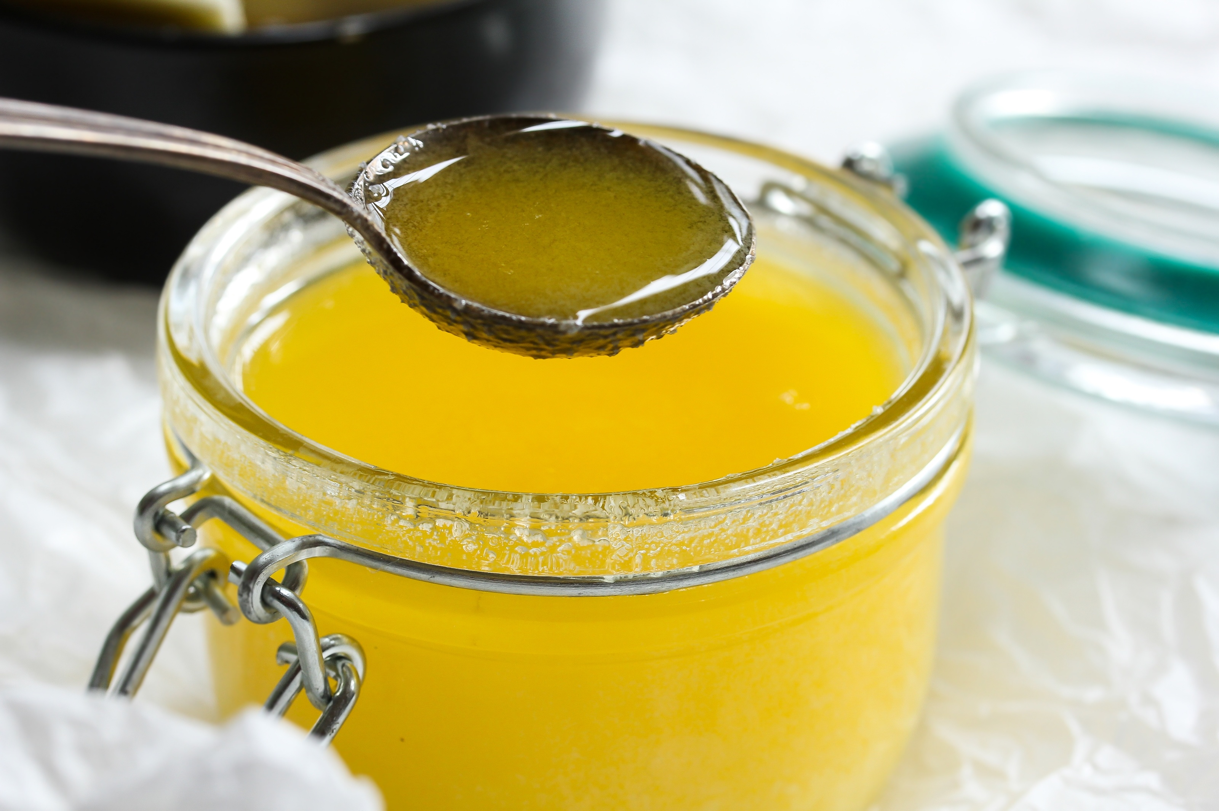
Amounts of Deuterium in Various Foods
Sugar: 146 ppm
Cottage Cheese: 136 ppm
Flour: 150 ppm
Olive Oil: 130 ppm
Coconut Oil: 110 ppm
Butter: 124 ppm
Ghee: 112 ppm

Slide 95
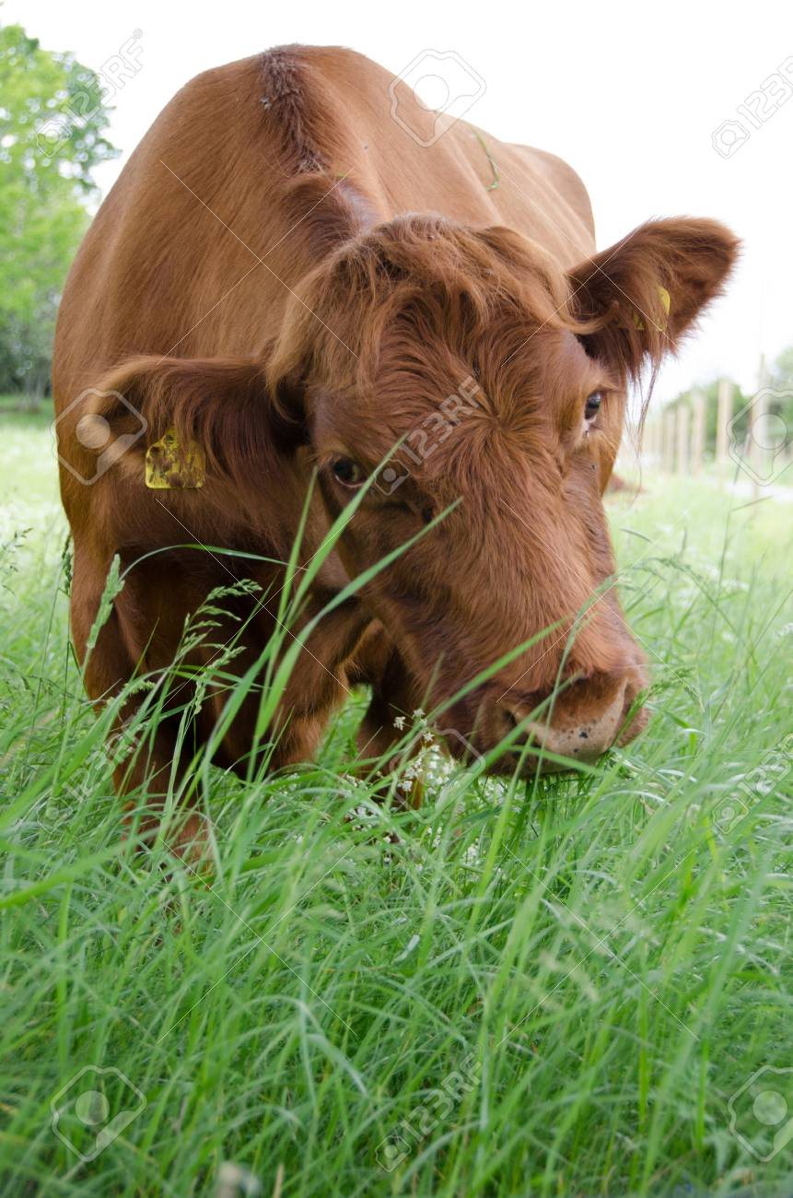
Deuterium in Foods and Mast-Cell Activation Syndrome*
Mast cells release histamines during an allergic reaction
Deuterium increases histamine release from mast cells
Plants get rid of deuterium by storing it in sugar and starch
Fruits, root vegetables (potato) and grains are high in deuterium
Meats from grain-fed animals are high in deuterium
Leafy green vegetables, animal fats (lard, tallow, butter) and plant fats (avocado, coconut, olive oil) are low in deuterium
Grass-fed beef and the dairy products derived from pastured cows are excellent sources of low-deuterium fat
*https://healinghistamine.com/deuterium-histamine-intolerance/

Slide 96
Waterfalls are Therapeutic!*
Waterfalls produce inhalable, negatively charged nano-water particles known as “Lenard ions” or ballo-electric ions
These particles are likely to be deuterium depleted
“Conclusions: Our study provides new data, which strongly support an “added value” of exposure to waterfall microclimate when combined with a therapeutic sojourn at high altitude including regular physical activity.”
Ocean waves probably have a similar effect
*C Grafetstätter et al. Physiol Anthropol. 2017; 36: 10.
Notes:
waterfalls_are_therapeutic.pdf

Slide 97
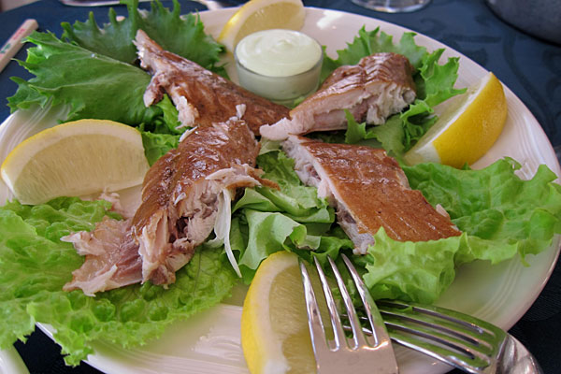
"Life expectancy in Iceland among the highest in Europe, infant mortality rate is lowest”*
"In 2015 the infant mortality rate in Iceland was 1.9 per 1,000 live births”
“The average in the European Union is 4.0, while the US has an infant mortality rate of 5.87"
Smoked puffin
black sand beach of town Vík í Mýrdal in Iceland.
Sólheimajökull Glacier
*https://icelandmag.is/article/life-expectancy-iceland-among-highest-europe-infant-mortality-rate-lowest

Slide 98
“The Jungle Effect: Healthiest Diets from Around the World” by Daphne Miller, MD
Iceland was one of the places she studied
Diet consists of fish, sheep, seabirds, potatoes, and other simple vegetables
Iceland also has glacier water which is low in deuterium, and basalt which is high in sulfur (maintain sulfate levels)
Many sulfur hot springs with therapeutic benefit
After a major eruption in the 1800’s, many islanders moved to northern Canada
They lost their health benefits

Slide 99
Many Nutrients Contribute to Mitochondrial Function*
Complex I
Complex III
Complex IV
Complex V
B1 = thiamine
B2 = riboflavin
B3 = niacin
B12 = cobalamin
*E. Wesselink et al. Clinical Nutrition 2019; 38: 982e995.
Notes:
TruthAboutHealth/nutrition_for_mitochondria_after_severe_disease.pdf
B2 riboflavin
B7 biotin
B1 thiamine
B5 pantothenic acid
B3 niacin

Slide 100
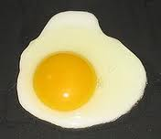
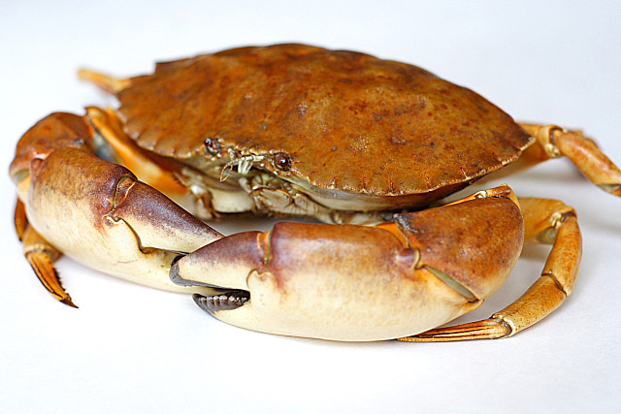
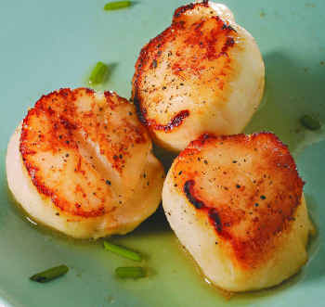
Eat Foods Containing Sulfur
Notes:
http://healthyeatingclub.com/info/books-phds/books/foodfacts/html/data/data5g.html

Slide 101
Supplemental Sources of Sulfur*
glucosamine sulfate
chondroitin sulfate
glutathione
N-acetylcysteine
alpha lipoic acid
taurine
DMSO, MSM
S-adenosylmethionine (SAMe)
Epsom salts (Mg-sulfate)
These can have many beneficial effects and are nearly nontoxic
My personal favorite is Epsom salt baths:
Magnesium sulfate uptake through the skin
*S Parcell, Alternative Medicine Review 7(1), 2002, 22-44
Notes:
./sulfur_in_human_nutrition_review.pdf

Slide 102
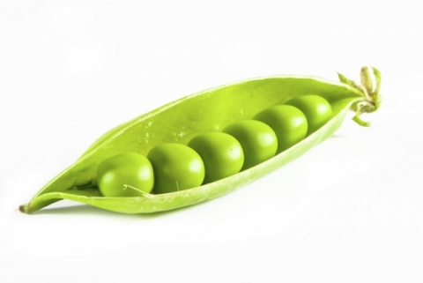
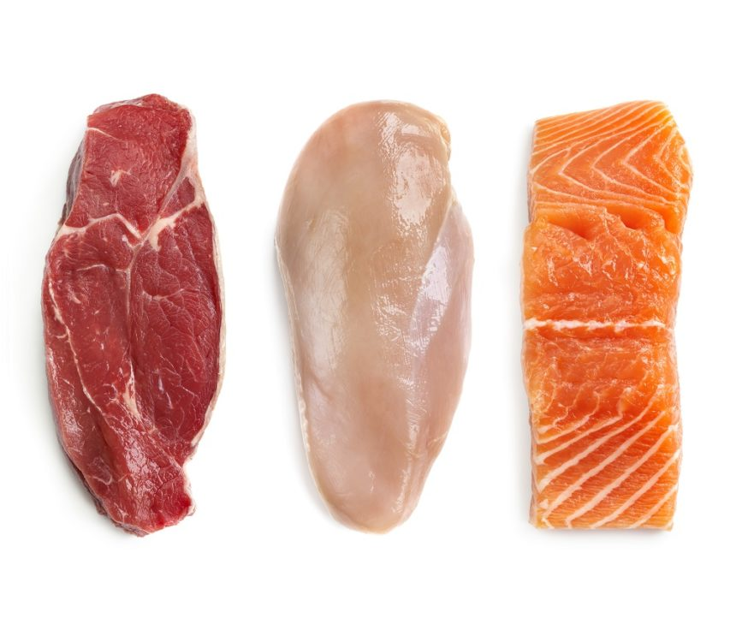
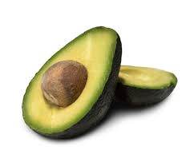
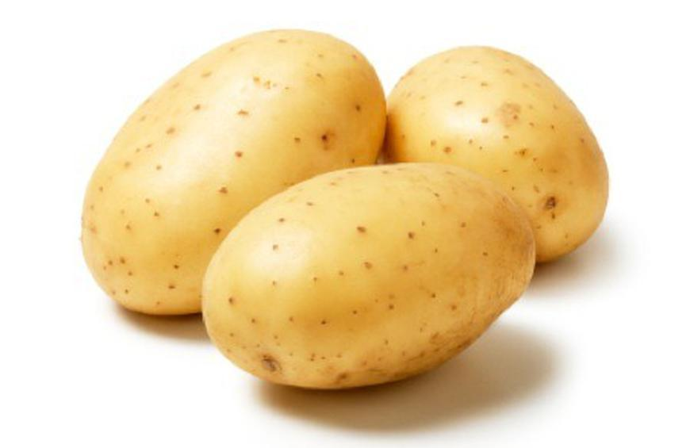
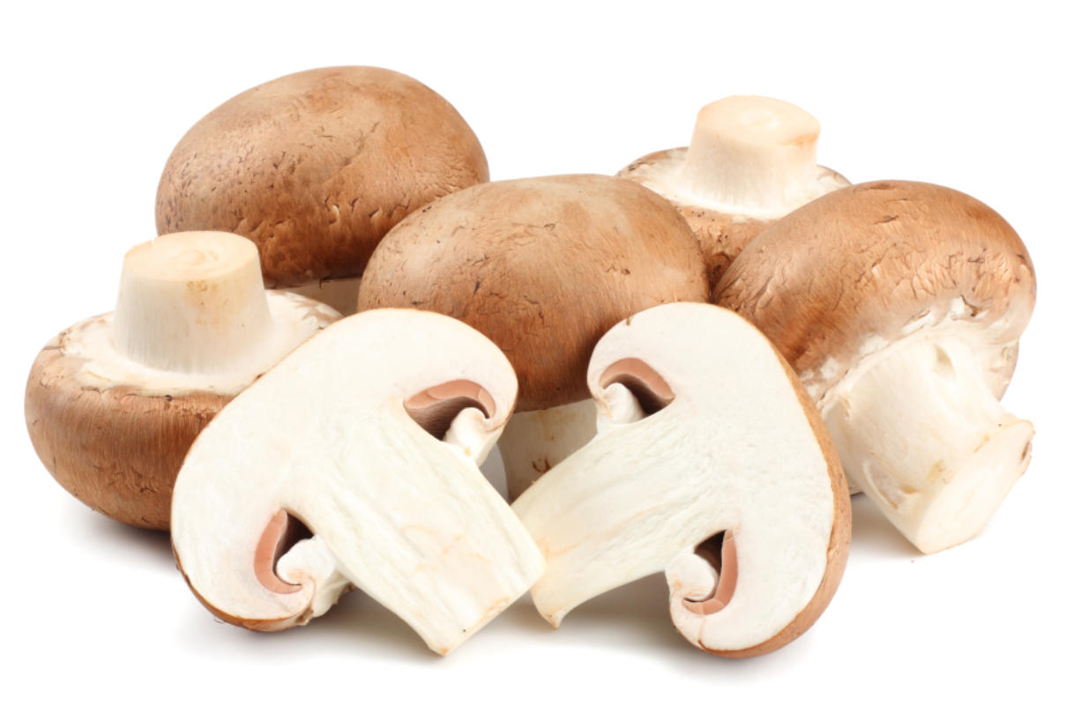
Foods High in Niacin → NAD(P)(H)
Many foods are rich in niacin, especially animal products like meat, fish and poultry.
Vegetarian sources include avocado, peanuts, whole grains, mushrooms, green peas and potatoes.

Slide 103
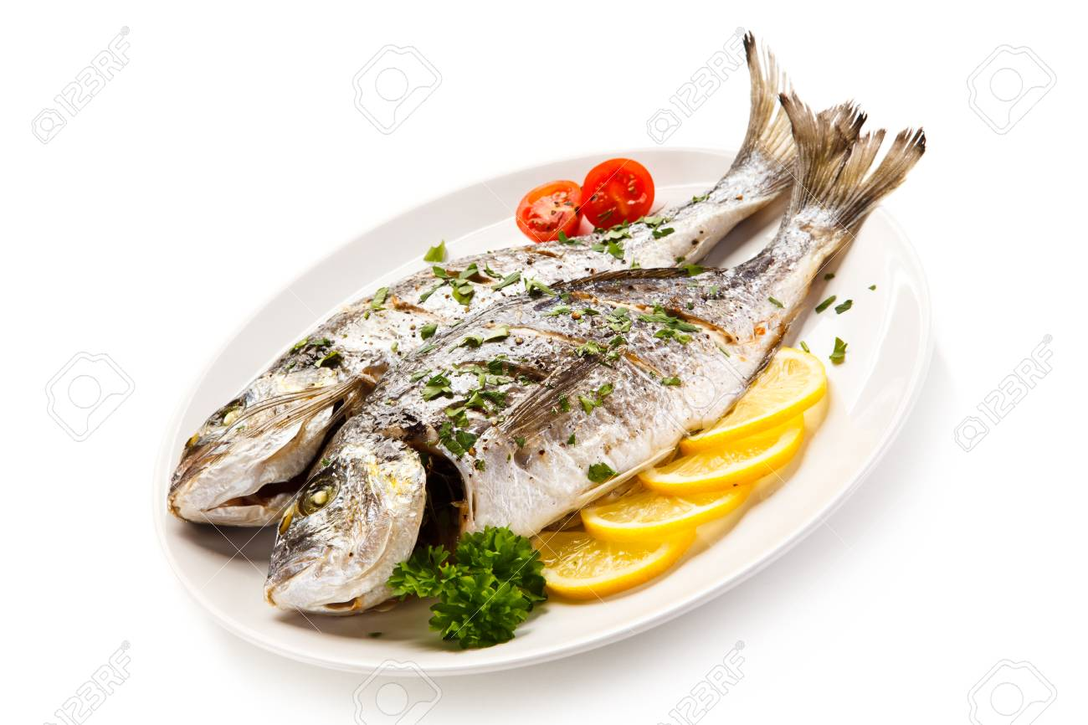
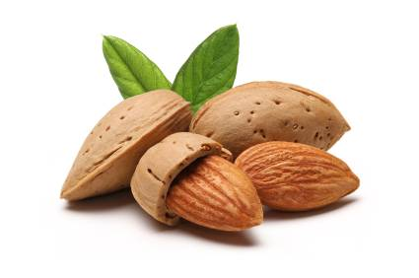
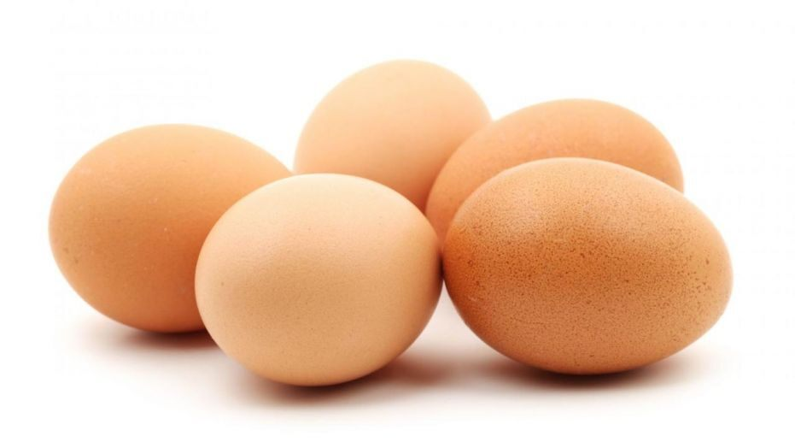
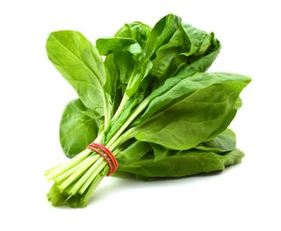
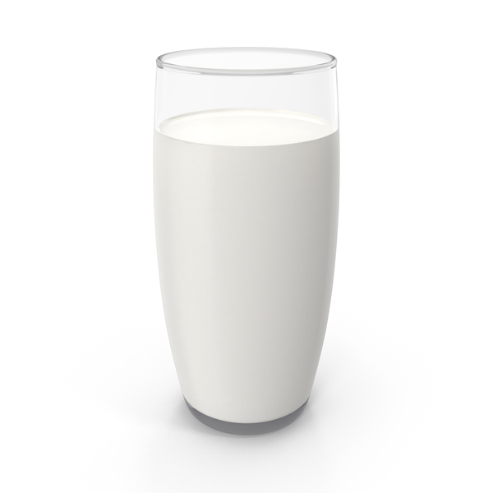
Riboflavin: Source for FAD in Flavoproteins
Foods high in riboflavin include beef, tofu, milk, fish, mushrooms, pork, spinach, almonds, avocados, and eggs

Slide 104
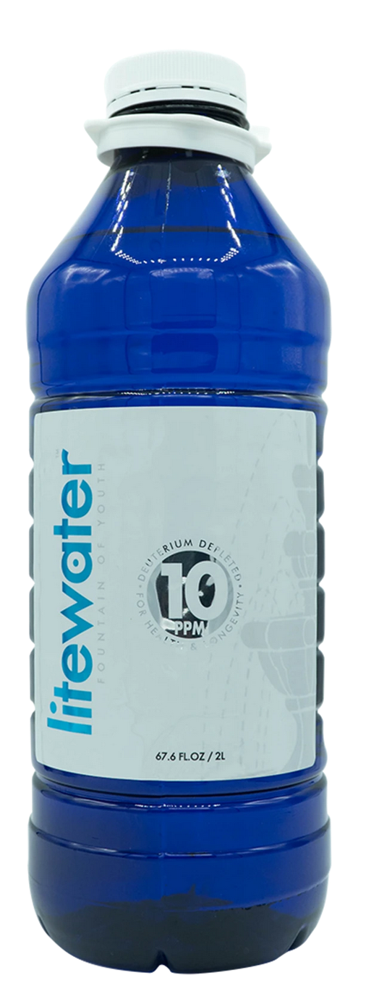
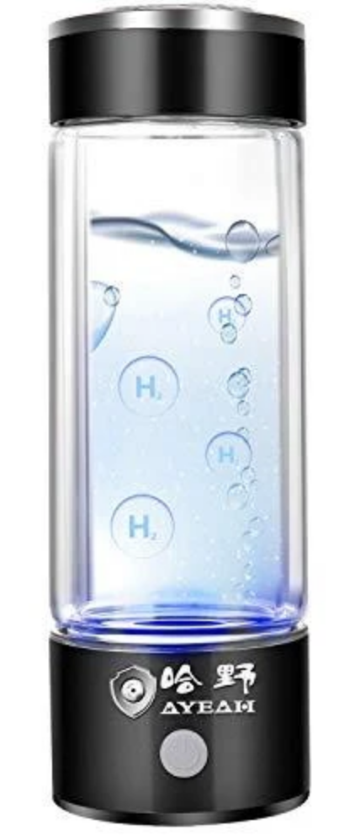
DDW, Glacier Water and Hydrogen Water

Slide 105
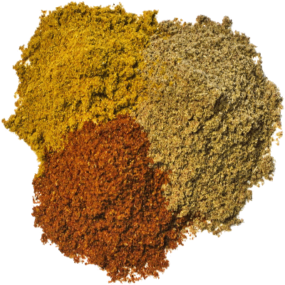
Flavonoids and Polyphenols!

Slide 106
Go Organic!

Slide 107
Summary
Deuterium is pervasive in the environment, and it is very damaging to the ATPase motors in the mitochondria
Biological organisms have devised sophisticated mechanisms to deal with it
A class of enzymes called flavoproteins have amazing skills to select hydrogen over deuterium in their product
These enzymes are disrupted by glyphosate
Heparan sulfate proteoglycans play an essential role in supplying protons to mitochondria by trapping deuterium in the extracellular matrix
Prion misfolding diseases are likely caused by an inability to maintain low deuterium in the organelles
SARS-CoV-2 induces a reaction in the lungs that supports renewal of mitochondrial health to the immune cells
Glacier water, foods rich in niacin and riboflavin, healthy fats and an organic diet all help protect from deuterium toxicity

