Slide 1
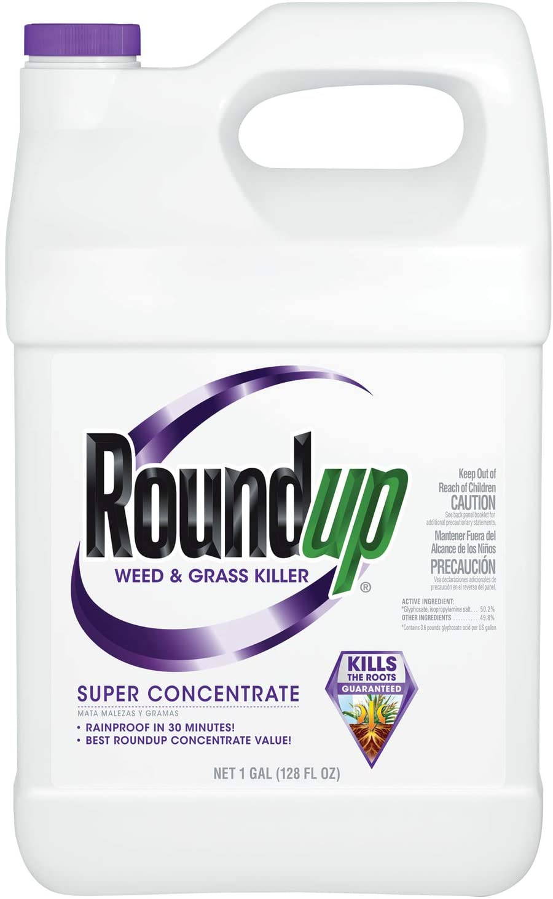

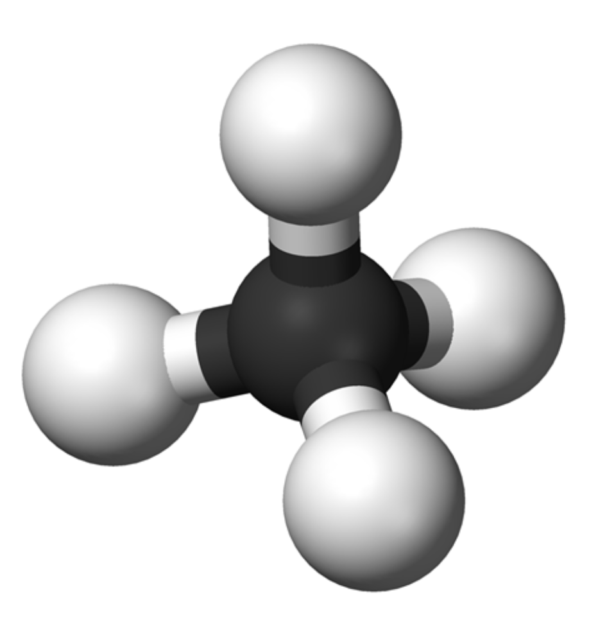
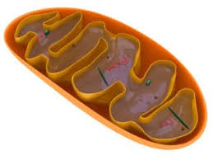
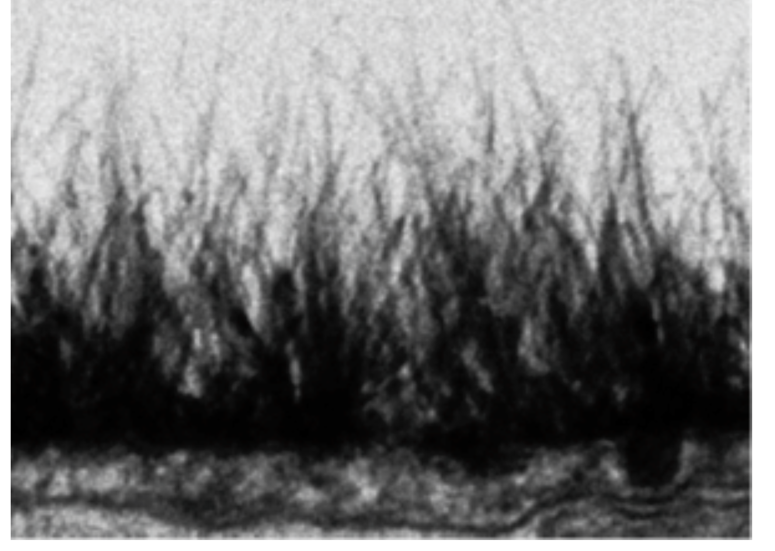
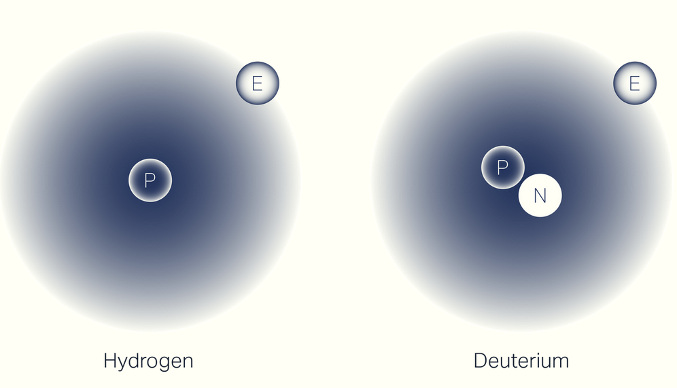
Deutenomics:
A Revolution Unfolding in Biology and Medicine
Stephanie Seneff
MIT CSAIL
Real Truth About Health Conference
Tuesday, April 9, 2024
April 9, 2024
Notes:
March 2024:
Started with Klinghart/Klinghardt_Feb.pptx
--> Seneff_Truth_2024.pptx
Combined it with Truth_2024.pptx add Quanta_2024.pptx
**************************************
See also: csail/2023/csail/ThursdayTalk_Nov.pptx
This started as the October 21 talk that I am giving to Meeting of the Minds:
2023/October/MeetingOfMinds_Oct21.pptx
**********************************
2023/TruthAboutHealth/Jerusalem2.pptx, Jerusalem_slides.pptx
https://www.bitchute.com/video/mcQzg9UfNiQm/
Dr. Stephanie Seneff: Glyphosate, Deuterium, Covid-19 and Mitochondrial Disease

Slide 2


Slide 3
Outline
Introduction
Gut Microbes Supply Deuterium-depleted Nutrients to the Host
Glyphosate Suppresses Dehydrogenases
Disrupted Glycolysis Leads to Fatty Liver Disease and Hyperlipidemia
Methionine Deficiency and Methylation Pathways
Glyphosate Damages Mitochondria
Collagen, Proline and Deuterium
Healthy Lifestyle
Summary

Slide 4
Introduction

Slide 5
A Personal Time Line
2007-2012 – Autism
  Autism is a complex developmental disorder associated with gut dysbiosis and defective methylation and sulfation pathways. Autism rates are alarmingly on the rise in the United States over the past two decades.
2012-2019 – Glyphosate
  Glyphosate is a pervasive herbicide in our food supply. Autism rates in the US have risen exactly in step with glyphosate usage on core crops. Glyphosate disrupts the gut microbiome and methylation and sulfation pathways.
2020-2023 – Deuterium
  Deuterium is a natural heavy isotope of hydrogen. Deuterium is highly damaging to the mitochondria, which produce ATP as an energy source for the cell. Organisms have developed sophisticated strategies to keep deuterium levels low in the mitochondria. These strategies depend critically on gut microbes and sulfation and methylation pathways.

Slide 6
The Big Picture
Deuterium is a natural heavy isotope of hydrogen
  It is present in the blood at 5x the concentration of calcium
Deuterium breaks the ATPase pumps in the mitochondria, causing energy loss and generating reactive oxygen species (ROS)
Nicotinamide Adenine Dinucleotide (NAD) is a major carrier of deuterium-depleted (“deupleted”) hydrogen (as NADH)
Methylation pathways preserve low-deuterium methyl groups
Glyphosate suppresses many proteins involved in deuterium homeostasis

Slide 7

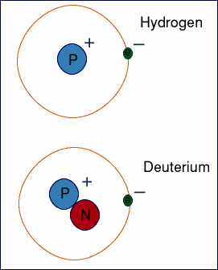
Deuterium = “Heavy” Hydrogen
Hydrogen has one proton and one electron
Deuterium has one proton, one electron and one neutron
  ~ Twice as heavy as hydrogen
  Present in ocean water at 155.8 ppm
  Has distinct physical and chemical properties compared to hydrogen
  Fats are low in deuterium compared to other foods
Deuterium management in the body involves trapping deuterium in collagen matrices and invoking specialized enzymes that choose hydrogen over deuterium for their reaction in order to fuel the mitochondria with hydrogen rather than deuterium

Slide 8

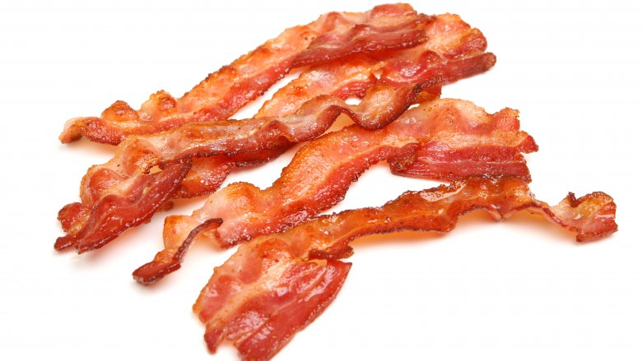
Ketogenic Diet and DDW: Health Benefits*
Deuterium depleted water (DDW) is essential for mitochondria to function properly
People whose water supply is naturally depleted in deuterium are healthier
Deuterium depletion maintains strong hydrogen bond networks in DNA (keeps it stable)
DDW inhibits tumor progression
A ketogenic diet is a deupleted diet
Glacial water is naturally depleted in deuterium because ice traps deuterium
*Laszlo G Boros et al. Medical Hypotheses 2016; 87: 69-74.
Notes:
Chemistry/Laszlo_Boros_Med_Hyp_deuterium_depleting_water_2016.pdf

Slide 9
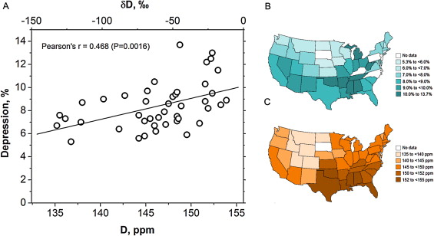
Deuterium in Water and Depression*
Prevalence of Depression
Deuterium levels in tap water
*Tatyana Strekalova et al. Behavioural Brain Research 277 (2015) 237–244.
Notes:
2020/GregNigh/deuterium_depression_US_water_2015.pdf
Fig. 1. Depression rates and deuterium content of tap water. (A) Correlation between reported rates of major depressive disorder in US states and content of deuterium in tap water in the USA. (B) The reported prevalence of individuals with depression in among adults aged ≥18 years in each US state [Centers for Disease Control and Prevention. Mental illness surveillance among adults in the United States. MMWR 2011;60 (Suppl):1–30]. (C) Geographical distribution of average deuterium content in the tap water in the continental USA from samples collected from each state for 2004–2013.

Slide 10
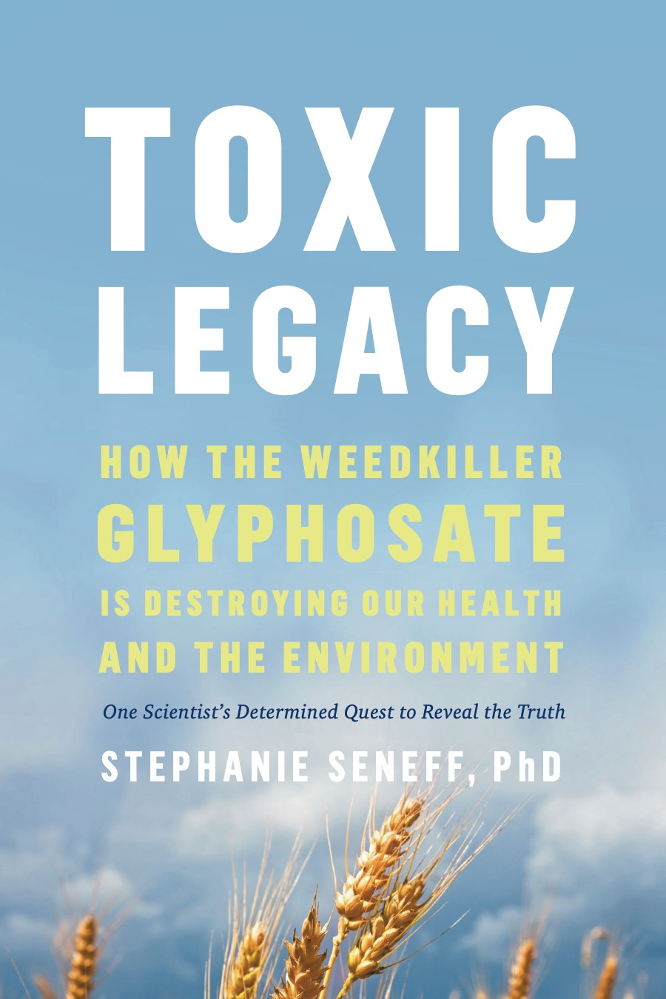
My Book on Glyphosate
Released by Chelsea Green in July 2021
Presents extensive data on glyphosate toxicity to animals and humans
Shows how glyphosate interferes with sulfate homeostasis
Argues that glyphosate is insidiously, cumulatively toxic through its diabolical insertion into proteins by mistake in place of the coding amino acid glycine
  This unique feature explains why it is causal in so many diseases
This book was selected by Kirkus Reviews as one of the top 100 non-fiction books of 2021

Slide 11
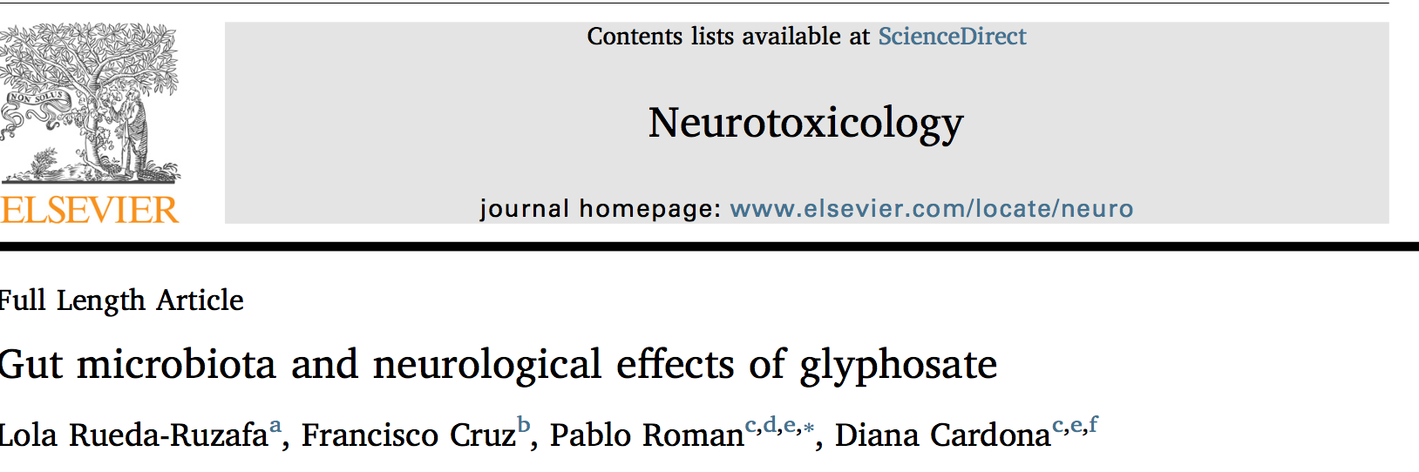
Neurotoxicology 2019; 75:1-8.
“In this work, we state a possible link between Gly[phosate]-induced dysbiosis and cognitive and motor aggravations in neurodegenerative and neurodevelopmental pathologies, such as autism spectrum disorder (ASD). Hence, we review the negative impact that Gly-induced dysbiosis may have on depression/anxiety, autism, Alzheimer’s and Parkinson’s diseases.”

Slide 12
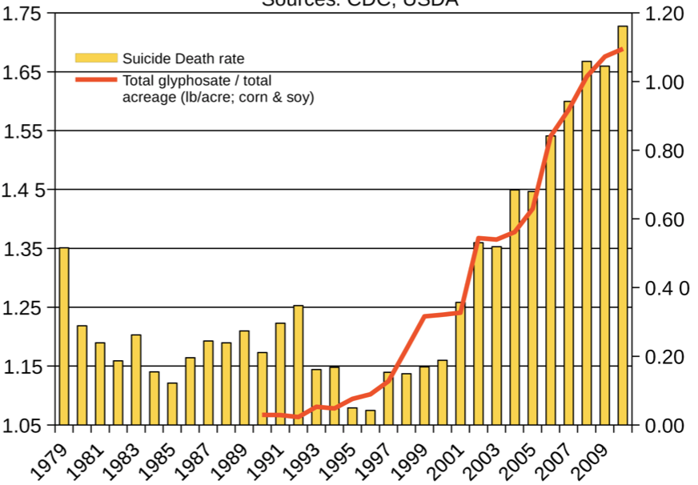
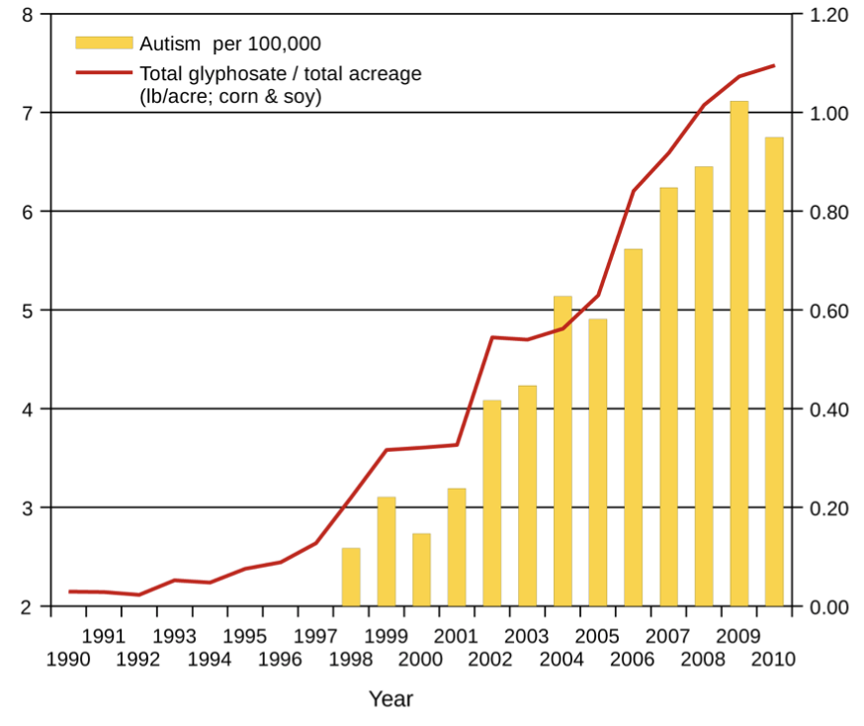
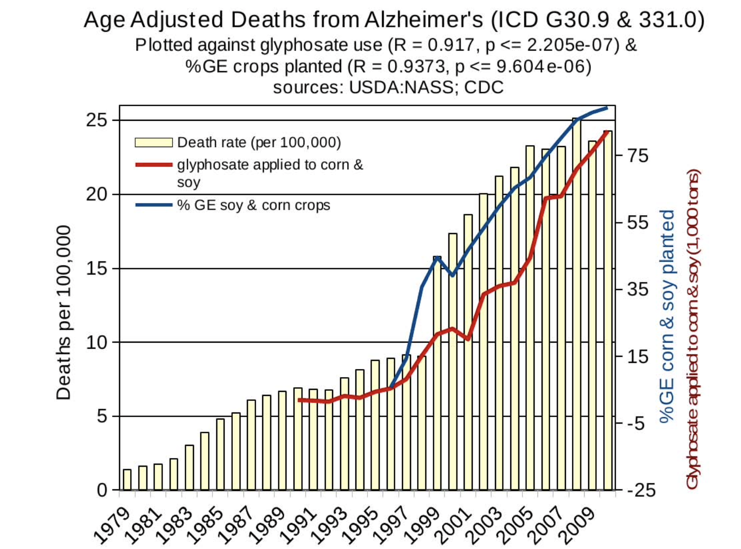
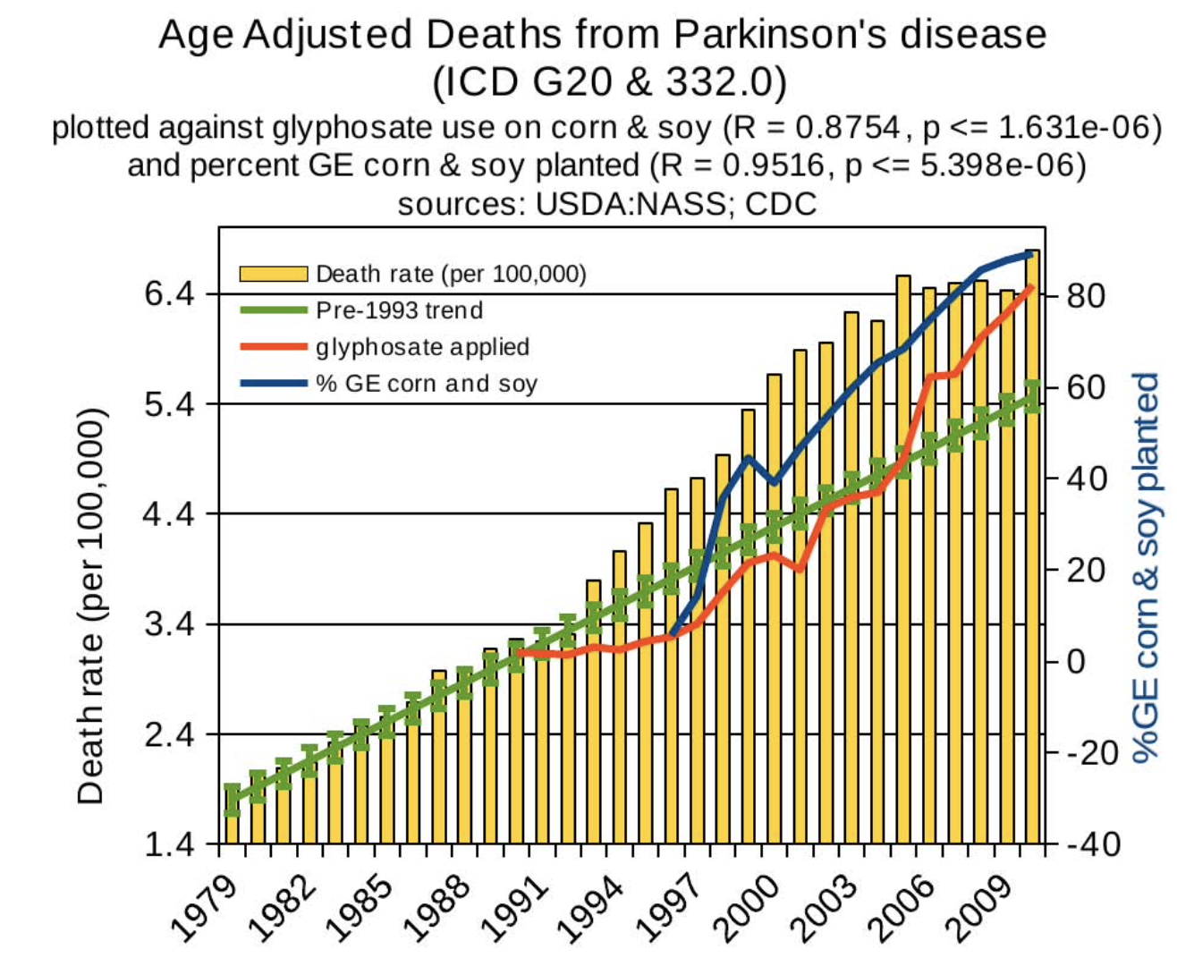
Death by Suicide
Autism
Alzheimer’s
Parkinson’s disease
Notes:
Hospital discharge diagnoses per 100,000

Slide 13
Gut Microbes Supply Deuterium-depleted Nutrients to the Host

Slide 14
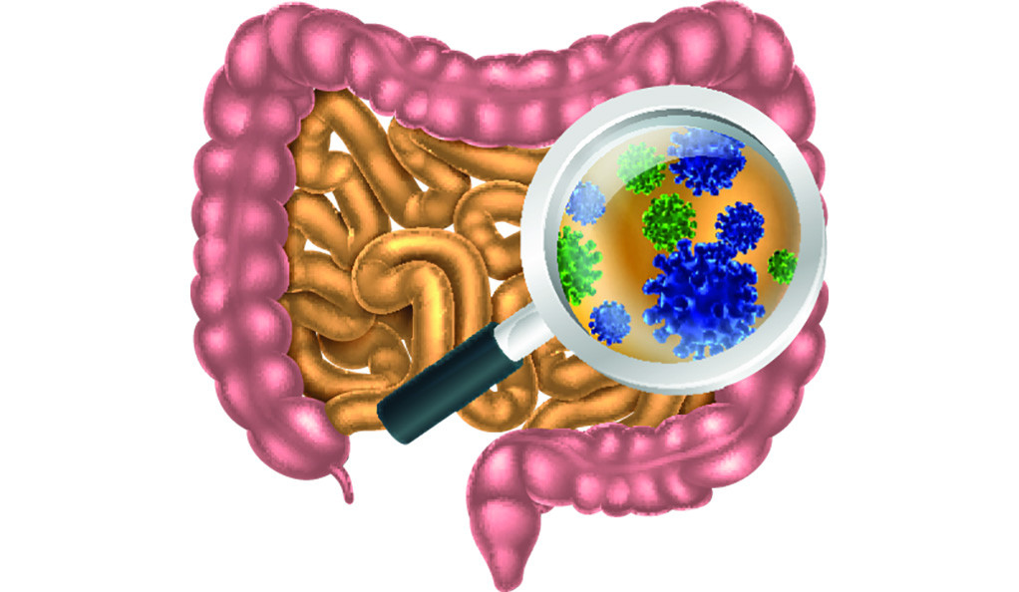
The Big Picture
Gut microbes produce hydrogen gas that is remarkably depleted in deuterium
  This gas is recycled back into organic nutrients by other microbes → the nutrients are also deuterium depleted
The enzymes involved have strong dependencies on glycine residues that could be substituted by glyphosate
  Intestinal bloating and gas pain may be caused by impaired hydrogen recycling due to glyphosate exposure
Hydrogen enriched water and other hydrogen therapies show therapeutic promise
  Is the benefit due to the low deuterium in the hydrogen gas?
DNA methylation may be a storage mechanism for low-deuterium nutrients

Slide 15
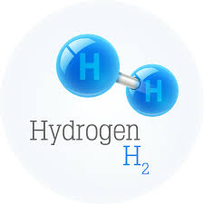
Hydrogen gas produced by microbes anaerobically from glucose or formate is depleted down to 30 ppm deuterium*
“Mass spectrometric analyses of the hydrogen produced by growing cells showed a deuterium content of about 30 ppm. (i.e., depleted by a factor of 4.4 to 5.1…).”
The same was true whether glucose or formate was the substrate.
The intracellular water and cellular hydrogen were not significantly depleted in deuterium.
*MI Krichevsky et al. JBC 1961 236(9): 2520-2525.
Notes:
Where?
lLaszlo_Boros/Krichevsky_1961_formate_formation_produces_deuterium_depleted_hydrogen.pdf

Slide 16
What happens to the hydrogen gas?
Hydrogen-producing bacteria
H₂
Sulfate-reducing bacteria
Methanogens
Acetogenic bacteria
Methane thiol
CH₃SH
Methane
CH₄
Acetate
CH₃COOH
Methionine
CO₂, H₂O, NADH
Acetyl-CoA
Hydrogen Cycling
Notes:
https://www.fixyourgut.com/sibo-methane-or-hydrogen-dominant-what-is-the-difference/

Slide 17
What happens to the hydrogen gas?
Hydrogen-producing bacteria
H₂
Sulfate-reducing bacteria
Methanogens
Universal Methyl Donor
Supplies DDW to Mitochondria
Acetogenic bacteria
Citric Acid Cycle
(fuels ATP)
Methane thiol
CH₃SH
Methane
CH₄
Acetate
CH₃COOH
Methionine
CO₂, H₂O, NADH
Acetyl-CoA
Hydrogen Cycling
Notes:
https://www.fixyourgut.com/sibo-methane-or-hydrogen-dominant-what-is-the-difference/

Slide 18

Carbon Cycle
Hydrogen Gas (4H₂)
O₂
Methane+ Water
H₂ O
NADH
Methylation Pathways
NAD+
Methanol
Carbon dioxide
NAD+
Water
NADH
NADH
NAD+
H+
Formaldehyde
NAD+
NADH
Carbonate
Carcinogen
NAD+
NADH
Formate

Slide 19
Carbon Cycle
Hydrogen Gas (4H₂)
O₂
Methane+ Water
H₂ O
NADH
NAD+
Methylation Pathways
The enzymes that extract hydrogen from methanol, formaldehyde and formate are called dehydrogenases.
This class of enzymes is suppressed by glyphosate.
They generate NADH to fuel the mitochondria with hydrogen that is low in deuterium.
Methanol
Carbon dioxide
NAD+
Water
NADH
NADH
NAD+
H+
Formaldehyde
NAD+
NADH
Carbonate
Carcinogen
NAD+
NADH
Formate

Slide 20
Dissimilatory sulfate reduction induced by glyphosate
Multiple enzymes involved in assimilatory sulfate reduction in E coli are disrupted by glyphosate (PAPS reductase, APS kinase, sulfite reductase)*
  Causes deficiency in methionine and other sulfur-containing amino acids
  Leads to increase in Desulfovibrio and Bilophila wadsworthia species
  Dissimilatory sulfate reduction → excessive hydrogen sulfide gas → brain fog
Disrupted sulfur assimilation leads to impaired iron absorption**
  Iron deficiency anemia is an epidemic worldwide
*W Lu et al. Mol Biosyst. 2013 Mar;9(3):522-30.
**BH Hudson et al. PNAS 2018 ePub ahead of print.
Notes:
.From:
2018/May/May5.pptx
2022/project/AutismMagazine/sulfur_assimilation_defects_iron_deficiency_anemia.pdf
Downregulated paper

Slide 21
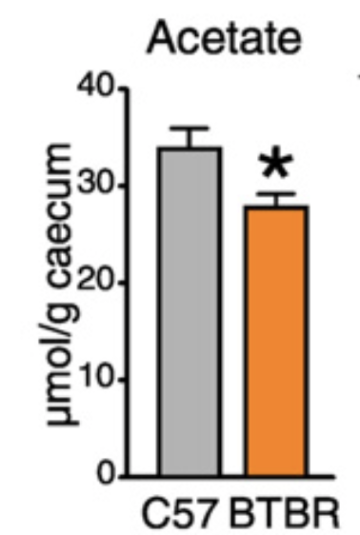
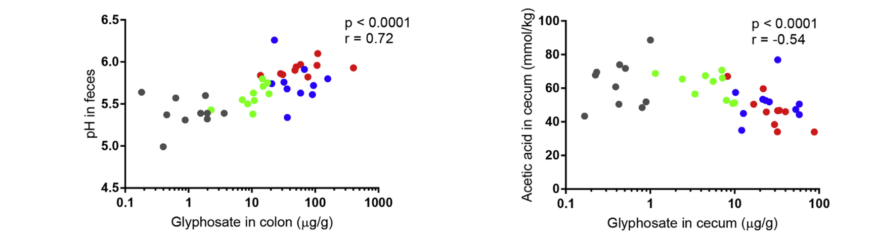
BTBR mice have low acetate, and glyphosate disrupts acetate synthesis in the gut*
BTBR mice are a well-established mouse model of autism
Children with autism had only 3.5 mg/ml acetate in stool samples compared to 5.1 in controls.**
BTBR mice
Glyphosate and pH
Glyphosate and Acetate
*LN Nielsen et al. Environmental Pollution 2018;233:364e376.
**JB Adams et al. BMC Gastroenterology 2011; 11:22.
Notes:
.csail/2022/project/AutismMagazine//low_acetate_gut_autism_2011.pdf
2018/AnthonySamsel/scleroderma/glyphosate_reduces_acetate_gut_2018.pdf
csail/2022/project/AutismMagazine/glyphosate_reduces_acetate_gut_2018.pdf
rats

Slide 22
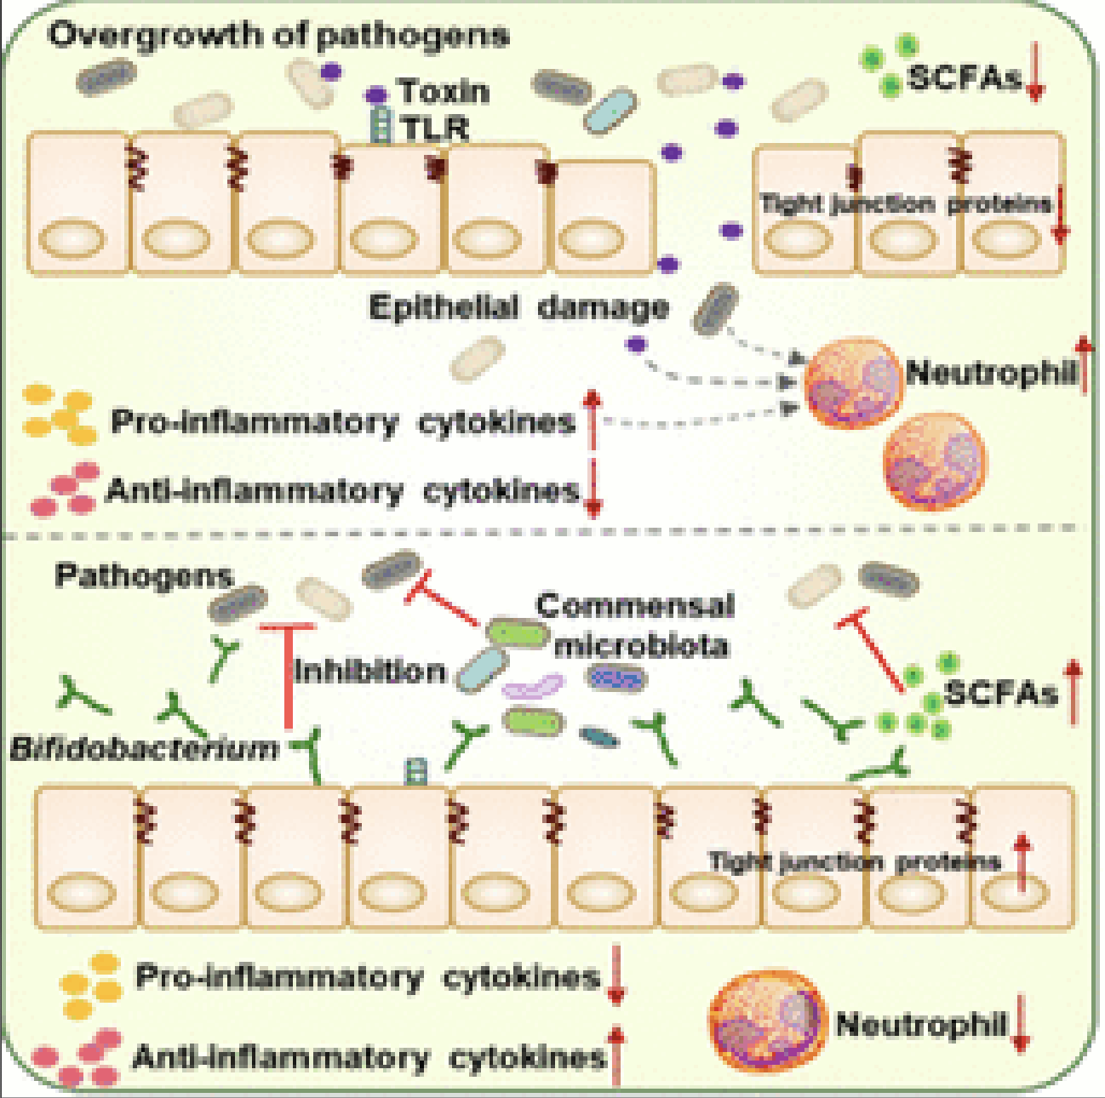
Bifidobacteria:
Beneficial Role in Colitis
In a mouse model of colitis, Bifidobacteria bifidum administration alleviated colitis symptoms, reduced proinflammatory cytokine production, reduced neutrophil levels, and enhanced tight junction health
Bifidobacteria inhibit growth of pathogens and increase production of short chain fatty acids
*Jiacui Shang et al., J. Agric. Food Chem. 2022, 70, 11678−11688.

Slide 23
Bifidobacteria:
Beneficial Role in Colitis
Bifidobacteria are especially sensitive to glyphosate compared to other microbes*
*PC Lehman et al. Environ Toxicol Pharmacol. 2023 Jun;100:104149.
In a mouse model of colitis, Bifidobacteria bifidum administration alleviated colitis symptoms, reduced proinflammatory cytokine production, reduced neutrophil levels, and enhanced tight junction health
Bifidobacteria inhibit growth of pathogens and increase production of short chain fatty acids
*Jiacui Shang et al., J. Agric. Food Chem. 2022, 70, 11678−11688.
Notes:
https://www.sciencedirect.com/science/article/abs/pii/S1382668923000911
Low-dose glyphosate exposure alters gut microbiota composition and modulates gut homeostasis

Slide 24
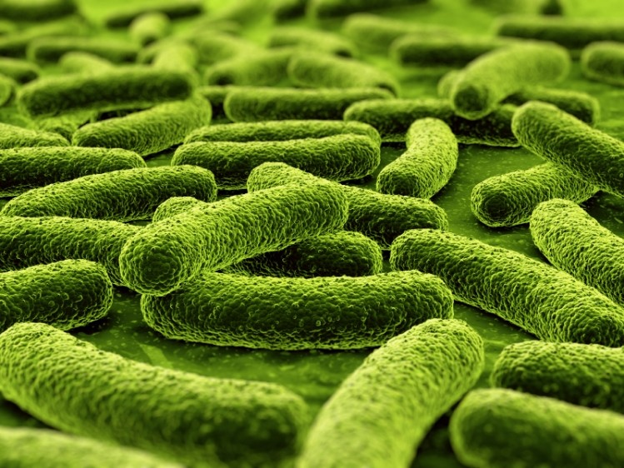
Benefits of Bifidobacteria*
Bifidobacteria metabolize starch to produce lactate and acetate
Many bacteria, but predominantly Firmicutes and Bacteroidites, produce hydrogen gas from lactate and acetate via hydrogenase enzymes
Firmicutes are butyrate-producing bacteria that supply the colonocytes with their favorite food
All these species need to be abundant to support hydrogen recycling
It is said that approximately 10 liters of hydrogen are produced daily in the human intestines.
Low hydrogen levels in the breath are linked to Parkinson's disease, rheumatoid arthritis, cardiovascular disease and Crohn's disease
*Yusuke Ichikawa et al., Med Gas Res. 2023 Jul-Sep;13(3):108-111.
Notes:
2024/TruthAboutHealth/overlooked_beneficits_hydrogen_producing_bugs_2023.pdf
HMO human milk oligosaccharides

Slide 25
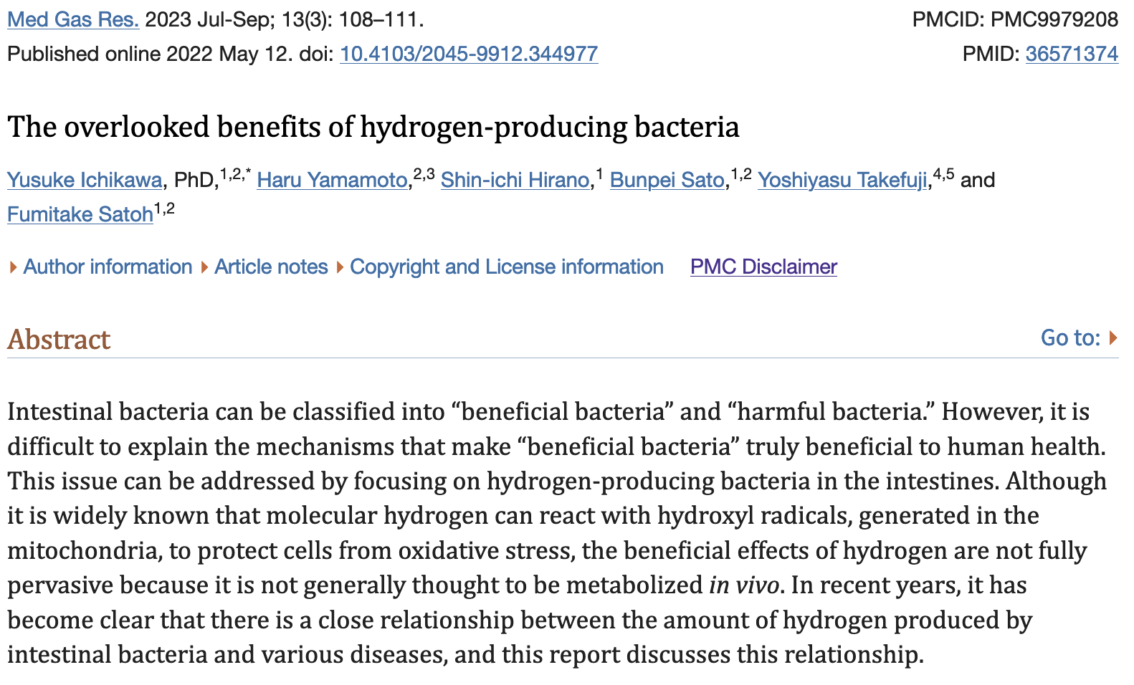
Notes:
2024/CHD/overlooked_benefits_of_hydrogen_producing_bacteria.pdf

Slide 26
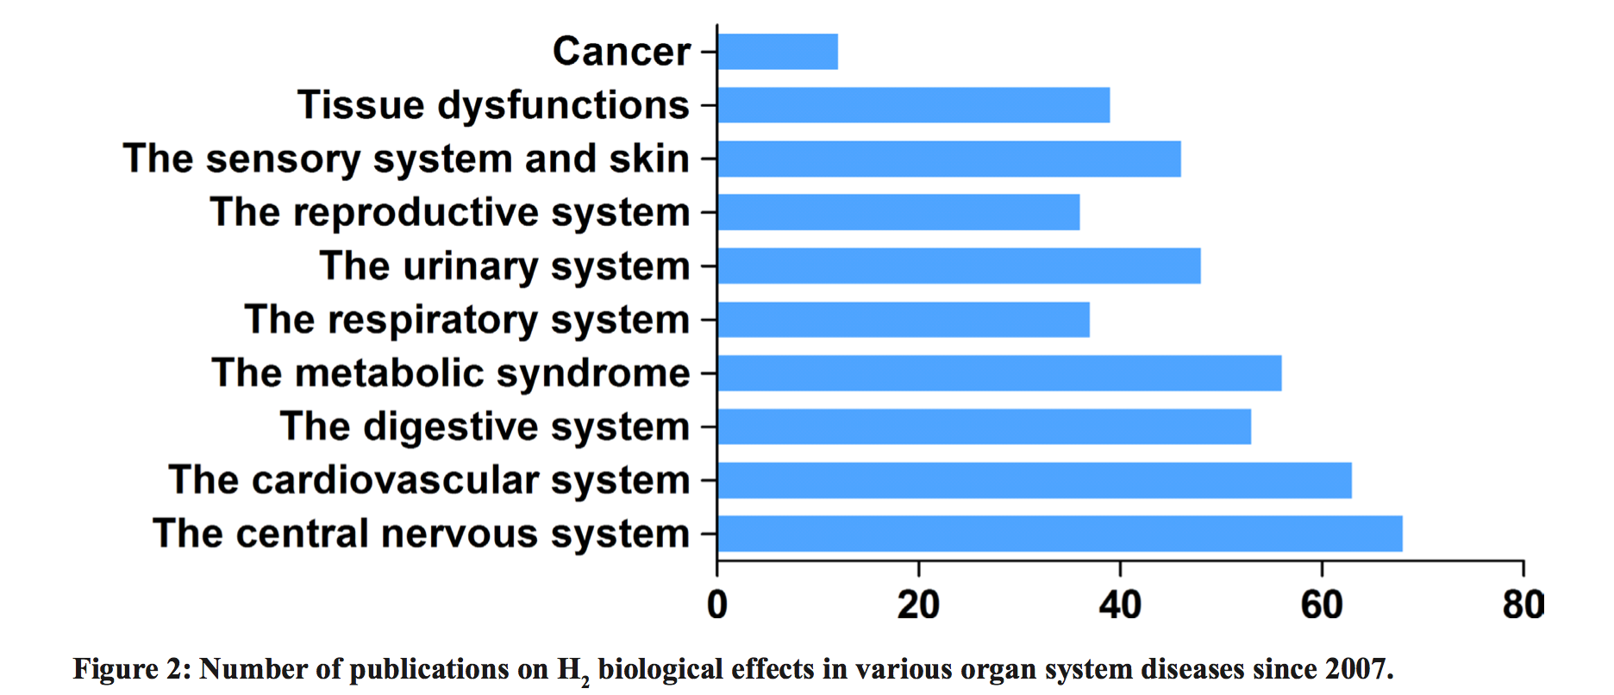
Hydrogen Gas as a Therapy*
*L Ge et al. Oncotarget 2017; 8(60): 102653-102673.

Slide 27
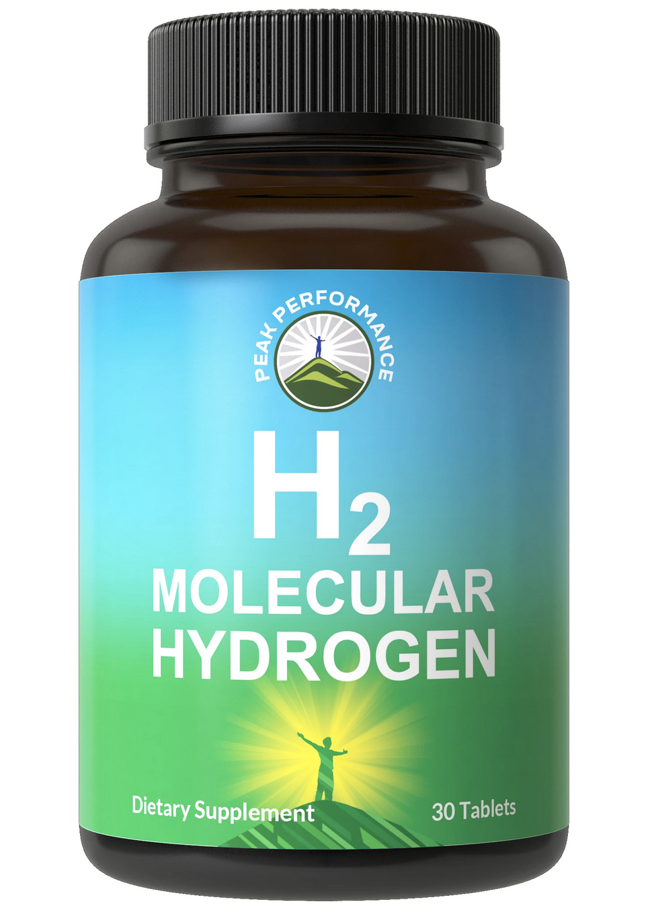
"Pilot study of H₂ therapy in Parkinson's disease: a randomized double-blind placebo-controlled trial”*
Hydrogen water is water with trapped hydrogen gas in it
It can be created by dropping tablets of elemental magnesium into tap water
  Mg + 2H₂O → Mg(OH)₂ + H₂
"The results indicated that drinking H₂-water was safe and well tolerated, and a significant improvement in total UPDRS [Unified Parkinson's Disease Rating Scale] scores for patients in the H₂-water group was demonstrated."
*Asako Yoritaka et al. Mov Disord 2013; 28(6): 836-9.

Slide 28
Glyphosate Suppresses Dehydrogenases

Slide 29
The Big Picture
Methane gas is converted by gut microbes in a series of steps into methanol, formaldehyde, formate, and ultimately carbon dioxide
The enzymes that extract hydrogen from methanol, formaldehyde and formate are called dehydrogenases.
  This class of enzymes is suppressed by glyphosate.
These enzymes generate NADH (H originally from hydrogen gas) to fuel the mitochondria with hydrogen that is low in deuterium
Methionine’s methyl group (derived from methane) is the universal methyl donor
Many methyl groups are attached to large molecules such as DNA, RNA, histones and other proteins
  Do these methyls serve as a storage form of low-deuterium hydrogens?

Slide 30
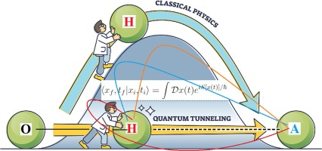
Enzymes Use Hydrogen Tunneling to Avoid Deuterium
A deuterium kinetic isotope effect (KIE) defines an enzyme's ability to deliver a proton to the product, rather than a deuteron
Many dehydrogenases have a high deuterium KIE (>>1)
An essential aspect of enzymatic action involves hydrogen tunneling (quantum physics)
Protons are far more efficient at tunneling than deuterons
Image credit: Graphical Abstract.
Luca Nanni. Chemical Physics 2023; 574: 112054.
Notes:
https://www.sciencedirect.com/science/article/abs/pii/S0301010423002367

Slide 31
Glyphosate Impairs NAD(P)(H) Pathways*
NAD(P)(H) is a major carrier of deuterium-depleted protons
NAD(P)(H) is derived from tryptophan
  Tryptophan is a major product of the shikimate pathway, blocked by glyphosate in plants and microbes
Glyphosate inhibits NADH dehydrogenase, which supplies deuterium-depleted protons to the ATPase pumps in the mitochondria
Glyphosate inhibits glucose 6 phosphate dehydrogenase (G6PD), which restores NADPH from NADP+
Glyphosate inhibits succinate dehydrogenase, the only enzyme that participates in both the citric acid cycle and oxidative phosphorylation in the mitochondria
  Succinate dehydrogenase deficiency is linked to many cancers
*S Seneff, Toxic Legacy, Chelsea Green Publishers, July 2021.

Slide 32
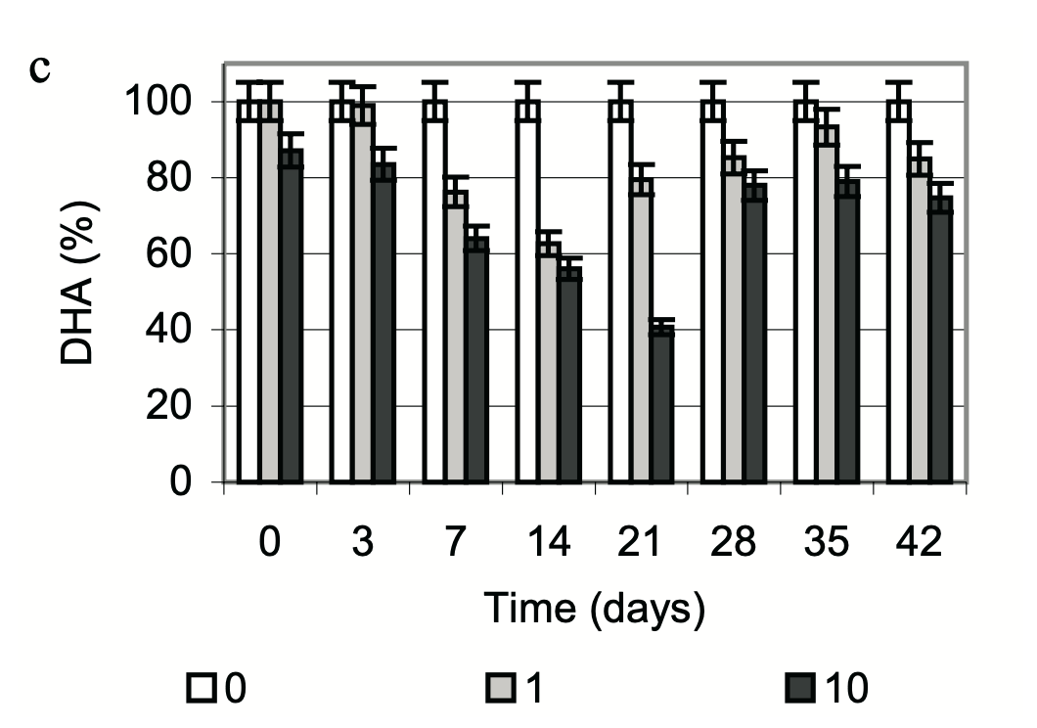
Glyphosate Suppresses Dehydrogenases in Soil Microbes*
In mollic gleysols (a type of soil prevalent in meadows and river bottoms), the level of microbial dehydrogenase activity decreased steadily over a three-week period following glyphosate exposure
dehydrogenase activity
Units: micrograms glyphosate/gram of soil
*RP Bennicelli et al. Int. Agrophysics, 2009, 23, 117-122.

Slide 33
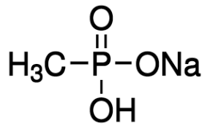
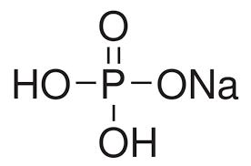
Hypothesis: Glyphosate Disrupts Proteins that Bind Phosphate
Glyphosate is a glycine molecule with a methylphosphonate unit attached to the nitrogen atom
Glyphosate kills weeds by suppressing EPSP synthase in the shikimate pathway
Glyphosate blocks EPSP synthase binding to the phosphate in PEP
The binding site for PEP has a highly conserved glycine residue
  If this glycine is swapped out for alanine, the enzyme becomes completely insensitive to glyphosate
  This is the basis for many GMO glyphosate-resistant crops*
Sodium Methyl-
phosphonate
Sodium Phosphate
*T Funke et al. Proc Natl Acad Sci U S A 2006; 103(35): 13010-13015
Notes:
From 2021/Toronto/BobMiller_shortened.pptx

Slide 34
Hypothesis: Glyphosate Disrupts Proteins that Bind Phosphate
Glyphosate is a glycine molecule with a methylphosphonate unit attached to the nitrogen atom
Glyphosate kills weeds by suppressing EPSP synthase in the shikimate pathway
Glyphosate blocks EPSP synthase binding to the phosphate in PEP
The binding site for PEP has a highly conserved glycine residue
  If this glycine is swapped out for alanine, the enzyme becomes completely insensitive to glyphosate
  This is the basis for many GMO glyphosate-resistant crops*
Many enzymes that glyphosate has been shown to suppress contain a “glyphosate susceptibility motif”: they bind phosphate at a site where there is at least one highly conserved glycine residue
Sodium Methyl-
phosphonate
Sodium Phosphate
*T Funke et al. Proc Natl Acad Sci U S A 2006; 103(35): 13010-13015
Notes:
From 2021/Toronto/BobMiller_shortened.pptx

Slide 35
Does Glyphosate Disrupt FAD binding in Dehydrogenases?
Many dehydrogenases are flavoproteins. They bind flavin-adenine dinucleotide (FAD) at a site with at least one highly conserved glycine residue. FAD facilitates the transfer of protons and electrons
A region near the carboxyl-terminal segment of FAD-binding dehydrogenases contains a highly conserved glycine-aspartate pair
Mutation of Gly-478 to alanine in a Bacillus NADH dehydrogenase caused complete loss of activity, due to loss of binding capacity to FAD*
Gly-478 is preceded by alanine, a small amino acid, leaving room for glyphosate's methylphosphonate unit
*Masato Shiraki and Noriyuki Kayama. Current Microbiology 2003; 46: 432–434.

Slide 36
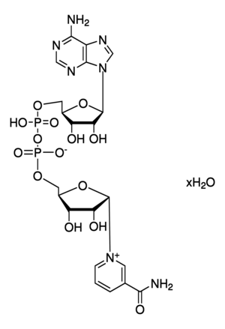
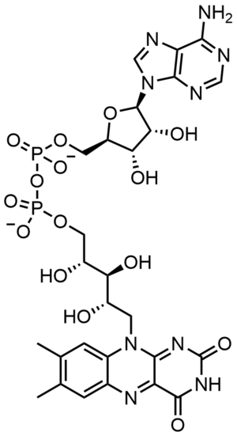
NAD and FAD
Adenine
Adenine
Phosphate
Phosphate
Phosphate
Phosphate
Flavin
Nicotinamide
NAD
FAD

Slide 37
NAD and FAD
Adenine
Adenine
Phosphate
Phosphate
FAD can be synthesized from riboflavin (vitamin B2)
NAD can be synthesized from niacin (vitamin B3) or the amino acid tryptophan
Phosphate
Phosphate
Flavin
Nicotinamide
NAD
FAD

Slide 38
Some dehydrogenases that are downregulated in E. coli when exposed to glyphosate*
NADH dehydrogenase
glucose-6-phosphate dehydrogenase
succinate dehydrogenase
malate dehydrogenase
α-ketoglutarate dehydrogenase
2-deoxy-D-gluconate dehydrogenase
acetaldehyde-CoA dehydrogenase
D-amino acid dehydrogenase
D-lactate dehydrogenase
NADP-specific glutamate dehydrogenase
3-isopropylmalate dehydrogenase
D-3-phosphoglycerate dehydrogenase
*Wei Lu et al. Molecular BioSystems 2013; 9: 522-530.

Slide 39
Some dehydrogenases that are downregulated in E. coli when exposed to glyphosate*
NADH dehydrogenase
glucose-6-phosphate dehydrogenase
succinate dehydrogenase
malate dehydrogenase
α-ketoglutarate dehydrogenase
2-deoxy-D-gluconate dehydrogenase
acetaldehyde-CoA dehydrogenase
D-amino acid dehydrogenase
D-lactate dehydrogenase
NADP-specific glutamate dehydrogenase
3-isopropylmalate dehydrogenase
D-3-phosphoglycerate dehydrogenase
*Wei Lu et al. Molecular BioSystems 2013; 9: 522-530.

Slide 40
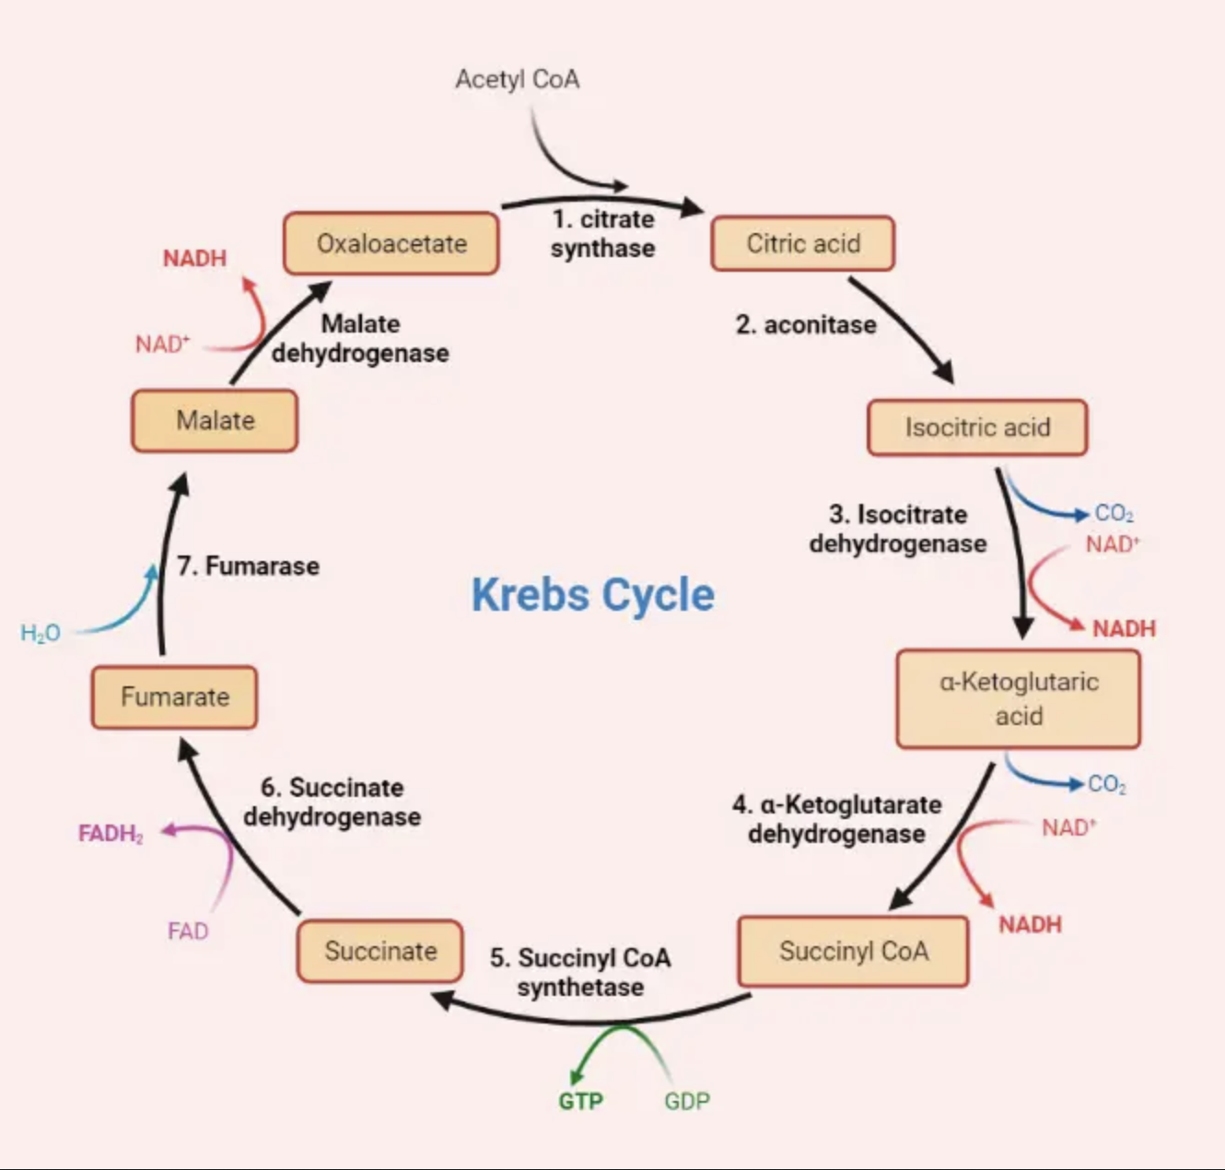
Citric Acid Cycle aka Krebs Cycle: Cellular respiration in the mitochondria

Slide 41
Citric Acid Cycle aka Krebs Cycle: Cellular respiration in the mitochondria
Malate dehydrogenase
Succinate dehydrogenase
α-ketoglutarate dehydrogenase

Slide 42
Disrupted Glycolysis Leads to Fatty Liver Disease and Hyperlipidemia

Slide 43
The Big Picture
Glycolysis is the “pre-processing” step that takes place in the cytoplasm and converts glucose into pyruvate
Many steps in glycolysis help to deplete deuterium in protons
At least two critical dehydrogenases in glycolysis have strong glyphosate susceptibility motifs
Genetic mutations in these genes lead to serious health issues, including glycation damage, microcephaly, seizures, cognitive impairment and liver damage

Slide 44
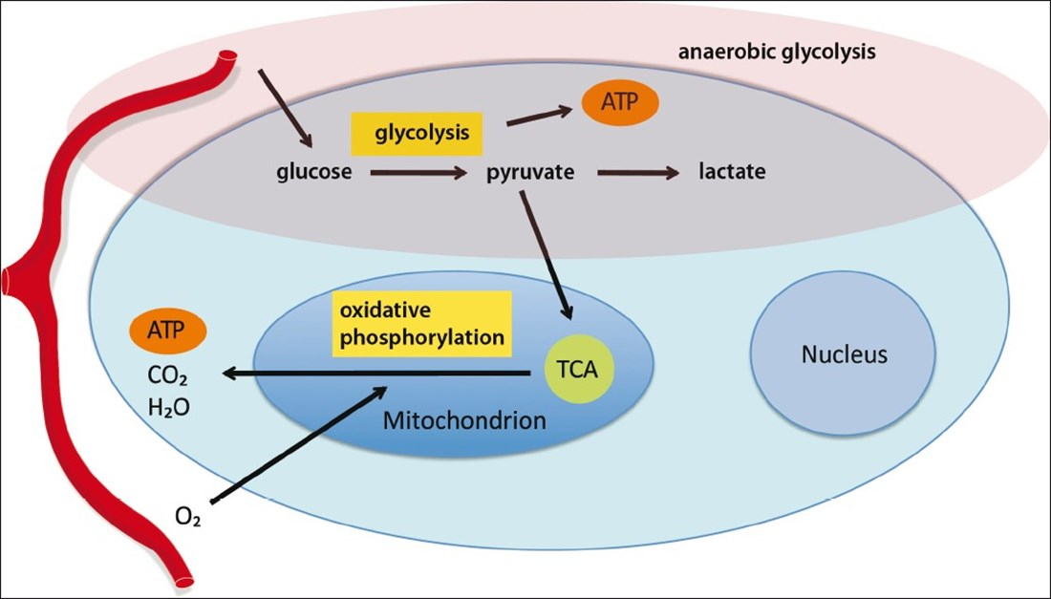
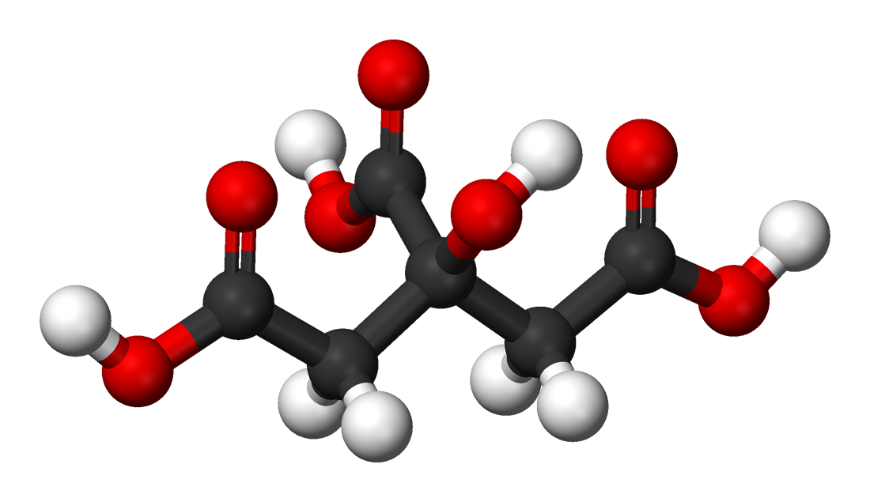
Simplified Glucose Metabolism
citric acid
TCA = tricarboxylic acid cycle = citric acid cycle
Notes:
2024/general/images/cell_metabolism.jpg
Came from a strange place – couldn’t identify reference.

Slide 45
Glycolysis and Glyphosate
Glycolysis is the anaerobic pathway in the cytoplasm that converts glucose to pyruvate
Pyruvate feeds into the citric acid cycle in the mitochondria and gets fully metabolized to carbon dioxide and water
Glycolysis involves several enzymes that deplete deuterium
Triosephosphate isomerase is an important enzyme in glycolysis that yields a deupleted proton that is then attached to NAD+ to make NADH
The dehydrogenase that yields NADH has a strong glyphosate-susceptibility motif

Slide 46
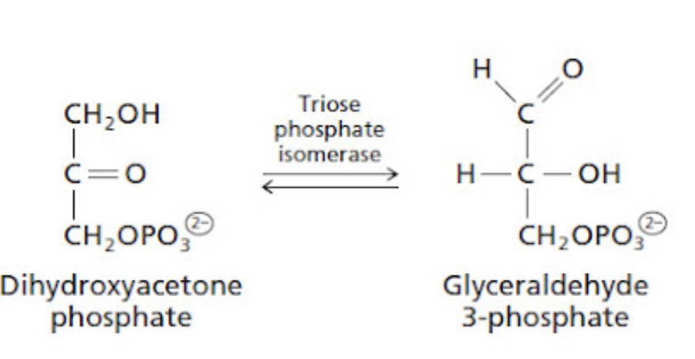
Triosephosphate Isomerase
deupleted
NAD+
NADH
Citric Acid Cycle
Glycerol,
Triglycerides
H
PEP
glyceraldehyde 3-phosphate dehydrogenase (GAPDH)
GAPDH is a dehydrogenase that has a strong glyphosate-susceptibility motif (highly conserved glycine that binds to NAD)
PEP = phosphoenolpyruvate – the molecule that EPSPS synthase binds to in the shikimate pathway
Notes:
Consensus: "Deuterium substitution at the C-2 position of substrate (R)-glyceraldehyde phosphate and at the 1-pro-R position of substrate dihydroxyacetone phosphate results in kinetic isotope effects on kcat of 1.6 and 3.4, respectively.”
-- EB Nickbarg and JR Knowles, 1988.

Slide 47
Triosephosphate Isomerase
deupleted
NAD+
NADH
If GAPDH is suppressed, triosephosphates are more susceptible to spontaneous conversion to methylglyoxal, possibly the most potent glycating agent known to biology
Citric Acid Cycle
Glycerol,
Triglycerides
H
PEP
glyceraldehyde 3-phosphate dehydrogenase (GAPDH)
GAPDH is a dehydrogenase that has a strong glyphosate-susceptibility motif (highly conserved glycine that binds to NAD)
PEP = phosphoenolpyruvate – the molecule that EPSPS synthase binds to in the shikimate pathway
Notes:
Consensus: "Deuterium substitution at the C-2 position of substrate (R)-glyceraldehyde phosphate and at the 1-pro-R position of substrate dihydroxyacetone phosphate results in kinetic isotope effects on kcat of 1.6 and 3.4, respectively.”
-- EB Nickbarg and JR Knowles, 1988.

Slide 48
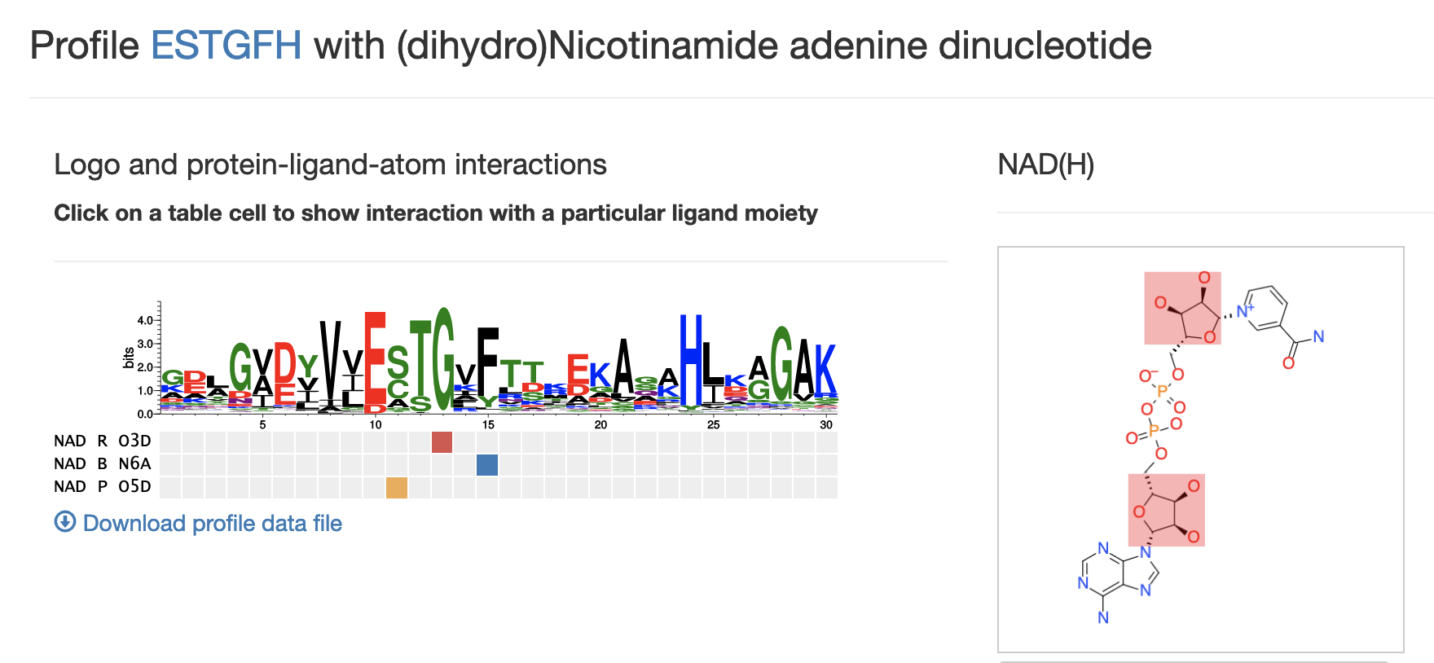
Highly conserved glycine at NAD binding site of glyceraldehyde 3-phosphate dehydrogenase*
*https://www.uniprot.org/uniprotkb/P04406/entry
*http://nbdb.bii.a-star.edu.sg/search
Notes:
http://nbdb.bii.a-star.edu.sg/search#results
https://www.uniprot.org/uniprotkb/P04406/entry
2024/deuterium/images/
NBD_on_glyceraldehyde_3_phosphate_dehydrogenase.png

Slide 49
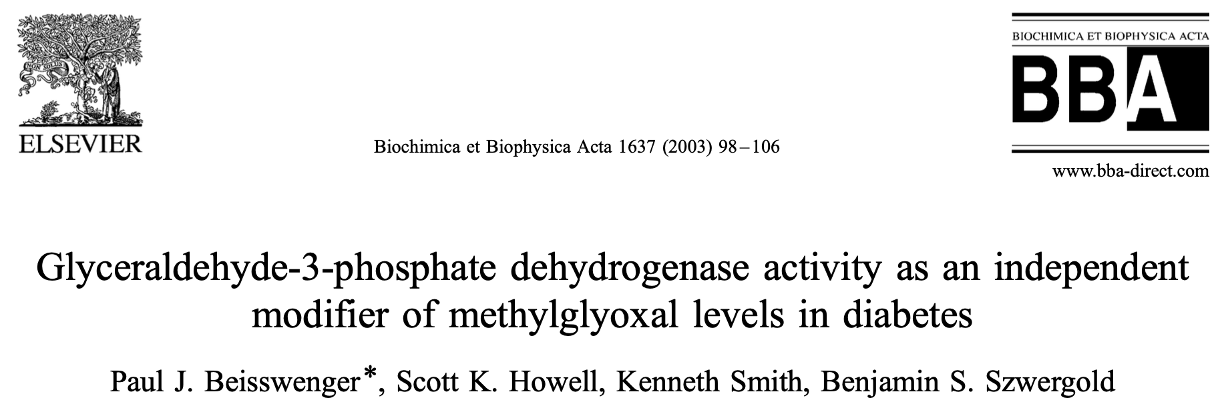
79% reduction of GAPDH activity resulted in a sixfold increase in methylglyoxal

Slide 50
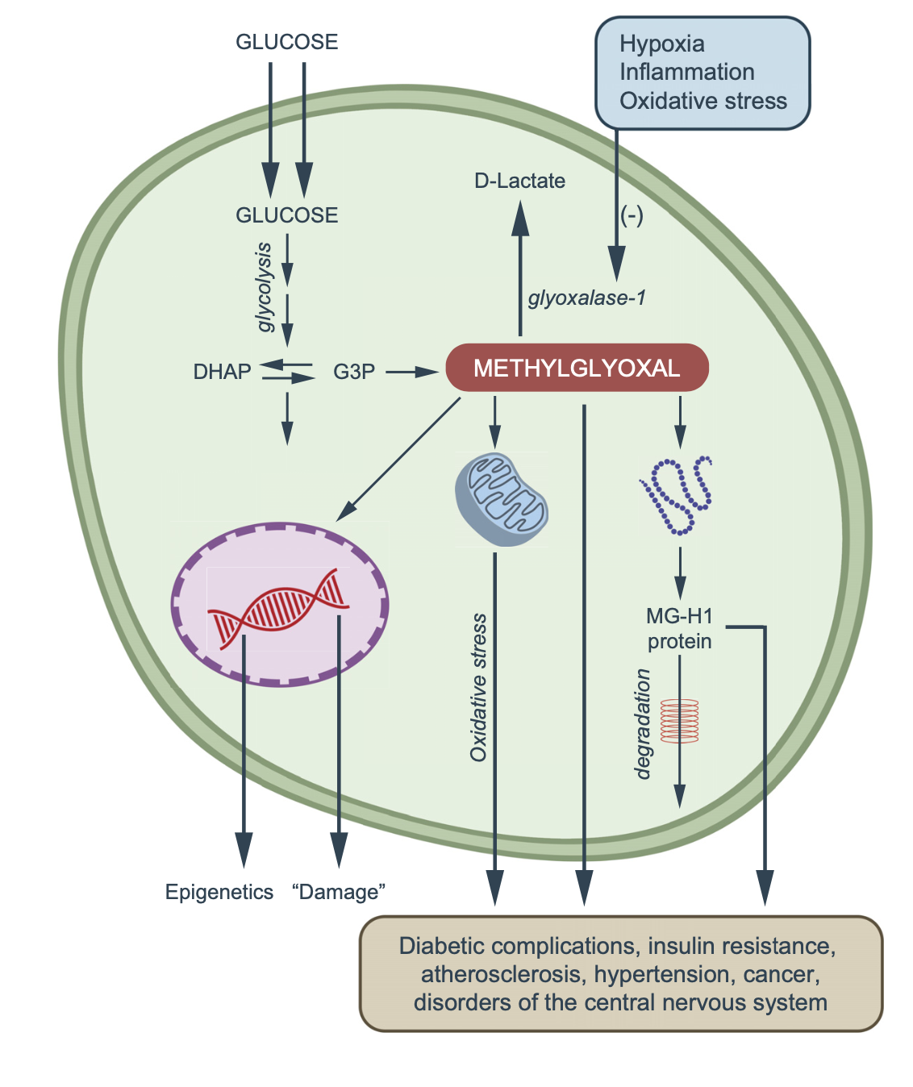
“Diabetic complications, insulin resistance, atherosclerosis, hypertension, cancer, disorders of the central nervous system.*”
*Graphical Abstract. CG Schalkwijk and CDA Stehouwer.
Physiol Rev 2020; 100:407–461.

Slide 51
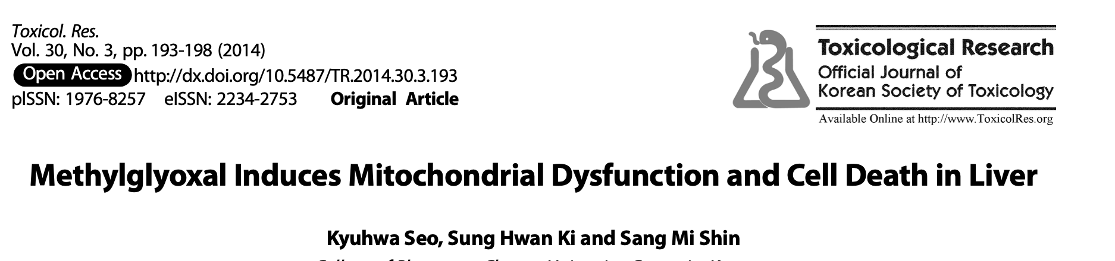
Elevated plasma level of methylglyoxal are associated with diabetes, obesity and fatty liver disease
Methylglyoxal induces oxidative stress
Methylglyoxal causes liver toxicity, as indicated by increased levels of ALT and AST
Methylglyoxal induces mitochondrial impairment and apoptosis in liver cells

Slide 52
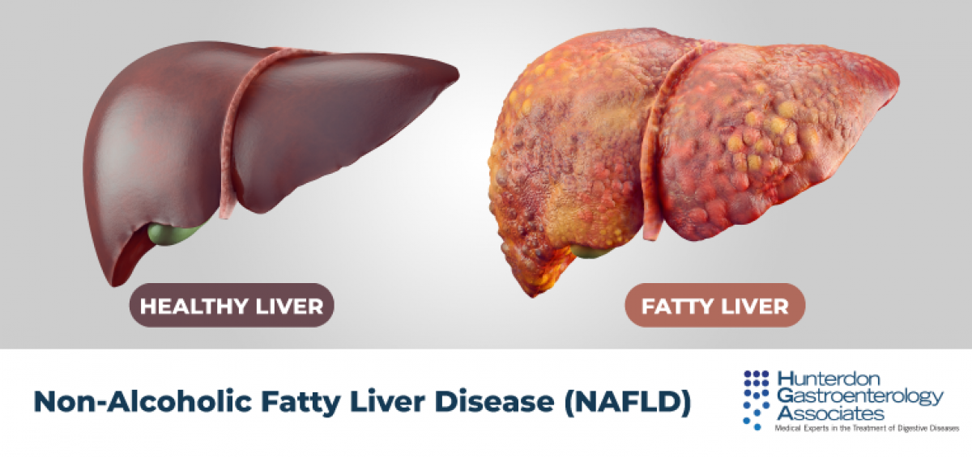
Is Glyphosate Causing an Epidemic in Fatty Liver Disease?
Worldwide epidemic in fatty liver disease today*
“Multiomics reveal non-alcoholic fatty liver disease in rats following chronic exposure to an ultra-low dose of Roundup herbicide”**
Glyphosate correlated with fatty liver disease in humans***
* Chris Estes et al. Hepatology 2018; 67(1): 123-133.
** Robin Mesnage et al. Sci Rep 2017; 7: 39328.
*** PJ Mills et al. Clinical Gastroenterology and Hepatology 2020;18(3):741-743.
Notes:
Where?
Attached/for_Laszlo/Mills_glyphosate_steatohepatitis_link_humans_2019.pdf

Slide 53
Hyperlipidemia (high blood cholesterol) at hospital discharge is increasing over time, in step with the rise in glyphosate usage on corn and soy crops
*www.westonaprice.org/health-topics/
modern-diseases/cholesterol-sulfate-deficiency-coronary-heart-disease/
Notes:
2024/CHD/images/hyperlipidemia_glyphosate.png

Slide 54
Some dehydrogenases that are downregulated in E. coli when exposed to glyphosate*
NADH dehydrogenase
glucose-6-phosphate dehydrogenase
succinate dehydrogenase
malate dehydrogenase
α-ketoglutarate dehydrogenase
2-deoxy-D-gluconate dehydrogenase
acetaldehyde-CoA dehydrogenase
D-amino acid dehydrogenase
D-lactate dehydrogenase
NADP-specific glutamate dehydrogenase
3-isopropylmalate dehydrogenase
D-3-phosphoglycerate dehydrogenase
*Wei Lu et al. Molecular BioSystems 2013; 9: 522-530.

Slide 55
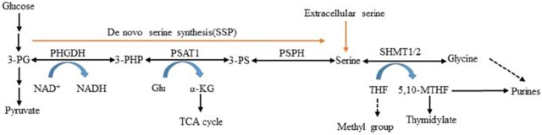
3-phosphoglycerate dehydrogenase
3-phosphoglycerate dehydrogenase (PHGDH) pulls an intermediate out of the glyclolysis pathway and initiates serine synthesis
Genetic defects in PHGDH lead to microcephaly, intractable seizures, and motor and cognitive impairments*
PHGDH has a highly conserved GxGxxG motif at the NAD binding site
*Koning T. Journal of Inherited Metabolic Disease 2006; 29: 347-351.

Slide 56
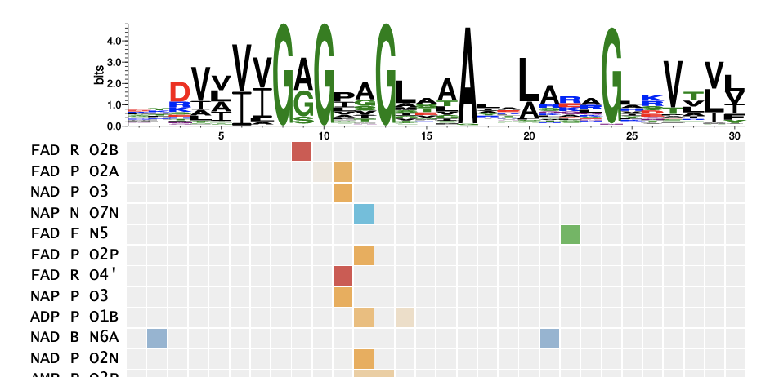
GxGxxG Motif at NAD binding site in 3-phosphoglycerate dehydrogenase

Slide 57
Methionine Deficiency and Methylation Pathways

Slide 58
The Big Picture
Methylation pathways attach methyl groups to histones and to the cytosines in DNA molecules
The methylation pattern of histones and DNA greatly influences gene expression
Cancer is associated with hypomethylated DNA
Methyls are metabolized while still attached to DNA, and the reaction yields succinate, an important source of protons in the mitochondria
Methionine is the original source of the methyls, so they are normally severely depleted in deuterium content
Supplemental methionine is problematic because it is usually synthesized in the chemistry lab rather than biologically synthesized
Rat studies have shown that methionine deficiency leads to longevity, but these studies are fatally flawed

Slide 59
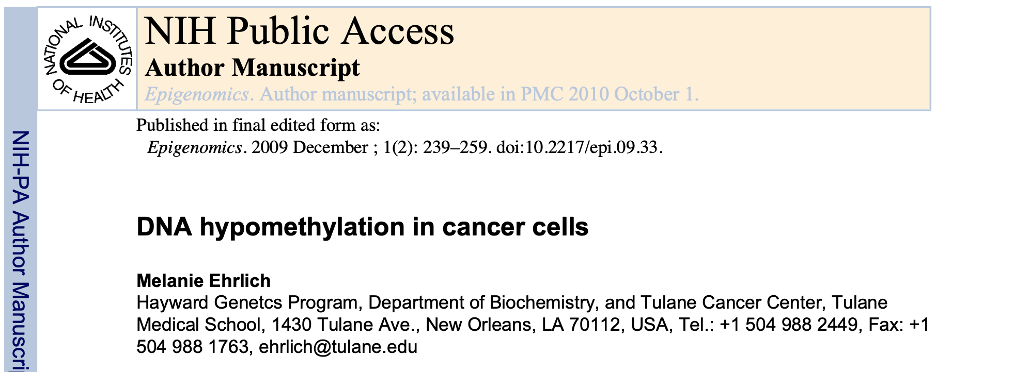
DNA hypomethylation is a ubiquitous feature of carcinogenesis
DNA hypomethylation can be found early in carcinogenesis, but can also be associated with tumor progression

Slide 60
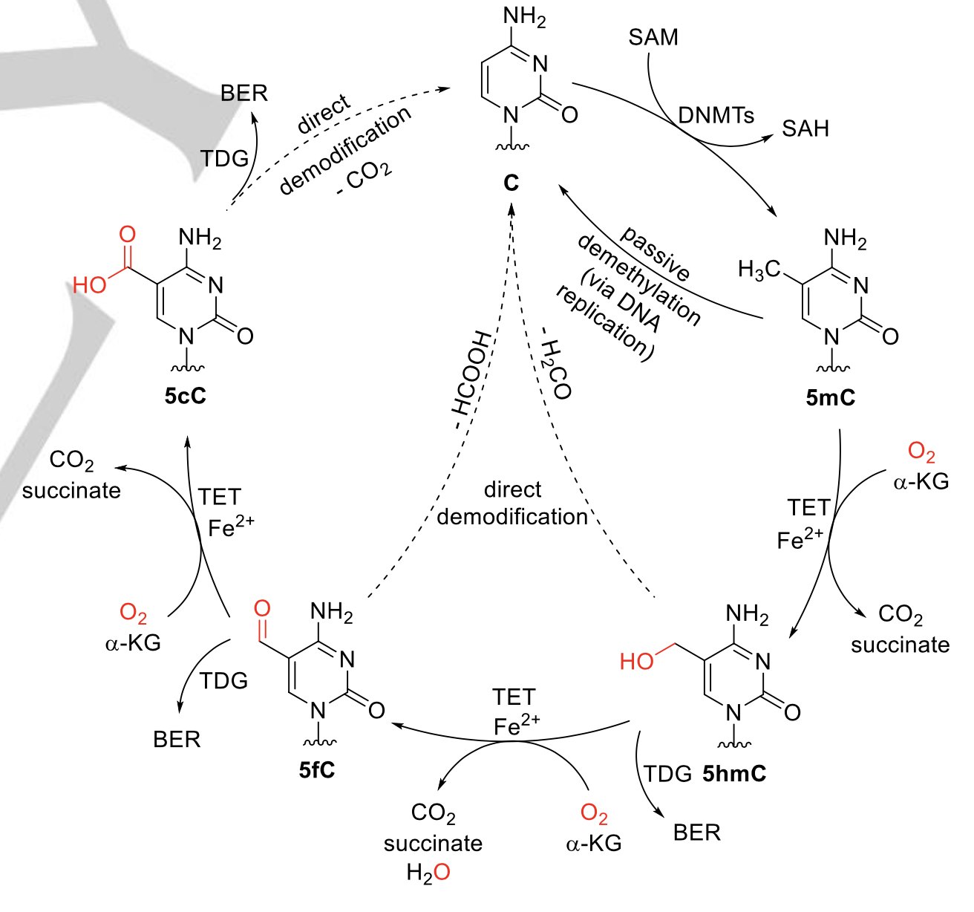
Demethylation of Cytosines in DNA*
cytosine
S-adenosyl methionine
BER
TDG
Protons are removed one by one from the methyl group originally attached to the nucleotide cytosine.
α-ketoglutarate (α-KG) is converted to succinate, which can then feed low-deuterium protons to the mitochondrial intermembrane space
The enzymes that achieve this feat are called ten eleven translocation (TET) family enzymes
5-methyl cytosine
5-carboxy cytosine
succinate
succinate
5-hydroxymethyl cytosine
5-formyl cytosine
succinate
*Figure 1. Niko Jonasson and Lena Daumann. Chemistry 2019; 25(52): 12091-12097.
Notes:
2023/deuterium/TET_deuterium_KIE_DNA_demethylation.pdf
See also: deuterium/acetylcholine.text
BER= base excision repair
Thymine DNA glycosylase (TDG) is a base excision repair (BER) enzyme, which is implicated in correction of deamination-induced DNA mismatches, the DNA demethylation process and regulation of gene expression.Mar

Slide 61
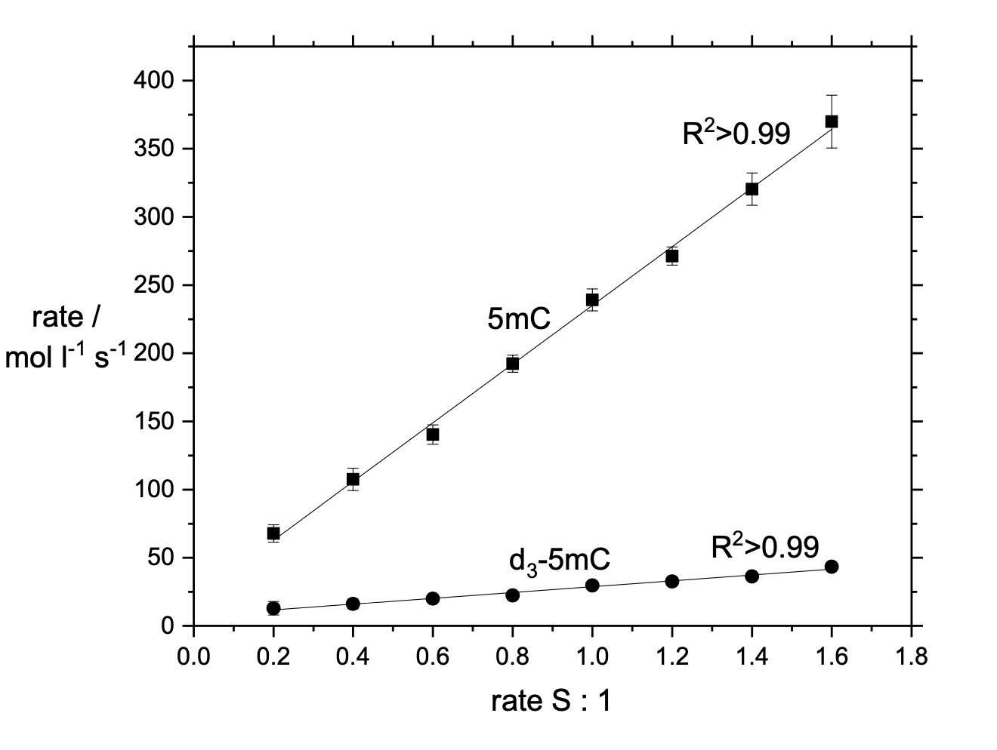
TET has a high deuterium kinetic isotope effect (KIE)*
When the three protons attached to the methyl group in 5-methyl cytosine are all replaced with deuterium, the reaction rate decreases dramatically
*Figure 6. Niko Jonasson and Lena Daumann. Chemistry 2019; 25(52): 12091-12097.
Notes:
2023/deuterium/TET_deuterium_KIE_DNA_demethylation.pdf
Figure 5. Initial rates for eight different ratios of 5mC:1 and 5hmC:1 in the concentration ranges 0.2-1.6 equiv. ([5mC] = 1-8 mM) and 0.02-0.16 equiv. ([5hmC] = 0.1-0.8 mM), respectively. [1] = 5 mM, S is either 5mC or 5hmC. All experiments were conducted with the same batch of 1 to allow for better comparability (The experiments were conducted in 96-well plate reader using 100 μl of a stock solution (10 mM) of 1 and corresponding amounts of stock solutions of 5mC and 5hmC. The overall volume was then adjusted to 200 μl, for more details, see supplementary information).

Slide 62

Fibromalgia linked with DNA Hypomethylation*
Fibromalgia has a hypomethylation DNA pattern
Enriched in genes implicated in stress response and DNA repair/free radical clearance
This set of genes is also enriched for other disorders, including schizophrenia, mood disorders, bulimia, hyperphagia, and obesity.
Is depletion of methyl groups in DNA an indicator of mitochondrial dysfunction due to excess deuterium?
*Daniel Ciampi de Andrade et al. Pain. 2017 Aug;158(8):1473-1480.
Notes:
deuterium/DNA_hypomethylation_fibromyalgia.text

Slide 63
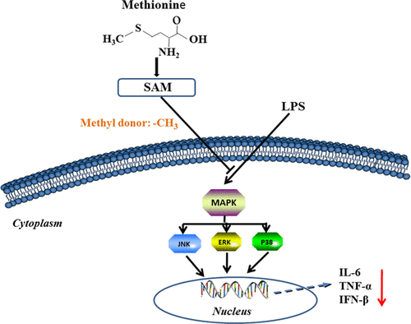

“Methionine Attenuates Lipopolysaccharide-Induced Inflammatory Responses via DNA Methylation in Macrophages”*
Methionine suppresses MAPK signaling via TLR4 through DNA methylation, and reduces production of inflammatory markers
Reduces inflammatory response to both COVID-19 and the mRNA vaccines
*Jian Ji et al. ACS Omega 2019; 4(1): 2331-2336.
Notes:
images/methionine_TNF_alpha_graph.png
https://pubs.acs.org/doi/10.1021/acsomega.8b03571
JulyPaper/methioinine_suppresses_MAPK_via_DNA_methylation.pdf

Slide 64
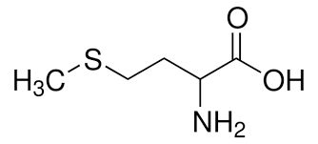
“Dietary” Methionine Deficiency Induces Longevity
“Forty percent methionine restriction decreases mitochondrial oxygen radical production and leak at complex I during forward electron flow and lowers oxidative damage to proteins and mitochondrial DNA in rat kidney and brain mitochondria.”*
Rats were fed synthetic amino acids instead of natural proteins
Treated group got 40% reduced supply of synthetic methionine
  They relied on methionine synthesized by the gut microbes
  Their methyl groups were therefore greatly reduced in deuterium
  Less deuterium in the mitochondria led to reduced ROS
*P Caro et al. Rejuvenation Res. 2009; 12(6): 421-34.
Notes:
deuterium/methionine_restriction_increases_longevity_rats.text
BINGO!!

Slide 65
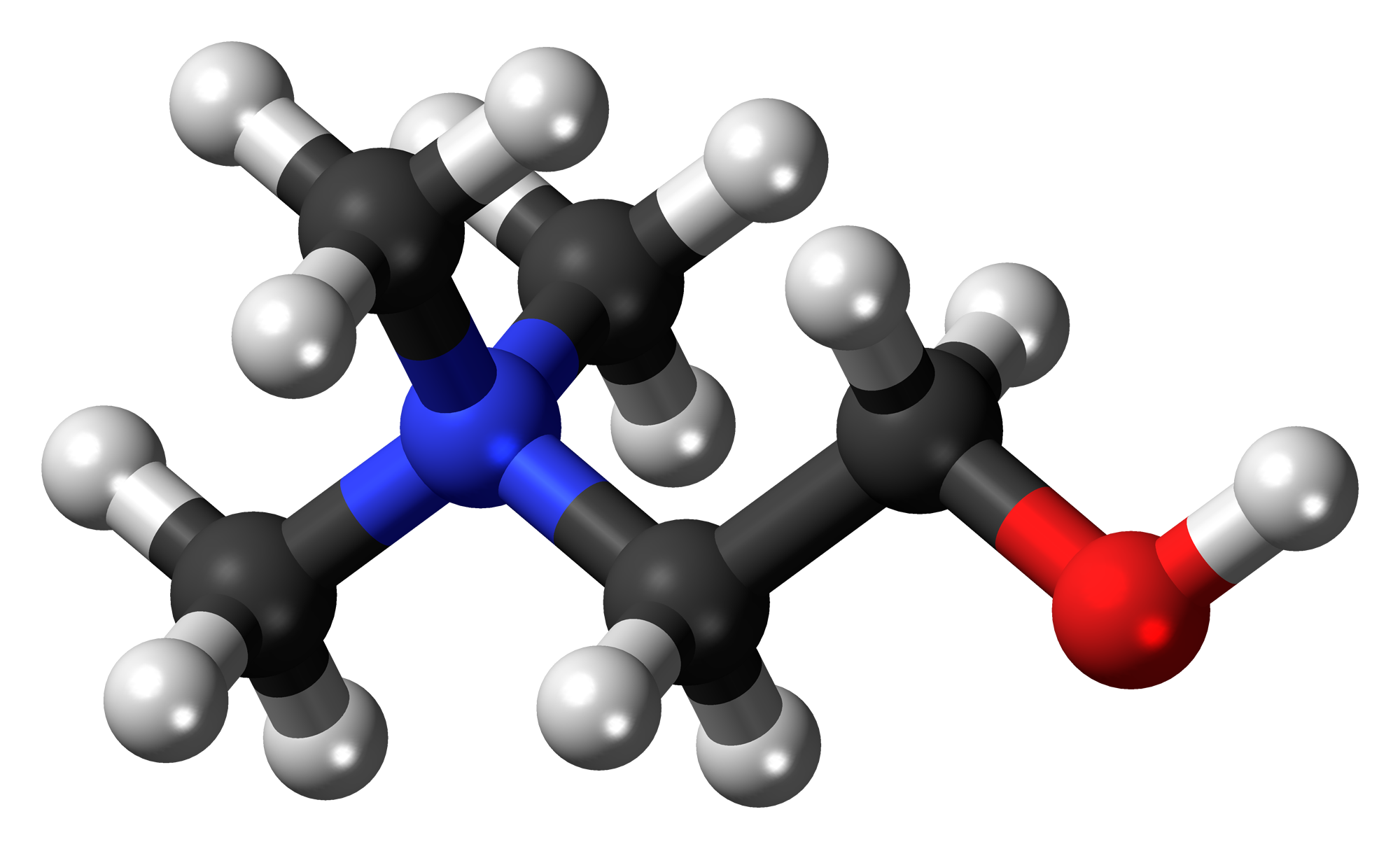
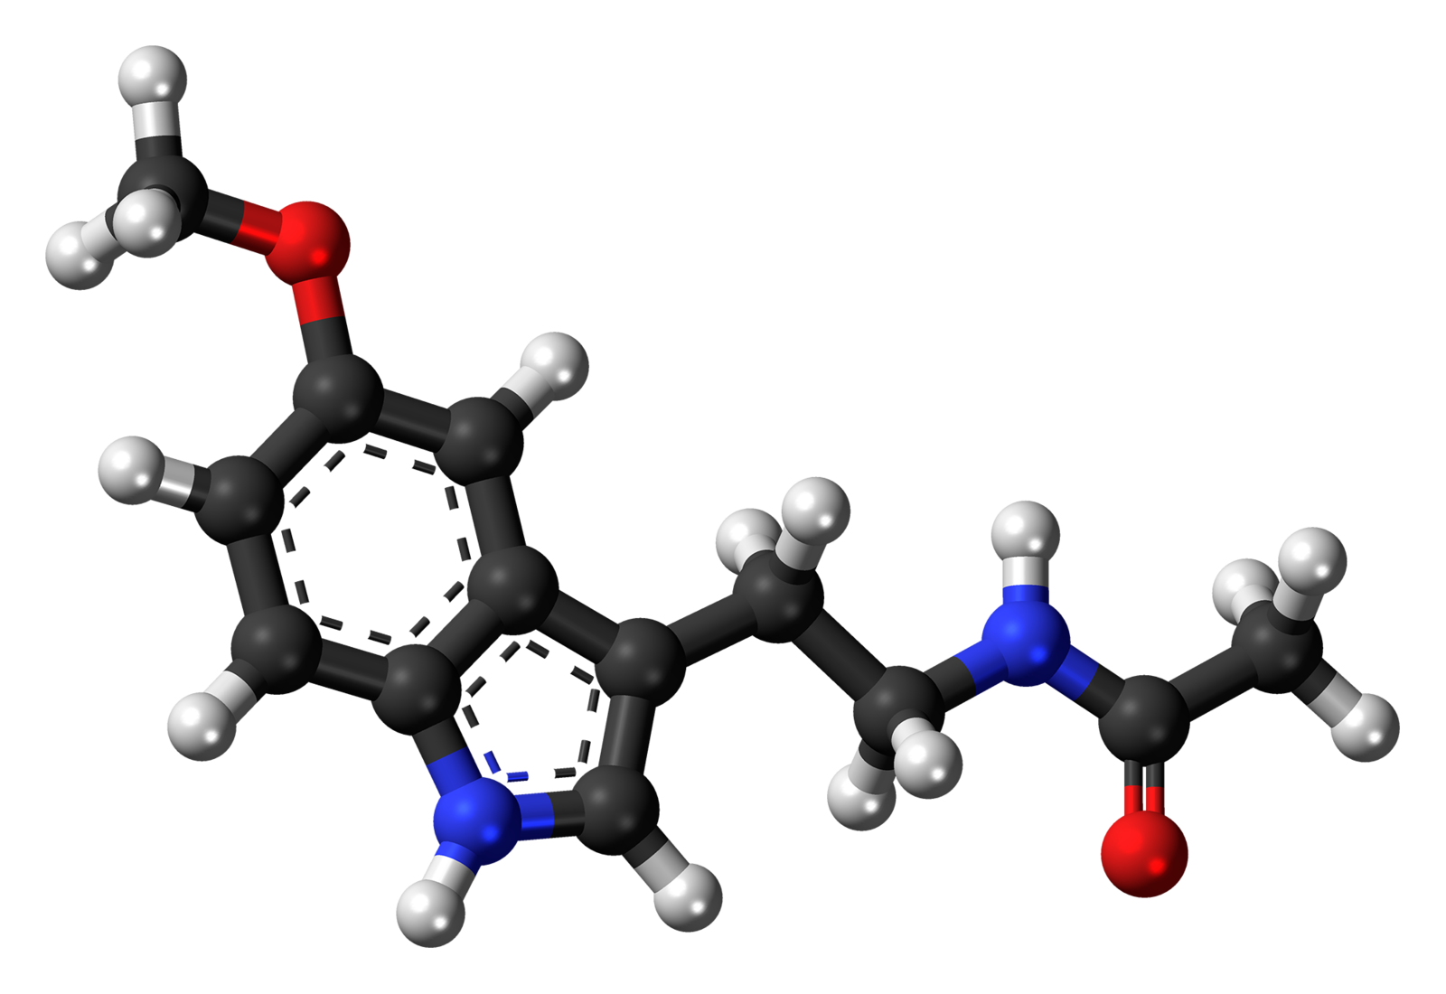
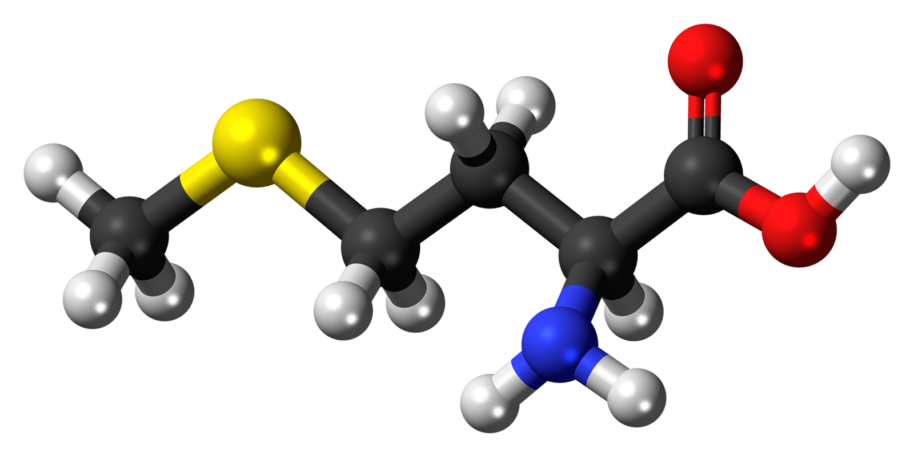
Problematic Supplements
choline
When these nutrients are taken as supplements, they are likely not depleted in deuterium, because they were synthesized in the chemistry lab instead of by living organisms
melatonin
methionine

Slide 66
Glyphosate Damages Mitochondria

Slide 67
Glyphosate Suppresses Succinate Dehydrogenase
Study on glyphosate’s effects on E. coli proteins found that glyphosate significantly suppressed three different components of the succinate dehydrogenase complex*
In vitro study on rat liver mitochondria in isolation exposed to Roundup found significant suppression of succinate dehydrogenase**
Analysis of mechanism of glyphosate suppression suggested it disrupted binding of succinate dehydrogenase to FAD***
Succinate dehydrogenase has the sequence “GAGGAG” (Gly-Ala-Gly-Gly-Ala-Gly) at the site where it binds FAD
*W Lu et al., Mol. Biosys. 9 (2013) 522–530.
**Francisco Peixoto Chemosphere 61 (2005) 1115-1122.
***R Ugarte. Computational Theor. Chem. 1043 (2014) 54–63.

Slide 68
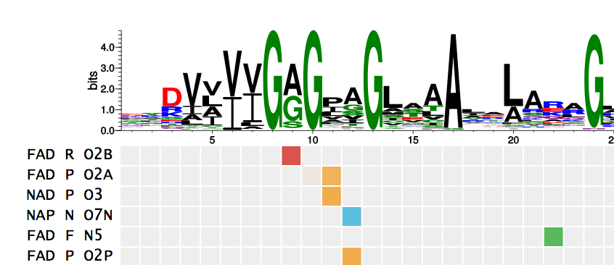
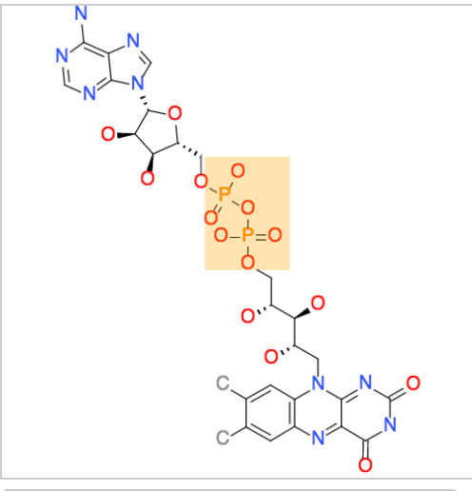
Succinate Dehydrogenase: GxGGxG Motif*
GAGGAG
FAD(H)
Binds FAD as a cofactor to catalyze electron transport in the mitochondria
*http://nbdb.bii.a-star.edu.sg/search
Notes:
P31040
Succinate dehydrogenase (SDH) or succinate-coenzyme Q reductase (SQR) or respiratory ... After the electrons are derived from succinate oxidation via FAD, they tunnel along the [Fe-S] relay until they reach the [3Fe-4S] cluster. ... To fully reduce the quinone in SQR, two electrons as well as two protons are needed.

Slide 69

“The Effects of Low-toxic Herbicide Roundup and Glyphosate on Mitochondria”*
*Figure 2. Olha M. Strilbyska et al. EXCLI Journal 2022;21:183-196.

Slide 70
“The Effects of Low-toxic Herbicide Roundup and Glyphosate on Mitochondria”*
Glyphosate reduced conversion of NAD+ to NADH by up to 45% in rat liver mitochondria in a dose-response relationship**
This is consistent with suppression of mitochondrial dehydrogenases
**OO Olorunsogo and EA Bababunmi. Toxicol Lett. 1980;7:149-52.
*Figure 2. Olha M. Strilbyska et al. EXCLI Journal 2022;21:183-196.

Slide 71

Glyphosate caused increased proliferation and mitochondrial dysfunction in human glioblastoma cells.*
*Claudia Daniele Bianco et al. Environmental Pollution 2023; 338: 122695.
Notes:
2023/glyphosate/glyphosate_induces_gliblastoma_cell_proliferation_2023.text
glyphosate induces proliferation in glioblastoma cells!!
Claudia Daniele Bianco, Fabiana Ourique, Daniela Coelho dos Santos,
Rozangela Curi Pedrosa, Maicon Roberto Kviecisnki, Ariane Zamoner,
Glyphosate-induced glioblastoma cell proliferation: Unraveling the
interplay of oxidative, inflammatory, proliferative, and survival
signaling pathways, Environmental Pollution, Volume 338, 2023, 122695.
https://doi.org/10.1016/j.envpol.2023.122695.

Slide 72
Collagen, Proline and Deuterium

Slide 73
The Big Picture
One third of the proteins in the human body are collagen molecules!
Collagen forms the glue that holds the body together
Collagen’s triple helix structure gives it strength and elasticity
Collagen has long sequences of GxyGxy… that are susceptible to glyphosate substitution
  Many glycine mutations lead to connective tissue disorders
Collagen is highly enriched in proline and hydroxyproline as well
Proline has special properties that allow collagen to trap and sequester deuterium
Peptidyl prolyl isomerase (PPIase) is a crucial class of enzymes that orchestrate collagen folding and trap deuterium in the endoplasmic reticulum
Proline plays a major role in cancer cell metabolism

Slide 74


Glyphosate!
OH
OH
P
O
Common sequence in collagen

Slide 75

Joint Hypermobility Syndrome
Joint Hypermobility Syndrome is a relatively common genetic condition that often involves mutations in glycine residues in collagen
  Connective tissue fragility, joint hypermobility, delayed wound healing, thin stretchy skin, abnormal scarring, vascular fragility, risk of aortic aneurism
Specific heritable disorders include Marfan syndrome (MFS), osteogenesis imperfecta (OI) and Ehlers–Danlos syndrome (EDS)
A mutation in a single glycine residue can lead to severe disease*
Caused by impaired folding of the collagen molecule leading to collagen deficiency
*R Inokuchi et al. Medicine (Baltimore). 2014 Dec;93(28):e291.

Slide 76
Proline Tightly Binds Deuterium*
"A sample of proline containing 17 atom percent D was boiled with 20% hydrochloric acid for 72 hours.”
“The proline isolated from this solution was found to contain 16.2% D.”
"Thus, even under these relatively drastic conditions exchange, if there is any, is very slow.”
Hypothesis:
Collagen folding in the endoplasmic reticulum involves trapping deuterium in proline molecules and ultimately sequestering it in the extracellular matrix and bone.
This reduces deuterium loading in other proteins.
*Marjorie Roloff Stetten. Doctoral Thesis. Columbia University, 1943.
Notes:
where??
2023/deuterium/proline_wont_release_deuterium_1943.pdf

Slide 77


Bone Collagen from Seals*
More than twice as much deuterium in proline and hydroxy-proline in the collagen of seals than is found in seawater
Anomalously high deuterium levels are also found in proline and hydroxyproline in other biological sources
*Hassan Gharibi et al. J. Am. Chem. Soc. 2022, 144, 6, 2484-2487.
Notes:
https://www.science.org/content/blog-post/proline-deuterium-mystery
A Proline Deuterium Mystery
https://pubs.acs.org/doi/epdf/10.1021/jacs.1c12512
bioRxiv version:
proline_seals_deuterium_enriched_bioRxiv.pdf

Slide 78

Proline dehydrogenase replaces succinate dehydrogenase in cancer cells
glutamic semialdehyde
Proline dehydrogenase (ProDH) substitutes for succinate dehydrogenase in the mitochondria when that enzyme is defective
This also increases the demand for glutamate in cancer cells, or they can steal proline from the extracellular matrix
proline dehydrogenase
ubiquinol
P5CR = pyrroline-5-carboxylate reductase
Notes:
where?

Slide 79

PYCR = pyrroline-5-carboxylate reductase
Proline Metabolic Pathways in Cancer Cells
*Figure 1. Pengyu Geng et al. Amino Acids (2021) 53:1769-1777.
Notes:
2023/TFIM/images/proline_metabolism.png
from: ../proline_metabolism_in_cancer.pdf

Slide 80
The cycle from proline to glutamate and back supplies high quality hydrogen to the mitochondria and leaves behind high-deuterium proline, which is put back into the matrix, enriching deuterium there
Proline Metabolic Pathways in Cancer Cells
*Figure 1. Pengyu Geng et al. Amino Acids (2021) 53:1769-1777.
Notes:
2023/TFIM/images/proline_metabolism.png
from: ../proline_metabolism_in_cancer.pdf

Slide 81
Healthy Lifestyle

Slide 82


A High-Fat Diet is a Low-Deuterium Diet
Butter, lard and coconut oil were among the foods with the lowest detected levels of deuterium among foods tested
The synthesis of fats involves transfer of hydrogen from NADPH into the growing fatty acid chain

Slide 83





Amounts of Deuterium in Various Foods
Sugar: 146 ppm
Cottage Cheese: 136 ppm
Flour: 150 ppm
Olive Oil: 130 ppm
Coconut Oil: 110 ppm
Butter: 124 ppm
Ghee: 112 ppm

Slide 84

Deuterium in Foods and Mast-Cell Activation Syndrome*
Mast cells release histamines during an allergic reaction
Deuterium increases histamine release from mast cells
Plants get rid of deuterium by storing it in sugar and starch
  Fruits, root vegetables (potato) and grains are high in deuterium
  Meats from grain-fed animals are high in deuterium
Leafy green vegetables, animal fats (lard, tallow, butter) and plant fats (avocado, coconut, olive oil) are low in deuterium
Grass-fed beef and the dairy products derived from pastured cows are excellent sources of low-deuterium fat
*https://healinghistamine.com/deuterium-histamine-intolerance/

Slide 85

Waterfalls are Therapeutic!*
Waterfalls produce inhalable, negatively charged nano-water particles known as “Lenard ions” or ballo-electric ions
These particles are likely to be deuterium depleted
“Conclusions: Our study provides new data, which strongly support an “added value” of exposure to waterfall microclimate when combined with a therapeutic sojourn at high altitude including regular physical activity.”
Ocean waves probably have a similar effect
*C Grafetstätter et al. Physiol Anthropol. 2017; 36: 10.
Notes:
waterfalls_are_therapeutic.pdf

Slide 86



"Life expectancy in Iceland among the highest in Europe, infant mortality rate is lowest”*
"In 2015 the infant mortality rate in Iceland was 1.9 per 1,000 live births”
“The average in the European Union is 4.0, while the US has an infant mortality rate of 5.87"
Smoked puffin
black sand beach of town Vík í Mýrdal in Iceland.
Sólheimajökull Glacier
*https://icelandmag.is/article/life-expectancy-iceland-among-highest-europe-infant-mortality-rate-lowest

Slide 87

“The Jungle Effect: Healthiest Diets from Around the World” by Daphne Miller, MD
Iceland was one of the places she studied
Diet consists of fish, sheep, seabirds, potatoes, and other simple vegetables
Iceland also has glacier water which is low in deuterium, and basalt which is high in sulfur (maintain sulfate levels)
  Many sulfur hot springs with therapeutic benefit
After a major eruption in the 1800’s, many islanders moved to northern Canada
  They lost their health benefits

Slide 88

Many Nutrient Deficiencies Contribute to Mitochondrial Dysfunction*
Complex I
Complex III
Complex IV
Complex V
B1 = thiamine
B2 = riboflavin
B3 = niacin
B5 = pantothenic acid
B12 = cobalamin
*E. Wesselink et al. Clinical Nutrition 2019; 38: 982e995.
Notes:
TruthAboutHealth/nutrition_for_mitochondria_after_severe_disease.pdf
B2 riboflavin
B7 biotin
B1 thiamine
B5 pantothenic acid
B3 niacin

Slide 89













Eat Foods Containing Sulfur
Notes:
http://healthyeatingclub.com/info/books-phds/books/foodfacts/html/data/data5g.html

Slide 90
Supplemental Sources of Sulfur*
glucosamine sulfate
chondroitin sulfate
glutathione
N-acetylcysteine
alpha lipoic acid
taurine
DMSO, MSM
S-adenosylmethionine (SAMe)
Epsom salts (Mg-sulfate)
These can have many beneficial effects and are nearly nontoxic
My personal favorite is Epsom salt baths:
Magnesium sulfate uptake through the skin
*S Parcell, Alternative Medicine Review 7(1), 2002, 22-44
Notes:
./sulfur_in_human_nutrition_review.pdf

Slide 91





Foods High in Niacin (B3) → NAD(P)(H)
Many foods are rich in niacin (B3), especially animal products like meat, fish and poultry.
Vegetarian sources include avocado, peanuts, whole grains, mushrooms, green peas and potatoes.

Slide 92





Riboflavin (B2): Source for FAD in Flavoproteins
Foods high in riboflavin (B2) include beef, tofu, milk, fish, mushrooms, pork, spinach, almonds, avocados, and eggs

Slide 93



DDW, Glacier Water and Hydrogen Water

Slide 94






Flavonoids and Polyphenols!

Slide 95




Treating Glyphosate Poisoning in Cows*
Activated charcoal, bentonite clay, humic and fulvic acids, and sauerkraut juice have been shown to be effective in reducing urinary levels of glyphosate and improving animal health
Sauerkraut
Juice
Fulvic Acid
Activated Charcoal
Bentonite Clay
*H Gerlach et al., J Environ Anal Toxicol 2014, 5:2
Notes:
Glyphosate/Monika_cows_humic_acid_fulvic_acid_treat_glyphosate.pdf
Activated charcoal
活性炭
clay
粘土
Niántǔ
Huóxìngtàn

Slide 96

Go Organic!

Slide 97
Summary
The herbicide glyphosate is pervasive in our food supply, and it is far more toxic than our regulators are willing to admit
Glyphosate’s mechanism of toxicity is unique, and it likely involves substituting for the amino acid glycine by mistake during protein synthesis in susceptible proteins
Glyphosate disrupts sulfation and methylation pathways, which results in mitochondrial dysfunction due to excessive deuterium accumulation
Mitochondria exposed to too much deuterium become dysfunctional, spewing out reactive oxygen species and producing insufficient ATP
Collagen traps deuterium in proline residues, but is highly susceptible to glyphosate toxicity
Many modern diseases are associated with mitochondrial dysfunction

