Slide 1
Download these slides from: people.csail.mit.edu/seneff

Slide 2
Most Popular Herbicide Glyphosate Causes Autism
Stephanie Seneff
MIT CSAIL
April 28, 2014
GLYPHOSATE
Notes:
People.csail.mit.edu/seneff/glyphosate/California_glyphosate.pptx

Slide 3
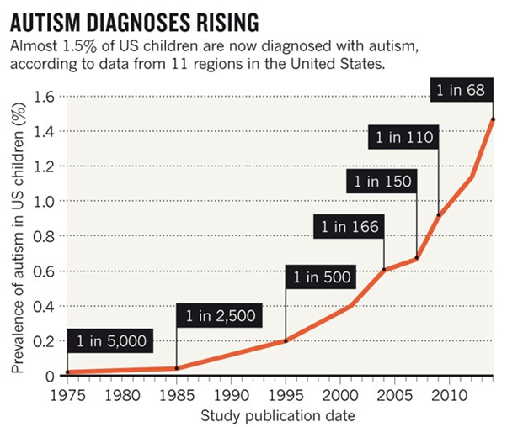
A Frightening Trend*
?
?
*K. Weintraub, Nature 479, Nov. 3 2011, 22-24.
Notes:
./NatureAutismRising.pdf

Slide 4
“If it is an environmental cause contributing to an increase, we certainly want to find it.”*
*K. Weintraub, Nature 479, Nov. 3 2011, 22-24.

Slide 5
“Autism is a multi-factorial condition”

Slide 6
“Autism is a single-factorial condition”

Slide 7
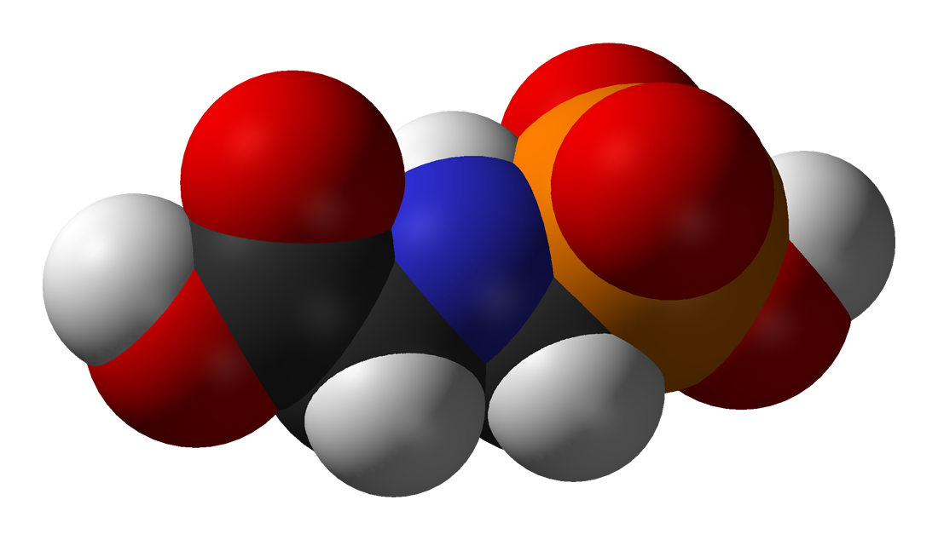
GLYPHOSATE

Slide 8
Outline
Autism and glyphosate: Introduction
Glyphosate is TOXIC to humans
My earlier papers reexamined
Glyphosate and aluminum
Glyphosate and arsenic
Glyphosate and manganese
Lactobacillus and anxiety
Glutamate and ammonia
Mitochondrial disorder
Thyroid hormone
Impaired bone development
Recommendations and Summary

Slide 9
Outline
Autism and glyphosate: Introduction
Glyphosate is TOXIC to humans
My earlier papers reexamined
Glyphosate and aluminum
Glyphosate and arsenic
Glyphosate and manganese
Lactobacillus and anxiety
Glutamate and ammonia
Mitochondrial disorder
Thyroid hormone
Impaired bone development
Recommendations and Summary

Slide 10
Glyphosate and Autism*
R = 0.9898; p <= 2.6e-06
Pearson Correlation Coefficient = 0.99
*Nancy Swanson, http://www.examiner.com/article/
data-show-correlations-between-increase-neurological-diseases-and-gmos
Notes:
Nancy Swanson – I have a fanclub account for her.
Individuals with disabilities in education act IDEA

Slide 11
Glyphosate and Autism*
U.S. Market is 25% of World Market of Roundup
R = 0.9898; p <= 2.6e-06
Pearson Correlation Coefficient = 0.99
*Nancy Swanson, http://www.examiner.com/article/
data-show-correlations-between-increase-neurological-diseases-and-gmos
Notes:
Nancy Swanson – I have a fanclub account for her.
Individuals with disabilities in education act IDEA

Slide 12
Is Glyphosate Nontoxic?
Monsanto has argued that glyphosate is harmless to humans because our cells don’t have the shikimate pathway, which it inhibits
However, our gut bacteria DO have this pathway
We depend upon them to supply us with essential amino acids (among many other things)
Other ingredients in Roundup greatly increase glyphosate’s toxic effects
Insidious effects of glyphosate accumulate over time
Most studies are too short to detect damage

Slide 13
Main Toxic Effects of Glyphosate*
Kills beneficial gut bacteria and allows pathogens to overgrow
Interferes with function of cytochrome P450 (CYP) enzymes
Chelates important minerals (iron, cobalt, manganese, etc.)
Interferes with synthesis of aromatic amino acids and methionine
Leads to shortages in critical neurotransmitters and folate
Disrupts sulfate synthesis and sulfate transport
*Samsel and Seneff, Entropy 2013, 15, 1416-1463

Slide 14
The Enhancing Effect of Adjuvants*
“Adjuvants in pesticides are generally declared as inerts, and for this reason they are not tested in long-term regulatory experiments. It is thus very surprising that they amplify up to 1000 times the toxicity of their APs [Active Principles] in 100% of the cases where they are indicated to be present by the manufacturer.”
*R. Mesnage et al.BioMed Research International 2014; Article ID:179691.
Notes:
Glypohsate/seralini_2014_pesticide_toxicity_adjuvants.pdf

Slide 15
Some Biomarkers for Autism
Disrupted gut bacteria; inflammatory bowel
Low serum sulfate
Methionine deficiency
Serotonin and melatonin deficiency
Defective aromatase
Zinc and iron deficiency
Urinary p-cresol
Mitochondrial disorder
Glutamate toxicity in the brain
Notes:
Samantha/zinc_deficiency_autism.text

Slide 16
Some Biomarkers for Autism
Disrupted gut bacteria; inflammatory bowel
Low serum sulfate
Methionine deficiency
Serotonin and melatonin deficiency
Defective aromatase
Zinc and iron deficiency
Urinary p-cresol
Mitochondrial disorder
Glutamate toxicity in the brain
These can all be explained as potential effects of glyphosate on biological systems
Notes:
Samantha/zinc_deficiency_autism.text

Slide 17
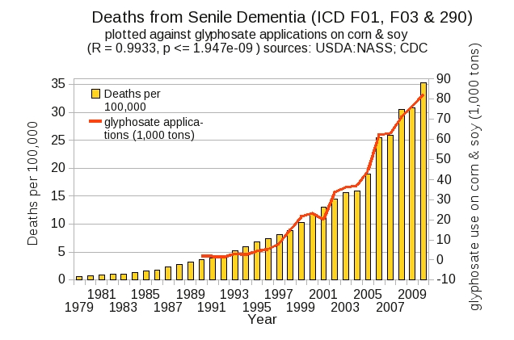
Dementia and Autism Have Much in Common
Plot kindly provided by Nancy Swanson

Slide 18
Outline
Autism and glyphosate: Introduction
Glyphosate is TOXIC to humans
My earlier papers reexamined
Glyphosate and aluminum
Glyphosate and arsenic
Glyphosate and manganese
Lactobacillus and anxiety
Glutamate and ammonia
Mitochondrial disorder
Thyroid hormone
Impaired bone development
Recommendations and Summary

Slide 19
Roundup Safety Claims Disputed*
“It is commonly believed that Roundup is among the safest pesticides. … Despite its reputation, Roundup was by far the most toxic among the herbicides and insecticides tested. This inconsistency between scientific fact and industrial claim may be attributed to huge economic interests, which have been found to falsify health risk assessments and delay health policy decisions.”
*R. Mesnage et al., Biomed Research International, Volume 2014 (2014),
Article ID 179691
Notes:
Glyphosate/ Mesnage_Seralini_2014_glyphosate_toxicity_proven.pdf
This is the first time that all these formulated pesticides have been tested on human cells well below agricultural dilutions.
adjuvants were also more cytotoxic through the disruption of membrane and mitochondrial respiration,
1000-fold enhancement w/ adjuvants

Slide 20
Glyphosate Test Report: Findings in American Mother's Breast milk, urine and water*
Moms Across America initiative!
Breast milk levels ranging from 76 ug/l to 166 ug/l are 760 to 1600 times higher than the European Drinking Water Directive allows
Urine testing shows glyphosate levels over 10 times higher than in Europe
Monsanto is wrong regarding bioaccumulation
*Posted on Apr 6 2014 - 4:19am by Sustainable Pulse

Slide 21
“Another claim of Monsanto's has been that residue levels of up to 5.6 mg/kg in GM-soy represent "...extreme levels, and far higher than those typically found" (Monsanto 1999).”
5.6
*Figure 1, T. Bohn et al. Food Chemistry 153, 15 June 2014, 207-215.
www.greenmedinfo.com/blog/how-extreme-levels-roundup-food-became-industry-normal
Notes:
http://www.greenmedinfo.com/blog/how-extreme-levels-roundup-food-became-industry-normal

Slide 22
Soy Formula Linked to Seizures in Autism*
"There was a 2.6-fold higher rate of febrile seizures, a 2.1-fold higher rate of epilepsy comorbidity and a 4-fold higher rate of simple partial seizures in the autistic children fed soy-based formula"
*CJ Westmark, PLOSOne March 12, 2014, DOI: 10.1371/journal.pone.0080488.
Notes:
./SoyFormulaSeizuresAutism.pdf

Slide 23
Outline
Autism and glyphosate: Introduction
Glyphosate is TOXIC to humans
My earlier papers reexamined
Glyphosate and aluminum
Glyphosate and arsenic
Glyphosate and manganese
Lactobacillus and anxiety
Glutamate and ammonia
Mitochondrial disorder
Thyroid hormone
Impaired bone development
Recommendations and Summary

Slide 24
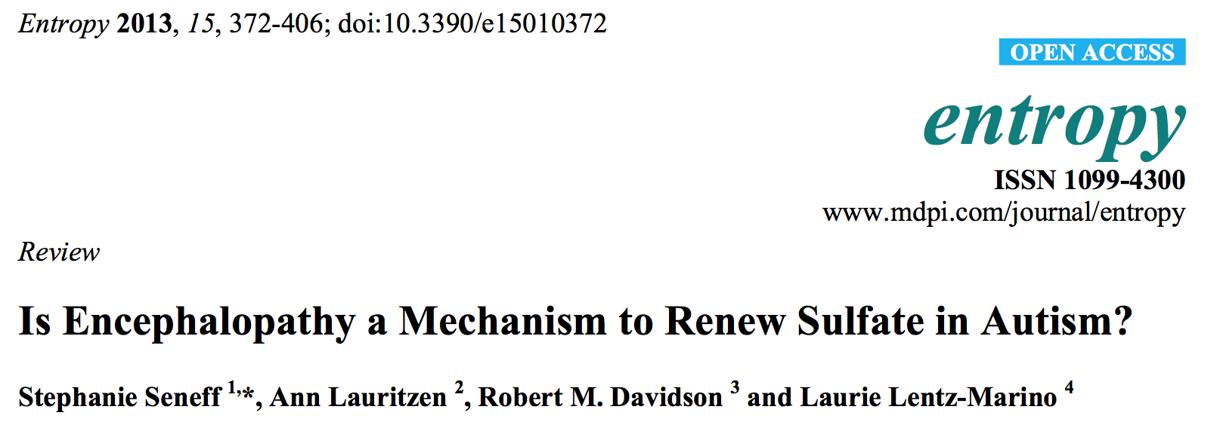
Two Papers

Slide 25
The First Paper
This paper used the US CDC VAERS database to link together preeclampsia, autism and pernicious anemia
Pernicious anemia is due to cobalamin (B12) deficiency
Preeclampsia is a strong risk factor for autism
The symptoms in adverse reactions linked to anemia recapitulate preeclampsia

Slide 26
The First Paper
This paper used the US CDC VAERS database to link together preeclampsia, autism and pernicious anemia
Pernicious anemia is due to cobalamin (B12) deficiency
Preeclampsia is a strong risk factor for autism
The symptoms in adverse reactions linked to anemia recapitulate preeclampsia
Glyphosate chelates cobalt which prevents gut bacteria from producing cobalamin

Slide 27
Figure from Our First Paper*
Glyphosate
*S. Seneff et al., Entropy 2012, 14, 2265-2290.
Notes:
Attached/preeclampsia_paper.pdf

Slide 28
Figure from Our Second Paper*
*S. Seneff et al. Entropy 2013, 15(1), 372-406.

Slide 29
Figure from Our Second Paper*
Glyphosate depletes glutathione and methionine
Glyphosate increases ammonia
Glyphosate increases glutamate
Glyphosate activates NMDA receptors
Glyphosate depletes serotonin
*S. Seneff et al. Entropy 2013, 15(1), 372-406.

Slide 30
Outline
Autism and glyphosate: Introduction
Glyphosate is TOXIC to humans
My earlier papers reexamined
Glyphosate and aluminum
Glyphosate and arsenic
Glyphosate and manganese
Lactobacillus and anxiety
Glutamate and ammonia
Mitochondrial disorder
Thyroid hormone
Impaired bone development
Recommendations and Summary

Slide 31
Autism, Glyphosate, Vaccine Reactions*
Glyphosate application to corn and soy, US
Children with Autism, US
# Adverse Reactions in VAERS
*Collaboration with Nancy Swanson
Notes:
Individuals with Disabilities Education Act

Slide 32
Autism, Glyphosate, Vaccine Reactions*
Glyphosate application to corn and soy, US
Glyphosate makes the aluminum (and mercury?) in vaccines much more toxic
Children with Autism, US
# Adverse Reactions in VAERS
*Collaboration with Nancy Swanson
Notes:
Individuals with Disabilities Education Act

Slide 33
Glyphosate enhances aluminum toxicity
Glyphosate interferes with acetaminophen metabolism

Slide 34
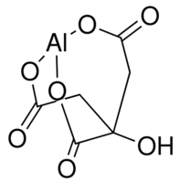
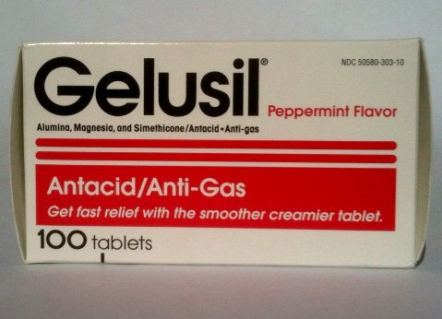
Aluminum Glyphosate*
Six different ways two glyphosate molecules can chelate aluminum
Aluminum citrate**
ALUMINA
aluminum
*M. Purgel et al., Journal of Inorganic Biochemistry 103 (2009) 1426–1438
** P. Sianina et al., Clin. Chem. 32/3, 539-541, 1986.
Notes:
AnthonySamsel/swine/aluminum_glyphosate.pdf
aluminum_citrate_absorbs_well_vinegar_antacids.pdf
Csail/2013/project/Anthony/

Slide 35
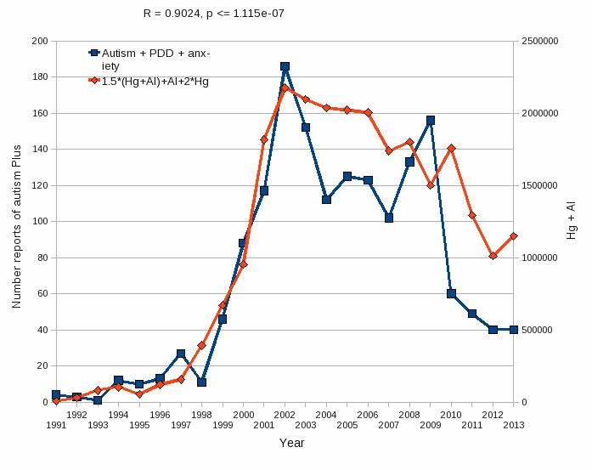
Aluminum & Mercury Autism & PDD & Anxiety
VAERS
database
Formula: Al + 1.5 x (Al w/ Hg) + 2.0 x Hg

Slide 36
Outline
Autism and glyphosate: Introduction
Glyphosate is TOXIC to humans
My earlier papers reexamined
Glyphosate and aluminum
Glyphosate and arsenic
Glyphosate and manganese
Lactobacillus and anxiety
Glutamate and ammonia
Mitochondrial disorder
Thyroid hormone
Impaired bone development
Recommendations and Summary

Slide 37
Glyphosate chelates many metal cations:
I suspect many adverse health effects from chelation of aluminum, arsenic, manganese, and cobalt

Slide 38
Glyphosate chelates many metal cations:
I suspect many adverse health effects from chelation of aluminum, arsenic, manganese, and cobalt

Slide 39
Sri Lanka is the first Country to Ban Glyphosate
arsenic
This problem did not exist in Sri Lanka prior to the 1990s.
Notes:
Project/Glyphosate/glyphosate_sri_lanka_kidney_failure_epidemiology.pdf

Slide 40
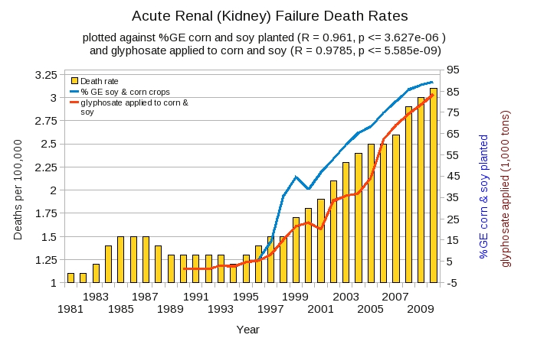
Acute Kidney Disease Death Rate Plotted Against Glyphosate and GMOs*
*Plot prepared by Nancy Swanson from available data online

Slide 41
Acute Kidney Disease Death Rate Plotted Against Glyphosate and GMOs*
Young male agricultural works in sugarcane fields desiccated with glyphosate are dying from kidney disease
*Plot prepared by Nancy Swanson from available data online

Slide 42
Outline
Autism and glyphosate: Introduction
Glyphosate is TOXIC to humans
My earlier papers reexamined
Glyphosate and aluminum
Glyphosate and arsenic
Glyphosate and manganese
Lactobacillus and anxiety
Glutamate and ammonia
Mitochondrial disorder
Thyroid hormone
Impaired bone development
Recommendations and Summary

Slide 43
Manganese!

Slide 44
“The mechanism by which glyphosate disrupts the EPSPS enzyme in plants and microorganism is by chelating the manganese metal co-factor of this enzyme. In other words it steals the ‘ignition key’ of the enzyme.”
Dr. Arden Andersen, D.O.,
Food Plague Primer: Glyphosate and Genetically Engineered Crops
Notes:
attached/Huber2/FoodPlaguePrimer.pdf

Slide 45
“Fundamentally the herbicidal effect of glyphosate is ultimately due to soil pathogens gaining access to the “weed” thanks to glyphosate’s weakening of the plant and killing of beneficial microbes by the chelation of manganese and other trace elements.”
Dr. Arden Andersen, D.O.,
Food Plague Primer: Glyphosate and Genetically Engineered Crops
Notes:
attached/Huber2/FoodPlaguePrimer.pdf

Slide 46
“Fundamentally the herbicidal effect of glyphosate is ultimately due to soil pathogens gaining access to the “weed” thanks to glyphosate’s weakening of the plant and killing of beneficial microbes by the chelation of manganese and other trace elements.”
Dr. Arden Andersen, D.O.,
Food Plague Primer: Glyphosate and Genetically Engineered Crops
This is analogous to glyphosate’s effect on gut bacteria: killing the beneficial bacteria and allowing the pathogens to overgrow
Notes:
attached/Huber2/FoodPlaguePrimer.pdf

Slide 47
Glyphosate Depletes Iron, Manganese and Zinc in Plants*
*D Huber, What About Glyphosate-Induced Manganese Deficiency?
Fluid Journal, 20-22.
Notes:
Glyphosate/glyphosate_induced_manganese_deficiency_plants_Huber.pdf

Slide 48
Severe Deficiency in Serum Manganese and Cobalt in Cows*
Eight different farms: all cows tested had glyphosate in the urine
*M. Krüger et al., J Environ Anal Toxicol 2013, 3:5
Notes:
glyphosate//cows_cobalt_deficiency_glyphosate.pdf

Slide 49
Severe Deficiency in Serum Manganese and Cobalt in Cows*
cobalamin
deficiency
???
Eight different farms: all cows tested had glyphosate in the urine
*M. Krüger et al., J Environ Anal Toxicol 2013, 3:5
Notes:
glyphosate//cows_cobalt_deficiency_glyphosate.pdf

Slide 50
Outline
Autism and glyphosate: Introduction
Glyphosate is TOXIC to humans
My earlier papers reexamined
Glyphosate and aluminum
Glyphosate and arsenic
Glyphosate and manganese
Lactobacillus and anxiety
Glutamate and ammonia
Mitochondrial disorder
Thyroid hormone
Impaired bone development
Recommendations and Summary

Slide 51
Glyphosate Kills Beneficial Bacteria*
Examined effect of glyphosate and Roundup on three food microorganisms widely used as starters in dairy technologies
Two are species of Lactobacillus
Roundup is always more potent than glyphosate, and in all cases, toxic from levels 10–100 times below the lowest agricultural uses (10,000 ppm).
Unpredictable consequences of Roundup on soil microorganisms have to be considered
*E Clair et al. Curr Microbiol (2012) 64:486–491
Notes:
Glyphosate/Clair_glyphosate_toxic_to_lactobacillus_2012.pdf

Slide 52
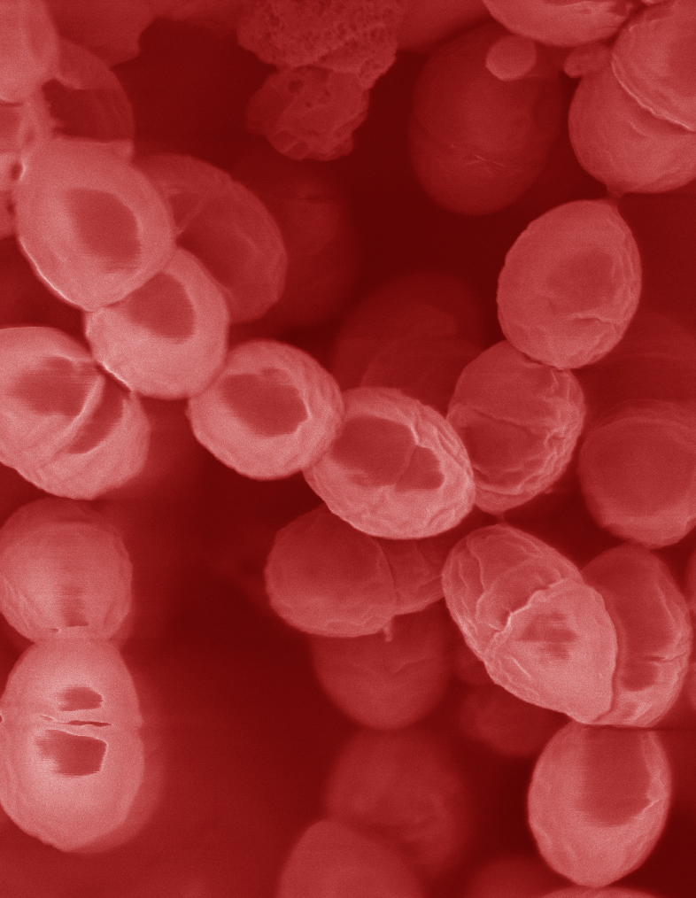
Lactobacillus Depends on Manganese!*
Many lactic acid bacteria contain very high intracellular manganese levels
Scavenges toxic oxygen species, particularly superoxide
Manganese deprivation suppresses growth
* FS Archibald and M-N Duong. Journal of Bacteriology Apr 1084, 1-8.
Notes:
Glyphosate/manganese/manganese_acquisition_by_lactobacillus.pdf

Slide 53
Lactobacillus Depends on Manganese!*
Many lactic acid bacteria contain very high intracellular manganese levels
Scavenges toxic oxygen species, particularly superoxide
Manganese deprivation suppresses growth
Lactobacillus levels are low in the gut in association with autism
* FS Archibald and M-N Duong. Journal of Bacteriology Apr 1084, 1-8.
Notes:
Glyphosate/manganese/manganese_acquisition_by_lactobacillus.pdf

Slide 54
Lactobacillus Alleviate Anxiety*
Patients suffered from chronic fatigue syndrome and associated anxiety
Patients were treated with probiotic strain of Lactobacillus (control group got a placebo)
Significant rise in both Latobacillus and Bifidobacteria in gut
Significant decrease in anxiety symptoms (p = 0.01)
Supports concept of gut-brain axis (communicate with brain via vagal nerve)
*R Av et al. Gut Pathog. 2009 Mar 19;1(1):6. doi: 10.1186/1757-4749-1-6.
Notes:
Glyphosate/manganese/manganese_alleviates_anxiety.text

Slide 55
Lactobacillus Alleviate Anxiety*
Patients suffered from chronic fatigue syndrome and associated anxiety
Patients were treated with probiotic strain of Lactobacillus (control group got a placebo)
Significant rise in both Latobacillus and Bifidobacteria in gut
Significant decrease in anxiety symptoms (p = 0.01)
Supports concept of gut-brain axis (communicate with brain via vagal nerve)
Increased anxiety is a comorbidity of autism
*R Av et al. Gut Pathog. 2009 Mar 19;1(1):6. doi: 10.1186/1757-4749-1-6.
Notes:
Glyphosate/manganese/manganese_alleviates_anxiety.text

Slide 56
Anxiety and Autism*
Specific Phobia: 30%
Obsessive-Compulsive Disorder: 17%
Social Anxiety Disorder/Agoraphobia: 17%
Generalized Anxiety Disorder: 15%
Separation Anxiety Disorder: 9 %
Panic Disorder: 2%
*Van Steensel, F.J.A., Bogels, S.M., & Perrin, S. (2011). Anxiety disorders in children and adolescents with autistic spectrum disorders: A meta-analysis. Clinical Child and Family Psychology Review, 14, 302-317.
Notes:
http://www.iidc.indiana.edu/?pageId=3616

Slide 57
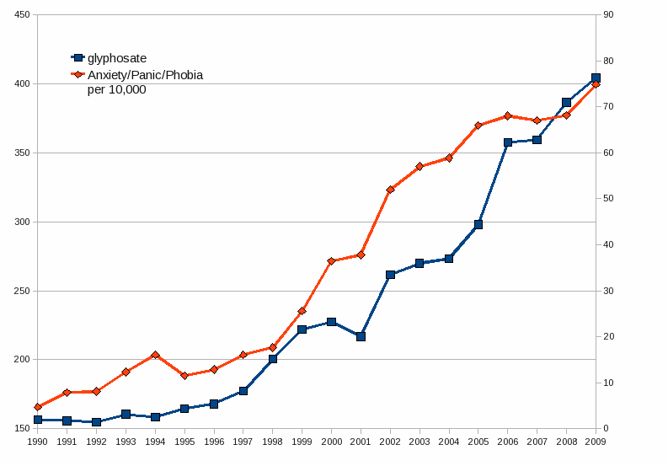
Glyphosate Application on Corn and Soy Plotted against Anxiety, Panic Disorder and Phobias*
*Plots provided by Dr. Nancy Swanson
Notes:
2014/AutismOne/images/anxiety.gif

Slide 58
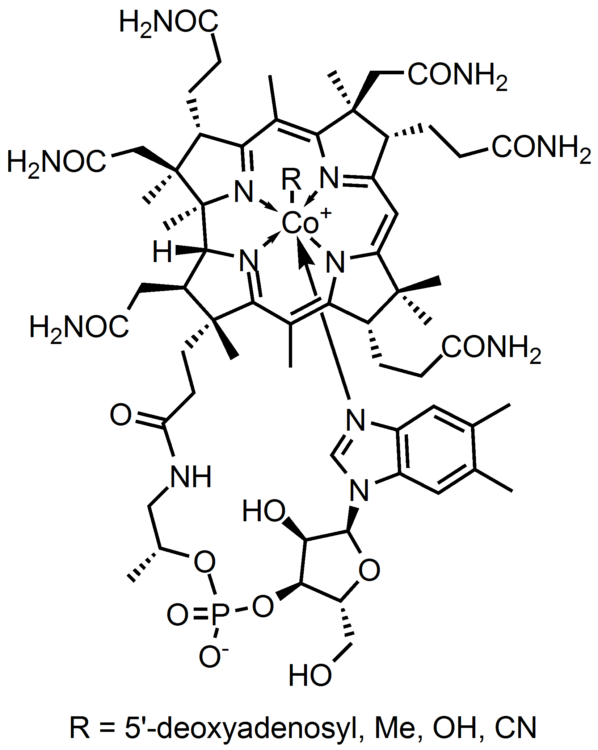
Bacteria Incorporate Cobalt and Iron into Cobalamin and Heme
Heme Iron
Cobalamin

Slide 59
Bacteria Incorporate Cobalt and Iron into Cobalamin and Heme
Glyphosate chelates cobalt and iron and prevents bacteria from producing these important molecules
Heme Iron
Cobalamin

Slide 60
The First Paper
This paper used the US CDC VAERS database to link together preeclampsia, autism and pernicious anemia
Pernicious anemia is due to cobalamin (B12) deficiency
Preeclampsia is a strong risk factor for autism
The symptoms in adverse reactions linked to anemia recapitulate preeclampsia

Slide 61
The First Paper
This paper used the US CDC VAERS database to link together preeclampsia, autism and pernicious anemia
Pernicious anemia is due to cobalamin (B12) deficiency
Preeclampsia is a strong risk factor for autism
The symptoms in adverse reactions linked to anemia recapitulate preeclampsia

Slide 62
Outline
Autism and glyphosate: Introduction
Glyphosate is TOXIC to humans
My earlier papers reexamined
Glyphosate and aluminum
Glyphosate and arsenic
Glyphosate and manganese
Lactobacillus and anxiety
Glutamate and ammonia
Mitochondrial disorder
Thyroid hormone
Impaired bone development
Recommendations and Summary

Slide 63
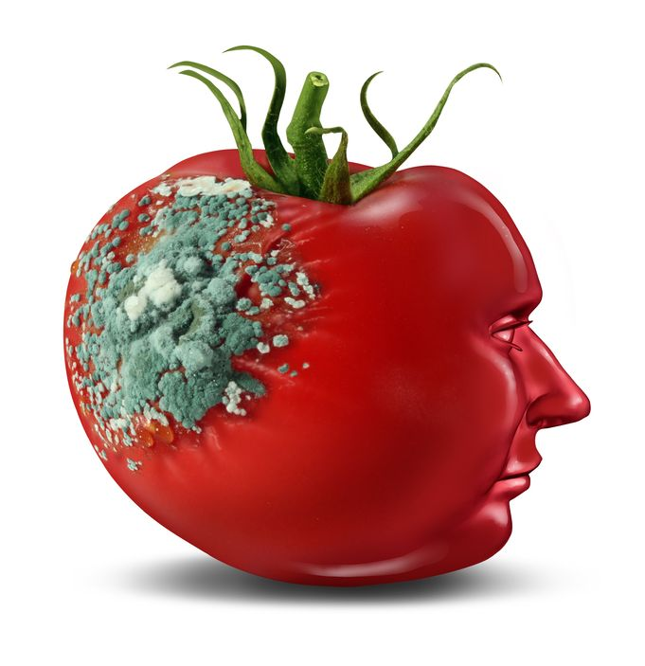
Glyphosate and Glutamate*
Acute exposure activates NMDA receptors and voltage-dependent calcium channels
Oxidative stress and neural cell death
Increased glutamate released into the synaptic cleft → excessive extracellular glutamate levels
Decreased glutathione content
Increased peroxidation of lipids (fats)
Chronic exposure:
Decreased glutamate uptake and metabolism
Induced calcium uptake
Induced oxidative stress
*http://www.greenmedinfo.com/blog/roundup-weedkiller-brain-damaging-neurotoxin
Notes:
http://www.greenmedinfo.com/blog/roundup-weedkiller-brain-damaging-neurotoxin
acute exposure (30 minutes) and chronic (pregnancy and lactation) exposure.
Why was this referenced??
T. Bohn et al. Food Chemistry 153, 15 June 2014, 207-215.

Slide 64
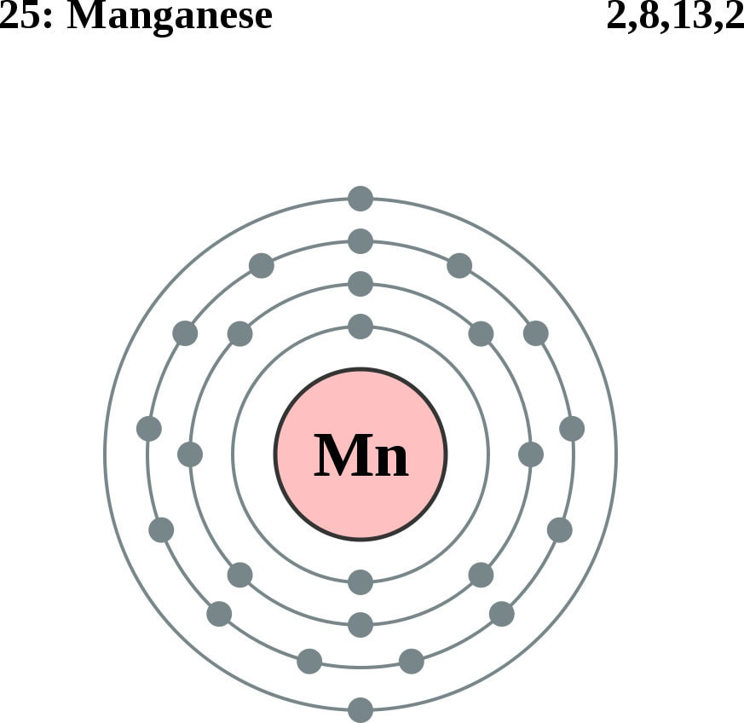
Glutamine Synthesis Depends on Manganese!
Glutamine synthetase
glutamate
glutamine
water
ammonium
Ammonium and glutamate toxicity in the brain
can arise because of insufficient manganese

Slide 65
Glutamate and GABA*
*NM Rowley et al. Neurochemistry International 61 (2012) 546–558.
Notes:
Treasures/glutamate_GABA_synthesis_transport_release.pdf
Fig. 1. Cartoon summarizing the synthesis, packaging, release, transport, and metabolism of glutamate and GABA. Glutaminase converts glutamine to glutamate, which is converted to GABA by GAD in GABAergic neurons. The neurotransmitters are subsequently transported by vesicular transporters into vesicles for release. Upon release, neurotransmitters are taken up by high affinity membrane transporters into neurons and surrounding glia where they can be recycled or metabolized via several enzymes. Abbreviations: 2-OG, 2-oxoglutarate; AAT, aspartate aminotransferase; Aralar, aspartate-glutamate carrier; Asp, aspartate; EAAT, excitatory amino acid transporter; GABA-T, GABA transaminase; GAD, glutamic acid decarboxylase; GAT, GABA transporter; GDH, glutamate dehydrogenase; SSA, succinic semialdehyde; TCA, tricarboxylic acid cycle; vGAT, vesicular GABA transporter; vGlut, vesicular glutamate transporter.

Slide 66
Glutamate and GABA*
Glutamate and ammonia both build up to toxic levels because of manganese deficiency
*NM Rowley et al. Neurochemistry International 61 (2012) 546–558.
Notes:
Treasures/glutamate_GABA_synthesis_transport_release.pdf
Fig. 1. Cartoon summarizing the synthesis, packaging, release, transport, and metabolism of glutamate and GABA. Glutaminase converts glutamine to glutamate, which is converted to GABA by GAD in GABAergic neurons. The neurotransmitters are subsequently transported by vesicular transporters into vesicles for release. Upon release, neurotransmitters are taken up by high affinity membrane transporters into neurons and surrounding glia where they can be recycled or metabolized via several enzymes. Abbreviations: 2-OG, 2-oxoglutarate; AAT, aspartate aminotransferase; Aralar, aspartate-glutamate carrier; Asp, aspartate; EAAT, excitatory amino acid transporter; GABA-T, GABA transaminase; GAD, glutamic acid decarboxylase; GAT, GABA transporter; GDH, glutamate dehydrogenase; SSA, succinic semialdehyde; TCA, tricarboxylic acid cycle; vGAT, vesicular GABA transporter; vGlut, vesicular glutamate transporter.

Slide 67
“Alteration of Plasma Glutamate and Glutamine Levels in Children with High-Functioning Autism”*
*C. Shimmura et al. PLoSone October 2011 6(1):e25340
Notes:
Table 1. Plasma Levels of Amino Acids and related compounds in Control Subjects and Individuals with HFA.
Glyphosate/glutamate_glutamine_autism_2011.pdf

Slide 68
Journal of Personal Science: One Child’s Autism Eliminated by Removal of Glutamate From Her Diet* By Katherine Reid
First Round:
Kale, cucumber, cilantro, nuts, seeds, fruits
Magnesium B-complex, vitamin D3, omega 3 fats (EPA, DHA)
Probiotics
Gluten free and casein free (no wheat, no milk)
Child improved significantly but still had autistic behaviors
Second Round:
ADD: ELIMINATE FREE GLUTAMATE
Child lost the "autism" label!
*blog.sethroberts.net/2013/05/17/journal-of-personal-science-
one-childs-autism-eliminated-by-removal-of-glutamate-from-her-diet
Notes:
./glutamate_autism_personal_story.pdf

Slide 69
Figure from Our Second Paper*
Glyphosate depletes glutathione and methionine
Glyphosate increases ammonia
Glyphosate increases glutamate
Glyphosate activates NMDA receptors
Glyphosate depletes serotonin
*S. Seneff et al. Entropy 2013, 15(1), 372-406.

Slide 70
Figure from Our Second Paper*
Glyphosate depletes glutathione and methionine
Glyphosate increases ammonia
Glyphosate increases glutamate
Glyphosate activates NMDA receptors
Glyphosate depletes serotonin
*S. Seneff et al. Entropy 2013, 15(1), 372-406.

Slide 71
Glyphosate suppresses tryptophan synthesis by plants and gut bacteria
Glyphosate suppresses aromatase which converts testosterone to estrogen
Glyphosate suppresses vitamin D activation in the liver
Autism is associated with low activated vitamin D and low brain serotonin
Vitamin D activates serotonin receptors in the brain
Estrogen rescues females by boosting serotonin levels in brain
Recommendation is supplements in both vitamin D and tryptophan (precursor to serotonin)
Notes:
Samantha/vitamin_D_regulates_serotonin_synthesis_2014.pdf

Slide 72
Outline
Autism and glyphosate: Introduction
Glyphosate is TOXIC to humans
My earlier papers reexamined
Glyphosate and aluminum
Glyphosate and arsenic
Glyphosate and manganese
Lactobacillus and anxiety
Glutamate and ammonia
Mitochondrial disorder
Thyroid hormone
Impaired bone development
Recommendations and Summary

Slide 73
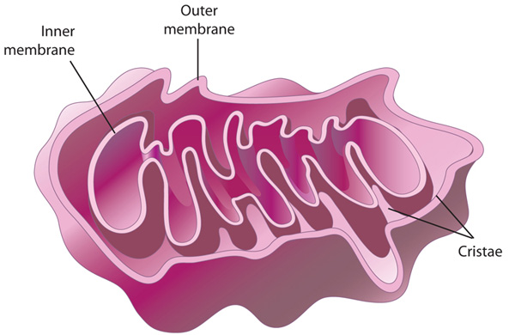
Autism and Mitochondrial Disorder*
“Five of 11 patients studied were classified with definite mitochondrial respiratory chain disorder, suggesting that this might be one of the most common disorders associated with autism”
Manganese superoxide dismutase plays a critical role in protecting mitochondria from oxidative damage
*G Oliveira et al. Developmental Medicine & Child Neurology 47(3), 185-189, 2005.
Notes:
http://onlinelibrary.wiley.com/doi/10.1111/j.1469-8749.2005.tb01113.x/full
69 kids total, they picked the 11 based on them being most likely to have it?
7.2% of 69 is still very high.

Slide 74
Detoxification of Superoxide (O₂⁻)
GLUTATHIONE
SELENIUM
MANGANESE
Glyphosate disrupts all of these!
IRON

Slide 75
Citric Acid Cycle in Mitochondria
aconitase
*PR Gardner. Methods in Enzymology 349:9–23.
Notes:
WIKI on aconitase – in definitions (notes)

Slide 76
Citric Acid Cycle in Mitochondria
aconitase
The iron sulfur cluster in aconitase is highly sensitive to oxidation by superoxide*
*PR Gardner. Methods in Enzymology 349:9–23.
Notes:
WIKI on aconitase – in definitions (notes)

Slide 77
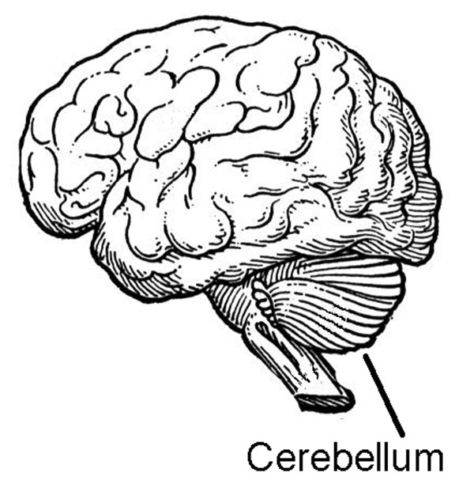
Aconitase Dysfunction and Brain Inflammation in Autism*
Frozen samples of post-mortem tissues from cerebellum and temporal cortex of autism patients compared with controls.
Compared to controls:
Aconitase activity was significantly reduced in the cerebellum and correlated with low glutathione levels
Biomorkers of inflammation were increased
*S. Rose et al. Transl Psychiatry (2012) 2:e134.
Notes:
Glyphosate/aconitase_autism.text

Slide 78
Aconitase & Glutathione in Cerebellum in Autism*
* S Rose et al. Transl Psychiatry (2012) 2:e134.
Notes:
Samantha/Evidence_of_oxidative_damage_and_inflammation_associated_with_lowglutathione_redox_status_in_the_Autism_Brain.pdf
From Gerry Koenig!!

Slide 79
Outline
Autism and glyphosate: Introduction
Glyphosate is TOXIC to humans
My earlier papers reexamined
Glyphosate and aluminum
Glyphosate and arsenic
Glyphosate and manganese
Lactobacillus and anxiety
Glutamate and ammonia
Mitochondrial disorder
Thyroid hormone
Impaired bone development
Recommendations and Summary

Slide 80
Maternal Low Thyroid and Autism*
“Severe maternal hypothyroxinemia early in gestation increased the likelihood of having an autistic child by almost 4-fold.”
Thyroid hormone is derived from tyrosine, one of the three aromatic amino acids produced via the shikimate pathway
*http://www.medscape.com/viewarticle/809718
Notes:
Samantha/LowThyroidAutism.pdf

Slide 81
Dopamine and Thyroid Hormone*
Like thyroid hormone, dopamine is derived from the aromatic amino acid tyrosine
Dopamine inhibits thyroid stimulating hormone
Corollary: insufficient dopamine leads to overactive thyroid → burnout
Thyroid hormone promotes synaptogenesis, synaptic vesicle and receptor recycling, neurotransmitter reuptake, and growth factor receptor signaling
*OP Soldin and M Aschner. Neurotoxicology 2007 September; 28(5):951–956
Notes:
Glyphosate/manganese_and_thyroid_hormone_Judy.pdf

Slide 82
Glyphosate and Thyroid Cancer*
*Graph kindly provided by Nancy Swanson

Slide 83
Outline
Autism and glyphosate: Introduction
Glyphosate is TOXIC to humans
My earlier papers reexamined
Glyphosate and aluminum
Glyphosate and arsenic
Glyphosate and manganese
Lactobacillus and anxiety
Glutamate and ammonia
Mitochondrial disorder
Thyroid hormone
Impaired bone development
Recommendations and Summary

Slide 84
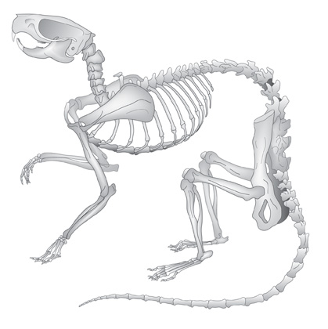
Glyphosate and Bone Development*
Dams treated with glyphosate in water from days 6 to 15 of their pregnancy
Effects on pups:
Lack of development of the ossification centers of the terminal phalanges (bones in fingers and toes)
Larger fontanelles ("soft spot") and incomplete development of skull bones
Absence of important bones or parts of bones, shortenings, bendings, asymmetry, fusions or clefts.
Surfactant polyoxyethyleneamine increased glyphosate's toxicity
*E. Dallegrave et al. Toxicology Letters 142 (2003) 45-52.
Notes:
Glyphosate/./abnormal_ossification_skeleton_glyphosate_rats_2003.pdf

Slide 85
Manganese and Bones*
“The multiple cellular effects of Mn deficiency include: decreased bone resorption, production of labile bone, and decreased synthesis of organic matrix. The serum level of Mn in a group of osteoporotic postmenopausal women was significantly lower than age-matched controls.”
*L. Strause and P. Saltman. Role of Manganese in Bone Metabolism.
Chapter 5, pp 46–55 in Nutritional Bioavailability of Manganese.
Notes:
http://pubs.acs.org/doi/abs/10.1021/bk-1987-0354.ch005
Glyphosate/manganese_and_bones.text

Slide 86
Osteoblasts build “Ground Substance”
Ground substance is made of chondroitin sulfate and osteocalcin – collagen is layered over this
Poor mineralization results from impaired chondroitin sulfate synthesis
Osteoblasts in bone
Childhood osteoarthritis and osteomalacia are an epidemic in the US today

Slide 87
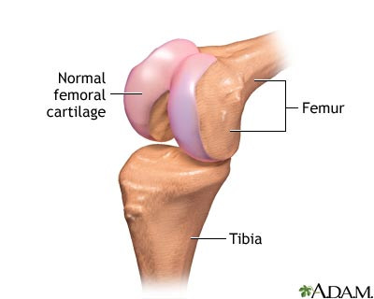
Chondroitin Sulfate Synthesis in Cartilage depends on Manganese*
Two critical enzymes are manganese dependent:
Polymerase enzyme forms the polysaccharide
Galactotransferase incorporates galactose that links the polysaccharide to the protein associated with it.
*RM Leach et al. Archives of Biochemistry and Biophysics 133(1), 1969, 22-28.
Notes:
glyphosate/chondroitin_sulfate_manganese_cartilege.text

Slide 88
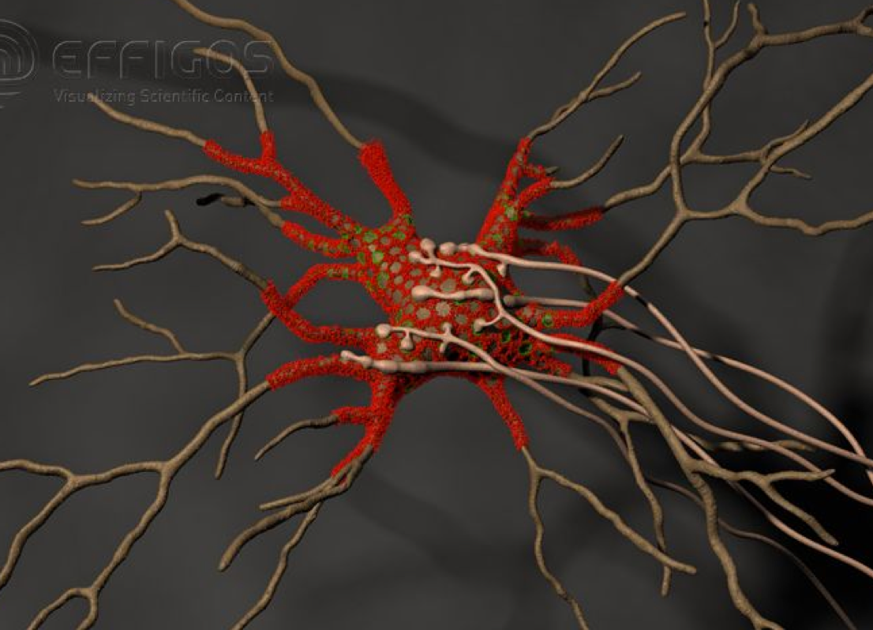
Perineuronal Nets*
Perineuronal nets (PNs) formed from chondroitin sulfate attached to hyaluronan, modulate GABAergic inhibitory signaling
Removal of PNs increased the excitability of interneurons in cultures
They provide an environment rich in anions (negative charge)
*G. Bruckner et al. Glia 8(3), 183-200, 1993.
Notes:
http://onlinelibrary.wiley.com/doi/10.1002/dneu.20361/full

Slide 89
Perineuronal Nets*
Perineuronal nets (PNs) formed from chondroitin sulfate attached to hyaluronan, modulate GABAergic inhibitory signaling
Removal of PNs increased the excitability of interneurons in cultures
They provide an environment rich in anions (negative charge)
Might manganese deficiency lead to impaired synthesis of perineuronal nets and increased neuronal excitability leading to cell death??
*G. Bruckner et al. Glia 8(3), 183-200, 1993.
Notes:
http://onlinelibrary.wiley.com/doi/10.1002/dneu.20361/full

Slide 90
Coral Die-Off & Chondroitin Sulfate*
Large amounts of chondroitin sulfate are adsorbed onto coral
Sulfate groups are of paramount importance to the adsorption process
Adsorption rate is a direct function of the amount of negative charge
*N. Volpi. Biomaterials 2002 Jul;23(14):3015-22.
Notes:
Project/glyphsate/chondroitin_sulfate_coral.text

Slide 91
“Disease Causes Starfish to Lose Arms, Dissolve into White Blobs of Goo” *
Glyphosate is used to kill seagrass in oyster beds
"Glyphosate and diuron are among the most frequently detected herbicides in oyster production areas"**
Starfish eat oysters
*http://natureworldnews.com/articles/4749/20131104/
disease-causes-starfish-lose-arms-dissolve-white-blobs-goo-video.htm
**F. Akcha et al. Aquatic Toxicology. 106-107 (pp 104-113), 2012
Notes:
Glyphosate/glyphosate_oyster_toxicity.text

Slide 92
Recapitulation
Glyphosate chelates manganese
Manganese deficiency leads to:
Disrupted gut bacteria → anxiety
Tyrosine depletion → thyroid disease
Glutamate and ammonium toxicity in the brain as well as glutamine deficiency
Mitochondrial damage
Impaired bone development and osteoporosis
Impaired development of perineuronal nets
Many of these pathologies are associated with autism

Slide 93
Outline
Autism and glyphosate: Introduction
Glyphosate is TOXIC to humans
My earlier papers reexamined
Glyphosate and aluminum
Glyphosate and arsenic
Glyphosate and manganese
Lactobacillus and anxiety
Glutamate and ammonia
Mitochondrial disorder
Thyroid hormone
Impaired bone development
Recommendations and Summary

Slide 94
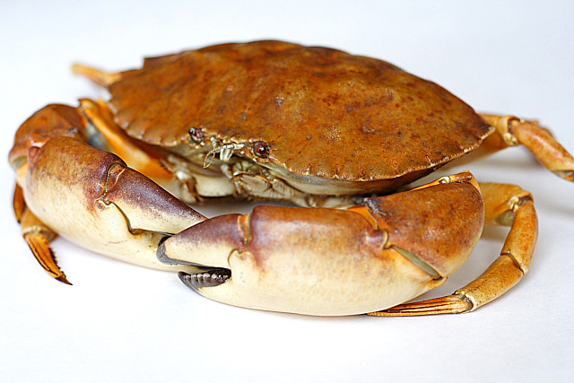
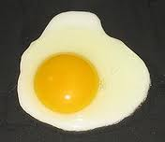
Foods High in Sulfur
Notes:
http://healthyeatingclub.com/info/books-phds/books/foodfacts/html/data/data5g.html

Slide 95
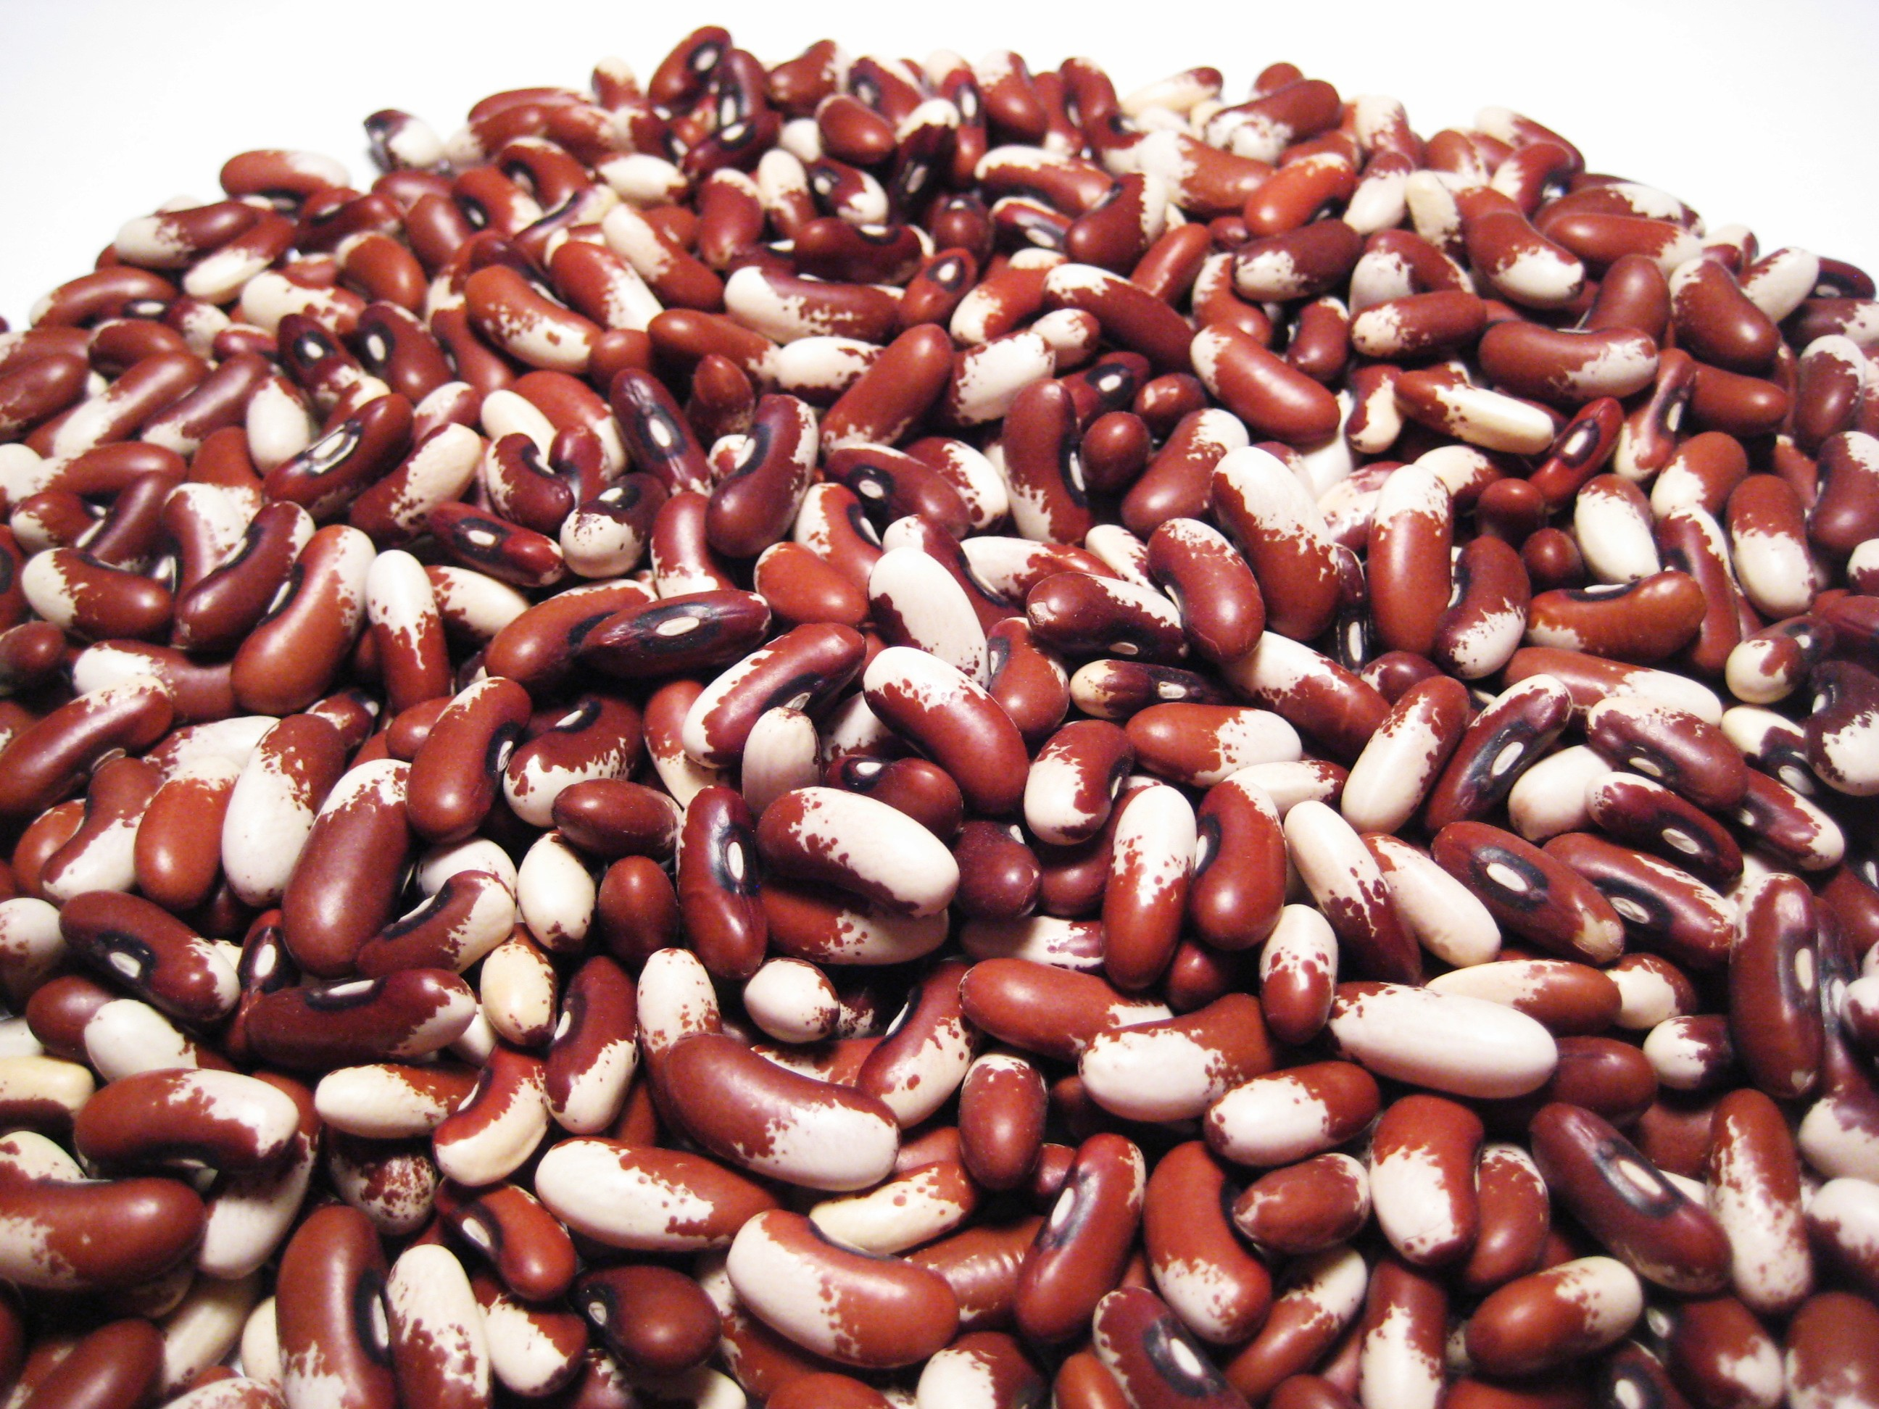
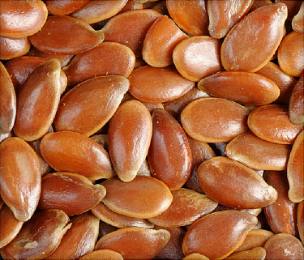
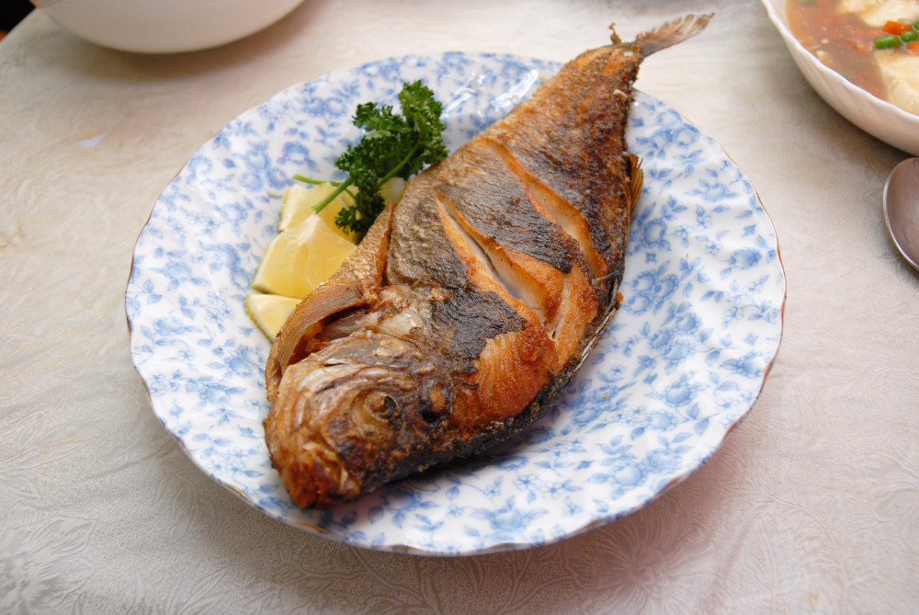
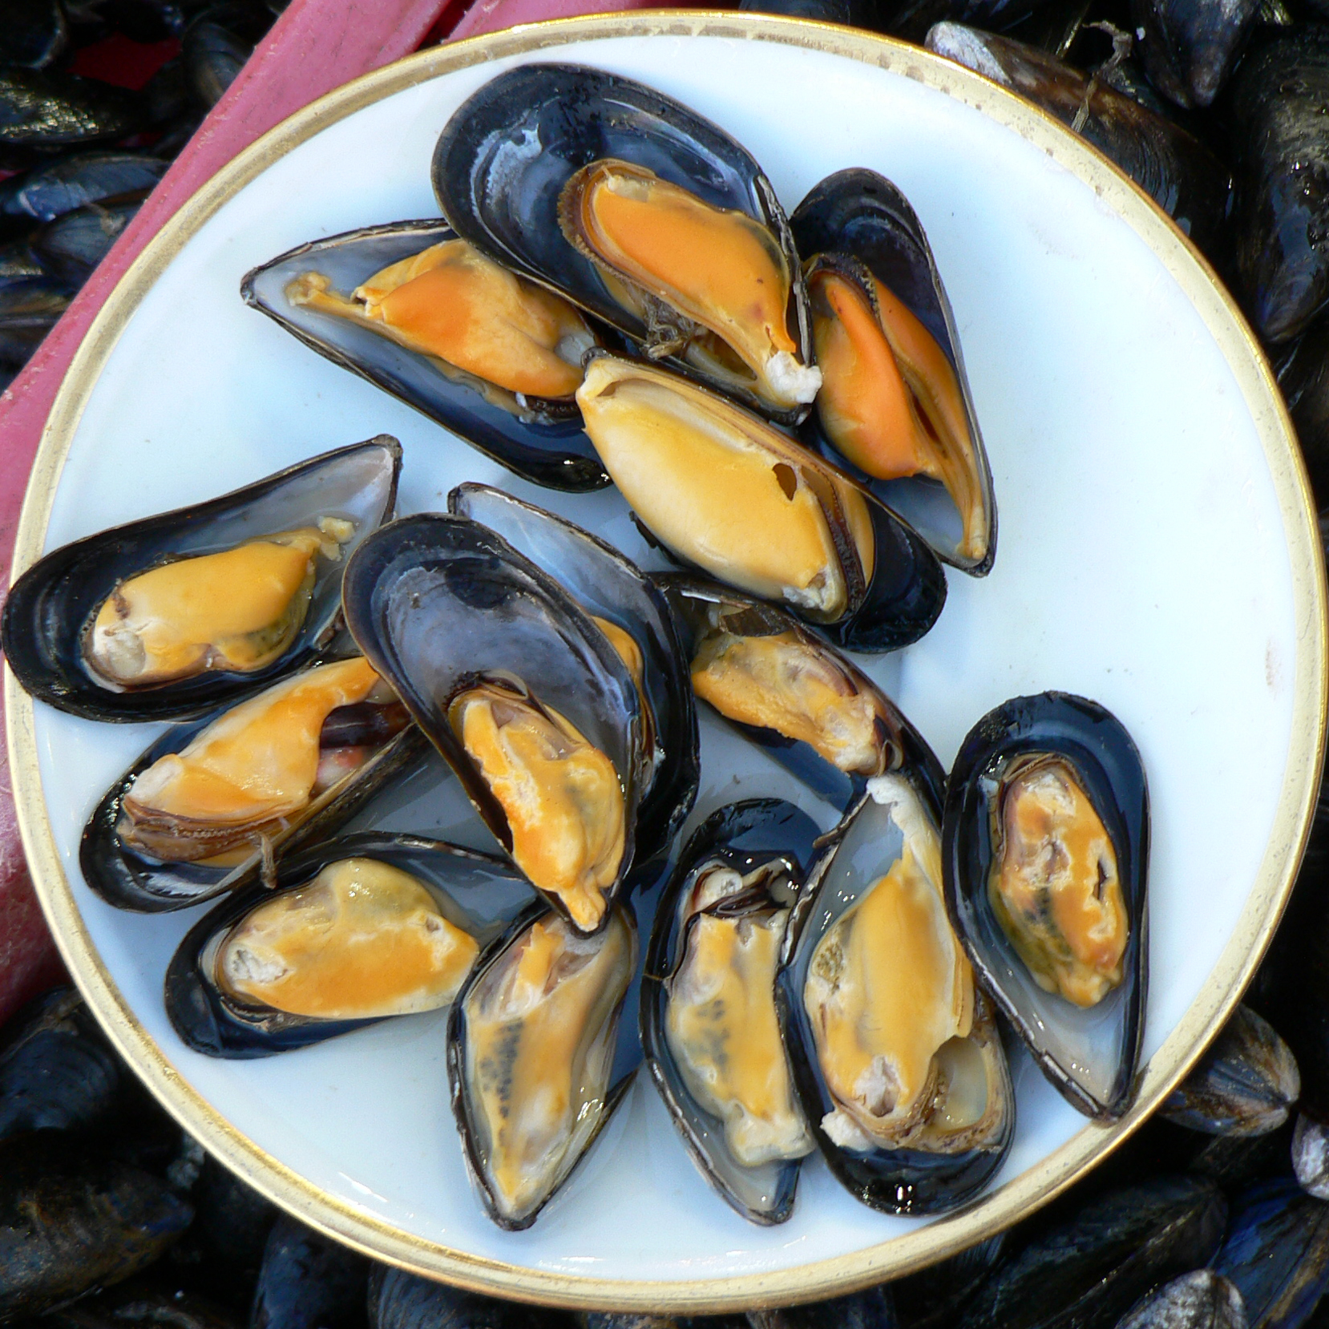
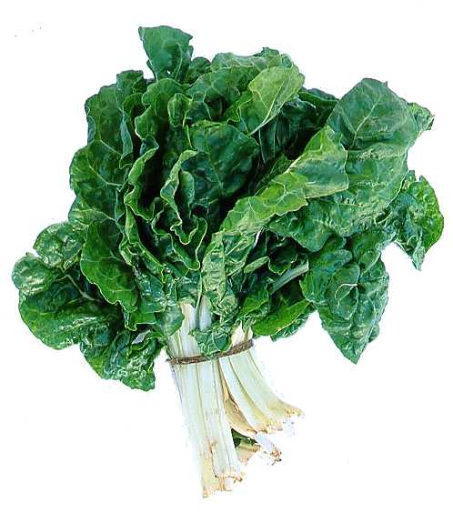
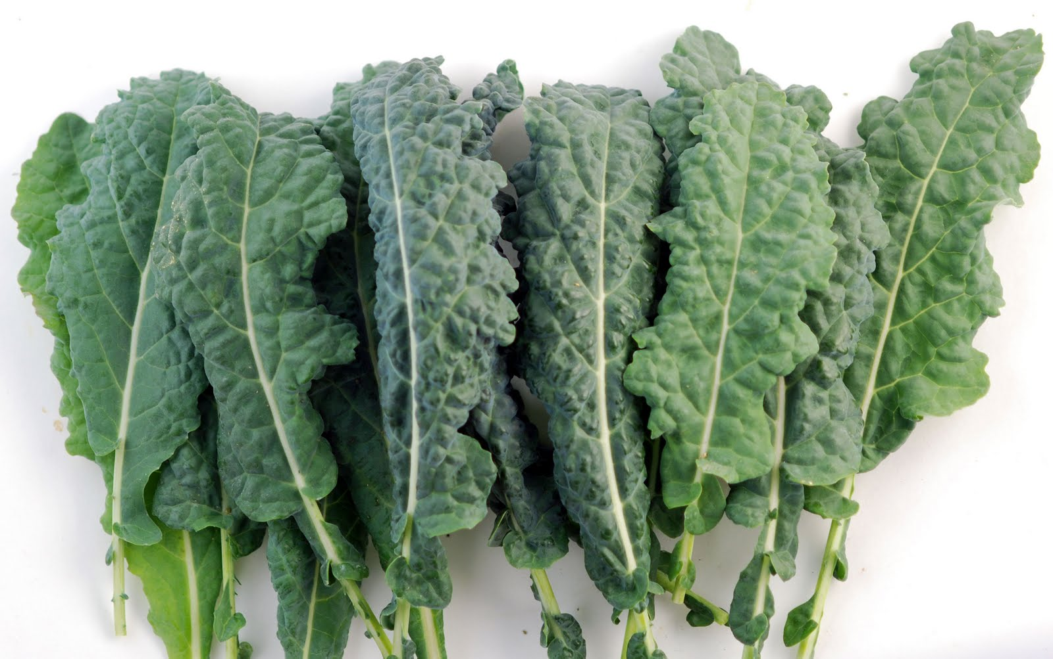
Foods High in Manganese

Slide 96
Go Organic!

Slide 97
Summary
Contrary to popular belief, glyphosate is toxic to humans and is likely the number one factor in the autism epidemic
Glyphosate’s chelation of rare minerals is a core component of its toxicity
Disrupted gut bacteria leads to multiple problems
Aluminum and manganese pathology can account for many aspects of autism
Dementia may well be the same story
Autism may be treatable through organic diet enriched in sulfur and manganese

