Slide 1
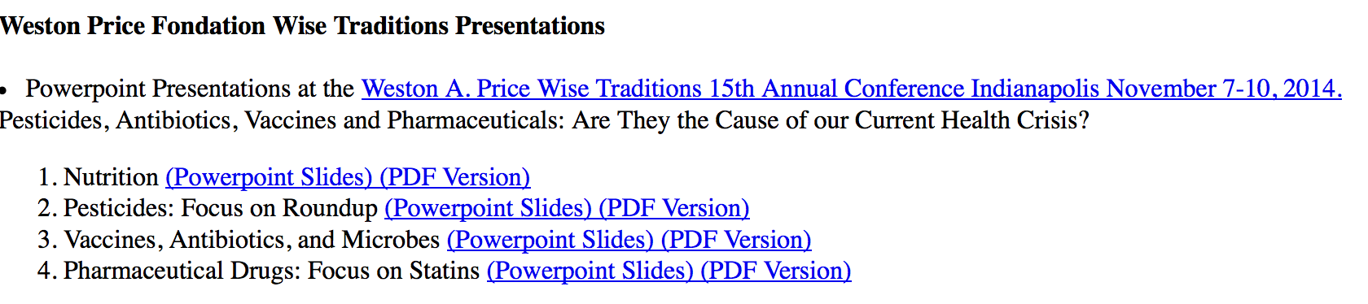
Download these slides! http://people.csail.mit.edu/seneff
….
….
Download individual files from these links:
people.csail.mit.edu/seneff/Indianapolis/
  Drugs.pdf Nutrition.pdf antibiotics_vaccines.pdf glyphosate_new.pdf
  Drugs.pptx Nutrition.pptx antibiotics_vaccines.pptx glyphosate_new.pptx
Notes:
Drugs.pdf Nutrition.pdf antibiotics_vaccines.pdf glyphosate_new.pdf
Drugs.pptx Nutrition.pptx antibiotics_vaccines.pptx glyphosate_new.pptx

Slide 2
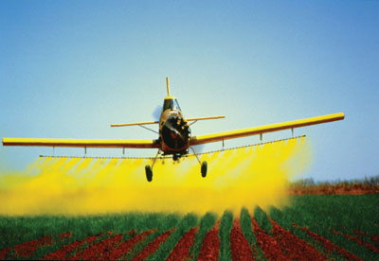
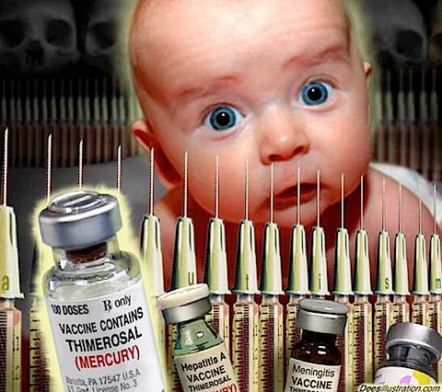
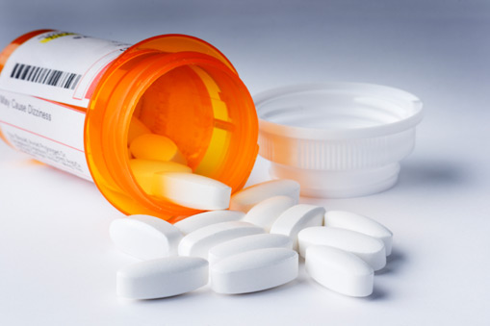
Pesticides, Antibiotics, Vaccines and Pharmaceuticals: Are They the Cause of our Current Health Crisis?
Stephanie Seneff
MIT CSAIL
Nov. 7 2014
WAPF Wise Traditions Workshop
Indianapolis, Illinois

Slide 3

The mind is like a parachute –
it works best when open!

Slide 4
"If people let the government decide what foods they eat and what medicines they take, their bodies will soon be in as sorry a state as are the souls who live under tyranny"
Thomas Jefferson (1743 - 1826)

Slide 5
Outline
Very brief overview
Nutrition and health
Pesticides: focus on Roundup
Vaccines, antibiotics and microbes
Pharmaceutical drugs: focus on statins

Slide 6
Outline
Very brief overview
Nutrition and health
Pesticides: focus on Roundup
Vaccines, antibiotics and microbes
Pharmaceutical drugs: focus on statins

Slide 7

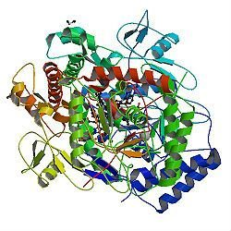
A Provocative Proposal
Cholesterol sulfate supplies oxygen, sulfur, cholesterol, energy energy and negative charge to all the tissues
Sulfate is synthesized from sulfide in skin and blood stream utilizing energy in sunlight
  Protects from UV damage and keeps microbes out
Endothelial Nitric Oxide Synthase (eNOS) performs the magic
The skin is a solar powered battery!

Slide 8
A Provocative Proposal
Cholesterol sulfate supplies oxygen, sulfur, cholesterol, energy energy and negative charge to all the tissues
Sulfate is synthesized from sulfide in skin and blood stream utilizing energy in sunlight
  Protects from UV damage and keeps microbes out
Endothelial Nitric Oxide Synthase (eNOS) performs the magic
BOLD CLAIM:
Deficiencies in cholesterol and sulfate supplies to the blood and to the tissues are the most important factor behind modern diseases
The skin is a solar powered battery!

Slide 9
eNOS is Very Vulnerable*
eNOS depends on:
  Cobalamin (vitamin B12, cobalt)
  Heme iron, sulfur, zinc, oxygen
  Glutathione
  Sunlight
  Tryptophan: converts UV to blue light; source of NAD
eNOS is a cytochrome P450 enzyme:
  Highly vulnerable to various environmental toxicants like mercury, aluminum, glyphosate, etc.
*S. Seneff et al., Entropy 2012, 14, 2492-2530.

Slide 10
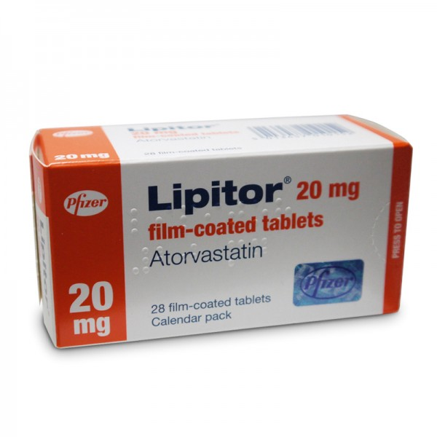
High Serum Lipids is Not Correlated with Ischemic Heart Disease!
Collaboration with Dr. Chen Li and Dr. Nancy Swanson

Slide 11
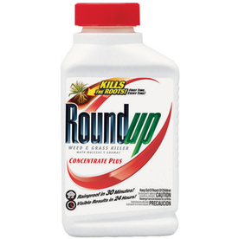
High Serum Lipids IS Correlated with Glyphosate Usage
Collaboration with Dr. Chen Li and Dr. Nancy Swanson

Slide 12
What happens to us in the modern world
Toxic chemicals in the food destroy the gut and then the liver and then the kidneys and the heart and the brain
Vaccines work synergistically with pesticides to cause harm to the brain
Drugs make things worse by disrupting essential biological pathways
We develop many painful and debilitating chronic illnesses

Slide 13
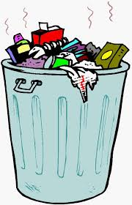
At the Cellular Level…
CELL
Cells deficient in cholesterol sulfate can’t recycle their garbage
They have two options:
  Proliferate to dilute the garbage
  Die and let a macrophage clean up the mess
When even the macrophages are sick:
  Proliferation is the only option → cancer
  Prostate cancer cells produce cholesterol sulfate
  Breast cancer cells produce estrone sulfate → good substitute for cholesterol sulfate

Slide 14
At the Cellular Level…
CELL
Cells deficient in cholesterol sulfate can’t recycle their garbage
They have two options:
  Proliferate to dilute the garbage
  Die and let a macrophage clean up the mess
When even the macrophages are sick:
  Proliferation is the only option → cancer
  Prostate cancer cells produce cholesterol sulfate
  Breast cancer cells produce estrone sulfate → good substitute for cholesterol sulfate
Neurons in the brain clear their cellular debris while we sleep, and they depend upon sulfate to do this.

Slide 15
Wake-Sleep Cycle*
“Circadian signals are more important than food or exercise for wellness. Wellness is about optimized circadian signal specificity and sensitivity.”
Jack Kruze, MD
*jackkruse.com/tensegrity-4-magnetism-electrons-sleep/
(Thanks to Lienke Katz for pointing me to Jack Kruze’s writings)

Slide 16
Wake-Sleep Cycle*
“Circadian signals are more important than food or exercise for wellness. Wellness is about optimized circadian signal specificity and sensitivity.”
Jack Kruze, MD
Healthy circadian rhythms
depend on sulfate
*jackkruse.com/tensegrity-4-magnetism-electrons-sleep/
(Thanks to Lienke Katz for pointing me to Jack Kruze’s writings)

Slide 17
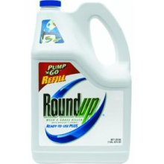
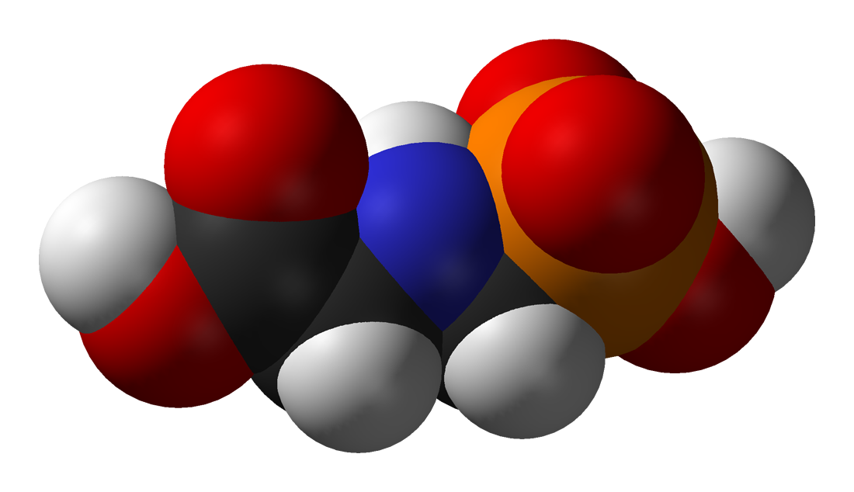
GLYPHOSATE

Slide 18
P < 0.0000077

Slide 19
U.S. Market is 25% of World Market of Roundup

Slide 20
Sleep disorder is associated with depression, Alzheimer’s disease, dementia, Parkinson’s disease, ADHD, multiple sclerosis and autism.

Slide 21
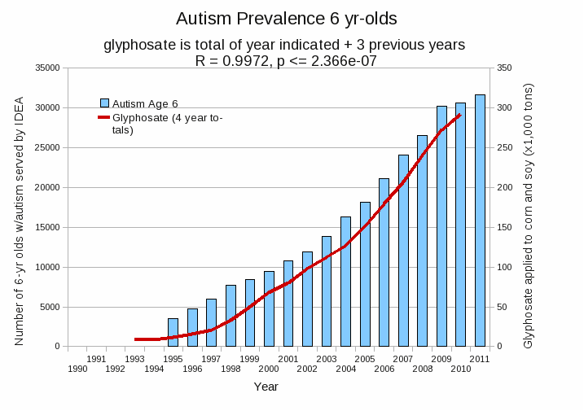
Autism Prevalence: 6 year olds
R = 0.9972
*Plot provided by Nancy Swanson, with permission
Data sources: autism: US Department of Education; Glyphosate: US Department of Agriculture
Notes:
Nancy/latest_plots/6-yr-old autism.gif
autism: USDE
oil consumption: USDA
glyphosate: USDA
GE crops: USDA
Mortality data: CDC

Slide 22
Is Glyphosate Toxic?
Monsanto has argued that glyphosate is harmless to humans because our cells don’t have the shikimate pathway, which it inhibits
However, our gut bacteria DO have this pathway
  We depend upon them to supply us with essential amino acids (among many other things)
Other ingredients in Roundup greatly increase glyphosate’s toxic effects
Insidious effects of glyphosate accumulate over time
  Most studies are too short to detect damage

Slide 23
Main Toxic Effects of Glyphosate*
Kills beneficial gut bacteria and allows pathogens to overgrow
Interferes with function of cytochrome P450 (CYP) enzymes
Chelates important minerals (iron, cobalt, zinc, manganese, etc.)
Interferes with synthesis of aromatic amino acids and methionine
  Leads to shortages in glutathione, critical neurotransmitters and folate
Disrupts sulfate synthesis and sulfate transport
*Samsel and Seneff, Entropy 2013, 15, 1416-1463

Slide 24
The Enhancing Effect of Adjuvants*
“Adjuvants in pesticides are generally declared as inerts, and for this reason they are not tested in long-term regulatory experiments. It is thus very surprising that they amplify up to 1000 times the toxicity of their APs [Active Principles] in 100% of the cases where they are indicated to be present by the manufacturer.”
*R. Mesnage et al.BioMed Research International 2014; Article ID:179691.
Notes:
Glyphosate/seralini_2014_pesticide_toxicity_adjuvants.pdf

Slide 25
Roundup Safety Claims Disputed*
“It is commonly believed that Roundup is among the safest pesticides. … Despite its reputation, Roundup was by far the most toxic among the herbicides and insecticides tested. This inconsistency between scientific fact and industrial claim may be attributed to huge economic interests, which have been found to falsify health risk assessments and delay health policy decisions.”
*R. Mesnage et al., Biomed Research International, Volume 2014 (2014),
Article ID 179691
Notes:
Glyphosate/ Mesnage_Seralini_2014_glyphosate_toxicity_proven.pdf
This is the first time that all these formulated pesticides have been tested on human cells well below agricultural dilutions.
adjuvants were also more cytotoxic through the disruption of membrane and mitochondrial respiration,
1000-fold enhancement w/ adjuvants

Slide 26
How to protect yourself?

Slide 27
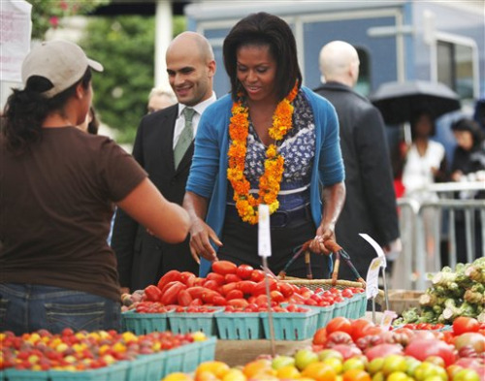
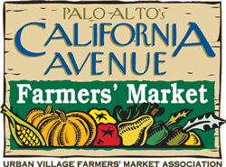
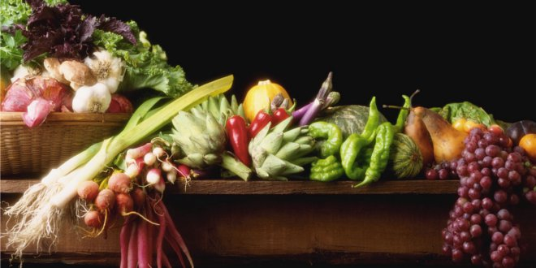
Go Organic!

Slide 28
How Much Does it Cost?
Food Organic Conventional
celery 2.99 1.99
cauliflower 4.99 2.99
Bartlett pears 2.69 1.99
orange juice 3.99 2.99
eggs 5.69 3.99
milk 4.69 2.99
cereal 4.56 3.91
TOTAL 29.60 20.85
increase bill by ~40%

Slide 29
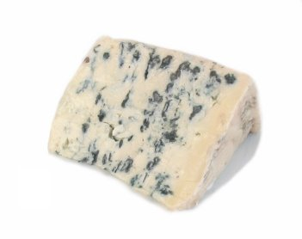
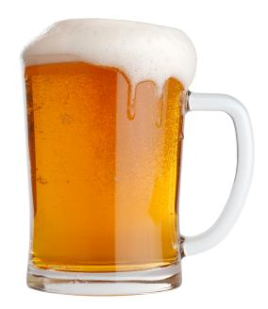
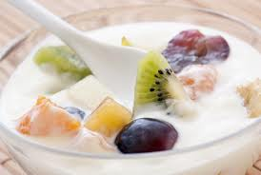
Probiotics! – Maintain Healthy Gut

Slide 30


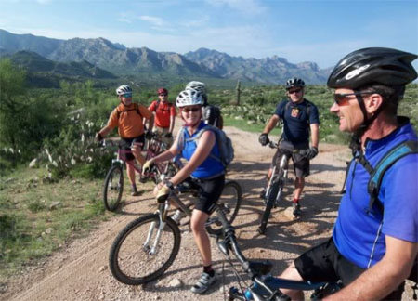
Escape to a sunny place in winter!
Notes:
Summer vacation on Mediterranean Sea resort, Antalya, Turkey

Slide 31
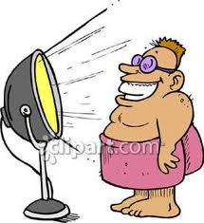
If you Live in Canada, Use a Sunlamp!

Slide 32
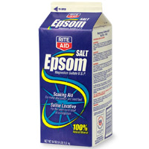

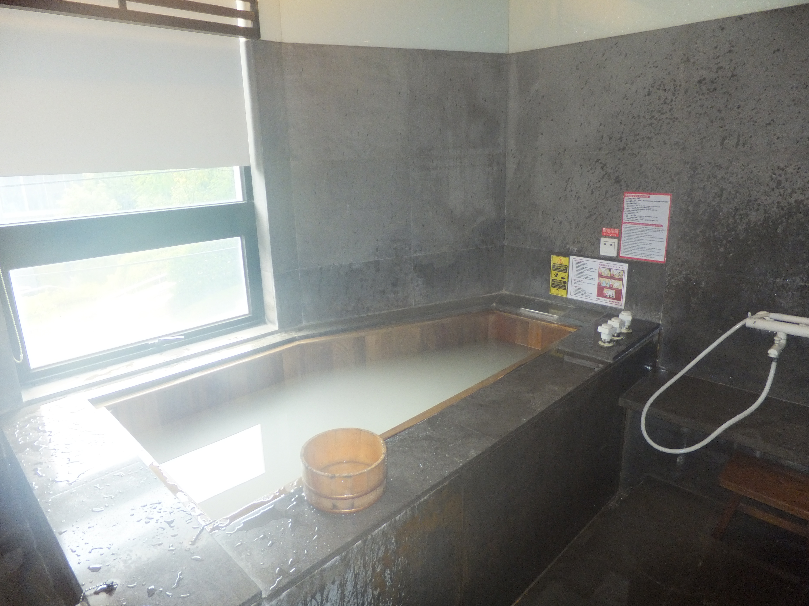
Epsom Salts!
Magnesium Sulfate in hot bath water is a cheap and easy way to get sulfate supply to the skin
Infrared heat also beneficial!

Slide 33
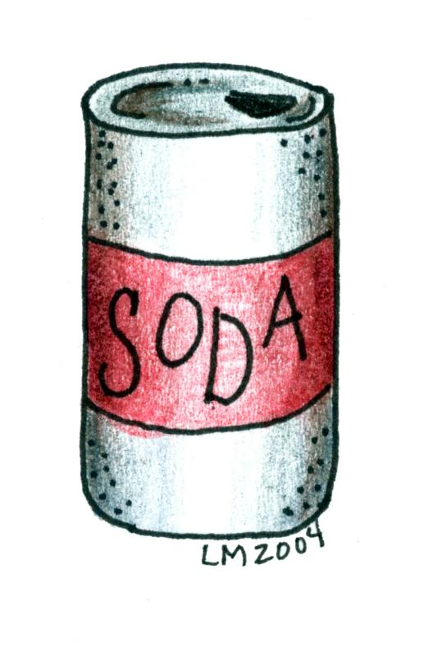
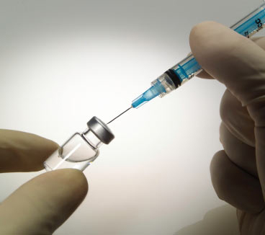
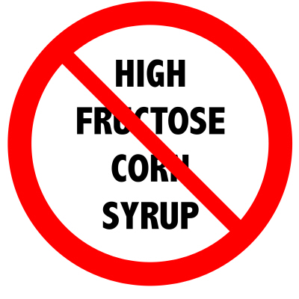
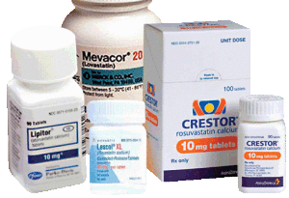
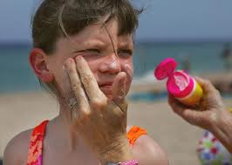
Don’ts!

Slide 34
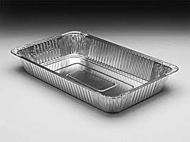
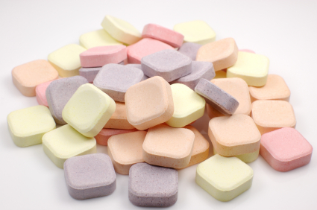
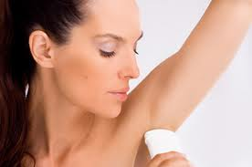
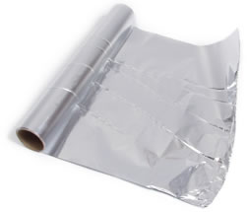
We are Too Comfortable with Aluminum!

Slide 35
Outline
Very brief overview
Nutrition and health
Pesticides: focus on Roundup
Vaccines, antibiotics and microbes
Pharmaceutical drugs: focus on statins

Slide 36
Outline
Overview
Sulfur Containing Foods and Supplements
Flavonoids and Polyphenols
Dietary Fats: Myths and Facts
Cancer, Sun and Micronutrients
Summary

Slide 37
Overview

Slide 38
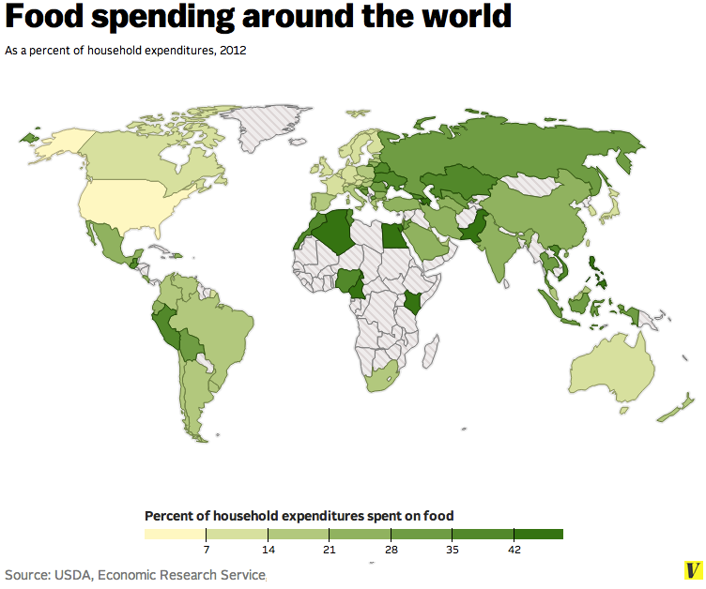
Notes:
http://www.vox.com/2014/7/6/5874499/map-heres-how-much-every-country-spends-on-food

Slide 39
US households spend the least percentage of their income on food
Notes:
http://www.vox.com/2014/7/6/5874499/map-heres-how-much-every-country-spends-on-food

Slide 40
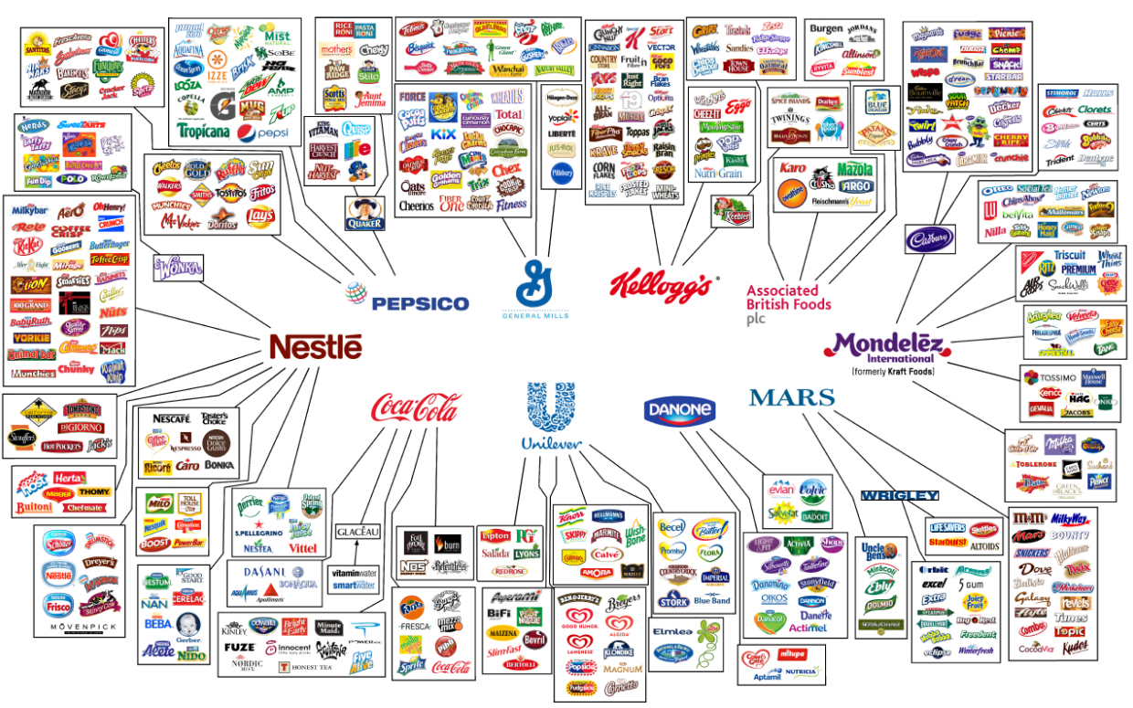
Ten Food Companies Control What We Eat*
*businessinsider.com/10-companies-that-control-what-we-buy-2014-7

Slide 41
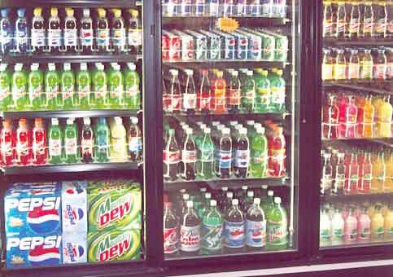
Sugar-Sweetened Beverages*
Sugar-sweetened beverages are the largest source of added sugar in our diet
In the US, high-fructose corn syrup is the major source of sweetener
40% increase in HFCS consumption over past 30 years
  Higher than any other food product
American Heart Association meeting report implicated 180,000 deaths/year to consumption of sugars in beverages
* AH Malik et al., Am J Cardiol. 2014 May 1;113(9):1574-80
Notes:
./sugar_sweetened_beverages_2014.pdf

Slide 42
But don’t just switch to non-calory sweeteners!*
"[W]e demonstrate that consumption of commonly used non-caloric artificial sweeteners formulations drives the development of glucose intolerance through induction of compositional and functional alterations to the intestinal microbiota."
*J Suez et al., Nature 2014, published online Sep 17, 2014

Slide 43
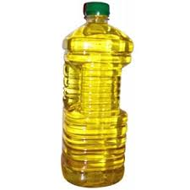
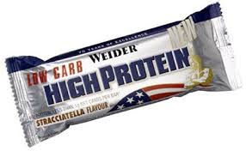
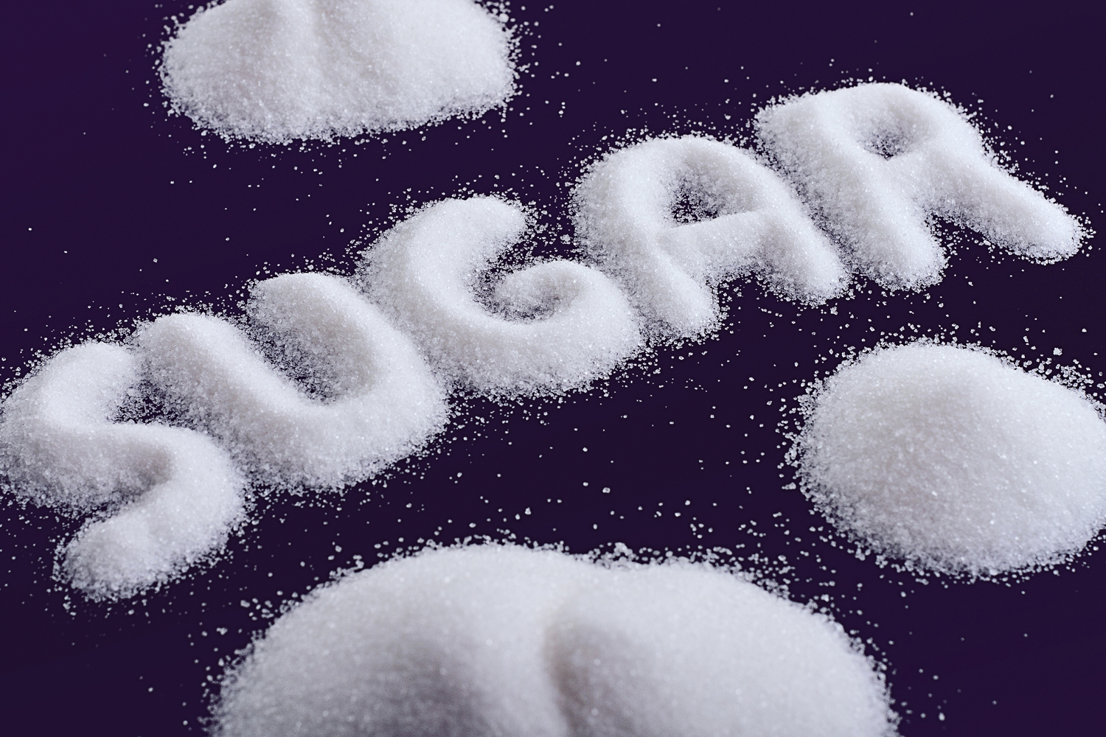
Sugar, fat or protein?
Sugar’s bad
Fat’s bad
Protein’s bad
And it’s all bad for the same reason ….
Toxic Chemicals

Slide 44
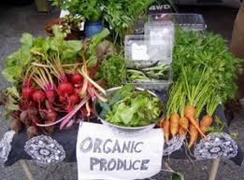
Organic Food is Better!*
Higher concentrations of polyphenols such as flavanones, stilbenes, flavones, flavonols and anthocyanins
Pesticide residues four times lower
Cadmium (toxic metal) levels significantly lower
*M. Barańskia et al., British Journal of Nutrition 2014, 112(05), 794-811.
Notes:
./organic_is_better.text
./Higher_antioxidant_and_lower_cadmium_concentrations_and_lower_incidence_ofpesticide_residues_in_organically_grown_crops_-_a_systematic_literaturereview_and_meta-analyses.pdf .
From Gerry

Slide 45
Industrial Agriculture is Depleting the Soil and Plants of Minerals*
The Earth’s soil is a dynamic mixture of rock particles, water, gases, and microorganism
  Just one cup of soil contains more microorganisms than there are people on the planet
We’ve destabilized our soil ecosystems through widespread use of monocrops, fertilizers, pesticides and insecticides
There’s a crisis in worldwide soil health that is rapidly becoming a crisis in human health.
*www.organicconsumers.org/articles/article_30899.cfm
Notes:
Indusrtrial_Ag_soil_mineral_depletion.pdf

Slide 46
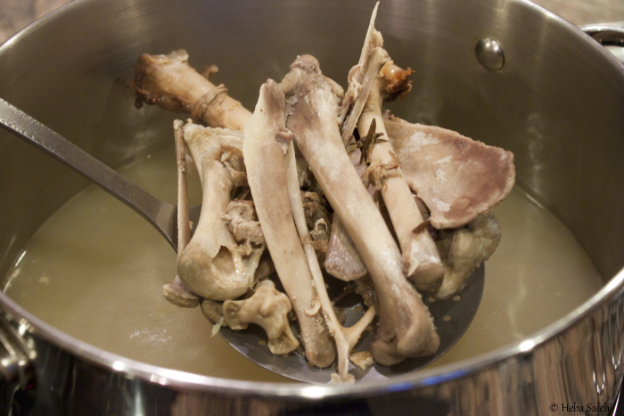
Making Bone Broth a Staple in Your Diet May Be the Key to Improving Your Health*
*articles.mercola.com/sites/articles/archive/2014/09/21/
hilary-boynton-mary-brackett-gaps-cookbook-interview.aspx
Notes:
./MercolaOnBoneBroth.pdf
http://articles.mercola.com/sites/articles/archive/2014/09/21/hilary-boynton-mary-brackett-gaps-cookbook-interview.aspx

Slide 47
Sulfur-Containing Foods
and Supplements

Slide 48
Are We Getting Enough Sulfur in Our Diet?*
Most abundant mineral element behind calcium and phosphorus
Chondroitin sulfate, glucosamine sulfate, etc. used to treat diseases of the joints
“Out of this study came information that suggested that a significant proportion of the population that included disproportionally the aged, may not be receiving sufficient sulfur and that these dietary supplements, were very likely exhibiting their pharmacological actions by supplying inorganic sulfur.”
*ME Nimni et al., Nutrition & Metabolism 2007, 4:24
Notes:
./enough_sulfur_question_mark_2007.pdf

Slide 49
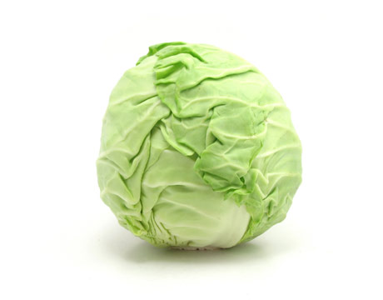
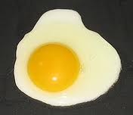
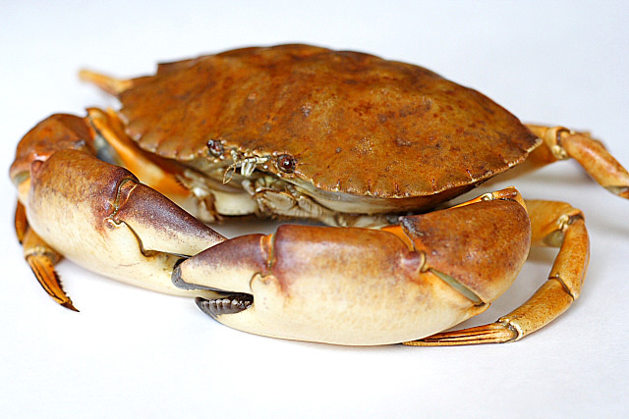
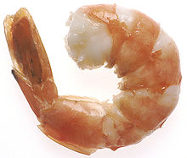
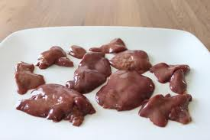
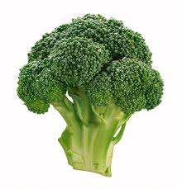
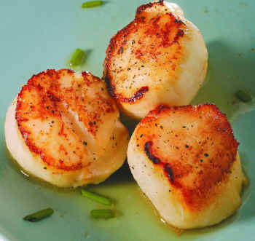
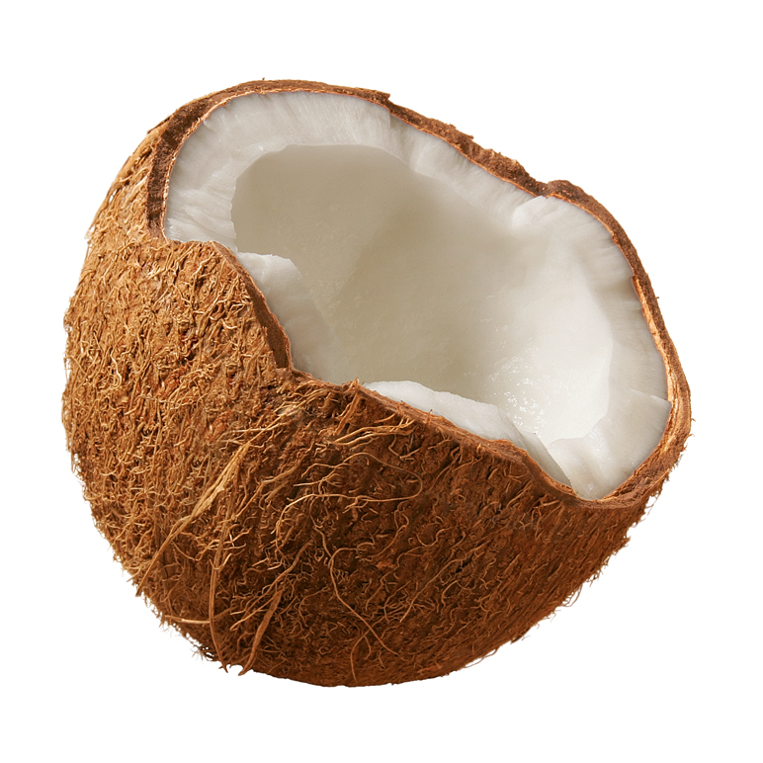
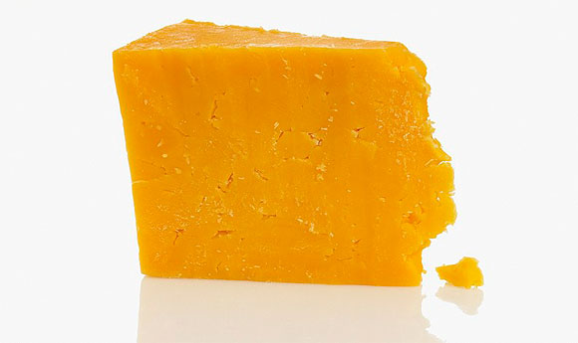
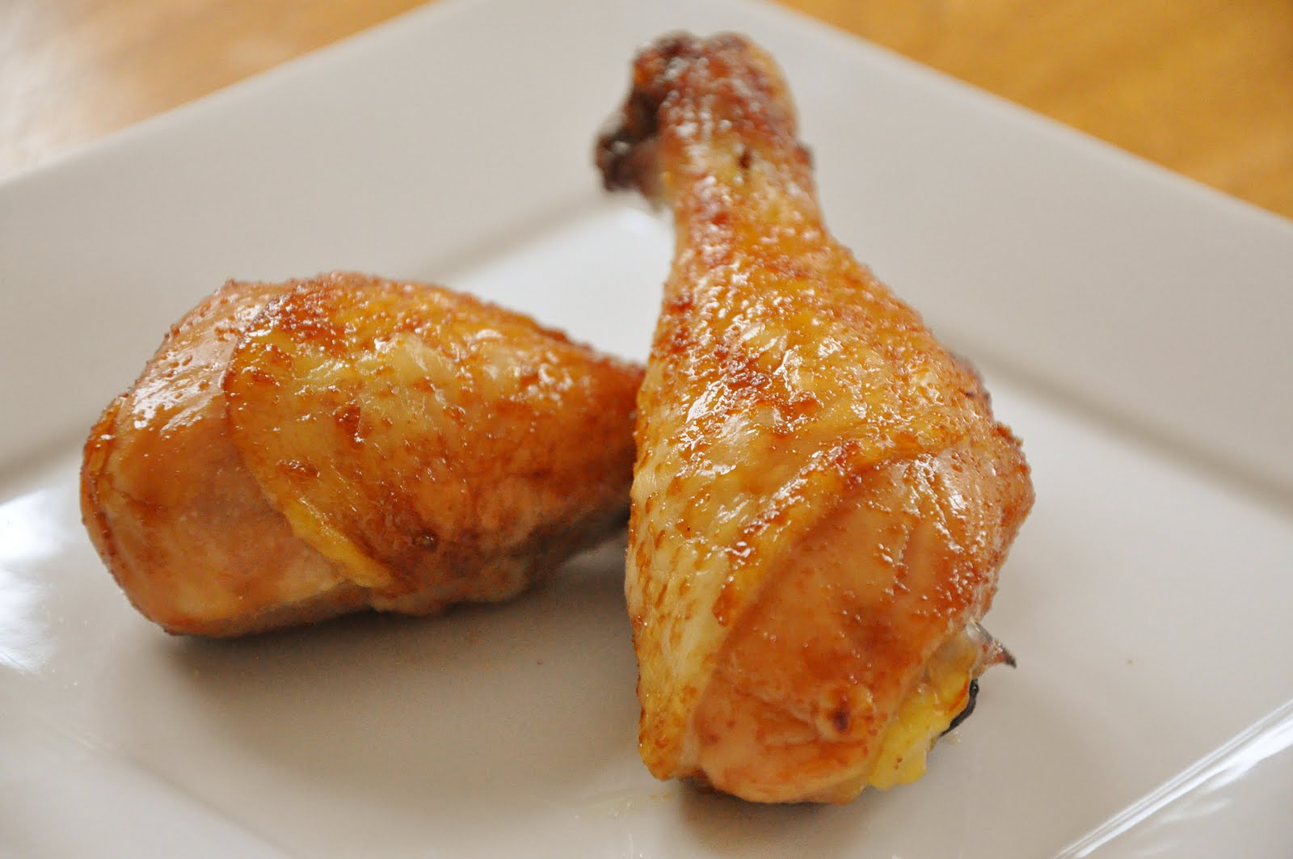
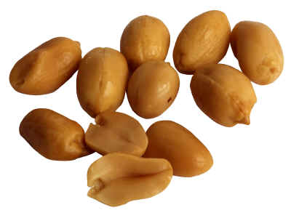
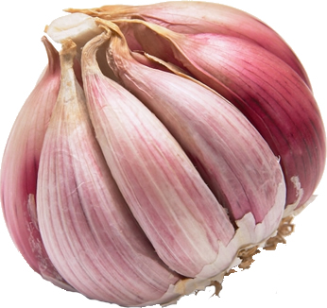



Eat Foods Containing Sulfur!
Notes:
http://healthyeatingclub.com/info/books-phds/books/foodfacts/html/data/data5g.html
http://www.livestrong.com/article/486021-foods-high-in-sulphur/

Slide 50
Supplemental Sources of Sulfur*
glucosamine sulfate
chondroitin sulfate
glutathione
N-acetylcysteine
alpha lipoic acid
taurine
DMSO, MSM
S-adenosylmethionine (SAMe)
Epsom salts (Mg-sulfate)
These can have many beneficial effects and are nearly nontoxic
My personal favorite is Epsom salt baths:
Magnesium sulfate uptake through the skin
*S Parcell, Alternative Medicine Review 7(1), 2002, 22-44
Notes:
./sulfur_in_human_nutrition_review.pdf

Slide 51
Supplemental Sources of Sulfur*
glucosamine sulfate
chondroitin sulfate
glutathione
N-acetylcysteine
alpha lipoic acid
taurine
DMSO, MSM
S-adenosylmethionine (SAMe)
Epsom salts (Mg-sulfate)
These can have many beneficial effects and are nearly nontoxic
My personal favorite is Epsom salt baths:
Magnesium sulfate uptake through the skin
*S Parcell, Alternative Medicine Review 7(1), 2002, 22-44
Notes:
./sulfur_in_human_nutrition_review.pdf

Slide 52


Alpha Lipoic Acid Has
Many Health Benefits*
*Figure 5, KP Shay et al., Biochimica et Biophysica Acta 1790 (2009) 1149–1160
Notes:
./alpha_lipoic_acid_protective_2009.pdf

Slide 53

Garlic!*
Garlic is among the best known medicinal plants
Anticarcinogenic, antithrombotic, antiatherosclerotic, hypolipidemic, antihypertensive, and antimicrobial
“Since early times, it is known that most of such properties are given by volatile sulfur-containing compounds that are not present in the intact plant, but are formed after tissue disruption via enzymatic reactions.”
*O. Calvo-Gómez et al., J. Chromatogr. A 1036 (2004) 91–93
Notes:
./garlic_sulfur_volatile_compounds_Mexico.pdf
Email from someone from Mexico
Also:
./Javier_Morales_Lopez_garlic_paper_Meexico.pdf

Slide 54


DMSO and Allicin (in Garlic)
DMSO
allicin
Notes:
See: Differentiationg_Sulfur_Compounds.pdf

Slide 55

Antimetastatic Activity of Sulforaphane*
Study on mice with induced metastatic lung cancer
Simultaneous supplementation with sulforaphane reduced proliferation and invasion of melanoma cells by inhibiting matrix metalloproteinases
  95.5% inhibition of lung tumor nodule formation
  94% increase in life span of tumor-bearing animals.
  GGT levels substantially lowered
*P Thejass and G Kuttan, Life Sci. 2006 May 22;78(26):3043-50.
Notes:
Treasures/antimetastatic_effects_of_sulforaphane.text

Slide 56



Bitter Taste May Battle Asthma*
Bitterness makes the muscles in the bronchial tubes relax and protects against asthma attack
“Bitter foods contain sulfur-based compounds which support the natural detoxification pathways in the liver”**
*scientificamerican.com/podcast/episode/bitter-taste-may-battle-asthma-13-04-17/
**naturessunshine.com/Blog/post/5-Reasons-Why-You-Should-Eat-Bitter-Foods-and-Herbs.aspx
Notes:
Strychine!!
Bitter melon
Arugula
Dandelion greens

Slide 57

Taurine Protects from Obesity*
Taurine reduces body fat in C elegans and rodents
Taurine enhances anorexigenic action of insulin
Intracerebroventricular injection of taurine reduces food intake and locomotor activity
  Likely through signaling pathways in the hypothalamus
*CS Solon et al., Amino Acids. 2012 Jun;42(6):2403-10.
Notes:
./taurine.text

Slide 58

Chicks Fed Taurine Learn Better*
“We found that taurine has a significant impact on the personality and memory of the birds. Those who were fed taurine as chicks were on average much bolder and better at learning in adulthood, than their counterparts who were not fed the extra taurine.”
*sciencedaily.com/releases/2007/08/070824220328.htm
Notes:
./spiders_taurine_birds.pdf

Slide 59


Glucosamine Sulfate: It’s the Sulfate!*
7 subjects
1 g glucosamine sulfate ingested
  Mean serum sulfate increased: 331 → 375 µM/L
1 g of acetaminophen annihilated the result:
  331 → 290 µM/L
  Chronic acetaminophen use depletes sulfate
*LJ Hoffer et al., Metabolism 50(7), 2001, 767-770.
Notes:
Treasures/glucosamine_sulfate_benefit_is_the_sulfate.text

Slide 60

Chondroitin Sulfate Prevents
Calcium Uptake by Mast Cells*
Mast cells respond to IgE and cytokines by releasing inflammatory mediators like histamine, leukotrienes, prostaglandins and tryptase
Mast cells also secrete heparin -- the most sulfated molecule known to biology
Chondroitin sulfate blocks mast cell secretions by suppressing calcium uptake
+ chondroitin sulfate
Notes:
./chondroitin_sulfate_inhibits_mast_cells.pdf

Slide 61
Chondroitin Sulfate Prevents
Calcium Uptake by Mast Cells*
Mast cells respond to IgE and cytokines by releasing inflammatory mediators like histamine, leukotrienes, prostaglandins and tryptase
Mast cells also secrete heparin -- the most sulfated molecule known to biology
Chondroitin sulfate blocks mast cell secretions by suppressing calcium uptake
I believe it’s the sulfate in chondroitin sulfate that is protective
+ chondroitin sulfate
Notes:
./chondroitin_sulfate_inhibits_mast_cells.pdf

Slide 62
Hydrogen Sulfide Gas as a Treatment*
If stressed cells are treated with AP39 (slowly releases hydrogen sulfide gas), mitochondria are protected and cells stay alive
  Prevents mitochondrial DNA damage
  Reverses blood vessel stiffening and lowers blood pressure
Cells naturally produce small amounts of hydrogen sulfide, which relaxes the arteries
*medicalxpress.com/news/2014-07-rotten-egg-gas-key-healthcare.html
Notes:
./Hydrogen\ sulfide\ for\ diabetes,\ dementia\ and\ heart\ attacks.pdf .

Slide 63






Flavonoids and Polyphenols!

Slide 64

Flavonoids: Three Hexagonal Rings

Slide 65
Flavonoids Transport Sulfate!
Flavonoids are found in fruits, vegetables, nuts, seeds, herbs, spices, stems, flowers, tea and red wine.
Flavonoids suppress nitric oxide synthesis in macrophages (inflammatory response)
In plants, they generally occur as glycosylated and sulfated derivatives

Slide 66

Red Wine is Antimicrobial*
“Our results show that red wine, at moderate concentration, inhibits the growth of some pathogenic species in an oral biofilm model.”
Propose polyphenols in wine are antimicrobial
This is likely protective against dental caries
*I Muñoz-Gonzaĺez, J. Agric. Food Chem. 2014, 62, 4731−4737
Notes:
./red_wine_antimicrobial_2014.pdf
From Anthony

Slide 67

Curcumin Has Many Benefits*
Suppresses carcinogenesis in skin, stomach, colon, breast and liver
Induces apoptosis in a wide variety of tumor cells
Downregulates various proinflammatory cytokines
There is a low incidence of colorectal cancer in India where curcumin is heavily used in curries
* SK Varid et al, Cancer Epidemiol Biomarkers Prev 2008;17:1411-1417.
Notes:
Cancer/curcumin_bioavailability_sulfate.pdf

Slide 68

Curcumin Has Many Benefits*
Loss of body fat and adipose- associated macrophages
Reduced inflammatory- related atherogenesis
Antidiabetic effect
  Lower Hemoglobin A1c
Lower total cholesterol and LDL-C
Higher HDL-C.
*S Cuengsamarna et al., journal of Nutritional Biochemistry 25 (2014) 144–150.
Notes:
GerryKoenig/Reduction_of_atherogenic_risk_in_patients_with_type_2_diabetes_bycurcuminoid_extract_-_an_RCT_marked.pdf

Slide 69

Three Forms of Curcumin*
SULFATE!!
* Figure 1 in SK Varid et al, Cancer Epidemiol Biomarkers Prev 2008;17:1411-1417.
Notes:
Figure 1. Structures of curcumin (I), curcumin glucuronide (II ), and curcumin sulfate (III ).
Cancer/curcumin_bioavailability_sulfate.pdf

Slide 70


Curcumin Goes Around and Around Delivering Sulfate to Liver!
curcumin

Slide 71
Curcumin Prevents Diabetes*
CONCLUSIONS:
“A 9-month curcumin intervention in a prediabetic population significantly lowered the number of prediabetic individuals who eventually developed type 2 diabetes. In addition, the curcumin treatment appeared to improve overall function of [pancreatic] beta-cells, with very minor adverse effects.”
*S Chuengsamarn et al., Diabetes Car 35, 2012, 2121-2127
Notes:
./Curcumin_Extract_for_Prevention_of_T2D.pdf

Slide 72


Glucosinolates!
Natural components of many pungent plants such as mustard, cabbage and horseradish
Contribute to plant defense against pests and diseases
Notes:
Horseradish!

Slide 73


Broccoli Sprouts*
Sprouts contain 30x nutrients of organic vegetables
Grow your own and eat them raw!
Controlled study in China:
Benzene and acrolein detoxed into urine
These are chemicals in dirty air from car exhaust and burning fuels
glucoraphanin
*articles.mercola.com/sites/articles/archive/2014/06/30/broccoli-sprout-detox.aspx
Notes:
http://articles.mercola.com/sites/articles/archive/2014/06/30/broccoli-sprout-detox.aspx
BroccoliSprouts.pdf
glucoraphanin

Slide 74



Quercetin: A Sulfate Transporter*
Sulfate
Glucuronide
Net effect:
gut delivers sulfate to the liver
*IR Rowland, Toxicol Pathol 1988 16:147-153.

Slide 75

Sulfated Flavonol Fights HIV*
Rutin is a citrus flavonoid found in buckwheat and asparagus
Sulfated rutin exhibited 50% inhibition against HIV viruses
  Blocked viral entry and virus-cell fusion
  Likely acts by interacting with envelope glycoproteins
Also inhibited Herpes virus
Unsulfated form had no activity against any HIV virus
*J. Tao et al., Antiviral Research 2007;75(3):227-233.
Notes:
./sulfated_molcule_treats_HIV.text

Slide 76

Coffee Gets Sulfated in the Gut*
“All the metabolites released in the digestive tract can be absorbed and further metabolized in the enterocyte and the liver by phase-II enzymes into their sulfated and/or glucuronidated conjugates.”
*R Fumeaux et al, Org. Biomol. Chem., 2010, 8, 5199–5211.
Notes:
Treasures/coffee_degradation_sulfation_gut_to_liver.pdf

Slide 77

Coffee Drinking Lowers GGT*
GGT is a liver enzyme that’s a strong marker for liver disease (and also diabetes and heart disease)
Coffee drinkers in Japan had lower GGT levels
GGT breaks down glutathione to release free cysteine
  Cysteine is a source of sulfate
*S kono et al., Am J Epidemiol. 1994 Apr 1;139(7):723-7.
Notes:
./Coffee\ and\ Serum\ Gamma-glutamyltransferase\ -\ A\ Study\ of\ Self-Defense\ Officials\ in\ Japan_marked.pdf

Slide 78
“Dark Chocolate Acutely Improves Walking Autonomy in Patients With Peripheral Artery Disease”*
“Intermittent claudication” is a clinical diagnosis given for muscle pain (ache, cramp, numbness or sense of fatigue), usually in the calf muscle, occurring during exercise, such as walking
  Often associated with arteriosclerosis
Dark chocolate was effective in improving symptoms
*L Loffredo et al., J Am Heart Assoc. 2014;3:e001072
Notes:
./dark_chocolate_muscle_pain_2014.pdf

Slide 79
Polyphenols Protect Corn from Fungus*
Resistance to ear rot and common smut (fungal infections) in Maize crops correlated with high content of polyphenols
These polyphenols also inhibited glycation and accumulation of AGEs
  This was correlated with resistance to fungal infections
Authors propose treating diabetes with these polyphenols
*DA Farsi et al., Phytother Res. 2008 Jan;22(1):108-12.
Notes:
./corn_fungus_polyphenols.text

Slide 80
How Do Polyphenols Protect?*
“There is no evidence that the beneficial effects of polyphenol-rich foods can be attributed to the antioxidant properties of these foods.”
Oxygen Radical Absorbance Capacity (ORAC)
  USDA has removed ORAC Database from NDL website due to mounting evidence that antioxidant capacity is irrelevant to health benefits
*ars.usda.gov/News/docs.htm?docid=15866
Notes:
They used to have this information but they don’t any more.

Slide 81

Ginkgo biloba protects from glyphosate*
"Treatment with G. biloba produced amelioration in indices of hepatotoxicity, nephrotoxicity, lipid peroxidation, and genotoxicity relative to Group II."
*K Cavuşoğlu, J Med Food. 2011 Oct;14(10):1263-72.
Notes:
./gingko_biloba_protects_from_glyphosate.text

Slide 82
Dietary Fats: Myths and Facts

Slide 83

What a Difference Three Decades can Make!

Slide 84

Cover story, Time Magazine, June 23, 2014
Notes:
./TimeMagazineJune2014_\ BUTTER-1.pdf

Slide 85
Ending the War on Fat*
“We cut the fat, but by almost every measure, Americans are sicker than ever. The prevalence of Type 2 diabetes increased 166% from 1980 to 2012. Nearly 1 in 10 American adults has the disease, costing the health care system $245 billion a year, and an estimated 86 million people are prediabetic. … Cardiovascular disease remains the country’s No. 1 killer.”
*Brian Walsh, TIME magazine, June 12, 2014
Notes:
./Ending\ the\ War\ on\ Fat.pdf .
Time
Bryan Walsh
June 12, 2014
http://time.com/2863227/ending-the-war-on-fat/

Slide 86
“People talk and write about cholesterol as ‘artery-clogging fat’. But this idea that you eat something, it gets into your bloodstream and it clogs your arteries is just false. Nothing remotely like that is happening.”
- Dariush Mozaffarian, cardiologist, Harvard Medical School
washingtonpost.com/national/health-science/you-probably-know-less-about-cholesterol-than-you-think-you-do-heres-some-help/2014/06/16/d9fa9350-e4fa-11e3-8f90-73e071f3d637_story.html

Slide 87
Low-Carb Diet Reduces Inflammation*
A low-carbohydrate diet, but not a low-fat diet, reduces inflammation in patients with type 2 diabetes
  Diets had similar effects on weight loss
Research conducted at Linkopping University in Sweden.
*L Jonasson et al., Annals of Medicine May 2014 46(3): 182-7.
Notes:
http://www.medicalnewstoday.com/releases/276631.php

Slide 88
“Dietary Carbohydrate restriction as the first approach in diabetes management. Critical review and evidence base”*
“Here we present 12 points of evidence supporting the use of low-carbohydrate diets as the first approach to treating type 2 diabetes”
“The 12 points are sufficiently compelling that we feel that the burden of proof rests with those who are opposed”
*RD Feinman et al., Nutrition, July 15, 2014 [Epub ahead of print]
Notes:
Feinman_low_carb_diet_treats_diabetes_best_2014.pdf

Slide 89


Saturated vs Unsaturated Fat??

Slide 90

Saturated Fat Protects from
Heart Disease*
*Figure from Hoenselaar, R. British Journal of Nutrition, 2012. (in article by Dr. Mercola)
Notes:
http://articles.mercola.com/sites/articles/archive/2014/06/23/butter-trans-fat.aspx

Slide 91

(OLD!) Experiment on Calves*
Fed three different fats: tallow, lard, soybean oil
Soybean oil group:
  more cholesterol in aorta, liver, muscle fat and coronary arteries
  persistent loose stools and intermittent diarrhea
  poor growth
  osteoporosis
  weight gain improved dramatically following cholesterol supplementation
*NL Jacobson et al., J Nutr. 1974 May;104(5):573-9.
Notes:
glyphosate/calves_fed_different_oils_sick_1974.pdf

Slide 92
(OLD!) Experiment on Calves*
“When forced to move about, several of the animals receiving the soybean-oil diets collapsed and seemed incognizant of their surroundings for short periods.”
Fed three different fats: tallow, lard, soybean oil
Soybean oil group:
  more cholesterol in aorta, liver, muscle fat and coronary arteries
  persistent loose stools and intermittent diarrhea
  poor growth
  osteoporosis
  weight gain improved dramatically following cholesterol supplementation
*NL Jacobson et al., J Nutr. 1974 May;104(5):573-9.
Notes:
glyphosate/calves_fed_different_oils_sick_1974.pdf

Slide 93

Fat and Oil Consumption: US*
*Graphs provided by Dr. Nancy Swanson, with permission
Notes:
Nancy/oils/domestic\ oil\ consumption.gif

Slide 94
Fat and Oil Consumption: US*
Huge increase in soybean oil around 2000
*Graphs provided by Dr. Nancy Swanson, with permission
Notes:
Nancy/oils/domestic\ oil\ consumption.gif

Slide 95
Fat and Oil Consumption: US*
We will revisit this topic when we discuss toxic chemicals in food
*Graphs provided by Dr. Nancy Swanson, with permission
Notes:
Nancy/oils/domestic\ oil\ consumption.gif

Slide 96
Low saturated fat diets don't curb heart disease risk or help you live longer*
“And anyone who has had a heart attack should not be thinking of replacing saturated fats with refined carbs or omega 6 fatty acids—particularly those found in processed vegetable oils containing large amounts of corn or safflower oil.”
Dr James DiNicolantonio
*www.sciencedaily.com/releases/2014/03/140305191429.htm
Notes:
./low_sat_fat_diet_causes_heart_disease.pdf

Slide 97

Are Polyunsaturated Fats Good?*
“Conclusion: Current evidence does not clearly support cardiovascular guidelines that encourage high consumption of polyunsaturated fatty acids and low consumption of total saturated fats.”
Healthy fat!
* R. Chowdhury et al. Ann Intern Med. 2014;160(6):398-406.
Notes:
./Chowdhury_saturated_fat_good.pdf
See also:
Attached/Chowdhury/ six files!

Slide 98

Book by Nina Teicholz
Reducing the saturated fat in our diets has been disastrous for our health as a nation, and we can, guilt-free, welcome these whole fats back into our lives.
Eggs, whole milk, meat, butter …
Notes:
dish up the red meat, eggs, and whole milk! In this well-researched and captivating narrative, veteran food writer Nina Teicholz proves how everything we've been told about fat is wrong.
For decades, Americans have cut back on red meat and dairy products full of "bad" saturated fats. We obediently complied with nutritional guidelines to eat "heart healthy" fats found in olive oil, fish, and nuts, and followed a Mediterranean diet heavy on fruits, vegetables, and grains. Yet the nation's health has declined. What is going on?
In The Big Fat Surprise, Teicholz reveals how 60 years of nutrition science has gotten it so wrong: how overzealous researchers have made basic scientific mistakes that, through a mix of ego and bias, allow dangerous misrepresentations to become dogma, and how scientists who dared oppose this consensus have been ostracized. For eight years, Teicholz has pored over the massive research literature and interviewed hundreds of leading experts to unravel the shockingly distorted claims of nutrition studies. She brings these researchers to life and shows how their ambitions, loyalties, and rivalries have undermined a field of research already full of difficult pitfalls.
With a lively narrative style akin to Michael Pollan's in The Omnivore's Dilemma and the scientific rigor of Gary Taubes in Good Calories, Bad Calories, Teicholz convincingly upends the conventional wisdom about all fats. Her groundbreaking claim is that more dietary fat leads to better health, wellness, and fitness. Science shows that reducing the saturated fat in our diets has been disastrous for our health as a nation, and we can, guilt-free, welcome these "whole fats" back into our lives.

Slide 99

“Whole Kernel Unrefined
Fresh-Pressed Virgin Coconut Oil”

Slide 100
The Vegetarian Myth*
We have big brains because of animal-based foods
Agriculture → bones and teeth fall apart
She was vegan for 20 years starting at 16 years old –save the planet, etc. but then changed her mind!
Meat is nutrient dense food
  Complete proteins (sulfur!)
  Fat-soluble nutrients: vitamins A, D, K2, E
  Coenzyme Q10, heme iron, fats!
Way too much sugar in modern diet – requires insulin
  Cancer and heart disease are unknown among hunter-gatherers
*The Vegetarian Myth, Lierra Keith
https://www.youtube.com/watch?v=rNON5iNf07o
Notes:
https://www.youtube.com/watch?v=rNON5iNf07o
What we eat is destroying both our bodies and the planet, according to author Lierre Keith, a recovering twenty-year vegan. While she passionately opposes factory farming of animals, she maintains that humans require nutrient-dense animal foods for good health. A grain-based diet is the basis for degenerative diseases we take for granted (diabetes, cancer, heart disease) - diseases of civilization. Annual grain production is destroying topsoil and creating deserts on a planetary scale. Lierre urges the restoration of perennial polycultures for longterm sustainability.

Slide 101

Sustainable Agriculture is the Answer*
Soil bacteria are essential for plant health
  Toxic pesticides and GMO Bt gene kill them
Chemical agricultural methods cause massive loss of carbon from soil → air → climate change
GMO Roundup-Ready corn for ethanol?
Cattle grazing on grass improve grass and soil
*articles.mercola.com/sites/articles/archive/2014/07/01/agriculture-pollution.aspx
Notes:
./MercolaOnAgriculture

Slide 102
Why You Should buy Meat from Small Farms*
Antibiotic resistant bacteria are present in 81% of ground turkey, 69% of pork chops 55% of ground beef and 39% of raw chicken parts
Ractopamine and Zilmax are drugs that increase protein in muscle
  Ractopamine is banned in 160 countries
Porcine Epidemic Diarrhea virus has wiped out 10% of american pigs
  Due to their unhealthy eating habits?
  Blood mixed from large numbers of animals is fed back to the animals
*articles.mercola.com/sites/articles/archive/2014/07/02/us-food-manufacturing-drugs.aspx
Notes:
http://articles.mercola.com/sites/articles/archive/2014/07/02/us-food-manufacturing-drugs.aspx
./MercolaMeat.pdf

Slide 103
Cancer, Sun and Micronutrients

Slide 104

Swedish Population Study on
Sun Exposure*
“We found that all-cause mortality was inversely related to sun exposure habits. The mortality rate amongst avoiders of sun exposure was approximately twofold higher compared with the highest sun exposure group”
*PG Lindqvist et al., Journal of Internal Medicine, 2014, 276; 77–86
Notes:
./sun_avoidance_increases_death_risk_Sweden_2014

Slide 105
Top Ten Melanoma States?*
1. Delaware—32.6
2. Vermont—32.3
3. New Hampshire—31.4
4. Wyoming—30.1
5. Oregon—29.6
6. Montana—29
7. Iowa—27.8
8. Washington—27.5
9. Utah—27.4
10. Maine—26.5
*Data from the CDC

Slide 106
Top Ten Melanoma States?*
1. Delaware—32.6
2. Vermont—32.3
3. New Hampshire—31.4
4. Wyoming—30.1
5. Oregon—29.6
6. Montana—29
7. Iowa—27.8
8. Washington—27.5
9. Utah—27.4
10. Maine—26.5
Northern Latitude and/or Rainy
*Data from the CDC

Slide 107
Skin Cancer and Sunscreen – What’s Going On?
Cutaneous malignant melanoma is the most rapidly increasing cancer in white populations
  This despite enormous increases in the use of sunscreen over the past 30 years
Melanin, the tanning agent that protects from burn, is produced from phenylalanine
Nicotinamide (niacin, B3) supplements protect from UV radiation

Slide 108
Skin Cancer and Sunscreen – What’s Going On?
Cutaneous malignant melanoma is the most rapidly increasing cancer in white populations
  This despite enormous increases in the use of sunscreen over the past 30 years
Melanin, the tanning agent that protects from burn, is produced from phenylalanine
Nicotinamide (niacin, B3) supplements protect from UV radiation
Phenylalanine is produced in plants and gut bacteria using the shikimate pathway,
which glyphosate disrupts

Slide 109

NAD Synthesis Depends on Tryptophan*
*http://www.bioscience.org/2009/v14/af/3428/fig3.jpg

Slide 110

Food Sources of Niacin
Eggs, bran, peanuts, meat, poultry, fish, red meat, legumes and seeds

Slide 111
Niacin and Breast Cancer*
Niacin is a precursor to NAD+
Cancer cells have low ratio of NAD+ to NADH because they overuse glycolysis for glucose processing, which reduces NAD+ to NADH
Low ratio is indicator of potential for metastasis
High dietary niacin can reverse this trend
*AF Santidrian, J Clin Invest 123(3), March 2013, 1068-1081.

Slide 112
Niacin and Breast Cancer*
Niacin is a precursor to NAD+
Cancer cells have low ratio of NAD+ to NADH because they overuse glycolysis for glucose processing, which reduces NAD+ to NADH
Low ratio is indicator of potential for metastasis
High dietary niacin can reverse this trend
“Strategies aimed at killing tumor cells by interfering with mitochondrial functions or NAD+ synthesis could, if not effectively lethal, inadvertently produce even more aggressive tumor cell phenotypes.”
*AF Santidrian, J Clin Invest 123(3), March 2013, 1068-1081.
Notes:
People have proposed such strategies to kill tumor cells, but it could backfire

Slide 113

Food sources of tryptophan
Notes:
The liver can synthesize niacin from the essential amino acid tryptophan

Slide 114
Chris Kresser on Vitamin K2*
Vitamin K2 has effects well beyond those of vitamin K1
  Both are involved in blood clotting
  Only K2 protects from prostate cancer and arterial calcification (hardening of the arteries)
Cows fed GM corn/soy feed in feed lots have very low levels of K2
  K2 is a product of the shikimate pathway, which glyphosate disrupts
  Butter from grass-fed cows has much more K2 than butter from feed lot cows
*chriskresser.com/vitamin-k2-the-missing-nutrient
Notes:
http://chriskresser.com/vitamin-k2-the-missing-nutrient

Slide 115






Food Sources of Vitamin K2

Slide 116
Iron Deficiency and Autism
Low maternal iron intake is linked with a five-fold greater risk of autism if the mother is 35 or older at the time of her child's birth, or if she has hypertension or diabetes*
Hypertension and diabetes are both going up in frequency in step with glyphosate usage on corn and soy crops
Glyphosate chelates iron and disrupts heme synthesis
*http://www.medicalnewstoday.com/articles/282867.php
Notes:
http://www.daijiworld.com/news/news_disp.asp?n_id=265319&utm_source=feedburner&utm_medium=feed&utm_campaign=Feed%3A+TodaysNewsOnDaijiworldcom+%28Today%27s+News+on+Daijiworld.com%29

Slide 117

“Iodine: What Cancer, Your Brain and Thyroid Have In Common”*
Discovered in 1811 by Bernard Courtois
Seaweed is an excellent source
Protects from breast cancer
Concentrated in thyroid glands, cerebrospinal fluid, saliva, breasts
  Thyroxin: regulates metabolism
  Goiter – thyroid becomes enlarged due to iodine deficiency
Iodine was added to bread in 1960’s
  Later, iodine replaced with bromine
  Fluoride in toothpaste and water makes things worse
  Selenium is needed to metabolize iodine
Iodine deficiency single largest cause of mental retardation
  ADHD?
*youtube.com/watch?v=lt_7592f67M&feature=youtu.be
Notes:
https://www.youtube.com/watch?v=lt_7592f67M&feature=youtu.be
12 minute video
Thyroid and breast cancer treated with iodine: apoptosis
bromine interferes with absorption of iodine

Slide 118
Selenium and Thyroid*
With insufficient selenium, thyroid operates in a state of stress
Highest selenium concentrations are in liver, kidneys and thyroid gland
Activation and deactivation of thyroid hormone depend on selenium
Selenium deficiency leads to inflammation in thyroid gland and autoimmune thyroid disease
Notes:
./selenium_thyroid_function.pdf
http://www.wellnessresources.com/health/articles/seleniums_vital_role_in_thyroid_hormone_function/

Slide 119




Food Sources of Selenium

Slide 120
Nutrition to Treat Alzheimer’s*
DHA/EPA, coconut oil, medium chain triglycerides
Prebiotics, probiotics
Curcumin resveratrol, ascorbate, blueberries
Selenium, zinc, thiamine, NAC, α-lipoic acid
Homocysteine, vitamin B12, vitamin K2, vitamin D
Low carb diet
Yoga, meditation, music, exercise
*DE Bredesen, Reversal of cognitive decline: A novel therapeutic program.
Aging Sep 2014 6(9), 1-11.
Notes:
10 patients studied. All but 1 were able to return to work.
Alzheimers/alzheimers_cured_through_nutrition_2014.pdf

Slide 121
Nutrition to Treat Alzheimer’s*
“It is noteworthy that the major side effect of this therapeutic system is improved health and optimal BMI (body mass index), a result in stark contrast to monopharmaceutical treatments.”
*DE Bredesen, Reversal of cognitive decline: A novel therapeutic program.
Aging Sep 2014 6(9), 1-11.
Notes:
10 patients studied. All but 1 were able to return to work.
Alzheimers/alzheimers_cured_through_nutrition_2014.pdf

Slide 122
Summary
Good nutrition is essential for good health
Chemical farming methods deplete nutrition in foods
Important foods to consume:
  Sulfur containing foods
  Foods high in saturated fat, omega-3 fats and cholesterol
  Polyphenols
  Foods rich in micronutrients: B-vitamins, minerals, etc.
This basically means a diet full of organic animal-based foods and organic fresh green vegetables and nuts
Getting plenty of sunlight exposure is also important
These changes may even reverse Alzheimer’s disease

