Slide 1
Download these slides!people.csail.mit.edu/seneff
….
….
Download individual files from these links:
people.csail.mit.edu/seneff/Indianapolis/
Drugs.pdf Nutrition.pdf antibiotics_vaccines.pdf glyphosate_new.pdf
Drugs.pptx Nutrition.pptx antibiotics_vaccines.pptx glyphosate_new.pptx
Notes:
Drugs.pdf Nutrition.pdf antibiotics_vaccines.pdf glyphosate_new.pdf
Drugs.pptx Nutrition.pptx antibiotics_vaccines.pptx glyphosate_new.pptx

Slide 2
Main Outline
Very brief overview
Nutrition and health
Pesticides: focus on Roundup
Vaccines, antibiotics and microbes
Pharmaceutical drugs: focus on statins

Slide 3
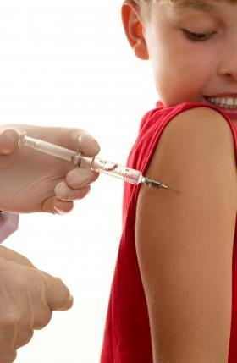
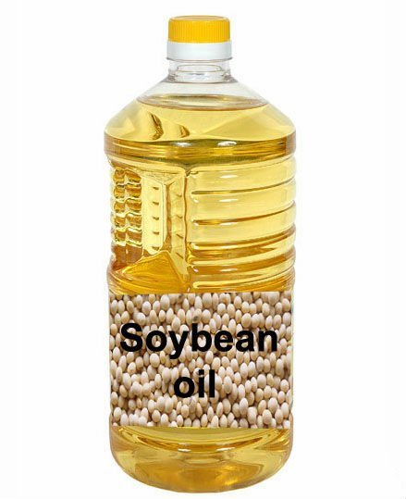
Roundup, aluminum and hexane: Synergistic partners in the autism epidemic
Stephanie Seneff
MIT CSAIL
Nov. 7, 2014

Slide 4
“We’ve pretty much sacrificed an entire generation of children. The longer we go, the more damage that is going to accumulate.”
Prof. Don Huber

Slide 5
Half of US Children are Chronically Ill*
“An estimated 43% of US children (32 million) currently have at least 1 of 20 chronic health conditions assessed, increasing to 54.1% when overweight, obesity, or being at risk for developmental delays are included”
*Christina D. Bethell et al., Academic Pediatrics 2011, 11(3s); S22-S33
Notes:
./US_children_are_sick.pdf

Slide 6
Outline
Autism & Glyphosate
Soy: Why It’s Dangerous
Glyphosate, Aluminum and Vaccines
Glyphosate and breast cancer
Bile Acid Disruption by Glyphosate
Arsenic toxicity → kidney failure
Manganese toxicity → Parkinson’s disease
Manganese deficiency → Autism
Infertility and Birth Malformations
Summary

Slide 7
Outline
Autism & Glyphosate
Soy: Why It’s Dangerous
Glyphosate, Aluminum and Vaccines
Glyphosate and breast cancer
Bile Acid Disruption by Glyphosate
Arsenic toxicity → kidney failure
Manganese toxicity → Parkinson’s disease
Manganese deficiency → Autism
Infertility and Birth Malformations
Summary

Slide 8
Brand New Study*
Data suggest ~75-80% of the tracked increase in autism since 1988 is due to an actual increase in the disorder rather than to changing diagnostic criteria
Polybrominated diphenyl ethers (fire retardants), aluminum adjuvants, and the herbicide glyphosate have increasing trends that correlate positively to the rise in autism.
*Environmental Health 2014, 13:73
Notes:
Samantha/autism_environmental_trends_aluminum_glyphosate_Cynthia_2014.pdf

Slide 9
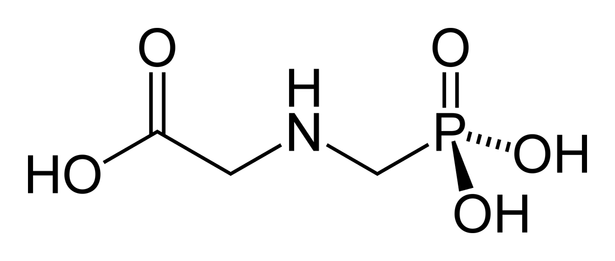
Glyphosate!!
Glyphosate is now the #1 herbicide in use in the U.S. and is increasingly used around the world
Developed and patented by Monsanto prior to the 1970’s
Introduced into the US food chain in 1974
Came out from under patent in 2000
Huge expansion of GMO “Roundup Ready” corn, soy, cotton, sugar beets, tobacco and canola crops has led to sharp increases in the last decade
Key issue is glyphosate resistant weeds
Also used as a desiccant on wheat, sugar cane and other crops
Notes:
WIKI

Slide 10
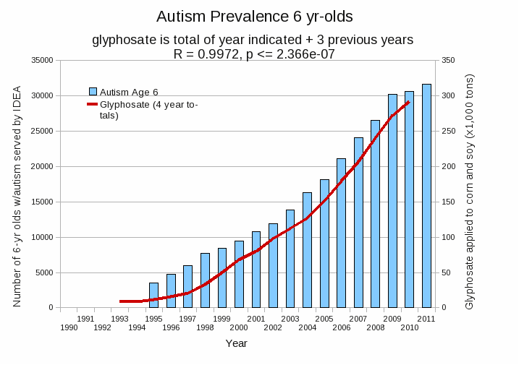
Autism Prevalence in US: 6 year olds
R = 0.9972
*Plot provided by Nancy Swanson, with permission
Data sources: autism: US Department of Education; Glyphosate: US Department of Agriculture
Notes:
Nancy/latest_plots/6-yr-old autism.gif
autism: USDE
oil consumption: USDA
glyphosate: USDA
GE crops: USDA
Mortality data: CDC

Slide 11
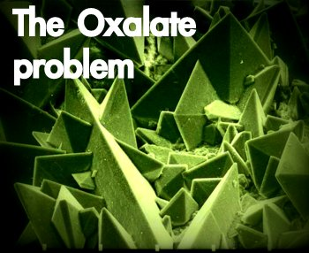
Autism Linked to Oxalate Crystals*
Crystals of oxalate form kidney stones and cause great discomfort
Study has shown at least 3-fold higher serum and urinary levels of oxalate in autistic kids**
*William Shaw, The Role of Oxalates in Autism and Chronic Disorders WAPF, March 26, 2010
**J Konstantynowicz et al., European Journal of Paediatric Neurology 16(5), 2012, 485-491.
Notes:
samantha/oxalates_in_autism.text~
samantha/william_shaw_on_oxalates_autism.text
http://www.westonaprice.org/health-topics/the-role-of-oxalates-in-autism-and-chronic-disorders/

Slide 12
Oxalate Metabolism*
*http://www.greatplainslaboratory.com/home/eng/oxalates.asp
Notes:
./oxalates.text

Slide 13
Glyphosate Metabolism*
*Figure 3 in L. Polligioni et al., FEBS Journal 278 (2011) 2753–2766
Notes:
Glyphosate/glyphosate_metabolism_to_glyoxylate.pdf

Slide 14
Monsanto Patents: 2002-2010: Pesticide Compositions Containing Oxalic Acid
“[origin: WO02069718A2] Pesticidal concentrate and spray compositions are described which exhibit enhanced efficacy due to the addition thereto of a compound which increases cell membrane permeability, suppresses oxidative burst, or increases expression of hydroxyproline-rich glycoproteins. More particularly, the present invention relates to a method of enhancing the herbicidal effectiveness of glyphosate concentrate and tank mix formulations containing one or more surfactants through the addition of oxalic acid.”
Monsanto Technology, St. Louis, MO
Notes:
https://data.epo.org/gpi/EP1389912A2-PESTICIDE-COMPOSITIONS-CONTAINING-OXALIC-ACID (quote)

Slide 15
Monsanto Patents: 2002-2010: Pesticide Compositions Containing Oxalic Acid
“[origin: WO02069718A2] Pesticidal concentrate and spray compositions are described which exhibit enhanced efficacy due to the addition thereto of a compound which increases cell membrane permeability, suppresses oxidative burst, or increases expression of hydroxyproline-rich glycoproteins. More particularly, the present invention relates to a method of enhancing the herbicidal effectiveness of glyphosate concentrate and tank mix formulations containing one or more surfactants through the addition of oxalic acid.”
Oxalic acid and oxalate are the same thing!
Monsanto Technology, St. Louis, MO
Notes:
https://data.epo.org/gpi/EP1389912A2-PESTICIDE-COMPOSITIONS-CONTAINING-OXALIC-ACID (quote)

Slide 16
Hypothesis: flooding with oxalate prevents metabolism of glyoxylate to oxalate. Glyoxylate is a very potent glycating agent, leading to widespread damage

Slide 17
“Oxalate crystals in the bone may crowd out the bone marrow cells, leading to anemia and immunosuppression”*
*http://www.greatplainslaboratory.com/home/span/oxalates.asp

Slide 18
“Oxalate crystals in the bone may crowd out the bone marrow cells, leading to anemia and immunosuppression”*
*http://www.greatplainslaboratory.com/home/span/oxalates.asp

Slide 19
Plot produced in collaboration with Dr. Nancy Swanson from available online data

Slide 20
This Detoxification Scheme is Essential in Red Blood Cells
Inhibited by glyphosate
Depleted by glyphosate
Depends on selenium

Slide 21
This Detoxification Scheme is Essential in Red Blood Cells
Inhibited by glyphosate
G6PD Deficiency Leads to Hemolysis and Anemia
Depleted by glyphosate
Depends on selenium

Slide 22
This Detoxification Scheme is Essential in RBCS
Inhibited by glyphosate
Anemia leads to low oxygen which induces chronic low grade encephalopathy linked to autism
Depleted by glyphosate
Depends on selenium

Slide 23
Outline
Autism & Glyphosate
Soy: Why It’s Dangerous
Glyphosate, Aluminum and Vaccines
Glyphosate and breast cancer
Bile Acid Disruption by Glyphosate
Arsenic toxicity → kidney failure
Manganese toxicity → Parkinson’s disease
Manganese deficiency → Autism
Infertility and Birth Malformations
Summary

Slide 24
GM soy imports implicated in health issues in China*
Autism rates have increased 100 times during the past 20 years
Parkinson's disease in China has increased over 20 fold during the last 20 years
Infertility rates have risen sharply:
2012: 15.6%
2002: 8%
1972: 3%
*http://blog.sina.com.cn/s/blog_502041670102em9z.html
former Vice President of the Academy of Military Science of China
Notes:
Csail/2014/project/Chenny/ChineseArticle_on_GMO_soy_Chenny_2014.pdf
http://blog.sina.com.cn/s/blog_502041670102em9z.html

Slide 25
“Another claim of Monsanto's has been that residue levels of up to 5.6 mg/kg in GM-soy represent "...extreme levels, and far higher than those typically found" (Monsanto 1999).
Study of glyphosate and AMPA (breakdown product) residues in soy crops*
5.6
*Figure 1, T. Bohn et al. Food Chemistry 153, 15 June 2014, 207-215.
www.greenmedinfo.com/blog/how-extreme-levels-roundup-food-became-industry-normal
Notes:
http://www.greenmedinfo.com/blog/how-extreme-levels-roundup-food-became-industry-normal

Slide 26
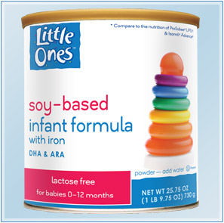
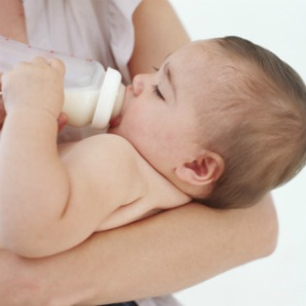
Soybean Oil and Protein Products*
Heavily used in processed foods
“White flakes" made by defatting soybeans by hexane extraction
→ Protein isolate and soy lecithin
Fat separated into soybean oil and used in soy infant formula (and many other products)
* EW Lusas and MN Riaz, J Nutr 1995, 125(3 Suppl): 573S-580S.
Notes:
http://europepmc.org/abstract/MED/7884536
Chenny/soy_protein_products.text

Slide 27
Soy Formula Linked to Seizures in Autism*
"There was a 2.6-fold higher rate of febrile seizures, a 2.1-fold higher rate of epilepsy comorbidity and a 4-fold higher rate of simple partial seizures in the autistic children fed soy-based formula"
*CJ Westmark, PLOSOne March 12, 2014, DOI: 10.1371/journal.pone.0080488.
Notes:
./SoyFormulaSeizuresAutism.pdf

Slide 28
Protein Bars!
“Most soy protein ingredients in meat analogs and nutrition bars, which are listed on labels as soy protein isolate, soy protein concentrate or textured vegetable protein, have undergone hexane processing.”*
*http://www.berkeleywellness.com/healthy-eating/food-safety/article/hexane-soy-food
Notes:
It’s hard to get a measure of soy protein consumption but a proxy is the measure of vegetable oil consumption – the residue from extraction of oil from soy is used as a protein additive

Slide 29
Synthetic Food
Liquid Vanilla:
Water, Sugar, Corn Maltodextrin, Sodium Caseinate, Milk Protein Concentrate, Soy Oil, Soy Protein Isolate, Corn Oil, Potassium Citrate, Calcium Beta-Hydroxy-Beta-Methylbutyrate, Canola Oil. Less than 0.5% of the Following: Whey Protein Concentrate, Magnesium Phosphate, Natural & Artificial Flavor, Cellulose Gel, Soy Lecithin, Sodium Phosphate, Potassium Phosphate, Potassium Chloride, Choline Chloride, Ascorbic Acid, Calcium Carbonate, Cellulose Gum, Carrageenan, Ferrous Sulfate, Salt, dl- Alpha-Tocopheryl Acetate, Gellan Gum, Zinc Sulfate, Niacinamide, Calcium Pantothenate, Manganese Sulfate, Cupric Sulfate, Vitamin A Palmitate, Thiamine Chloride Hydrochloride, Pyridoxine Hydrochloride, Riboflavin, Folic Acid, Chromium Chloride, Biotin, Sodium Molybdate, Sodium Selenate, Potassium Iodide, Phylloquinone, Cyanocobalamin, and Vitamin D3. *
*abbottnutrition.com/brands/products/ensure-muscle-health

Slide 30
Toxic Effects of Inhaled Hexane*
Low: Dizziness, headache, nausea, vomiting
High: Death from asphyxiation
Chronic: Peripheral neuropathy, pain, weakness, loss of sensation, impaired gait, muscle atrophy, visual disturbances
*N-HEXANE. Toxicology data network Hazardous Substances Data Bank. US National Library of Medicine
Notes:
Chenny/hexane_microbes_1991.pdf
ADD THIS

Slide 31
Toxic Effects of Inhaled Hexane*
Low: Dizziness, headache, nausea, vomiting
High: Death from asphyxiation
Chronic: Peripheral neuropathy, pain, weakness, loss of sensation, impaired gait, muscle atrophy, visual disturbances
Hexane allowances in China are much higher than allowances in Europe.
The US does not restrict or measure hexane levels in foods.
*N-HEXANE. Toxicology data network Hazardous Substances Data Bank. US National Library of Medicine
Notes:
Chenny/hexane_microbes_1991.pdf
ADD THIS

Slide 32
Vegetable Oil Consumption: All Uses*
Mostly Soy!
*Graphs provided by Dr. Nancy Swanson, with permission
Notes:
Nancy/oils/veg oil domestic disappearance.gif

Slide 33
Human Fat and Oil Consumption: US*
*Graphs provided by Dr. Nancy Swanson, with permission
Notes:
Nancy/oils/domest oil\ consumption.gif

Slide 34
Baking or Salad + Frying or Cooking Oil
Autism, Developmental Delay or Anxiety disorder
Counts in VAERS database of adverse reaction reports mentioning these conditions
* Plots provided by Dr. Nancy Swanson with permission
Notes:
./under\ 6\ ADD\ etc\ vs\ veg\ oil.gif

Slide 35
Outline
Autism & Glyphosate
Soy: Why It’s Dangerous
Glyphosate, Aluminum and Vaccines
Glyphosate and breast cancer
Bile Acid Disruption by Glyphosate
Arsenic toxicity → kidney failure
Manganese toxicity → Parkinson’s disease
Manganese deficiency → Autism
Infertility and Birth Malformations
Summary

Slide 36
Autism, Glyphosate, Vaccine Reactions*
Glyphosate application to corn and soy, US
Children with Autism, US
# Adverse Reactions in VAERS
*Collaboration with Nancy Swanson
Notes:
Individuals with Disabilities Education Act

Slide 37
Autism, Glyphosate, Vaccine Reactions*
Glyphosate application to corn and soy, US
Glyphosate makes the aluminum (and mercury?) (and glutamate??) in vaccines much more toxic??
Children with Autism, US
# Adverse Reactions in VAERS
*Collaboration with Nancy Swanson
Notes:
Individuals with Disabilities Education Act

Slide 38
Glyphosate enhances aluminum toxicity
Glyphosate interferes with acetaminophen metabolism

Slide 39
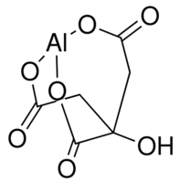
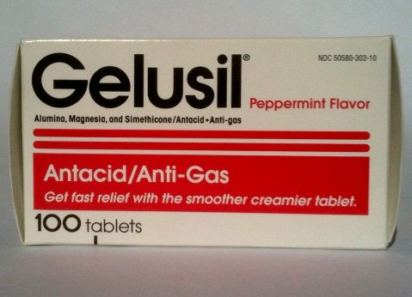
Aluminum Glyphosate*
Six different ways two glyphosate molecules can chelate aluminum
Aluminum citrate**
ALUMINA
aluminum
*M. Purgel et al., Journal of Inorganic Biochemistry 103 (2009) 1426–1438
** P. Sianina et al., Clin. Chem. 32/3, 539-541, 1986.
Notes:
AnthonySamsel/swine/aluminum_glyphosate.pdf
aluminum_citrate_absorbs_well_vinegar_antacids.pdf
Csail/2013/project/Anthony/

Slide 40
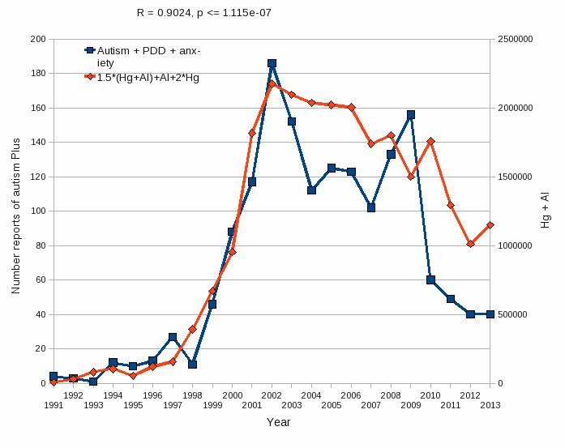
Aluminum & Mercury Autism & Developmental Delay & Anxiety
VAERS
database
Tabulations from US Vaccine Adverse Event Reporting System (VAERS)
Formula: Al + 1.5 x (Al w/ Hg) + 2.0 x Hg
* Plots provided by Dr. Nancy Swanson with permission

Slide 41
Baking or Salad + Frying or Cooking Oil
Autism, Developmental Delay or Anxiety disorder
Counts in VAERS database of adverse reaction reports mentioning these conditions
* Plots provided by Dr. Nancy Swanson with permission
Notes:
./under\ 6\ ADD\ etc\ vs\ veg\ oil.gif

Slide 42
Baking or Salad + Frying or Cooking Oil
Autism, Developmental Delay or Anxiety disorder
Hypothesis: hexane, glutamate and glyphosate work synergistically with aluminum and mercury to sensitize children to vaccines
Counts in VAERS database of adverse reaction reports mentioning these conditions
* Plots provided by Dr. Nancy Swanson with permission
Notes:
./under\ 6\ ADD\ etc\ vs\ veg\ oil.gif

Slide 43
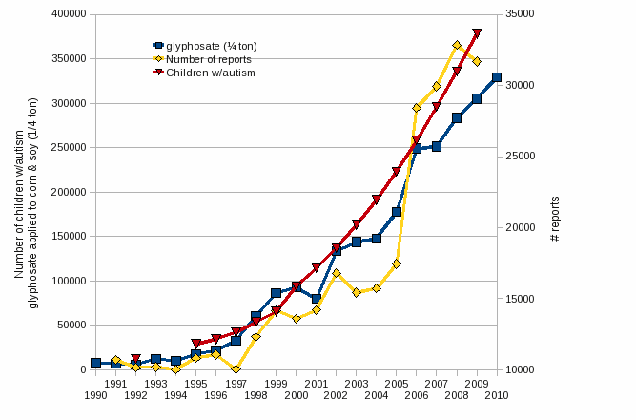
Another Possibility: Modifications to the Surfactant Adjuvants!
2000
2005

Slide 44
sec.gov/Archives/edgar/data/1110783/000103570403000400/c77652exv99w2.htm

Slide 45
New Roundup Transorb'R' Herbicide Formu- lation to Hit Retail Shelves in Eastern Canada*
“In 2004, this powerful new formulation was chosen by more western Canadian growers than any other non-selective herbicide on the market. Grower satisfaction with the performance in the field has reached new heights - 99% of growers who used Roundup WeatherMAX were satisfied with their experience.”
*JANUARY 3, 2005
Notes:
The product received its registration certificate in October 2003 after six years of research and development work and field testing across various regions in Canada. It was introduced in Western Canada last
season.

Slide 46
The Enhancing Effect of Adjuvants*
“Adjuvants in pesticides are generally declared as inerts, and for this reason they are not tested in long-term regulatory experiments. It is thus very surprising that they amplify up to 1000 times the toxicity of their APs [Active Principles] in 100% of the cases where they are indicated to be present by the manufacturer.”
*R. Mesnage et al.BioMed Research International 2014; Article ID:179691.
Notes:
Glyphosate/seralini_2014_pesticide_toxicity_adjuvants.pdf

Slide 47
Outline
Autism & Glyphosate
Soy: Why It’s Dangerous
Glyphosate, Aluminum and Vaccines
Glyphosate and breast cancer
Bile Acid Disruption by Glyphosate
Arsenic toxicity → kidney failure
Manganese toxicity → Parkinson’s disease
Manganese deficiency → Autism
Infertility and Birth Malformations
Summary

Slide 48
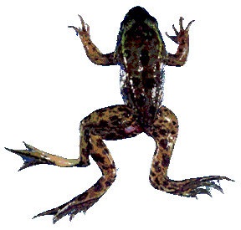
Glyphosate is an endocrine disruptor that promotes breast cancer*
Low and environmentally relevant concentrations of glyphosate possess estrogenic activity
Glyphosate caused human hormone-dependent breast cancer cells to proliferate at concentrations of parts per trillion
Additive effect from genistein, a phytoestrogen in soybeans
* S. Thongprakaisang et al., Food Chem Toxicol. 2013 Jun 8. S0278-6915(13)00363-3.
Notes:
./glyphosate_and_breast_cancer.text
Swine/glyphosate_breast_cancer.pdf
Please make a note that this study shows Glyphosate effects down to parts per trillion (10 to the minus12th).
In this study, we found that glyphosate at a log interval concentration ranging from 10-12 to 10-6 M increased the cell proliferation of a hormorne dependent breast cancer T47D ce

Slide 49
Glyphosate Test Report: Findings in American Mother's Breast milk, urine and water*
Moms Across America initiative!
Breast milk levels ranging from 76 ug/l to 166 ug/l are 760 to 1600 times higher than the European Drinking Water Directive allows
Urine testing shows glyphosate levels over 10 times higher than in Europe
Monsanto is wrong regarding bioaccumulation
*Posted on Apr 6 2014 - 4:19am by Sustainable Pulse

Slide 50
Glyphosate Test Report: Findings in American Mother's Breast milk, urine and water*
Moms Across America initiative!
Breast milk levels ranging from 76 ug/l to 166 ug/l are 760 to 1600 times higher than the European Drinking Water Directive allows
Urine testing shows glyphosate levels over 10 times higher than in Europe
Monsanto is wrong regarding bioaccumulation
If it’s in the breast milk
then it is in the breast!
*Posted on Apr 6 2014 - 4:19am by Sustainable Pulse

Slide 51
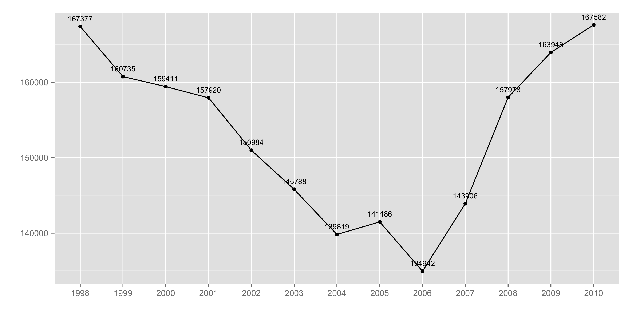
CDC Hospital Discharge Data on Breast Cancer Trends*
Collaboration with Dr. Chen Li and Dr. Nancy Swanson
*ICD9 codes 174-175 , ftp://ftp.cdc.gov/pub/Health_Statistics/NCHS/Datasets/NHDS

Slide 52
Same Data: Caucasians Only*
*ICD9 codes 174-175 , ftp://ftp.cdc.gov/pub/Health_Statistics/NCHS/Datasets/NHDS

Slide 53
Once Estrogen Model Is Subtracted …
Plot Drawn by Dr. Nancy Swanson
*ICD9 codes 174-175 , ftp://ftp.cdc.gov/pub/Health_Statistics/NCHS/Datasets/NHDS

Slide 54
Roundup Disrupts Steroid Synthesis*
StAR protein mediates rate-limiting step in steroid synthesis
Roundup suppresses StAR protein by 90% and reduces steroidogenesis by 94%
This affects both the production of sex hormones in the gonads and the production of cortisol and aldosterone in the adrenal glands
*L.P. Walsh et al., Environmental Health Perspectives 108(8), 2000 769-776.
Notes:
Glyphosate/roundup_inhibits_StAR_protein_expression.pdf
reduction in StAR expression in the adrenal gland may affect carbohydrate metabolism, immune system function, and water balance.

Slide 55
Mammary Tumors in Rats*,**
Rats through their entire lifespan exposed to Roundup at levels well below established safety limits
*G.-E. Séralini et al., Food Chem. Toxicol. (2012) [retracted]
**G-E Séralini et al. Environmental Sciences Europe 2014, 26:14
Notes:
Images/seralini_rats.png
./seralini_paper.pdf
1-Seralini&al.ESEU-RepublishedInVivo_June2014.pdf
2-Seralini et al-RetTR- 1-s2.0-S0278691512005637-main.pdf
3 Seralini&al.ESEU-Conflicts_June2014.pdf

Slide 56
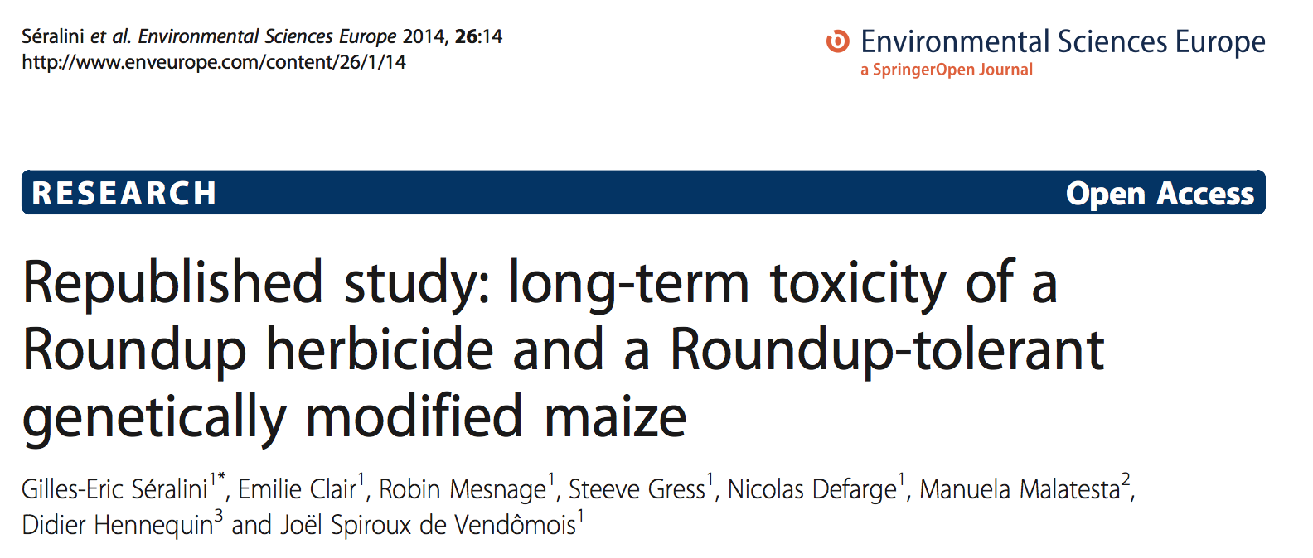
Notes:
1-Seralini&al.ESEU-RepublishedInVivo_June2014.pdf
2-Seralini et al-RetTR- 1-s2.0-S0278691512005637-main.pdf
3 Seralini&al.ESEU-Conflicts_June2014.pdf

Slide 57
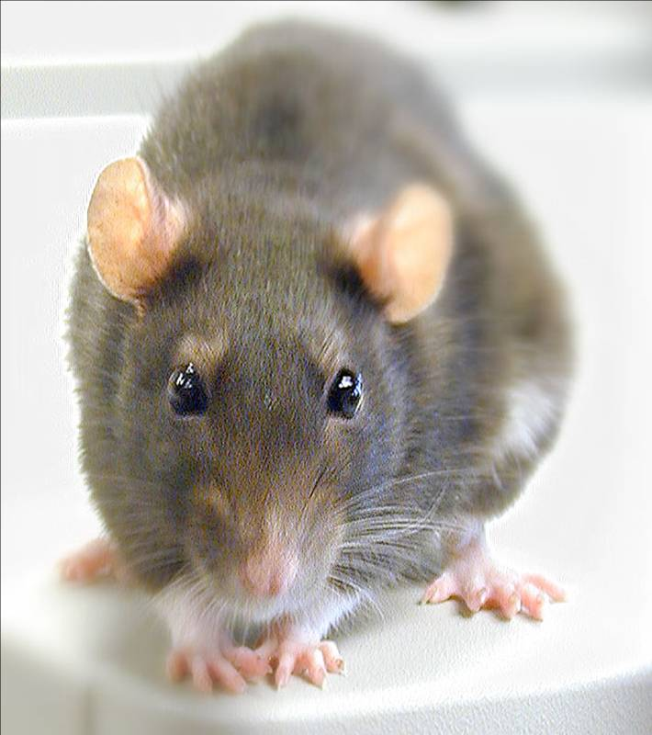
Conclusions from Rat Study *
Female rats had greatly increased risk of mammary tumors
Males had significantly increased risk of tumors of the liver and kidney
Sex hormone disruption for both males and females
Enhanced oxidative stress
Very significant kidney dysfunction
Effects didn’t become apparent until after 4 months
*G-E Séralini et al. Environmental Sciences Europe 2014, 26:14
Notes:
Spacedoc/mercola/GMOS_mouse_study_2012.pdf

Slide 58
Outline
Autism & Glyphosate
Soy: Why It’s Dangerous
Glyphosate, Aluminum and Vaccines
Glyphosate and breast cancer
Bile Acid Disruption by Glyphosate
Arsenic toxicity → kidney failure
Manganese toxicity → Parkinson’s disease
Manganese deficiency → Autism
Infertility and Birth Malformations
Summary

Slide 59
“Biliary excretion may be a major homeostatic mechanism for preventing both deficiency and toxicity of manganese.”*
*Malechki et al., J Nutr 126(2): 489-98, 1996.
Notes:
Glyphosate/biliary_excretion_of_manganese.pdf

Slide 60
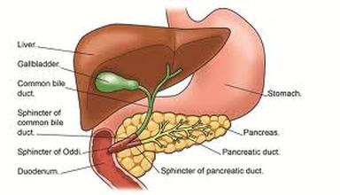
Studies on Glyphosate Exposure to Karp (Fish) in Africa*
“The changes in liver tissues are congestion of sinosoids, congestion of central vein and proliferation of the bile ductular epithelium.”
Bile Ducts
*K. Ramah, African Journal of Biotechnology 10(7), 1112-1116, 14 Feb. 2011
Notes:
./carp_glyphosate_bile.pdf

Slide 61
Studies on Glyphosate Exposure to Karp (Fish) in Africa*
“The changes in liver tissues are congestion of sinosoids, congestion of central vein and proliferation of the bile ductular epithelium.”
Proliferating bile epithelial cells are a major source of growth factors leading to liver fibrosis**
Bile Ducts
*K. Ramah, African Journal of Biotechnology 10(7), 1112-1116, 14 Feb. 2011.
**N Sedlaczek et al., Am J Pathol 158(4):1239-44, 2001.
Notes:
./carp_glyphosate_bile.pdf
Glyphosate/bile_epithelial_cells_induce_fibrosis.text

Slide 62
What Does This Mean?
Hypothesis: bile flow is impeded because the bile acids are not converted to the more hydrophilic form that allows them to flow
Likely due to inhibition of the many cytochrome P450 enzymes that oxidize bile acids
This will lead to impaired metabolism of fats
Unoxidized bile acids are toxic to the liver
Both manganese and arsenic are exported through the bile acids
Impaired export leads to their accumulation in liver

Slide 63
Outline
Autism & Glyphosate
Soy: Why It’s Dangerous
Glyphosate, Aluminum and Vaccines
Glyphosate and breast cancer
Bile Acid Disruption by Glyphosate
Arsenic toxicity → kidney failure
Manganese toxicity → Parkinson’s disease
Manganese deficiency → Autism
Infertility and Birth Malformations
Summary

Slide 64
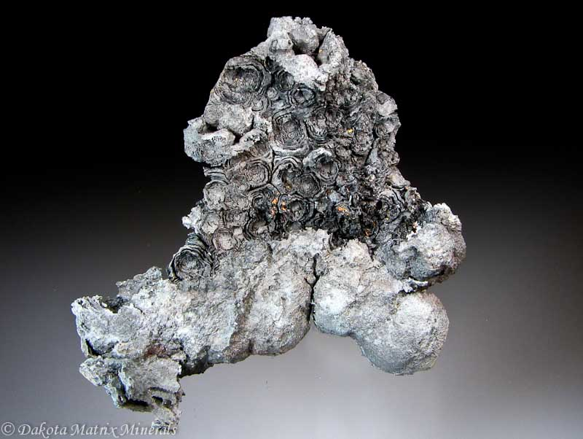
Arsenic Export Through Bile Acids*
Arsenic (a toxic metal) is removed from the body through two paths: biliary excretion by the liver and urinary excretion in the kidney
The biliary path depends critically upon glutathione bioavailability
Glutathione is depleted in the liver by glyphosate
*Z. Gregus et al. Toxicol Sci. 2000 Jul;56(1):18-25.
Notes:
Glyphosate/biliary_excretion_of_arsenic_glutathione.pdf
Z. Gregus et al. Toxicol Sci. 2000 Jul;56(1):18-25.
Biliary and Urinary Excretion of Inorganic Arsenic: Monomethylarsonous Acid as a Major Biliary Metabolite in Rats
Zoltán Gregus1,
Ágnes Gyurasics and
Iván Csanaky

Slide 65
Sri Lanka is the first country to ban glyphosate
arsenic
This problem did not exist in Sri Lanka prior to the 1990s.
Notes:
Project/Glyphosate/glyphosate_sri_lanka_kidney_failure_epidemiology.pdf

Slide 66
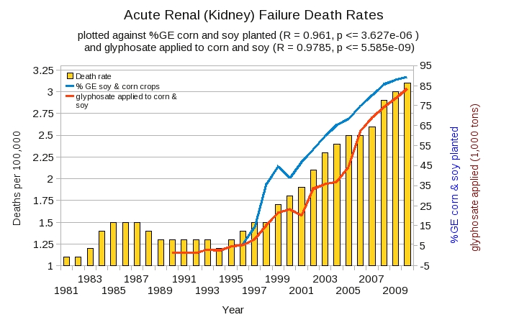
Acute Kidney Disease Death Rate in US Plotted Against Glyphosate and GMOs*
*Plot prepared by Nancy Swanson from available data online

Slide 67
Outline
Autism & Glyphosate
Soy: Why It’s Dangerous
Glyphosate, Aluminum and Vaccines
Glyphosate and breast cancer
Bile Acid Disruption by Glyphosate
Arsenic toxicity → kidney failure
Manganese toxicity → Parkinson’s disease
Manganese deficiency → Autism
Infertility and Birth Malformations
Summary

Slide 68
Manganese, Bilirubin, and Cholestasis
A mouse model of cholestasis (blocked bile flow) can be induced by exposure to manganese and bilirubin*
Glyphosate increases the release of bilirubin**
Bilirubinemia in neonates is a risk factor for autism***
*MY Akoume et al., Toxicol Sci 73: 378-385, 2003.
**FO Okonkwo et al., Pakistan Journal of Biological Sciences 16(18): 939-944, 2013.
***M Kaplan et al., J Pediatr 128(5 Pt 1): 695-7 1996.

Slide 69
Where Does the Manganese Go?
Brainstem Nuclei

Slide 70
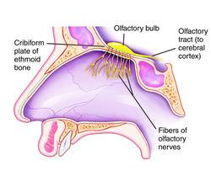
“Manganism” in Welders*
Manganese-containing nanoparticles breathed in through the nose are taken up into the central nervous system
A key pathway is via the olfactory tract, directly to the brain stem nuclei
Manganese, unlike most other metals, can travel across synapses and then along connecting axons to spread eventually to distant regions of the brain
*RG Lucchini et al. Neuromolecular Med. 2009;11(4):311-21
Notes:
Glyphosate/manganism.pdf
Neuromolecular Med. 2009;11(4):311-21. doi: 10.1007/s12017-009-8108-8. Epub 2009 Dec 10.
From manganism to manganese-induced parkinsonism: a conceptual model based on the evolution of exposure.
Lucchini RG¹, Martin CJ, Doney BC.
Author information
which Mn in inspired air can gain access the body to: 1) direct uptake
into the CNS via uptake into the olfactory or trigeminal presynaptic
nerve endings located in the nasal mucosa and the subsequent
retrograde axonal transport directly into the CNS; 2) transport across

Slide 71
“Manganism” in Welders*
Manganese-containing nanoparticles breathed in through the nose are taken up into the central nervous system
A key pathway is via the olfactory tract, directly to the brain stem nuclei
Manganese, unlike most other metals, can travel across synapses and then along connecting axons to spread eventually to distant regions of the brain
The pathology is very similar to Parkinson’s disease
*RG Lucchini et al. Neuromolecular Med. 2009;11(4):311-21
Notes:
Glyphosate/manganism.pdf
Neuromolecular Med. 2009;11(4):311-21. doi: 10.1007/s12017-009-8108-8. Epub 2009 Dec 10.
From manganism to manganese-induced parkinsonism: a conceptual model based on the evolution of exposure.
Lucchini RG¹, Martin CJ, Doney BC.
Author information
which Mn in inspired air can gain access the body to: 1) direct uptake
into the CNS via uptake into the olfactory or trigeminal presynaptic
nerve endings located in the nasal mucosa and the subsequent
retrograde axonal transport directly into the CNS; 2) transport across

Slide 72
C. elegans Study: Parkinsons Disease*
Chronic exposure to Touchdown (a glyphosate-containing herbicide) led to degeneration of dopaminergic and GABAergic neurons [in brainstem nuclei]
A manganese-containing fungicide also damaged these neurons
*R. Negga et al. Neurotox Res. 2012 April ; 21(3): 281–290.
Notes:
Glyphosate/glyphosate_parkinsons_worms.pdf
hronic, but perhaps not acute, exposure to TD leads to DAergic degeneration in C. elegans.

Slide 73
Parkinson’s Disease Following Glyphosate Accident (Acute Exposure)*
52 year old man developed Parkinsonian symptoms just one month following accidental spill of glyphosate product onto skin – remained in skin contact for 30 minutes
Hyperintense signal in globus pallidus and substantia nigra (indicative of manganese accumulation in brainstem nuclei)
*ER Barbosa et al., Mov Disord 16(3): 565-8, 2001.

Slide 74
Parkinsonism after Chronic Exposure to Glyphosate*
44 year old woman experienced rigidity, slowness and resting tremor
She worked for previous 3 years in the glyphosate manufacturing section of a chemical factory in China
MRI showed hyperintense signal in substantia nigra
*G Wang et al., Parkinsonism Relat Disord. 2011 Jul;17(6):486-7.
Notes:
Parkinsonism_glyphosate1.png, parkinsonism_glyphosate2.png

Slide 75
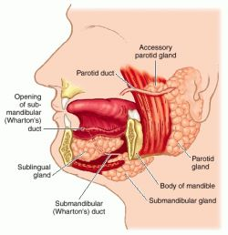
Arsenic Poisoning* and Manganese Poisoning** Induce Intense Salivation
And manganese levels in saliva are a good indicator of manganese toxicity in occupationally exposed individuals (welders)***
*LA Selby et al., Environmental Health Perspectives 19,183-189, 1977.
**K Shuqin et al. British Journal of Industrial Medicine 1992 49: 66-69.
***Wang et al. Toxicol Lett. 2008 Jan 4;176(1):40-7.
Notes:
./manganese_in_saliva.text
Glyphosate/arsenic_salivation_animals.pdf

Slide 76
Arsenic Poisoning* and Manganese Poisoning** Induce Intense Salivation
And manganese levels in saliva are a good indicator of manganese toxicity in occupationally exposed individuals (welders)***
Glyphosate exposure to rats induced a dramatic increase in the weight of the salivary glands along with impaired liver/bile function****
*LA Selby et al., Environmental Health Perspectives 19,183-189, 1977.
**K Shuqin et al. British Journal of Industrial Medicine 1992 49: 66-69.
***Wang et al. Toxicol Lett. 2008 Jan 4;176(1):40-7.
****P Chan and J Mahler, Toxicity Report Series 16:1-D3, 1992.
Notes:
./manganese_in_saliva.text
Glyphosate/arsenic_salivation_animals.pdf
glyphosate_bile_acids_salivary_glands_toxicity_study_1992.text
Chan and Mahler 1992

Slide 77
Salivary Glands Damaged by Glyphosate*
“A no­effect level for cytoplasmic alteration of the parotid and submandibular salivary glands in this study was not reached.”
*PC Chan, and JF Mahler, NTP Technical Report on Toxicity Studies of Glyphosate, National Toxicology Program, Toxicity Reports Series Number 16, NIH Publication 92­3135, July 1992. Table 6: p. 24
Notes:
Glyphosate/
salivary_gland_result_on_page_24.pdf

Slide 78
Outline
Autism & Glyphosate
Soy: Why It’s Dangerous
Glyphosate, Aluminum and Vaccines
Glyphosate and breast cancer
Bile Acid Disruption by Glyphosate
Arsenic toxicity → kidney failure
Manganese toxicity → Parkinson’s disease
Manganese deficiency → Autism
Infertility and Birth Malformations
Summary

Slide 79
“The mechanism by which glyphosate disrupts the EPSPS enzyme in plants and microorganism is by chelating the manganese metal co-factor of this enzyme. In other words it steals the ‘ignition key’ of the enzyme.”
Dr. Arden Andersen, D.O.,
Food Plague Primer: Glyphosate and Genetically Engineered Crops
Notes:
attached/Huber2/FoodPlaguePrimer.pdf

Slide 80
“Fundamentally the herbicidal effect of glyphosate is ultimately due to soil pathogens gaining access to the “weed” thanks to glyphosate’s weakening of the plant and killing of beneficial microbes by the chelation of manganese and other trace elements.”
Dr. Arden Andersen, D.O.,
Food Plague Primer: Glyphosate and Genetically Engineered Crops
Notes:
attached/Huber2/FoodPlaguePrimer.pdf

Slide 81
“Fundamentally the herbicidal effect of glyphosate is ultimately due to soil pathogens gaining access to the “weed” thanks to glyphosate’s weakening of the plant and killing of beneficial microbes by the chelation of manganese and other trace elements.”
Dr. Arden Andersen, D.O.,
Food Plague Primer: Glyphosate and Genetically Engineered Crops
This is analogous to glyphosate’s effect on gut bacteria: killing the beneficial bacteria and allowing the pathogens to overgrow
Notes:
attached/Huber2/FoodPlaguePrimer.pdf

Slide 82
Glyphosate Depletes Iron, Manganese and Zinc in Plants*
*D Huber, What About Glyphosate-Induced Manganese Deficiency?
Fluid Journal, 20-22.
Notes:
Glyphosate/glyphosate_induced_manganese_deficiency_plants_Huber.pdf

Slide 83
Severe Deficiency in Serum Manganese and Cobalt in Cows*
Eight different farms: all cows tested had glyphosate in the urine
*M. Krüger et al., J Environ Anal Toxicol 2013, 3:5
Notes:
glyphosate//cows_cobalt_deficiency_glyphosate.pdf

Slide 84
Severe Deficiency in Serum Manganese and Cobalt in Cows*
cobalamin
deficiency
???
Eight different farms: all cows tested had glyphosate in the urine
*M. Krüger et al., J Environ Anal Toxicol 2013, 3:5
Notes:
glyphosate//cows_cobalt_deficiency_glyphosate.pdf

Slide 85
Sub-Outline
Glyphosate and manganese deficiency
Lactobacillus and anxiety
Glutamate and ammonia
Mitochondrial disorder
Impaired bone development

Slide 86
Glyphosate Kills Beneficial Bacteria*
Examined effect of glyphosate and Roundup on three food microorganisms widely used as starters in dairy technologies
Two are species of Lactobacillus
Roundup is always more potent than glyphosate, and in all cases, toxic from levels 10–100 times below the lowest agricultural uses (10,000 ppm).
Unpredictable consequences of Roundup on soil microorganisms have to be considered
*E Clair et al. Curr Microbiol (2012) 64:486–491
Notes:
Glyphosate/Clair_glyphosate_toxic_to_lactobacillus_2012.pdf

Slide 87
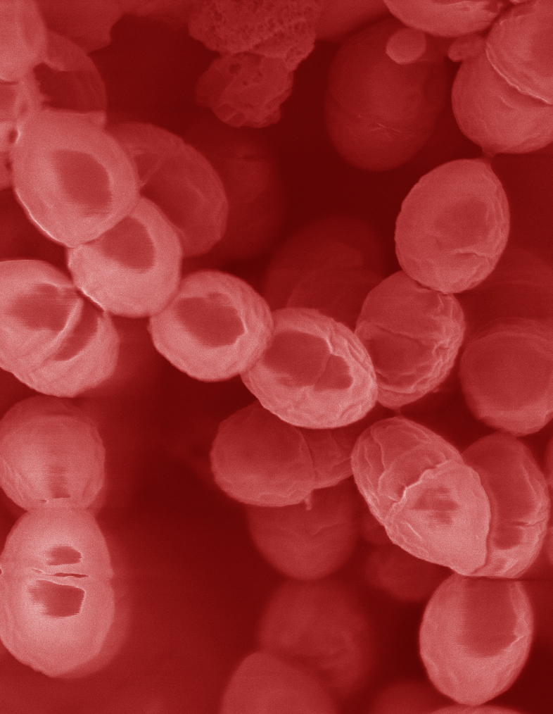
Lactobacillus Depends on Manganese!*
Many lactic acid bacteria contain very high intracellular manganese levels
Scavenges toxic oxygen species, particularly superoxide
Manganese deprivation suppresses growth
* FS Archibald and M-N Duong. Journal of Bacteriology Apr 1084, 1-8.
Notes:
Glyphosate/manganese/manganese_acquisition_by_lactobacillus.pdf

Slide 88
Lactobacillus Depends on Manganese!*
Many lactic acid bacteria contain very high intracellular manganese levels
Scavenges toxic oxygen species, particularly superoxide
Manganese deprivation suppresses growth
Lactobacillus levels are low in the gut in association with autism
* FS Archibald and M-N Duong. Journal of Bacteriology Apr 1084, 1-8.
Notes:
Glyphosate/manganese/manganese_acquisition_by_lactobacillus.pdf

Slide 89
Lactobacillus Alleviate Anxiety*
Patients suffered from chronic fatigue syndrome and associated anxiety
Patients were treated with probiotic strain of Lactobacillus (control group got a placebo)
Significant rise in both Latobacillus and Bifidobacteria in gut
Significant decrease in anxiety symptoms (p = 0.01)
Supports concept of gut-brain axis (communicate with brain via vagal nerve)
*R Av et al. Gut Pathog. 2009 Mar 19;1(1):6. doi: 10.1186/1757-4749-1-6.
Notes:
Glyphosate/manganese/manganese_alleviates_anxiety.text

Slide 90
Lactobacillus Alleviate Anxiety*
Patients suffered from chronic fatigue syndrome and associated anxiety
Patients were treated with probiotic strain of Lactobacillus (control group got a placebo)
Significant rise in both Latobacillus and Bifidobacteria in gut
Significant decrease in anxiety symptoms (p = 0.01)
Supports concept of gut-brain axis (communicate with brain via vagal nerve)
Increased anxiety is a comorbidity of autism
*R Av et al. Gut Pathog. 2009 Mar 19;1(1):6. doi: 10.1186/1757-4749-1-6.
Notes:
Glyphosate/manganese/manganese_alleviates_anxiety.text

Slide 91
Anxiety and Autism*
Specific Phobia: 30%
Obsessive-Compulsive Disorder: 17%
Social Anxiety Disorder/Agoraphobia: 17%
Generalized Anxiety Disorder: 15%
Separation Anxiety Disorder: 9 %
Panic Disorder: 2%
*Van Steensel, F.J.A., Bogels, S.M., & Perrin, S. (2011). Anxiety disorders in children and adolescents with autistic spectrum disorders: A meta-analysis. Clinical Child and Family Psychology Review, 14, 302-317.
Notes:
http://www.iidc.indiana.edu/?pageId=3616

Slide 92
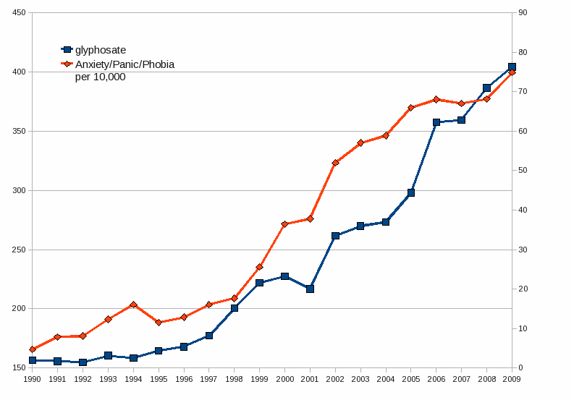
Glyphosate Application on Corn and Soy Plotted against Anxiety, Panic Disorder and Phobias*
*Plots provided by Dr. Nancy Swanson
Notes:
2014/AutismOne/images/anxiety.gif

Slide 93
Sub-Outline
Glyphosate and manganese deficiency
Lactobacillus and anxiety
Glutamate and ammonia
Mitochondrial disorder
Impaired bone development

Slide 94
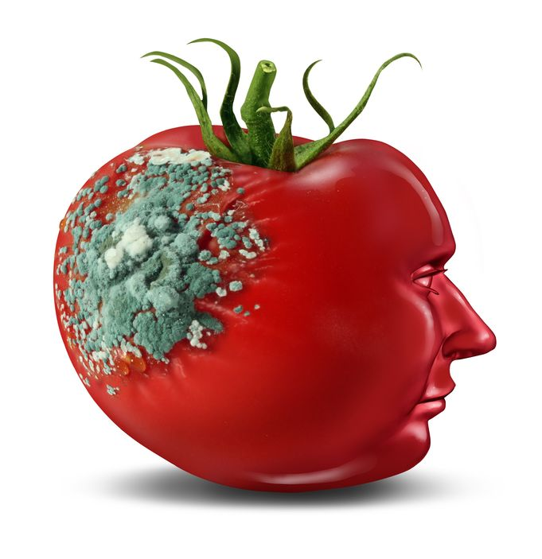
Glyphosate and Glutamate*
Acute exposure activates NMDA receptors and voltage-dependent calcium channels
Oxidative stress and neural cell death
Increased glutamate release into the synaptic cleft → excessive extracellular glutamate levels
Decreased glutathione content
Increased peroxidation of lipids (fats)
Chronic exposure:
Decreased glutamate uptake and metabolism
Induced calcium uptake
Induced oxidative stress
*http://www.greenmedinfo.com/blog/roundup-weedkiller-brain-damaging-neurotoxin
Notes:
http://www.greenmedinfo.com/blog/roundup-weedkiller-brain-damaging-neurotoxin
acute exposure (30 minutes) and chronic (pregnancy and lactation) exposure.
Why was this referenced??
T. Bohn et al. Food Chemistry 153, 15 June 2014, 207-215.

Slide 95
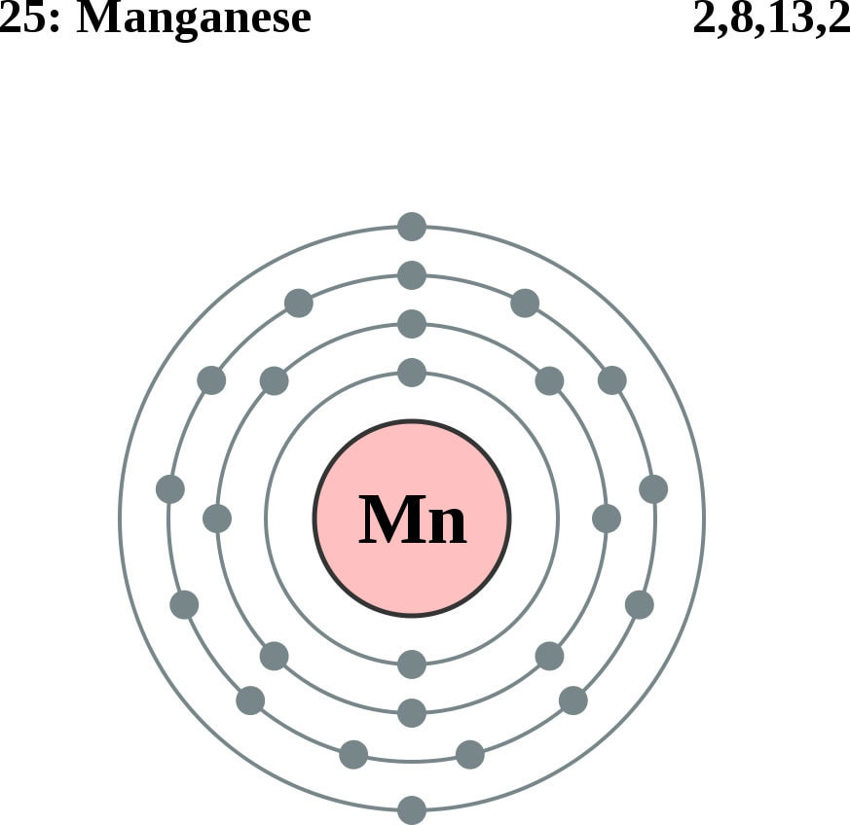
Glutamine Synthesis Depends on Manganese!
Glutamine synthetase
glutamate
glutamine
water
ammonium
Ammonium and glutamate toxicity in the brain
can arise because of insufficient manganese

Slide 96
“Alteration of Plasma Glutamate and Glutamine Levels in Children with High-Functioning Autism”*
*C. Shimmura et al. PLoSone October 2011 6(1):e25340
Notes:
Table 1. Plasma Levels of Amino Acids and related compounds in Control Subjects and Individuals with HFA.
Glyphosate/glutamate_glutamine_autism_2011.pdf

Slide 97
Journal of Personal Science: One Child’s Autism Eliminated by Removal of Glutamate From Her Diet* By Katherine Reid
First Round:
Kale, cucumber, cilantro, nuts, seeds, fruits
Magnesium B-complex, vitamin D3, omega 3 fats (EPA, DHA)
Probiotics
Gluten free and casein free (no wheat, no milk)
Child improved significantly but still had autistic behaviors
Second Round:
ADD: ELIMINATE FREE GLUTAMATE
Child lost the "autism" label!
*blog.sethroberts.net/2013/05/17/journal-of-personal-science-
one-childs-autism-eliminated-by-removal-of-glutamate-from-her-diet
Notes:
./glutamate_autism_personal_story.pdf

Slide 98
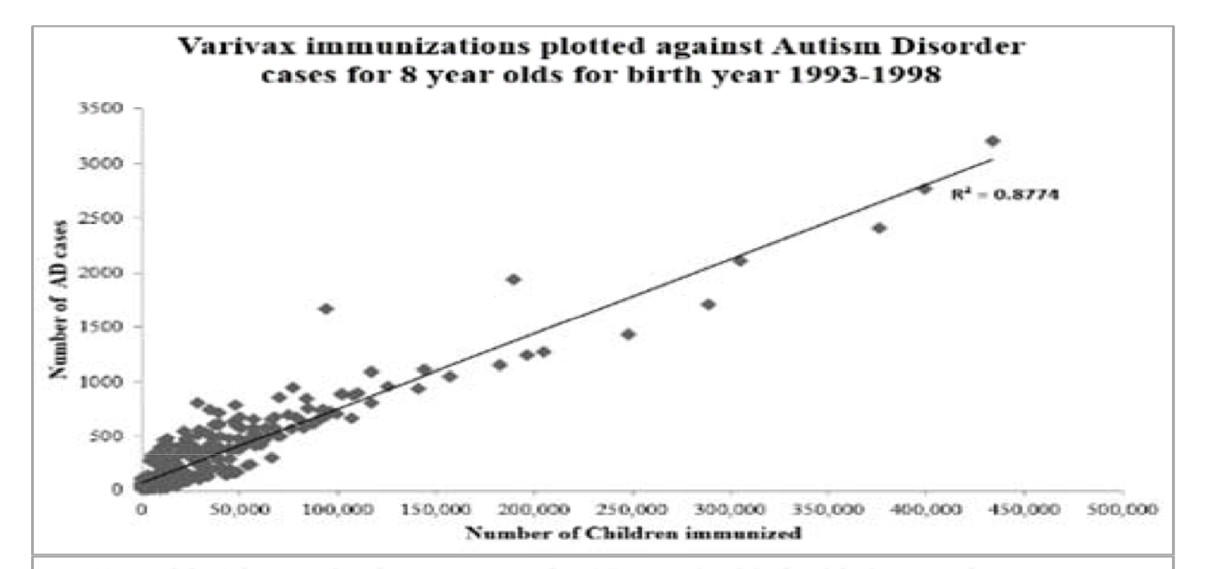
Varivax and Hepatitus A Vaccines: Linked to Autism*
Contains Glutamate
Contains Aluminum
*TA Deisher et al., Journal of Public Health and Epidemiology 6(9), 271-284, 2014.
Notes:
Samantha/Autism_Varicella_Deisher_2014.pdf
The United States, Western Australia, United Kingdom and Denmark settings were used

Slide 99
Sub-Outline
Glyphosate and manganese deficiency
Lactobacillus and anxiety
Glutamate and ammonia
Mitochondrial disorder
Impaired bone development

Slide 100
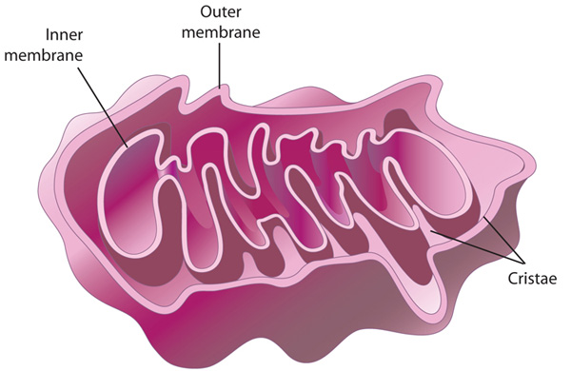
Autism and Mitochondrial Disorder*
“Five of 11 patients studied were classified with definite mitochondrial respiratory chain disorder, suggesting that this might be one of the most common disorders associated with autism”
Manganese superoxide dismutase plays a critical role in protecting mitochondria from oxidative damage
*G Oliveira et al. Developmental Medicine & Child Neurology 47(3), 185-189, 2005.
Notes:
http://onlinelibrary.wiley.com/doi/10.1111/j.1469-8749.2005.tb01113.x/full
69 kids total, they picked the 11 based on them being most likely to have it?
7.2% of 69 is still very high.

Slide 101
Detoxification of Superoxide (O₂⁻)
GLUTATHIONE
SELENIUM
MANGANESE
Glyphosate disrupts all of these!
IRON

Slide 102
Citric Acid Cycle in Mitochondria
aconitase
*PR Gardner. Methods in Enzymology 349:9–23.
Notes:
WIKI on aconitase – in definitions (notes)

Slide 103
Citric Acid Cycle in Mitochondria
aconitase
The iron sulfur cluster in aconitase is highly sensitive to oxidation by superoxide*
*PR Gardner. Methods in Enzymology 349:9–23.
Notes:
WIKI on aconitase – in definitions (notes)

Slide 104
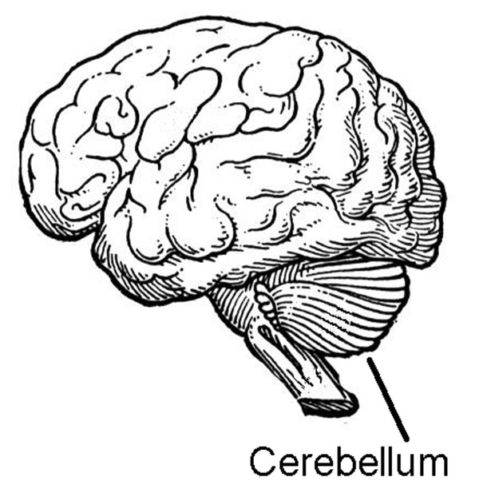
Aconitase Dysfunction and Brain Inflammation in Autism*
Frozen samples of post-mortem tissues from cerebellum and temporal cortex of autism patients compared with controls.
Compared to controls:
Aconitase activity was significantly reduced in the cerebellum and correlated with low glutathione levels
Biomorkers of inflammation were increased
*S. Rose et al. Transl Psychiatry (2012) 2:e134.
Notes:
Glyphosate/aconitase_autism.text

Slide 105
Aconitase & Glutathione in Cerebellum in Autism*
* S Rose et al. Transl Psychiatry (2012) 2:e134.
Notes:
Samantha/Evidence_of_oxidative_damage_and_inflammation_associated_with_lowglutathione_redox_status_in_the_Autism_Brain.pdf
From Gerry Koenig!!

Slide 106
Comorbidities of Autism
Effects of Glyphosate
Chelation of manganese
Overgrowth of gut pathogens Chelation of manganese
Low aconitase
Mitochondrial damage
Excess glutamate in brain Chelation of cobalt
Encephalopathy Chelation of aluminum
Hypersensitivity to vaccines Chelation of iron
Anemia Disruption of
Cobalamin deficiency heme synthesis
Low serum sulfate Inactivation of
Low vitamin D CYP enzymes
Low serotonin Suppression of
Sleep disorder shikimate pathway
Hypothyroidism
Low folate
Chelation of cobalt
Chelation of aluminum
Chelation of iron
Disruption of heme synthesis
Inactivation of CYP enzymes
Suppression of shikimate pathway

Slide 107
Sub-Outline
Glyphosate and manganese deficiency
Lactobacillus and anxiety
Glutamate and ammonia
Mitochondrial disorder
Impaired bone development

Slide 108
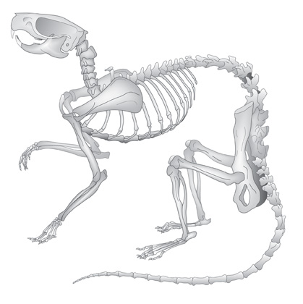
Glyphosate and Bone Development*
Dams treated with glyphosate in water from days 6 to 15 of their pregnancy
Effects on pups:
Lack of development of the ossification centers of the terminal phalanges (bones in fingers and toes)
Larger fontanelles ("soft spot") and incomplete development of skull bones
Absence of important bones or parts of bones, shortenings, bendings, asymmetry, fusions or clefts.
Surfactant polyoxyethyleneamine increased glyphosate's toxicity
*E. Dallegrave et al. Toxicology Letters 142 (2003) 45-52.
Notes:
Glyphosate/./abnormal_ossification_skeleton_glyphosate_rats_2003.pdf

Slide 109
Manganese and Bones*
“The multiple cellular effects of Mn deficiency include: decreased bone resorption, production of labile bone, and decreased synthesis of organic matrix. The serum level of Mn in a group of osteoporotic postmenopausal women was significantly lower than age-matched controls.”
*L. Strause and P. Saltman. Role of Manganese in Bone Metabolism.
Chapter 5, pp 46–55 in Nutritional Bioavailability of Manganese.
Notes:
http://pubs.acs.org/doi/abs/10.1021/bk-1987-0354.ch005
Glyphosate/manganese_and_bones.text

Slide 110
Osteoblasts build “Ground Substance”
Ground substance is made of chondroitin sulfate and osteocalcin – collagen is layered over this
Poor mineralization results from impaired chondroitin sulfate synthesis
Osteoblasts in bone
Childhood osteoarthritis and osteomalacia are an epidemic in the US today

Slide 111
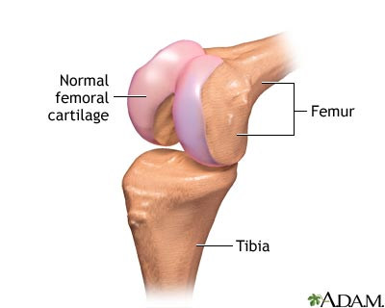
Chondroitin Sulfate Synthesis in Cartilage depends on Manganese*
Two critical enzymes are manganese dependent:
Polymerase enzyme forms the polysaccharide
Galactotransferase incorporates galactose that links the polysaccharide to the protein associated with it.
*RM Leach et al. Archives of Biochemistry and Biophysics 133(1), 1969, 22-28.
Notes:
glyphosate/chondroitin_sulfate_manganese_cartilege.text

Slide 112
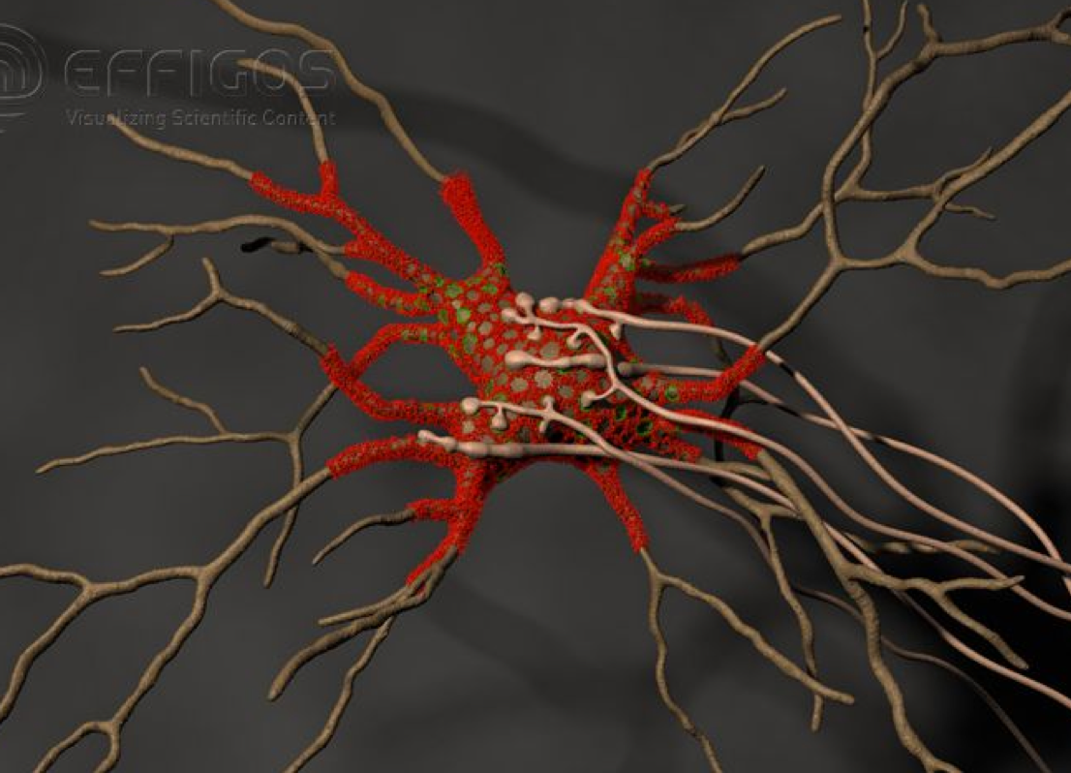
Perineuronal Nets*
Perineuronal nets (PNs) formed from chondroitin sulfate attached to hyaluronan, modulate GABAergic inhibitory signaling
Removal of PNs increased the excitability of interneurons in cultures
They provide an environment rich in anions (negative charge)
*G. Bruckner et al. Glia 8(3), 183-200, 1993.
Notes:
http://onlinelibrary.wiley.com/doi/10.1002/dneu.20361/full

Slide 113
Perineuronal Nets*
Perineuronal nets (PNs) formed from chondroitin sulfate attached to hyaluronan, modulate GABAergic inhibitory signaling
Removal of PNs increased the excitability of interneurons in cultures
They provide an environment rich in anions (negative charge)
Might manganese deficiency lead to impaired synthesis of perineuronal nets and increased neuronal excitability leading to cell death??
*G. Bruckner et al. Glia 8(3), 183-200, 1993.
Notes:
http://onlinelibrary.wiley.com/doi/10.1002/dneu.20361/full

Slide 114
Coral Die-Off & Chondroitin Sulfate*
Large amounts of chondroitin sulfate are adsorbed onto coral
Sulfate groups are of paramount importance to the adsorption process
Adsorption rate is a direct function of the amount of negative charge
*N. Volpi. Biomaterials 2002 Jul;23(14):3015-22
Notes:
Project/glyphsate/chondroitin_sulfate_coral.text

Slide 115
“Disease Causes Starfish to Lose Arms, Dissolve into White Blobs of Goo” *
Glyphosate is used to kill seagrass in oyster beds
"Glyphosate and diuron are among the most frequently detected herbicides in oyster production areas"**
Starfish eat oysters
*http://natureworldnews.com/articles/4749/20131104/
disease-causes-starfish-lose-arms-dissolve-white-blobs-goo-video.htm
**F. Akcha et al. Aquatic Toxicology. 106-107 (pp 104-113), 2012
Notes:
Glyphosate/glyphosate_oyster_toxicity.text

Slide 116
Outline
Autism & Glyphosate
Soy: Why It’s Dangerous
Glyphosate, Aluminum and Vaccines
Glyphosate and breast cancer
Bile Acid Disruption by Glyphosate
Arsenic toxicity → kidney failure
Manganese toxicity → Parkinson’s disease
Manganese deficiency → Autism
Infertility and Birth Malformations
Summary

Slide 117
Latest News in US: 2014 Statistics
U.S. maternal deaths near all-time high
18.5 per 100,000 births today compared to 7.2 in 1987
We now rank lower than China, as #60 on a list of 180 countries
Our rate is more than 3x that in Great Britain
Teen pregnancy, birth and abortion rates have declined to historic lows over the last 30 years
13% drop in teen pregnancy in the past year

Slide 118
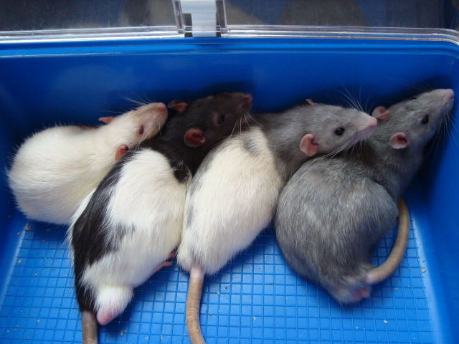
Glyphosate, Sperm and Aromatase*
Acute exposure (0.5%) of Roundup in fifteen 60-day-old male rats during an 8-day period
Aromatase mRNA levels increased by at least 50% in treated rats at all times
Protein expression also increased
Aromatase converts testosterone to estrogen
*E. Cassault-Meyer et al. Environmental Toxicology and Pharmacology 38 (2014) 131–140
Notes:
Glyphosate/glyphosate_alters_sperm_aromatase_Seralini_2014.pdf

Slide 119
Glyphosate, Sperm and Aromatase*
Acute exposure (0.5%) of Roundup in fifteen 60-day-old male rats during an 8-day period
Aromatase mRNA levels increased by at least 50% in treated rats at all times
Protein expression also increased
Aromatase converts testosterone to estrogen
Aromatase is defective in association with autism
*E. Cassault-Meyer et al. Environmental Toxicology and Pharmacology 38 (2014) 131–140
Notes:
Glyphosate/glyphosate_alters_sperm_aromatase_Seralini_2014.pdf

Slide 120
Glyphosate, Sperm and Aromatase*
Acute exposure (0.5%) of Roundup in fifteen 60-day-old male rats during an 8-day period
Aromatase mRNA levels increased by at least 50% in treated rats at all times
Protein expression also increased
Aromatase converts testosterone to estrogen
Aromatase is a Cytochrome P450 Enzyme
*E. Cassault-Meyer et al. Environmental Toxicology and Pharmacology 38 (2014) 131–140
Notes:
Glyphosate/glyphosate_alters_sperm_aromatase_Seralini_2014.pdf

Slide 121
Inhibition of Cytochrome P450 Enzymes (CYPs) by Various Pesticides*
Study in rats on 2,4-D, clofibrate, MCPA, and glyphosate
*E Hetanen et al., Acta Pharmacol. Et Toxicol. 1983, 53, 103-1 12.
Notes:
./lyphosate_inhibits_CYPS_and_other_issues.pdf
Fig. 1. The concentration of hepatic cytochrome P-450 in rats exposed to clofibrate, glyphosate, 2,4dichlorophen- oxyacetic acid (2,4-D) or 4-chloro-2-methylphenoxyace- tic acid (MCPA) for 2 weeks. The doses of 2,4-D and MCPA are also shown. The meansfS.E.M. are shown. The statistical significances were analyzed with Student's t-test using controls as a reference group. The following symbol is used: *: P<0.05.

Slide 122
"Male fertility under threat as average sperm counts drop”*
Study of 26,600 men in France found sperm concentration had decreased by 32% since the 1990s.
Numbers steadily dropped by 2% per year from 1989 to 2005.
Proportion of normally formed sperm also declined by about 1/3.
* M. Rolland et al., Hum Reprod. 2013 Feb;28(2):462-70.
Notes:
./falling_sperm_counts.text
Falling_sperm_counts.article.text

Slide 123
Sperm Motility and Manganese*
Sperm have an unusual form of adenylate cyclase that depends upon manganese as a cofactor
This enzymes produces cAMP which is necessary for flagella formation
Flagella are what make sperm able to swim
*T Braun and RF Dods,Proc Nat Acad Sci USA 1975;72(3):1097-1101.

Slide 124
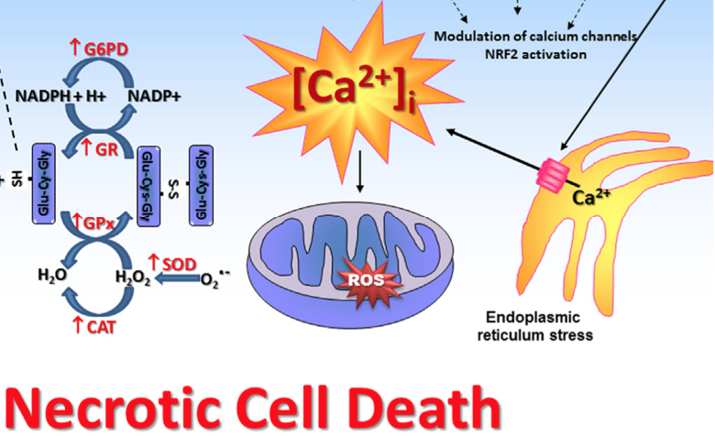
Glyphosate’s Effects on Sertoli Cells in Rat Testis*
Concentrations 10-fold more diluted than that recommended for herbicide action
Several pathologies noted:
Depletes glutathione (essential antioxidant)
Enhanced lipid and protein oxidation
Activates calcium channels; promotes calcium release from ER (stress response); induces cell death
Increases mitochondrial membrane permeability to calcium and protons
*V.L. Oliveira Cavalli et al., Free Radical Biology and Medicine 65, Dec. 2013, 335-346.

Slide 125
Glyphosate and Anencephaly*
Yakima, Benton and Franklin counties in Washington State have an unusually high number of pregnancies affected by the birth defect, anencephaly
75 pesticides were analyzed in studying contamination due to surrounding agriculture
47 (63%) of these were detected
Glyphosate was applied in large amounts, but was not studied
5% solution of glyphosate was also used heavily around irrigation ditches to control weeds
Main herbicide recommended due to its “low toxicity”
Glyphosate has been linked to anencephaly due to its effect on retinoic acid
*Barbara H. Peterson. Farm Wars, http://farmwars.info/?p=11137

Slide 126
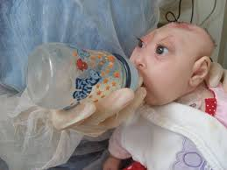
“Glyphosate, Brain Damaged Babies, and
Yakima Valley - A River Runs Through It”*
8
6
4
2
0
Noxious aquatic weed
control program with
Glyphosate ‘Rodeo’
1980 1990 2000 2010 2020
“Glyphosate, Three Rivers, and Anencephaly”
Yakima Harold Republic
Slide thanks to Prof. Don Huber, with permission
*Farm Wars 3/6/14
Notes:
From Don Huber:
Attached/LondonGlyphosate/
2014-0618_Huber_short.ppt

Slide 127
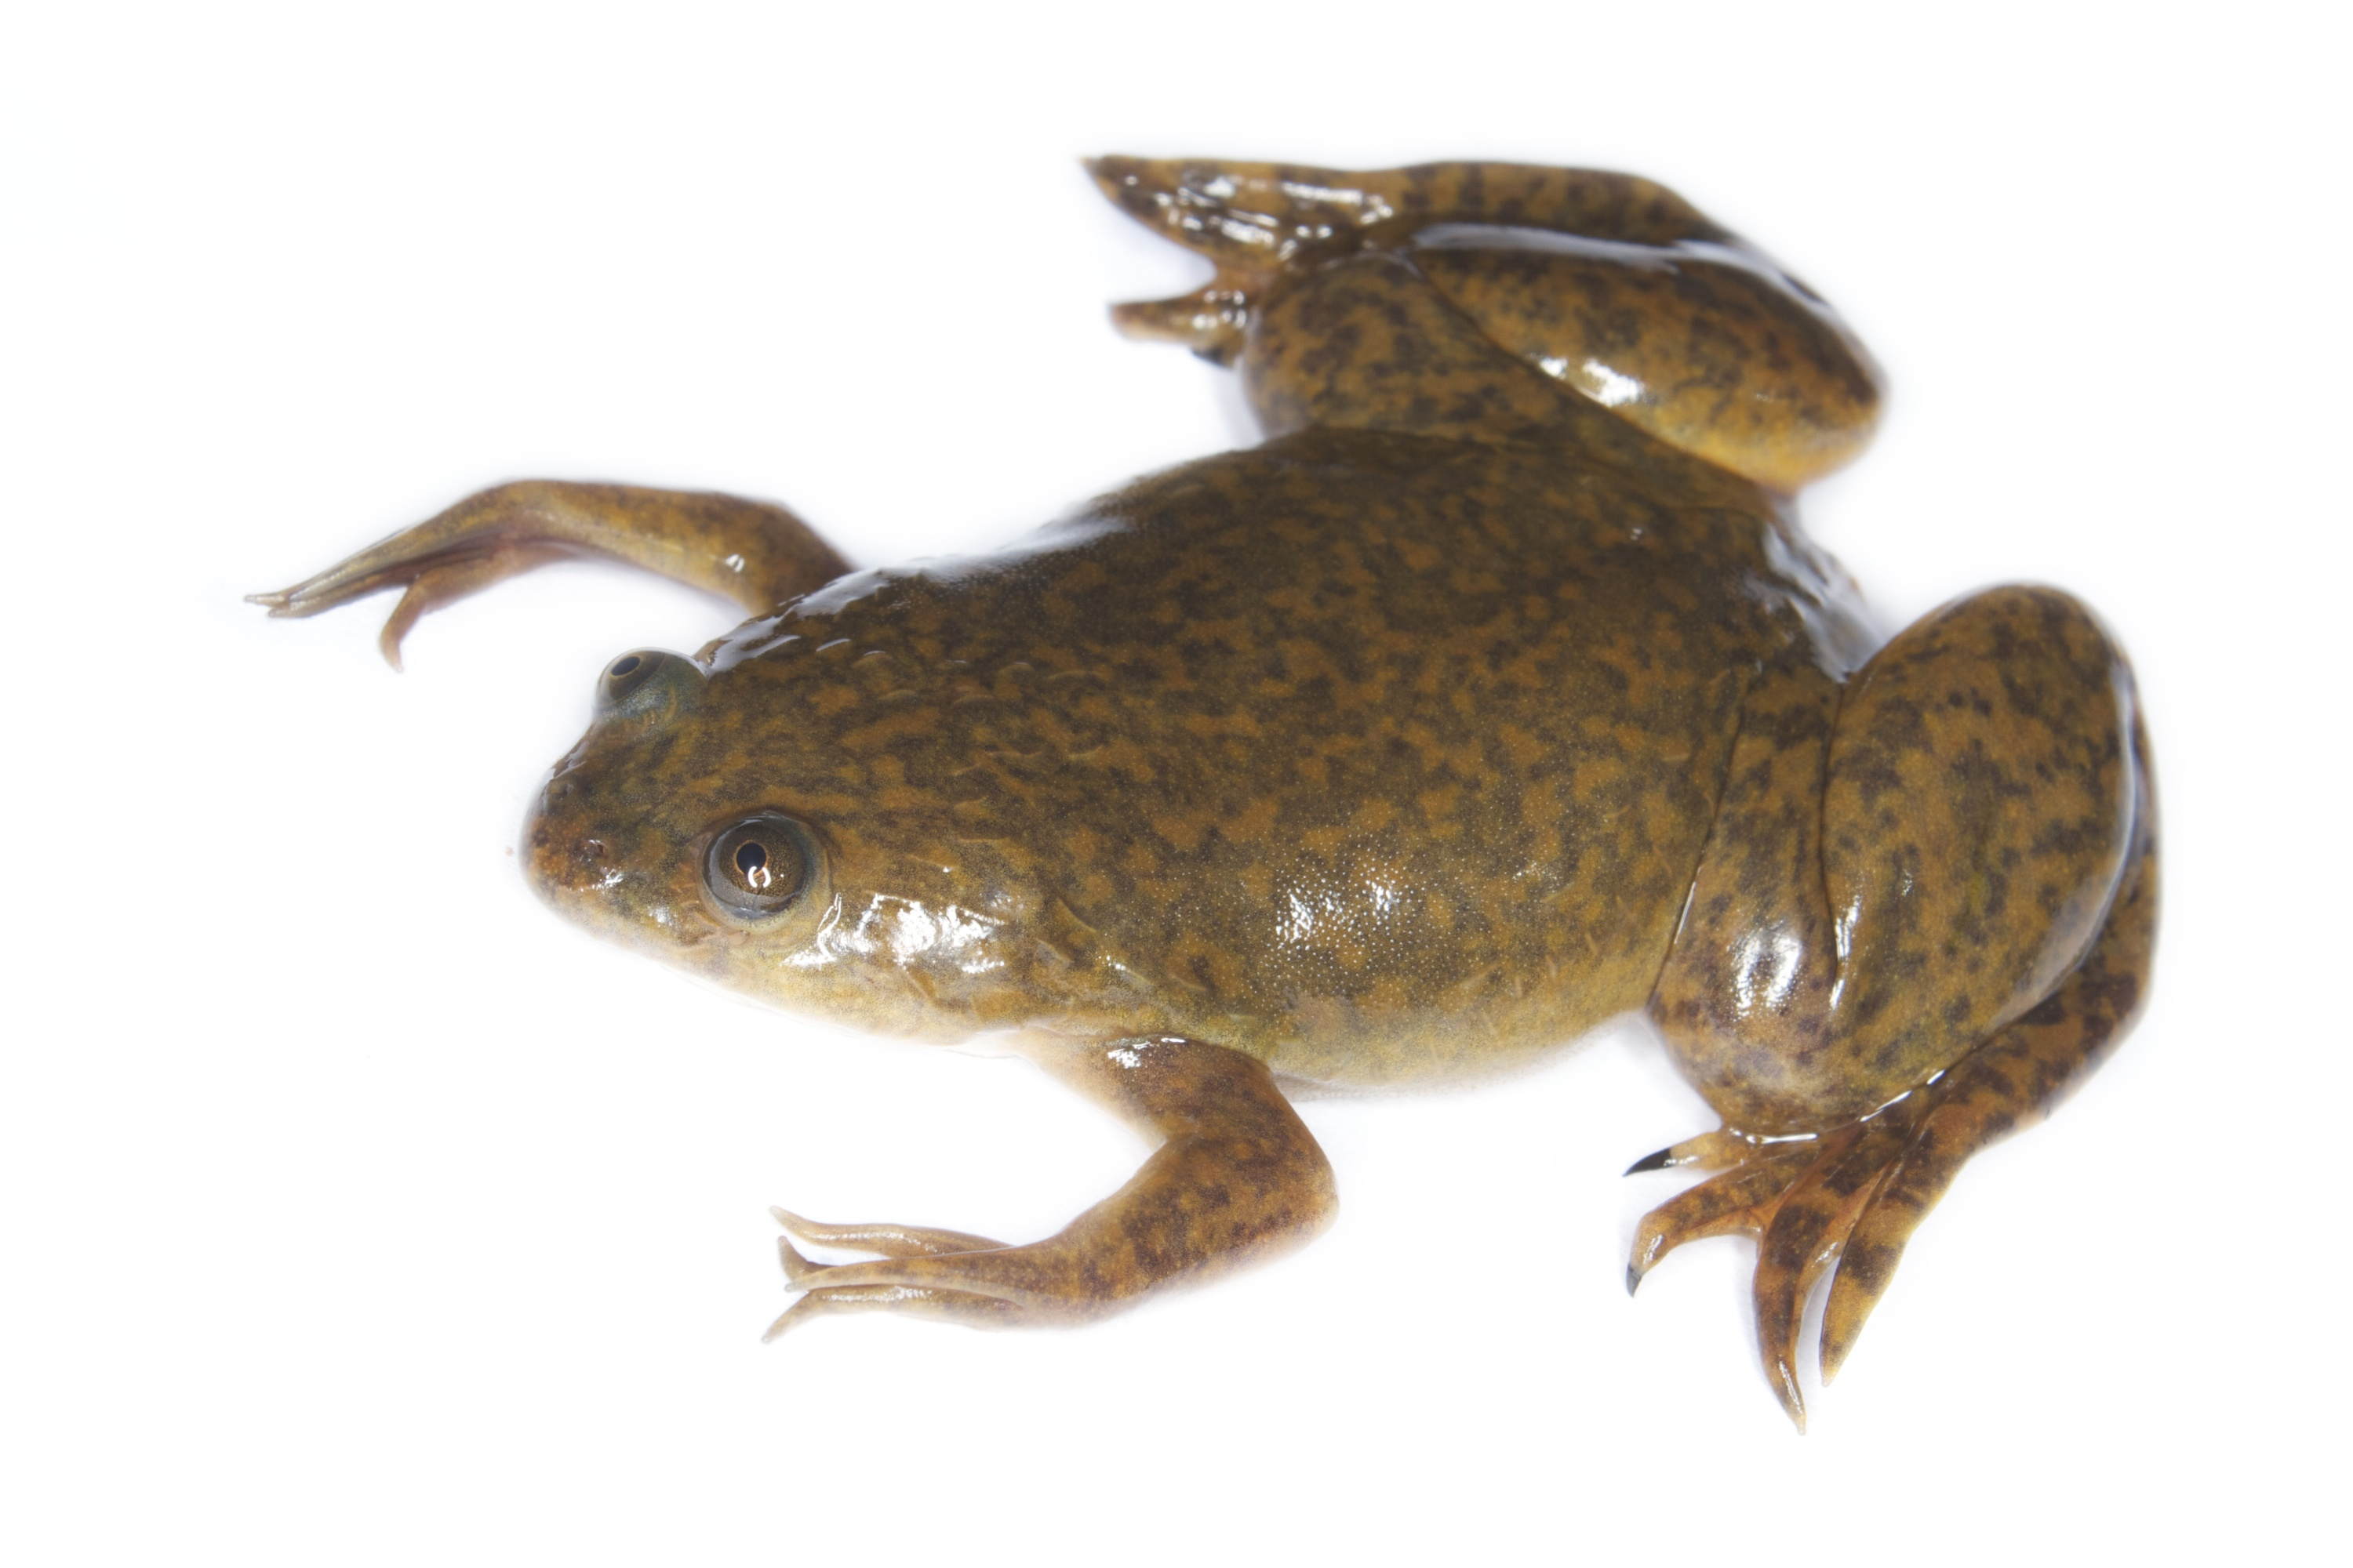
Glyphosate Upregulates Retinoic Acid*
CYP Enzyme Repression
Small Brain
*A. Carrasco, Teratogenesis by glyphosate based herbicides and other pesticides. Relationship with the retinoic acid pathway. In Breckling, B. & Verhoeven, R. (2013) GM-Crop Cultivation – Ecological Effects on a Landscape Scale. Theorie in der Ökologie 17. Frankfurt, Peter Lang.

Slide 128
What to Do!

Slide 129
Go Organic!

Slide 130
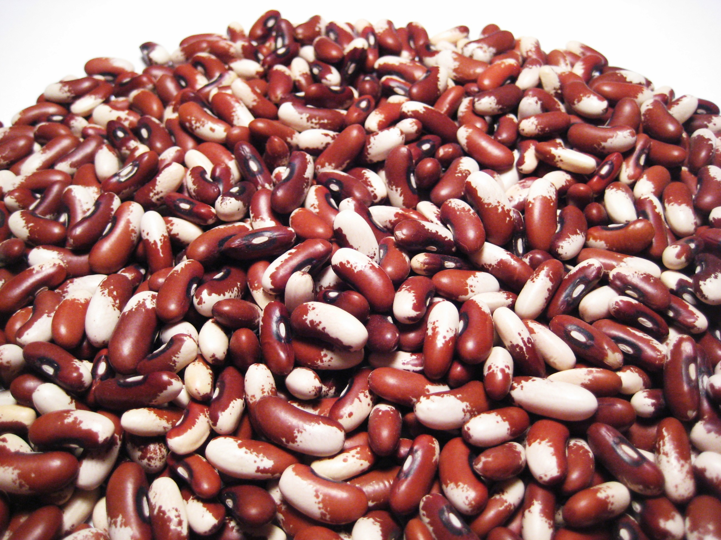
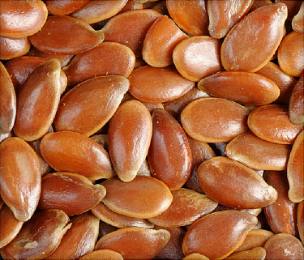
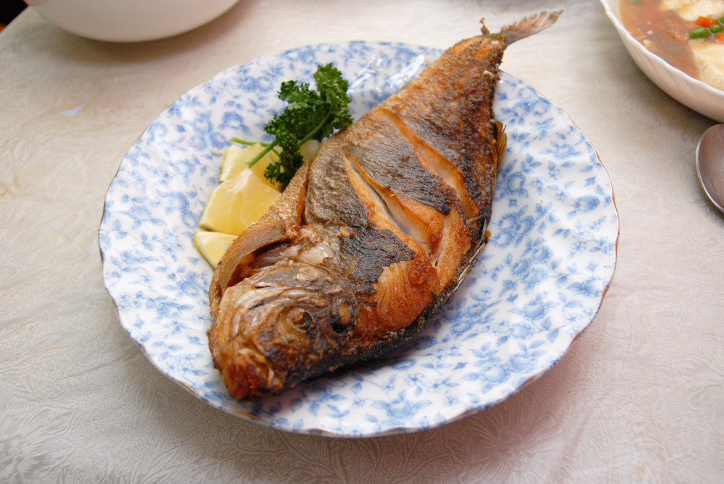
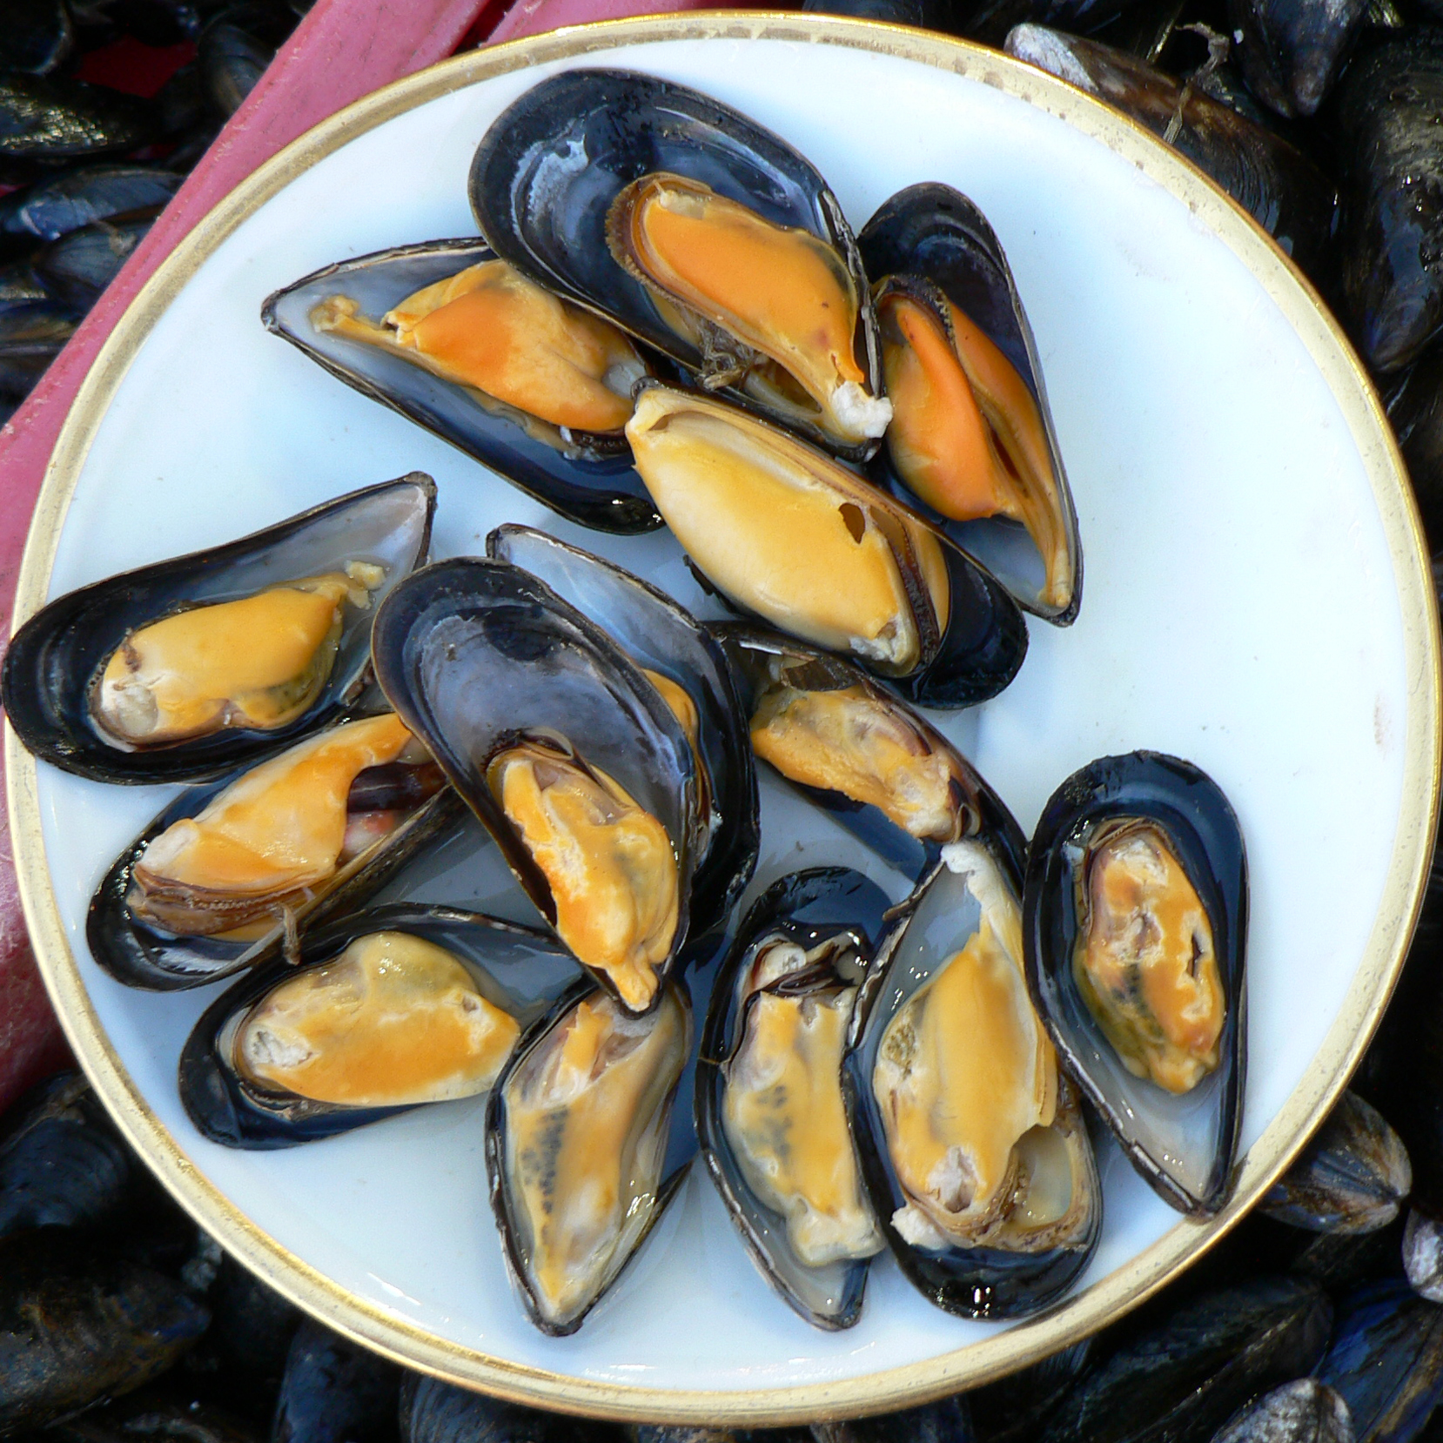
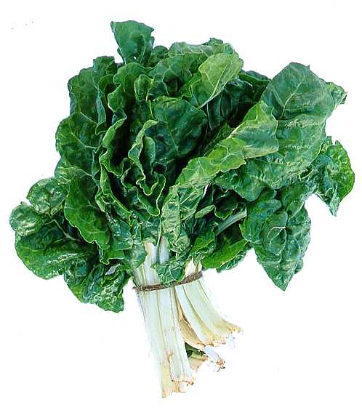
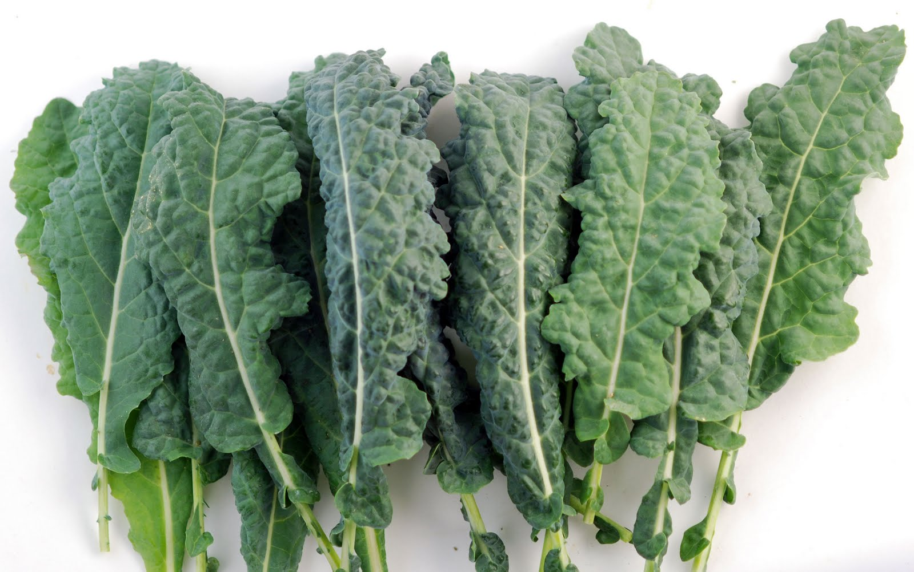
Eat Foods Containing Manganese

Slide 131
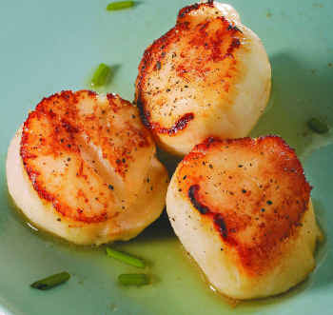
Eat Foods Containing Sulfur
Notes:
http://healthyeatingclub.com/info/books-phds/books/foodfacts/html/data/data5g.html

Slide 132
Summary
Glyphosate contamination in our food supply is a serious threat to health
Compounded by use of hexane in chemical processing
Here, I have focused on autism, breast cancer, Parkinson’s disease, infertility and birth defects
GM “Roundup Ready” soy processed into soy protein and soybean oil using hexane is a toxic food
A key feature of glyphosate’s toxicity is disruption of bile acids, leading to manganese accumulation in the liver and deficiencies elsewhere

