Slide 1
Download These Slides!
http://people.csail.mit.edu/seneff/Oahu2015.pdf

Slide 2

Roundup and GMO and the Rise of Modern Disease
Stephanie Seneff
MIT CSAIL

Slide 3
In a time of universal deceit,
telling the truth is a revolutionary act.
— George Orwell

Slide 4
You never change things by fighting the existing reality.
You change something by building a new world that makes the existing model obsolete.
— Buckminster Fuller

Slide 5
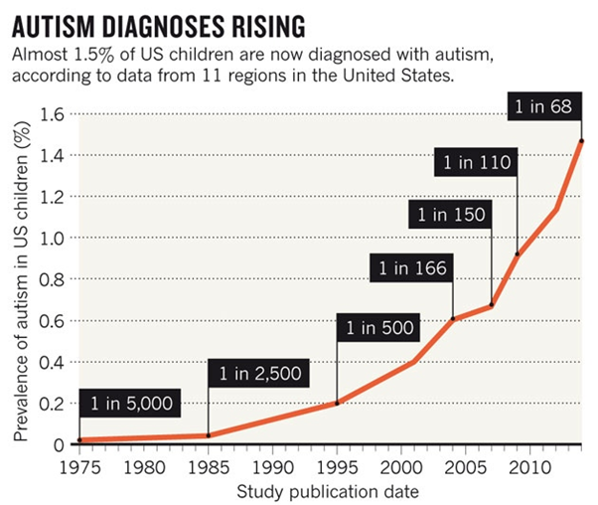
A Frightening Trend*
?
?
12 years
*K. Weintraub, Nature 479, Nov. 3 2011, 22-24.
Notes:
./NatureAutismRising.pdf

Slide 6
Percentage of children with Autism in the US
50%
2032

Slide 7
Percentage of children with Autism in the US
50%
Half the children born in 2032 will be diagnosed with autism
2032

Slide 8
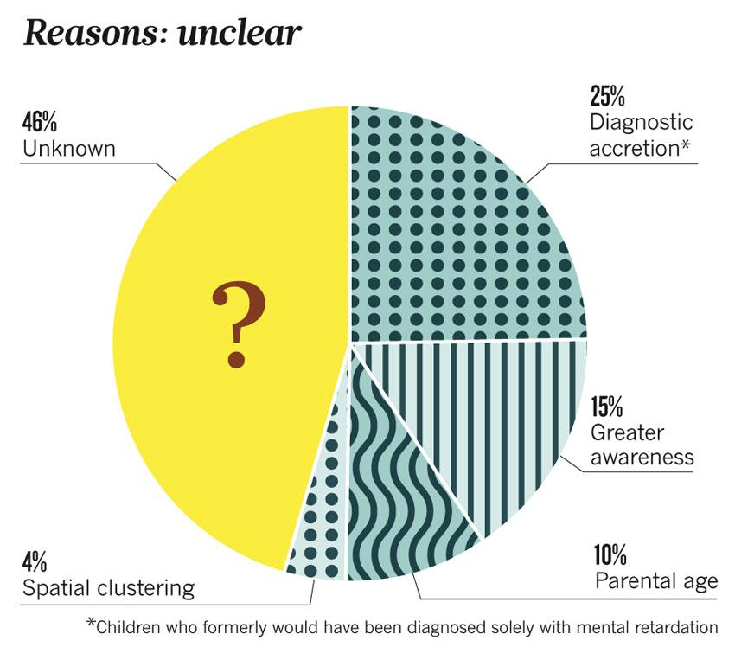
“If it is an environmental cause contributing to an increase, we certainly want to find it.”*
*K. Weintraub, Nature 479, Nov. 3 2011, 22-24.

Slide 9

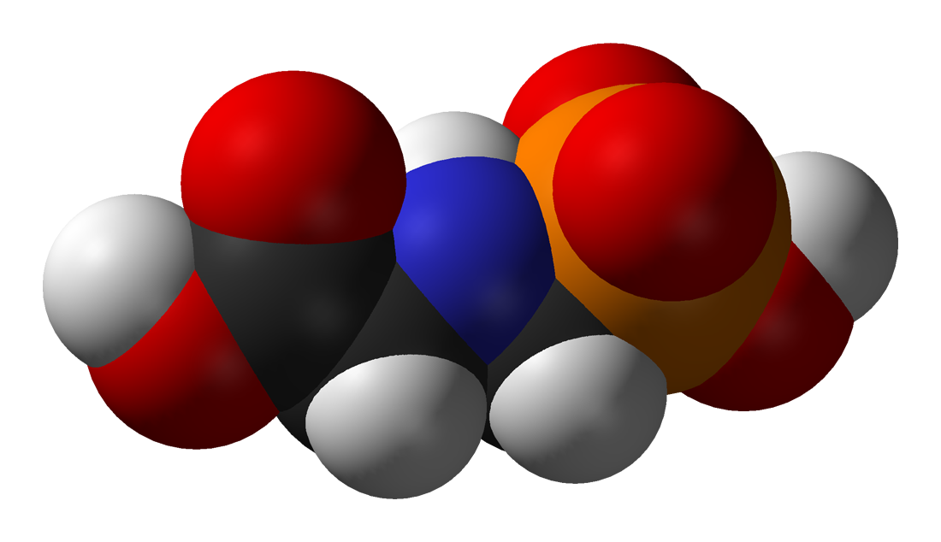
GLYPHOSATE

Slide 10
Outline
History of Glyphosate & GMOs
Glyphosate and Autism
Glyphosate and Vaccines
Breast Cancer
Glyphosate, Oxalate and Anemia
Chondroitin Sulfate and the Skeleton
Glyphosate and Climate Change
Summary

Slide 11
History of
Glyphosate and GMOs

Slide 12
Is Glyphosate Toxic?
Monsanto has argued that glyphosate is harmless to humans because our cells don’t have the shikimate pathway, which it inhibits
However, our gut bacteria DO have this pathway
  We depend upon them to supply us with essential amino acids (among many other things)
Other ingredients in Roundup greatly increase glyphosate’s toxic effects
Insidious effects of glyphosate accumulate over time
  Most studies are too short to detect damage

Slide 13
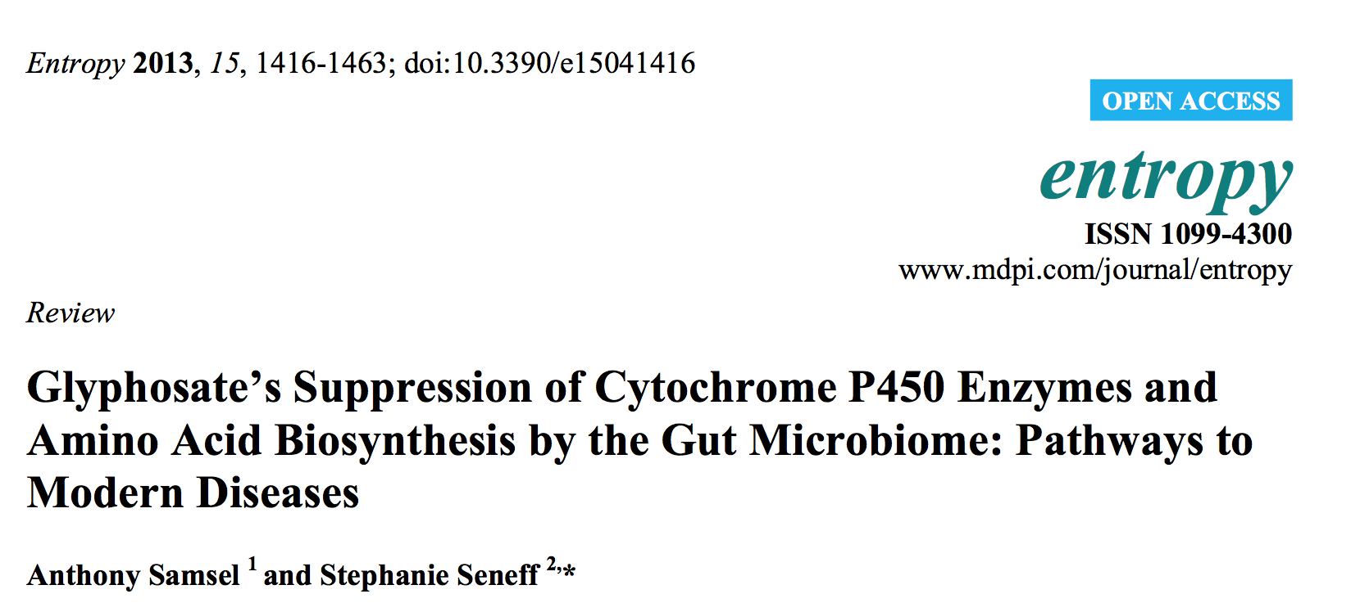
Paper Published in 2013

Slide 14
Main Chemical Effects of Glyphosate*
Interferes with function of cytochrome P450 (CYP) enzymes
Chelates important minerals (iron, cobalt, manganese, etc.)
Interferes with synthesis of aromatic amino acids and methionine
  Leads to shortages in critical neurotransmitters and folate
Disrupts sulfate synthesis and sulfate transport
*Samsel and Seneff, Entropy 2013, 15, 1416-1463

Slide 15
Glyphosate:
The Central Mechanisms
Glyphosate acts as an antibiotic to disrupt gut bacteria, leading to overgrowth of pathogens
Disruption of liver CYP enzymes leads to impaired bile flow and low vitamin D
  This disrupts sulfate synthesis and transport
  Also impairs detoxification of other toxic chemicals
Damage to red blood cells leads to anemia and toxicity due to free iron
  Hypoxia ensues → low grade encephalopathy
Leaky gut and leaky brain barrier lead to neuronal exposure to dangerous metals and neurotoxins

Slide 16
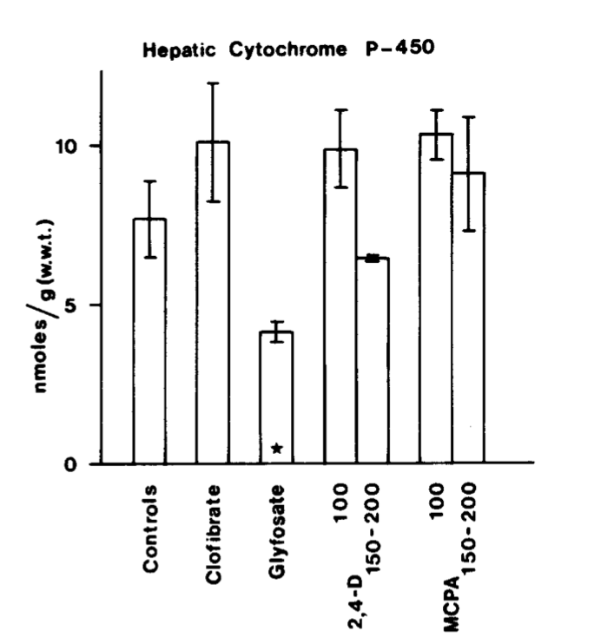
Inhibition of Cytochrome P450 Enzymes (CYPs) by Various Pesticides*
Study in rats on 2,4-D, clofibrate, MCPA, and glyphosate
*E Hetanen et al., Acta Pharmacol. Et Toxicol. 1983, 53, 103-1 12.
Notes:
./glyphosate_inhibits_CYPS_and_other_issues.pdf
Fig. 1. The concentration of hepatic cytochrome P-450 in rats exposed to clofibrate, glyphosate, 2,4dichlorophen- oxyacetic acid (2,4-D) or 4-chloro-2-methylphenoxyace- tic acid (MCPA) for 2 weeks. The doses of 2,4-D and MCPA are also shown. The meansfS.E.M. are shown. The statistical significances were analyzed with Student's t-test using controls as a reference group. The following symbol is used: *: P<0.05.

Slide 17
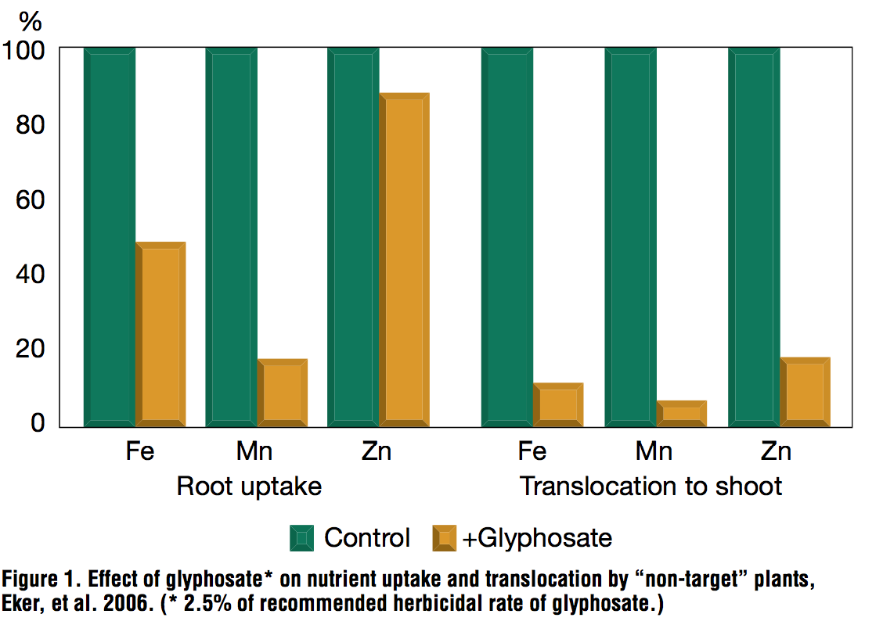
Glyphosate Depletes Iron, Manganese and Zinc in Plants*
*D Huber, What About Glyphosate-Induced Manganese Deficiency? Fluid Journal, 20-22.
Notes:
Glyphosate/glyphosate_induced_manganese_deficiency_plants_Huber.pdf

Slide 18
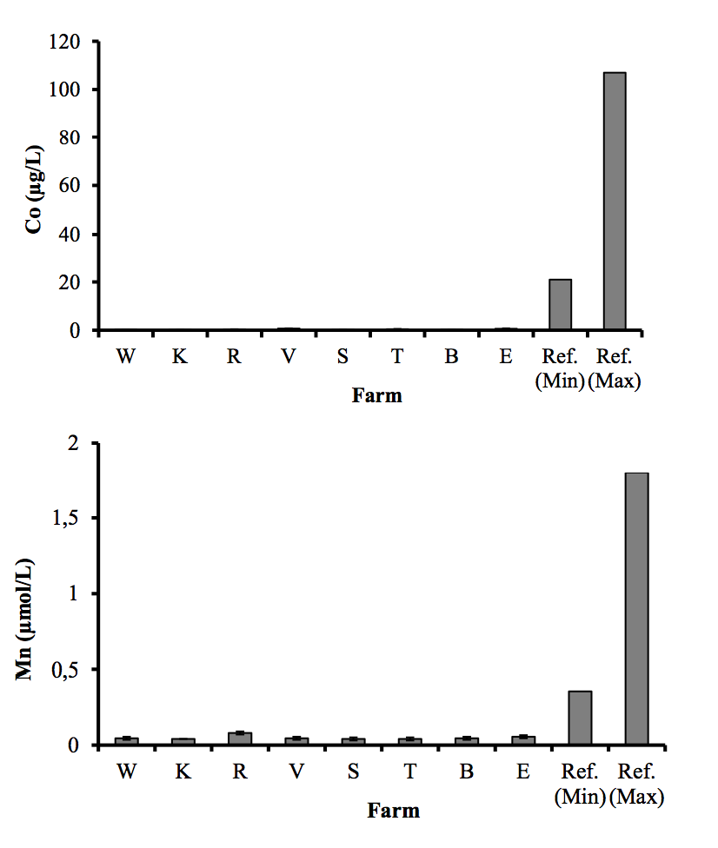
Severe Deficiency in Serum Manganese and Cobalt in Cows*
Cobalt
Manganese
Eight different farms: all cows tested had glyphosate in the urine
*M. Krüger et al., J Environ Anal Toxicol 2013, 3:5
Notes:
glyphosate//cows_cobalt_deficiency_glyphosate.pdf

Slide 19
The Enhancing Effect of Adjuvants*
“Adjuvants in pesticides are generally declared as inerts, and for this reason they are not tested in long-term regulatory experiments. It is thus very surprising that they amplify up to 1000 times the toxicity of their APs [Active Principles] in 100% of the cases where they are indicated to be present by the manufacturer.”
*R. Mesnage et al.BioMed Research International 2014; Article ID:179691.
Notes:
Glyphosate/seralini_2014_pesticide_toxicity_adjuvants.pdf

Slide 20
Roundup Safety Claims Disputed*
“It is commonly believed that Roundup is among the safest pesticides. … Despite its reputation, Roundup was by far the most toxic among the herbicides and insecticides tested. This inconsistency between scientific fact and industrial claim may be attributed to huge economic interests, which have been found to falsify health risk assessments and delay health policy decisions.”
*R. Mesnage et al., Biomed Research International, Volume 2014 (2014),
Article ID 179691
Notes:
Glyphosate/ Mesnage_Seralini_2014_glyphosate_toxicity_proven.pdf
This is the first time that all these formulated pesticides have been tested on human cells well below agricultural dilutions.
adjuvants were also more cytotoxic through the disruption of membrane and mitochondrial respiration,
1000-fold enhancement w/ adjuvants

Slide 21
While it was claimed that the GMO Roundup-Ready Crops (corn, soy, canola, sugar beets, cotton, tobacco and alfalfa) would lead to less glyphosate usage, the exact opposite has happened, due to the appearance of multiple “Roundup-Ready” weeds

Slide 22
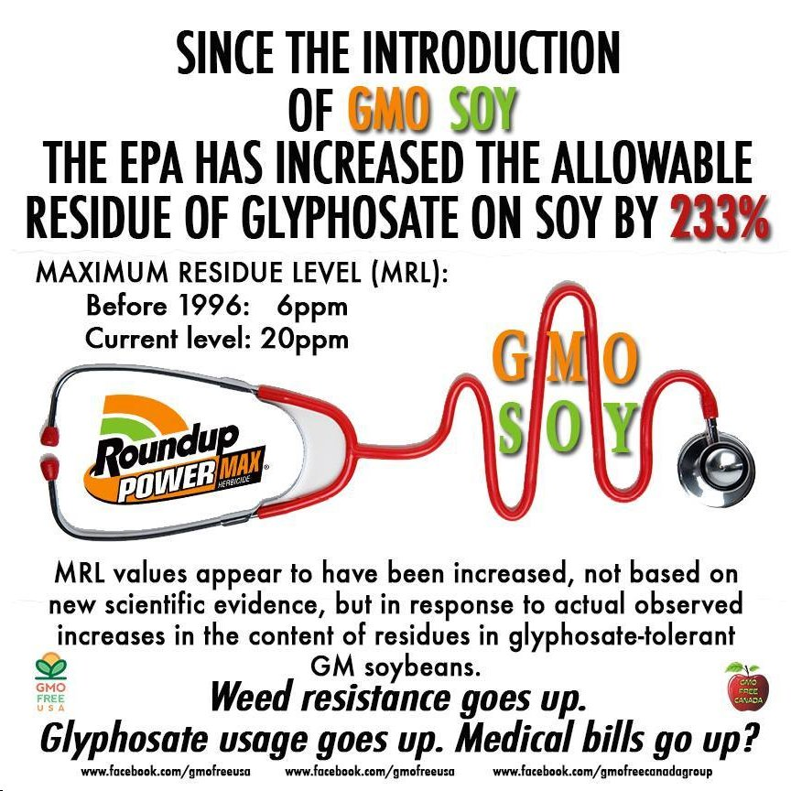

Slide 23
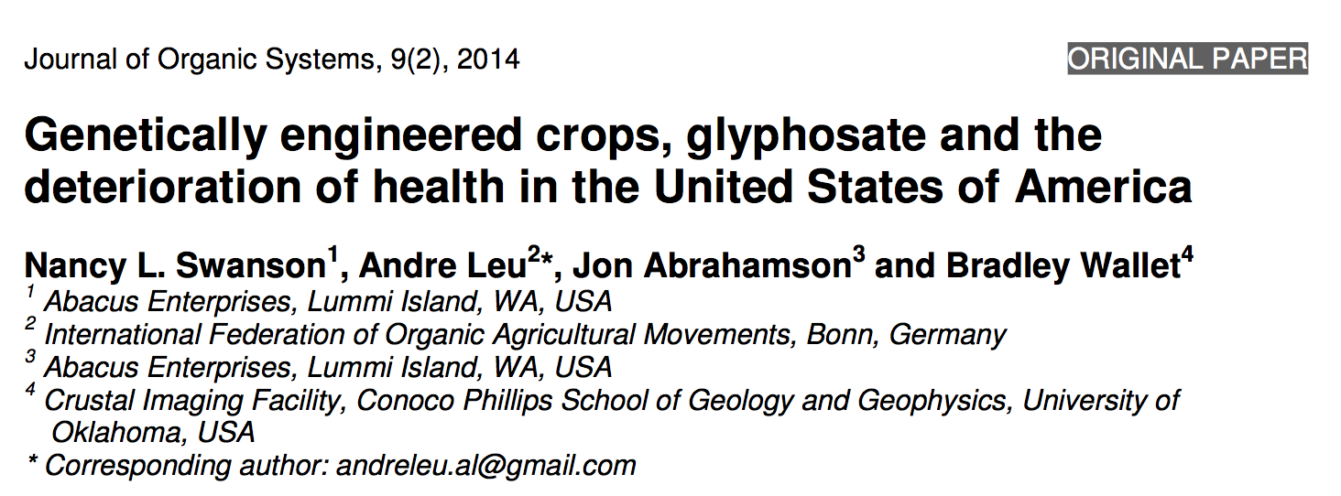
Paper Recently Published

Slide 24
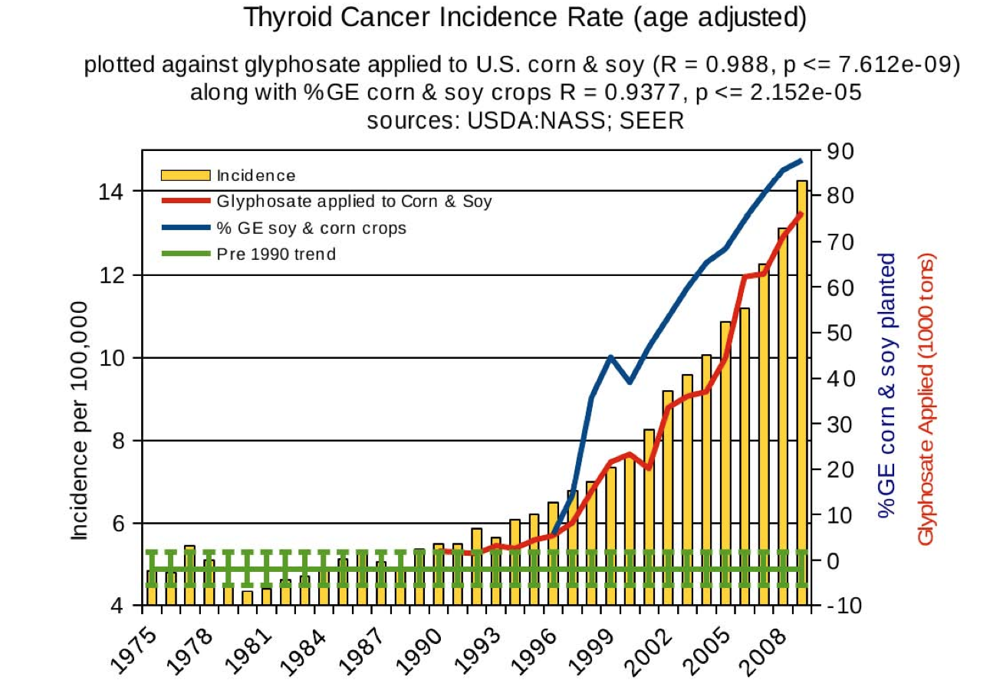
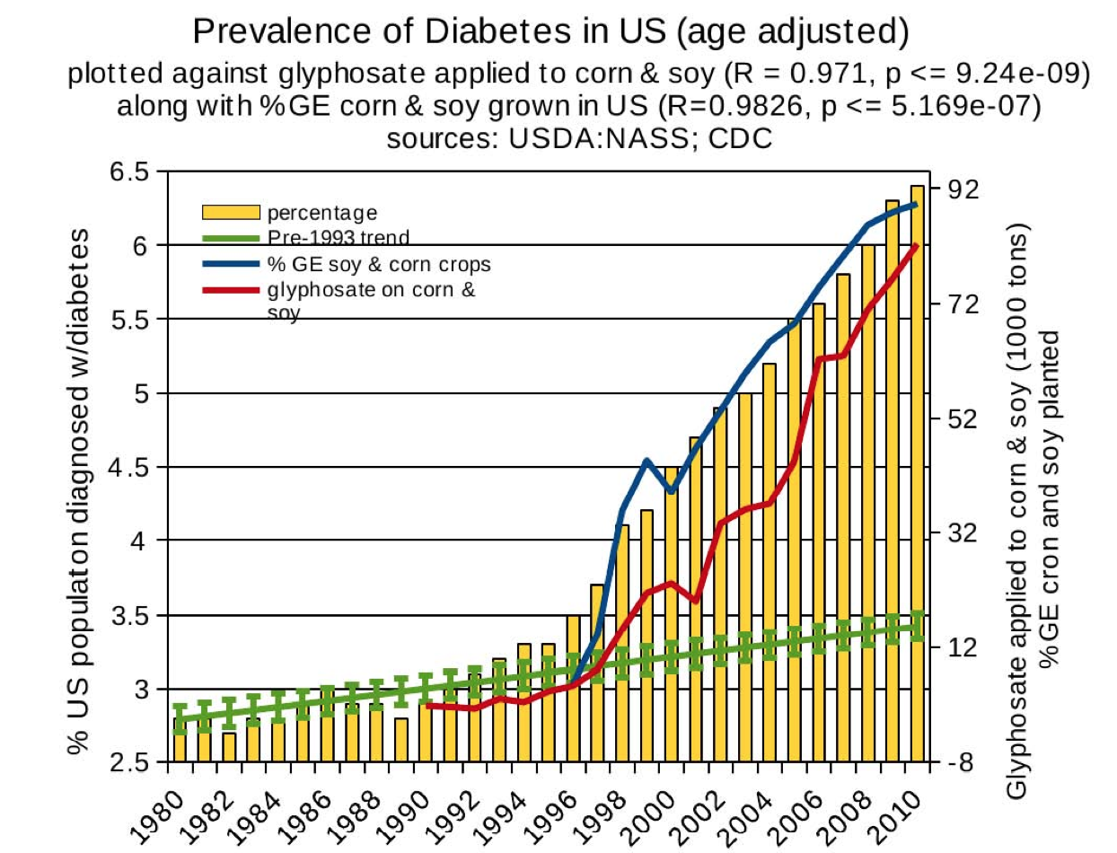
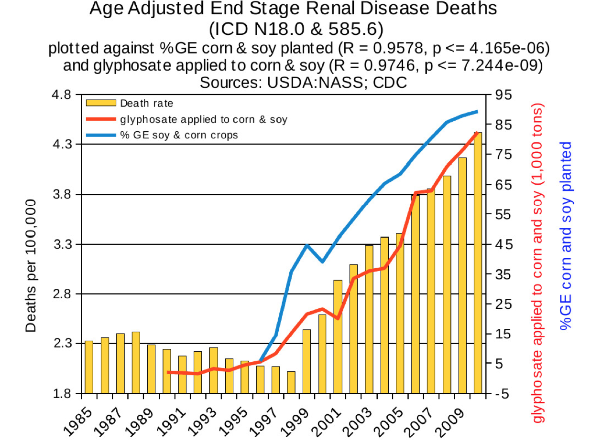
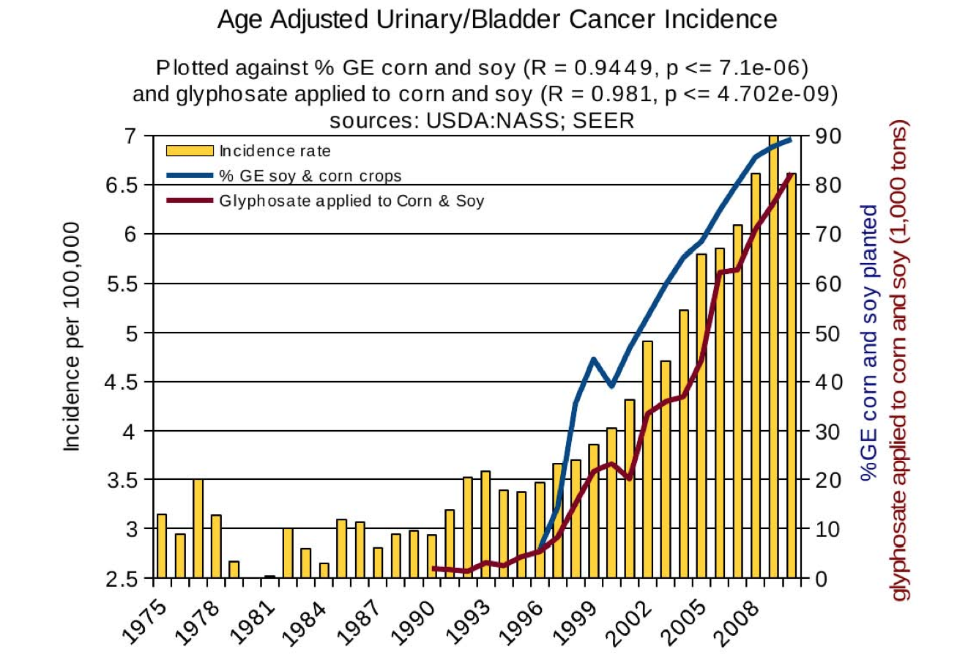
Thyroid cancer
Diabetes
End stage
renal disease
Urinary/bladder
cancer

Slide 25
Quote from the Conclusion*
“Although correlation does not necessarily mean causation, when correlation coefficients of over 0.95 (with p-value significance levels less than 0.00001) are calculated for a list of diseases that can be directly linked to glyphosate, via its known biological effects, it would be imprudent not to consider causation as a plausible explanation.”
*NL Swanson et al. Journal of Organic Systems 9(2), 2014, p. 32,

Slide 26
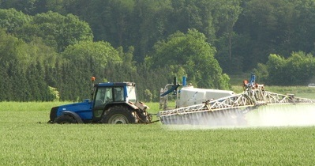
Enlist Duo!
The answer to glyphosate resistance in weeds!
Corn and soybean crops will soon be engineered to resist both glyphosate and 2,4 D
Enlist Duo contains a mixture of both of these herbicides
The synergistic effects can only be imagined at this time

Slide 27
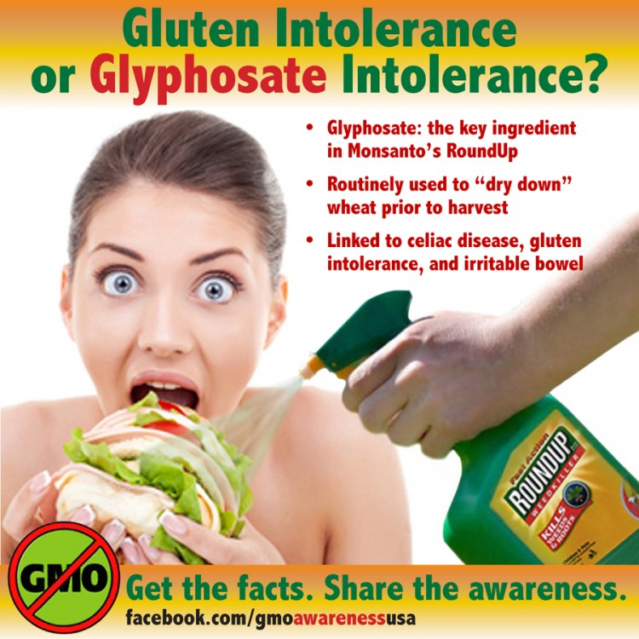

Slide 28
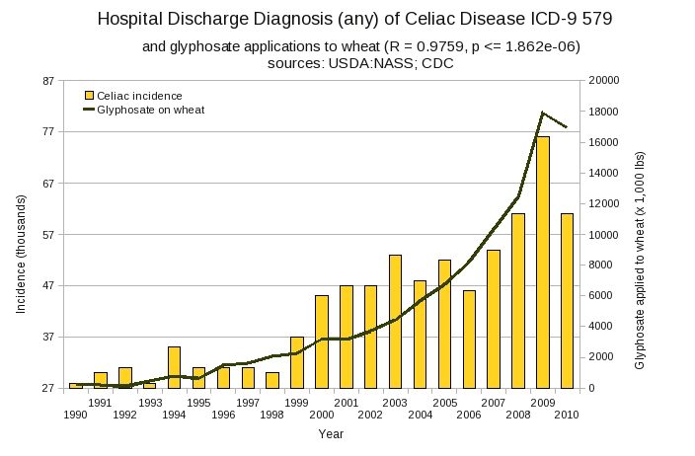
Wheat! Not corn and soy!
Graph provided by Dr. Nancy Swanson

Slide 29

Source: http://healthytraditions.com/glyphosate-tested/

Slide 30
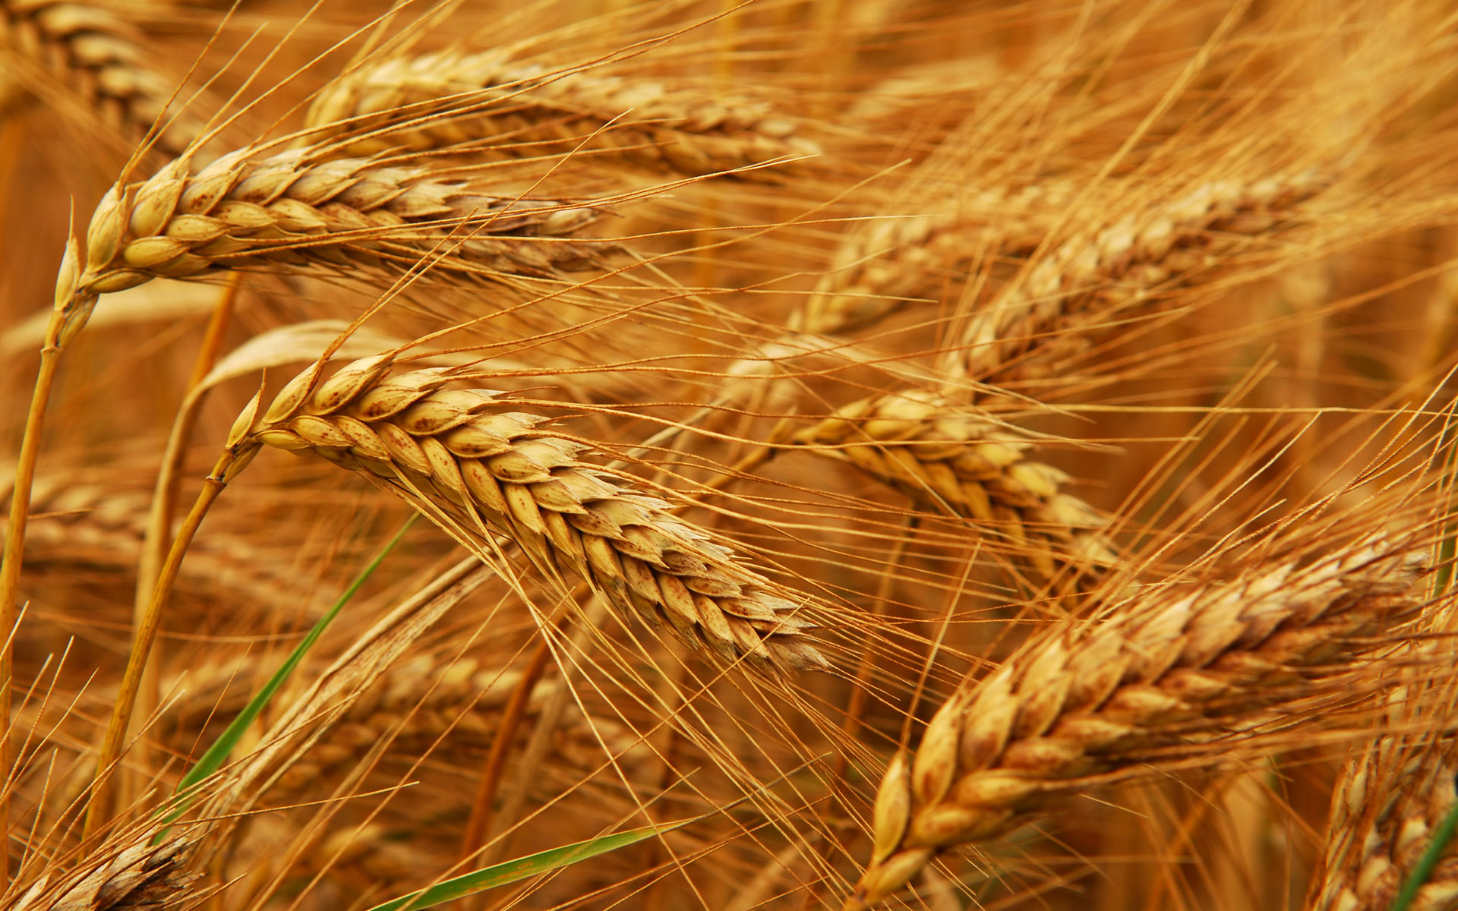
Human Dietary Experiment on Wheat & Inflammatory Bowel Syndrome*
Significant improvement in symptoms with dietary organic wheat from ancient source
  Abdominal pain (P< 0.0001)
  Bloating (P=0.004)
  Stool consistency (P<0.001)
  Tiredness (P< 0.0001)
Reduced pro-inflammatory cytokines: IL-6, IL-17, interferon-gamma, VEGF
*F. Sofi et al., Br J Nutr. 2014 Feb 13:1-8. [Epub ahead of print]
Notes:
Csail/2014/Anthony/ancient_wheat_not_allergenic.text

Slide 31
Glyphosate and Autism

Slide 32
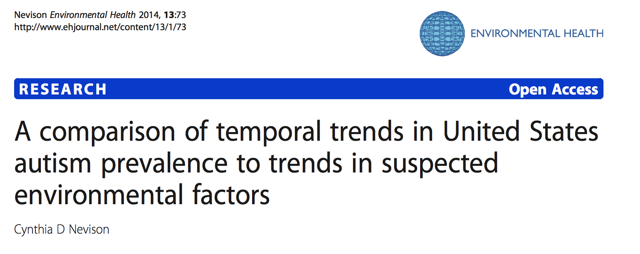
New Study*
Data suggest ~75-80% of the tracked increase in autism since 1988 is due to an actual increase in the disorder rather than to changing diagnostic criteria
Polybrominated diphenyl ethers (fire retardants), aluminum adjuvants, and the herbicide glyphosate have increasing trends that correlate positively to the rise in autism.
*C. Nevison Environmental Health 2014;13:73.
Notes:
Samantha/autism_environmental_trends_aluminum_glyphosate_Cynthia_2014.pdf

Slide 33
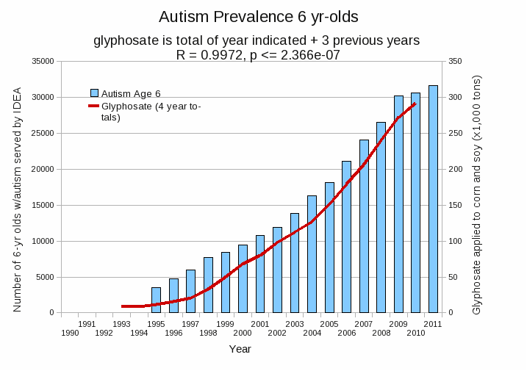
Autism Prevalence: 6 year olds
R = 0.9972
*Plot provided by Nancy Swanson, with permission
Data sources: autism: US Department of Education; Glyphosate: US Department of Agriculture
Notes:
Nancy/latest_plots/6-yr-old autism.gif
autism: USDE
oil consumption: USDA
glyphosate: USDA
GE crops: USDA
Mortality data: CDC

Slide 34
Autism Prevalence: 6 year olds
U.S. Market is 25% of World Market of Roundup
R = 0.9972
*Plot provided by Nancy Swanson, with permission
Data sources: autism: US Department of Education; Glyphosate: US Department of Agriculture
Notes:
Nancy/latest_plots/6-yr-old autism.gif
autism: USDE
oil consumption: USDA
glyphosate: USDA
GE crops: USDA
Mortality data: CDC

Slide 35
Glyphosate Test Report: Findings in American Mother's Breast milk, urine and water*
Moms Across America initiative!
Breast milk levels ranging from 76 ug/l to 166 ug/l are 760 to 1600 times higher than the European Drinking Water Directive allows
Urine testing shows glyphosate levels over 10 times higher than in Europe
Monsanto is wrong regarding bioaccumulation
*Posted on Apr 6 2014 - 4:19am by Sustainable Pulse

Slide 36
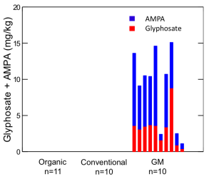
“Another claim of Monsanto's has been that residue levels of up to 5.6 mg/kg in GM-soy represent "...extreme levels, and far higher than those typically found" (Monsanto 1999).
Study of glyphosate and AMPA (breakdown product) residues in soy crops*
5.6
*Figure 1, T. Bohn et al. Food Chemistry 153, 15 June 2014, 207-215.
www.greenmedinfo.com/blog/how-extreme-levels-roundup-food-became-industry-normal
Notes:
http://www.greenmedinfo.com/blog/how-extreme-levels-roundup-food-became-industry-normal

Slide 37

Soy Formula Linked to Seizures in Autism*
"There was a 2.6-fold higher rate of febrile seizures, a 2.1-fold higher rate of epilepsy comorbidity and a 4-fold higher rate of simple partial seizures in the autistic children fed soy-based formula"
*CJ Westmark, PLOSOne March 12, 2014, DOI: 10.1371/journal.pone.0080488.
Notes:
./SoyFormulaSeizuresAutism.pdf

Slide 38

Some Biomarkers for Autism
Disrupted gut bacteria; inflammatory bowel
Low serum sulfate
Methionine deficiency
Serotonin and melatonin deficiency
Defective aromatase
Zinc and cobalamin deficiency
Urinary p-cresol
Mitochondrial disorder
Seizures; Glutamate toxicity in the brain
Notes:
Samantha/zinc_deficiency_autism.text

Slide 39
Some Biomarkers for Autism
Disrupted gut bacteria; inflammatory bowel
Low serum sulfate
Methionine deficiency
Serotonin and melatonin deficiency
Defective aromatase
Zinc and iron deficiency
Urinary p-cresol
Mitochondrial disorder
Seizures; Glutamate toxicity in the brain
These can all be explained as potential effects of glyphosate on biological systems
Notes:
Samantha/zinc_deficiency_autism.text

Slide 40
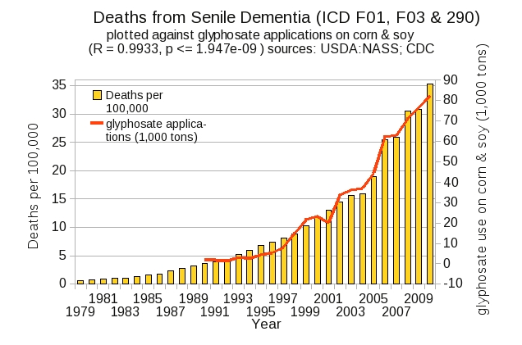
Dementia and Autism Have Much in Common
Plot kindly provided by Nancy Swanson

Slide 41
Glyphosate and Vaccines

Slide 42
Case Study: Evidence that Glyphosate Penetrates the Brain Barrier*
58 year old woman ingested glyphosate (suicide attempt)
Glyphosate showed up in blood (1294 μg/mL) and cerebrospinal fluid (122 μg/mL)
Associated with both disseminated intravascular coagulation (DIC) and aseptic meningitis
*C Sato et al., Clinical Toxicology (2011) 49, 118–120
Notes:
Glyphosate/glyphosate_IL_6_meningitis_2011.pdf
DIC = widespread clotting and bleeding.

Slide 43

Glyphosate Suppresses
Melatonin Synthesis!
Glyphosate interferes with shikimate pathway in plants and microbes → tryptophan depletion*
Tryptophan is sole precursor to melatonin
Melatonin binds to aluminum, cadmium, copper, iron and lead, reducing their toxicity**
Melatonin is produced by the pineal gland and regulates the wake/sleep cycle
*N. de María et al., J Agric Food Chem 2006, 54, 2621-2628.
**J. Limson et al. J. Pineal Res. 1998; 24:15–21.
Notes:
ChrisNice/Melatonin_binds_toxic_metals_1999.pdf

Slide 44
Sleep Disorder, Aluminum, and the Pineal Gland
Sleep disorder is linked to many neurological diseases:
  Autism, Alzheimer’s, ADHD, depression, schizophrenia, ALS, Parkinson’s disease, etc.
Insomnia occurs much more frequently as an adverse reaction to vaccines containing aluminum than to those not containing aluminum (p < 0.0025)*
Insomnia also occurs much more frequently in ALL adverse reactions after the year 2000 compared to before 2000 (p < 0.009)*
Pineal gland is heavily perfused and outside of the blood brain barrier
  Susceptible to aluminum toxicity
*Seneff et al., Entropy 2012, 14, 2227-2253.

Slide 45
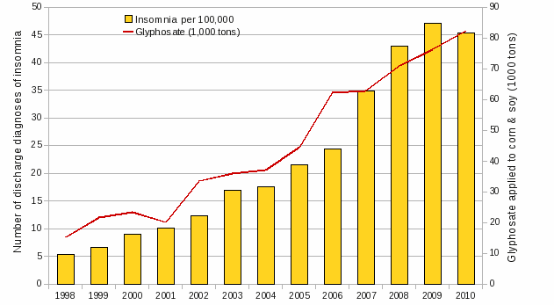
Insomnia is Strongly Correlated with Glyphosate Usage
R = 0.98
Plot provided by Dr. Nancy Swanson; Data from CDC Hospital Discharge database

Slide 46
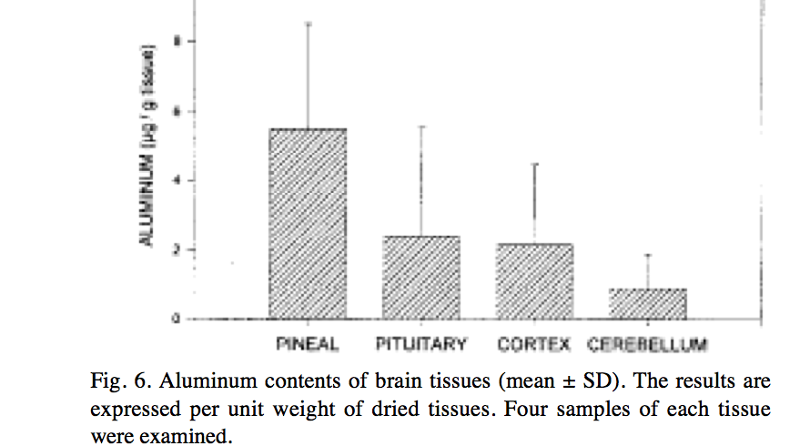
Aluminum in the Pineal Gland*
*S.B. Lang et al./Bioclectrochemistry and Bioenergetics 41(1996)191—195
Notes:
Csail/2013/ChrisShaw/piezoelectricity_aluminum_pineal_gland.pdf

Slide 47
Glyphosate and Aluminum: Partners in Crime
Glyphosate induces pathogens like C. difficile in gut, leading to leaky gut syndrome
  C. diff produces p-cresol which promotes aluminum uptake by cells
  p-Cresol is a known biomarker for autism
  p-Cresol is an important factor in kidney failure which leads to aluminum retention in tissues → dementia
Glyphosate cages aluminum to promote entry
Glyphosate promotes calcium uptake by voltage-activated channels
  Aluminum gains entry as calcium mimetic

Slide 48
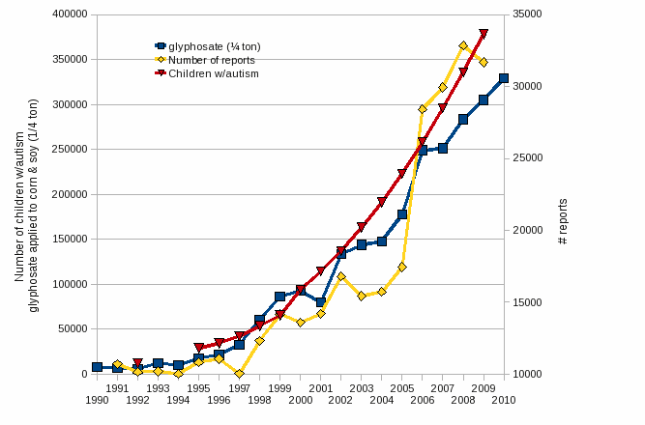
Autism, Glyphosate, Vaccine Reactions*
Glyphosate application to corn and soy, US
Children with Autism, US
# Adverse Reactions in VAERS
*Collaboration with Dr. Nancy Swanson
Notes:
Individuals with Disabilities Education Act

Slide 49
Autism, Glyphosate, Vaccine Reactions*
Glyphosate application to corn and soy, US
Is this steep rise linked to the
Introduction of WeatherMax?
Stay tuned…
Children with Autism, US
# Adverse Reactions in VAERS
*Collaboration with Dr. Nancy Swanson
Notes:
Individuals with Disabilities Education Act

Slide 50
Autism, Glyphosate, Vaccine Reactions*
Glyphosate application to corn and soy, US
Glyphosate makes the aluminum (and mercury?) (and glutamate??) in vaccines much more toxic??
Children with Autism, US
# Adverse Reactions in VAERS
*Collaboration with Dr. Nancy Swanson
Notes:
Individuals with Disabilities Education Act

Slide 51
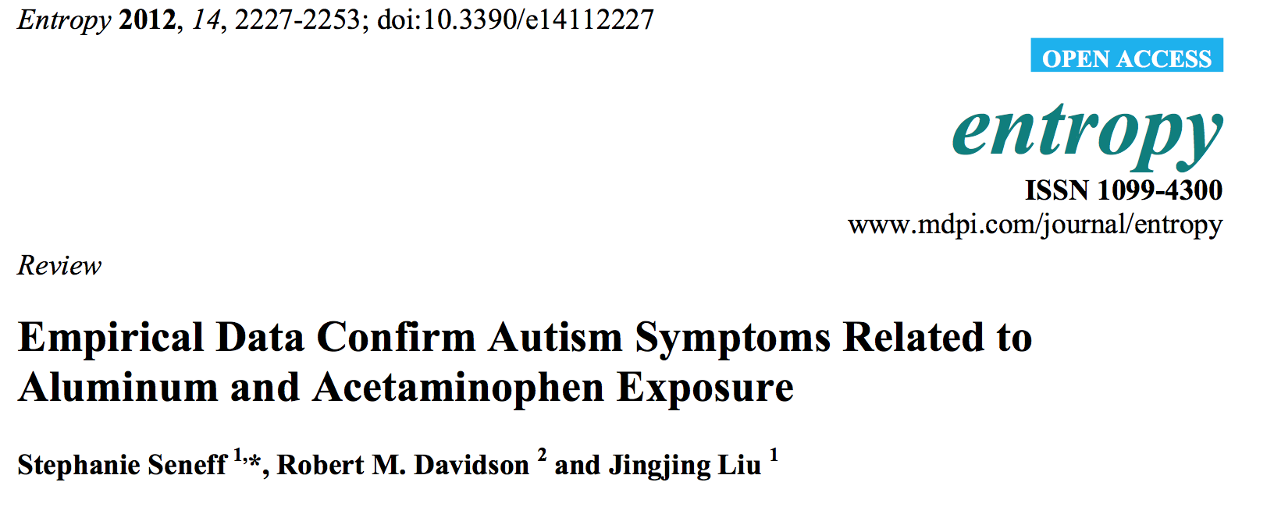
Glyphosate enhances aluminum toxicity
Glyphosate interferes with acetaminophen metabolism

Slide 52
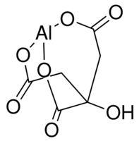
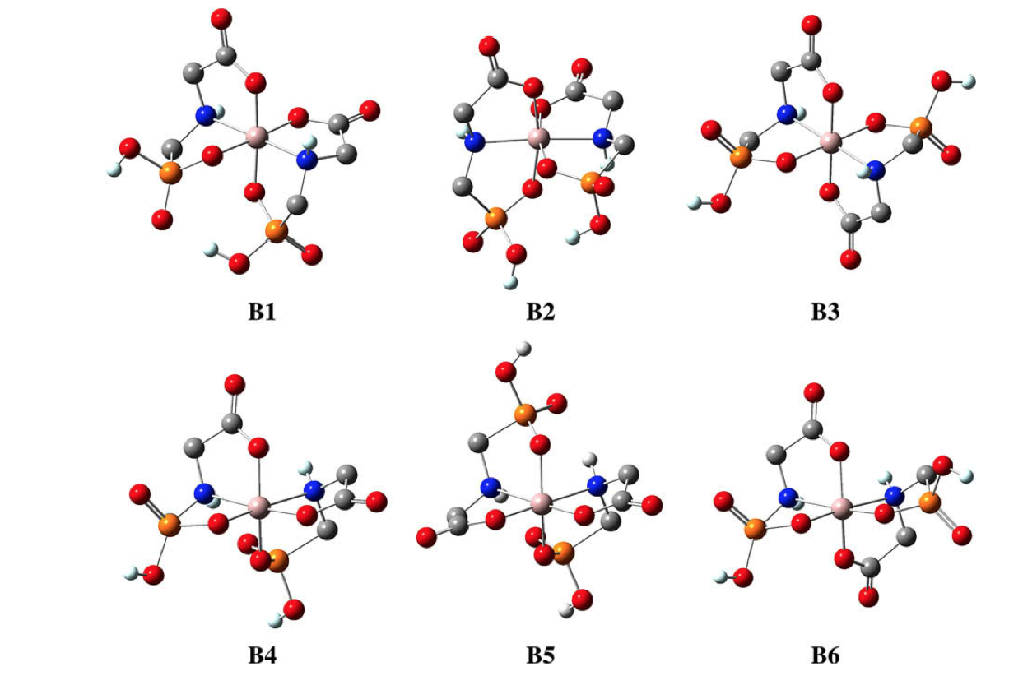
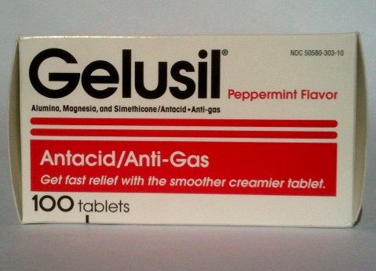
Aluminum Glyphosate*
Six different ways two glyphosate molecules can chelate aluminum
Aluminum citrate**
ALUMINA
aluminum
*M. Purgel et al., Journal of Inorganic Biochemistry 103 (2009) 1426–1438
** P. Sianina et al., Clin. Chem. 32/3, 539-541, 1986.
Notes:
AnthonySamsel/swine/aluminum_glyphosate.pdf
aluminum_citrate_absorbs_well_vinegar_antacids.pdf
Csail/2013/project/Anthony/

Slide 53
MMR and Autism
Andrew Wakefield found a connection in 1998 in a now retracted publication*
CDC claimed proof of no link in 2004 paper**
Whistleblower, Dr. William Thompson, has just come forward:
  Data supported significant increased risk for autism in black males with early vaccine
  Demand for birth certificate hid this finding
I believe it has to do with glutamate!
*A Wakefield et al., The Lancet 1998; 351 (9103): 637–41. (RETRACTED)
**F DeStefano et al., Pediatrics 2004;113;259-266 .

Slide 54
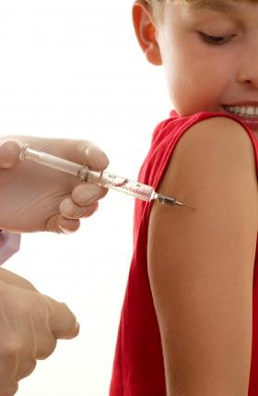
Glutamate is an Additive in Vaccines!
Flu vaccines (FluMist), MMR (measles, mumps and rubella), Rabies vaccine and Varicella vaccine (chicken pox) all contain glutamate
Anecdotal evidence links these vaccines with autism
My own studies on VAERS revealed a correlation between autism and MMR*
Glyphosate’s depletion of manganese prevents glutamate breakdown
*S. Seneff et al., Entropy 2012, 14, 2227-2253.
Notes:
Seizures facial swelling anaphylactic shock
Joint pain

Slide 55
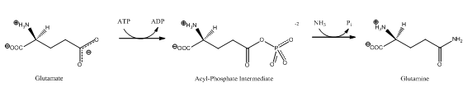
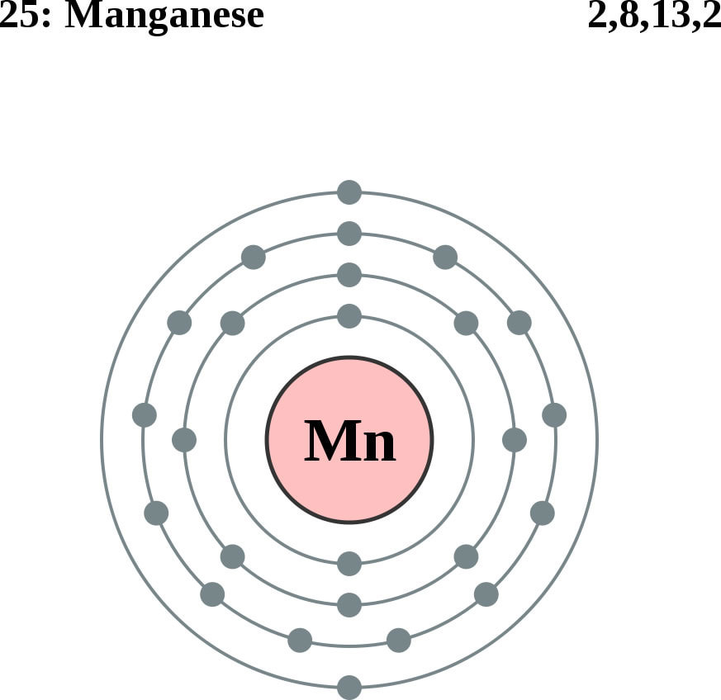
Glutamate Detoxification Depends on Manganese!
Glutamine synthetase
glutamate
glutamine
water
ammonium
Ammonium and glutamate toxicity in the brain
can arise because of insufficient manganese

Slide 56
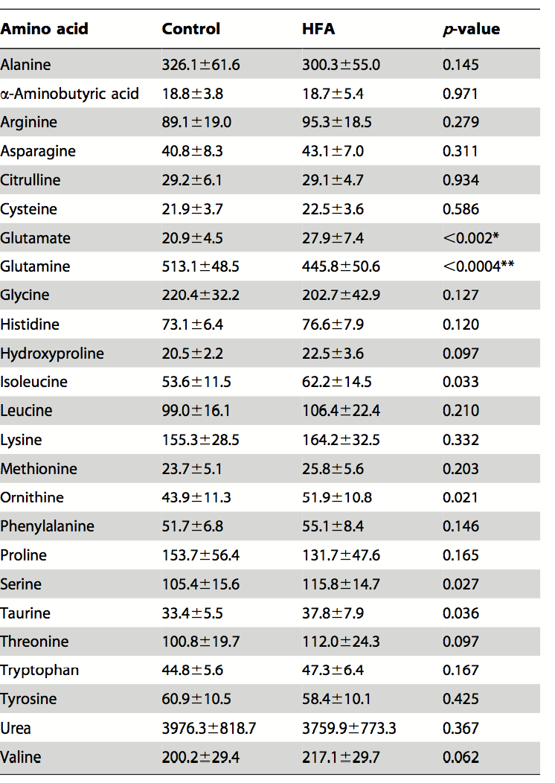

“Alteration of Plasma Glutamate and Glutamine Levels in Children with High-Functioning Autism”*
*C. Shimmura et al. PLoSone October 2011 6(1):e25340
Notes:
Table 1. Plasma Levels of Amino Acids and related compounds in Control Subjects and Individuals with HFA.
Glyphosate/glutamate_glutamine_autism_2011.pdf

Slide 57
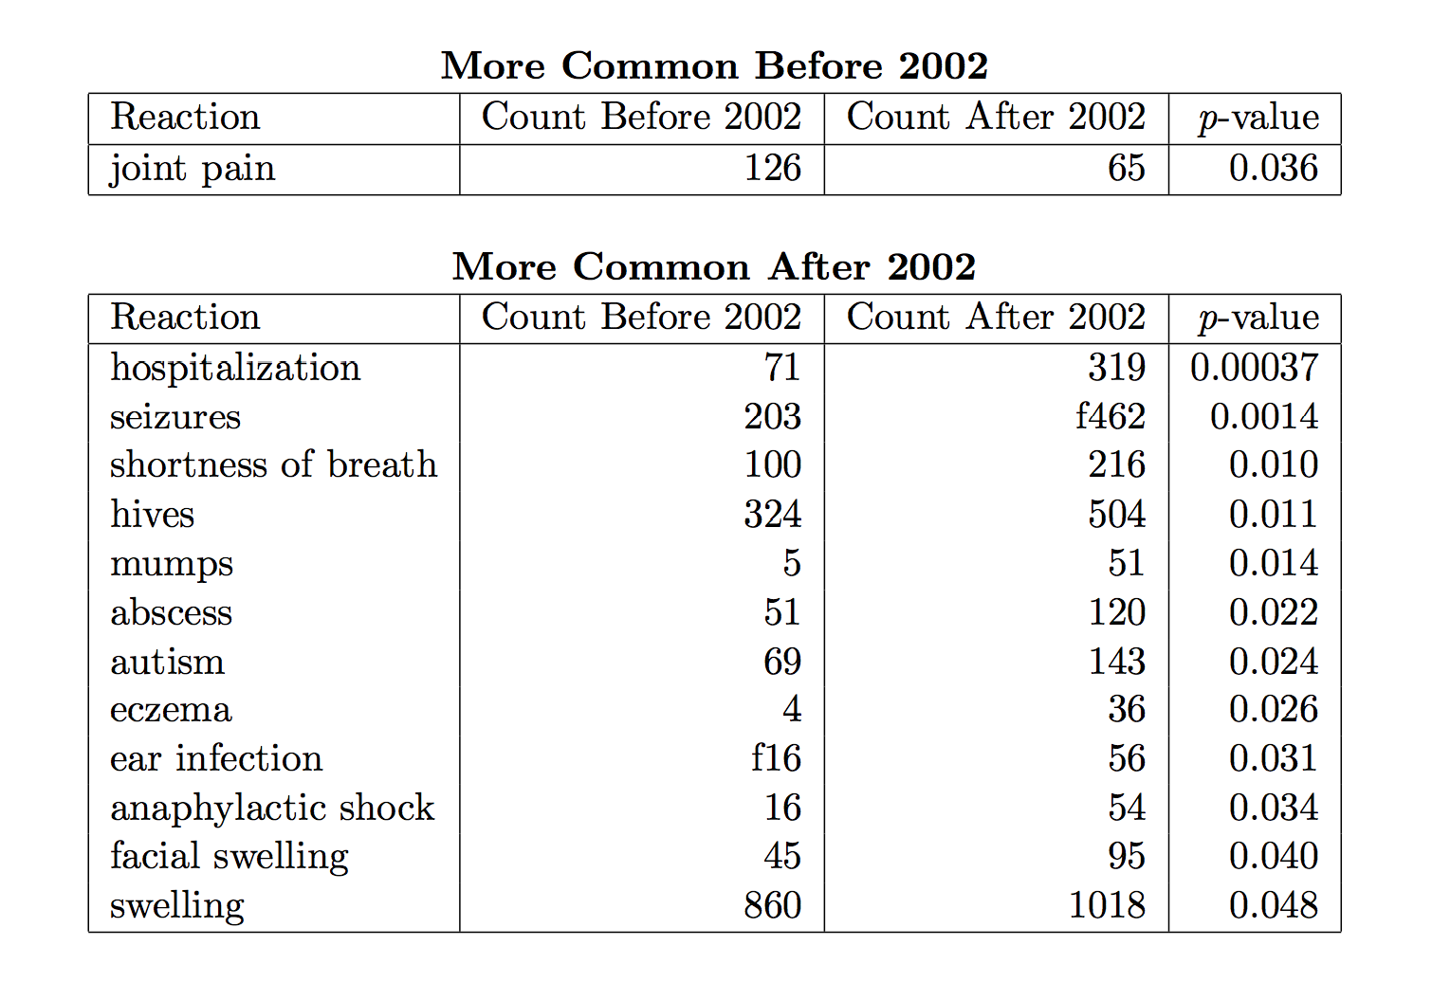
Symptoms of Adverse Reactions to MMR before and after 2002*
*Data analyzed from the VAERS database

Slide 58
Symptoms of Adverse Reactions to MMR before and after 2002*
Joint pain
seizures
shortness of breath
hives
These are all characteristic symptoms of allergies to MSG
eczema
anaphylactic shock
Facial swelling
swelling
swelling
*Data analyzed from the VAERS database

Slide 59
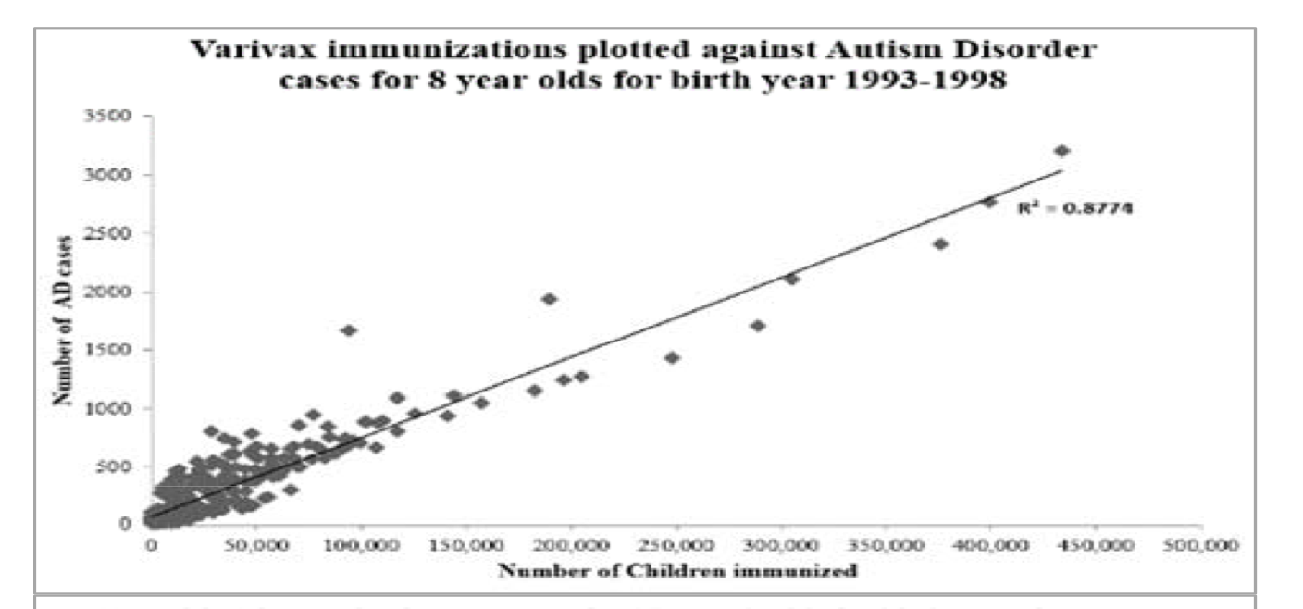
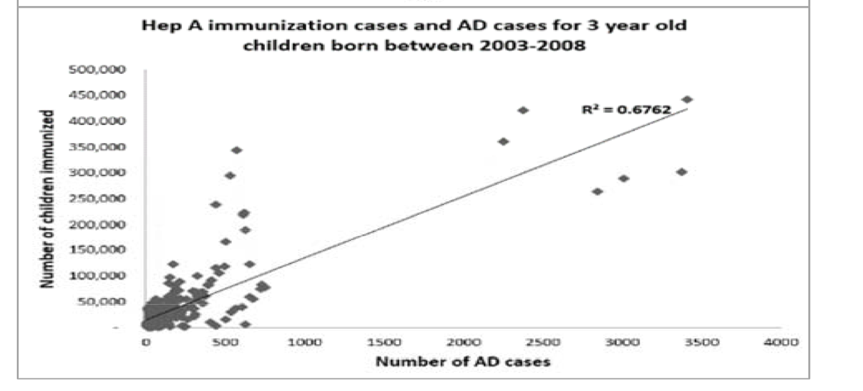
Varivax and Hepatitis A Vaccines: Linked to Autism*
Contains Glutamate
Contains Aluminum
*TA Deisher et al., Journal of Public Health and Epidemiology 6(9), 271-284, 2014.
Notes:
Samantha/Autism_Varicella_Deisher_2014.pdf
Chicken pox

Slide 60
Recapitulation
Glyphosate’s inhibition of the shikimate pathway likely impairs melatonin synthesis
  Leads to sleep disorder, associated with many diseases
Pineal gland is highly susceptible to aluminum
Glyphosate promotes aluminum entry past the gut and brain barriers and uptake by the cells
Glyphosate also promotes glutamate toxicity due to manganese deficiency, leading to acute reaction to glutamate in MMR vaccine and other vaccines

Slide 61
Breast Cancer

Slide 62
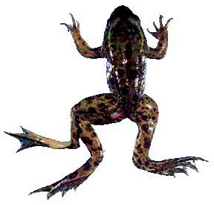
Glyphosate is an endocrine disruptor that promotes breast cancer*
Low and environmentally relevant concentrations of glyphosate possess estrogenic activity
Glyphosate caused human hormone-dependent breast cancer cells to proliferate at concentrations of parts per trillion
Additive effect from genistein, a phytoestrogen in soybeans
* S. Thongprakaisang et al., Food Chem Toxicol. 2013 Jun 8. S0278-6915(13)00363-3.
Notes:
./glyphosate_and_breast_cancer.text
Swine/glyphosate_breast_cancer.pdf
Please make a note that this study shows Glyphosate effects down to parts per trillion (10 to the minus12th).
In this study, we found that glyphosate at a log interval concentration ranging from 10-12 to 10-6 M increased the cell proliferation of a hormorne dependent breast cancer T47D ce

Slide 63
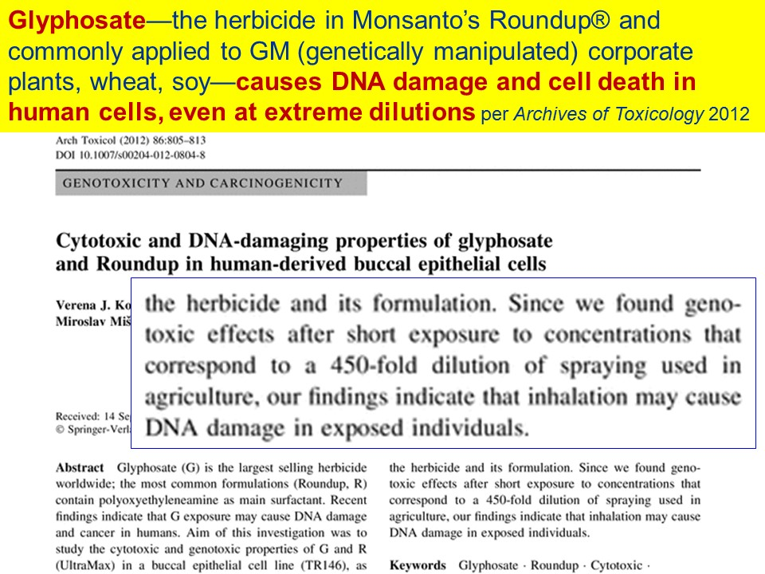
Glyphosate Causes DNA Damage and Cell Death at Extreme Dilutions

Slide 64
CDC Hospital Discharge Data on Breast Cancer Trends*
1998 1999 2000 2001 2002 2003 2004 2005 2006 2007 2008 2009 2010
Collaboration with Dr. Chen Li and Dr. Nancy Swanson
*ICD9 codes 174-175 , ftp://ftp.cdc.gov/pub/Health_Statistics/NCHS/Datasets/NHDS

Slide 65
CDC Hospital Discharge Data on Breast Cancer Trends*
1998 1999 2000 2001 2002 2003 2004 2005 2006 2007 2008 2009 2010
Collaboration with Dr. Chen Li and Dr. Nancy Swanson
*ICD9 codes 174-175 , ftp://ftp.cdc.gov/pub/Health_Statistics/NCHS/Datasets/NHDS

Slide 66
Same Data: Caucasians Only
Use simple exponential model to account for impact of reduced estrogen therapy
1998 1999 2000 2001 2002 2003 2004 2005 2006 2007 2008 2009 2010
Collaboration with Dr. Chen Li and Dr. Nancy Swanson
*ICD9 codes 174-175 , ftp://ftp.cdc.gov/pub/Health_Statistics/NCHS/Datasets/NHDS

Slide 67
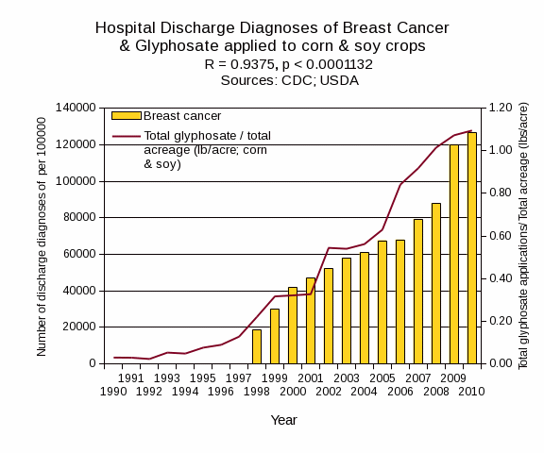
Once Estrogen Model Is Subtracted …
Plot Drawn by Dr. Nancy Swanson
*ICD9 codes 174-175 , ftp://ftp.cdc.gov/pub/Health_Statistics/NCHS/Datasets/NHDS

Slide 68
Roundup Disrupts Steroid Synthesis*
StAR protein mediates rate-limiting step in steroid synthesis
Roundup suppresses StAR protein by 90% and reduces steroidogenesis by 94%
This affects both the production of sex hormones in the gonads and the production of cortisol and aldosterone in the adrenal glands
*L.P. Walsh et al., Environmental Health Perspectives 108(8), 2000 769-776.
Notes:
Glyphosate/roundup_inhibits_StAR_protein_expression.pdf
reduction in StAR expression in the adrenal gland may affect carbohydrate metabolism, immune system function, and water balance.

Slide 69
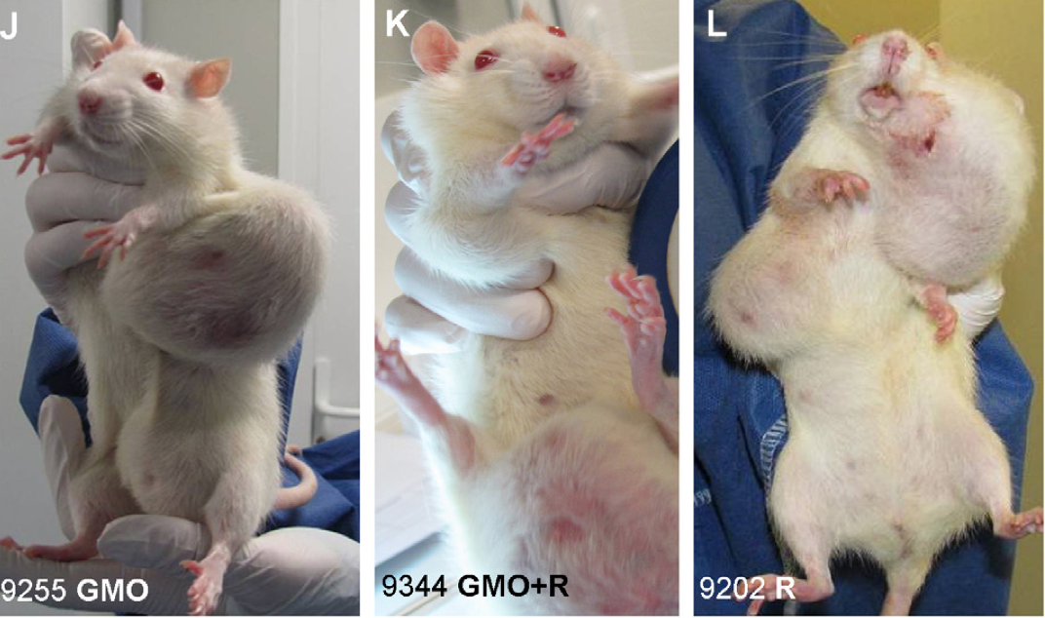
Mammary Tumors in Rats*
Rats through their entire lifespan exposed to Roundup at levels well below established safety limits
*G-E Séralini et al. Environmental Sciences Europe 2014, 26:14
Notes:
Images/seralini_rats.png
./seralini_paper.pdf
1-Seralini&al.ESEU-RepublishedInVivo_June2014.pdf
2-Seralini et al-RetTR- 1-s2.0-S0278691512005637-main.pdf
3 Seralini&al.ESEU-Conflicts_June2014.pdf

Slide 70
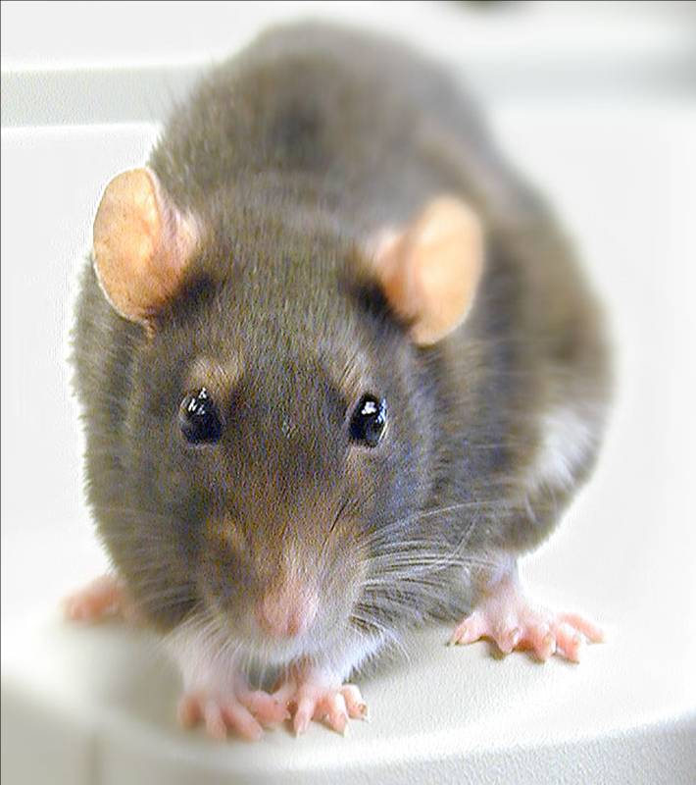
Conclusions from Rat Study *
Female rats had greatly increased risk of mammary tumors
Males had significantly increased risk of liver and kidney disease
Sex hormone disruption for both males and females
Enhanced oxidative stress
Shorter life span
Effects didn’t become apparent until after 4 months
*G-E Séralini et al. Environmental Sciences Europe 2014, 26:14
Notes:
Spacedoc/mercola/GMOS_mouse_study_2012.pdf

Slide 71
Chondroitin Sulfate
and the Skeleton

Slide 72
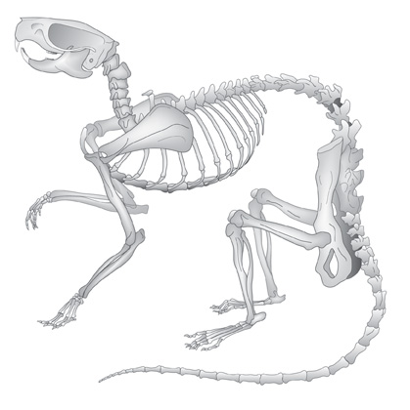
Glyphosate and Bone Development*
Dams treated with glyphosate in water from days 6 to 15 of their pregnancy
Effects on pups:
  Lack of development of the ossification centers of the terminal phalanges (bones in fingers and toes)
  Larger fontanelles ("soft spot") and incomplete development of skull bones
  Absence of important bones or parts of bones, shortenings, bendings, asymmetry, fusions or clefts.
  Surfactant polyoxyethyleneamine increased glyphosate's toxicity
*E. Dallegrave et al. Toxicology Letters 142 (2003) 45-52.
Notes:
Glyphosate/./abnormal_ossification_skeleton_glyphosate_rats_2003.pdf

Slide 73
Manganese and Bones*
“The multiple cellular effects of Mn deficiency include: decreased bone resorption, production of labile bone, and decreased synthesis of organic matrix. The serum level of Mn in a group of osteoporotic postmenopausal women was significantly lower than age-matched controls.”
*L. Strause and P. Saltman. Role of Manganese in Bone Metabolism.
Chapter 5, pp 46–55 in Nutritional Bioavailability of Manganese.
Notes:
http://pubs.acs.org/doi/abs/10.1021/bk-1987-0354.ch005
Glyphosate/manganese_and_bones.text

Slide 74
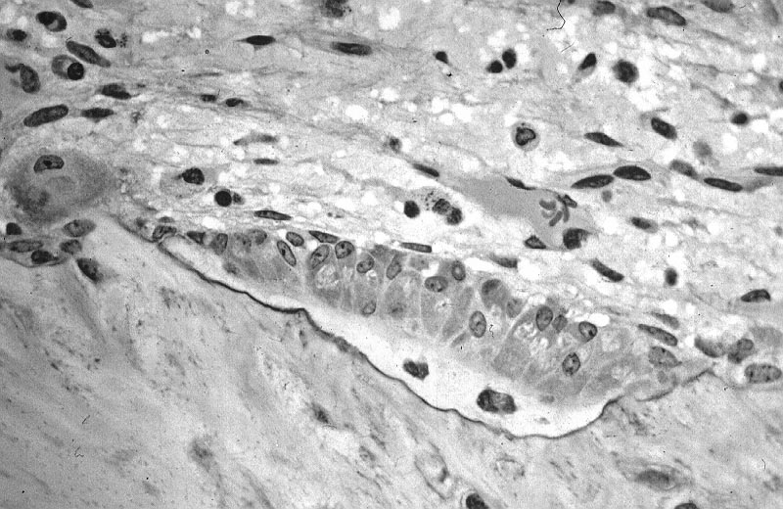
Osteoblasts build “Ground Substance”
Ground substance is made of chondroitin sulfate and osteocalcin – collagen is layered over this
Poor mineralization results from impaired chondroitin sulfate synthesis
Osteoblasts in bone
Childhood osteoarthritis and osteomalacia are an epidemic in the US today

Slide 75
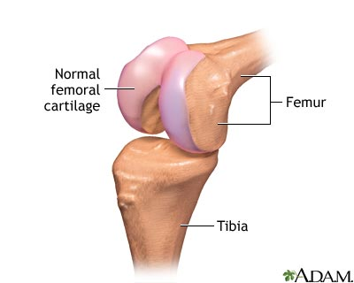
Chondroitin Sulfate Synthesis in Cartilage depends on Manganese*
Two critical enzymes are manganese dependent:
  Polymerase enzyme forms the polysaccharide
  Galactotransferase incorporates galactose that links the polysaccharide to the protein associated with it.
*RM Leach et al. Archives of Biochemistry and Biophysics 133(1), 1969, 22-28.
Notes:
glyphosate/chondroitin_sulfate_manganese_cartilege.text

Slide 76
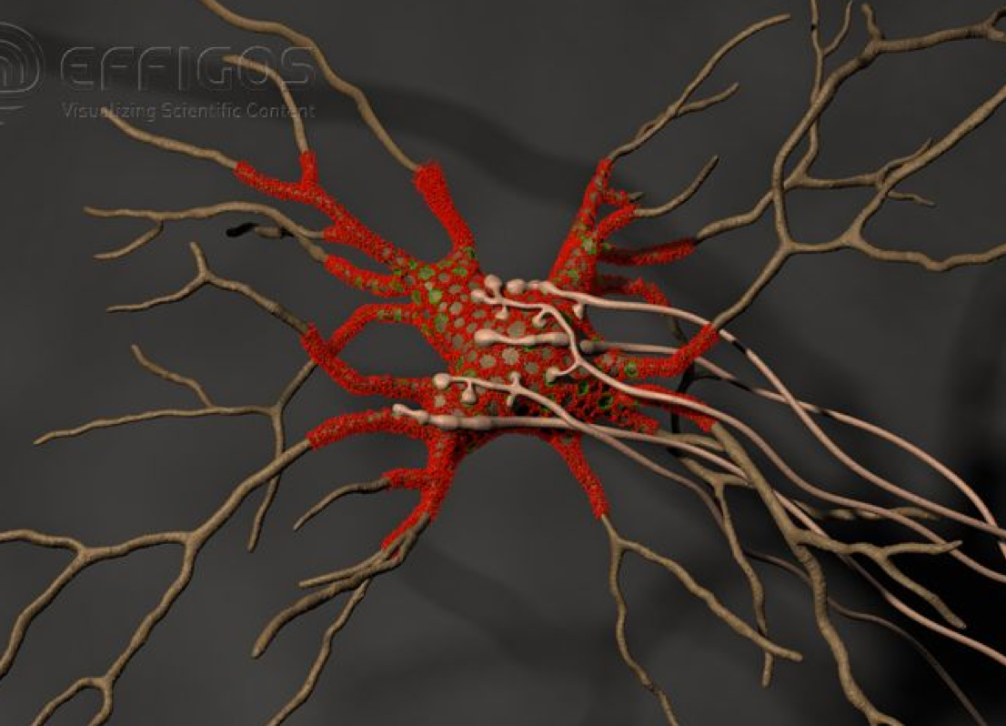
Perineuronal Nets*
Perineuronal nets (PNs) formed from chondroitin sulfate attached to hyaluronan, modulate GABAergic inhibitory signaling
Removal of PNs increased the excitability of interneurons in cultures
They provide an environment rich in anions (negative charge)
*G. Bruckner et al. Glia 8(3), 183-200, 1993.
Notes:
http://onlinelibrary.wiley.com/doi/10.1002/dneu.20361/full

Slide 77
Perineuronal Nets*
Perineuronal nets (PNs) formed from chondroitin sulfate attached to hyaluronan, modulate GABAergic inhibitory signaling
Removal of PNs increased the excitability of interneurons in cultures
They provide an environment rich in anions (negative charge)
Might manganese deficiency lead to impaired synthesis of perineuronal nets and increased neuronal excitability leading to cell death??
*G. Bruckner et al. Glia 8(3), 183-200, 1993.
Notes:
http://onlinelibrary.wiley.com/doi/10.1002/dneu.20361/full

Slide 78

Coral Die-Off & Chondroitin Sulfate*
Large amounts of chondroitin sulfate are adsorbed onto coral
Sulfate groups are of paramount importance to the adsorption process
Adsorption rate is a direct function of the amount of negative charge
*N. Volpi. Biomaterials 2002 Jul;23(14):3015-22
Notes:
Project/glyphsate/chondroitin_sulfate_coral.text

Slide 79

“Disease Causes Starfish to Lose Arms, Dissolve into White Blobs of Goo” *
Glyphosate is used to kill seagrass in oyster beds
"Glyphosate and diuron are among the most frequently detected herbicides in oyster production areas"**
Starfish eat oysters
*http://natureworldnews.com/articles/4749/20131104/
disease-causes-starfish-lose-arms-dissolve-white-blobs-goo-video.htm
**F. Akcha et al. Aquatic Toxicology. 106-107 (pp 104-113), 2012
Notes:
Glyphosate/glyphosate_oyster_toxicity.text

Slide 80
Recapitulation
Manganese deficiency due to defects in chondroitin sulfate causes impaired bone development and defective perineuronal nets
  Explains epidemic in osteomalacia and osteoporosis
  Offers hypothesis for neuronal cell death
  Explains joint issues related to defective cartilage
Manganese deficiency due to glyphosate exposure may explain the recent diseases in coral and starfish

Slide 81
Glyphosate and
Climate Change

Slide 82

Nitrous
oxide
Sulfate
reduced!!!

Slide 83
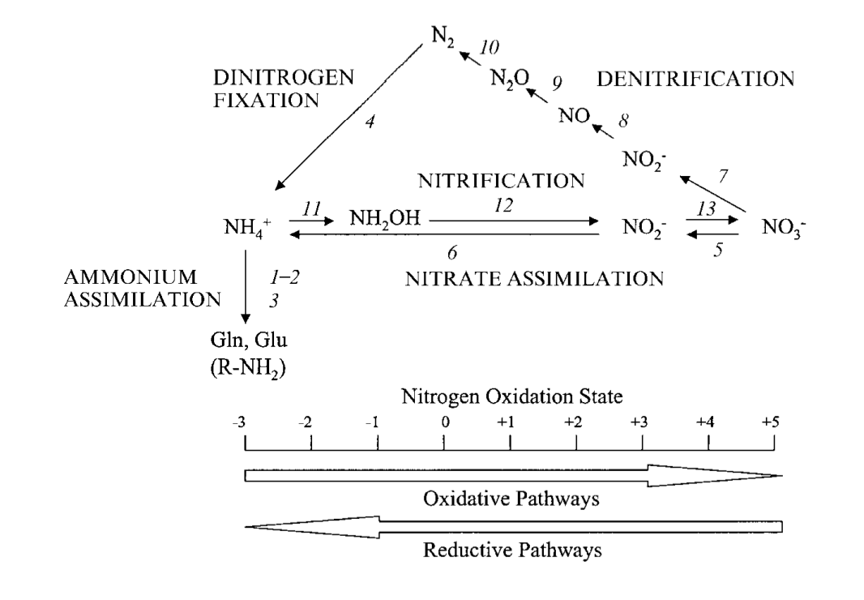
The Nitrogen Cycle*
Nitrous Oxide
Requires Manganese
*P Cabello et al., Microbiology (2004), 150, 3527–3546
Notes:
./nitrogen_cycle_archaea.pdf
Glutamine synthetase (GS) is a ubiquitous enzyme with a central role in nitrogen metabolism.

Slide 84
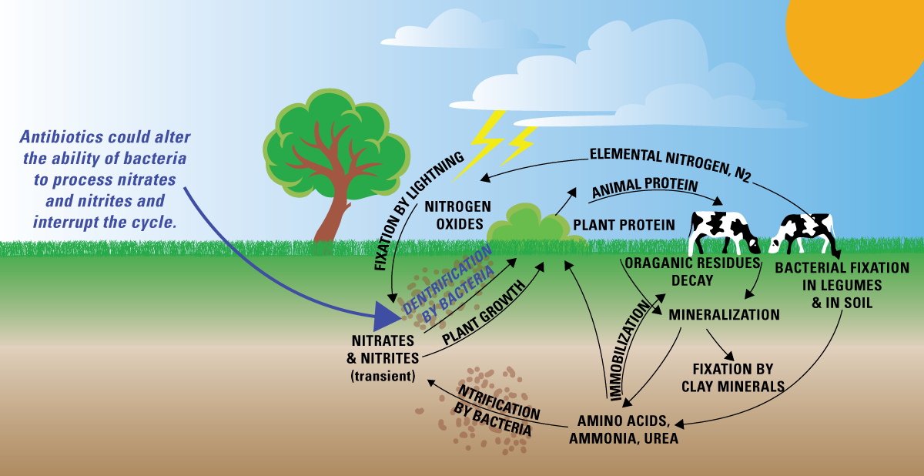
The Nitrogen Cycle and Antibiotics*
*http://toxics.usgs.gov/highlights/antibiotics_gw/
Notes:
./AntibioticsInGroundwater.pdf

Slide 85
The Nitrogen Cycle and Antibiotics*
Glyphosate is a patented antimicrobial agent
*http://toxics.usgs.gov/highlights/antibiotics_gw/
Notes:
./AntibioticsInGroundwater.pdf

Slide 86
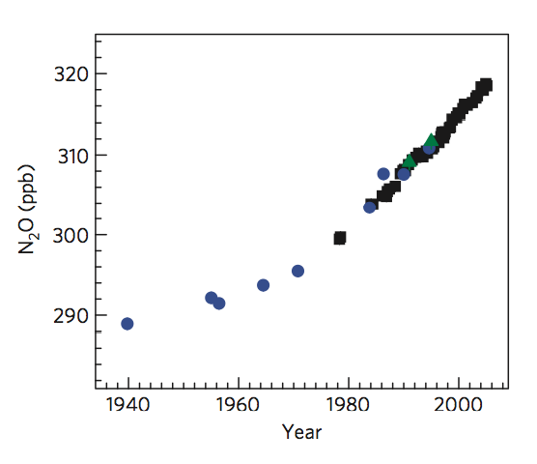
Nitrous Oxide Levels Over Time*
Glyphosate first introduced
*S Park et al., Nature Geoscience 2012; 5: 261-265.
Notes:
./nitrous_oxide_levels_over_time_2012.pdf

Slide 87
Two Quotes from the Paper*
"This result confirms that the increase in the atmospheric N₂O burden is largely due to nitrogen-based agricultural fertilizer use.”
"Given that nitrous oxide is both a long-lived greenhouse gas and a stratospheric ozone-depleting substance, this increase is of global concern.”
*S Park et al., Nature Geoscience 2012; 5: 261-265.
Notes:
./nitrous_oxide_levels_over_time_2012.pdf

Slide 88
Algal blooms and Dead Zones
Algal blooms in lakes due to runoff from farmlands with excess phosphate fertilizers lead to anaerobic “dead zone” at depth where nitrous oxide is produced in abundance
*P Cabello et al., Microbiology (2004), 150, 3527–3546
Notes:
./nitrogen_cycle_archaea.pdf

Slide 89
Nitrates and Public Health*
Excess nitrogen oxides in drinking water can cause methemoglobinemia, leading to lysis of red blood cells and oxygen deprivation in infants
If left untreated, it can result in “confusion, cyanosis, imbalance, hemodynamic instability, coma, and death.”
Important newly recognized source is nitrogen- reducing gut microbes that proliferate during acute gastrointestinal infection
*Richard et al., The Ochsner Journal, 14:2392-398,2014
Notes:
JudyHoy/Reexamining_the_Risks_of_Drinking-Water_Nitrates_on_drinking_Water.pdf

Slide 90
Glyphosate, Oxalate
and Anemia

Slide 91
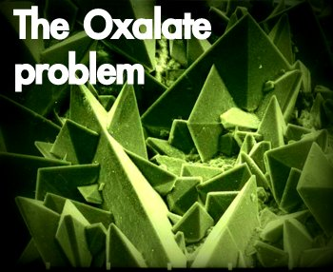

Autism Linked to Oxalate Crystals*
Crystals of oxalate form kidney stones and cause great discomfort
Study has shown at least 3-fold higher serum and urinary levels of oxalate in autistic kids**
*William Shaw, The Role of Oxalates in Autism and Chronic Disorders WAPF, March 26, 2010
**J Konstantynowicz et al., European Journal of Paediatric Neurology 16(5), 2012, 485-491.
Notes:
samantha/oxalates_in_autism.text~
samantha/william_shaw_on_oxalates_autism.text
http://www.westonaprice.org/health-topics/the-role-of-oxalates-in-autism-and-chronic-disorders/

Slide 92
“Cerebral edema, and perhaps injury to other organs, could result from oxalate crystal deposition in small blood vessels in the brain and other organs.”*
*K Froberg et al., Clin Toxicol (Phila). 2006;44(3):315-8.
Notes:
2015’Anthony/oxalate_crystals_brain.text

Slide 93
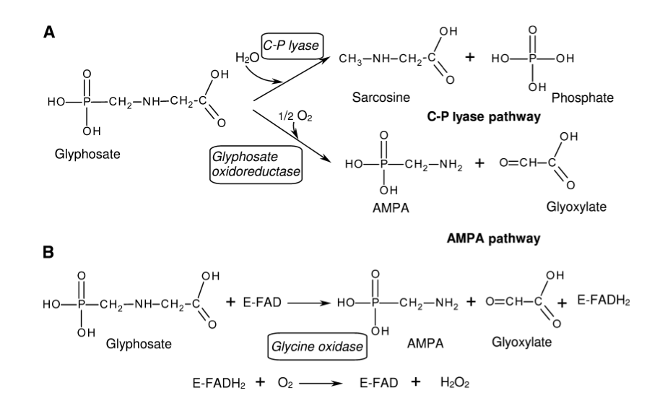
Glyphosate Metabolism*
*Figure 3 in L. Polligioni et al., FEBS Journal 278 (2011) 2753–2766
Notes:
Glyphosate/glyphosate_metabolism_to_glyoxylate.pdf

Slide 94
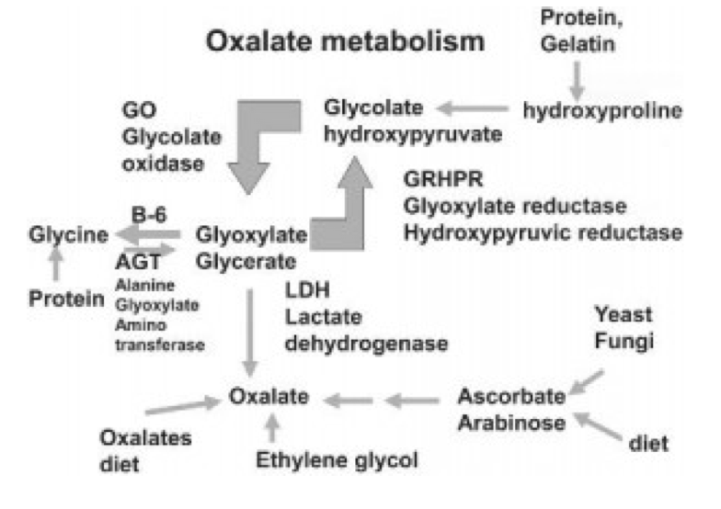
Oxalate Metabolism*
*http://www.greatplainslaboratory.com/home/eng/oxalates.asp
Notes:
./oxalates.text

Slide 95
Oxalate Suppresses Lactate Dehydrogenase
Lactate dehydrogenase converts pyruvate to lactate, but also converts glyoxylate to oxalate
Oxalate suppresses its activity*
Glyphosate was also shown to suppress its activity by 3-fold in studies on E coli**
*RJS Duncan et la., European J. Biochem. 11 (1969) 58-61.
**W Lu et al., Mol. BioSyst 2012;9:522-530.
Notes:
2015/Anthony/oxalate_inhibits_glyoxylate_metabolism_1969.pdf

Slide 96
Hypothesis: flooding with oxalate prevents metabolism of glyoxylate to oxalate. Glyoxylate is a very potent glycating agent, leading to widespread damage.
This also inhibits glyphosate breakdown to glyoxylate.

Slide 97

Monsanto Patents: 2002-2010:
Pesticide Compositions Containing Oxalic Acid
“[origin: WO02069718A2] Pesticidal concentrate and spray compositions are described which exhibit enhanced efficacy … More particularly, the present invention relates to a method of enhancing the herbicidal effectiveness of glyphosate concentrate and tank mix formulations containing one or more surfactants through the addition of oxalic acid.”
Monsanto Technology,
St. Louis, MO
Notes:
https://data.epo.org/gpi/EP1389912A2-PESTICIDE-COMPOSITIONS-CONTAINING-OXALIC-ACID (quote)
“[origin: WO02069718A2] Pesticidal concentrate and spray compositions are described which exhibit enhanced efficacy due to the addition thereto of a compound which increases cell membrane permeability, suppresses oxidative burst, or increases expression of hydroxyproline-rich glycoproteins. More particularly, the present invention relates to a method of enhancing the herbicidal effectiveness of glyphosate concentrate and tank mix formulations containing one or more surfactants through the addition of oxalic acid.”

Slide 98
Monsanto Patents: 2002-2010:
Pesticide Compositions Containing Oxalic Acid
“[origin: WO02069718A2] Pesticidal concentrate and spray compositions are described which exhibit enhanced efficacy … More particularly, the present invention relates to a method of enhancing the herbicidal effectiveness of glyphosate concentrate and tank mix formulations containing one or more surfactants through the addition of oxalic acid.”
Oxalic acid and oxalate are the same thing!
Monsanto Technology,
St. Louis, MO
Notes:
https://data.epo.org/gpi/EP1389912A2-PESTICIDE-COMPOSITIONS-CONTAINING-OXALIC-ACID (quote)
“[origin: WO02069718A2] Pesticidal concentrate and spray compositions are described which exhibit enhanced efficacy due to the addition thereto of a compound which increases cell membrane permeability, suppresses oxidative burst, or increases expression of hydroxyproline-rich glycoproteins. More particularly, the present invention relates to a method of enhancing the herbicidal effectiveness of glyphosate concentrate and tank mix formulations containing one or more surfactants through the addition of oxalic acid.”

Slide 99

Oxalate Enhances Glyphosate’s Toxicity to Plants at Small Concentrations*
*Figure 1, Monsanto Patent #US 7,771,736 B2, Aug. 10, 2010

Slide 100

sec.gov/Archives/edgar/data/1110783/000103570403000400/c77652exv99w2.htm

Slide 101
WEATHERMAX!!
sec.gov/Archives/edgar/data/1110783/000103570403000400/c77652exv99w2.htm

Slide 102
New Roundup Transorb'R' Herbicide Formu- lation to Hit Retail Shelves in Eastern Canada*
“In 2004, this powerful new formulation was chosen by more western Canadian growers than any other non-selective herbicide on the market. Grower satisfaction with the performance in the field has reached new
heights - 99% of growers who used Roundup WeatherMAX were satisfied with their experience.”
*www.highbeam.com/doc/1P2-13686824.html
JANUARY 3, 2005
Notes:
The product received its registration certificate in October 2003 after
six years of research and development work and field testing across
various regions in Canada. It was introduced in Western Canada last
season.

Slide 103

“Oxalate crystals in the bone may crowd out the bone marrow cells, leading to anemia and immunosuppression”*
*http://www.greatplainslaboratory.com/home/span/oxalates.asp

Slide 104
“Oxalate crystals in the bone may crowd out the bone marrow cells, leading to anemia and immunosuppression”*
*http://www.greatplainslaboratory.com/home/span/oxalates.asp

Slide 105
Plot produced in collaboration with Dr. Nancy Swanson from US Government data

Slide 106

This Detoxification Scheme is Essential in Red Blood Cells
Inhibited by glyphosate
Product of shikimate pathway
Depleted by glyphosate
Depends on selenium

Slide 107
This Detoxification Scheme is Essential in Red Blood Cells
Inhibited by glyphosate
Product of shikimate pathway
G6PD Deficiency Leads to Hemolysis and Anemia
Depleted by glyphosate
Depends on selenium

Slide 108
Anemia leads to low oxygen which induces chronic low grade encephalopathy linked to autism

Slide 109


Slide 110
Vitamin D Deficiency Epidemic
Year

Slide 111
Vitamin D Deficiency Epidemic
Vitamin D depends on CYP enzymes for activation in the liver and the kidney
Year

Slide 112
Vitamin D Deficiency Epidemic
Vitamin D protects from sulfate wasting
from the kidneys*
Year
*MJG Bolt et al., American Journal of Physiology - Endocrinology and Metabolism
2004;287(4):E744-E749.

Slide 113
Vitamin D Deficiency Epidemic
Autism is associated with vitamin D deficiency, low serum sulfate and high urinary sulfate*
Year
*RH Waring et al., Journal of Nutritional and Environmental Medicine 2000;10(1):25-32.

Slide 114

Recent Study from China*
Serum Vitamin D
*Z-L Gong et al., NeuroReport 2014, 25:23–27
Notes:
Samantha/autism_vitamin_D_deficiency_Chinese_study.pdf
Boxplot of serum 25(OH) D levels between ASD patients and normal cases. The mean serum 25(OH) D levels were significantly (P = 0.002) lower in children with ASD as compared with normal cases. 25(OH) D, 25-hydroxyvitamin
d

Slide 115
Recapitulation
Glyphosate induces anemia and iron toxicity by disrupting red blood cells
  Anemia induces hypoxia and low grade encephalopathy
New formulation, WeatherMax, introduced in 2005, is more toxic to both plants and animals
  Likely contains oxalate that suppresses glyphosate detoxification
  High serum oxalate is linked to autism
Vitamin D deficiency epidemic post 2005 may be caused by disruption of liver CYP enzymes
  This will lead to sulfate deficiency due to wasting at kidneys

Slide 116
Summary
Glyphosate contamination in our food supply is a serious threat to human health
Glyphosate is implicated in autism, breast cancer, Celiac disease, vitamin D deficiency, sleep disorders, osteoarthritis and many other health issues
Suspected addition of oxalate to the formulation in 2005 led to significant increases in toxicity to both plants and animals
Iron dysbiosis and anemia are important factors
Glyphosate may be working synergistically with vaccine ingredients to cause increased harm
Glyphosate may play a significant role in climate change

Slide 117

One Final Message:
Go Organic!

Slide 118
Thank You!

