Slide 1
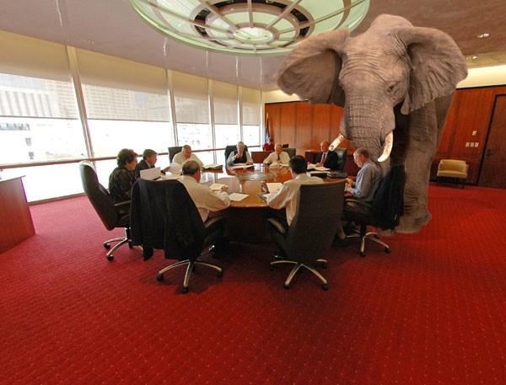
Glyphosate: The Elephant in the Room
Stephanie Seneff
MIT
April 12, 2014

Slide 2
"If we do not save the environment then whatever we do in civil rights will be of no meaning because then we will have the equality of extinction."
-- Martin Luther King

Slide 3
Download These Slides
http://people.csail.mit.edu/seneff/SeneffGlyphosateYale.pptx (or .pdf)

Slide 4
Outline
Introduction
Autism and Dementia
Obesity and Digestive Disorders
Endocrine Disruption and Cancer
Species in Stress (two slides)
Summary

Slide 5
Autism and Dementia

Slide 6
“Children today are sicker than they were a generation ago. From childhood cancers to autism, birth defects and asthma, a wide range of childhood diseases and disorders are on the rise. Our assessment of the latest science leaves little room for doubt: pesticides are one key driver of this sobering trend.”*
*http://www.emagazine.com/earth-talk/pesticides-and-childrens-health
Notes:
Rosemary:
http://gmandchemicalindustry9.wordpress.com/european-food-safety-authority-and-the-seralini-paper-on-rat-tumours/
http://www.emagazine.com/earth-talk/pesticides-and-childrens-health

Slide 7
“One of the puzzling aspects of autism is the marked increase in the incidence of autism that began in the United States in the early 1980s and has appeared to increase continuously since then.”
-William Shaw, Journal of Restorative Medicine 2013; 2: First line of Introduction.
The rate was one in fifty in the most recent estimate last year

Slide 8
Conditions Associated with Autism
Disrupted gut bacteria
Deficiencies in serotonin and melatonin
Impaired sulfur metabolism
Is there a toxic environmental substance that has been on the rise since 1980 and that could account for these comorbidities?

Slide 9
GLYPHOSATE

Slide 10
Glyphosate use rose 1500% from 1994 to 2005.*
100 million pounds of glyphosate is used every year on more than a billion acres.
Huge expansion of GMO “Roundup-Ready” corn, soy, cotton and canola crops has led to sharp increases in the last decade
*Cherry B. GM crops increase herbicide use in the United States.
Science in Society 45, 44-46, 2010

Slide 11
Nancy Swanson, http://www.examiner.com/article/
data-show-correlations-between-increase-neurological-diseases-and-gmos

Slide 12
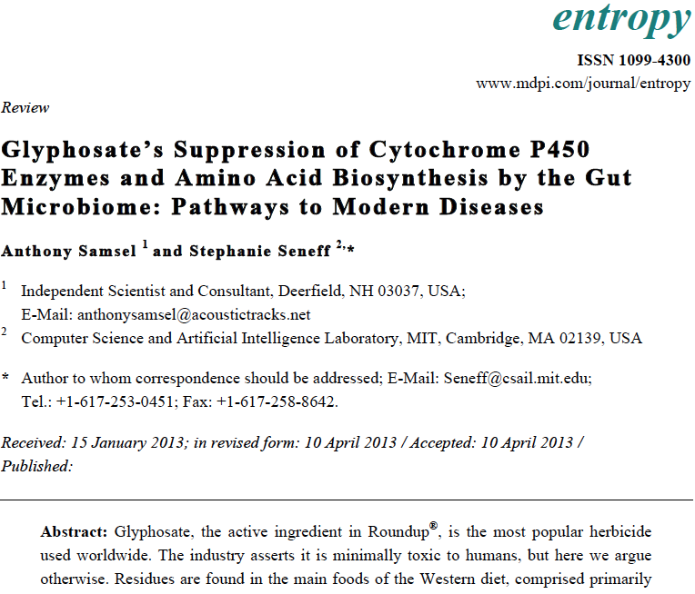
Recent Publication

Slide 13
Is Glyphosate Nontoxic?
Monsanto has argued that glyphosate is harmless to humans because our cells don’t have the shikimate pathway, which it inhibits
However, our gut bacteria DO have this pathway
We depend upon them to supply us with essential amino acids (among many other things)
Other ingredients in Roundup greatly increase glyphosate’s toxic effects
Insidious effects of glyphosate accumulate over time
Most studies are too short to detect damage

Slide 14
Main Toxic Effects of Glyphosate*
Kills beneficial gut bacteria and allows pathogens to overgrow
Interferes with function of cytochrome P450 (CYP) enzymes
Chelates important minerals (iron, zinc, manganese, etc.)
Interferes with synthesis of aromatic amino acids and methionine
Leads to shortages in critical neurotransmitters
Disrupts sulfate synthesis and sulfate transport
*Samsel and Seneff, Entropy 2013, 15, 1416-1463

Slide 15
Some Biomarkers for Autism
Disrupted gut bacteria; inflammatory bowel
Low serum sulfate
Methionine deficiency
Serotonin and melatonin deficiency
Defective aromatase
Zinc, iron and vitamin D deficiency
Urinary p-cresol
High serum nitrate and ammonia
Impaired immune function
Chronic low-grade inflammation in the brain
Notes:
Samantha/zinc_deficiency_autism.text

Slide 16
Some Biomarkers for Autism
Disrupted gut bacteria; inflammatory bowel
Low serum sulfate
Methionine deficiency
Serotonin and melatonin deficiency
Defective aromatase
Zinc and iron deficiency
Urinary p-cresol
High serum nitrate and ammonia
Impaired immune function
Chronic low-grade inflammation in the brain
These can all be explained as potential effects of glyphosate on biological systems
Notes:
Samantha/zinc_deficiency_autism.text

Slide 17
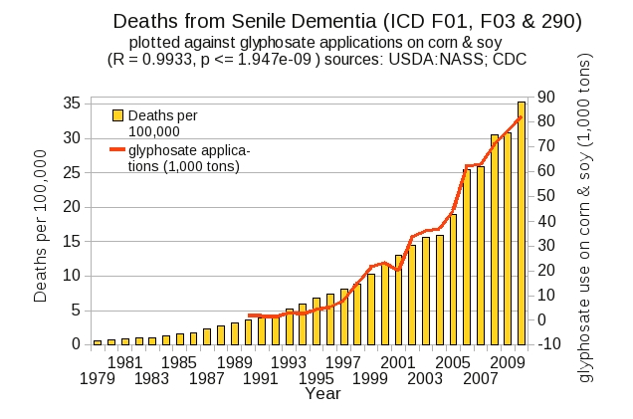
Dementia and Autism Have Much in Common
Plot kindly provided by Nancy Swanson

Slide 18
Obesity and Digestive Disorders

Slide 19
Is Glyphosate Making Us Obese?

Slide 20
Obesity in US over Time*
Glyphosate was introduced into the food chain in 1975
*Figure 1 in R.J. Johnson et al., Am J Clin Nutr 2007;86:899–906.
Notes:
Sugar intake per capita in the United Kingdom from 1700 to 1978 (30, 31; E) and in the United States from 1975 to 2000 (32; 􏰏) is compared with obesity rates in the United States in non-Hispanic white men aged60–69y(17;F).Valuesfor1880-1910arebasedonstudiesconducted in male Civil War veterans aged 50–59 y (18).

Slide 21
Nancy Swanson, http://www.examiner.com/article/
data-show-correlations-between-increase-neurological-diseases-and-gmos

Slide 22
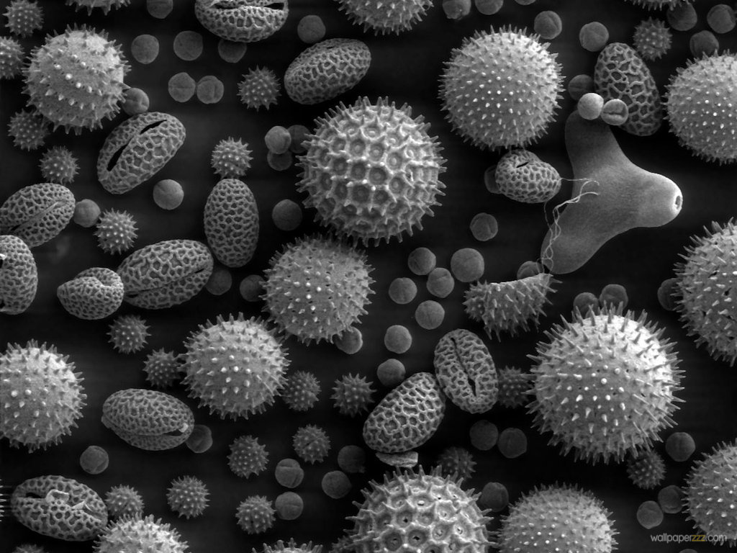
Gut Microbes and Obesity
Our microbes outnumber our own cells 10 to 1
There are between 200 and 300 different species in a typical person.
Environmental toxins like glyphosate can cause an overgrowth of pathogens in the gut
They release toxic phenols
This can lead to inflammatory bowel disease
And a direct path to obesity!
Gut microbes from an obese person induced obesity in mice*
*N. Fei and L. Zhao, The ISME Journal, Online Publication Dec. 2012
Notes:
*See: http://www.usaprepares.com/health/scientists-link-obesity-to-gut-bacteria

Slide 23
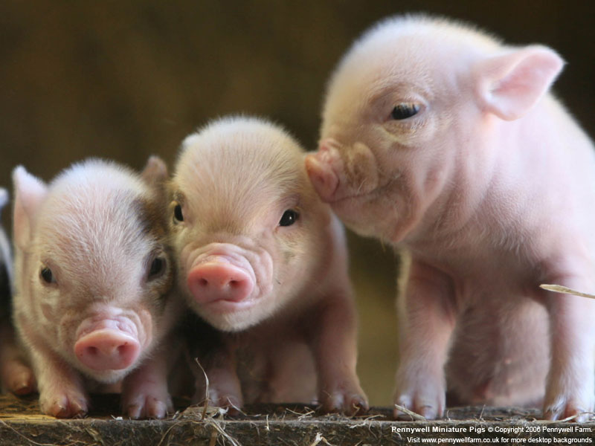
Pigs Fed GMOs Develop Inflamed Gut*
Pigs have a similar digestive system to humans
Digestive problems observed anecdotally in GMO-fed pigs
inflammation in stomach and intestine, stomach ulcers, thinning of intestinal walls, increase in haemorrhagic bowel disease
Follow-on Experiment:
168 just-weaned pigs fed "typical diet,” soy and corn, until slaughtered
Half fed GMO versions, half organic.
*J.A. Carman et al., Journal of Organic Systems, 8(1), 2013.
Notes:
Swine/pigs_fed_GMOs_inflamed_gut.pdf
Also pigs_GMOs_summary.pdf
./Pigs_Study_NaturalNews.pdf
http://www.beyondpesticides.org/dailynewsblog/?p=10823

Slide 24
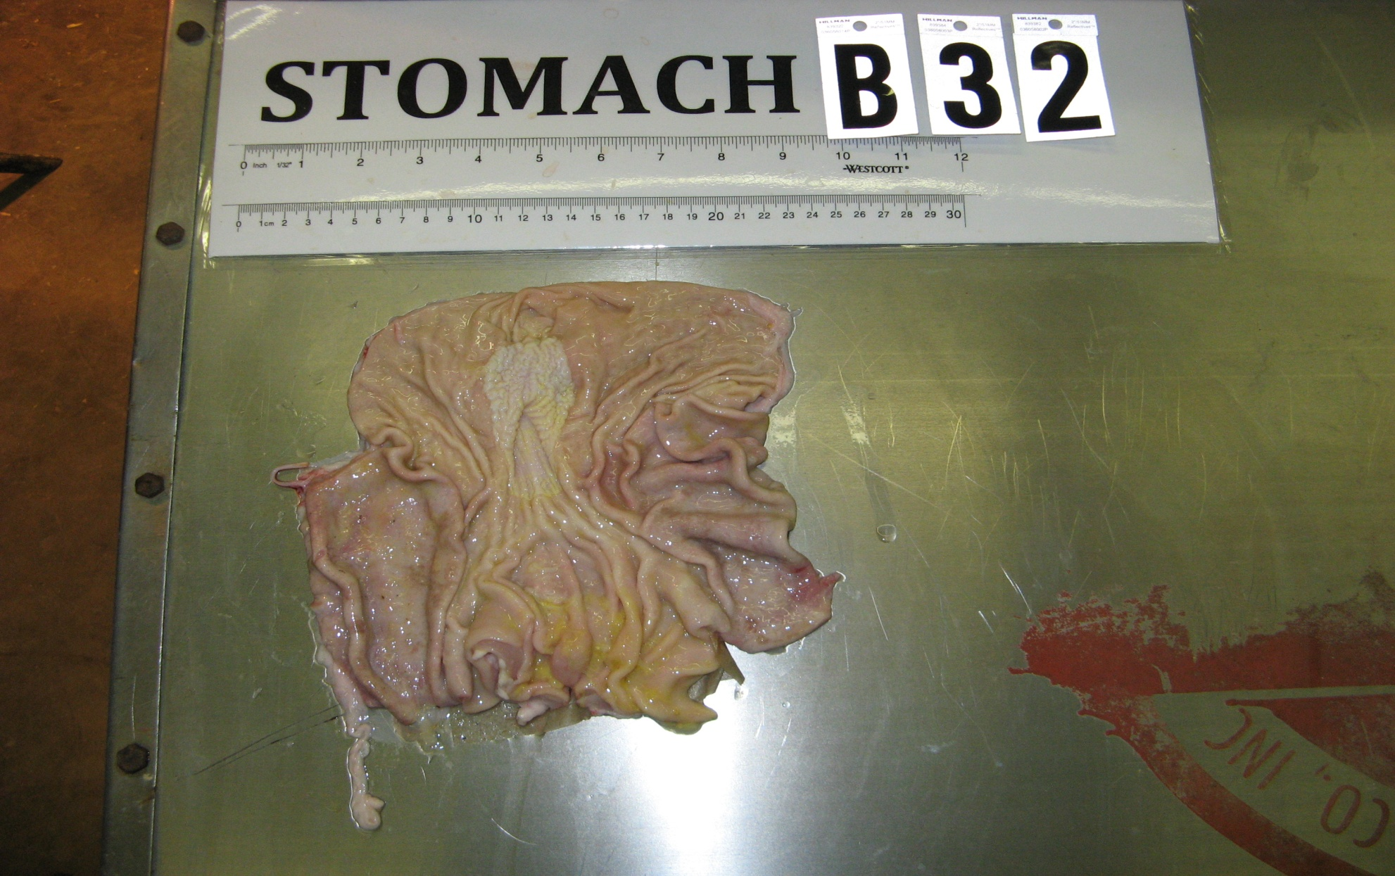
Pigs Fed GMOs Develop Inflamed Gut*
Blind autopsies conducted
Female pigs' uterus 25% larger in GMO-fed pigs
Female pigs 2.2x more likely to get severe stomach inflammation on GMO diet
Males were 4x more likely
Non-GMO Feed
GMO Feed
Photos kindly provided by Howard Vlieger
GMO Feed
*J.A. Carman et al., Journal of Organic Systems, 8(1), 2013.
Notes:
Swine/pigs_fed_GMOs_inflamed_gut.pdf
Also pigs_GMOs_summary.pdf
./Pigs_Study_NaturalNews.pdf

Slide 25
Human Digestive System Disorders
We are seeing an alarming increase in the US in many diseases related to the gut
Crohn’s disease, inflammatory bowel disease, colitis, acid reflux disease, gluten and casein intolerance, celiac disease, leaky gut
The gut-brain axis links neurological disorders with gut disorders
I believe that glyphosate is a major cause

Slide 28
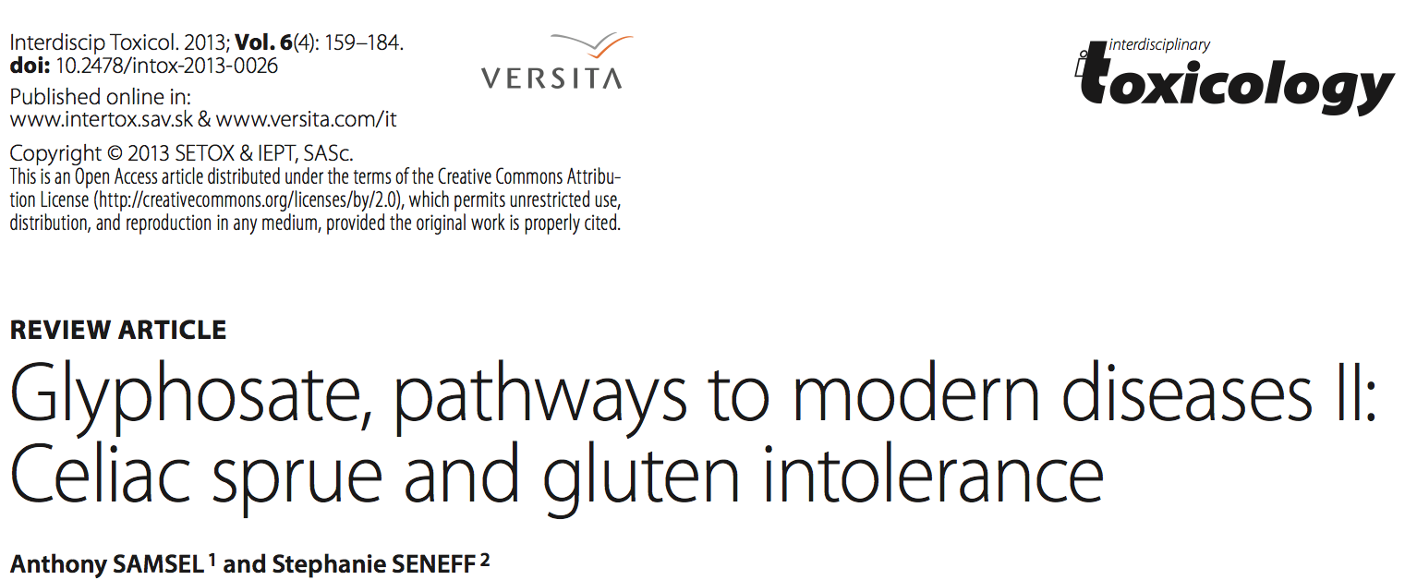
Recent Publication (Dec. 2013)

Slide 29
Wheat! Not corn and soy
Graph provided by Nancy Swanson, with permission

Slide 30
“We may be able to knock out 80% to 90% of the resistant ryegrass with glyphosate. ”
Desiccation with Glyphosate*
Advantages:
Hastens maturity to harvest
Weed control for next year's crop
Reduces green material and therefore strain on harvesting machinery
Disadvantages
Herbicide cannot be washed out prior to human use.
Animals fed herbicide-treated crops --> contamination in animal products
Crops include wheat, barley, legumes, corn, sunflower, kiwi, grapes (wine), raspberries, apples, soybeans, alfalfa, sugar cane
*Ron Smith, Western Farm Press, Mar. 23, 2013

Slide 31
Celiac Disease, Glyphosate and Non Hodgkin’s Lymphoma
Glyphosate preferentially kills bifidobacteria*
Bifidobacteria are depleted in celiac disease**
Celiac disease is associated with increased risk to non Hodgkin’s lymphoma***
Glyphosate itself is also linked directly to non Hodgkin’s lymphoma****
*A.A. Shehata et al., Curr Microbiol. 2013 Apr;66(4):350-8.
** M. Velasquez-Manoff, NY Times Sunday Review, Feb. 23, 2013.
*** C. Catassi et all, JAMA. 2002 Mar 20;287(11):1413-9.
****M. Eriksson et al., Int J Cancer. 2008 Oct 1;123(7):1657-63.
Notes:
**./ bifidobacteria_celiac_disease.text
Cancer/Celiac_disease_increases_hodgkins_lymphoma.text
./Celiac_and_bacteria.text

Slide 32
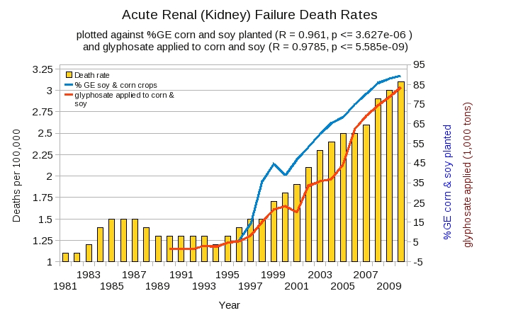
Acute Kidney Disease Death Rate Plotted Against Glyphosate and GMOs*
*Plot prepared by Nancy Swanson from available data online

Slide 33
Acute Kidney Disease Death Rate Plotted Against Glyphosate and GMOs*
Young male agricultural works in sugarcane fields desiccated with glyphosate are dying from kidney disease
*Plot prepared by Nancy Swanson from available data online

Slide 34
Acute Kidney Disease Death Rate Plotted Against Glyphosate and GMOs*
Sri Lanka and El Salvador have now banned glyphosate usage in agriculture
*Plot prepared by Nancy Swanson from available data online

Slide 35
Endocrine Disruption and Cancer

Slide 36
Roundup Safety Claims Disputed*
“It is commonly believed that Roundup is among the safest pesticides. … Despite its reputation, Roundup was by far the most toxic among the herbicides and insecticides tested. This inconsistency between scientific fact and industrial claim may be attributed to huge economic interests, which have been found to falsify health risk assessments and delay health policy decisions.”
*R. Mesnage et al., Biomed Research International, 2014 In Press
Notes:
Glypohsate/ Mesnage_Seralini_2014_glyphosate_toxicity_proven.pdf

Slide 37
Glyphosate is an endocrine disruptor that promotes breast cancer*
Low and environmentally relevant concentrations of glyphosate possess estrogenic activity
Glyphosate caused human hormone-dependent breast cancer cells to proliferate at concentrations of parts per trillion
* S. Thongprakaisang et al., Food Chem Toxicol. 2013 Jun 8. S0278-6915(13)00363-3.
Notes:
./glyphosate_and_breast_cancer.text
Swine/glyphosate_breast_cancer.pdf
Please make a note that this study shows Glyphosate effects down to parts per trillion (10 to the minus12th).
In this study, we found that glyphosate at a log interval concentration ranging from 10-12 to 10-6 M increased the cell proliferation of a hormorne dependent breast cancer T47D ce

Slide 38
Mammary Tumors in Rats*
Rats through their entire lifespan exposed to Roundup at levels well below established safety limits
*G.-E. Séralini et al., Food Chem. Toxicol. (2012) [retracted]
http://dx.doi.org/10.1016/j.fct.2012.08.005
Notes:
Images/seralini_rats.png
./seralini_paper.pdf

Slide 39
Glyphosate and Anencephaly*
Yakima, Benton and Franklin counties in Washington State have an unusually high number of pregnancies affected by the birth defect, anencephaly
75 pesticides were analyzed in studying contamination due to surrounding agriculture
47 (63%) of these were detected
Glyphosate was applied in large amounts, but was not studied
5% solution of glyphosate was also used heavily around irrigation ditches to control weeds
Main herbicide recommended due to its “low toxicity”
Glyphosate has been linked to anencephaly due to its effect on retinoic acid
*Barbara H. Peterson. Farm Wars, http://farmwars.info/?p=11137

Slide 40
Glyphosate Upregulates Retinoic Acid*
Small Brain
*A. Carrasco, Teratogenesis by glyphosate based herbicides and other pesticides. Relationship with the retinoic acid pathway. In Breckling, B. & Verhoeven, R. (2013) GM-Crop Cultivation – Ecological Effects on a Landscape Scale. Theorie in der Ökologie 17. Frankfurt, Peter Lang.

Slide 41
An Important Paper (2012)
“A substantial body of evidence demonstrates that glyphosate and Roundup cause teratogenic effects and other toxic effects on reproduction, as well as genotoxic effects. From an objective scientific standpoint, attempts by industry and government regulatory bodies to dismiss this research are unconvincing and work against the principle that it is the responsibility of industry to prove that its products are safe and not the responsibility of the public to prove that they are unsafe.”
Notes:
Anthony/Claires_article_glyphosate_dangerous.pdf

Slide 42
Glyphosate Kills Liver Cells*
Doses far below those used in agriculture kill liver cells in vitro
Downregulated synthesis of glutathione, critical for detox of environmental chemicals
Upregulated synthesis of CYP enzymes
Likely due to interference with their function
*C. Gasnier et al., Journal of Occupational Medicine and Toxicology 2010, 5:29.

Slide 43
Species in Stress

Slide 44
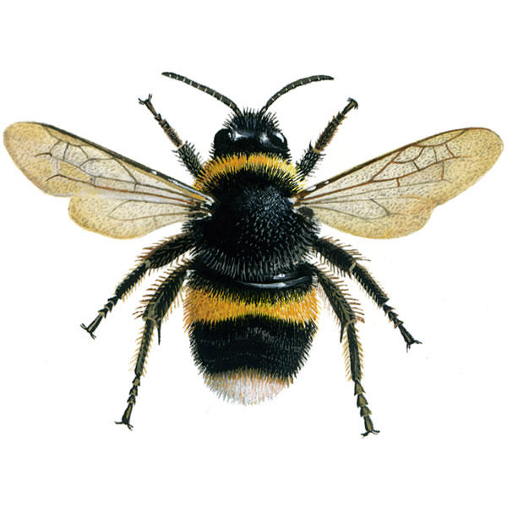
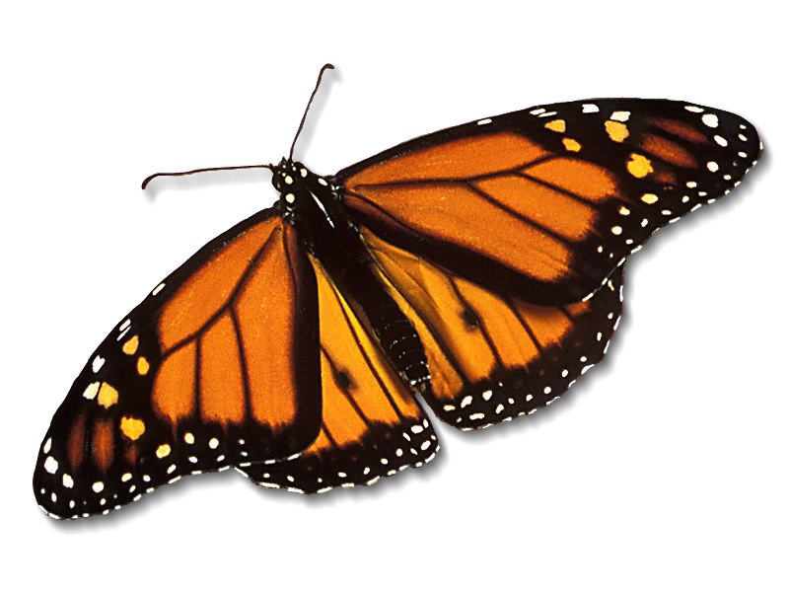
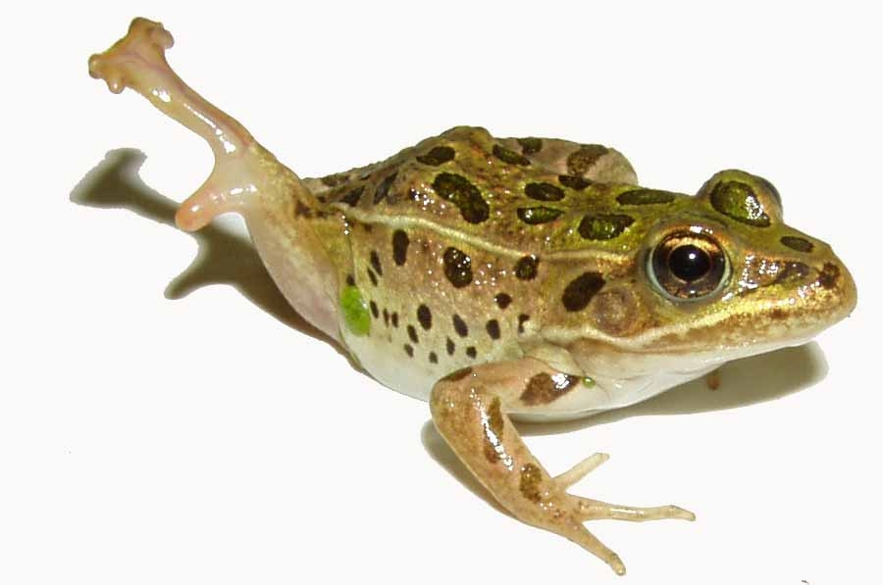
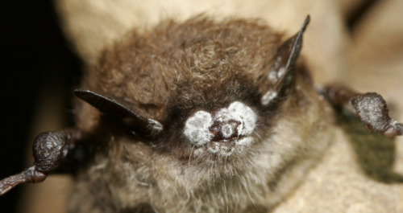
Species in Stress
Fungus Infection
Fungus Infection
Fungus Infection
Fungus Infection
*R. Mason et al., Journal of Environmental Immunology and Toxicology 1:1, 3-12; 2013
Notes:
Frogs -- drop 3.7% every year, meaning they could disappear in half of the habitats they now occupy nationwide in 26 years
Monarch butterflies – milkweed being killed by glyphosate
http://salsa3.salsalabs.com/o/1881/p/dia/action3/common/public/?action_KEY=12506

Slide 45
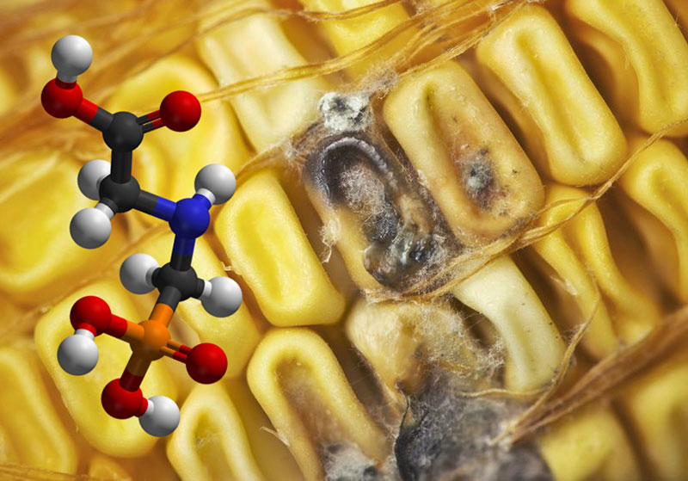
Roundup herbicide enhances the growth of aflatoxin-producing fungi*
*Barberis et al., Journal of Environmental Science and Health, Part B: Pesticides, Food Contaminants, and Agricultural Wastes. 2013, 48(12), 1070-1079.

Slide 46
“Aflatoxins are mutagenic, carcinogenic, teratogenic, hepatotoxic, immunosuppressive, and they also inhibit several metabolic systems”*
*Barberis et al., Journal of Environmental Science and Health, Part B: Pesticides, Food Contaminants, and Agricultural Wastes. 2013, 48(12), 1070-1079.
Notes:
glyphosate/glyphosate_promotes_fungus_growth_2014.pdf
Aflatoxins (AFs) are extensively known to be potent mutagenic,
carcinogenic, teratogenic, hepatotoxic, immunosuppressive, and they
also inhibit several metabolic systems.[13,14]

Slide 47
Summary
I believe we need to be very worried about glyphosate in the food and water supplies
Glyphosate’s disruption of gut bacteria, depletion of essential amino acids and minerals, and interference with cytochrome P450 enzymes have widespread consequences
Glyphosate may be the most important factor in the recent die-off of many species
Glyphosate may be the most important factor in the U.S. health crisis related to obesity, autism, dementia, celiac disease, kidney failure, etc.
Notes:
Mention paper has a lot more

