Slide 1
Autism, Depression and Alzheimer’s: A Shared Underlying Pathology and Treatment
Wise Traditions London
March 18, 2012
Stephanie Seneff
MIT

Slide 2
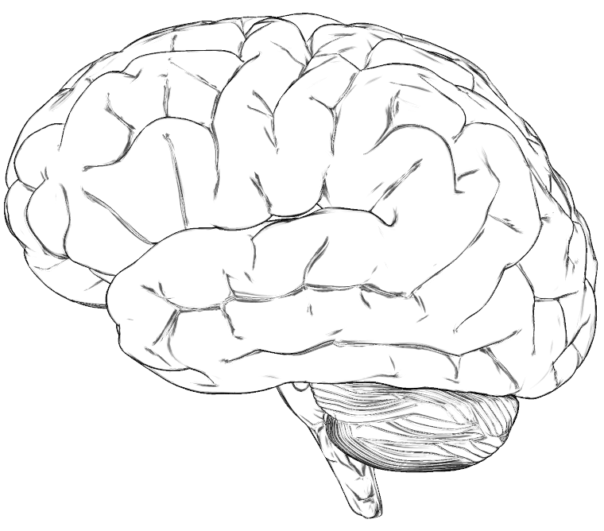
A Hypothesis
Many neurological diseases of the brain have a common origin:
Insufficient supply of cholesterol and sulfate to the brain (cholesterol sulfate deficiency)
Powerful additional burden of toxic metal exposure (e.g., aluminum, mercury) due to impaired ability to detoxify and eliminate them

Slide 3
A Prelude*
“Nutrition and Alzheimer's disease: The detrimental role of a high carbohydrate diet”
Too much dietary sugar (especially fructose) leads to impaired cholesterol supply to brain
This results in impaired glucose metabolism in the brain (type III diabetes)
This leads to mitochondrial damage, unfolded protein response, and neuron death
I still believe what we wrote in that article, but it was only part of the story.
* Seneff et al., European Journal of Internal Medicine 22:2, 134-40, Apr. 2011

Slide 4
Outline
Cholesterol
Sulfate
Aluminum
Infection
Mitochondrial Dysfunction
Summary

Slide 5
Cholesterol

Slide 6
Low Cholesterol and Depression*
29,133 men were followed for 5-8 years.
Baseline cholesterol levels were recorded
Self-reported depression
Data on hospital treatments due to depressive disorders
Deaths from suicide tabulated
"Low serum total cholesterol was associated with low mood and subsequently a heightened risk of hospital treatment due to major depressive disorder and of death from suicide.”
* Partonen et al., The British Journal of Psychiatry 175:259-262, 1999.

Slide 7
Smith-Lemli-Opitz Syndrome (SLOS) *
Extremely low cholesterol
High 7-dehydrocholesterol (enzyme impaired)
75% on autistic spectrum
Lack of speech
Severe behavior abnormalities: frequent temper tantrums, hyperactivity, violent outbursts, destruction of property, self-mutilation
UV-light sensitivity
* Autism and Cholesterol, William Shaw, PhD,
http://vimeo.com/12616011

Slide 8
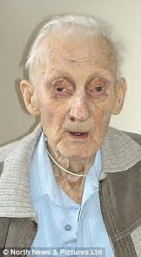
17 Year Study on Elderly*
Begun in 1990: all subjects were at least 70 years old
Measured serum cholesterol, ability to synthesize cholesterol, and ability to absorb cholesterol through the intestines
Low values of all three parameters were associated with accelerated mental decline and increased physical frailty
Subjects with low values on all three had 4 ½ years decreased life span
Low cholesterol is associated with increased frailty and accelerated mental decline, as well as early death
* Tilvis et al., Annals of Medicine, Early Online, 2011
Notes:
Cancer/serum_cholesterol_prognosis_elderly.pdf

Slide 9
Alzheimer’s and Serum Cholesterol
"Significantly lower lipid levels were found in patients with AD, than in controls. Patients in the late phase of AD had significantly lower entire lipid profile than controls and significantly lower cholesterol and LDL-C levels than patients in the middle stage of AD.”*
*Presečki et al., Coll. Antropol. 35, Suppl. 1: 115–120, 2011.
Notes:
For_vic/alzheimers_low_cholesterol.pdf

Slide 10
Recapitulation
Low cholesterol is associated with depression
Low cholesterol is associated with a rare genetic disease, SLOS: 75% of cases have autism
Low cholesterol is associated with increased mental decline in elderly
Degree of severity in Alzheimer’s inversely proportional to cholesterol levels

Slide 11
Sulfate

Slide 12
Article on Autism
“ Might cholesterol sulfate deficiency contribute to the development of autism spectrum disorder?”
Stephanie Seneff, Robert Davidson and Luca Mascitelli, Medical Hypotheses 8, 213–217, 2012.

Slide 13
Sulfate in Fetal Development*
Fetus depends on mother for sulfate supply
Sulfate is essential for transporting sterols (like estrogen and DHEA) and supplying extracellular matrix proteins everywhere with sufficient negative charge
Sulfate detoxifies xenobiotics like acetaminophen (tylenol) and is essential for disposing of toxins like aluminum and mercury
Sulfate is severely deficient in autistic children (1/5 the normal level of free sulfate in blood stream)**
* Dawson, “Sulfate in Fetal Development,” Semin Cell Dev Biol 2011
** Horvath and Perman, Current Gastroenterology Reports 4:3, 251-258, Jun 2002.
Notes:
Cancer/sulfate_in_fetal_development.pdf
Dawson PA. Sulfate in fetal development. Semin Cell Dev Biol (2011), doi:10.1016/j.semcdb.2011.03.004
Horvath: http://www.ncbi.nlm.nih.gov/pubmed/12010627

Slide 14
Sulfate and Autistic Correlates
Autism is associated with several health issues:
Eczema, asthma
Susceptibility to infection
digestive problems
Eczema and asthma:*
Caused by filaggrin deficiency
Cholesterol sulfate in skin stimulates filaggrin synthesis
Susceptibility to infection:
Sulfate protects cells in blood from bacteria
Digestive problems:**
Sulfate deficiency leads to leaky gut syndrome
* Nakae et al., The FASEB Journal 22:782.2, 2008
** Waring and Klovrza, J Nutr & Environ Medicine 10:25-32, 2000
Notes:
RH WARING PAPER 2000.pdf in robert_davidson/ThePaper/
Gastrointestinal FunctionSulphation capacity also affects the gastrointestinal tract. The mucins which line the gut, providing both protective and adhesive properties, are sulphated glycoproteins which rely on the degree of sulphation and the addition of negative charges to maintain their structures in an extended con􏲵guration [30]. Reduced sulphation has been associated with in􏲶 ammation and gut dysfunction, coupled with a breakdown in the protective properties of the mucins and an increase in permeability [31]. Many children with autism also have digestive problems and 9 out of 20 (42%) in one survey had increased gut permeability when challenged by the mannitol/lactulose test [32]. This 􏲵 nding has led to the idea that a “leaky” gut may be more permeable to dietary proteins and peptides. Groups working in two separate laboratories have found diet-derived peptides in urine from children with autism [33,34] which were attributed to incomplete hydrolysis of casein and gluten proteins from milk and wheat respectively [35]. Peptides of this type can show “opioid” activity, crossing the gut wall and penetrating the blood–brain barrier to act on the central nervous system [36]. They may be responsible for the social withdrawal, insensitivity to pain and altered responses to sensory stimuli which are commonly described in autism. Use of naloxone and other opiate antagonists has been reported to reduce the levels of self-injury, again suggesting that “opioid excess” may be a factor in autistic behaviour [37].

Slide 15
Relationship with GAPS*
Mucins lining the gut are sulphated glycoproteins
Rely on sulphation to maintain negative charge
Reduced sulphation is associated with leaky gut syndrome
Gut is more permeable to peptides such as casein and gluten proteins
Results in gluten intolerance
Peptides act as opioids by penetrating blood brain barrier
Peptides could be responsible for social withdrawal, insensitivity to pain, and impaired sensory response
* Waring and Klovrza, J Nutr & Environ Medicine 10, 25-32, 2000

Slide 16
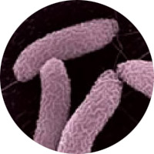
Imbalance in Gut Biota
Autistic kids have an excess of bacterium named “Desulfovibrio” in their guts*
This bacterium can thrive on both sulfate and nitrate**
Nitrate is toxic to other bacteria and kills them off
Sulfate gets depleted from mucoproteins
Autism is associated with excess nitrate in the blood (derived from nitric oxide)***
* S.M. Finegold et al., Anaerobe 1-3, 2012
** Gibson et al., Journal of Applied Bacteriology 65:241-247, 1988
*** T.L. Sweeten et al., Biological Psychiatry 55:4, 434-437, Feb 15, 2004
Notes:
vitaminK/microbiology_of_regressive_autism.pdf (from Sue Dieffenbach)
vitaminK/nitric_oxide_impairs_intestinal_barrier_function.pdf
vitaminK/sulfovibrio_autism_nitrates_1988.pdf
vitaminK/oxidative_stress_in_autism.pdf
vitaminK/serum_nitrates_elevated_autism.text

Slide 17
“Microbiology of Regressive Autism”*
Nitrate
Endotoxin
Feedback Loop
Nitric Oxide Synthesis
* S.M. Finegold et al., Anaerobe 1-3, 2012

Slide 18
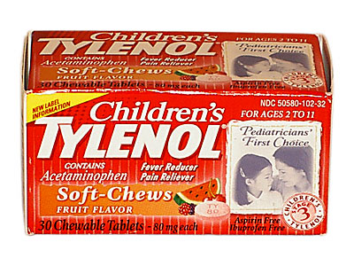
Tylenol and Autism*
Tylenol is detoxified and eliminated via sulfation
Autistic kids are severely impaired in this process
Reflects reduced supply of sulfate
Tylenol therapy could result in further depletion of sulfate stores
This same pathway is necessary to eliminate excess adrenalin and dopamine from the brain
Impairment could lead to the formation of neurotoxic substances with psychedelic effects
* Alberti et al., Biol Psychiatry 46, 420–424, 1999.
Notes:
vitaminK/autism_sulfation_deficit.pdf
vitaminK/sulfur_metabolism_in_autism.pdf

Slide 19
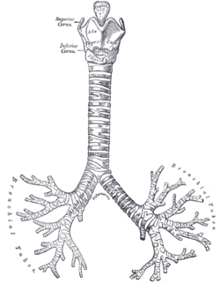
Sulfur, Asthma and Tylenol*
Autistic kids are especially susceptible to asthma
There has been a sharp increase in childhood asthma over the past 30 years
Timing corresponds with aspirin scare in 1980’s
Bronchial tube epithelial cells produce cholesterol sulfate
Cholesterol sulfate protects from asthma through its effect on profilaggrin
Tylenol causes increased bronchial constriction and wheezing
Tylenol depletes sulfur stores through its elimination process
* C. Aschwanden, "Studies suggest an acetaminophen-asthma link," Dec. 19, 2011, NY Times
Notes:
./NYTimes_asthma_and_acetaminophine.text

Slide 20
Cholesterol Sulfate in Placental Villi*
Placental villi are highly enriched in cholesterol sulfate, especially in third trimester of pregnancy
Mother’s serum cholesterol sulfate steadily rises through pregnancy
In third trimester, villi contain 24 pmol/mg of cholesterol sulfate, compared to only 1.5 in blood serum of a non-pregnant woman
* Lin et al., Journal of Chromatography B, 704 (1997) 99–104

Slide 21
Paradoxical Effect of Mother’s High Cholesterol*
Women with high serum cholesterol paradoxically give birth to children with low serum cholesterol
These children already have fatty streaks in their arteries (beginnings of atherosclerosis)
Hypothesis: cholesterol sulfate is mode of transport of cholesterol across placenta
Corollary: high serum cholesterol (LDL) is associated with low serum cholesterol sulfate
* Palinski, Circ. Res. 2009;104;569-571
Notes:
Palinski, Circ. Res. 2009;104;569-571
Maternal_cholesterol_placenta.pdf

Slide 22
DHEA Sulfate
DHEA is a sterol synthesized from cholesterol
Most common steroid in the blood stream
DHEA transport depends on sulfation
Autistic adults had significantly lower serum levels of DHEA sulfate*
DHEA sulfate stimulates dendritic growth in mouse neurons**
Genetically engineered mice with defective DHEA synthesis die as 8 day-old embryos
* Strous et al. Neuropsychopharmacol, 15(3):305-9, 2005
** Bair and Melon, Molecular and Cellular Biology 24(12):5383–5390, 2004
Notes:
Cancer/dhea_sulfate_reduced_autism.text
Cancer/DHEA_deficiency_lethal_mouse_embryos.pdf

Slide 23
DHEA Sulfate and Childhood Depression*
Childhood depression is common
1%–2% of prepubertal children
3%–8% of adolescents
20% will experience depression at some point before age 20
Experiments with depressed rats:
Only treatment with DHEAS produced a significant decrease in immobility, compared to saline-administered controls.
“Explores the possibility that DHEA(S), at low doses and/or in conjunction with clinically used antidepressants may have therapeutic potential in some cases.”
* Malkesman et al., Advances in Pharmacological Sciences Volume 2009, Article ID 405107.
Notes:
DHEA_sulfate_depression.pdf
DHEAS_crosses_BBB.pdf

Slide 24
Recapitulation
Sulfate deficiency is a strong feature of autism
Autistic kids have 1/5 the free sulfate in blood serum as controls
Eczema, asthma, leaky gut, susceptibility to infection are all explained by sulfate deficiency
Sulfate plays an important role in detoxifying and eliminating toxins like aluminum and Tylenol
Sulfate deficiency interferes with supply of essential sterols to the fetus:
Cholesterol, vitamin D3, estrogen, …
DHEA sulfate deficiency associated with both autism and depression

Slide 25
Sulfur Deficiency in Alzheimer’s
Normal
Sulfur
Alzheimer’s is associated with a severe sulfur deficiency in the brain
Ratio of sulfatide to ceramide in both gray and white matter is extremely low*
I hypothesize that this is because of insufficient cholesterol sulfate supply
* X. Han et al., J. Neurochem, 82(4), 809-18, 2002

Slide 26
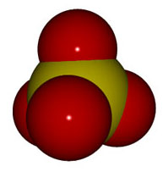
Sulfate and Alzheimer’s*
As in autism, Alzheimer’s patients have extremely low sulfate levels in the blood
Similar reduction to 20% of normal value
Serum cysteine/sulfate ratio:
Alzheimer’s 477
Parkinson’s 521
ALS 506
Controls 96
Cysteine levels were not significantly different
* Heafield et al., Neuroscience Letters 110:216-220, 1990

Slide 27
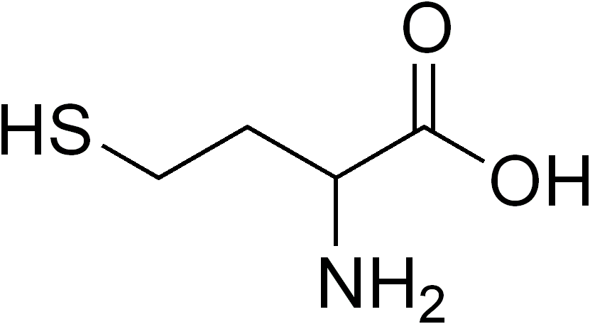
Elevated Homocysteine and Dementia*
40% increased risk to dementia with each 5μmol/l increment in serum homocysteine
Highest quartile had double the risk
Elevation in homocysteine preceded onset of dementia
Two other studies showed significant increase in homocysteine in Alzheimer’s patients compared to age-matched controls
*Seshadri et al., N Engl J Med 346:7, 476-483, Feb 14, 2002
Notes:
vitaminK/homocysteine_and_alzheimers.pdf

Slide 28
I explain this the same way I explain elevated homocysteine and cardiovascular disease: homocysteine is needed to produce sulfate in the artery wall, resulting in oxidative damage

Slide 29
Recapitulation
Sulfur deficiency in brain associated with dementia
Extremely low ratio of sulfatide to ceramide
Serum cysteine/sulfate ratio is abnormally high (5x normal) in Alzheimer’s, Parkinson’s and ALS
Elevated serum homocysteine in dementia
Due to need to produce sulfate in artery wall?

Slide 30
Aluminum

Slide 31
Aluminum in Autism and Alzheimer’s
Autism and Alzheimer's may be manifestations of the same problem
Flu shots increase risk to Alzheimer’s
Aluminum in dialysis fluid (kidney failure) causes dementia
Aluminum adjuvant is present in many vaccines
Sulfate is needed to safely eliminate aluminum from the body
Aluminum accumulation in brain causes many problems that could explain autism symptoms and Alzheimer’s symptoms

Slide 32
“Aluminum is not perceived, I believe, by the public as a dangerous metal. Therefore, we are in a much more comfortable wicket in terms of defending its presence in vaccines.” —Dr. John Clements, WHO vaccine advisor

Slide 33
Aluminum in Vaccines*
*from presentation by Dr. Christopher Shaw, in Workshop on Vaccine Safety: Evaluating the Science, Jamaica, Jan. 3-7, 2011.
Notes:
Slide 23 in Shaw_PPT.pdf
DTaP=Diphtheria, Tetanus, and acellular Persussis; HepA=Hepatitis A; HepB=Hepatitis B Hib=Haemophilus influenza type b; PCV=Pneumococcal; MenC=Meningococcal group C

Slide 35
Flu Shots and Alzheimer’s*
“According to Hugh Fudenberg, MD, the world's leading immunogeneticist and 13th most quoted biologist of our times: If an individual has had 5 consecutive flu shots between 1970 and 1980 (the years studied) his/her chances of getting Alzheimer's Disease is 10 times higher than if he/she had one, 2 or no shots. Dr. Fudenberg said it … was due to mercury and aluminum that is in every flu shot. The gradual mercury and aluminum buildup in the brain causes cognitive dysfunction”
* http://www.royalrife.com/flu_shots.html
Dr. Hugh Fudenberg, J. Clin. Invest, 2000 & 2004.

Slide 36
Aluminum in Vaccines: A Neurological Gamble*
In 1999, vaccine industry responded to autism parents’ concerns about mercury, but simultaneously began increasing aluminum exposure
* Neil Z. Miller, Thinktwice Global Vaccine Institute, www.thinktwice.com
Notes:
robert_davidson/Miller on Alum in vaccines.pdf
--> images/aluminum_in_vaccines.png

Slide 37
The Safety Trials are Rigged*
The industry has gotten by with putting aluminum into the so-called “placebo”
They can titrate it so that the vaccine has just enough extra adverse reactions to be believable
The placebo itself is unsafe
* Tomljenovic and Shaw, “Aluminum Vaccine Adjuvants: Are they Safe?” Current Medicinal Chemistry, 2011, 18, 2630-2637

Slide 38
The Amish are Protected*
“Several autism-free zones exist in the United States in what is otherwise a sea of childhood autism. Most prominent among these are Amish communities in Pennsylvania and Ohio where parents rarely vaccinate their children. The only exceptions were several vaccinated children that were adopted. [61]”
* http://vaccinationcouncil.org/2011/06/01/vaccines-and-brain-inflammation
Notes:
Robert_davidson/vaccinationcouncil.org-Vaccines_and_Brain_Inflammation__International_Medical_Council_on_Vaccination.pdf
Cancer/Sugar_neutrophils_infection.pdf
Robert_davidson/aluminum_vaccine_adjuvants_unsafe.pdf

Slide 39
Aluminum and Alzheimer’s Disease *
Aluminum is a neurotoxin that inhibits more than 200 biologically important functions
Aluminum has been associated with multiple diseases affecting the nervous system:
Dialysis encephalopathy
ALS (Lou Gehrig's disease)
Parkinsonism dementia in Guam
Alzheimer's disease
Aluminum may play crucial role as a cross-linker in amyloid beta oligomerization
* Kawahara and Kato-Negishi, International J. Alzheimer's Disease, Article ID 276393,2011
Notes:
vitaminK/aluminum_alzheimers_amyloid.pdf

Slide 40
Aluminum, Dialysis, and Dementia*
Patients with end-stage kidney disease
Aluminum in water in the dialysate
Leads to severe dementia
Occurs after three to five years of dialysis
Can be avoided by careful filtering of water supply
* Wills and Savory, Environmental Health Perspectives 63, 141-147, 1985

Slide 41
Aluminum Exposure and Memory, Depression*
25 symptomatic workers from the same aluminum smelting plant
22 (88%) reported frequent loss of balance
21 (84%) reported memory loss
21 (84%) showed physical signs of incoordination
19 were tested for depression on the Minnesota Multiphasic Personality Inventory
17 (89%) tested positive for depression
*White et al., Arch Intern Med. 152(7):1443-1448, 1992.

Slide 42
Studies with VAERS Database on Aluminum & Depression
VAERS: Vaccine Adverse Event Reporting System, maintained by CDC
Tabulate word frequencies for mentions of "depression" in adverse reactions to aluminum-containing vaccines versus non-aluminum-containing vaccines.
231 mentions in aluminum-containing vaccines versus 85 in age-matched controls
Highly significant result (p = 0.005)

Slide 43
Aluminum’s Many Effects in the Brain
Kawahara and Kato-Negishi, International J. Alzheimer’s Disease 2011, Article ID 276393
Notes:
http://www.hindawi.com/journals/ijad/2011/276393/cta/

Slide 44
A Role for Fluoride?*
Aluminum fluoride administered to rats in drinking water
Fluoride promotes uptake of aluminum in gut and crossing of blood brain barrier
Al-F administered rats developed copper-colored skin and sparse fur
They were unhealthy and many died
Striking brain abnormalities were detected
Aluminum was clearly present in the brain
* J.A. Varner et al., Brain Research 784:284-298, 1998.
Notes:
vitaminK/aluminum_fluoride_effects_on_rat_brain.pdf

Slide 45
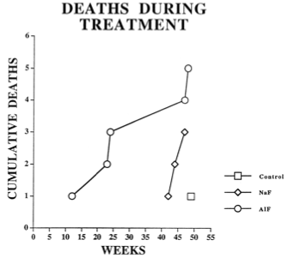
Control
Sodium fluoride
Aluminum fluoride

Slide 46
Recapitulation
Strong evidence exists for an association between aluminum exposure and:
Alzheimer’s/dementia
Autism
Depression
Aluminum is highly toxic and has well-known adverse effects in multiple areas of brain function
These effects are enhanced by fluoride

Slide 47
Infection

Slide 48
Alzheimer’s and Infection
Chronic Inflammation and Amyloidogenesis in Alzheimer's Disease: The Emerging Role of Infection:
Ten review articles by experts in the field on this subject in a Special Issue of the Journal of Alzheimer’s Disease (2008)

Slide 49
Special Issue Devoted to Alzheimer's and Infection: Key Points
Pathogens can produce progressive chronic diseases like Alzheimer’s, asthma, and heart disease
Alzheimer himself proposed involvement of infective agents in Alzheimer's 100 years ago
Pathogens stimulate inflammation
Pathogens evade host defenses and establish chronic latent infections
Persistent superoxide, nitric oxide and peroxynitrite (ROS) cause DNA damage and apoptosis and alter gene expression
Environmental toxins and poor nutrition weaken immune system and provide opportunity to bacteria and viruses

Slide 50
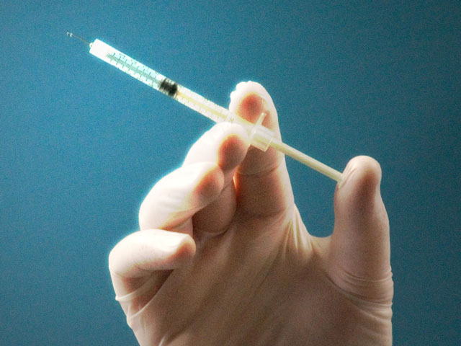
Amyloid Beta Immunization Trials*
Phase II trials: immunize Alzheimer’s patients against amyloid beta
Trial halted early due to increased risk to meningoencephalitis
Addition of Tween 80 (polysorbate 80) in phase II suspected to increase risk
* Gilman et al., Neurology 64, 1553-1562, 2005.
Notes:
vitaminK/Abeta_clinical_trial_failed.pdf

Slide 51
Amyloid Plaque Structure, and a Theory
Microglia and amyloid plaque accumulate side-by-side in a central region surrounded by astrocytes
Microglia harbor dormant bacteria
Should the bacteria leave, they will encounter the plaque, which will kill them
The astrocytes guard the gates and shield the neurons from the damaging plaque
Microphotograph from Schwab et al., Journal of Alzheimer’s Disease 13 359–369, 2008.
Notes:
Picture from alzhiemers_inflammation_2008.pdf

Slide 52
Immune Dysfunction in Autism*
Autistic children often demonstrate an inappropriate or ineffective immune response to pathogen challenge
Products of immune activation such as cytokines may be responsible for many common features of autism, such as mood and sleep disturbances.
Studies with mice on maternal influenza virus infection at mid-gestation resulted in autistic-like behaviors in offspring
* Ashwood et al., Journal of Leukocyte Biology 80: 1-15, Jul 2006.
Notes:
vitaminK/immune_dysfunction_autism.pdf

Slide 53
A Remarkable Case Example*
A girl, completely normal until age 14
She became ill with fever and slight headache
One week later she developed severe headache and seizures
Over the next month or two she developed classic symptoms of autism
She never recovered
* http://neuroskeptic.blogspot.com/2010/11/autism-following-viral-infection.html
Gilberg, Journal of Autism and Developmental Disorders 16:3, 369-375, 1986
Notes:
vitaminK/case_study_autism_14years.pdf
http://neuroskeptic.blogspot.com/2010/11/autism-following-viral-infection.html
Gillberg, C. (1986). Brief report: Onset at age 14 of a typical autistic syndrome. A case report of a girl with herpes simplex encephalitis Journal of Autism and Developmental Disorders, 16 (3), 369-375 DOI: 10.1007/BF01531665

Slide 54
Immune System and Depression*
Major depression is associated with an increased production of pro-inflammatory cytokines, such as interleukin 1(IL-1), IL-6 and interferon γ (IFN-γ)
Antidepressant therapy does not correct this problem
* M. Maesa et al., Cytokine 9:11 853-858, Nov 1997
Notes:
vitaminK/depression_il-6.text

Slide 55
Recapitulation
Impaired immunity is associated with dementia, autism, and depression
Alzheimer’s plaque can be viewed as shielded region where pathogens are trapped and destroyed
A case study showed autism can develop in a 14-year old child post-infection
Excess production of inflammatory cytokines is a common feature of these diseases

Slide 56
Mitochondrial Dysfunction

Slide 57
Energy Metabolism in the Cell
Many proteins in the mitochondria are susceptible to oxidative damage
MITOCHONDRION
From http://hdl.handle.net/10603/2611
Notes:
vitaminK/energy_metabolism_in_cells_THESIS_chapter1.pdf
http://ir.inflibnet.ac.in:8080/jspui/handle/10603/2611
Chapter 1 figure 1.1
Figure 1.1: Energy metabolism in eukaryotic cells. Oxidation of nutrients in the cytosol and in the mitochondria leads to adenosine triphosphate (ATP) synthesis by the oxidative phorphorylation system. The ATP generated by this process is then used to drive biosynthetic reactions and other processes in the cell that require energy.

Slide 58
Autism and Mitochondrial Dysfunction*
Autism patients have an increased incidence of impaired mitochondrial function
I propose this is due to the same mechanisms that lead to Alzheimer’s disease
Excess synthesis of nitric oxide in artery wall causes damage to mitochondria over time
* Weissman et al., “Mitochondrial Disease in Autism Spectrum Disorder Patients:
A Cohort Analysis,” PLoS ONE 3:11, e3815, 1-6, 2008.
Notes:
vitaminK/mitochondrial_disease_autism.pdf

Slide 59
Hannah Poling and Mitochondria*
Received 5 vaccines at age of 19 months
DTaP, Hib-titer, MMR, varicella, polio
Two days later, lethargic, irritable, febrile
Ten days later developed chicken pox [vaccine-induced].
Delays in neurologic and psychological development ensued
Months later, diagnosed with encephalopathy caused by mitochondrial enzyme deficit.
Her family successfully sued Department of Health and Human Services and received $1.5 Million compensation under the Vaccine Injury Compensation Program (VICP).
* M.D. Offit, N Engl J Med 358:2089-209, May 15, 2008.
Notes:
M.D. Offit, N Engl J Med 358:2089-209, May 15, 2008. – he defends industry in this article.
http://www.nejm.org/doi/full/10.1056/NEJMp0802904

Slide 60
Depression and Mitochondrial Dysfunction*
Depressed patients often complain of other symptoms such as fatigue, impaired memory, and anxiety
“Somatization” is a term used to dismiss these symptoms
In the study, depressed patients exhibited:
Significantly lower ATP production and respiratory chain enzyme ratios
Clear evidence of mitochondrial DNA damage
* Ann Gardner, "Mitochondrial dysfunction and alterations of brain HMPAO SPECT in
depressive disorder - perspectives on origins of somatization,"
PhD Thesis, Karolinska Institutet at Karolinska University Hospital in
Huddinge,Neurotec Institution, Division of Psychiatry, Stockholm, Sweden.
Notes:
vitaminK/mitochondrial_dysfunction_depression.pdf

Slide 61
A Simple Theory
Cholesterol-sulfate depletion in the skin and blood leads to huge increase in microbial burden
Depletion aggravated by cumulative toxic metal exposures
Results in increased susceptibility to disease
Immune system responds by producing excess of ROS such as nitric oxide and hypochlorite
Chronic exposure to ROS leads to mitochondrial damage to neurons
Impairment eventually manifested as neurological disease

Slide 62
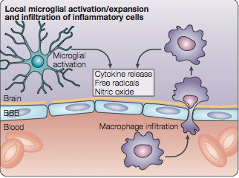
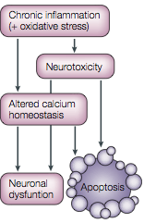
Common Underlying Pathology*
NITRIC OXIDE
CALCIUM
Applies to autism, Alzheimer’s disease, Parkinson’s disease, ALS, depression and seizures,
as well as lysosomal storage disorders (rare genetic diseases)
* Jeyakumar et al., Nature Reviews:Neuroscience 6, Sep. 2005.
Notes:
vitaminK/lysosomal_disorders_brain.pdf
Figure 2 | Neuroinflammation — the point of convergence for distinct neurodegenerative disorders. Chronic microglial activation and macrophage infiltration are prominent features in the CNS of patients and mouse models with the gangliosidoses and non-lysosomal storage disorders — namely, Alzheimer’s disease, Parkinson’s disease, amyotrophic lateral sclerosis, Huntington’s disease and prion diseases (see also BOX 3). Activated resident microglial cells and recruited macrophages that cross the blood–brain barrier (BBB) generate oxygen-free radicals, nitric oxide and other potentially toxic products, such as cytokines. This leads to chronic inflammation, which is accompanied by oxidative stress — a process that parallels disease progression in animal models of both lysosomal storage disorders and more common neurodegenerative diseases. Although these diseases have distinct pathogenic causes that lead to microglial activation, the mechanisms that contribute to neurodegenerative processes, such as neuronal dysfunction and apoptosis, are not exclusive to each disorder; for example, altered calcium homeostasis is another common feature of many lysosomal storage disorders and more common neurodegenerative diseases.

Slide 63
Reactive Oxygen and Nitrogen Species Cause Oxidative Damage
Peroxynitrite: ONOO⁻
These can kill microbes, but they can also harm the host cells over time
Nitric Oxide: NO
Superoxide: O₂⁻
Hypochorite: ClO⁻
Hydroxyl radical: OH.
Hydrogen Peroxide: H₂O₂

Slide 64
Diffusion Rates of Various Ionizing Gases*
* From Pacher et al., Physiol Rev 87: 315–424, 2007.
Notes:
From vitaminK/NO_review_LONG.pdf

Slide 65
Alzheimer’s and Adiponectin*
Elevated serum adiponectin level was associated with an increased risk of dementia and AD in women
Adiponectin increases insulin sensitivity and suppresses inflammation
Insulin resistance and inflammation are hallmarks of Alzheimer’s disease
WHAT is going ON?
* Himbergen et al., Arch Neurol. 2012. Published online Jan 2, 2012.
Notes:
Csail/2011/Tufts/Tufts_adiponectin.email

Slide 66
Mitochondrial Uncoupling Protein: Stimulated by Adiponectin
Dissipates the proton gradient before it can be used to provide the energy for oxidative phosphorylation
Notes:
Goes with adiponectin slide.
See WIKI: adiponectin → uncoupling proteins.
vitaminK/adiponectin_effect_on_mice_brain.pdf → excite UCP1 → thermal energy loss → protect from mitochondrial damage???

Slide 67
Oxidative Phosphorylation is Derailed in Alzheimer’s Disease!!
Mitochondrial Complex I is impaired, so glucose can’t be metabolized
Skip Complex I and then insulin sensitivity can be restored!!
Problems:
Generate heat
Lose ATP (energy)

Slide 68
Complex I
ATP

Slide 69
Some Iron-Sulfur Clusters*
Iron sulfur clusters are highly susceptible to oxidative damage!
* From “Nitric Oxide cytotoxicity and Functions of Iron-Sulfur Enzymes in Escherichia Coli”
Ph.D. Thesis, B. Ren, Louisiana State University, Aug 2009.
Notes:
vitaminK/nitric_oxide_bacteria_iron_sulfur_clusters_thesis_2009.pdf

Slide 70
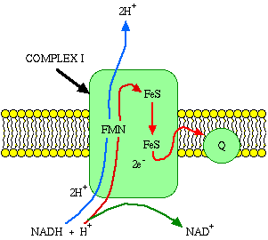
Learning from Plants!*
Mitochondrial energy-dissipating system
Generate heat instead of ATP at Complex I
Plant Uncoupling Mitochondrial Protein is activated by reactive oxygen species
*Vercesi et al., Annu. Rev. Plant Biol. 57:383–404, 2006.
Notes:
vitaminK/plant_uncoupling_systems_mitochondria.pdf

Slide 71
Defective electron transport chain generates more ROS in vicious cycle!
From http://hdl.handle.net/10603/2611
Notes:
vitaminK/energy_metabolism_in_cells_THESIS_chapter1.pdf
Figure 1.4: A schematic representation of ROS generation through respiratory chain and other sources, its consequences upon cell function. A fraction of oxygen is incompletely reduced by oneelectron-transfer to generate ROS and organic free radicals, which are disposed by coordinated action of antioxidant enzymes. If ROS escapes the antioxidant defense, they may cause oxidative damage and mutate the mtDNA. This may finally result in defective electron transport chain (ETC). The defective ETC not only works less efficiently in ATP synthesis but also generates more ROS, which will further enhance the oxidative damage to various biomolecules in mitochondria or the whole cell.

Slide 72
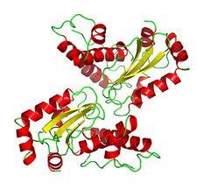
Down Syndrome and Hydrogen Peroxide *
Down syndrome associated with over-expression of superoxide dismutase (generates H₂O₂)
This enzyme resides on chromosome 21
Extra copy characteristic of Downs
Many consequences:
Reduced physical work capacity
Obesity
Reduced sympathetic response
Increased oxidative stress and free radicals
Premature aging
Early onset of cataracts and Alzheimer’s disease
* Fernhall and Otterstetter, J Appl Physiol 94: 2158–2165, 2003
Notes:
vitaminK/Downs_sympathetic_response_defect.pdf

Slide 73
eNOS in Down Syndrome Placenta*
Normal
Down
eNOS synthesis was reduced in amniotic fluid of Downs infants
eNOS was concentrated around the nucleus of cells
Nitric oxide production was enhanced
* Salvolini et al. Europ J Clin Invest 41:1, 23-29, 2011.
Notes:
vitaminK/VEGF_NO_amniotic_fluid_Downs.pdf

Slide 74
Sulfate production is impaired!
eNOS in Down Syndrome placenta cells is not attached to the membrane

Slide 75
Recapitulation
Mitochondrial dysfunction is a common pathology in autism, depression and Alzheimer’s disease
Caused by excessive generation of reactive species like peroxynitrite and hydrogen peroxide
Feedback loop accelerates downward spiral
Important contribution is excess pathogen exposure
Adiponectin helps rescue cells by allowing bypass of mitochondrial complex I

Slide 76
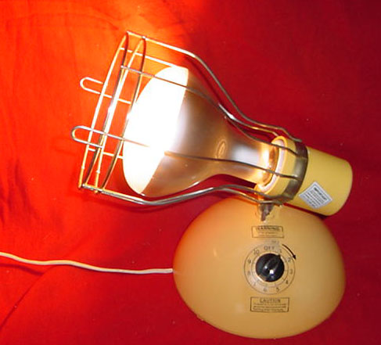
Treatment!

Slide 77
Summary
Autism, Alzheimer’s and depression have much in common
All could be caused by insufficient cholesterol sulfate synthesis in the skin
Inability to detoxify aluminum and mercury
Increased susceptibility to infections
Increased generation of reactive oxygen species
Damage to mitochondria
Ultimate consequence is impaired neuron functioning in the brain

Slide 78
Thank you!

