Slide 1
Let the Sun Shine In!!
Wise Traditions London
March 17, 2012
Stephanie Seneff
MIT

Slide 2
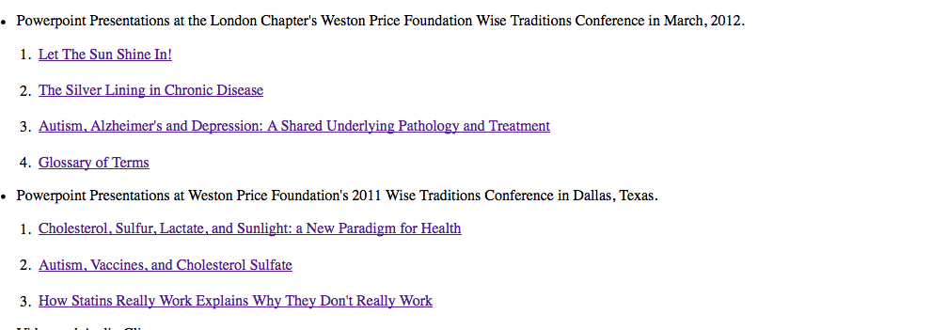
You can Download My Slides! http://people.csail.mit.edu/seneff

Slide 3
The only reason to worry about inadequate sun exposure is the possibility of a vitamin D deficiency.
This can be corrected by taking a vitamin D supplement.
RIGHT??
WRONG!!

Slide 4
A Radical Theory
Our bodies need sun exposure to produce cholesterol sulfate, which provides cholesterol and sulfate to all the tissues of the body

Slide 5
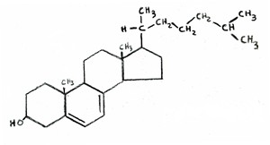
Cholesterol and Vitamin D3
Cholesterol
Vitamin D3
Cholesterol and Vitamin D3 are nearly identical in chemical structure
Vitamin D3 is synthesized from cholesterol in the skin upon exposure to sunlight
Both molecules are sulfated!

Slide 6
Cholesterol and Cholesterol Sulfate
Sulfation makes cholesterol water-soluble and therefore much easier to transport
SULFATE
Notes:
From cholesterol_sulfate_agile.pdf – this was the original article on that topic.

Slide 7
How to Stay Healthy
Plenty of dietary sulfur
Plenty of dietary cholesterol
Plenty of sun exposure

Slide 8
Outline
The importance of cholesterol and sulfate to health
The many roles of cholesterol sulfate
Endothelial Nitric Oxide Synthase (eNOS)
Oxygen management
Are sunscreens doing more Bad than Good?
What to do if you live in the U.K.

Slide 9
The Importance of Cholesterol and Sulfate to Health

Slide 10
Think about Sulfate!
Cells in the skin produce vitamin D3 sulfate upon exposure to the sun
The precursor to vitamin D3 is cholesterol
Cells also produce an abundance of cholesterol sulfate
I believe this is the more important molecule!
Many of the alleged benefits of vitamin D3 are actually benefits of cholesterol sulfate
Protection against cancer, diabetes and cardiovascular disease; improved immune function

Slide 11
A Novel Proposal
Cholesterol sulfate, produced in the skin, supplies oxygen, sulfur, cholesterol, energy and negative charge to the tissues
Sulfate is synthesized from sulfide in the skin and blood stream utilizing the energy in sunlight
Protects from UV damage and keeps microbes out
Sunscreen interferes with this process
The skin is a solar powered battery!

Slide 12
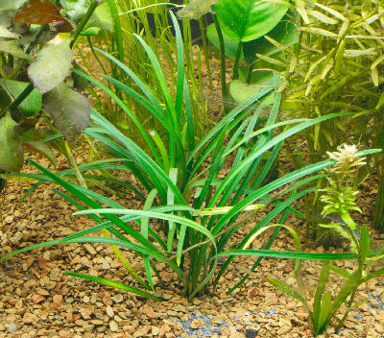
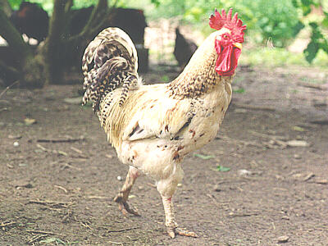
Cholesterol is Essential for Mobility and a Nervous System
Plants contain no cholesterol
Plants can’t move
Plants don’t have a nervous system
In a sense, cholesterol is to animals as chlorophyll is to plants

Slide 13
Cholesterol is a Miracle Worker
In the brain:
Synapse: promotes cell-cell communication
Myelin sheath: insulates channel from signal loss
In the membranes of all cells
Prevents ion leaks
Protects from pathogens (microbes)
In the plasma lipoprotein (LDL, HDL)
Essential for protecting contents from oxidation damage and pathogens during transport to cells
Precursor to vital hormones
Vitamin D
All the sex hormones (testosterone, estrogen, etc.)
Cortisone: the stress hormone
Aids in digestion of fats

Slide 14
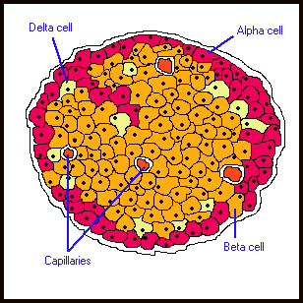
Cholesterol is Essential for Insulin Release *
Experiment with pancreatic beta cells
Expose them to toxin that impairs cholesterol synthesis
Cells secrete significantly less insulin in response to glucose challenge
This is one Reason Why Statin Drugs Increase Risk to Diabetes
* Xia et al., Endocrinology 149:10, 5136-5145, 2008.
Notes:
vitaminK/cholesterol_impacts_pancreas_insulin_release.pdf

Slide 15
Sulfate is Vastly Underappreciated!
Sulfate is the 4th most abundant anion in the blood and protects it from coagulating
Detoxifies drugs, food additives, and environmental toxins like aluminum and mercury
Essential component of extracellular matrix proteins throughout the tissues
Cerebroside sulfate is a major constituent of meylin sheaths surrounding axons in neurons

Slide 16
Lack of Sunlight May Raise Stroke Risk*
Strokes are caused by blood instability: clots and hemorrhages
Is this due to insufficient sulfate in blood?
Study involved 16,500 people
Tracked the history of where they had lived
Looked at weather statistics for those places
Found 60% increased risk to stroke for lowest sun exposure (relationship with both latitude and weather patterns)
*A. Mozes, HealthDay, RSS Feed, Feb 2, 2012.
Notes:
./sunlight_stroke_healthday.text
6,500

Slide 17
Sulfated Glycosaminoglycans (GAGs)
Prominent in extracellular matrix of all cells
Amount of sulfate depends on availability
Crucial for maintaining negative charge and protecting from infection
These are also known as “mucopolysaccharides”
http://www.science-autism.org/sulphate.htm

Slide 18
Ten Positive Effects of Mucopolysaccharides *
A lipid-clearing effect in the blood.
Stimulation of cellular metabolism.
Efficient metabolism of fatty acids.
Increase in RNA and DNA synthesis of cells.
Increase in growth, size and quantity of normal cells.
Anti-atherosclerosis, anti-atherogenic activities.
Anti-inflammatory effect.
Anti-thrombogenic and anti-coagulant activity.
Increases the number of coronary artery branches and collateral circulation in experimental atherosclerosis.
Accelerates healing, regeneration and repair of cardiovascular tissue
Many of these effects can be explained by the fact that they supply sulfate
* http://www.vitaflex.com/res_csaa.php
Notes:
./mucopolysaccharides.pdf

Slide 19
Recapitulation
Cholesterol is a key distinguishing molecule for animals, and without it they would die
Precursor to many hormones & vitamin D3
Keeps cell membranes healthy
Crucial role in brain
Immune functions
Sulfate is found in large amounts surrounding all cells
Maintains blood stability
Keeps microbes in check
Detoxifies poisons
Protects axons in neurons

Slide 20
The Many Roles of Cholesterol Sulfate

Slide 21
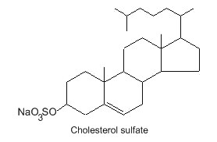
Cholesterol Sulfate: What’s It All About?*
Omnipresent in blood serum in small amounts
Collects around exterior of red blood cells (RBCs) and gives them a negative charge field
Keeps cells from sticking together or sticking to capillary walls
Prevents RBCs from falling apart
Can travel freely in blood and readily migrates from one cell to another
* Strott, J. Lipid Res. 44, 2003

Slide 22
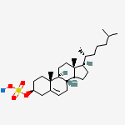
Cholesterol Sulfate Synthesis in the Skin
Keratinocytes synthesize abundant cholesterol sulfate once they mature
This synthesis takes place in the outer layer of the epidermis
Cholesterol sulfate catalyzes synthesis of profilaggrin, one of the two key proteins forming the cross-linked mesh that protects from bacterial invasion and prevents water loss

Slide 23
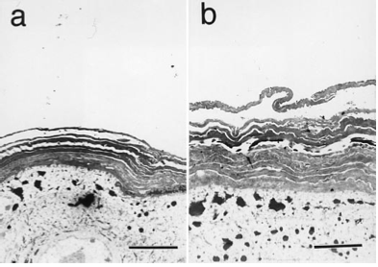
Cholesterol Sulfate Thickens Outer Layer of Skin*
Untreated mice
Mice treated for three days with topical cholesterol sulfate
* Sato et al. J. Invest. Dermatol. 111:2, 189-193, 1998.
Notes:
vitaminK/cholesterol_sulfate_inhibits_trypsin.pdf

Slide 24
Keratinocytes Require Air Exposure*
Submerged
Exposed to Air
Something in the air is needed to allow the cells to grow and mature
* Asselineau et al., Exp Cell Res 159, 536-539, 1985.
Notes:
vitaminK/keratinocytes_mature_in_air_exposure.pdf

Slide 25
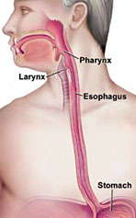
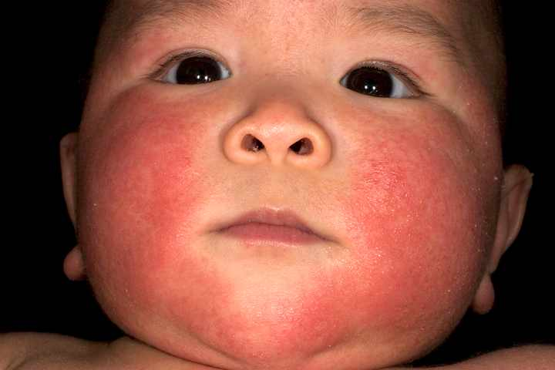
Filaggrin Plays a Crucial Role
Loss of filaggrin function associated with
Increased skin permeability
Susceptibility to eczema and asthma
Eosinophilic Esophagitis: (EoE)*
* Schroeder et al., Expert Rev clin Immunol. 6:6, 929-937, 2010.
Notes:
vitaminK/eosinophilic_esophagitis.text
http://www.medscape.com/viewarticle/731955_3
Eczema = atopic dermatitis

Slide 26
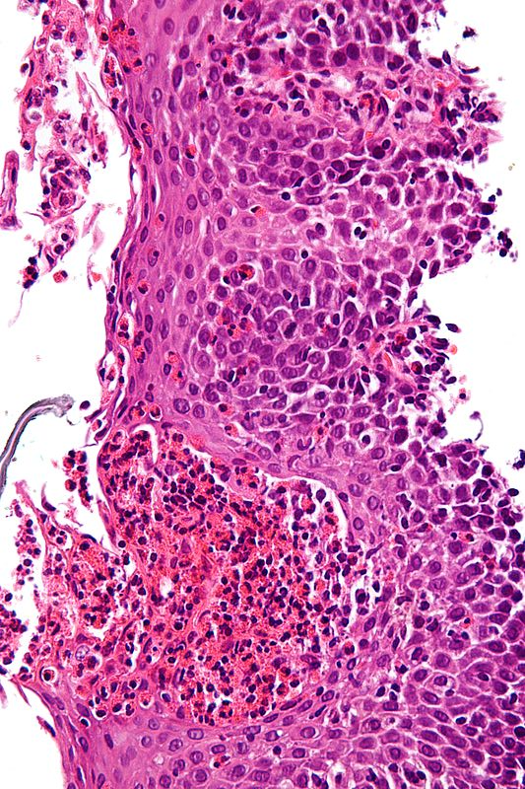
More on EoE*
Allergic inflammatory condition of the esophagus
Eosinophils invade esophagus
Release toxins that kill viruses and induce tissue damage
Person has difficulty swallowing
Eats very slowly
Food gets stuck in the throat
* Schroeder et al., Expert Rev clin Immunol. 6:6, 929-937, 2010.
Notes:
Characteristic features are present:
Abundant eosinophils - criteria vary; one common definition is: > 20 eosinophils/0.24 mm².
Papillae are elongated; papillae reach into the top 1/3 of the epithelial layer.
Basal cell hyperplasia; > 3 cells thick or >15% of epithelial thickness.
Spongiosis.

Slide 27
Cholesterol Sulfate in the Lungs*
Bronchial tubes produce cholesterol sulfate in the epithelial cells as they mature and form the outer layer of the bronchial epithelium
* Rearick et al., J. Cell. Physiol. 133:3, 573-578, Dec. 1987.
Notes:
vitaminK/lungs_bronchial_epithelium_cholesterol_sulfate.text

Slide 28
Sulfated Glycosaminoglycans (GAGs)
Prominent in extracellular matrix of all cells
Amount of sulfate depends on availability
Crucial for maintaining negative charge and protecting from infection
I propose that cholesterol sulfate is a major supplier of sulfate to these GAGs
http://www.science-autism.org/sulphate.htm

Slide 29
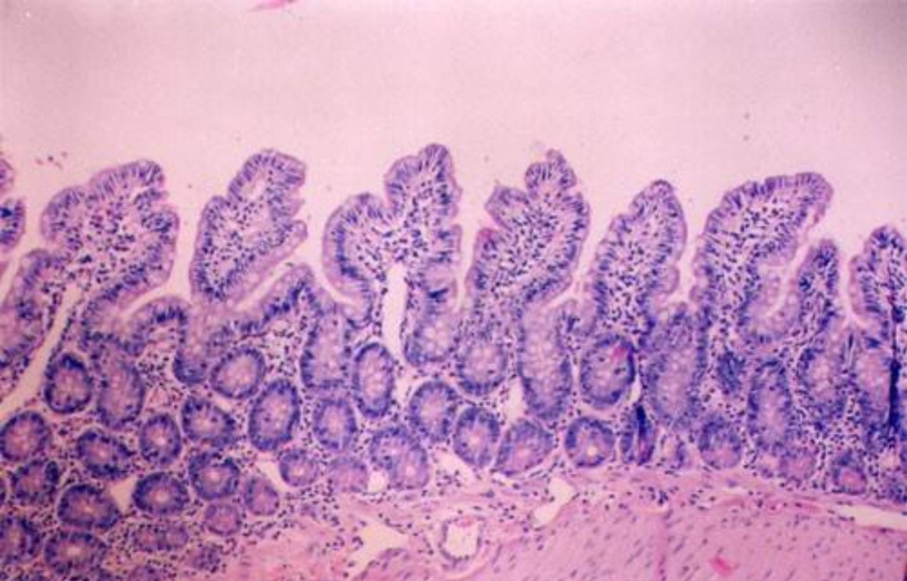
Cholesterol Sulfate and Trypsin *
Trypsin is an enzyme released by the pancreas, which digests proteins
Too much trypsin leads to breakdown of collagen glue that maintains structural integrity of intestinal mucosa (GAGs)
Cholesterol sulfate suppresses trypsin synthesis (protects mucosa from breakdown)
* Ito et al, J. Biochem. 123, 107-114, 1998.
Notes:
vitaminK/cholesterol_sulfate_inhibits_pancreatic_enzymes.pdf

Slide 30
Cholesterol Sulfate Inhibits Trypsin *
* Sato et al., J. Investigative Dermatology, 11:2, 189-193, Aug 1998
Notes:
vitaminK/cholesterol_sulfate_inhibits_trypsin.pdf

Slide 31
Trypsin and Cell Culture
Trypsin is used in cell culture dishes to keep cells from sticking to the sides and bottom of the dish
Cells must only be in contact with trypsin for < 1 minute: otherwise trypsin may damage the cells

Slide 32
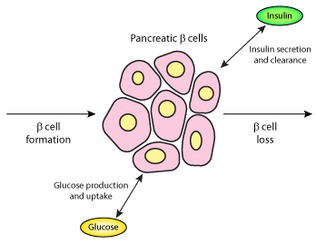
Heparan Sulfate in Pancreas *
Beta cells in pancreas produce insulin
They also produce an abundance of heparan sulfate
In type I diabetes, inflammatory cells break down basement membrane and penetrate pancreatic islets
These inflammatory cells produce heparanase, which destroys heparan sulfate
This leads to cell death of beta cells and diabetes
Inflammatory cells
Heparan Sulfate is Essential to Proper Function of Beta Cells and Insulin Production
Heparan sulfate
Insulin
* Ziolkowski et al., J Clin Invest. 122(1): 132–141, Jan 2012.
Notes:
vitaminK/heparan_sulfate_diabetes.pdf

Slide 33
Recapitulation
Cholesterol sulfate plays many important roles in the body: skin, blood, esophagus, lungs, and pancreas
Cholesterol sulfate in the skin and lungs keeps bacteria out and water in
Cholesterol sulfate protects collagen from breakdown by trypsin
Heparan sulfate protects pancreas during insulin synthesis

Slide 34
Endothelial Nitric Oxide Synthase
(eNOS)

Slide 35
eNOS!!
Endothelial nitric oxide synthase (eNOS) is a very interesting molecule
It’s known for its role in synthesizing nitric oxide (NO) from L-Arginine
But I think it has a much more important role as well, which is its primary role:
To synthesize sulfate from sulfur in the presence of sunlight
N → NO → NO₃⁻²
S → SO₂ → SO₄⁻²

Slide 36
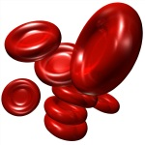
Where is eNOS Found? What does it do?
In keratinocytes in the skin
In the endothelial cells lining the artery walls
In several cell types in the blood:
red blood cells, platelets, mast cells
eNOS synthesizes nitric oxide from L-Arginine
It makes no sense for a red blood cell to synthesize nitric oxide!!

Slide 37
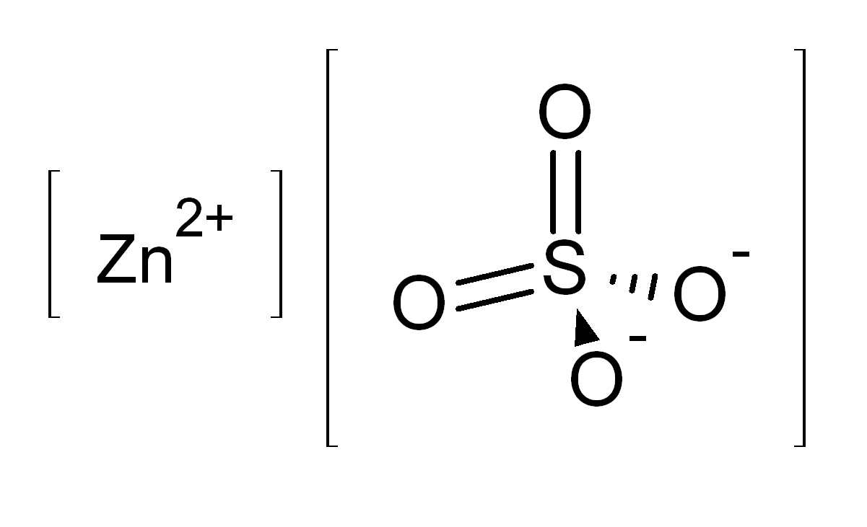
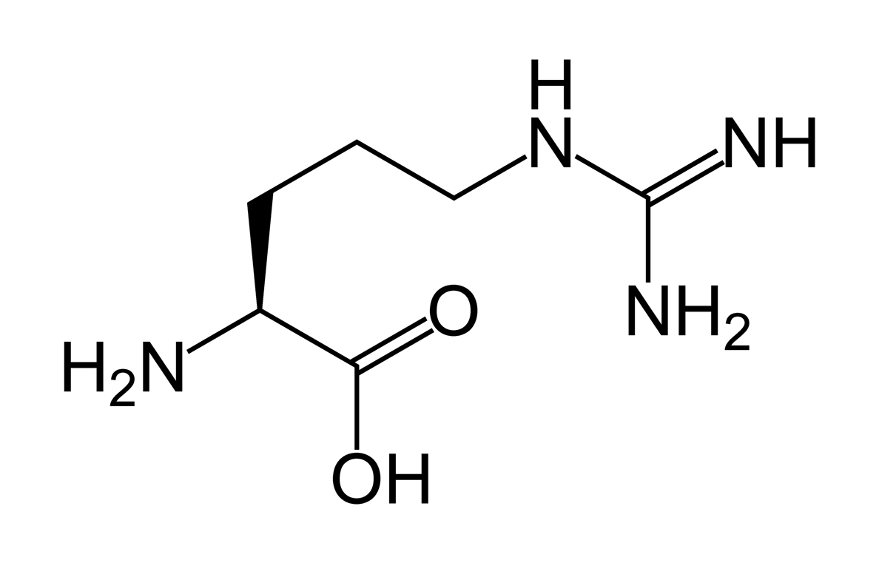
Hemoglobin binds strongly to nitric oxide: this neutralizes the effect of both of them!
The red blood cell keeps the substrate for nitric oxide synthesis out:
I hypothesize that it uses eNOS to make sulfate instead !
L-ARGININE
eNOS

Slide 38
eNOS and Caveolae*
eNOS switches to nitrate synthesis after calcium enters the cell.
Calcium enters the cell once its membrane is depleted in cholesterol.
sulfate
* Michel and Feron, J. Clin. Invest. 100(9) 2146-2152, 1997
Notes:
Cancer/NOS_review.pdf
Michel (Series Editor) and Olivier Feron
J. Clin. Invest. © The American Society for Clinical Investigation, Inc. 0021-9738/97/11/2146/07 $2.00 Volume 100, Number 9, November 1997, 2146–2152 http://www.jci.org
Michel and Feron, J. Clin. Invest. 100(9) 2146-2152, 1997
Palmitoylation contributes to membrane association.

Slide 39
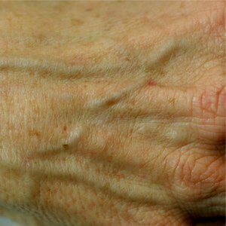
Sunlight, eNOS, and Sulfate
RBC’s, platelets and keratinocytes produce abundant cholesterol sulfate
They are all exposed to sunlight at the surface of the skin
They all contain eNOS
They all need sulfate
Endothelial cells line the blood vessel wall
They are decorated with an abundant supply of heparan sulfate and other sulfated GAGs

Slide 40
eNOS with and without L-Arginine
If either L-Arginine substrate or BH₄ cofactor is reduced, eNOS synthesizes O₂⁻ (superoxide) instead of NO
O₂⁻ and NO combine to make OONO⁻ , (“Oh NO!”) a potent oxidizing agent
Katusic, Am J Physiol Heart Circ Physiol 281:H981-H986, 2001.
Notes:
Sulfur/tetrahydrobiopterin/tetrahydrobiopterin_endothelial_dysfunction.pdf

Slide 41
Where does the Sulfur Come From?
It can come directly from hydrogen sulfide or sulfur dioxide gas in the air!
This means a major nutrient can be supplied through the skin!
Reaction is catalyzed by vitamin B12 (Cobalamin) and glutathione
Vitamin B12 fits into eNOS cavity
Vitamin B12 binds to glutathione
Glutathione can carry an extra sulfur atom in transit: GSSH
Glutathione S-transferase binds to eNOS

Slide 42
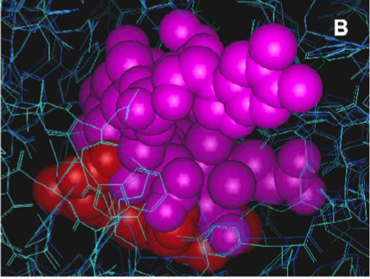
Cobalamin can Fit into nNOS Heme Pocket*
Purple: Cobalamin
Red: Heme pocket of nNOS
* Weinberg et al., Free Radic Biol Med. 46(12): 1626–1632, 2009
Notes:
vitaminK/cobalamin_NOS_interaction_Ann.pdf
Docking of the “base-off” form of cobalamin (as in Figure 5A) in the heme pockets of NOS2 (dark blue) and NOS1 (cyan), illustrating the extent of the ligand-binding cavity relative to the size of cobalamin. Heme is shown in red and cobalamin in purple. The very large substrate-binding pocket accommodates surprisingly large ligands, including porphyrins (similar in size and shape to the corrin shown here). The insertion of cobalamin into the heme pocket is ultimately limited by a beta sheet near V567 (NOS1). The configuration shown generates a 0.4Angstrom clash with the valine side chain in the crystal structure from PDB P_1ZVL, and represents the approximate limit of insertion of cobalamin, assuming slight rearrangements in the backbone are possible. A similar configuration with approximately 80% overlap of the corrin and heme can be obtained without backbone or unrelaxable side chain clashes. Slight torsioning of some active site residue side chains and repositioning of the DMBzI moiety of the cobalamin (visible as rings in solid rendering at the upper right) was necessary. The aromatic side chains visible at the bottom of the figure at the edge of the access channel are W306 and Y706 in NOS1.

Slide 43
How It Works
FAD, FMN: flavins (respond to sunlight by emitting electrons)
Fe = Iron in the heme group
Zinc in the cavity
between the two
eNOS molecules
draws in sulfur
atom and attracts ionized oxygen → SO₄⁻²
e⁻
In cells in the skin, endothelial cells lining the artery walls, red blood cells, platelets and mast cells
e⁻
Superoxide
Fe
BH₄
e⁻
FMN
FAD
Zinc
e⁻
S
FAD
FMN
Fe
BH₄
Superoxide
S + 2O₂⁻
SO₄⁻²

Slide 44
Recapitulation
eNOS is a much-studied molecule, but I propose that its main role has been overlooked
eNOS is found in cell types that have ample opportunity to receive sunlight and ample need for sulfate
I have proposed a mechanism for sulfate synthesis by eNOS catalyzed by sunlight
eNOS in red blood cells makes absolutely no sense, unless it is producing sulfate instead of nitric oxide

Slide 45
Oxygen Management

Slide 46
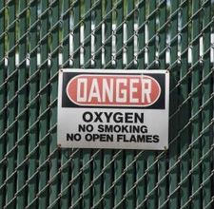
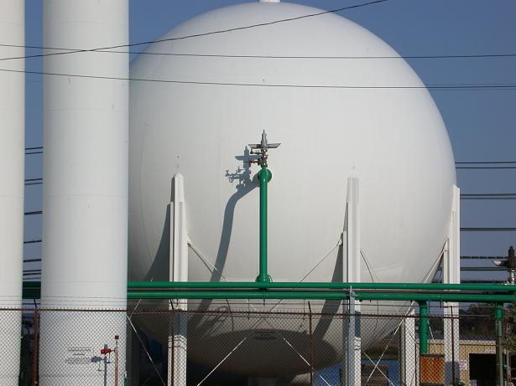
Oxygen is both
essential to life
and highly toxic
Notes:
Got a hot date and forgot to light the barby? No Worries mate, 3-5 gallons of liquid oxygen is guaranteed to have a perfect fire in 3 seconds!
Photo credit: http://www.doeblitz.net/ghg/

Slide 47
Analogy: A Brick Oven
Sunlight promotes sulfate synthesis in the skin,
fixating oxygen in the sulfate molecule inside caveolae, a protected environment
Sunlight-based Oxygen Management

Slide 48
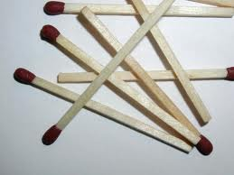
Or a Messy Office with Matches
Nitric oxide produced in endothelium fixates oxygen in nitrate molecule
Inflammation-based Oxygen Management

Slide 49
Result: House Burns Down

Slide 50
Effect of Cholesterol on Ion Leaks*
Consume Energy
Cell walls typically contain 50 mole percent cholesterol
Gives up!
Activity of Na+/K+ pump
Mole Percent Cholesterol
As membrane cholesterol is depleted, Na⁺/K⁺ pump must consume more ATP to keep K⁺ ions inside and Na⁺ ions outside
* T.H. Haines, Progress in Lipid Research 40:299–324, 2001.
Notes:
Cancer/haines_sodium_leaks.pdf

Slide 51
When a cell is deprived of cholesterol, it faces two tough choices:
Reduce the number of caveolae
Allow more ion leaks
This leads to insulin resistance (fewer caveolae) and excess ROS (more energy requirements)
Potassium
Sodium

Slide 52
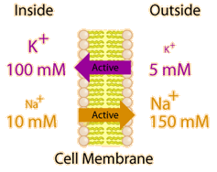
When cholesterol is depleted ….
Membrane starts leaking sodium and potassium
Cell wastes a lot of energy pumping them back
Eventually, it gives up, replacing potassium with calcium
It has to replace sulfate with nitrate at the same time
Here’s why……

Slide 53
Hofmeister Series*.**
"as important to protein chemistry as Mendel was to genetics.”
Anions: SO₄²⁻ > HPO₄² ⁻> CH₃CO₂⁻ > Cl⁻ > NO₃⁻
Cations: Al³⁺ > Mg²⁺ > Ca⁺ > Na⁺ > K⁺ > NH₄⁺
Kosmotropes
Chaotropes
Can’t pair “like” with “like” because they will form a tight bond and precipitate out
Kosmotrope: Make proteins less water soluble
Chaotrope:
Make proteins more water soluble
*http://www.lsbu.ac.uk/water/hofmeist.html
**http://www.lbl.gov/Science-Articles/Archive/CSD-protein-clues.html
Notes:
Taiwan
http://www.lbl.gov/Science-Articles/Archive/CSD-protein-clues.html
Carboxylates are kosmotropes
CH3CO2- = acetate
CH3COHCOOH = Lactic acid
http://www.lsbu.ac.uk/water/hofmeist.html
./chaotropic_protein_interactions_HARD.pdf
To circumvent these problems, we have investigated the use of
chaotropic salts (i.e. salts whose anions favor the transfer of apolar
groups to water (5)) for dissociating proteins.
Such salts are known to increase the solubility of non-polar
molecules in water, and thermodynamic evidence suggests that they act
by making water more “disordered” or lipophilic (5, 6). Previous
studies have shown that relatively low concentrations of chaotropic
salts cause the dissociation of actin, hemoglobin, and
antigen-antibody complexes (7-9).

Slide 54
Balancing Kosmotropes and Chaotropes*
Anions: SO₄²⁻ > HPO₄² ⁻> CH₃CO₂⁻ > Cl⁻ > NO₃⁻
Cations: Al³⁺ > Mg²⁺ > Ca⁺ > Na⁺ > K⁺ > NH₄⁺
Healthy Balance
Healthy Balance
* Idea inspired by many discussions with Robert Davidson

Slide 55
Cell Membrane Cholesterol Depletion
Cells (especially muscles and neurons) can no longer maintain ion gradients for small ions (e.g., sodium and potassium) across membranes
Energy burn necessitates switch to calcium [larger atom]
Switch from sulfate synthesis to nitrate synthesis to compensate for kosmotropic cations
Cells become deficient in sulfate

Slide 56
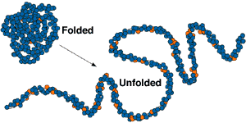
Unfolded Protein Response
Cells must constantly titrate balance between chaotropic and kosmotropic ions to keep proteins from dissolving (excess chaotropes) or precipitating out (excess kosmotropes)
Loss of ions through [cholesterol deficient] membranes leads to insufficient control of balance
Protein folding machinery fails and cell can no longer synthesize proteins

Slide 57
Recapitulation
Oxygen transport in blood is dangerous
Sulfate molecule supports safe transport
Cholesterol depletion in cell forces switch to nitrogen-based transport:
Force eNOS to synthesize NO instead of sulfate
Leads to widespread damage to cell proteins and fats due to reactive nitrogen species like peroxynitrite
Imbalance between chaotropes and kosmotropes results in protein misfolding

Slide 58
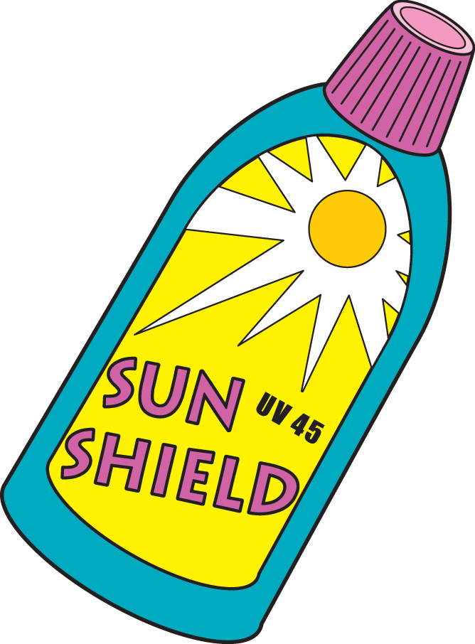
Are Sunscreens doing
more Harm than Good?

Slide 59
“Sunscreens Biohazard*”
Sunscreen chemicals harm humans, fish, and coral.
They do not prevent skin cancers, they promote them.
Absorbed through the skin, they disrupt our body’s balanced hormone ecosystem.
Bioaccumulating in fish, they disrupt both freshwater and marine ecosystems.
*by Elizabeth Plourde, PhD

Slide 60
Sunscreens Interfere with Vitamin D3 Synthesis*,**
SPF 8 → 92.5% reduction
SPF 15 → 99% reduction
Estimated costs resulting from excess cancer due to Vitamin D deficiency in 2004 in U.S.:
$40-$56 billion
Estimated cost from excess UV exposure:
$6-7 billion
Cost due to cholesterol sulfate loss???
* Elizabeth Plourde, Sunscreens Biohazard, pp. 174-175
** W.B. Grant, Adv Exp Med Biol. 624:16-30, 2008.

Slide 61
Vitamin D and Breast Cancer*
Lower vitamin D3 levels associated with larger tumor size (p = 0.0063)
Patients with vitamin D3 level < 30 ng/mL at diagnosis had significantly increased risk of relapse after three years
* S. Hatse et al. "Vitamin D status in newly diagnosed breast cancer patients inversely correlates with tumor size and moderately correlates with outcome," SABCS 2011;
Abstract P5-05-01.

Slide 62
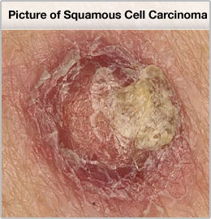
Sunscreen and Skin Cancer in the U.S.*
“There is an epidemic of NMSC [nonmelanoma skin cancer] in the United States, as illustrated by comparison with the previously published estimates and the 4.2% yearly average increase in cases in the Medicare population from 1992 to 2006.”
* Rogers et al. Arch Dermatol 146:3 283-287, Mar 2010
Notes:
For_vic/sunscreen_skin_cancer.pdf

Slide 63
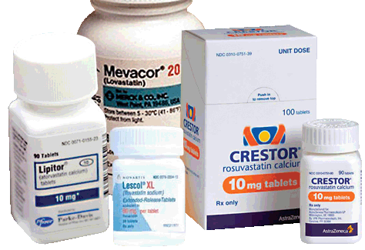
Are Statin Drugs Part of the Problem?*
If the first two statin trials are combined, a statistically increased frequency of NMSC is associated with statin therapy
Incidence of NMSC has been excluded in all reports from subsequent statin trials.
Is it the fact that statins deplete cholesterol from the skin that directly leads to the skin cancer increase?
* Mascitelli et al., Dermato-Endocrinology 2:1, 37-38, 2010.
Notes:
For_vic/statins_and_nomelanoma_skin_cancer.pdf

Slide 64
Highest-octane Sunscreens contain Aluminum
In 1998, FDA approved use of sunscreens containing zinc oxide and titanium dioxide
Aluminum hydroxide is used as a surfactant to create nanoparticle-sized metal oxides
This converts sunscreen from a white cream to a transparent gel, which is more palatable
DOES THE ALUMINUM ENTER THE SURFACE CELLS AND SUPPRESS SULFATE SYNTHESIS??

Slide 65
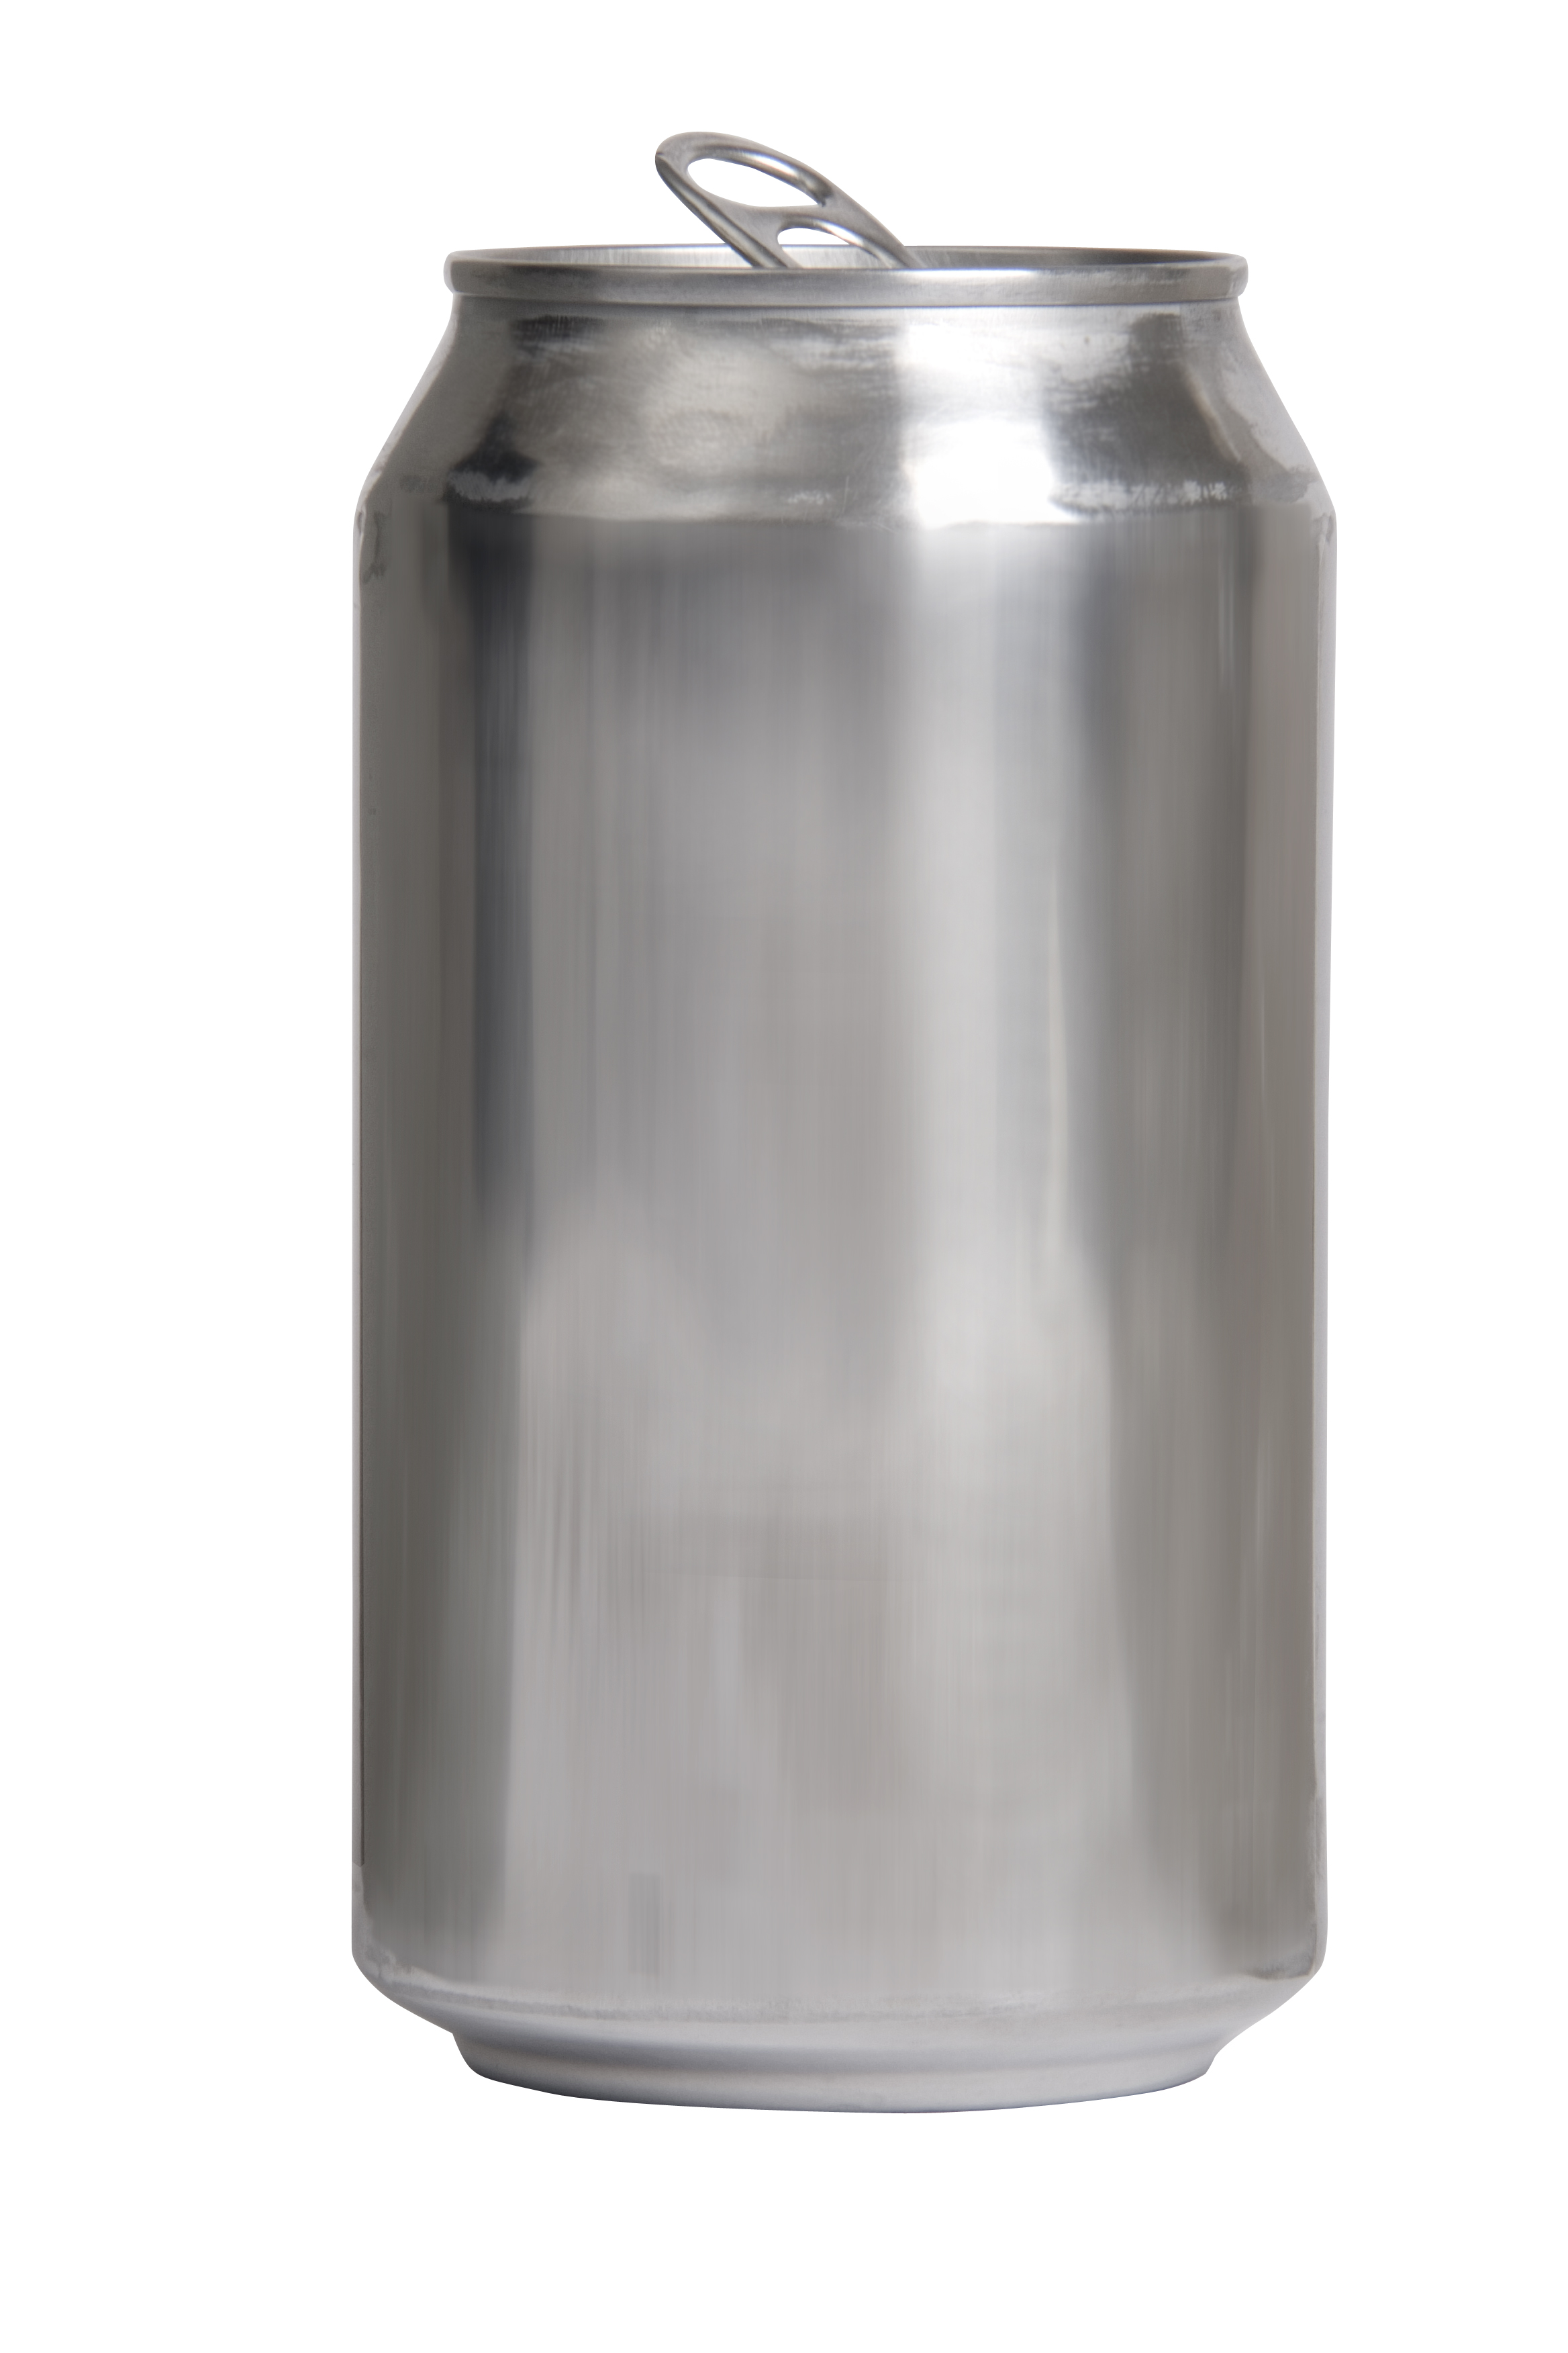
How can Aluminum Cause Cancer??
Aluminum (like calcium on steroids) causes eNOS to detach from cell membrane
Interferes with sulfate synthesis
Sulfate synthesis mops up oxidizing agents
Cholesterol sulfate promotes cross links in filaggrin and keratin
Cross links hold cells in place
Without cross links, cells become disengaged from neighbors and start multiplying
Results in impaired tight junctions between cells
Leads to tumor development
Notes:
Might have an answer in vitaminK/epidermis_review.pdf

Slide 66
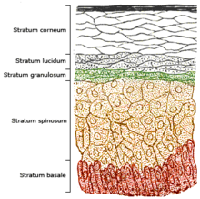
How the Skin Maintains the Barrier*
Cholesterol Sulfate
Squamous differentiation to keratinocytes in stratum corneum
Abundant cholesterol sulfate produced
Transglutaminase activity increases in parallel
Transglutaminase forms cross-linked envelopes
Affords protection from microbial invasion and water loss
*Jetten et al., J invest Derm 92:203-209, 1989

Slide 67
Vitamin A is Commonly Found in Sunscreens
Claimed to be antioxidant and slow skin aging
Stratum corneum
Cholesterol Sulfate
Vitamin A (Retinoic Acid)

Slide 68
Exposing Skin Cells to Vitamin A
“Retinoids [vitamin A] inhibit cholesterol sulfate accumulation and the increase in transglutaminase activity”
* Quote from abstract,
Jetten et al. J Invest Dermatol. 93;1, 108-15, 1989.
Notes:
vitaminK/retinoic_acid_inhibits_cholesterol_sulfate.text
Squamous cells
Retinoids inhibit cholesterol sulfate accumulation and the increase in transglutaminase activity by PMA but do not affect the commitment to terminal cell division.

Slide 70
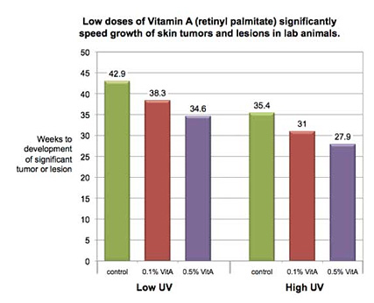
Vitamin A Accelerates Skin Cancer*
* Andrew Schneider, AOL News, May 24, 2010
aolnews.com/2010/05/24/study-many-sunscreens-may-be-accelerating-cancer
Notes:
http://o.aolcdn.com/photo-hub/news_gallery/6/6/666245/1274481905965.JPEG
http://www.aolnews.com/2010/05/24/study-many-sunscreens-may-be-accelerating-cancer/

Slide 71
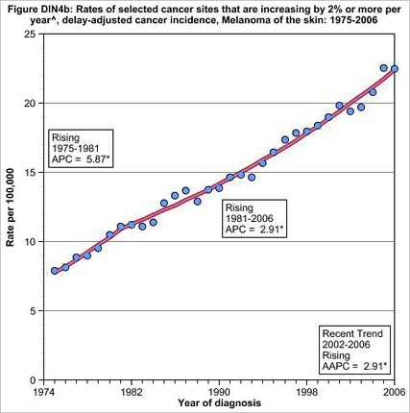
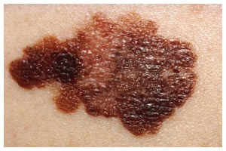
Skin Melanoma Increasing 2% per Year since 1974*
* Andrew Schneider, Aol News, May 24, 2010
aolnews.com/2010/05/24/study-many-sunscreens-may-be-accelerating-cancer
Notes:
http://www.aolnews.com/2010/05/24/study-many-sunscreens-may-be-accelerating-cancer/

Slide 72
Recapitulation
Despite a 30-fold increase in the use of sunscreens over the past 30 years, skin cancer rates have steadily risen
I propose that sunscreens are the cause of this observed increase
The natural mechanisms that exist in the skin to protect from UV rays are far more effective
These mechanisms are impaired by sunscreens
Sunscreens prevent the skin from producing vitamin D3
Sunscreens contain aluminum, which derails eNOS’ ability to make sulfate
Sunscreens contain vitamin A, which interferes with cholesterol sulfate synthesis

Slide 73
A Footnote: Chemtrails*
A not widely publicized geoengineering scheme involves spraying particulate matter in the stratosphere to modify the weather
One proposal is that aluminum hydroxide is a major component
Excess aluminum found on Mount Shasta in California and in Hawaii may constitute evidence
Aluminum is damaging to plants as well as animals, and we could potentially consume aluminum in plants grown in aluminum-contaminated soils
Aluminum may also destroy the soil for future crops
* www.westonaprice.org/thumbs-up-dvdmedia/
what-in-the-world-are-they-spraying-by-griffin-murphy-a-wittenberger
Notes:
http://www.westonaprice.org/thumbs-up-dvdmedia/what-in-the-world-are-they-spraying-by-griffin-murphy-a-wittenberger
./Chemtrails.pdf

Slide 74
What to do if you Live in the British Isles?

Slide 75
The Scots’ Paradox*
“The mortality of Scots is higher than that of the English across all social classes even though many aspects of culture, environment and health provision are the same.”
Geography and climate provide little sun in Scotland
Diseases associated with insufficient vitamin D and sunshine
* O. Gillie, Anticancer Research 32:237-248, 2012.
Notes:
UK_Scotland_low_sun_bad_health.pdf

Slide 76
Ultraviolet Exposure and Mortality among Women in Sweden*
38,472 Women selected in 1991-1992, aged 30-49
monitored for 15 years
Questionnaire asked about frequency of sunbathing vacations and sunburn
Increased sunburn frequency associated with reduced all-cause mortality
Sunbathing vacations more than once a year reduced risk to cardiovascular disease and mortality
* Yang et al., Cancer Epidemiol Biomarkers Prev. 20(4):683-690, 2011

Slide 77
Exploit Summer Sun!
Spend as much time outside in the summer sun as you can manage
Throw away the sunscreen!!
Your body can stock up on cholesterol sulfate for the winter months

Slide 78
Drink Raw Milk!!
Raw milk contains vitamin D3 sulfate
Pasteurization destroys it
Vitamin D2 (?) artificially added to pasteurized milk is not going to work

Slide 79
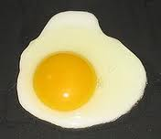
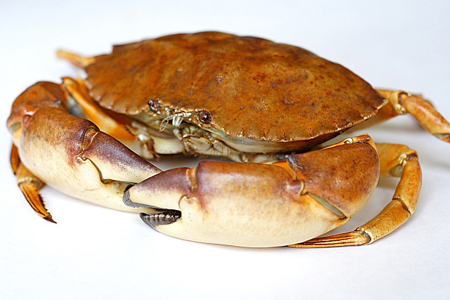
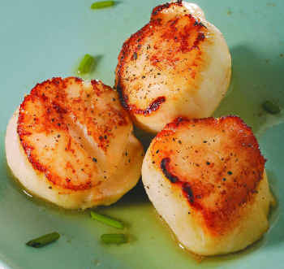
Eat Foods Containing Sulfur
Notes:
http://healthyeatingclub.com/info/books-phds/books/foodfacts/html/data/data5g.html

Slide 80
Escape to the Mediterranean in Winter
Notes:
Summer vacation on Mediterranean Sea resort, Antalya, Turkey

Slide 81
Use a Sunlamp!

Slide 82
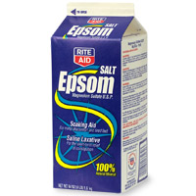
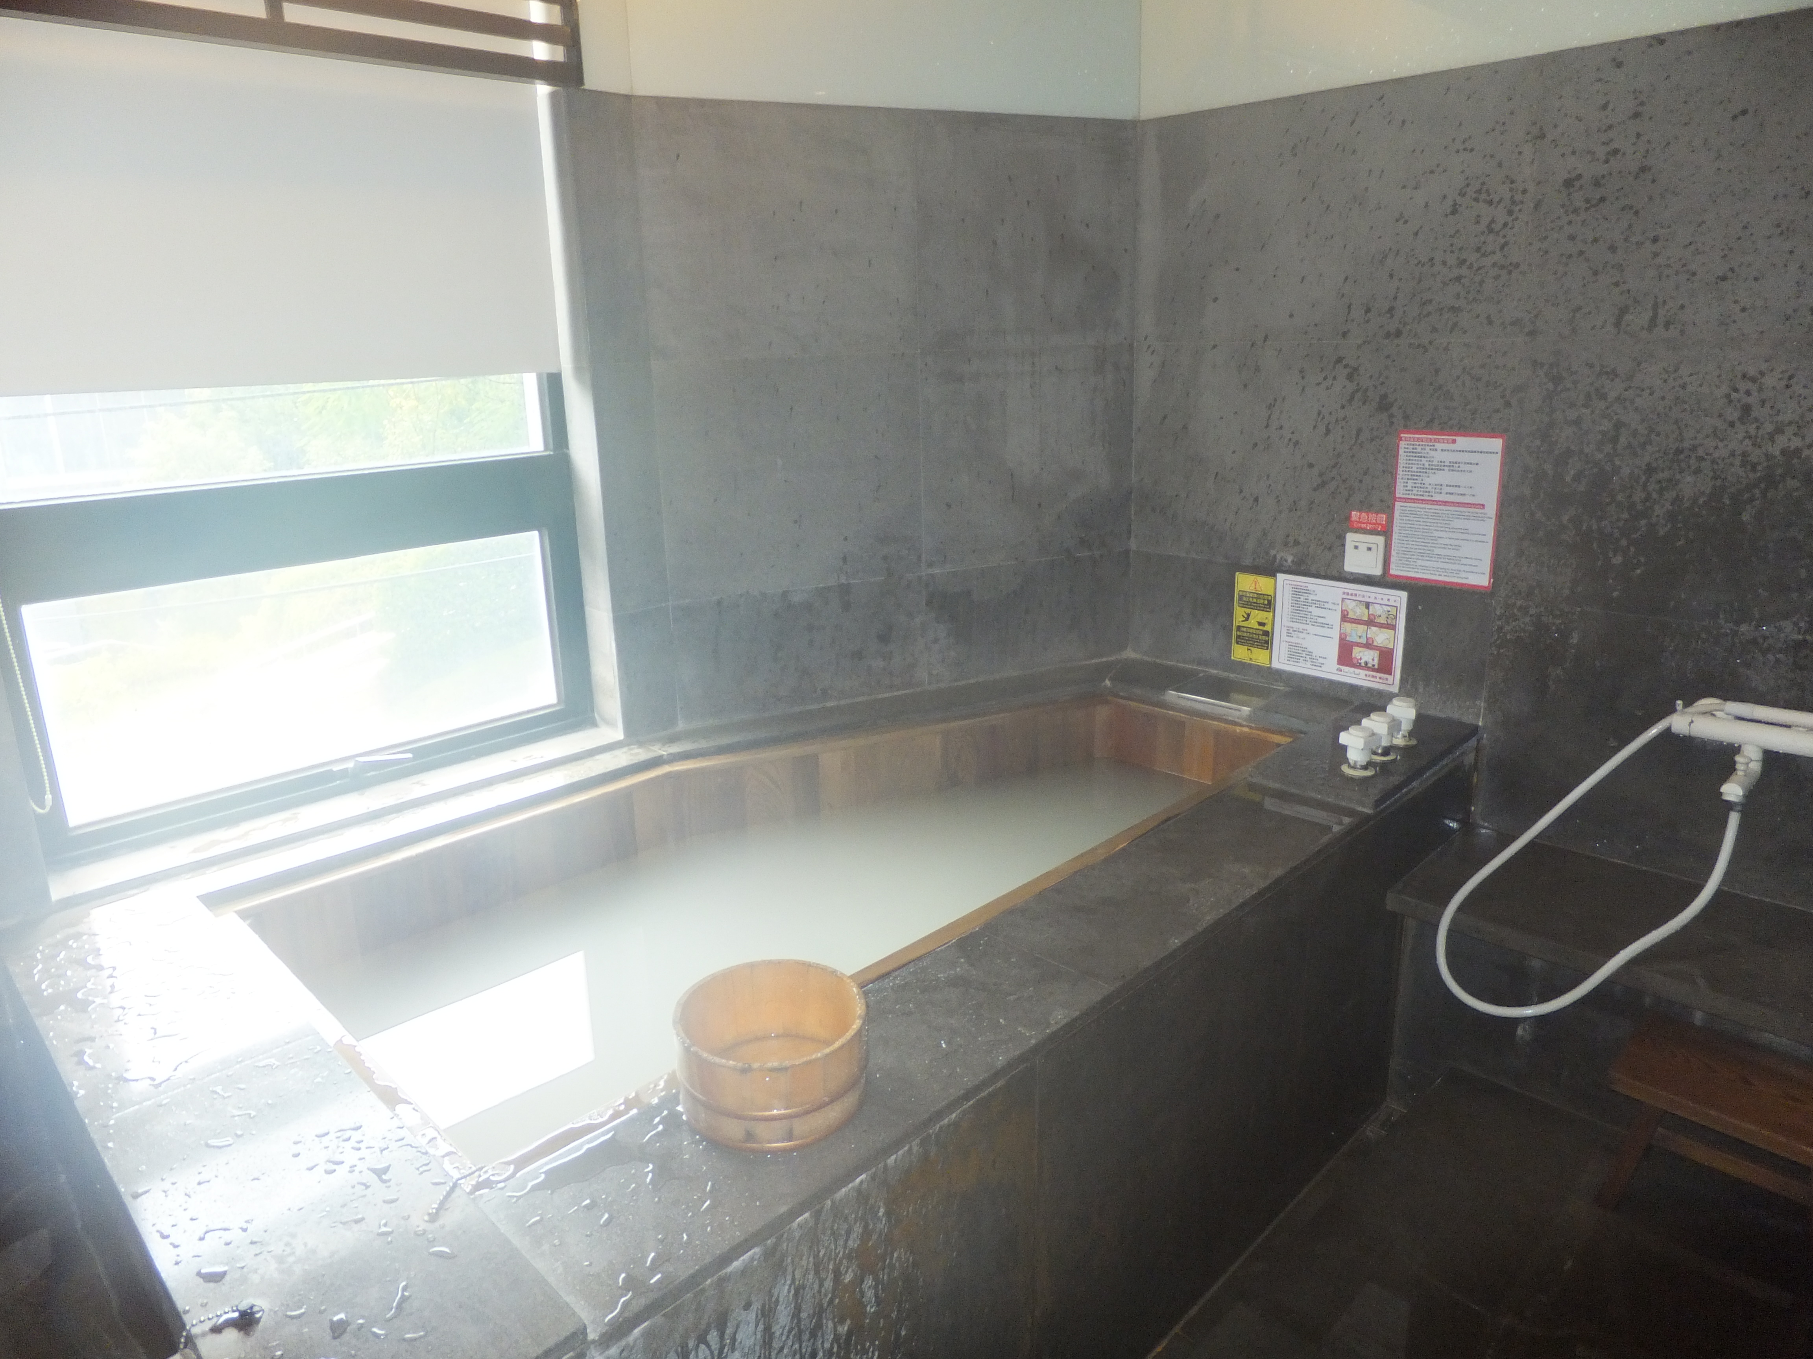
Epsom Salts!
Magnesium Sulfate in hot bath water is a cheap and easy way to get sulfate supply to the skin

Slide 83
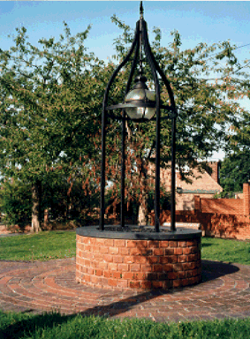
The Well in the Town of Epsom!!*
* http://www.epsom.townpage.co.uk/epsomsalts.gif

Slide 84
Epsom Spa Assembly Rooms*
A place today to down a couple of beers to replenish your sulfur supply!!
* http://www.jdwetherspoon.co.uk/static/gallery/4192-pub-page.jpg

Slide 85
Summary
Sun exposure to the skin is about much more than vitamin D3 synthesis
I propose a radical new theory that the skin can capture both sulfur and oxygen from the air in the form of the sulfate molecule, but it depends upon sun exposure to work
Sunscreens are damaging not just because they prevent vitamin D3 synthesis, but because they actively promote skin cancer

Slide 86
Thank you!

