Slide 1
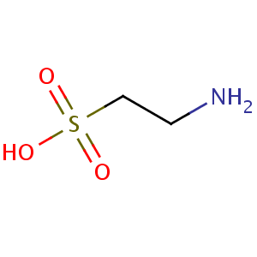
Taurine: A Mysterious Molecule with Intriguing Possibilities
Stephanie Seneff
Wise Traditions Workshop
Weston A. Price Foundation
Monday, Nov. 12, 2012
Download the slides from: http://people.csail.mit.edu/seneff/

Slide 2
Outline
Introduction
Some Biochemistry
Some Observed Benefits of Taurine
The Skin
The Heart
The Pancreas
The Brain
The Blood
Mitochondrial Diseases
Encephalitis
Cancer
Summary

Slide 3
1. Introduction

Slide 4
Have you thought about taurine?*
* Ann Lauritzen, Wise Traditions Workshop, WAPF 2011, Dallas, TX

Slide 5
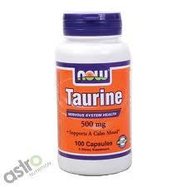
What is Taurine?
Taurine is the most common free amino acid in the body
Taurine is never incorporated into any protein, and it hardly ever participates in any reaction
Yet taurine is found in high concen- tration in the heart, brain, and liver
What is it doing there???

Slide 6
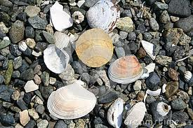
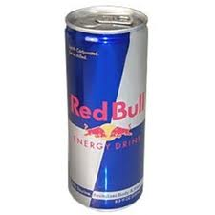
Some Interesting Facts about Taurine*
Important in many marine species for osmosis (as an osmolyte)
Shallow water clams and snails have significantly more than deeper water species
Cats become blind if raised without taurine
Brain taurine levels decline with age in mammals; replaced with glutamate
Argument used to justify presence in energy drinks
* P.H. Yancey, J Experimental Biology 208, 2819-2830, 2005.
Notes:
vitaminK/osmolytes_review_taurine_2005.pdf

Slide 7
Taurine has Many Known Roles*
Maintains osmotic balance in cells
Bile acid formation (digest fats)
Roles in mitochondria
Helps them maintain their membrane potential
Suppresses superoxide synthesis (oxidation damage)
Clinical observations
Maintains healthy skin
Protects against diabetes and heart disease
Protects against heart arrhythmias
Low taurine in blood associated with many cancers
* Wesseling et al., Hypertension. 2009, 53, 909-911
Notes:
vitaminK/taurine_2009.pdf

Slide 8
Taurine is found only in animal-based foods

Slide 9
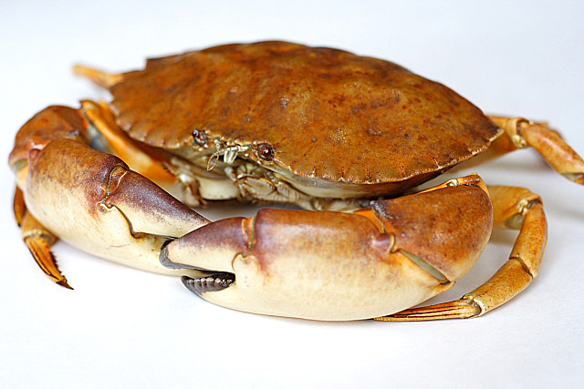
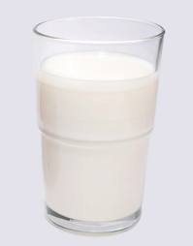
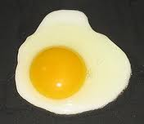
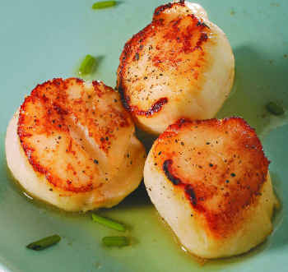
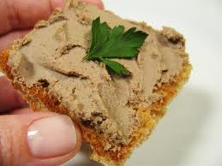
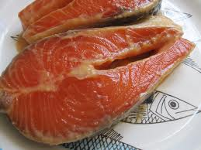
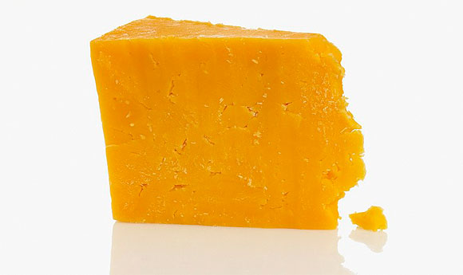
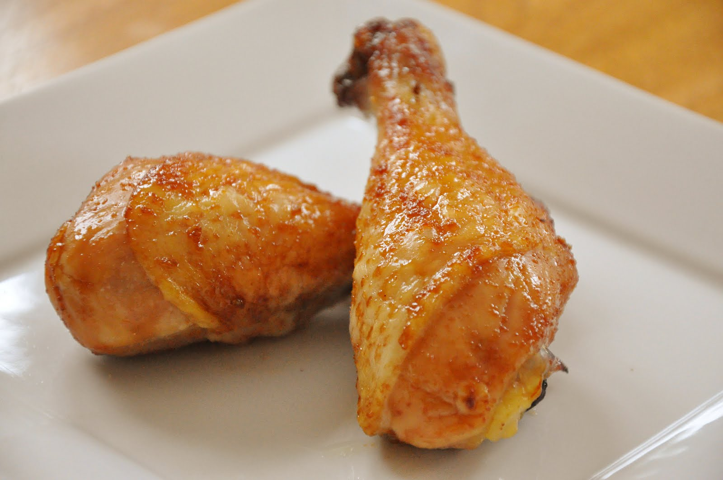
Food Sources of Taurine
Eggs, meat, fish, seafood, dairy

Slide 10
Fish Oil + Taurine*
Experiment on diabetic/obese mice, three groups
Fish oil
Fish oil + taurine
Soybean oil
Serum glucose levels significantly lower in mice fed fish oil (with or without taurine)
Fish oil + taurine group had enhanced GLUT4 distribution in plasma membrane of muscle tissue.
GLUT4 is the key catalyst for glucose uptake in muscles
*Mikami et al., J. Food Sci. 2012 Jun, 77(6), H114-20.
Notes:
Fish_oil_taurine.text

Slide 11
A Provocative Hypothesis
Taurine is very stable (many claim it is inert)
Taurine is stored in heart and brain as buffer for sulfate supply during extreme adverse conditions
Encephalitis leads to sulfate renewal!
Hypochlorite (bleach) [released by immune cells to fight infection]
Fever [enhances energy of reaction]
Seizures [induce electric current and provide free electrons]

Slide 12
The Importance of Sulfate: SO₄⁻²
I have traced most modern diseases to a deficiency in the supply of sulfate (I will talk much more about this tomorrow)
Two critical points:
Sulfation of cholesterol is essential for cholesterol transport – sulfate deficiency implies cholesterol deficiency
Sulfation is essential for managing sugar: insufficient sulfate supply leads to diabetes

Slide 13
2. Some Biochemistry

Slide 14
Taurine!

Slide 15
Is Taurine an Amino Acid?
Sulfonyl
Carboxyl is replaced by Sulfonyl

Slide 16
Taurine Synthesis Pathway*
Essential amino acid
If you have to synthesize taurine from precursors, these other roles are sacrificed!
* Wesseling et al., Hypertension. 2009, 53, 909-911
Source of sulfate
Essential to protein folding
Potent antioxidant
Notes:
vitaminK/taurine_2009.pdf
vitaminK/acetaminophen_toxicity_hypotaurine_NAC_2010.pdf
Figure. A simplified biosynthesis pathway from methionine to taurine. Methionine is converted to homocysteine in 3 steps. Homocysteine is used as a substrate to form cysteine in 2 steps but can also be converted back to methionine by 2 different mechanisms. Cysteine, precursor for the important antioxidant glutathione and the gaseous transmitter/signaling molecule H2S, can be further converted to cysteine sulfinate. Cysteine sulfinate is converted to taurine in 2 steps via 2 different pathways. Tau- rine can decrease methionine by decreasing uptake. Whether taurine decreases homocysteine directly or via a reduction of methionine is unclear.

Slide 17
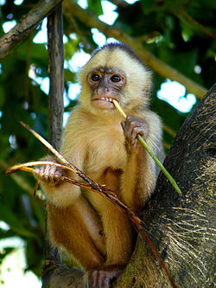
Big Hints from Early Literature*
Article published in 1960
Fed cholesterol to monkeys
Induced atherosclerosis
If sulfur-containing nutrients are added, atherosclerosis is prevented
Taurine worked as well as other molecules like cysteine, methionine, and glutathione
* G.V. Mann et al., Am. J. Clin. Nutr. 8, 491-497, 1960.

Slide 18
Breaking down Taurine to get Sulfate
A Hint: hypochlorite is released by neutrophils to fight infection
Citric Acid Cycle
Such a reaction might be possible in the human,
but it’s not easy
Notes:
From Bob from where?
vitaminK/taurine_to_acetyl_CoA.pdf

Slide 19
Another Useful Reaction
C₂H₇NO₃S + H₂O → NH₄+ CH₃COO- + H₂S + O₂
taurine + water → ammonia + acetate + hydrogen sulfide + oxygen
cysteine
N-acetyl cysteine
Vasorelaxation
Oxidize to thiosulfate & cholesterol sulfate
Generate ATP
Nutritional supplement for Tylenol overdose and to treat sulfate deficiency in autism

Slide 20
3. Some Observed Benefits of Taurine

Slide 21
Taurocholic Acid: in Bile Acids
Makes bile acids more water soluble
Aids in digesting fats
cholesterol
taurine

Slide 22
The Skin

Slide 23
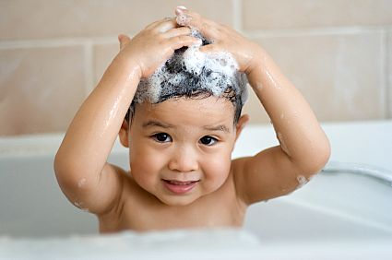
SLS: a Skin Irritant*
Sodium lauryl sulfate (SLS) is added to shampoos mainly to make them foamy
Surfactant ( = “surface active agent”)
Used in many commercial formulations because it is inexpensive, offers great foaming, and can be thickened easily with salt
SLS is a skin irritant -- induces dry, scaly skin due to its surfactant effects
* Lee and Maibach, Contact Dermatitis, 1995, 13, 1-7
Notes:
vitaminK/sodium_lauryl_sulfate.pdf

Slide 24
Taurine, SLS, and the Skin*
Taurine accumulates in outermost keratinocyte layer of the skin following UV exposure
Stimulates synthesis of ceramides, cholesterol, and fatty acids
SLS induces an increase in water loss through the skin, inflammation, and proliferation
Incubation w/ SLS + taurine
Decrease in IL-1α and prostaglandin E2 (inflammatory agents)
Stabilization of membrane integrity
Improvement in keratinocyte viability
* B. Anderheggen et al., J Cosmet Sci. 2006 Jan-Feb;57(1), 1-10
Notes:
vitaminK/taurine_improves_skin_barrier.text

Slide 25
The Heart

Slide 26
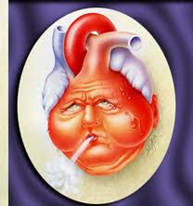
Sudden Cardiac Death*
Sudden cardiac death is the leading cause of death in industrially developed countries
Accounts for 300,000 - 500,000 deaths per year in U.S.
Due to ventricular fibrillation: life-threatening heart arrhythmia
Manifested by low heart rate variability
Triggered by adrenalin in response to stress
Intracellular potassium and calcium dysregulation → insufficient membrane cholesterol?
* G.E. Billman, Am J Physiol Heart Circ Physiol 297:H1171-H1193, 2009
Notes:
For_vic/arrhythmias_exercise_sudden_cardiac_arrest_2009.pdf

Slide 27
Cardioprotective Effects of Taurine*
Taurine is normally found in highest concentration in the heart
Antiarrhythmic effects observed experimentally in cats, dogs and guinea pigs.
Addition of taurine
Prevents loss of potassium by myocardium
Reverses adverse effects of adrenalin and digoxin
Eliminates the pathological ECG changes caused by strophanthin in isolated guinea pig hearts.
My hypothesis: Is taurine a source of sulfate for cholesterol sulfate synthesis?
* Georgy Eby, Taurine Role in Cardiology and Cardiac Arrhythmias
http://george-eby-research.com/html/taurine.html

Slide 28
High Dietary Taurine Reduces Apoptosis (Cell Death) and Atherosclerosis*
High dietary fish associated with decreased cardiovascular death rate
Taurine is highly concentrated in fish
High dietary taurine reduces risk of coronary heart disease and insulin resistance
Taurine deficiency can also lead to obesity, a risk factor for heart disease
* A. Zulli et al., Hypertension, 53, 1017-1022, 2009
Notes:
vitaminK/taurine_reduces_apoptosis_and_atherosclerosis_2009.pdf
Also:
Taurine_heart_disease.pdf
Physiological_roles_taurine_heart_muscle.pdf

Slide 29
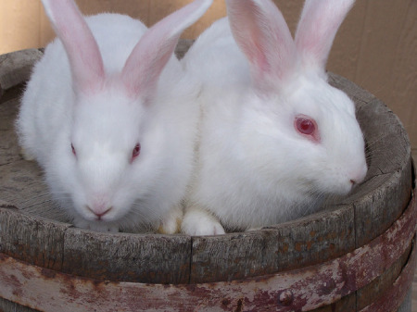
High Dietary Taurine Reduces Apoptosis and Atherosclerosis: Experiment*
Rabbits fed high cholesterol diet
Examined effect of taurine supplements on left main coronary artery
Results
Reduced serum homocysteine levels
Endoplasmic Reticulum stress reduced in endothelial cells which protected them from apoptosis
Reduced atherosclerosis in artery wall
Reduced serum HDL
* A. Zulli et al., Hypertension, 53, 1017-1022, 2009
Notes:
vitaminK/taurine_reduces_apoptosis_and_atherosclerosis_2009.pdf

Slide 30
High Dietary Taurine Reduces Apoptosis and Atherosclerosis*: My Interpretation
Taurine reacted with hypochlorite which allowed it to be metabolized to sulfate
Protected LDL from hypochlorite toxicity
Reduced uptake of LDL into plaque
Platelets utilized newly available sulfate to produce cholesterol sulfate from cholesterol obtained from HDL
Depleted HDL
Homocysteine could be diverted to cysteine and glutathione instead of being held in reserve as an alternative source of sulfate.
Serum homocysteine levels dropped
* A. Zulli et al., Hypertension, 53, 1017-1022, 2009
Notes:
vitaminK/taurine_reduces_apoptosis_and_atherosclerosis_2009.pdf

Slide 31
Recapitulation
Sudden cardiac death is leading cause of death in Western nations
Taurine is highly concentrated in the heart
Protects from sudden cardiac death
Low dietary taurine associated with increase in insulin resistance, obesity, and heart disease
Taurine protects rabbits from cholesterol-diet-induced cardiovascular disease
I hypothesize that these effects are due to taurine's ability to promote cholesterol sulfate synthesis

Slide 32
The Pancreas

Slide 33
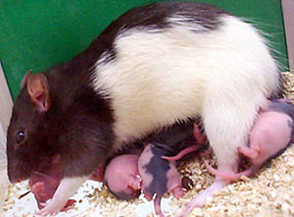
Taurine and Pancreatic Islet Cells*
Mother rats fed low-protein diet during gestation and lactation
Offspring had vulnerable islets in their pancreas (leading to diabetes)
Excess production of toxic nitric oxide
Increased apoptosis (cell death)
Supplement with taurine in protein-deficient mothers alleviates these effects
This shows how maternal diet can have long-term effects on offspring!
* K Goosse et al., Journal of Endocrinology (2009) 200, 177–187
Notes:
vitaminK/taurine_epigenetics_islet_cells_rats.pdf
vitaminK/taurine_insulin_secretion_rats_low_protein_diet.pdf
In conclusion, a maternal low-protein diet programmes a different pattern of gene expression in islet-cells of adult progeny. Higher NO. production by these islets could be an important factor in the subsequent cell death. The prevention of these events by maternal taurine supplementation emphasizes the importance of taurine during endocrine pancreas development.

Slide 34
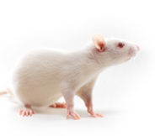
Taurine, Fructose, and Diabetes*
Fructose induces diabetes
Rats fed cornstarch compared with rats fed fructose (60% of dietary calories)
Fructose induced insulin resistance (well-known response)
Supplement with 2% taurine solution ad libitum protected rats from insulin resistance
* Nandhini et al., Singapore Med J, 46(2), 82-87, 2005
Notes:
vitaminK/taurine_fructose_fed_rats_2005.pdf
Only difference in diet was cornstarch vs fructose

Slide 35
Taurine, Fructose, and Diabetes*
Taurine Completely Eliminated the Sugar Spike Caused by Fructose
CON= cornstarch
FRU = fructose
TAU = taurine
* Nandhini et al., Singapore Med J, 46(2), 82-87, 2005
Notes:
vitaminK/taurine_fructose_fed_rats.pdf

Slide 36
The Brain

Slide 37
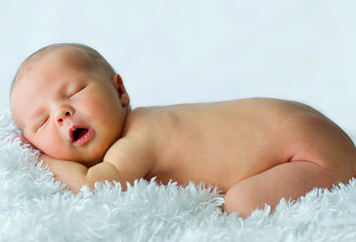
Taurine in Development*
Highest concentration occurs in developing brain
Taurine concentrations fall during development
Converted to sulfate?
Neonates have 3x levels of adults
True for humans, monkeys, mice, rabbits, rats, and insects
* R.J. Huxtable, Physiological Reviews 72(1), 101-163, Jan 1992

Slide 38
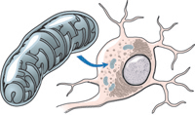
Taurine is Neuroprotective*
Taurine prevents excitotoxicity induced by glutamate in neurons
Mitochondrial electron gradient is calcium regulated
Activation by glutamate →
Extracellular calcium influx
Mobilization from internal stores (mitochondria)
Associated with decrease in mitochondrial energy metabolism
Pretreatment with taurine normalized calcium homeostasis and prevented mitochondrial impairment
mitochondrion
* A. El Idrissi and E. Trenkner, J. Neuroscience, 19(21), 9459-9468, 1999.
Notes:
vitaminK/glutamate_regulated_by_taurine_in_neurons.pdf

Slide 39
The Blood

Slide 40
Taurine Protects Platelets from Blood Clots*
Taurine is especially concentrated in nervous system and platelets
Cats are often afflicted with a taurine-deficiency cardiomyopathy along with arterial thromboembolism
Blood clot blocks flow to heart
Taurine suppresses release of thromboxane by platelets which triggers blood clot formation
Study confirmed this is true for humans as well
* K.C. Hayes et al., Am. J. Clin. Nutr. 1989; 49:1211-6.
Notes:
vitaminK/taurine_modulates_platelet_aggregation.pdf

Slide 41
Sub-optimal taurine status may promote platelet hyperaggregability in vegetarians*
“Plasma taurine levels are lower, and urinary taurine excretion is substantially lower, in vegetarians than in omnivores. Platelets are rich in taurine, which functions physiologically to dampen the calcium influx evoked by aggregating agonists – thereby down-regulating platelet aggregation.”
* M.F. McCarty, Medical Hypotheses, 63(3), 426-433, 2004.
Notes:
http://anthonycolpo.com/green-mile-star-dies-after-becoming-vegetarian/

Slide 42
Outline
Introduction
Some Biochemistry
Some Observed Benefits of Taurine
The Skin
The Heart
The Pancreas
The Brain
The Blood
Mitochondrial Diseases
Encephalitis
Cancer
Summary

Slide 43
4. Mitochondrial Diseases

Slide 44
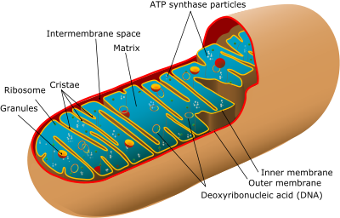
Mitochondrial Diseases*
Mitochondria convert food into ATP for energy
Mitochondrial stage I impairment associated with many neurological and muscular disorders
Mitochondrial Diseases
Often caused by mutations in mitochondrial genes
Symptoms include poor growth, loss of muscle coordination, muscle weakness, visual problems, hearing problems, learning disabilities, heart disease, liver disease, kidney disease, gastrointestinal disorders, respiratory disorders, neurological problems, autonomic dysfunction, and dementia.
* From Wikipedia

Slide 45
“Human mitochondrial diseases caused by lack of taurine modification in mitochondrial tRNAs”*
* Kirino and Suzuki, RNA Biology 2(2), 41-44, June 2005.
Notes:
tRNA_wobble_taurine_mitochondria.pdf
IN vitaminK/taurine_2009.pdf:
A novel hypothesis is that taurine conjugates to mitochondrial transfer RNA and, thus, prevents formation of mitochondrial superoxide.12
Volume 2, Issue 3, pages 376–386, May/June 2011
Cell and molecular biologyu

Slide 46
Defects from Genetic Mitochondrial Disorders*
Mutations prevent taurine attachments to tRNAs
(1) Impair UUG gene translation (taurine)
NADH-Coenzyme Q reductase impaired
Mitochondrial Complex I disrupted
(2) Impair AAA and AAG (taurine + S)
Defect in whole mitochondrial translation
Question: Does the additional S play a highly significant role in enabling gene translation??
Generic taurine deficiency might lead to
similar mitochondrial impairments
* Kirino and Suzuki, RNA Biology 2(2), 41-44, June 2005.
Notes:
tRNA_wobble_taurine_mitochondria.pdf
Volume 2, Issue 3, pages 376–386, May/June 2011
Cell and molecular biologyu

Slide 47
Fever, Autism, and Mitochondria*
Found a plausible link between mitochondria, fever, and taurine
Fever impacts autism
Some regress after fever, some improve
Subset with mitochondrial dysfunction regress
Aggressive treatment may worsen outcome
Acetaminophen (Tylenol) depletes sulfate
Fever suppression prevents sulfate regeneration from taurine?
* Shoffner et al., J Child Neurol. 2009 Sep 22
Notes:
vitaminK/fever_mitochonrial_disease.text

Slide 48
“Fever Plus Mitochondrial Disease Could Be Risk Factors for Autistic Regression”*
14% of the children with both autism and mitochondrial disease suffered regression following vaccination
All children with ASD (1 in 110 children born)
Children with ASD and mitochondrial disease
60% with regression events
70% with fever or infection
1/3 with vaccination
* http://blog.autismspeaks.org/2010/03/11/fever-regression/
Notes:
./fever_autism_mitochondria.pdf
Figure 1. The Findings of Shoffner, et al1 on Autistic Regression in
Children with Mitochondrial Disease and Autism Spectrum Disorder
(ASD). The current best figures for the point prevalence of ASD in the
US (blue circle; 1 in 110)10, the risk of “definite” mitochondrial
disease among children with ASD (4%)2, and the birth risk of childhood
forms of mitochondrial disease (purple circle; 1 in 4000)8 are
represented as Venn diagrams at the top. The Top 10 Shoffner paper
studied 28 children within the intersection of these 2 important
disease groups. The numbers in purple boxes represent the numbers
reported in the study. “FUO” is fever of unknown origin. The standard
clinical definitions for “possible”, “probable”, and “definite”
mitochondrial disease are referred to as the modified Walker
criteria3.

Slide 49
5. Encephalitis

Slide 50
A Provocative Proposal: Encephalitis is Protective!
Taurine is kept in reserve as a buffer for sulfate supply
Encephalitis enables conversion of taurine to sulfate
This is an important positive outcome of encephalitis

Slide 51
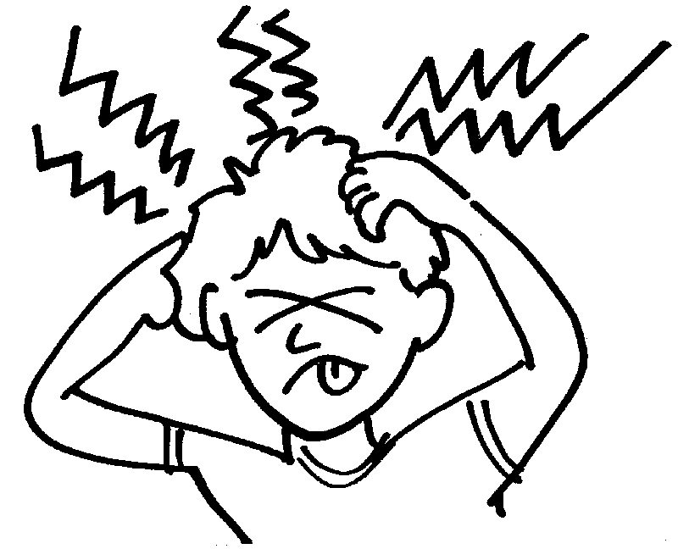
What is Encephalitis?
Encephalitis is an acute inflammation of the brain
Usually caused by infection, most often by a virus, but sometimes by bacteria, a fungus, or a parasite.
Symptoms
Headache
Fever
Confusion
Sleepiness
Fatigue
Seizures and convulsions
Tremors
Memory problems

Slide 52
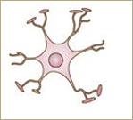
Fighting the Infection: Nitric Oxide and Hypochlorite
Neutrophils follow microbes into brain
Attack microbes with antimicrobial agents:
Nitric oxide
Hypochlorite
Excess nitric oxide → ammonia → complex reaction in the astrocyte
Frees up taurine to protect from hypochlorite damage (by becoming taurine chloramine)
hypochlorite
Neutrophil
Nitric oxide
taurine chloramine
taurine
ammonia
Astrocyte

Slide 53
Taurine Chloramine is Energized!
Although it is believed that taurine is inert, taurine chloramine can be metabolized to sulfate!! (at least by some species)
Can humans do this?? – maybe!

Slide 54
Some More Help from Astrocytes
Astrocytes release both taurine and glutamate after swelling in response to ammonia exposure
Glutamate is an active neurotransmitter capable of inducing a 2Hz resonance phenomenon
This could be a key source of seizures
Seizures provide electric current

Slide 55
Glutamate Cycling
glutamate
Ammonia
Glutamate is an active neurotransmitter
Conversion to glutamine renders it inactive during transport
glutamine
Presynaptic neuron
mitochondrion
Synapse
Astrocyte
Postsynaptic neuron

Slide 56
Glutamate during Encephalitis
glutamate
During encephalitis, astrocyte releases ammonia from glutamine in mitochondria and ships out glutamate
Ammonia
glutamine
mitochondrion
Glutamate can induce seizures
Presynaptic neuron
ammonia
Synapse
Astrocyte
Postsynaptic neuron

Slide 57
Why is Ammonia Needed in the Mitochondrion?
To replace taurine!
Astrocyte releases both taurine and glutamate into the medium
Ammonia replaces taurine as buffering agent in mitochondria
Helps them maintain basic pH
THIS FREES UP TAURINE TO PRODUCE SULFATE!!!

Slide 58
Glutamate during Encephalitis
glutamate
Ammonia replaces taurine in mitochondrion and frees up taurine for something else!
Ammonia
glutamine
mitochondrion
TAURINE!
Presynaptic neuron
ammonia
Synapse
Astrocyte
Postsynaptic neuron

Slide 59
Hypochlorite + Taurine → Salvation!
hypochlorite
Neutrophil
Nitric oxide
taurine chloramine
taurine
ammonia
Astrocyte

Slide 60
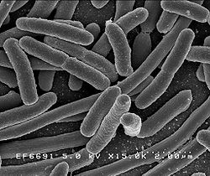
A Role for Microbes!*
Hypothesis: brain infection allows bacteria to supply sulfate to the brain
Under stress conditions, glutamate is released by astrocytes in the brain and metabolized to α-ketoglutarate in the neurons (substitutes for glucose metabolism to generate energy)
E coli and many other bacteria can utilize the enzyme α-ketoglutarate dioxygenase to metabolize taurine
Inputs oxygen, α-ketoglutarate, taurine
Outputs carbon dioxide succinate, sulfite and aminoacetaldehyde
This enzyme is induced during sulfate starvation
Sulfite is easily oxidized to sulfate
Microbes allowed to flourish in the brain to supply sulfate!
*K.P. McCusker and J.P. Klinman *Tetrahedron Letters 50 (2009) 611–613
Notes:
vitaminK/taurine_hydroxylation_keto_glutarate_sulfate_Laurie.pdf

Slide 61
Recapitulation
Encephalitis may be a mechanism to renew sulfate supply to the brain, by breaking down taurine
Complex mechanism involves glutamate, hypochlorite, nitric oxide, ammonia, etc.
Fever and seizures also provide catalysis
Bacteria may be permitted into the brain to help carry out the reaction

Slide 62
6. Cancer

Slide 63
Taurine and Breast Cancer*
Progressive inhibition of apoptosis (cell death) and induction of angiogenesis (blood vessel growth) contribute to tumor initiation, growth and metastasis in the pathogenesis of breast cancer
Taurine displays antineoplastic effects through
Downregulation of angiogenesis
Enhancement of tumor cell apoptosis
* I. M. El Agouza et al. Angiogenesis 14, 321–330, 2011

Slide 64
Taurine and Breast Cancer*
85 women
50 with diagnosed breast cancer
10 with benign tumors
5 with family history
20 controls
Serum taurine sharply reduced in women with breast cancer (p<0.001)
100% detection, 0% false alarms
* I. M. El Agouza et al. Angiogenesis 14, 321–330, 2011
Notes:
vitaminK/taurine_breast_cancer.pdf

Slide 65
Taurine and Breast Cancer*
VEGF accelerates growth
α
* I. M. El Agouza et al. Angiogenesis 14, 321–330, 2011
Notes:
vitaminK/taurine_breast_cancer.pdf

Slide 66
Taurine Induces Apoptosis*
Proliferate
Tumor cell
VEGF
Tumor cell
Tumor cell
Tumor cell
TNF-α
Die
Tumor cells are robust against exposure to toxic agents; they proliferate while other normal cells die
* A. Jacobi et al, Anticancer Drugs 16(9), 917-921, 2005.
Notes:
vitaminK/taurine_breast_cancer.pdf – reference 15
15. Jacobi A, Menenakos C, Braumann C (2005) Taurolidine a new drug with anti-tumor, anti-angiogenic effects. Anticancer Drugs 16(9):917–921

Slide 67
Taurine Induces Apoptosis*
+ Taurine
Proliferate
Tumor cell
Tumor cell
VEGF
Tumor cell
Tumor cell
TNF-α
Die
Tumor cells are robust against exposure to toxic agents; they proliferate while other normal cells die
* A. Jacobi et al, Anticancer Drugs 16(9), 917-921, 2005.
Notes:
vitaminK/taurine_breast_cancer.pdf – reference 15
15. Jacobi A, Menenakos C, Braumann C (2005) Taurolidine a new drug with anti-tumor, anti-angiogenic effects. Anticancer Drugs 16(9):917–921

Slide 68
Low Serum Taurine and Cancer
Many different cancers have been found to be associated with unusually low serum taurine levels
Breast cancer
Ovarian cancer
Bladder cancer
Lung cancer
Uterine cancer
Liver cancer
Colon cancer
Gastro-intestinal cancer
Endometrial cancer
Hypothesis: cancer depletes taurine by converting it to sulfate
Tumor cells typically overproduce sulfated polysaccharides

Slide 69
7. Summary

Slide 70
Food Sources of Taurine
Eggs, meat, fish, seafood, dairy

Slide 71
Summary
Taurine is a fascinating and poorly understood molecule!
We need to worry about dietary deficiencies, especially vegetarians
Taurine is protective in cancer, heart disease, and diabetes – i.e., the major diseases of modern times
Taurine plays an essential role in development
Taurine’s many benefits may stem from its role in supplying a buffer for sulfate to the body

Slide 72
Thank you!

Slide 73
Hydrogen Sulfide Protects Mitochondria *
* Figure 10 in L.-F. Hu et al, Mol Pharmacol 75:27–34, 2009
Notes:
WHERE??
Fig. 10. Proposed signaling mechanisms for the effects of H2S on rotenone-induced apoptosis. Rotenone induces complex I inhibition, which initiates the dissipation of 􏰇􏲛m, causing the matrix swelling and promoting the opening of mitochondrial permeability transition pore. Rotenone may also stimulate intracellular p38/JNK MAPK pathway. The activation of p38/JNK MAPK, in turn, induces the recruitment of cytoplasmic apoptotic members of Bcl-2 family proteins (e.g., Bax, Bid) to mitochondria and forms permeability transition pore, causing the release of cytochrome c to cytosol. The cytosolic apoptotic executors (cytochrome c, Apaf-1, and pro-caspase-9) form apoptosome, which leads to activation of pro-caspase-9, subsequently activating caspase-3. The mechanisms underlying the antiapoptotic effects of H2S may result from opening of mitoKATP channels, which in turn mediates the prevention of 􏰇􏲛m loss and the inhibition of p38/JNK MAPK pathway.

Slide 74
Taurine-modified tRNAs in Mitochondria*
* From Suzuki et al., WIREs RNA 2011, 2, 376-386
Notes:
Our previous studies revealed the absence of posttranscriptional taurine modification at the anticodon wobble uridine in mutant mt tRNAs isolated from cells derived from patients with two major classes of mitochondrial diseases, MELAS (mitochondrial myopathy, encephalopathy, lactic acidosis, and stroke-like episodes) and MERRF (myoclonus epilepsy associated with ragged red fibers). Defective taurine modification of the mutant mt tRNAs results in a deficiency in protein synthesis as the cognate codons of the mutant mt tRNA cannot be decoded. These findings represent the first evidence of a molecular pathogenesis caused by an RNA modification disorder.  2011 John Wiley & Sons, Ltd. WIREs RNA 2011 2 376–386 DOI: 10.1002/wrna.65
vitaminK/taurine_mitochdondrial_tRNAs.pdf
EMBO J. 2002 December 2; 21(23): 6581–6589.
doi: 10.1093/emboj/cdf656
PMCID: PMC136959
Taurine as a constituent of mitochondrial tRNAs: new insights into the functions of taurine and human mitochondrial diseases
Takeo Suzuki,¹ Tsutomu Suzuki,^{1,2,3} Takeshi Wada,^{1,2} Kazuhiko Saigo,^{1,2} and Kimitsuna Watanabe^{1,2,3}

