Slide 1
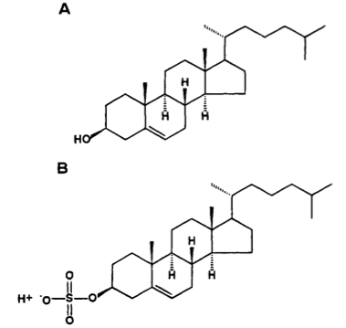
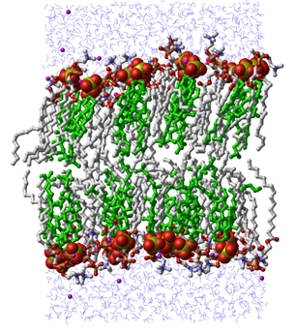
2. Cholesterol Sulfate
Stephanie Seneff
Wise Traditions Workshop
November 8, 2013
people.csail.mit.edu/seneff/WAPF_Slides_2013/2_cholesterol_sulfate.pdf

Slide 2
”If we all worked on the assumption that what is accepted as true is really true, there would be little hope of advance."
-- Orville Wright

Slide 3
Outline
Introduction
Cholesterol sulfate
Heparan sulfate proteoglycans (HSPGs)
Atherosclerosis is protective
How statins really work explains why they don’t really work
Maintaining blood stability
Cancer to the rescue?
Summary

Slide 4
Introduction

Slide 5
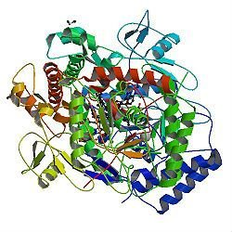
A Provocative Proposal
Cholesterol sulfate supplies oxygen, sulfur, cholesterol, energy energy and negative charge to all the tissues
Sulfate is synthesized from sulfide in skin and blood stream utilizing energy in sunlight
Protects from UV damage and keeps microbes out
Endothelial Nitric Oxide Synthase (eNOS) performs the magic
The skin is a solar powered battery!

Slide 6
Cholesterol and Cholesterol Sulfate
Sulfation makes cholesterol water-soluble and therefore much easier to transport
SULFATE
Notes:
From cholesterol_sulfate_agile.pdf – this was the original article on that topic.

Slide 7
When cholesterol and sulfate “hold hands” they can navigate the waters together

Slide 8
Think about Sulfate!
Cells in the skin produce vitamin D3 sulfate upon exposure to the sun
The precursor to vitamin D3 is 7-dehydrocholesterol
Cells also produce an abundance of cholesterol sulfate
I believe this is the more important molecule!
Many of the alleged benefits of vitamin D3 are actually benefits of cholesterol sulfate
Protection against cancer, diabetes and cardiovascular disease; improved immune function

Slide 9
Heart Disease Mortality and Sunlight*
*Grimes et al., Q. J. Med. 1996; 89:579-589
Notes:
vitaminK/sunlight_heart_disease.pdf

Slide 10
Lack of Sunlight May Raise Stroke Risk*
Strokes are caused by blood instability: clots and hemorrhages
Is this due to insufficient sulfate in blood?
Study involved 16,500 people
Tracked the history of where they had lived
Looked at weather statistics for those places
Found 60% increased risk to stroke for lowest sun exposure (relationship with both latitude and weather patterns)
*A. Mozes, HealthDay, RSS Feed, Feb 2, 2012.
Notes:
./sunlight_stroke_healthday.text
6,500

Slide 11
Ultraviolet Exposure and Mortality among Women in Sweden*
38,472 women selected in 1991-1992, aged 30-49
monitored for 15 years
Questionnaire asked about frequency of sunbathing vacations and sunburn
Increased sunburn frequency associated with reduced all-cause mortality
Sunbathing vacations more than once a year reduced risk to cardiovascular disease and mortality
* Yang et al., Cancer Epidemiol Biomarkers Prev. 20(4):683-690, 2011

Slide 12
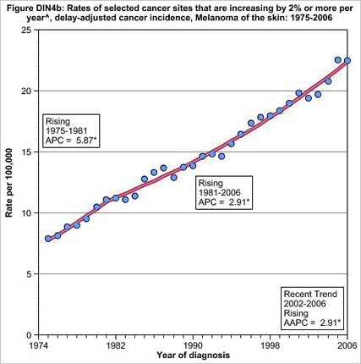
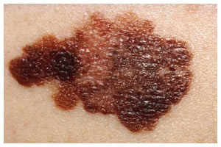
Skin Melanoma Increasing 2%/Yr since 1974*
This corresponds to a 30-fold increase in the use of sunscreen
* Andrew Schneider, Aol News, May 24, 2010
aolnews.com/2010/05/24/study-many-sunscreens-may-be-accelerating-cancer
Notes:
http://www.aolnews.com/2010/05/24/study-many-sunscreens-may-be-accelerating-cancer/

Slide 13
How to Stay Healthy
Plenty of dietary sulfur
Plenty of dietary cholesterol
Plenty of sun exposure

Slide 14
Cholesterol Sulfate

Slide 15
Cholesterol is a Miracle Worker
In the brain:
Synapse: promotes cell-cell communication
Myelin sheath: insulates channel from signal loss
In the membranes of all cells
Prevents ion leaks
Protects from pathogens (microbes)
In the plasma lipoprotein (LDL, HDL)
Essential for protecting contents from oxidation and glycation damage during transport to cells
Precursor to vital hormones
Vitamin D
All the sex hormones (testosterone, estrogen, etc.)
Cortisone: the stress hormone
Aids in digestion of fats

Slide 16
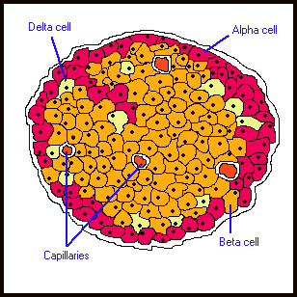
Cholesterol is Essential for Insulin Release *
Experiment with pancreatic beta cells
Expose them to toxin that impairs cholesterol synthesis
Cells secrete significantly less insulin in response to glucose challenge
* Xia et al., Endocrinology 149:10, 5136-5145, 2008.
Notes:
vitaminK/cholesterol_impacts_pancreas_insulin_release.pdf

Slide 17
Cholesterol is Essential for Insulin Release *
Experiment with pancreatic beta cells
Expose them to toxin that impairs cholesterol synthesis
Cells secrete significantly less insulin in response to glucose challenge
This is one reason why statin drugs increase risk to diabetes
* Xia et al., Endocrinology 149:10, 5136-5145, 2008.
Notes:
vitaminK/cholesterol_impacts_pancreas_insulin_release.pdf

Slide 18
Sulfate is Vastly Underappreciated!
Sulfate is the 4th most abundant anion in the blood and protects it from coagulating
Detoxifies drugs, food additives, and environmental toxins like aluminum and mercury
Essential component of extracellular matrix proteins throughout the tissues
Cerebroside sulfate is a major constituent of meylin sheaths surrounding axons in neurons

Slide 19
Cholesterol Sulfate Deficiency
Cholesterol sulfate deficiency leads to filaggrin deficiency which is associated with:
Atopic Dermatitis
Eosinophilic Esophagitis
Asthma
These three conditions are on the rise and are associated with autism and celiac disease

Slide 20
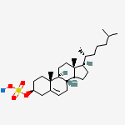
Cholesterol Sulfate Synthesis in the Skin
Keratinocytes synthesize abundant cholesterol sulfate as they mature
This synthesis takes place in the outer layer of the epidermis
Cholesterol sulfate catalyzes synthesis of profilaggrin, one of the two key proteins forming the cross-linked mesh that protects from bacterial invasion and prevents water loss

Slide 21
Water loss
Microbe penetration
Impaired wound healing in atopic dermatitis
*J.A. Segre, J Clin Invest.2006;116:1150-58
Notes:
Treasures/epidermal_barrier_formation_review.pdf
Figure 2
Figure 2
Role of barrier acquisition in the epidermal response to wound healing. Under normal conditions the epidermis serves as a barrier to retain water within the body and prevent the entry of infectious agents (e.g., microbes) or chemical agents. Den- dritic Langerhans cells, resident in the epidermis, recognize, process, and present antigens to T lymphocytes. In response to trauma to the epidermis, depicted as a full-thickness epi- dermal wound, keratinocytes increase their proliferation rate and cytokine release. Keratinocytes proliferate and migrate to re-epithelialize the wounded area. T lymphocytes are recruited into the damaged skin. As part of the normal process, kerati- nocytes initiate the process of terminal differentiation to restore the epidermal barrier. However, if the process of terminal dif- ferentiation or barrier recovery is impaired, the skin can enter an inflammatory state.

Slide 22
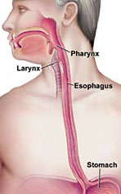
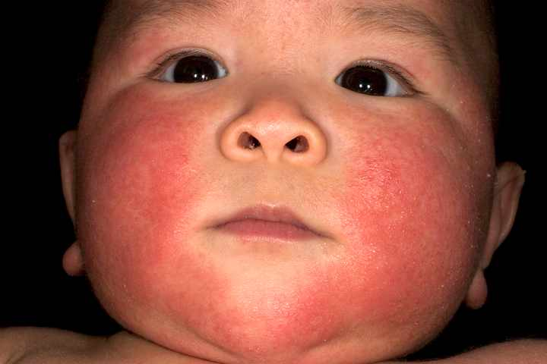
Filaggrin Plays a Crucial Role
Loss of filaggrin function associated with
Increased skin permeability
Susceptibility to eczema and asthma
Eosinophilic Esophagitis: (EoE)*
* Schroeder et al., Expert Rev clin Immunol. 6:6, 929-937, 2010.
Notes:
vitaminK/eosinophilic_esophagitis.text
http://www.medscape.com/viewarticle/731955_3
Eczema = atopic dermatitis

Slide 23
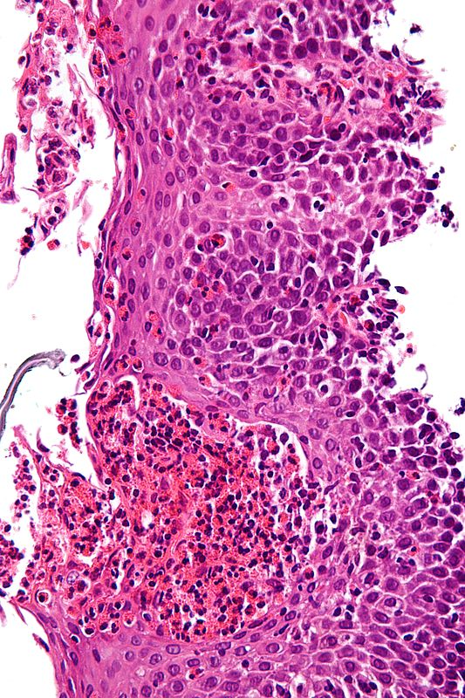
EOE: A Modern Disease*
Allergic inflammatory condition of the esophagus
Eosinophils invade esophagus
Release toxins that kill viruses and induce tissue damage
Person has difficulty swallowing
Eats very slowly
Food gets stuck in the throat
* Schroeder et al., Expert Rev clin Immunol. 6:6, 929-937, 2010.
Notes:
Characteristic features are present:
Abundant eosinophils - criteria vary; one common definition is: > 20 eosinophils/0.24 mm².
Papillae are elongated; papillae reach into the top 1/3 of the epithelial layer.
Basal cell hyperplasia; > 3 cells thick or >15% of epithelial thickness.
Spongiosis.

Slide 24
A Very Bad Idea

Slide 25
Cholesterol Sulfate in the Lungs*
Bronchial tubes produce cholesterol sulfate in the epithelial cells as they mature and form the outer layer of the bronchial epithelium
* Rearick et al., J. Cell. Physiol. 133:3, 573-578, Dec. 1987.
Notes:
vitaminK/lungs_bronchial_epithelium_cholesterol_sulfate.text

Slide 26
Cholesterol Sulfate in Horses’ Hoofs! *
37-43% cholesterol
15-20% cholesterol sulfate
*P.W. Wertz and P.T. Downing, J Lipid Res 25, 1985, 1320-1323.
Notes:
./HorsesHoof_CholesterolSulfate_1985.pdf

Slide 27
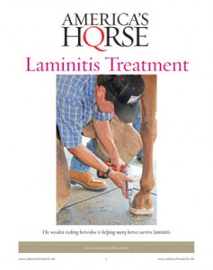
Laminitis (Founder)
Lameness in horses due to inflammation in the hoof
Can be caused by exposure to herbicides and nitrate fertilizers
Is This due to Impaired
Cholesterol Sulfate Supply to the Hoof?
Notes:
WIKI

Slide 28
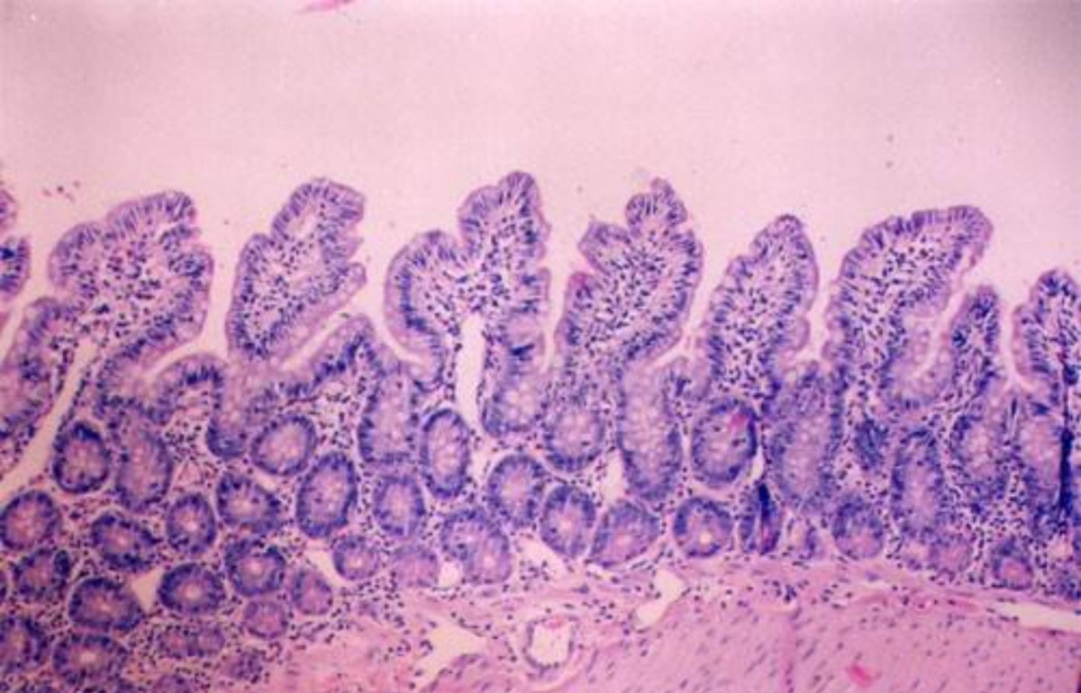
Cholesterol Sulfate and Trypsin*
Trypsin is an enzyme released by the pancreas, which digests proteins
Too much trypsin leads to breakdown of collagen glue that maintains structural integrity of intestinal mucosa (GAGs)
Cholesterol sulfate suppresses trypsin synthesis (protects mucosa from breakdown)
* Ito et al, J. Biochem. 123, 107-114, 1998.
Notes:
vitaminK/cholesterol_sulfate_inhibits_pancreatic_enzymes.pdf

Slide 29
Cholesterol Sulfate Inhibits Trypsin *
* Sato et al., J. Investigative Dermatology, 11:2, 189-193, Aug 1998
Notes:
vitaminK/cholesterol_sulfate_inhibits_trypsin.pdf

Slide 30
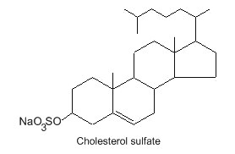
Recapitulation
Cholesterol sulfate plays many important roles in the body: skin, blood, esophagus, lungs, and pancreas
Cholesterol sulfate in the skin and lungs keeps bacteria out and water in
Horses’ hooves are loaded with cholesterol sulfate
Cholesterol sulfate protects collagen from breakdown by trypsin

Slide 31
Heparan Sulfate Proteoglycans (HSPGs)

Slide 32
Sulfated Biomolecules*
Sulfated mucopolysaccharides (glycosaminoglycans)
Steroid sulfates
Phenol sulfates
Tyrosine sulfation
Bilirubin sulfate
Arylamine sulfates
Choline sulfate in lichens, fungi and marine algae
Sulfolipids
*IH Goldberg, The sulfolipids. J. Lipi Res. Apr. 1961, 2(2), 103-109.
Notes:
Treasures/sulfolipids_review_1961.pdf

Slide 33
Sulfated Biomolecules*
Sulfated mucopolysaccharides (glycosaminoglycans)
Steroid sulfates
Phenol sulfates
Tyrosine sulfation
Bilirubin sulfate
Arylamine sulfates
Choline sulfate in lichens, fungi and marine algae
Sulfolipids
*IH Goldberg, The sulfolipids. J. Lipi Res. Apr. 1961, 2(2), 103-109.
Notes:
Treasures/sulfolipids_review_1961.pdf

Slide 34
Sulfated Glycosaminoglycans (GAGs)
Prominent in extracellular matrix of all cells
Amount of sulfate depends on availability
Crucial for maintaining negative charge and protecting from infection
http://www.science-autism.org/sulphate.htm

Slide 35
Sulfated Glycosaminoglycans (GAGs)
Prominent in extracellular matrix of all cells
Amount of sulfate depends on availability
Crucial for maintaining negative charge and protecting from infection
These are also known as “mucopolysaccharides”
http://www.science-autism.org/sulphate.htm

Slide 36
Ten Positive Effects of Mucopolysaccharides *
A lipid-clearing effect in the blood.
Stimulation of cellular metabolism.
Efficient metabolism of fatty acids.
Increase in RNA and DNA synthesis of cells.
Increase in growth, size and quantity of normal cells.
Anti-atherosclerosis, anti-atherogenic activities.
Anti-inflammatory effect.
Anti-thrombogenic and anti-coagulant activity.
Increases the number of coronary artery branches and collateral circulation in experimental atherosclerosis.
Accelerates healing, regeneration and repair of cardiovascular tissue
* http://www.vitaflex.com/res_csaa.php
Notes:
./mucopolysaccharides.pdf

Slide 37
Ten Positive Effects of Mucopolysaccharides *
A lipid-clearing effect in the blood.
Stimulation of cellular metabolism.
Efficient metabolism of fatty acids.
Increase in RNA and DNA synthesis of cells.
Increase in growth, size and quantity of normal cells.
Anti-atherosclerosis, anti-atherogenic activities.
Anti-inflammatory effect.
Anti-thrombogenic and anti-coagulant activity.
Increases the number of coronary artery branches and collateral circulation in experimental atherosclerosis.
Accelerates healing, regeneration and repair of cardiovascular tissue
Many of these effects can be explained by the fact that they supply sulfate
* http://www.vitaflex.com/res_csaa.php
Notes:
./mucopolysaccharides.pdf

Slide 38
Heparan Sulfate: Wonder Worker
Polymers of sugars with attached nitrogen and sulfates: safe glucose storage

Slide 39
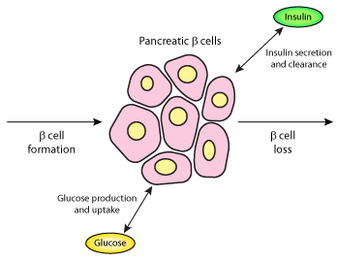
Heparan Sulfate in Pancreas *
Beta cells in pancreas produce insulin
They also produce an abundance of heparan sulfate
In type I diabetes, inflammatory cells break down basement membrane and penetrate pancreatic islets
These inflammatory cells produce heparanase, which destroys heparan sulfate
This leads to cell death of beta cells and diabetes
Inflammatory cells
Heparan sulfate
Insulin
* Ziolkowski et al., J Clin Invest. 122(1): 132–141, Jan 2012.
Notes:
vitaminK/heparan_sulfate_diabetes.pdf

Slide 40
Heparan Sulfate in Pancreas *
Beta cells in pancreas produce insulin
They also produce an abundance of heparan sulfate
In type I diabetes, inflammatory cells break down basement membrane and penetrate pancreatic islets
These inflammatory cells produce heparanase, which destroys heparan sulfate
This leads to cell death of beta cells and diabetes
Inflammatory cells
Heparan Sulfate is Essential to Proper Function of Beta Cells and Insulin Production
Heparan sulfate
Insulin
* Ziolkowski et al., J Clin Invest. 122(1): 132–141, Jan 2012.
Notes:
vitaminK/heparan_sulfate_diabetes.pdf

Slide 41
Various Factors that Increase Sulfate*
An increase of the 35S-sulfate deposit is effected regularly by infections, by injections of toxins and proteins, by hypoxemia, dietetic influence, muscular over-exertion, weather influence and increase of the blood pressure.
SMPS= Sulfated mucopolysaccharides
*Report by Bernhard Muschlien
SMPS = Sulfated mucopolysaccharides = glycosaminoglycans
First published in the German language in the SANUM-Post magazine (17/ 1991)
Notes:
Treasures/bacteria_renew_sulfate_German.pdf

Slide 42
A Provocative Hypothesis
Cells store glucose temporarily in HSPGs, protected by sulfate
When cholesterol and sulfate are in short supply, storage of sugars in HSPGs becomes impaired
This is the source of insulin resistance and diabetes!

Slide 43
Disrupted Signaling when HSPGs are Depleted*
HPGs = Heparan Sulfate Proteoglycans
*Figure 5 in P Muller and AF Schier, Developmental Cell 21, July 19, 2011, 145-158.
Notes:
Where???
Figure 5. Effective Diffusion
Interactions of signaling molecules with HSPGs. HSPGs are often associated with epithelial cell surfaces. Binding to HSPGs can alter the mobility of a signal, concentrate ligand at the surface of cells, promote or hinder ligand-receptor interactions, and influence the extracellular stability of a ligand. For example, in the absence of HSPGs, signaling molecules may not be retained on the cell surface and thereby fail to travel to the next cells.
Or Wendy/Ann/
Treasures/2011_extracellular_movement_signaling_molecules.pdf

Slide 44
Sulfotransferases (Transfer sulfate from one molecule to another)
Carbohydrate sulfotransferase
Galactose-3-O-sulfotransferase
Heparan sulfate sulfotransferases (2-O, 3-O, 6-O)
N-deacetylase/N-sulfotransferase
Tyrosylprotein sulfotransferase
Uronyl-2-sulfotransferase
Estrone sulfotransferase
Chondroitin 4-sulfotransferase

Slide 45
Recapitulation
Heparan sulfate proteoglycans (HSPGs) are everywhere in the body
They play a crucial role in ion transport, nutrient uptake, and cell signalling
They protect pancreas during insulin production
I propose that they also provide a temporary storage depot for glucose
Deficient sulfate leads to diabetes
Multiple sulfotransferases attest to the importance of sulfate to the body

Slide 46
Atherosclerosis is Protective!

Slide 47
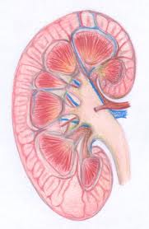
End Stage Kidney Disease and Cardiovascular Disease*
Dialysis patients have extreme risk
to cardiovascular disease
High serum cholesterol
High blood pressure
High serum homocysteine
Obesity
Inflammation
Abnormally low
homocysteine
Abnormally low blood pressure
Abnormally low cholesterol
Emaciated
* Kalantar-Zadeh et al., American Journal of Kidney Diseases 42:5 864-881, 2003
Notes:
Cancer/malnutrition_inflammation_dialysis_review.pdf
Because MICS leads to a low body mass index, hypocholesterolemia, hypocreatininemia, and hypohomocysteinemia, a “reverse epidemiology” of cardiovascular risks can occur in dialysis patients.
However, it’s also associated with IL-6, inflammation and muscle wasting, i..e,
A switch to nitrogen-based oxygen transport!!
Low serum albumin suggests low zeta potential

Slide 48
My Conclusion from This
Inflammation is the ONLY “Risk Factor” that counts:
All the other “Risk Factors” are protective measures!

Slide 49
Sulfates in the Kidneys*
Glucose
Glutamine
*K.-I. Nagai et al., Proc Jpn Acad Ser B Phys Biol Sci. 2008 January; 84(1): 24–29
Notes:
AnthonySamsel/celiac/sulfolipids_kidney_function_LukeMilano.pdf
Working hypothetical metabolic fate of glycolytic (glucose) and gluconeogenic (glutamine) substrates on biosynthesis of renal tubular sulfolipids. Cer-h, ceramide with hydroxy fatty acids; GalCer-h, galactosylceramide with hydroxy fatty acids; Glc, glucose; Glc 1-p, glucose 1-phosphate; Glc 6-p, glucose 6-phosphate; Gln, glutamine. Symbol, , with dashed arrows indicates comparatively inactive pathway in the isolated renal proximal tubules from well-fed rat. Sulfated lipids are indicated by hatching.
Working hypothetical metabolic fate of glycolytic (glucose) and gluconeogenic (glutamine) substrates on biosynthesis of renal tubular sulfolipids. Cer-h, ceramide with hydroxy fatty acids; GalCer-h, galactosylceramide with hydroxy fatty acids; Glc, glucose; Glc 1-p, glucose 1-phosphate; Glc 6-p, glucose 6-phosphate; Gln, glutamine. Symbol, , with dashed arrows indicates comparatively inactive pathway in the isolated renal proximal tubules from well-fed rat. Sulfated lipids are indicated by hatching.

Slide 50
Statins and Kidney Failure*
Kidney failure is alarmingly on the rise in the US and elsewhere
Associated with a 23-fold increase in risk to heart disease!
Statins are being overprescribed for patients with kidney failure
Severe muscle pain & rhabdomyolysis
Increased risk to dementia and diabetes
No improvement in kidney function
* M.A. Lanaspa et al., Nature Communications, 2013; Aug 24. [Epub ahead of print]
Notes:
For_vic/statins_bad_end_stage_kidney_disease.text

Slide 51
Heart Disease: A Theory!
Cardiovascular plaque develops as an alternative mechanism to produce cholesterol sulfate from damaged LDL and homocysteine

Slide 52
A Recent Paper
S. Seneff, A. Lauritzen, R. Davidson, and L. Lentz-Marino.
“Is Endothelial Nitric Oxide Synthase a Moonlighting Protein Whose Day Job is Cholesterol Sulfate Synthesis? Implications for Cholesterol Transport, Diabetes and Cardiovascular Disease.”
Entropy 2012, 14, 2492-2530.

Slide 53
What Happens when Cholesterol Sulfate Synthesis is Impaired??
Cardiovascular disease!!!
Activities in Plaque Produce Cholesterol Sulfate to Supply the Heart!

Slide 54
They Knew a Long Time Ago*
Article published in 1960
Fed cholesterol to monkeys
induced atherosclerosis
If sulfur-containing nutrients are added, atherosclerosis is prevented
These nutrients provide source of sulfate to enable cholesterol transport
* G.V. Mann et al., Am. J. Clin. Nutr. 8, 491-497, 1960.
Notes:
./ monkeys_sulfur_solves_cholesterol_problem_1960

Slide 55
They Knew a Long Time Ago*
Article published in 1960
Fed cholesterol to monkeys
induced atherosclerosis
If sulfur-containing nutrients are added, atherosclerosis is prevented
These nutrients provide source of sulfate to enable cholesterol transport
"A form of vascular disease resembling human atherosclerosis has been produced in the New World primate Cebus fatuella. ... In order to produce these phenomena, the diets had to be rich in cholesterol, choline and neutral fat but relatively low in organic sulfur compounds. Without this deprivation of organic sulfur the response of the serum lipids to cholesterol feeding was small."
* G.V. Mann et al., Am. J. Clin. Nutr. 8, 491-497, 1960.

Slide 56
“Heart Stents Still Overused, Experts Say”*
Two misconceptions
Heart attack caused by blocked artery
Eating fatty foods induces fat build-up
Heart attack is actually caused by thrombus formation (blood clot) that often occurs in a region of the artery where plaque is not obstructive
Stent insertion is expensive and is not living up to the promise of protection
*Anahad O’Connor, NY Times, Aug. 16, 2013
Notes:
./heart_stents_overused_Victor.pdf

Slide 57
Steps in Atherosclerosis*
Inflamed endothelium provides adhesion molecules to trap and hold macrophages
Macrophages through scavenger process take up oxidized LDL and become foam cells
Interleukins and growth factors promote proliferation of smooth muscle cells (artery thickening)
Extracellular matrix proteins are degraded
Vulnerable plaque eruption: thrombosis
* Libby et al., Circulation 105:1135-1143, 2002
Notes:
Libby –
.cancer/libby_inflammation_heart_disease.pdf

Slide 58
Cardiovascular Plaque*
*Figure 3 in L. Badimón et al., Rev Esp Cardiol. 2009;62(10):1161-78 (p. 1163)
Notes:
. Schematic representation of the progression of atherosclerotic plaque from initial stages of endothelial dysfunction to advanced stages with the presence of complicated plaques. M-CSF indicates macrophage colony stimulating factor; MCP-1, monocyte chemotactic protein 1; MMP, metalloproteinases; PAI-1, plasminogen activator inhibitor 1; PDGF, platelet-derived growth factor; TF, tissue factor; UPA, urokinase plasminogen activator

Slide 59
Many Good Reasons for ROS
ROS (reactive oxygen species) are a key component of inflammation in the artery
ROS are needed to produce sulfate*
Oxidation of glycated LDL makes it accessible to macrophages for breakdown**
Peroxynitrite (product of reaction between superoxide and nitric oxide) is toxic to pathogens***
* Mitsuhashi et al. Shock 24(6) 529-34, 2005.
** Kaplan and Aviram, Arterioscler Thromb Vasc Biol 21(3) 386-93 2001.
*** Alvarez et al., J. Biol. Chem. 286, 6627-6640, 2011.
Notes:
Vitamink/peroxynitrite_fights_infetion.text
vitaminK/ROS_h2s_to_sulfite_shock_2005.text

Slide 60
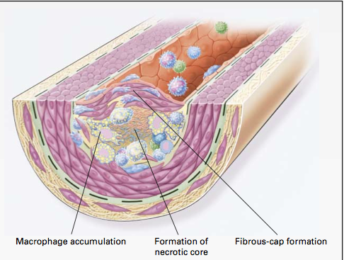
Macrophages and Cholesterol*
Macrophages in artery wall take up oxidized LDL and export extracted cholesterol to HDL-A1
Macrophages eventually become damaged by exposure to oxidizing and glycating agents → necrotic core
* Wang and Oram, J. Biol. Chem. 277 (7) , 5692–5697, 2002
Notes:
Results showed that unsaturated fatty acids markedly inhibited ABCA1-mediated cholesterol and phospholipid efflux from macrophages when ABCA1 was induced by a cAMP analog. This was accompanied by a reduction in the membrane content of ABCA1 and a decrease in apoA-I binding to whole cells and to ABCA1. In contrast, saturated fatty acids had no effect on these processes.
vitaminK/unsaturated_fatty_acids_inhibit_cholesterol_efflux_from_macrophages.pdf
vitaminK/unsaturated_fatty_acids_inhibit_cholesterol_efflux_from_macrophages.pdf

Slide 61
Macrophage Proliferation in Plaque*
*Figure 4, C.S. Robbins et al., Nature Medicine, Aug. 2013
[ePub ahead of print]
Notes:
Heart/macrophages_proliferate_in_plaque_2013.pdf

Slide 62
Declaring War on Macrophages*
Macrophages replicate inside plaque
Suppressing their entry into plaque is not enough!
Proposal: develop new therapy that suppresses proliferation of macrophages in plaque
"It's a bit like killing off the army to be sure there's no collateral damage when invaders attack your country”
--David Diamond, Member of THINCs
*C.S. Robbins et al., Nature Medicine, Aug. 2013 [ePub ahead of print]
Notes:
For_vic/idiocy_suppressing_macrophages_for_heart_disease.text

Slide 63
Elevated Homocysteine and Heart Disease*
587 patients with coronary artery disease followed over median period of 4.6 years
Homocysteine > 15 micromol/Liter → 6.5-fold increase in death rate compared to homocysteine < 10 micromol/L
*P.O. Lim et al., Journal of Human Hypertension (2002) 16, 411–415.
Notes:
In celiac/celiac_disease_hypertension.pdf

Slide 64
Pathway from Homocysteine to Sulfate*
When folate and B12 are deficient, nearly all homocysteine is converted to homocysteine thiolactone
homocysteine thiolactone
Vitamin A
thioretinamide
Superoxide:
Reactive oxygen species
(ROS)
Vitamin C
sulfite
alpha keto butyrate
retinoic acid
Sulfite oxidase
PAPS
*McCully, Annals of Clinical and Laboratory Science 41:4, 300-313, 2011
sulfate
Notes:
Spacedoc/McCully/ChemicalPathologyHomocysteineV_McCully.pdf
Figure 1. Hypothetical scheme for synthesis of thioretinamide, oxidation to sulfite and sulfate, and activation of sulfate to phosphoadenosine phosphosulfate, explains sulfation of glycosaminoglycans (GAG) to form sulfate esters [2]. In this scheme superoxide is synthesized from the heme oxygenase group of cystathionine synthase [34], catalyzing retinoic acid synthesis from retinol. Synthesis of thioretinamide from retinoic acid and homocysteine thiolactone is catalyzed by cystathionine synthase and dehydroascorbate.
is hydro- lyzed to Hcy by a calcium-dependent Hcy thiolactonase (HTase) tightly associated with HDL in serum (Jakubowski 1999a). !!
When methionine synthase activity is inhibited by folate or vitamin B-12 deprivation, almost all Hcy is converted to thiolactone.
!

Slide 65
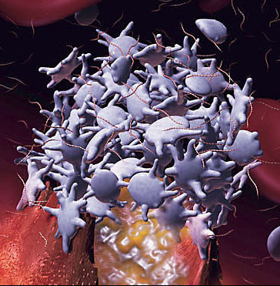
Platelets and Cholesterol Sulfate*
Platelets and RBCs both synthesize cholesterol sulfate (Ch-S)
Ch-S is present in the atherosclerotic lesions in the aorta
Platelets will accept cholesterol only from HDL-A1
Platelet synthesis rate increases 300-fold when PAPS is available.
PAPS is formed from ATP and sulfate
Platelet aggregation leads to thrombosis
HDL suppresses aggregation; LDL promotes it
* Yanai et al, Circulation 109, 92-96, 2004

Slide 66
Steps in Atherosclerosis: Reinterpreted
Endothelial cells lining artery walls feeding the heart release inflammatory agents
Macrophages infiltrate artery wall
Macrophages extract cholesterol from oxidized LDL and deliver it to HDL-A1.
Platelets extract cholesterol from HLD-A1 and convert it to cholesterol sulfate, with help from PAPS
Macrophages die and build up necrotic core

Slide 67
Putting it All Together
homocysteine
Heart muscle cell
Synthesize sulfate
sulfate
ATP
PAPS
Lipid Raft
Red Blood Cell
Cholesterol Sulfate
RBC
insulin
Platelet
glucose
(3)
HDL-A1
macrophage
Ch
Ch
Artery Wall
oxLDL
LDL
ApoE
ROS
Inflammatory Agents
Endothelial Cell

Slide 68
Putting it All Together
homocysteine
Heart muscle cell
Synthesize sulfate
sulfate
Cholesterol protects the heart from ion leaks and sulfate allows it to safely metabolize glucose
ATP
PAPS
Lipid Raft
Red Blood Cell
Cholesterol Sulfate
RBC
insulin
Platelet
glucose
(3)
HDL-A1
macrophage
Ch
Ch
Artery Wall
oxLDL
LDL
ApoE
ROS
Inflammatory Agents
Endothelial Cell

Slide 69
Statins Increase Plaque Calcification*
6673 people studied (2413 on statins 4260 not on statins)
Mean age 59, 55% male
Evaluated using coronary CT angiography - noninvasive method to visualize atherosclerotic features
Statin use was associated with increased prevalence of calcified plaque and increasing numbers of coronary segments possessing calcified plaque
*R. Nakazato et al. Atherosclerosis 225(1), 148-153, November 2012.
Notes:
For_vic/statins_increase_calcified_plaque.text

Slide 70
I hypothesize that treatments aimed at reducing the supply of cholesterol to the plaque will eventually lead to severe deficiencies in cholesterol and sulfate supply to the heart, resulting in heart failure.

Slide 71
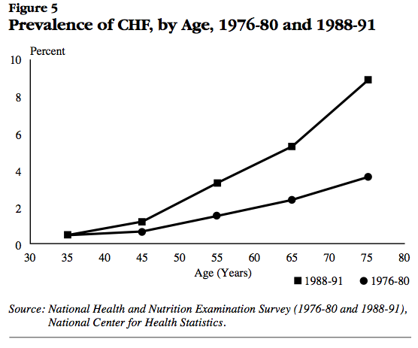
Congestive Heart Failure
Post-statins
Pre-statins
National Heart, Lung, and Blood Institute National Institutes of Health Data Fact Sheet
Notes:
http://library.thinkquest.org/27533/facts.html
./heart_failure_stats_1990s.pdf

Slide 72
Recapitulation
Kidney disease is associated with inversion of factors for heart disease risk
Kidneys depend critically on sulfates for function
Inflammation is required to synthesize sulfate
Cardiovascular disease can be best characterized as a factory to supply cholesterol and sulfate to the heart and kidney
Statin drugs, through their ability to deplete the supply of cholesterol to the plaque, can lead to heart failure and kidney failure down the road

Slide 73
How Statins Really Work Explains Why They Don’t Really Work

Slide 74
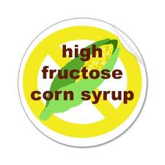
Sugar: The Bitter Truth*
Robert Lustig, UCSF Professor of Pediatrics, has done more than anyone to promote the idea that fructose is damaging to your health
In his 90-minute lecture, he discusses the critical role that the liver plays in detoxifying fructose
Nearly 4 million views from YouTube
* http://uctv.tv/search-details.aspx?showID=16717
Notes:
Robert H. Lustig, MD, UCSF Professor of Pediatrics in the Division of Endocrinology, explores the damage caused by sugary foods. He argues that fructose (too much) and fiber (not enough) appear to be cornerstones of the obesity epidemic through their effects on insulin

Slide 75
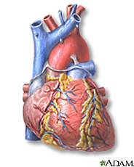
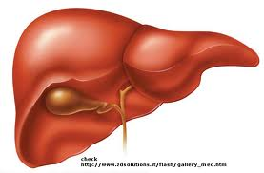
Liver Detoxifies Fructose
LDL (fats)
Fructose
Dietary fructose is toxic -- a severe glycating agent
Liver takes up fructose and turns it into fat
Fat is exported to tissues packaged in LDL particles
Cholesterol is required to “wrap” synthesized fats

Slide 76
A Proposal
Statins prevent liver from detoxifying fructose
Muscles (type-II fibers) aggressively convert dietary sugars to lactate instead *
Muscles experience severe glycation damage
Cells die and release their contents as debris
Insufficient clean-up by macrophages leads to collateral damage
Fructose and glucose build up and cause widespread glycation damage
Cascade effect
* G. de Pinieux et al., Br J Clin Pharmacol 42:333–337, 1996

Slide 77
How Statins Change Fructose Metabolism
LDL (fats)
Statins
Lactate
sugars
Liver can’t come up with enough cholesterol to “wrap” synthesized fats with LDL
Muscle cells must dispose of sugars via anaerobic metabolism (convert to lactate)
Heart and liver benefit from a healthy fuel source

Slide 78
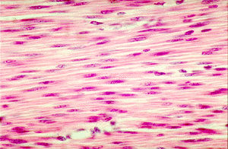
But, …The Muscle Cells Get Wrecked*
Patients on statins routinely get creatine phosphokinase levels monitored for possible muscle damage
However, even when creatine phosphokinase levels are not elevated, myopathy (muscle weakness) can occur, and is often associated with muscle damage
Patients on statins are often advised to continue statin therapy in this circumstance
This is bad advice
* Mohaupt et al., CMAJ 181(1-2), E11-E18, Jul 2009
Notes:
http://sportsmedicine.about.com/od/anatomyandphysiology/a/MuscleFiberType.htm
It is generally accepted that muscle fiber types can be broken down into two main types: slow twitch (Type I) muscle fibers and fast twitch (Type II) muscle fibers. Fast twitch fibers can be further categorized into Type IIa and Type IIb fibers.
Because fast twitch fibers use anaerobic metabolism to create fuel, they are much better at generating short bursts of strength or speed than slow muscles. However, they fatigue more quickly.
I have also read that APOE determines muscle types with 2 being slow twitch, 3 fast twitch adn 4 super fast twitch.
-an email message from Robert Thornett
In current clinical practice, patients who present with muscle symptoms while receiving statin therapy have their creatine phosphokinase levels measured. If the level is within normal limits or is modestly elevated (current recommendations in- clude creatine phosphokinase < 1950 U/L6), patients are fre- quently advised to continue their current statin therapy. This is based on the assumption that a lack of increased creatine phosphokinase levels supports a lack of underlying muscle damage. Our findings suggest that normal or moderately ele- vated levels of creatine phosphokinase do not exclude statin- associated muscle injury. Thus, alternative treatment strate- gies for patients with muscle symptoms need to be evaluated.

Slide 79
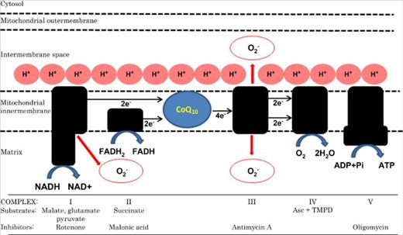
Mitochondrial Disruption by Statins
Depleted by Statins
Cell is Forced to Switch to Anaerobic Metabolism
Slide adapted from Statins and Miofibrillar Response, R. Laforge

Slide 80
Widespread glycation and ROS damage in muscle cells kills them
BUT
They don’t die properly!

Slide 81
Cytotoxic T-cells initiate apoptosis cascade and clean up cell debris following programmed cell death mediated by Fas-FasL signaling*
* See: L.M. Blanco-Colio et al., Circulation 108:1506-1503, 2003

Slide 82
Cell Apoptosis
Impaired Muscle Fiber
Fas
Both Fas and FasL must migrate from the cytoplasm to the membrane to be activated
This requires isoprenylation by geranylgeranyl pyrophosphate
Statins suppress these mechanisms
Cell dies through necrosis instead
T-cell
FasL
* See: L.M. Blanco-Colio et al., Circulation 108:1506-1503, 2003
Notes:
./apoptosis_skeletal_muscle_myopathy_Fas.pdf
+ Fasl_inhibition_by_statins.pdf
+ p53_fas_death_receptor_apoptosis.pdf
P53 actiation induces Fas to membrane; requires geranylgeranylation; membrane Fas activates FasL and apoptosis cascade.
Immunohisto- chemical studies have demonstrated that Fas antigen is ex- pressed on muscle fibers from patients with various muscle wasting diseases, but not in normal muscle cells (18,19).
target cell killing by cytotoxic T lymphocytes
The execution phase is the final pathway of the actual apoptotic death program and is accomplished largely by the caspase family of proteases, consisting of caspase 9 and caspases 3, 6, 7 (29,32).

Slide 83
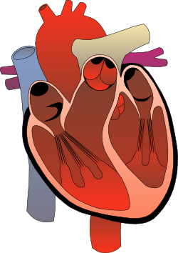
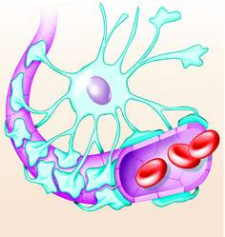
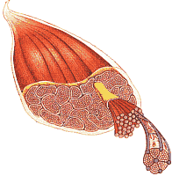
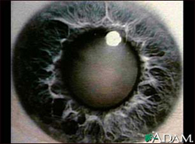
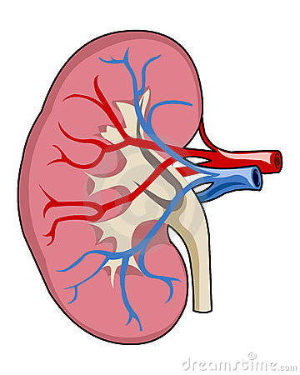
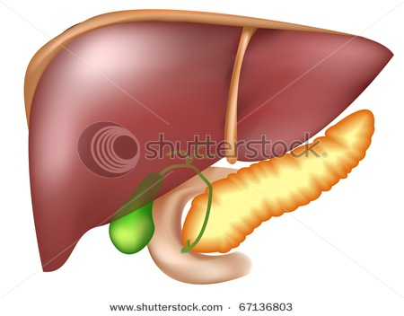
memory problems
fructose
cataracts
Heart failure
lactate
Kidney failure
liver failure
Glycation Damage
AGEs
diabetes
Notes:
Pancreas_AGEs.pdf
Cataracts
Hair loss
Hearing loss
Arthritis
Dementia
Frailty

Slide 84
memory problems
fructose
cataracts
Heart failure
Statins make you grow old faster
lactate
Kidney failure
liver failure
Glycation Damage
AGEs
diabetes
Notes:
Pancreas_AGEs.pdf
Cataracts
Hair loss
Hearing loss
Arthritis
Dementia
Frailty

Slide 85
Statins, Diabetes, and Cataracts*
Large study: 6397 patients
Divided into four groups: ±diabetes, ±statins
Looked at 50% point for age of diagnosis of cataracts
Taking a statin gives you cataracts three years earlier
 | Age: No statins | Age: With statins
No diabetes | 57.3 | 54.9
With diabetes | 55.1 | 51.7
* C.M. Machan et al, Optom Vis Sci. 2012 Aug;89(8):1165-71.
Notes:
For_vic/statins_diabetes_cataracts.text

Slide 86
Statins Promote Muscle Fiber Atrophy*
Statins induce synthesis of atrogin-1 in muscles, inducing skeletal muscle atrophy
In controlled experiments, Lovastatin promoted muscle fiber damage in zebrafish embryos
*J.-I. Hanai, et al., J. Clini Invest. 117(12) 2007, 3940-3951.
Notes:
For-vic/atrogin-1_induces_muscle_wasting_statins.pdf

Slide 87
Myopathy, Weakness and Chondroitin Sulfate*
Chondroitin sulfate deficiency in muscles leads to severe limb and respiratory weakness
Prednisone (a synthetic corticosteroid) produced a marked increase in strength
Hypothesis: prednisone sulfate supplies sulfate to synthesize chondroitin sulfate
*M.T. al-Lozi et al., Neurology. 1998 Feb;50(2):526-9.

Slide 88
Heparin prevents Oxidative Damage from Fenton Reaction*
Superoxide (0₂⁻) is a key ROS in the mitochondria
Iron oxidation (Fenton reaction) induces superoxide
Fe(II) + 0₂ + 20H → Fe(III)(OH) ₂⁺ + 0₂⁻
Heparin (many sulfates) induces acidic environment that changes the reaction as follows:
4Fe(II) + 0₂ + 4H⁺ → 4Fe(III) + 2H₂0
This produces water (harmless) rather than superoxide (destructive)
superoxide
water
*M.A. Ross et al., Biochem. J. 1992, 286, 717-720.

Slide 89
“Chronic and age-related increases in ROS production will cause mitochondrial damage and dysfunction that perpetuate a catastrophic cycle of cellular injury, further ROS generation, mitochondrial decline, and cell death.”*
.* S.W. Ballinger et al., Circ Res. 2000;86. P. 965

Slide 90
Lactate and Heart Failure*
Plasma lactate levels at rest are a marker for oxidative capacity
Study involving 10,000 participants
Resting lactate levels measured
Monitored for ten years subsequently
Lactate levels grouped into quartiles
Highest quartile had significant increased incidence of heart failure and death
*K. Matsushita et al., Am J Epidemiol. 2013 Jun 30. [Epub ahead of print].

Slide 91
Recapitulation
Liver normally detoxifies fructose by converting it to fat → LDL
Statins impair this process
Muscle cells respond by converting fructose to lactate
Supplies alternative fuel to liver, heart, and brain
But muscles suffer glycation damage as a consequence
Statins interfere with distressed muscle cell's ability to signal distress
Cell dies an unnatural rather than a programmed cell death
Fructose accumulates and causes widespread glycation
This has widespread consequences, including heart failure
Cataracts, a sign of AGEing, happen sooner on statins

Slide 92
Maintaining Blood Stability

Slide 93
The Glycocalyx
Negatively charged gel-like mesh lining the walls of all arteries, veins and capillaries
Depends crucially on sulfated polysaccharides
Particularly heparan sulfate proteoglycans (HSPGs)
Sulfate creates “exclusion zones”
Helps protect cells in wall from ion leaks and contact with enzymes suspended in blood
Greatly reduces amount of flowing blood (decreases resistance, lowers blood pressure)
Stores energy in “battery” constructed from structured water

Slide 94
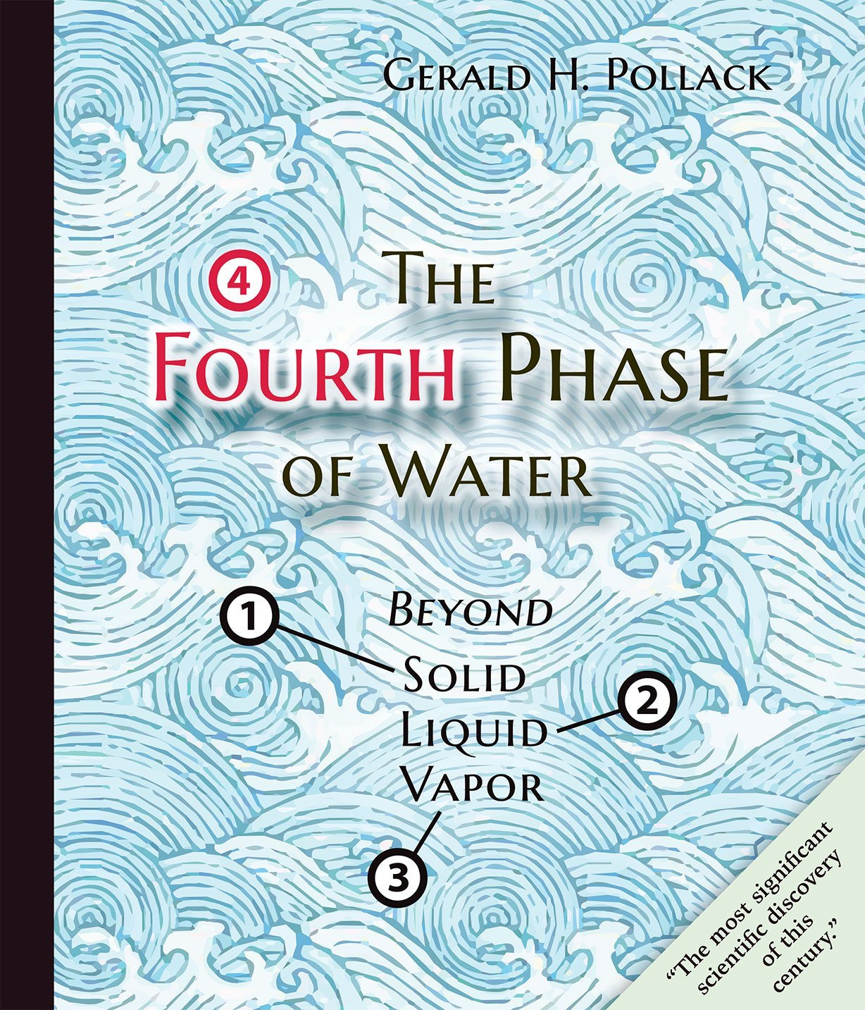

Slide 95
Dr. Mercola Interviews Dr. Gerald Pollack*
"The Fourth Phase of Water" = the Exclusion Zone (EZ)
Profoundly excludes things, even small molecules
H₃O₂ instead of H₂O -- negatively charged!
Fills most of your cells and the extracellular tissues
"polywater" - water as a polymer
Many experiments in Pollack’s laboratory confirm the existence of EZ water
A hydrophilic surface (sulfate!) will promote growth of EZ water upon exposure to infrared light
EZ water absorbs UV light (270 nm) and this builds charge!
Water flows in small diameter tubes and the flow rate increases upon exposure to sunlight
Could the same thing be happening in your capillaries?
Pressure, oxygen, light, and infrared energy all build EZ water
*http://articles.mercola.com/sites/articles/archive/2013/08/18/exclusion-zone-water.aspx
Notes:
./GeraldPollackInterview.pdf

Slide 96
A Quote from Pollack’s Book*
“And so it is with the exclusion zone. Order cannot persist without a continual supply of energy. The separated charges will slowly recombine, and order will give way to disorder. The exclusion zone’s outer reaches will wear thin like an eroding beach.”
– page 95, The Fourth Phase of Water
Sunlight renews the exclusion zones throughout your body!

Slide 97
Therapeutic Value of Sauna Therapy (Infrared light)*
Impaired vascular function associated with hypertension, hyperlipidemia, diabetes, obesity
Sauna therapy ameliorates endothelial dysfunction and improves health
Increased eNOS synthesis in aorta in animal experiments
Decreased body weight and body fat in obese subjects
Improved cardiac function in patients with heart failure
Infrared expands exclusion zones 4-fold**
*S. Biro et al., Exp Biol Med (Maywood). 2003 Nov;228(10):1245-9.
**B. Chai et al., J Phys Chem B. 2009 October 22; 113(42): 13953–13958.

Slide 98
Effect of Radiant Energy on Near-Surface Water *
“The main question, however, is where the energy for building these charged, low-entropy zones might come from. It is shown that radiant energy profoundly expands these zones in a reversible, wavelength-dependent manner. It appears that incident radiant energy may be stored in the water as entropy loss and charge separation.”
*B. Chai et al., J Phys Chem B. 2009 October 22; 113(42): 13953–13958.
Notes:
Bob_davidson/Pollack/2009_Pollack_radiant_energy…

Slide 99
Key Role for Sulfates
Sulfates decorate exterior of cell, e.g., as heparan sulfate proteoglycans (HSPGs) or as cholesterol sulfate (Ch-S)
Sulfates carry negative charge and keep suspended cells from sticking together
Sulfates, as kosmotropes, create exclusion zone – gel-like environment to protect cell
Cell
Notes:
magnet

Slide 100
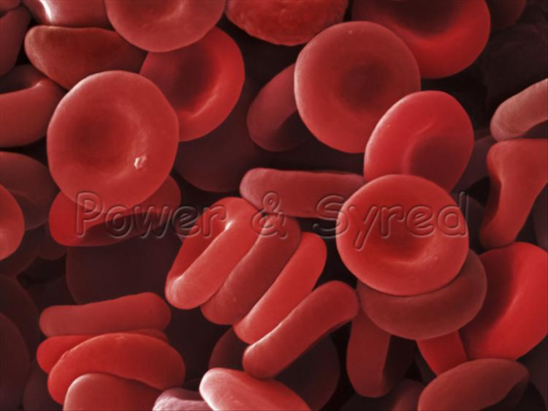
Zeta Potential
Zeta potential indicates degree of repulsion between similarly charged particles in a dispersion (e.g., the blood)
High zeta potential confers stability
RBCs and platelets resist aggregation
Low zeta potential causes flocculation and coagulation (blood clot)
Proposal: a steady drop in zeta potential in the blood as we age is the source of many modern diseases

Slide 101
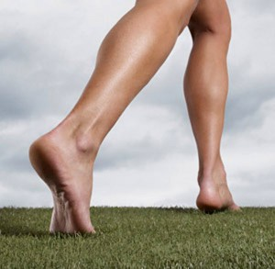
Grounding the Human Body Reduces Blood Viscosity*
Blood viscosity is strongly influenced by the surface charge on the suspended particles (like RBCs)
A higher repulsive surface charge increases spacing between RBCs, reduces clumping, lowers viscosity, and lowers peripheral resistance to flow (blood pressure)
Grounding transfers electrons from soil to the body
Increases zeta potential, lowers blood viscosity
*G. Chevalier et al., J Alternative and Complementary Medicine, 1–9, 2012

Slide 102
Hypothesis
When blood becomes deficient in negative charge (sulfates), glycocalyx becomes unhealthy
Endothelial cells develop gaps that allow blood to seep into tissues
Blood clots are needed to plug the holes
Mistakes can lead to dangerous blockage
Deep vein thrombosis
Pulmonary thrombosis

Slide 103
Strokes are Happening at Younger Age*
Incidence of stroke is increasing among people under 55 years old
959 patients followed through 2012 (aged 18 to 50 years at time of stroke)
Suffered from stroke between 1980 and 2010.
Compared with age-matched young adults without stroke
Stroke victims have higher risk of dying prematurely
3.4-fold higher risk in the 40- to 50-year-old age group
6.4 fold higher risk in the 18-29 year olds
Underlying vascular disease remains active throughout life?
*L.C. Rutten-Jacobs et al., JAMA. 2013 Mar 20;309(11):1136-44.
Notes:
./stroke_at_young_age.text

Slide 104
"High Cholesterol Levels Are Associated with Improved Long-term Survival after Acute Ischemic Stroke"*
190 stroke patients studied
Survival rates (P= 0.0001):
3-mo 1-yr 5-yr
100% 98% 84% high-cholesterol group
92% 87% 57% low-cholesterol group
*I. Markaki et al., Journal of Stroke and Cerebrovascular Diseases, 2013: 1-7.
Notes:
For_vic/high_cholesterol_protective_in_stroke.pdf

Slide 105
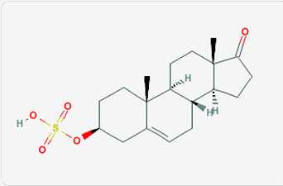
DHEA Provides Sulfate?*
In aging rats:
eNOS expression is lowered
Response of vascular smooth muscle to nitric oxide is decreased
Weakened resistance to oxidative damage
DHEA supplement ameliorates these effects and delays aging process
*S. Wu et al., Gerontology 2007;53:234–237.
Notes:
Where??
Treasures/DHEA_reduces_arterial_aging_rats.text

Slide 106
Recapitulation
Sulfates in the glycocalyx maintain proper function of the artery wall and smooth flow of the blood
Gerald Pollack has revolutionized our understanding of water as a miracle molecule
Infrared light induces growth of exclusion zone
Grounding can improve blood stability by providing negative charge through currents from the ground
High cholesterol leads to longer survival following stroke
DHEA sulfate can improve aging vessels

Slide 107
Cancer to the Rescue?

Slide 108
“Cancer as a Metabolic Disease”*
Turns cancer theory upside down!
Impaired mitochondrial function leads to switch to aerobic glycolysis
Cancer cells convert glucose to lactate, producing a tiny amount of energy
Consume lots of glucose
Metabolic dysfunction precedes genetic mutations
*T.N. Seyfried and L.M. Shelton, Nutrition and Metabolism 7:7, 2010

Slide 109
“Cancer as a Metabolic Disease”*
Turns cancer theory upside down!
Impaired mitochondrial function leads to switch to aerobic glycolysis
Cancer cells convert glucose to lactate, producing a tiny amount of energy
Consume lots of glucose
Metabolic dysfunction precedes genetic mutations
Tumor is a factory where damaging (glycating) sugars are converted into healthy fuel to supply to heart and brain
*T.N. Seyfried and L.M. Shelton, Nutrition and Metabolism 7:7, 2010

Slide 110
Breast Cancer Overtreatment*
200,000 Norwegian women followed over two consecutive 6-year periods
Half received regular breast exams and mammograms, while the other half did not
Those receiving monitoring developed 22% more incidence of breast cancer
Researchers concluded that the control group had probably had as many cancers as the “treatment” group, but these cancers had resolved on their own!
Another possibility is that the radiation in the mammogram induced breast cancer
*P.H. Zahl et al., Arch Intern Med. 2008;168(21):2311-2316.
Notes:
From Dr. Mercola
./MercolaOnBreastCancer.pdf
./breast_cancer_frequency_mammogram_screening.pdf
./breast_cancer_study_Norway.pdf

Slide 111
“Heparan Sulfate and Heparanase as Modulators of Breast Cancer Progression”*
Heparanase is a potent tumor modulator due to its protumorigenic, proangiogenic, and prometastatic activities
Plays a role in bone metastasis
Heparanase breaks down heparin sulfate into fragments of 4 to 7 kDa size
Heparinase is upregulated in all human sarcomas and carcinomas
Syndecan-1 shedding is an important step in tumor invasion and metastasis
*A.M. Gomes et al., BioMed Research International, 2013, article ID: 852093
Notes:
Cancer/Gomes_2013_heparanase_and_cancer_and_HSPGs.pdf
Possibly the best article I have ever read!!!!

Slide 112
“Heparan Sulfate and Heparanase as Modulators of Breast Cancer Progression”*
Heparanase is a potent tumor modulator due to its protumorigenic, proangiogenic, and prometastatic activities
Plays a role in bone metastasis
Heparanase breaks down heparin sulfate into fragments of 4 to 7 kDa size
Heparinase is upregulated in all human sarcomas and carcinomas
Syndecan-1 shedding is an important step in tumor invasion and metastasis
Is the tumor providing heparan sulfate to the blood?
*A.M. Gomes et al., BioMed Research International, 2013, article ID: 852093
Notes:
Cancer/Gomes_2013_heparanase_and_cancer_and_HSPGs.pdf
Possibly the best article I have ever read!!!!

Slide 113
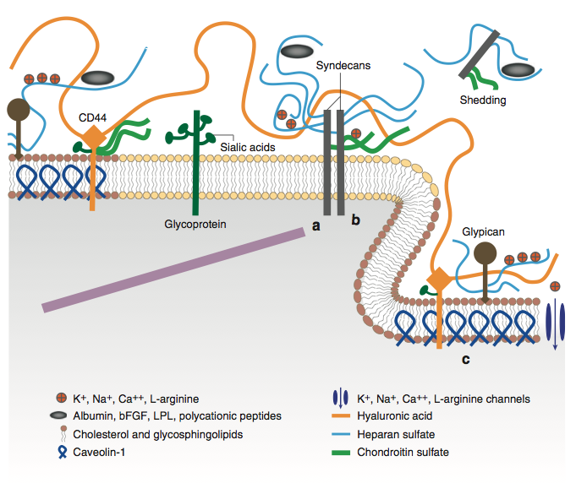
Syndecan Shedding in Breast Cancer
Figure 1 from Weinbaum et al., Annu. Rev. Biomed. Eng. 2007. 9:121–67
Notes:
a) The cytoplasmic domains of syndecans can associate with linker molecules, which connect them to cytoskeletal elements. (b)

Slide 114
Hydrolysis of Estrone Sulfate and Dehydroepiandrosterone (DHEA) Sulfate by MCF-7 Human Breast Cancer Cells*
Breast cancer tumor cells break down estrone sulfate and DHEA sulfate in order to supply sulfate to the blood stream??
*J.H.MacIndoe et al., Endocrinology Sep 1, 1988, 123(3), 1281-1287.

Slide 115
Curing Cancer Brings on Health Problems*
“The rise in cancer survival in Britain is a ‘double-edged sword’ a charity has warned, because the NHS is ‘woefully unprepared’ to cope with the number of patients who go on to suffer long-term health problems.”
“… one in four survivors is left suffering long-term debilitating health conditions as a result of the disease, or the treatment for it.”
*http://www.telegraph.co.uk/health/healthnews/10188236/
Rise-in-cancer-survival-is-a-double-edged-sword.html
Notes:
NHS = national health service
CSAIL/2013/project/WAPF/double_edged_sword.text

Slide 116
Curing Cancer Brings on Health Problems, Cont’d*
Many cancer survivors suffer extreme pain up to five years after diagnosis
Women diagnosed with breast cancer are almost twice as likely to get heart failure
Men diagnosed with prostate cancer are more than twice as likely to get osteoporosis
Many treated for prostate cancer or bowel cancer suffer from incontinence
*http://www.telegraph.co.uk/health/healthnews/10188236/
Rise-in-cancer-survival-is-a-double-edged-sword.html

Slide 117
Chemotherapy for Breast Cancer*
Chemotherapy induces anemia
EPO (erythropoietin) sometimes given to induce RBC regeneration from bone marrow
This can lead to thrombosis (blood clots)
Alternative is blood transfusions to restore hemoglobin count
These problems suggest that breast cancer is associated with unstable blood
*http://www.medpagetoday.com/HematologyOncology/Anemia/40536
Notes:
http://www.medpagetoday.com/HematologyOncology/Anemia/40536

Slide 118
Cognitive Decline and Breast Cancer*
"Patients treated with hormonal therapy were five times more likely to exhibit cognitive decline as compared with a control group. Chemotherapy was not a significant predictor of cognitive decline."
Suppressed ability to synthesize estrone sulfate leads to widespread sulfate deficiency in the brain?
*http://www.medpagetoday.com/MeetingCoverage/MBCS/41486
Rugo H, et al "Prospective study of cognitive function in women with early-stage breast cancer: Predictors of cognitive decline" BSC 2013.
Notes:
./hormone_therapy_cognitive_decline.text
30% of patients exhibited cognitive decline

Slide 119
Statins and Breast Cancer*
Population-based case-control study of breast cancer
1,068 cases compared to 902 controls
Current users of statins for 10 years or longer
1.83-fold increased risk of invasive ductal carcinoma (accounts for 7 out of 10 cases in UK)
1.97-fold increased risk of invasive lobular carcinoma (10 to 15% of cases)
I hypothesize that this is because statins deplete cholesterol sulfate supply and disrupt sugar metabolism
*J.A. McDougall et al., Cancer Epidemiol Biomarkers Prev. 2013 Jul 5. (Epub ahead of print)
Notes:
http://cebp.aacrjournals.org/content/early/2013/07/04/1055-9965.EPI-13-0414.abstract
For_vic/statins_and_breast_cancer.text

Slide 120
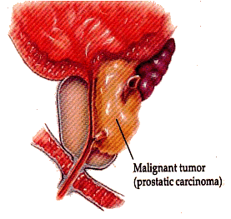
Cholesterol Sulfate in Prostate Cancer*
“Remarkably, cholesterol sulfate … was observed exclusively in the cancerous tissue, enabling its clear identification”
*Livia S. Eberlin et al. Anal Chem. 2010 May 1; 82(9): 3430–3434.
Notes:
Cancer/cholesterol_sulfate_in_prostate_cancer.pdf
Purdue University and the Indiana University School of Medicine h

Slide 121
"Hormone Use in Prostate Cancer May Harm Kidneys"*
Analysis included 10,250 men, who were followed for an average of 4.1 years
Androgen deprivation therapy (ADT) led to significantly increased risk of acute kidney injury in men being treated for prostate cancer
Hyperglycemia is a well established adverse effect of ADT, and this stresses the kidney
Is this due to insufficient sulfate supply to the body??
*Charles Bankhead, MedPage Today, Jul 16, 2013
Notes:
./prostate_cancer_anti_androgen_therapy_kidney_damage.pdf

Slide 122
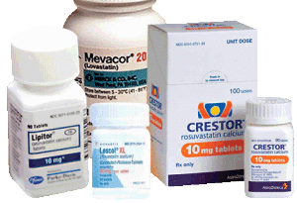
Statins and Prostate Cancer*
388 prostate cancer cases compared to 1,552 controls
Ever-use of any statin was associated with a significant 55% increased risk to prostate cancer
Highest cumulative dose group had 86% increased risk
*CC Chang et al., Prostate. 2011 Dec;71(16):1818-24
Notes:
./NaturalNewsonBreastCancerStatins.pdf
For_vic/Statins_cause_prostate_cancer.pdf

Slide 123
Iclusig: A Drug that’s Failing*
Chemotherapy for leukemia
“Fatal and life-threatening heart attack, stroke, loss of blood flow to the extremities resulting in tissue death, and severe narrowing of blood vessels in the extremities, heart, and brain requiring urgent surgical procedures to restore blood flow”
*http://www.medpagetoday.com/HematologyOncology/Leukemia/42637

Slide 124
Cancer and Deep Vein Thrombosis*
Deep vein thrombosis is the second-leading cause of death among cancer patients (after infection)
Chemotherapy increases risk of thrombosis 6.5x
Hypothesis: Removing the tumor removes the protective effect
*Previtali et al., “Risk Factors for Venous and Arterial Thrombosis”,
Blood Transfusion 9:120-38, 2011
Notes:
vitamink/thrombosis_review_BOB.pdf
Dvt_review_2001.pdf
Cancer patients undergoing surgical procedures have at least twice the risk of postoperative DVT and more than 3 times the risk of fatal PE than noncancer patients undergoing similar procedures.600

Slide 125
Colon Cancer Tumor Cells Synthesize Hydrogen Sulfide*
Hydrogen sulfide induces cell growth in tumor cells by promoting glycolysis and oxidative phosphorylation (breaking down glucose to produce ATP).
Hydrogen sulfide is produced by the enzyme Cystathionine-β-synthase (CBS) in these cells
It is upregulated in these cells and promotes their growth
Suppression of hydrogen sulfide synthesis is being proposed as a technique to kill the tumor
The tumor is able to synthesize sulfate from the hydrogen sulfide gas it produces??
* K. Modisa et al., Nitric Oxide, 31(2), 1 Sept. 2013, p.S50.
Notes:
Cancer/hydrogen_sulfide_in_colon_cancer.text
Cancer/cystathionine_beta_synthase_makes_H2S_colon_cancer_2013

Slide 126
William Li: Can we eat to starve cancer?*
You can starve a tumor (prevent blood vessel growth) by eating certain foods that inhibit angiogenesis (blood vessel growth)
Natural inhibitors of angiogenesis:
Resveratrol (red grapes, wine); ellagic acid (strawberries)
Turmeric, garlic, glusoamine (sulfate)
Olive oil, tea, parsley, etc. (flavonoids)
Also protect from obesity
All of these foods either contain sulfate transporters or contain sulfur or both
*TED Talk: https://www.youtube.com/watch?v=B9bDZ5-zPtY
Notes:
You-tube video: I watched it.
TedTalk_eat_to_prevent_cancer.text

Slide 127
Recapitulation
Cancer is a metabolic disease
Cancers cells consume massive amounts of glucose and produce massive amounts of lactate
Treating cancer can lead to deteriorating health
Heart failure, extreme pain, osteoporosis, mental decline, anemia, deep vein thrombosis
Breast cancer and prostate cancer supply sulfated sterols to the body
These are essential to maintain healthy blood
Foods that promote sulfate synthesis and sulfate transport can cause tumor to shrink

Slide 128
Summary
Sunlight-catalyzed cholesterol sulfate synthesis in the skin is essential for long-term health
Heart disease is a compensatory mechanism to synthesize cholesterol sulfate
Heparan sulfate proteoglycans (HSPGs) are pervasive in the body, and sulfate depletion leads to diabetes, heart disease, and kidney disease
Statin drugs work by destroying skeletal muscles to provide lactate for the heart
Hemostasis depends on adequate sulfate in the blood
Cancer may develop as a strategy to both reduce blood sugar levels and produce sulfated sterols

Slide 129
What’s Next?
Early afternoon (1:30 p.m. – 3 p.m.)
Gut Microbes: How They Help Us Out
Autism, Depression, and Alzheimer's Disease
Late afternoon (3:30 p.m. – 5 p.m.)
Glyphosate: The Elephant in the Room
Nutrition: Facts and Fiction

